Slide 1
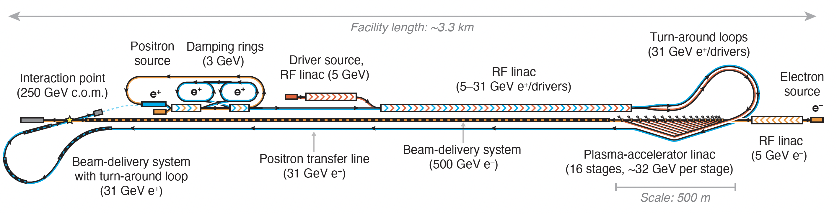
Hybrid Asymmetric Linear Higgs
Factory (HALHF)
B. Foster, R. D’Arcy & C.A. Lindstrøm
Foster, D’Arcy and Lindstrøm, New J. Phys. 25, 093037 (2023)
Lindstrøm, D’Arcy and Foster, arXiv:2312.04975

Slide 2
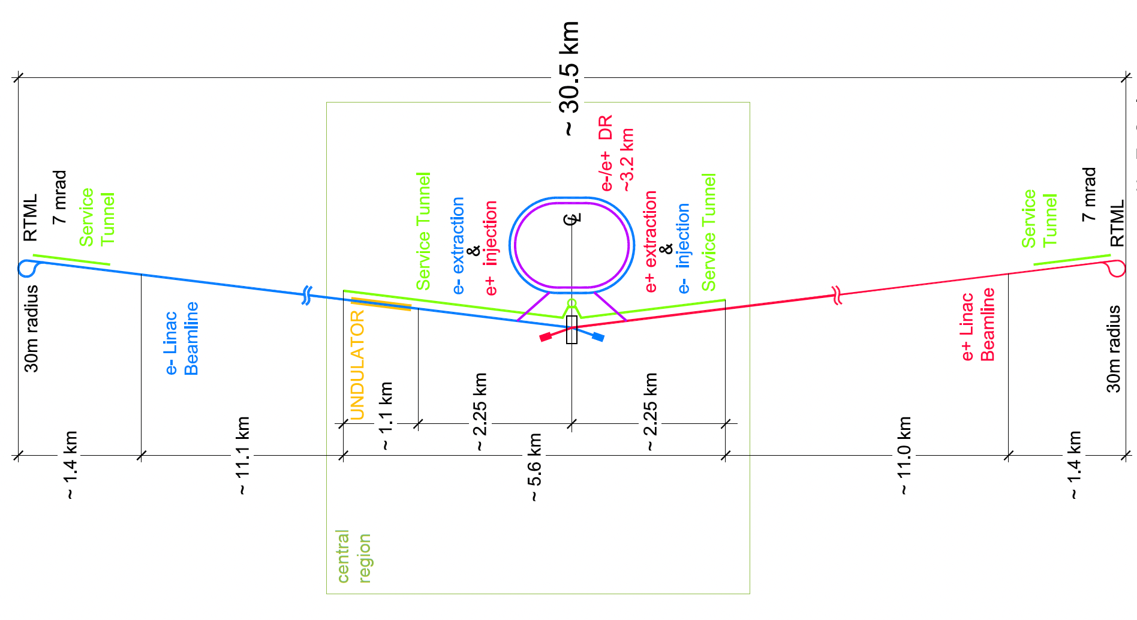

Hybrid Asymmetric Linear Higgs
Factory (HALHF)
ILC
FCC
https://arxiv.org/2303.10150

Slide 3
Outline of Talk
Introduction to PWFA & Motivation
The HALHF Concept
Upgrades to HALHF Infrastructure
Forward Look, Timeline & Current Status

Slide 4


I: Plasma Wave Acceleration
Wake Excitation
Particle Acceleration

Slide 5
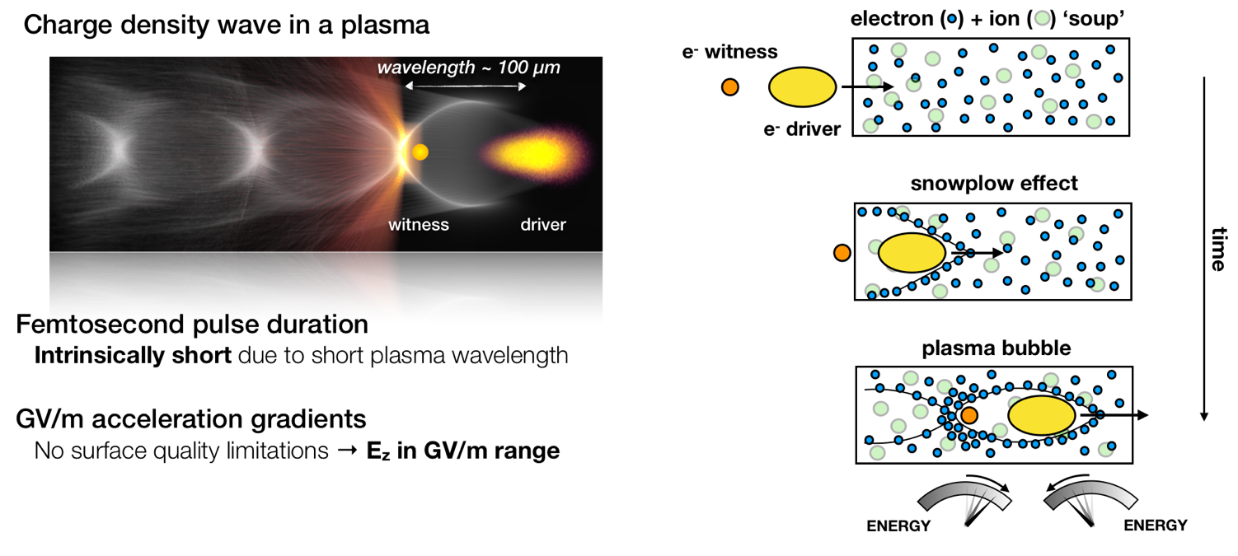
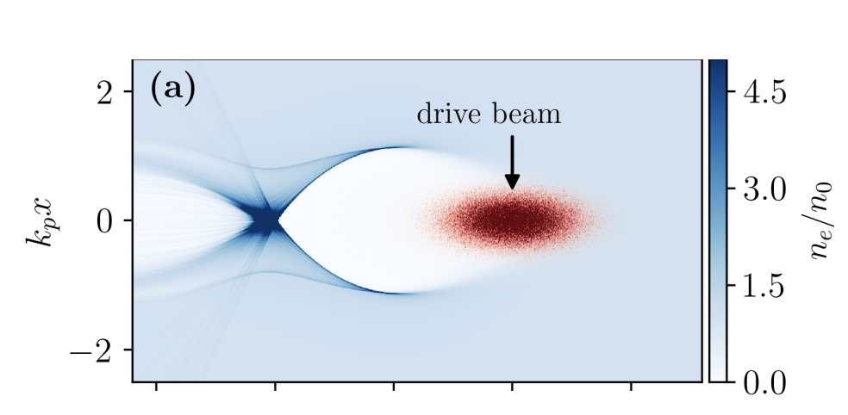
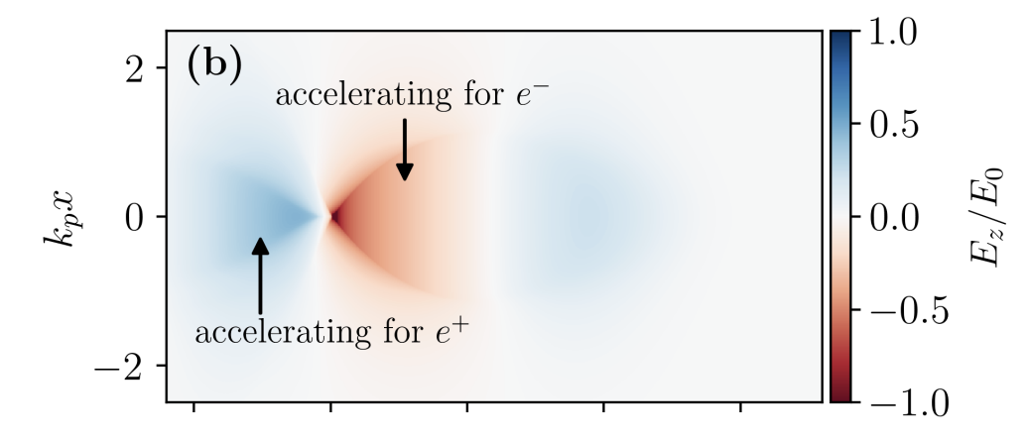
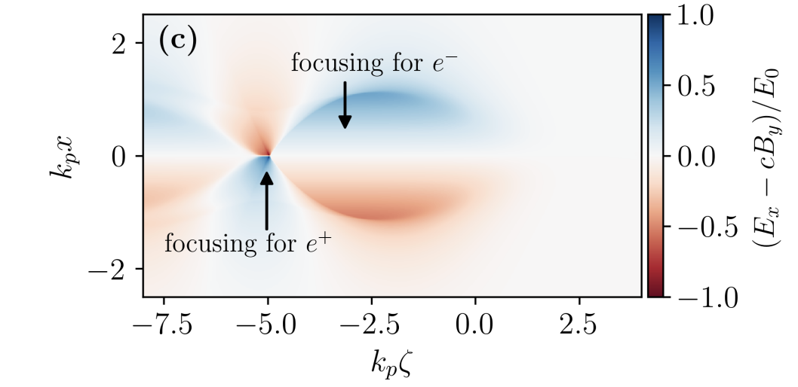
Plasma Wave Acceleration
Notes:
Blow-out – size ~ plasma wavelength

Slide 6
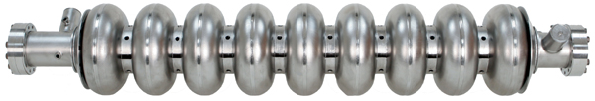
Cavities cf Plasmas
SCRF Cavity
Plasma
wakefield

Slide 7
Cavities cf Plasmas
SCRF Cavity
Plasma
wakefield

Slide 8
Setting the scale
Notes:
Contrast with conventional cavities….
Work at Lawrence Berkeley Laboratory. 40 TW laser pulse (3 * 10 18 W/cm2) – 1 GeV in 3.3 cm
produced 33 GV/m fields. Beam quality lousy! Florian is at forefront of this table top infra-red FELs.

Slide 9
LWFA & PWFA
Two main methods of exciting a wake-field in a plasma
Using a high-powered laser (LWFA)
Using electric field from intense particle beam (PWFA)
Each has advantages & disadvantages – for PWFA:

Slide 10
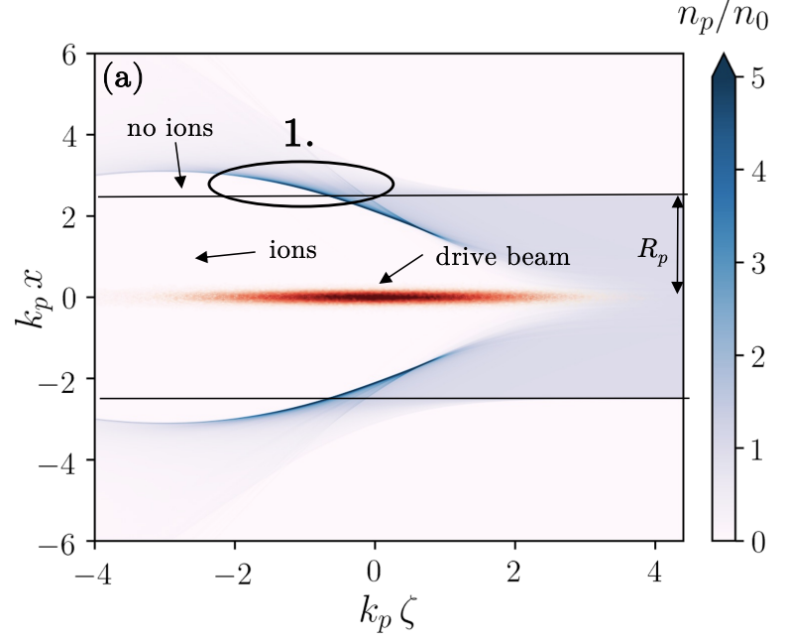
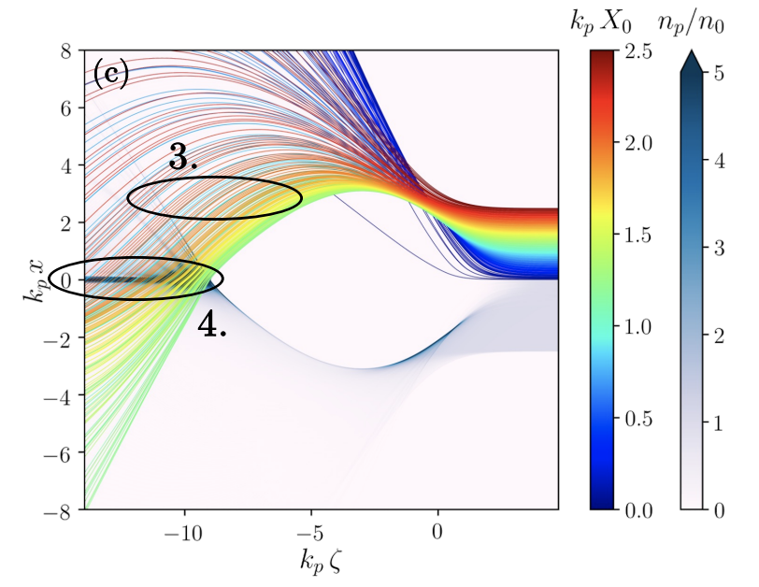
Positron Acceleration
There are many schemes for e+ acceleration – but currently, none can be tested
experimentally.
Most involve some short of shaping or truncation of plasma to inhibit or stop return flow of
electrons from blowout.
Ack: S. Deiderichs:
https://ediss.sub.uni-hamburg.de/bitstream/ediss/10403/1/SDiederichs-PhD-Thesis.pdf

Slide 11
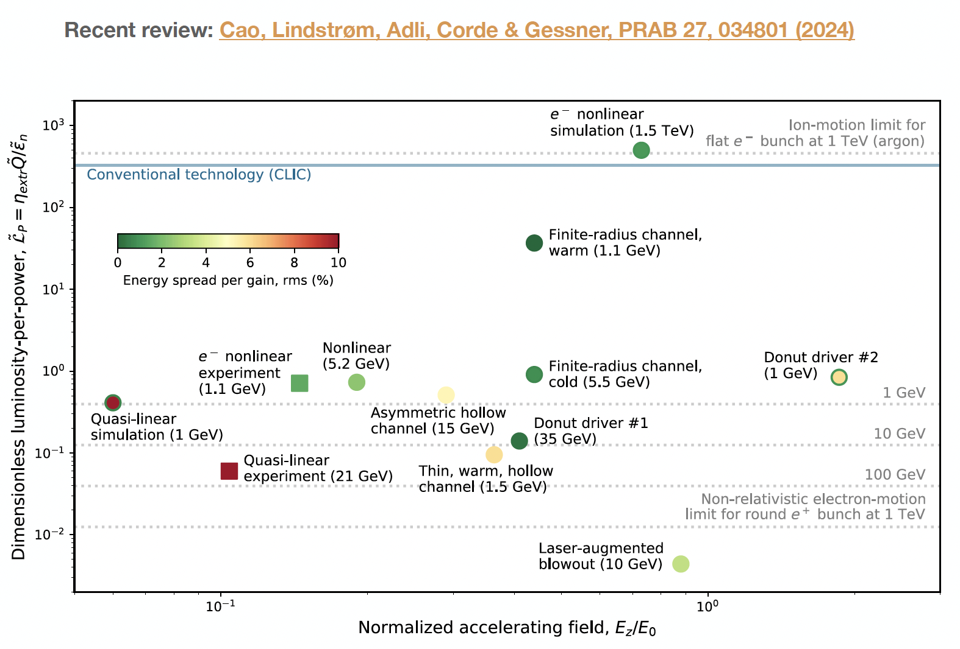
Positron Acceleration
Even if one of these schemes proves to work reliably and reproducibly, they are
generally VERY inefficient

Slide 12
II: Hybrid Asymmetric Linear
Higgs Factory (HALHF)
The basic idea is – there are enough problems with a PWFA e⁻ accelerator; e⁺ is even more difficult. Bypass this for e⁺e⁻ collider by using conventional linac for e⁺.
For this to be attractive financially, conventional linac must be low energy => asymmetric energy machine.
This requirement led to (at least for us) unexpected directions – the more asymmetric the machine became, the better!

Slide 13
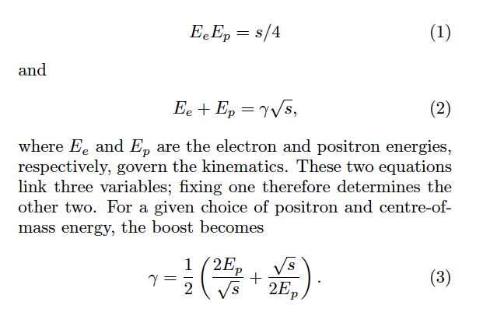
Relativistic Refresher
It turns out that the (an) optimum (see below) for E_{cm} = 250 GeV is to pick E_{e} = 500 GeV, E_{p}= 31 GeV, which gives a boost in the electron direction of γ ~ 2.13.

Slide 14
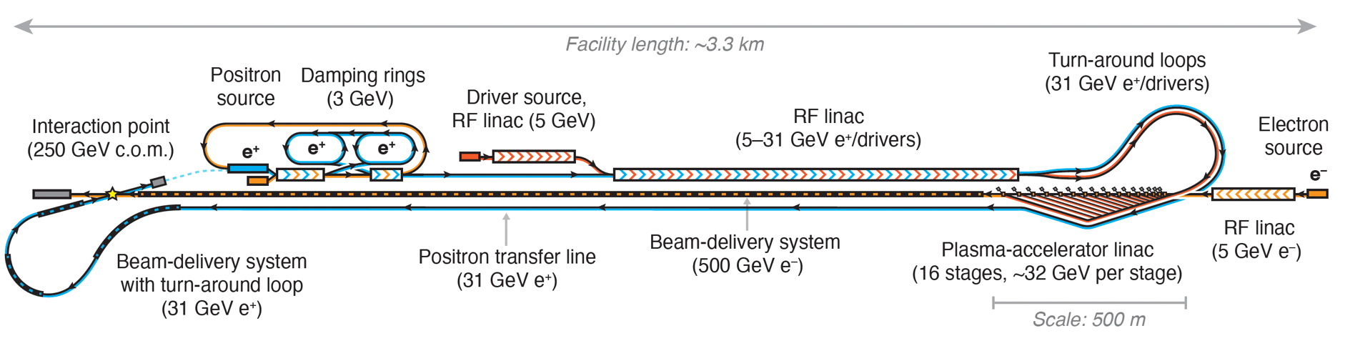
HALHF Layout
e-
e+
e+ BDS
e- BDS
Overall facility length ~ 3.3 km – which will fit on ~ any of the major (or even ex-major) pp labs. (NB. A service tunnel a la ILC is costed but not shown)

Slide 15
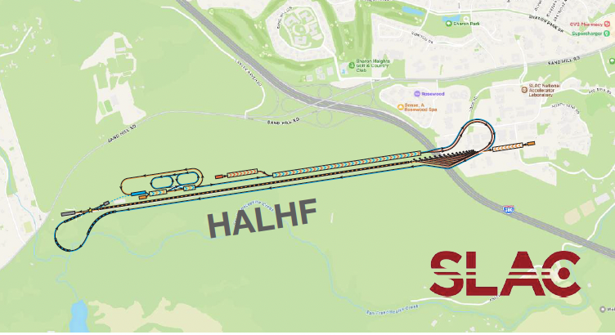
HALHF Layout
e-
e+
e+ BDS
e- BDS
Overall facility length ~ 3.3 km (NB. A service tunnel à la ILC is costed but not shown)
fits on ~ any of the major (or even ex-major) pp labs.

Slide 16
Energy Efficiency
Asymmetric machines less energy efficient than symmetric – energy lost “in accelerating the C.o.M.” For equal bunch charges => 2.5 times more energy required for same C.o.M. energy.
Can be reduced by introducing asymmetry into beam charges – increase charge of low-energy beam and decrease high-energy s.t. N² = N_{e}N_{p} constant => L conserved.
P/P₀ = (N_{e}E_{e}+N_{p}E_{p})/(N*sqrt(s))
Optimum is to scale e⁺ charge by sqrt(s)/(2E_{p}), i.e. factor ~ 4.
Producing so many e⁺ problematic – compromise by scaling by factor 2 (2*e⁺, ½* e⁻).
Reduces energy increase to 1.25. Also reduces bunch charge in PWFA arm.

Slide 17
Emittance reduction
Geometric emittance of bunch scales with 1/E .
Lower-energy e⁺ beam must have smaller β function at I.P. – use β_{x} /β_{y} = 3.3/0.1 mm c.f. CLIC 8.0/0.1 mm.
In contrast, high-energy e⁻ beam - β function can be increased.
More interesting is to increase the e⁻ emittance AND reduce the β function => normalized emittance can be 16 times higher for the same L => increased tolerances in PWFA arm.
Beam-beam focusing effect on L must be simulated with Guinea Pig.

Slide 18
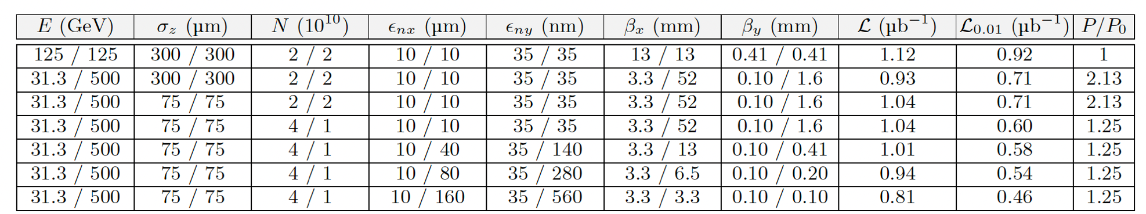
Beam-beam Effects
Guinea-Pig results:
ILC
HALHF
HALHF with reduced emittance for PWFA

Slide 19
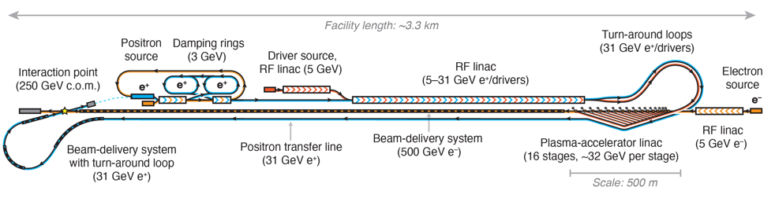
Positron Source
“Conventional” e⁺ sources are not trivial – that for ILC, which has relaxed requirements wrt HAHLF, still under development.
e⁻ accelerated to 5 GeV and then collide with target to produce e⁺ which are accumulated, bunched and accelerated to 3 GeV and then damped in 2 rings (~identical to CLIC but bigger e⁺ bunch charge (4*10¹⁰ e⁺).
May be possible to use spent e⁺ bunch after collision rather than dedicated e⁻ bunch, with cost savings.

Slide 20
Main RF Linac
Split in 2, to accelerate e⁻ PWFA drive beams from 1 – 5 GeV & then
both e⁺ and e⁻ from 5 GeV to 31.3 GeV.
Assumed gradient of 25 MV => 1.25 km long.
Delivers total average power of 21.4 MW => including e⁺ power and
ε ∼ 50%, wall-plug 47 MW.
Assumed warm L-band linac – CW SRF could be used but would change
bunch pattern.
Before drivers, e⁺ bunch accelerated with 180º phase offset.

Slide 21
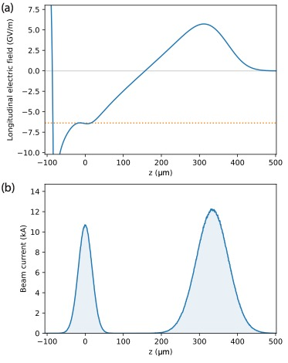
PWFA Linac
~ 80% polarized source
Drivers go through turn-around and
then distributed to plasma cells via
undulating delay chicane.
Assuming TR ~ 1, e- bunch accelerated
by 31 GeV/5m stage => 16 stages
with ρ ~ 7*10¹⁵ => 6.4 GV/m.
Interstage optics needs ~ <26.5m>
but scales with sqrt(E); <gradient>~1.2 GV/m
Total length of PWFA linac = 410m.

Slide 22
Bunch-train pattern.
Assuming L-band linac:

Slide 23
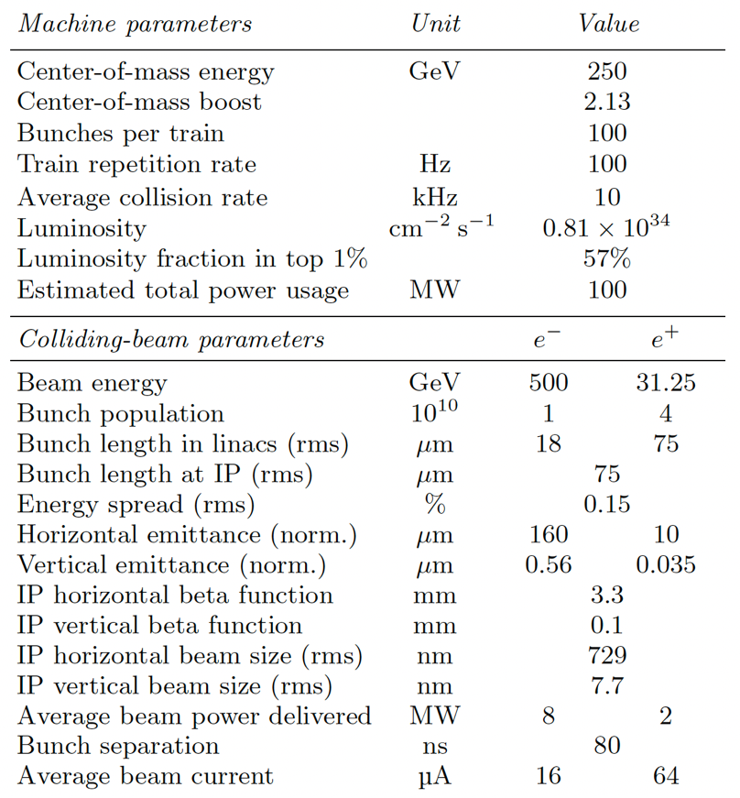
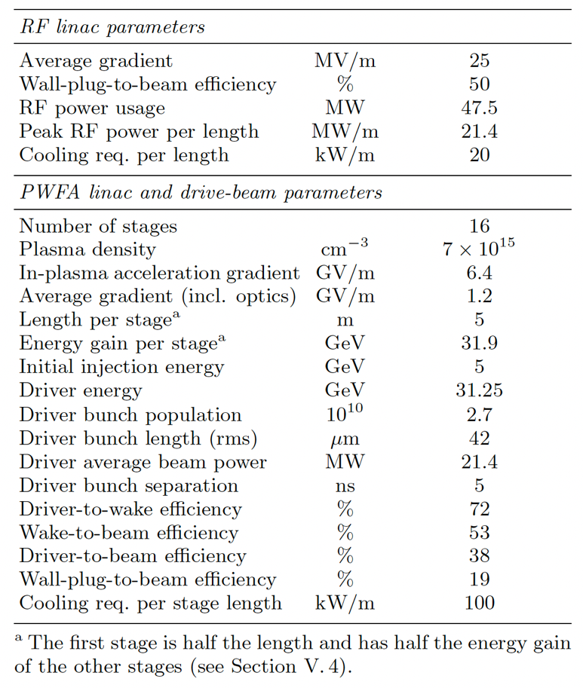
HALHF Parameter Table

Slide 24
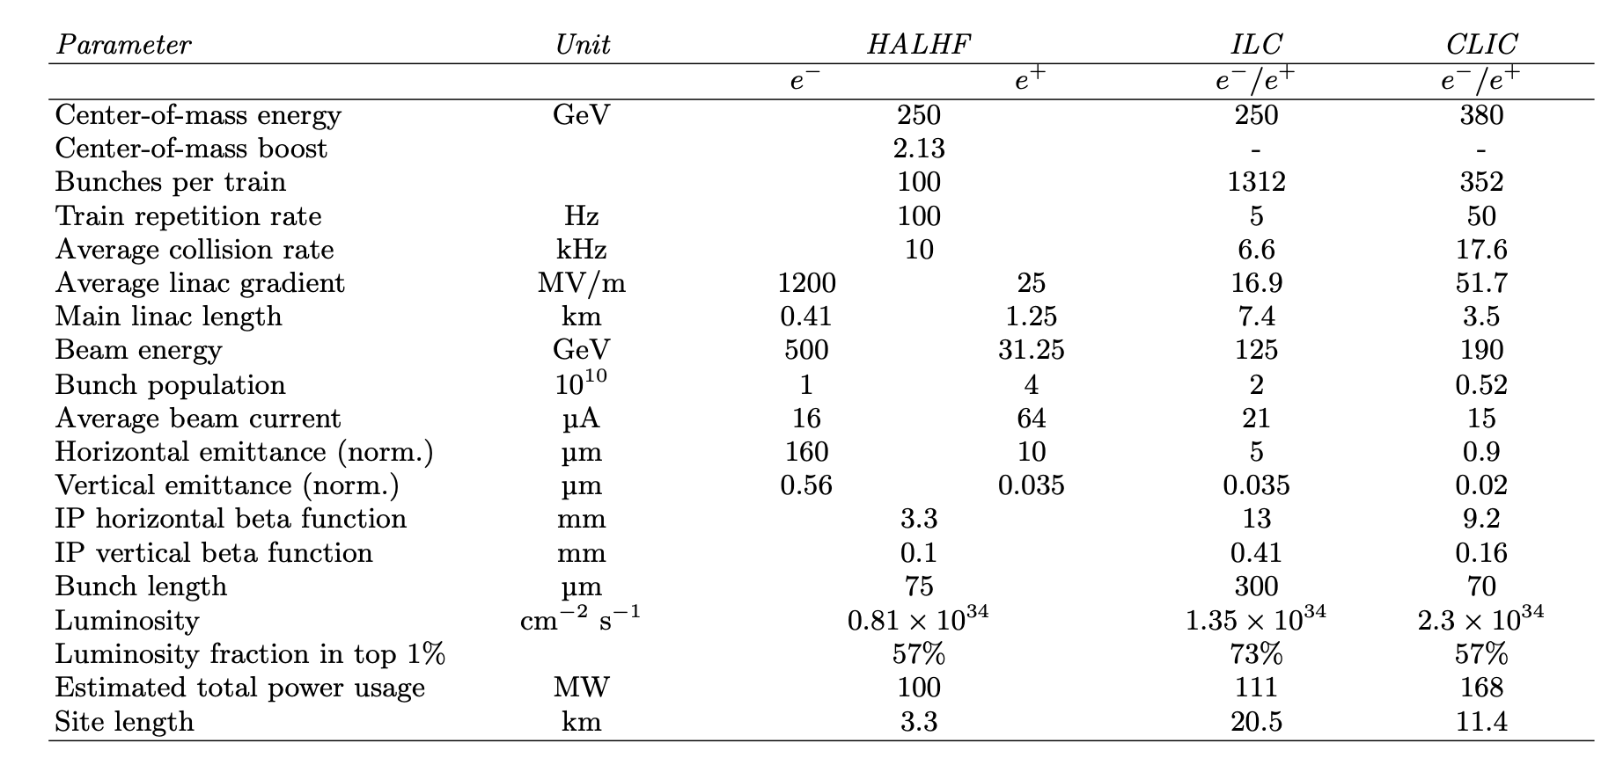
HALHF Parameters cf
ILC & CLIC

Slide 25
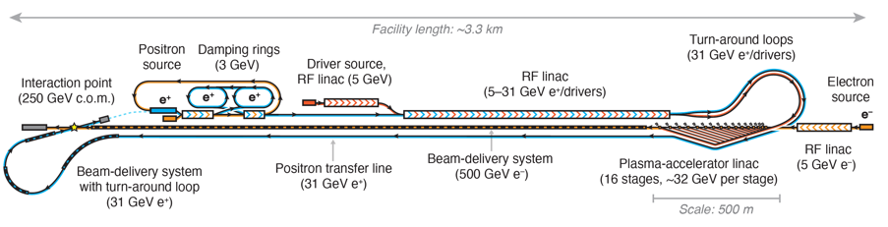
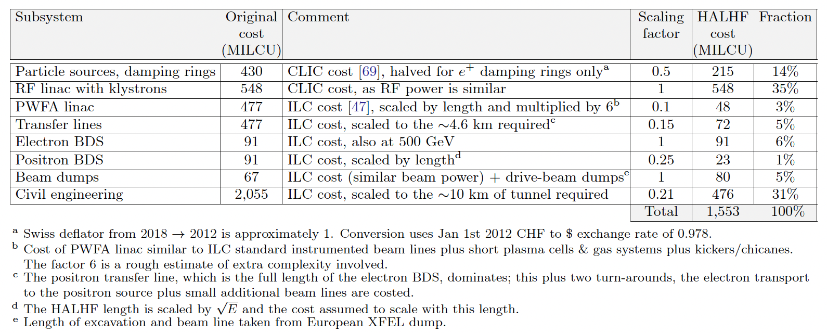
Cost Estimate
Scale from existing costed projects wherever possible – mostly ILC – very rough – not better than 25% accurate.

Slide 26

Cost Estimate
Snowmass study ITF of various accelerator costs gives ILC Higgs Factory Total Project Cost (TPC) (= US accounting) of $7 – 12B (2021 $). Scaling this by the value estimate (~European accounting) of HALHF/ILC@Snowmass gives HAHLF TPC ~ $2.3 – 3.9B: c.f. EIC TPC = ~< $2.8B. Direct estimate by ITF people (Seeman/Gessner) gives $4.46B.

Slide 27

Running Costs
Dominated by power to produce drive beams.
(100*16*4.3nC + 6.4nC)*100 => 47.5 MW@50% eff.
Damping rings: 2*10 MW.
Cooling – assume similar to CLIC => 50% of RF power (corresponds to 20 kW/m).
For magnets and other conventional sources assume ~9 MW.
Gives total power requirement ~ 100 MW – similar to other proposals.

Slide 28
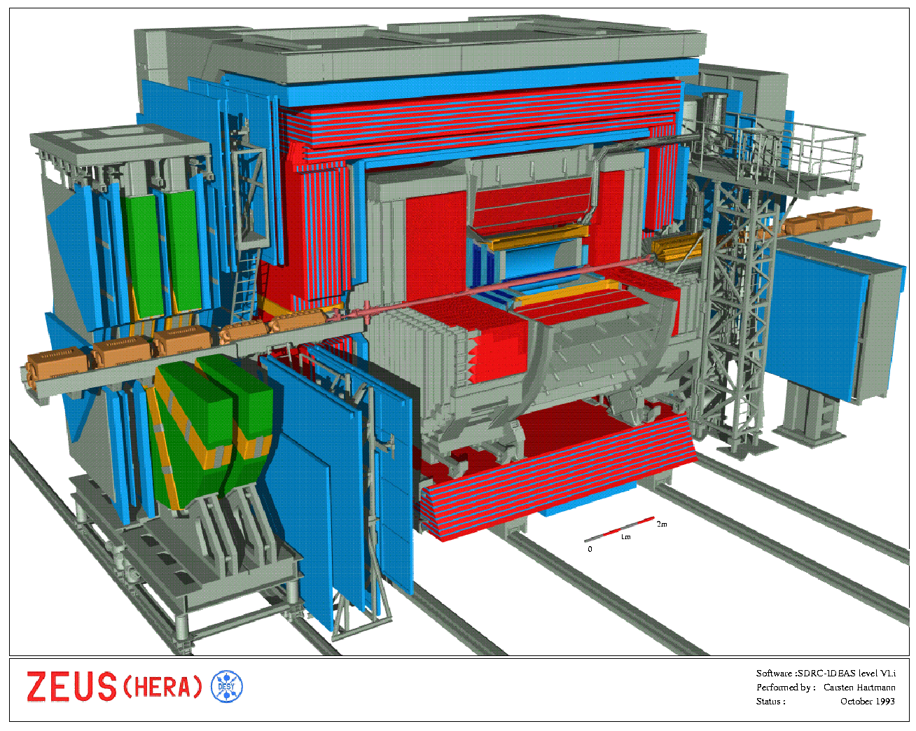
Experimentation at HALHF
Boost is smaller than
HERA - HERA detectors
very similar to those at
symmetric machines.
Measurement of L via
Bhabha (e⁺e⁻ -> e⁺e⁻)
- rate reduced by
1/(θγ)² & e⁺ scattered
into barrel – but not a
problem. Singles rate
good for machine
optimisation

Slide 29
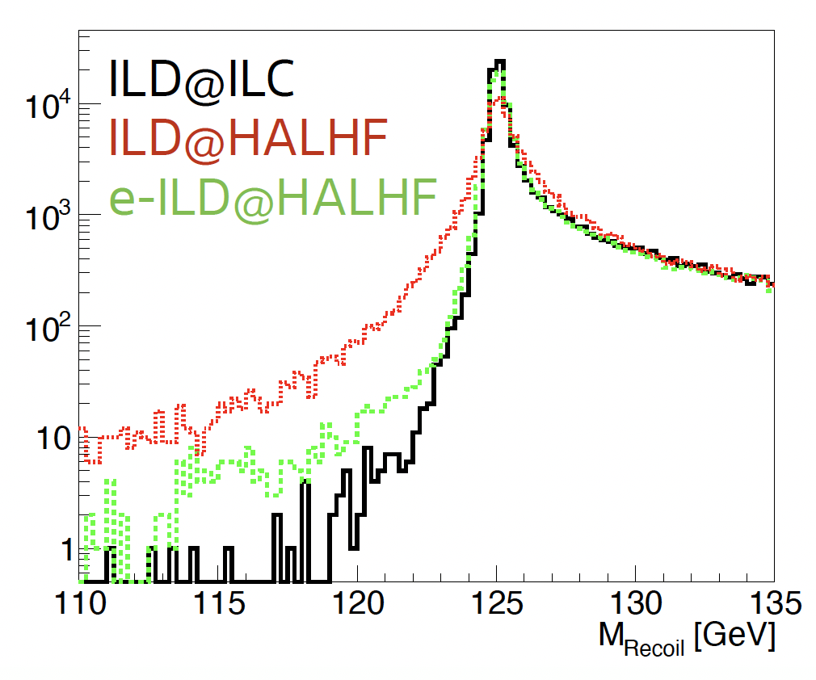
Experimentation at HALHF
Preliminary study
(M. Berggren,
A. Laudrain(DESY))
with long ILD barrel:
~ 20% degradation
of Higgs resolution.
“Proper” detector
design required.

Slide 30
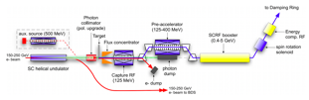
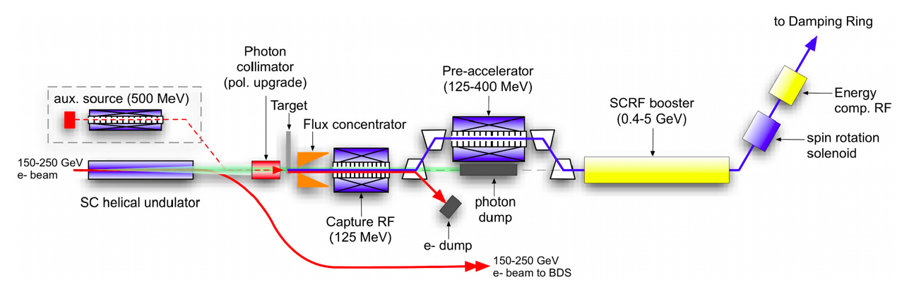
III: Upgrades
Produce e⁺ polarization via ILC-like scheme - ideas exist for E(e⁻) 500 GeV; wiggler probably longer and more expensive. Cost ~ 300 MILCU minus conventional source cost.

Slide 31
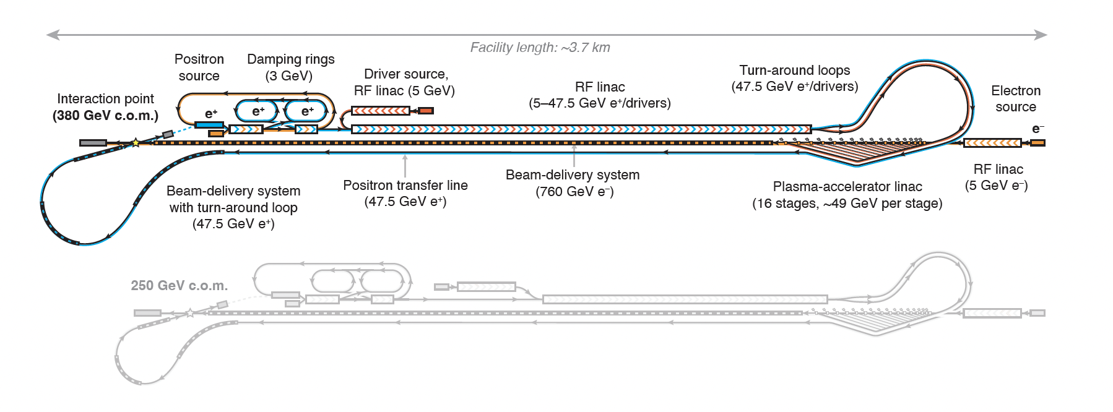
Outline of Upgrade Suite
Energy upgrade to ttbar (380 GeV).
47.5 GeV positrons / 760 GeV electrons(same # of stages, same boost)
=> +130 m PWFA linac; Added cost ~23%; >~25% more power.

Slide 32
Outline of Upgrade Suite
Energy upgrade to Higgs self-coupling, ttH Yukawa (550 GeV).
68.5 GeV positrons / 1.1 TeV electrons(same # of stages, same boost, plasma cell length increased to 11m);
=> RF linac more than doubled in length – 2.75 km;
+254 m PWFA linac;
Roughly 48% increase in cost cf Higgs factory; power increases by 90 MW to 190 MW.

Slide 33
2-IP Upgrade
Unlike circular machines, in LCs, extra IPs just share L. CLIC has only 1 detector; ILC has 2 “oscillating” ones.
HALHF can either share L or double it – with an extra linac!
Cost: T-shape: larger footprint - 250 MILCU; 2linac - 690 MILCU
Running costs @ Higgs: T-shape: same; 2linac – 150 MW

Slide 34
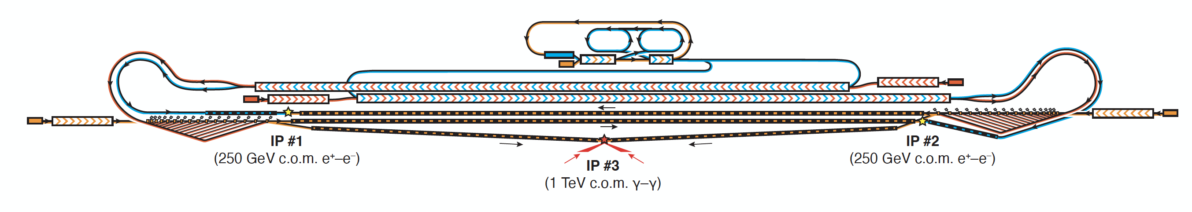
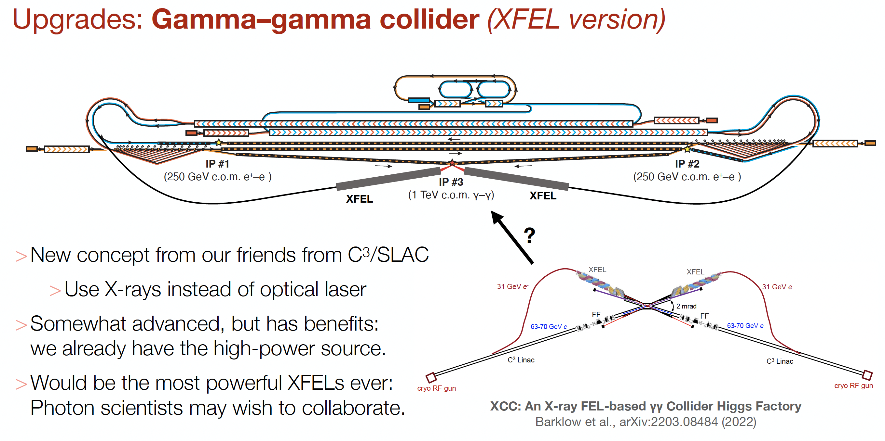
Outline of Upgrade Suite
γγ.

Slide 35

Outline of Upgrade Suite
Multi-TeV
Requires solution of positron
acceleration in plasma
e⁺
e⁻
Multi-TeV
e⁺e⁻ IP

Slide 36
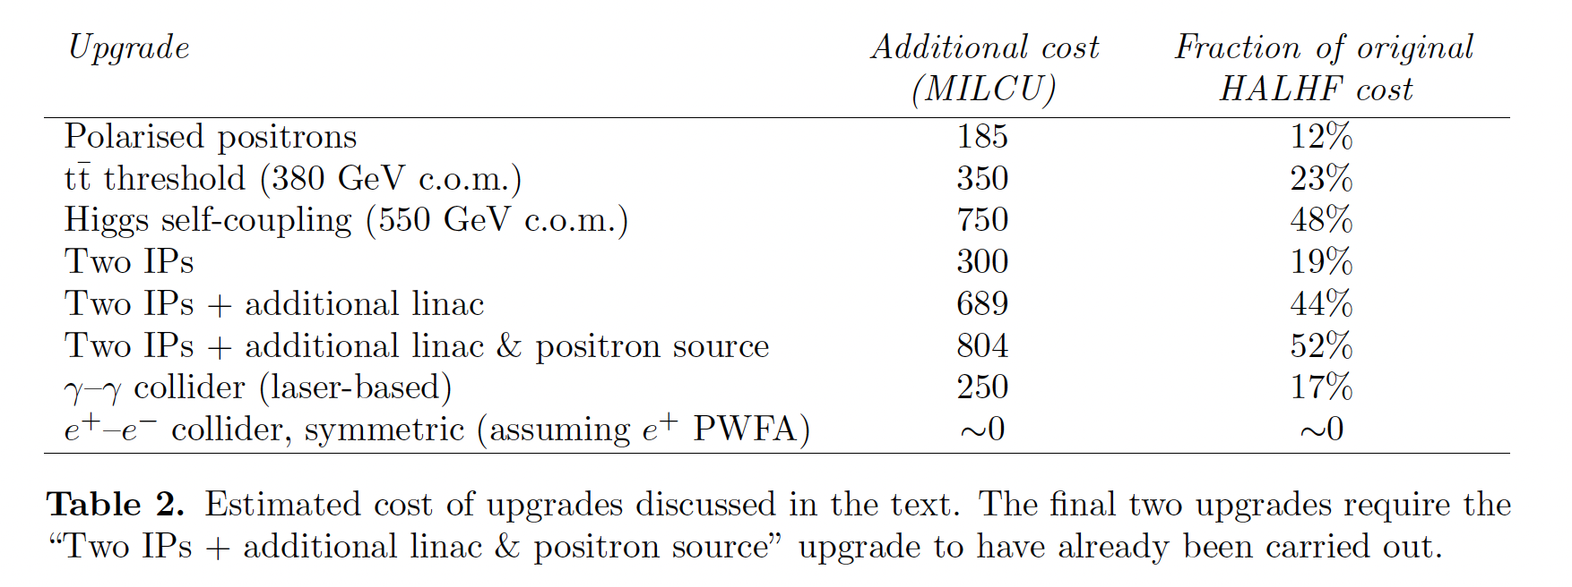
Upgrade Summary

Slide 37
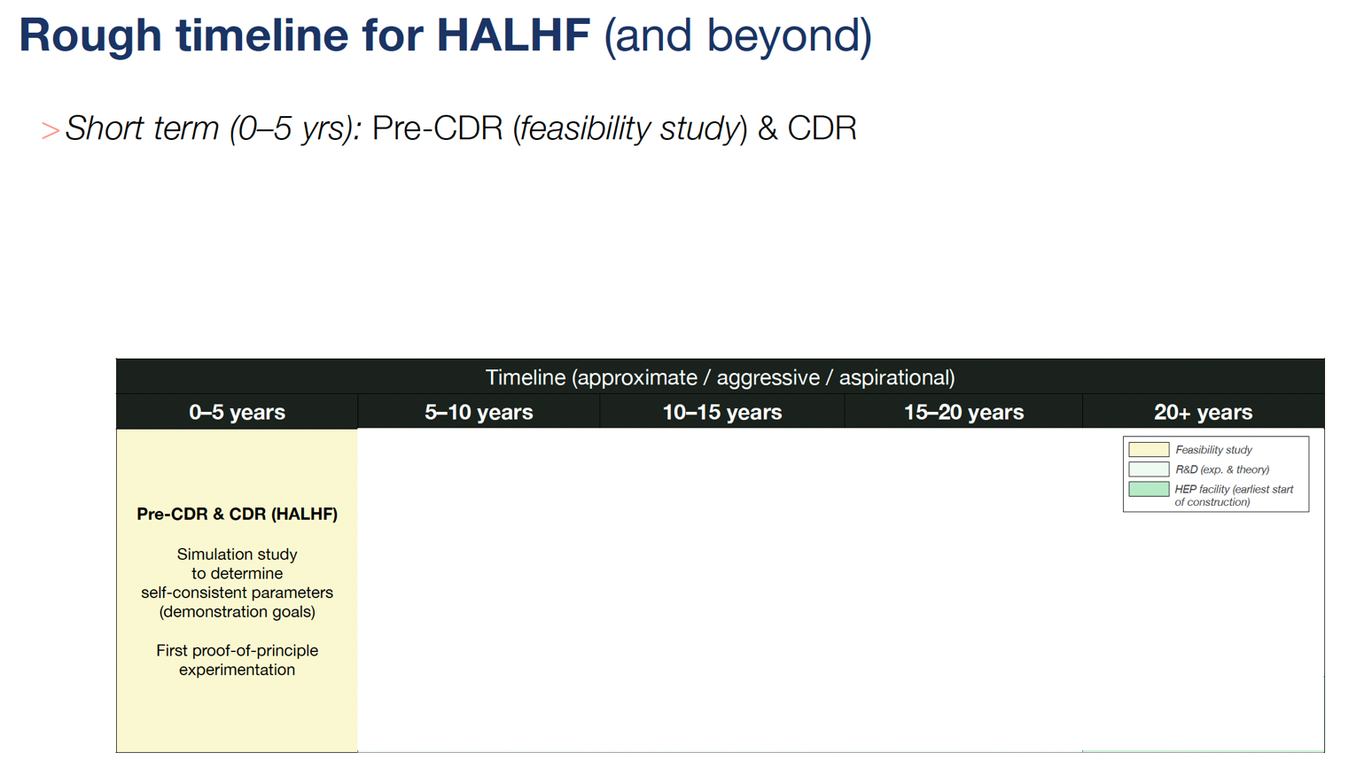
IV: R&D Required

Slide 38
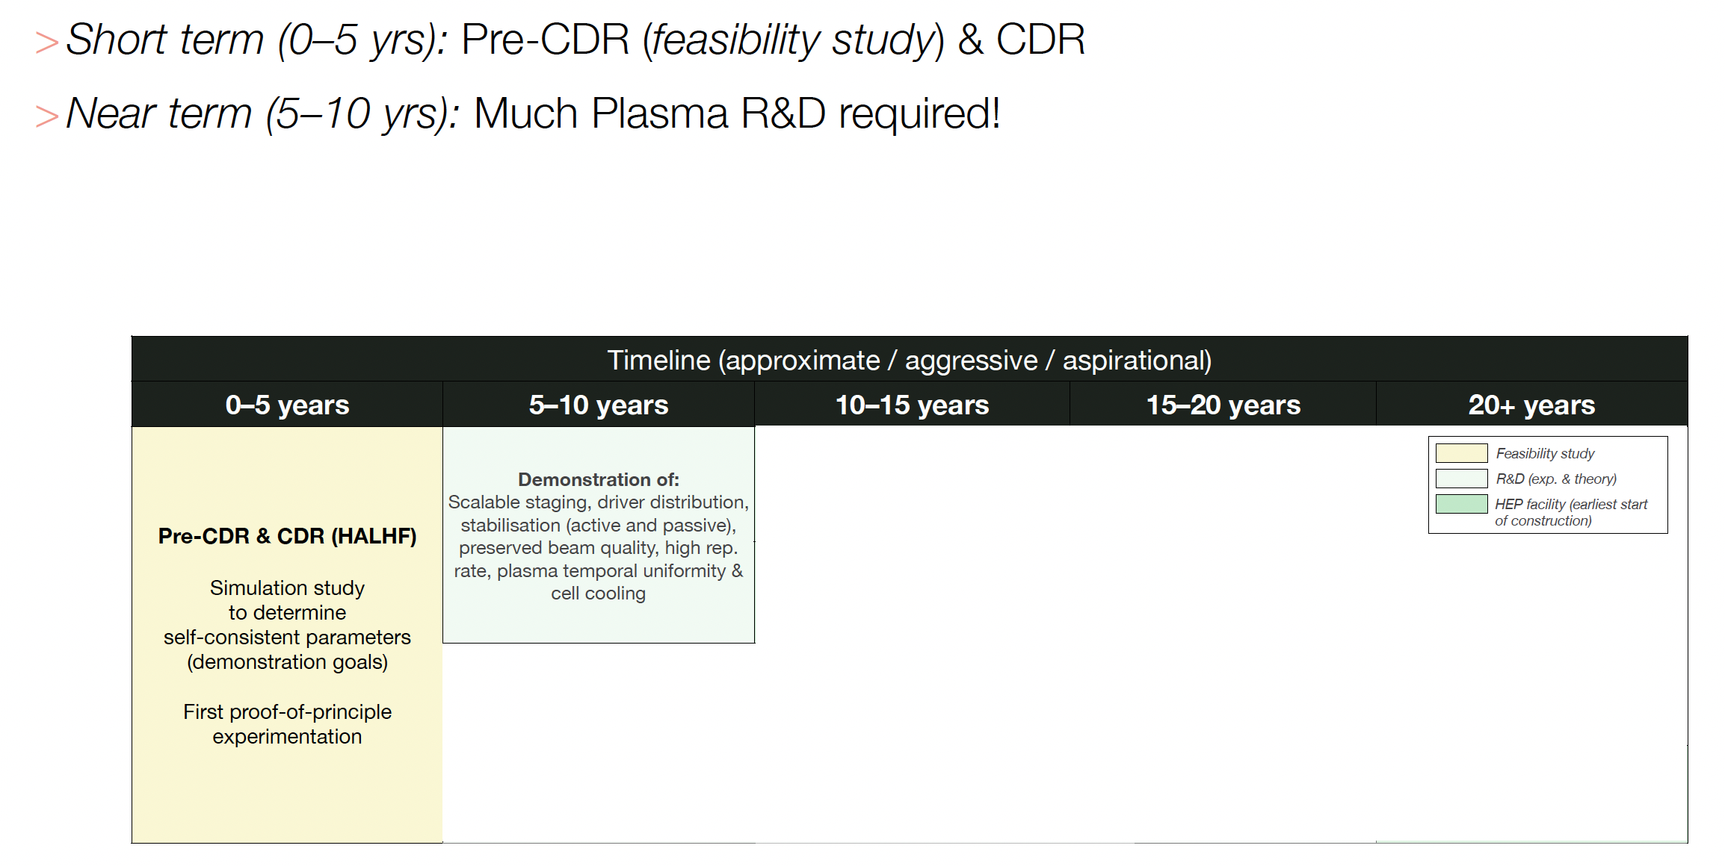
R&D Required

Slide 39
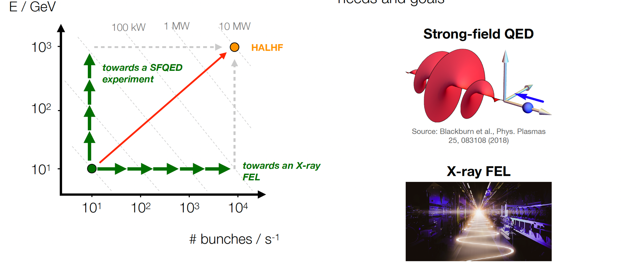
Path to construction
“Valley of death” in performance goal requires decoupled strategy.

Slide 40
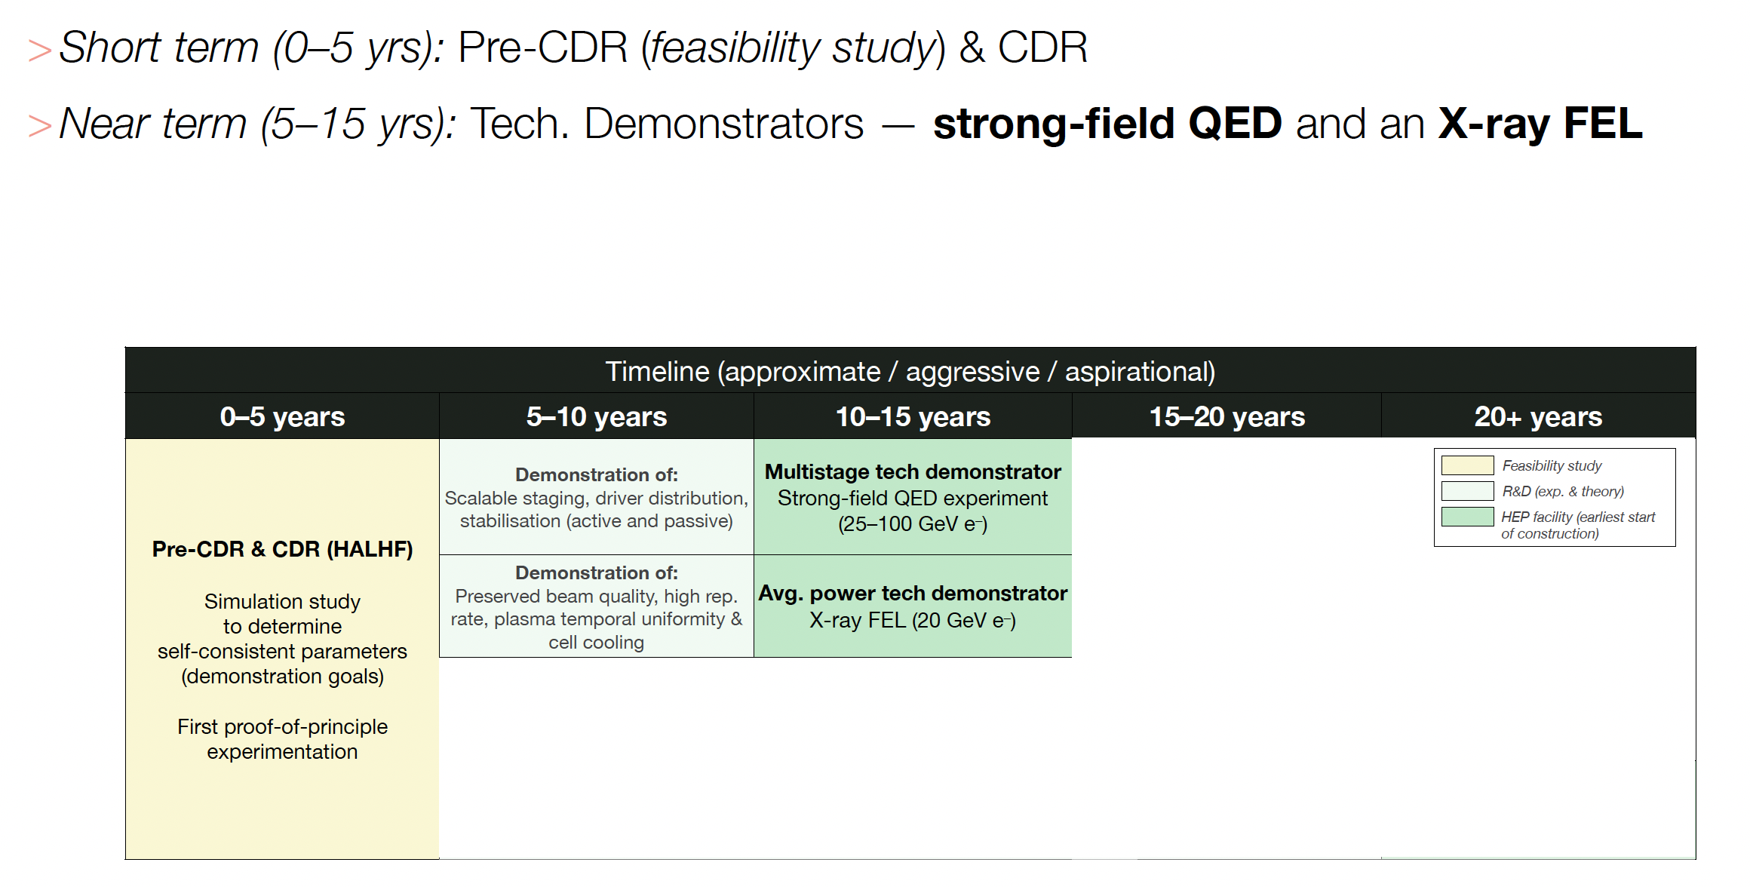
Path to construction

Slide 41
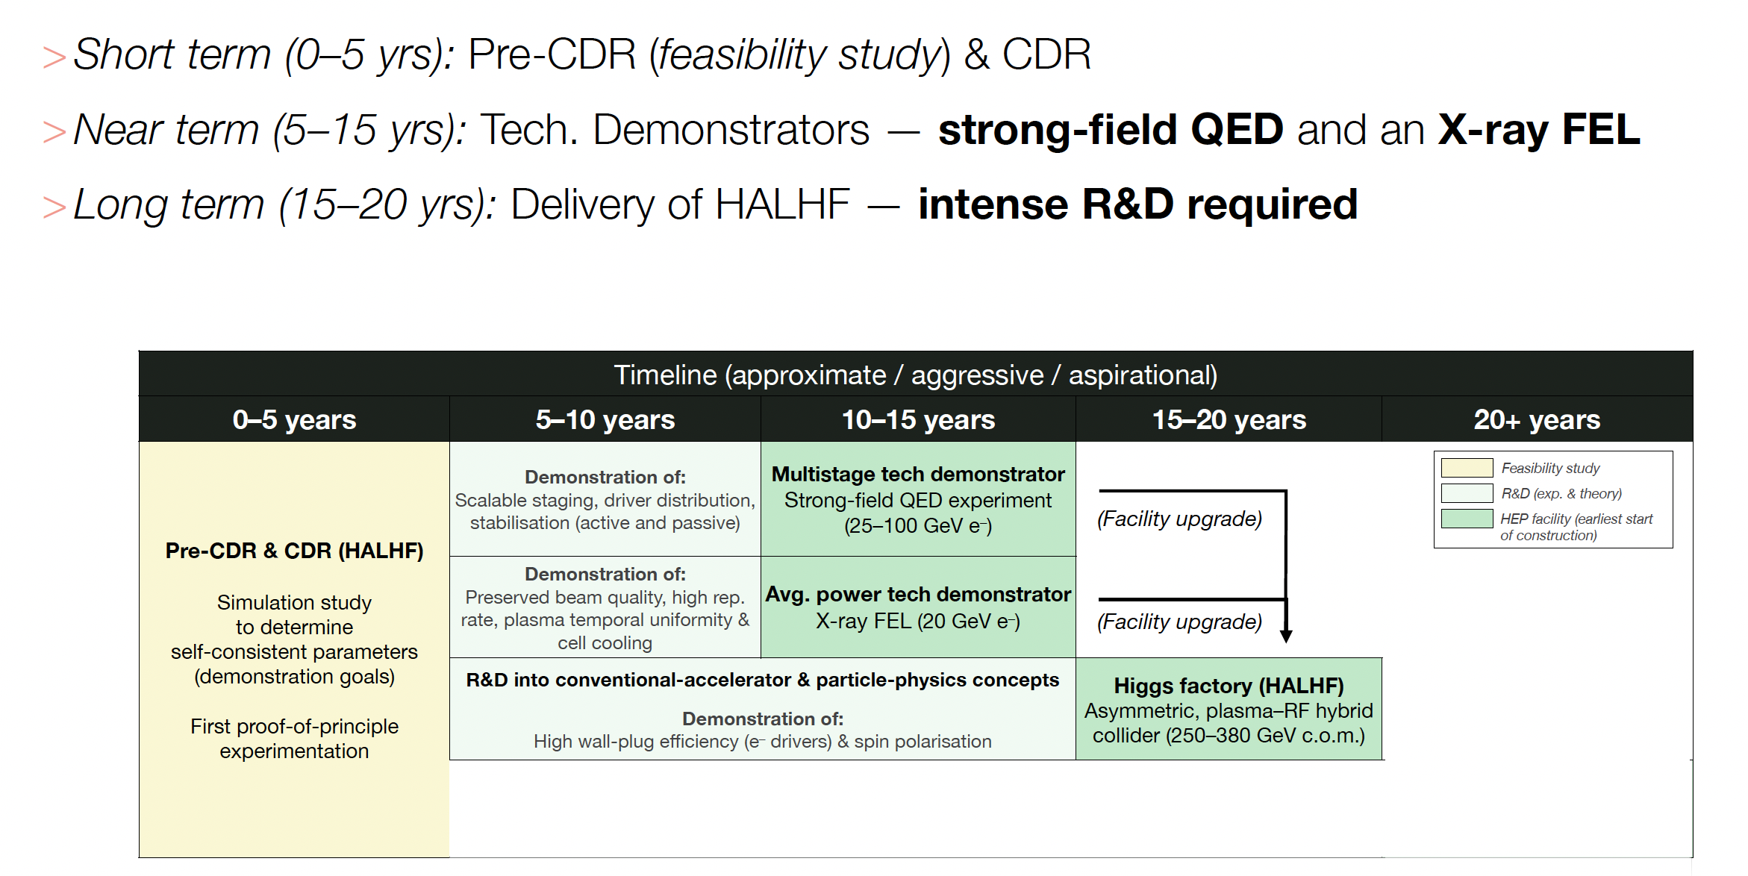
Path to construction

Slide 42
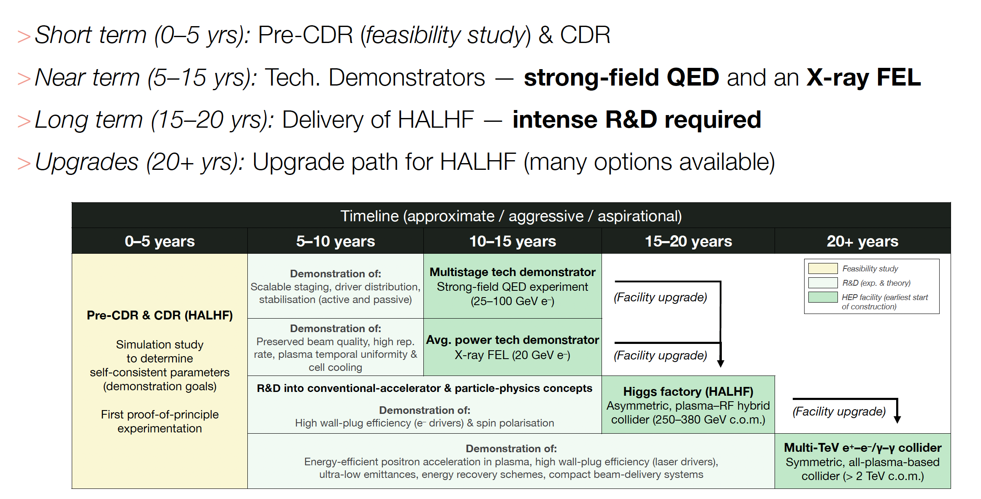
Path to construction

Slide 43
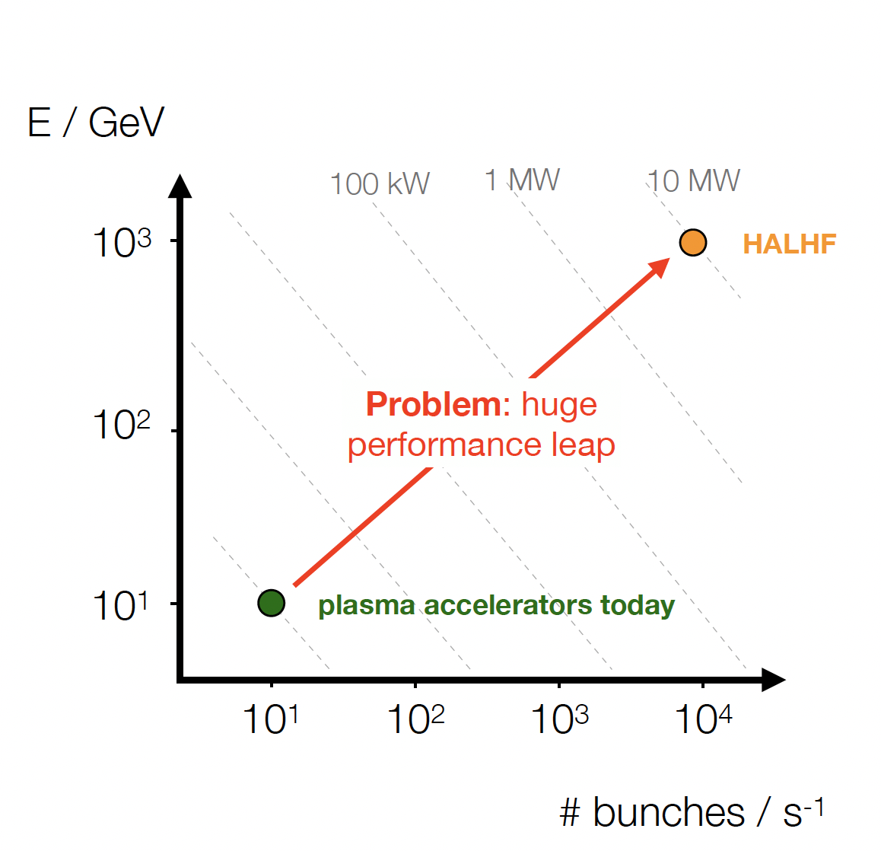
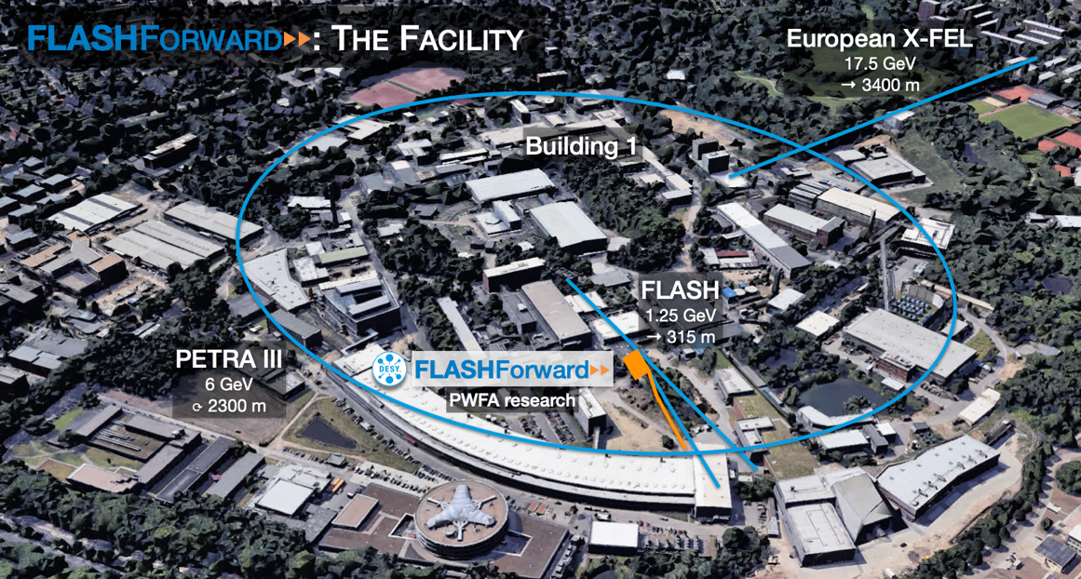
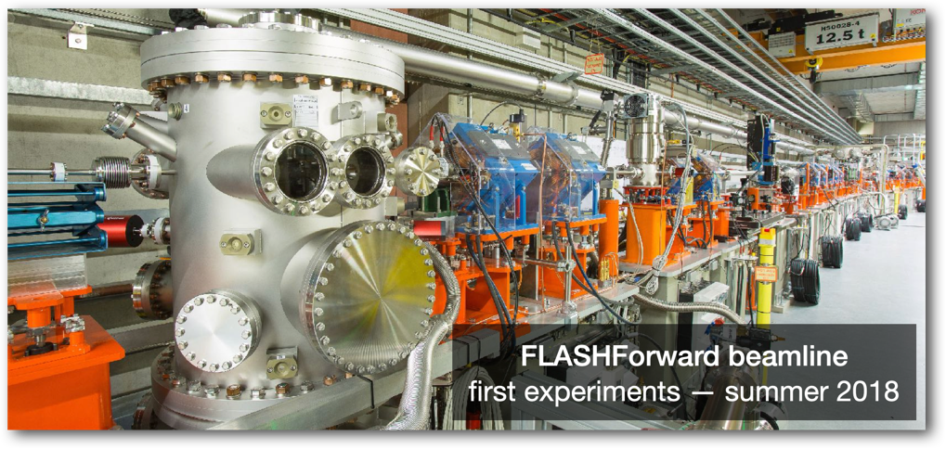
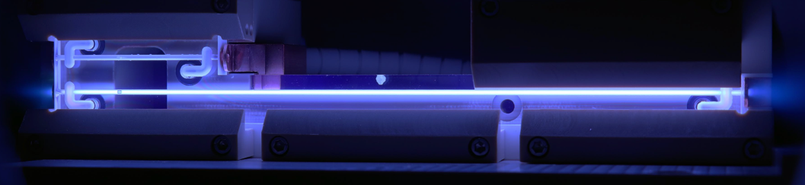
Long Journey Ahead
FLASHForward@DESY results

Slide 44

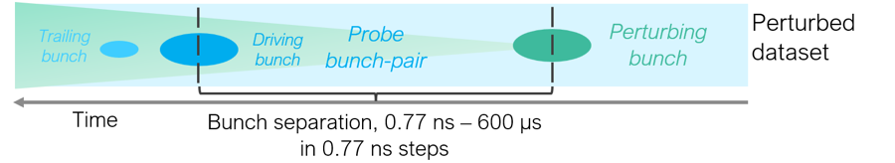
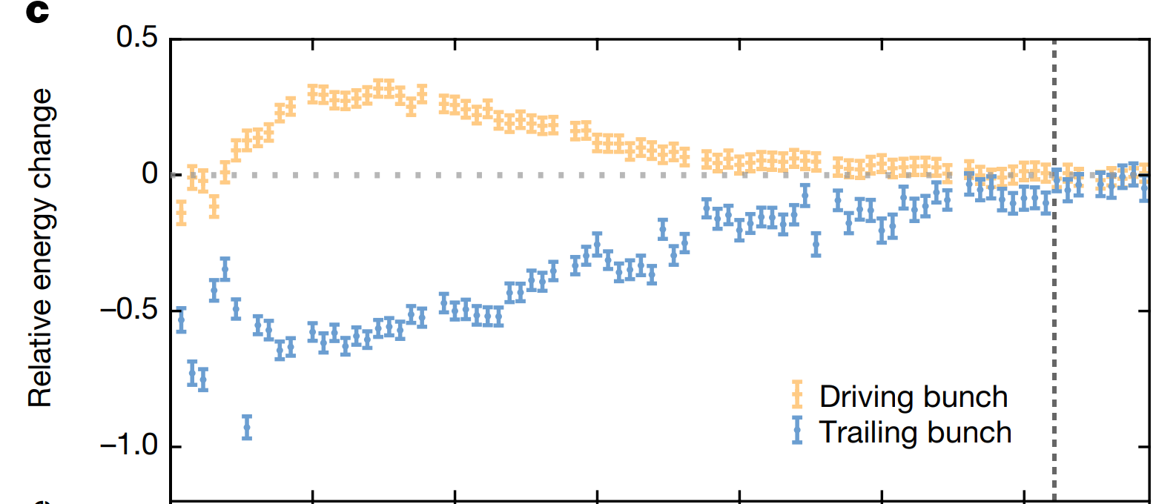

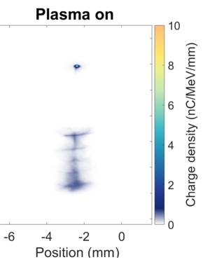
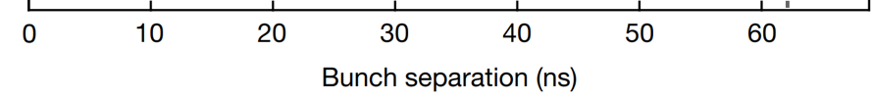
Rate limits in Plasma
Demonstrates >10 MHz repetition
Rate in Ar – lighter gases faster.
3
1
63 ns
Trailing bunch
Driver
Accelerated bunch on the energy spectrometer
Diagram and image courtesy: F. Pena, J. Beinortaitė
[1] R. D’Arcy, BF, et al., Nature 603, 58-62 (2022)
Notes:
In principle, the plasma recovers quickly enough to enable MHz acceleration. However, there are also other mechanisms in play, such as cell heating and gas expulsion.
BRIDGE: Now we want to actually do acceleration at MHz
44

Slide 45
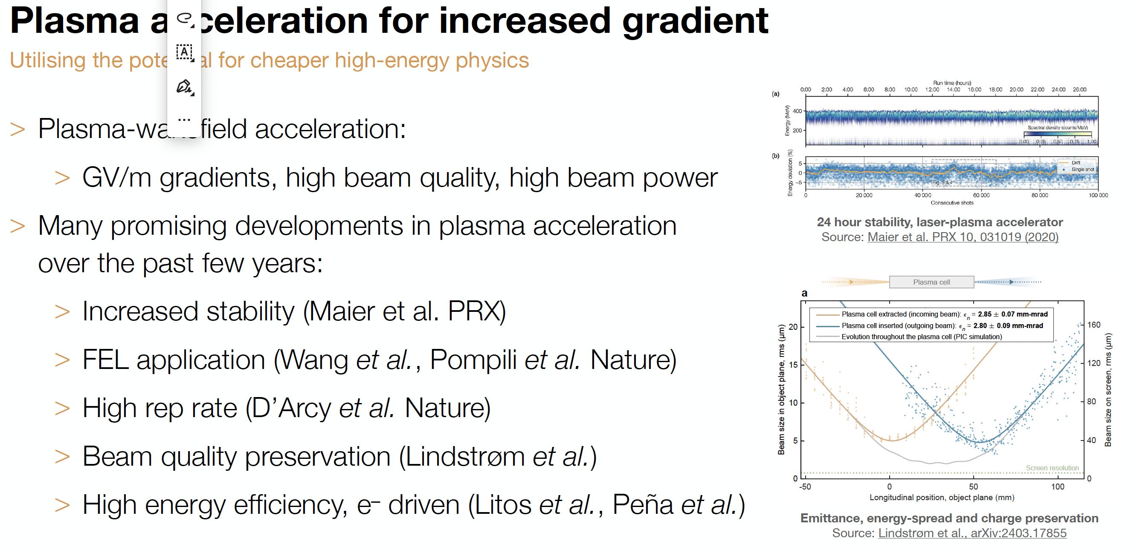
Plasma Progress
3
1
Notes:
In principle, the plasma recovers quickly enough to enable MHz acceleration. However, there are also other mechanisms in play, such as cell heating and gas expulsion.
BRIDGE: Now we want to actually do acceleration at MHz
45

Slide 46
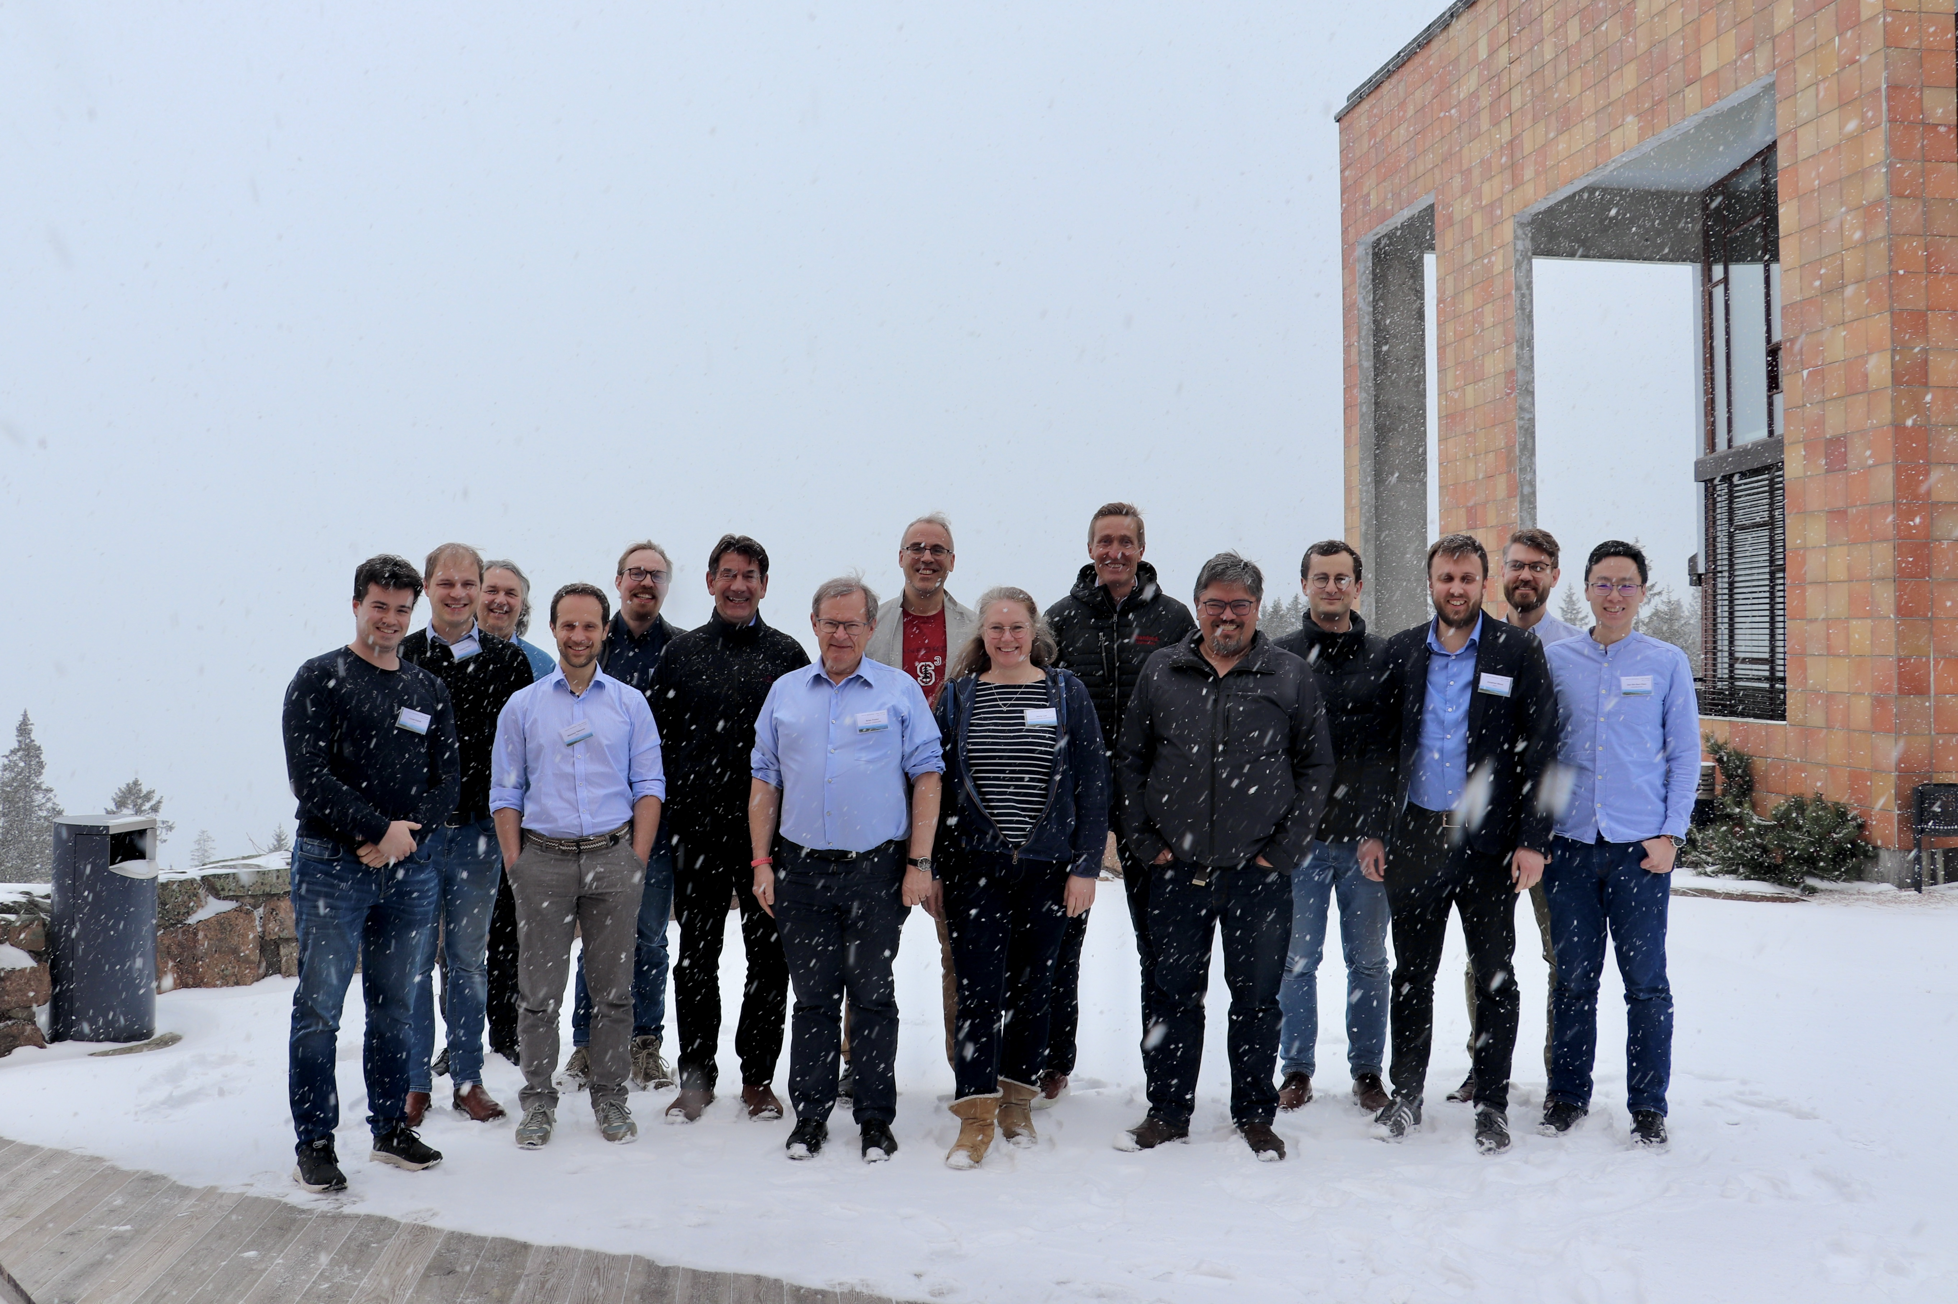
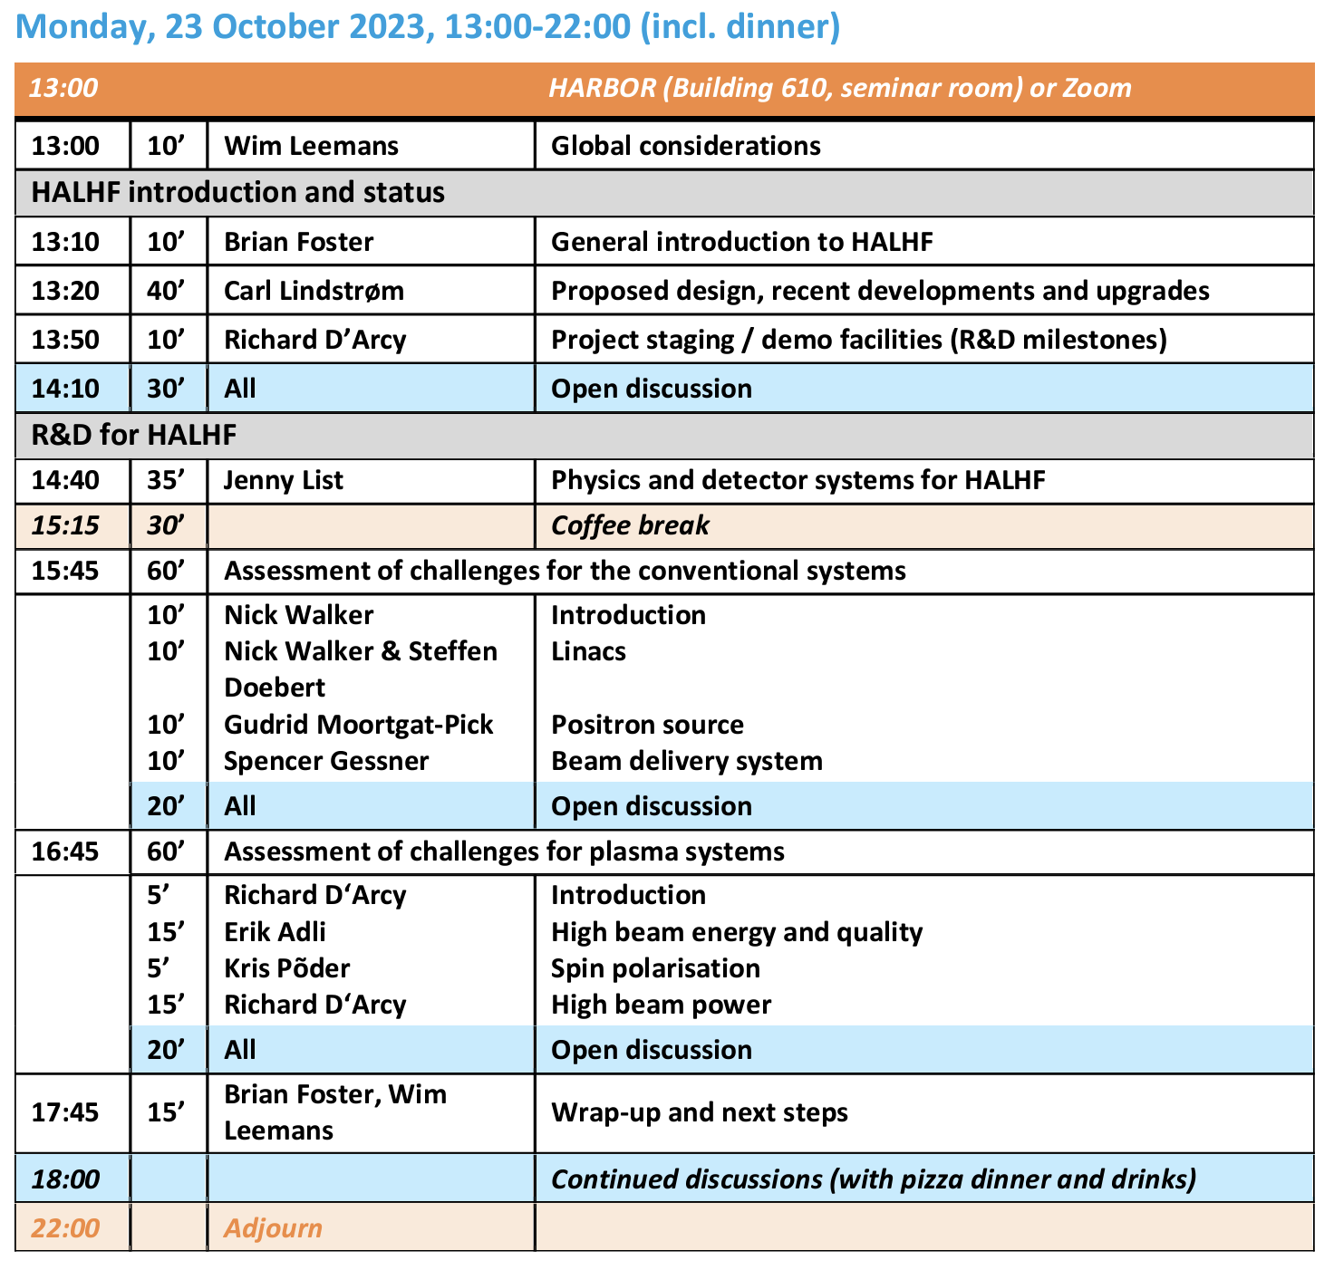
Current Status
HALHF Collaboration
“kick-off” meeting
@ DESY 23/10/23.
Attendance ~ 50.
HALHF Workshop
@ Oslo 4-5/4/24.
Attendance ~ 30 (physical+ Zoom).
https://indico.cern.ch/event/1370201/

Slide 47
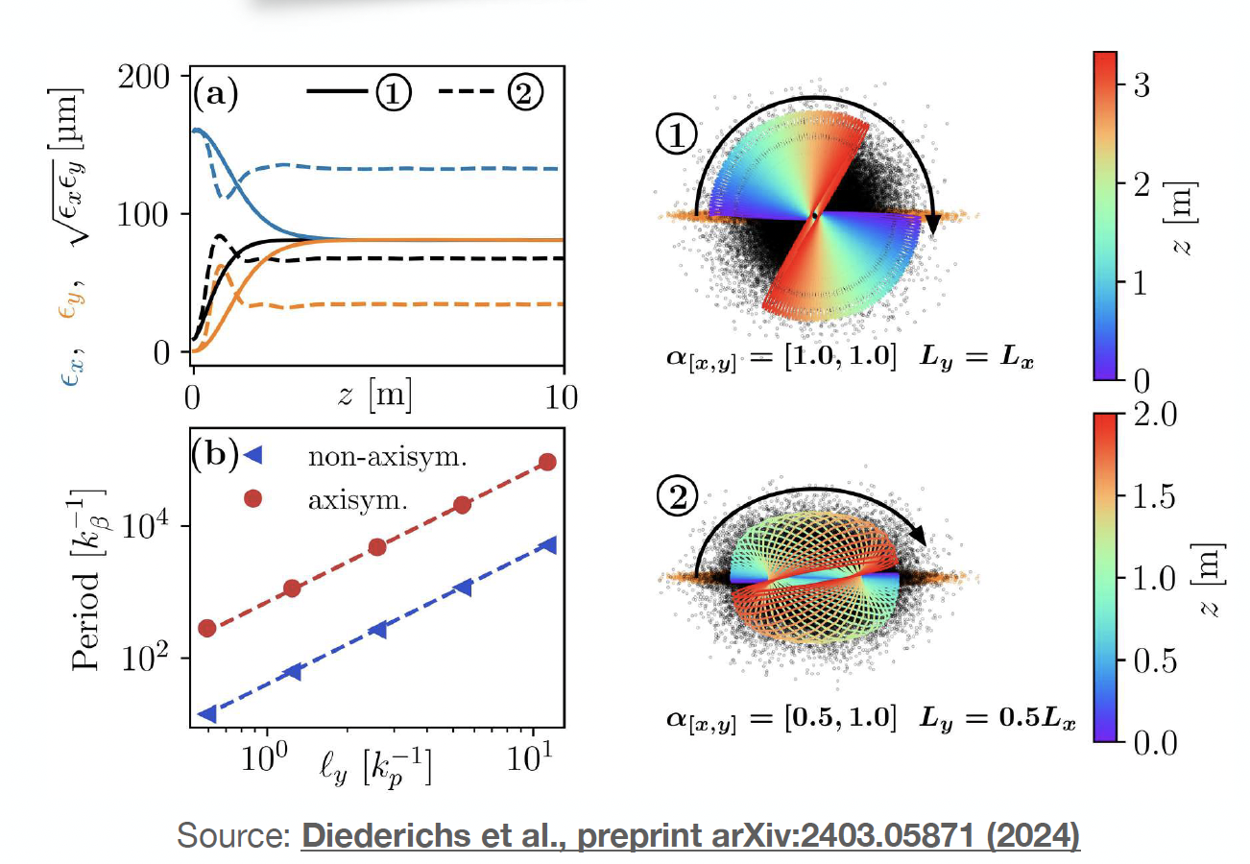
Selected Updates
PWFA arm:
  Flat beams (essential to get required lumi at IP while minimising beamsstrahlung)
    “Resonant emittance mixing of flat beams in plasma accelerators”
    S. Diederichs et al., arXiv:2403:05871
    Issue: when ion motion present,
    non-linear focusing mixes planes
    => Flat beams don’t stay flat
    Possible solution: flat drive beams
    Seems to work – but need to
    evaluate ion-motion from witness
    beam

Slide 48
Parameter Optimisation
A “simple” cost model utilising Bayesian optimisation:
> Need to implement sufficient complexity for all parameters to have high-cost extrema:
> Example:
  Low rep. rate — long runtime = high cost of constant-power overheads
  High rep. rate — high peak power = high cost of power infrastructure
> Currently implemented (analytic only, no simulation):
> RF linacs (voltage limited by power and BDR, efficiency based on filling time/cooling)
> Damping rings (radius based on bunch-train length, damping-time limits, rep rate)
> Plasma linac (lengths and efficiencies, but not yet effect on emittance)
> PWFA emittance growth due to instabilities (model by Lebedev et al.)
> + turnarounds, BDS, tunnels, power infrastructure, general overheads, dumps

Slide 49
Parameter Optimisation
Very much work in progress
> However, clear conclusion that reducing plasma density from original baseline of 7*10¹⁵ is beneficial;
> Downside: Lower density reduces the accelerating gradient
  It turns out the gradient is not so crucial (a major lesson learnt from HALHF, though this will be less true at multi-TeV)
  At ~2 GV/m, the PWFA arm is ~850 m (x2 longer ➞ interstage optics dominate)
Upside: Everything else is easier
  The cell cooling requirements go down (scales as E_{z}) from ~90 to ~30 kW/m (2*CLIC)
  Transverse instabilities are reduced (parameter/jitter studies required to quantify exactly)
  Ionisation potential of the beam is reduced (beam density goes down), which permits use of heavier gases like xenon (also desired for reduced ion motion)
  Matching, alignment, and synchronisation tolerances reduced (beta functions are larger)
  Bunches are longer, currents are lower (less compression/stretching required)

Slide 50
Parameter Optimisation
Also indicates that separating positron and drive-beam acceleration
may be advantageous both for flexibility and cost – but still exploring;
Also reduced energy asymmetry may be better – still exploring this too
Comprehensive simulation campaign using
  plasma density 1*10¹⁵.
  Gradient: 2 GV/m.
  Efficiency: ~35% wake-to-beam efficiency, driver depletion efficiency 75–80%
  Electron charge still about 1.6 nC. Driver charge around 8 nC. Transformer ratio ~1.5 (somewhat shaped/triangular driver)

Slide 51
Status of “Conventional” Arm
Working Groups for:
Linac; Polarisation in PWFA; Positron Source; BDS
Others required: Damping Rings, overall Beam Dynamics & machine lattice, etc.
Limited by lack of visible funding! CAL ERC Grant only explicit support
Linac: both CW SCRF and warm L-band linacs seem possible, although difficult. “Combined function” also seems possible, although separated function would be advantageous if affordable – optimisation tool!

Slide 52
Towards an advanced LC
Technology being developed for HALHF could also enhance a “conventional” LC design:
Assume: ILC has been built,
-> 2x125GeV linacs available
Goal: upgrade electron arm to 500GeV with plasma
-> 125x500GeV -> 500GeV COM; γ ~ 1.2
-> upgrade a Higgs factory to a tth / Zhh factory
Use electron linac for drive and witness beam:
run a lower gradient but higher current, upgrade RF on electron arm
Use space for undulator source between electron ML and BDS to install plasma booster
Feed boosted electrons into existing BDS (laid out for 500GeV)
Space for
plasma booster
(B. List)

Slide 53
Summary & Outlook
HALHF is a smaller, cheaper, greener Higgs Factory - & more
Work on optimizing parameters underway – there will be
changes!
Regular monthly HALHF accelerator meetings
In parallel, physics & detector studies continue,
coordinated by J. List.
Oslo Workshop last week; working towards next workshop
in Erice, 3-8.10.24
Short-term goal: “pre-CDR” input to European Strategy and
to comprehensive global LC plan.

