Slide 1


AGATA@GANIL.2
intro
E. Clément
GRC - 2019

Slide 2
Goals of the workshop
Is there a scientific interest to host AGATA at GANIL at the end of the decade ?
For which physics cases ?
Which facility / setup ?
Who ?
Prepare the « GANIL » letter of intents to the AGATA steering committee

Slide 3
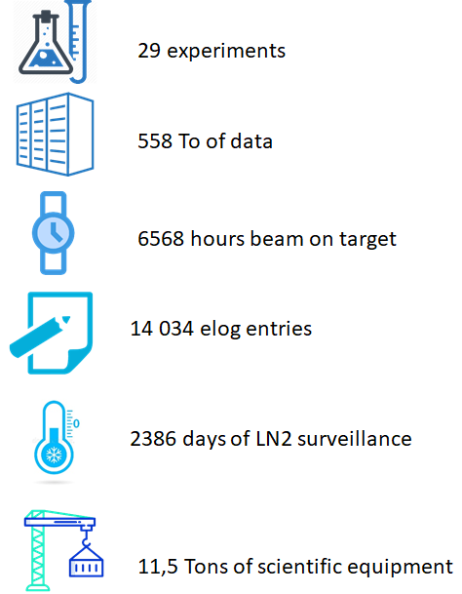
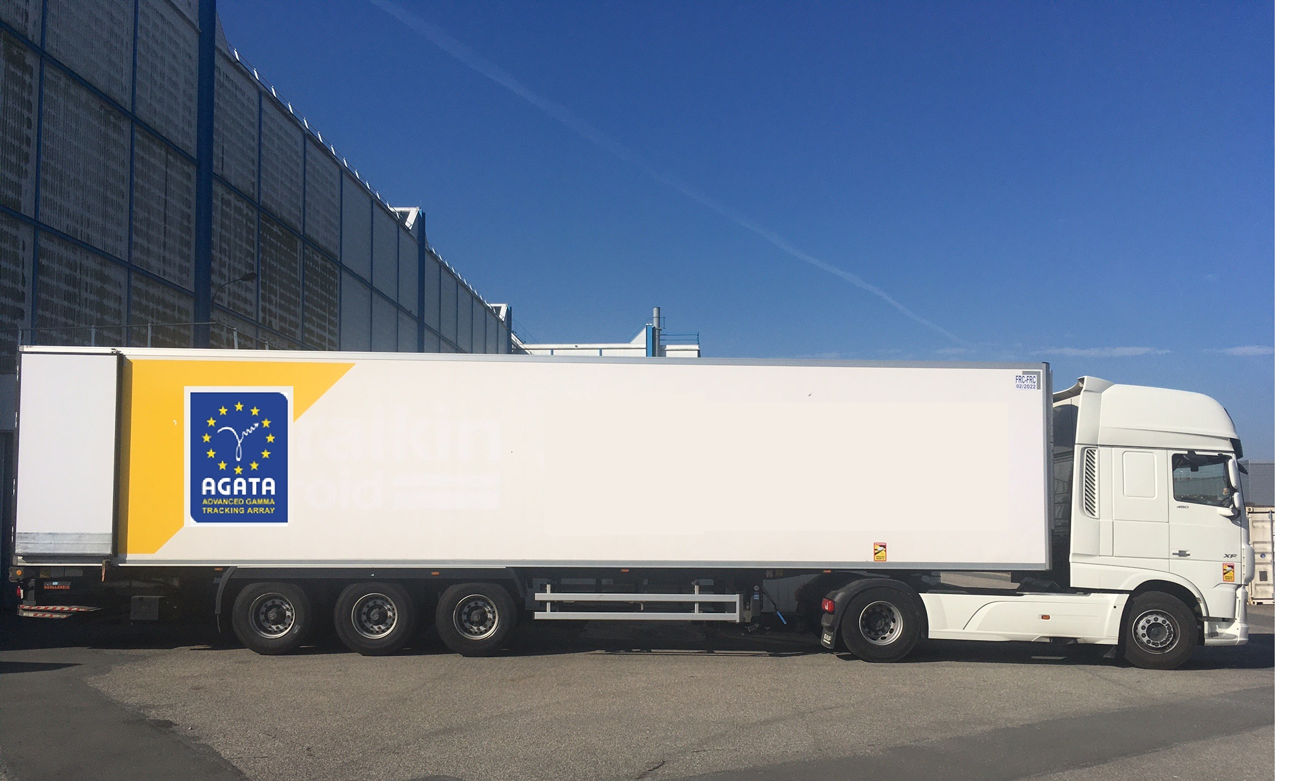
AGATA campaign #1 at GANIL
After 7 years [2014-2021], the AGATA@GANIL campaign was completed

Slide 4
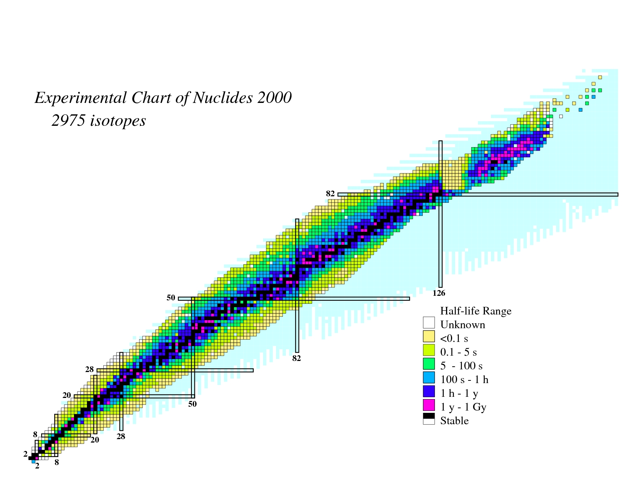
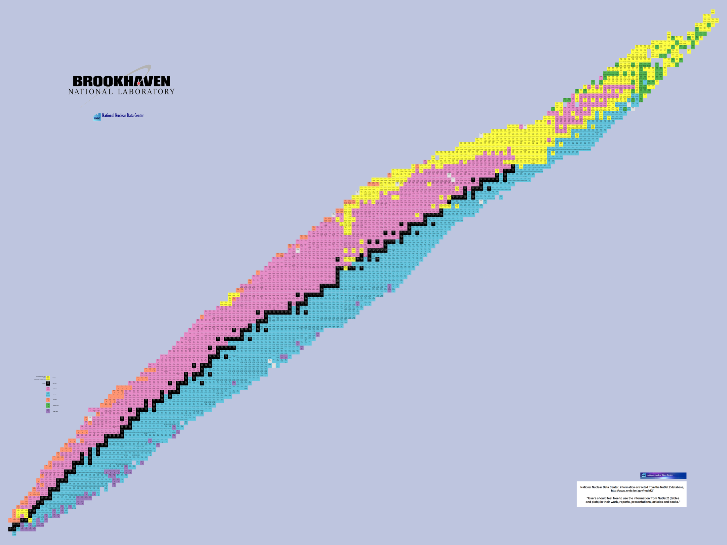
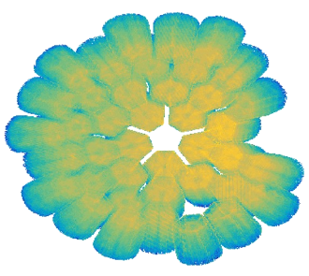
Experiments performed in 2015-2021 at GANIL with AGATA
RIB
SHE Cross section ²³⁸U+²³⁸U in MNT
Search for Double Gamma decay in ¹³⁷Cs source
Reaction mechanism : Fission of Light Hg
Octupole – Quadrupole correlation in ¹¹²Xe
²⁰⁸Pb
Studies of excited states in ^{102,103}Sn
Octupole correlation in ²⁰⁷Pb
Evolution of collectivity around N=50: lifetime measurements ^{104,106}Sn
Exploration of alpha-cluster : the unique case of ²¹²Po (²⁰⁸Pb + α)
N=126 Xe+Pt spectroscopy after MNT
Evolution of collectivity around N=50: lifetime measurements ⁹⁴Ru
Shape transition in the neutron-rich W isotopes
Search for isoscalar pairing in the N=Z nucleus ⁸⁸Ru
Transition Quadrupole Moments in ^{166,168}Dy.
¹⁰⁰Sn
i_{13/2} single particle state in ¹³³Sn and high spin in ¹⁰⁸Zr
Isospin Symmetry Breaking in the A=63,71 mirror nuclei
¹³²Sn
Shape evolution in neutron rich fission fragments in the mass A~100 region
Above barrier narrow resonances in ¹⁵F
⁶⁸Ni
⁷⁸Ni
Shell evolution around N=50: ⁸¹Ga spectroscopy
Deter. the α+¹⁵O radiative capture rate
Evolution of collectivity around N=52: lifetime measurements in ^{83,84}Ge
Evolution of collectivity around N=40: lifetime measurements in ^{73,75}Ga
Evolution of collectivity around N=40: lifetime measurements in ⁶⁴Fe
⁴⁸Ca
Proton-neutron interactions across the N = 28 shell closure via ⁴⁷K(d,p)⁴⁸K
Lifetime measurements of excited states in neutron-rich C and O isotopes
Evolution of the shell structure in the region of neutron-rich Ti isotopes
The lifetime in ²³Mg as a probe for classical novae models
3-body contribution in ²⁰O structure
Is there a problem with protons in N=28 nucleus ⁴⁶Ar ?

Slide 5
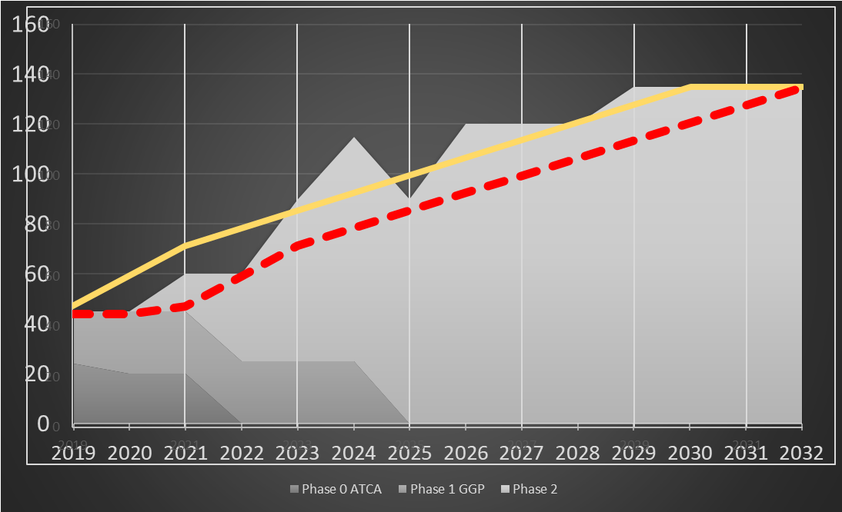
Project Plan Phase 2
The detailed Project Plan : ATRIUM-563607, ATRIUM-563609
MoU funding scheme (section 3.6)
The present project plan, conceived technically for a 4π array,
foresees the construction of a 3π array with capital investment from 2021 to 2030, consistent with the MoU,
The production of the Triple Clusters constrains the project
The project plan is based on an annual production of 2-3 Triple Clusters (ordered, produced, assembled and tested)
→ A 2π system available by the end of the LNL campaign ( ~ 2025-2026) and for the start of the next campaign >2026 (SPES, FAIR, GANIL, ISOLDE …)
Close to the 3π system delivered by the end 2028-2029
The project plan will evolve to the construction of the 4π array
86
90
79
83
70
72
77
67
62
Capsules order placed
Main milestone
Clusters in operation
90
Capsules order - visibility
Electronic channels ordered

Slide 6
AGATA at LNL – next steps
AGATA Collaboration Council and AGATA Steering Committee have discussed last year about the location of AGATA after 2025.
Legnaro campaign of AGATA, started in May 2022, has been officially approved by the AGATA Steering Committee until the end of 2026.
2026
Study of nuclear structure using fusion of heavy ions beams

Slide 7

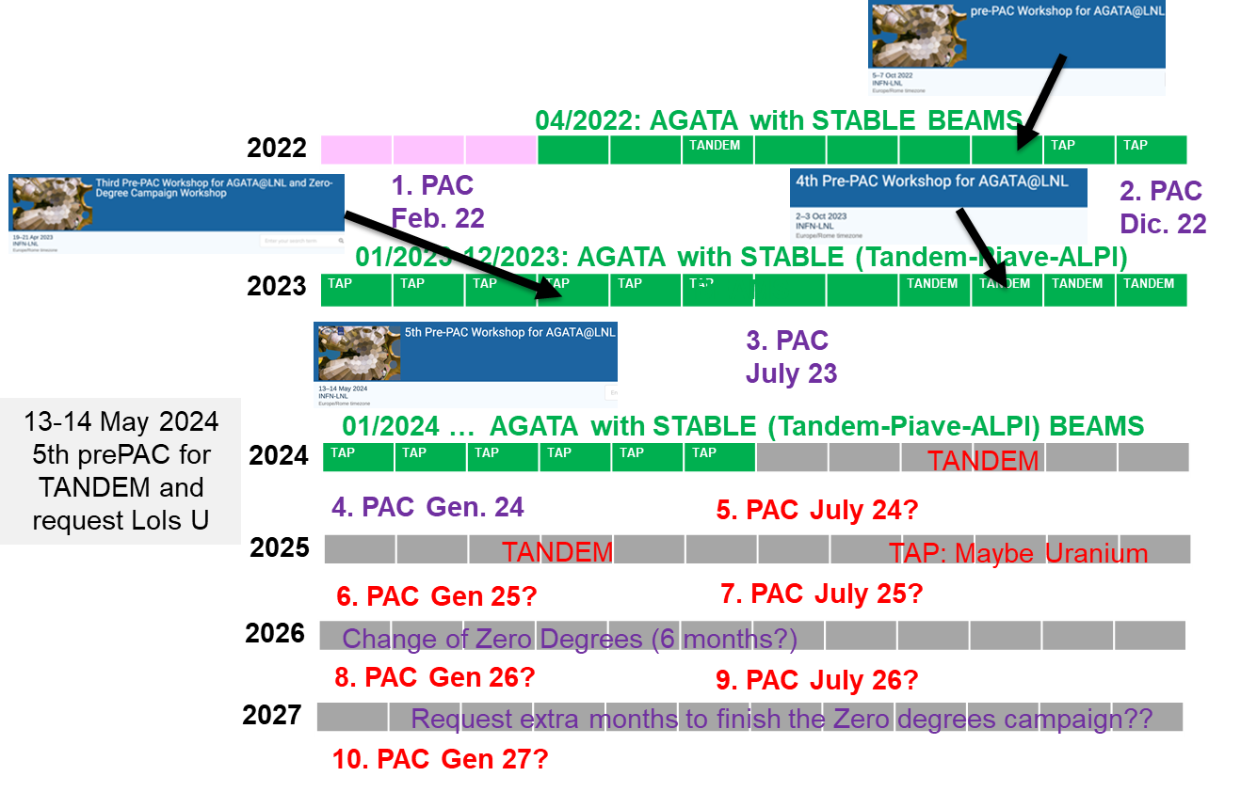
LNL Status and next campaigns
The ASC is currently assessing the future beyond 2026. A letter has been sent to the management of the host laboratories asking for their wishes by the end of May.
The next step will be the AGATA / ACC week in Milan in September
2027
2028
LNL + SPES ?
GANIL/SPIRAL1 ?
2029
2030
GSI/FAIR ?
2031
2032
JYFL ?
HIE-ISOLDE ?
Courtesy Magda and Javier.

Slide 8
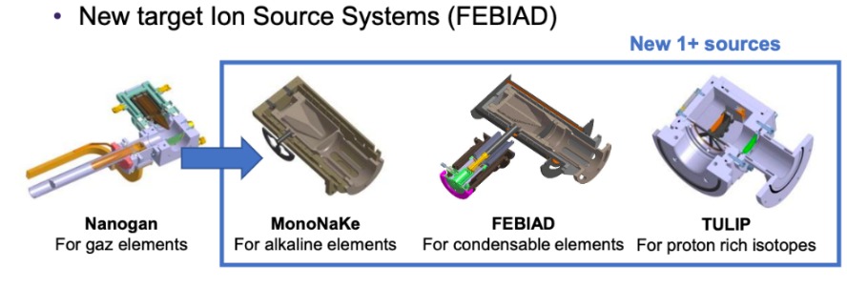
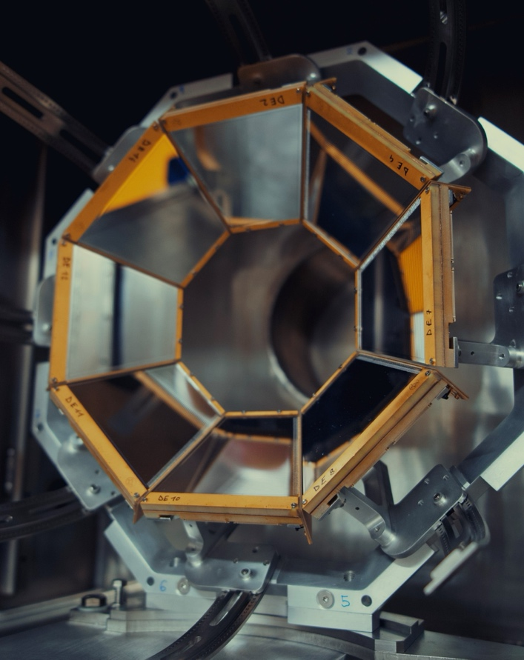
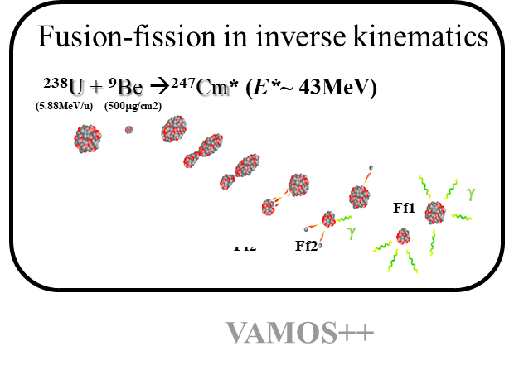
AGATA@GANIL.2 Proposal :
0° degree campaign using the SPIRAL1 beams with MUGAST/GRIT and VAMOS
  SPIRAL1 experiments have a strong impact (1 PRL and 1 Nature with AGATA+MUGAST under referee procedure at the moment) and are “uniqueness” experiments using coulomb excitation and transfer reactions in the fields of nuclear structure, astrophysics and dynamic.
  He, Ne, Ar, Kr, O, N, F, K beams are operational. GANIL is putting a strong effort on SPIRAL1 in-beam tests. Several tests have been performed in 2021-2023 leading to a list of 50 new isomers/isotopes with intensities suitable for acceleration using CIME
  see : https://www.ganil-spiral2.eu/scientists/ganil-spiral-2-facilities/available-beams/
  On-going developments on cryogenic targets at IJCLab (H, He) (F. Galtarossa et al, NIMA 108 (2021), 165830)
~28° degree campaign for fission using the newly PISTA-VAMOS setup
New PISTA array at forward angle
For E* and fissionning system identification
High intensity and high quality Pb, Th (new), U beams are available
Isotopic identification of fission fragments from Ni to Gd elements

Slide 9
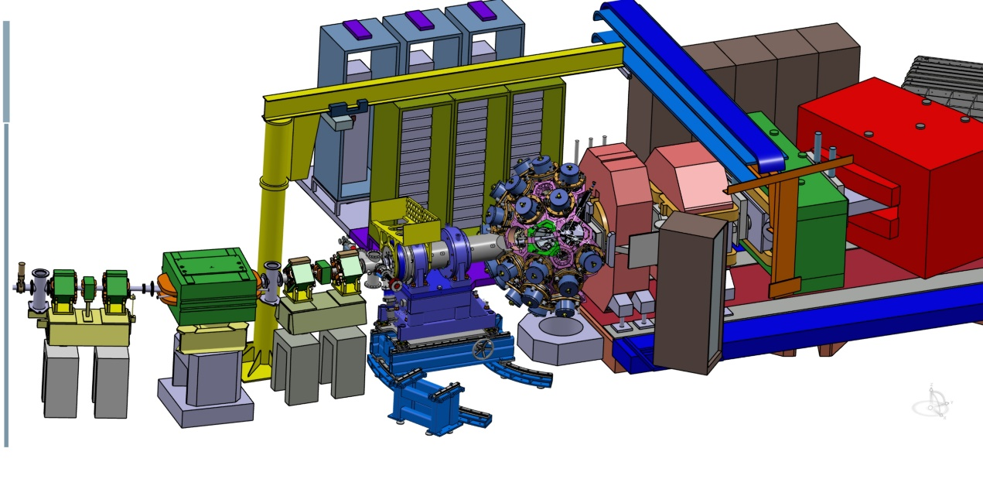
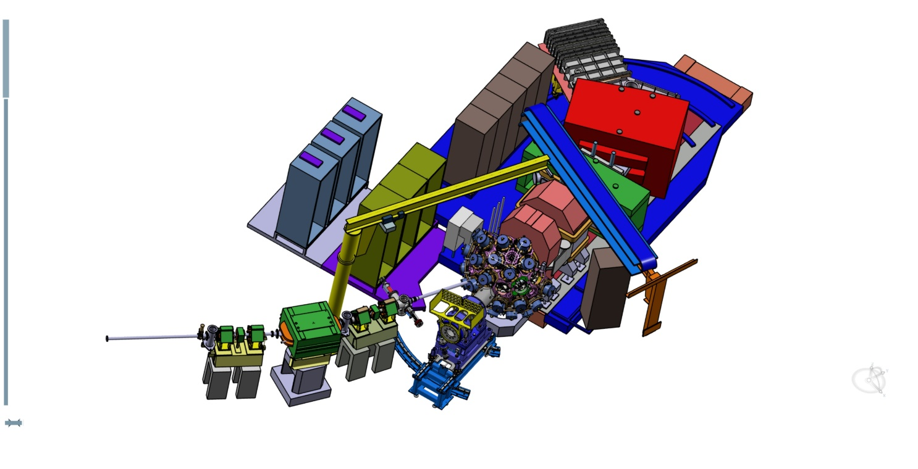
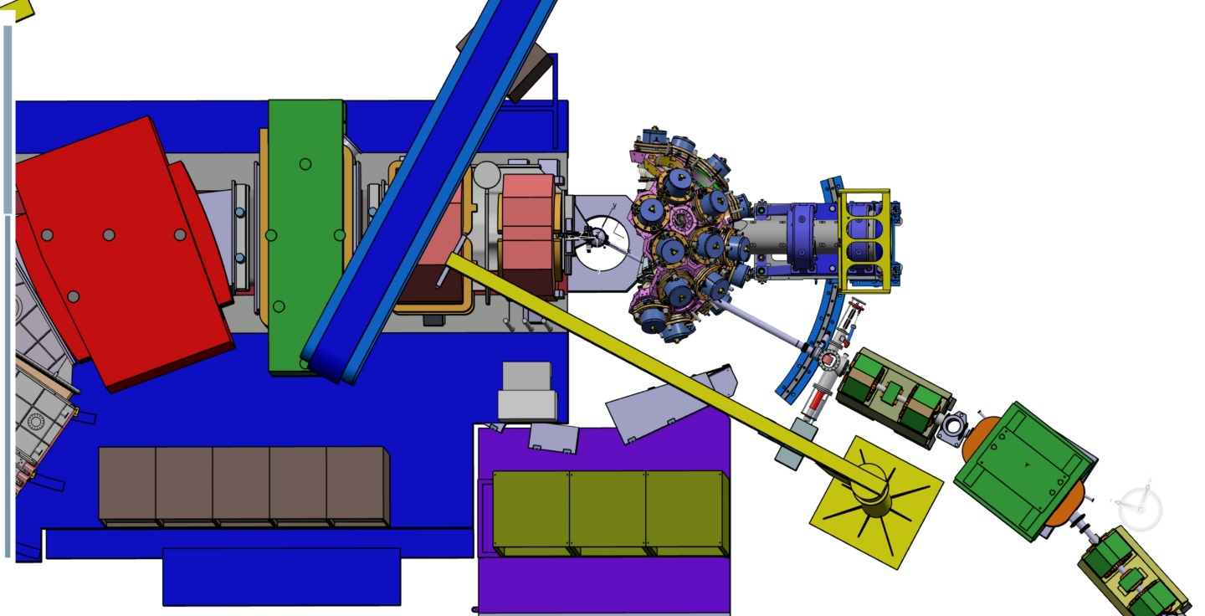
AGATA 2π can fit in G1

Slide 10
