Slide 1
A robust testing platform for pixelated detectors
P. Maj , G.W.Deptuch, D.S.Górni, G. Pinaroli, Timothy Kersten
Instrumentation Department, Brookhaven National Laboratory, Upton NY 11973, USA
PIXEL 2024
Nov 18 -22 , 2024, Strasbourg , France

Slide 2
Outline
Challenges of pixelated structures testing
Testing priorities
Prototyping platform for ASIC testing at BNL
Examples of pixelated structures designed at BNL

Slide 3

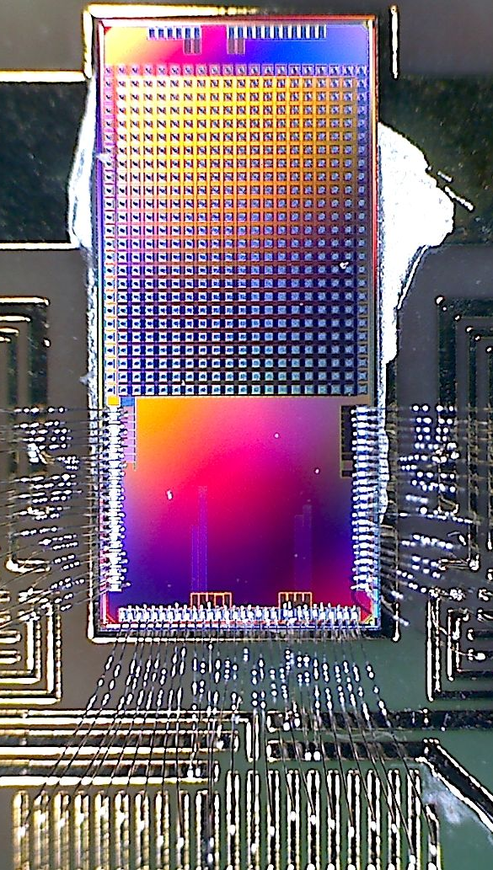
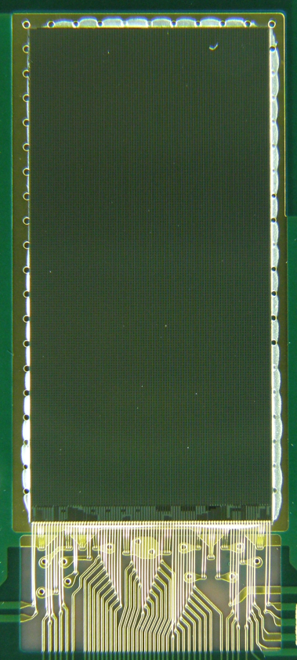
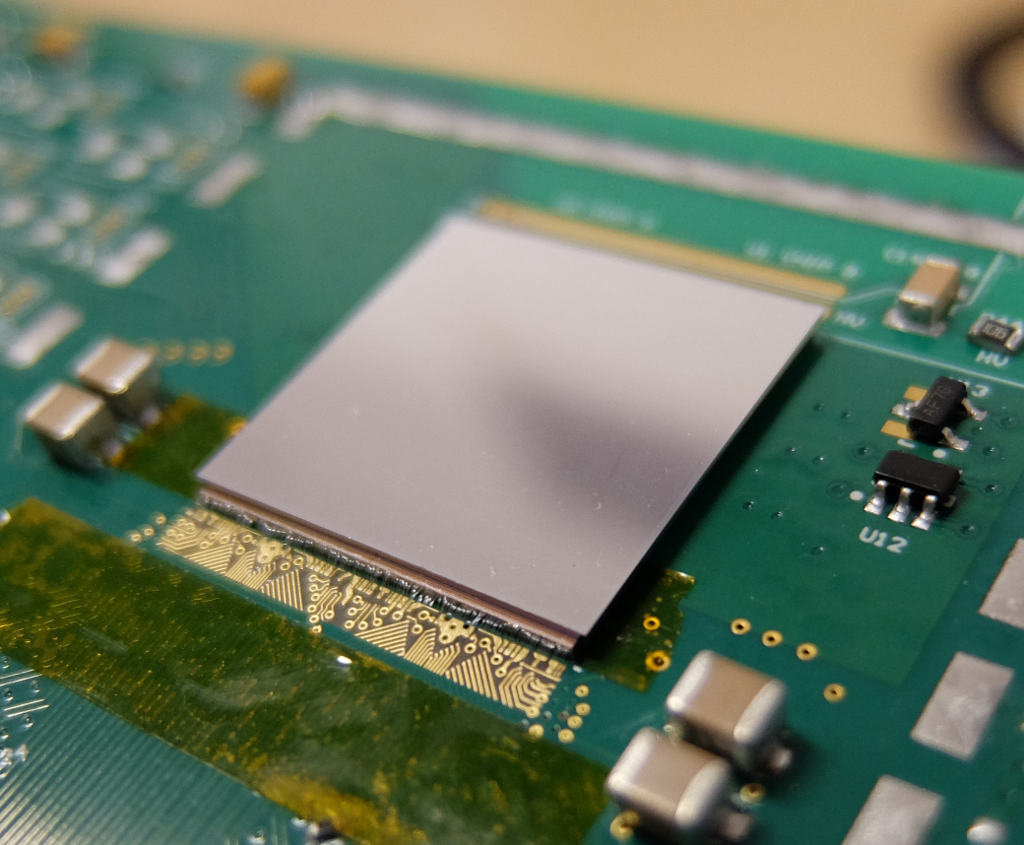
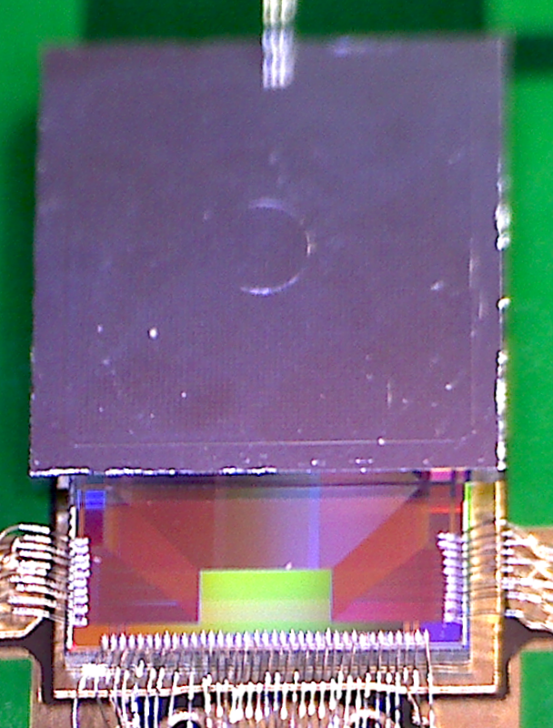

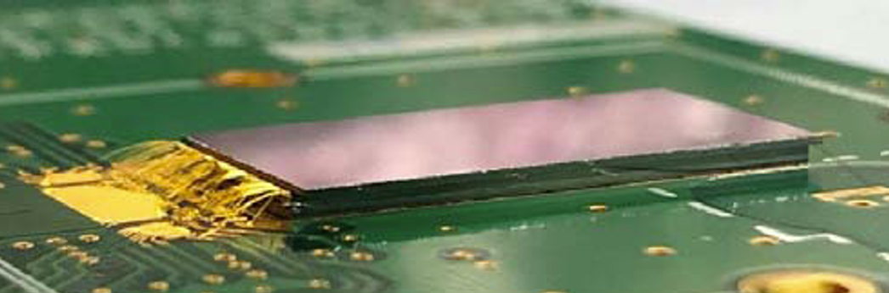
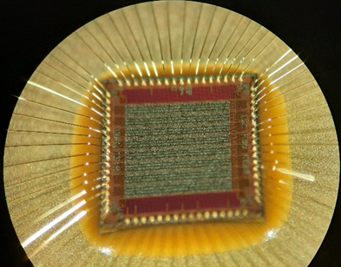
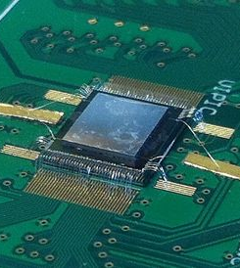
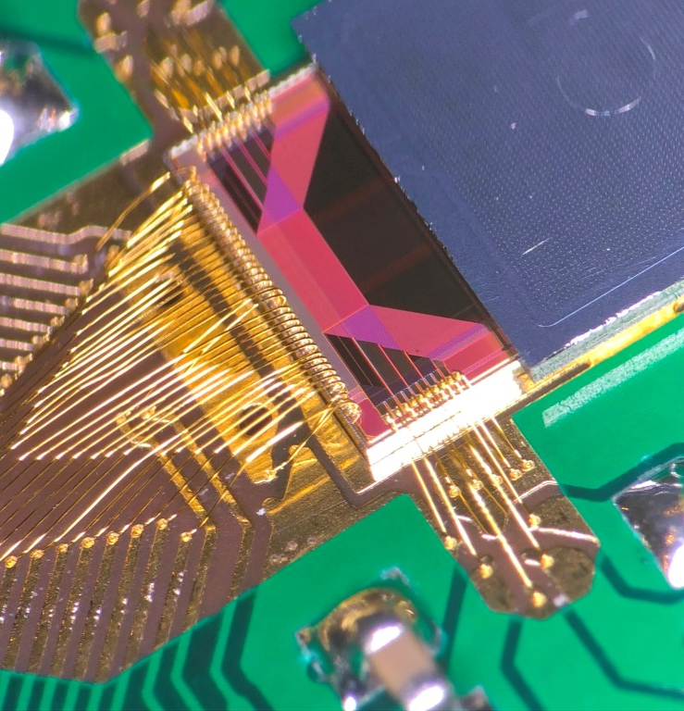
Testing Challenges – author experience
complex developments
advancement in development
small technology node
Chips grow with complexity due to lower technology node, increased functionality and increased readout speed
40nm
130nm
180nm
130nm
130nm
40nm
40nm
28nm
2011
PXD18K
2013
VIPIC
2014
UFXC
2017
Chase Jr
2018
COGITO
2020
FRIC
2023
LN PIX
2023
IntelPixel

Slide 4
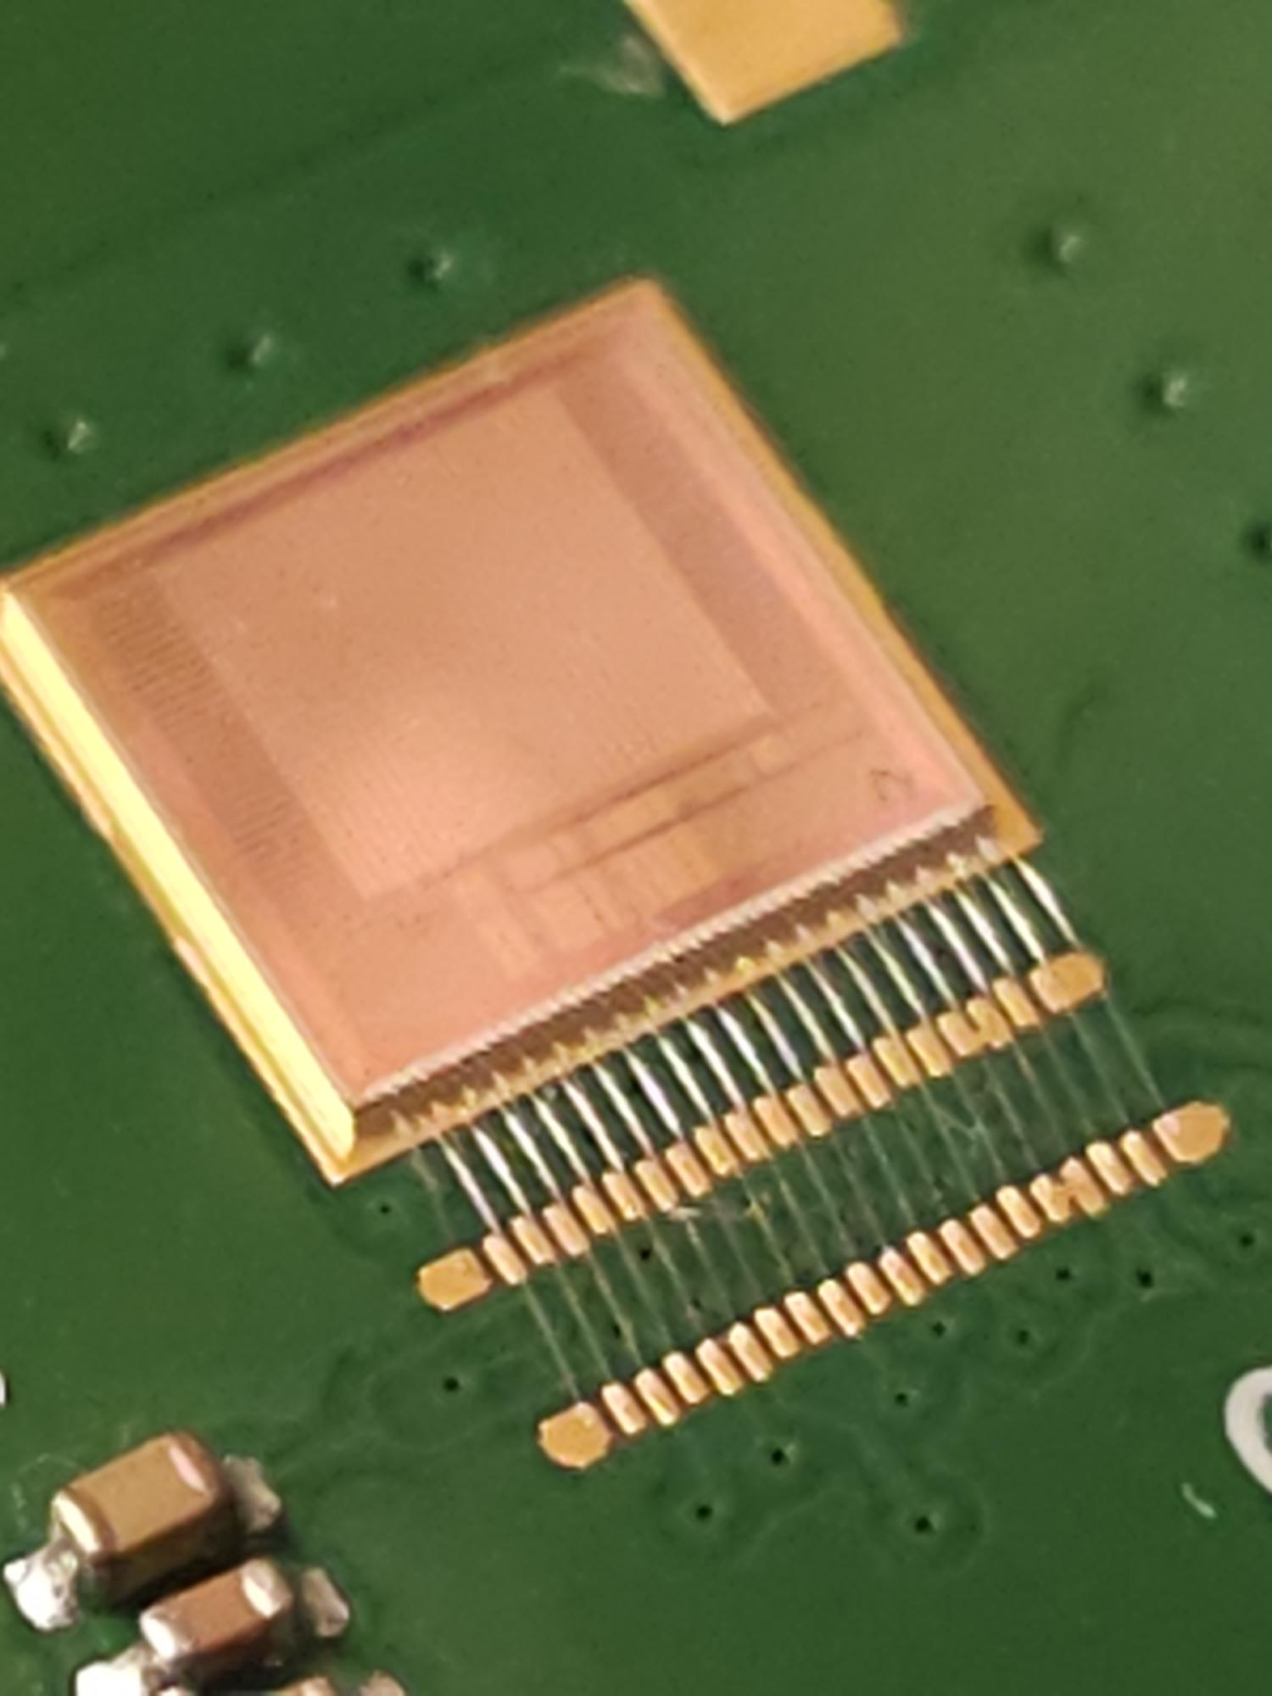
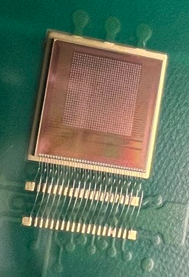
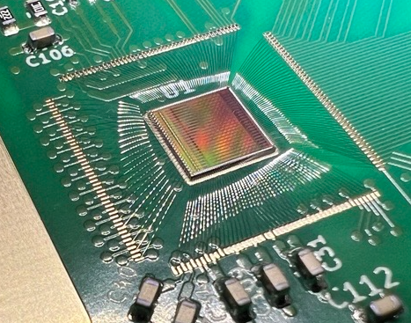
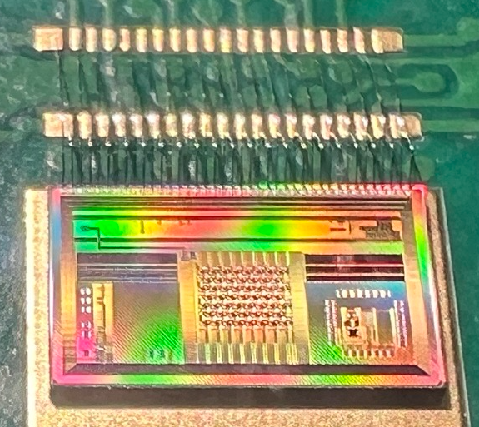
Testing Challenges
2024 AI/ML
2024 EDWARD
2024 HEXID
2024 FFFI
Only digital stream
Analog and digital stream synchronized
Only Digital output stream

Slide 5
A dedicated DAQ system’s drawbacks
Challenges with developing a dedicated data acquisition system towards a single ASIC testing are flowing:
Time consuming design – design anticipating future changes
Debugging of the DAQ before connecting ASIC + necessary changes
Developing a firmware for FPGA and CPU
Expensive due to time necessary for delivery
Ages quickly
Multiple developers involved - high coupling in the system as bug’s are targeted at different levels depending on developer’s availability.
All the above isn’t helping with testing of our ASIC

Slide 6
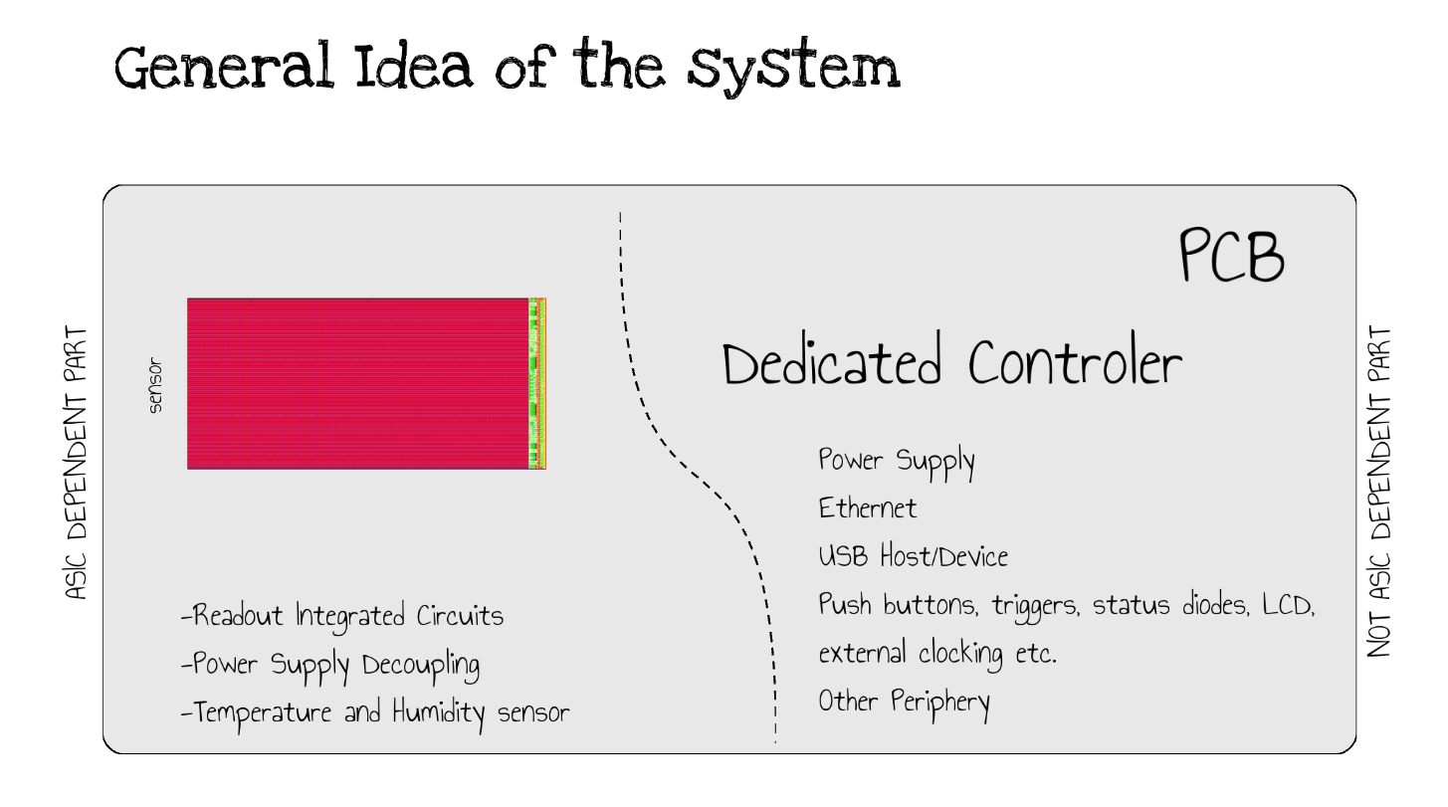
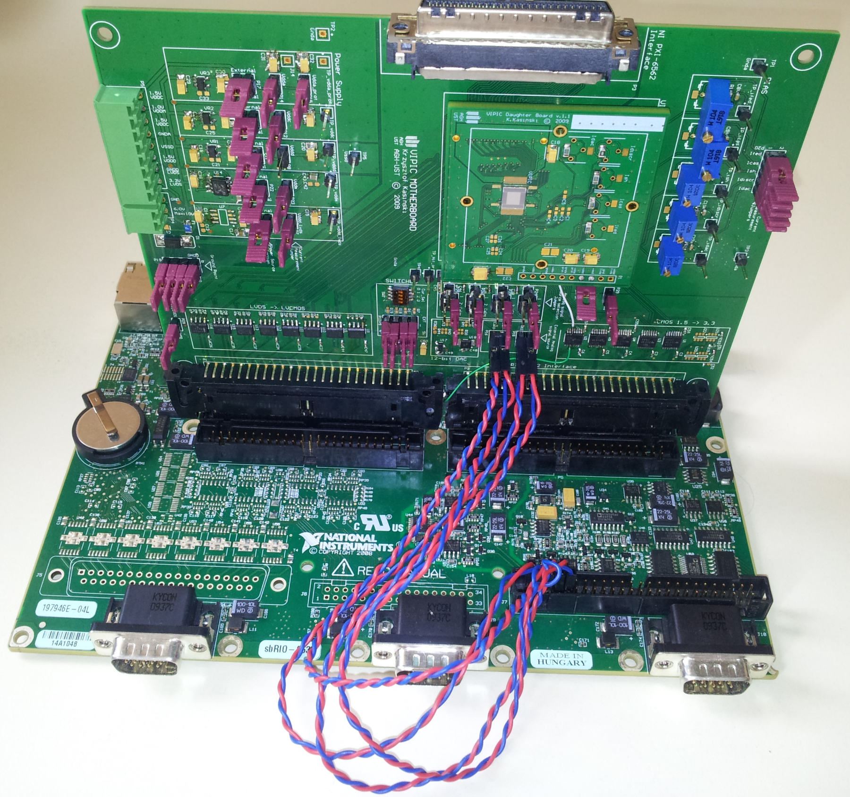
Overcoming dedicated DAQ drawbacks
Separate parts of the design which are an -dependent and which can be purchased
Define the hardware behavior with software

Slide 7
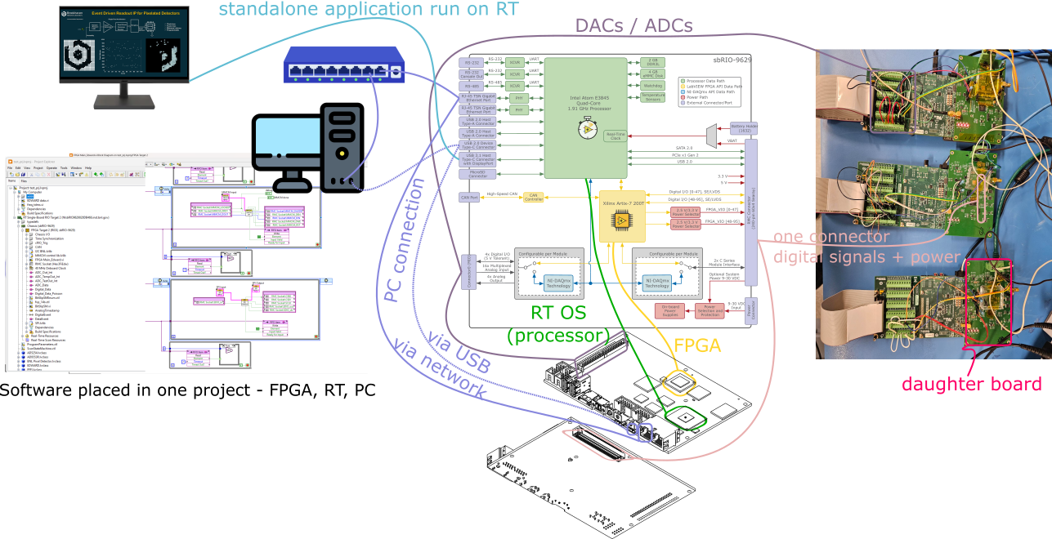
ASIC testing patform at BNL

Slide 8
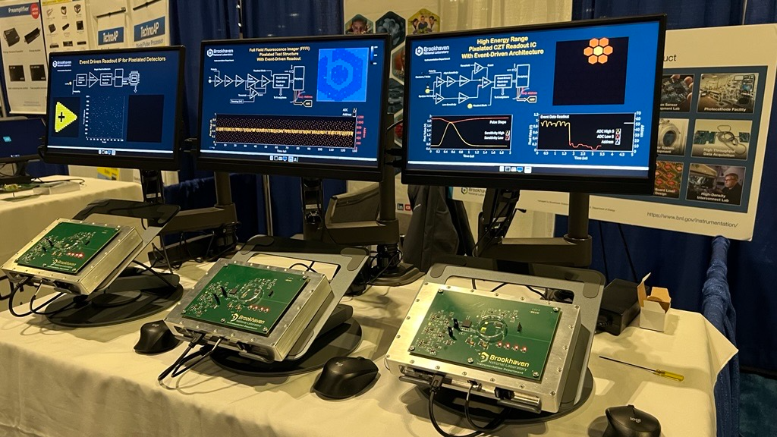
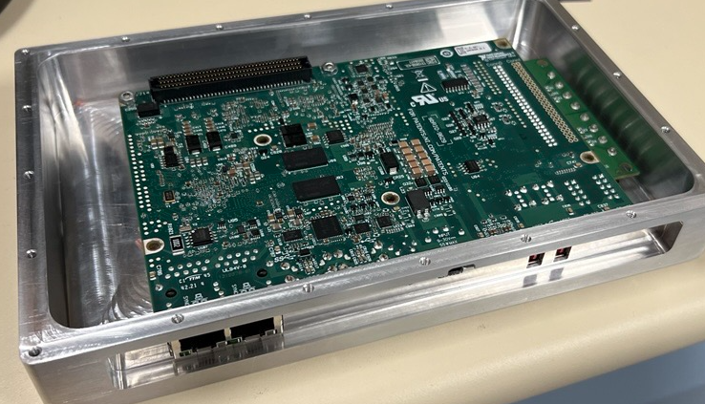

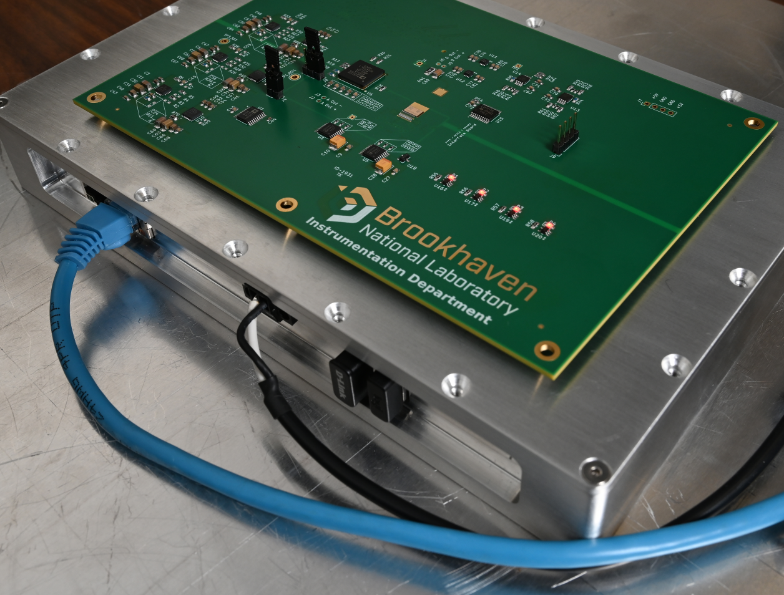
ASIC testing at BNL
1st BNL BOOTH at IEEE/NSS 2024
An of-the-shelf controller
Passive cooling
Metal casing for cooling and
electromagnetic noise enclosure
Daughter PCB
ADC
DACs for biasing
LDOs for power
Voltage level converters
Connector for interface

Slide 9
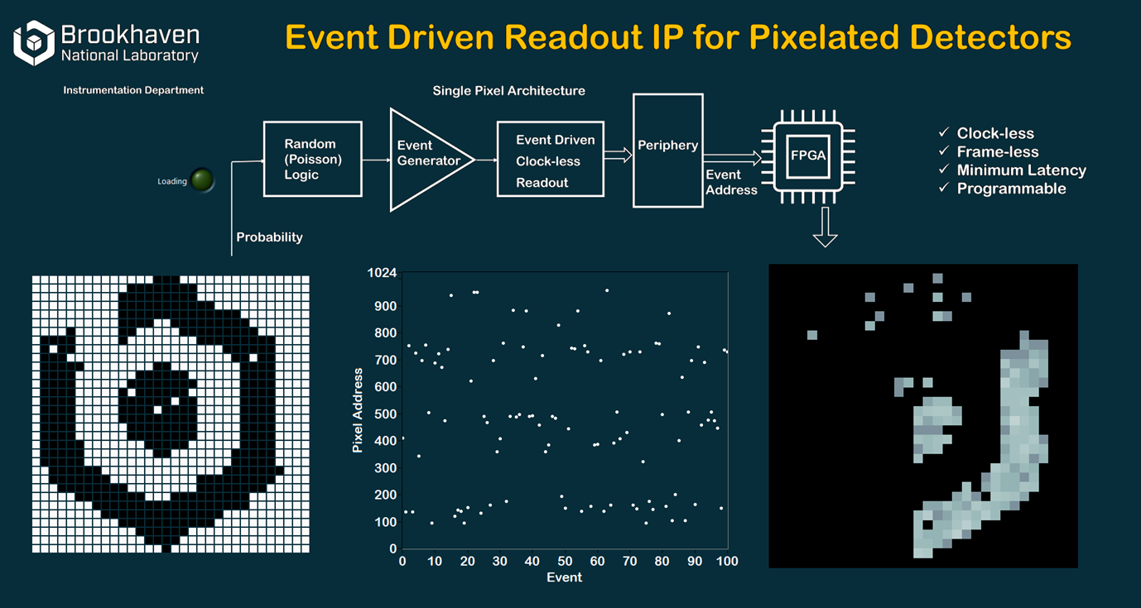
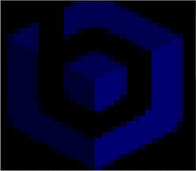


Slide 10
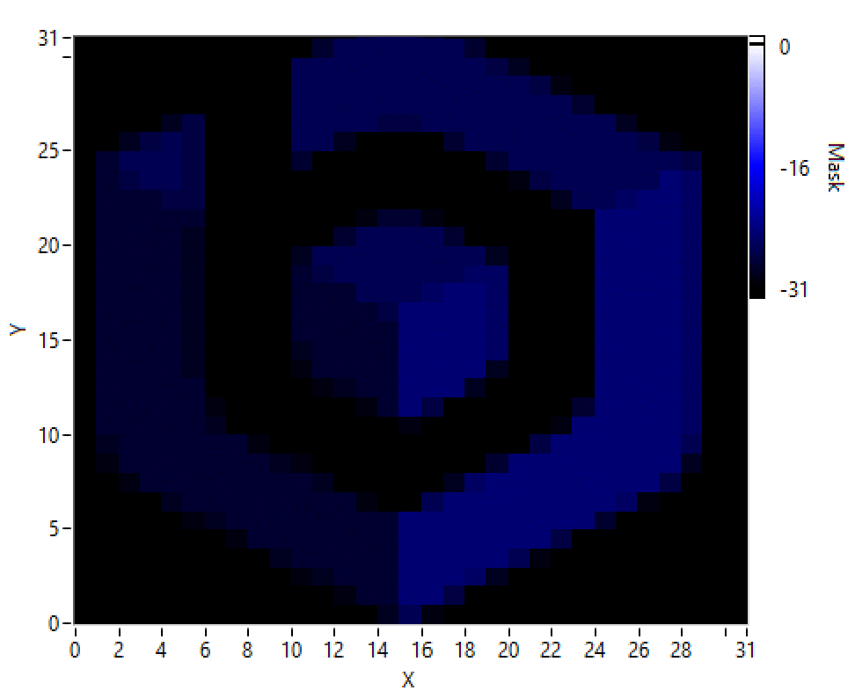
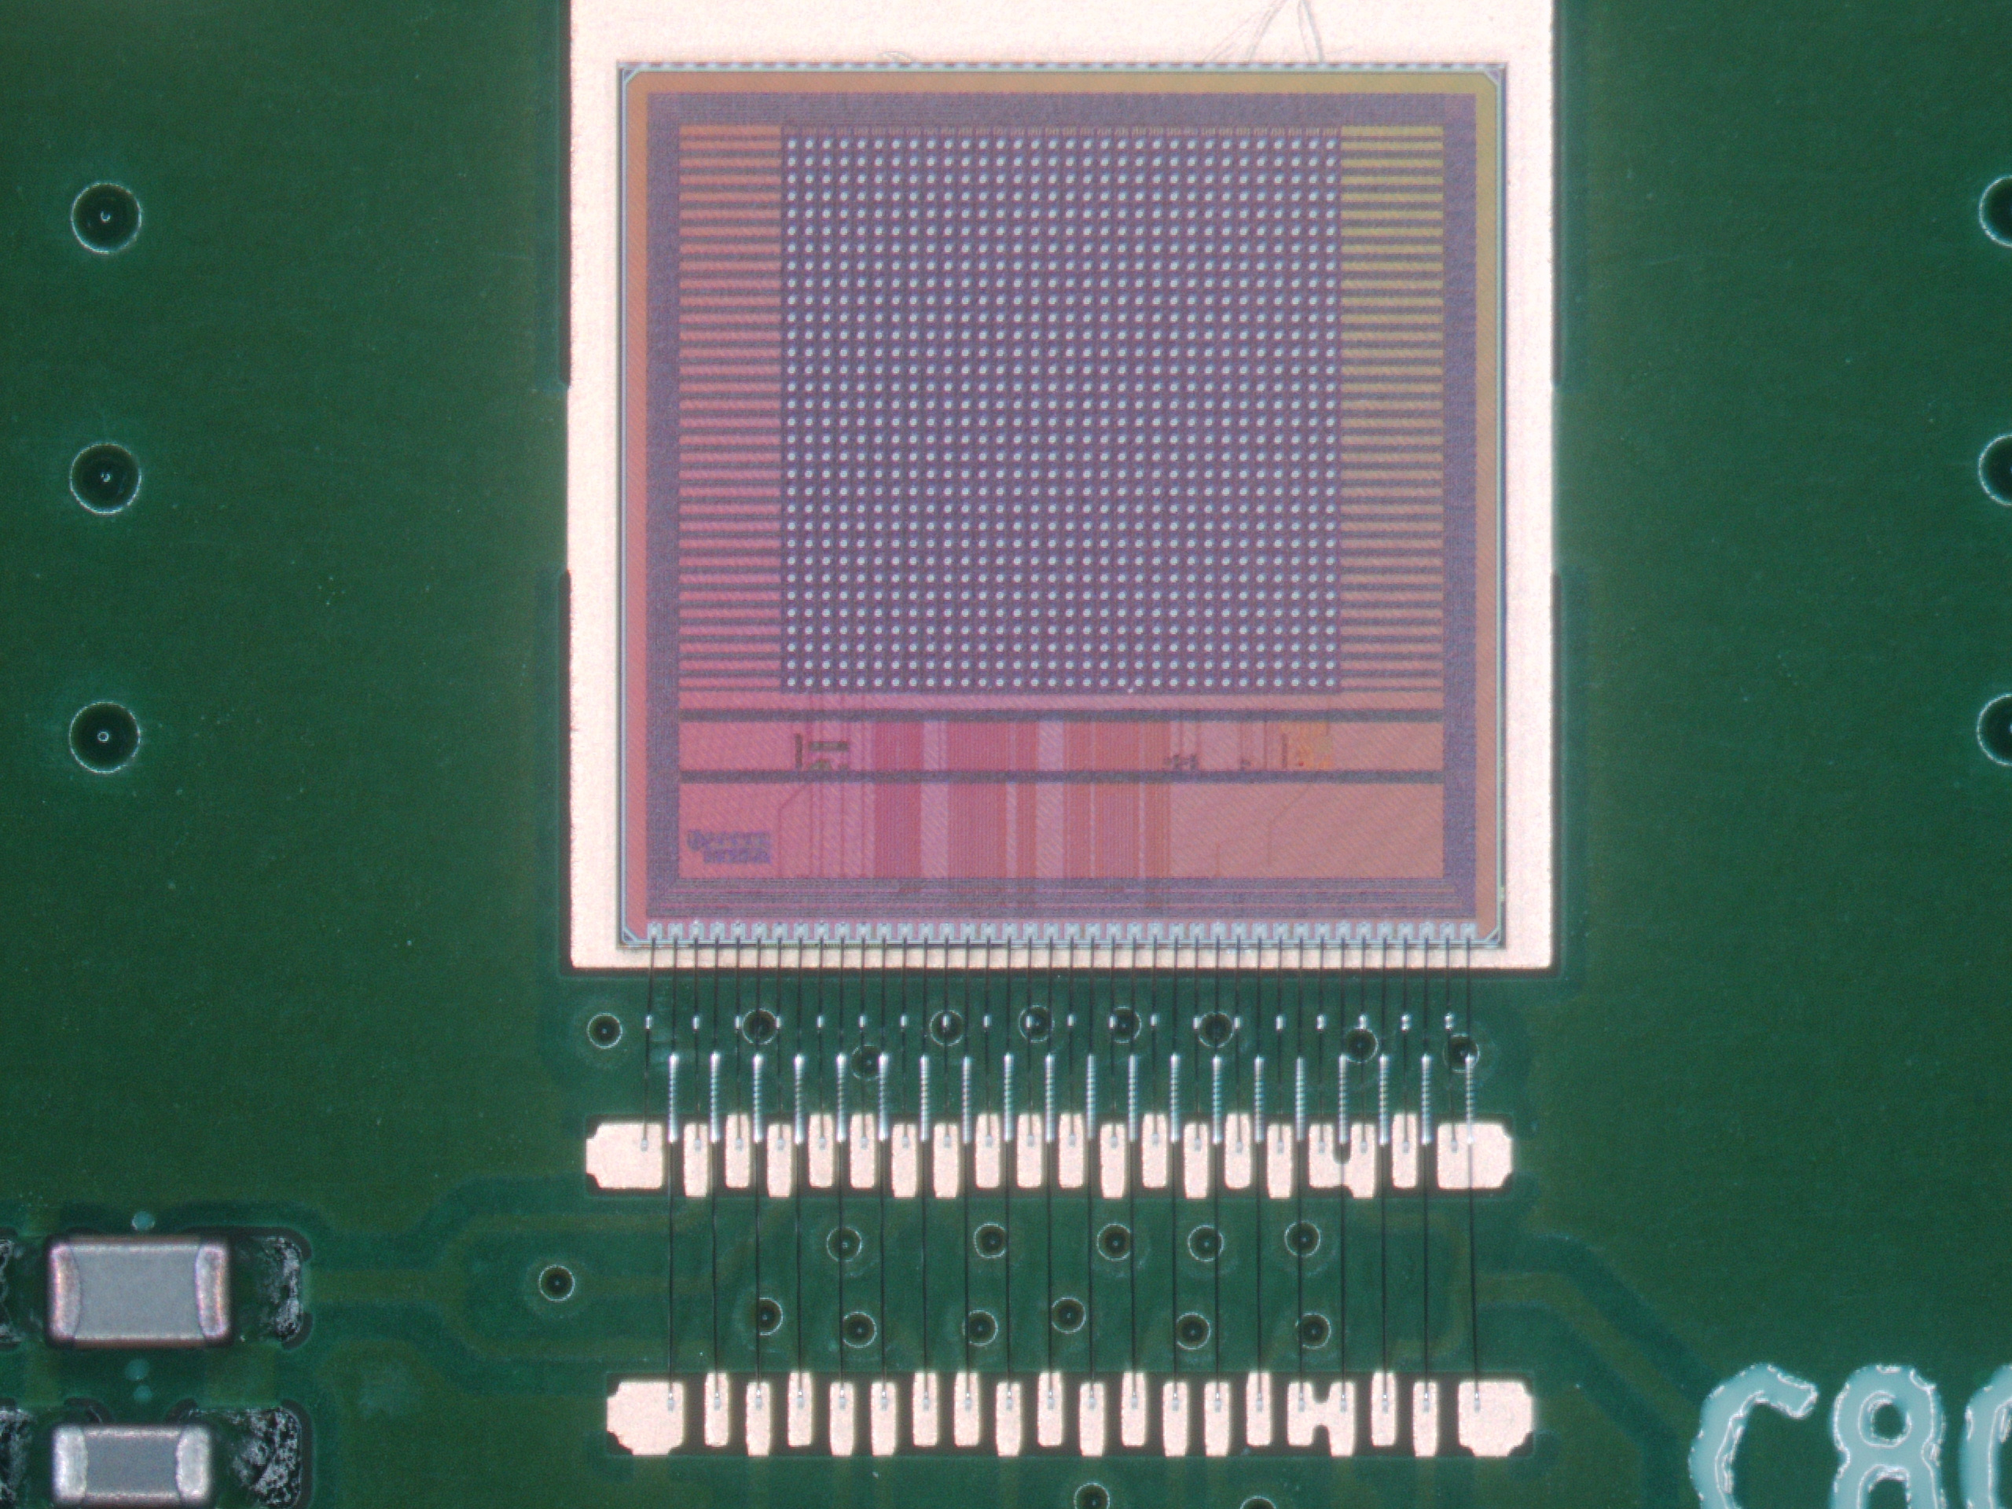
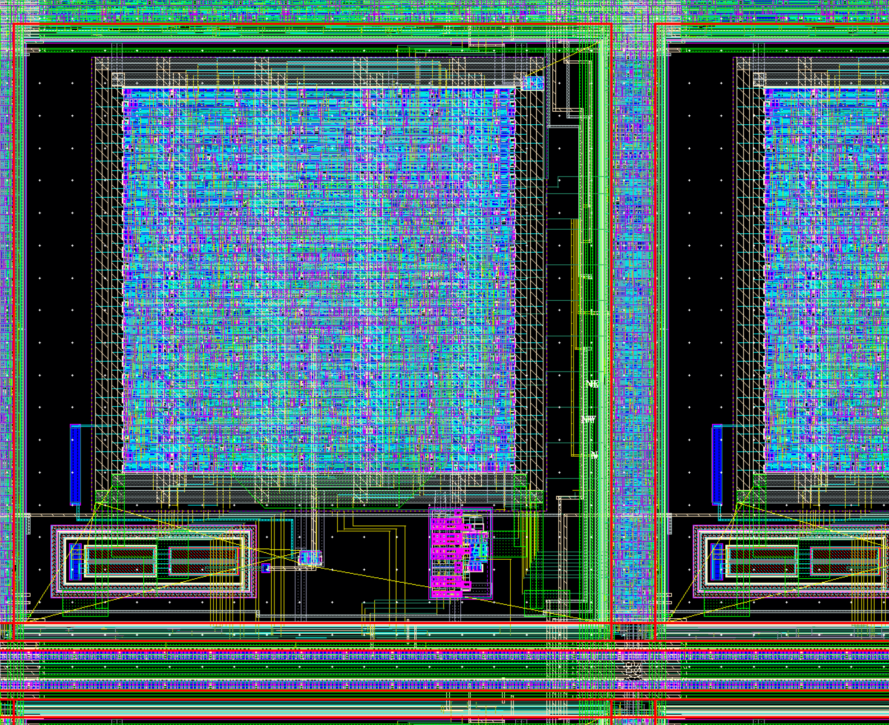
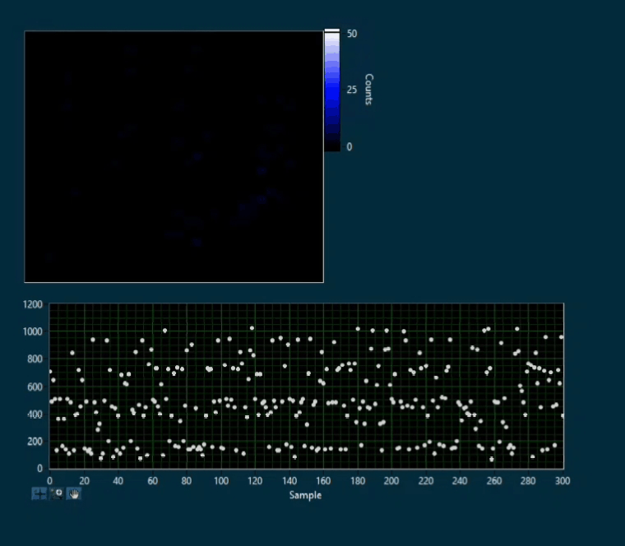
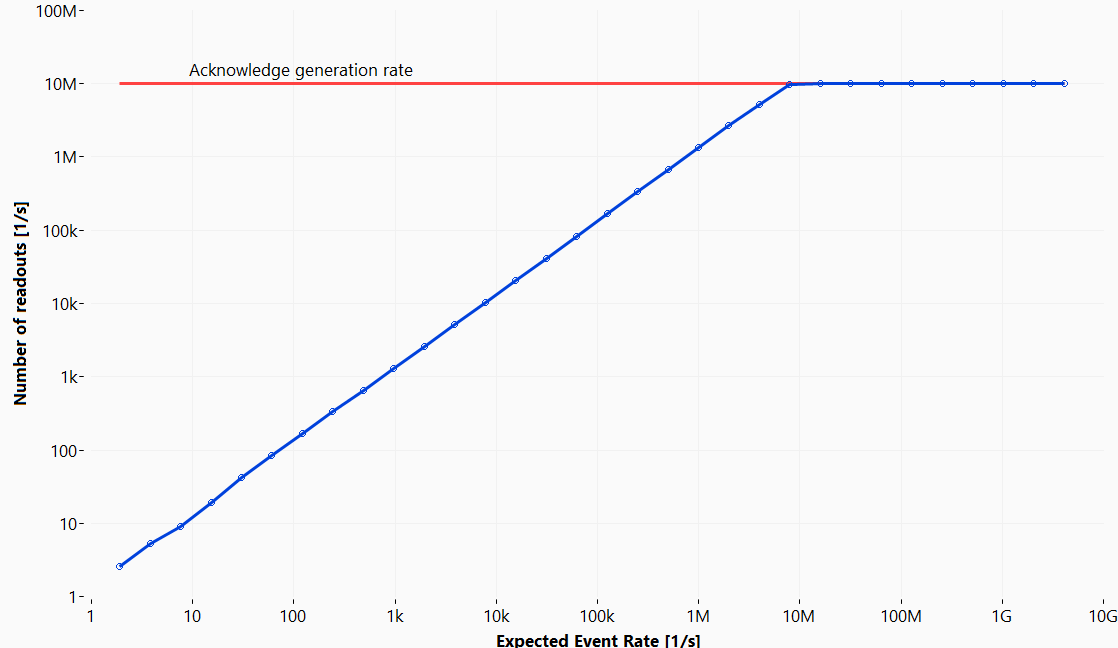
Examples of BNL systems - EDWARD
matrix of pixels
32x32
peripherals
Results of tests presented at TWEPP 2024

Slide 11
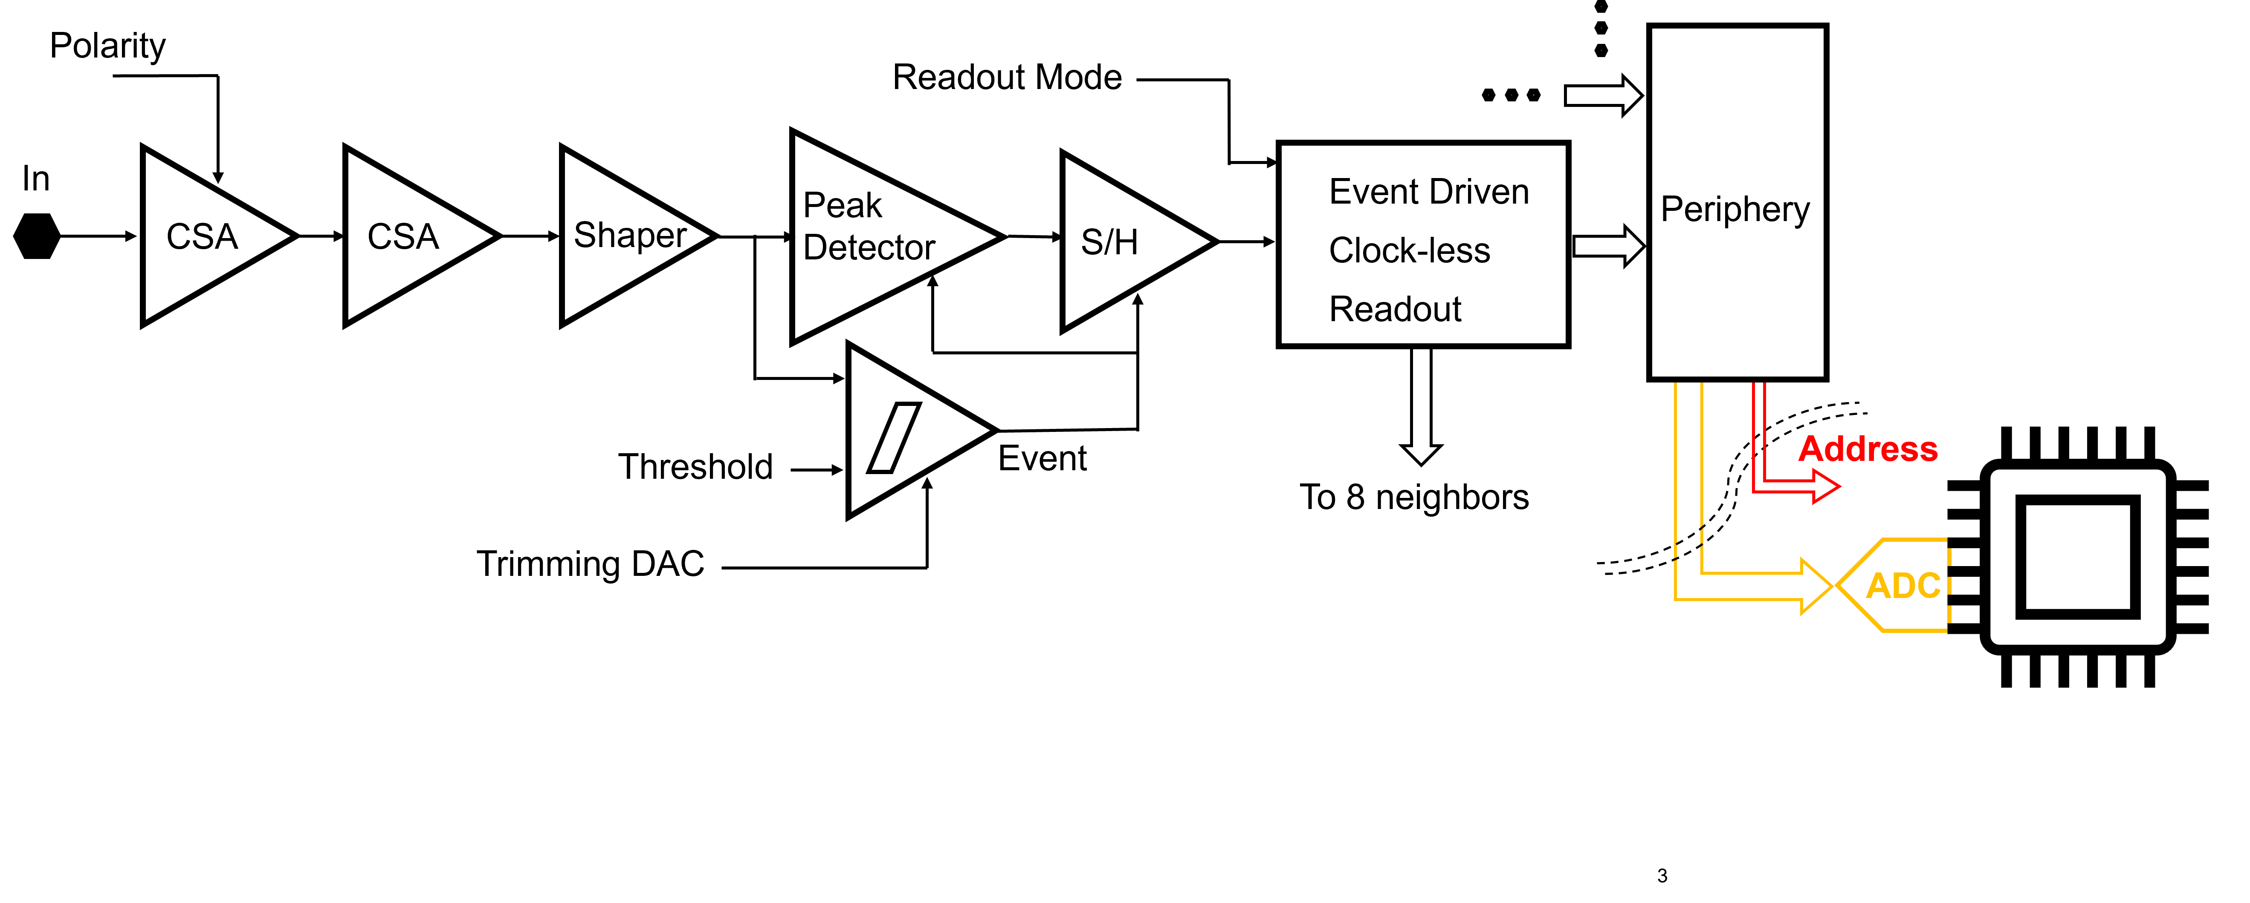
Examples of BNL systems – Full Field Fluorescence Imager
[1] D.S. Gorni et al, https://dx.doi.org/10.1088/1748-0221/17/04/C04027,2022
[2] D.S. Gorni et al, https://doi.org/10.1088/1748-0221/19/04/c04035

Slide 12
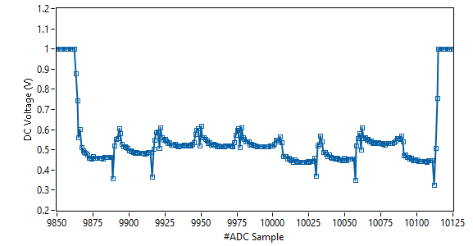
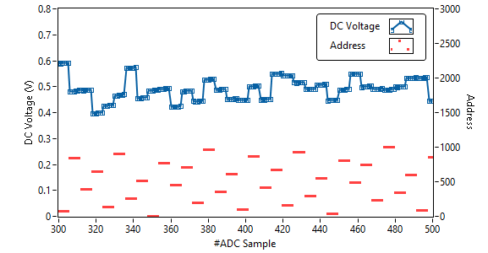
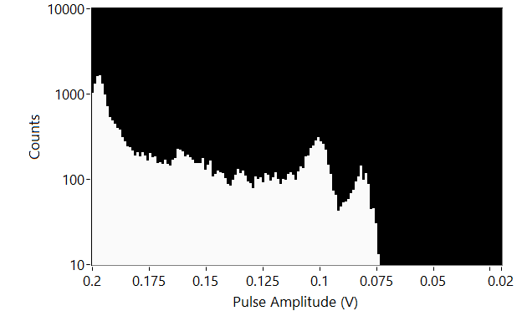
Examples of BNL systems – FFFI (or 3FI)
analog amplitude
analog amplitude
numerical addresses
Central pixel
time [au]
No event
8 neighbors
No event
time [au]
Fe55 Preliminary
Preliminary results presented at SRI 2024

Slide 13
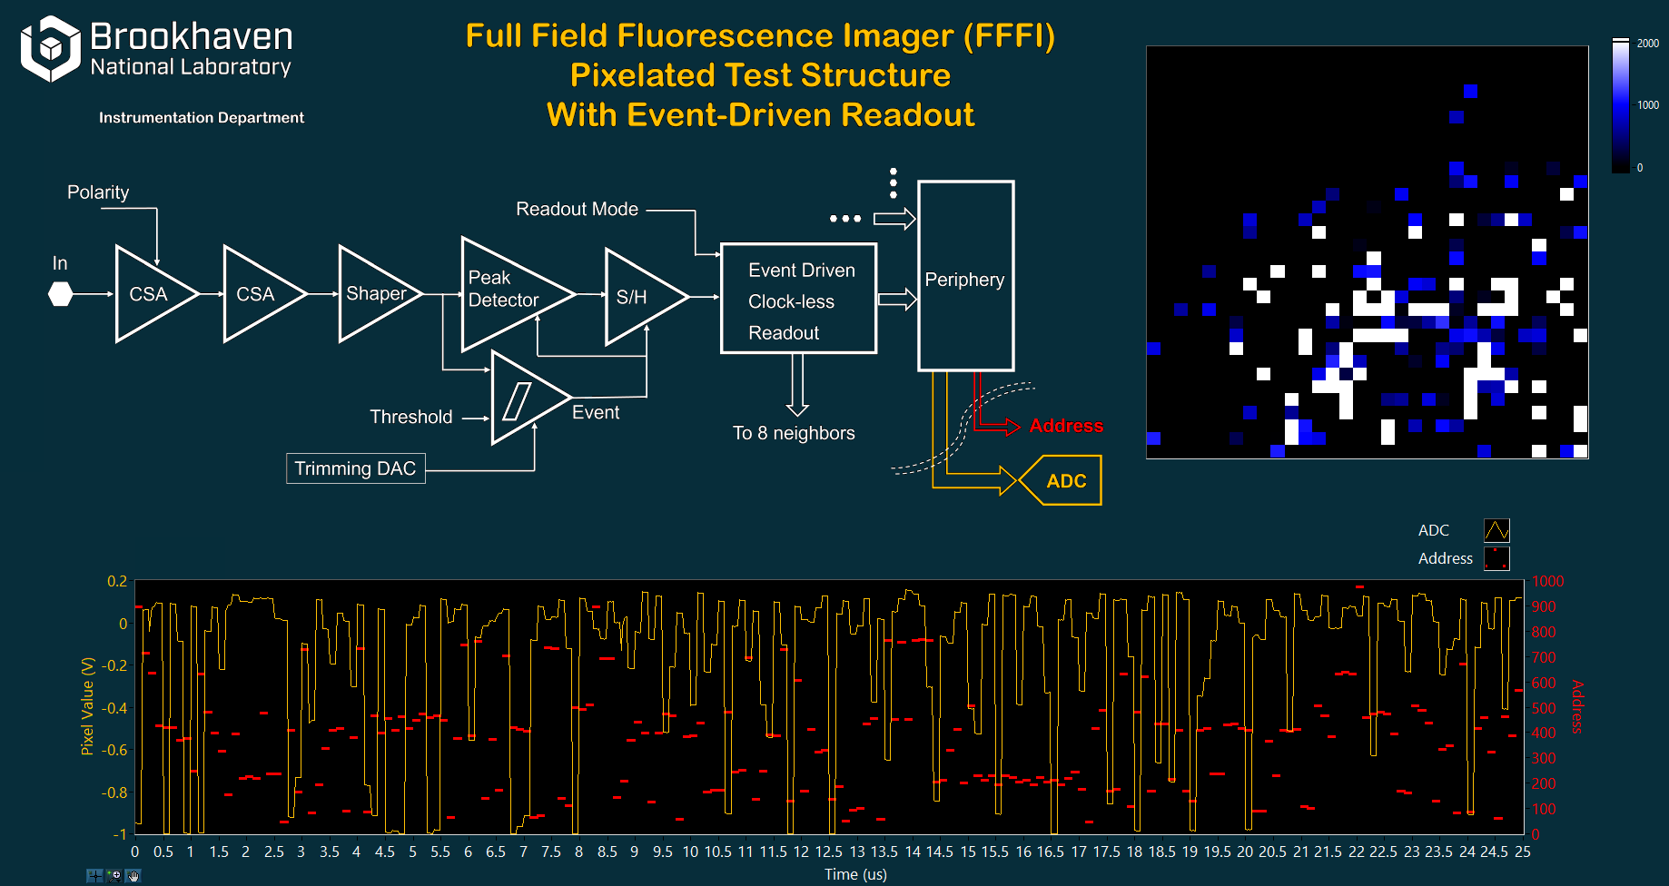

Slide 14
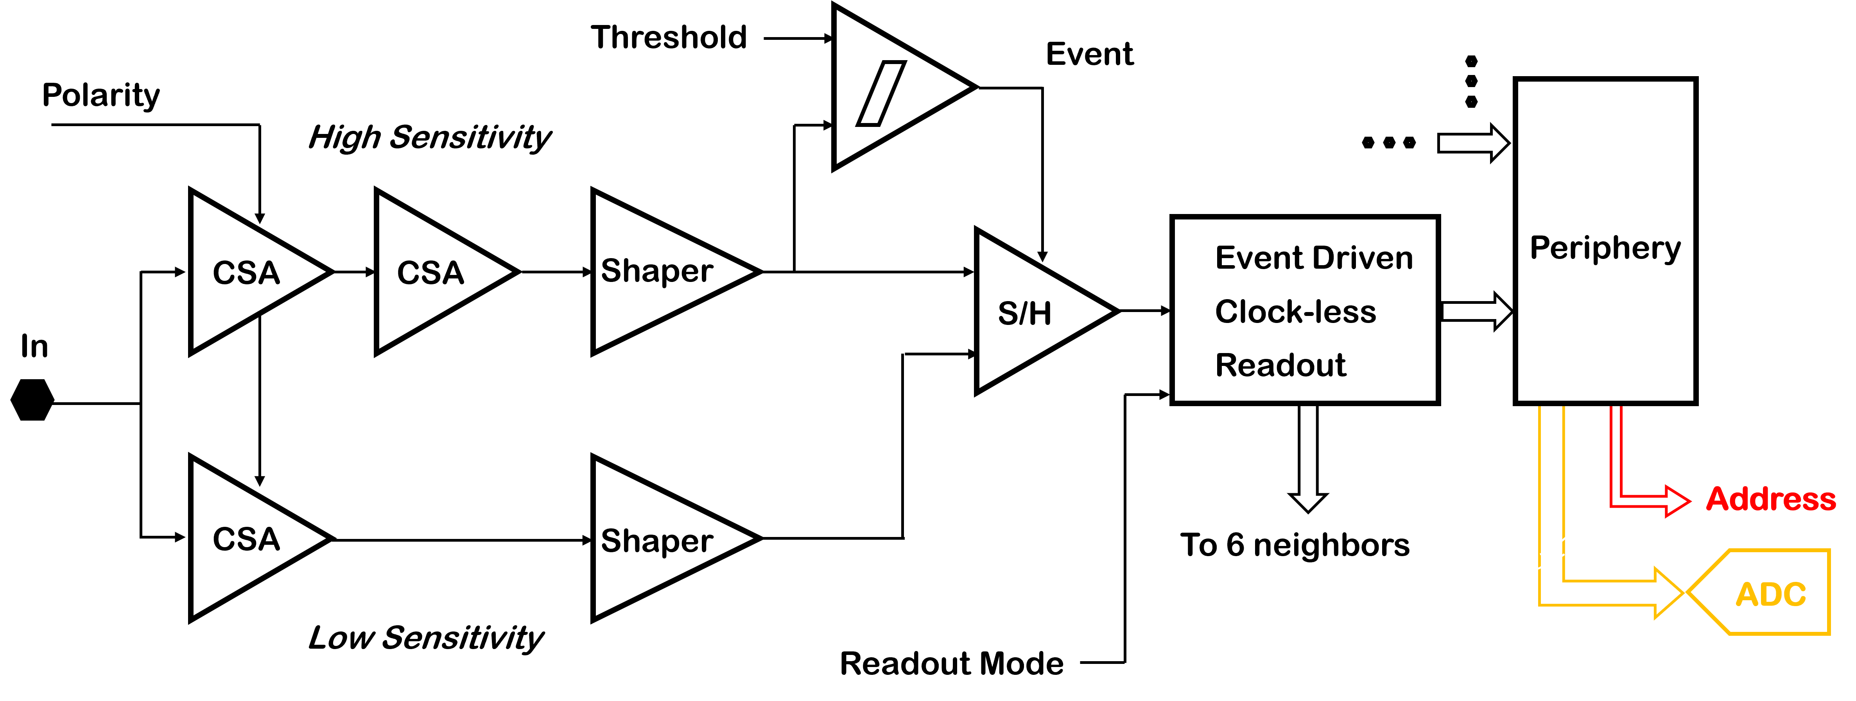
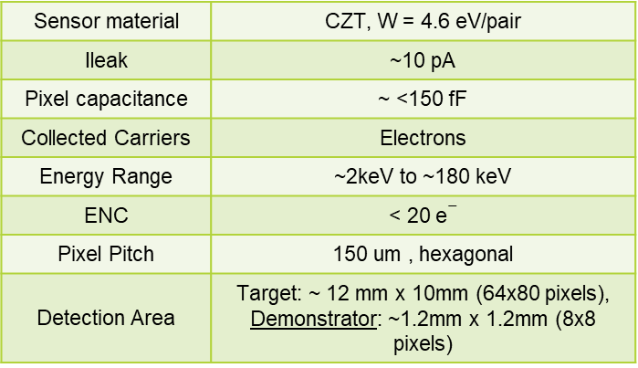
Examples of BNL systems - HEXID
The Hyper-spectral Energy resolving X-ray Imaging Device (HEXID)
CZT Imager for next generation Hard X-ray space telescope.
Sensor material | CZT, W = 4.6 eV/pair
Ileak | ~10 pA
Pixel capacitance | ~ <150 fF
Collected Carriers | Electrons
Energy Range | ~2keV to ~180 keV
ENC | < 20 e$−$
Pixel Pitch | 150 um , hexagonal
Detection Area | Target: ~ 12 mm x 10mm (64x80 pixels), Demonstrator: ~1.2mm x 1.2mm (8x8 pixels)
Preliminary Results presented at NSS 2024
[1] G. Pinaroli et al, https://doi.org/10.1117/12.26769913
[2] G. Pinaroli et al, https://doi.org/10.1117/12.3019976

Slide 15
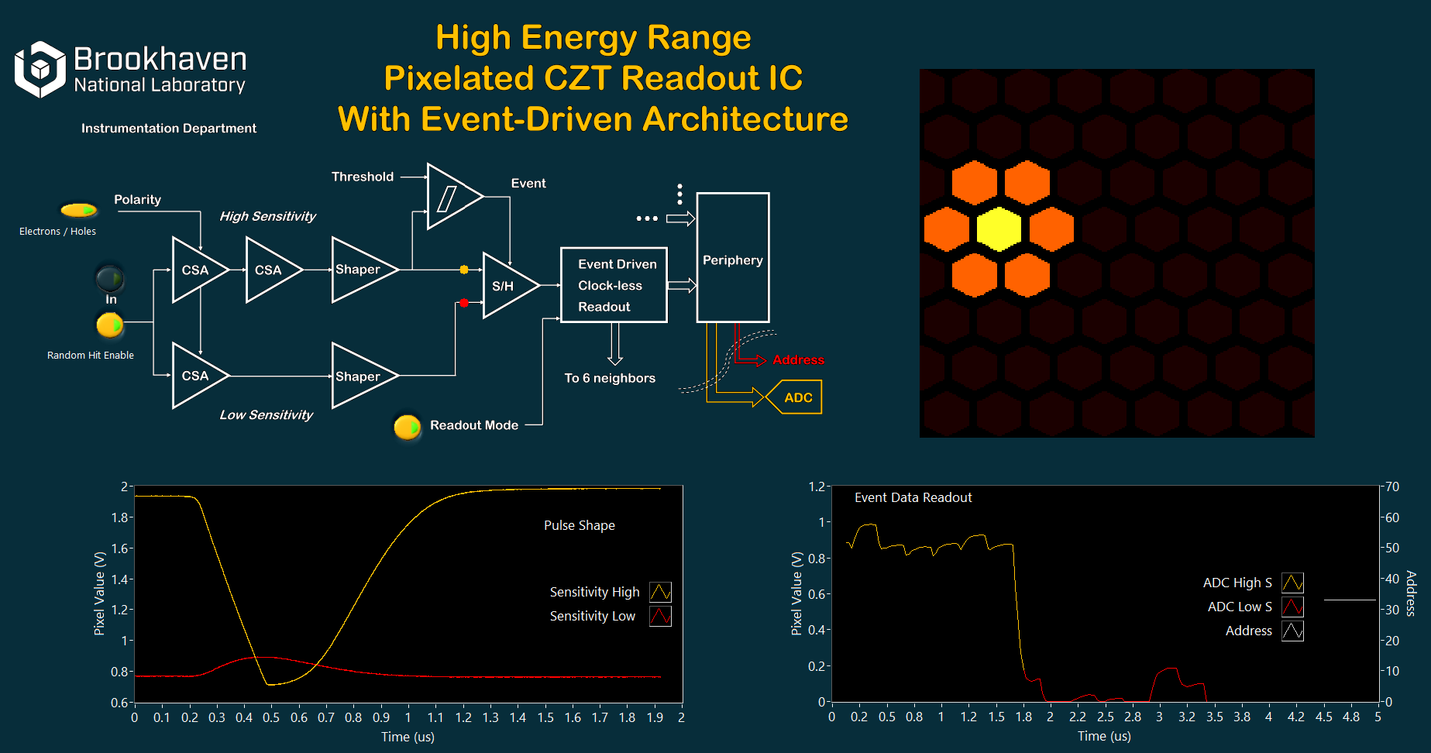

Slide 16
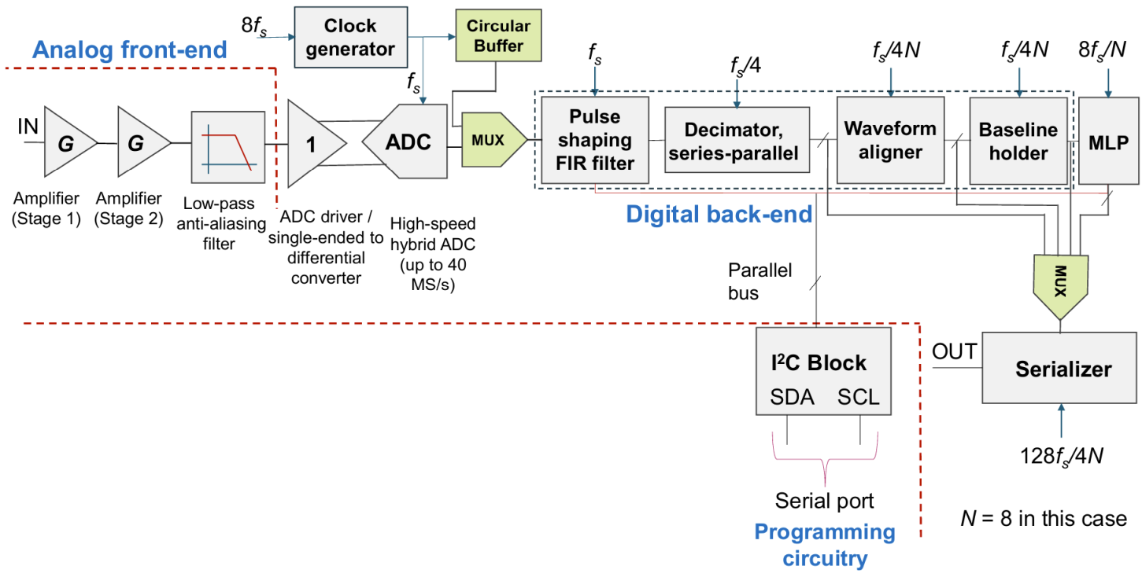
Examples of BNL systems – AI/ML
Preliminary Results presented at NSS 2024

Slide 17
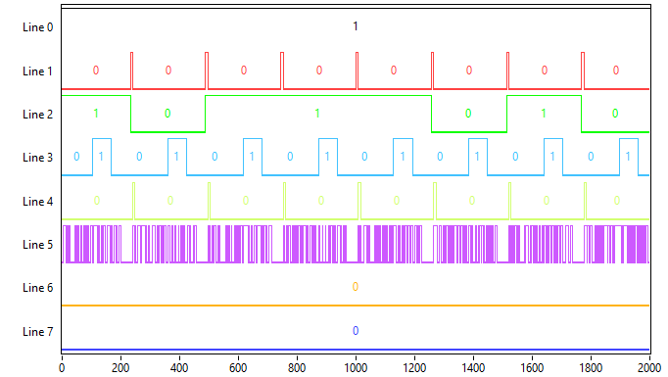
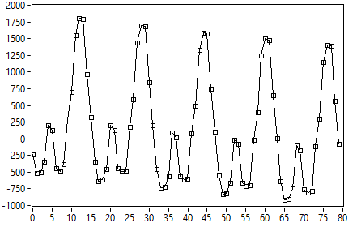
Examples of BNL systems – AI/ML

Slide 18
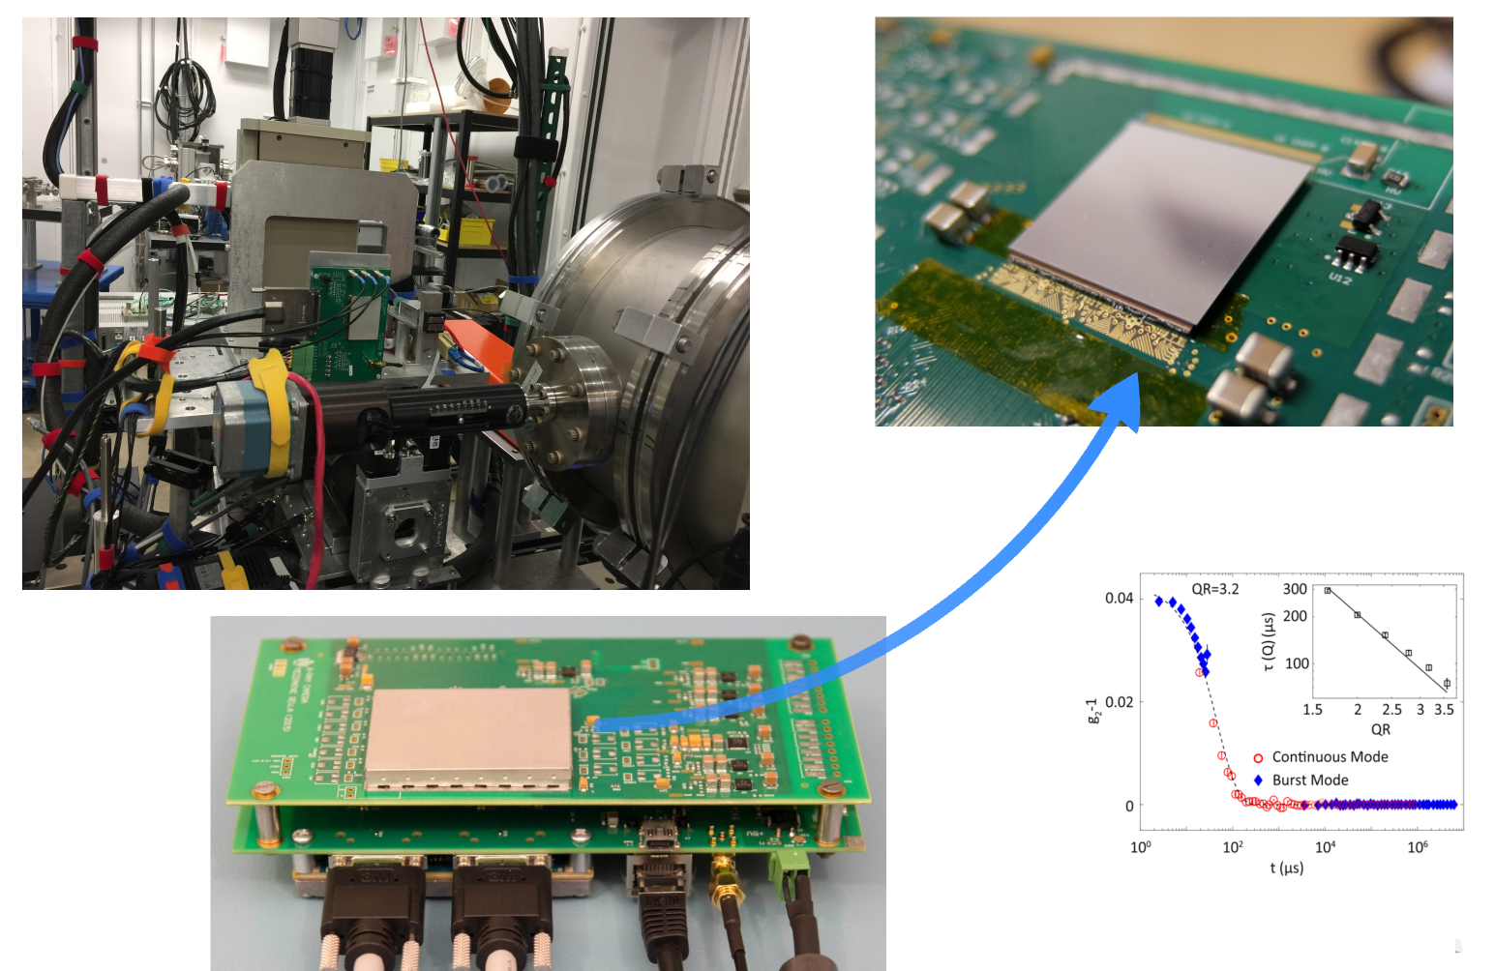

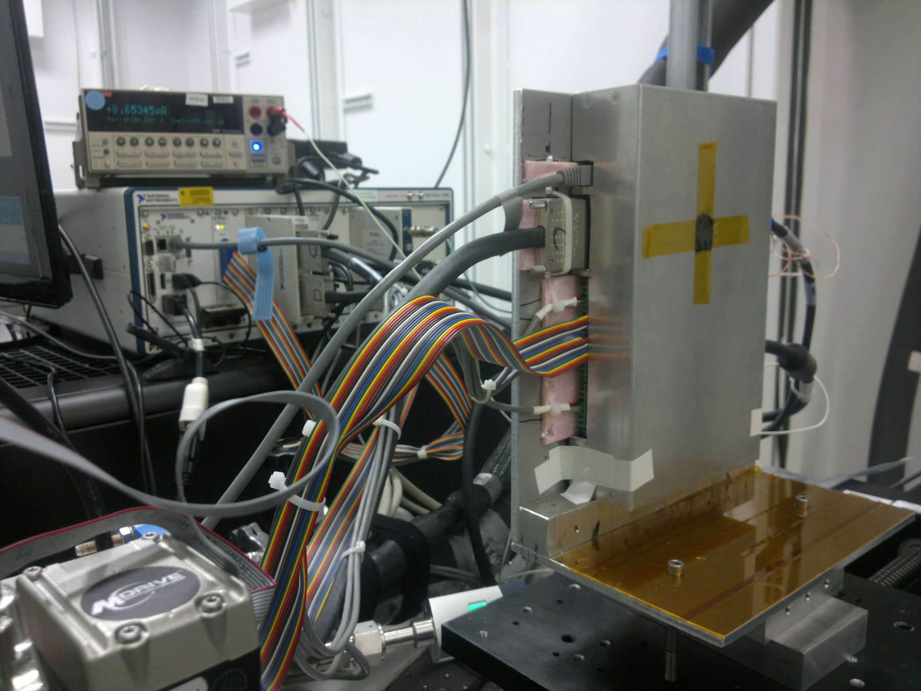
Future plans – FFFI at Sychrotron

Slide 19
Conclusions
Rapid Development Through Off-the-Shelf Controllers: Leveraging commercially available platforms significantly accelerates the development of testing systems.
Streamlined ASIC Testing: Dedicated prototyping systems allow us to focus on ASIC-specific challenges, such as power supply, biasing, and analog/digital signal analysis
Scalability and Reusability: The modular design and flexible software ecosystem provide scalability, allowing components and code to be reused across projects
Single Software Platform: A single software platform makes it unique acceleration of system integration, data transfer and an efficiency of debugging.
Proven Success: From testing single dies, dies with sensor up to synchrotron experiments and a commercial product prototypes, these platforms have enabled quick, reliable solutions that meet our needs

Slide 20
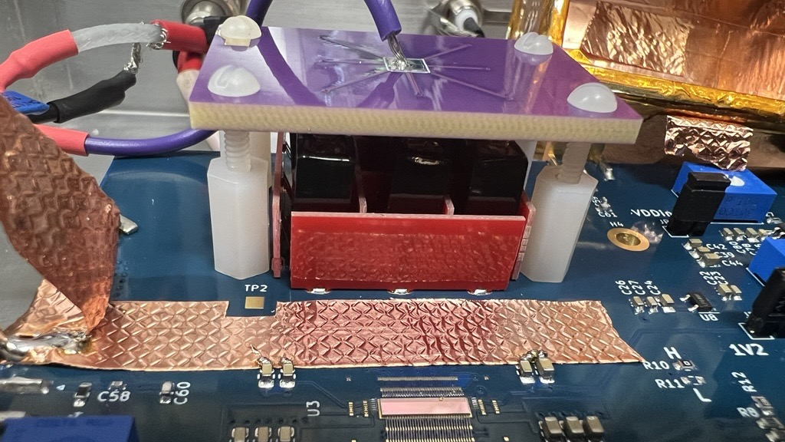
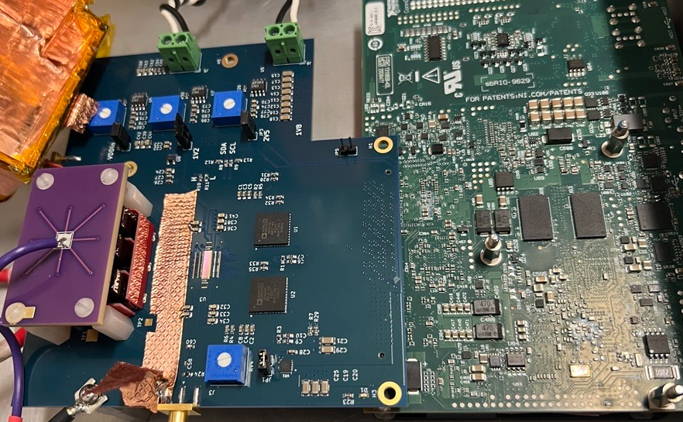
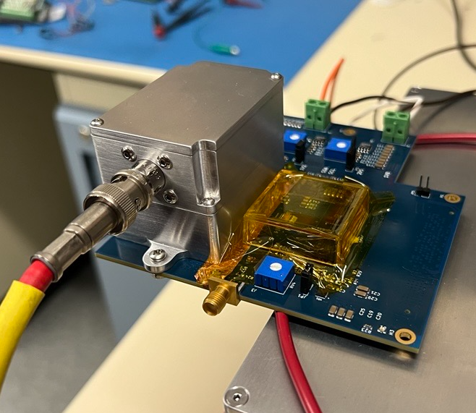
BCKP Examples of BNL systems – Fish Grid geometry CZT
32-channels 14-bit 65 MHz → 30 Gbps data stream
All in FPGA DSP:
Decimation, filtering, convolution, pedestal, peak detection, buffering, snippet handling, single channel stream
Data streaming to sd, usb-c, network, WiFi, embedded GUI
battery powered

Slide 21
BCKP Examples of BNL systems - HEXID
The Hyper-spectral Energy resolving X-ray Imaging Device (HEXID)

