Slide 1









Status of MIMOSIS
Supported by
(05P19RFFC1)
M. Deveaux, for the CBM-MVD collaboration
A. Altingun², Julio Andary¹, Benedict Arnoldi-Meadows¹, Ole Artz¹, Jérôme Baudot², Grégory Bertolone², Auguste Besson², Norbert Bialas¹, Roma Bugiel², Gilles Claus², Claude Colledani², Hasan Darwish^{1,2,3}, Michael Deveaux^{1,3,6}, Andrei Dorokhov², Guy Dozière², Ziad El Bitar², Ingo Fröhlich^{1,3}, Mathieu Goffe², Benedikt Gutsche¹, Fabian Hebermehl¹, Abdelkader Himmi², Christine Hu-Guo², Kimmo Jaaskelainen², Oliver Michael Keller⁶, Michal Koziel¹, Franz Matejcek¹, Jan Michel¹, Frédéric Morel², Christian Müntz¹, Hung Pham², Christian Joachim Schmidt³, Stefan Schreiber¹, Matthieu Specht², Dennis Spicker¹, Joachim Stroth^{1,3,4}, Isabelle Valin², Roland Weirich^{1,} Marc Winter⁵and Yue Zhao²
¹Goethe-Universität Frankfurt, Germany
²Université de Strasbourg, CNRS, IPHC UMR 7178, Strasbourg, France
³GSI Helmholtzzentrum für Schwerionenforschung GmbH, Germany
⁴Helmholtz Forschungsakademie Hessen für FAIR, Germany
⁵IJCLab, UMR9012 – CNRS / Université Paris-Saclay / Université de Paris, France
⁶Facility for Antiproton and Ion Research in Europe GmbH,Germany
Measurements leading to these results have been performed at the Test Beam Facility at DESY Hamburg (Germany), a member of the Helmholtz Association (HGF)

Slide 2
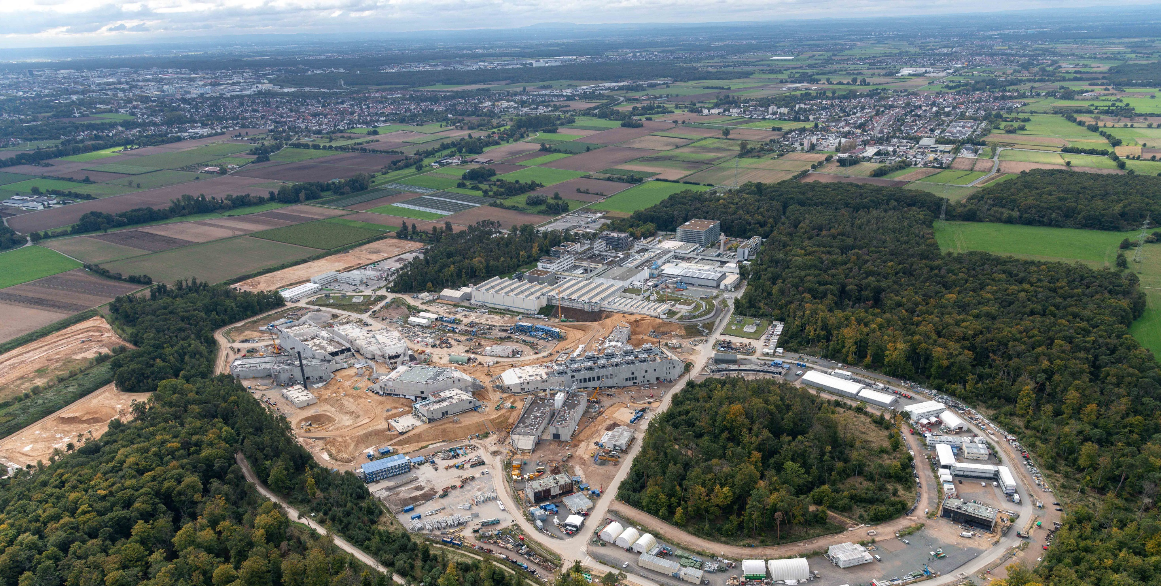
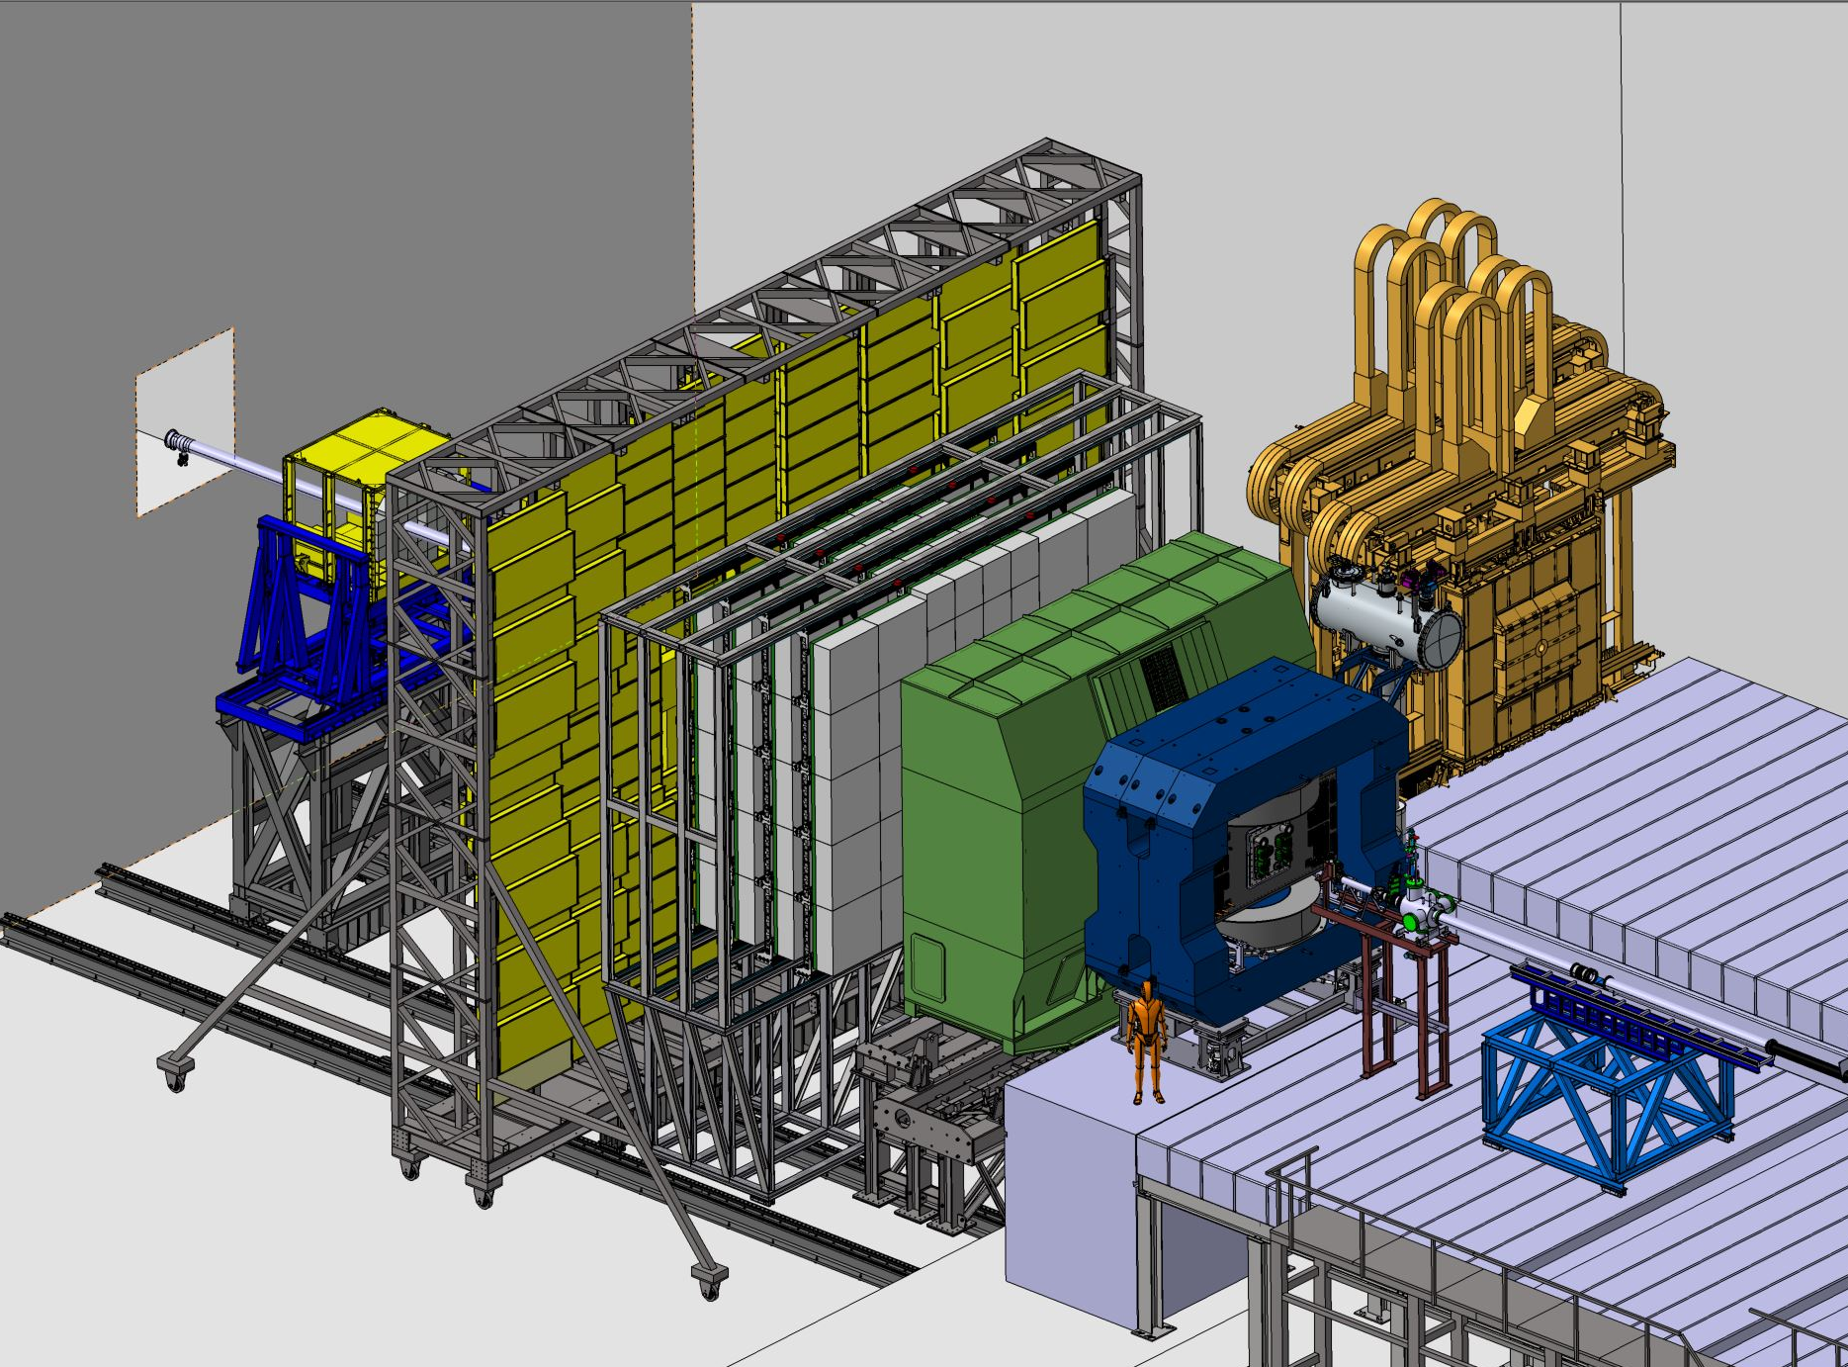
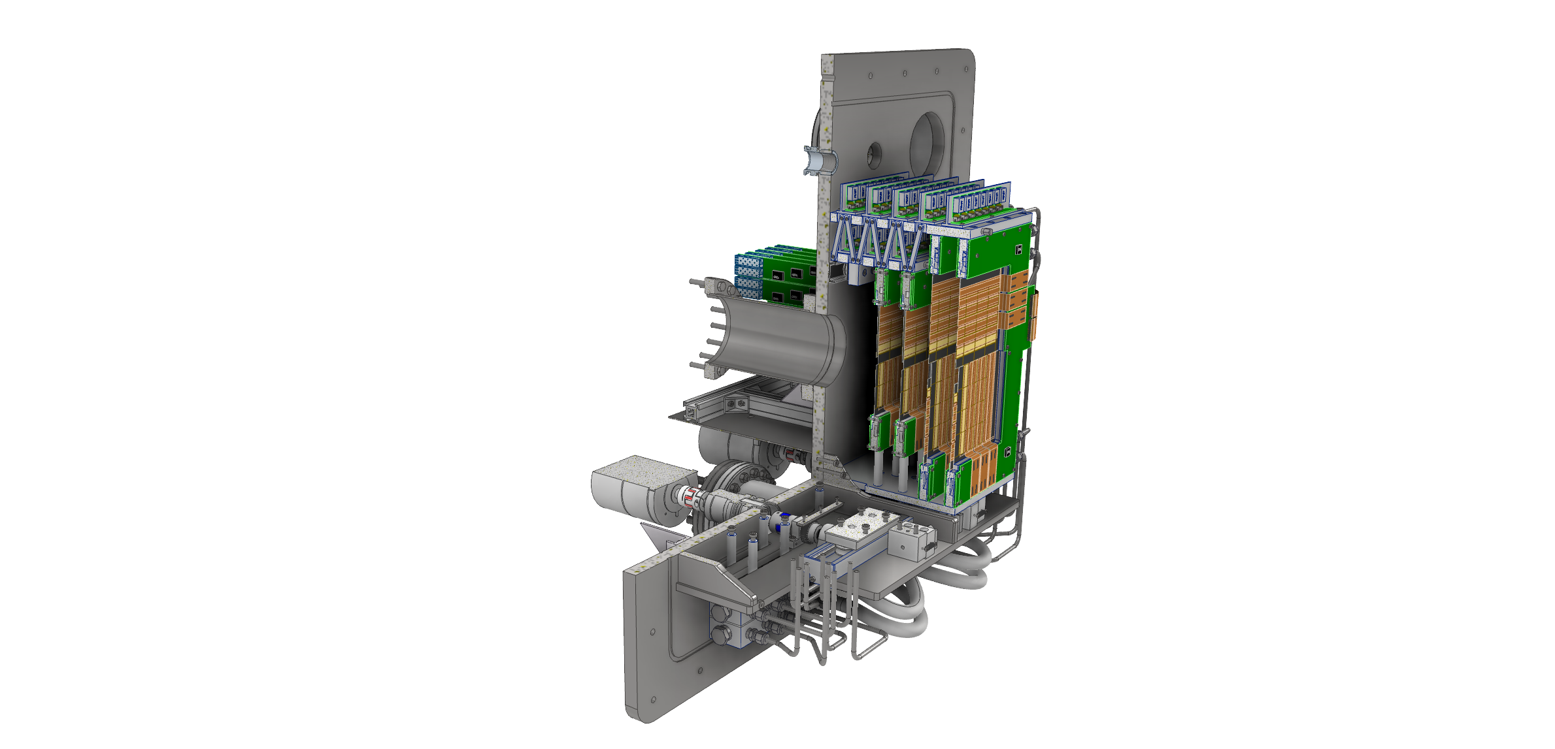

Compressed Baryonic Matter (CBM) experiment @ FAIR
MVD
Beam
Aim of the CBM Micro Vertex Detector (MVD):
Open charm reconstruction
Low momentum tracking
…
=> $σ=5 µm$ and <0.5% X₀/layer.
at 100 kHz ~10 AGeV Au+Au collisions.
10 MHz ~30 GeV p+Au collisions.
CAD: F. Matejcek

Slide 3
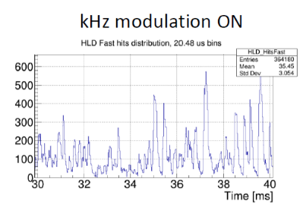
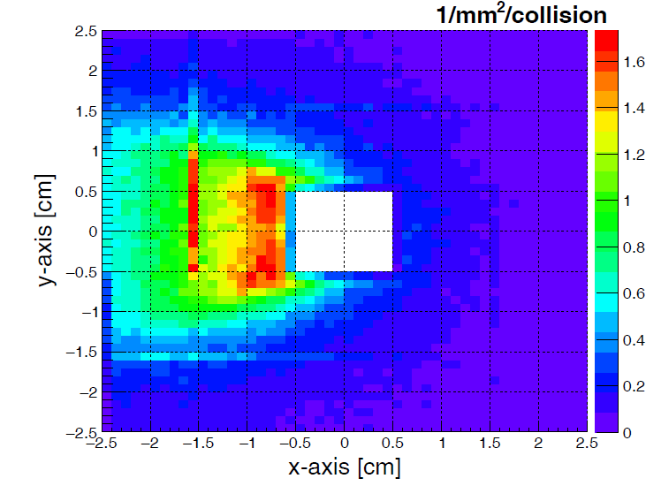
Requirements on the sensor
 | Requirements
Spatial, time resolution | ~5 µm, 5 µs
Sensor thickness | ~ 50 µm
Power dissipation (in vacuum) | <100 mW/cm²
Radiation doses | 7 × 10¹³ neq/cm² ~ 5 MRad
Radiation gradient over sensor | ~ 100%
Heavy ion tolerance | 1 kHz/cm²
Rate (average/ 35 µs peak) | 20 / 80 MHz/cm²
~10 x ALPIDE
Size of MIMOSIS-1
~20 x ALPIDE
(internal)
Need to design customized sensor for CBM: MIMOSIS
(Minimum Ionizing MOs active pixel sensor for experiments at and beyond the SchwerIonen Synchrotron)
Derive from ALPIDE (priority encoder readout) in TJ180nm.
Add fully depleted sensing node.
Re-design digital front- and back end (higher bandwidth, elastic buffer…)

Slide 4


MIMOSIS R&D plan
MIMOSIS-0 (2018)
Demonstrate pixel concept.
Demonstrate zero suppression.
Demonstrate readout concept.
In synergy with:
Add features
Fix issues
MIMOSIS-1 (2020)
Full dimension sensor
Add buffer structure.
SEE hardening 1/2
Design optimization
Add features
Fix issues
MIMOSIS-2 (Q2/2023)
On-chip pixel grouping.
Final pixels.
SEE hardening 2/2
Design optimization
Fix issues
MIMOSIS-2.1 (Q2/2024)
We are here
MIMOSIS-3
Final sensor for mass production
Final design choice
Fix issues

Slide 5
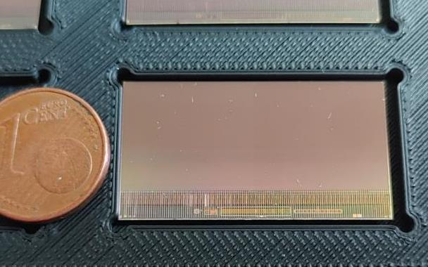

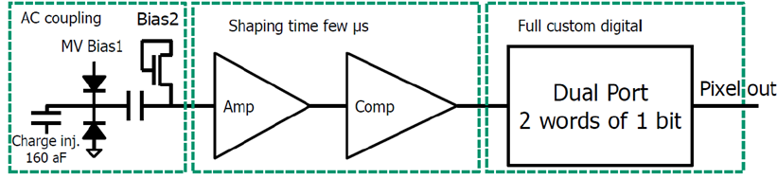
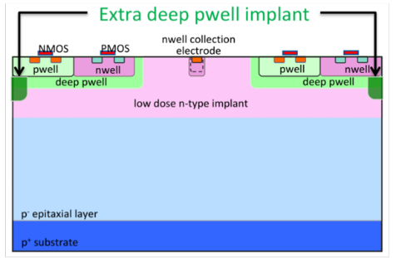
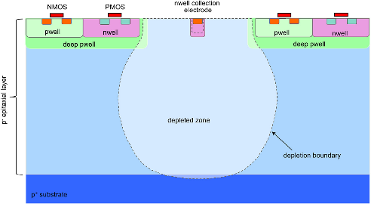

MIMOSIS, the sensor for the MVD (inspired by ALPIDE)
Size: 504 x 1024 pixels (27x30µm²), 5µs time binning
Full integrated: 20 MHz/cm² (80 MHz/cm² for 35µs), ~70mW/cm²
Fully depleted: >20V top bias
>20V HV top bias
MIMOSIS-1, 60µm thick
Inject test signal into pixel
Capacitor blocks HV
Known from ALICE/ALPIDE
First proposed by W. Snoeys et al.
H. Pernegger et al., 2017 JINST 12 P06008
standard
p-stop
+ Radiation hardness
- Spat. Resolution
Standard
Rad. hard, candidate 1
Epitaxial layer thickness: 25µm, 50µm (new => reported today).

Slide 6
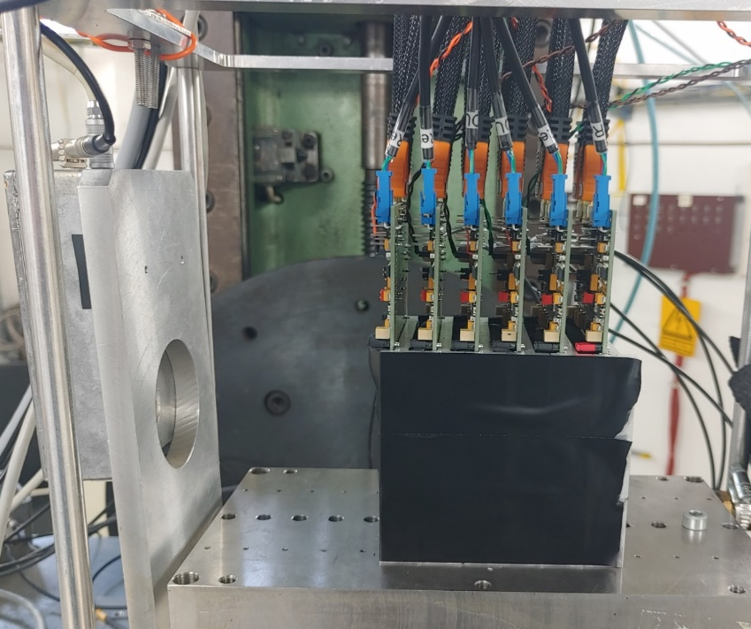
MIMOSIS-1/2.1 beam test setup
MIMOSIS - beam telescope:
6 MIMOSIS-1 or 2.1 sensors
4 reference sensors (standard epi-layer)
2 device under test
Reference Track Uncertainty:
  2.5 µm + 1.5 µm Mult. Scattering (DESY only)
Irradiation:
1 MeV reactor neutrons (TRIGA, Ljubjana).
Few 10 keV X-rays (KIT)
Storage at room temperature.
Beam test:
5 GeV e- Beam @ DESY
120 GeV Pion Beam @SPS-CERN
~ 1 GeV d – beam @ COSY
Stabilized room temperature

Slide 7
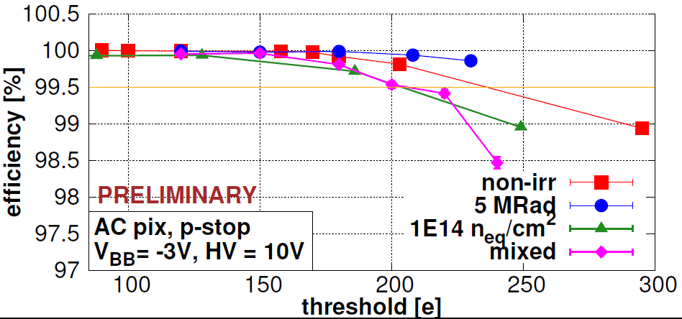
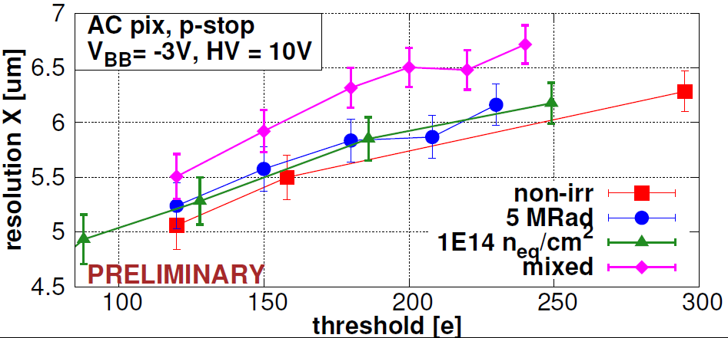
MIMOSIS-1 performance: New and after 5 MRad + 10¹⁴n_{eq}/cm²
CBM
Best performing pixel: AC P-stop
Efficiency >99% (end of life-time).
Spatial resolution: ~6 µm
Dark rate:
  Marginal before irradiation.
  <10⁻⁶ after irradiation.
Short dimension
of 27x30µm² pixel.
Conclusion on sensor performance:
All pixels work excellent before irradiation.
Standard pixels show best spatial resolution.
P-stop AC pixel most radiation hard, matches requirements of CBM.

Slide 8
Sensor performance: MIMOSIS-1 vs. MIMOSIS 2.1
Default working range
Observations:
MIMOSIS-2.1 reaches lower threshold than MIMOSIS-1.
MIMOSIS-2.1 reaches even(!) higher efficiency than MiSIS-1.
Best performance: Novel 50µm epitaxial layer with p-stop.
Dark occupancy marginal for all sensors (noisy pixels NOT masked).
Design goal
noise
H. Darwish, A. Altingun
Preliminary, 10. Sept. 24
p-stop, vbb=-1V, HV=10V, no masking
Det. limit
noise

Slide 9
MIMOSIS 2.1: Cluster multiplicity
Frequency [1]
Radiation hard (?), good resolution
Radiation soft, good resolution
Fired pixel/hit [1]
Observation:
MIMOSIS-2.1 p-stop 50µm combines high cluster multiplicity with rad. tolerant structure.
Might yield best combination of spatial resolution and radiation tolerance.
Radiation hard, reduced resolution

Slide 10
Spatial resolution, MIMOSIS-1 vs. MIMOSIS 2.1
Default working range
+ ~0.5 µm for longer pixel dimension
Observations:
MIMOSIS-2.1 and MIMOSIS-1 show mostly same resolution for 25 µm (expected, discrepancy to be studied).
MIMOSIS-2.1 50 µm reaches better resolution (as hoped).
~500 nm align-
ment uncertainty?
Design goal (open charm)
Preliminary conclusion:
Novel 50 µm p-stop appears most promising.
Need to confirm radiation tolerance before concluding => t.b.d. Q1/2025.
H. Darwish, A. Altingun
Preliminary, 10. Sept. 24
p-stop, vbb=-1V, HV=10V, no masking

Slide 11

Latch-up studies (MIMOSIS-2 with ~4 AMeV Au-ions)
Requirement for MVD:
  Must withstand 1kHz/cm² ions with
    LET< 35 MeV cm²/mg.
    (H. Darwish, PhD under preparation)
Preliminary test results (Bit flips):
  Frequent single bit errors seen.
  Correction in status registers works…
    … but may be overwhelmed by simultaneous to 2-bit flips (at unrealistically high ion fluxes).
  Data registers not protected.
Preliminary test results (Latch-up):
  No LU for LET≲50 MeV cm²/mg.
  Some LU seen above.
Beam impact test: few 100 MHz/cm² for few ms - OK.
CBM requirement
$$σ=\frac{N_{LU}}{Φ}$$
Preliminary
10. Sept 2024
> 1 LU/lifetime
< 1 LU/lifetime
MIMOSIS-2
B. Arnoldie-Meadows,
PhD under preparation
Required
Safety margin
Preliminary conclusion: Sensor matches requirements – no LU protection system needed.
T.b.d: Bit flip tolerance of data chain.

Slide 12
Summary and conclusion
MIMOSIS-1/2.1 form the full-size prototypes of the MIMOSIS sensor for the CBM-MVD.
    5 µs / ~5 µm time/spatial resolution.
    80 MHz/cm² peak rate.
MIMOSIS-1: irradiated with up to 3x10¹⁴ n_{eq}/cm² were tested in laboratory and in beam.
    >> 99% detection efficiency after 10¹⁴ n_{eq}/cm², 5 MRad and a combination of both
    <10⁻⁶ fake hit rate (after 10¹⁴ n_{eq}/cm², <0.05% of all pixels masked)
    ~6 µm spatial resolution before and after irradiation => Satisfactory w.r.t requirement.
MIMOSIS-2.1:
    Further improved detection efficiency and spat. resolution with 50 µm p-stop sensing node.
    Tolerates HI with up to LET ~50 MeV cm² / mg without observed latch-up.
    Tolerates and corrects bit-flips in steering registers.
Open issues (still t.b.d): SEE tolerance of data path, Rad. tolerance of p-stop 50µm sensing node.
MIMOSIS-2.1 matches the requirements of the CBM-MVD…
… and forms a mile-stone toward a sensor for higgs-factories.
Submission of final sensor foreseen mid 2025. Open for collaboration on further applications.

Slide 13
Backup

Slide 14
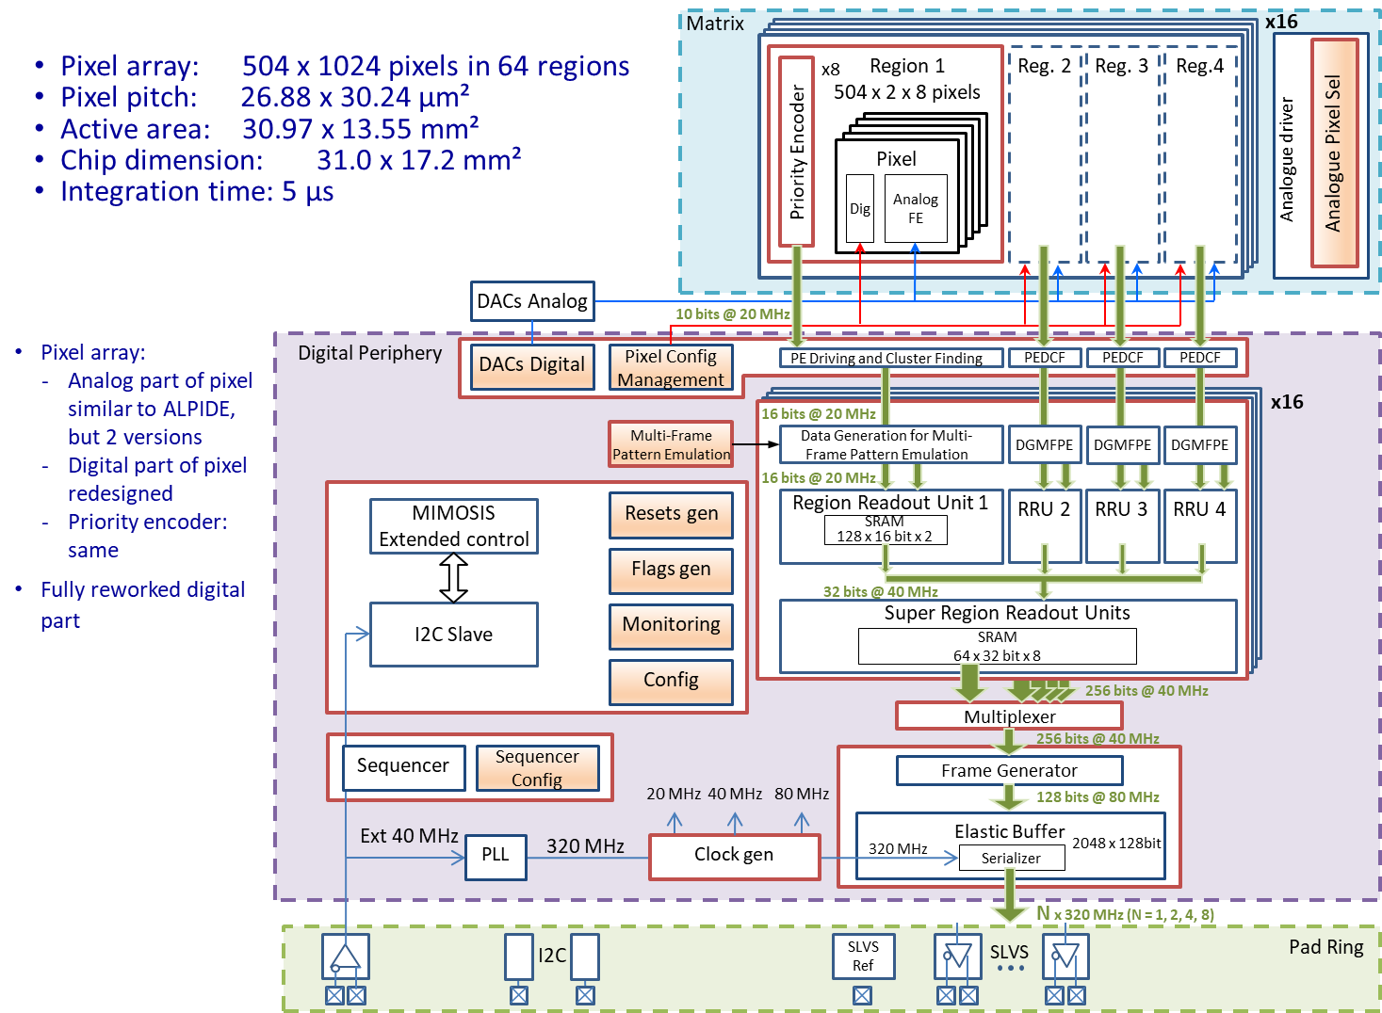
MIMOSIS block diagram

