Slide 1
Development of 20.2 Mpixel CITIUS detector for the XFEL facility SACLA
Haruki Nishino^{1,2}, Kyosuke Ozaki², Yoshiaki Honjo², Toshiyuki Hiraki², Kazuo Kobayashi^{1,2}, Koji Motomura², Takashi Sugimoto^{1,2}, Mitsuhiro Yamaga^{1,2}, Yasumasa Joti^{1,2}, Takaki Hatsui²
JASRI¹、RIKEN²

Slide 2
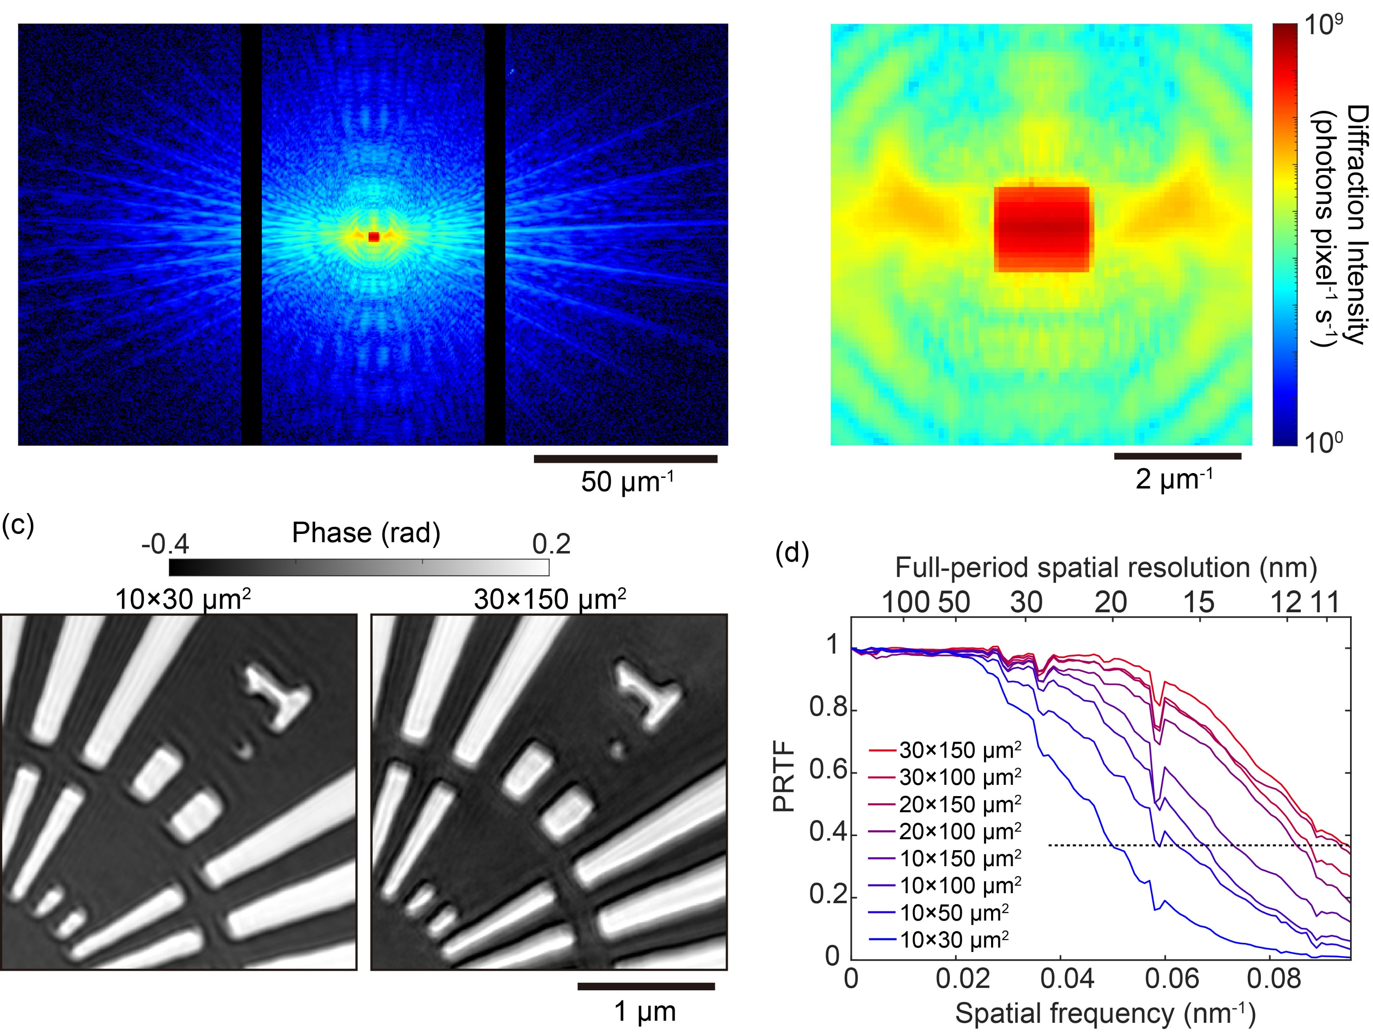
Use Case of CITIUS for X-rays
Intensity Mapping
Number of Photons for each pixel
Single Photon Sensitivity
  noise << 0.018 phs rms @ 8 keV
Ultra-high dynamic range
  continuous X-rays: 1 Gphotons/s/pixel
  pulsed X-rays for 6 keV
    1/66 photon noise (25 e-rms)
    17,000 photons/pixel/pulse (28 Me-)
    S/N = 1.12 x 10^6, best in class
Photon Event Recording
Condition
  Flux Density < 1 phs/pixel/frame
Photon Event data
  Photon energy from charge (Spectro-Imaging)
  Sub-pixel imaging (“Super-resolution”)
  Polarization from Auger electrons
  Direction from Compton scattered electrons
  ”Spectral streaking”
Max. Intensity at detector: 250 Mcps/pixel
Low-Q Region
This talk
Count
Conceptual Design: 2023-2024
Sensor Module Development: 2025-2020
Integration: 2021-
Energy [eV]
This talk
This talk
Count
This talk
Energy [eV]

Slide 3
Pixel Cross Section (72.6 µm)
p-in-n
3D integration: Sensor + ASIC
Drain terminal to collect interface leakage current
1 nA/cm² @ room temperature
Pixel schematic not shown due to restrictions.

Slide 4
Pixel Circuitry
Pixel schematic not shown due to restrictions.
Circuitry
similar to lateral overflow
no charge amplifier
Gain
All the gains are converted sequentially
No in-pixel gain switching
Gain selection
High/Mid. : Selected by an on-chip logic.
High/Mid/Low: selected by off-chip logic
In-pixel buffer
3 Gains: read then exposure (for pulsed X-rays)
2 Gains: read while exposure (for continuous X-rays)
1 gain: read while exposure (event recording)
Shutter
Global shutter operation
Power consumption
3.6 uW/pixel
Total power incl. on-chip ADCs, 8 W/280k pixels (0.54 W/cm2)

Slide 5
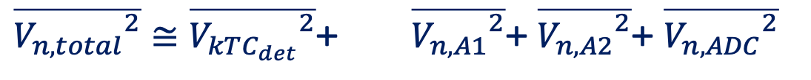
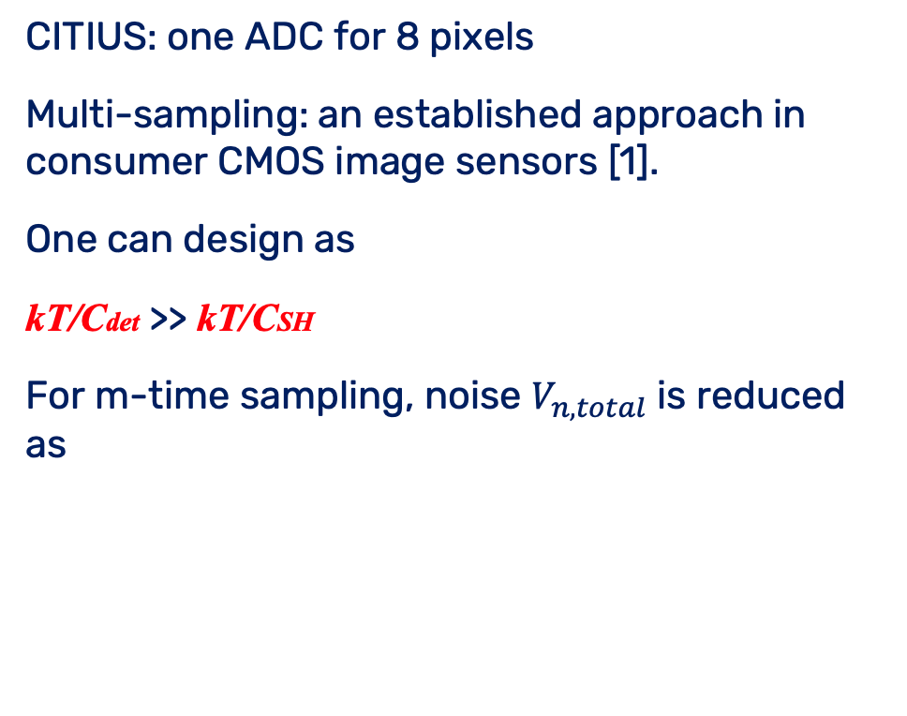

Readout Noise Reduction by Multi-Sampling
CITIUS: one ADC for 8 pixels
Multi-sampling: an established approach in consumer CMOS image sensors [1].
One can design as
kT/Cdet >> kT/CSH
For m-time sampling, noise $V_{n,total}$ is reduced as
Pixel
VDD
kT/Cdet
S/H
+
A1
kT/CSH
V_{n, A1}
+
V_{n, A2}
A2
+
ADC
$$\sqrt[m]{ }$$
V_{n, ADC}
$\overline{{V_{n,total}}^{2}}≅\overline{{V_{kTC_{det}}}^{2}}$+ $\overline{{V_{n,A1}}^{2}}$+ $\overline{{V_{n,A2}}^{2}}\text{+} \overline{{V_{n,ADC}}^{2}}$
Circuit noise, except for kT/C noise, can be reduced at the slower frame rate
1) Kawahito, S. (2011). Architectures for Low-noise CMOS Electronic Imaging. In: Seitz, P., Theuwissen, A. (eds) Single-Photon Imaging. Springer Series in Optical Sciences, vol 160. Springer, Berlin, Heidelberg.
5

Slide 6
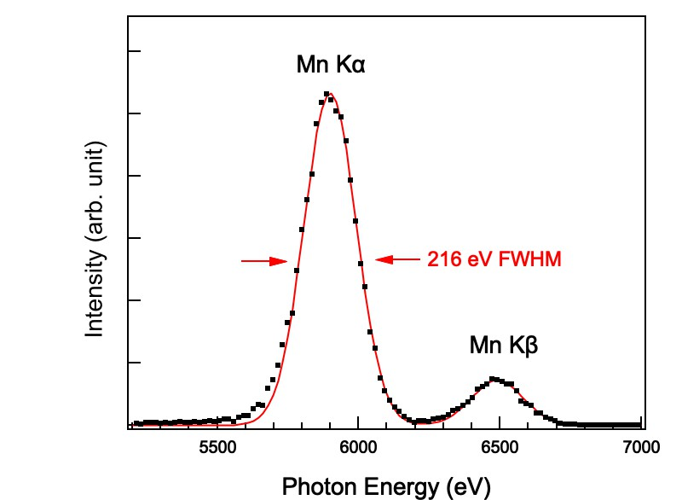
8-Sampling Results
Energy Resolution @ 5.9 keV
Single sampling @ 26.1 kframes/s 360 eV FWHM (40 e-rms)
8-sampling @ 2.2 kframes/s 216 eV FWHM (22 e-rms)

Slide 7
Demonstrated Performance
Parameters |  | Value |  | unit
 |  | CITIUS for XFEL (SACLA) | MPCCD (Phase III)
Sensor | Sensor Material | Silicon |  | N/A
 | Thickness | 650 | 300 | µm
 | Pixel Size | 72.6 | 50 | µm
 | Pixel Number | 0.28 | 0.5 | Mpixels/sensor module
 | Peak Signal | 17,000 | 2,400 | phs/pixel@6 keV
 |  | 28 | 4 | Me-/pixel
 | Typical noise | 25 | 250 | e-rms
 | Frame Rate | 60* | 60 | Hz
 | Data Rate | 1.6** | 0.06 | GB/s @ digital out
System | Imaging area | 321 × 393 | 100 × 100 | mm²
 | Pixel Number | 20.2 | 4 | Mpixels
 | Data Rate | 107* | 0.48 | GB/s @digital out
x 2.1
x 1.5
x 0.6
x 7
x < 1/7
x 5
x 242
* The maximum frame rate of CITIUS (XFEL variant) is 5 kHz.
** The data rate of CITIUS is the total raw data rate from the sensor. Each frame data has 16 multi- AD sampled data.

Slide 8
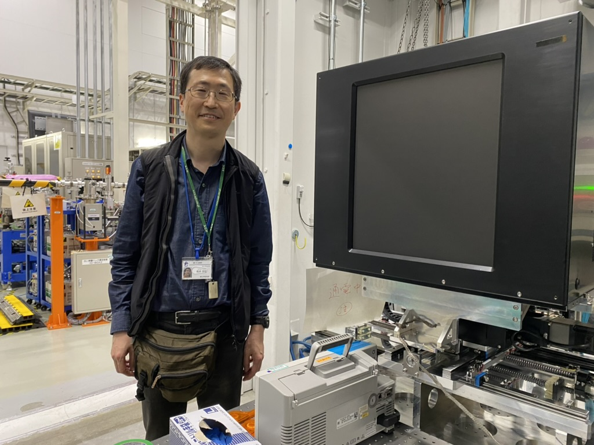
CITIUS 20.2M for SACLA
SALCA: XFEL facility with 60 Hz
Major Specifications
Max. Frame rate: 5 kHz
DAQ for SACLA: 960 Hz in the 16-sampling mode
(1 pulse image is taken by 16 images)
DAQ bandwidth:
620 Gbps @ 32 bit/pixel
107 GB/s
9 PB/day, when operated continously
First Beam Test:
July 2024
# of components: 12,586/system
Engineering intensive project
The outcome of a large collaboration.

Slide 9
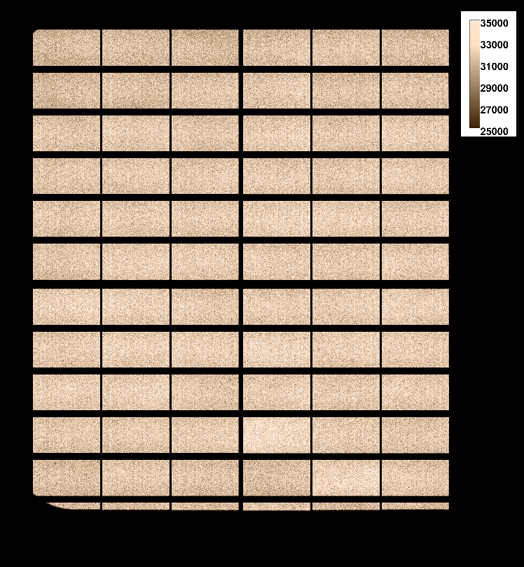
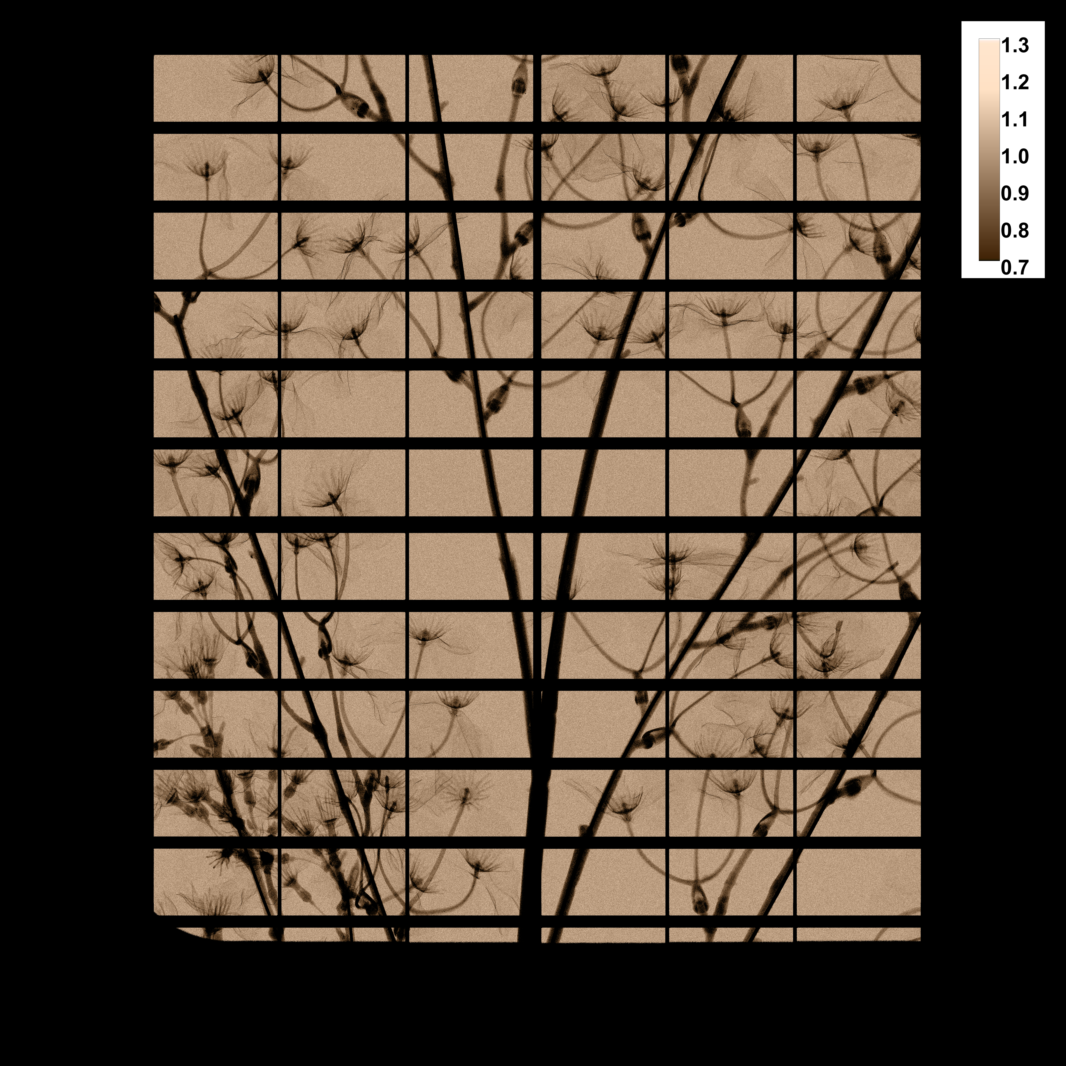
Mo 40 kV,500 µA, total exposure time 338 ms (6400 frames)
flat field image
dark subtracted
transmitted image
flat field corrected

Slide 10

Enlarged view of the transmitted image
flat field corrected

Slide 11
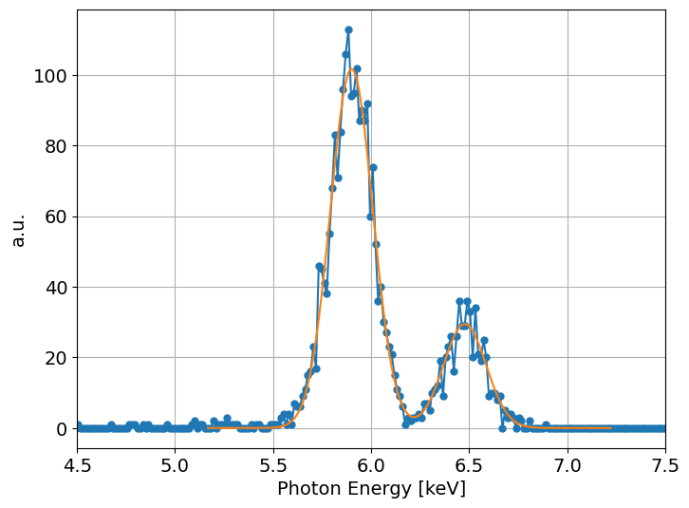
Noise and Energy Resolution
XFEL mode, 16-sampling
Noise 25 e-rms
〜250 eV FWHM
Peak Signal 28 Me-
(17,000 phs@6 keV)

Slide 12
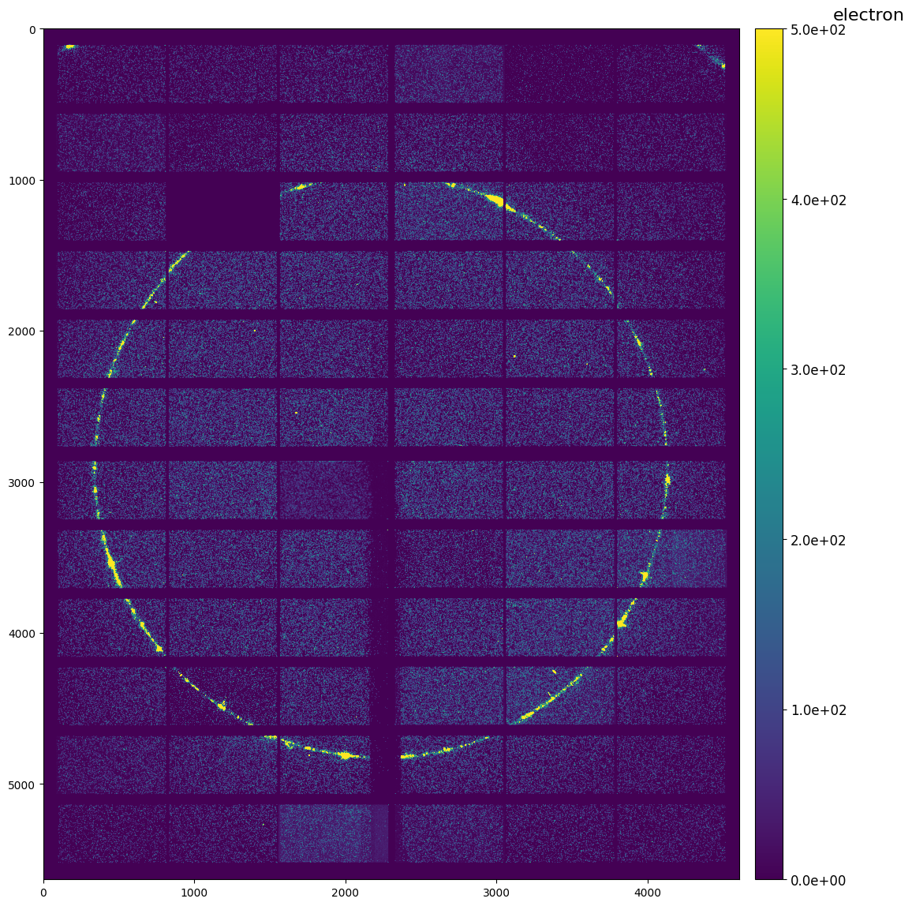
SFX at SACLA with CITIUS 20.2M
First light
failure during commissioning
one sensor damaged
by direct beam during experiments
Successful structure determination demonstrated.
The first science experiments were carried out!

Slide 13
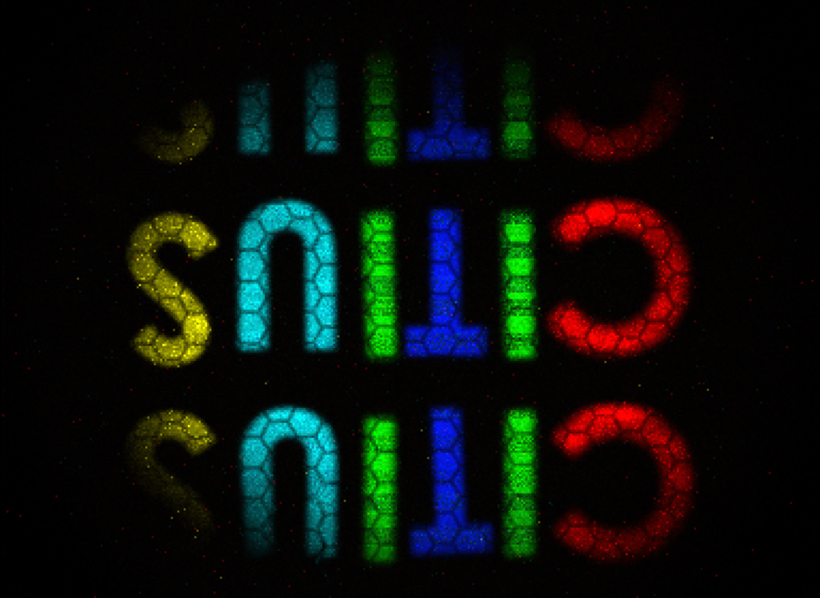
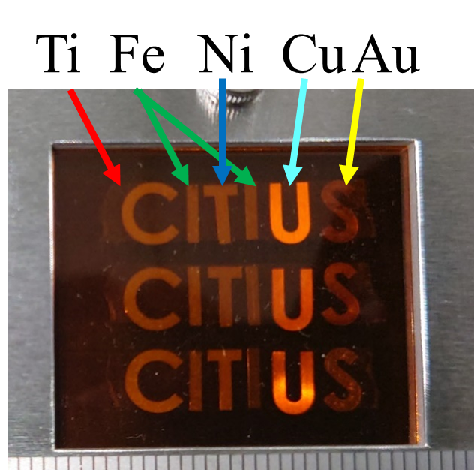
X-ray Spectro-imaging by using a Lab. X-ray source
295 mm
CITIUS
8.5 Mframes
326 s
8.5 GB
at 26.1 kframes/s
Sample
Mo target
50 kV, 300 mA
50 mm
7 mm
CITIUS 280k
30 mm
Notes:
ラボ光源で分光イメージングをデモンストレーションした結果を一つご紹介します。
今回のデモンストレーションは、金属元素のマッピングになります。
実験の模式図が左の図になります。
X線管からのX線を金属試料に当て、試料からの蛍光X線をガラスキャピラリを介してCITIUSで計測しました。
今回用いた金属試料の外観写真が右になります。
文字の形に整形した5種類の金属を並べ、カプトンで挟み込んだものになります。

Slide 14
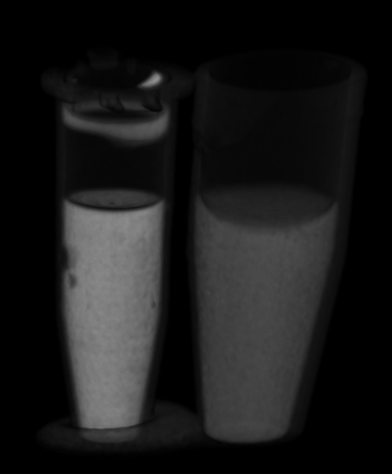
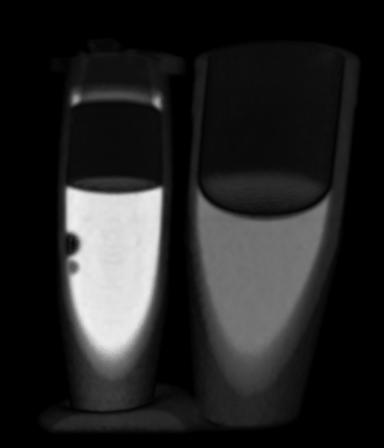
Laboratory based Spectral CT
V. Di Trapani^{1,2*}, F. De Marco^{1,2}, F. Arfelli^{1,3}, Y. Honjo⁵, K. Ozaki⁵, H. Nishino^{5,6}, Y. Joti^{5,6}, T. Hatsui⁵, F. Orsini⁵, P. Thibault^{1,2}, R. H. Menk^{2,3,4}
1) University of Trieste, 2) Elettra Sincrotrone 3) INFN Trieste, 4) Mid Sweden Univ., 5) RIKEN 6) JASRI
presented at iWoRiD 2024
Spectral decomposed CT
(blue Ag, green KBr Gray polyethylene)
Conventional CT
Analyzed Spectral Resolution in this experiments.
540 eV FWHM @ 5.9 keV, 670 eV FWHM @ 27.3 keV

Slide 15

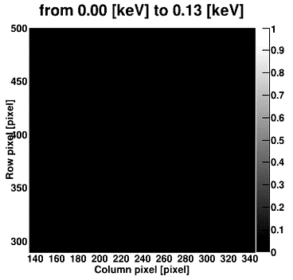
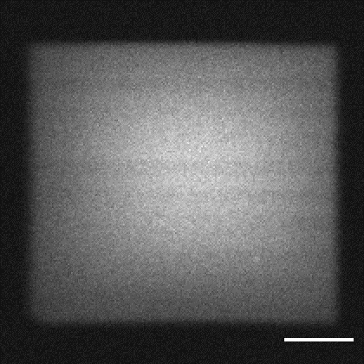

Non-Destructive X-ray Beam Monitor for SPring-8-II
Demonstration
Shield Wall
CITIUS
electron
Pinhole
Undulator
Monochromator
X-rays
Spectro-Imaging
Frontend
slit
Total Intensity
Diamond thin film
BL03XU Optical Hutch
Ring Current: 10 mA
Front end slit: 3.2 mm (h.)×2.8 mm (vert.)
Gap: ：17.76 mm (fundamental at 12.4 keV)
CITIUS 280k
1.4 Mframes
54 s
1.4 GB
at 26.1 kframes/s
0.7 mm

Slide 16
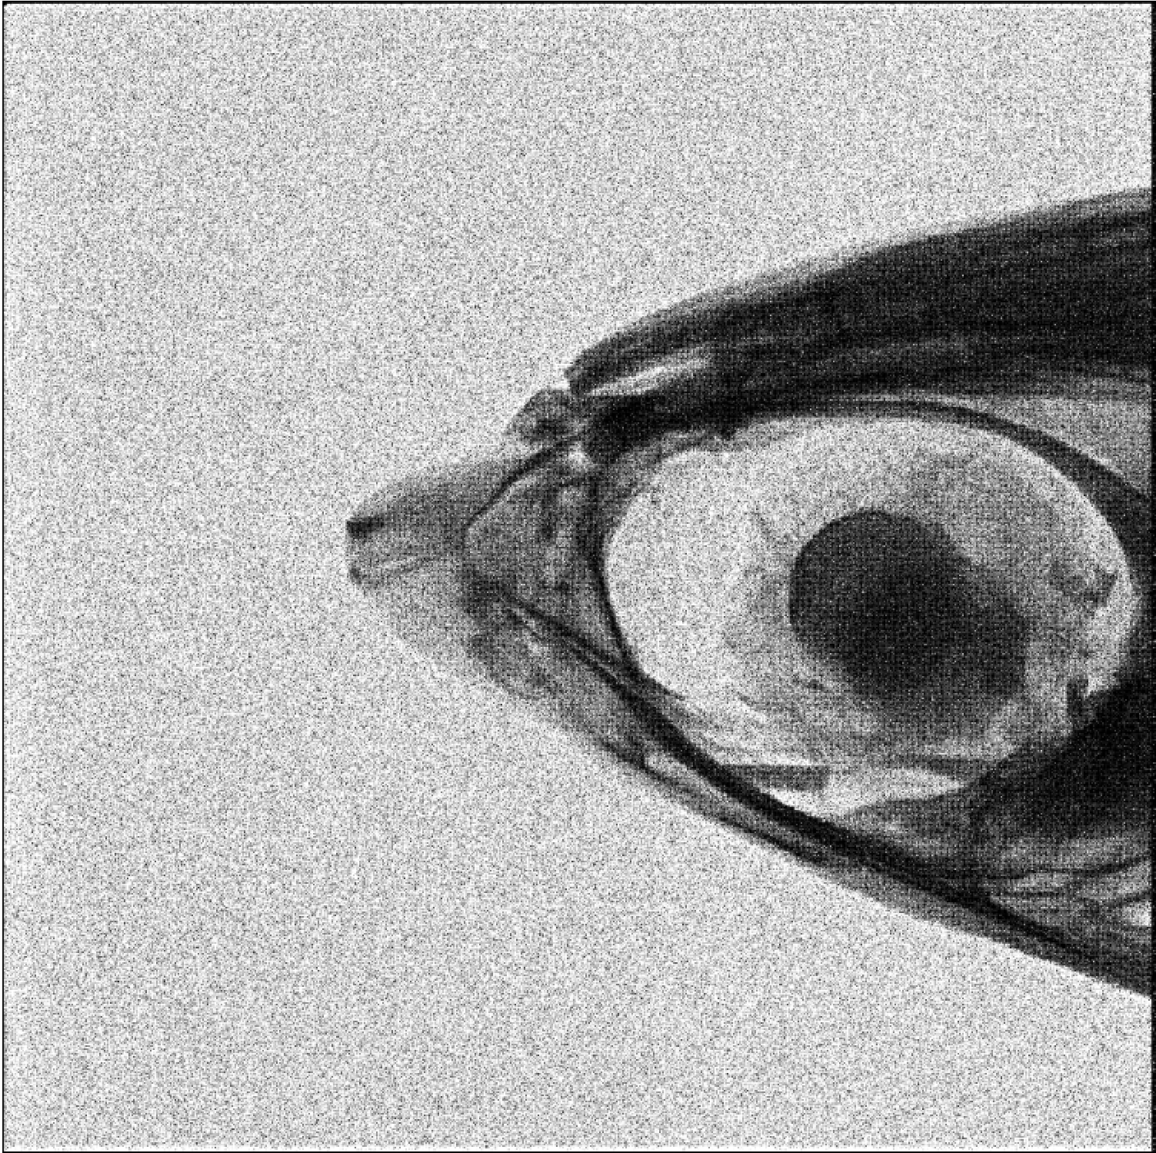
Sub-Pixel Imaging at virtual 14.5 µm Pixel Resolution
Method used in this sub-pixel imaging
R. Hosono, et.al., Opt Express, Vol 26(16) (2018). 21044.
Data were taken at 26.1 kframes/s
72.6 µm
14.5 µm
Off-chip computation
Signal charge spread over pixels

Slide 17
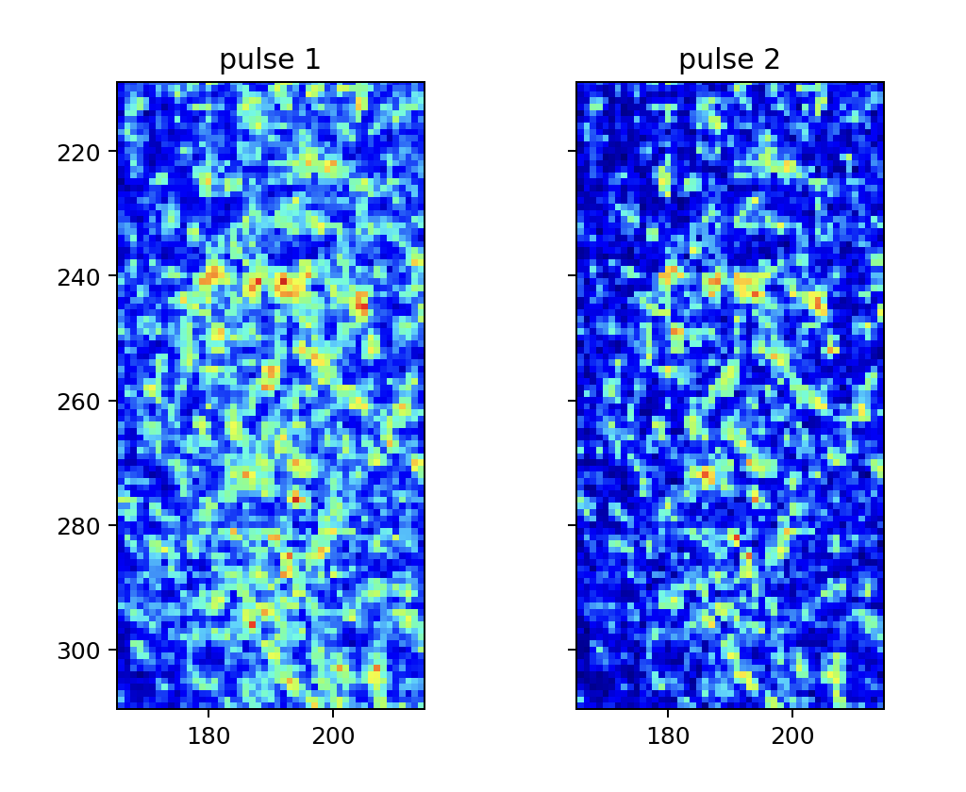
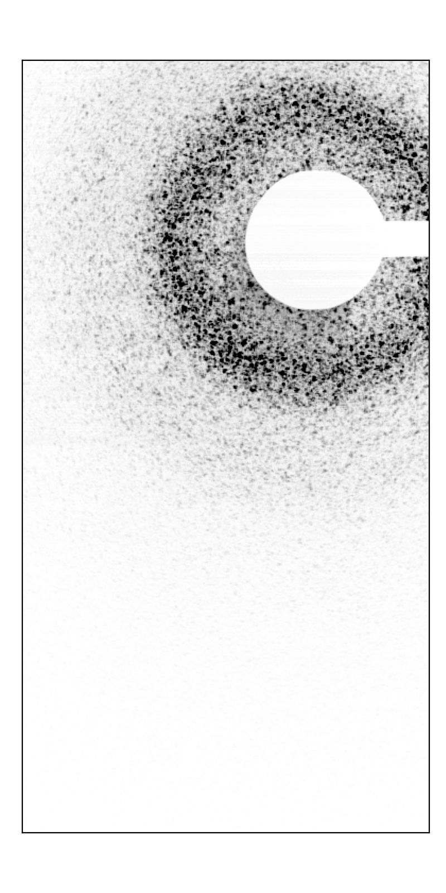
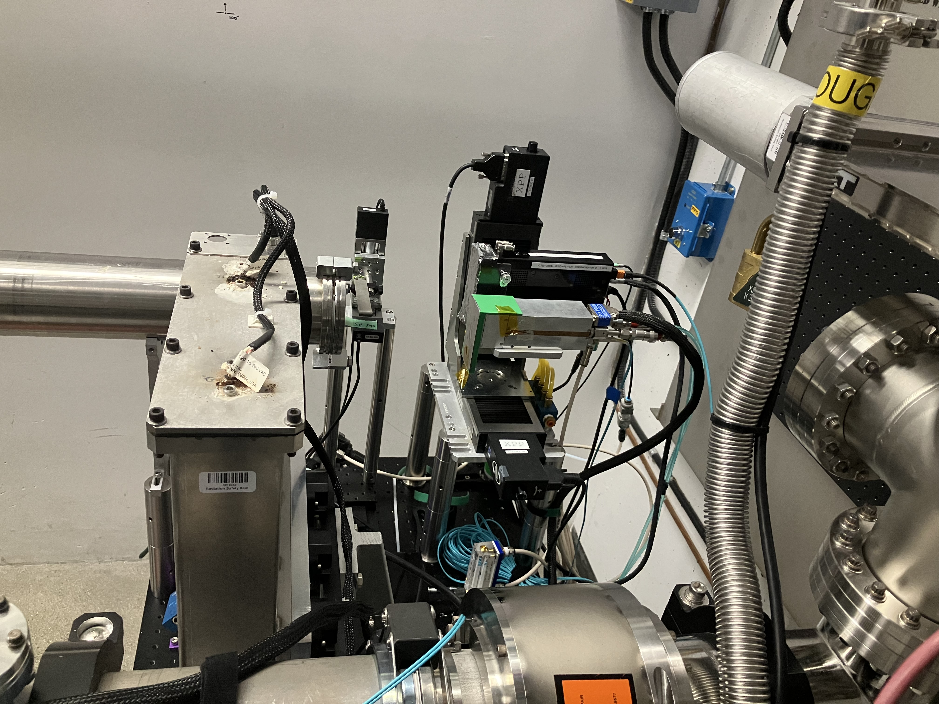
”Spectral Streaking”
Measure arrival time from the detected charge
Yanwen Sun, Mario Balcazar, Zhu Diling, Takahiro Sato, Sanghoon Song, Tim B. van Driel, Vincent Esposito, Conny Hansson, Alex Halavanau, Kazutaka Nakahara, Jana B. Thayer, Angelo Dragone, Mark Sutton, Paul Fuoss
LCLS: has a unique operation mode of double XFEL pulse.
CITIUS: a double shutter mode for acquiring two successive pulses.
Shutter Opening/closing takes 100-150 ns.
CITIUS distinguished two pulses with 75 ns separation.
280k sensor
Preliminary
Analysis was done by taking the shutter open/close time constant of about 100-150 ns

Slide 18
Use Case of CITIUS for X-rays
Intensity Mapping
Number of Photons for each pixel
Single Photon Sensitivity
  noise << 0.018 phs rms @ 8 keV
Ultra-high dynamic range
  continuous X-rays: 1 Gphotons/s/pixel
  pulsed X-rays for 6 keV
    1/66 photon noise (25 e-rms)
    17,000 photons/pixel/pulse (28 Me-)
    S/N = 1.12 x 10^6, best in class
Photon Event Recording
Condition
  Flux Density < 1 phs/pixel/frame
Photon Event data
  Photon energy from charge (Spectro-Imaging)
  Sub-pixel imaging (“Super-resolution”)
  Polarization from Auger electrons
  Direction from Compton scattered electrons
  ”Spectral streaking”
Max. Intensity at detector: 250 Mcps/pixel
Low-Q Region
This talk
Count
Energy/Arrival time…
This talk
This talk
Count
This talk
Energy/Arrival time…

Slide 19
Acknowledgment
RIKEN and JASRI Team
  Kazuo Kobayashi, Koji Motomura, Kyo Nakajima, T. Kudo, T. Sugimoto, M. Yamaga, T. Kameshima, Y. Inagaki, K. Fujiwara, T. Nakagawa, Y. Oyaki, M. Kimoto, M. Nakamachi, M. Yabashi, T. Ishikawa
RIKEN R-CCS
  S. Matsuoka, K. Sato, K. Sano, F, Shoji and their division members
Private Companies
  Sony Semiconductor Solutions
  GLORY System Create Ltd
  Nihon Gijyutu Center
  Meisei Electric Co. Ltd.
  JEPICO Corporation
  Tokyo Electron Device Limited
Thank you for your attention.

