Slide 1
Matterhorn, a high flux, single photon counting detector for 4th generation synchrotrons
Roberto Dinapoli, Aldo Mozzanica, Anna Bergamaschi, Bernd Schmitt, Carlos Lopez Cuenca, Christian Rueder,Davide Mezza, Dhanya Thattil, Dominic Greiffenberg, Erik Fröjdh, Filippo Baruffaldi, Jiaguo Zhang, Jonathan Mulvey, Julian Heymes, Khalil Daniel Ferjaoui, Kirsty Paton, Konstantinos Moustakas, Mar Carulla Areste, Martin Brückner, Martin Mueller, Partick Sieberer, Saverio Silletta, Shuqui Li, Simon Ebner, Thomas King, Vadym Kedych, Viktoria Hinger, Viveka Gautam, Xiangyu Xie.
11th PIXEL conference, Strasbourg France, 18-22 November 2024

Slide 2
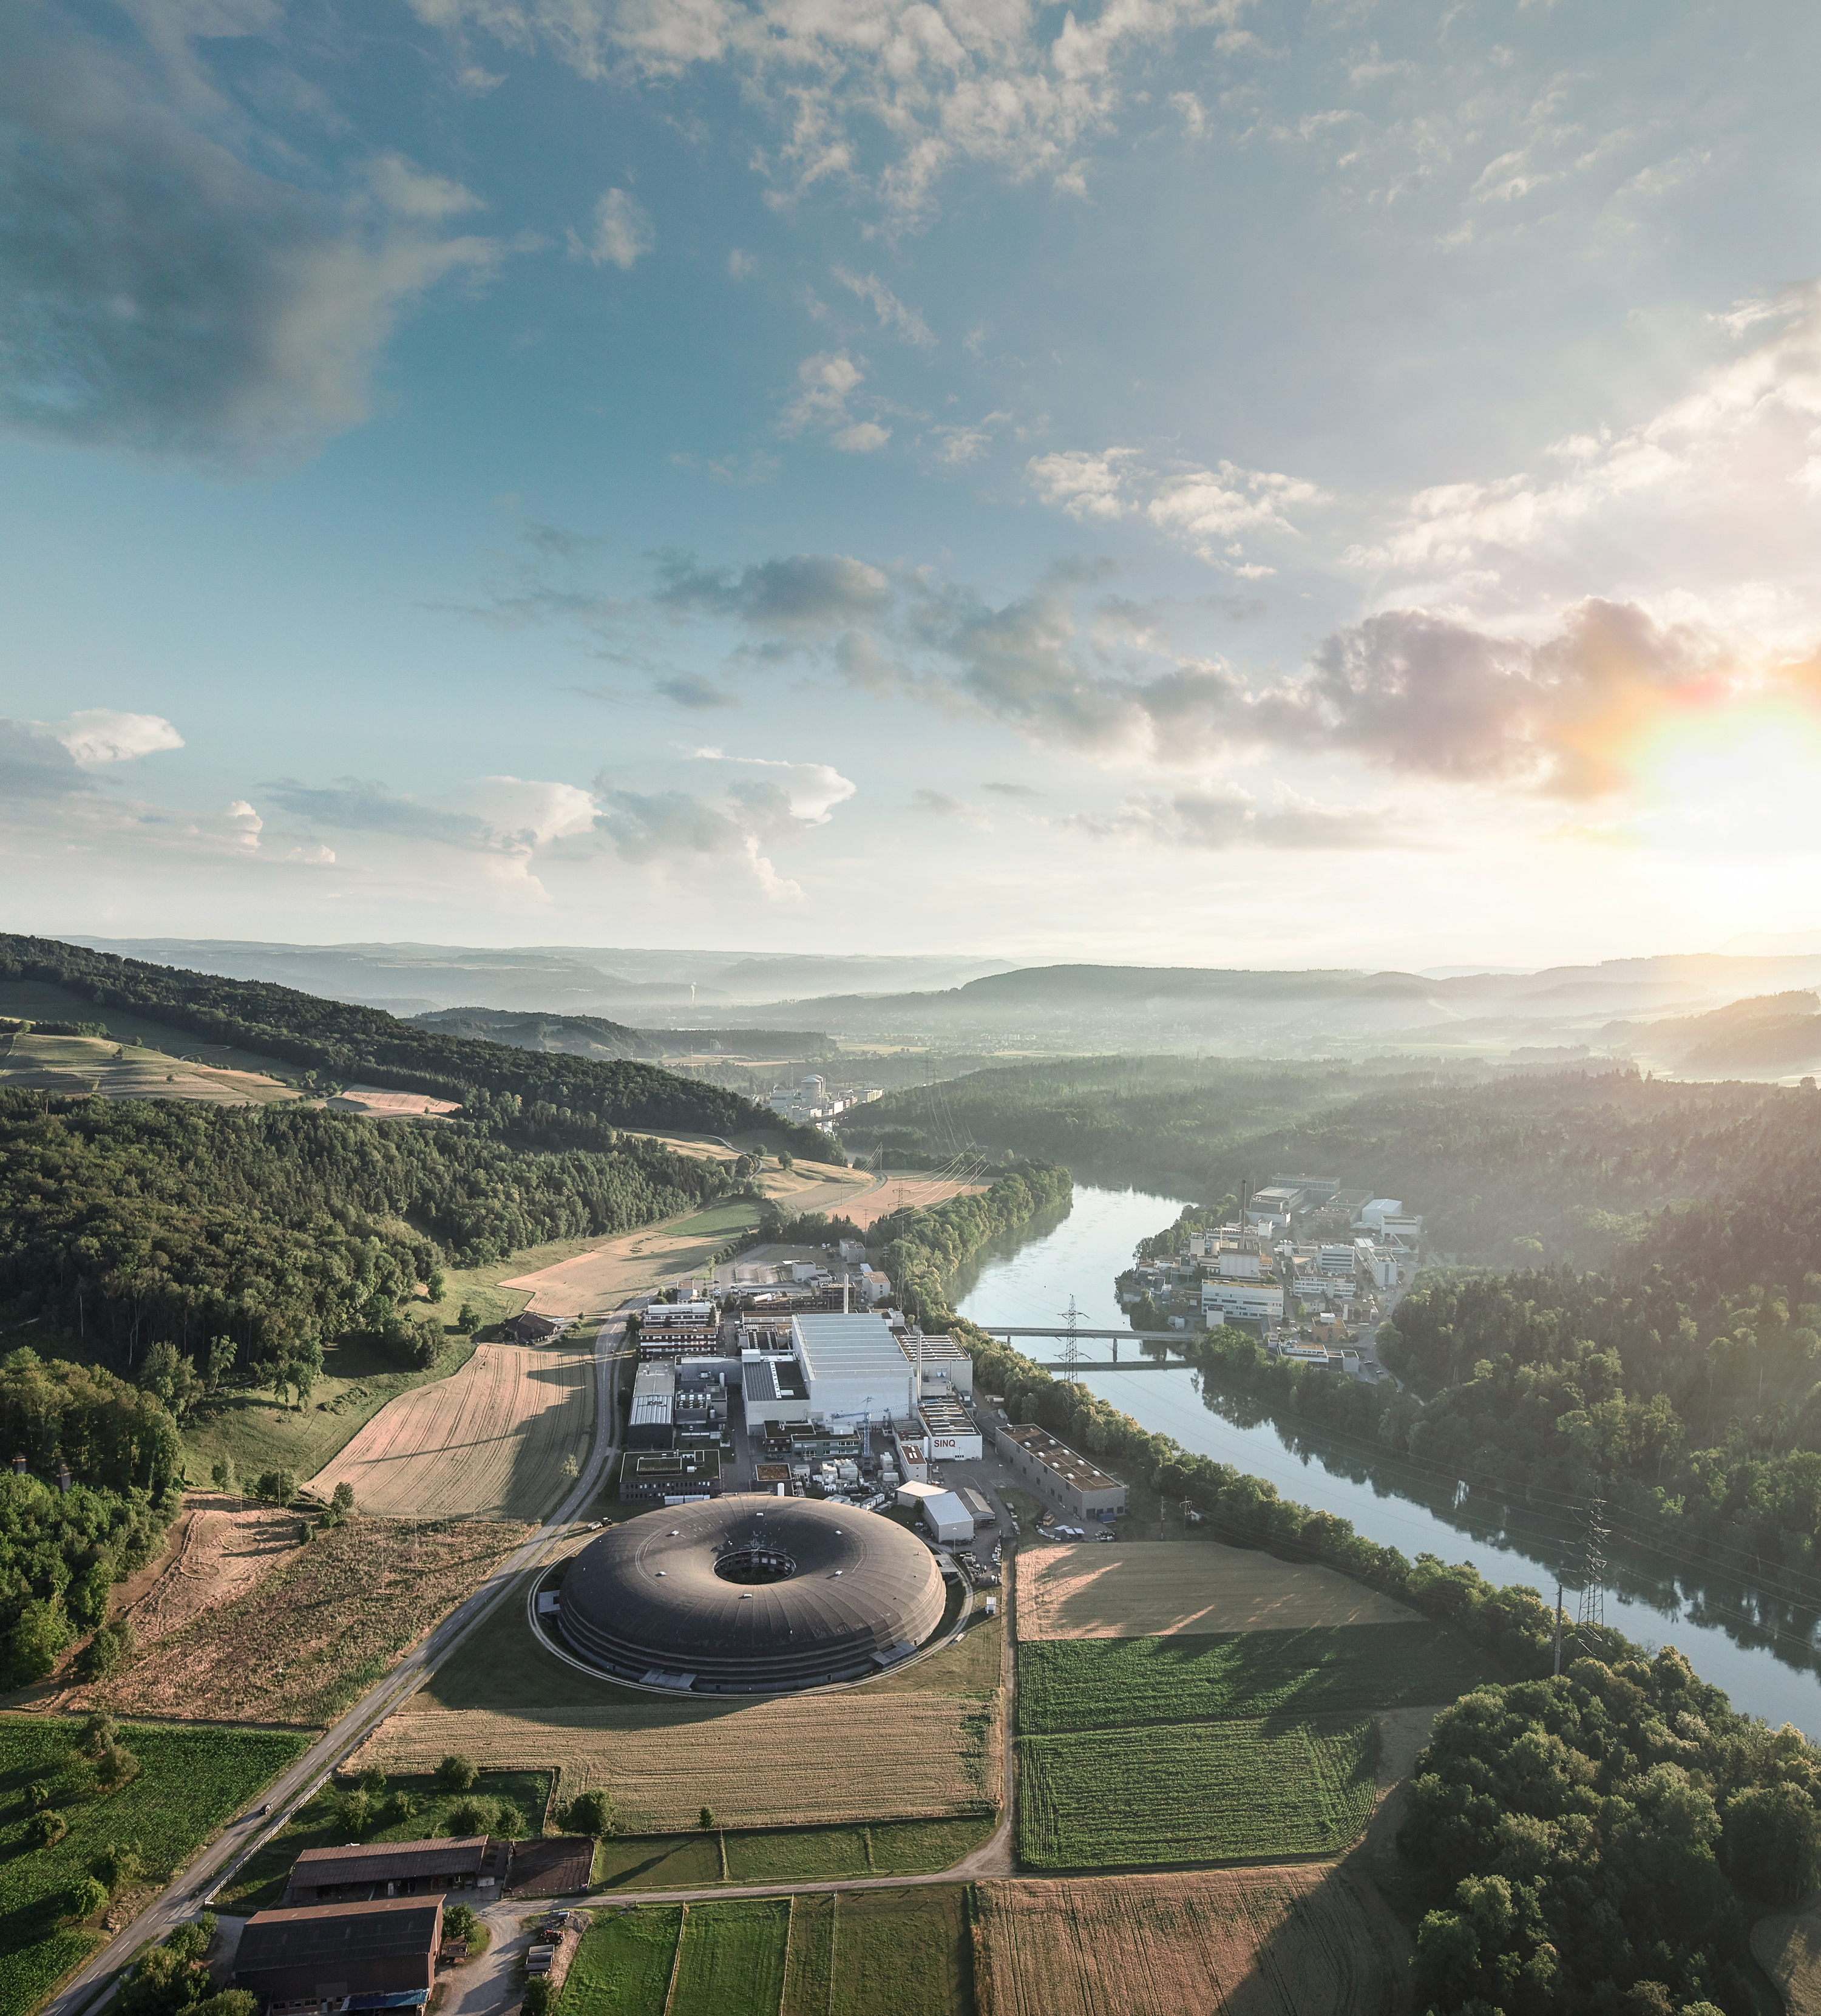
SLS 2.0 – a 4th generation synchrotron
Increased coherent flux [1]:
>100x at 10 keV
Up to 1000x at 20 keV
Increased electron energy (2.4 → 2.7 GeV)
Higher energy photons (80 keV)
[1] SLS 2.0 Storage Ring Technical Design Report PSI Bericht Nr. 21-02 November 2021

Slide 3
SLS 2.0 – a 4th generation synchrotron
Increased coherent flux [1]:
>100x at 10 keV
Up to 1000x at 20 keV
Increased electron energy (2.4 → 2.7 GeV)
Higher energy photons (80 keV)
For the detector this means:
Faster count rate
Higher frame rate
Wider energy range
[1] SLS 2.0 Storage Ring Technical Design Report PSI Bericht Nr. 21-02 November 2021

Slide 4
SLS 2.0 – a 4th generation synchrotron
Increased coherent flux [1]:
>100x at 10 keV
Up to 1000x at 20 keV
Increased electron energy (2.4 → 2.7 GeV)
Higher energy photons (80 keV)
For the detector this means:
Faster count rate
Higher frame rate
Wider energy range
- 15-20 M photons/pixel/second
- 20 kHz continuous frame rate
- 250 eV – 80 keV
[1] SLS 2.0 Storage Ring Technical Design Report PSI Bericht Nr. 21-02 November 2021

Slide 5
SLS 2.0 – a 4th generation synchrotron
Increased coherent flux [1]:
>100x at 10 keV
Up to 1000x at 20 keV
Increased electron energy (2.4 → 2.7 GeV)
Higher energy photons (80 keV)
For the detector this means:
Faster count rate
Higher frame rate
Wider energy range
- 15-20 M photons/pixel/second
- 20 kHz continuous frame rate
- 250 eV – 80 keV
LGADs
High Z
[1] SLS 2.0 Storage Ring Technical Design Report PSI Bericht Nr. 21-02 November 2021

Slide 6
SLS 2.0 – a 4th generation synchrotron
Increased coherent flux [1]:
>100x at 10 keV
Up to 1000x at 20 keV
Increased electron energy (2.4 → 2.7 GeV)
Higher energy photons (80 keV)
For the detector this means:
Faster count rate
Higher frame rate
- 15-20 M photons/pixel/second
- 20 kHz continuous frame rate
Charge integration
Single Photon Counting
[1] SLS 2.0 Storage Ring Technical Design Report PSI Bericht Nr. 21-02 November 2021

Slide 7
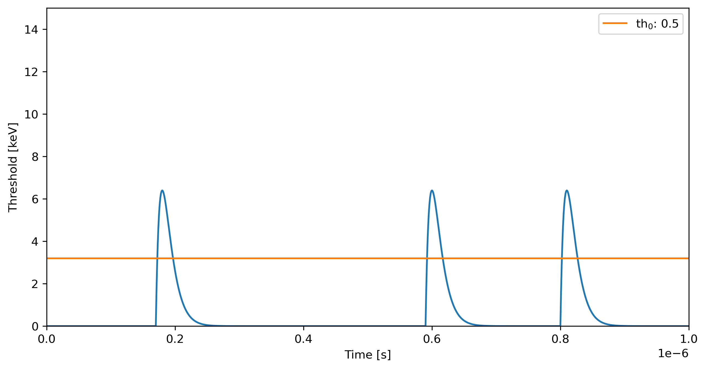
The “speed challenge”: high photon flux
Single photon counting works extremely well if the incoming photon rate is reasonable low

Slide 8
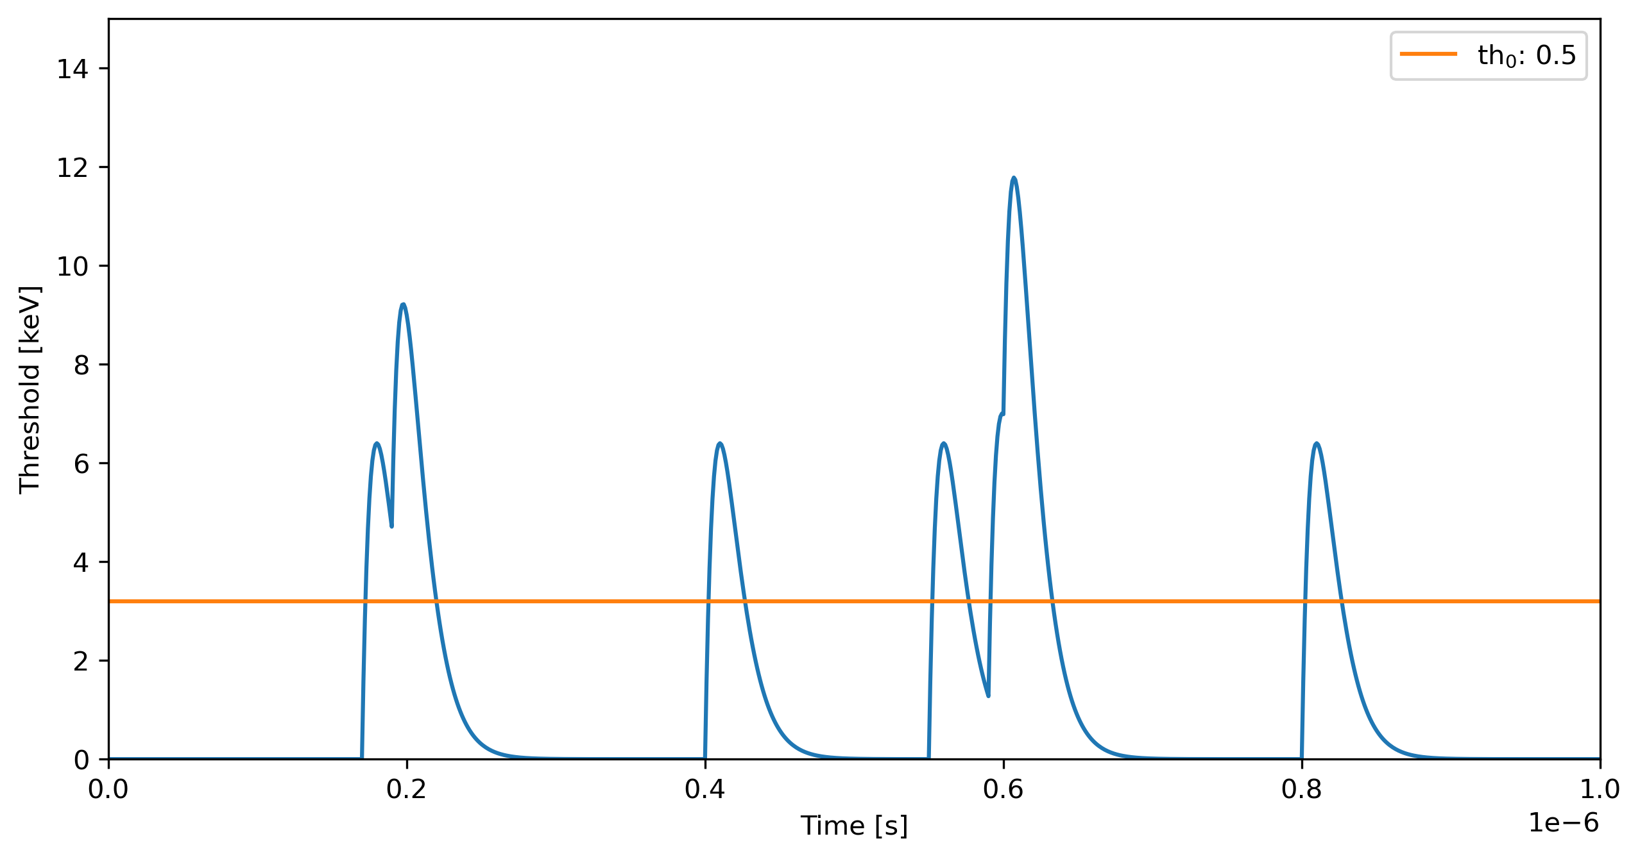
The “speed challenge”: high photon flux
Single photon counting works extremely well if the incoming photon rate is reasonable low
But as the rate increases we lose efficiency due to pulse pileup

Slide 9
The “speed challenge”: high photon flux
Single photon counting works extremely well if the incoming photon rate is reasonable low
But as the rate increases we lose efficiency due to pulse pileup
Pile-up mitigation techniques for SPC:
Time over threshold
Retriggering
…

Slide 10
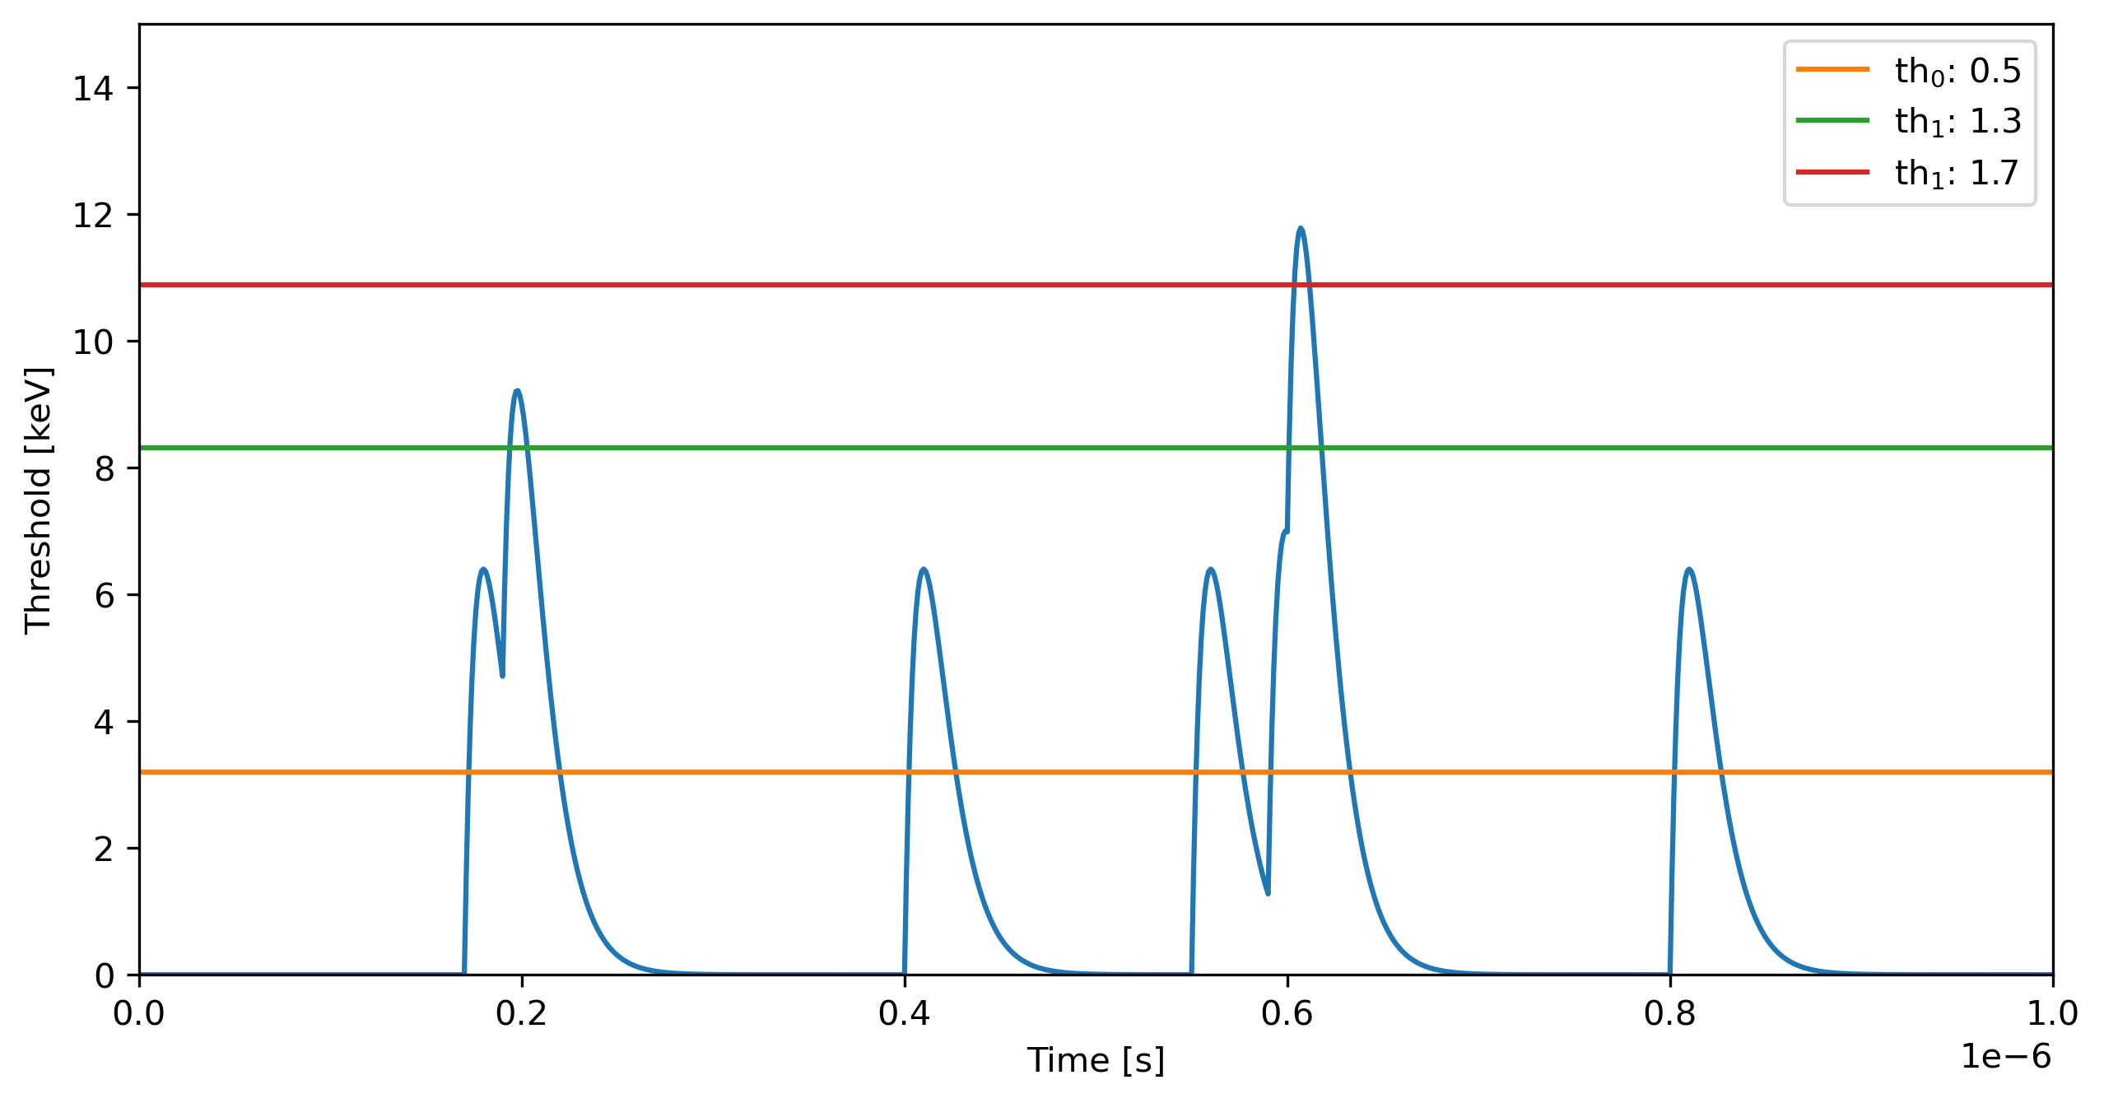
Pile-up counting with multiple thresholds
Th as fraction of photon energy
Paralyzable counter: $m=ne^{−τn}$
Probablility of two and three events pile-up:
$p_{2}=e^{−τn}(1−e^{−τn})$
$p_{3}=e^{−τn}$ ${(1−e^{−τn})}^{2}$
$m_{s}=m+$ $m_{2}+m_{3}$
Counter 2
170%
Counter 1
130%
100%
Counter 0
50%
[1] Glenn F. Knoll, Radiation Detector and Measurement 4th Edition, Wiley
[2] M. Andrae The MYTHEN III Detector System - A single photon counting microstrip detector for powder diffraction experiments ETHZ Doctoral Thesis
100%: Energy of the monochromatic incoming photons

Slide 11
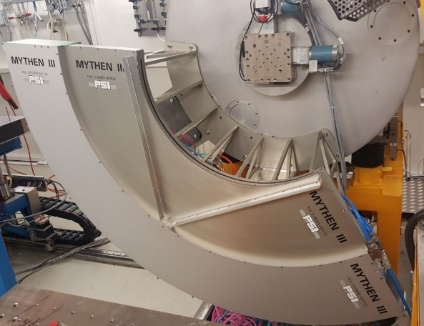
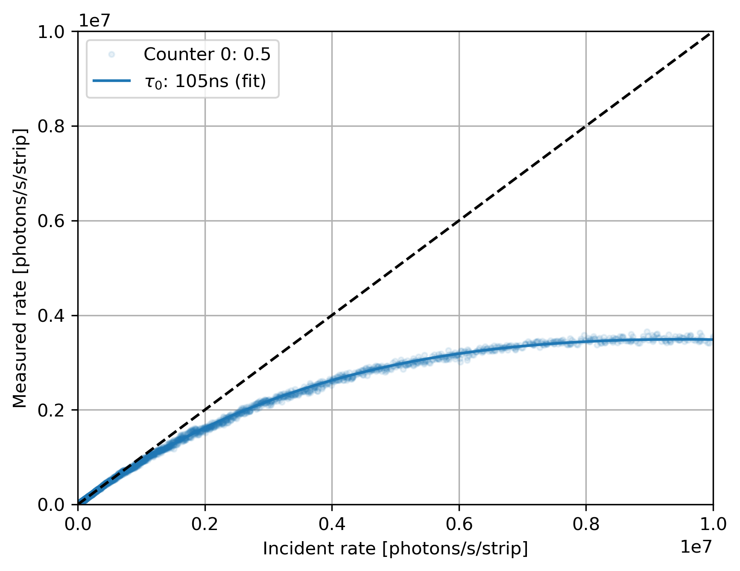
Multi-thresholding : proof of concept with Mythen3.02 (1D)
MS Beamline @ SLS
Settings: standard
Energy: 15 keV
90% efficiency at:
Single counter : 1.03Mcps
$m=ne^{−τn}$

Slide 12
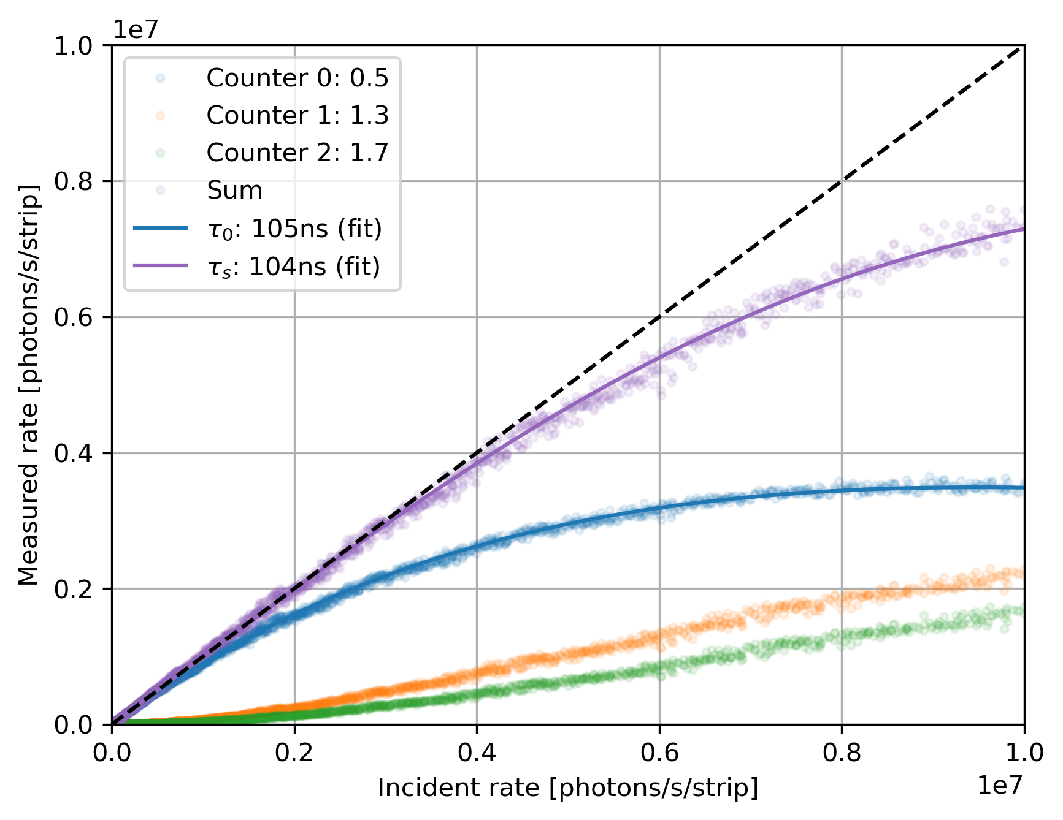
Multi-thresholding : proof of concept with Mythen3.02 (1D)
MS Beamline @ SLS
Settings: standard
Energy: 15 keV
90% efficiency at:
Single counter : 1.03Mcps
Three counters : 6 Mcps
Noise: 175e- RMS
$m_{s}=m+$ $m_{2}+m_{3}$
$m=ne^{−τn}$
$p_{3}=e^{−τn}$ ${(1−e^{−τn})}^{2}$
$$p_{2}=e^{−τn}(1−e^{−τn})$$

Slide 13
Multi-thresholding : proof of concept with Mythen3.02 (1D)
MS Beamline @ SLS
Settings: standard
Energy: 15 keV
90% efficiency at:
Single counter : 1.03Mcps
Three counters : 6 Mcps
Noise: 175e- RMS
x6
Settings: Fast [1]
Single counter 3.52 Mcps
Three counters 20.87 Mcps
Noise:~250e-
x6
[1] M Andrä The MYTHEN III Detector System - A single photon-counting microstrip detector for powder diffraction experiments ETHZ PhD Thesis 2021

Slide 14
Matterhorn – a new single photon counter for SLS2.0
 | EIGER | MATTERHORN
Technology | UMC 250 nm | UMC 110 nm
Pixel size | 75 x 75 um² | 75 x 75 um²
Thresholds | 1 | 4
Counter depth | 12 bit (3x4) | 4x16 bit
90% efficiency | 350k counts/pixel/s* | 15-20M counts/pixel/s
Module size | 4x8cm² | 4x8cm²
HighZ/LGAD | No | Yes
*DECTRIS EIGER2 90% efficiency at ~2 Mcps (UMC 110nm)
T. Donath et. al. EIGER2 hybrid-photon-counting X-ray detectors for advanced synchrotron diffraction experiments J. Synchrotron Rad. (2023). 30, 723-738

Slide 15
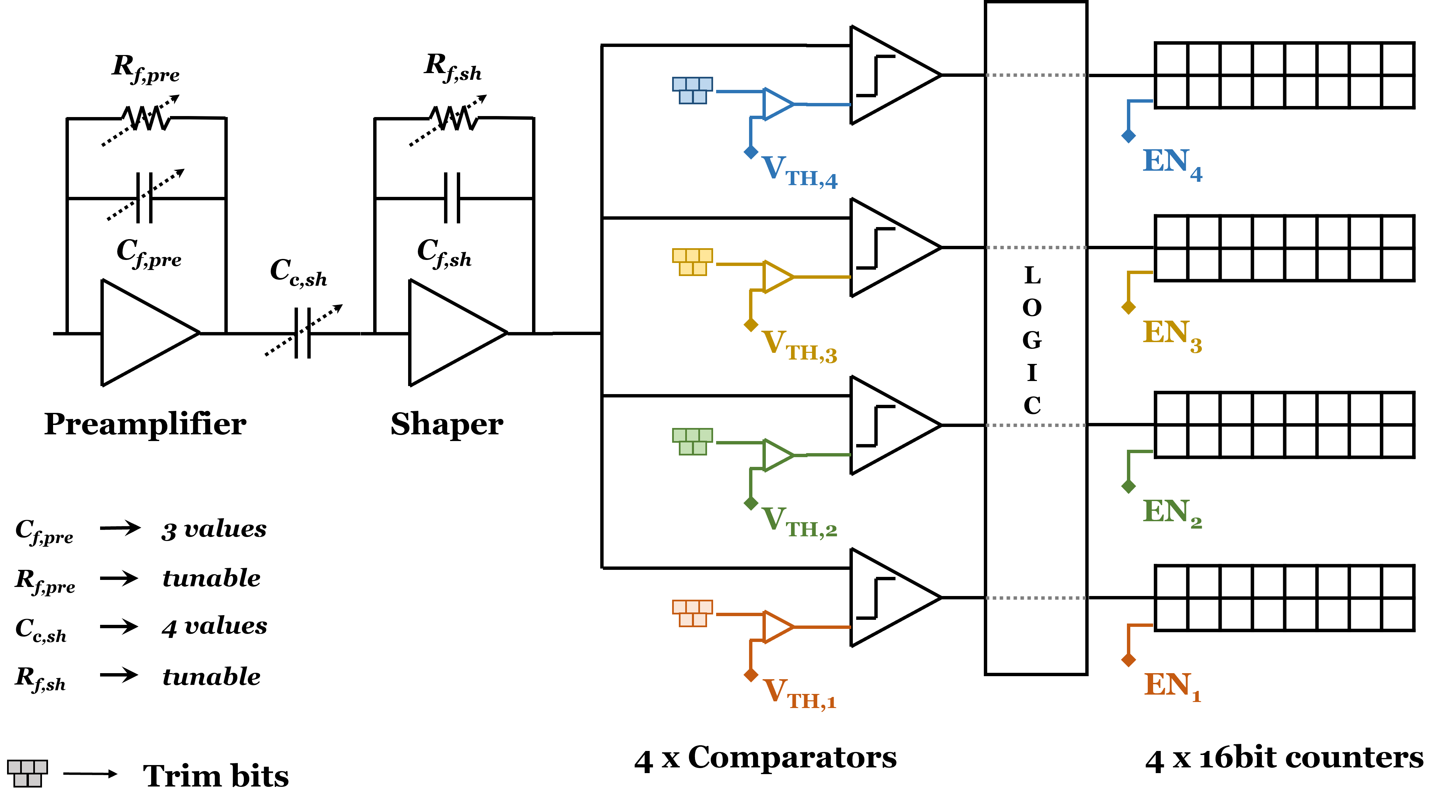
Matterhorn pixel architecture
1)
1)
(Vrf voltage)
Pixel
(Vrfsh voltage)
1)
¹⁾ Both e⁻ and h⁺ readout possible
Static power/pixel (4 comparators) | 9.6μW

Slide 16
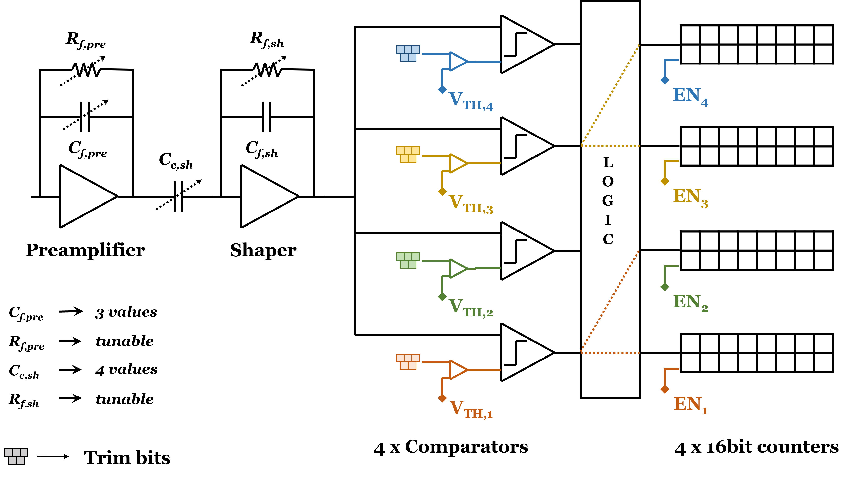
Matterhorn pixel architecture
2)
Pixel
²⁾ One comparator can be connected to two counters (pump-probe)

Slide 17
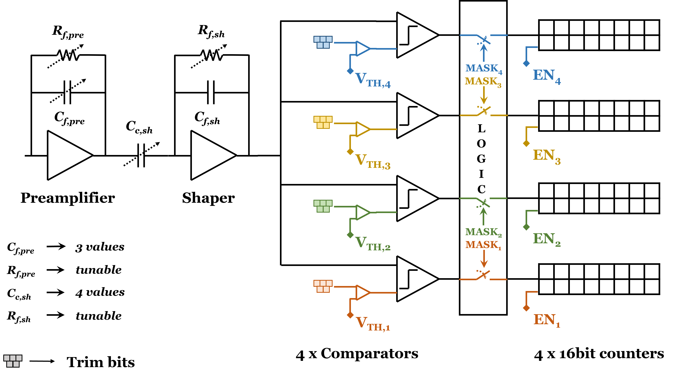
Matterhorn pixel architecture
3)
Pixel
³⁾ Each comparator can individually be ‘masked’ (disconnected from the counter)
→ reduce switching for noisy channels

Slide 18
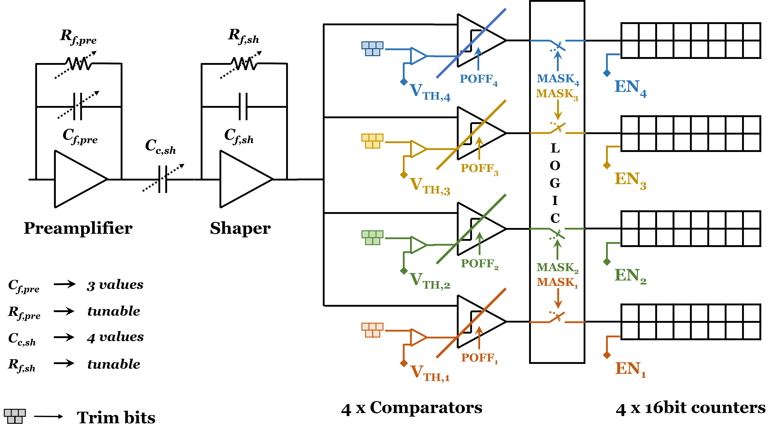
Matterhorn pixel architecture
Pixel
4)
⁴⁾ Each comparator can individually be powered-off when noisy or not used

Slide 19
Periphery blocks
PLL
Locking range: 930 MHz ÷ 2600 MHz
Power: 18 mW
Pixel & counter selector
CML driver
Main driver and pre-emphasis current tunable (3 bits): 3 mA ÷ 15 mA
Pre-emphasis delay tunable (2 bits)
Pixel/counter addressing logic
Pixel/counter readout logic (includes 16 or 8 bit mode)
8b/10b encoding
High speed serializers
All periphery logic synthesized with digital tools for the first time!

Slide 20
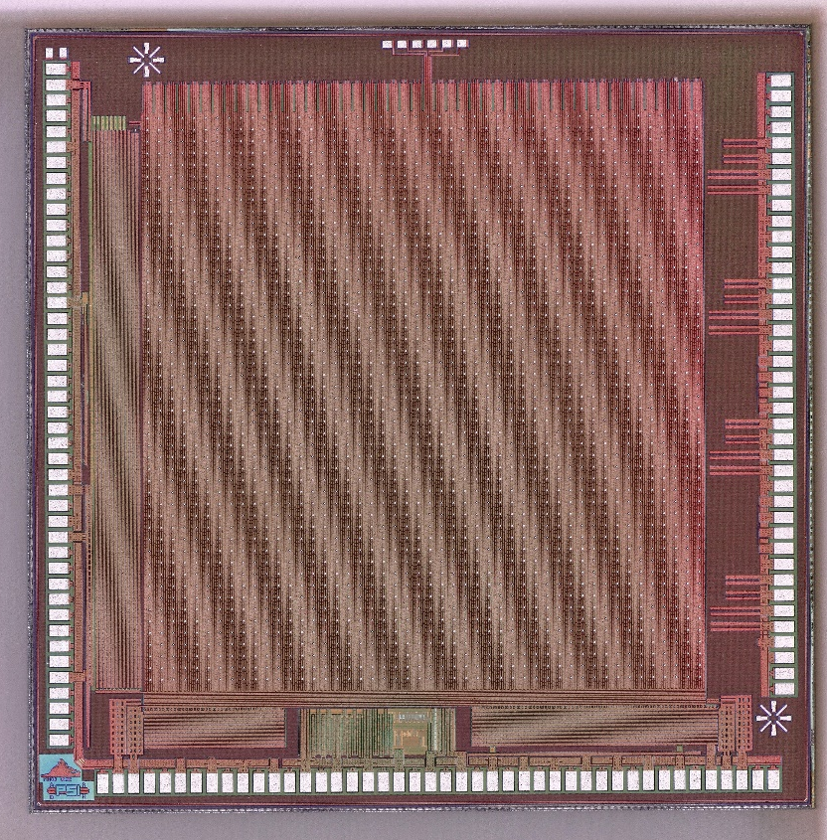
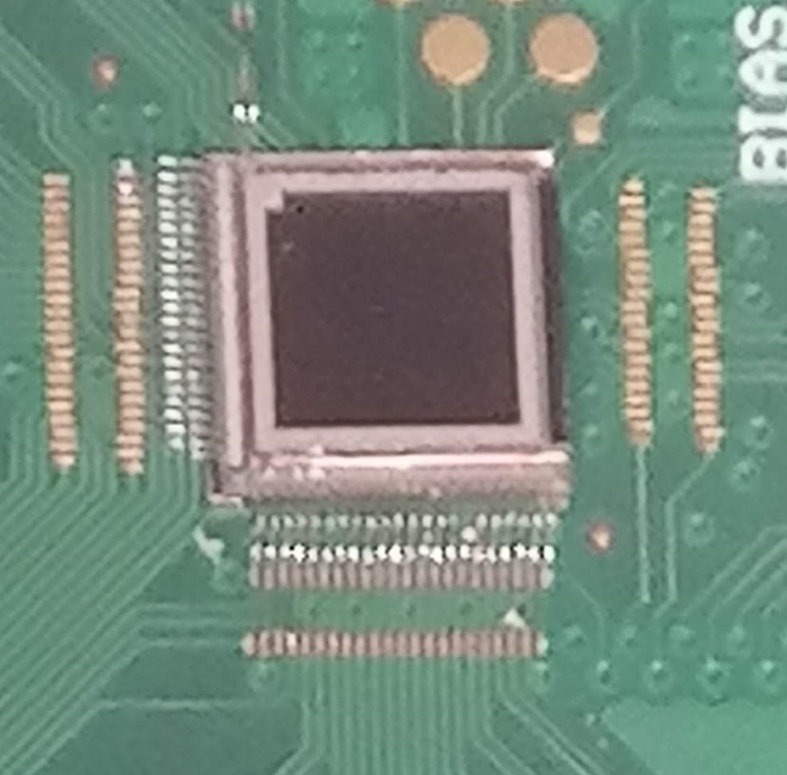
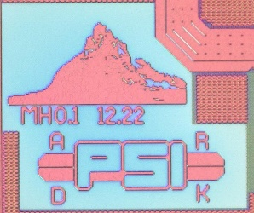
Matterhorn 0.1, 12.2022
Matterhorn prototypes
Matterhorn 0.2,10.2023
ASICs: ~5x5 mm² (3.6x3.6 active=48x48=2304 pixels)
MPW chips bump-bonded to sensor
2 Pre/shaper variations
2 Comparator variations
2x 1.6 GHz serializers
1.6 GHz CML driver (with pre-emphasis)
One pixel version only
2x 3.125 GHz serializers
3.125 GHz CML driver
Internal DACs for biasing
Some “features” fixed

Slide 21
Matterhorn 0.1, 12.2022
Matterhorn prototypes
Matterhorn 0.2,10.2023
ASICs: ~5x5 mm² (3.6x3.6 active=48x48=2304 pixels)
MPW chips bump-bonded to sensor
PLL working
Jitter < 5 ps
(limited by measurement setup)
HS logic/data transmission working
BER< 10⁻¹⁵
(limited by measurement time)
DACs working
8 bits
2 Pre/shaper variations
2 Comparator variations
2x 1.6 GHz serializers
1.6 GHz CML driver (with pre-emphasis)
One pixel version only
2x 3.125 GHz serializers
3.125 GHz CML driver
Internal DACs for biasing
Some “features” fixed

Slide 22
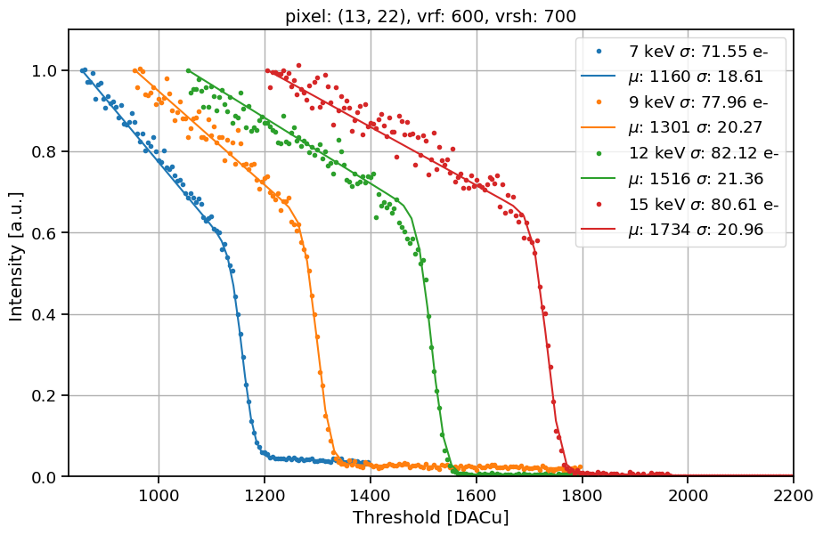
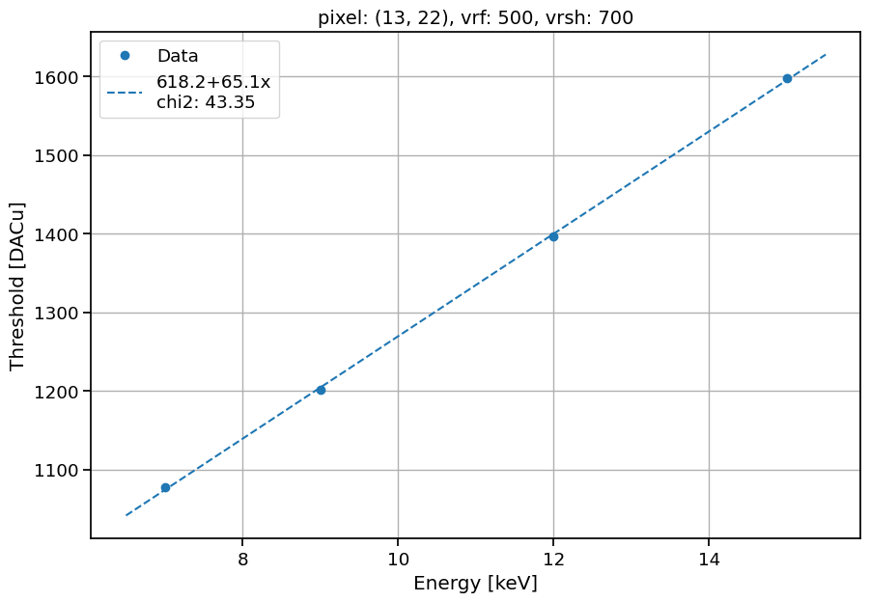
Basic characterization of MH02
Metrologie beamline at SOLEIL with help from: Marie Andrä and Arkadiusz Dawiec
Calibration at: 7, 9, 12, 15 keV
Threshold scans fitted with analytical model:
$f\left(x\right)=\left(p_{0}+p_{1}x\right)+0.5\left(1+Erf\left(\frac{x−μ}{\sqrt{2}∙σ}\right)\right)\left(A+C\left(x−μ\right)\right)$
Single pixel data

Slide 23
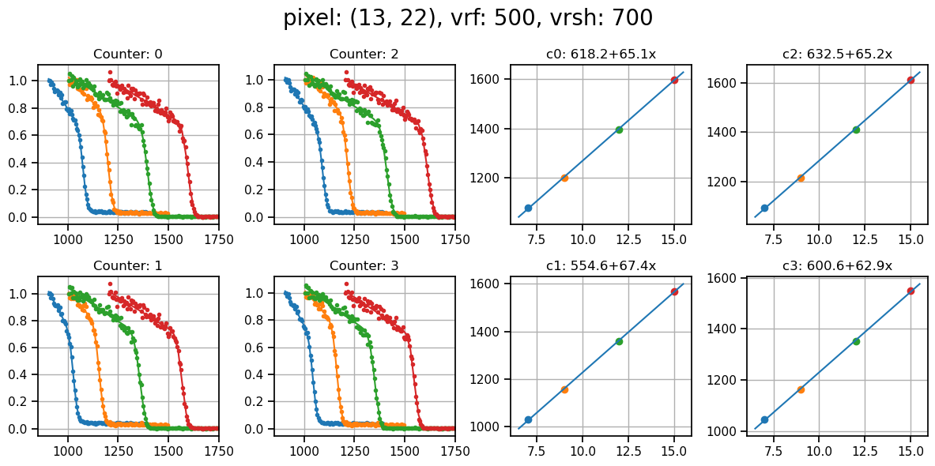
Four counters scan
Scanned at the same time

Slide 24
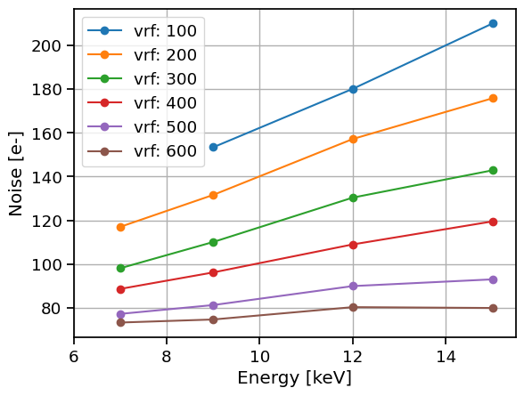
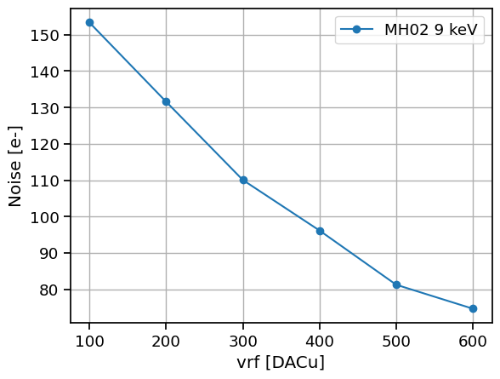
Noise performance of MH02
Preamplifier feedback voltage
(gain)
fast - slow

Slide 25
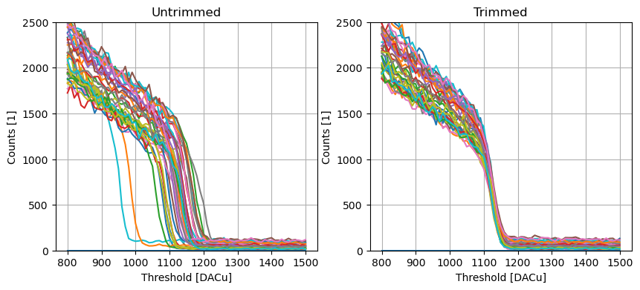
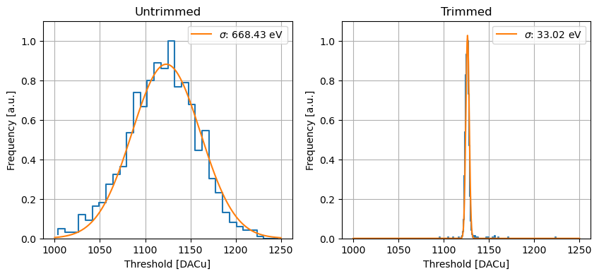
Threshold dispersion at 9 keV
vrf | Untrimmed [eV] | Trimmed [eV]
200 | 998 | 59
300 | 905 | 43
400 | 668 | 33
500 | 477 | 29
:16 to 20
8e-
Small chip (48x48 pixels)
Non optimized trimming procedure

Slide 26
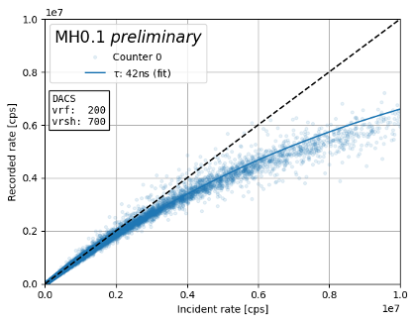
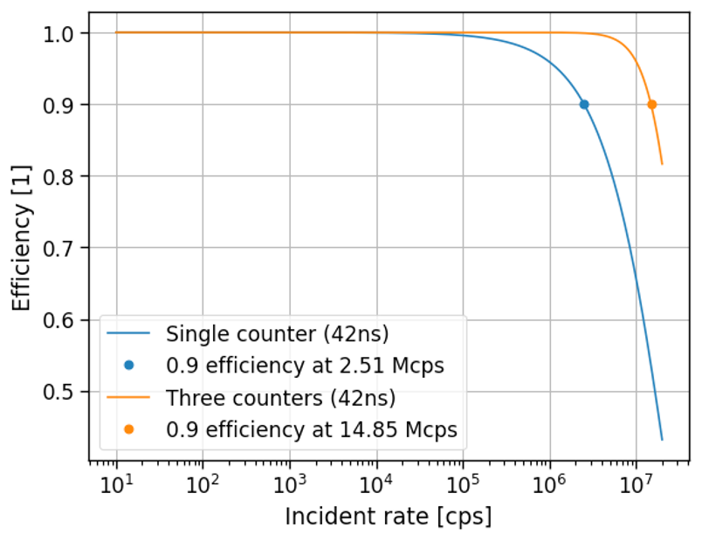
Single counter rate tests at MS beamline - MH01
Measurement
Predicted rate capability using analytical model

Slide 27
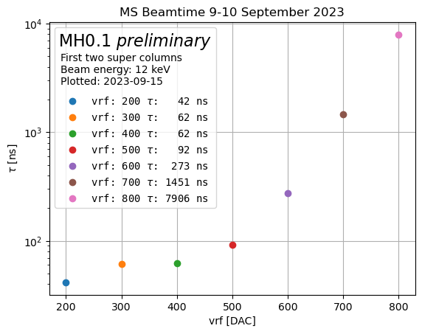
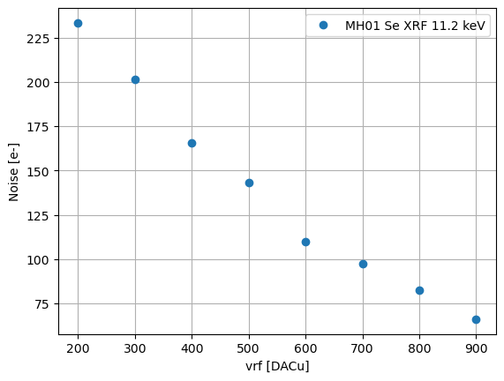
Single counter rate tests at MS beamline – MH01
Note: slightly over estimated due to kB peak

Slide 28
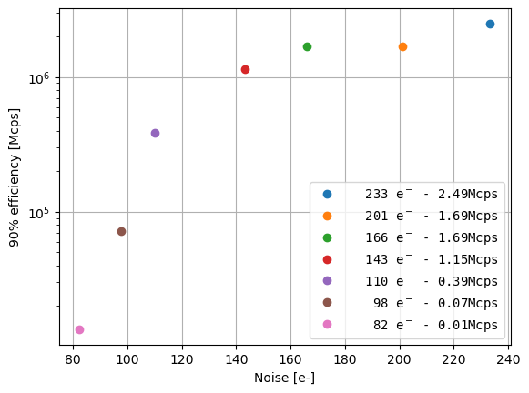
Single counter rate tests at MS beamline – MH01
Noise vs. rate capability

Slide 29
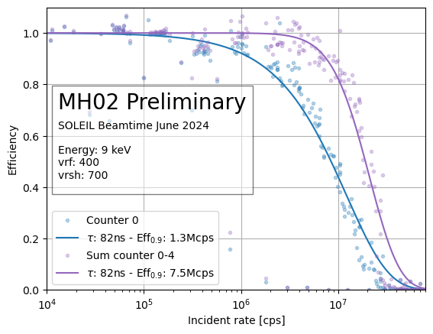
Multi threshold rate tests at SOLEIL with MH02
Counter 0
x6
Sum counter 0-3

Slide 30
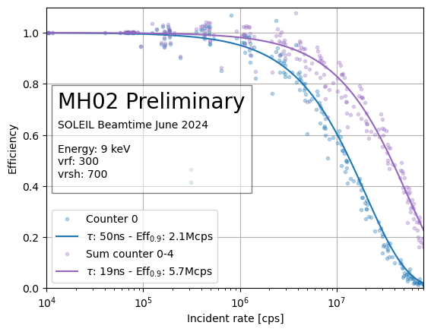
Multi threshold rate tests at SOLEIL with MH02
Counter 0
x6
Counter 0
x3
Sum counter 0-3
Sum counter 0-3
Note: fitted with simple paralyzable function

Slide 31
Multi threshold rate tests at SOLEIL with MH02
Counter 0
x6
Counter 0
x3
Sum counter 0-3
Sum counter 0-3
Comparator biased in “low power” mode
Vrf can be set even lower (100-150)
Preamp/shaper biases can be further tuned

Slide 32
The “speed challenge”: high frame rate
 | EIGER | MATTERHORN 1
Technology | 250 nm | 110 nm
Chip outputs | 32xCMOS, 200 Mb/s | 4xCML, 3.125 Gb/s
Single chip | 6.4 Gb/s | 12.5 Gb/s
Module (8 chips) | 51.2 Gb/s | 100 Gb/s
Readout channels/module | 2x10Gbit/s | 1x100Gbit/s
Frame rate | ~10 kHz 8bit (burst) | ~20 kHz 8bit (continuous)
Continuous R/W | Yes | Yes

Slide 33
Timeline
SLS2.0
Second prototype (MPW) Submitted
Single module detectors?
Matterhorn
Full ASIC submission
Multi module
detectors
First prototype submitted (MPW)
First prototype back!
Planned submission
of third prototype
Second prototype back!

Slide 34
Timeline
SLS2.0
Second prototype (MPW) Submitted
Single module detectors?
Full ASIC submission
Matterhorn
Multi module
detectors
First prototype submitted (MPW)
First prototype back!
Planned submission
of third prototype
Second prototype back!

Slide 35
Matterhorn 1, the full-size chip
MH 1.0
~2 cm
Same pixel as Matterhorn 0.2
MH0.2
 | MATTERHORN 1
Technology | 110 nm
Chip active area | 1.92x1.92 cm² 256x256 pixels
Pixel size | 75 x 75 um²
Thresholds | 4
Counter depth | 4x16 bit
Trim bits/compar. | 6
Static power/pixel (4 comparators) | 9.6μW
HighZ/LGAD | Yes
New features
Pixel data transfer:
Current mode signal distribution (to pixel periphery)
New periphery, additional features:
Global signals distribution (RES,STO,EN<0:3>)
Counter summing mode
4 bit mode
64b/66b encoder for serializers
SPI interface for configuration/slow control
Gating (4 independent EN) <20ns
No active circuitry on the chip sides (less dead area)

Slide 36
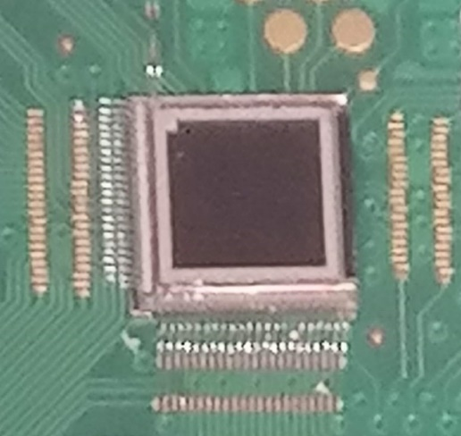
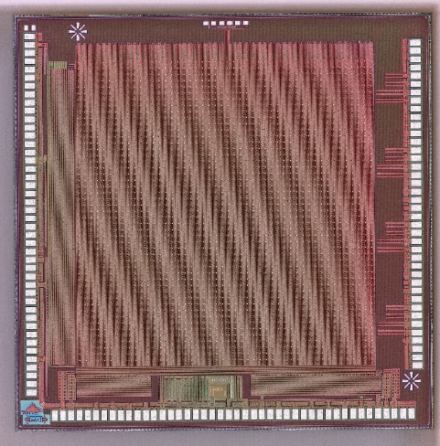
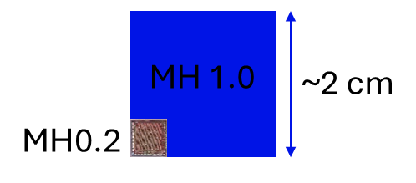
Conclusion and outlook
Matterhorn is a new SPC detector for SLS2.0 targeting:
20Mcps count rate with 10% loss of efficiency
250 eV – 80 keV energy range (with LGADs and HighZ)
20kHz frame rate; <20 ns gating
Results from MH01 and MH02:
Noise down to <~80e- in slow settings
Demonstrated ~7.5 Mcps at 90% efficiency using multiple thresholds
Tau of 42ns in single counter mode indicates 15Mcps should be possible with pileup counting
Tuning ASIC parameters
Submission of full ASIC spring 2025…

Slide 37
THANKS!
Left to right: Jiaguo Zhang, Bechir Braham, Konstantinos Moustakas, Viktoria Hinger, Christian Ruder, Shqipe Hasanaj, Dominic Greiffenberg, Julian Heymes, Anna Bergamaschi, Khalil Ferajoui, Carlos Lopez-Cuenca, Xiangyu Xie, Pawel Kozłowski, Martin Brückner, Roberto Dinapoli, Kirsty A. Paton, Filippo Baruffaldi, Mar Carulla, Bernd Schmitt, Thomas King, Patrick Sieberer
Not in the picture: Simon Ebner, Erik Fröjdh, Davide Mezza, Aldo Mozzanica, Dhanya Thattil, Viveka Gautam, Vadym Kedych, Shuqui Li, Martin Mueller, Saverio Silletta

Slide 38
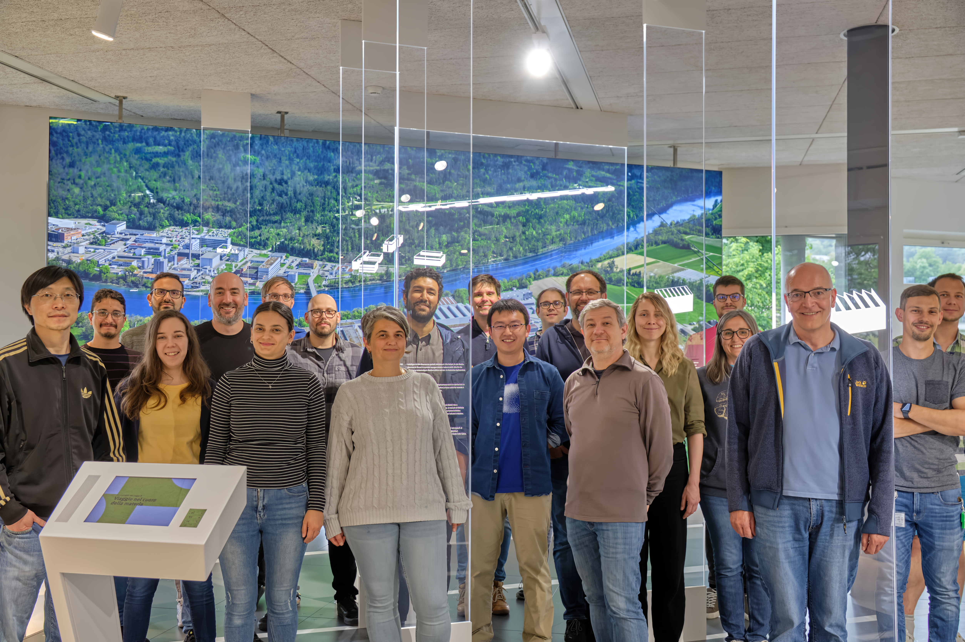
THANKS!
Left to right: Jiaguo Zhang, Bechir Braham, Konstantinos Moustakas, Viktoria Hinger, Christian Ruder, Shqipe Hasanaj, Dominic Greiffenberg, Julian Heymes, Anna Bergamaschi, Khalil Ferajoui, Carlos Lopez-Cuenca, Xiangyu Xie, Pawel Kozłowski, Martin Brückner, Roberto Dinapoli, Kirsty A. Paton, Filippo Baruffaldi, Mar Carulla, Bernd Schmitt, Thomas King, Patrick Sieberer
Not in the picture: Simon Ebner, Erik Fröjdh, Davide Mezza, Aldo Mozzanica, Dhanya Thattil, Viveka Gautam, Vadym Kedych, Shuqui Li, Martin Mueller, Saverio Silletta

Slide 39
Backup slides

Slide 40
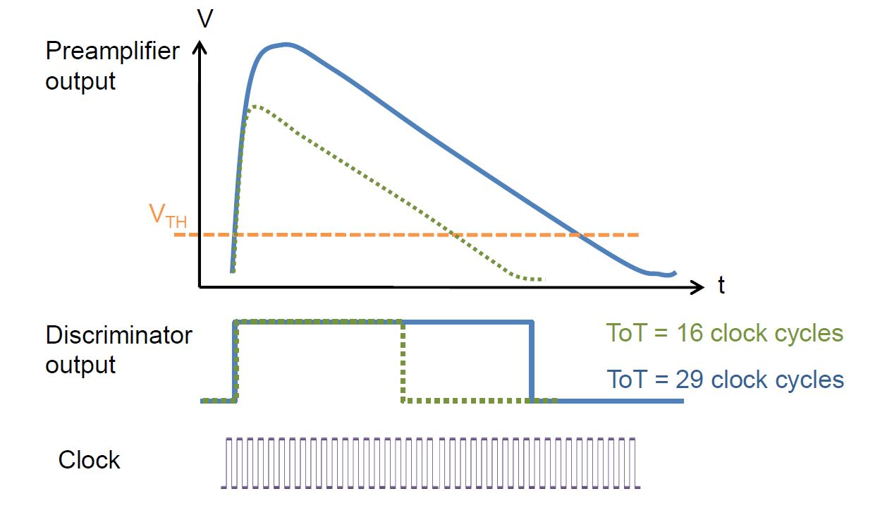
Pile-up mitigation techniques
Use charge integration with dynamic gain switching (Jungfrau, Jungfrau 2)
Time over threshold/retriggering
Credit: R. Ballabriga

Slide 41
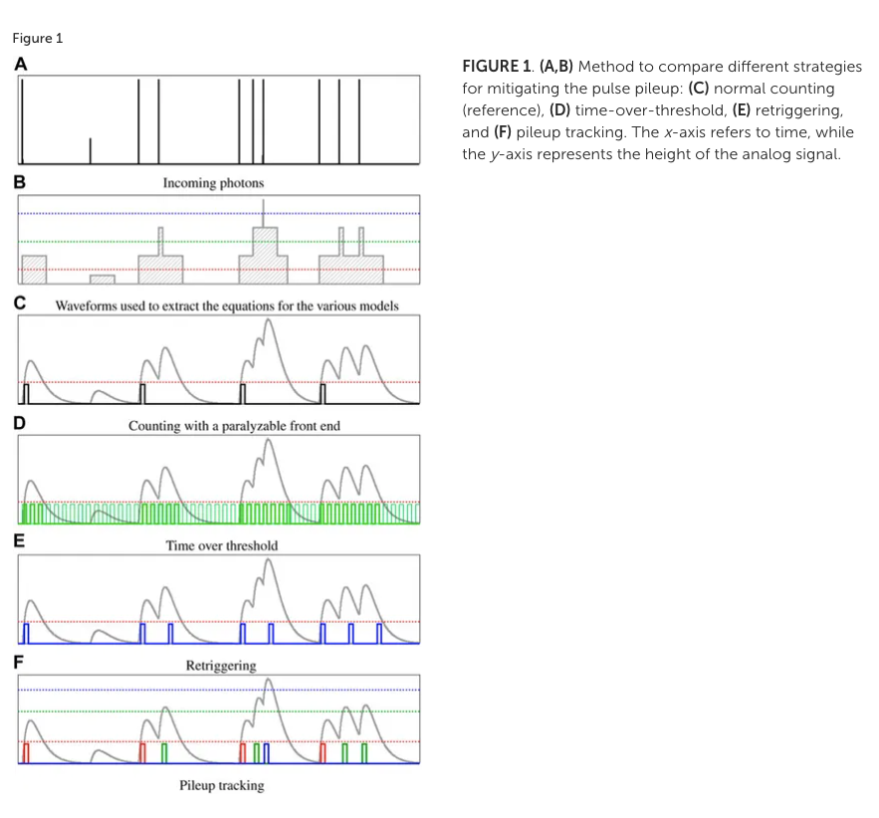
Operating modes of a single photon “counter”

Slide 42
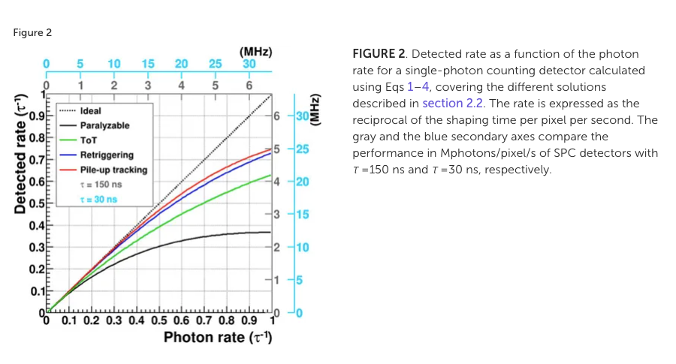
Comparison of pileup mitigation
[1] A. Bergamaschi et. al. Time-over-threshold readout to enhance the high flux capabilities of single-photon-counting detectors J. Synchrotron Rad. 18, 923-929. 2011
[2] P. Zambon, Dead time model for X-ray photon counting detectors with retrigger capability, NIMA 2021

Slide 43
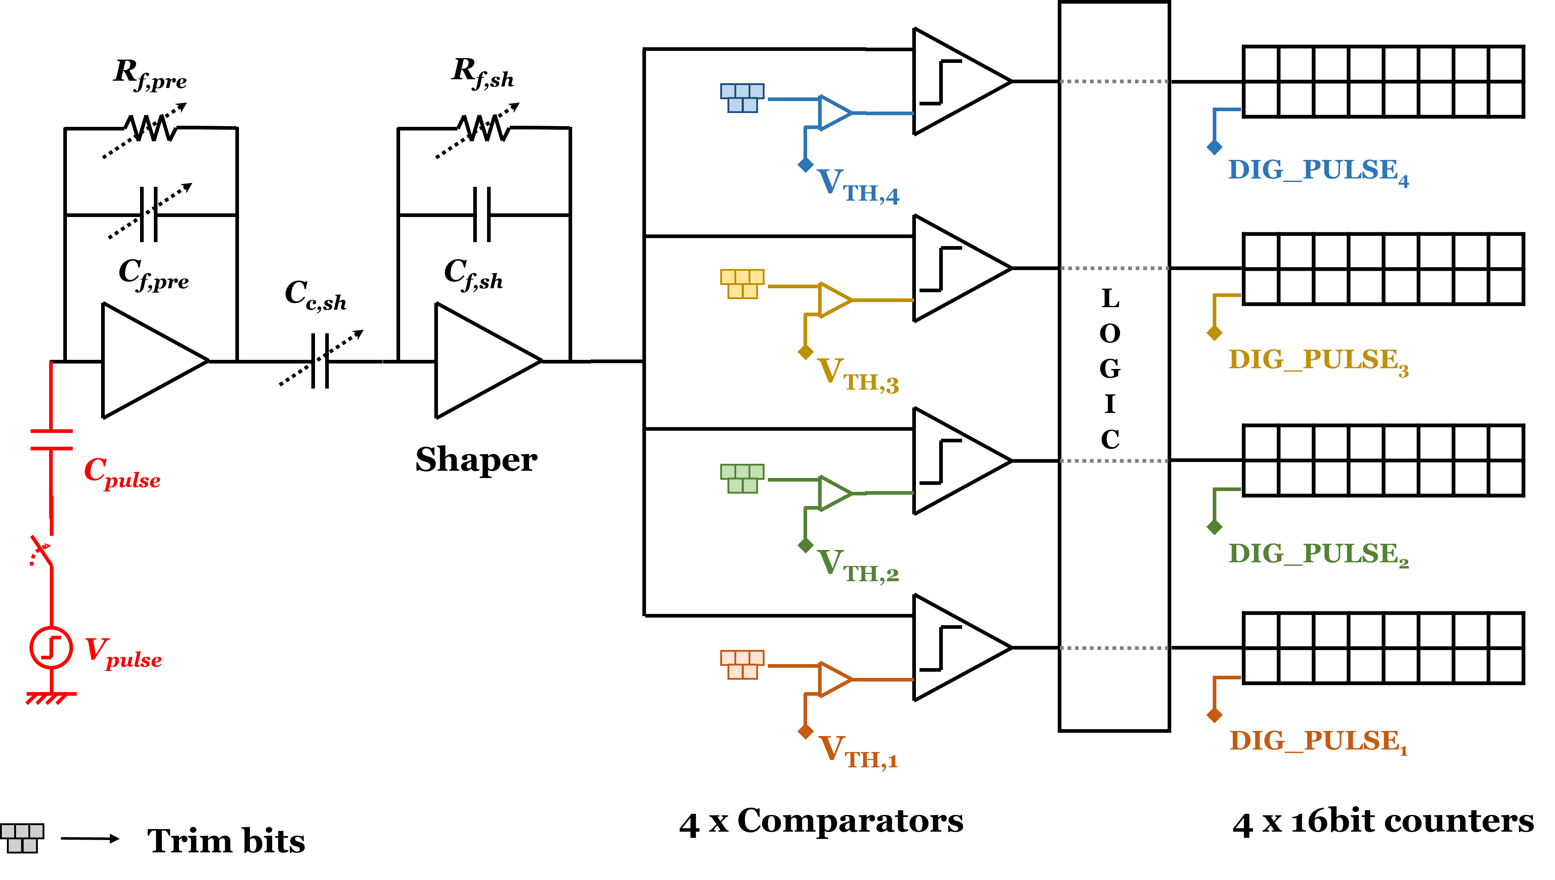
Pixel testability
Pre
Count2
Shaper
Comp2
6)
6)
6)
5)
Pixel
6)
⁵⁾ The preamp can be pulsed with a programmable voltage step
Preamp and shaper outputs of pixel 0,0 can be monitored
⁶⁾ Each counter can individually be pulsed
Comparator and “count” outputs of pixel 0,47 can be monitored

Slide 44
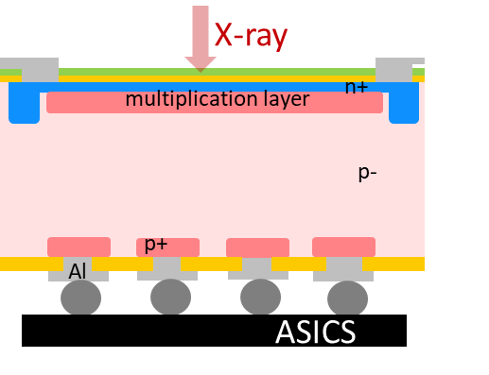
The «energy challenge»: low photon energies
Soft X-ray applications at SwissFEL and SLS (250 eV – 2 keV)
Low quantum efficiency (QE):
Development of “thin entrance window” sensor
Low signal-to-noise ratio (SNR):
Increase the signal with inverse Low Gain Avalanche Diodes (iLGADs) with a multiplication factor 5-20
Results: 80 % QE for a planar pin diode @250eV
Results: nominal noise of 35 e⁻ with standard sensor at RT down to 3.7 e⁻ at -22 ºC with Moench

Slide 45
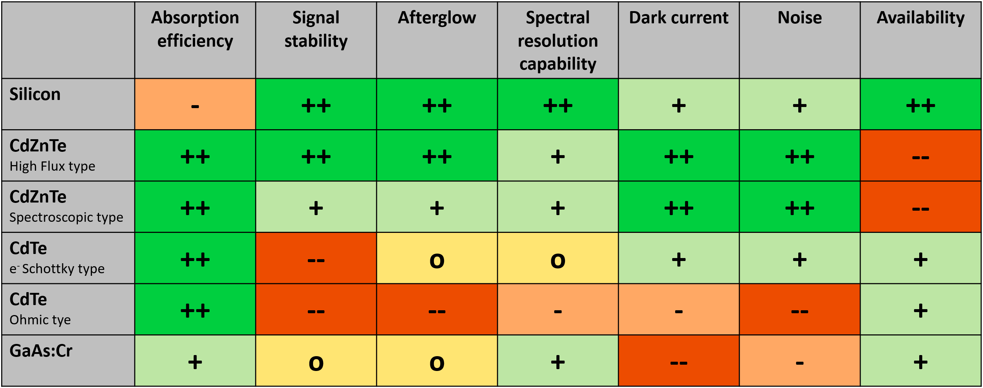
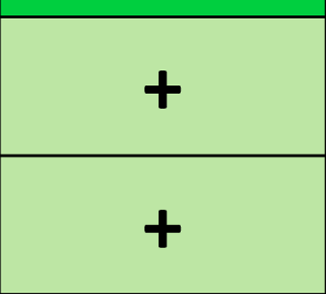
The «energy challenge»: high photon energies
Hard x-ray applications at Synchrotrons, 15-80keV
CdZnTe is the material of choice above 15 keV
4×4 cm² sensor commercially available
Dynamic behavior (signal stability, afterglow) close to silicon sensors
Higher photon energies need to be studied
Crystal defects influence sensor uniformity
Fluorescence photons with long absorption range
GaAs:Cr is promising, but doesn‘t perform as well as CdZnTe
Two European suppliers, 8×4 cm² sensors available
○ Afterglow acceptable up to photon fluxes
 Continuous: <10⁽⁸⁻⁹⁾ ph/mm²·s  Pulsed: <10⁽⁶⁻⁷⁾ ph/mm² ·pulse
Some signal loss at photon fluxes above > 3×10¹⁰ ph/mm²·s
Crystal defects influence sensor uniformity, variation of effective pixel size + Short hole lifetime  Craters
High dark current  For long exposure times: ideally SPC

Slide 46
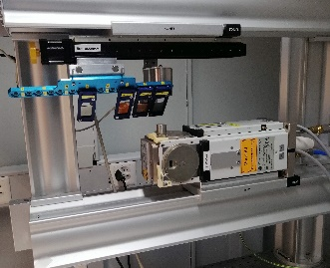
Timeline
Move to new building
SLS2.0
Second prototype (MPW) Submitted
Single module detectors?
Matterhorn
Full ASIC submission
Multi module
detectors
First prototype submitted (MPW)
First prototype back!
Planned submission
of third prototype
Second prototype back!

Slide 47
