Slide 1
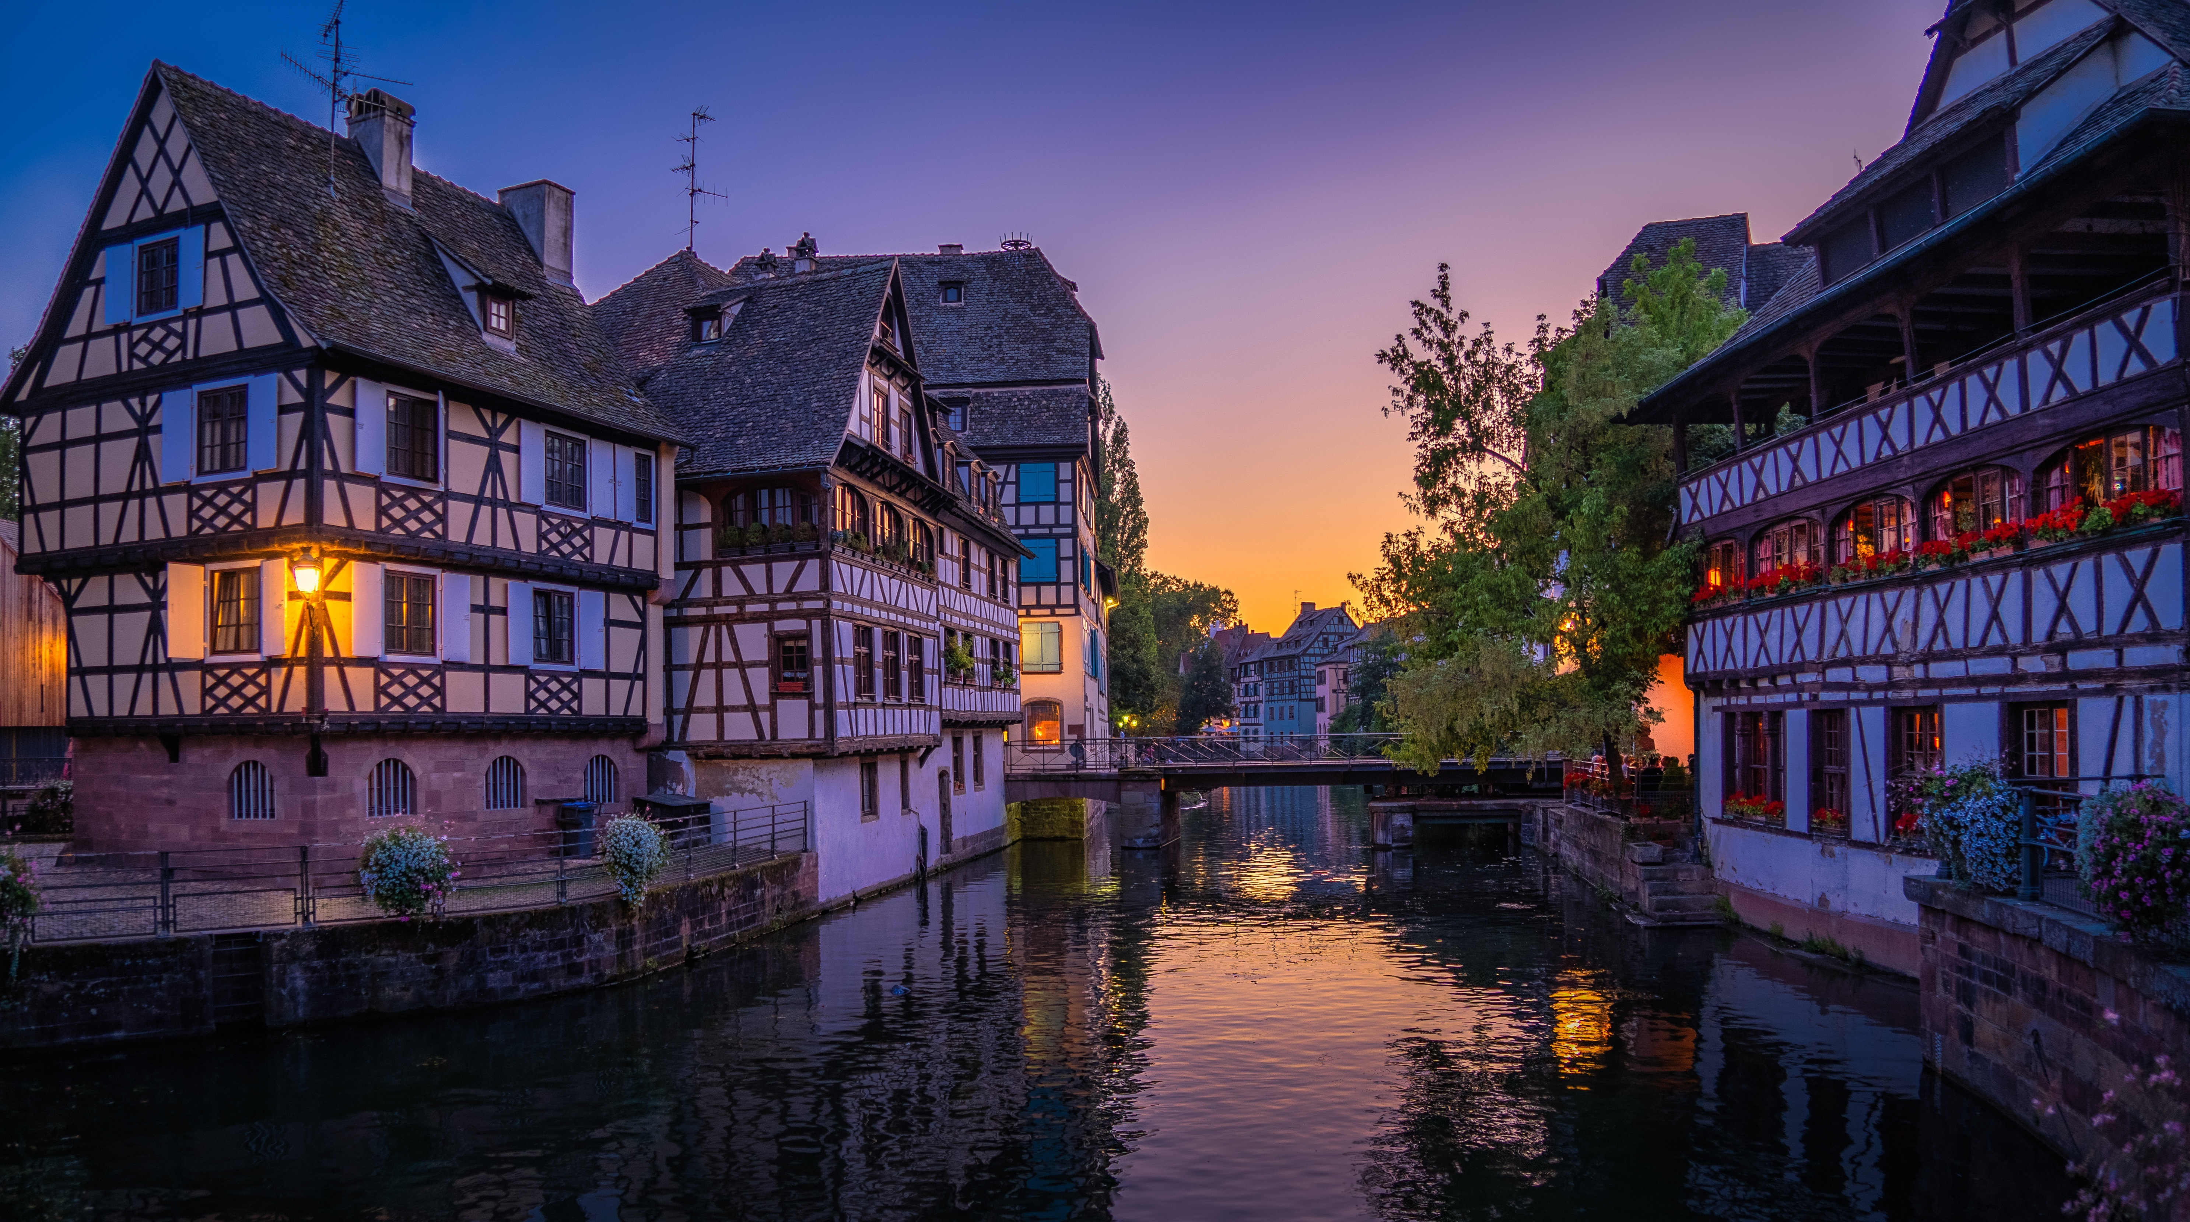






Design and optimisation of radiation resistant AC- and DC-coupled resistive LGADs
A. Fondacci, T. Croci, D. Passeri, R. Arcidiacono, N. Cartiglia, M. Boscardin, M. Centis Vignali, G. Paternoster, O. Hammad Ali, L. Lanteri, L. Menzio, F. Siviero, M. Ferrero, V. Sola, A. Morozzi, F. Moscatelli

Slide 2




An impossible challenge?
Spatial resolution $\sim 5 µm$
Temporal resolution $\sim 10 ps$
Is there a way to fulfil the four specifications simultaneously?
$\sim 50k$ pixels/cm²
Each pixel requires a lot of power
The signal in thin sensors is very small
Bulky cooling infrastructure
Plenty of power
Very low material budget
Very low power consumption
alessandro.fondacci@pg.infn.it

Slide 3
An intriguing candidate for future colliders
alessandro.fondacci@pg.infn.it

Slide 4
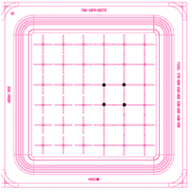
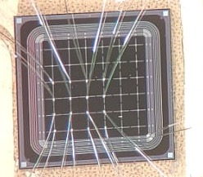
FBK RSD2 performance summary
Layout
$\sim 50k$ pixels/cm²
Device made and bonded
alessandro.fondacci@pg.infn.it

Slide 5
RSD LGAD: AC or DC coupled electrodes?
$\sim 50k$ pixels/cm²
alessandro.fondacci@pg.infn.it

Slide 6
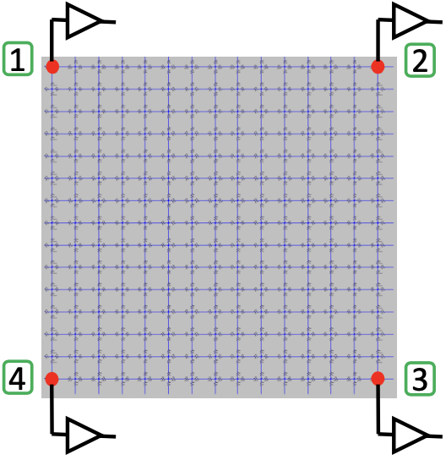
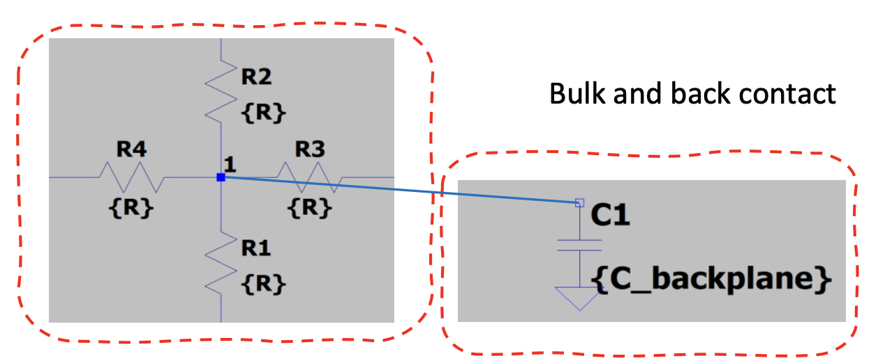
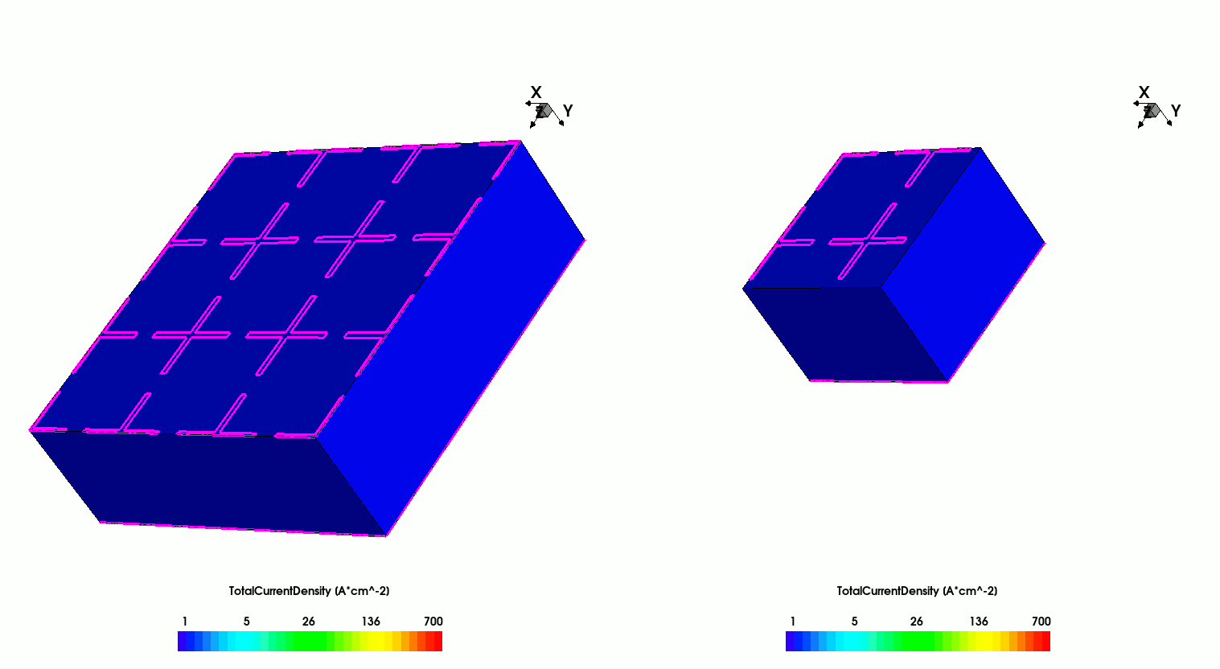
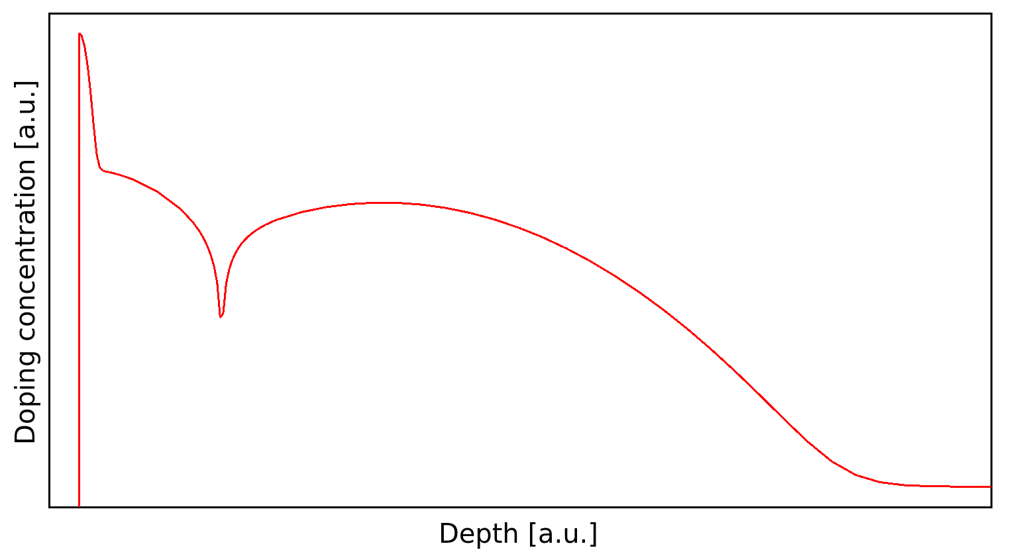
Simulation approach (SPICE & TCAD)
$\sim 50k$ pixels/cm²
SPICE: Quick estimation of the optimal sheet resistance (2 kΩ/sq)
2 kΩ/sq
Full 3D TCAD: Evaluation of various geometrical layouts (pad and pixel shapes and dimensions) and technological options (resistive strips and silicon oxide trenches) on signal-sharing properties.
alessandro.fondacci@pg.infn.it

Slide 7
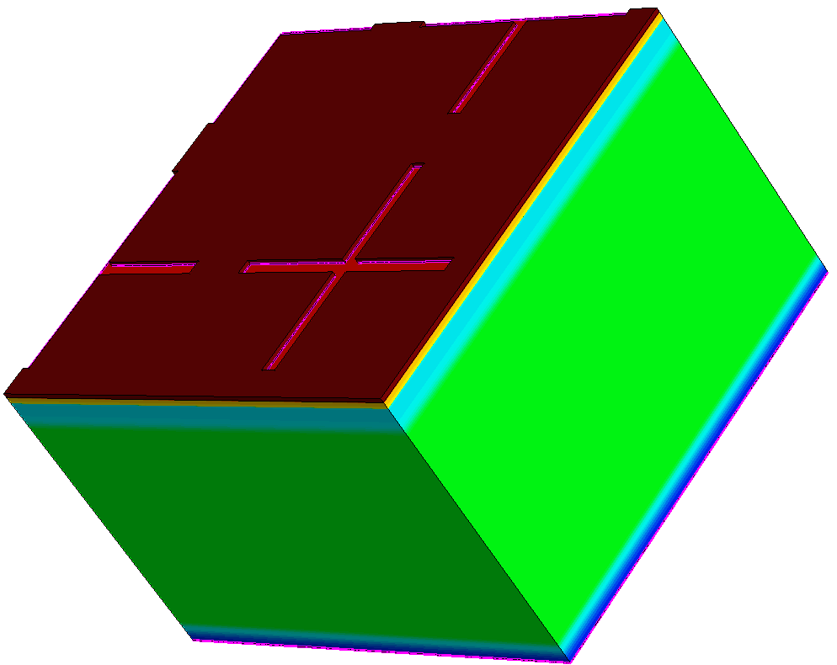

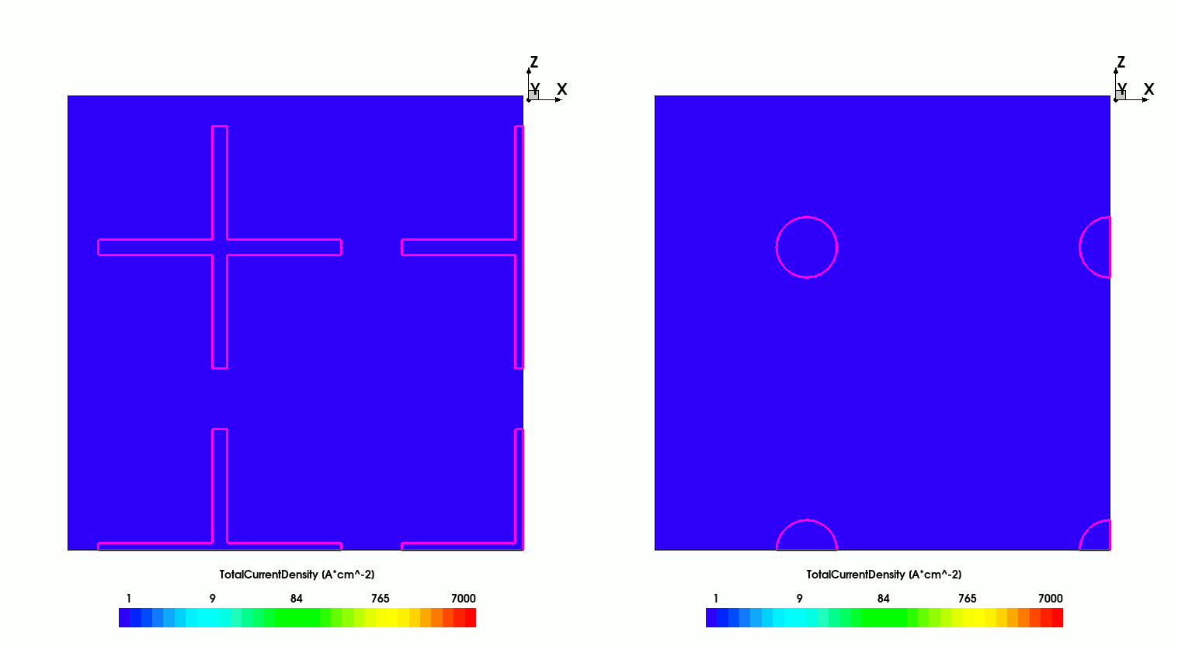
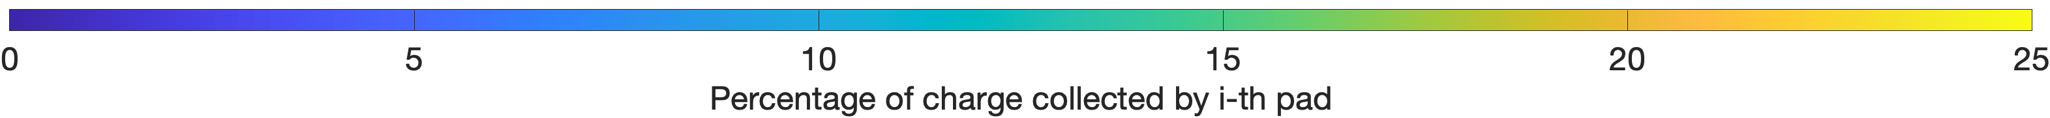
Playing with pad shape
MIP
MIP
MIP
MIP
Thickness = 20 µm;
Pitch = 20 µm;
Cross length = 16 µm ;
Cross width = 1 µm.
Thickness = 20 µm;
Pitch = 20 µm;
Pad radius = 2 µm.
alessandro.fondacci@pg.infn.it

Slide 8
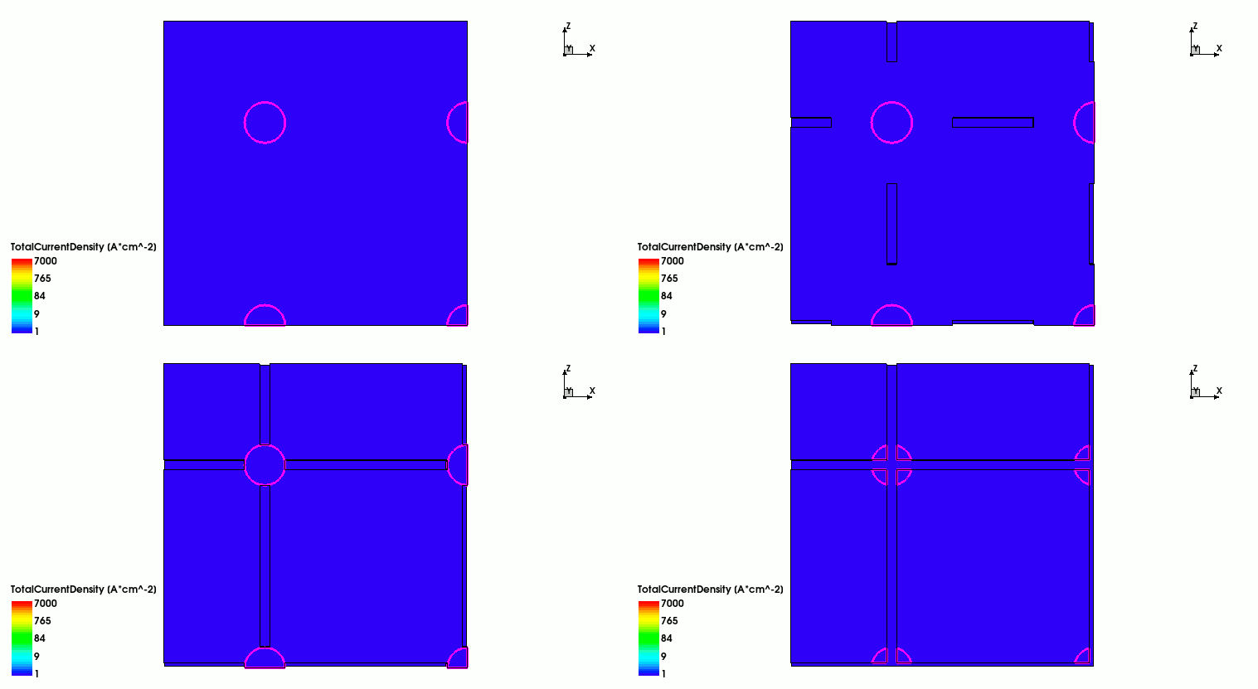
Silicon oxide trenches
MIP
MIP
MIP
MIP
alessandro.fondacci@pg.infn.it

Slide 9
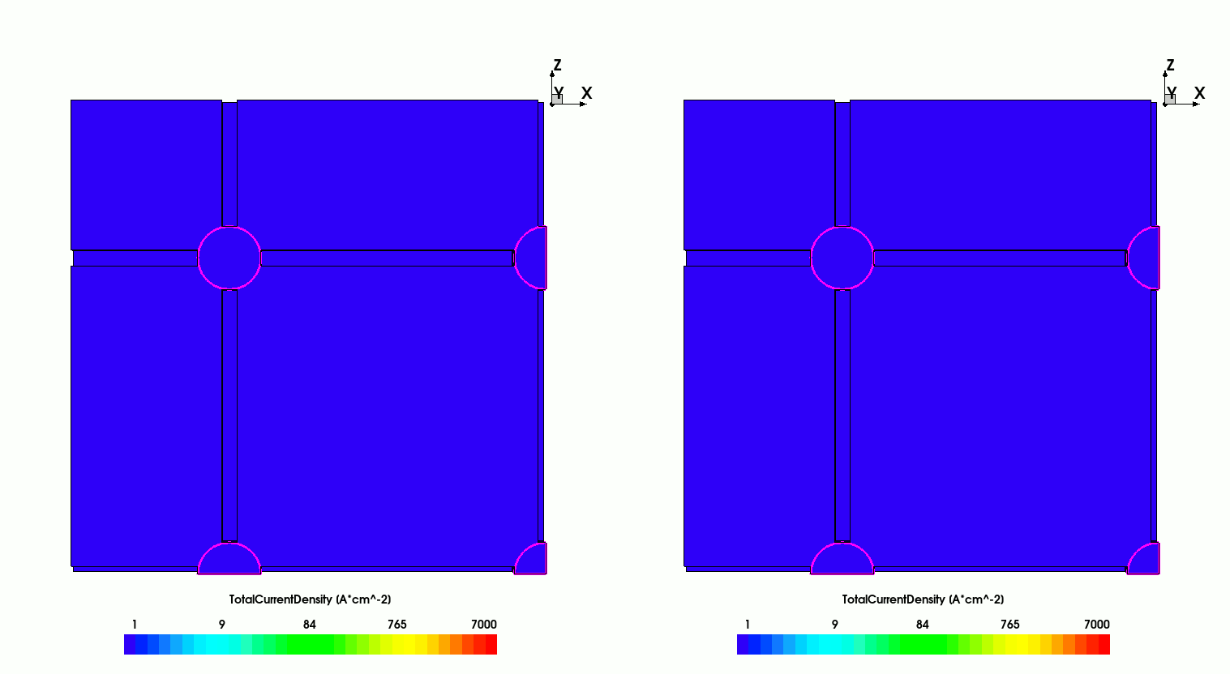
Watch out for contact resistance
MIP
MIP
alessandro.fondacci@pg.infn.it

Slide 10
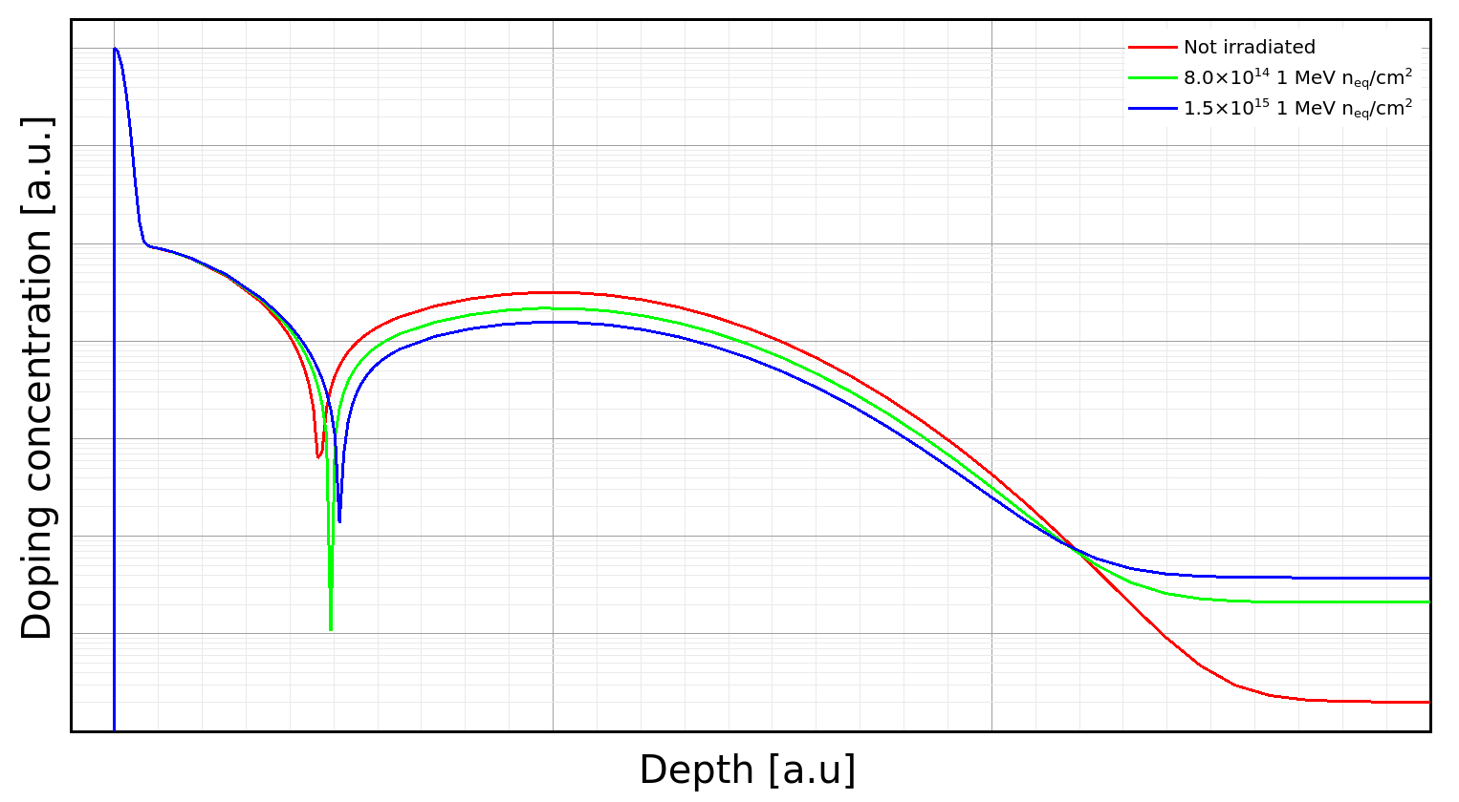
Radiation damage modelling @ PG
$\sim 50k$ pixels/cm²
alessandro.fondacci@pg.infn.it

Slide 11
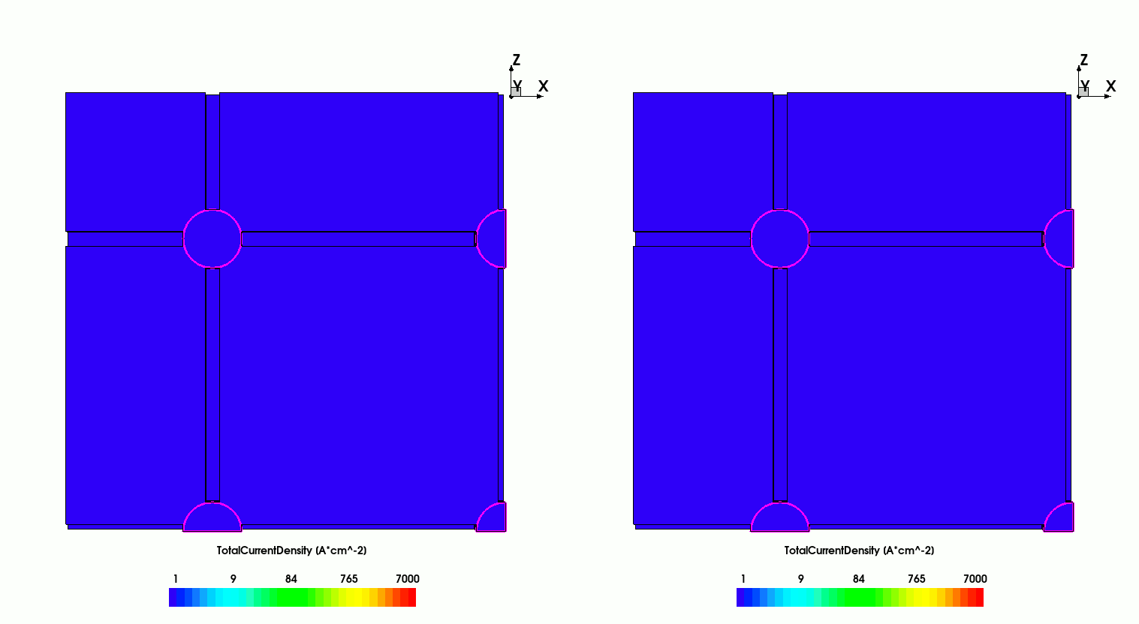
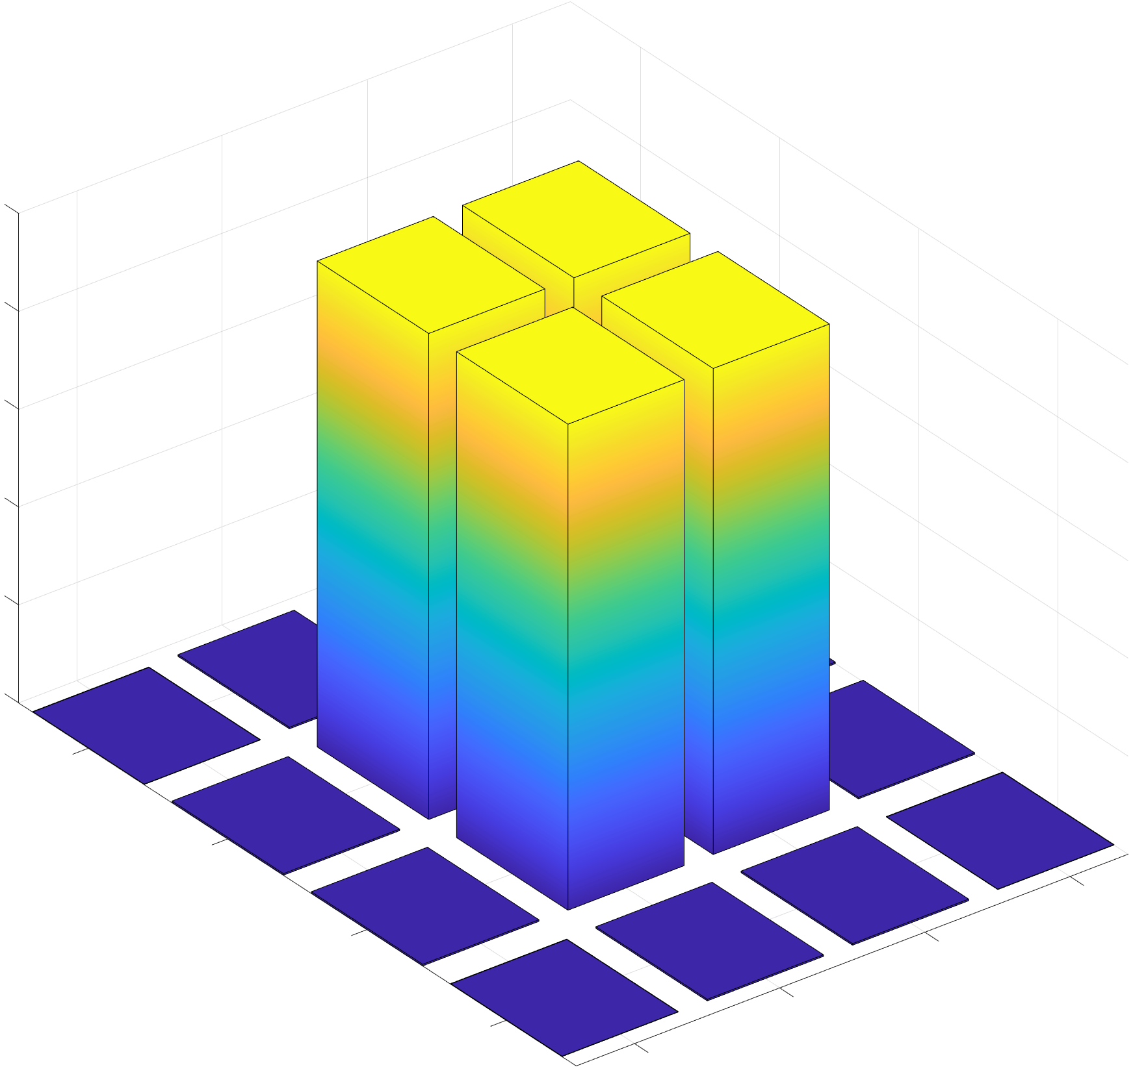

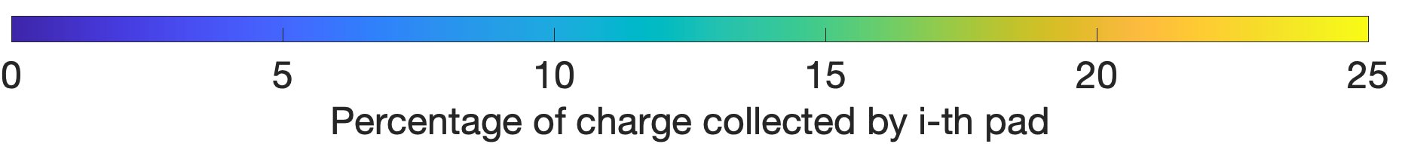
After irradiation performances
1.5×10¹⁵ 1 MeV n_{eq}/cm²
As the fluence increases, the total collected charge decreases due to charge trapping.
However, the total collected charge is always divided in the same way by the resistive plane.
8.0×10¹⁴ 1 MeV n_{eq}/cm²
MIP
MIP
MIP
MIP
24.82
24.70
0.08
0.08
0.14
0.14
0.02
0.02
alessandro.fondacci@pg.infn.it

Slide 12
Conclusions
DC-RSDs are promising candidates for future colliders (e.g. FCC);
Their first production was guided by comprehensive 3D TCAD simulations:
  The pads should be small to avoid introducing significant distortion into the impact point reconstruction;
  Pad-to-pad trenching effectively confines the signal when utilising small circular pads.
The wafers left the clean room a fortnight ago, and the first experimental measurements were carried out.
alessandro.fondacci@pg.infn.it

Slide 13
Backup
$\sim 50k$ pixels/cm²

Slide 14
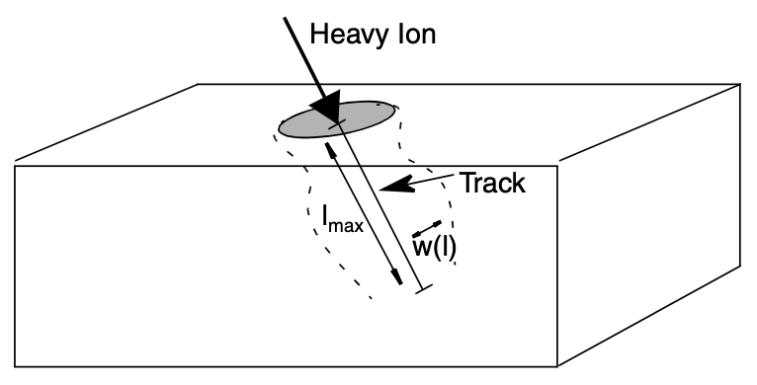


Heavy Ion Model
A MIP can be modelled through the Heavy Ion Model, whose generation rate is given by the following expression:
  $$G\left(l,w,t\right)=\left\{\begin{matrix}G_{LET}\left(l\right)R\left(w,l\right)T(t) & if l<l_{max} \\ 0 & if l≥l_{max}\end{matrix}\right.$$
$T\left(t\right)$ is a function describing the temporal variation of the generation rate;
  In particular, it’s a Gaussian function whose mean value represents the moment of the heavy ion penetration.
$R\left(w,l\right)$ is a function describing the spatial variation of the generation rate;
  It too is a Gaussian and $w\left(l\right)$ represents its standard deviation.
$G_{LET}(l)$ represents the linear energy transfer generation density, expressed in e/h pairs per cm³ by default .
$\sim 50k$ pixels/cm²
How many e/h pairs are generated by the MIP for each µm crossed?
$\frac{Energy Loss \left[eV/µm\right]}{3.68 eV}$
$Energy Loss\left[{keV}/{µm}\right]=0.027\ln\left(depth\right)+0.126$
S. Meroli et al., Energy loss measurement for charged particles in very thin silicon layers, Journal of Instrumentation, vol. 06, P06013, Jun. 2011

Slide 15
Charge imbalance algorithm
$\sim 50k$ pixels/cm²

Slide 16
Crosses of various sizes
$\sim 50k$ pixels/cm²

Slide 17
Crosses 🤼‍♂️ bars
$\sim 50k$ pixels/cm²

Slide 18
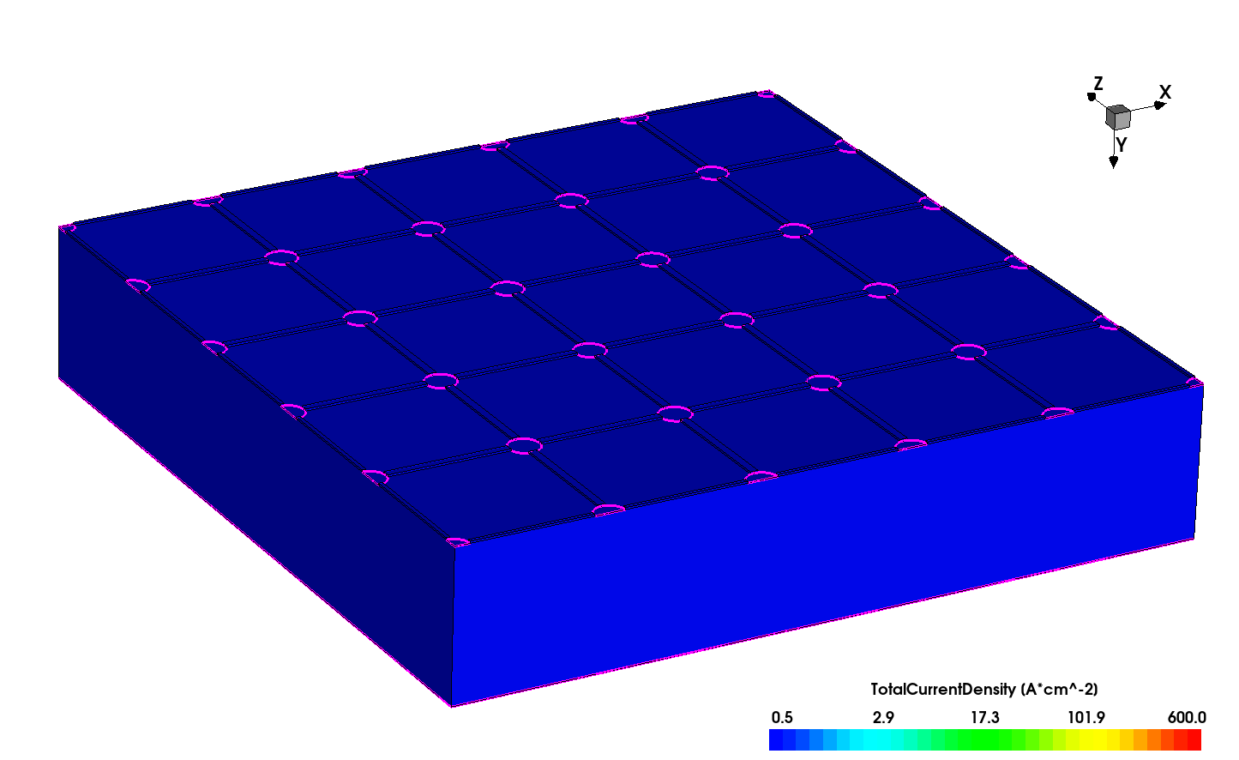
Resistive strips
$\sim 50k$ pixels/cm²

Slide 19
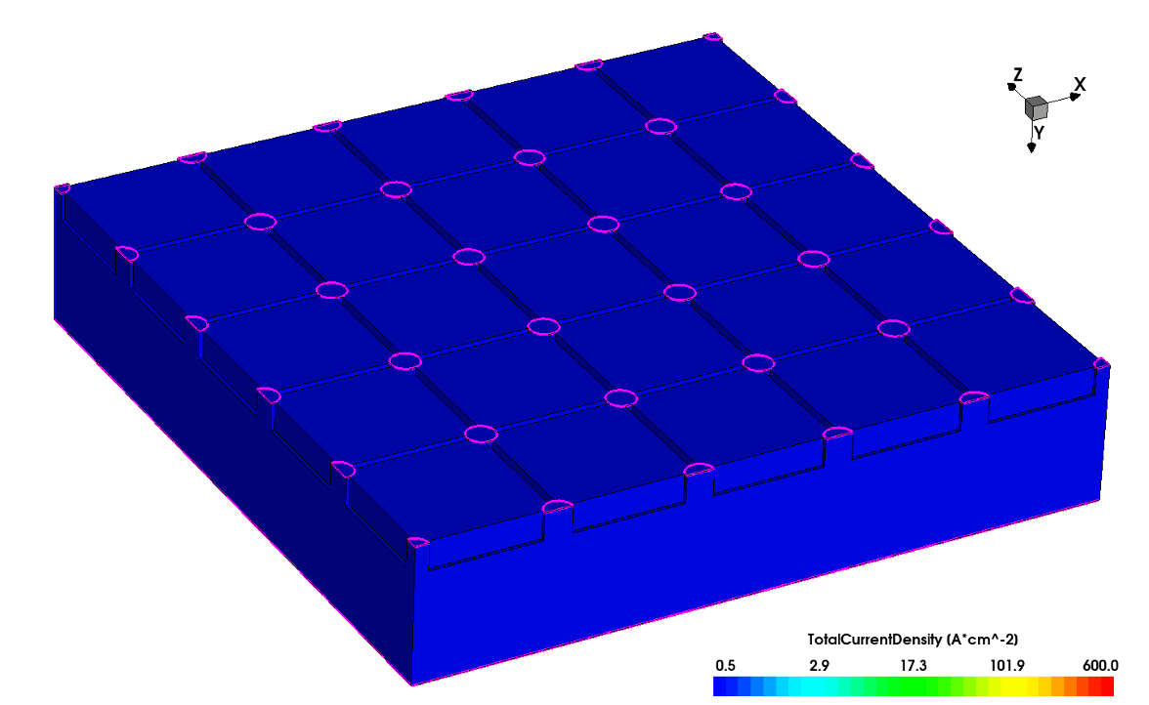
Silicon oxide trenches
$\sim 50k$ pixels/cm²

Slide 20
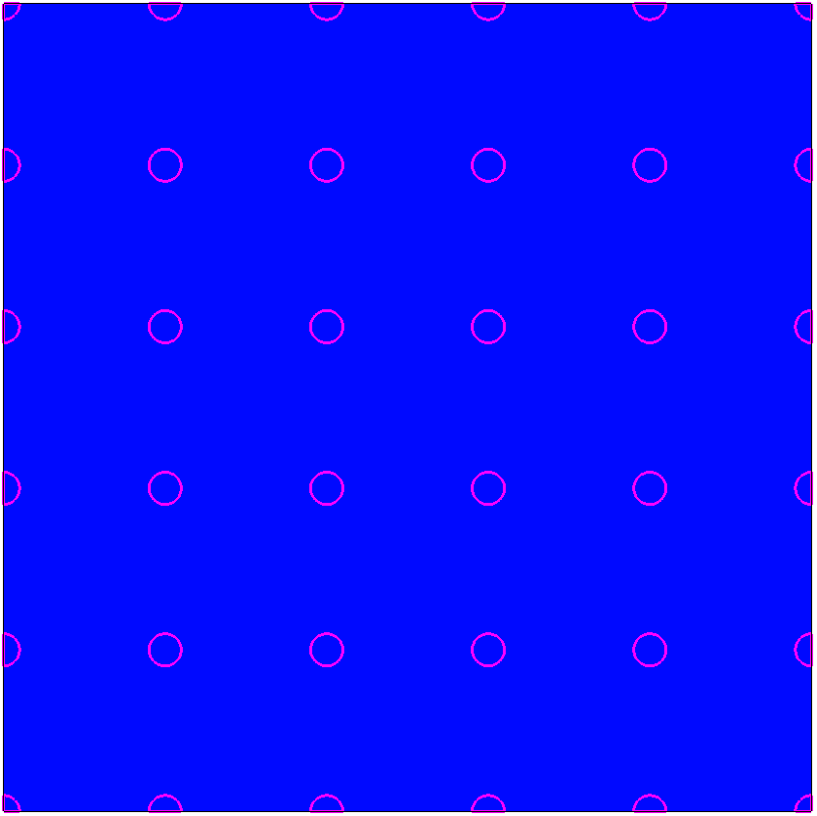
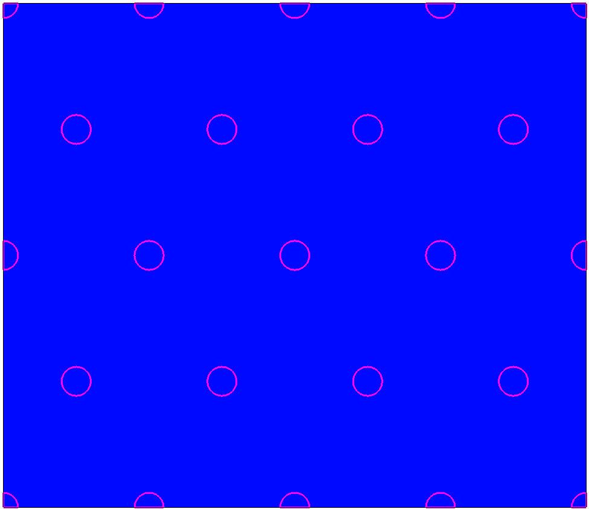
Different pad arrangements
$\sim 50k$ pixels/cm²
Matrices of squares
Matrices of hexagons

Slide 21
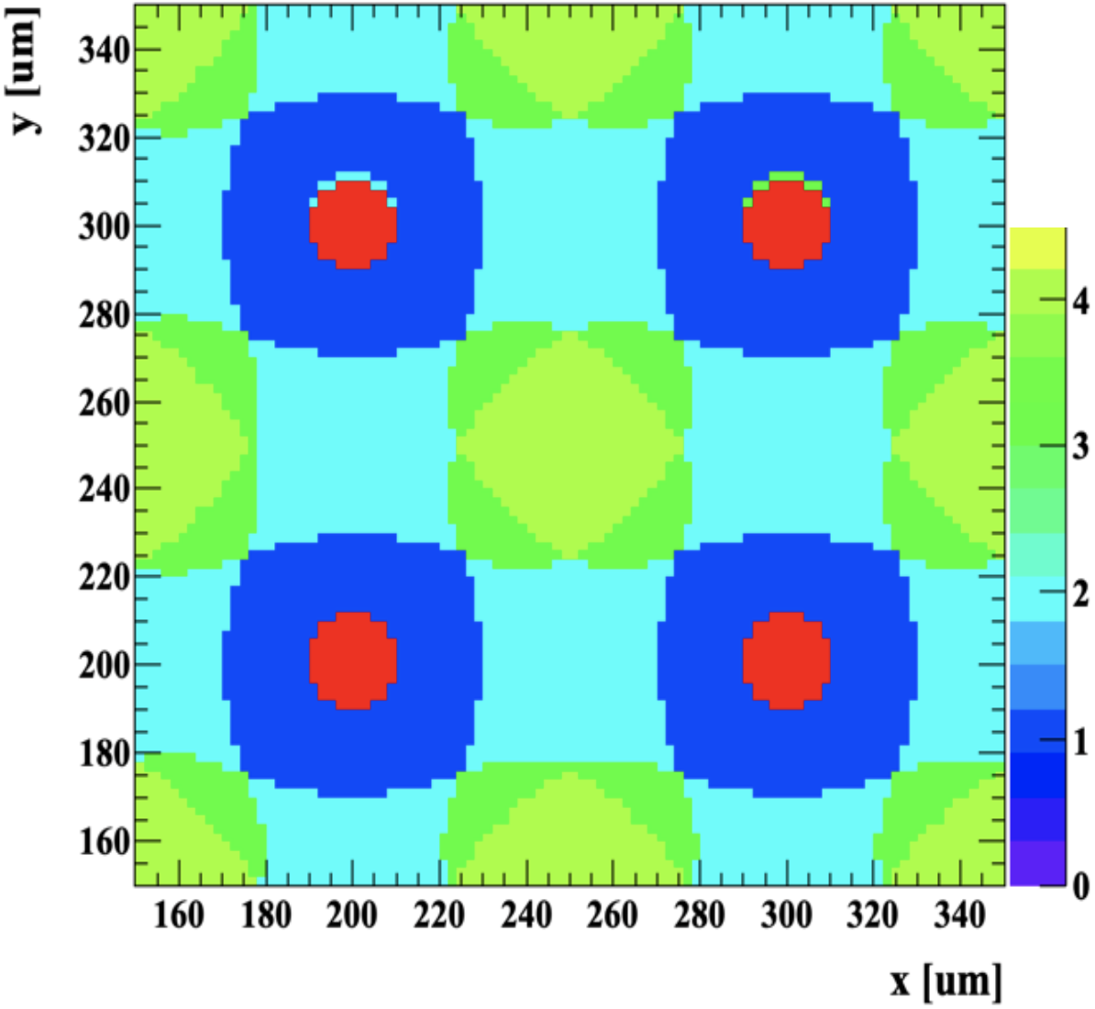
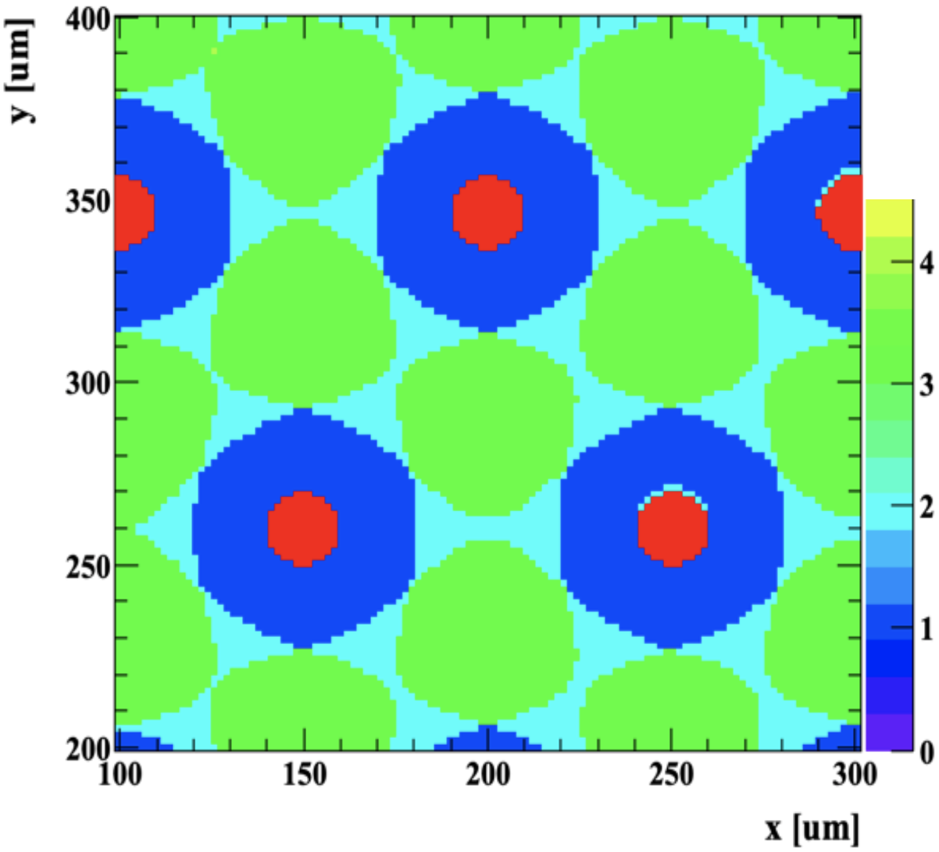
Different pad arrangements
$\sim 50k$ pixels/cm²
Matrices of squares
Matrices of hexagons
Percentages by event type:
1-electrode: 30%
2-electrode: 40%
3-electrode: 14%
4-electrode: 16%
Percentages by event type:
1-electrode: 38%
2-electrode: 25%
3-electrode: 37%

Slide 22
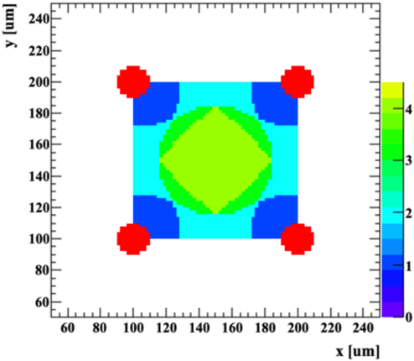
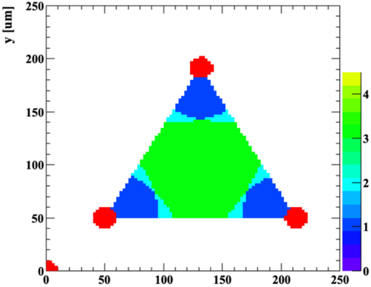
Different pad arrangements
By adding silicon oxide trenches
$\sim 50k$ pixels/cm²
Matrices of squares
Matrices of hexagons
Percentages by event type:
1-electrode: 30%
2-electrode: 40%
3-electrode: 14%
4-electrode: 16%
Percentages by event type:
1-electrode: 38%
2-electrode: 25%
3-electrode: 37%
25%
28%
33%
12%
12%
60%
30%

