Slide 1
4D tracking with large RSD pixels and the FAST3 ASIC
N. Cartiglia
INFN, Torino, Italy
R. Arcidiacono, M. Ferrero, L. Lanteri, L. Menzio,
F. Siviero, V. Sola, R. White,

Slide 2
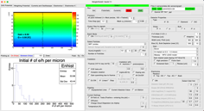
The contest: a 3-pronged approach to 4D tracking
Development of LGAD-based silicon sensors designed to achieve combined resolutions of 20-30 ps and 10 microns, the so-called 4D-tracking.
Production of the FAST ASIC family, aimed at achieving the best front-end design for LGADs.
The creation of a software simulator, Weightfield2 (WF2) to guide the designs of UFSDs and the FAST ASICs
UFSD
FAST
WF2
See the Bibliography slide for details

Slide 3
RSD principle of operation in one picture

Slide 4
Final goal of RSD R&D in two pictures
RSD: LGAD with resistive read-out (AC-LGAD)
The signal is shared among near-by electrodes
Pixel size
~ 25 x 25 μm²
Electronics
Pixel size
~ 250 x 250 μm²
~ 150 μm
Contacts
~ 50 μm
--
---
- --
+
++
+++
---
- --
++
+++
Resistive implant
Silicon bulk
Gain implant
Standard Tracker
RSD-based tracker
1/100 number of electrodes
With fewer electrodes, the power budget allows for measuring also the time of arrival

Slide 5
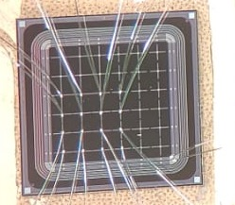
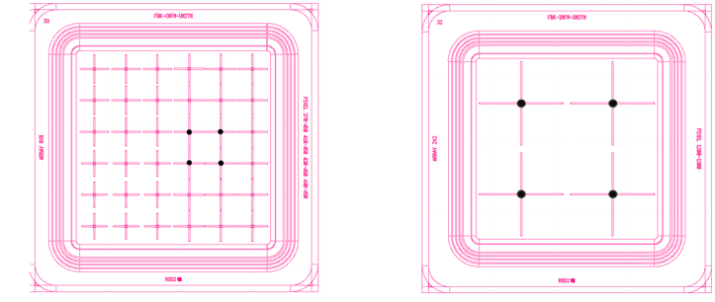
RSD2 sensors with cross-shaped electrodes
RSD1 and RSD2 FBK sensor productions explored several electrode geometries.
Pitch = 450 μm
Pitch = 1300 μm
Pitch = 450 μm
Our studies demonstrated that
cross-shaped electrodes
provide the best performance

Slide 6
RSD2 sensors with cross-shaped electrodes
RSD1 and RSD2 FBK sensor productions explored several electrode geometries.
Pitch = 450 μm
Pitch = 450 μm
This is the structure under study

Slide 7
Electronics: What is the best pre-amp choice?
WF2 simulation of the
Energy deposition in a 50 mm sensor
Current Amplifier
Fast slew rate
Higher noise
Sensitive to Landau bumps
WF2 simulation of the current signal in a 50 mm sensor
Charge Sensitive Amplifier
Slower slew rate
Quieter
Integration helps the signal smoothing

Slide 8
Electronics: What is the best pre-amp choice?
WF2 simulation of the
Energy deposition in a 50 mm sensor
Current Amplifier
Fast slew rate
Higher noise
Sensitive to Landau bumps
WF2 simulation of the current signal in a 50 mm sensor
The Family of FAST ASICs
Charge Sensitive Amplifier
FAST1
FAST2
Slower slew rate
Quieter
Integration helps the signal smoothing
FAST3

Slide 9
FAST2(3) ASIC versions
FAST2(3) were designed in UMC 110 nm CMOS technology by Microelectronic group of INFN Torino
FAST2(3) Amplifier-only architecture
FAST(3) amplifier-discriminator architecture
Inverter
stage
Preamplifier
Inverter stage
Preamplifier
Buffer
stage
FAST3 vs FAST2:
Larger dynamic range
Better channel matching

Slide 10
FAST2(3) ASIC versions
FAST2(3) were designed in UMC 110 nm CMOS technology by Microelectronic group of INFN Torino
FAST2(3) Amplifier-only architecture
FAST(3) amplifier-discriminator architecture
Inverter
stage
Preamplifier
Inverter stage
Preamplifier
Buffer
stage
FAST3 vs FAST2:
Larger dynamic range
Better channel matching
The results presented here are obtained with this version

Slide 11
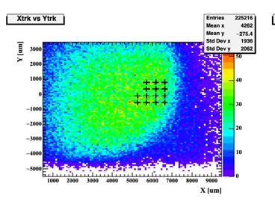
DESY test beam line
TLU Tracker
4
4
Tracker
RSD
Tracker
5 GeV/c electron beam
CAEN Logic Unit
MCP
3
Two distinct paths:
Trigger path
Data path
2
1
EUDAQ
3
Oscilloscope
MCP
CAEN
Digitizer
PC
Sensor matrix

Slide 12
DESY test beam line
TLU Tracker
4
4
Tracker
RSD
Tracker
5 GeV/c electron beam
CAEN Logic Unit
MCP
3
Two distinct paths:
Trigger path
Data path
2
1
EUDAQ
3
Oscilloscope
MCP
CAEN
Digitizer
PC
In the following, results from two complementary beam tests (both at DESY)
TB5: RSD2 + FAST2
TB6: RSD2 + FAST3
Sensor matrix

Slide 13
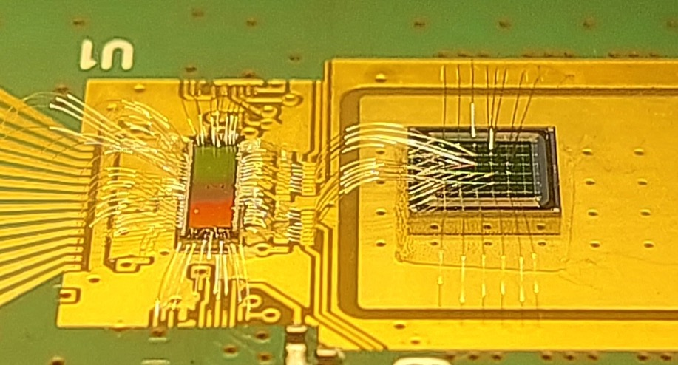
The read-out board
FAST2(3)
RSD2

Slide 14
Signal amplitude vs hit position
These plots show the signal amplitude seen by one electrode.
Amplitude [a.u.]
6% of signal amplitude
at the pixel edge
Amplitude map as a function of the hit position (tracker x,y)
Amplitude as a function of distance from the electrode
The spread of the signal is about one pixel

Slide 15
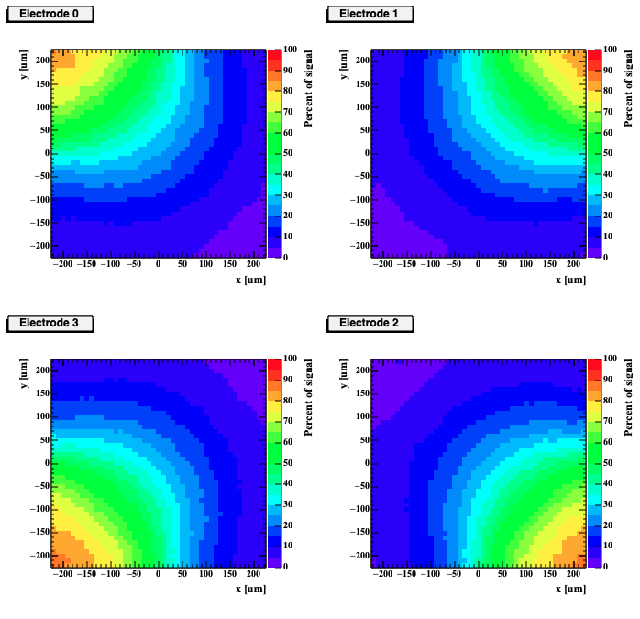
Position reconstruction method: sharing template
Electrode 1
Electrode 3
Step 1:
For each position in the pixel, produce look-up tables with the fraction of the signal seen by each of the 4 electrodes as a function of position
(done with test beam data)
15%
50%
Electrode 2
Electrode 4
5%
30%

Slide 16
Position reconstruction method: sharing template
Electrode 1
Electrode 3
Step 1:
For each position in the pixel, produce look-up tables with the fraction of the signal seen by each of the 4 electrodes as a function of position
(done with test beam data)
15%
50%
Step 2:
For each event, find in the look-up tables the best bin that matches the measured signal fractions seen by the four electrodes.
Electrode 2
Electrode 4
5%
30%
Note: the look-up tables are a property of the sensors, once measured, they can be used with every read-out.

Slide 17
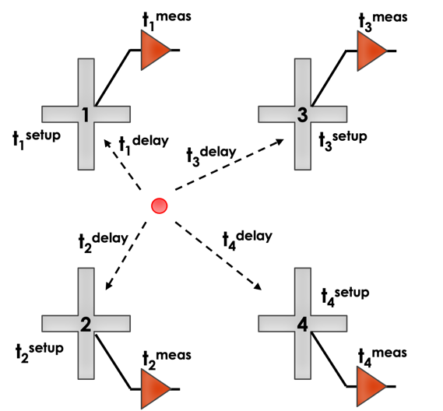
Temporal reconstruction method
Step 1:
Each electrode provides a time estimate (constant fraction discriminator at 50%)
Correct for signal delay (using a delay template; see backup)
Correct for set-up offset

Slide 18
Temporal reconstruction method
Step 1:
Each electrode provides a time estimate (constant fraction discriminator at 50%)
Correct for signal delay (using a delay template; see backup)
Correct for set-up offset
Step 2:
Combine the estimators
$$t^{hit}= \sum_{1}^{4}{\frac{t_{i}^{hit}A_{i}^{2}}{A_{i}^{2}}}$$

Slide 19
Examples of data taking
Tracker x,y
Reconstructed hit position on the RSD according to the DESY tracker
(pattern due to the triggering choice)

Slide 20
Examples of data taking
Tracker x,y
RSD x,y
Reconstructed hit position on the RSD according to the DESY tracker
(pattern due to the triggering choice)
Reconstructed hit position on the RSD according to the RSD reconstruction
The DESY tracker and RSD (x,y) reconstructions look very similar

Slide 21
Results: 450-μm pitch, position resolution
The position resolution, even at very low gain, is between 15 – 20 microns, less than 5% of the pixel size.
The resolution is limited by systematic effects such as alignment with the tracker.

Slide 22
Results: 450-μm pitch, position resolution
FAST2
The temporal resolution reaches 50 ps at a high gain
The resolution is limited by the CAEN digitizer performance (about 50 ps)

Slide 23
Future RSD research paths
RSD (AC-LGAD)
DC-RSD
-+
-+
-+
-+
-+
-+
-+
-+
-+
-+
-+
-+
Cathode
E Field
E Field
Anode
This design has been manufactured in several productions by FBK, BNL, and HPK
Finished first production
The main advantage of the DC-RSD design is the ability to control the signal spread
See DC-RSD details at Pixel 2024:
R. Arcidiacono, DC resistive read-out silicon sensors for future 4D tracking
A. Fondacci, Design and optimization of radiation resistant AC- and DC-coupled resistive LGADs

Slide 24
Conclusions and outlook
In the past years, we have investigated the possibility of achieving excellent combined position and temporal resolutions reducing the number of electrodes using resistive silicon detectors coupled with the full-custom ASIC FAST
We have tested the performance of RSD (AC-LGAD) sensors with cross-shaped electrodes coupled to the FAST2(3) ASIC. We achieved:
position resolution better than 5% of the pitch ( <20 microns for 450-micron pitch)
temporal resolution of 50 ps (limited by the set-up)
We designed and produced an improved version of the RSD sensors, DC-RSD
DC-RSD +FAST3 will be tested at beam test (DESY) next month
Resistive Silicon Detectors are a good fit for systems that require a low material budget and a low power consumption

Slide 25
Acknoledgment
The measurements leading to these results have been performed at the Test Beam Facility at DESY Hamburg (Germany), a member of the Helmholtz Association (HGF).
We kindly acknowledge the following funding agencies and collaborations:
RD50
INFN – FBK agreement on sensor production;
INFN projects 4DShare, RSD
Dipartimento di Eccellenza, Univ. of Torino (ex L. 232/2016, art. 1, cc. 314, 337); Ministero della Ricerca, Italia, PRIN 2022, 4DShare;
Grant TRAPEZIO 2021 Fondazione San Paolo, Torino.

Slide 26
Bibliography
DC-RSD
DC resistive read-out silicon sensors for future 4D tracking, R. Arcidiacono et. al (Pixel 2024)
A. Fondacci,
"DC-coupled resistive silicon detectors for 4D tracking", L. Menzio et al., NIMA 1041 (2022) 167374, arxiv.org/abs/2204.07226 (pdf)
RSD2:
First test beam measurement of the 4D resolution of an RSD pixel matrix connected to a FAST2 ASIC, L. Menzio, F. Siviero et al, https://arxiv.org/abs/2402.01517, NIMA 1065 (2024), 169526 (pdf)
High precision 4D tracking with large pixels using thin resistive silicon detectors. R. Arcidiacono et al, NIMA, 1057 (2023), 168671 (pdf)
FAST3:
FAST3 ASIC: front-end electronic with ps resolution, designed for thin LGADs read-out, R. Ferrero TWEPP Conference 2024
FAST3: Front-End Electronics to Read Out Thin Ultra-Fast Silicon Detectors for ps Resolution, A. M. Rojas, et al., 2022 IEEE Latin American Electron Devices Conference (LAEDC), Cancun, Mexico, 2022, pp. 1-4, doi:10.1109/LAEDC54796.2022.9908192.
FAST2:
Amplifier discriminator ASICs to read-out thin Ultra-Fast Silicon detector for ps resolution, A. Rojas et al., 2021 IEEE Nuclear Science Symposium and Medical Imaging Conference (NSS/MIC), Piscataway, NJ, USA, 2021, pp. 1-4, doi: 10.1109/NSS/MIC44867.2021.9875441.
FAST:
Design and characterization of the FAST chip: a front-end for 4D tracking systems based on Ultra-Fast Silicon Detectors aiming at 30 ps time resolution, E. J. Olave et al., NIMA 985 (2021) 164615, HSTD12
A multichannel front-end readout ASIC for picosecond time resolution systems based on UFSD, E. J. Olave et al., JINST 15. C07012-C07012. 10.1088/1748-0221/15/07/C07012 July 2020
FAST: a 30 ps time resolution front-end ASIC for a 4D tracking system based on UFSD, F. Fausti, J. Olave, N. Cartiglia, TWEPP 2019
Weigthfield2:
Manual and download available at https://www.to.infn.it/~cartigli/Weightfield2/index.html
Weightfield2: a fast simulator for silicon and diamond solid state detector, F. Cenna et al., NIMA 796 (2015) 149-153

Slide 27
Bonus slides

Slide 28
FAST3 specifications
Table of specifications
Power rail | 1.2 V
Number of Ch | 16
Power consumption | 2.3 + 7.7 mW/ch
Input dynamic range | 3-40 fC
RMS Noise | 1.1 mV
Output signal (@ 8 fC) | 102 mV
SNR (@ 8 fC) | 93
Voltage output range | $\sim$ 800 mV
Bandwidth | $\sim$ 1 GHz
Temporal Jitter (@ 8 fC) | 20 ps
5 mm
1.5 mm
Bottom side: Input pad
Top side: Output pad
Lateral sides: Bias and Power input

Slide 29
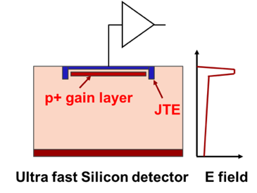
The UFSD – RSD sensors
30-50 μm
-------------
+++++++++
UFSD: LGAD optimized for timing
RSD: LGAD with resistive read-out (AC-LGAD)
The signal is seen only in one pixel
The signal is shared among near-by electrodes
Why RSD?
Use signal sharing to achieve excellent position and time resolutions while keeping the number of electrodes low

Slide 30
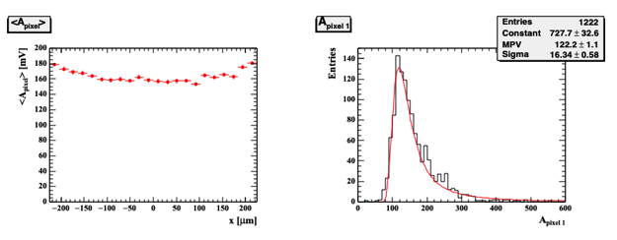
Electrode and pixel signal properties
Electrode signal properties
Signal amplitude on a single electrode as a function of distance from the electrode
Signal rise time as a function of distance from the electrode
Pixel signal (sum of 4 elec. signals) properties
Sum of the 4 electrode amplitudes in a pixel (projection along the x-projection)
Sum of the 4 electrode amplitudes in a pixel

Slide 31
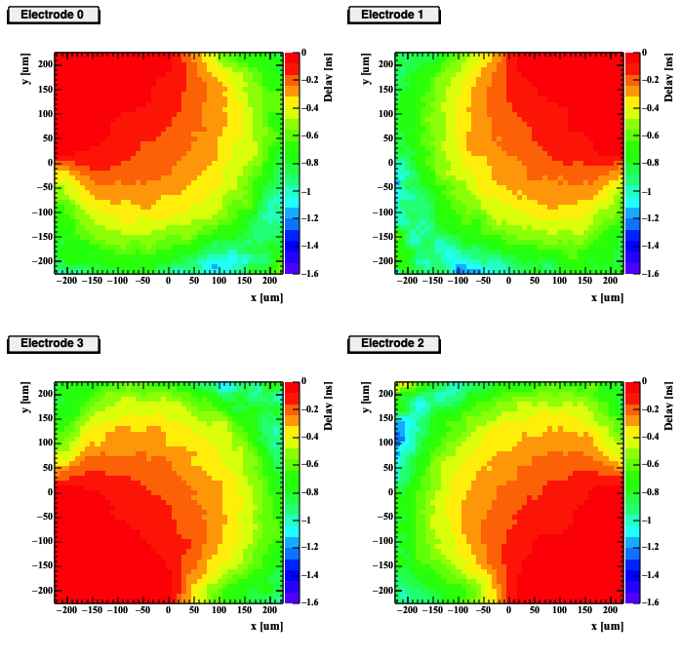
Delay template
Timing template

Slide 32
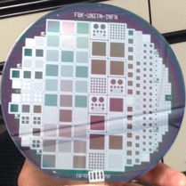
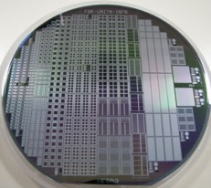
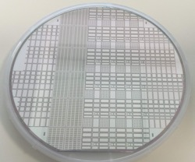
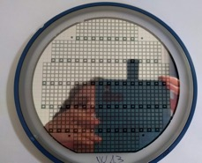
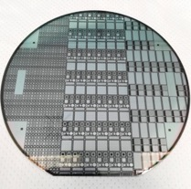
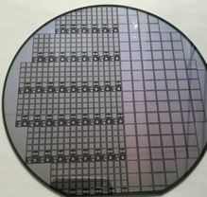
The UFSD project: brief history
Aim: develop sensors with excellent temporal and spatial resolutions via a series of productions and design refinements
Long term R&D, Not for a specific experiments
UFSD1
UFSD2
2016: UFSD1 First 300 μm thick LGAD (FBK 6” wafer )
2017: UFSD2 First 50 μm thick LGAD (FBK 6” wafer )
Gain layer doping: Boron, Gallium, Boron + Carbon,
3. Fall 2018: UFSD3 50 μm LGAD (FBK 6” wafer), produced with the stepper (many Carbon levels, studies of interpad design)
4. June 2019: UFSD3.1 50 μm LGAD (internal FBK) interpad design.
5. June 2019 RSD1 Resistive AC-LGAD (FBK 6” wafer)
6. June 2020: UFSD3.2 25, 35, 45, and 55 μm LGAD, carbon studies, deep, shallow gain implant (FBK 6” wafer
UFSD3
UFSD3.1
UFSD3.2
7. Q1/2021: UFSD3.3 (FBK 6” wafer)
8. Q1/2021: Trench-Isolated (FBK 6” wafer)
9. Q2/2021: RSD2 (FBK 6” wafer)
10. Q2/2021: ExFlux -> optimized for extreme fluence
Project fully funded for 3 more years
RSD1

