Slide 1

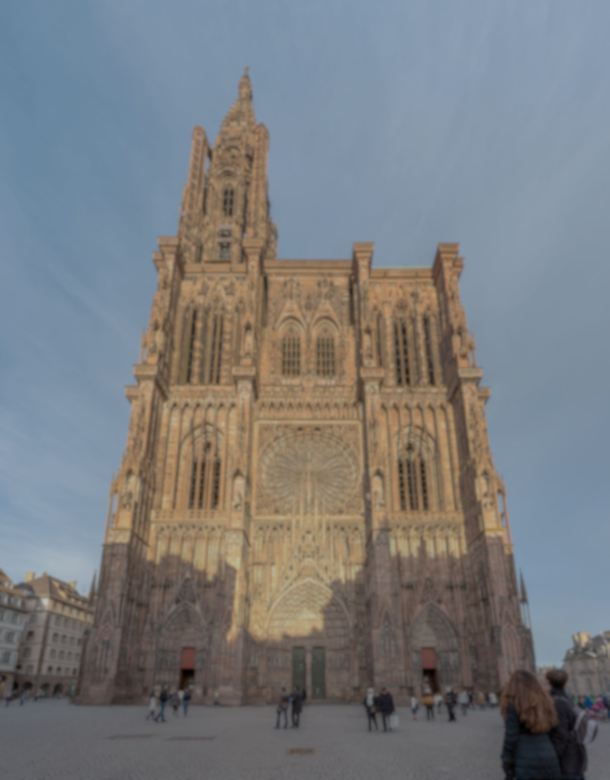
Operational Experience and Performance with the ATLAS Pixel detector at the LHC
Marcello Bindi
University of Goettingen
on behalf of the ATLAS Collaboration
11th International Workshop on Semiconductor Pixel Detectors for Particles and Imaging (Pixel 2024), 18th – 22nd November 2024,
Collège Doctoral Européen, University of Strasbourg, France.

Slide 2
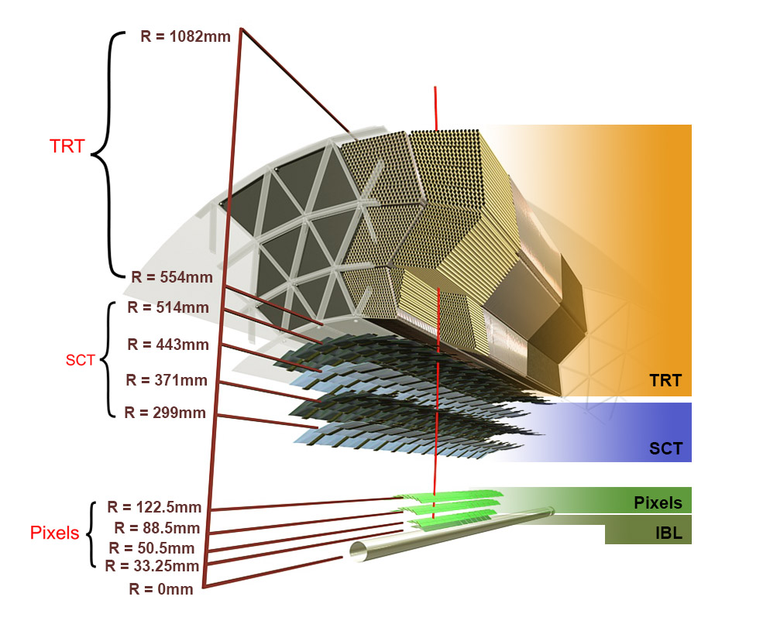
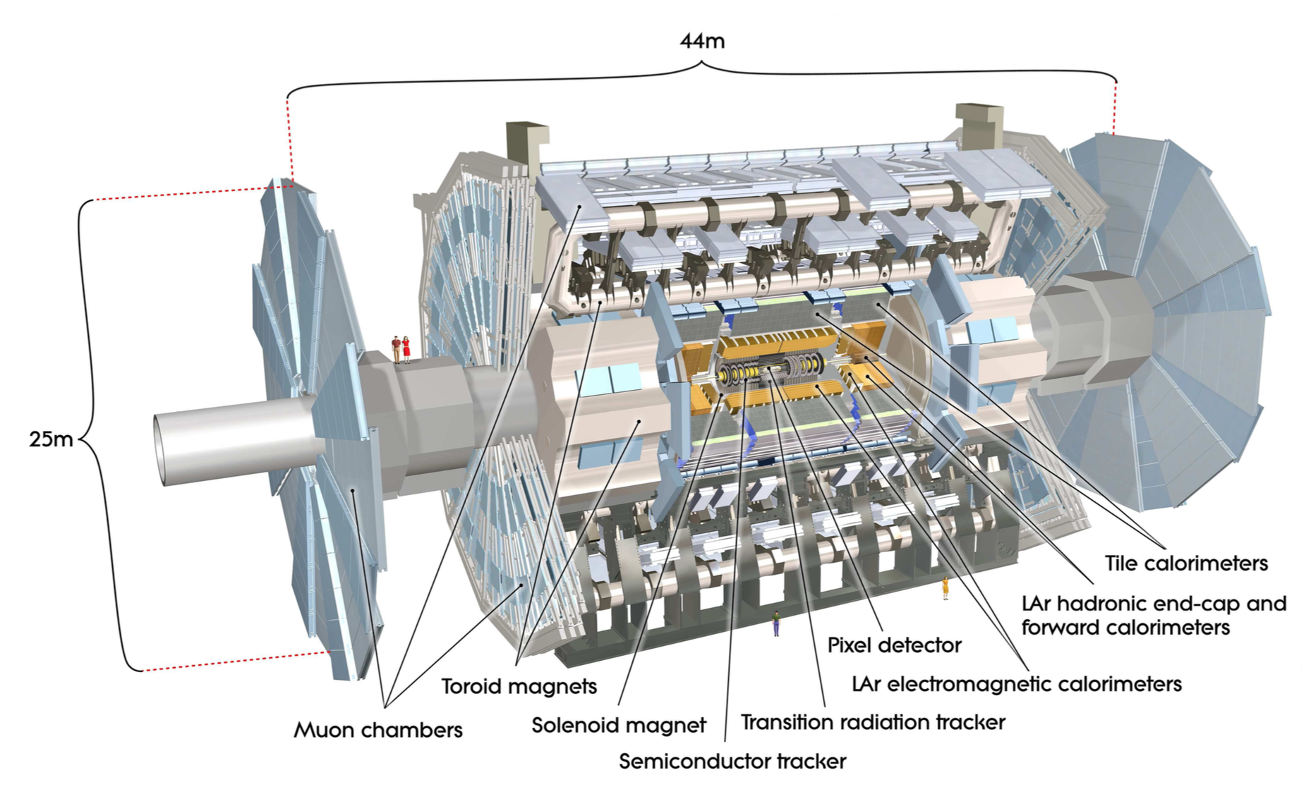
The ATLAS detector @ LHC
ATLAS Inner Detector (ID) tracker
Pixel Detector
Silicon Strip Detector (SCT)
Transition Radiation Tracker (TRT)
Run 1 : 2010 - 2012 ➔ 3 pixel layers
Run 2/Run 3 : 2015 - 2024 ➔ 4 pixel layers
2

Slide 3
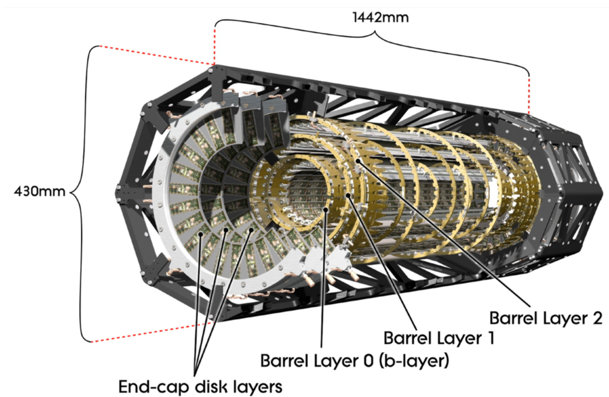
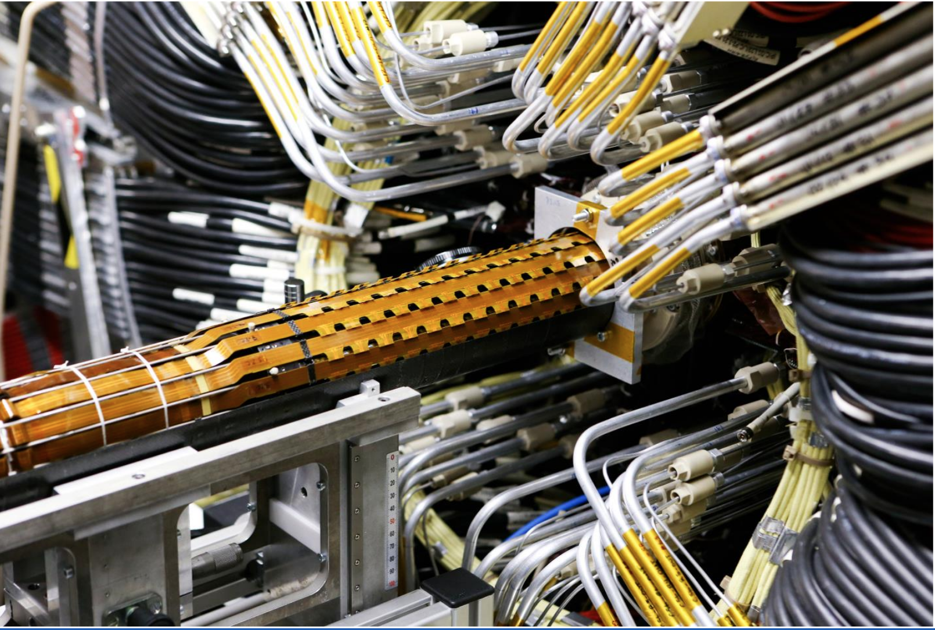
The ATLAS Pixel (+ IBL) detector
3 + 1 pixel layers in barrel
2 x 3 pixels endcaps
 | Pixel (3 layers) |  | IBL (1 layer)
Sensor Technology | n⁺-in-n (only planar) |  | n⁺-in-n/n⁺-in-p (planar/3D)
Sensor Thickness | 250 μm |  | 200/230 μm
Front End Technology | FE-I3 250 nm CMOS |  | FE-I4 130 nm CMOS
Pixel Size | 50 x 400 μm² (short side along R-φ) |  | 50 x 250 μm² (short side along R-φ)
Radiation Hardness | 50 Mrad (500 kGy) ~ 1 x 10¹⁵ n_{eq}·cm⁻² |  | 250 Mrad (2.5 MGy) ~ 5 x 10¹⁵ n_{eq}·cm⁻²
Barrel <Radius> or EndCaps Radius_{Min} | B-Layer | 5.05 cm | 3.35 cm
 | Layer 1 | 8.85 cm
 | Layer 2 | 12.25 cm
 | EndCaps | 8.88 cm
2024 modules, 92 M channels, 1.92 m² of silicon
Insertable B-Layer (IBL)
added in 2014 (Run 2)
ATLAS pixel detector electronics and sensors,G Aad et al 2008 JINST 3 P07007
Production and Integration of the ATLAS Insertable B-Layer, B. Abbott et al 2018 JINST 13 T05008
3

Slide 4
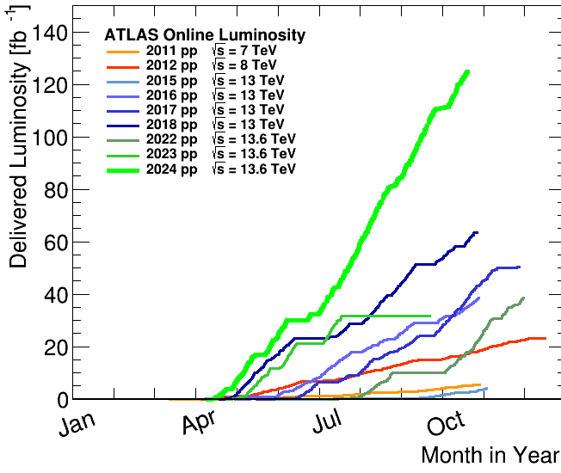
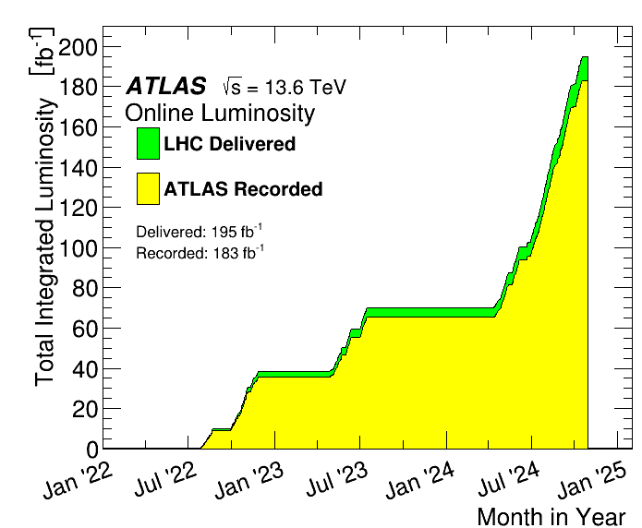
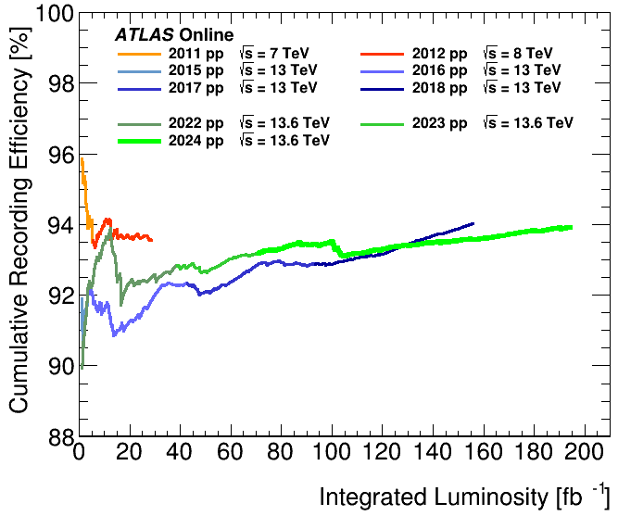
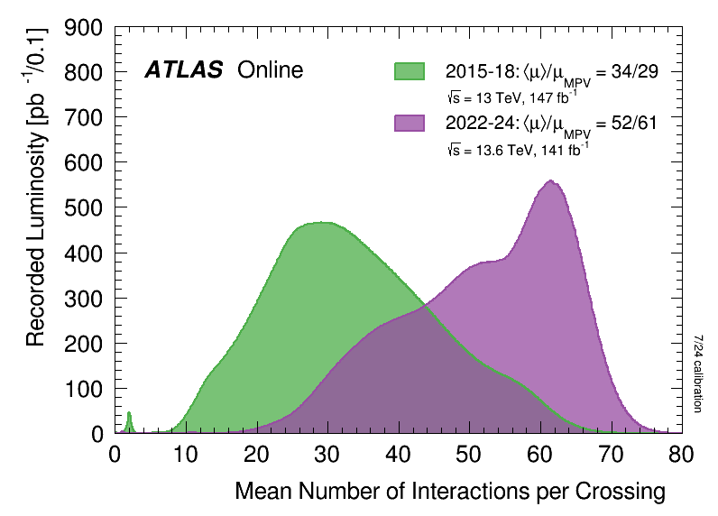
LHC/ATLAS status at end of 2024
LHC delivered ~380 fb⁻¹ (~350 fb⁻¹ for IBL) over 16 years of operation (10 in IBL)
Fluence received (inner layers):
➔IBL 1.9 x 10¹⁵ n_{eq} cm⁻²
➔B-Layer 1.4 x 10¹⁵ n_{eq} cm⁻²
200 fb⁻¹ more expected by mid-2026
➔IBL ~ 3 x 10¹⁵ n-eq cm⁻²
➔B-Layer ~ 2 x 10¹⁵ n-eq cm⁻²
Run 3
ATLAS recording efficiency
94% (Run 3 cumulative)
with L1 Trigger ~ 95 kHz
Pile up (μ)
levelling target set to 64 (2024)
up to 10⁻³ hit/pixel/event.
(inner layers)
Reminder: Pixel outer layers designed for:
fluence ~ 1 x 10¹⁵ n_{eq}cm⁻²
μ ~ 23
➔ Run 3 operation well beyond the detector design parameters (especially B-Layer)!
μ=64
4

Slide 5
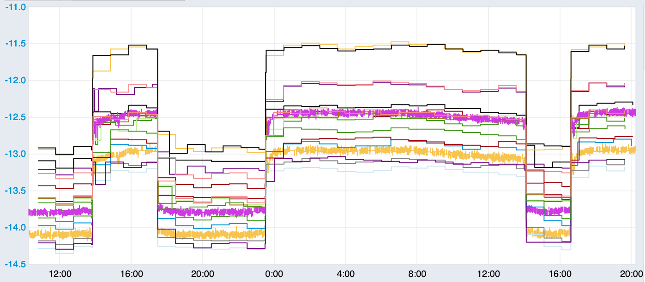
Pixel detector status
Cooling set points at -25 ºC/-20 ºC during LHC collision months
(-5 ºC /-7.5 ºC during shutdowns).
IBL Temperatures measured on the flex
Interfill
period
LHC collisions
C₃F₈ evaporative in Pixel outer layers and CO₂ bi-phase in IBL are very stable.
% Disabled Modules
Various failure types (NTC, Rx Plugin, HV open, module not configuring/sending data)
Some failures are temporary, others are unrecoverable.
Number of disabled modules quite stable:
➔recently 6 modules recovered in Layer 1
thanks to redundancy lines/fibers
(readout speed reduced 160 Mbps →80 Mbps)
Layer | 2018 | 2023 | 2024
Disks | 5.2 | 4.5 | 5.5
B-Layer | 6.2 | 5.2 | 7.3
Layer 1 | 5.8 | 4.4 | 3.6
Layer 2 | 4.8 | 6.3 | 7.4
IBL (Frontends) | 0.7 | 0.9 | 0.9
Total | 4.5 | 4.4 | 5.0
95% detector working fraction!
5

Slide 6
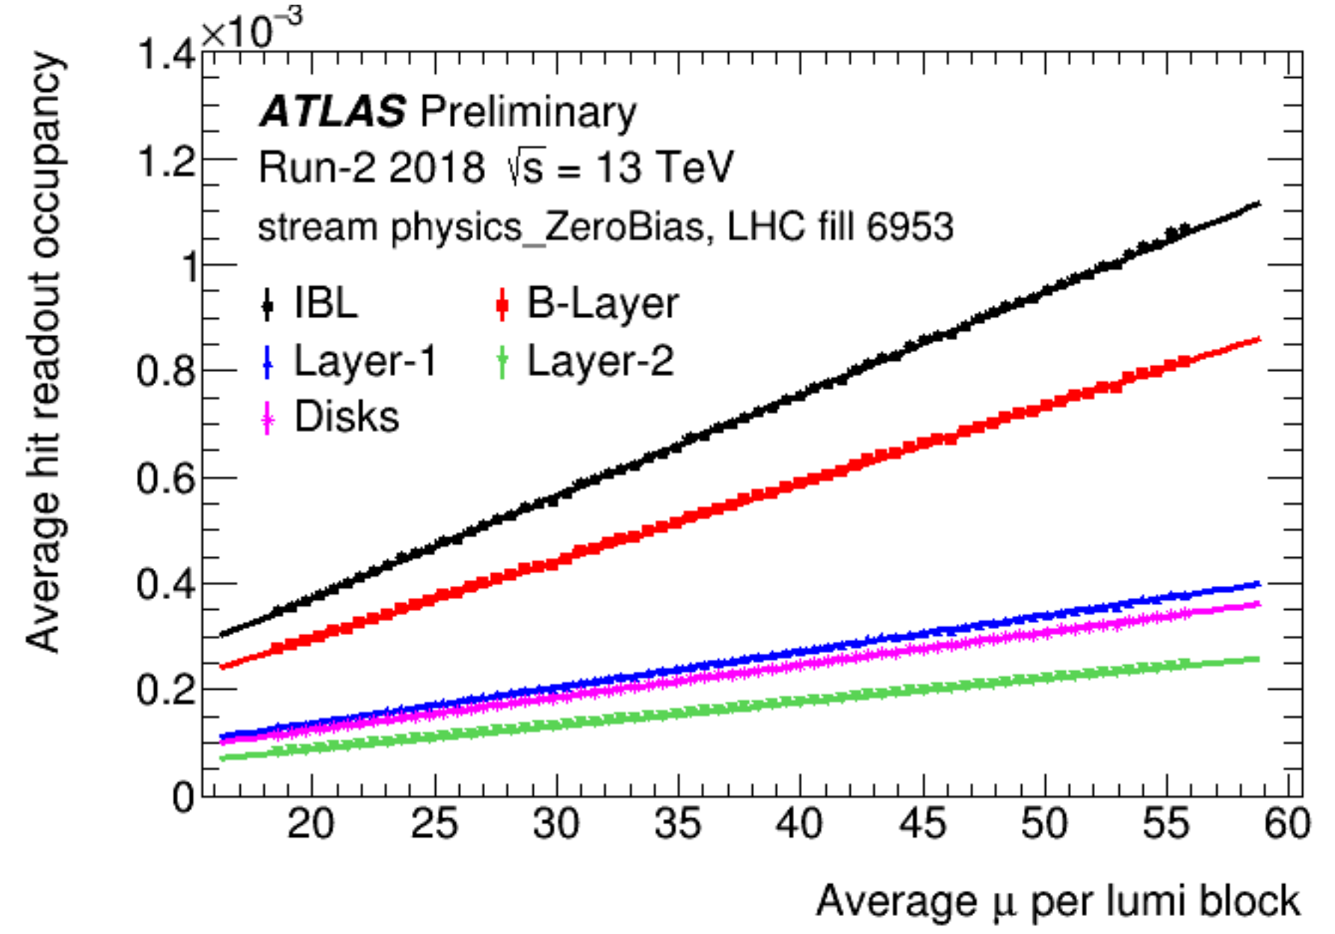
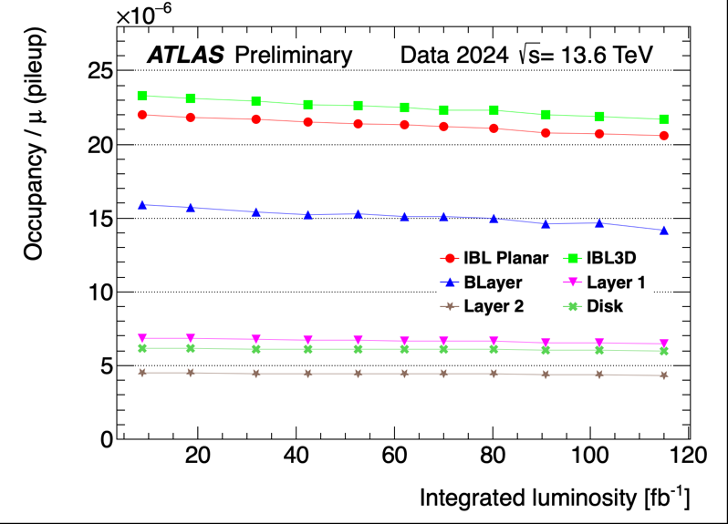
Pixel operation: Deadtime and Occupancy
Deadtime
After years of improvements on Sw/Fw ➔ Pixel dead time < 0.1 % in 2024!
Recovery mechanism (module, ROD) very rare thanks to the periodic reconfiguration of front-end registers (see next slide).
Occupancy vs Pileup
Occupancy vs Integrated Lumi
Pixel hit occupancy should scale linearly with μ (bandwidth extrapolations).
Possible deviations from linearity occur during fills (SEE) or vs the integrated luminosity (radiation damage) ➔ good thermometer of the detector “health”!
6

Slide 7
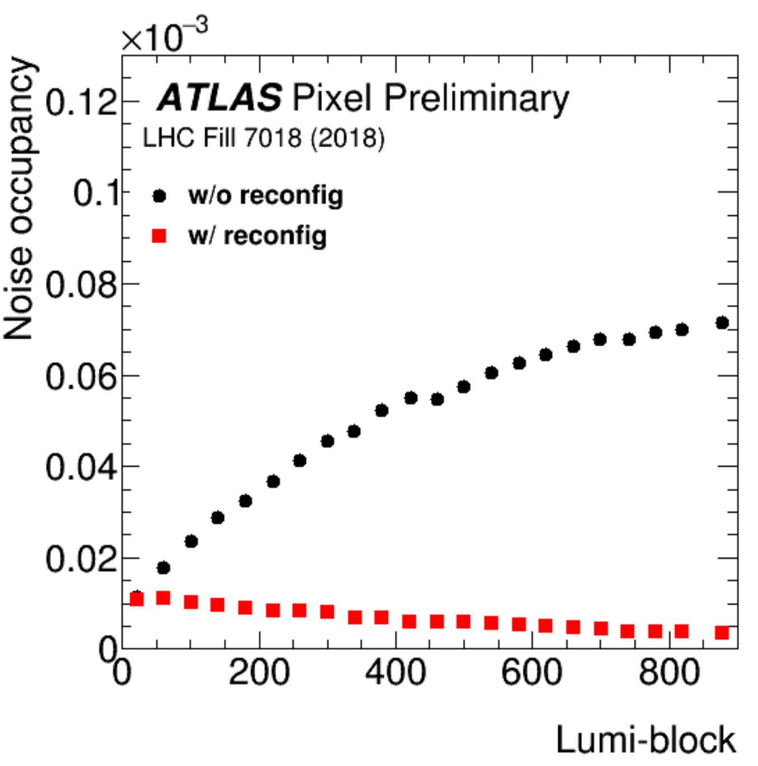
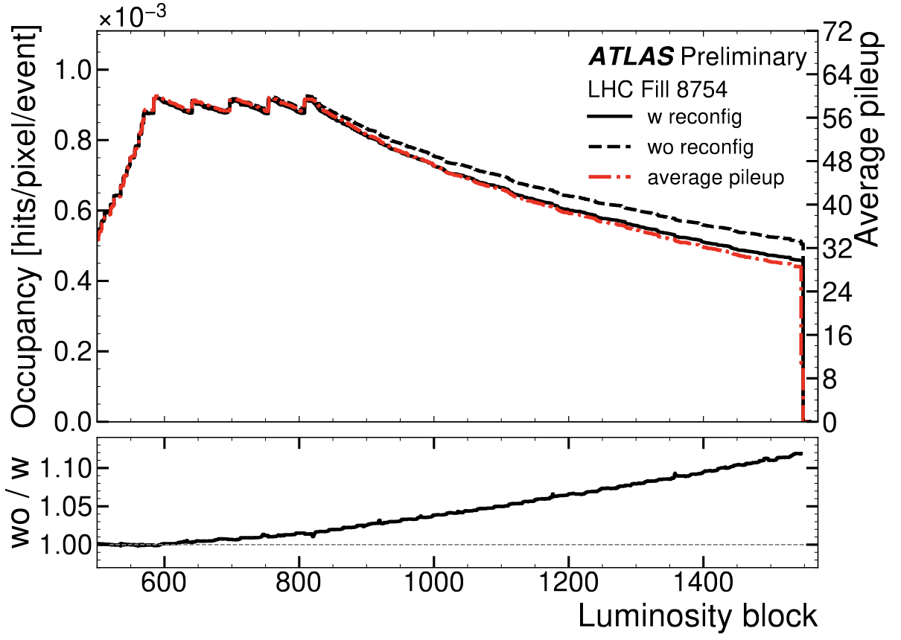
Radiation on FE electronics: SEE
Big charge deposit in FE electronics can flip the state
of global/local memory cells
IBL FE-I4 global registers affected by SEE already in 2017
➔ periodical reconfiguration of FE global registers.
Higher luminosity fills (up to 8 hours of leveling lumi)
SEE becoming relevant for FE-I4 single pixel registers
➔ periodical reconfiguration of single pixel registers
➔ clear noise reduction observed during test (2018).
Measurements of Single Event Upset in ATLAS IBL
IBL
Occupancy increase (+15%) by end of fill (May 2023) in staves w/o reconfig. Staves w/ reconfig follow more closely the μ profile.
Run 3 strategy:
IBL full FE-I4 reconfiguration
(completed gradually in ~11 minutes, without adding extra dead time to ATLAS)
7

Slide 8
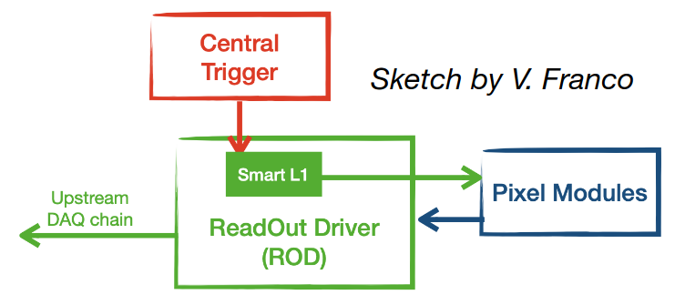
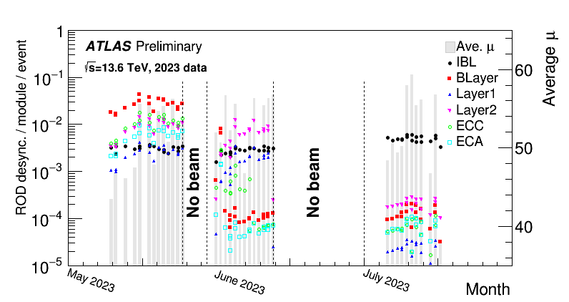
Pixel operation: ROD Desynch
ROD desynchronization (wrong assignment of event identification) has been main source of inefficiency in outer Pixel layers (especially B-Layer) until June 2023.
Introduction of “SmartL1 Fw” mechanism reduced drastically (3 orders of magnitude) the “ROD desynchronization” in outer pixel layers. How?
  Triggers not propagated whenever modules
  are late closing previous events .
  ROD keeps track of # “vetoed” triggers,
  maintaining data stream synchronization.
Preventing modules from getting desynchronized by introducing a known limited inefficiency.
IBL not really affected by ROD desynchronization (FE-I4 chip optimized for higher data rate).
  Further improvements (August 2024) via Fw that compensates for a FE misbehaviour where a single event split into two events.
2023
2024
1%
8

Slide 9
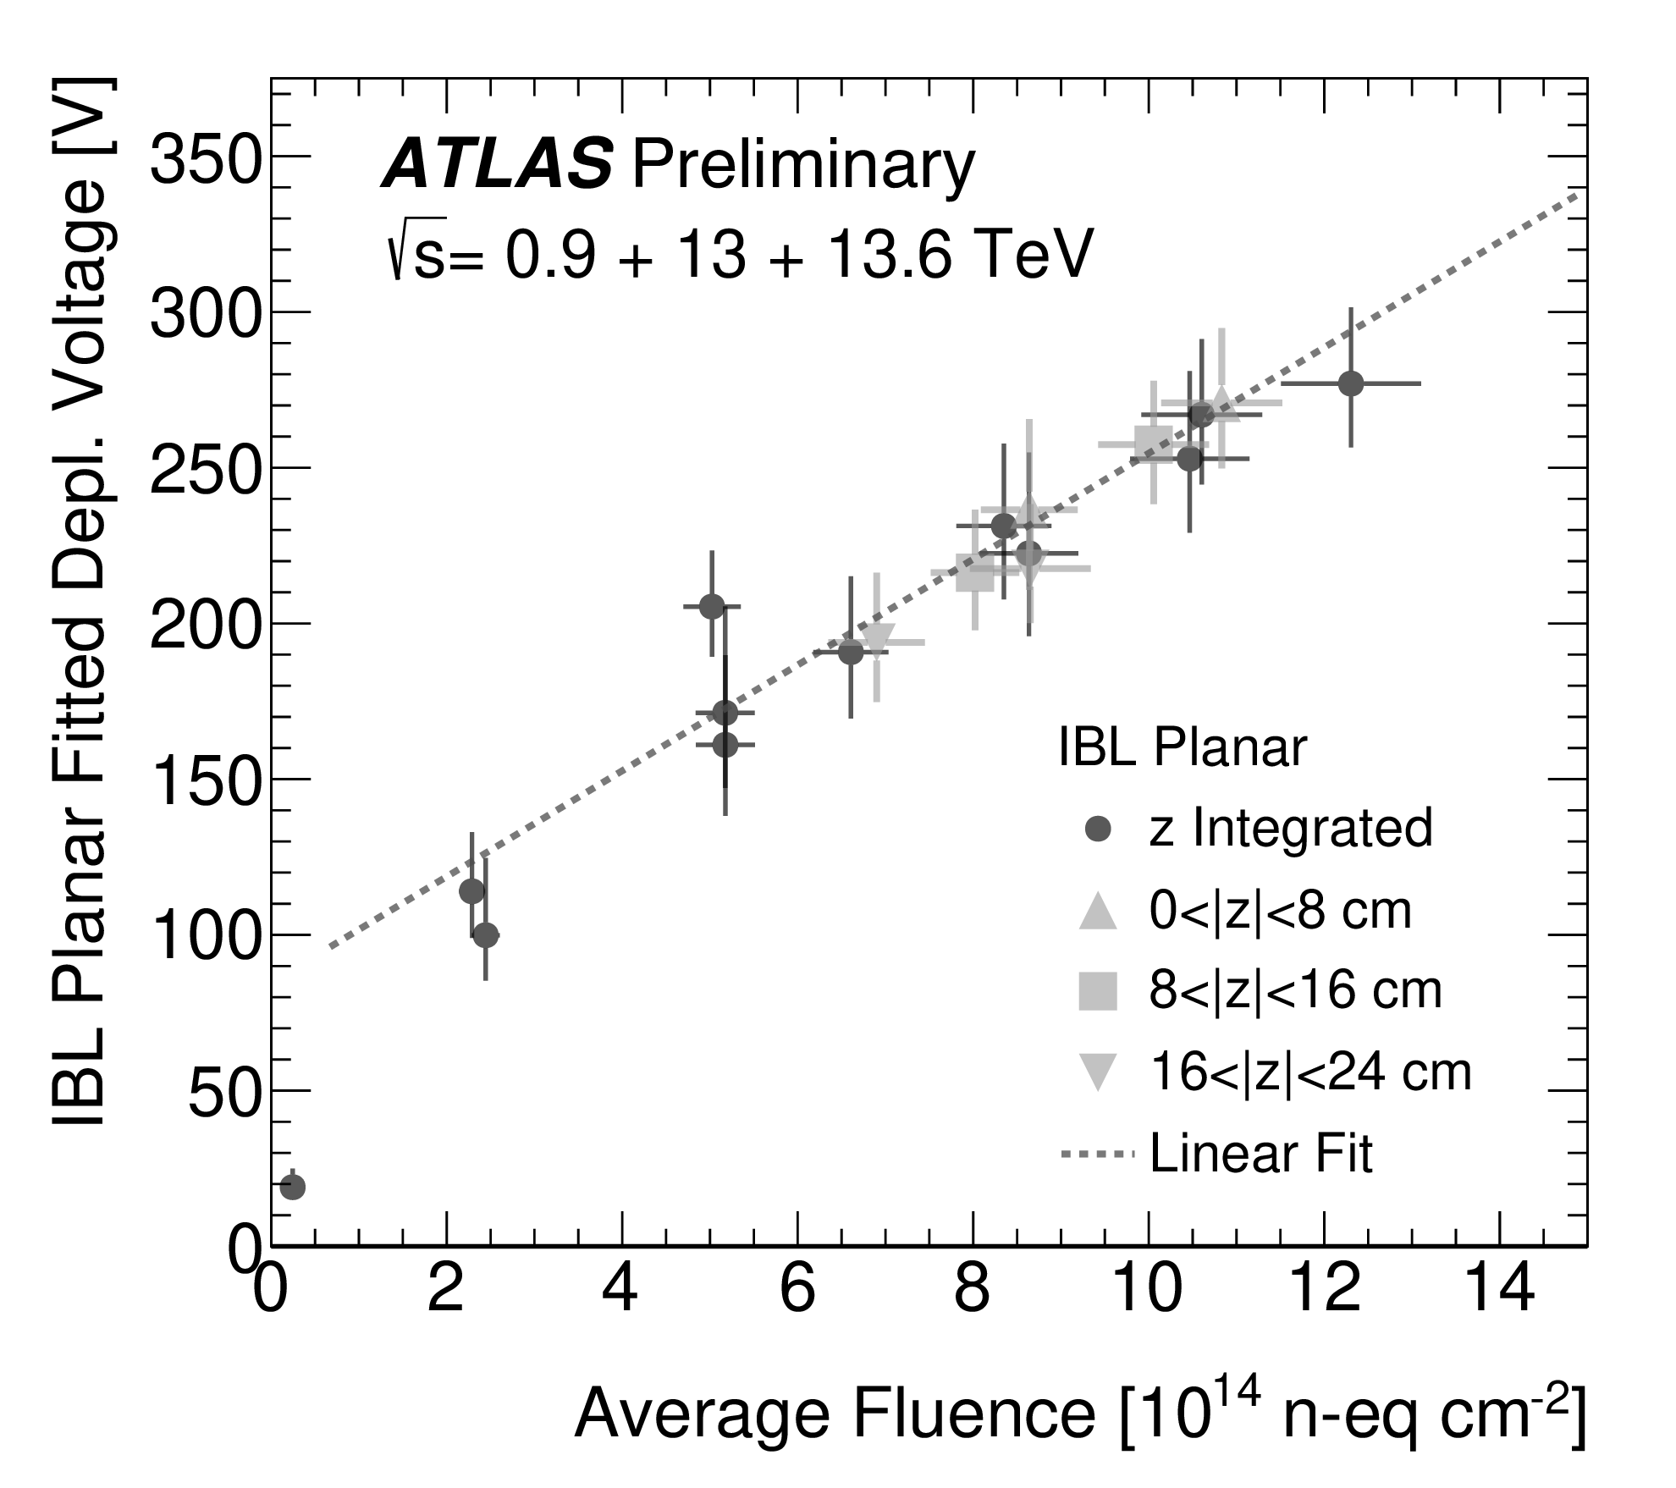
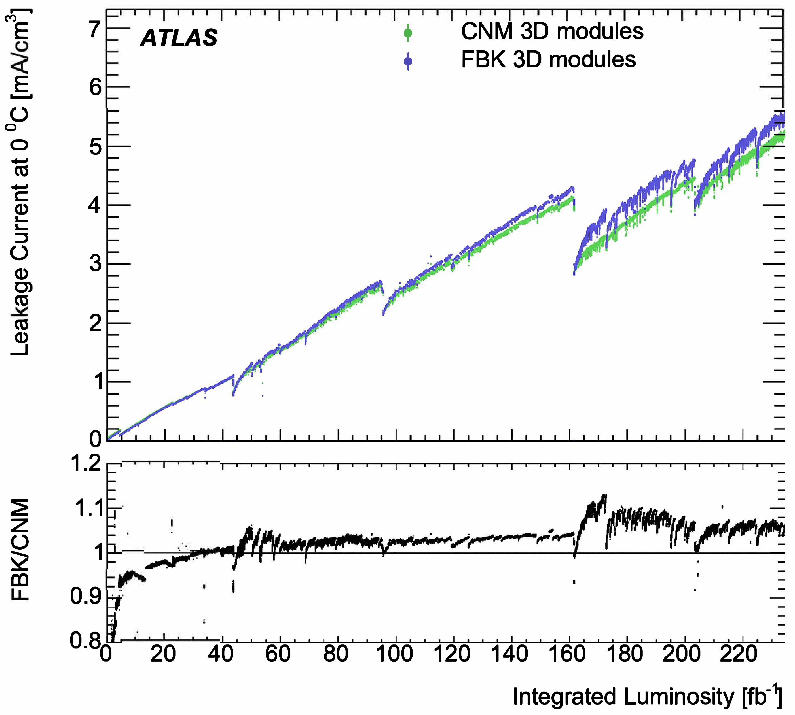
Depletion voltage/Leakage current
Depletion voltage monitoring via bias voltage (HV) scans during collisions (begin/end of each year)
➔ decide the operating bias
voltages for the year ahead.
Depletion voltage in IBL scales linearly with fluence (cooling stability constrains any annealing).
Leakage current monitoring during fills (and via IV scans) ➔ linear increase with integrated lumi.
Making sure we have enough headroom till the end of Run 3.
Leakage current data used to extract fluence seen by the detector.
IBL 3D
9

Slide 10
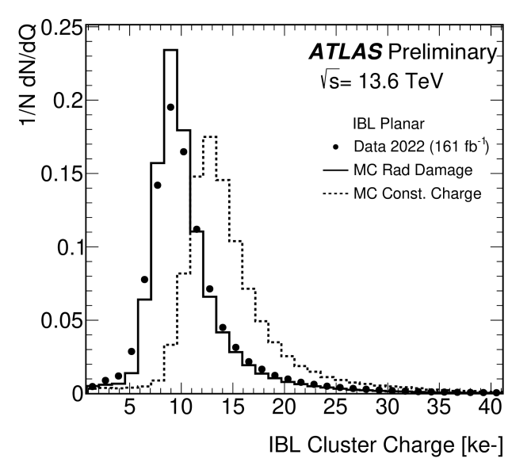
Fighting radiation damage: configuration
Module configuration initially used to accommodate for readout problems, typically correlated to bandwidth consumption.
  Read out speed, Front-end latency, TOT target point for MIP ,Threshold modulation vs η, ..
Impact of radiation damage on cluster charge becoming evident by end of 2017.
➔ Sensor bias voltage and analog thresholds updated yearly!
Bias Voltages
 | 2015 |  | 2024
IBL-Planar | 80 V | .. | 450 V
IBL-3D | 20 V | .. | 70
B-Layer | 250 V | .. | 500 V
Layer 1 | 150 V | .. | 350 V
Layer 2 | 150 V | .. | 350 V
Disks | 150 V | .. | 350 V
Gradually increased, typically at the begin of each year
Analog Thresholds
 | 2015 |  | 2024
IBL | 2500e | .. | 1500e
B-Layer | 3500e | .. | 4700e
Layer 1 | 3500e | .. | 4300e
Layer 2 | 3500e | .. | 4300e
Disks | 3500e | .. | 4300e
Increasing or decreasing depending on readout limitations or radiation damage
Cluster charge from data doesn’t match anymore the MC with constant charge..
10

Slide 11
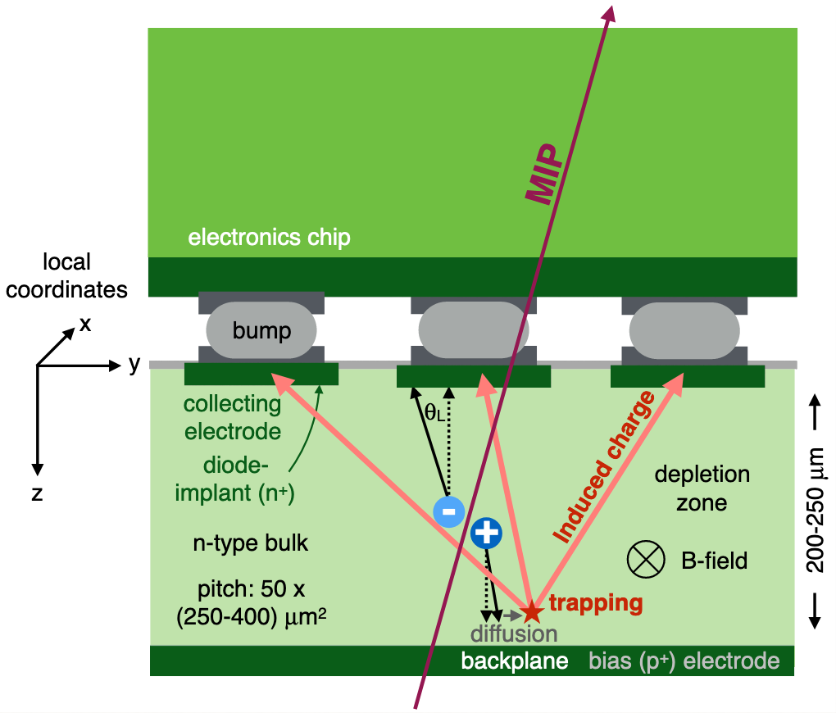
Modeling the radiation damage: MC
Development of new radiation damage (digitizer) MC.
Extensive validation of the new digitizer
➔ official ATLAS Run 3 MC.
Exploit the radiation damage MC to train our clustering/tracking algorithms (NN).
Extrapolate CCE/depletion voltage to the end of Run 3, providing guidance for detector operation (HV, thresholds, tunings points, ..)
Modelling radiation damage to pixel sensors in the ATLAS detector
See poster on Rad. Damage MC from
M. Bomben
➔ CCE ~ 30% at end of Run 3, for both IBL and B-Layer!
~ 3 x 10¹⁵ n-eq cm⁻²
~ 2 x 10¹⁵ n-eq cm⁻²
11

Slide 12
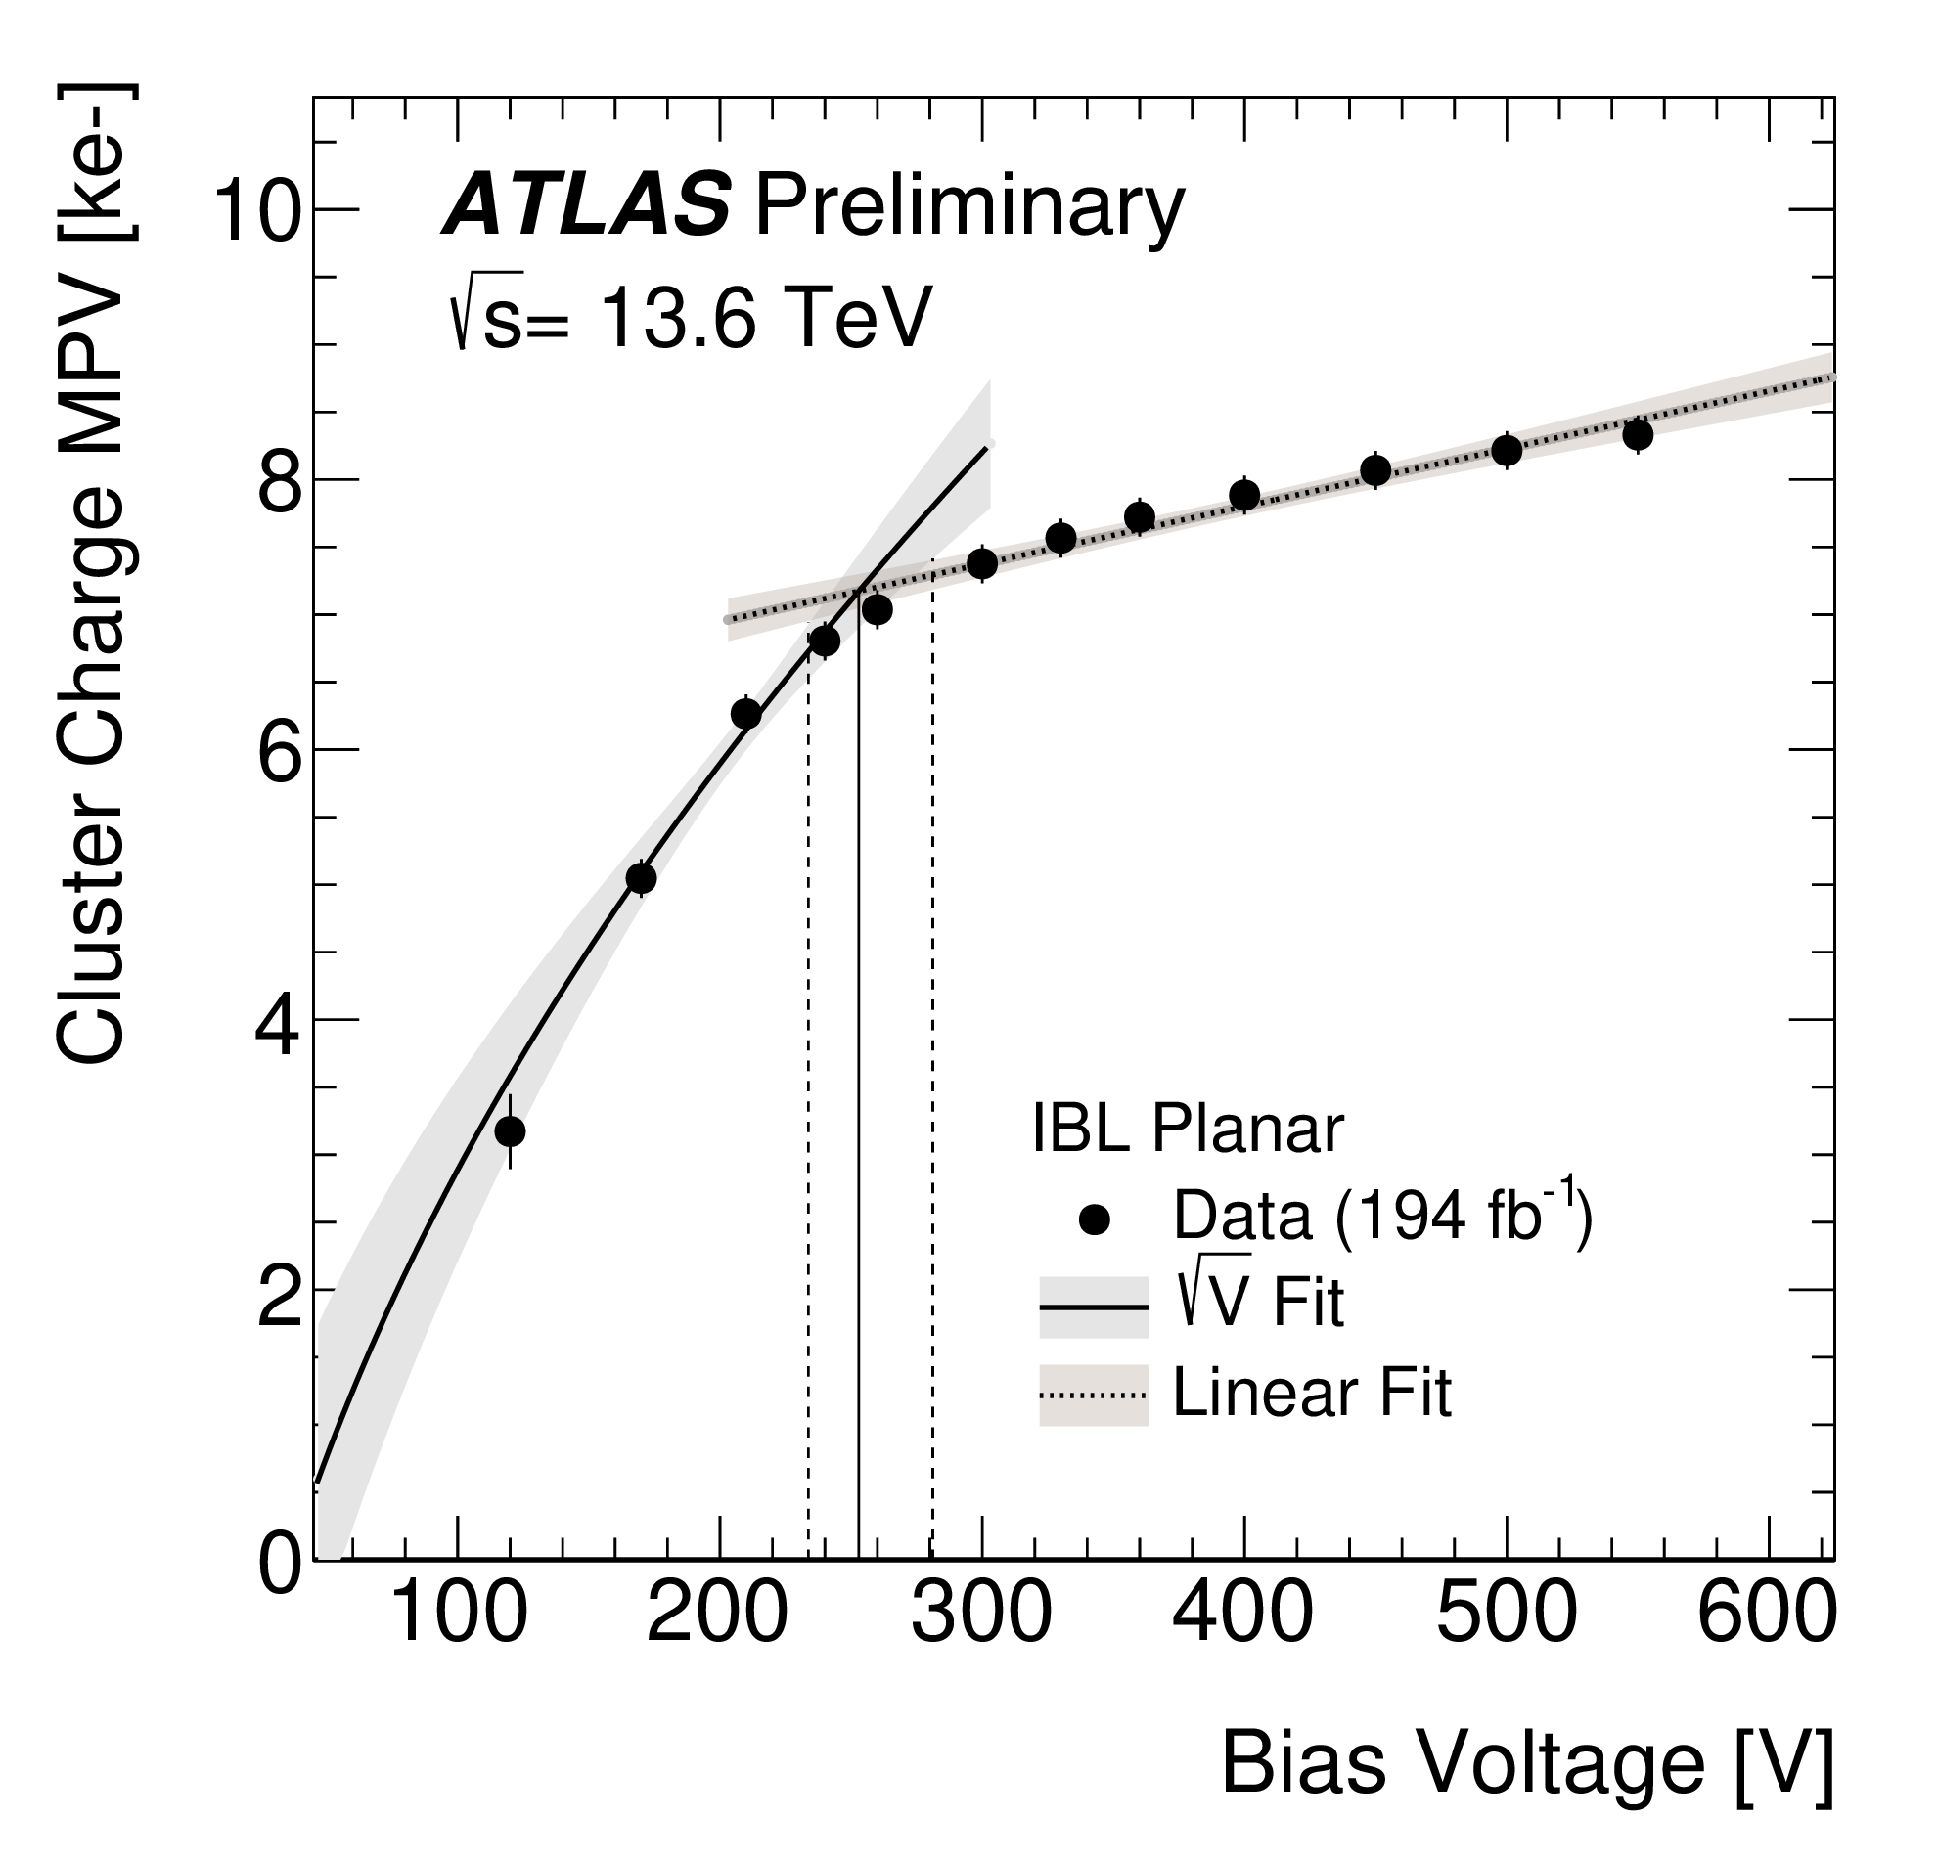
Cluster charge/Depletion voltage
Cluster charge (corrected for Si path) very well reproduced by Radiation Damage MC.
Exploiting the predictive power to check the cluster charge/shape at the end of Run 3.
Extraction of depletion voltage from HV scan during LHC fills.
Good agreement between data and MC (biggest uncertainties from fluence and electron trapping rate).
12

Slide 13
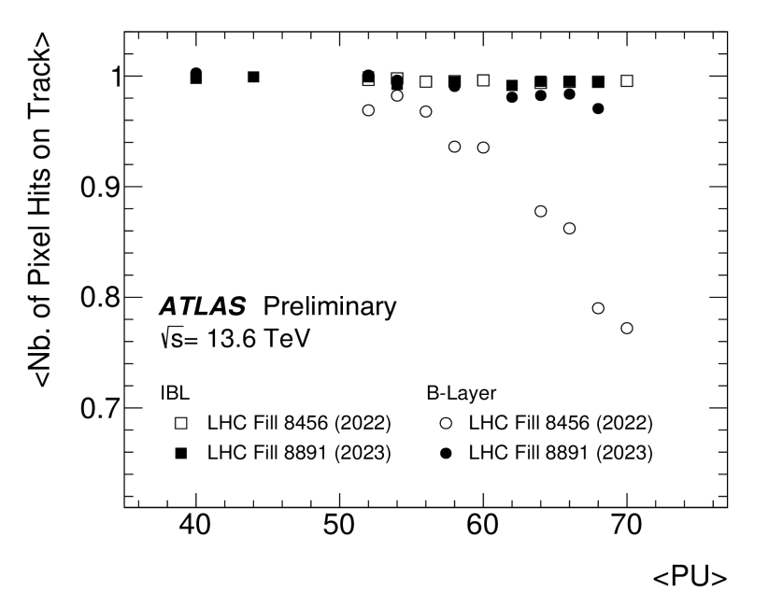
Hits on track efficiency
Run 2:
Readout error age
Run 3:
Radiation damage era
Most of the hit-on-track inefficiencies driven by readout problems (desynch):
particularly relevant for the B-Layer and Endcap, minor for IBL.
Predicting the hit-on-track efficiency by considering the radiation damage on the sensor via cluster charge shrinking below threshold.
μ=64
Extrapolating # Hits-on-track from average 2024 ➔ end of Run 3
(based on LHC “optimistic” scenario, 580 fb⁻¹ at the end of Run 3):
B-Layer 0.97 (2024) ➔ 0.95 (2026)
IBL 0.99 (2024) ➔ 0.96 (2026)
13

Slide 14
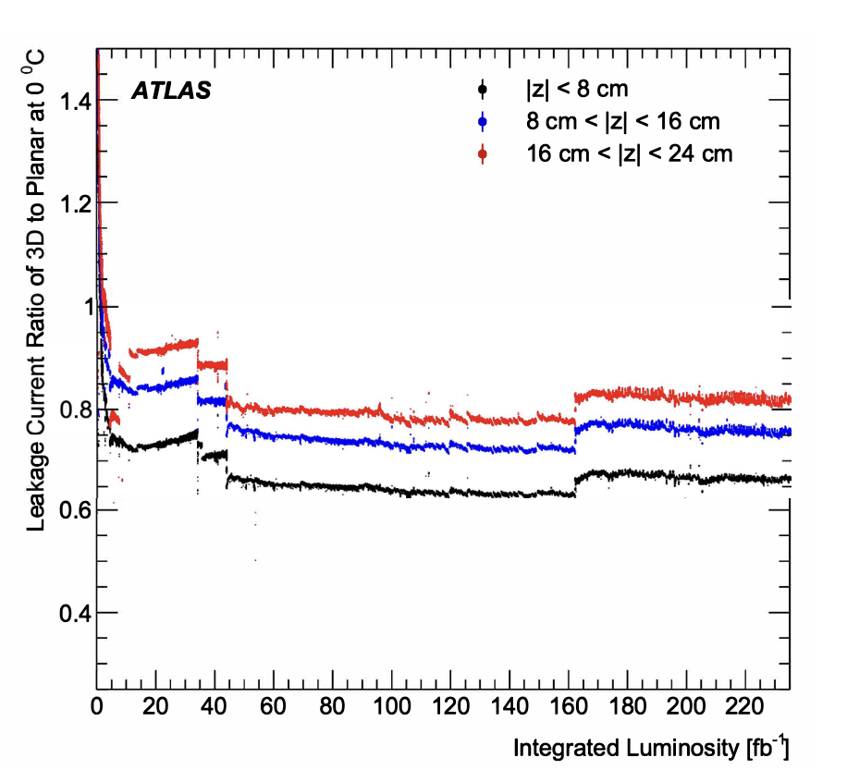
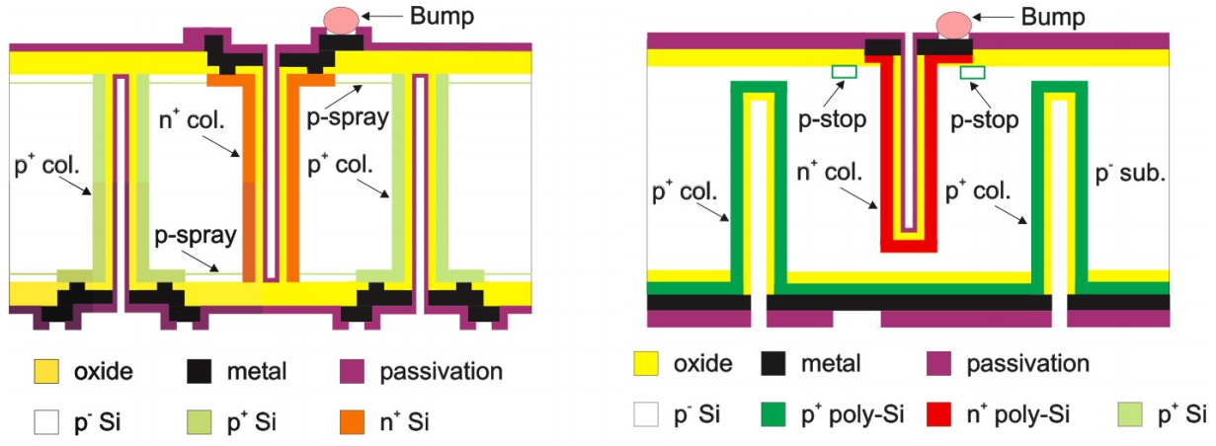
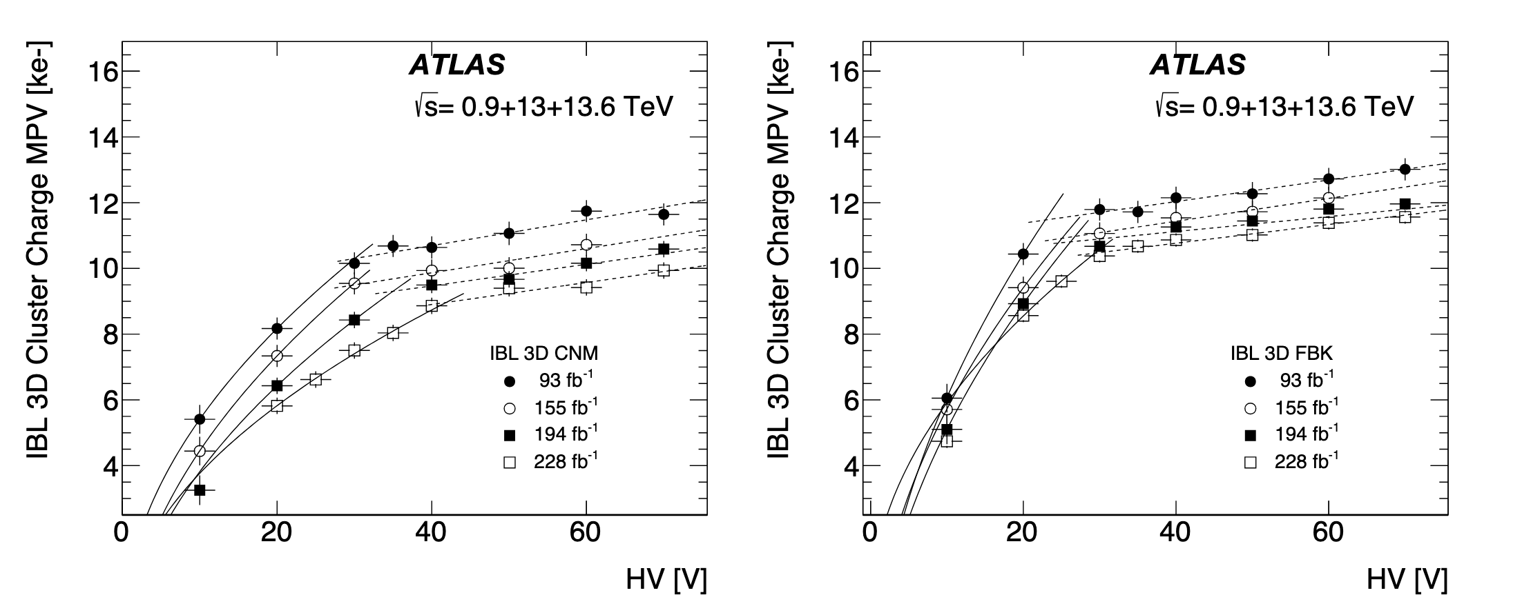
IBL 3D.. or the “ITk inner layer precursor”
3D pixel sensors located at outer ends of IBL staves ( 245<|𝑧|<335 mm or 1.90<|𝜂|<2.55), accounting for LHC beam spot length in 𝑧.
➔ The first large scale 3D pixel detector (0.5 m²) installed at LHC!
Two different designs adopted: full-column (FBK) vs partial (CNM) pass through + other differences like guard rings vs fences or p-stop vs p-spray
Leakage current (for fluence extraction)
HV scans with collisions to monitor the depletion voltage.
Rad Damage model also implemented for 3D sensor (FBK design only).
14

Slide 15
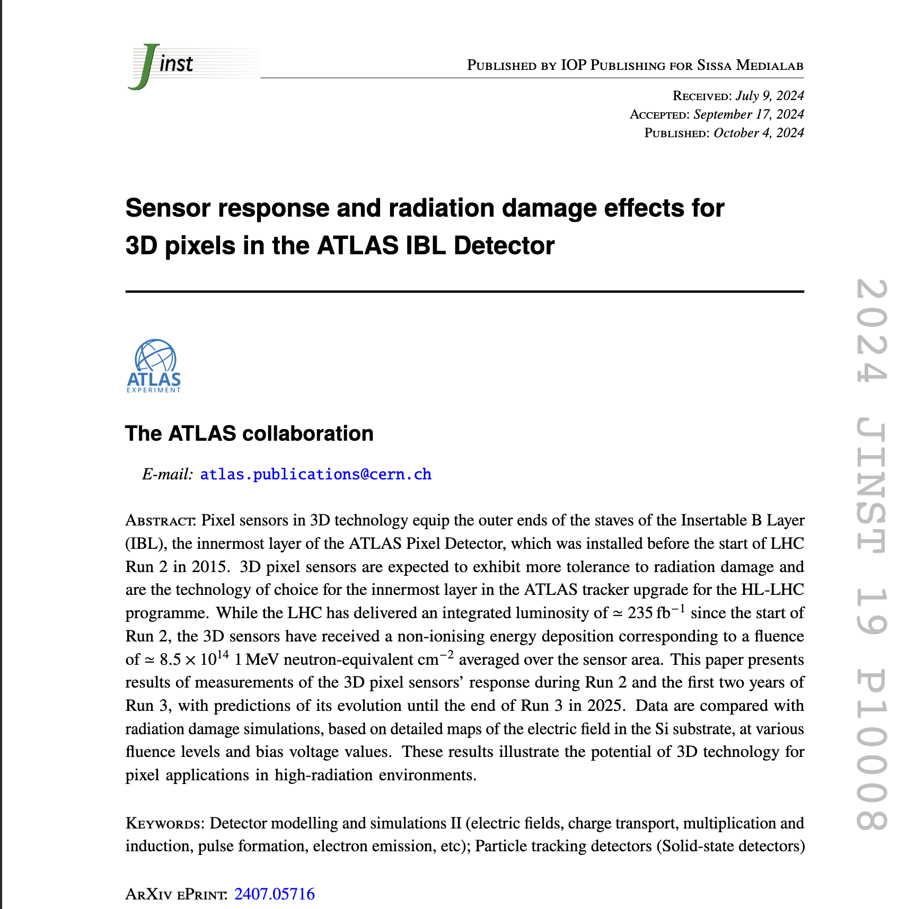
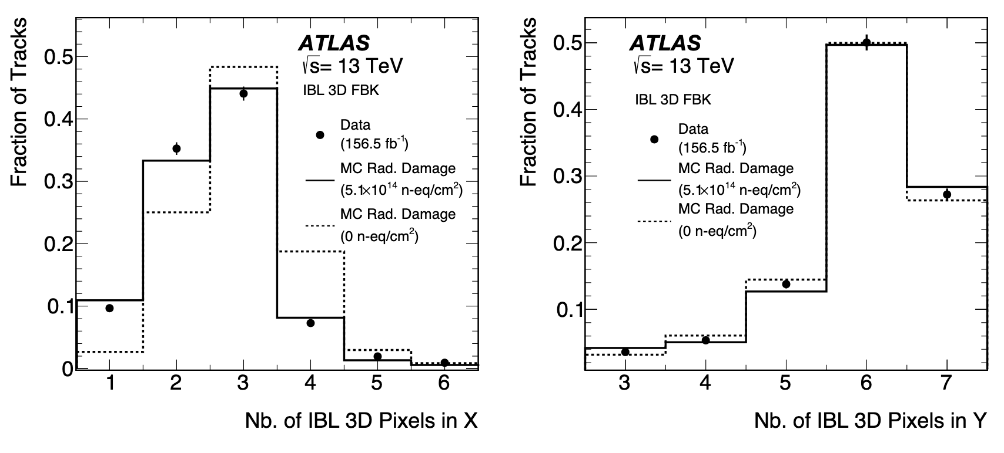
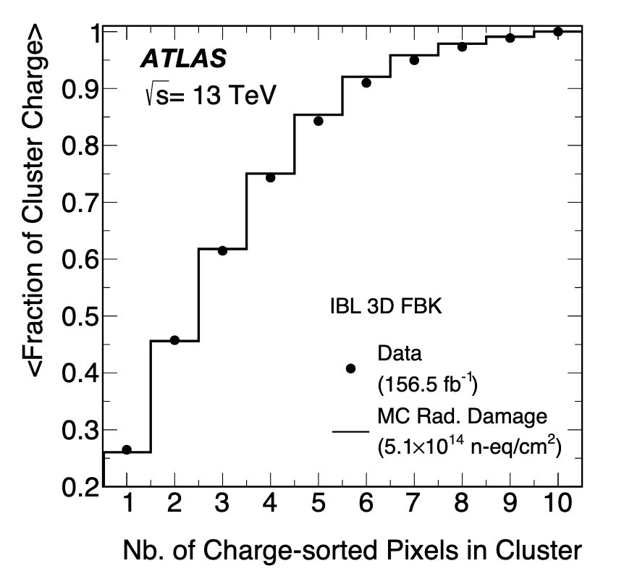
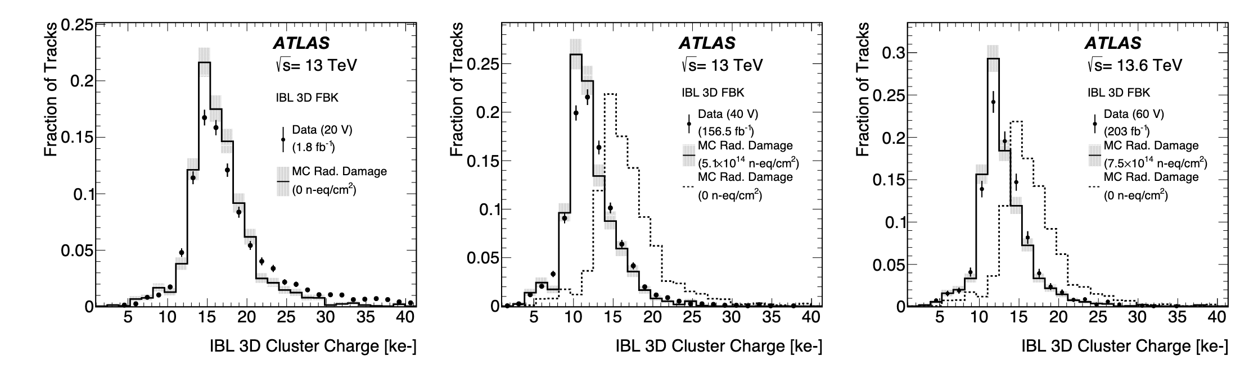
IBL 3D: new Performance Paper
New paper published recently about IBL 3D performance
Good agreement between data and Rad Damage MC that describes well the clusters size (including charge sharing) and the MPV of the cluster charge vs integrated luminosity.
Integrated Luminosity
15

Slide 16
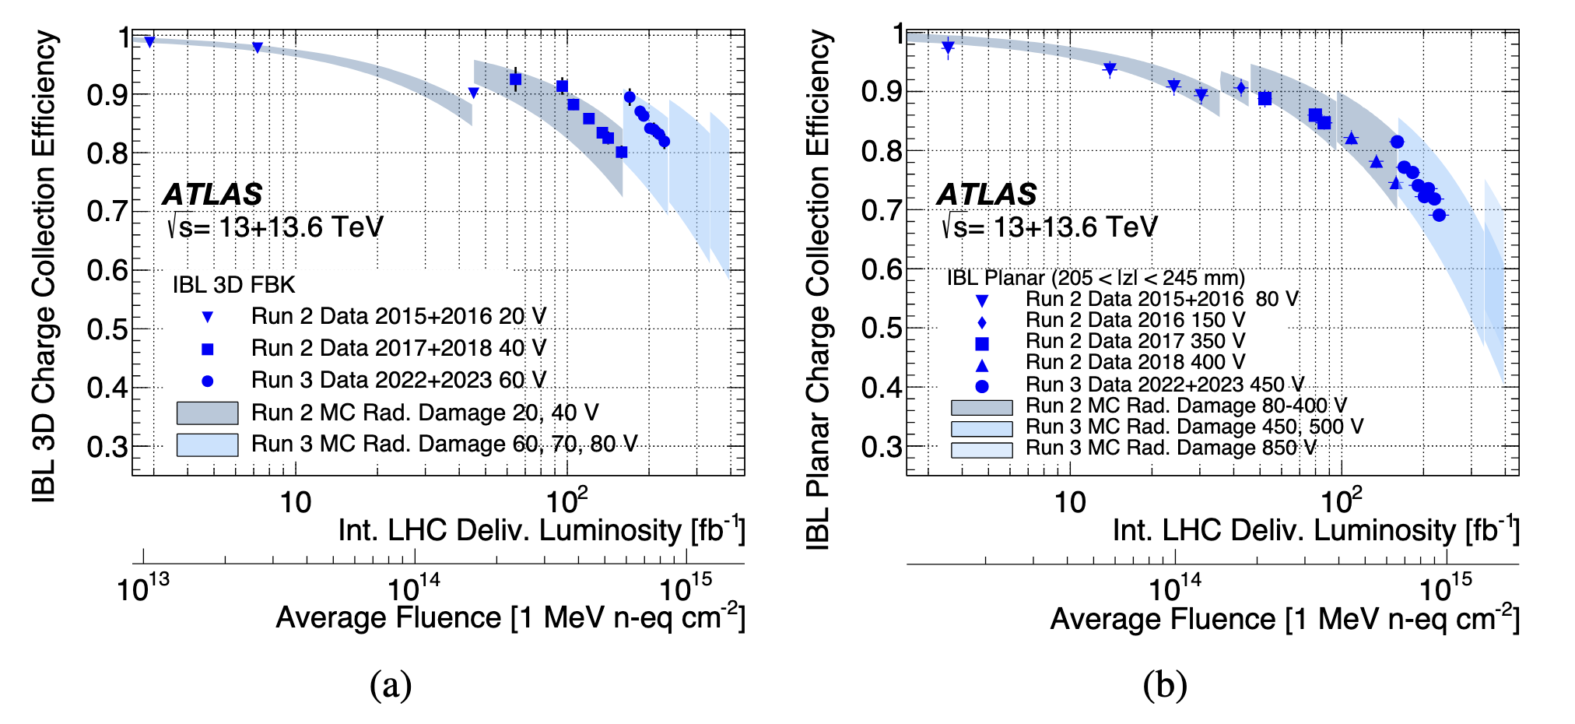
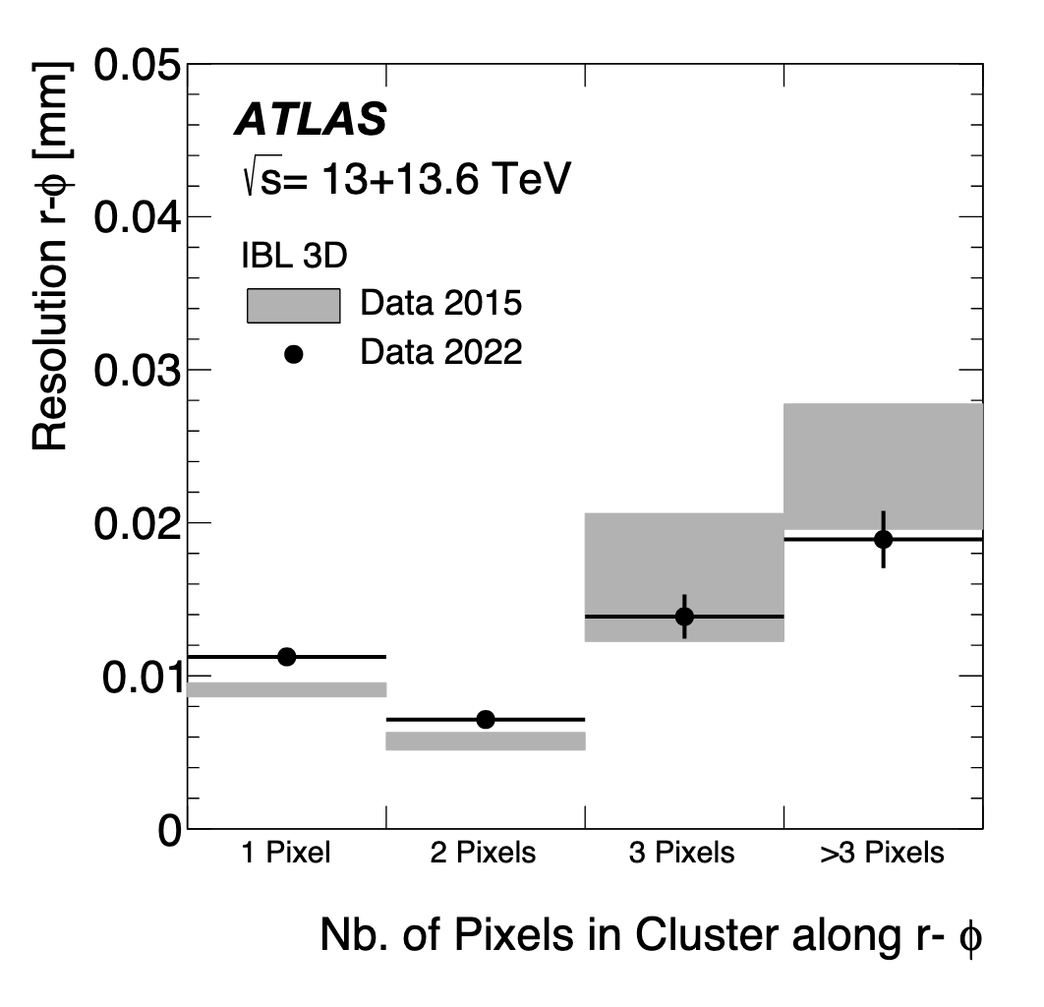
IBL 3D: new Performance Paper
New paper published recently about IBL 3D performance
IBL 3D showing better CCE respect to IBL planar sensors for the same fluence
➔ ~15% less reduction in the CCE at the end of 2023 (~8.3 ×10¹⁴ n_{eq}/cm²).
➔ difference expected to grow to ∼25% at the end of Run 3 (~1.5 × n_{eq}/cm²).
Resolution in r-Φ (using overlap method) averaged over all cluster:
  2015 data (8.6 ± 0.4) vs (8.1 ± 0.3) MC
  2022 data (9.7 ± 0.4) vs (9.1 ± 0.4) MC
Large pixel multiplicity (small incidence angle in longitudinal projections) → the total 3D pixel cluster charge is large → radiation damage effects on resolution are limited.
16

Slide 17
Conclusion and outlook
ATLAS Pixel detector is operating in Run 3 under very challenging conditions (well beyond the design): μ ≳ 60, trigger rate ~ 100 kHz, fluence ≳ 10¹⁵ n_{eq} cm⁻² in the innermost layers.
Detector cooling is very stable, and hardware failures are under control. DAQ and DQ efficiencies (historically affected by dead time and desynchronization) have reached their peak values.
Tremendous efforts on operation (detector configuration optimization) and on DAQ (stabilize/streamline the system), culminated with the deployment of SmartL1 Fw:
➔ Pixel (ATLAS) benchmark for max. operational μ ( → max. instantaneous
luminosity → max. integrate luminosity) increased considerably.
Radiation damage became a fundamental aspects of the detector performance. New radiation damage digitiser developed/included in ATLAS Run 3 MC.
CCE vs fluence for data and radiation damage simulation show good agreement, allowing extrapolations to the end of Run 3. Despite 30% CCE expected at the end Run 3, hits-on-track will remain high (≳ 95%) thanks to detector parameter optimization (HV, Threshold).
New Paper on IBL 3D sensor published: improved response of 3D pixels after 10¹⁵ n_{eq} cm⁻² of fluence, with ~25 % gain in CCE compared to planar sensors at the end of Run 3. Cluster properties well described; 3D sensor spatial resolution not much affected by radiation.
Outlook: Very important experience for HL-LHC tracker upgrades, giving insight about future detector operation, supporting choices for next upgrade phases.
Ready to face more radiation till mid 2026 and test the ultimate conditions!
17

Slide 18
Back-up

Slide 19
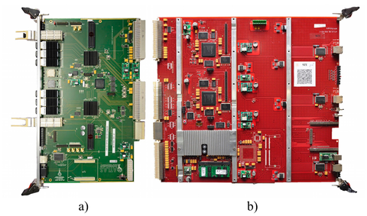
Pixel Detector Read Out Upgrades
The Run 1 Pixel read-out system went through a series of upgrades using the new IBL read-out:
  Layer2 (2015/2016 Winter Shutdown)
  Layer1 (2016/2017 Winter Shutdown)
  B-Layer/Disks (2017/2018 Winter Shutdown)
Overcome bandwidth limitations but also enhance debugging capability and Sw/Fw flexibility.
Finally in 2018, one unified read-out system that brought Pixel many advantages:
  the operation of different type of FEs will always be there but…transparent for most of the operations!
19

Slide 20
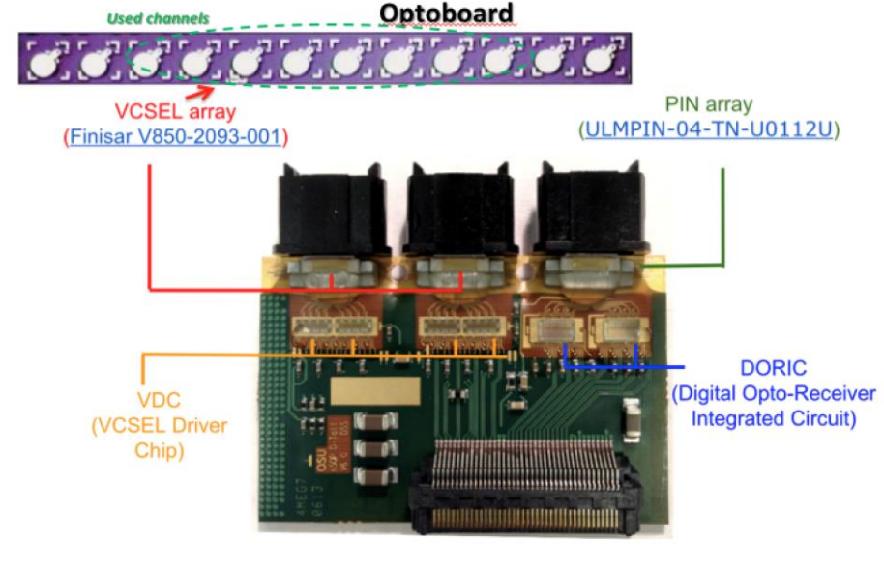
Opto-Board replacement during LS2
Relevant number of VCSEL (laser array) failures during Run 2 (~3%).
  humidity being the main suspect.
New Opto-Board production (with new VCSELs) ➔ >400 qualified.
Selective replacement done (178 OBs) in February 2021.
  replacement of OBs hosting dead VCSELs (25 modules recovered) or VCSEL alive with a shifted optical spectrum.
Sealing of Optoboxes (hosting OBs) to keep the boards dry (humidity concern).
➔ no failures observed so far!
OFF-DETECTOR electronics
Optical fibers
(~ 100 m)
Copper cables
(a few m)
ON-DETECTOR electronics
20

Slide 21
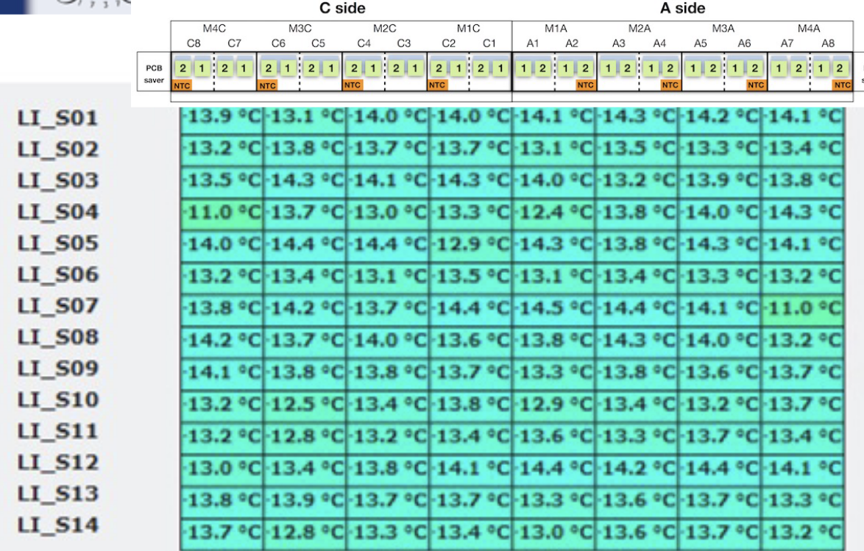
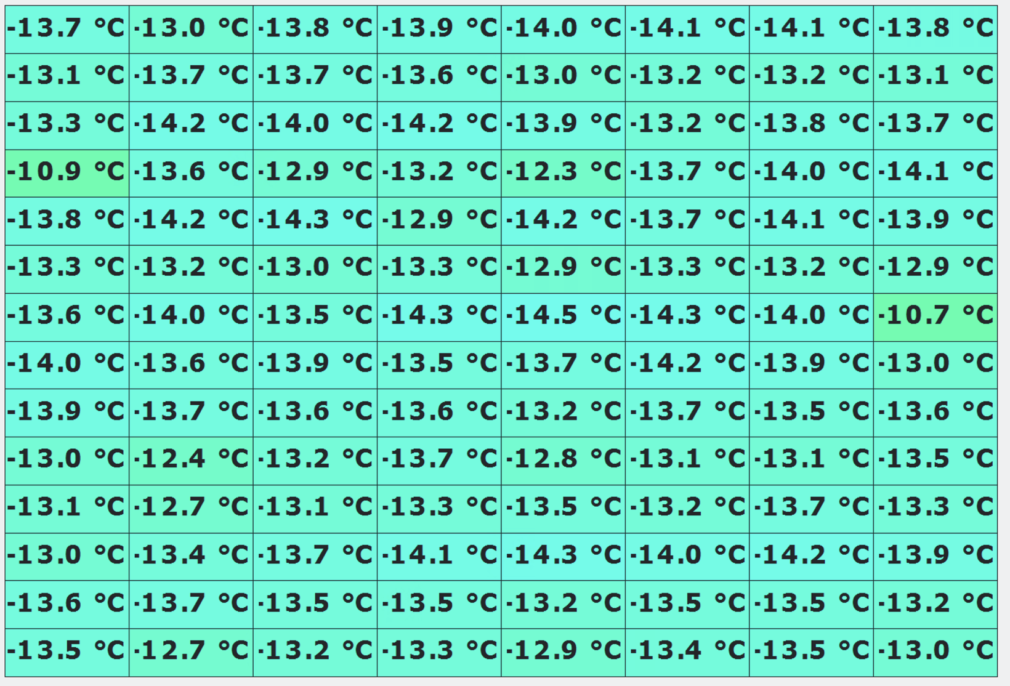
Pixel detector status: Cooling
  Detector kept cold most of the time.
    Pixel (and strips) uses C₃F₈ evaporative whilst IBL uses CO₂ bi-phase cooling ➔ very stable so far.
  A new thermosiphon system (instead of standard compressors) was developed and used in Run 3 (shared between Pixel and strips).
IBL Temperatures measured
on module flex (NTC)
Typical temperature set points | PIXEL | IBL
Detector ON | -20 ºC /-25 ºC | -20 ºC
Detector OFF (winter shutdowns) | -5 ºC | -7.5 ºC
rΦ
Resolution To be improved
(Marcello)
z
21

Slide 22
Pixel detector status
Rx Plugins failures (off-detector electronics, receiving data from modules) ➔ not fully understood but easily replaceable and relatively small fraction.
NTC failures (increasing with accumulated radiation)
➔ causing temperature interlock, loosing temp. readout in single modules.
Other module failures (HV open, not configuring, no data..) under control:
➔ a few modules (6) recently recovered in Ly1 using redundancy lines/fibers
(readout speed had to be reduced from 160 mbps to 80 mbps).
Layer | 2018 |  | 2023 |  | 2024
 | Disabled/Total | % | Disabled/Total | % | Disabled/Total | %
Disks | 15/288 | 5.2 | 13/288 | 4.5 | 16/288 | 5.5
B-Layer | 18/286 | 6.2 | 15/286 | 5.2 | 21/286 | 7.3
Layer 1 | 29/494 | 5.8 | 22/494 | 4.4 | 18/494 | 3.6
Layer 2 | 33/676 | 4.8 | 43/676 | 6.3 | 50/676 | 7.4
Total (Pixel) | 95/1744 | 5.4 | 93/1744 | 5.3 | 105/1744 | 6.0
IBL (Frontends) | 3/448 | 0.7 | 4/448 | 0.9 | 4/448 | 0.9
Total | 98/2192 | 4.5 | 97/2192 | 4.4 | 109/2192 | 5.0
95% detector working fraction!
22

Slide 23
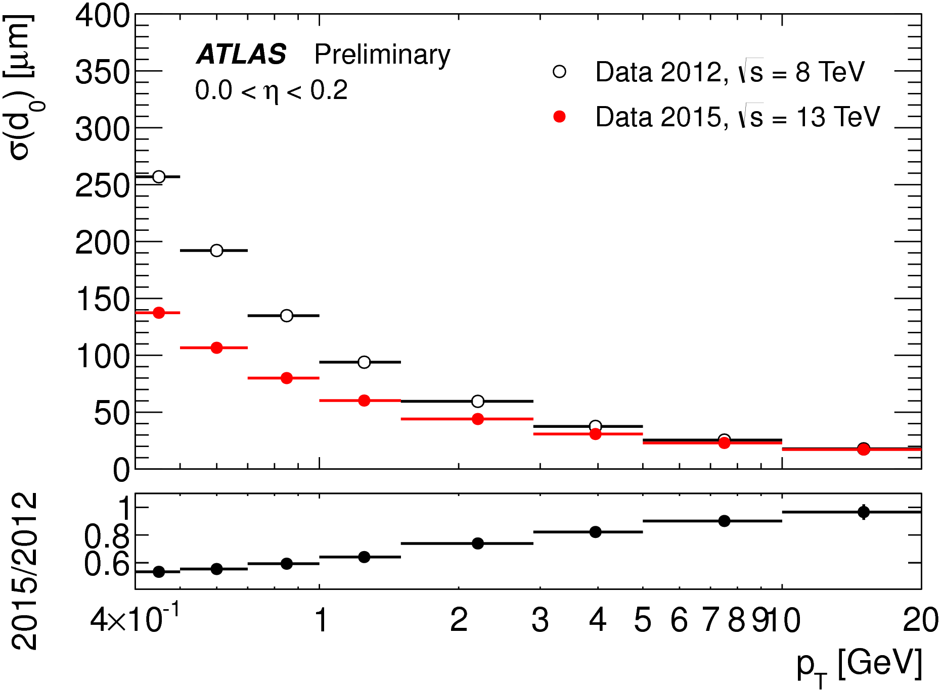
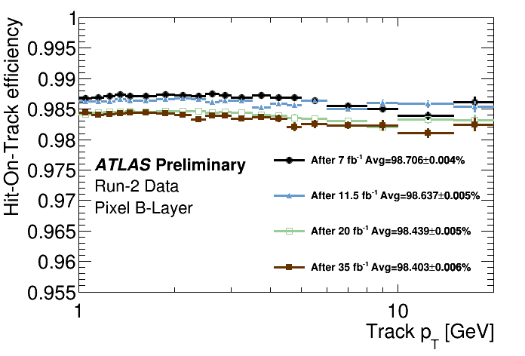
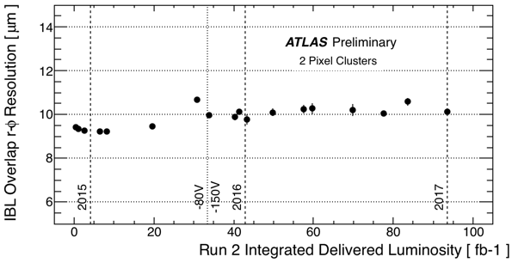
Pixel performance in Run 2
Impact parameter resolution improvements after IBL insertion (2015)
B-Layer Hit-on-track efficiency > 98% (2016)
IBL spatial resolution (transverse R-φ plane) ~< 10 μm over Run 2.
23

Slide 24
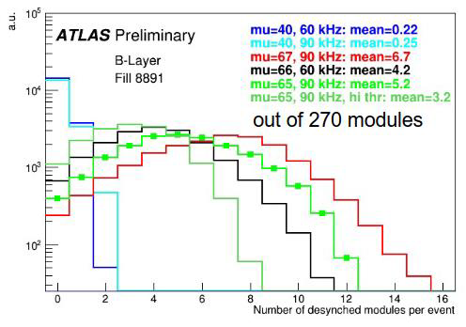
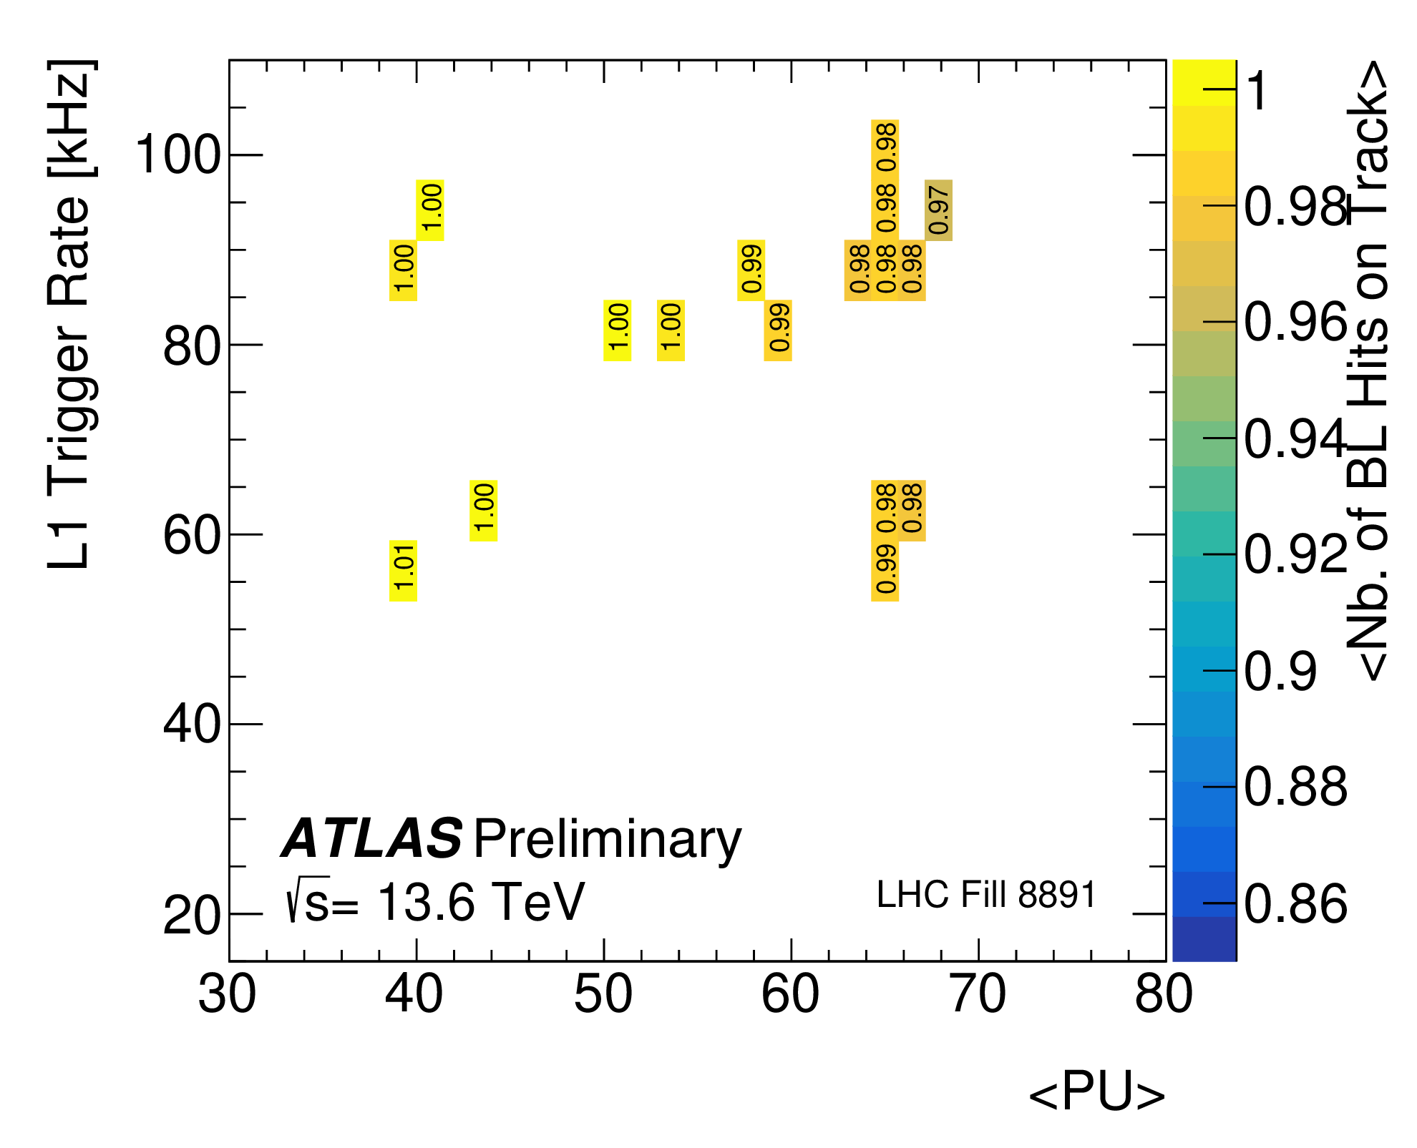
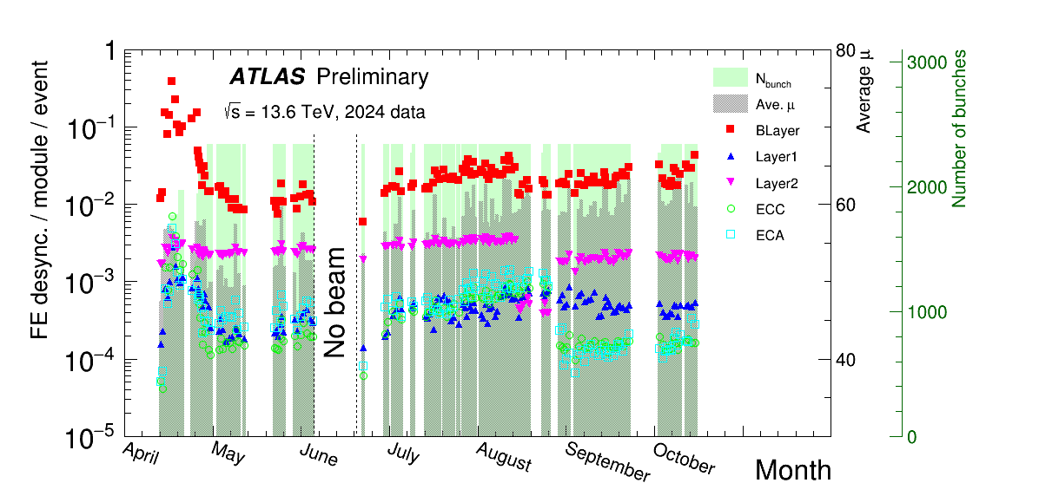
Pixel operation: FE Desynch
Remaining de-synchronization is internal to the modules (16 FEs sharing the same micro-controller chip - MCC )
Single FE can desynchronize, until next ATLAS Event Counter Reset (ECR), issued every 5 seconds.
Increasing thresholds can mitigate the desync, as far as don’t impact cluster properties/hits-on-track efficiency.
Direct relation between desynchronization and lack of hits-on-track
  Problem typically correlated with high-rate/mu ➔ high bandwidth consumption.
  Present also in fills with low #bunches and high mu ➔ related to spacing of triggers.
1%
24

Slide 25
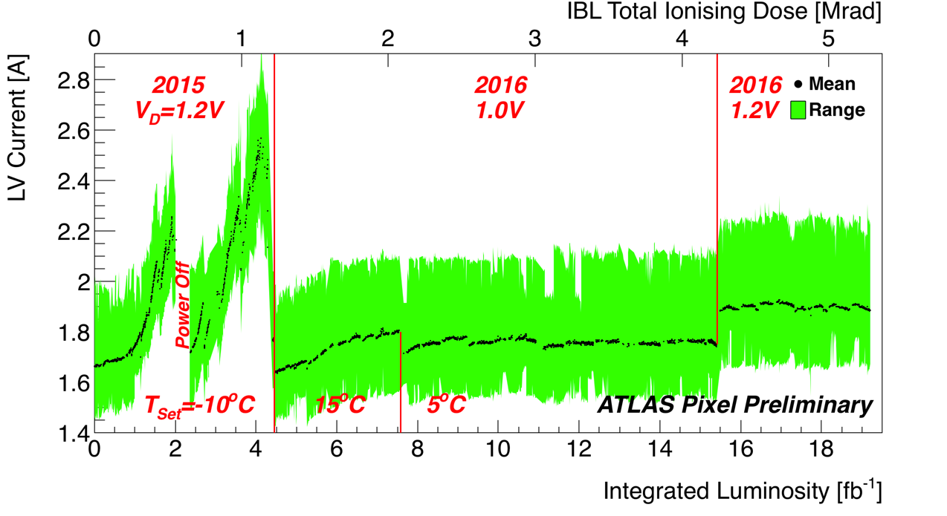
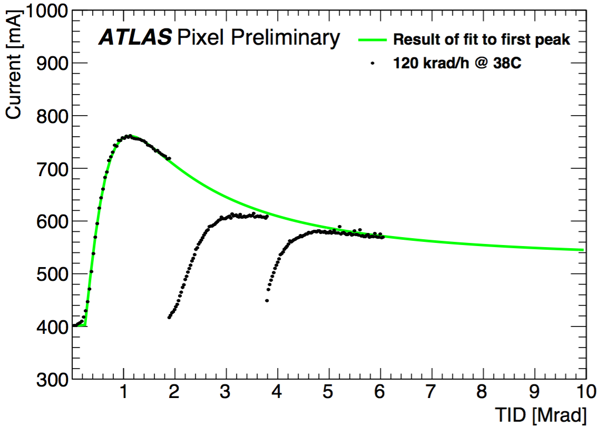
IBL TID at the begin of Run2
IBL Total Ionizing Dose (TID) effect causing relevant increase of FE-I4 currents
  "Production and Integration of the ATLAS Insertable B-Layer” JINST paper for more info about IBL
Induced by the usage (~Millions) of 130 nm IBM transistor technology
  Known to have a special leakage current evolution
25

Slide 26
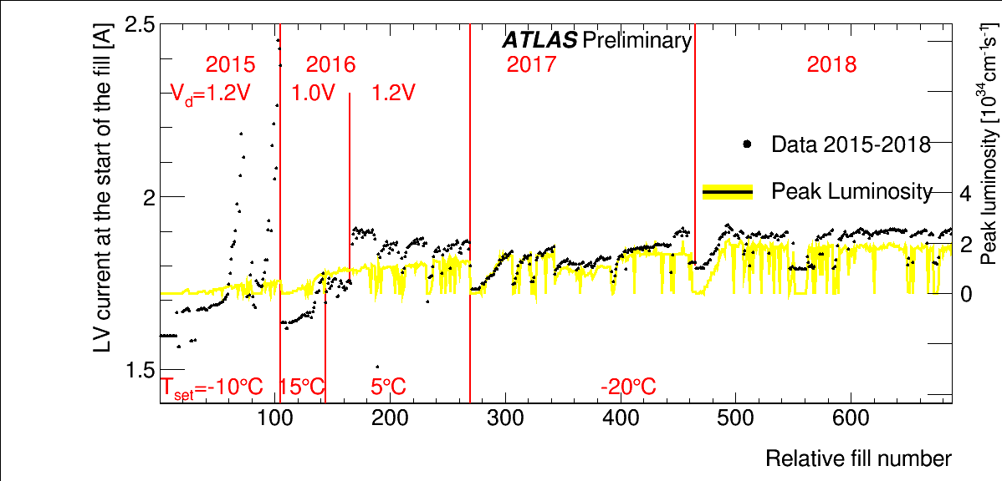
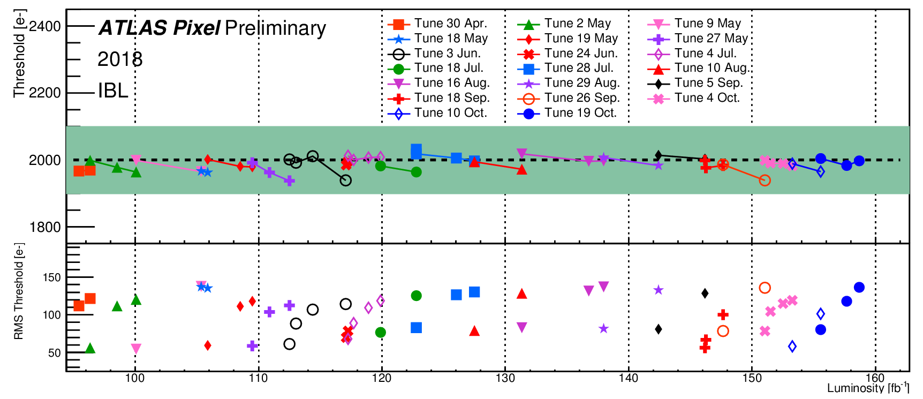
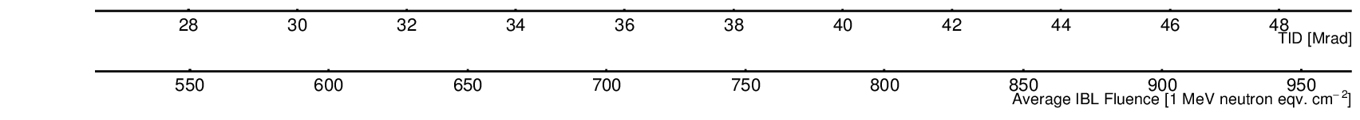
Impact of radiation on FE electronics: TID
LV power system
➔ Low voltage current
consumption heavily
affected (2015-2016)
➔ under control by 2017,
when correlation with
Inst Luminosity become
finally visible
(digital activity in the chip)
FE-I4 (De)Tuning
drift of Thresholds and Time-Over -Threshold
(TOT)
regular (~weekly)
re-tuning needed
during Run 2!
26

Slide 27
Radiation on FE electronics: SEE
Big charge deposit in FE electronics can flip the state
of global/local memory cells
IBL FE-I4 affected by SEE already in 2017
➔ periodical reconfiguration of FE global registers.
Higher luminosity fill in Run 3
➔ SEE becoming relevant in single pixel latches!
  noisy pixels ..firing whilst they should be masked.
  quiet pixel ..stop firing during a fill.
Solution: periodical reconfiguration of single pixel registers ➔ clear gain observed during test run (2018).
Measurements of Single Event Upset in ATLAS IBL
IBL
Run 3 strategy:
full FE reconfiguration
(completed gradually in ~11 minutes, without adding extra dead time to ATLAS)
27

Slide 28
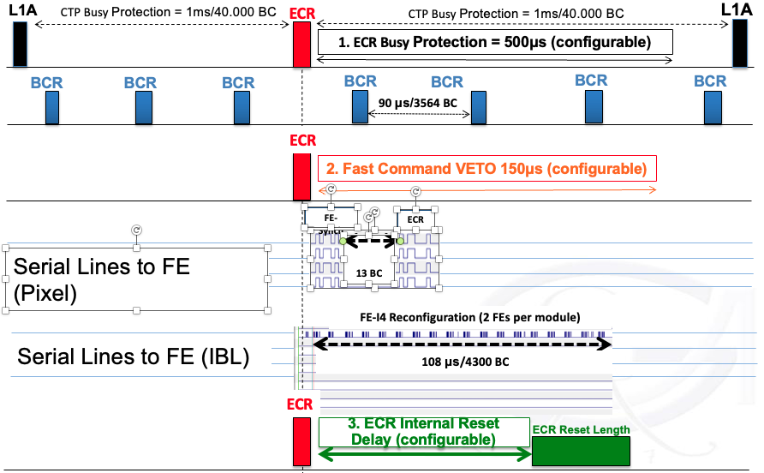
IBL register reconfiguration @ECR

Slide 29
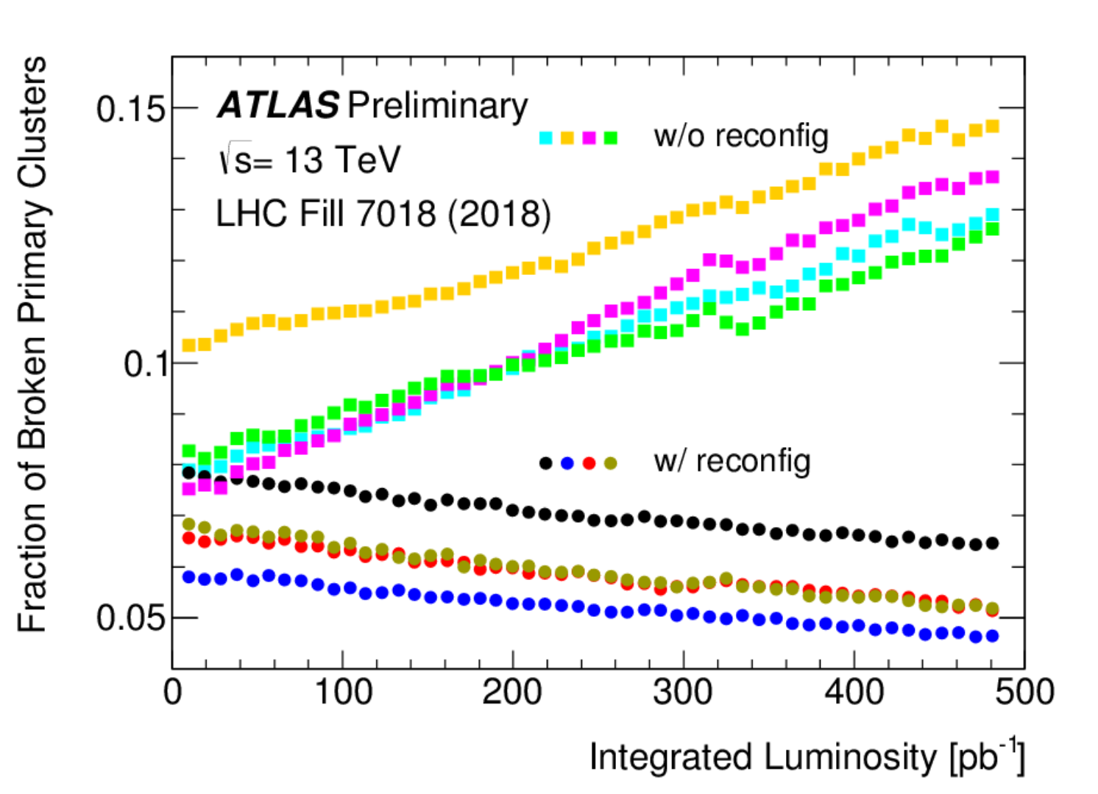
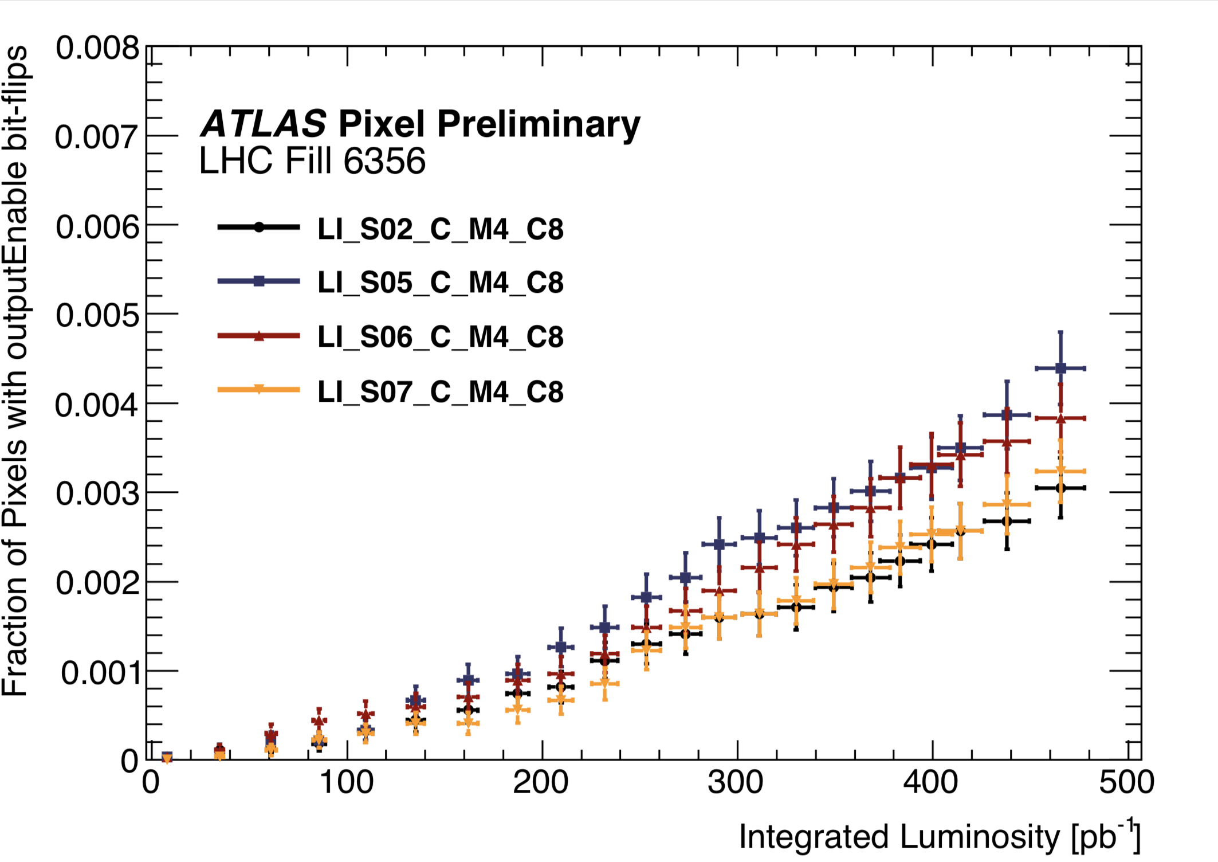
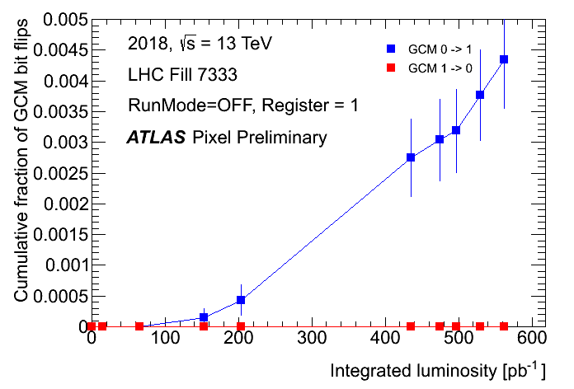

FE-I4 SEU studies
29

Slide 30

Impact of radiation on sensor
dE/dx and cluster size decrease due to the decreased charge collection efficiency (slow slope).
HV (threshold) increase (decrease) shows gain in dE/dx.
  however, thresholds increased in 2016 due to bandwidth limitations (B-Layer).
Charge collection constantly measured via HV scans
  MPV of the fitted Landau cluster charge affected
  ➔ decrease of plateau.
30

Slide 31
Fighting radiation damage: configuration
Readout electronics/services/module configuration were upgraded/replaced/changed to accommodate for bandwidth limitations, hardware failures, radiation damage.
  Read out speed, Front-end latency, TOT target point for MIP ,Threshold modulation vs η, ..
Sensor bias voltage (HV) and analog thresholds updated yearly!
Run 2
Run 3
 | 2015 | 2016 | 2016 | 2017 | 2018 |  | 2022 | 2023 | 2024
IBL-Planar | 80 V | 80 V | 150 V | 350 V | 400 V |  | 450 V | 450 V | 450 V
IBL-3D | 20 V | 20 V | 20 V | 40 V | 40 V |  | 60 | 60 | 70
B-Layer | 250 V | 350 V |  | 350 V | 400 V |  | 450 V | 450 V | 500 V
Layer 1 | 150 V | 200 V |  | 200 V | 250 V |  | 300 V | 350 V | 350 V
Layer 2 | 150 V | 150 V |  | 150 V | 250 V |  | 300 V | 350 V | 350 V
Disks | 150 V | 150 V |  | 150 V | 250 V |  | 300 V | 350 V | 350 V
Bias Voltages
 | 2015 | 2016 | 2016 | 2017 | 2018 |  | 2022 | 2023 | 2024
IBL | 2500e | 2500e |  | 2500e | 2000e |  | 1500e | 1500e | 1500e
B-Layer | 3500e | 3500e/5000e |  | 5000e | 5000/4300e |  | 4300/ 3500e | 4700e | 4700e
Layer 1 | 3500e | 3500e |  | 3500e | 3500e |  | 3500e | 4300e | 4300e
Layer 2 | 3500e | 3500e |  | 3500e | 3500e |  | 3500e | 4300e | 4300e
Disks | 3500e | 3500e |  | 3500e | 3500e |  | 3500e | 4300e | 4300e
Analog Thresholds
31

Slide 32


Pixel “Hybrid” threshold
Keep adjusting threshold and HV but…
limitations on the read-out bandwidth if thresholds decreased too much!
* central Eta: 4300e high Eta: 5000e
Run 2 Bias Voltage Evolution
ATLAS Run2 benchmark
L1Trigger = 100 kHz
<μ> = 60
➔Module to read-out system
bandwidth usage needs to stay within 80%
32

Slide 33

Pixel Leakage currents
Measured leakage currents quite well described (annealing, temperature dependence) by the Hamburg Model but:
  scaling factor per layer and z bin is required
  towards the end of Run 2, the leakage currents seem overestimated.
Pixel: Leakage current per module expected at the end of Run 3
within the power supply limitation (< 2 mA per sensor).
33

Slide 34

Fighting the reverse annealing
Keeping the detector cold during LS2 to prevent reverse annealing
➔ keep the depletion voltage
under control (B-layer, IBL).
Warm up periods unavoidable due to the ID maintenance during LS2
Target to stay warm for < 60 days during the LS2.
Detector warm for 43 (23) days in Pixel (IBL)
Exploring colder operating set points
(-25ºC/-30ºC).for late Run 3.
34

Slide 35

Radiation damage MC
New Pixel digitization model was developed and is now under validation before entering the official ATLAS simulation
Recent paper available here: JINST 14 (2019) 06 P06012
Charge carriers will drift toward the collecting electrode due to electric field, which is deformed by radiation damage (double peak).
Their path will be deflected by magnetic field (Lorentz angle) and diffusion.
Electron and hole lifetime inversely
proportional to fluence:
➔ charge trapping,
➔ reduction of the collected charge.
Available for both Planar and 3D sensors.
➔ due to performance constraints (CPU),
not used in IBL 3D and Pixel Disks
35

Slide 36



Modelling the radiation damage in the sensor
36

Slide 37


z-dependence comparisons
Fluence-to-luminosity conversion factors extracted from the leakage current, Lorentz angle and Depletion Voltage measurements:
less fluence at at high |z| on IBL data respect to Pythia + FLUKA/Geant4 predictions
more flat distributions in outer Pixel layers.
37

Slide 38


Outer Pixel layers
38

Slide 39


PUB Note on first Run 3 collisions
End of LS2 (cosmics) and begin of Run 3 (900 GeV collisions) used to test new configurations with increased HV and lowered thresholds.
Effect of radiation damage on cluster charge data, very well reproduced by new Radiation Damage MC!
Fraction of tracks with Pixel hits slightly affected in the central part of the detector (short silicon path traversed and higher radiation damage).
HV | Run 2 (End Of) | Run 3 (Start of)
IBL Planar IBL 3D | 400 V 40 V | 450 V 60 V
B-Layer | 400 V | 450 V
Layer 1 | 250 V | 300 V
Layer 2 | 250 V | 300 V
Disks | 250 V | 300 V
Performance of ATLAS Pixel Detector and Track Reconstruction at the start of Run 3 in LHC Collisions at 900 Gev
39

Slide 40


Spatial resolution
Spatial resolution (r-phi and z) computed using the overlap region:
  well reproduced by new Radiation Damage MC.
  data improvements by using NN training on Rad. Dam. MC samples.
Limited effect of radiation damage on the tracking performance for the Run 2 fluence: impact parameter d₀ resolution well reproduced by both MC.
40

