Slide 1
From geometries, advanced beam sources to multi-dimensional actors Current developments employing the new OpenGATE at the Medical University of Vienna
H. Fuchs
Department of Radiation Oncology, Medical University of Vienna

Slide 2
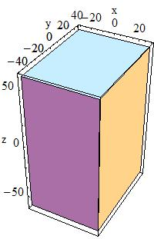
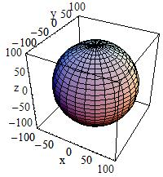
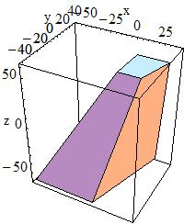
Complex geometries
New OpenGate10
Many geometries out of the box
Box, sphere, advanced trapezoids..
Even images (CT, mhd)
You can even add/subtract volumes
What else is needed?
You might get any shape
It could be a lengthy way

Slide 3
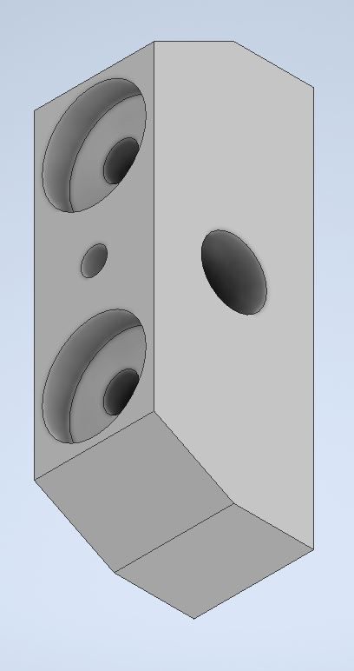
Complex geometries II
This object can be constructed using boolean operations
But why?
Most complex objects to simulate exist as computer aided design (CAD) files
Standard Triangle Language (STL)
Objects described with multiple triangles
Standard exchange format
For 3D printers, Inventor, AutoCAD etc
Read STL files directly with OpenGATE

Slide 4
Complex geometries III
New geometry object „Tesselated“
Reads STL files
No material -> must be defined
Works like the other geometries
A similar thing exists in Gate v9
Documentation available, example test067_stl_volume
Question
STL is designed for a single component
Multiple components including materials in a STEP file
Is there interest?

Slide 5
Advanced phase space source I
Employ phase space files
Store all particles going through a volume
Initial particles and secondaries as well
Data is stored in root files
Use these for your simulation
Previous (Gate v9) phase space source lacked features
Extended phase space source “PhaseSpaceSource”

Slide 6
Advanced phase space source II
Allows rotation/translation of source
Simulate the correct number of primary particles
PDGCode
Energy threshold
Other particles simulated, but not counted in number of particles to simulate
Multi-threaded
Starting index can be supplied “entry_start”
Documentation available, example test019 and test060

Slide 7
treatmentPlanPhsSource
You want to simulate an iontherapy treatment plan?
Use ionbeamtherapy package in the contrib folder
Can read treatment plans (Thx to MedAustron team)
Needs a beam modell
Works perfectly
What if you want to be more realistic?
Modell your nozzle
What if
it is confidential or
you want to modell a secondary energy spectra?

Slide 8
treatmentPlanPhsSource II
Employ phase space files
Store all particles going through a volume
Initial particles and secondaries as well
Data is stored in root files
Create a phase space file for every monoenergetic energy
Use these to simulate your treatment plan
Compatible with iontherapy package “treatmentPlanPhsSource”
Same options
Plus all features of phase space source
Documentation available, example test060

Slide 9
Multidimension images: Motivation
Biological effects actor development
Lineal energy seems to be an interesting approach
Direct simulation of lineal energy not feasible
AMDM
Using tabulated values
2 parameters per voxel in 11 bins
Currently under development
Output data
3 physical dimensions
Plus two vector dimensions or 3 dimensions
Parisi et al. J. Appl. Clin. Med. Phys. 2023 (24)

Slide 10
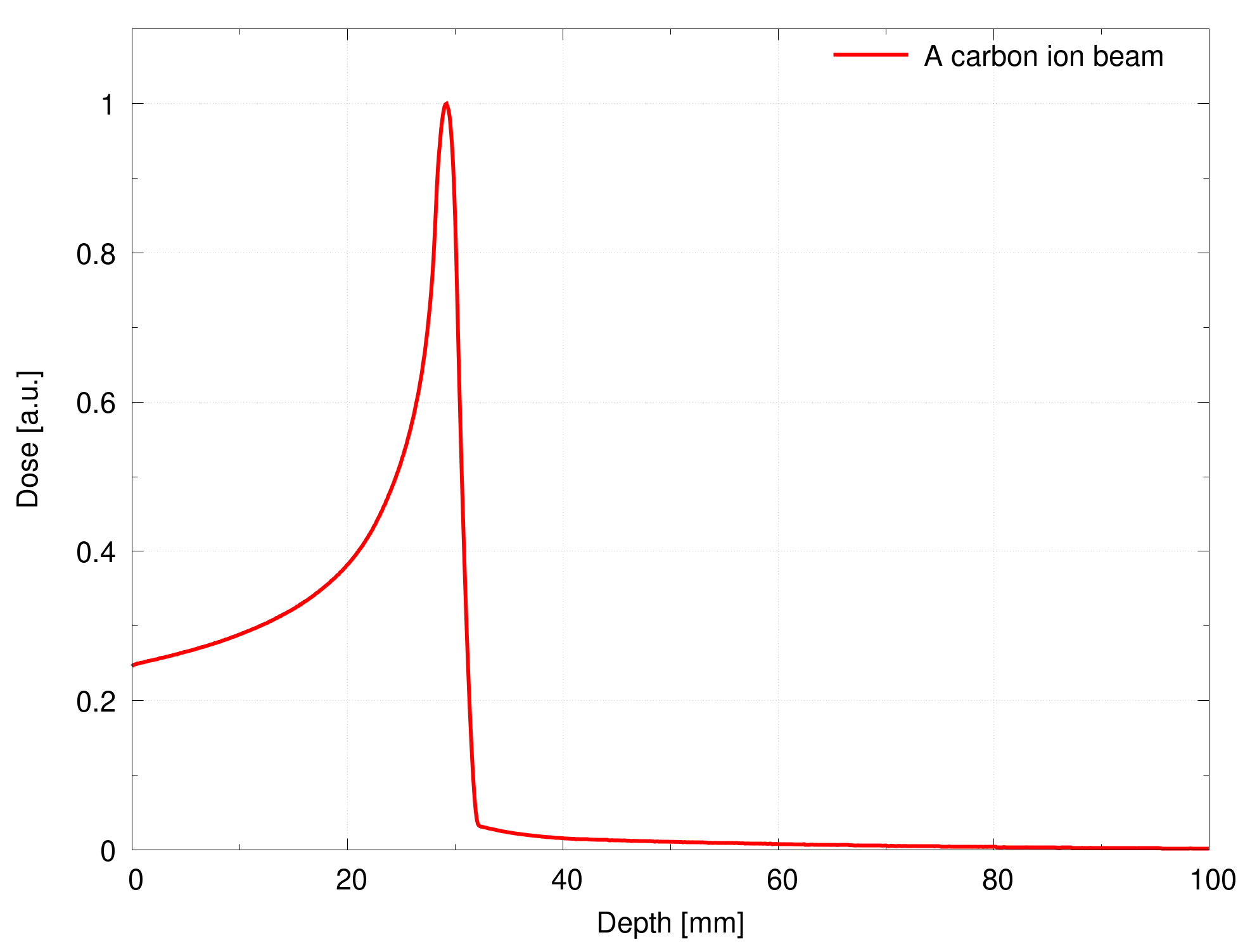
Multidimensional images
An image is a multi-dimensional array
plus some additional information (Offset, resolution etc.)
Typical 1D, 2D, 3D
Implemented in OpenGate using ITK
Used for
Output: e.g. dose actor (MetaImage .mhd)
Input: e.g. image volume
A 1D image

Slide 11
Multidimensional images II
OpenGate uses python to control the c++ part
Acchieved using pthon bindings e.g. pybind
Very convenient
Slightly more complex development, but worth it
Insight Toolkit (ITK)
available for python and c++
Itk supports multi-dimensional images
MetaImage format support multi-dimensional images

Slide 12
Multidimensional images III
Insight Toolkit (ITK) supports multi-dimensional images
MetaImage format support multi-dimensional images
OpenGATE
Images from c++ side passed to python side
Can we create a 4D image with OpenGATE?
Not easily
most OpenGATE image code designed for 3 dimensions
Partial extension to 4 dimensions
Can we create a 3D image with multiple histograms (e.g. vectors) or more dimesions?
Well, not easily

Slide 13
Multidimensional images IV
The python module of ITK is compiled from c++
The c++ code allows almost unlimited-dimensional images
Images as well as VectorImage for histograms etc.
To save space, not all possibilities from c++ are available
E.g. not all ITK pyhton wrappers are compiled
In ITK make file (to create the python module)
Per default only image dimensions 1-3 as well as vector dimensions 1-3 are availabe
No 4D image
No 3D image containing as third dimension 4 histograms

Slide 14
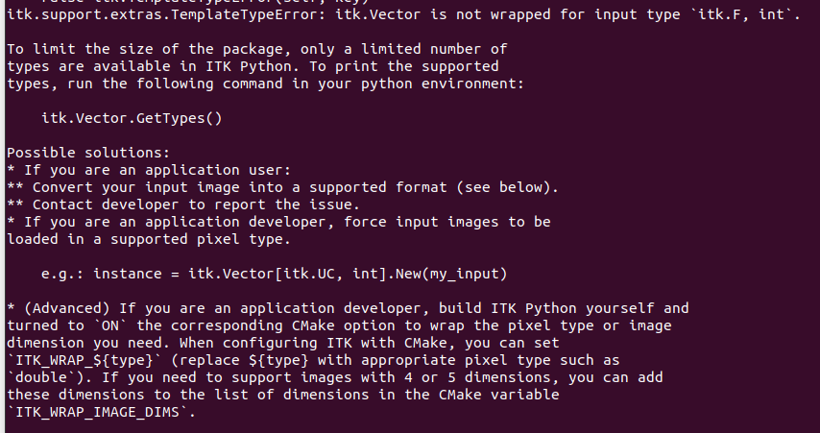
Multidimensional images V
Try opening a 4D image or a 4D vector image using ITK an python

Slide 15
Multidimensional images VI
A solution
Compile ITK manually
Set the cmake option
ITK_WRAP_VECTOR_COMPONENTS 2;3;4;5;6;7;8;9;10;11 ITK_WRAP_IMAGE_DIMS 2;3;4
But, your code would only run on your machine…
Currently no easy solution
Try not to use such images on the python side
Only in the c++ core of OpenGate

Slide 16
Summary & Outlook
New python based OpenGATE is cool
STL capabilites from Gate v9 now in OpenGATE
Advanced phase space and treatement plan options
Combination of Python and c++
Powerful
Challenging for more exotic cases

