Slide 1


DIRECTA - Deep learnIng in REal time for CTA
Thomas Vuillaume

Slide 2
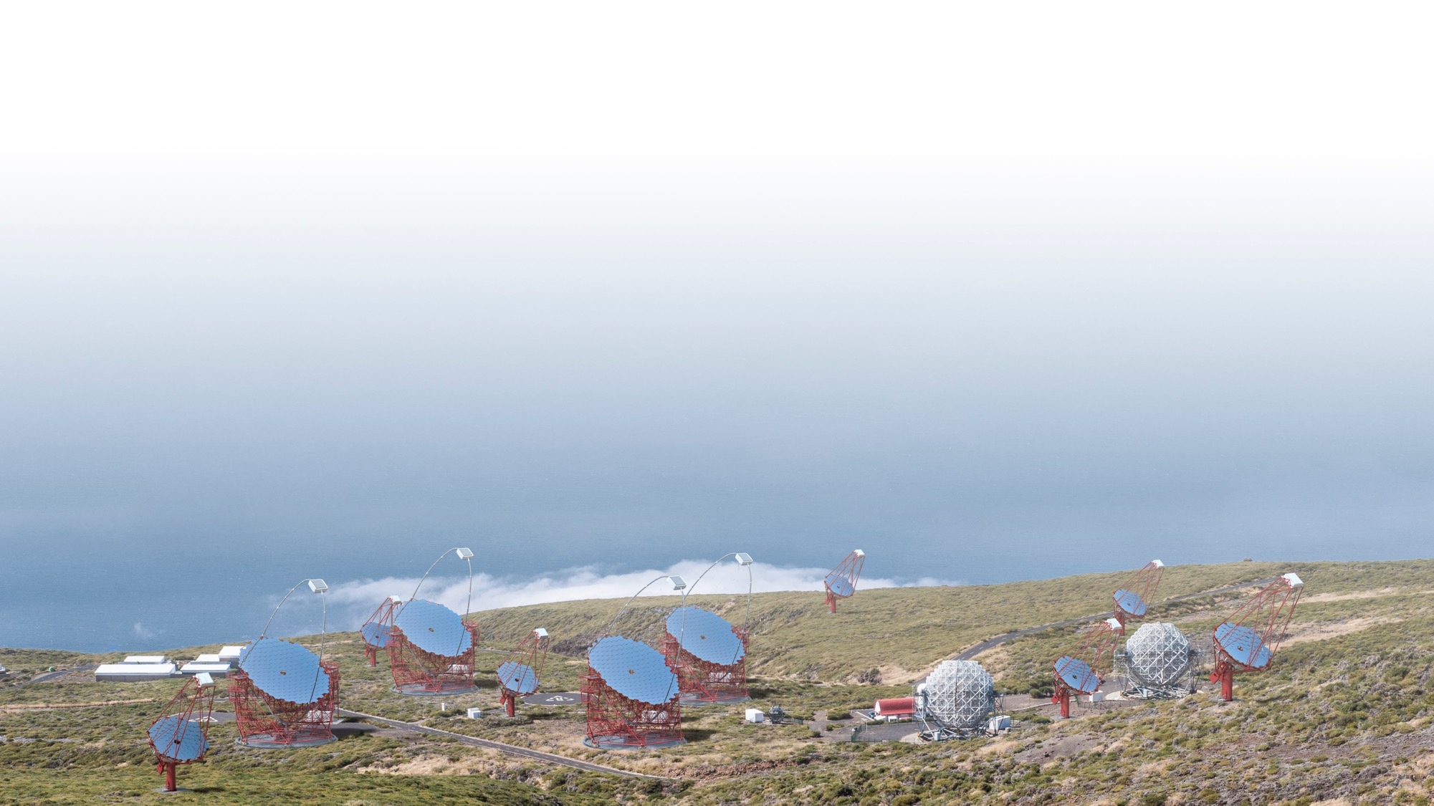








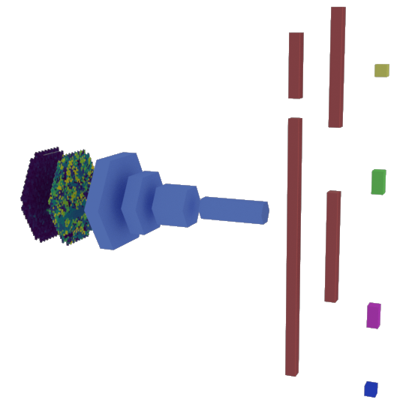
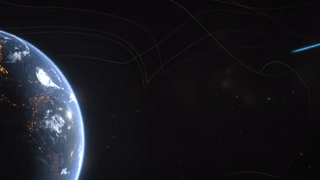

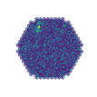

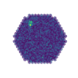
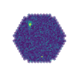
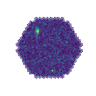
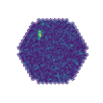
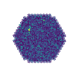
GAMMALEARN
deep learning for the Cherenkov Telescope Array
class
distance
e⁻
direction
PetaBytes
of Data
at a rate of
tens of GB/s
Deep Convolutionnal Neural Networks
reconstruct the physical parameters
of the primary particle
from the telescopes images
e⁻
energy
e⁻
e⁻
e⁺
e⁻
e⁺
e⁻
e⁻
e⁺
Contact: thomas.vuillaume@lapp.in2p3.fr

Slide 3
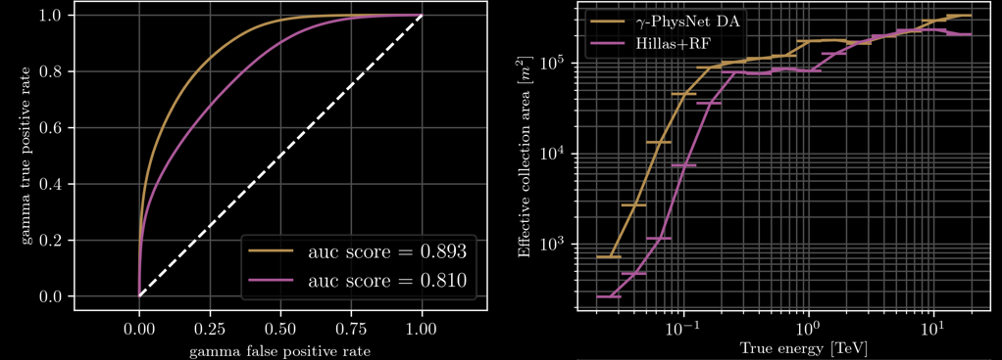
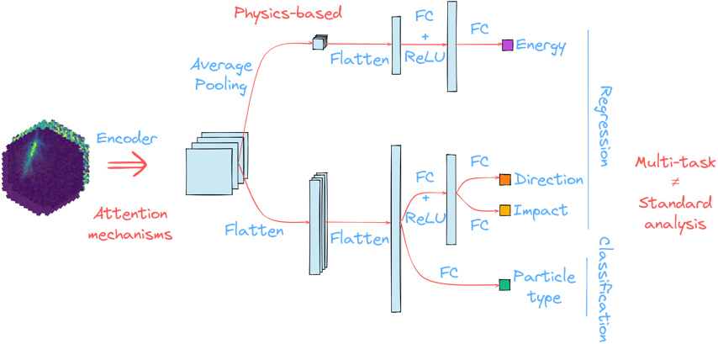
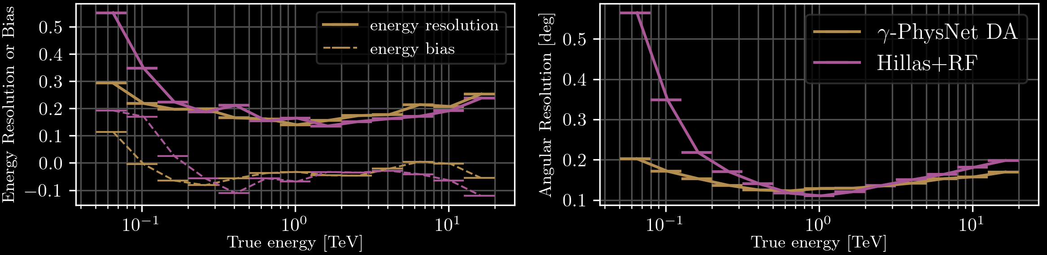
GAMMALEARN RESULTS on LST-1 simulated data
Better:
Sensitivity
Angular resolution
Energy resolution
compared to the standard analysis
https://arxiv.org/abs/2108.04130

Slide 4
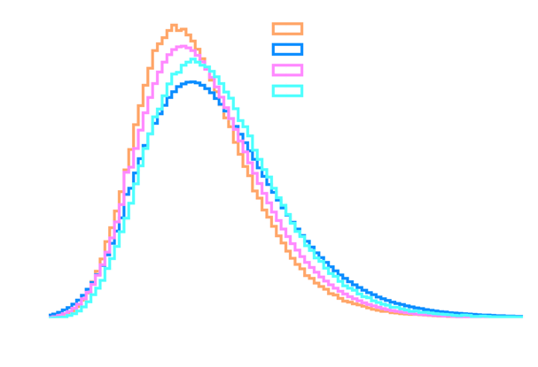
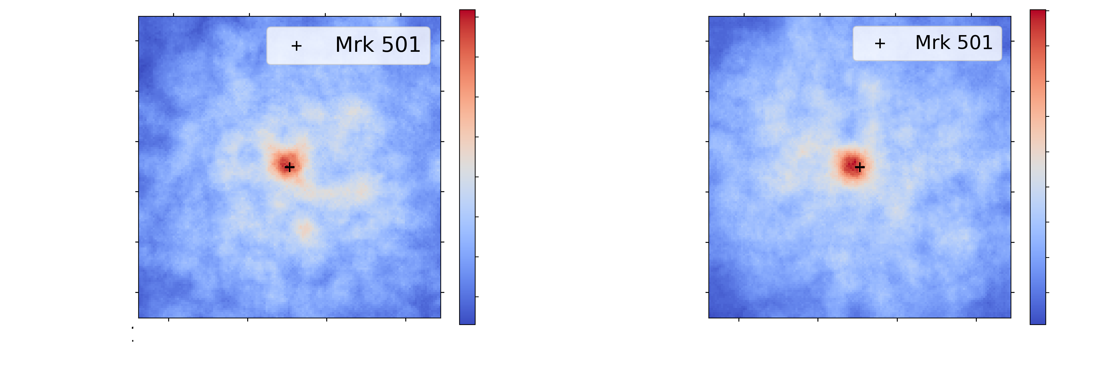

GAMMALEARN RESULTS on LST-1 real data
Mrk501 | Standard analysis | GammaLearn
Excess | 148.7 | 192.7
Background | 238.3 | 226.3
Significance | 7.6𝝈 | 9.8𝝈
➔ Better significance than standard analysis
Great asset for low-energy and transient sources
Need work to automatise the analysis and adapt it to real-time constraints
https://arxiv.org/abs/2108.04130

Slide 5
The DIRECTA project
GOAL
Bring GammaLearn solutions for event reconstruction in real time
Grant
French ANR (Agence Nationale de la Recherche), 332.241€
Duration
36 months, from Feb 2024 to Feb 2027
COSTS
2 years of research engineer, 2 years of postdoctoral researcher

Slide 6
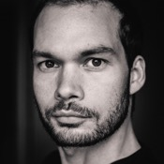
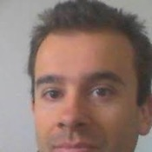


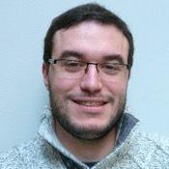
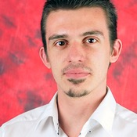
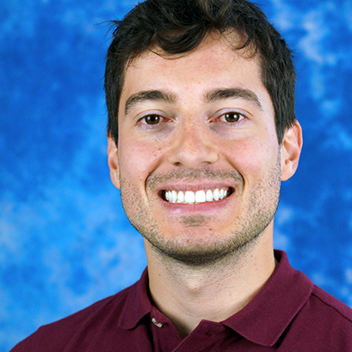
MEET THE TEAM
Thomas Vuillaume¹
PI, research engineer, deep learning and IACT data analysis
Alexandre Benoit²
^{Full Professor, deep learning}
Cyann Plard¹
^{PhD student, data analysis}
Vincent Pollet¹
Research Enginner, RTA and machine learning
Justine Talpaert¹
Research Enginner, data engineer
Sami Caroff¹
Co-PI, researcher, transient sources and real-time analysis
Benoit Aubert¹
Research engineer, HPC and real-time expert
Michaël Dell’aiera¹
^{PhD student, deep learning}
Brondon Waffa-Pagou
deep learning
Postdoc
^{Physicist}
1 – LAPP, CNRS, Univ, Savoie Mont-Blanc
2 – LISTIC, Univ. Savoie Mont-Blanc
+ anyone willing to work on this subject ☺

Slide 7
GOAL
🎯
Ready-to-use analysis
in real-time

Slide 8
GOAL
Analysis broken into steps and adaptable to certain conditions
🎯
Ready-to-use analysis
in real-time

Slide 9
GOAL
Analysis broken into steps and adaptable to certain conditions
Ready-to-use analysis for data in conditions close to simulations
Ready-to-use analysis for any data
🎯
Ready-to-use analysis
in real-time

Slide 10
GOAL
AUTOMATISATION
Complete pipeline to easily run end-to-end analysis
Analysis broken into steps and adaptable to certain conditions
Ready-to-use analysis for data in conditions close to simulations
Ready-to-use analysis for any data
🎯
Ready-to-use analysis
in real-time
PERFORMANCES EVALUATION
Physics performances
Crab analysis

Slide 11
GOAL
AUTOMATISATION
Complete pipeline to easily run end-to-end analysis
PERFORMANCES EVALUATION
Physics performances
Transient sources analysis
Analysis broken into steps and adaptable to certain conditions
Ready-to-use analysis for data in conditions close to simulations
Ready-to-use analysis for any data
🎯
Ready-to-use analysis
in real-time
AUTOMATISATION
Deal with observation pointing directions and conditions in an automated way
Apply domain adaptation in production
PERFORMANCES EVALUATION
Physics performances
Crab analysis

Slide 12
GOAL
AUTOMATISATION
Complete pipeline to easily run end-to-end analysis
INTEGRATION
Integration into ACADA/LST-1 real-time pipeline
PERFORMANCES EVALUATION
Physics performances
Transient sources analysis
Analysis broken into steps and adaptable to certain conditions
Ready-to-use analysis for data in conditions close to simulations
Ready-to-use analysis for any data
🎯
Ready-to-use analysis
in real-time
AUTOMATISATION
Deal with observation pointing directions and conditions in an automated way
Apply domain adaptation in production
PERFORMANCES EVALUATION
Physics performances
Crab analysis
PERFORMANCES EVALUATION
Speed performances
Physics performances in RTA
Transient sources analysis

Slide 13
TASKS OVERVIEW
T. Vuillaume, A. Benoit, M. Dell’aiera and J. Talpaert
*contributions to other tasks are welcome
 | TV | SC | AB | CP | MD | PA | VP | JT | BP | pd
Task 1: Dealing with the telescope pointing Define strategies to handle multiple telescope pointings Explore these strategies and determine the best trade-off Implementation of the selected strategy | ✔️ |  | ✔️ |  | ✔️ |  |  | ✔️ | ✔️
Task 2: Dealing with changing observation conditions Real-time adaptation strategy of the domain-adaptation Implementation in an automated workflow to adapt to the night condition Physics performance analysis | ✔️ |  | ✔️ |  | ✔️ |  |  | ✔️
Task 3: Performances of γ-PhysNet in real-time Analysis of the current computing performances Reconstruction performances under RTA constraints Define the best trade-off to apply in production | ✔️ | ✔️ | ✔️ |  |  | ✔️ | ✔️ | ✔️ |  | ✔️
Task 4: Integration of γ-PhysNet in the collaboration real-time pipeline Adapt existing RTA to use GPUs and gammalearn Test the pipeline in parallel with the standard reconstruction Real data production using the pipeline | ✔️ | ✔️ |  |  |  | ✔️ | ✔️ | ✔️ |  | ✔️
Task 5: Real data analysis Support in the observation of transient sources Analysis of transient sources data Proof of concept on pulsar emission |  | ✔️ |  | ✔️ |  |  |  |  |  | ✔️

Slide 14
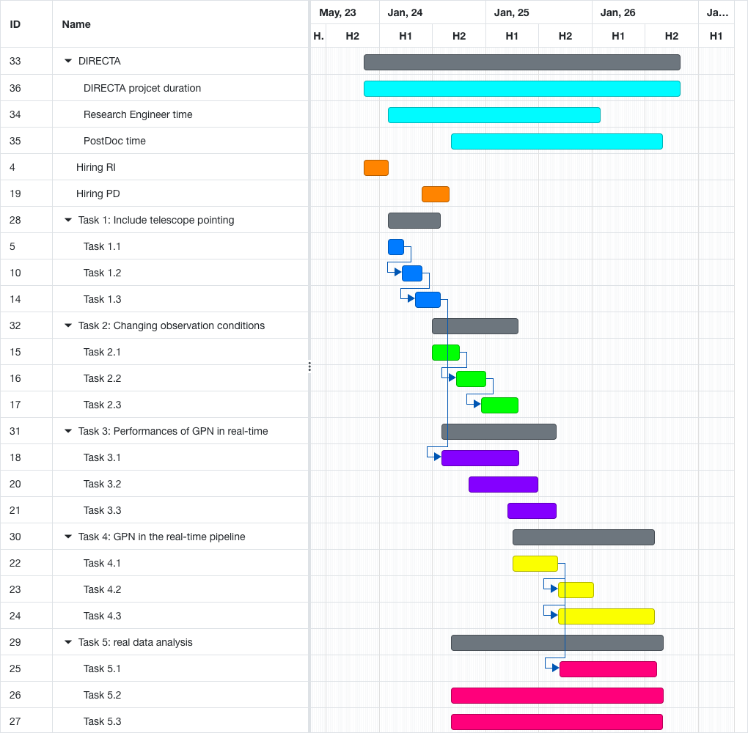
TASKS OVERVIEW

Slide 15
DELIVERABLES
Presentations to the CTA LST collaboration and internal reporting
Presentations in conferences
Technical publication
A workflow running on the CTA LST cluster at La Palma and able to deal with the data observing conditions along with documentation for CTA LST collaboration members to use.
A prototype of real-time LST-1 pipeline, including the CNN in the reconstruction.
Open-source code published in the ESCAPE OSSR.
Analysis and publications of transient and pulsars sources with γ-PhysNet

Slide 16
THANK YOU
Public webpage: https://purl.org/gammalearn/directa
Proposal: https://gitlab.in2p3.fr/gammalearn/directa/project/anr-proposal

