Slide 1
Monitoring
&
POWER SUPPLIES

Slide 2
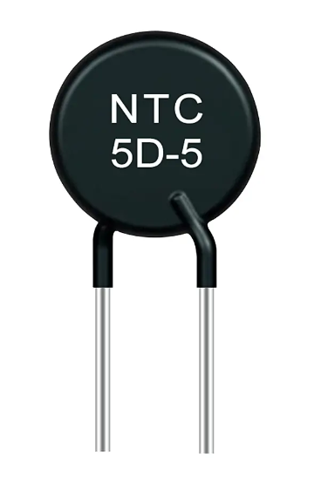
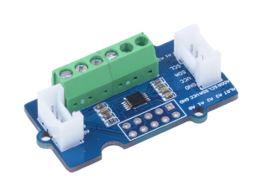
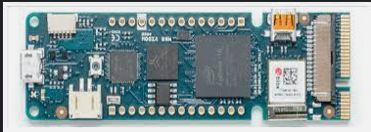
MONITORING & interlock
Monitoring_board
Vidor_board
CAEN_IT_board
T_{NTC}
x8
ADC
x8
I2C
ATOM Lite 1
T / Hum
SHT85
I2C
FPGA
Interlock
Power Supplies
Press
x2
ADC
x2
I2C
ATOM Lite 2
ALARM SOFT (to DCS)
DCS
ALARM HARD (to FPGA)
INTERLOCK SIGNAL (if several successive ALARM HARD)

Slide 3
Vidor board
Inputs signals :
  ALARM_T from 8 Temperature channels
  ALARM_H from 1 Humidity channel
  ALARM_P from 2 Pressure channel
  Logic Level 1=OK 0=nOK
Outputs signals :
  IT30 to switch OFF the LP Supplies channels 3 to 0
  IT47 to switch OFF the LP Supplies channels 7 to 4
Flexible point-to-point routing (red wires)

Slide 4
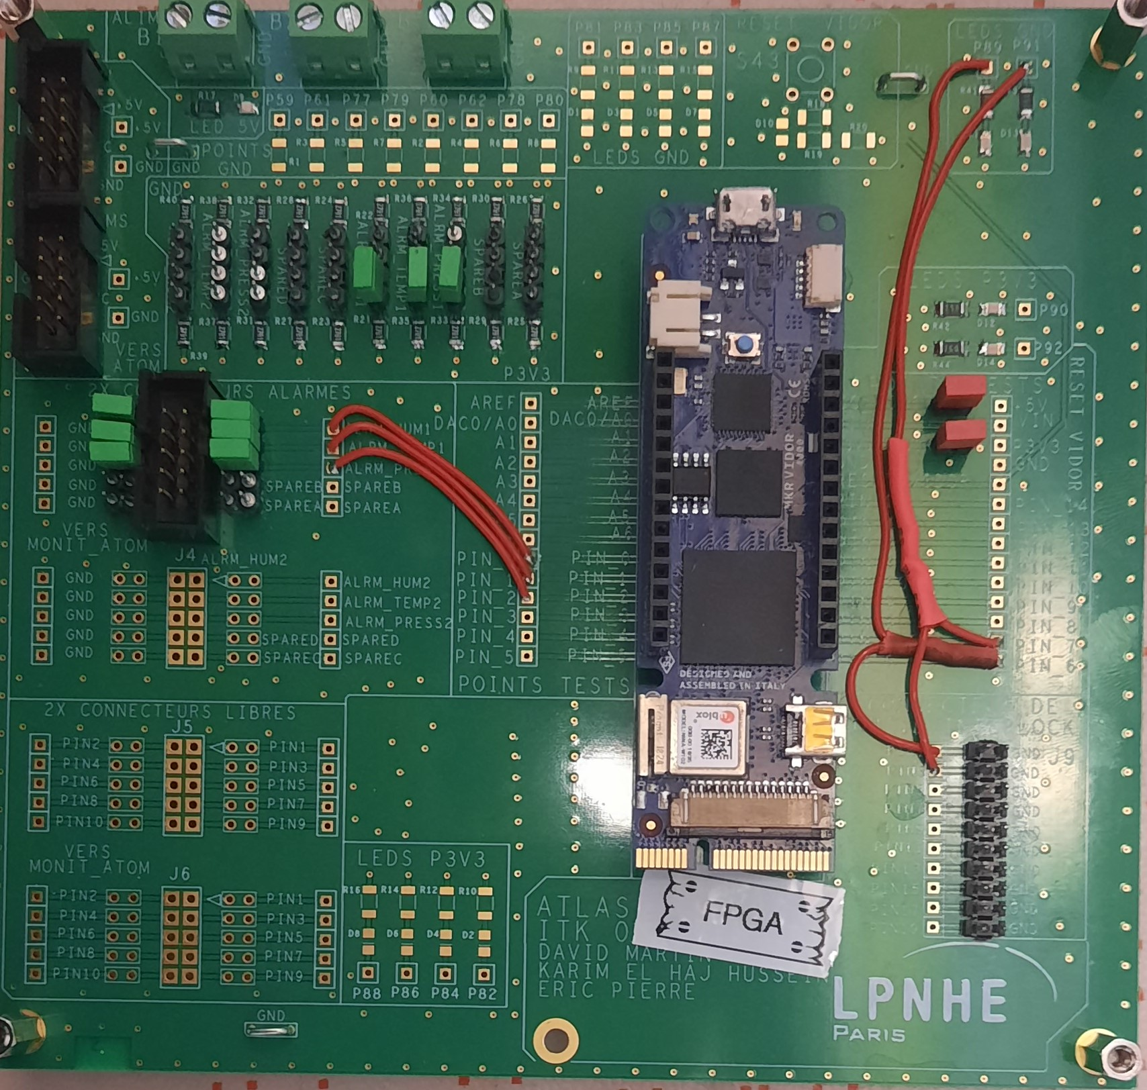
Populated
PCB
Power connectors
Led power on
Pull-Down
Pull-up
ALARM_H
ALARM_T
ALARM_P
1 = OK = led on
IT_30
IT_74

Slide 5
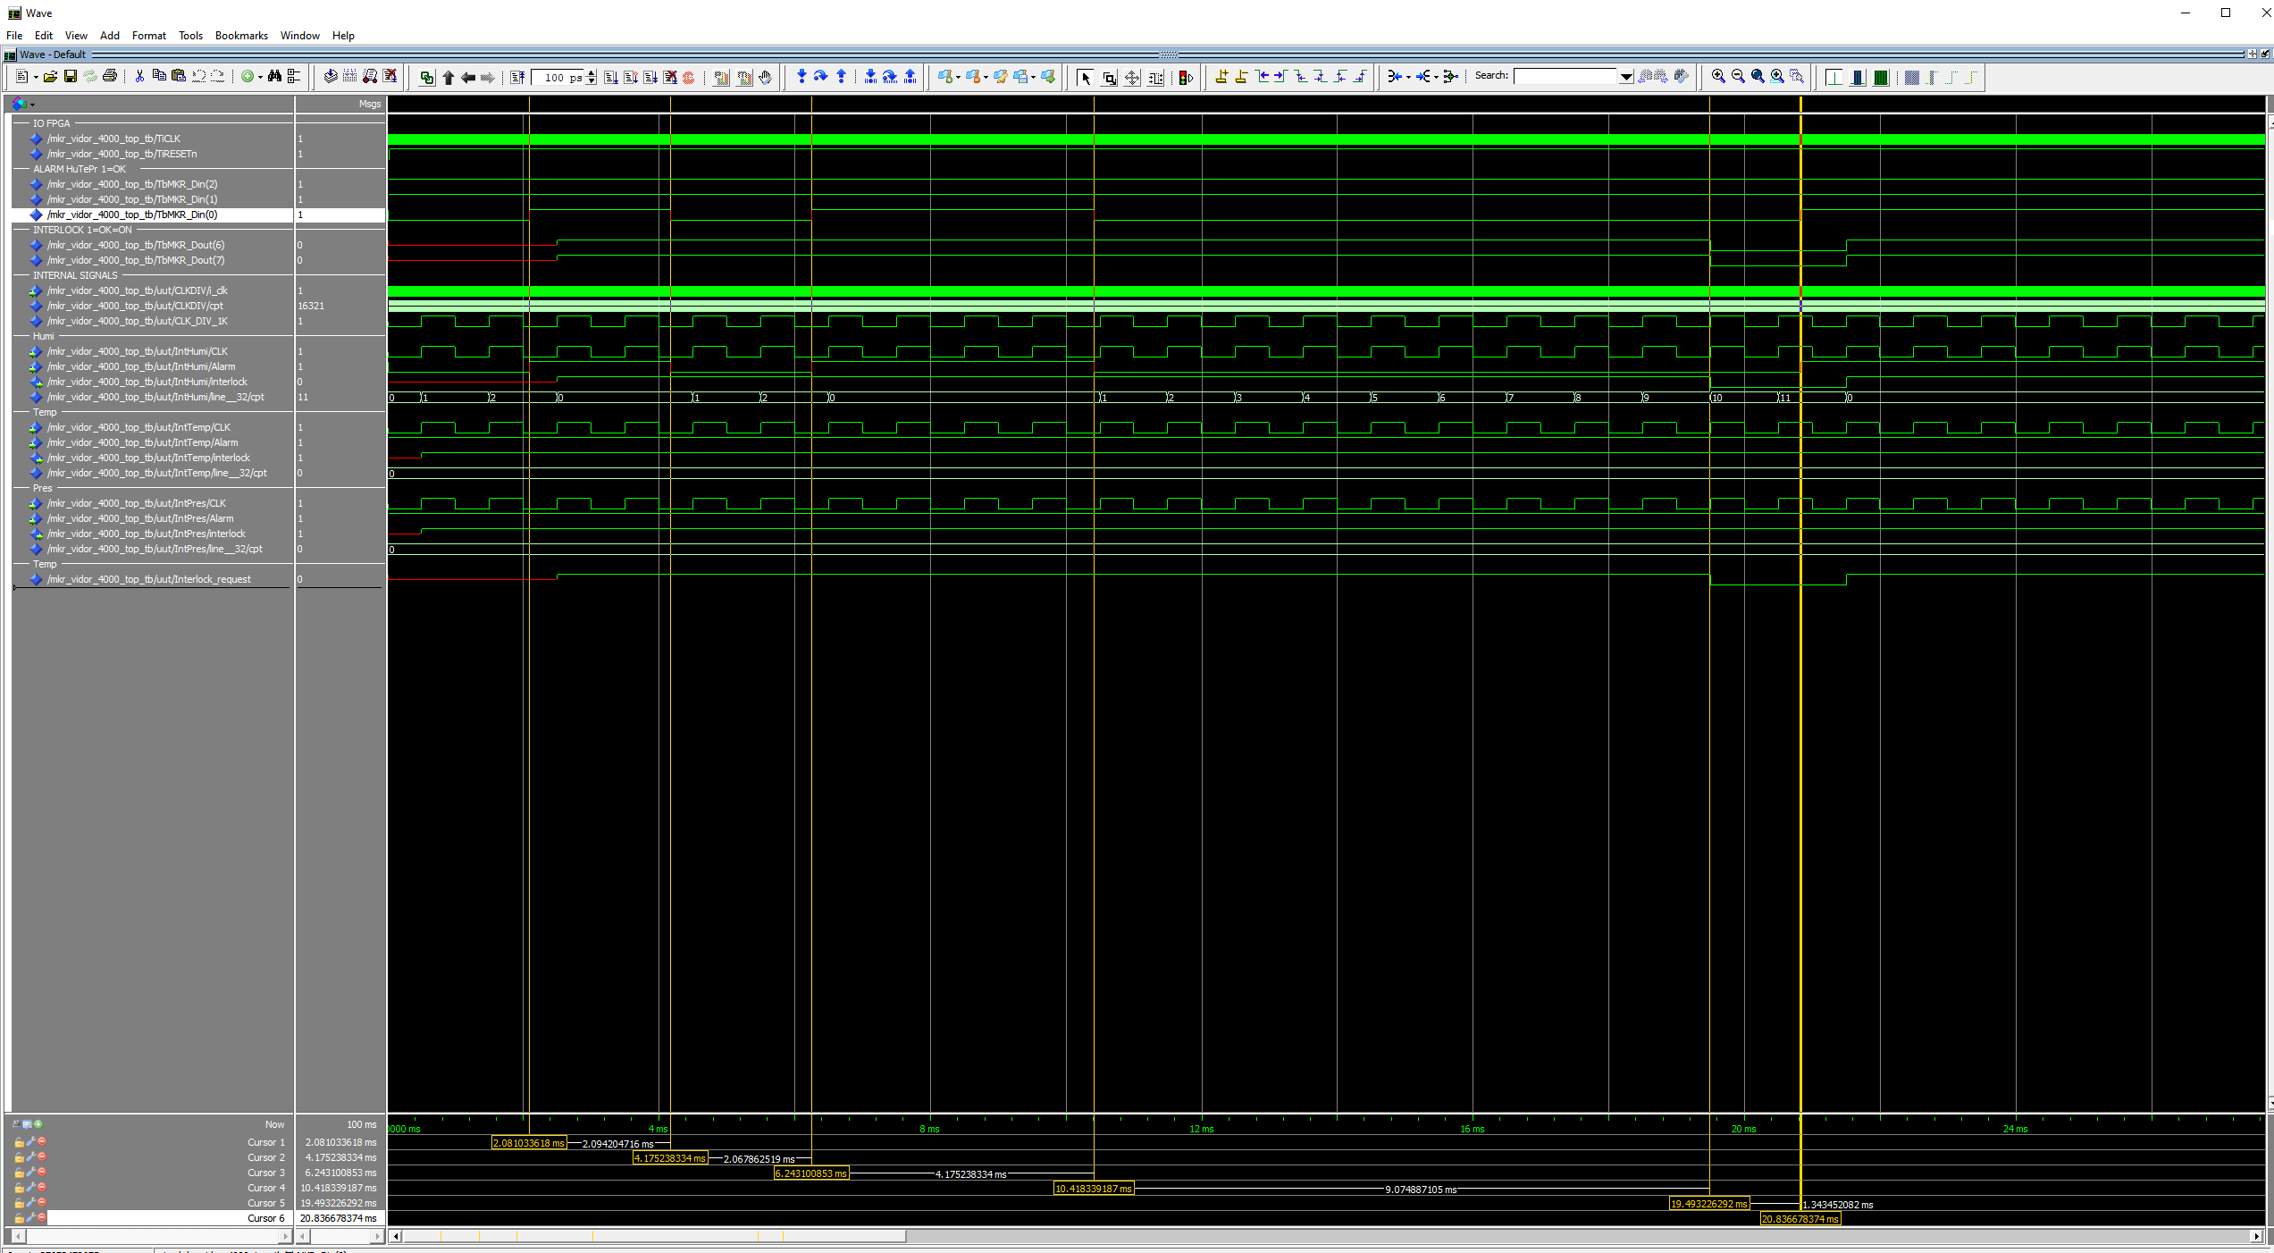
Simulation
An ALARM is on going.
It is difficult to read anything about this simulation but the principle is as follows: in order to avoid an unwanted INTERLOCK, one of the ALARMS must be at 0 for at least 9 ms for it to be triggered.
INTERLOCK remains ON (ALARM too short)
INTERLOCK goes down (ALARM too long)

