Slide 1
RN for Health Applications

Slide 2
Rationale
Develop new approaches of personalized medicine (in oncology as well as for neurology)
α, β⁻
Auger
ɣ, β⁺
Speciation / fundamental studies for some RN of interest with poorly understood chemistry
Production of RN : targetry, extraction / purification
Complexation / radiolabelling
Valorization of RN through pre-clinical studies

Slide 3
Topics
Sc-44
Establishment of a generator of ⁴⁴Ti/⁴⁴Sc
Radiolabelling
Microfluidic
Preclinical studies
Auger emitters
-Understand the speciation of Ru/Rh
-Establish a chromatographic-based ¹⁰³Ru/^{103m}Rh generator
Nanomedicine
-develop robust methodologies by AF4 to characterize NPs
Evaluate the theranostic potential of NPs
Contribute to the normalization and intercomparison exercises
At-211
-better understand At chemistry
-contribute to improving current radiolabeling protocols
2,25 + 2 ETP
0,2 + 1 ETP
0,1 + 0,5 ETP
0,1 + 0,5 ETP

Slide 4
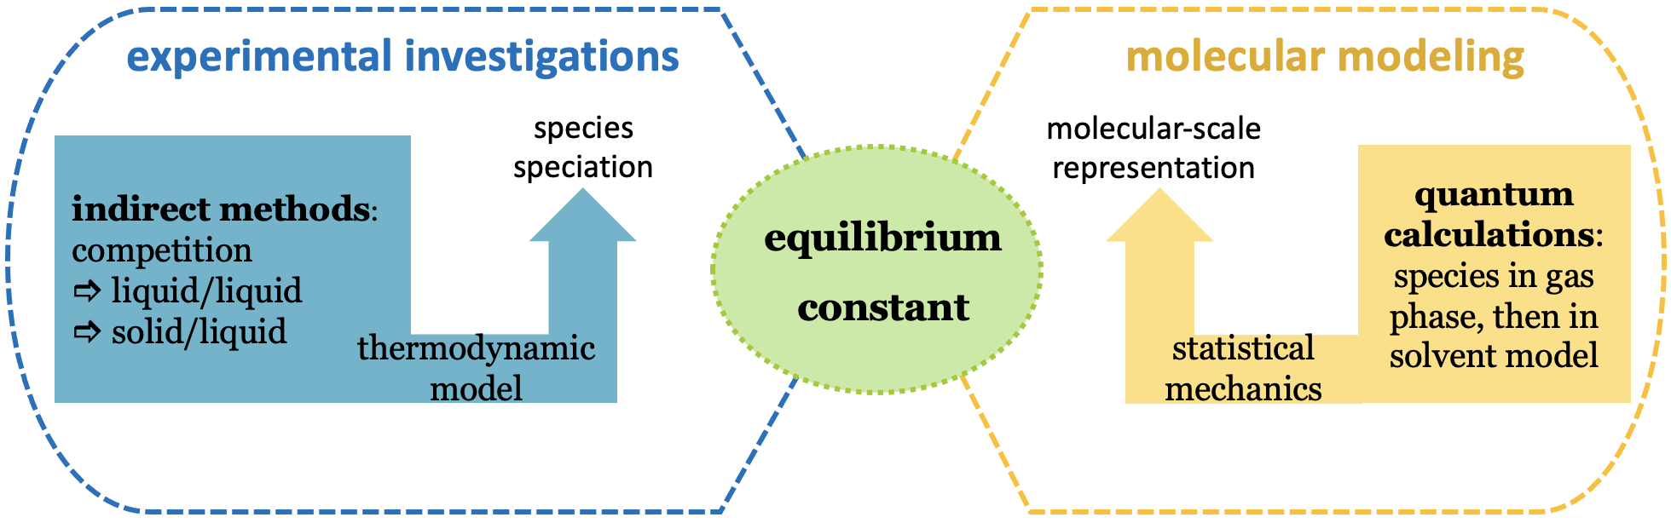
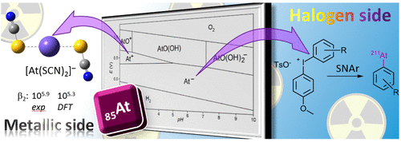

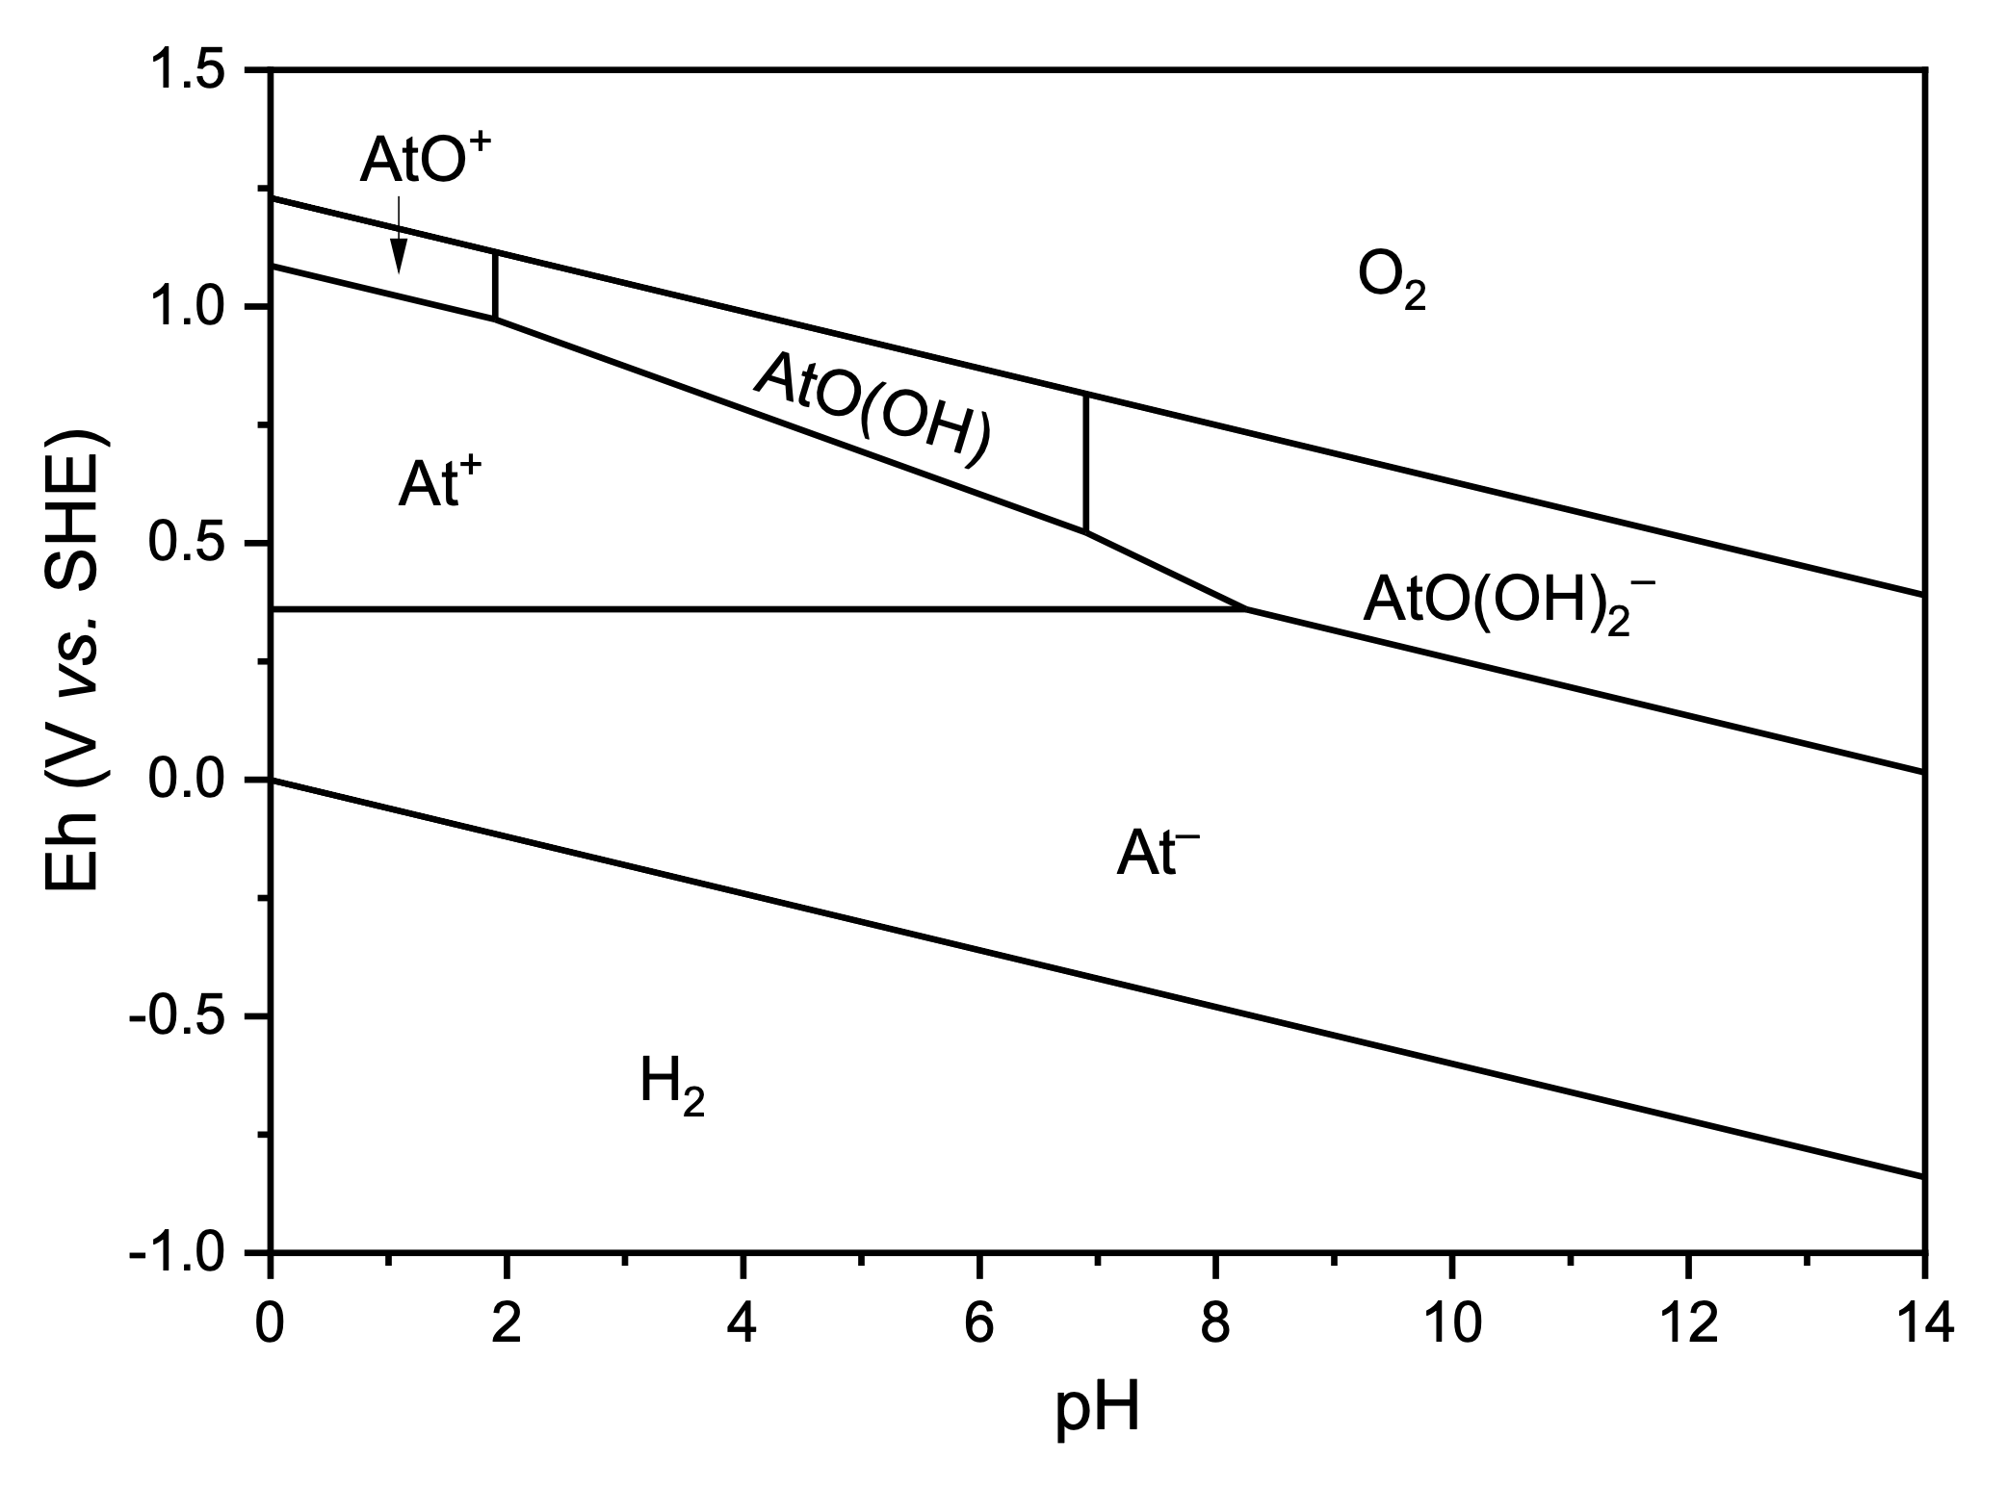

1. Astatine
Project led by G. Montavon
A review of the work conducted at the Nantes site for almost 20 years in fundamental chemistry (Subatech/CEISAM), as well as the development of innovative radiolabeling protocols (CRCINA)
Subatech
CEISAM
F. Guérard et al. Acc. Chem. Res. 2021
L. Liu et al. Inorganic Chemistry 2022
Notes:
première figure: The work conducted at the Nantes site for almost 20 years on astatine has been reviewed in "Account of Chemical Research" (Guerard et al., 2021).
deuxième figure CEISAM/SUBATECH: fundamental chemistry, coupling molecular modeling and experimental radiochemistry (Subatech/CEISAM) (CRCINA: the development of innovative radiolabeling protocols (CRCINA)
troisième figure: during the period 2019-2023, we notably finalized the Pourbaix diagram of astatine in the water stability domain (Liu et al., 2022)

Slide 5
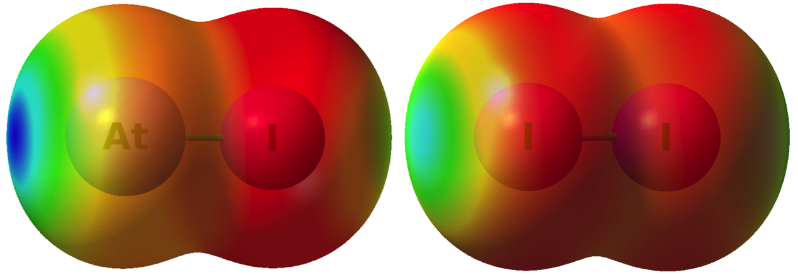
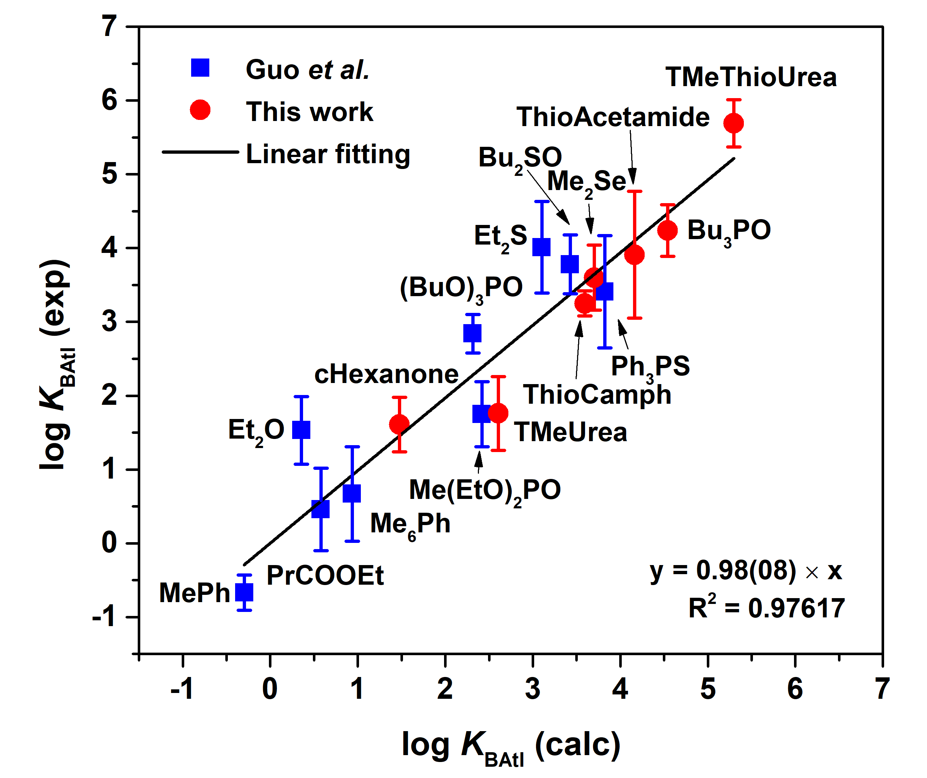
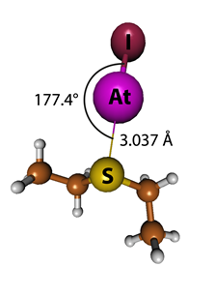
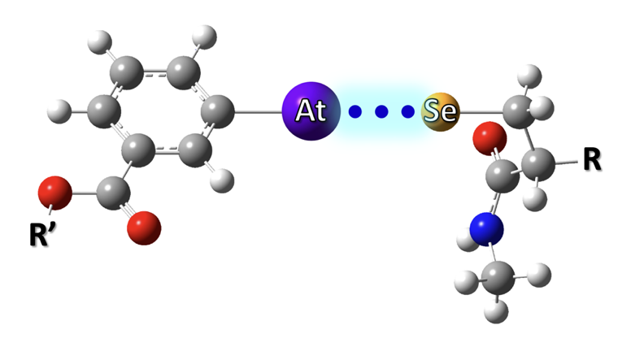
2. Astatine
Halogen-bonded adducts involving At
Relationship between the experimentally deduced pK_{BAtI} scale and theoretically deduced pK_{BAtI} scale for the same Lewis bases
Molecular electrostatic potentials (MEPs); 2c-B3LYP/AVDZ level of theory. A positive value of the MEP indicates an electrophilic region.
N. Guo et al. Nature Chemistry 2018
Halogen bonding causing in vivo instability?
strong XB interactions with the selenocysteine residue
Yssartier et al., RSC MEDICINAL CHEMISTRY, 2024
L. Liu et al. Chemistry – a European Journal 2020, S. Sarr et al. Chem. Phys. Chem. 2020; S. Sarr et al. Molecules 2021; S. Sarr et al. Phys. Chem. Chem. Phys. 2021; L. Liu et al. Chemical Science, 2021
Notes:
première figure: thanks to the coupled experimental/theoretical approach, we the identified the halogen bonding with astatine compounds AtI (Guo et al., 2018). We can see on the figure the positive value of the MEP indicates an electrophilic region where the interaction takes place with lewis bases
deuxième figure: we continued to explore the nature of this bond (Sarr et al., 2020, 2021a and b, Liu et al., 2020, 2021); we propose a database of stability constants for a variety of lewis bases; on the figure, you can see the good correlation between the calculated and experimental values.
troisième figure: we showed as well that this bond could be the cause of the instability problem of astatine-labeled molecules in vivo (Yssartier et al., 2024). This result opens up new radiolabeling opportunities (ongoing patent application CRCINA/CEISAM)

Slide 6
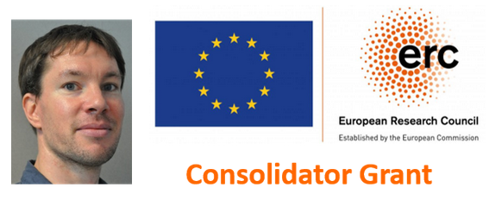
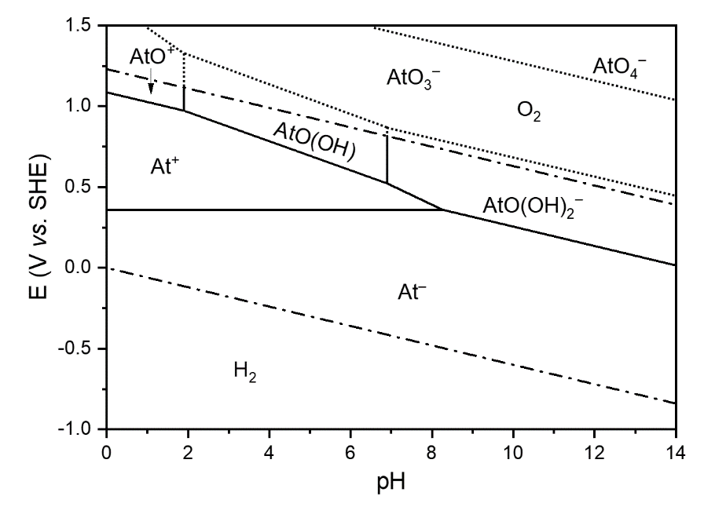
3. Astatine
ERC Consolidator Grant - project SAt Radio (F. Guérard) 2023-2028
Exploring the complexation chemistry of At(I,III)
Existence domain and reactivity of a species proposed in the 1960s
F. Bassal et al. Inorganic Chemistry 2020
Notes:
The work carried out by the CRCINA (radiolabeling chemistry), CEISAM (molecular modeling), and Subatech (experimental radiochemistry) consortium has served as the basis for the "ERC Consolidator Grant" project SAt Radio (Stable 211 At labeled radiopharmaceuticals for targeted α therapy), led by F. Guerard (CRCINA, 2023-2028). Subatech is involved in two actions: one related to exploring the complexation chemistry of astatine (+I, +3), a subject on which the Subatech/CEISAM consortium has been working for many years (e.g. Bassal et al., 2020), and the other associated with exploring a species with an oxidation state of (+V), AtO3-, proposed in the 1960s, which would exist in highly oxidizing environments (in the domain of water instability).

Slide 7
Staff (2019-2023)
N. Audouin (T, Arronax, 10%)
C. Colas => T. Démartinecourt (IE, NU, 100%)
C. Alliot (IR, Arronax, 10%)
C. Métivier (IR, NU, 100%)
S. Huclier (EC, NU, 50%)
PhD candidates
Cyann Larralde (2022-2025) : Approche théranostique de la Maladie d’Alzheimer par des hexapeptides
(funding Région Bretagne – IMTA)
Marie Théry (2021-2024) : spéciation du Ru et du Rh pour la mise au point d‘un générateur ¹⁰³Ru/^{103m}Rh
(funding Région PdL – Arronax)
Nour El Ayoubi (2021-2024) : Développement et évaluation de radio-immunoconjugués à base d'anticorps modifiés pour le ciblage du cancer du sein triple négatif.
(funding Nantes Université- Isite NExT)
Mattia Mazza (2017-2020) : Evaluation Chimique, radiochimique et biologique de glyco-saccharides en oncologie osseuse
(funding Subatech – IMTA CNRS)

Slide 8
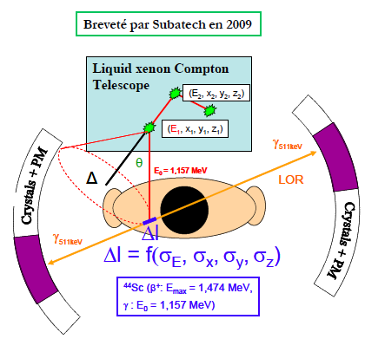

2. Sc-44
Activity Started since 2007
Thèse de R. Kerdjoudj (2011-2014)
Irradiation at Arronax
d + ⁴⁴CaCO₃ → 2n + ⁴⁴Sc (^{44m}Sc)
Sc-44m (T_{1/2}= 58.6 h – IT - Eγ= 270 keV (86%)
Use as an in-vivo ^{44m}Sc/⁴⁴Sc generator
→ monitor longer biodis
Process extraction, purification, radiolabeling optimised
2
HNO3 1M
CaCO₃ Target +HCl 4M
1
3
HF 6.10-2M
DGA resin (Triskem ®)
CO₂, Ar37, C11, F18, N13, K39, Ca45
^{44m}Sc/⁴⁴Sc
Evaporation to dryness
+ 600µL HCl 0,1M
Notes:
8
Groupe Evaluation AERES 13-14 janvier 2011

Slide 9


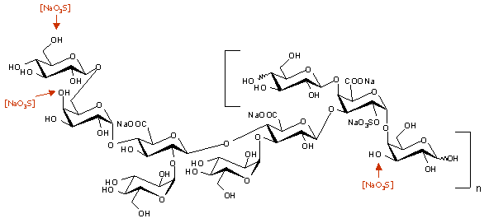
2. Sc-44
Glycosaminoglycans (GAG) revealed antimetastatic properties = > work on exopolysaccharide (EPS) derivative
M. Mazza
2017-2020
Radical Depolymerization
+
Over-sulfation
* Chopin et al. Biomed Res Int. 2015; ID508656:9p.
M_{w} >10⁶ g mol⁻¹ ; SO₄²⁻ = 3 % High anticoagulant effects
M_{w} < 10⁴ g mol⁻¹ ; SO₄²⁻ = 16 %; Very low anticoagulant effects
The presence of the sulfate groups on EPS-DRS was awaited to enhance the complexation.
The biological effects of EPS are maintained after complexation with scandium on different cell lines
(MNNG/HOS osteosarcoma, A375 melanoma, A549 lung adenocarcinoma, U251 glioma, MDA231 breast cancer, Caco2 colon cancer.)
All complexes revelead stronger anti-proliferative effect compared to DRS alone

Slide 10
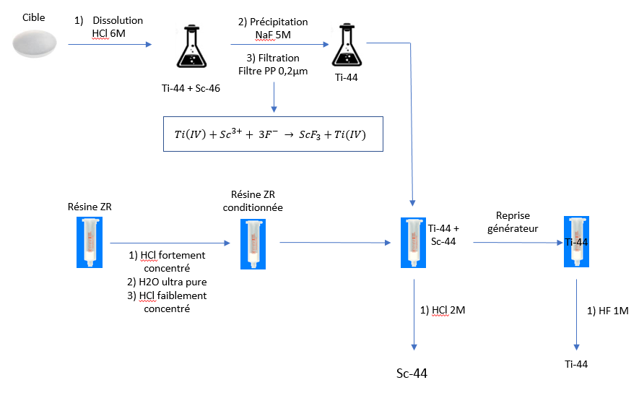
2. Sc-44
Pr. C.S. Cutler
  ⁴⁴Ti/ ⁴⁴Sc generateur (T_{1/2} Ti≈ 60 years)
  Set up of the wet chemistry and separative chemistry (2018-2019)
  Main achievements since 2019
  - Ti speciation in solution monitored and better controlled (HF kinetics) => process adapted
  - Additional step to change the eluate conditions suitable with the radiolabelling step
  - Recycling of ⁴⁴Ti and loading a « fresh » generator
  Brevet No 20306383.9 – 1212 : A method for the generation of Scandium-44 (submitted in 2021 – published in 2023)
Notes:
10
Groupe Evaluation AERES 13-14 janvier 2011

Slide 11
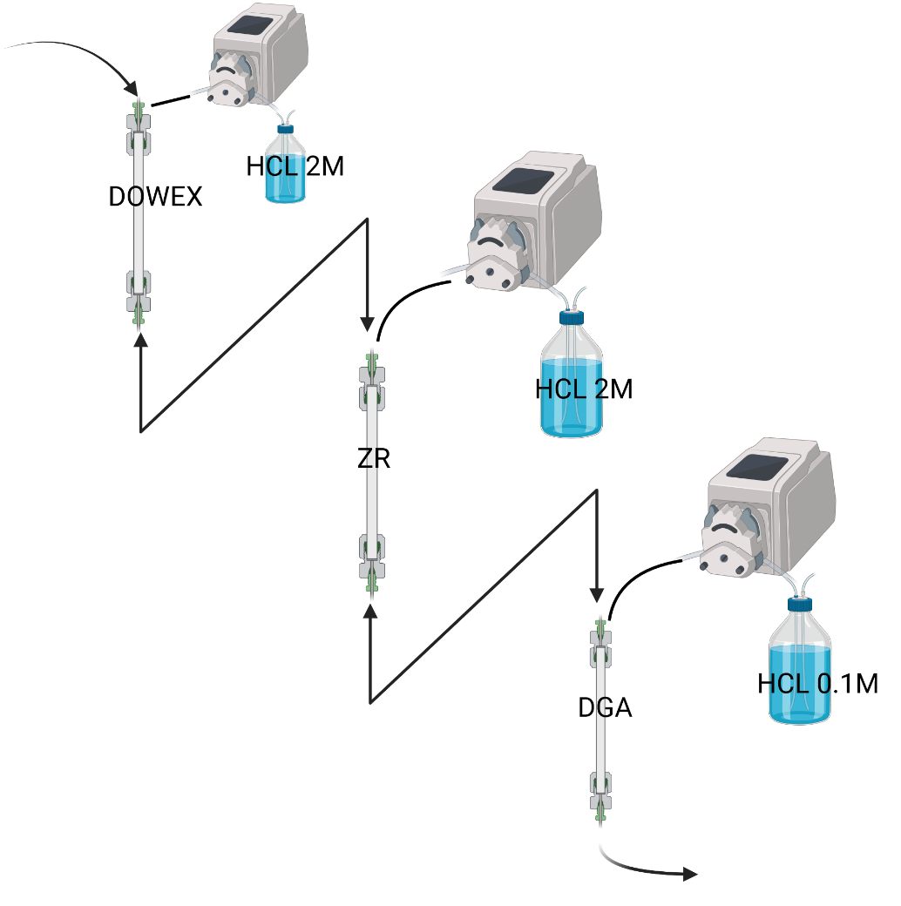
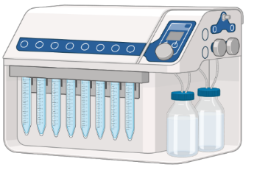
2. Sc-44
HF 1M
⁴⁴Ti Breakthrough monitoring
Spec. 0.001% of A_{tot} / reached 0.01%
Sc-44
Radiolabelling
  Perspectives:
Short term: setting up of a generator for preclinical studies : Increased activity up to 37MBq
Medium term: explore the potential of automatisation in micro-fluidic + synthesis module to ease the use of such generator
Notes:
11
Groupe Evaluation AERES 13-14 janvier 2011

Slide 12


2. Sc-44
Pr. S. Lapi
log β _{app} = 6.0 ± 0.2 at pH = 5
Pr. F. Denat
Pr. B. Zeglis
+
⁴⁷Sc
98% at RT
but 1Sc : 789 LH8
+
⁴⁴Sc (eluted from ⁴⁴Ti/⁴⁴Sc generator)
Article to be submitted soon to Dalton Trans.
Functionalization possible to be further conjugated to a Mabs and/or by click

Slide 13

2. Sc-44
  2 on going PhD works:
  -one on application for triple negative breast cancer in collaboration with CRCI²NA (Thèse N. El Ayoubi – Oct 2021-Oct 2024)
  Preclinical application and comparison with another theranostic RN: ⁶⁴Cu
  - one on application as an early diagnostic agent for Alzheimer’s disease in collaboration with IRSET Rennes (Thèse C. Larralde Oct 2022-Oct -2025)
  Goals :
  in cellulo characterization inhibitors peptides of the fibrillation and by FFF (shape factor)
  Coupling peptides with chelates
  Optimization of peptides-chelates with ⁴⁴Sc; ⁶⁴Cu
  Characterization of radiolabeled peptides-chelates by FFF-ɣ to check/monitor peptides integrity

Slide 14
2. Sc-44
LEVEL | Project | Role
Regional | TransForMed | Member
National | GdR CNRS Agents d’Imagerie Moléculaire Projet Ligue contre le cancer | Responsible axe “nuclear probes” Partner
European | Euronanomed III – I²PAD (partenaires Polatom (PL); University of Prague (CZ); Horia Hulubei (H); CEA, INSERM) | Co-PI
International | NExT-ICoN en partenariat avec Triumf (Canada), University of Wisconsin-Madison (USA); University of Alabama @ Birmingham (USA) | PI

Slide 15

2. Sc-44 : perspectives
Moving on with ⁴⁴Ti/⁴⁴Sc generator developments
maturation project SATT
Keep working on preclinical studies and on neurological disorders studies to engage the community around Scandium-based tracers
Support the development of XEMIS camera on CIMA imaging platform by providing preclinical doses of ⁴⁴Sc (from the generator)
Running studies with ⁴⁷Sc in therapeutic combination with ⁴⁴Sc (collab. UAB)
Prestation contract with EMI to be signed soon for c-Met probes radiolabelling

Slide 16
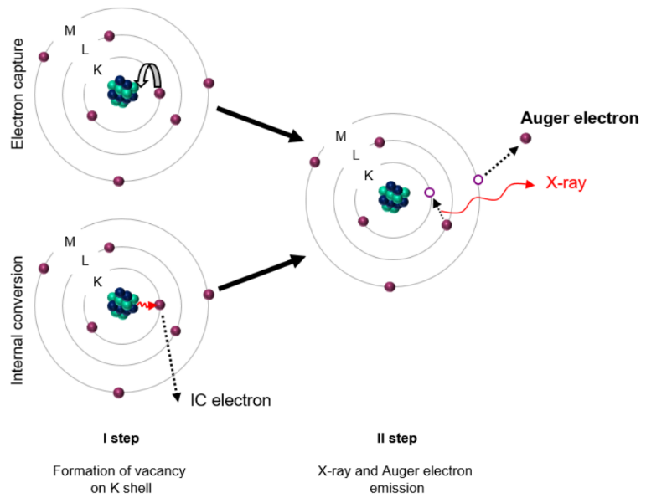
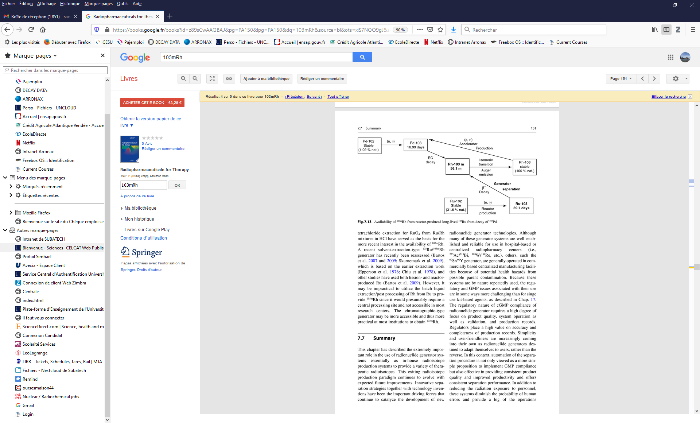
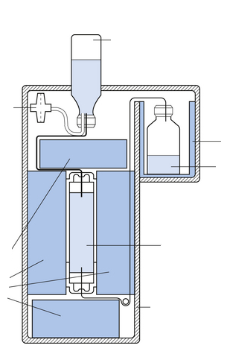
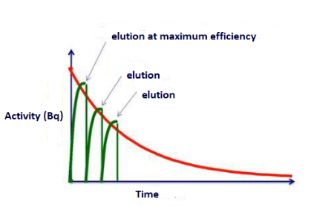
3. Auger Emitters
Activity Started in 2021
Status of Auger Emitters in Nuclear Medicine
PhD M. Thery
2021- in progress
^{103m}Rh = interesting for therapy
Could be obtained from ¹⁰³Ru or ¹⁰³Pd
^{103m}Rh : short half-life (56.1 min)
Radionuclide Generator

Slide 17

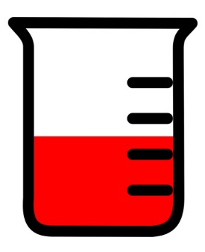
3. Auger Emitters
Understand Ru chemistry :
Hydrated RuCl₃
Hydrated RhCl₃
In HCl
[Ru(IV)₂OCl₁₀]⁴⁻
Ru(IV)Cl₅⁻
Rh(III)Cl₂⁺
Ru(III)Cl₅²⁻
Ru(III)Cl₆³⁻
Rh(III)Cl₆³⁻
Ru(III)Cl₂⁺
Ru(III)Cl₃
Rh(III)Cl₄⁻
Rh(III)Cl₃
Rh(III)Cl₅²⁻
Ru(IV)Cl₄
Ru(IV)Cl₃⁺
Ru(IV)Cl₆²⁻
Ru(III)Cl₄⁻
Espèces colloïdales de Rh(III)
Espèces poly-nucléaires de Rh(III)
Espèces colloïdales de Ru(IV) (nm->1µm)
Espèces colloïdales de Ru(III) (nm->1µm)
Complicated Speciation
Mix of different species + importance of the preparation route of the stock solution
Speciation less complicated than Ru
One single redox state (Rh^{III})
Understand Ru chemistry :
AF4 : colloïdal species ?
LDI-TOF : polynuclear and polycharged species
CE-ICP-MS : speciation and constants
Strategy : Separation via ^{IV}Ru/^{III}Rh

Slide 18



3. Auger Emitters
Main goal : Find an effective way of separating Ru and Rh (using a chromatographic system, in chlorinated media)
Ru
Test on different resins
Kd determined
Ru
Ru
Conditions
Loaded activity= 1.8 MBq (¹⁰³Ru/⁹⁷Ru = 0.34%)
2M HCl 1mL/min (elution 15 mL )
Gamma spec quantification
Rh
Rh
Rh
Ru(IV)-> Ru(III) conversion is at the equilibrium in the laoding solution and then is re-oxidized into Ru(IV)
→ lower breakthrough %
The breakthrough is related and controlled by Ru(III) and then :
Ru (III) ⇄ Ru(IV) ⇄$\overline{ Ru(IV)}$
Ru (III) ⇄ Ru(IV) ---$\overline{ Ru(IV)}$
In solution
In the extracting resin
Proof of concept of a ¹⁰³Ru/^{103m}Rh is done = > must be tested with larger activities

Slide 19

3. Auger Emitters: perspectives
Ru speciation data : accurate knowledge of the thermodynamics and physicochemical properties of Ru in aqueous solution
=> to develop chemical processes to purify ⁹⁷Ru from Mo and other metals
=> to finalize a ¹⁰³Ru/^{103m}Rh generator
2) Scrutinize the radiolabeling routes based on the accurate understanding and control of Ru speciation with the final goal of optimizing this process.
3) Production of ⁹⁷Ru is based on Mo(α,x)
complete existing data on Mo speciation
develop and optimize a recycling process for Mo.
European project MS COFUND SEED PhD in partnership with ORANO

Slide 20
4. Nanomedicine
Activity Started in 2014
Innovation in drug-delivery systems => nanomedicine
Nanoparticles NPs = improved pharmaco-kinetics properties thank to an accurate control of their size, and of their interactions with living organisms
Particularly suitable for theranostics aspects with RN
2 “new” projects that have started at the end of 2023
-Projet PHC BoRN :
Beta Radiotherapy of Prostate Cancer with Theranostic Radiolabeled Gold Nanoparticles
(project in collaboration with NCSR Demokritos (Greece) : 2024-2025
Role French PI.
Goals
Determination of the size, surface charge of AuNPs grafted with DOTAGA for prostate cancer,
Evaluation of ⁴⁴Sc/ ⁶⁴ Cu radiolabeling for imaging; in combination with ¹⁷⁷Lu for therapy
Evaluation of physico-chemical properties post-radiolabeling (size, surface charge, integrity)

Slide 21

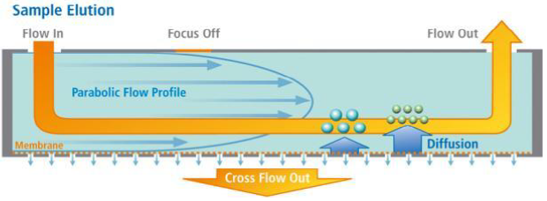
4. Nanomedicine
Activity started since 2014
Projet Euramet MetrIno : Metrology for Innovative nanoparticles (2023-2026)
Role partner
Goals :Develop and validate characterization methods of nano-drugs.
=> Clinical formulations, including synthetic NPs composed of lipids (liposomes and RNA-LNP) and metallic oxydes (hafnium and iron oxydes) used for MRI
Methodology : separation AF4-coupled to UV-MALS-RI + gamma ray detector

Slide 22
4. Nanomedicine : technical platform of FFF
REFERENNS@UNIV-NANTES.FR

Slide 23
4. Nanomedicine
Level | Project | Role
Regional | REFERENN’s platform | Responsible
National | GdR CNRS Agents d’Imagerie Moléculaire | Responsible axe “nuclear probes”
European | PHC France Grèce Euramet project Metrology for innovative nanoparticles | French PI Member

Slide 24
4. Nanomedecine perspectives
Propose reference methods of FFF for nanomedicine
Develop the FFF platform (joint platform with Ifremer and INRAE): REFERENN'S
3 Flow-FFF chains, 1 HF5 chain (analysis of macromolecules, peptides, proteins, liposomes, micelles, nanoparticles)
Apply the methodologies deployed for the micro/nano plastics part
- in environmental waters
-in living beings (collaboration with the University of Vienna) because coupling environmental nano plastics with PET tracers to assess their bioD => assess their impact in vivo.
Request from AFNOR for ISO/CD 21362 norm= > validation in French
Nanotechnologies — Analyse des nano-objets par fractionnement par couplage flux-force asymétrique et à force centrifuge

Slide 25
Scientific production (2019-2023)
1. Astate
10 articles
2. Scandium
6 articles + 1 submitted
1 patent
3 in preparation (submission in 2024)
2 invited conferences
3 Talk international conf
6 Posters international conf
2 Posters national conf
3. Auger Emitters
1 Article accepté + 1 en preparation
2 Talk international conf
3 Posters international conf
2 Posters national conf
4. Nanomedicine
1 book chapter
2 articles
1 invited conference
1 invited seminar
1 Talk international conf

Slide 26





















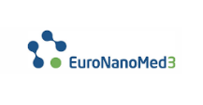
















Valorisation de la recherche – rayonnement international
GdR nationaux
&
International Symposium on Field- and Flow-based Separations, Nantes-France, 3-6June 2024
TheraScCoop ICoN

Slide 27
Highlights (2019-2023)
Prix Fulbright (2019) – S. Huclier
Invited stays (S. Huclier):
2024 David Gueffen School of Medicine – University of California Los Angeles (USA)
2019-2020 New York State University at Stony Brook (USA)
2018 Brookhaven National Laboratory (BNL) - Medical Isotope Research and Production
(MIRP) – Upton, NY (USA)
-Elected Member - steering board Association Francophone des Sciences Séparatives (AFSEP) since 2023
-Elected President - Groupe Francophone des Techniques de Fractionnement Flux Force G4F since 2021.
- Expert Member of ISO /TC 229 commission on NPs caracterization
- Participation to XP ISO TS 21362 norm writing (2018)
2 international conferences as a Chair-person
2022 | 24th International Symposium of Radiophamaceuticals Sciences (ISRS) | 29 Mai au 2 Juin 2022 | Nantes (France) | > 650 attendees | Role Chairman, member of local organizing committee and international scientific committee
2024 | 23rd International Symposium on Flow Field Fractionation (FFF 2024) | 3-6 Juin 2024 | Nantes (France) | 120 - 130 attendees | Co-Chairman and local organizing committee and International scientific committee

Slide 28
1. Sc-44
To check if the biological effects of EPS are maintained after complexation with scandium
Biological effects included anti-proliferative effect on different cancer cell lines:
MNNG/HOS osteosarcoma, A375 melanoma, A549 lung adenocarcinoma, U251 glioma, MDA231 breast cancer, Caco2 colon cancer.
SO₄²⁻ = 16%
HOS cell line
DRS:Sc complexes
All complexes revelead stronger anti-proliferative effect compared to DRS alone
No effect on cell viability
The cytostatic effect could be due to some interference with cell-cell adhesion proteins that causes a progressive detaching of cells from the gold biosensor of RTCA xCELLigence
Backup slide ?

