Slide 1
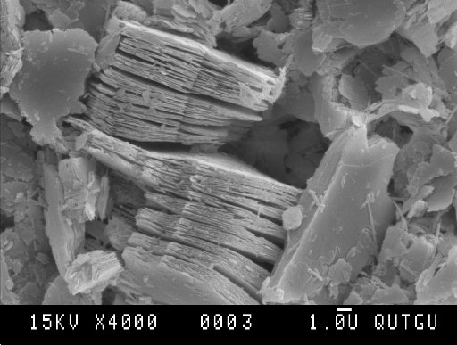
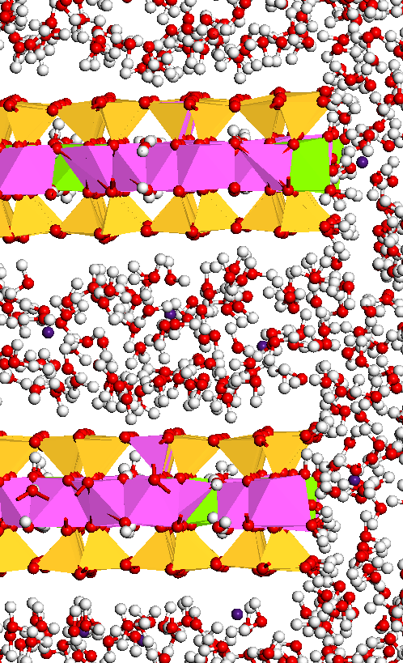
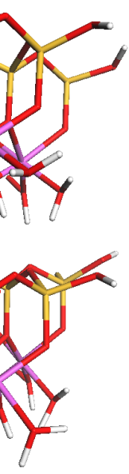
Molecular Modeling (2019 – 2024)
Andrey G. KALINICHEV, Brice F. NGOUANA-WAKOU,
Iuliia ANDRONIUK, Sylvia MUTISYA, Debashish BANERJEE, Pinar CITLI, Jakub LICKO, Sébastien LE CROM
50 nm
Ni²⁺
E-mail: kalinich@subatech.in2p3.fr
https://www.imt-atlantique.fr/en/person/andrey-kalinichev

Slide 2




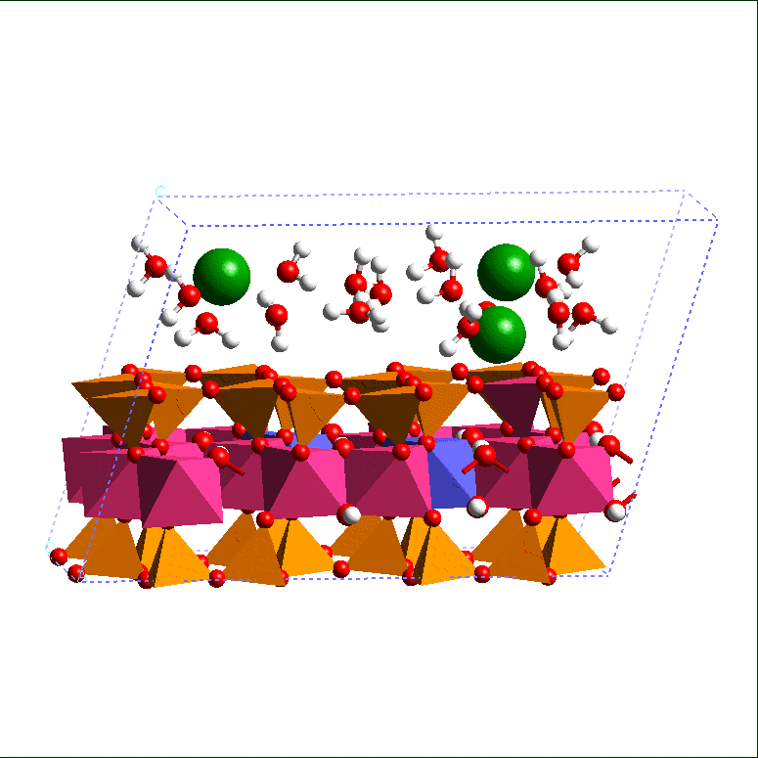
Molecular Modeling at EMN (IMTA) / SUBATECH
Molecular Modeling has been created in 2010 as a new research team within the Radiochemistry Group of SUBATECH in the context of the industrial chair «Storage and Disposal of Radioactive Waste» at the Ecole des Mines de Nantes with the focus on the computational molecular modeling for radioactive waste disposal applications
Funded by
In the general context of improving molecular-scale understanding of the interactions between radionuclides, clay and cement materials, and organic molecules, the specific problems include:
  Adsorption and mobility of cations and anions in clay environment
  Effects of clay composition, site substitutions, and edge sites on the adsorption and mobility of radionuclides
  Effects of organics on the adsorption and mobility of radionuclides in clays
  Effects of hydrogen bonding and proton transfer on the hydration structure, energetics, dynamics, and chemical reactivity of aqueous cations and anions at clay edges
  Addressing the same range of problems for cement phases, calcite, quartz, and other materials relevant to radioactive waste disposal
1 μm

Slide 3
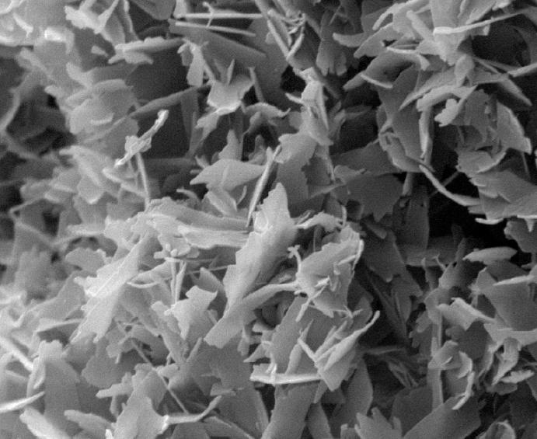
Molecular Modeling - Research Competences and Objectives
Classical and ab-initio atomistic computer simulations of materials for quantitative understanding of the properties and processes of clay-related and cement-related systems and their interfaces with fluids on the fundamental molecular scale: adsorption and transport of ions (radionuclides); effects of organic molecules; effects of fluid composition; effects of temperature, etc.
Principal Research Directions in the last 5 years (2019-2024):
1 μm
Continuation of the ClayFF force field development and parametrization
Development of more realistic models for clayey and cementitious materials taking into account their natural compositional and structural disorder
Quantification of the effects of specific surface sites on the adsorption and transport of molecular species in clays and other disordered materials
Role of nano-particle edges in the clay and cement modeling
Quantification of the effects of molecular gases (H₂, CO₂, CH₄,..) on the adsorption and transport of radionuclides clay and cement materials
Effects of organic matter on the complexation and aggregation of ions in clay and cement materials
Effects of temperature and other thermodynamic conditions on the above processes
5 μm

Slide 4
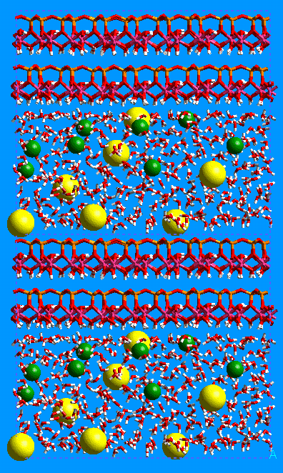
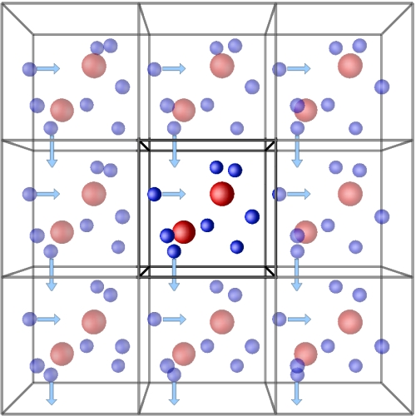
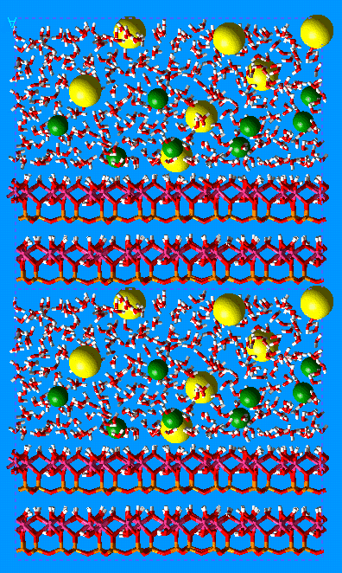
Classical Molecular Dynamics (MD) Simulations
Classical simulations calculate energy and forces between atoms based on a force field that is a set of parameters describing atomic interactions
The length- and time- scales of classical MD can reach ~1 μm and ~1 μs
Numerically solve Newtonian equation of motion for N interacting particles:
r_{i}(t+Δt) = r_{i}(t) + v_{i}(t) Δt + ½ a_{i}(t) Δt² ; Δt ~ 1 fs = 10⁻¹⁵ s
a_{i} = F_{i}/m = [ - ∂U(r_{1,}r_{2,...} r_{N}) / ∂r_{i} ] / m ; i = 1, 2 ,…, N (N ~ 10³ - 10⁶ atoms)
U = ΣΣU_{ij} = ΣΣ(A_{ij}/r_{ij}¹² - B_{ij}/r_{ij}⁶ + q_{i}q_{j} /e₀r_{ij}) + Σ ½k_{b} (r_{ij} - r₀)² + Σ ½k_{θ} (θ_{ij} - θ₀)²
Short-range repulsion v-d-Waals Coulombic bond stretching bond bending
Time averaging over a dynamic trajectory of the simulated system
Periodic boundary conditions (PBC)
3.2 nm
http://isaacs.sourceforge.net/phys/pbc.html

Slide 5
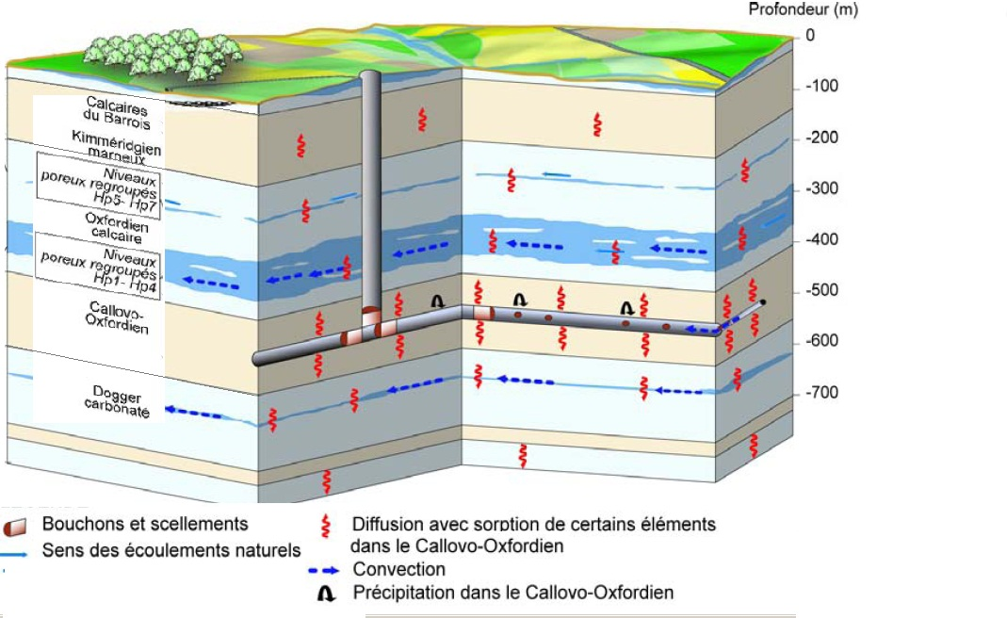
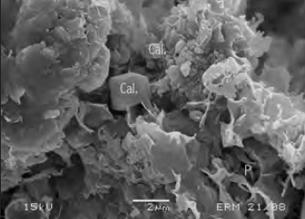
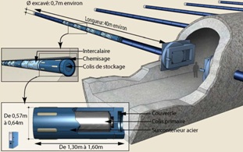
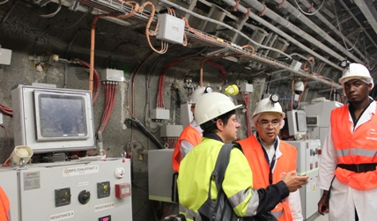
Molecular-Scale Understanding of the Adsorption and Transport of Radionuclides in Cox Clay Formations
Image source: ANDRA
Radioactive waste
repository
41% clay (illite, smectite, and interstratified I/S)
31% calcite
25% quartz and feldspar
3% other minerals
~1% organic matter
Simulating clay and cement is non-trivial
Variable composition, low symmetry,
complex crystal structures
Incompletely and poorly characterized,
occur as very fine-grained material
Availability of empirical force-fields for
realistic molecular modeling

Slide 6
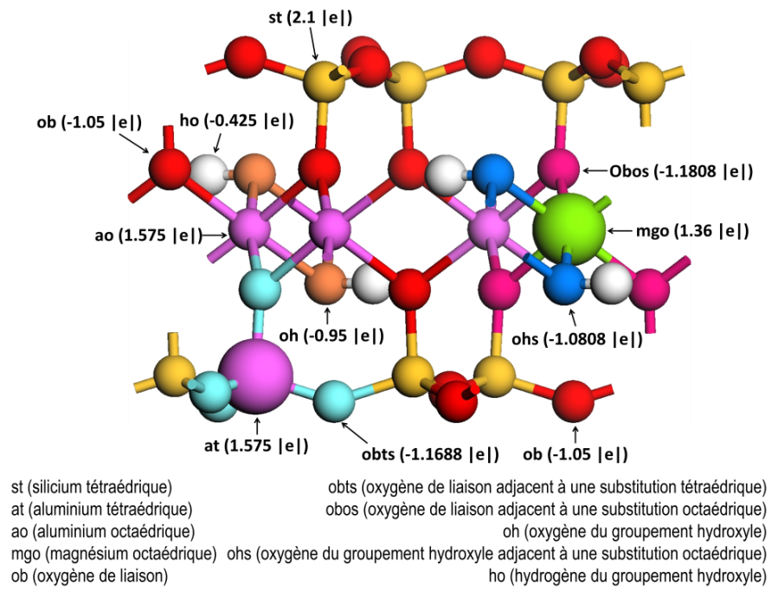
ClayFF Construction and Parametrization
T
No explicit bonds – quasi-ionic
LJ parameters for all oxygen atoms are assumed to be equal to Ow for SPC water
Both assumptions are
great simplifications of reality,
but they seem to work quite well
Al
O
Mg
Al
Si
T
Accurate determinations of partial charges are required to represent charge distributions of interlayer and external surfaces where electrostatic forces control sorption and transport processes
Atomic charges derived from DFT calculations for cluster and periodic models of simple oxide and hydroxide phases: Mg(OH)₂, Al(OH)₃, SiO₂, kaolinite…
Allows for charge delocalization among coordinating oxygens for substitutions
ClayFF: Cygan, Liang, Kalinichev, J. Phys. Chem. B, 108 1255-1266 (2004)
Cygan, Greathouse, Kalinichev, J. Phys. Chem. C, 125 17573-17589 (2021)

Slide 7
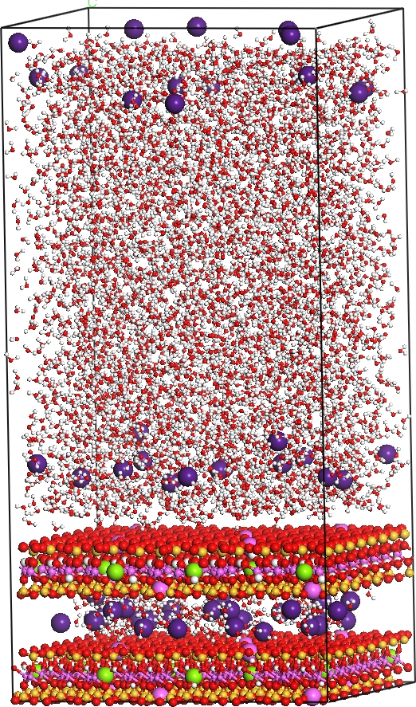
MD Modeling of Clay-Solution Interfaces
Classical Newtonian dynamics
N_{tot} ~ 3,000 – 10,000 atoms
N_{H2O} ~ 0 – 1,000 molecules
ClayFF force field (Cygan et al., 2004)
a × b × c ~ 3 × 3 × 10 nm³
Periodic boundary conditions
NVT- or NPT-ensemble T=300K; P =1 bar
t ~ 200 - 1,000 ps
Δt = 0.5-1.0 fs
Solution structure:
  Atomic density profiles (⊥)
  Atomic density surface distributions ( | | )
  Topology of the interfacial H-bond network
Dynamics:
  Diffusion coefficients (longer time scale)
  Spectra of vibrational and rotational dynamics (shorter time scale)
Aqueous solution
~7nm
~10nm
Clay
layers
~3nm

Slide 8
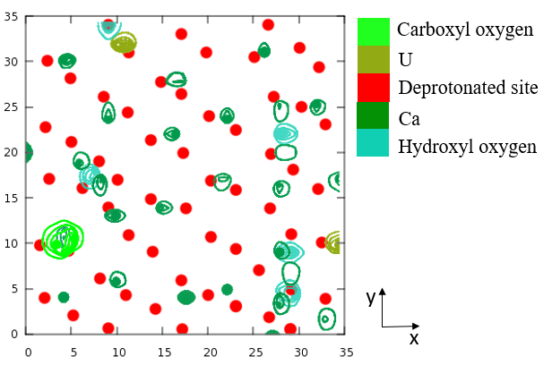
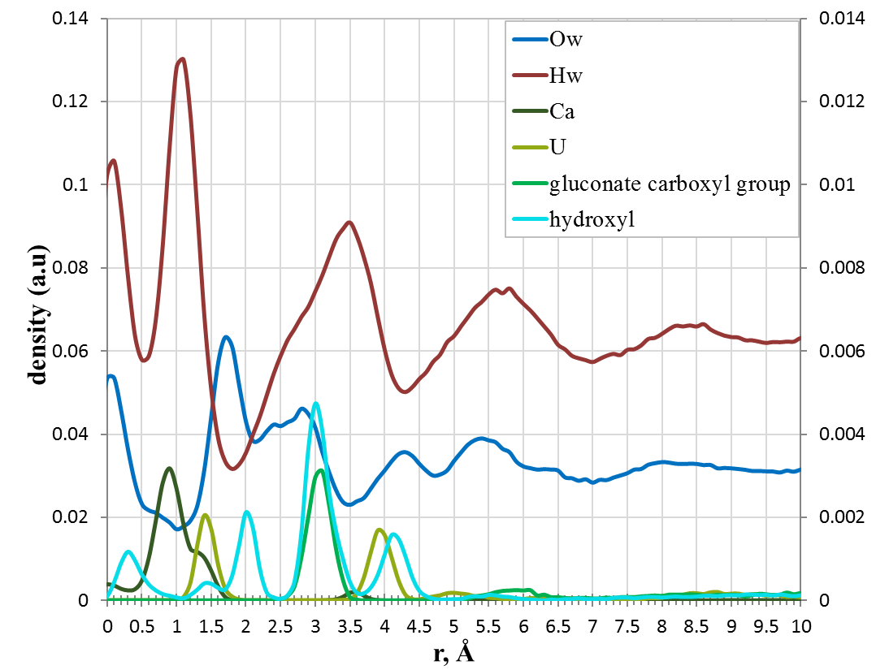
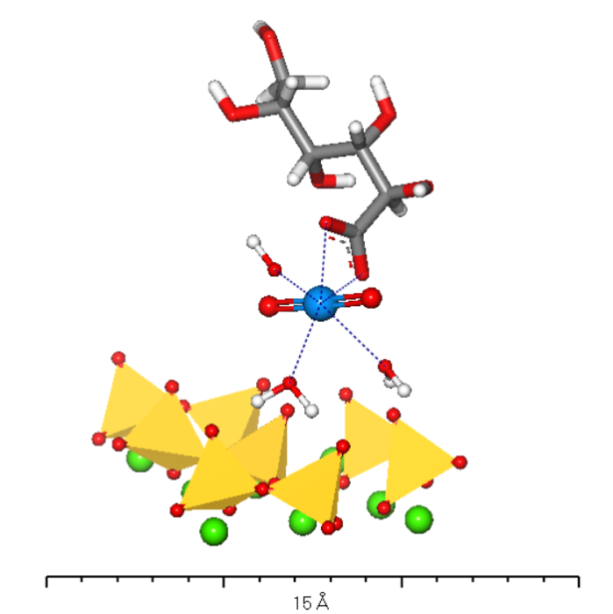
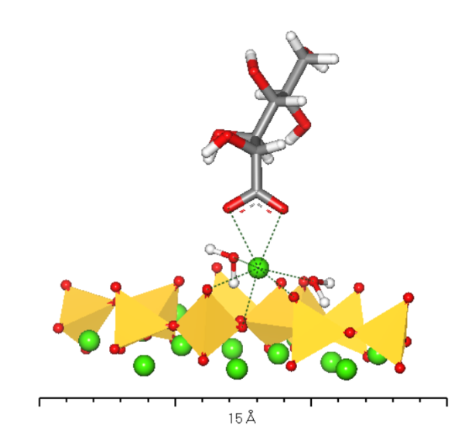
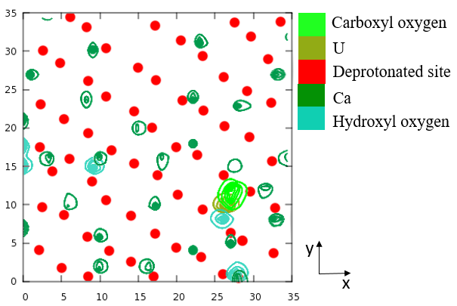
Uranyl / Gluconate Solutions on the C-S-H surfaces
Atomic density profiles normal to the C-S-H-1.4 surface for the solution with UO₂²⁺ and gluconate
Distribution of ions on the C-S-H-1.4 surface-1
Distribution of ions on the C-S-H-1.4 surface-2
I.Androniuk, A.G.Kalinichev (2020) Appl. Geochem., 113, 104496

Slide 9
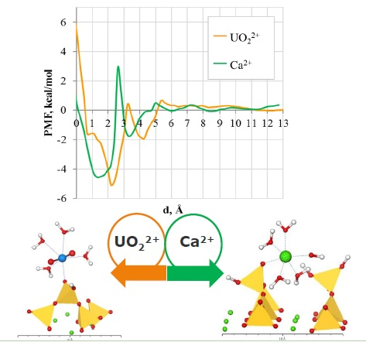
Competition of UO₂²⁺ and Ca²⁺ for Adsorption Sites
Adsorption free energy (PMF) as a function of distance between UO₂²⁺, Ca²⁺ and deprotonated silanol group of the bridging Si tetrahedra on the C-S-H surface at C/S = 0.83
High energy barrier between the inner-sphere (IS) and outer-sphere (OS) surface complexes
Approximately the same depth of the potential wells for both IS and OS
Ion exchange and competition for the same surface sites are very likely
I.Androniuk, C.Landesman, P.Henocq, A.G.Kalinichev (2017) Phys. Chem. Earth A/B/C, 99, 194-203
I.Androniuk, A.G.Kalinichev (2020) Appl. Geochem., 113, 104496
P.Henocq, C.Landesman, I.Androniuk, A.G.Kalinichev (2024) Cement and Concrete Research, in prep.

Slide 10
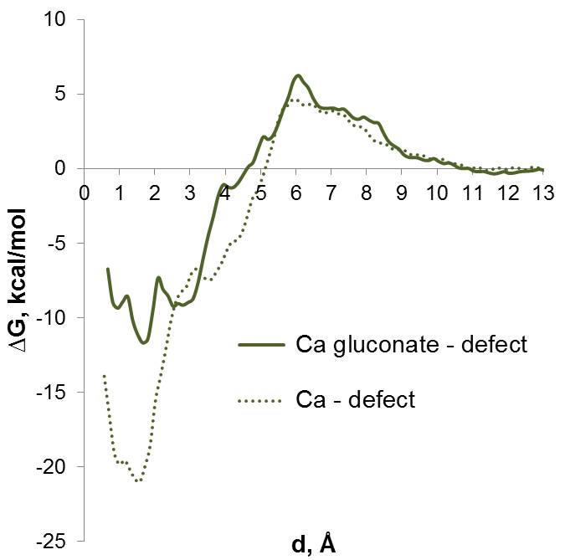
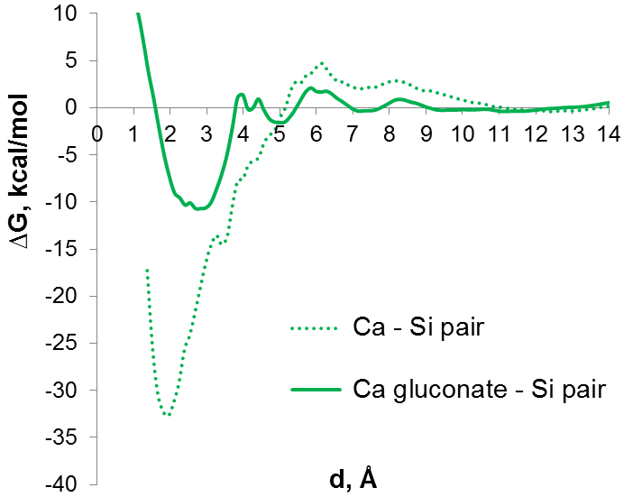
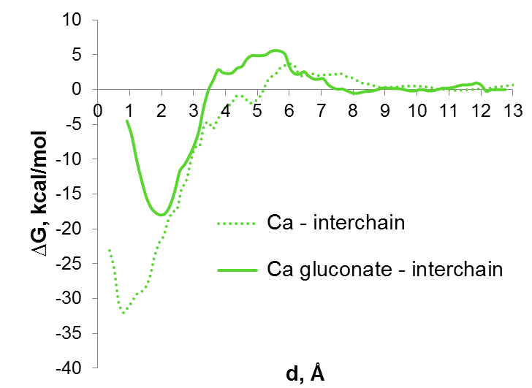
Effect of Gluconate on Ion Binding to C-S-H Surface
The binding of Ca²⁺ to the C-S-H surface becomes much weaker and potentially may result in a higher probability of substitution for a competing solution cation (e.g., Na⁺ or UO₂(OH)₃⁻)
Effect of gluconate is the same for all the sorption sites studied.
Even though the adsorption energy decreases, complexation between Ca-gluconate and C-S-H surface remains stable.
I.Androniuk, A.G.Kalinichev (2020) Appl. Geochem., 113, 104496
P.Henocq, C.Landesman, I.Androniuk, A.G.Kalinichev (2024) Cement and Concrete Research, in prep.

Slide 11
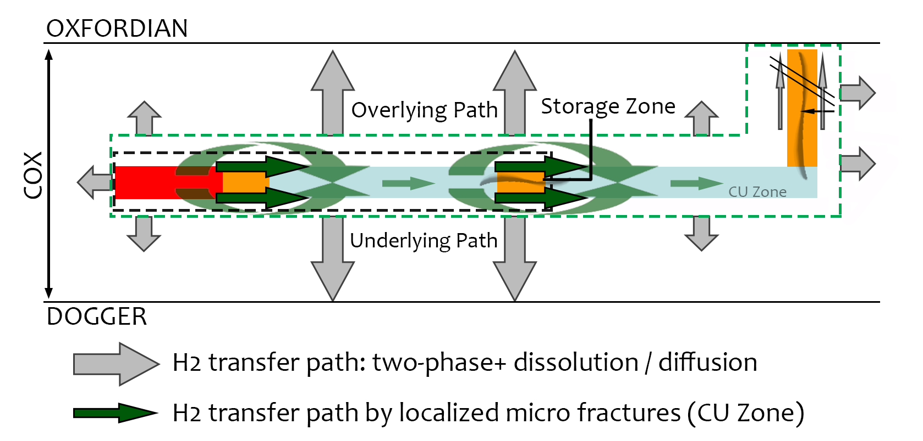
Gas Formation under Waste Storage Conditions
PhD thesis of Pinar CITLI (February 2024)
Anaerobic corrosion of metals
H₂
Degradation of organic matter
CH₄
CO₂
Radiolysis of water due to radioactive decay
CH₄
H₂
O₂
CO₂
Dissolution in water and diffusion
Two-phase water flow
Transfer along micro fractures
Transfer along fractures
Gas accumulation
Gas pressure build-up
Over
pressure
Fracture of surrounding clay rock

Slide 12
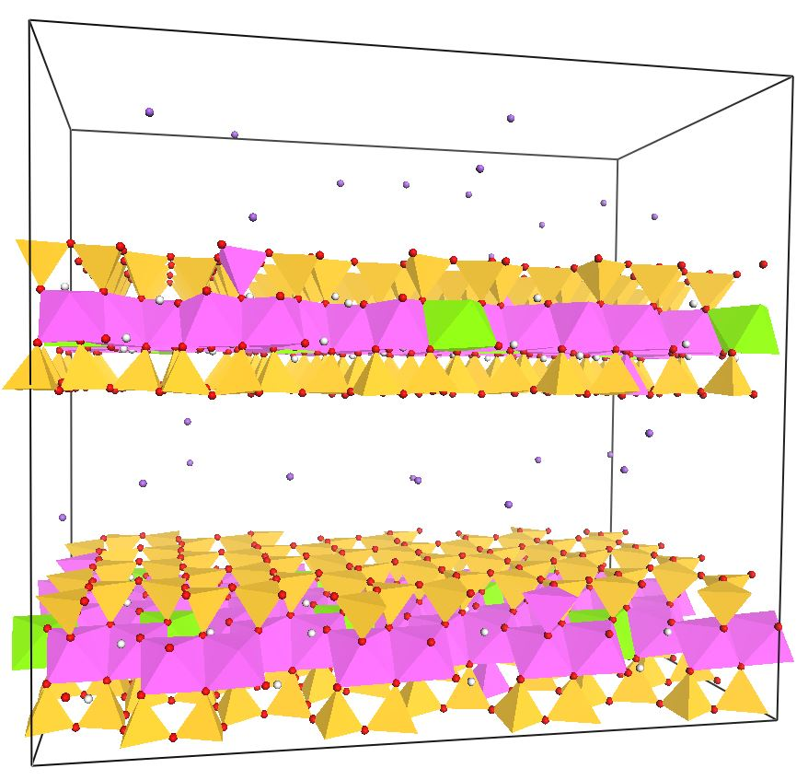
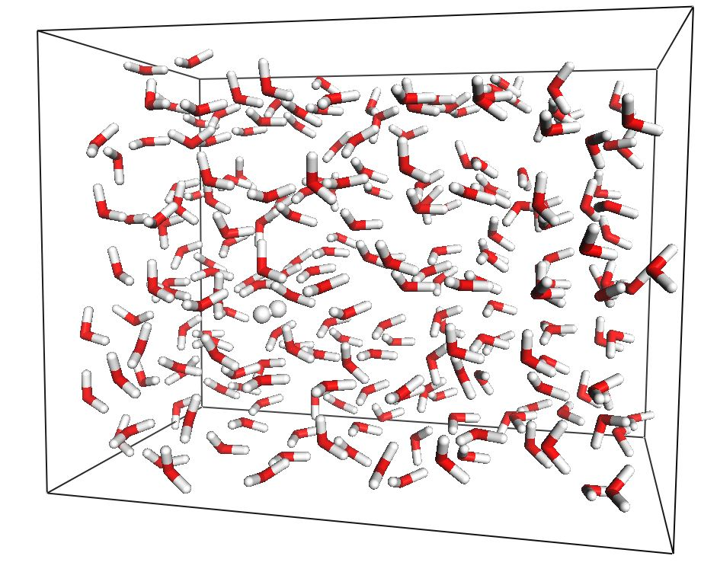
GCMC simulations of H₂ Adsorption in Clay
PhD thesis of Pinar CITLI (February 2024)
Grand Canonical Monte Carlo (GCMC) simulations of H₂/H₂O binary mixtures
T = 298, 323 and 363 K ; P = up to 120 bar, 1000 bar and 10,000 bar
  µ,V,T
Insertion
Simulation box
Bulk solution reservoir
Particle exchange
Effect of temperature
Effect of pressure
Comparison of simulations results with experimental data
Solubility of H₂ in the clay interlayers
Effect of pore size and hydration level
Effect of interlayer cation

Slide 13
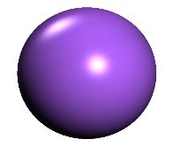
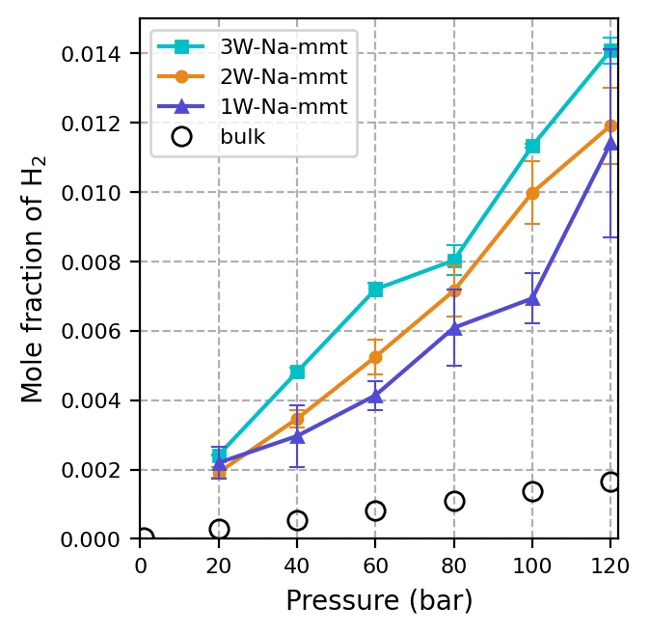
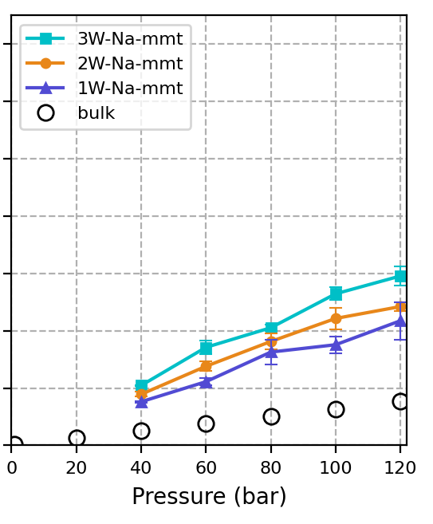
Oversolubility of H₂ in the interlayers
298 K
Na⁺
323 K
7 to 8 times greater solubility than in bulk
2 to 4 times greater solubility than in bulk

Slide 14
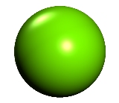
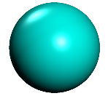
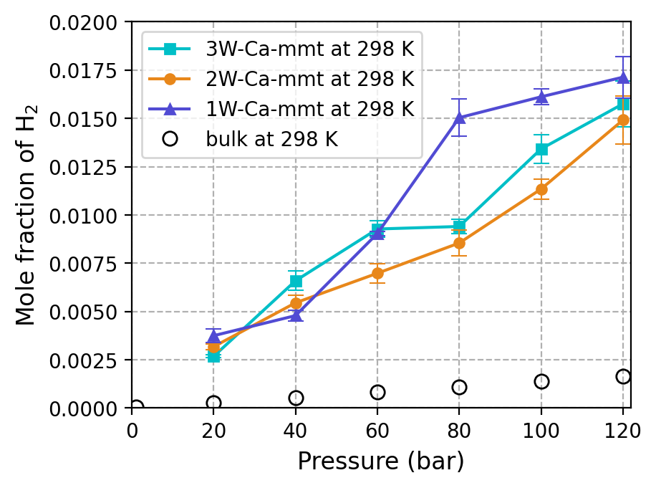
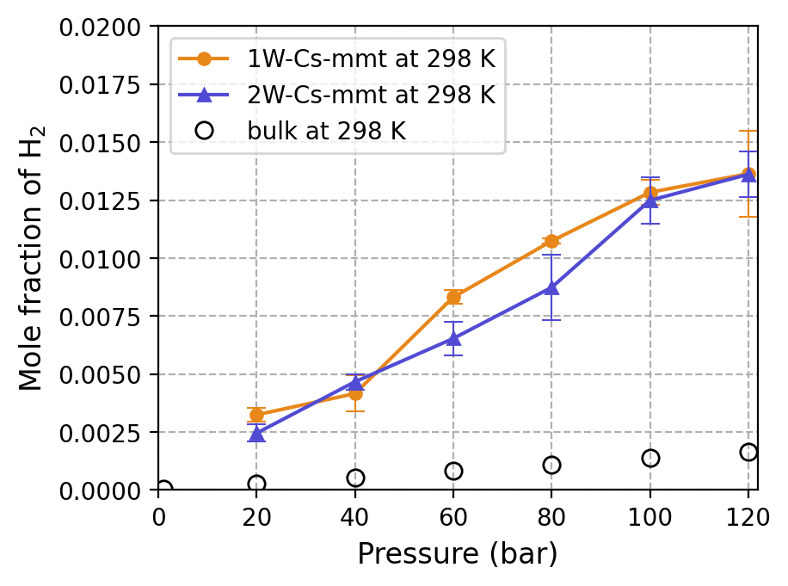
Oversolubility of H₂ in the interlayers
Ca²⁺
Cs⁺
Up to 9 times greater solubility than in the bulk
8 times greater solubility than in the bulk
P.Citli, A.G.Kalinichev (2024) Grand Canonical Monte Carlo simulations of hydrogen adsorption in the interlayers of hydrated montmorillonite. Applied Clay Science, (submitted).

Slide 15
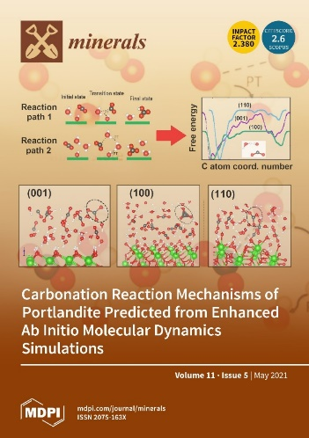
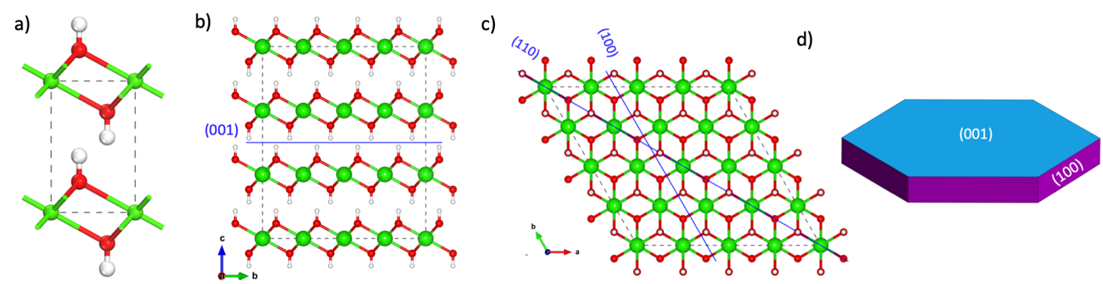
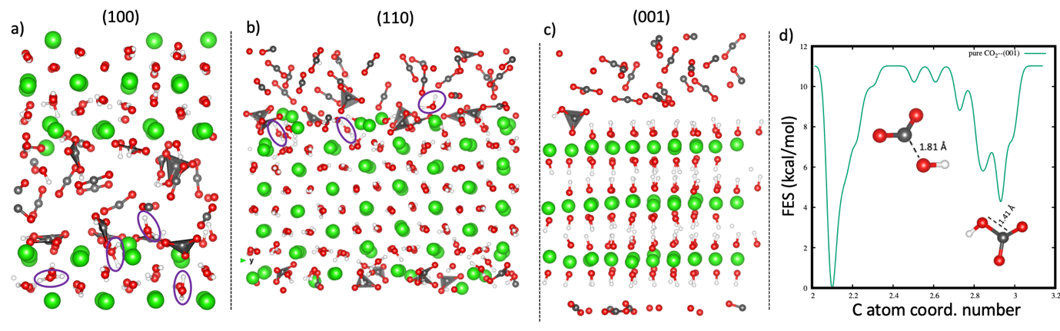
Reactivity of CO₂ with Portlandite Surfaces – Ab Initio MD
$$Ca{\left(OH\right)}_{2}+CO_{2}⟶CaCO_{3}+H_{2}O$$
S.Mutisya, A.G.Kalinichev, Minerals, 11, 509 (2021)

Slide 16
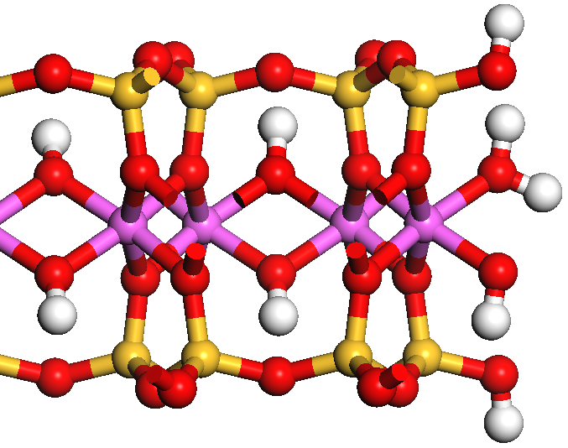
ClayFF Development - Modeling of Particle Edges
Aggregate of clay particles
Basal (001) surfaces and interlayers are extensively studied; their properties are reasonably well known
Clay edges have received much less attention yet
Basal (001) surface
Interlayer pore
Ab initio (quantum) MD is a direct answer,
but it is very expensive computationally
AIMD ⇒ ~n×100 atoms; ~15×15×15Å³; t ~10-50 ps
Edge surfaces
S.V.Churakov, Geochim. Cosmochim. Acta, 71, 1130-1144 (2007)
X. Liu et al., Geochim. Cosmochim. Acta (2012, 2013, 2014, 2015)
S. Tazi et al., Geochim. Cosmochim. Acta, 94 1-11 (2012)
Primary clay particle
Inter-particle pore
ClayFF Parametrization for Clay Edges
New special ClayFF bending terms
for Mg-O-H, Al-O-H, and Si-O-H
  U_{ClayFF-MOH} = U_{ClayFF-orig} + U_{M-O-H} =
  = U_{ClayFF-orig} + k (θ −θ₀ )²
  k and θ₀ have to minimize the differences between DFT and ClayFF-MOH results
Pouvreau, Greathouse, Cygan, Kalinichev, J.Phys.Chem.C, 121, 14757-14771; 2019, 123, 11628–11638

Slide 17
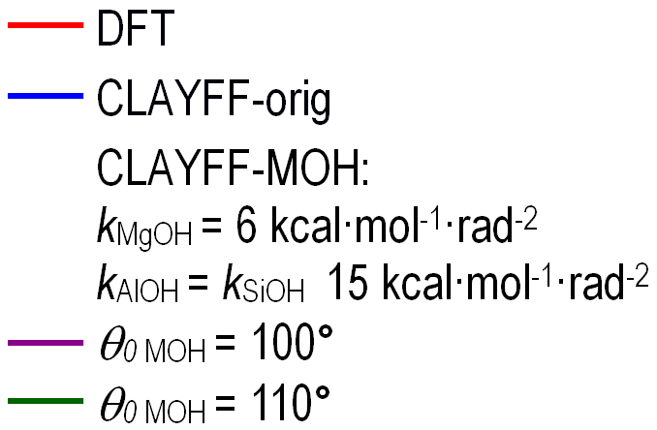
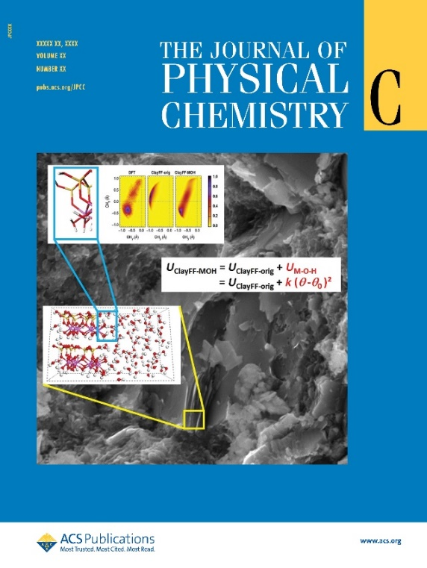
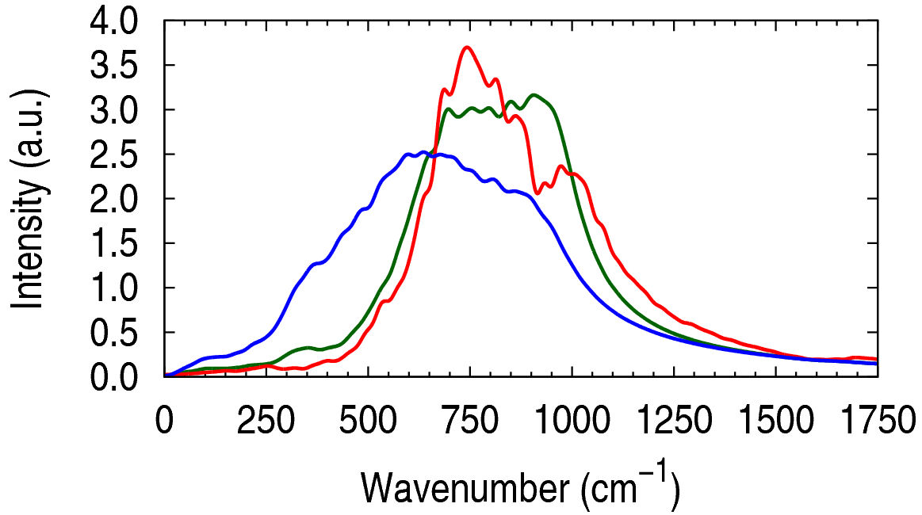
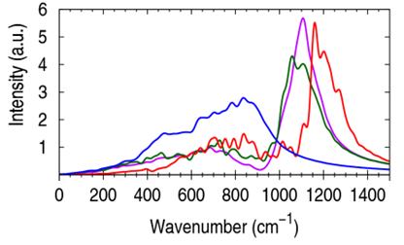
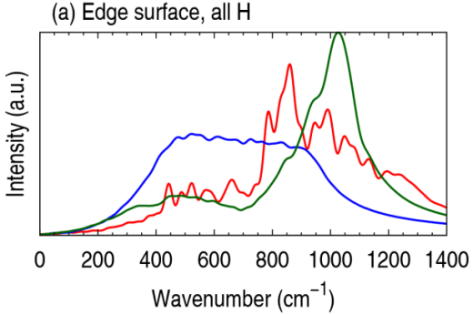
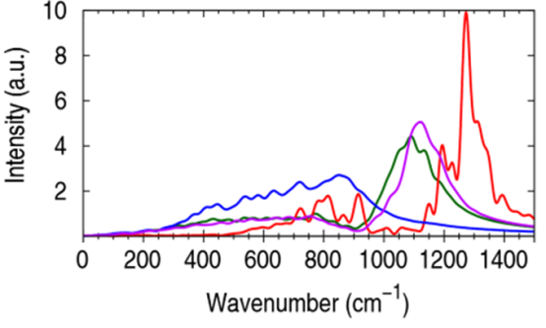
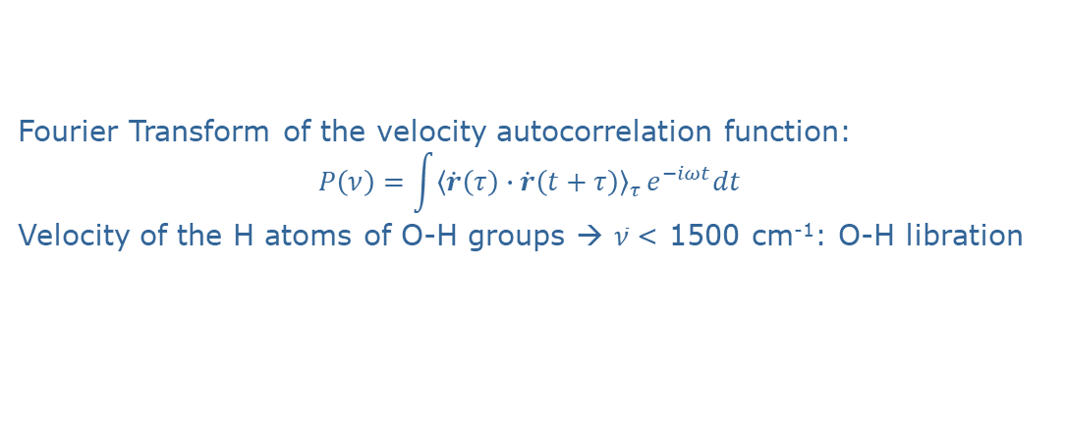
ClayFF: O-H Librational (M-O-H Bending) Spectra
Fourier Transform of the velocity autocorrelation function:
$$P\left(ν\right)=\int{{〈\dot{r}\left(τ\right)∙\dot{r}\left(t+τ\right)〉}_{τ}}e^{−iωt}dt$$
  Velocity of the H atoms of O-H groups → $\overline{ν}$< 1500 cm⁻¹: O-H libration
Kaolinite edge A
Brucite edge
Gibbsite edge
Kaolinite edge B
Spectra shifted of 250 to 600 cm⁻¹ and narrowed
Kaolinite: as expected not much difference between θ₀=100° and θ₀=110°
M.Pouvreau, J.A.Greathouse, R.T.Cygan, A.G.Kalinichev, J.Phys.Chem.C, 2019, 123, 11628–11638

Slide 18
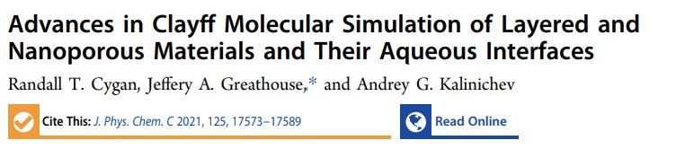
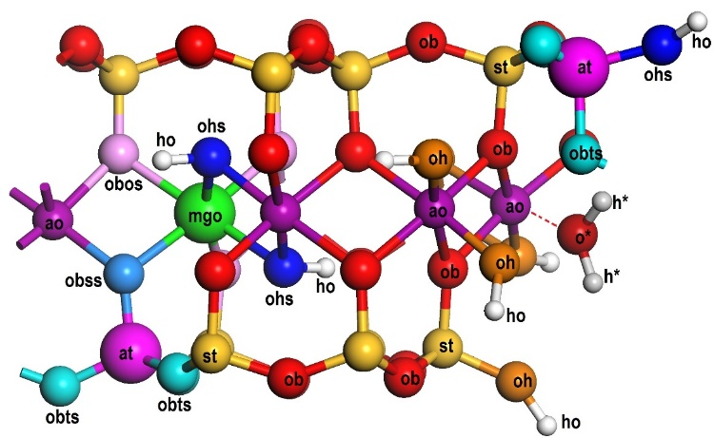
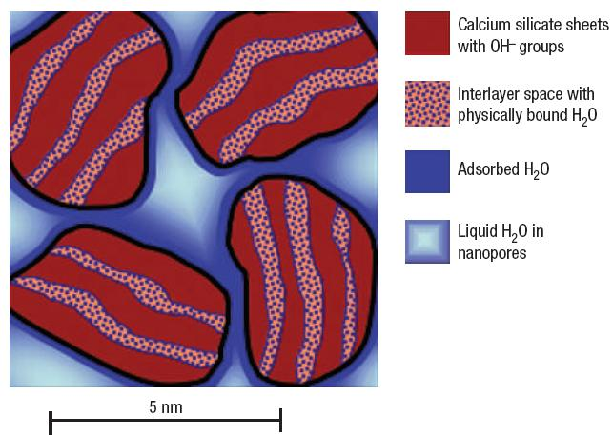
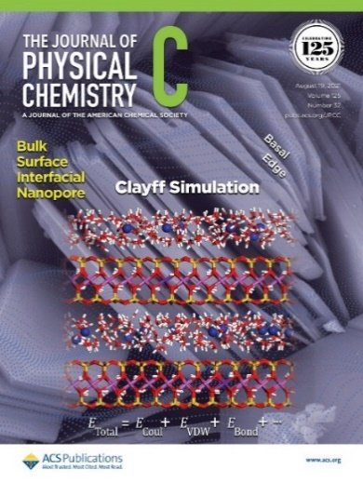
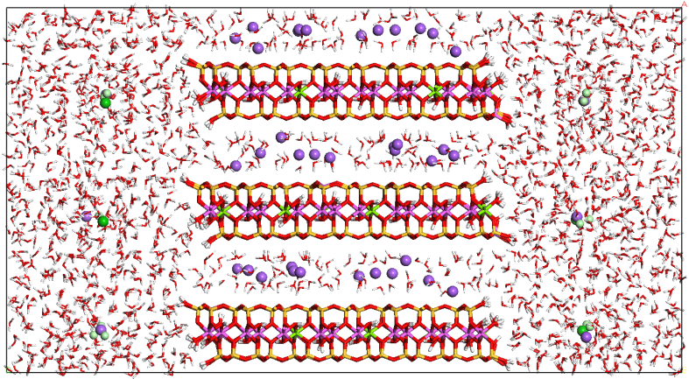
ClayFF Development - Modeling of Particle Edges
Aggregate of clay nanoparticles
Inter-particle pore
Interlayer pore
Primary clay particle
Aggregate
of cement nanoparticles
Cygan, Greathouse, Kalinichev (2021)
J. Phys. Chem. C, 125 17573-17589

Slide 19
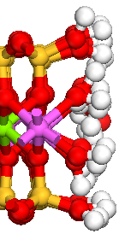






Montmorillonite Clay Nanoparticle Edge Surfaces
(001) Basal surface
(010) Edge surface
B chains
$≡$Si/Al(OH) and $≡$Al/Mg(OH₂)(OH) sites
Edge surface protonation at near-neutral pH
(110) Edge surface
AC chains
$≡$Si/Al(OH) and $≡$Al/Mg(OH₂) sites
B.F.Ngouana-Wakou et al., J.Phys.Chem.C, 2024, in prep.

Slide 20


Interlayer vs Edge Adsorption of NORM in Clay
All cations are more stable in the interlayer compared to the interface
The associated average free energy gain are as follows :
~10 kJ/mol for Na⁺
~25 kJ/mol for Sr²⁺
~19 kJ/mol for Ba²⁺
The energy gain when Na⁺ enters the interlayer region is almost doubled for Sr²⁺ and Ba²⁺: 1 Sr²⁺/Ba²⁺ for 2 Na⁺ ions
Interlayer
Na⁺
Sr²⁺
Ba²⁺
This is consistent with our statistical analyses showing that ~70% of Sr²⁺/Ba²⁺ initially present in the interfacial region migrate in the interlayers during the simulations
There are noticeable energy barriers at the (010) edge for Sr²⁺/Ba²⁺ to enter the MMT interlayers
B.F.Ngouana-Wakou et al., J.Phys.Chem.C, 2024, in prep.

Slide 21



CO₂ and CH₄ Gases in Clay Nanoparticles
Simulation cells used in the constant reservoir composition molecular dynamics (CRC-MD) calculations of CO₂/CH₄ partitioning into pores bounded by montmorillonite basal surfaces and showing the different regions and the bias forces
N.Loganathan et al. (2019) Phys.Chem.-Chem.Phys, 21, 6917-6924
S.V.Kraevsky et al. 2020) Applied Clay Science, 186, 105442.
D.I.Grekov et al. (2020) Phys.Chem.-Chem.Phys, 22, 16727-16733
N.Loganathan et al. (2020) J.Phys.Chem. C, 124, 2490−2500
D.I.Grekov et al. (2021) J.Phys.Chem. C, 125, 11499–11507

Slide 22


H₂ Gas Adsoption on Different Clay Surfaces
S. Mutisya, A.G. Kalinichev (2024) J. Phys. Chem. C, in preparation

Slide 23

H₂ Gas Adsoption on Different Clay Surfaces
(010) Edge model
S. Mutisya, A.G. Kalinichev (2024) J. Phys. Chem. C, in preparation

Slide 24




Molecular Modeling – External Collaborations (1)
CEA Marcoule – molecular mechanisms controlling the rate of alteration and chemical durability of nuclear waste glass.
PhD thesis co-advised by AGK:
Kamalesh DAMODARAN, 09/2020 - 12/2022;
Sumit TIWARI, 10/2022 - 10/2025
K. Damodaran, J.-M. Delaye, A.G. Kalinichev, S. Gin (2022) Deciphering the non-linear impact of Al on chemical durability of silicate glass. Acta Materialia, 225, 117478.

Slide 25




Molecular Modeling – External Collaborations (2)
Turkey (Department of Chemistry, Hacettepe University) – layered double hydroxides (LDHs) - anionic clays for environmental and medical applications
Poland (Institute of Geological Sciences, Polish Academy of Sciences – development of I/S COx models; hydrophobicity of smectites; clay-organic interactions
Synthesis, characteriza-tion, and MD simulations of Mg-Al-LDH intercalated with tetraborate anions for application for boron neutron capture therapy (BNCT) – potential brain cancer treatment using ¹⁰B isotope delivered close to tumor cells
Cs⁺/Na⁺ exchange in interstratified I/S (COx)
Molecular nature of clay surface hydrophobicity
M.Szczerba, A.G.Kalinichev, M.Kowalik (2020)
Appl. Clay Sci., 188, 105497
Z.Chen, N.Loganathan, M.Szczerba, G.Montavon,
A.G.Kalinichev (2024) Env. Sci. Technol, in revision
A.N.Ay, B.Zumreoglu-Karan, A.G.Kalinichev, V.Rives, R.Trujillano, A.Temel (2020) Journal of Porous Materials, 27, 735–743

Slide 26




Molecular Modeling – External Collaborations (3)
Russia (International Laboratory for Supercomputer Atomistic Modelling and Multi-scale Analysis, National Research University Higher School of Economics, Moscow) – atomistic simulations of clay-related and cement-related systems
Calcium aluminates (AFm cement phase) as potential adsorbents for anionic radionuclides (³⁶Cl⁻, ¹²⁹I⁻): [Ca₂Al(OH)₆] X·2H₂O, X = Cl⁻, I⁻
Terminated in March 2022
due to the war in Ukraine
E.V.Tararushkin et al. (2022) Cement and Concrete Res., 156, 106759.
V.V.Pisarev et al. (2022) Journal of Molecular Liquids, 366, 120290
M.A.Logunov et al. (2022) Polymer Science A, 64, 908-917
E.V.Tararushkin et al. (2023) Materials, 16, 5026.
E.V.Tararushkin et al. (2023) Minerals, 13, 408.
E.V.Tararushkin et al. (2023) Minerals, 13, 1018.
A.A.Glushak et al. (2024) Appl. Geochem., under review.
Cl⁻
anion site
H₂O site

Slide 27



Molecular Modeling – External Collaborations (4)
Russia (International Laboratory for Supercomputer Atomistic Modelling and Multi-scale Analysis, National Research University Higher School of Economics, Moscow) – atomistic simulations of clay-related and cement-related systems
Uranyl adsorption at the hydrated clay surfaces
Terminated in March 2022
due to the war in Ukraine
Illite K_{1.3}(Al_{3.5}Mg_{0.5})[Si_{7.2}Al_{0.8}]O₂₀(OH)₄
Smectite [Ca(H₂O)₆]_{0.4}(Al_{3.2}Mg_{0.8})[Si₈]O₂₀(OH)₄
A.D.Krot, I.E.Vlasova, E.V.Tararushkin, A.G.Kalinichev (2024) Minerals, 14, 109.

Slide 28



Molecular Modeling – Links to Experiment
X.Liu et al. (2022) Nature Reviews Earth & Environment 3, 461-476.

Slide 29



Molecular Modeling - Methods Development
https://aipea.org/aes-books/

Slide 30


Molecular Modeling – Research Output
International dissemination activities (2019-2024)
    25 publications in high quality peer-reviewed journals
    3 publications were featured on the journals’ covers
    11 invited lectures and talks at major international conferences (Goldschmidt, ACS, CMS, ICC, Migration)
    43 other oral and poster presentations at major
    international conferences
    7 publications in preparation
    A.Kalinichev co-organized 4 special sessions/symposia
    at major international conferences
    In 2019-2020 A.Kalinichev was elected and served as the President of the Clay Minerals Society
    A.Kalinichev is also currently:
      Editor-in-Chief of the section Clays and Engineered
      Mineral Materials of the journal Minerals
      Assoc. Editor of the journal Clays and Clay Minerals
      Assoc. Editor of the journal Frontiers in Nuclear Engineering
      Assoc. Editor of the journal Discover - Minerals

Slide 31
Molecular Modeling – Perspectives for 2024-2029
PhD project of Jakub Licko simulating the effects of small organic molecules on the adsorption and mobility of actinyls in clay will continue through 2024-2025.
H₂ gas in different (un)saturated clay and cement systems for the problems of geological nuclear waste disposal. This is thematically strongly linked with the new EURAD-GAS project and collaboration with colleagues at University of Grenoble. This work will be also extended to other technological applications, such as underground H₂ gas storage.
Collaboration with US colleagues (Sandia National Labs, Michigan State University) on the development of the ClayFF force field will continue by potentially including the effects of chemical reactivity at the clay and cement particle edges. With the arrival of Sébastien
Le Crom – an expert in the polarizable force field development and application (PIM) – we may venture into adding the effects of polarizability to the current version of ClayFF.
A new MD-simulation project to quantify the effects of soil organic matter on the mobility of Ra²⁺ in the environment is currently being developed in collaboration with Gilles Montavon at Subatech.
The collaboration with CEA Marcoule on the atomistic simulation of nuclear waste glass corrosion and durability will continue at least through the end of 2025.
New PhD project on molecular modeling of CO₂ mineralization is beginning in the fall of 2024 in collaboration with Sébastien Le Crom and Jean-François Boily (Umeå University, Sweden) in the framework of the SEED program at IMT Atlantique.
A new collaborative project “High fidelity multiscale solute transport modelling in nano-porous media under fluctuating thermodynamic and saturation conditions” is currently being developed in collaboration with colleagues from the Geological Survey of Finland and the University of Helsinki.

Slide 32






Acknowledgments
R.T.Cygan, J.-J.Liang, J.A.Greathouse – Sandia National Labs, USA
R.J.Kirkpatrick , J.Wang, P.Kumar, G.M Bowers, N.Loganathan, – UIUC, MSU, USA
B.Grambow, B.Ngouana, M.Pouvreau, I.Androniuk, S.Mutisya, P.Citli – Subatech
M.Szczerba, J.Srodon – ING PAN, Krakow, Poland
Financial and Computational Support:
Grand Equipment National de Calcul Intensif (GENCI)
Très Grand Centre de Calcul du CEA (TGCC)
IMT Atlantique - Industrial Chair
“Storage and Disposal of Radioactive Waste”
EU Horizon 2020 Program - grants No. 640979 & 764810
Russian Academic Excellence Project “5-100” (2017-2022)

