Slide 1
Materials for nuclear

Slide 2
Outline
General overview
Research activities
Perspectives

Slide 3
From treatment to disposal of radioactive wastes, an opening to recycling: research programs
General overview | Research activities – part 1 | Research activities – part 2 | Research activities – part 3 | Perspectives
Treatment – Conditioning
Geological disposal
Recycling
Link to large amount of metallic wastes to dispose of
Chemical treatment (decontamination) & associated secondary effluents
Evaluation of new matrices for conditioning primary (metals) and secondary wastes (sludge)
Evolution and behaviour of ILW/HLW wastes in disposal conditions
Chemical/Physical durability of matrices of conditioning
Reactitvity at interfaces (glass, steel, clay, cement) & effects of irradiation and radiolysis
Solubility of tetravalent oxides
Analytical development for radionuclides difficult to be measured (DTM)
Evaluation of possible recycling of valuable materials
Exploring the recycling of depleted uranium in cementitious materials
Migration of RNs in cementitious materials

Slide 4










From treatment to disposal of radioactive wastes, an opening to recycling: project fundings
General overview | Research activities – part 1 | Research activities – part 2 | Research activities – part 3 | Perspectives
Treatment – Conditioning
Geological disposal
Recycling – Valorisation
WP CORI
WP ACED
WP Concord
W4 Metallic Wastes
W4 Metallic Wastes

Slide 5
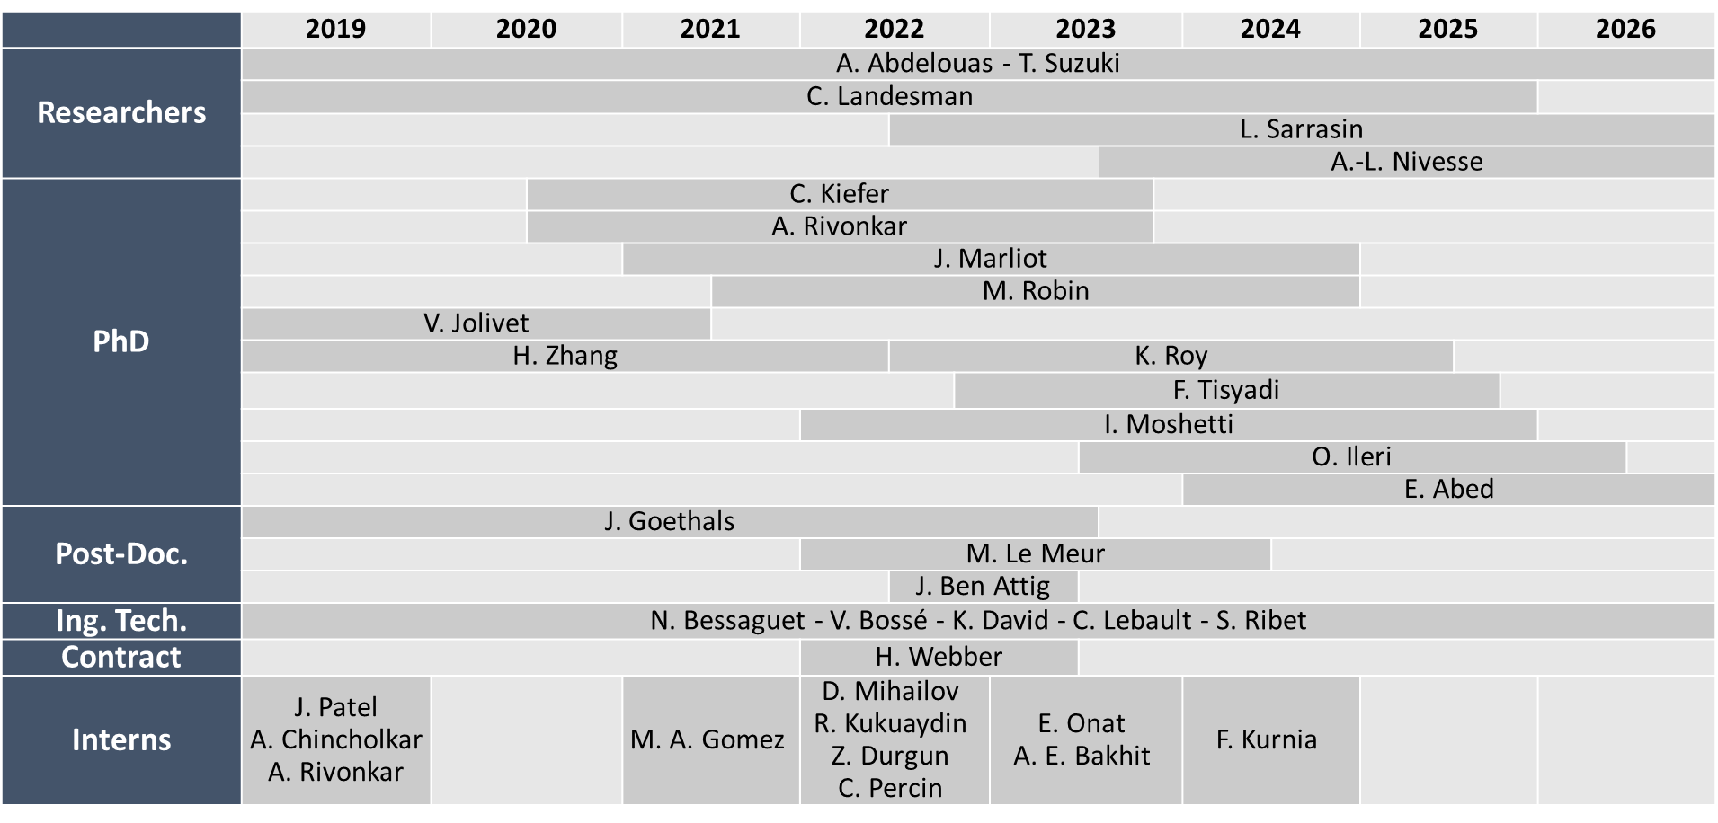
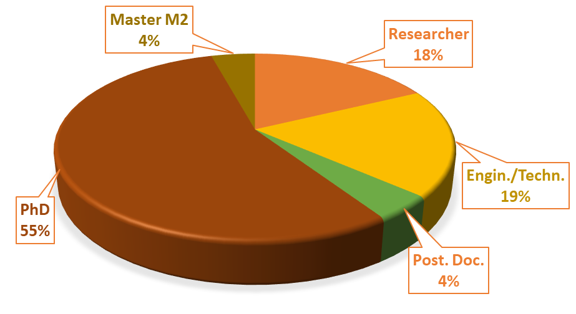
Distribution effort
General overview | Research activities – part 1 | Research activities – part 2 | Research activities – part 3 | Perspectives
In 2024

Slide 6
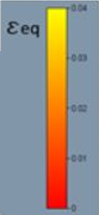
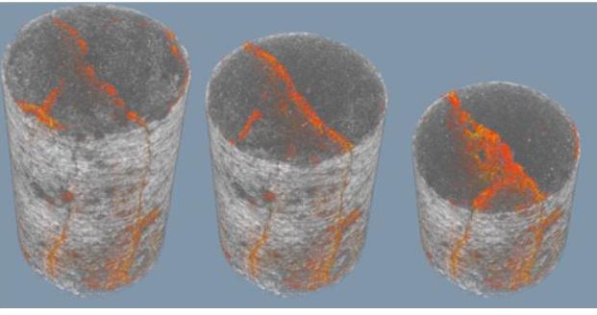
Dissemination & Implication
General overview | Research activities – part 1 | Research activities – part 2 | Research activities – part 3 | Perspectives
2019-2024
Publications [preparation, submitted]
52 [4]
XRCT on fractured mortar: 3D deformation map
© J. Marliot
International conferences (orals, posters)
14
Steering committees for Inter. Conf.
2
Executive committees:
NEEDS
GDR Scinée « fuel cycle »
EuradScience

Slide 7
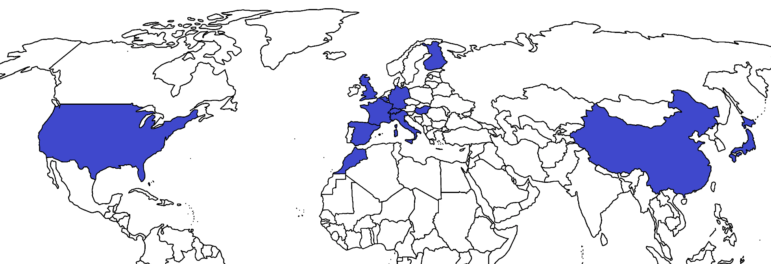













Collaborations
General overview | Research activities – part 1 | Research activities – part 2 | Research activities – part 3 | Perspectives
1
1
1
1
11
2
1
1
1
1
3
1
1

Slide 8
Highlights on Radionuclides difficult to measure (DTM)
First case study
Measurement of Pb-210 in scales from geothermal metallic wastes
Participant of the consortium
Application of the method developped during PREDIS and Tesmarac projects on real sample
Development of methodologies to measure by gamma spectrometry with accuracy, in correlation with Monte-Carlo simulations
International intercomparison exercice
Development of new radiochemical methodologies for nuclear applications
Selection of key DTM radionuclides
Selection of materials
Selection of radio-/chemical procedures
Development & optimizations
Low gamma emitter 45.6 keV
Organization of international webinar

Slide 9
Presentation of research activities
General overview | Research activities – part 1 | Research activities – part 2 | Research activities – part 3 | Perspectives
Treatment – Conditioning
Geological disposal
Recycling – Valorisation
Chemical treatment of metallic components (stainless steel, inconel) & associated secondary effluents
Evaluation of new matrices for conditioning (MKP, geopolymers)
Solubility of tetravalent oxide
Analytical development for radionuclides difficult to be measured (DTM)
Migration of RNs in cementitious materials and fractured mortars
Reactivity at the interface glass/steel/clay
Iodine doped glass durability

Slide 10
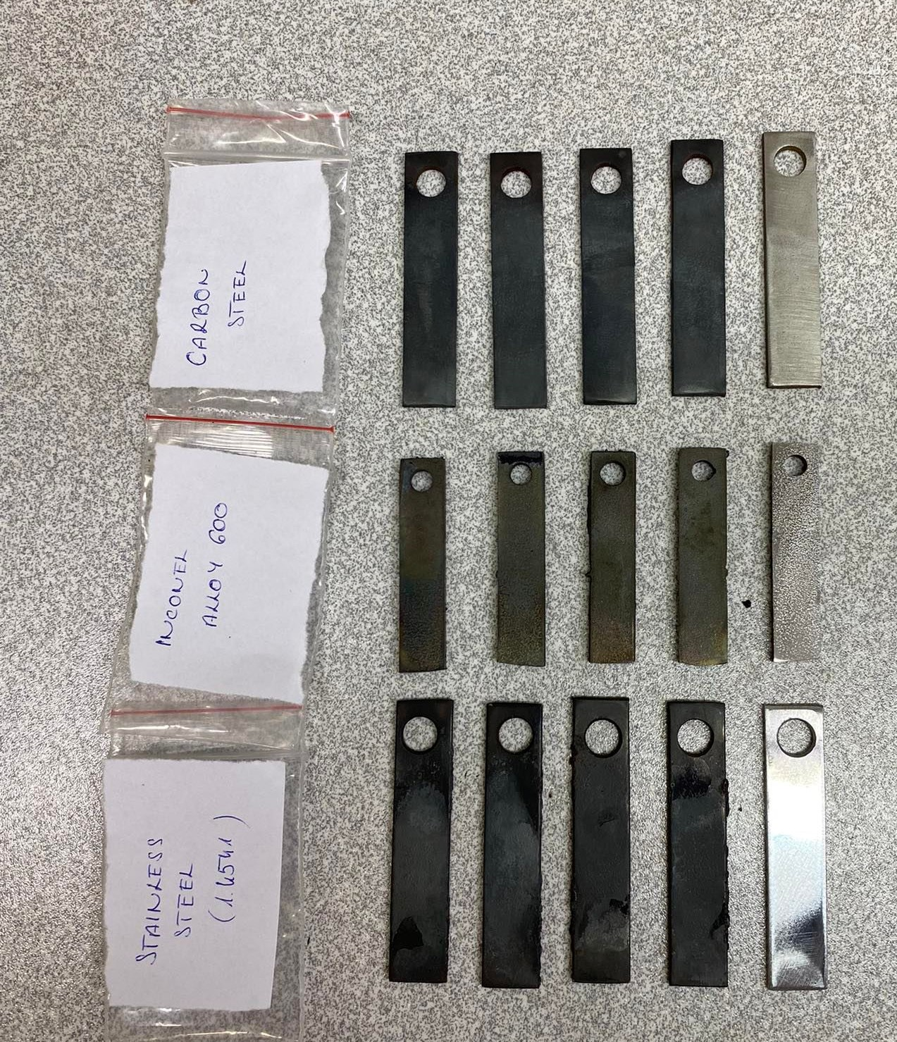
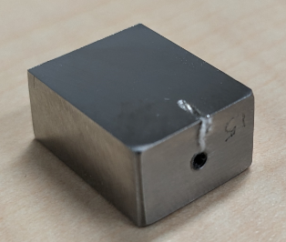
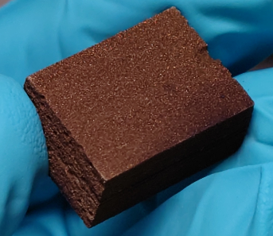
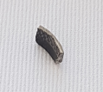
Metallic wastes: context
General overview | Treatment – Conditioning | Geological disposal | Recycling | Perspectives
Corroded stainless steel samples
Dismantling and decommissioning of NPPs.
  large volumes of waste which may over-saturate the capacity of waste disposal repository.
Significant contribution from metallic components
  500,000 to 600,000 tons of metallic wastes in 30 years expected in France [1]
    130,000 tons steam generators.
    13,000 tons/year metals from dismantling.
Typically used metals include Ni-alloys and stainless steels.
Research in 4 steps:
  Step 1: chemical decontamination of corroded metals
  Step 2: treatment of secondary effluents
  Step 3: evaluation of new matrixes for conditioning
  Step 4: conditioning sludges in new matrixes
Radioactive inconel sample
Autorité de sûreté nucléaire, ASN REPORT on the state of nuclear safety andradiation protection in France. May 2022

Slide 11

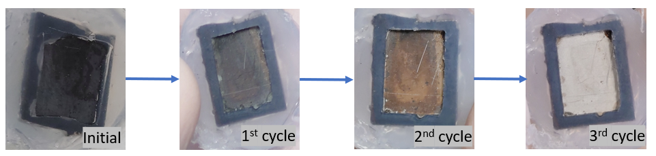
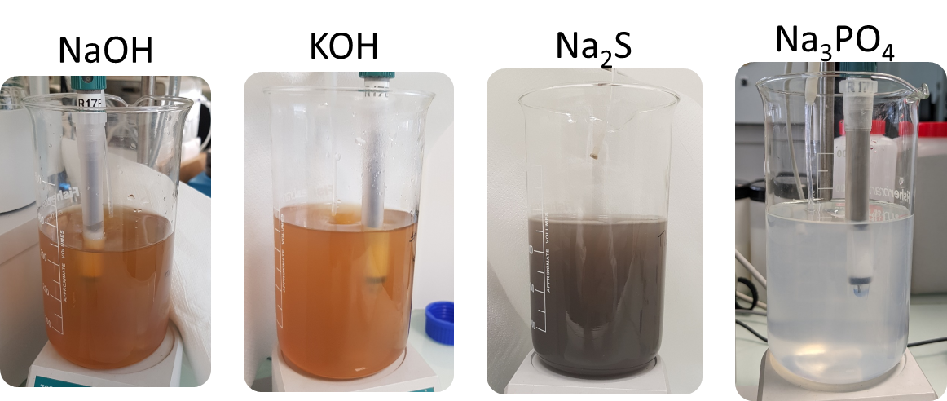
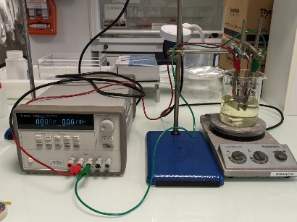
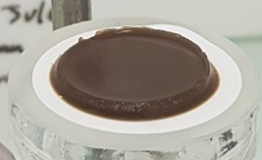
Chemical treatment of metallic components & associated secondary effluents
General overview | Treatment – Conditioning | Geological disposal | Recycling | Perspectives
©A. RIVONKAR (PhD), M. Robin (PhD), A. E. BAKHITE (M2)
Step 1: chemical treatment of metal
Step1: 15mM KMnO₄ / 3mM HNO₃
Step2: 18.5mM H₂C₂O₄
80°C, under agitation
T°C
Flow rate
Chemical concentration
Chemical composition
Contact time
Use of UV
Volume/Surface ratio
Metal surface treatment optimised
  Applied to SS316, SS304, A690
H₂C₂O₄ destruction:
  Less complex process
  → no UV light treatment
Reduction of treatment time: 50%
  Less contact time
LCC/LCA:
  Safer, environmentally friendly
  more economic
Chemicals compatible with:
  Effluent treatment
  WAC for conditioning/storage
Step 2: chemical treatment of secondary effluent
electrocoagulation

Slide 12
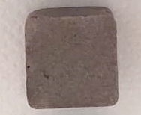
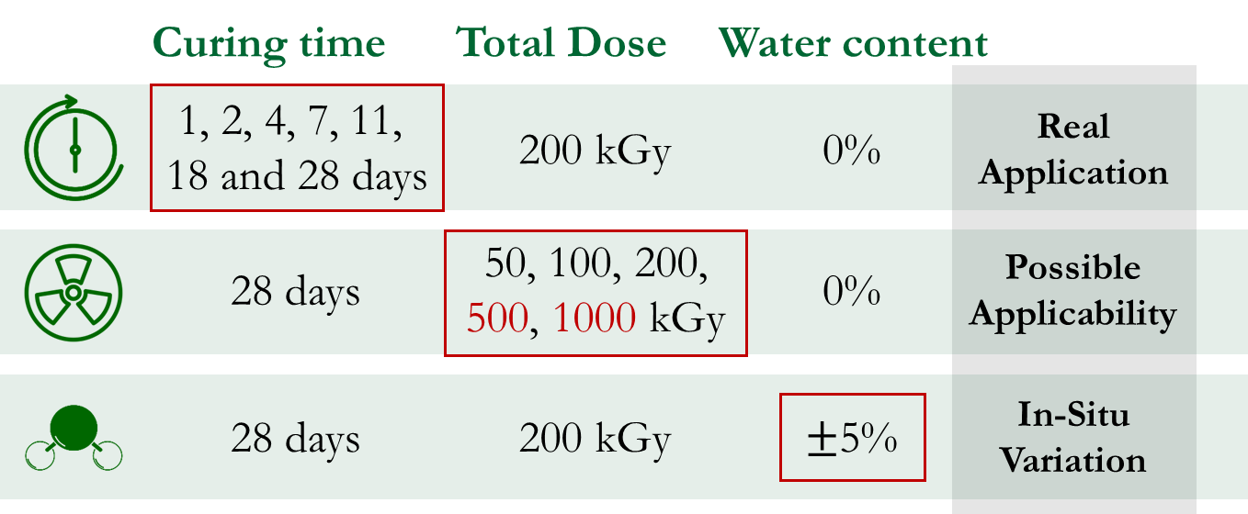
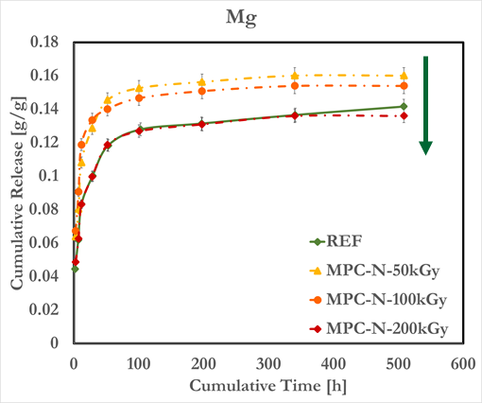
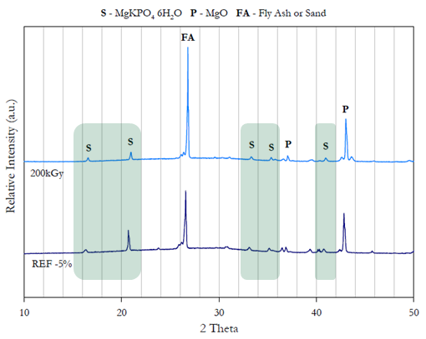
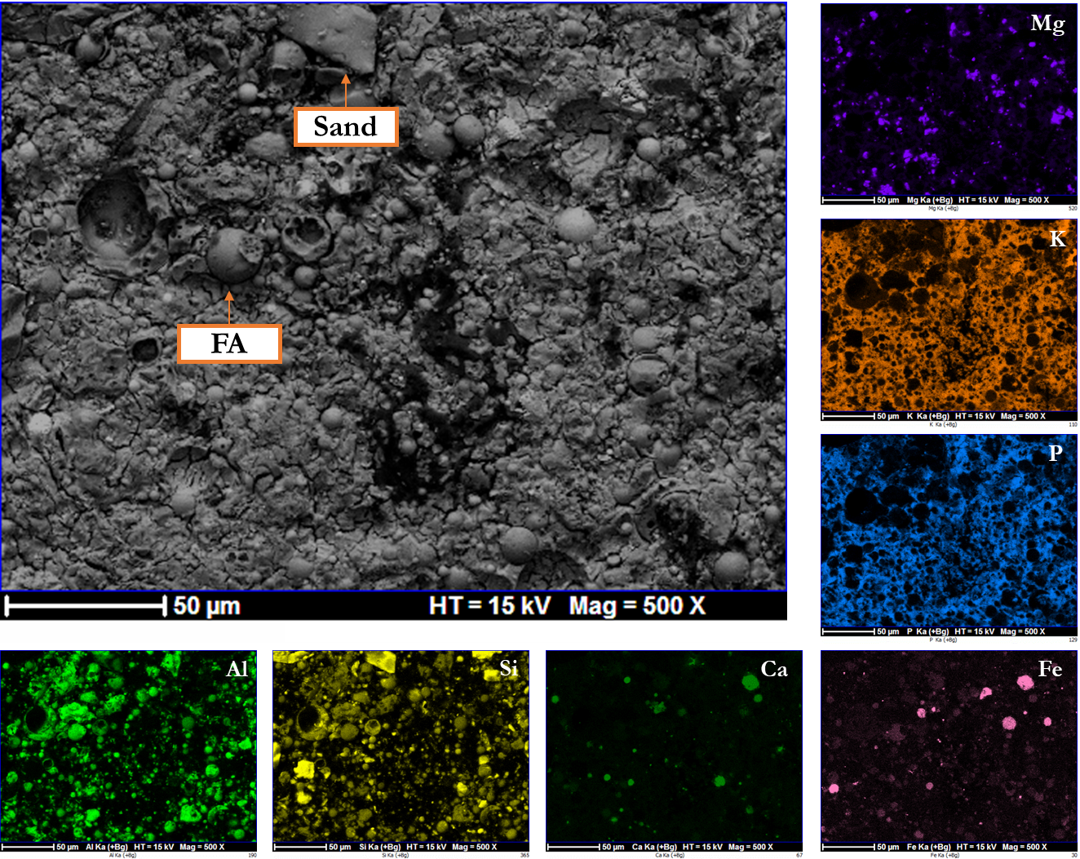
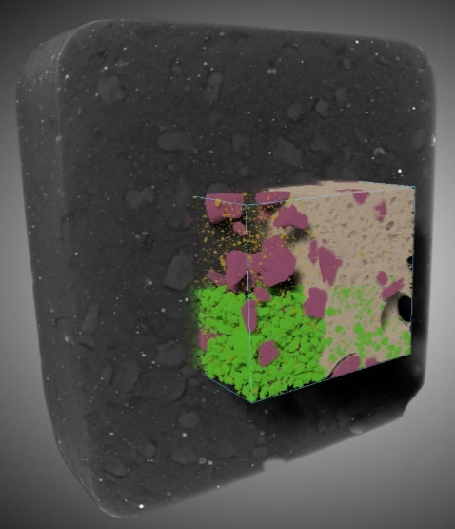
Effects of gamma irradiation on the behavior of magnesium potassium phosphate cement MPC
General overview | Treatment – Conditioning | Geological disposal | Recycling | Perspectives
Step 3: evaluation of new matrixes for conditioning
© I. MOSCHETTI (PhD)
Full characterization of MPC:
  XRD, SEM-EDX, mapping, X-ray tomography, nano-indentation
Validation:
  Structure, chemical composition
Evaluated parameters
  Chemical durability
  Durability under γ-irradiation
  Physical properties
Stability of the MPC structure under γ-irradiation (Cs-137 source)
K-struvite KMg(PO₄)•6(H₂O)

Slide 13

Summary & Perspectives
General overview | Treatment – Conditioning | Geological disposal | Recycling | Perspectives
Metalic decontamination
Decontamination of effluents
O. ILERI (PhD)
Treatment – conditioning of radioactive sludge from chemical decontamination in new matrixes
Optimisation of the formulation based on the chemical composition of generated sludges
Synthesis of surrogate samples for their evaluation:
  Chemical, physical and mechanical
  Under radiation and radiolysis
  Relative humidity effect
Application to samples:
  From previous decontaminations from surrogate samples
  From radioactive sludges samples
Contribution in WP STREAM
Evaluation of new matrixes (GP, MKP)
Articles published : 6
Articles submitted : 1
Articles in preparation : 1
International Conferences-Seminars :
  Oral: 3
  Poster: 3
National workshop : 4

Slide 14
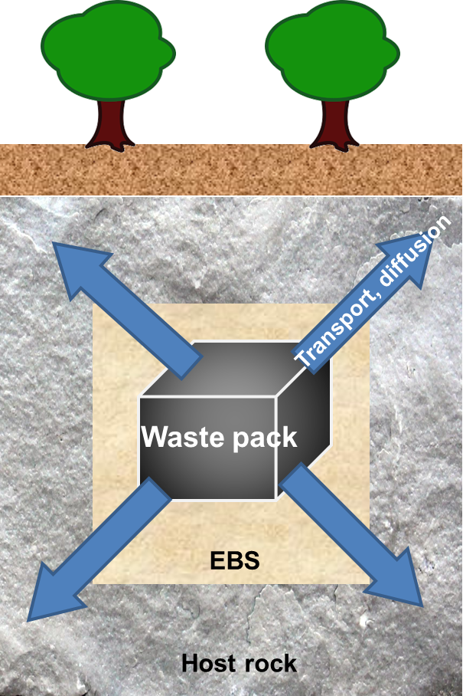
ILW and HLW nuclear wastes
General overview | Treatment – Conditioning | Geological disposal | Recycling | Perspectives
Understanding the behavior of ILW and HLW, as source term, in deep geological formation
  ILW considered : compacted metallic wastes in cementitious environment
    Focus on the ZrO₂-H₂O system controlling Zr(IV) solubility
    Focus on the formation of a co-precipitate U-Pu oxide implanted in metallic hulls
  HLW considered: glass waste
    Incorporation of volatile iodine in glass matrix, using high pressure
Understanding of the transport and diffusion of RNs in engineered barrier system
  Focus on the cementitious materials: cement & mortar
Understanding the chemical evolution of materials at the interface
  Glass / steel / clay

Slide 15
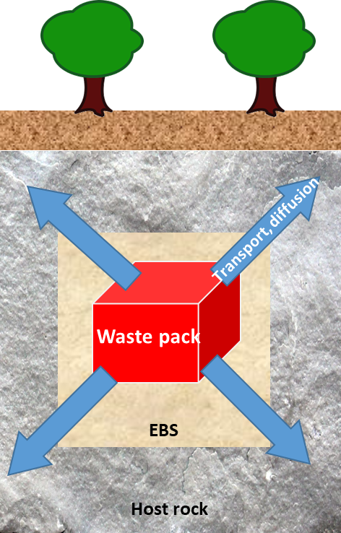


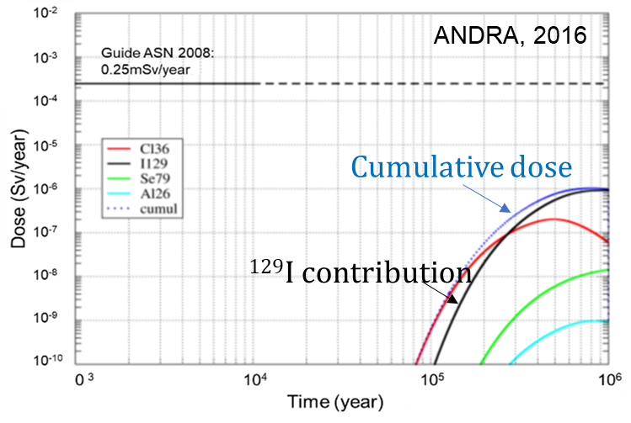
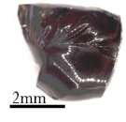
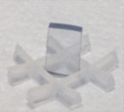
Conditioning of iodine in HLW glass type
General overview | Treatment – Conditioning | Geological disposal | Recycling | Perspectives
Questions raised :
Very long-lived radionuclide (15.7 M years)
High mobility in disposal environment
Major contribution in dose release
Incorporation of iodine at high pressure
Articles : 8
Intern. Conf. :
  Oral: xx
  Poster: xx
Vapor phase
© V. JOLIVET (PhD),
H. ZHANG (PhD), K. ROY (PhD)
Incorporation of iodine using high pressure (Geology Science)
  Increase with boron content
  Surrounded by Na >> Ca
During non-aturated conditions (%RH):
  Retention of iodine in hydrated layer
  Mass loss increase when iodine is incorporated
Initial rate evaluation in aqueous phase:
  Congruent release of I, B and Si
Vapor phase
Aqueous phase

Slide 16
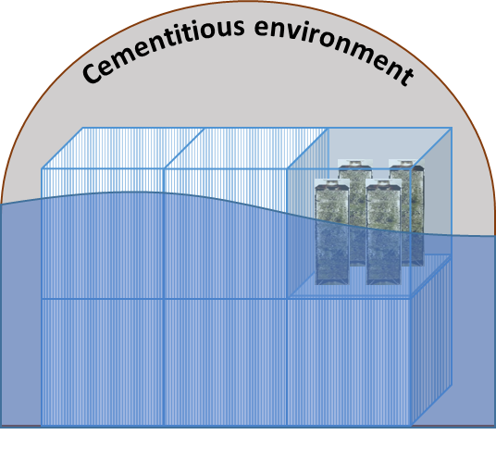
Solubility of Zr, U-Pu oxides in alkaline system
General overview | Treatment – Conditioning | Geological disposal | Recycling | Perspectives
Concentration in hulls
FP
U
Pu
AP
ILW wastes
Effect of T°C on ZrO₂(am, hyd, fresh) solid:
  Increase of particle size
  Decrease of number of hydration waters (→cristal.)
Effect of ageing:
  Significant decrease in solubility with increasing particle size / crystallinity
  Solub.: fresh > aged 4 months > aged 10 months
Effect of crystallography
  Solub. : amorphous > tetragonal/cubic > monoclinic
U-Pu co-precipitation observed
Interlink solubility / particle size
Effect of ageing
ZrO₂
Zr-alloy
ZrO₂
intern.
extern.
ZrO₂
Questions raised :
Solubility of ZrO₂ from amorphous to aged solid in alkaline and Portlandite water
  Effect of T°C, ageing time and media
Solubility of (U,Pu)O₂ in highly reducing conditions
  Formation of a critical mass (U,Pu)O₂
Articles in preparation: 2
International Conferences-Seminars :
  Oral: 1
  Poster: 5
Contribution in WP DITUSC
(U,Pu)O₂

Slide 17
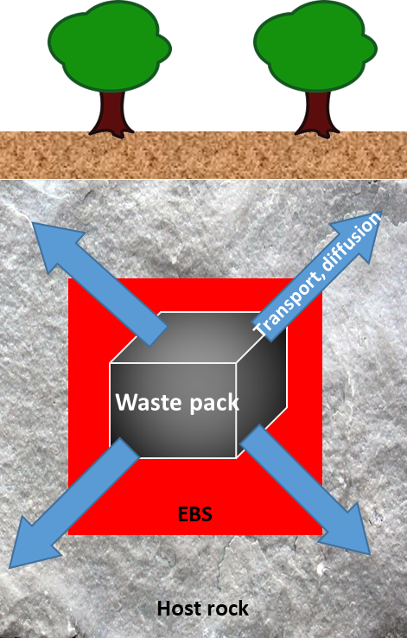

Engineered barrier system: Uptake and diffusive transport
General overview | Treatment – Conditioning | Geological disposal | Recycling | Perspectives
Study of RNs uptake and transport properties in cementitious materials in complex environments, coupling experiments/solid characterisation/modelling
Influence of salt plumes: Se(IV)
Effect of salt (Na₂SO₄): Se(IV)
- Strong decrease of R_{d} consistent with a selenite/sulphate competition for sorption sites
- Very low value for D_{e}^{ACW}(Se(IV)) (3 10⁻¹⁵ m² s⁻¹)
- “Salt effect “ measurable but rather limited (D_{e}(Se) ↘ by 2)
Effect of organics (ISA): U(VI)
- Sorption
Whatever the degradation stage, a threshold [ISA] exists above which Rd(U) values strongly decrease → effect of ISA-U(VI) complexation
- Diffusion
In presence of ISA, U(VI) diffusion depth ≈ degradation front whereas
In absence of ISA, U(VI) diffusion depth < degradation front
Sorption isotherms
Diffusion profile of Se(IV)
HR-ICP-MS laser ablation
Laser spot line
80 µm
Influence of isosaccharinic acid : U(VI)
Sorption isotherms
U(VI) diffusion profiles
No effect
HCP degradation stage II
HCP degradation stage III
[ISA] threshold range

Slide 18
Summary & Perspectives
General overview | Treatment – Conditioning | Geological disposal | Recycling | Perspectives
Source Term (waste package)
Continuation of the research work on the interplay of thermodynamics and kinetics in repository context:
  Solid phase transformation of hydroxides and hydrous oxides
  Spent fuel dissolution under reducing conditions
  Contribution in WP DITUSC (strategic study)
Parameters controlling the dissolution of modern spent fuel (eg. UO₂ doped with Cr) under gamma-radiolysis
  Dissolution under anoxic and storage conditions
  Effect of low doses
  Contribution in WP SAREC
Engineered barrier system & Interfaces
Study of the passivation, corrosion, and dissolution of novel metallic coatings and ceramics for HLW containers/canisters
  Durability evaluation under corrosive environment
  Effect of irradiation
  Contribution in WP InCoMand

Slide 19



Optimizing metallic waste characterization & procedures for minimization and recycling
General overview | Treatment – Conditioning | Geological disposal | Recycling | Perspectives
Radioactive metallic waste from decommissioning
Mech./ chem. decontamination & clear
Clear & Melt
Melting
Clearance
Melt & Clear
Historical information
Installation simulation
Non Destructive Analysis
Disposal
Destructive Analysis
Wait & Clear
Reuse for other purpose
Reuse
& Recycle
RW classification
(Exempt, VLLW, LLW, …)
Shielding
Recycling
Cask production
Improved assay accuracy and/ or precision
Less conservatism in RW inventory and classification
Disposal as radioactive waste

Slide 20

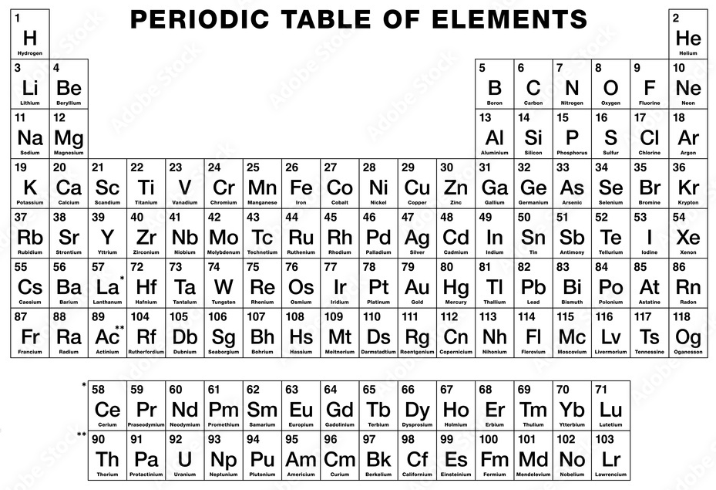
Difficult to measure radionuclides DTM
General overview | Treatment – Conditioning | Geological disposal | Recycling | Perspectives
Sample: synthetic solution or surrogate
Separation / Purification by chromatographic resins
Specific conditioning for measurements
Selection of an adapted analytical technique
Zr-93 decays to stable Nb-93 by β emission
  E_{max} : 60.0 keV (73%) and 90.8 keV (27%)
  Key long-lived FP and AP for decommissioning
    Significant contributor to total waste inventory over long timescales
  Generally measured by scaling factor
  Need of standardization of protocol for measurement
³H
¹⁴C
³⁶Cl
⁴¹Ca
⁵⁵Fe
⁵⁹Ni
⁶³Ni
⁹⁰Sr
⁹³Zr
⁹⁹Tc

Slide 21
Difficult to measure radionuclides DTM
General overview | Treatment – Conditioning | Geological disposal | Recycling | Perspectives
Acidic solution HCl/HNO₃
Digestion of metal sample Fe, Ni, Cr
+
Addition: Zr, Mn, Sb, Ce, Mo
DTM characterized by low energy emission
  Difficulty to measure directly pure β emitters
  destructive method
Multiple separation tested by chromatographic resins
Coupling chemical theory and experimental data:
  Difficulty to access to standards
  Application to other fields (ex. Geothermy)
Separation by chromatographic resins
ICP-MS measurement
Zr-90
LSC measurement
Zr-93
Perspectives
Continuation of the research work : E. ABED (PhD)
  Development of methodologies for Mo-93 and Nb-94
  Contribution to WP ICARUS
Inter-comparison exercise on activated steel
  Collaboration with SMART service and IPHC
Efficiency chemical separation
Activity ⁹³Zr
Article : 1
Internationale conference:
  Poster: 1

Slide 22
Review of previous period and development of research activities
General overview | Treatment – Conditioning | Geological disposal | Recycling | Perspectives
Previous period
Current period
2014
2019
2024
Pristine material
Treatment
Conditioning
Recycling
Disposal
Disposal

Slide 23
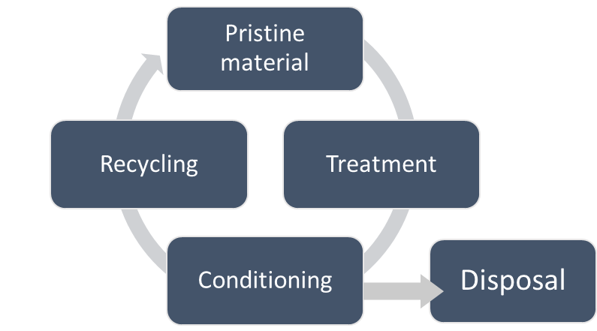
Evolution of the research program
General overview | Treatment – Conditioning | Geological disposal | Recycling | Perspectives
WP STREAM
WP ICARUS
WP SAREC
WP InCoMand
WP DITUSC
Treatment of secondary effluents
Chemical-physical-radiological evaluation
Development of a radiochemical procedure for the measure of DTM
Conditioning sludges in new matrixes
Standardisation of the procedure
Low gamma dose on spent fuel surrogate radiolysis
Evaluation on new fuel type, doped with Cr
Irradiation effect on steel at the interface with clay
Effect of relative humidity on steel hydratation
Strategic study on the parameters controling the solubility of oxides
From amorphous to crystalline phases
WP KM
Capacity building knowledge (Courses, Trainings,…)
Implementation and transfer
Networking
Nuclearisation

Slide 24
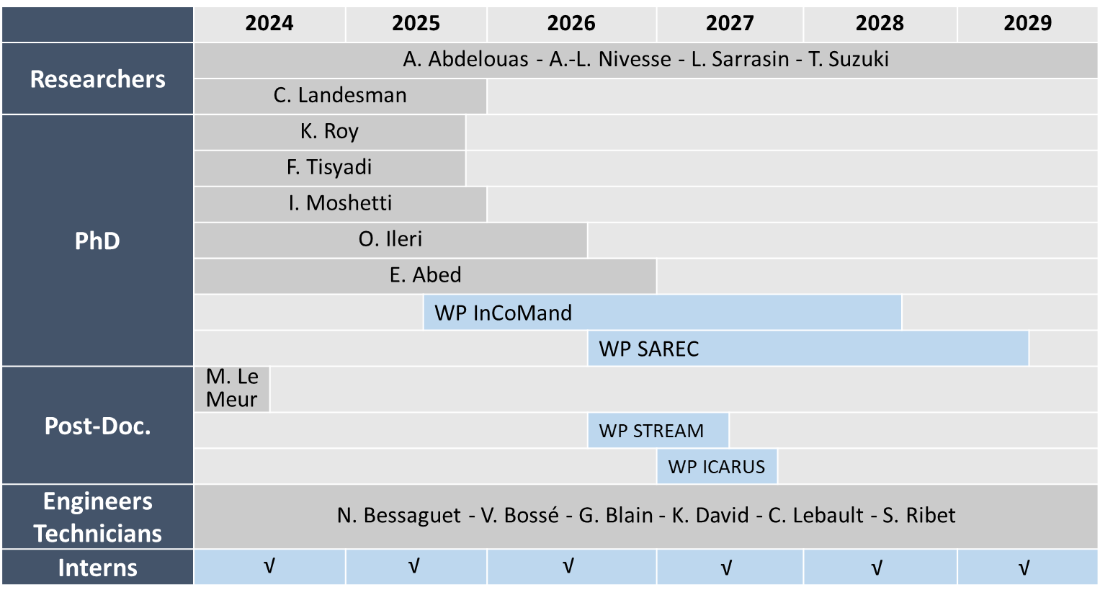
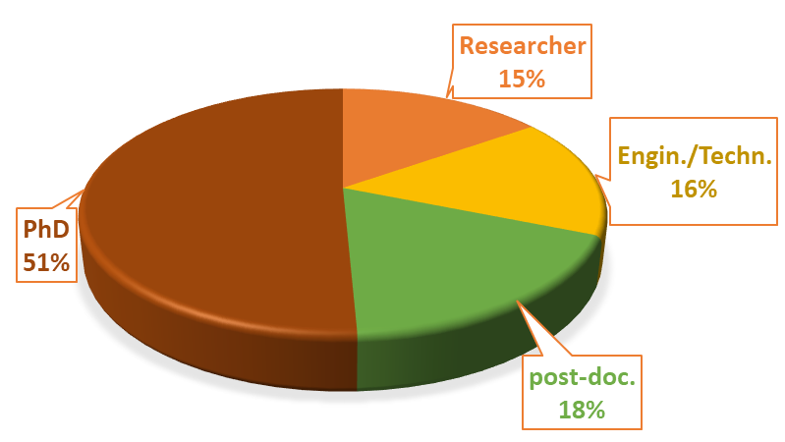
Staff contributing to « materials for nuclear »
General overview | Treatment – Conditioning | Geological disposal | Recycling | Perspectives

Slide 25
SWOT
Strengths
Weaknesses
Opportunities
Threats
Ongoing research on waste management issues (source term, diffusion/transport, sustainability) ....
Need to strengthen skills, particularly in materials characterization (engineer profile)
New collaborations thanks to the EURAD1 & PREDIS projects → Polimi, UMan, NNL, ....
Increased interest in recycling-valorization of nuclear wastes (metals, concrete, DU....)
Limited number of staff members
Development/reinforcement of the knowledge and skills related to existing and innovative materials (glasses, oxides, metals, cements, clays, etc. ....).
Working with unsealed radioactive sources (diffusion/transport coefficients, surrogate, kinetics/thermodynamics, particle synthesis, etc.)
Increased interest in understanding geopolymers materials as conditioning materials
Interest in analytical approach to measure DTM
Risk of non-renewal of analytical instruments due to lack of funding
Andra, ORANO, EDF, ES …
Researches mainly Professors
Heavily relying on short term contractual activities
Limited number of staff members
Recruitment problems (PhD students, post-docs, temporary engineers) in addition to administrative burdens
@Abdel: les items en rouge à mettre dans le SWOT de l’équipe

