Slide 1




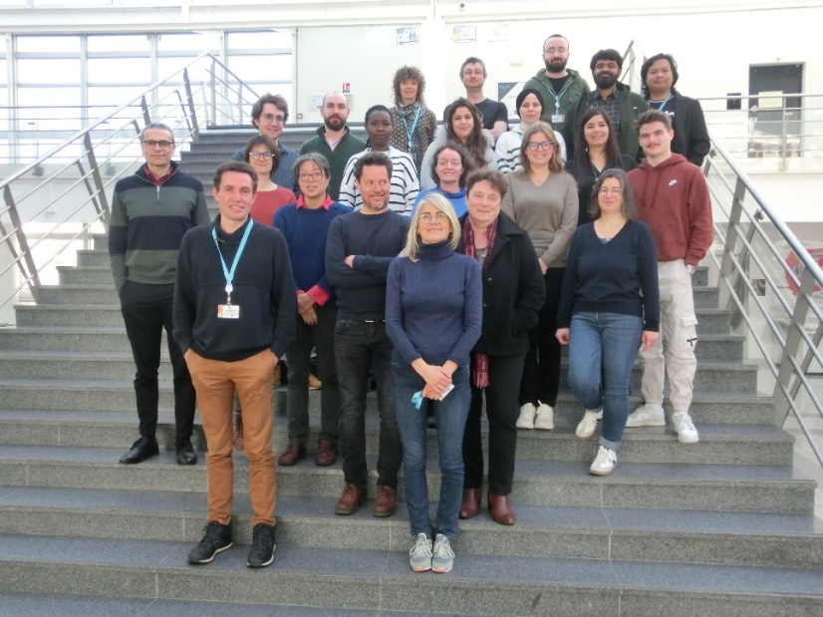
Conseil Scientifique
April 29th 2024
Radiochemistry Team

Slide 2
Outline
15h00 : 15h20 Introduction (A. Abdelouas)
15h20 : 15h30 Presentation of technical pool (K. David)
15h30 : 16h00 Presentation of « Materials for Nuclear Applications » & « Radiation Chemistry » (A. Abdelouas)
16h00 : 16h30 Coffee break
16h30 : 17h00 Presentation of « Radionuclides & Environment » (G. Montavon)
17h00 : 17h30 Presentation of « Modeling » (A. Kalinichev)
17h30 : 17h50 Presentation of « Radionuclides & Health » (S. Huclier)
17h50 : 18h30 Discussion

Slide 3
Radiochemistry: Human Resources
42 staff members (February 2024)
Permanents (19)
CNP (23)
A. Abdelouas
C. Bailly
B. Grambow
N. Bessaguet
S. Huclier
G. Blain
A. Kalinichev
V. Bossé
C. Landesman
K. David
S. Le Crom
C. Lebault
G. Montavon
S. Ribet
A.L. Nivesse
O. Péron
L. Sarrasin
T. Suzuki
J. Vandenborre

Slide 4
Operating budget labs/Personnel
2019-2023

Slide 5














Organization
Team Leader : A. Abdelouas
Technical Leaders: K. David & S. Ribet
Radionuclides
&
Health
S. Huclier
Astate
Scandium
Nanoparticles
Auger radiotherapy
Radionuclides
&
Environment
G. Montavon
UTOPIA
TIRAMISU
TERROIR
RETENTION
NODSSUM
TRACE
Nuclear Materials
T. Suzuki
DIADEM
EURAD / ACED
EURAD/ CONCORD
EURAD / CORI
PREDIS
ORANO
ANR I-Clean Up
MAEVA
Radiation chemistry
J. Vandenborre
Neptunium chemistry
Pulsed radiolysis
RAPHY
EURAD / CORI
Réseau Bq
Modelling
Kalinichev A.
EURAD / GAS
HSE University (Moscou)
LCLT (CEA Marcoule)
Chaire « Radioactive Waste disposal »
Kalinichev A., Grambow. B.
4

Slide 6
Highlights

Slide 7
National outreach
Local and Regional Level:
  OSUNA, member of the Scientific Council & the steering committee (G. Montavon, K. David, C. Landesman, O. Péron, A.L. Nivesse)
  TRANSFORMED, member of the Scientific Council (S. Huclier, J. Vandenborre)
National Level:
  ZATU, member of the steering committee (G. Montavon)
  Chair ‘Storage’ (B. Grambow, A. Kalinichev)
  NEEDS Steering Board (C. Landesman)
  GDR SCINEE Steering Board (G. Montavon, T. Suzuki)
  GDR AIM Steering Board (S. Huclier)
  Francophone Group of G4F (S. Huclier, President)
  LABCOM TESMARAC (G. Montavon, Director)
  LABEX IRON Steering Board (G. Montavon)

Slide 8
International outreach
International Level:
  EURAD SCIENCE Steering Board (B. Grambow)
  EJP EURAD – Participation/lead in 5 Work Packages:
    CORI, FUTURE, ACED, GAS, UMAN, CONCORD (All group members)
  PREDIS WP Lead (A. Abdelouas, B. Grambow, T. Suzuki)
  RADONORM (G. Montavon)
  I2PAD WP Lead (S. Huclier)
  CONCERT/ALLIANCE, scientific representative of CNRS/IN2P3 (G. Montavon)
  Expert for ASN with regard the Low Level Long Lived waste (B. Grambow)
  Chairwoman of 21st edition of ‘International Symposium of Field and Flow-based separation techniques’ (3-7 June 2024) (S. Huclier)
  Chairwomen of the international symposium of radiopharmaceutical sciences in Nantes (May 2022)
  Expert for ISO AFNOR (S. Huclier)
  Organisation of the ‘Migration Conference’ in 2023 (B. Grambow & the Team)
  Group leader at JAEA, Japan (B. Grambow)

Slide 9
Contribution into E & T
Education & Training:
  An average of 10 interns per year (BSc, MSc)
  An average of 13 PhD per year
  Masters at Nantes Université (O. Péron, S. Huclier)
  Master GRISSE at Nantes Université (O. Péron)
  Master A3M, Option AIES at Nantes Université (O. Péron)
  Management of 2 international master programs (taught in English):
    NE (A. Abdelouas)
    EMJMD SARENA (A. Abdelouas & C. Hartnack)
  Expert for International Institute of Nuclear Energy – I2EN (A. Abdelouas)
  Expert for International Atomic Energy Agency (IAEA) (A. Abdelouas)
  Teaching in international institutions
    IFCEN (T. Suzuki, A. Abdelouas)

Slide 10
European Commission Peer Review of PREDIS
Review Committee (March 8th, 2024)
  Jolanta Cyziene (Lithuania, Geological survey)
  Gerald Ouzounian (France, earlier Andra)
  Bo Stromberg (Sweden, SSM)
  Hans Forsström (Sweden, earlier SKB, IAEA, EC)
  Seif Ben-Hadj Hassine (EC)
The leader (Hans) wondered "what has really went bad in this project, because we don't see it?" ... I was thinking what to answer, and my mind was also blank. It is not that we are hiding anything, as we simply have done a great job together. you all have proven this via your presentations and the Q&A over the past 3 days, and the preparations over the past month(s).
Hans and Seif noted that our proposal did not have a great score in the 2020 evaluation, and they were skeptical about the added value and need for PREDIS. Today they admitted "we were wrong - you have done great things".

Slide 11
Summary (1/2)
Strengths:
  Multidisciplinarity from environment to health with a strong emphasis on nuclear energy,
  Large laboratories space for radiochemistry,
  Multi-scales collaborations and responsibilities from local, regional national to international levels,
  Strong link with industrial and institutional partners (utilities, WMO, TSO, Europe,…)
  Strong contribution in the education & training in the field of radiochemistry,
  Highly dedicated colleagues working together toward the sustainability of the first radiochemistry group in France,
  Highly attractive for international students and staff (China, Ukraine, Russia, Indonesia, Turkey, India, Germany, Italy, Portugal, Romania, Algeria, Morocco, Tunisia, Ethiopia etc.).
Opportunities:
  New partnerships thanks to European projects
  Renewal of ZATU
  New development of radioecology (monitoring and remediation)
  New applications for nanomedecine and radiation chemistry
  New applications for molecular modeling (e.g. white hydrogen)

Slide 12
Summary (2/2)
Weaknesses:
  Need to strengthen skills, particularly in materials characterization
  Limited number of staff members
  Researchers mainly Professors
Threats:
  Heavily relying on short term contractual activities
  Risk of non-renewal of analytical instruments due to lack of funding
  Retirement of skilled technical staff

