Slide 1
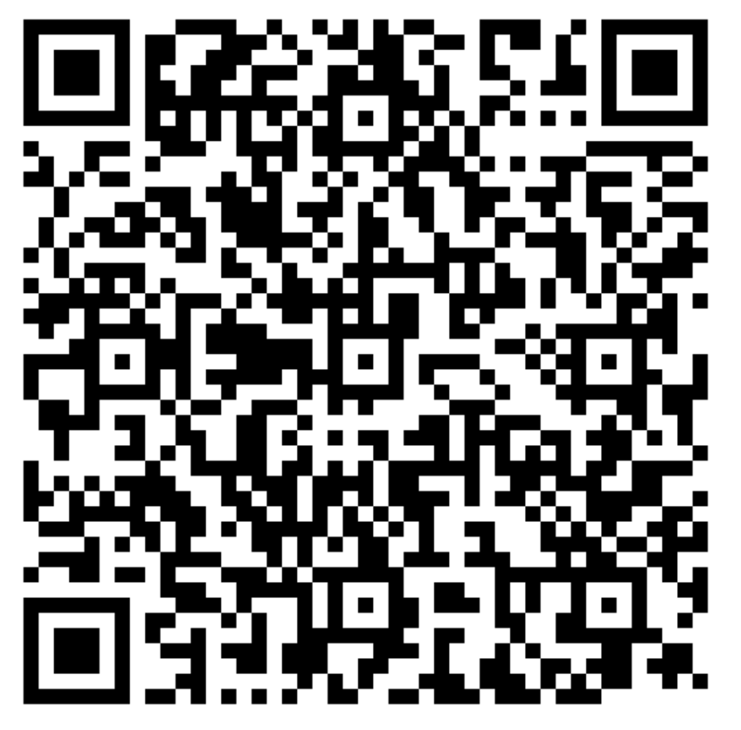
Detecting gravitational waves from space
An introduction to LISA Instrument
Flash me to get some more course material !
Dr. Henri Inchauspé Institute for Theoretical Physics, KU Leuven LISA School 2025, Les Houches

Slide 2
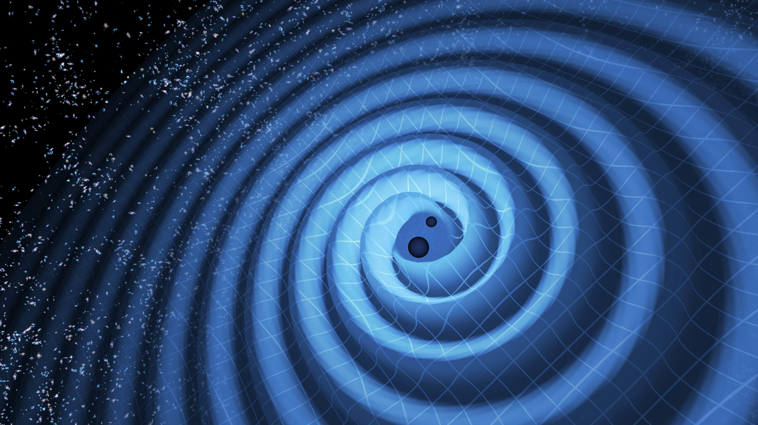
Astronomy
The novel ASTRONOMY of the gravitational Universe
Flash me to get some more course material !
Dr. Henri Inchauspé, Institute for Theoretical Physics, KU Leuven - LISA School 2025, Les Houches

Slide 3

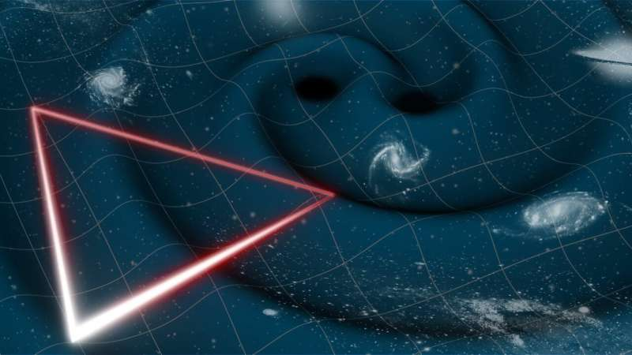
LISA to observe the GW Universe !
Astronomy
LISA is a gravitational waves detector in space
LISA is a spaced-based gravitational waves astrophysical observatory
Dr. Henri Inchauspé, Institute for Theoretical Physics, KU Leuven - LISA School 2025, Les Houches

Slide 4
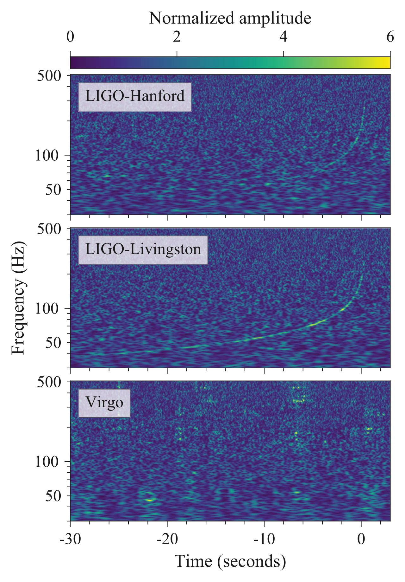
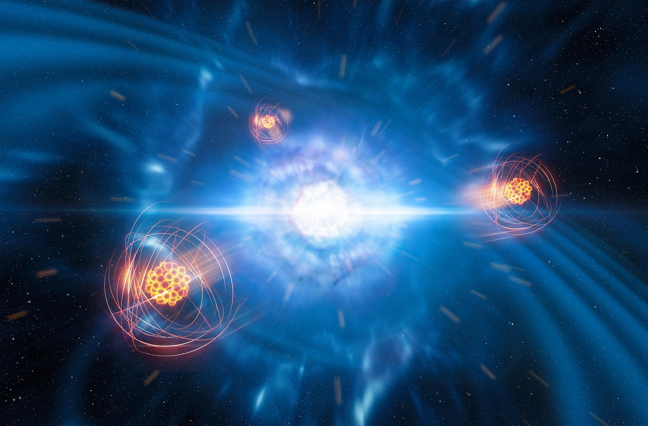
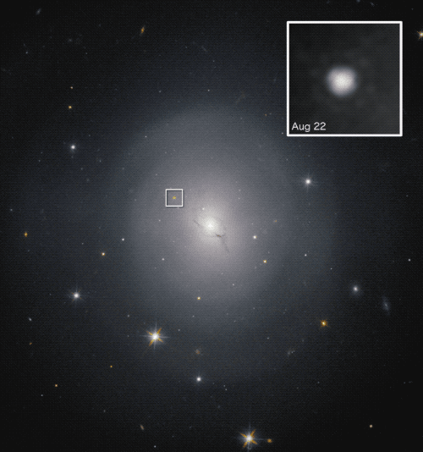

GW170817
Astronomy
https://en.wikipedia.org/wiki/GW170817#cite_note-55
Short Gamma Ray Burst identification
Artist's impression of strontium emerging from a neutron star merger. https://www.eso.org/public/news/eso1917/
First direct evidence that BNS mergers significantly contribute to heavy atoms nucleosynthesis
https://gwosc.org/audio/
First successful EM follow-up of GW event by Fermi-GBM and Integral
Hubble picture of the identified host galaxy NGC4993 ($47.6±3.4Mpc≈155Mly$) with inset showing GRB170817A over 6 days. Credit: NASA and ESA
Stringent constraints on scalar-tensor theories of Gravity.
The GW170817 signal as measured by the LIGO and Virgo gravitational wave detectors. Signal is invisible in the Virgo data. Achieved localization within $16\deg^{2}$.
Dr. Henri Inchauspé, Institute for Theoretical Physics, KU Leuven - LISA School 2025, Les Houches

Slide 5
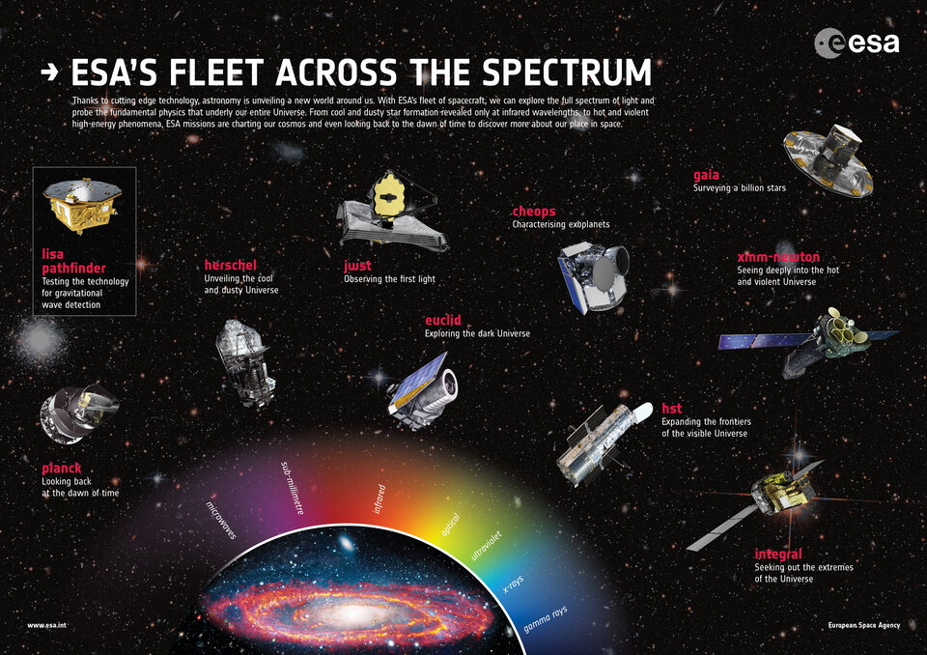
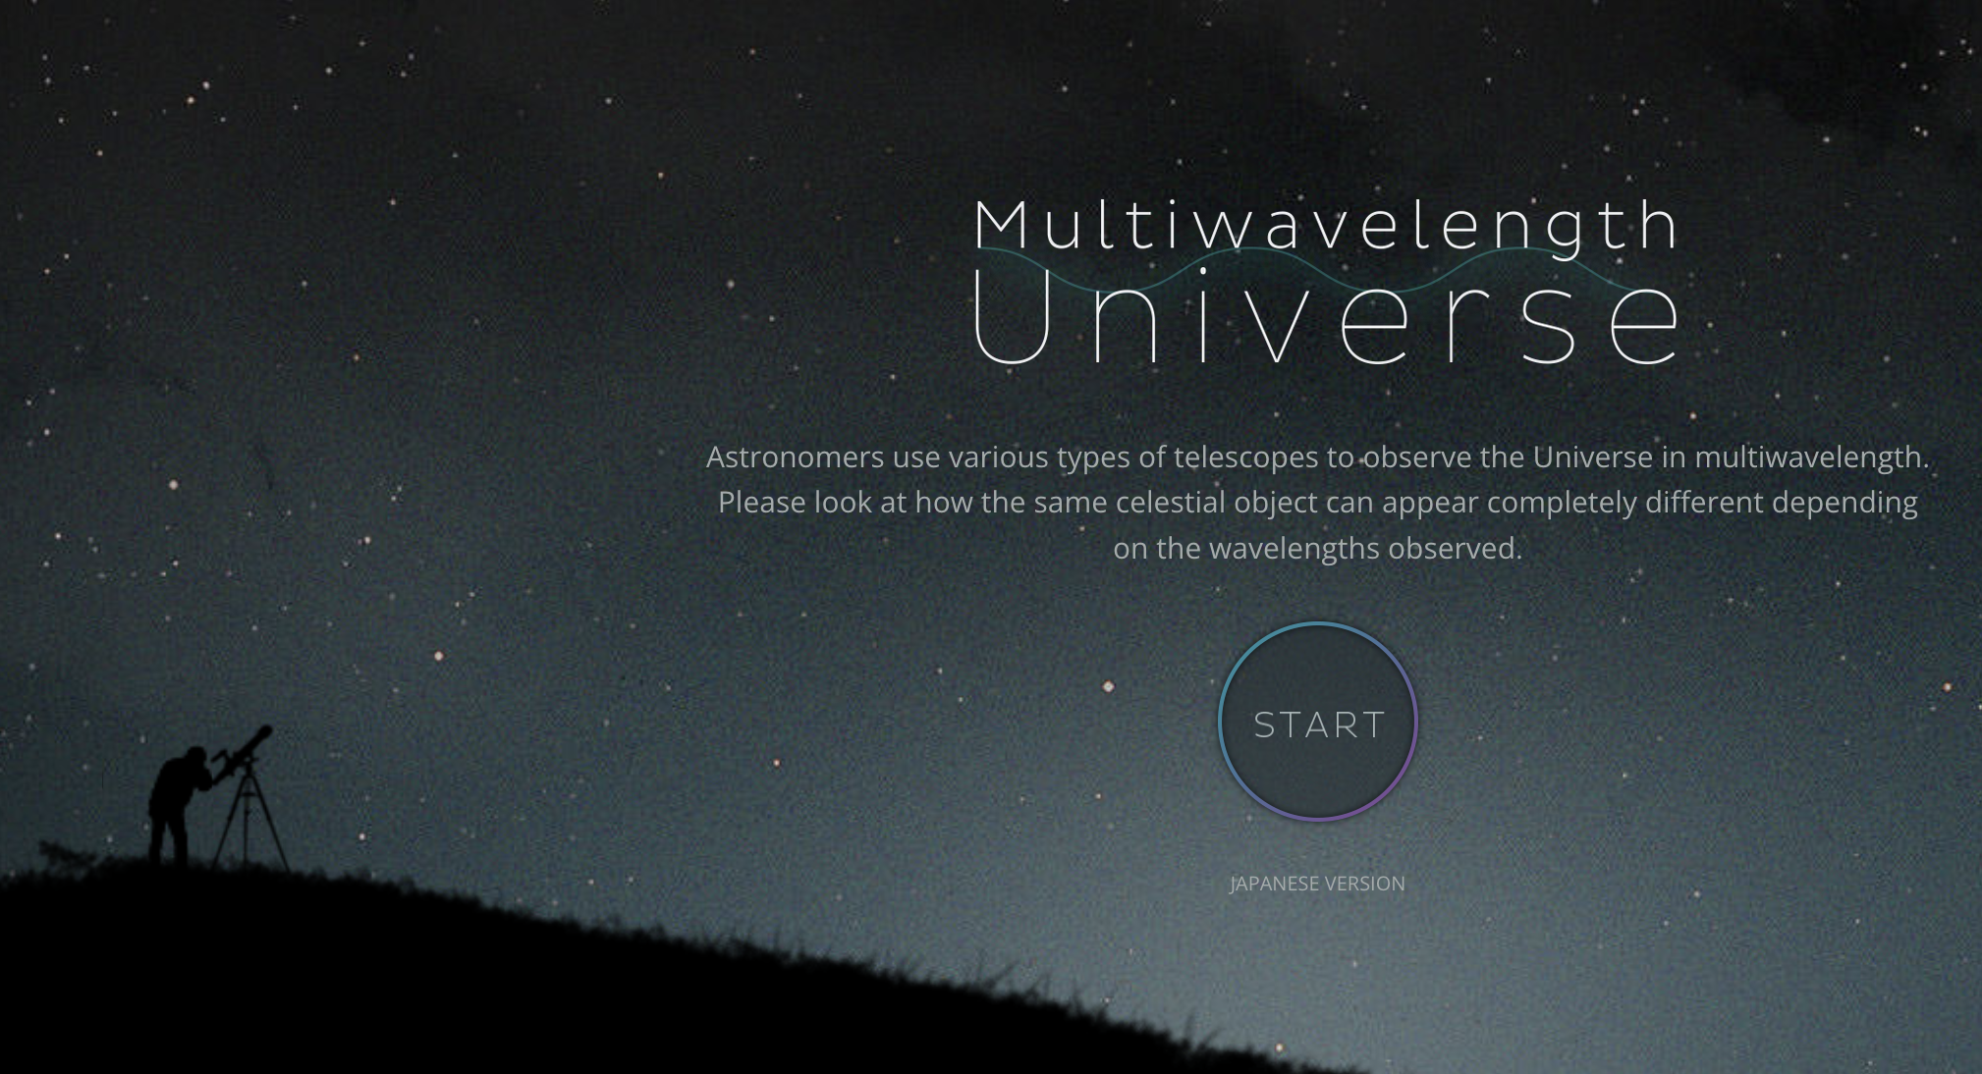
Multi-Wave length (EM) astronomy
Astronomy
A single Universe, but a multitude of perspective, across the EM spectrum.
And now with gravitational waves.
Dr. Henri Inchauspé, Institute for Theoretical Physics, KU Leuven - LISA School 2025, Les Houches

Slide 6
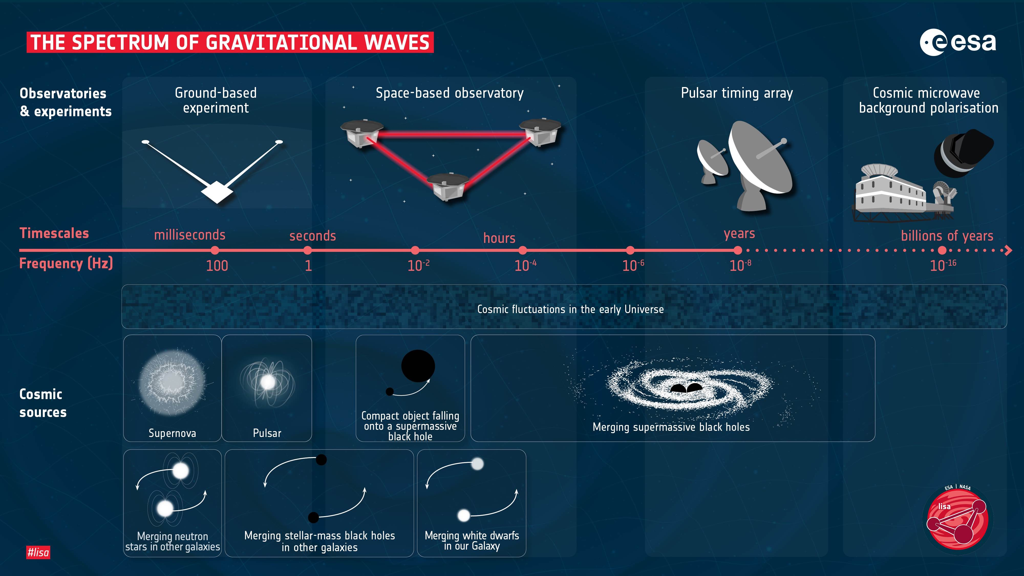
Multi-band Gravitational Waves Astronomy
Astronomy
And the GW astronomy of the millihertz
Similar picture for GW astronomy: different band, unique perspective on the Universe.
The lower, the heavier: Astro systems scale grows as frequency decreases.
Probing physics at early time and high energy far from reach by other means.
Dr. Henri Inchauspé, Institute for Theoretical Physics, KU Leuven - LISA School 2025, Les Houches

Slide 7
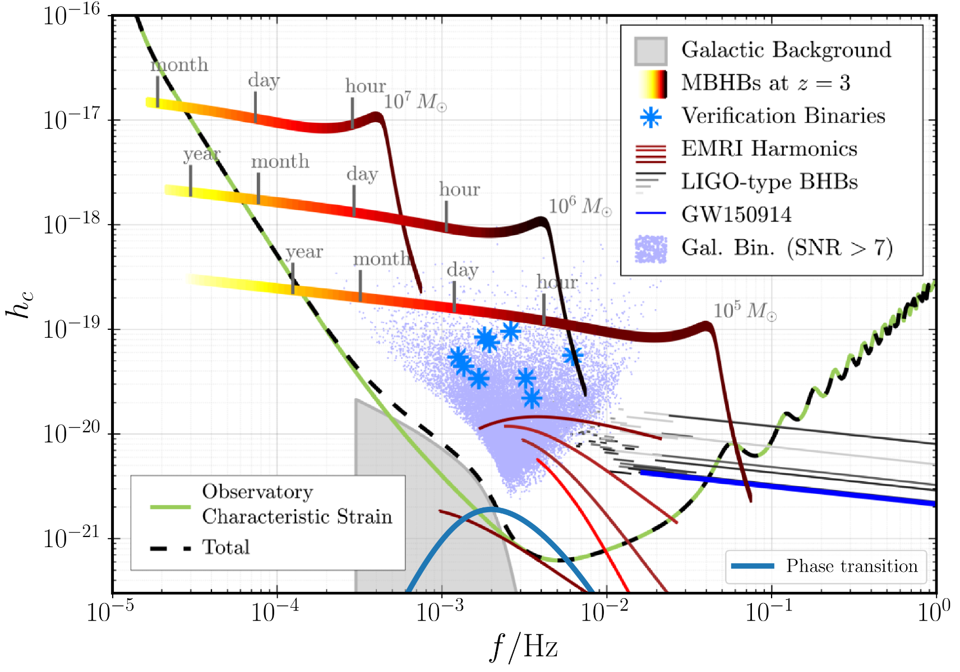
LISA and the GW astronomy of the millihertz
Astronomy
Space-based observation open up the millihertz band.
Very rich and diverse:
Supermassive Black Holes Binaries mergers (SMBHBs)
Extreme-Mass Ratio Inspirals (EMRIs)
Galactic Binaries (White Dwarves). Stellar mass black holes coalescence. (Continuous)
Stochastic Backgrounds (Astro, Cosmo)
Dr. Henri Inchauspé, Institute for Theoretical Physics, KU Leuven - LISA School 2025, Les Houches

Slide 8
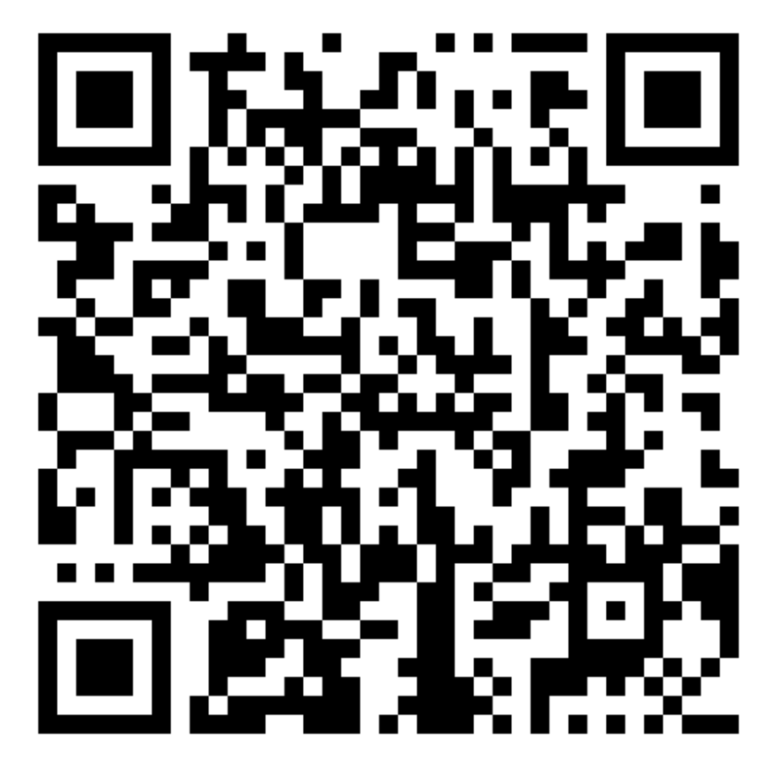
LISA mission
LISA: Europe largest science space MISSION ever
Flash me to get some more course material !
Dr. Henri Inchauspé, Institute for Theoretical Physics, KU Leuven - LISA School 2025, Les Houches

Slide 9
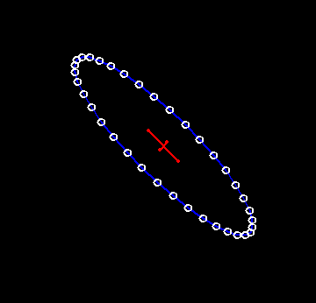
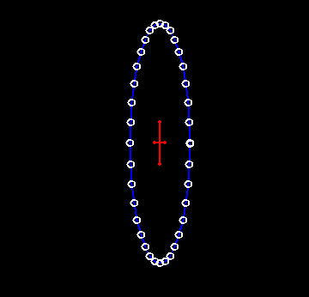
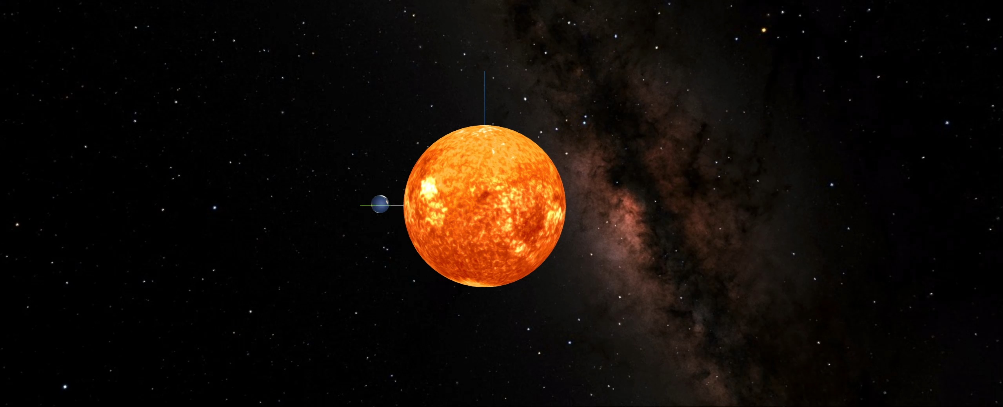
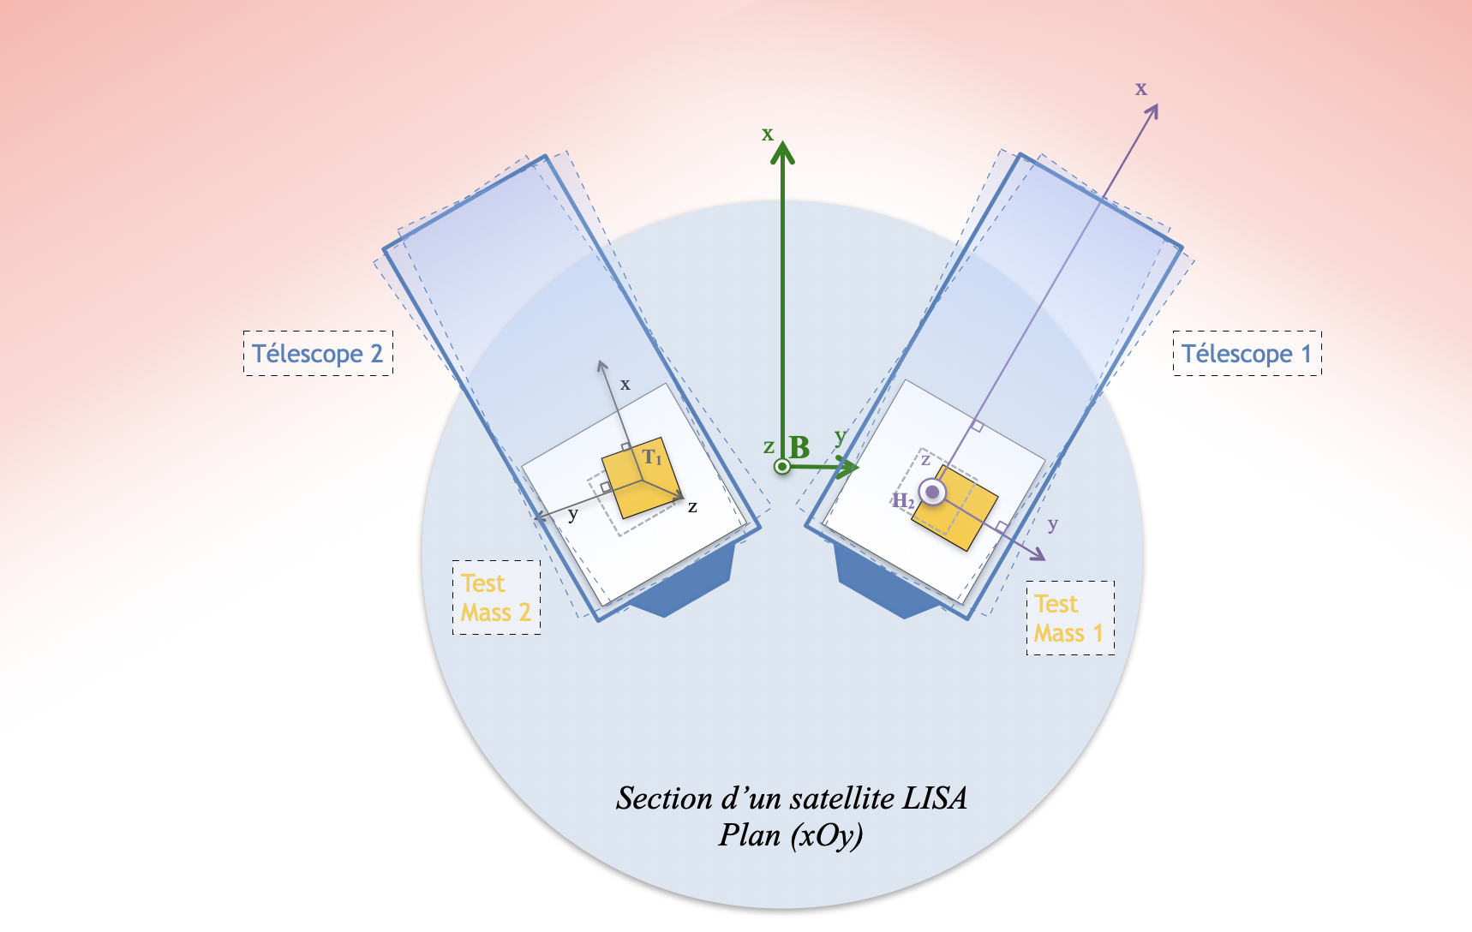
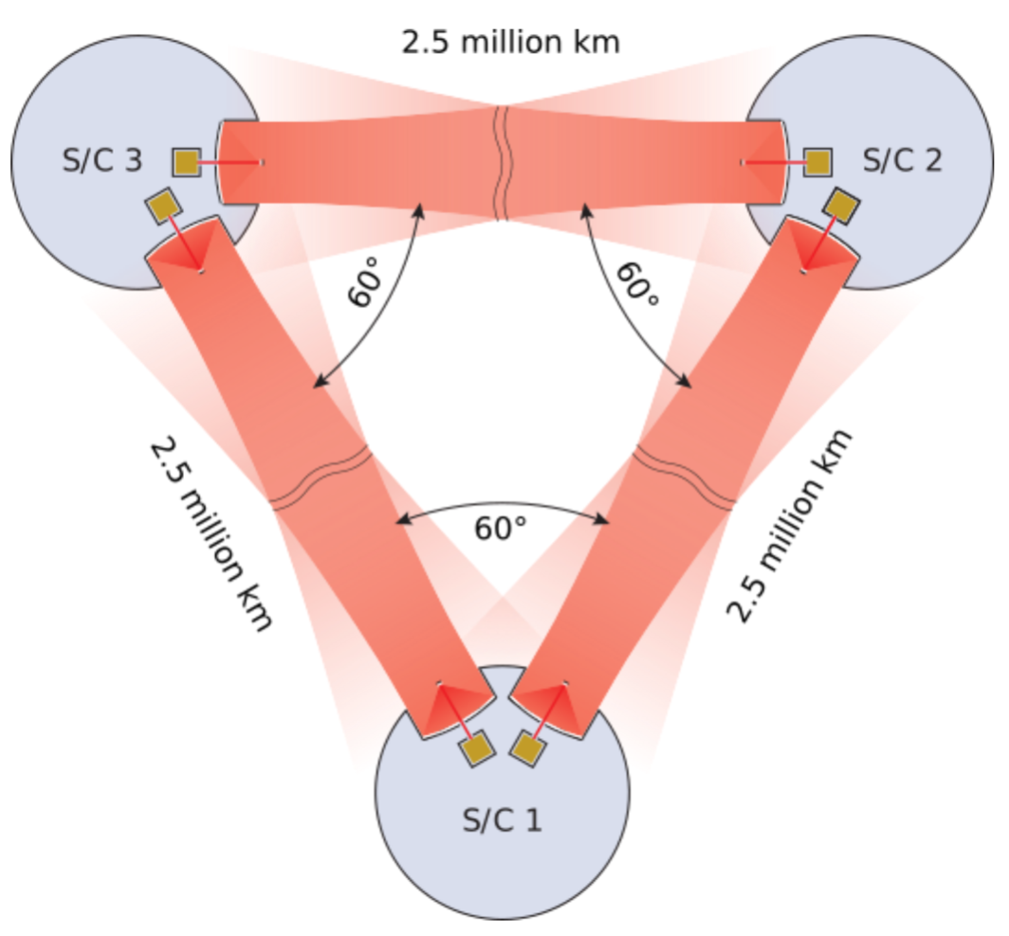
The space-based observatory LISA
LISA mission
Largest laser interferometer never built
Millihertz band imposes to go to space:
To deploy solar system scale arm length.
To get free from terrestrial noise ( seismic, acoustic, Newtonian noise)
Detection principle:
Oscillatory deformation of collection of free-falling observes.
Laser interferometry, with unequal and time-varying arms : TDI
Animation: Ricardo Waibel (ITP, Heidelberg University)
Orbits: H. Halloin (APC, UPCité)
Milky Way map: JPL, NASA
Dr. Henri Inchauspé, Institute for Theoretical Physics, KU Leuven - LISA School 2025, Les Houches
Notes:
Longueur de bras déployée =
Pas de perturbations terrestres

Slide 10
LISA mission
First challenge: Free-falling, inertial test masses
Dr. Henri Inchauspé, Institute for Theoretical Physics, KU Leuven - LISA School 2025, Les Houches

Slide 11
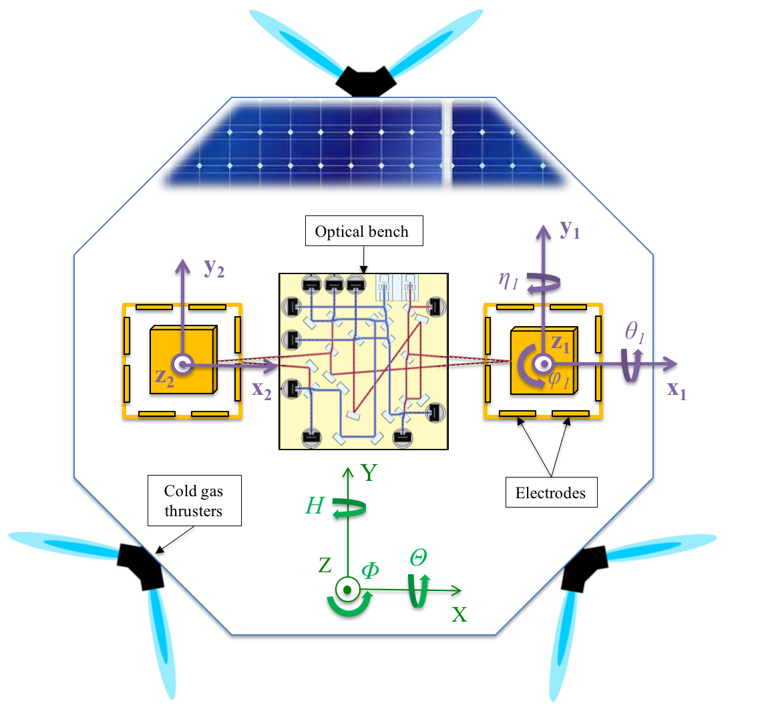
LISA Pathfinder, paving the way to GW detection in space
LISA mission
Constructing references of inertia in space
Main goal: Measuring residual differential acceleration between two « free-floating » test masses. = Measurement of quality of free-fall for the test-masses. (Test mass 1 free-fall, test-mass 2 suspended)
Understanding physical origins of the residual noise.
Two main novelties / breakthroughs:
sub-picometer metrology in space: laser interferometry
test-mass wireless discharging (UV lamp via photoelectric effect)
At low frequency: 3 orders of magnitude gain in sensitivity.
Various experiments: enhancing / stimulating a specific coupling and probing impact on the start acceleration.
Dr. Henri Inchauspé, Institute for Theoretical Physics, KU Leuven - LISA School 2025, Les Houches

Slide 12
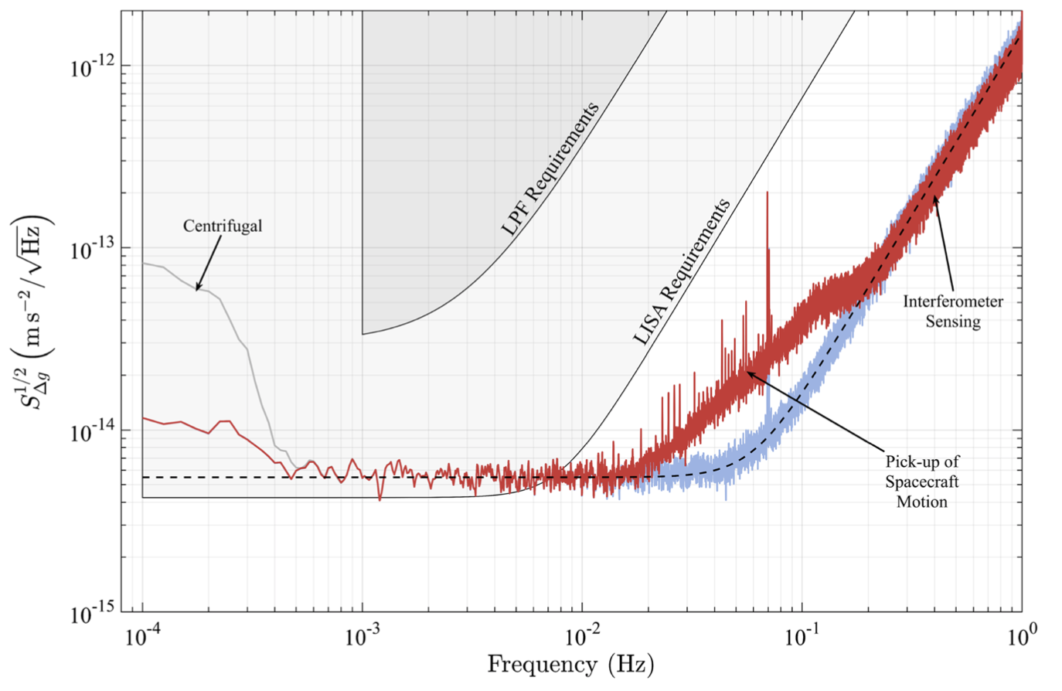
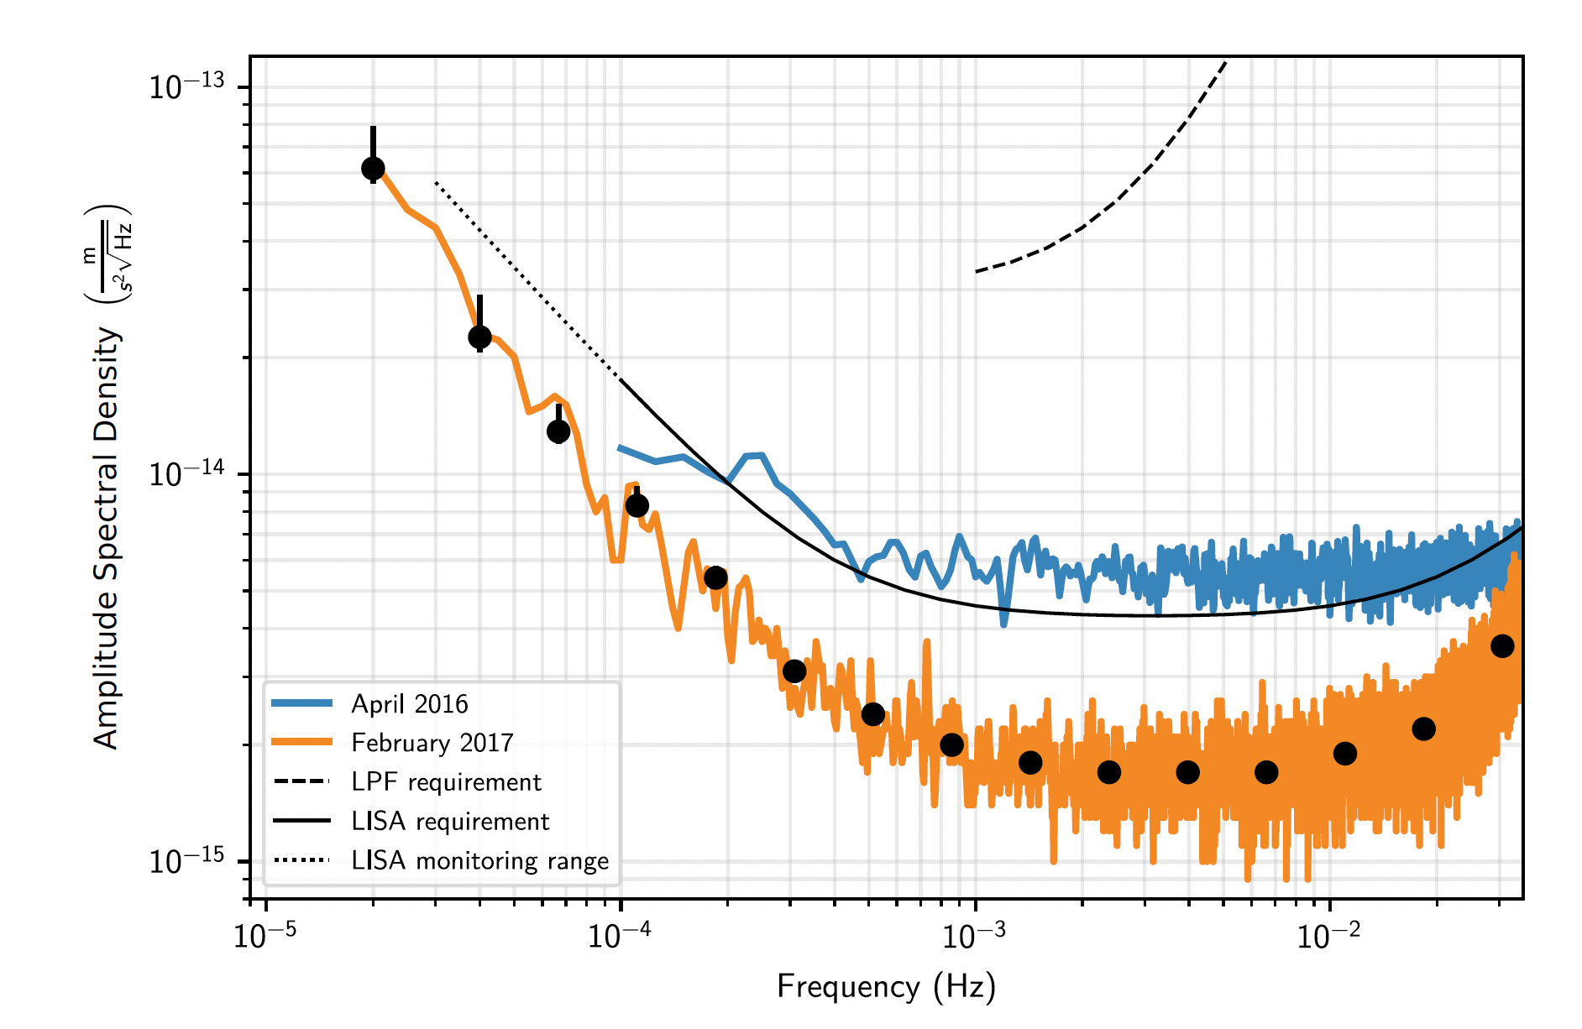
Acceleration noise: physical origin
Brownian noise
Actuation noise + Mystery noise (low frequency)
OMS sensing noise (high frequency)
April 2016
April 2016
Spectral representation of differential acceleration noise of LISA Pathfinder test masses and post-processing removal of residual coupling components with the satellite.
February 2017

Slide 13
LISA mission
Second challenge: A 2.5 million of km arm length interferometer
Dr. Henri Inchauspé, Institute for Theoretical Physics, KU Leuven - LISA School 2025, Les Houches

Slide 14
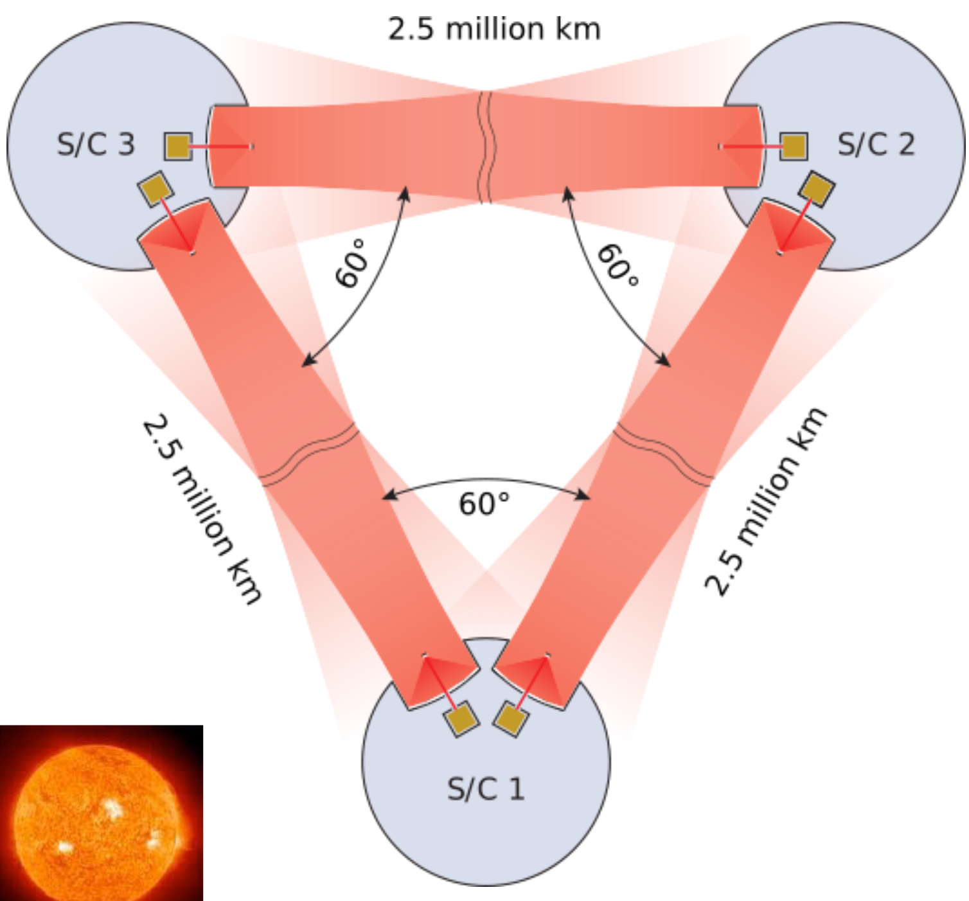
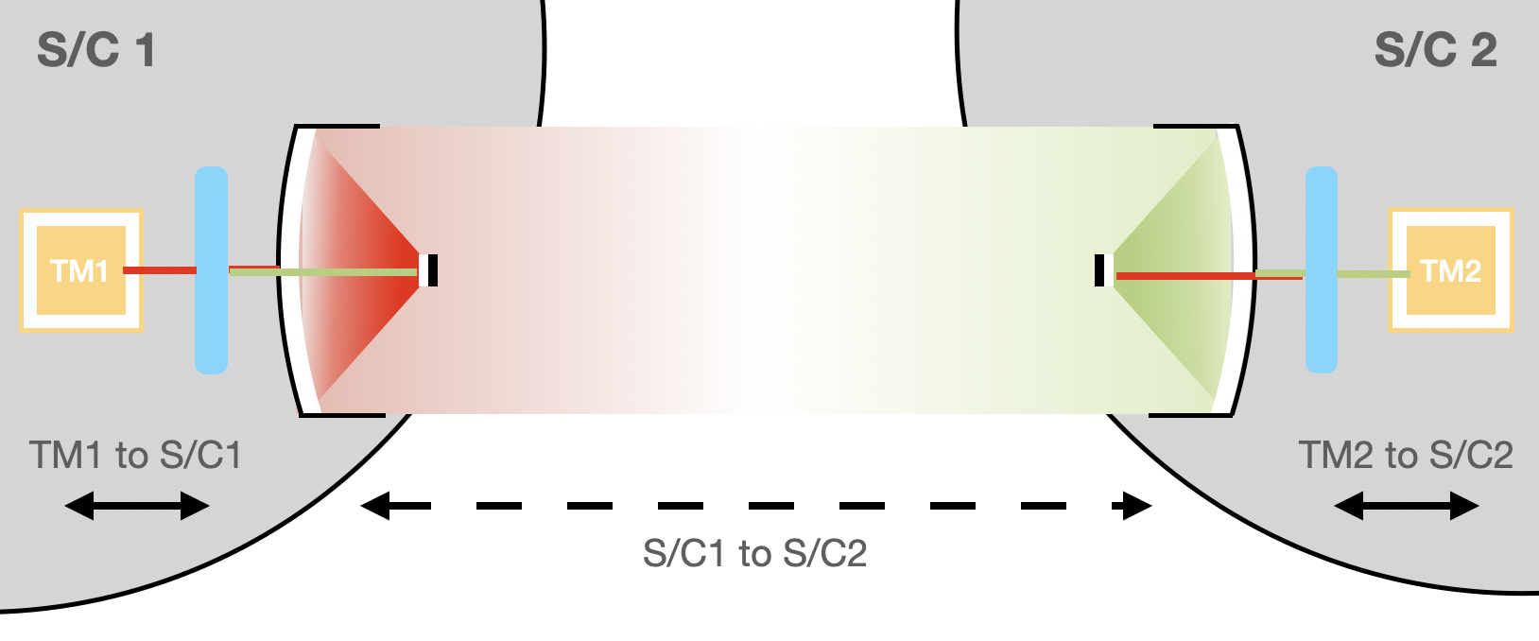
Long-range laser interferometry
LISA mission
2.5 million of km ranging with… picometer precision !!!
LISA: now the test masses are on-board different SC, and 2.5 million of km apart.
Large arm = large effective deformation + larger wavelength.
Laser power emitted 1W, received $≈$ pW. Cannot been reflected back —> transponder scheme
Arm-length defined by orbits: unequal and time-varying.
Laser frequency noise 8 orders of magnitude above target GW strain !
Mirror-to-mirror measurement performed in 3 steps:
Local test-mass to local satellite.
Local satellite to distant satellite.
Distant satellite to distant test-mass.
Dr. Henri Inchauspé, Institute for Theoretical Physics, KU Leuven - LISA School 2025, Les Houches

Slide 15
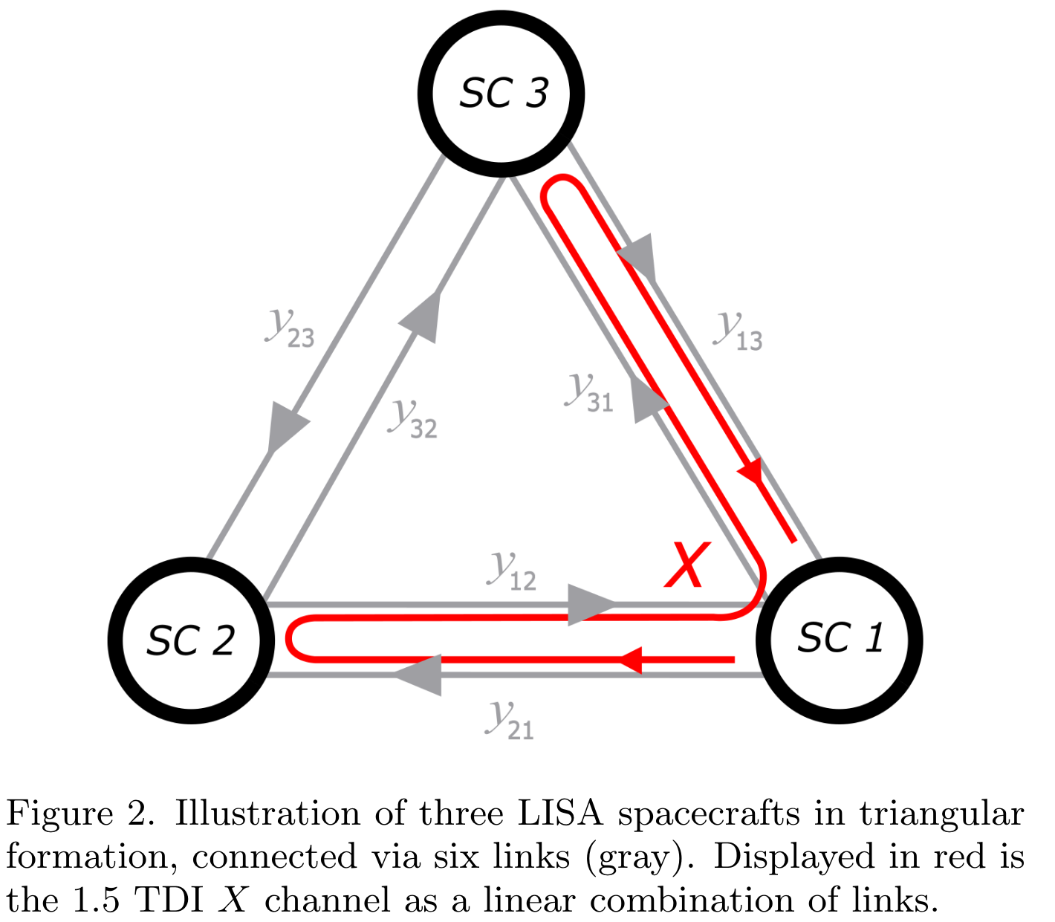
Time-Delay Interferometry (TDI)
LISA mission
Laser frequency noise largely dominates the single link measurements.
Classical Michelson scheme: one single primary laser split across nearly equal optical path: at recombination, the noise is coherent and cancels out !
Impossible with LISA. Needs to compose our interferences in post-processing:
6 Inter-Spacecraft Interferometers (ISI): beatnotes frequency time-series $y_{ij}(t)$ are measured and down-streamed.
6 Test-Mass Interferometers (TMI) to measure the S/C noisy motion w.r.t. local inertial reference frames.
They are delayed and linearly combined to make the laser noise coherently added and suppressed.
This is Time-Delay Interferometry (TDI).
Dr. Henri Inchauspé, Institute for Theoretical Physics, KU Leuven - LISA School 2025, Les Houches

Slide 16
LISA response
LISA response model to GW
Dr. Henri Inchauspé, Institute for Theoretical Physics, KU Leuven - LISA School 2025, Les Houches

Slide 17
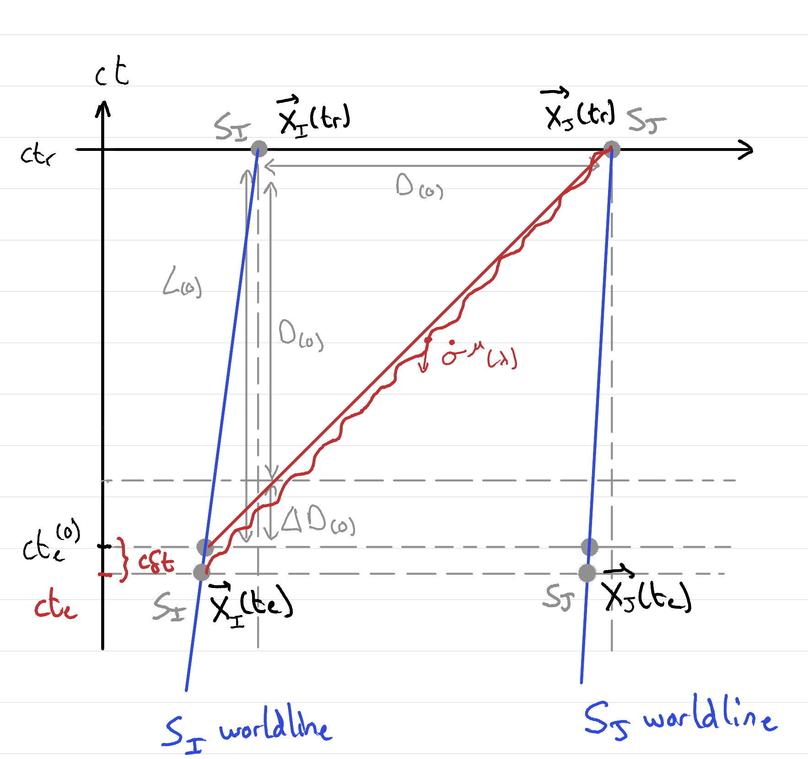
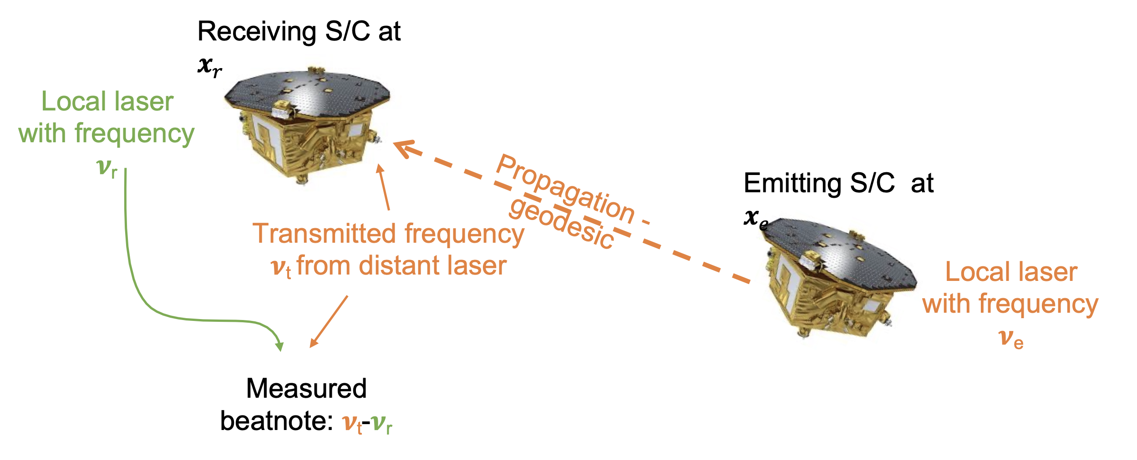
From van der Steen et al. 2025
LISA response
Dr. Henri Inchauspé, Institute for Theoretical Physics, KU Leuven - LISA School 2025, Les Houches

Slide 18
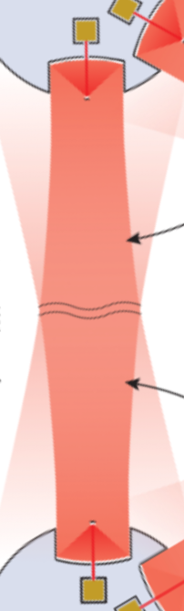
From van der Steen et al. 2025
LISA response
Single-link response
LISA GW Response (Python code, Bayle et al.)
Dr. Henri Inchauspé, Institute for Theoretical Physics, KU Leuven - LISA School 2025, Les Houches

Slide 19
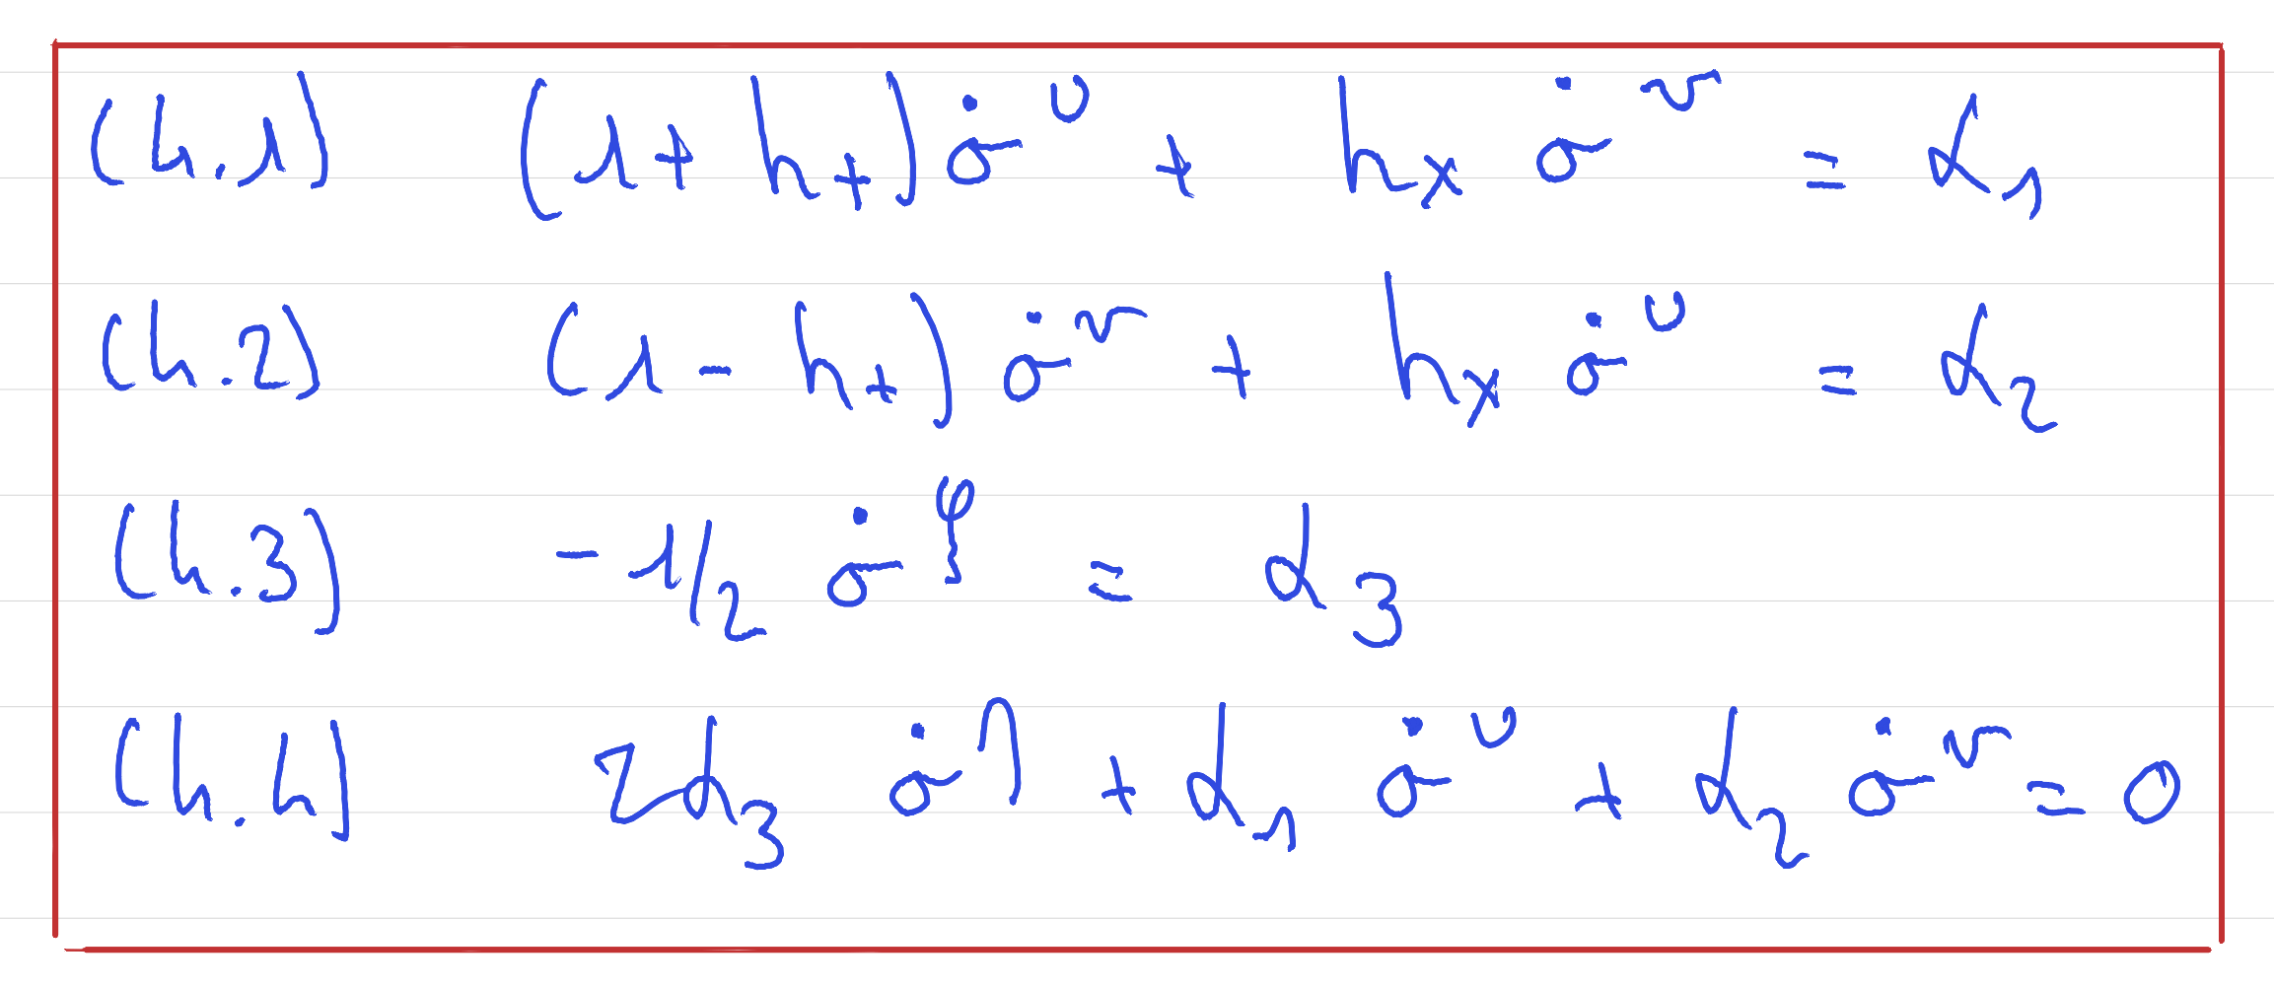
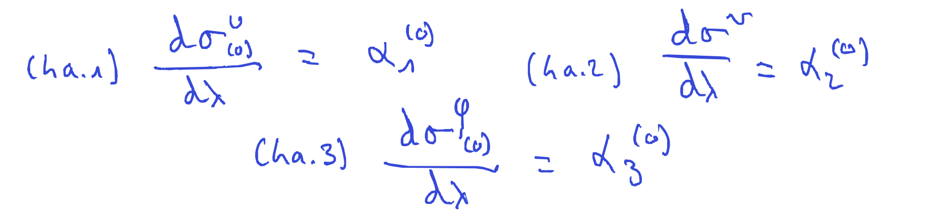
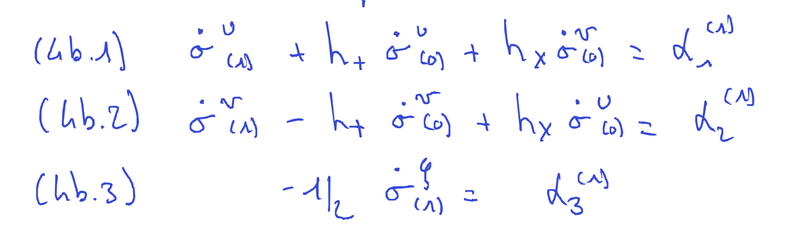
Photon geodesic equations
From van der Steen et al. 2025
LISA response
1. Zeroth order:
2. Linear order:
Dr. Henri Inchauspé, Institute for Theoretical Physics, KU Leuven - LISA School 2025, Les Houches

Slide 20
GW in TT gauge
LISA response
Small oscillatory perturbation of spacetime metric propagating across space.
Propagates two degrees of freedom.
In TT gauge (coordinate systems), the dynamical, non-zero components are contained in the spatial part of the metric, and orthogonal to the propagation axis $\overset{⃗}{z}$ (transverse wave).
Far from the source: plane waves
$$g_{μν}=η_{μν}+h_{μν}+O(h^{2})$$
$$h_{μν}^{TT}=\left(\begin{matrix}0 & 0 & 0 & 0 \\ 0 & h_{+}(t,\overset{⃗}{x}) & h_{×}(t,\overset{⃗}{x}) & 0 \\ 0 & h_{×}(t,\overset{⃗}{x}) & -h_{+}(t,\overset{⃗}{x}) & 0 \\ 0 & 0 & 0 & 0\end{matrix}\right)$$
$$h_{ij}(t,\overset{⃗}{x})=h_{ij}(\overset{⃗}{k}⋅\overset{⃗}{x}-ω_{gw}ct)$$
Dr. Henri Inchauspé, Institute for Theoretical Physics, KU Leuven - LISA School 2025, Les Houches

Slide 21
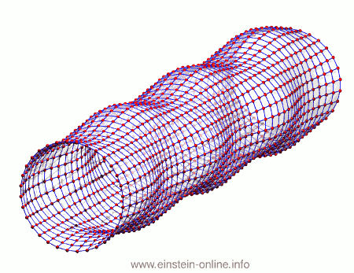
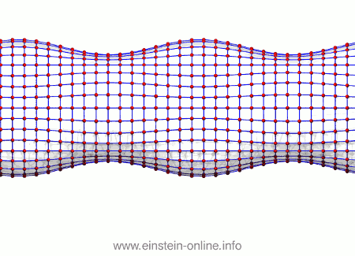
Plane wave solutions
LISA response
Wave traverse: space deformation occurring on plane orthogonal to k, and decomposable into polarization basis:
All points of plane orthogonal to the propagation vector k have same amplitudes $A^{+}(t),A^{×}(t)$ and phase at time t:
$$A_{ij}(u)=A^{+}(u)ϵ_{ij}^{+}+A^{×}(u)ϵ_{ij}^{×}$$
$$k^{α}=ω(t)\left[\begin{aligned}1 \\ \overset{̂}{k}\end{aligned}\right]$$
$$h_{ij}(t,\overset{⃗}{x})=A_{ij}(\overset{̂}{k}⋅\overset{⃗}{x}-ct)e^{ik_{α}x^{α}}$$
Dr. Henri Inchauspé, Institute for Theoretical Physics, KU Leuven - LISA School 2025, Les Houches

Slide 22
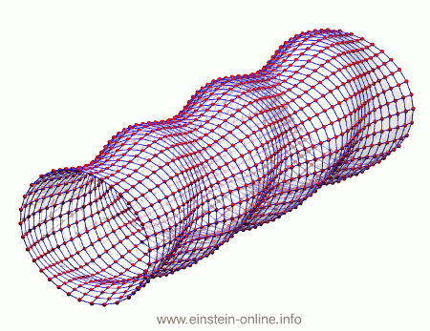
Plane wave solutions
LISA response
Wave traverse: space deformation occurring on plane orthogonal to k, and decomposable into polarization basis:
All points of plane orthogonal to the propagation vector k have same amplitudes $A^{+}(t),A^{×}(t)$ and phase at time t:
$$A_{ij}(u)=A^{+}(u)ϵ_{ij}^{+}+A^{×}(u)ϵ_{ij}^{×}$$
$$k^{α}=ω(t)\left[\begin{aligned}1 \\ \overset{̂}{k}\end{aligned}\right]$$
$$h_{ij}(t,\overset{⃗}{x})=A_{ij}(\overset{̂}{k}⋅\overset{⃗}{x}-ct)e^{ik_{α}x^{α}}$$
Dr. Henri Inchauspé, Institute for Theoretical Physics, KU Leuven - LISA School 2025, Les Houches

Slide 23
LISA detection
Beatnotes and interferences
Flash me to get some more course material !
Dr. Henri Inchauspé, Institute for Theoretical Physics, KU Leuven - LISA School 2025, Les Houches

Slide 24
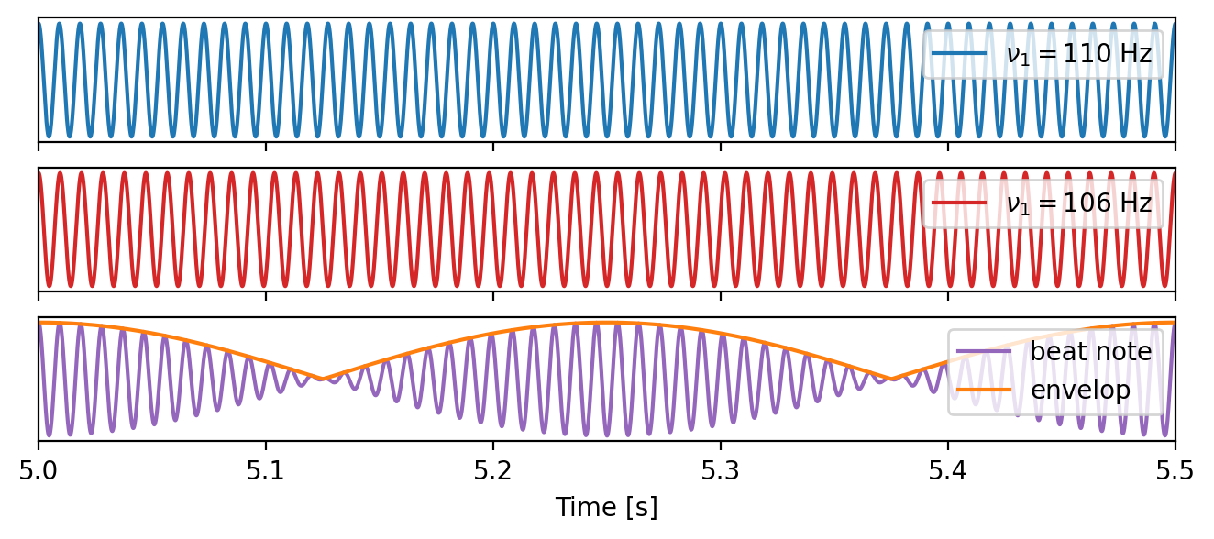
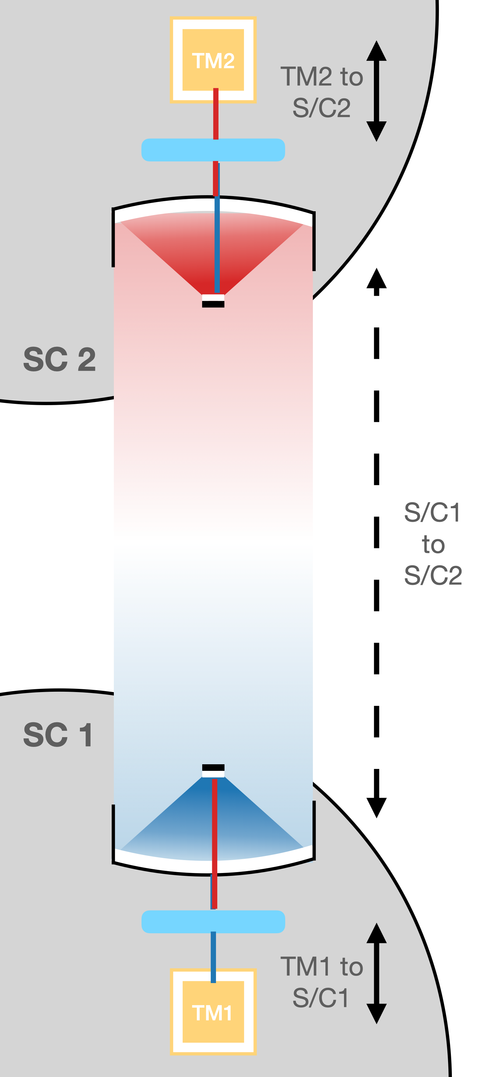
Heterodyne interferometry
LISA detection
$$δν=ν_{2}-ν_{1}$$
$$cos\left(2πν_{1}t\right)+cos\left(2πν_{2}t\right)=2cos\left[2π(ν_{1}+ν_{2})t\right]cos\left[2πδνt\right]$$
Dr. Henri Inchauspé, Institute for Theoretical Physics, KU Leuven - LISA School 2025, Les Houches

Slide 25
Heterodyne interferometry
LISA detection
$$δν=ν_{2}-ν_{1}$$
$$cos\left(2πν_{1}t\right)+cos\left(2πν_{2}t\right)=2cos\left[2π(ν_{1}+ν_{2})t\right]cos\left[2πδνt\right]$$
Dr. Henri Inchauspé, Institute for Theoretical Physics, KU Leuven - LISA School 2025, Les Houches

Slide 26
Heterodyne interferometry
LISA detection
$$δν=ν_{2}-ν_{1}$$
$$cos\left(2πν_{1}t\right)+cos\left(2πν_{2}t\right)=2cos\left[2π(ν_{1}+ν_{2})t\right]cos\left[2πδνt\right]$$
Dr. Henri Inchauspé, Institute for Theoretical Physics, KU Leuven - LISA School 2025, Les Houches

Slide 27
Heterodyne interferometry
LISA detection
$$δν=ν_{2}-ν_{1}$$
$$cos\left(2πν_{1}t\right)+cos\left(2πν_{2}t\right)=2cos\left[2π(ν_{1}+ν_{2})t\right]cos\left[2πδνt\right]$$
Dr. Henri Inchauspé, Institute for Theoretical Physics, KU Leuven - LISA School 2025, Les Houches

Slide 28
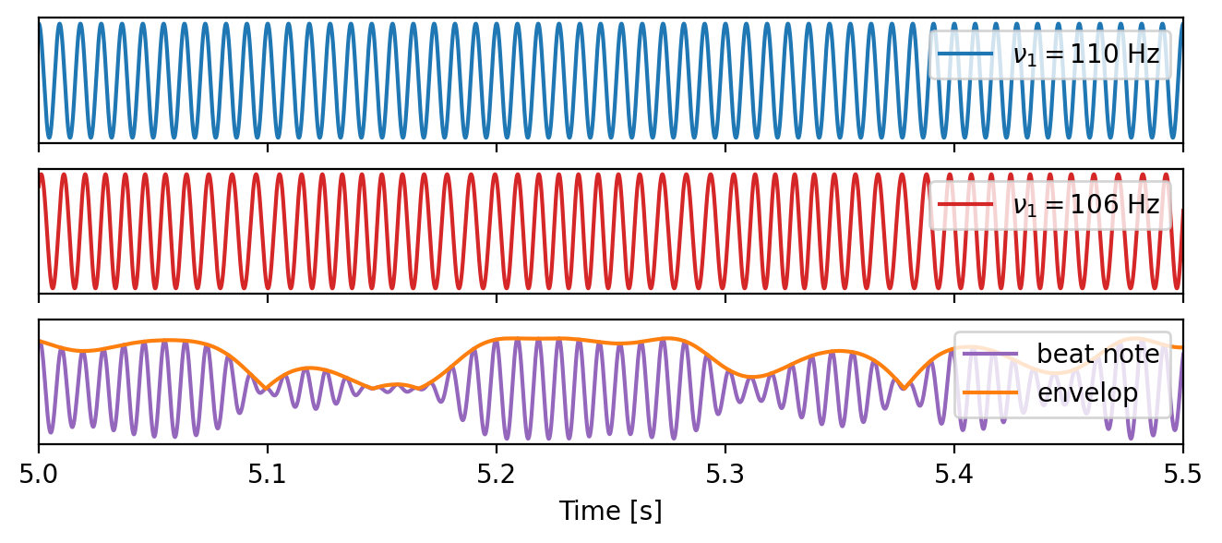
Heterodyne interferometry + GW
LISA detection
$$δν=ν_{2}-ν_{1}$$
$$cos\left(2πν_{1}t\right)+cos\left(2πν_{2}t\right)=2cos\left[2π(ν_{1}+ν_{2})t\right]cos\left[2πδνt\right]$$
Dr. Henri Inchauspé, Institute for Theoretical Physics, KU Leuven - LISA School 2025, Les Houches

Slide 29
Heterodyne interferometry + GW
LISA detection
$$δν=ν_{2}-ν_{1}$$
$$cos\left(2πν_{1}t\right)+cos\left(2πν_{2}t\right)=2cos\left[2π(ν_{1}+ν_{2})t\right]cos\left[2πδνt\right]$$
Dr. Henri Inchauspé, Institute for Theoretical Physics, KU Leuven - LISA School 2025, Les Houches

Slide 30
Heterodyne interferometry + GW
LISA detection
$$δν=ν_{2}-ν_{1}$$
$$cos\left(2πν_{1}t\right)+cos\left(2πν_{2}t\right)=2cos\left[2π(ν_{1}+ν_{2})t\right]cos\left[2πδνt\right]$$
Dr. Henri Inchauspé, Institute for Theoretical Physics, KU Leuven - LISA School 2025, Les Houches

Slide 31
Heterodyne interferometry + GW
LISA detection
$$δν=ν_{2}-ν_{1}$$
$$cos\left(2πν_{1}t\right)+cos\left(2πν_{2}t\right)=2cos\left[2π(ν_{1}+ν_{2})t\right]cos\left[2πδνt\right]$$
Dr. Henri Inchauspé, Institute for Theoretical Physics, KU Leuven - LISA School 2025, Les Houches

Slide 32
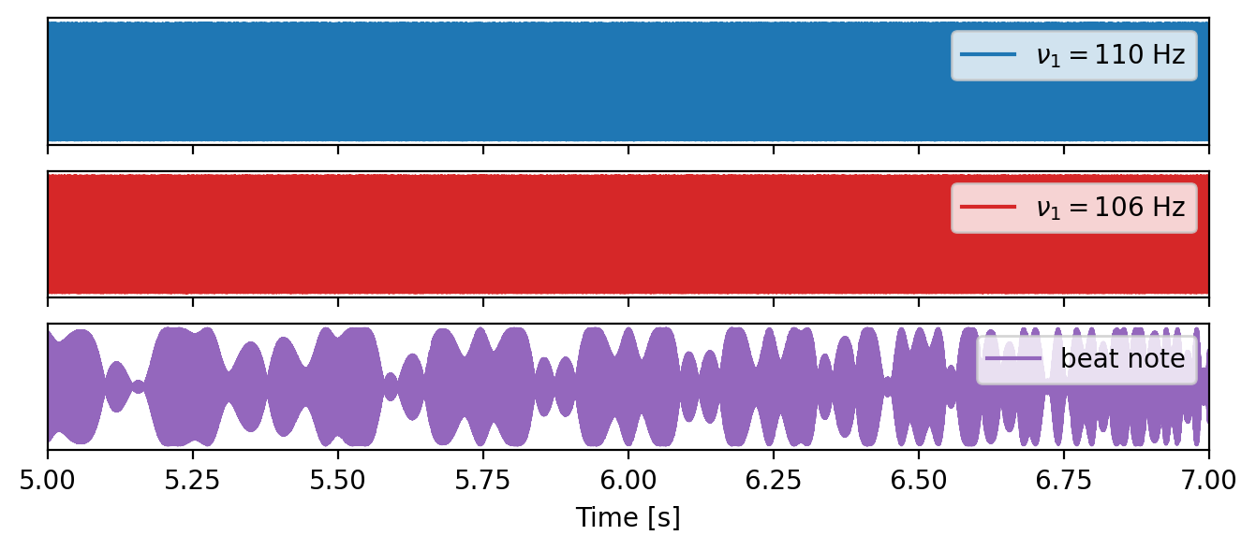
Heterodyne interferometry + GW + White Noise
LISA detection
$$δν=ν_{2}-ν_{1}$$
$$cos\left(2πν_{1}t\right)+cos\left(2πν_{2}t\right)=2cos\left[2π(ν_{1}+ν_{2})t\right]cos\left[2πδνt\right]$$
Dr. Henri Inchauspé, Institute for Theoretical Physics, KU Leuven - LISA School 2025, Les Houches

Slide 33
Heterodyne interferometry + GW + White Noise
LISA detection
$$δν=ν_{2}-ν_{1}$$
$$cos\left(2πν_{1}t\right)+cos\left(2πν_{2}t\right)=2cos\left[2π(ν_{1}+ν_{2})t\right]cos\left[2πδνt\right]$$
Dr. Henri Inchauspé, Institute for Theoretical Physics, KU Leuven - LISA School 2025, Les Houches

Slide 34
Heterodyne interferometry + GW + White Noise
LISA detection
$$δν=ν_{2}-ν_{1}$$
$$cos\left(2πν_{1}t\right)+cos\left(2πν_{2}t\right)=2cos\left[2π(ν_{1}+ν_{2})t\right]cos\left[2πδνt\right]$$
Dr. Henri Inchauspé, Institute for Theoretical Physics, KU Leuven - LISA School 2025, Les Houches

Slide 35
Heterodyne interferometry + GW + White Noise
LISA detection
$$δν=ν_{2}-ν_{1}$$
$$cos\left(2πν_{1}t\right)+cos\left(2πν_{2}t\right)=2cos\left[2π(ν_{1}+ν_{2})t\right]cos\left[2πδνt\right]$$
Dr. Henri Inchauspé, Institute for Theoretical Physics, KU Leuven - LISA School 2025, Les Houches

Slide 36
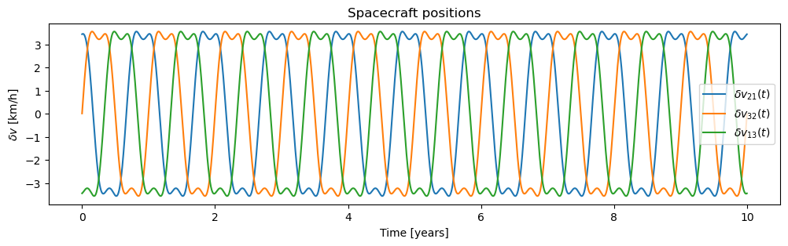
Doppler shift and frequency plan
LISA detection
$$δν=δν_{21}+δν_{orb}+δν_{gw}(+δν_{noise})$$
LISA constellation flexing yearly.
Relative velocity between SC along line of sight
DC / out-of-band Doppler shift of laser beams to account for.
Frequency plan to keep a stable beat note frequency range.
Dr. Henri Inchauspé, Institute for Theoretical Physics, KU Leuven - LISA School 2025, Les Houches

Slide 37
LISA detection
Working around laser noise
Flash me to get some more course material !
Dr. Henri Inchauspé, Institute for Theoretical Physics, KU Leuven - LISA School 2025, Les Houches

Slide 38
Time-Delay Interferometry
LISA detection
Suppressing primary noises
Laser frequency noise: fluctuations about 8 orders of magnitude above GW strain typical amplitude.
Direct Michelson interferometry impossible: arm length asymmetric and variations driven by spacecraft orbits.
Strategy: measure beat-note frequencies real-time across the constellation, and synchronize / build interferences on-ground !
Key post-processing: Time-Delay Interferometry (TDI)
Dr. Henri Inchauspé, Institute for Theoretical Physics, KU Leuven - LISA School 2025, Les Houches

Slide 39
Time-Delay Interferometry
LISA detection
Second Generation TDI
First generation TDI 1.5.
Suppresses laser noise exactly for unequal, static arm-length:
$$\begin{matrix}X_{1}= & y_{13}+D_{13}y_{31}+D_{131}y_{12}+D_{1312}y_{21} \\ & -(y_{12}+D_{12}y_{21}+D_{121}y_{13}+D_{1213}y_{31})\end{matrix}$$
Dr. Henri Inchauspé, Institute for Theoretical Physics, KU Leuven - LISA School 2025, Les Houches

Slide 40
Time-Delay Interferometry
LISA detection
Second Generation TDI
Second generation TDI 2.0
16 links combination.
Second round-trip reverse of both beams to « accumulate » time-varying delays symmetrically.
First order correction to time-varying arm-lengths.
$$\begin{matrix}X_{2}= & X_{1}+D_{1321}y_{12}+D_{131212}y_{21}+D_{1312121}y_{13}+D_{13121213}y_{31} \\ & -(D_{12131}y_{13}+D_{121313}y_{31}+D_{1213131}y_{12}+D_{12131312}y_{21})\end{matrix}$$
Dr. Henri Inchauspé, Institute for Theoretical Physics, KU Leuven - LISA School 2025, Les Houches

Slide 41
LISA detection
The quieter place in the solar system
Flash me to get some more course material !
Dr. Henri Inchauspé, Institute for Theoretical Physics, KU Leuven - LISA School 2025, Les Houches

Slide 42
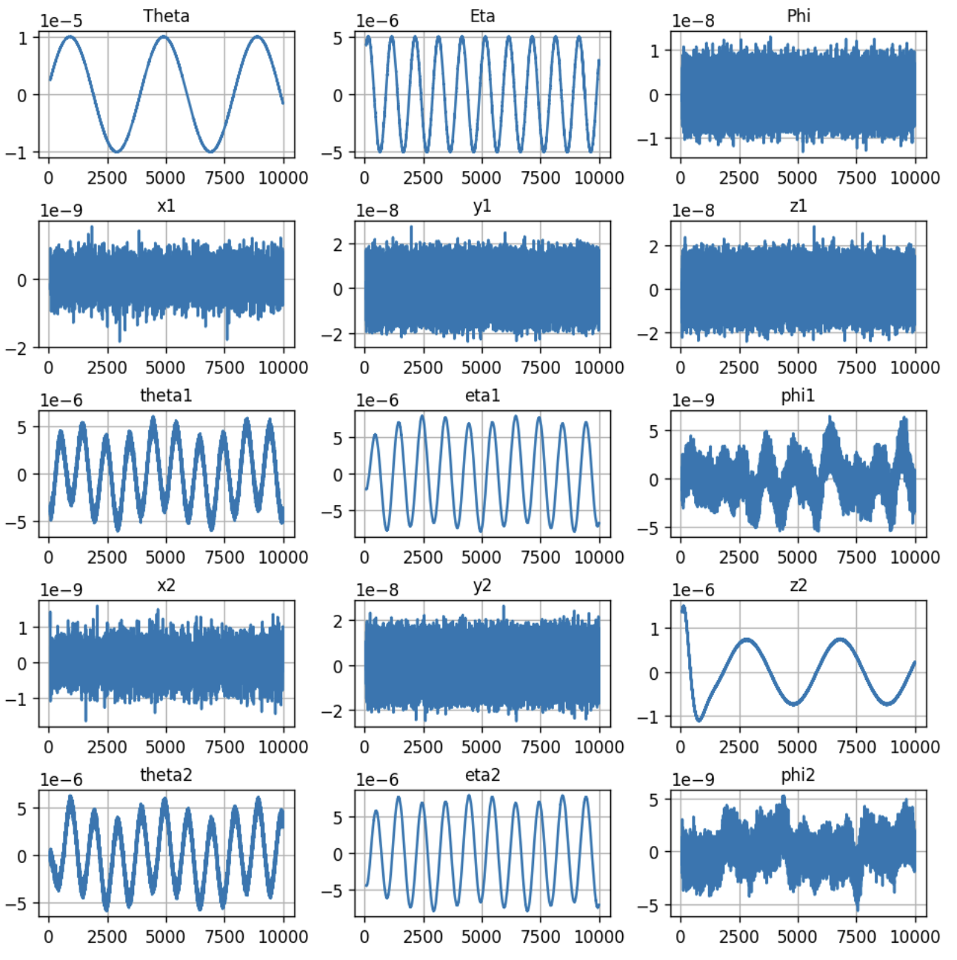
From LISA Pathfinder to LISA
LISA detection
Locking S/C trajectory on quiet test masses
… since the S/C motion is locked on the super quiet test masses.
At low frequency, the S/C as quiet as the test masses. > 1 ton spacecraft stable at $≈{10}^{-14}m.s^{-2}/\sqrt{Hz}$ level essentially when control gain is stiff.
S/C and test mass control: 15 DOFs to bring to target point, stabilize and optimize the jitter.
Target points:
Attitude control: MOSA pointing distant MOSAs (telescope and S/C rotation)
Drag-Free control: S/C thrusts to follow a virtual average test masses.
Suspension control: differential TM motion corrected with electrostatic forces
Dr. Henri Inchauspé, Institute for Theoretical Physics, KU Leuven - LISA School 2025, Les Houches

Slide 43
Incidence angle of long-range beam ==> S/C attitude measurement Differential Wavefront Sensing (DWS)
< nrad.Hz^{-1/2}
x1, x2 ==> Inteferometer (IFO) ~pm.Hz^{-1/2}
TMs actuated via capacitive (electrostatic) system
ONLY when unavoidable
and NOT along x1 or x2 axes
y1, y2, z1, z2 ==> Capacitive sensing (GRS)
~nm.Hz^{-1/2}
S/C actuated via micro-propulsion (and locked on TMs = Drag-Free)

Slide 44
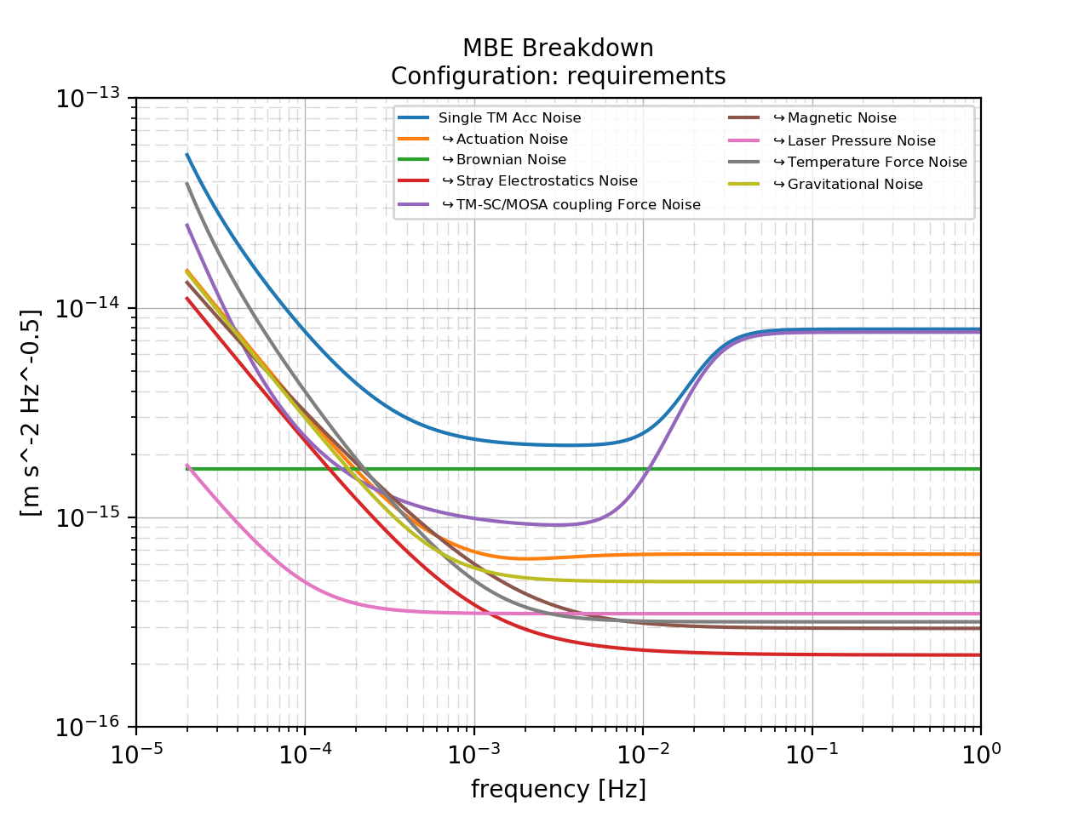
Acceleration noise: noise budget for LISA
Back slides
Main goal: Measuring residual differential acceleration between two « free-floating » test masses. = Measurement of quality of free-fall for the test-masses. (Test mass 1 free-fall, test-mass 2 suspended)
Understanding physical origins of the residual noise.
Two novelties / breakthroughs:
sub-picometer metrology in space: laser interferometry
test-mass wireless discharging (UV lamp via photoelectric effect)
At low frequency: 3 orders of magnitude gain in sensitivity.
Various experiments: enhancing / stimulating a specific coupling and probing impact on the start acceleration.
Spectral representation of differential acceleration noise of LISA Pathfinder test masses and post-processing removal of residual coupling components with the satellite.
Same models and parameters are scaled to LISA to build the noise budget.
Dr. Henri Inchauspé, Institute for Theoretical Physics, KU Leuven - LISA School 2025, Les Houches

Slide 45
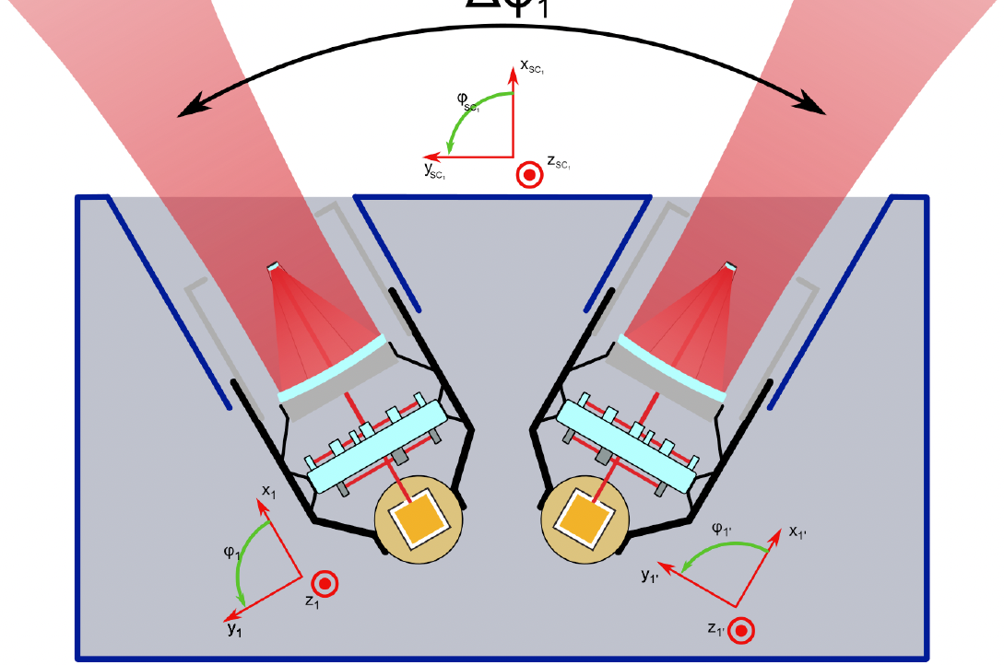
Back slides
Dr. Henri Inchauspé, Institute for Theoretical Physics, KU Leuven - LISA School 2025, Les Houches

Slide 46
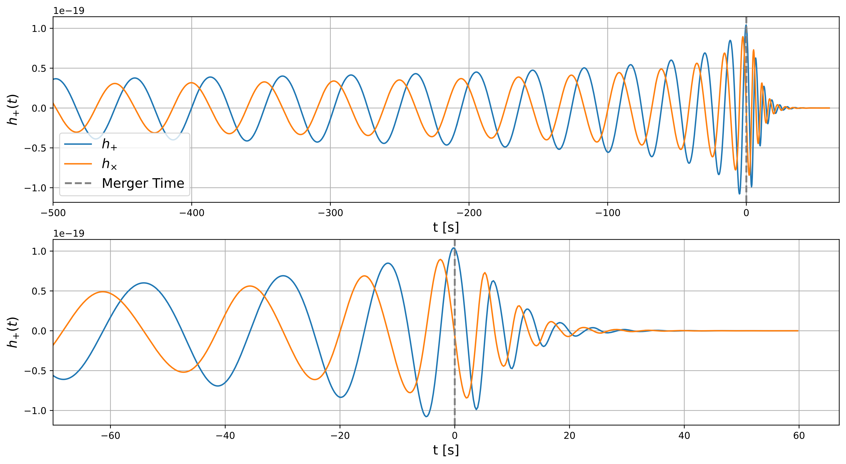
Example: chirp signal from BH mergers
Back slides
Late inspiral
Merger
Ringdown
Dr. Henri Inchauspé, Institute for Theoretical Physics, KU Leuven - LISA School 2025, Les Houches

Slide 47
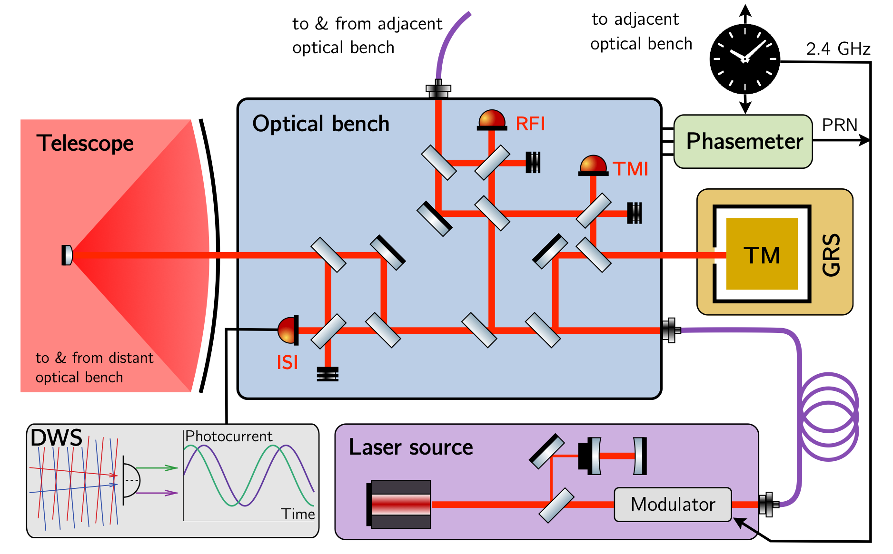
Three steps optical measurement
Back slides
LISA: indirect differential measurement from mirror to mirror:
TMI 21: tracking spacecraft SC1 motion w.r.t. local ($≈$ inertial) masses TM21 along line of sight.
ISI 21 and (ISI 12): tracking SC1 to SC2 optical path variation (including relative motion, but also GW)
TMI 12: tracking spacecraft SC2 motion w.r.t. local ($≈$ inertial) masses TM12 along line of sight.
Combining everything within TDI to suppress out the S/C noisy motion.
(ISI: Inter Spacecraft Interferometer TMI: Test Mass Interferometer)
Dr. Henri Inchauspé, Institute for Theoretical Physics, KU Leuven - LISA School 2025, Les Houches

