Slide 1
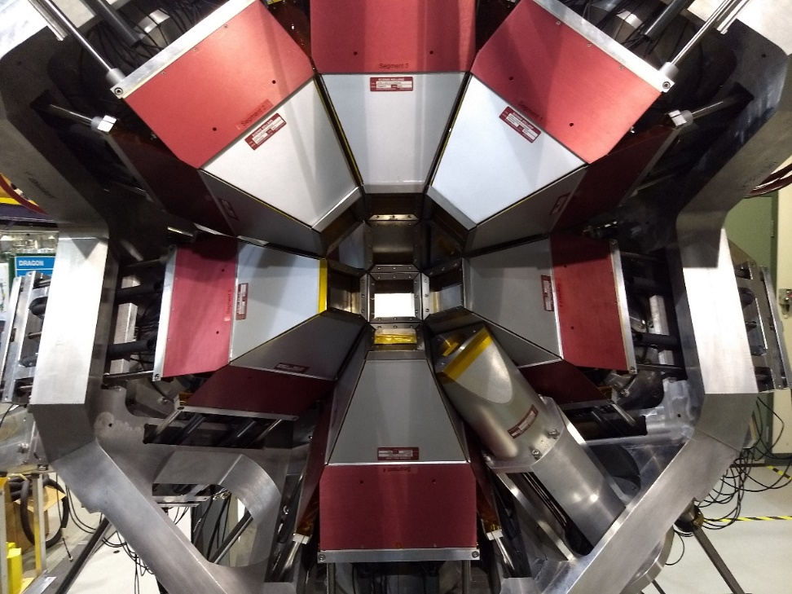
The GRIFFIN Spectrometer at TRIUMF: Its capabilities and Science Highlights
Paul Garrett
University of Guelph

Slide 2

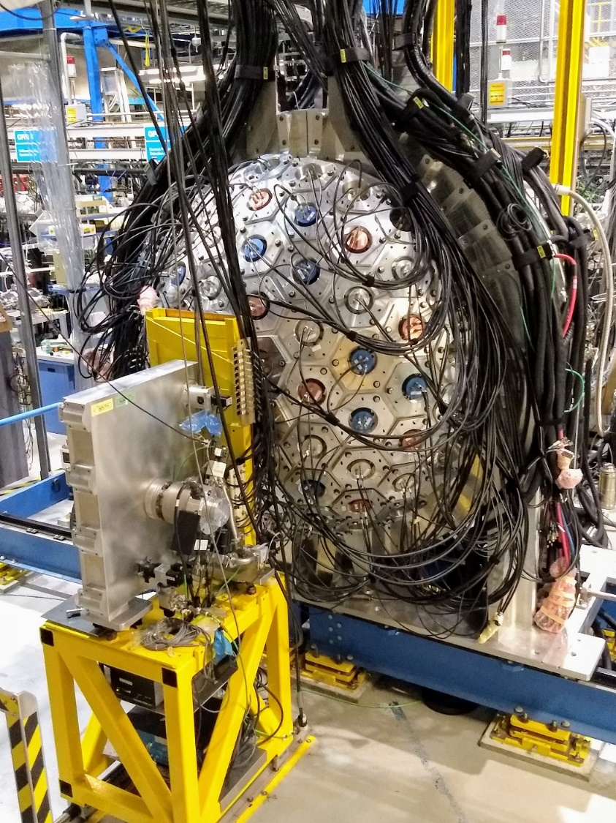
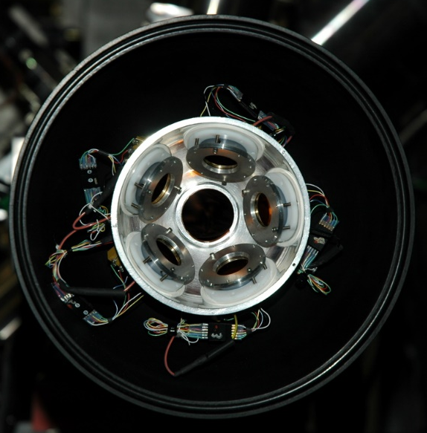
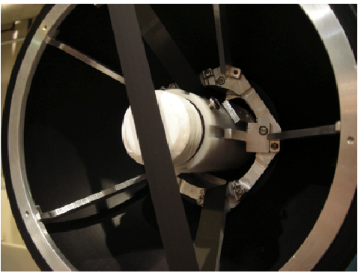
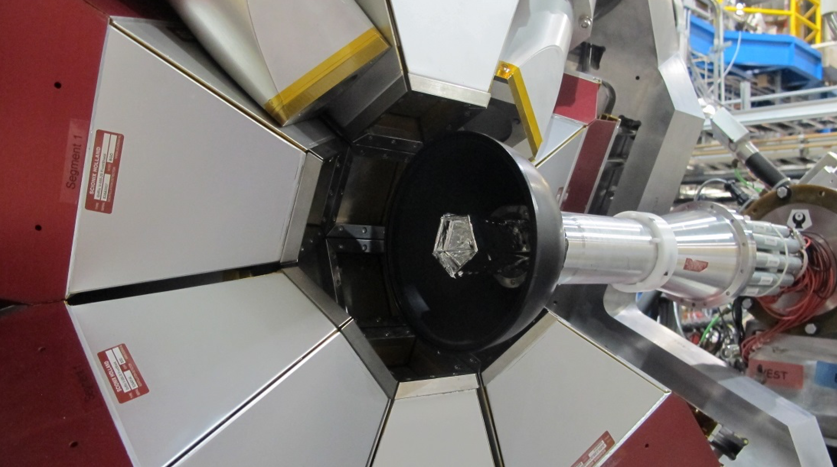
Our workhorse – the GRIFFIN spectrometer
GRIFFIN has a full suite of detector systems for comprehensive measurements of the decay

Slide 3
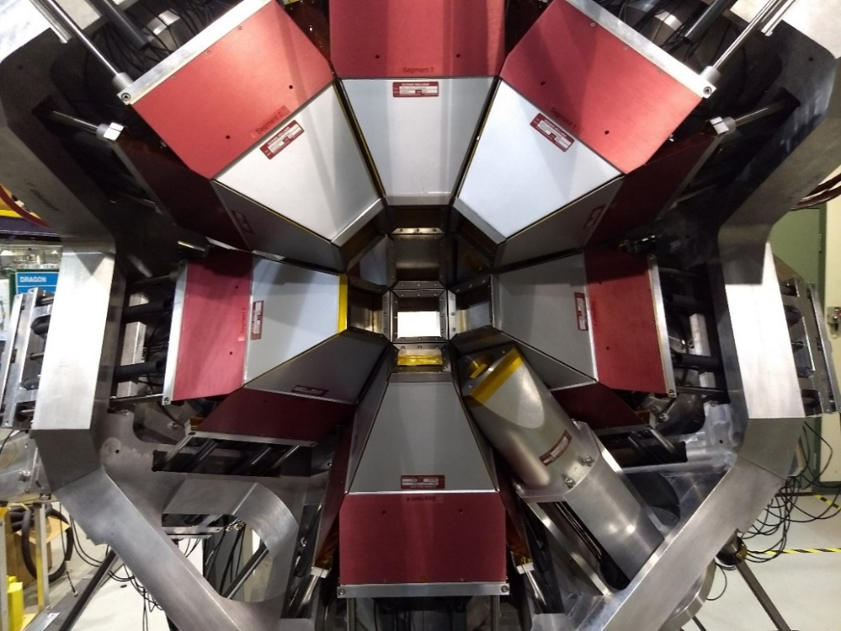
The GRIFFIN spectrometer
Up to 16 BGO-suppressed clover detectors with >40% relative efficiency HPGe crystals
High-throughput triggerless DAQ built based on 50 MHz clock for timestamps capable of writing 300 MB/s sustained
Custom GRIF digitizers (14-bit, 100 MHz)
  Real experiments have run with >200 MB/s, total HPGe rate of 1.5 MHz (25KHz/crystal)
Single-crystal
Add-back
15 detectors, 11 cm distance

Slide 4
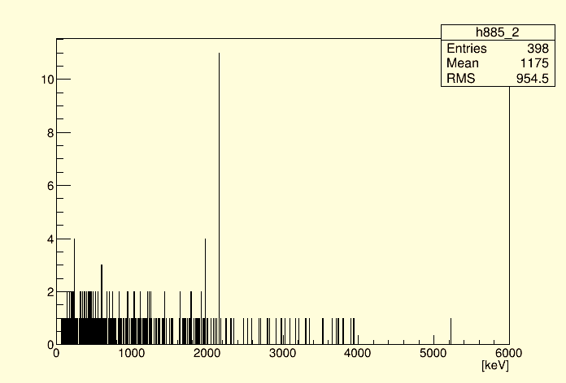
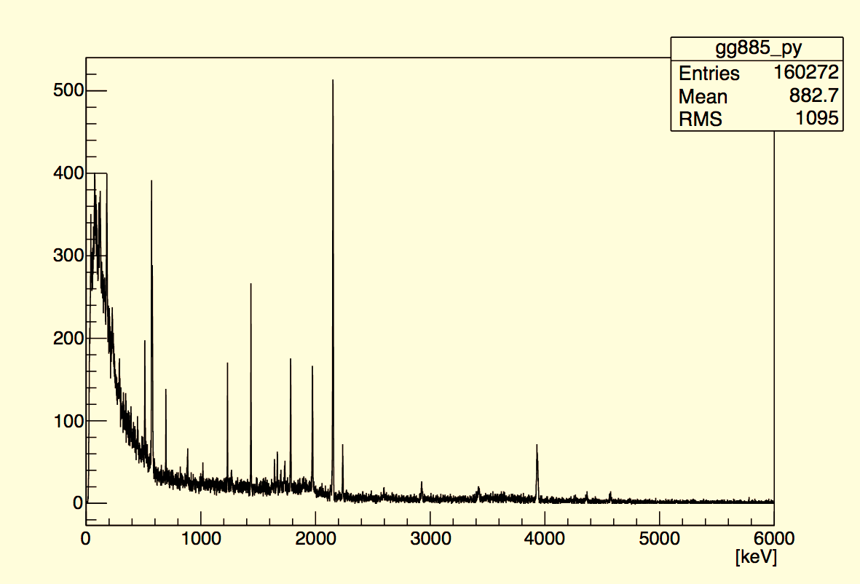
Comparison of our previous 8π and GRIFFIN spectrometers
γ coincidences with 885-keV 2⁺→0⁺ in ³²Mg
8π: 2-3 pps, 5 days
GRIFFIN: ~9 pps, ~2 days
C. Mattoon et al., PRC75, 017302 (2007)
Note scale!

Slide 5
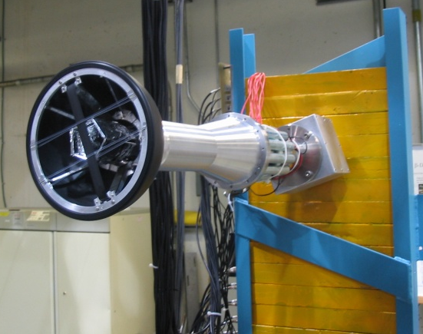
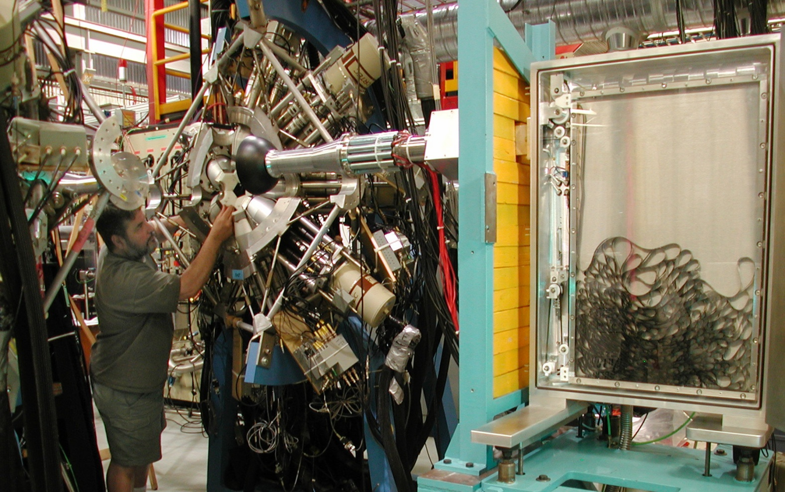
Moving tape collector for transport of activity
Beam implanted onto a moving tape at center of array
  Allows for movement of long-lived activity out of focus of spectrometer
Tape speeds, dwell times, etc., variable. Control of beam-kicker and tape movement controlled by DAQ
Tape Cassette
Tape transport very flexible: can be motionless, or operated in continuous motion
Disadvantage: study of long-lived activity in presence of intense, short-lived isobar
Lead Shielding
Built by E. Zganjar, LSU

Slide 6
Adjustable beam-on and tape movement enables lifetime measurements
Use of programmable logic unit to control beam delivery to GRIFFIN via a fast beam kicker as short as ~20 ms.
Al or Fe₂O₃ coated mylar tape used
¹²⁸Cd T_{½} = 245.8(21) ms
R. Dunlop et al., PRC 93, 062801(R) (2016)
Separation of β-decaying isomers of ¹²⁹Cd with nearly identical half lives

Slide 7
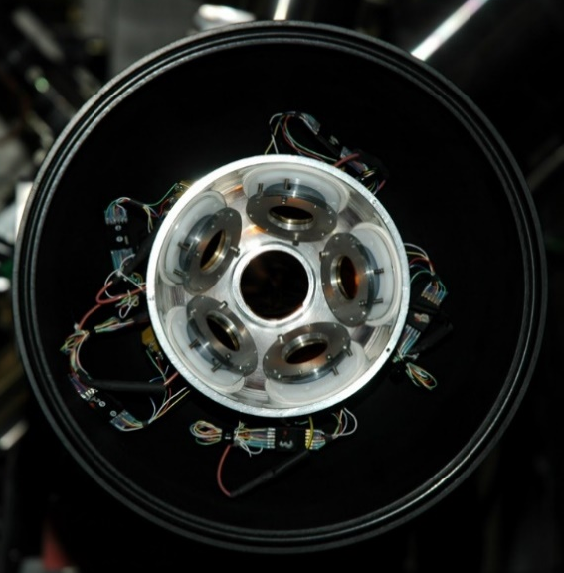
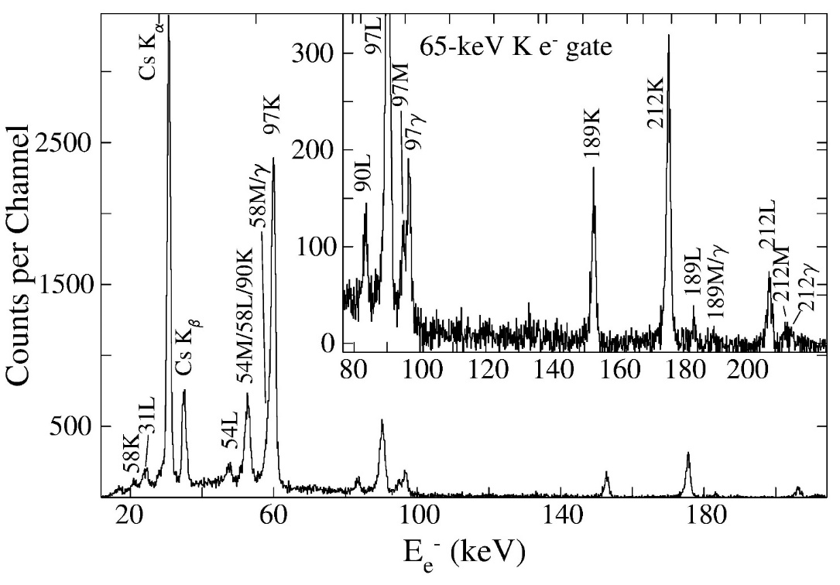
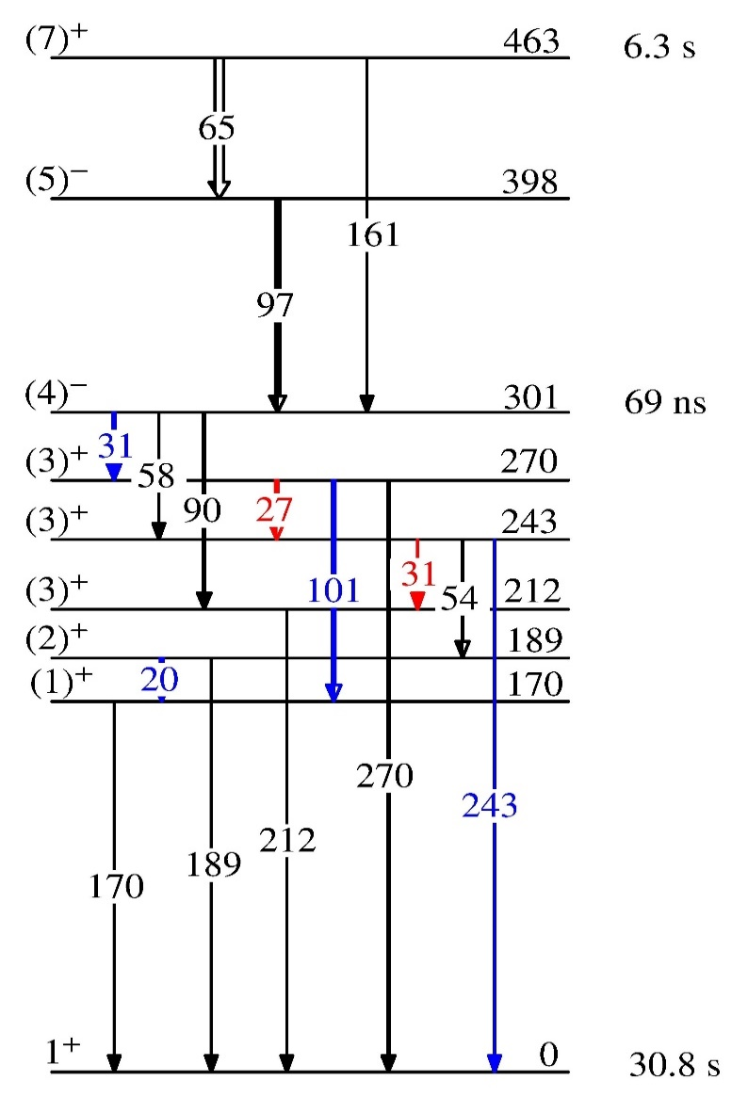
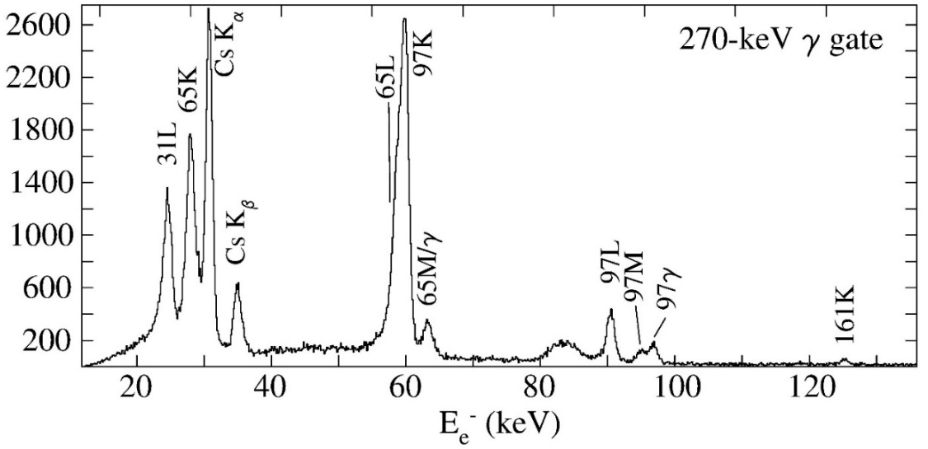
Importance of conversion electron spectroscopy: ¹²⁴Cs^{m} isomer decay and e⁻e⁻ coincidences
Ability to perform γe⁻ and e⁻e⁻ coincidences important for level scheme with large number of low-energy levels, e.g., odd-odd nuclei
IT: 99.89%
e⁻ coincidences with 65-keV M2 transition
Previously unobserved transition
A.J. Radich et al., EPJ A53, 184 (2017).

Slide 8
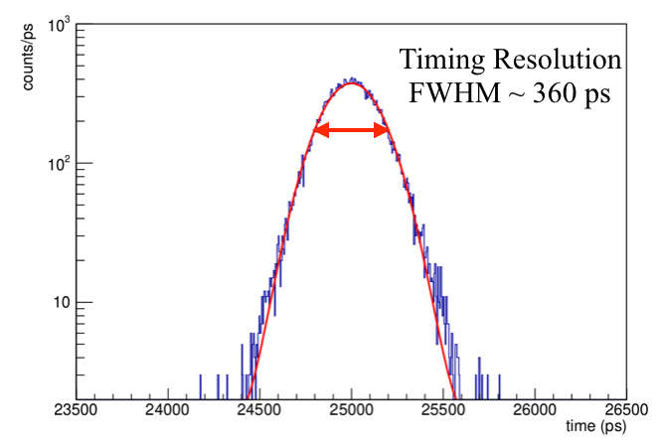
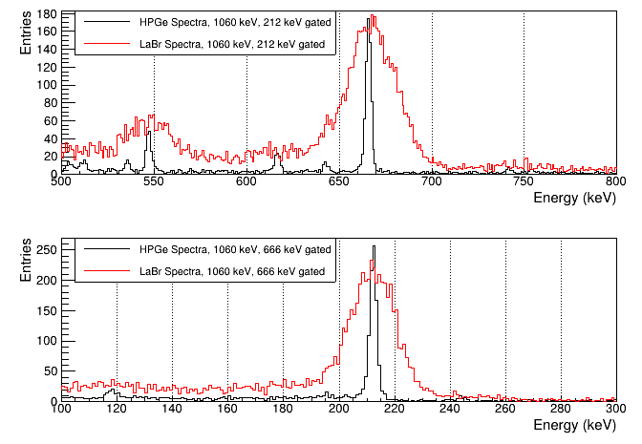
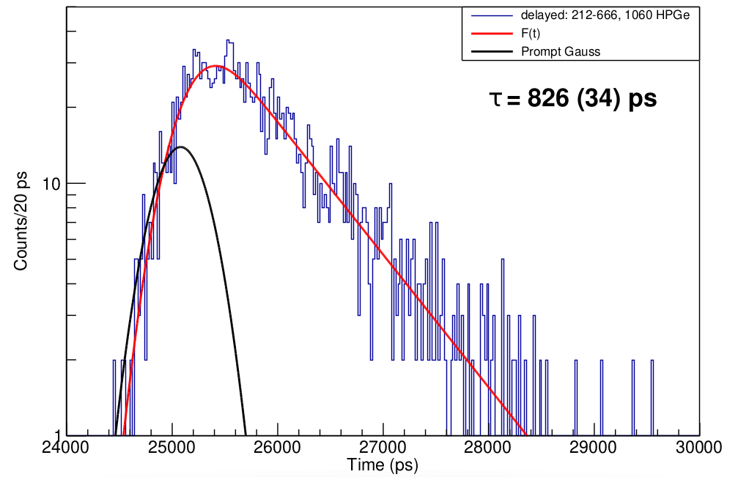
LaBr₃(Ce) array: Lifetime measurements in ¹⁰⁰Zr
8 LaBr3(Ce) detectors with individual BGO shields
Typically, use triple coincidences with GRIFFIN HPGe selecting pathway, TAC START and STOP selected in LaBr₃ coincidence events.
⁶⁰Co 1332+1173 keV gated
Comparison of HPGe and LaBr₃ specta with 1060-keV HPGe gate, 212 (top) or 666 (bottom) keV LaBr₃ gate
HPGe gate
1060-keV
878
2₂⁺
TAC spectra for 212-keV level after gating
LaBr₃ gate
666-keV
212
2₁⁺
LaBr₃ gate
212-keV
Final result: 857(12) ps, NNDC 828(22) ps
Lifetime analysis: Harris Bidaman (Guelph)

Slide 9
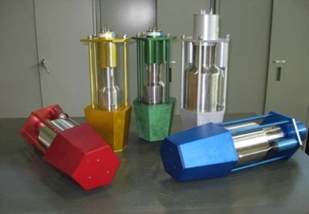
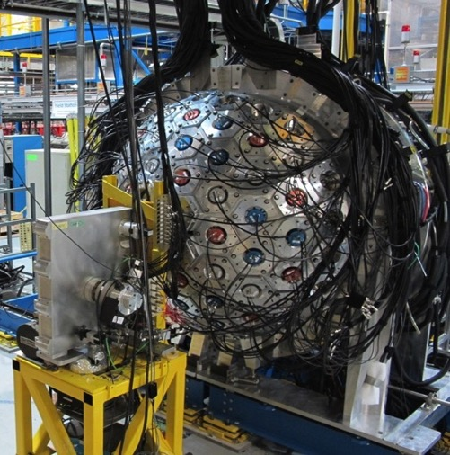
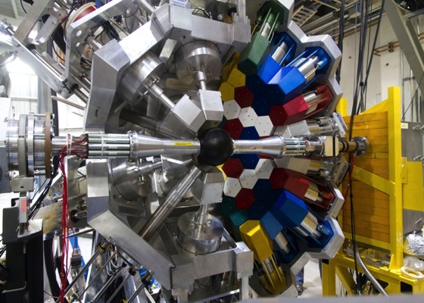
GRIFFIN+DESCANT
70 element array of deuterated scintillator for neutron detection
Enables β-γ-e⁻-neutron spectroscopy
~1π solid angle
Neutron energy from time-of-flight (50cm flight path)
Neutron-γ discrimination from pulse shape
GRIFFIN + DESCANT, August 2016

Slide 10
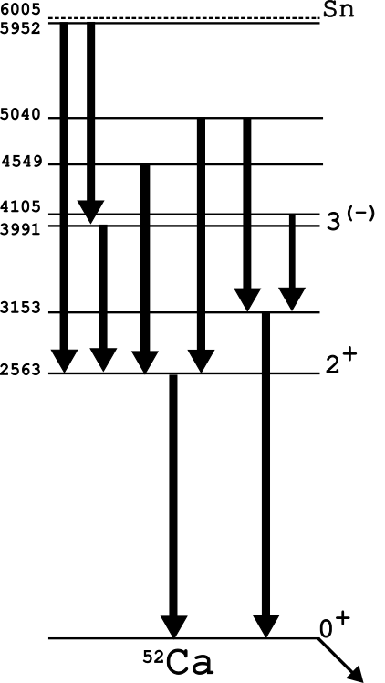
Heavy-K decays studied with GRIFFIN+DESCANT
DESCANT 70-element array of C₆D₆ liquid scintillator designed for neutron tagging from reactions with accelerated beams
Used with GRIFFIN for β-n decay studies
TOF
Analysis by R. Coleman, V. Bildstein, Guelph
PSD

Slide 11
Nuclear structure studies with γ-ray spectroscopy following β-decay
Three general themes
  Studies related to fundamental symmetries, e.g. superallowed Fermi β decay, characterized by high-precision measurements
    Structure information on the daughters gathered in the process
  Studies related to nuclei far from stability, characterized by weak beams and low rates
    Can be compensated somewhat by GRIFFIN’s capabilities or long durations
  Studies related to nuclei on or near stability, characterized by intense beams and high rates

Slide 12
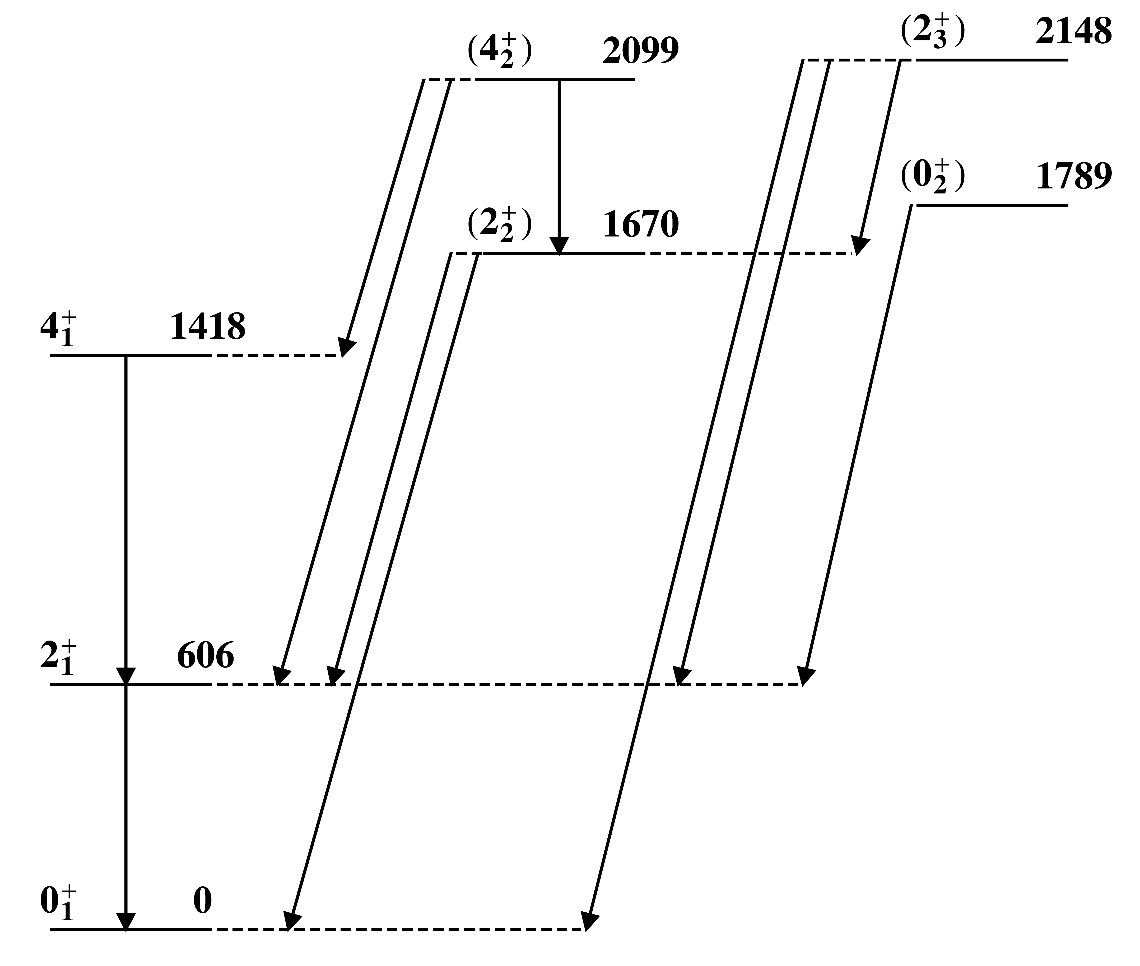
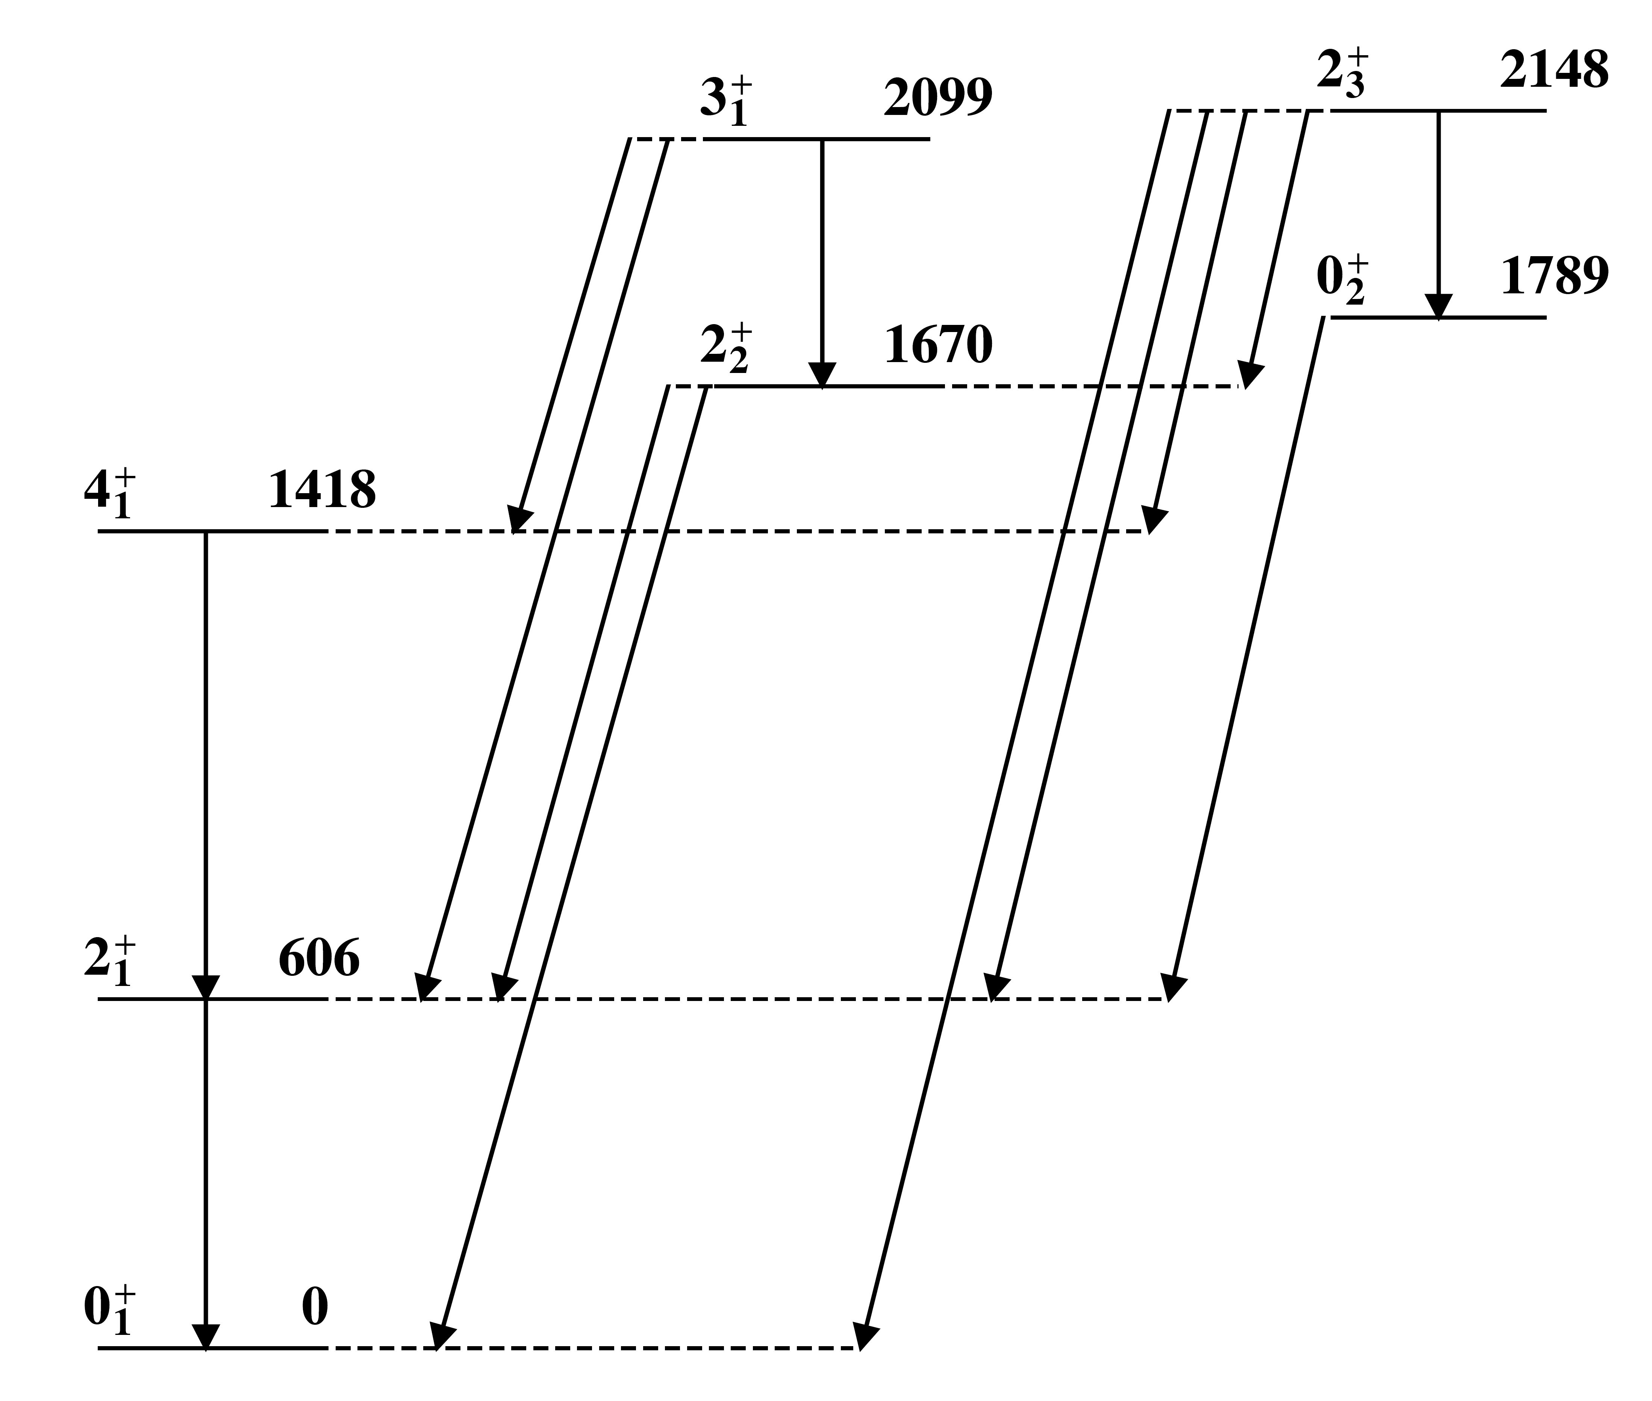
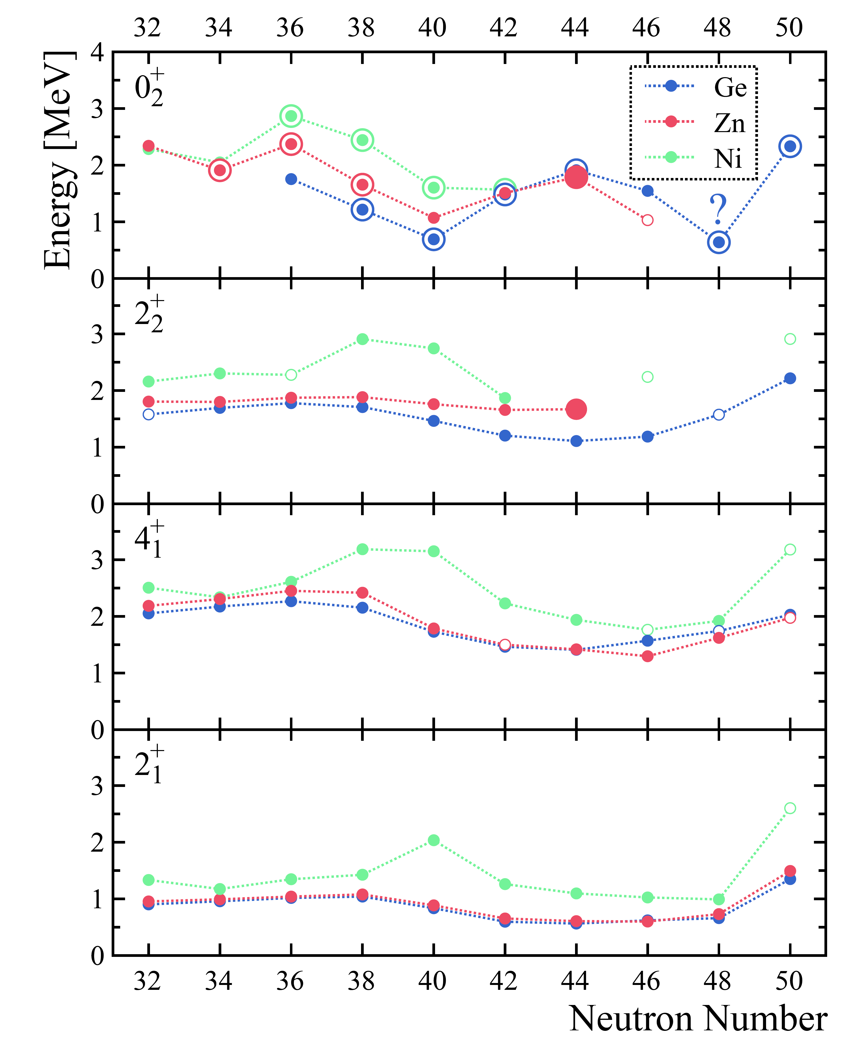
⁷⁴Zn and extension of the N=40 island of inversion
Systematics of 0₂⁺ states resemble parabolic trends often observed
New γ rays observed
Angular correlations enabled firm (and corrected) spin assignments
  M. Rocchini et al., PRL 130, 122502 (2023)

Slide 13
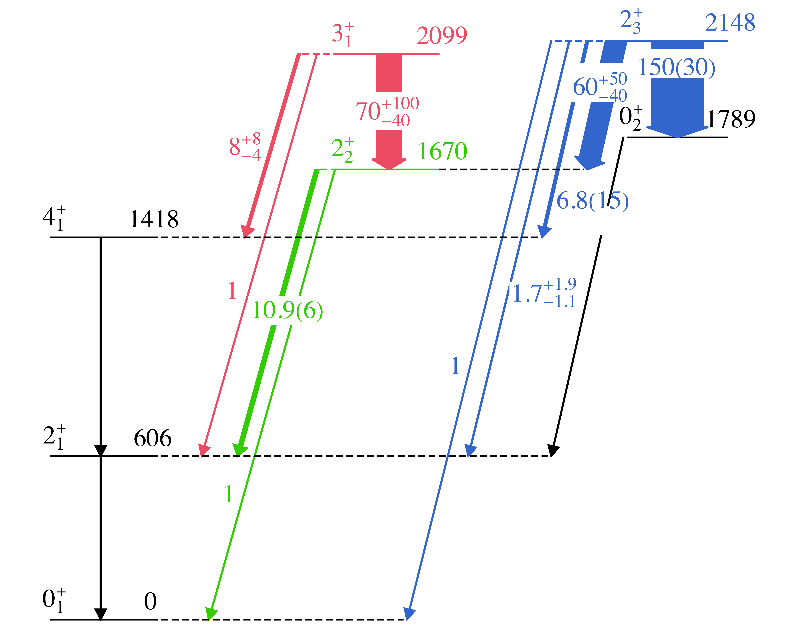
LSSM calculations for ⁷⁴Zn
By Silvia Lenzi, Frédéric Nowacki, Duc D. Dao
LNPS interaction, pf shell for protons, 1p_{3/2} 0f_{5/2} 1p_{1/2} 0g_{9/2} 1d_{5/2} orbitals for neutrons
DNO-SM: Constrained Hartree-Fock shell-model calculations
  D.D. Dao and F. Nowacki, PRC 105, 054314 (2022)
Excellent agreement both for the spectra and the relative B(E2) values
Relative B(E2)
  M. Rocchini et al., PRL 130, 122502 (2023)

Slide 14
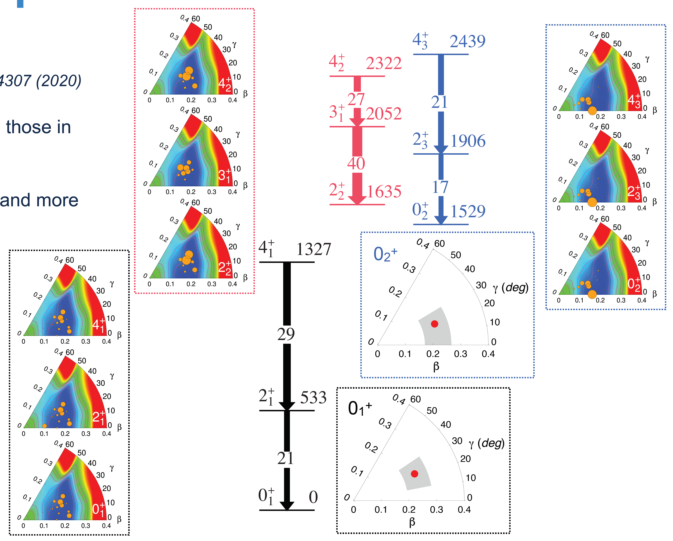
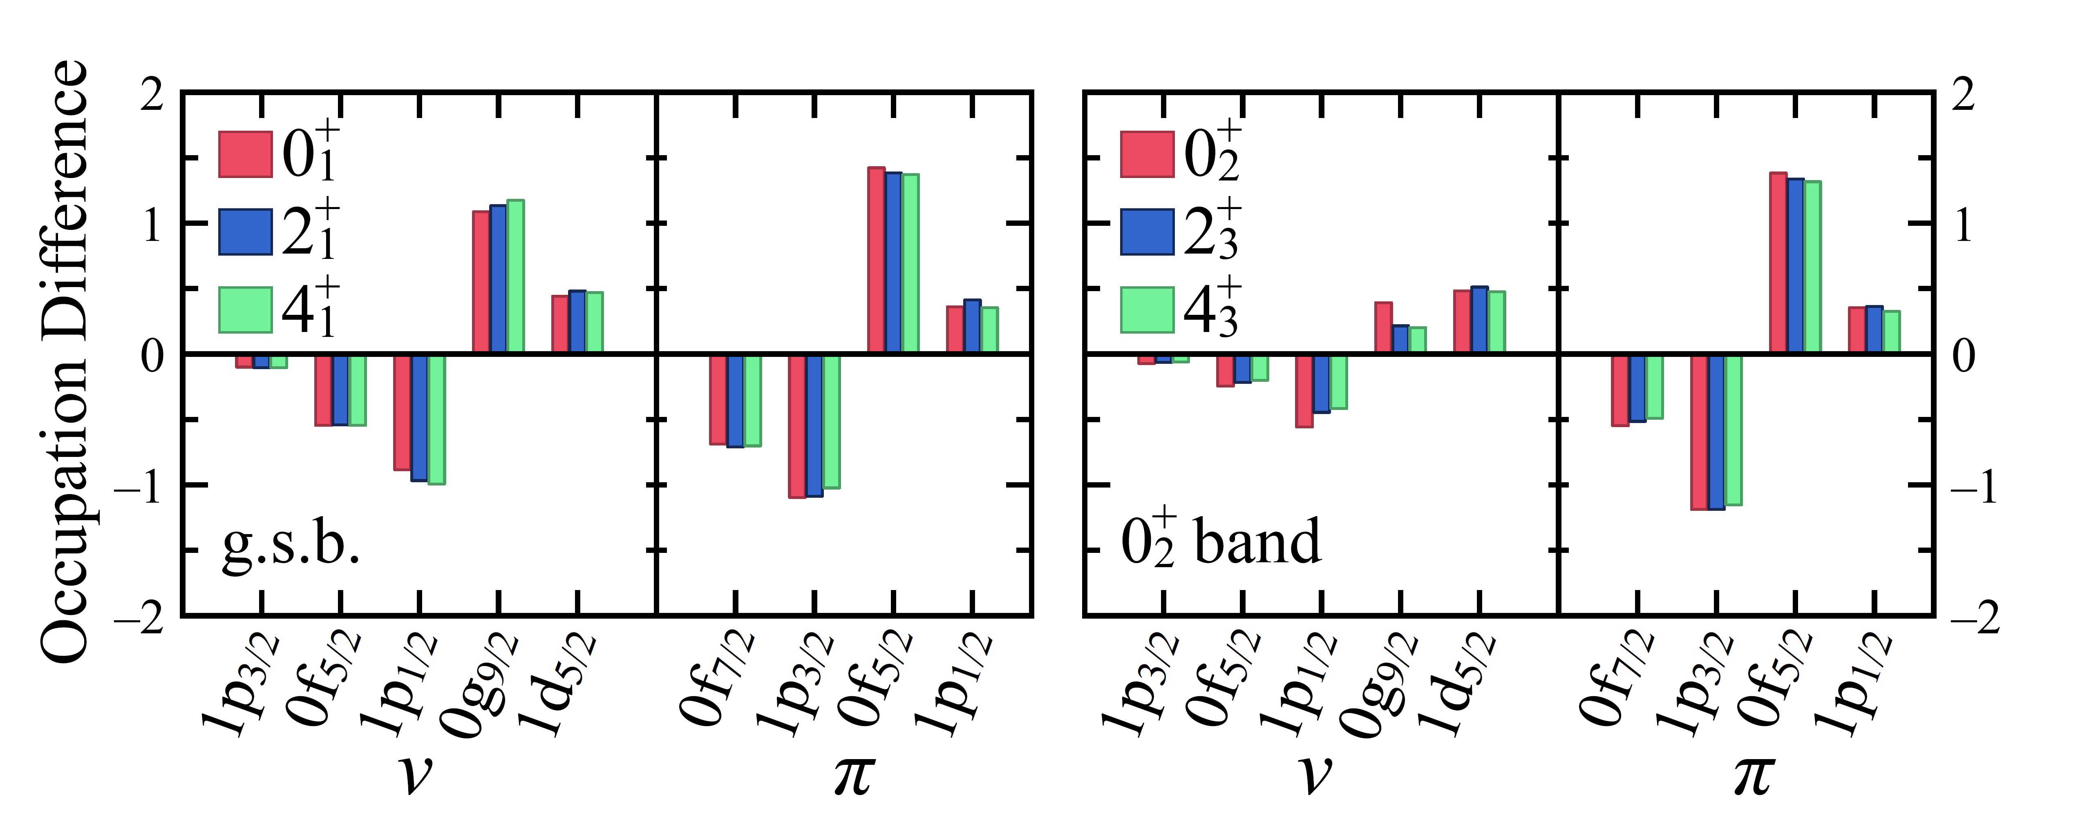
Calculated shapes from LSSM for ⁷⁴Zn
Triaxial ground state
0₂⁺ state slightly less deformed and more prolate than 0₁⁺ state
Ground state has high p-h content for – an inverted configuration – compared to excited state
  M. Rocchini et al., PRL 130, 122502 (2023)

Slide 15
Recent results on ¹⁸⁶Pb – elucidating triple shape coexistence
A spectroscopic tour de force, using γγ and γe⁻ spectroscopy with recoil decay tagging at Jyvaskyla, observed the weak, in-band 2₁⁺→ 0₂⁺ transition establishing the 0₂⁺ state as the head of the prolate band with B(E2; 2₁⁺→ 0₂⁺ ) = 190(80) W.u.
Results indicated small mixing of 0₂⁺ and 0₃⁺ states
Ojala et al, Nature Communications 5, 213 (2022)

Slide 16
β decay of ¹⁸⁸Tl with covers a wide spin range in the daughter – ideal for detailed study of ¹⁸⁸Hg
Main goals:
  Determine spins-parities of levels populated
  Seek/confirm “γ” band
  Since ^{186,188}Pb have multiple shapes based on excited 0⁺ states, do similar structures also exist in ¹⁸⁸Hg?
Beam of ~10⁶ ions/s in both isomer and ground state delivered to GRIFFIN spectrometer
¹⁸⁸Hg electron spectrum

Slide 17
Level scheme constructed using γγ and γe⁻ coincidences
Example – spectra from coincidence condition on 327 keV 4⁺→2⁺ transition in prolate band
γ-ray spectrum
e⁻ spectrum

Slide 18
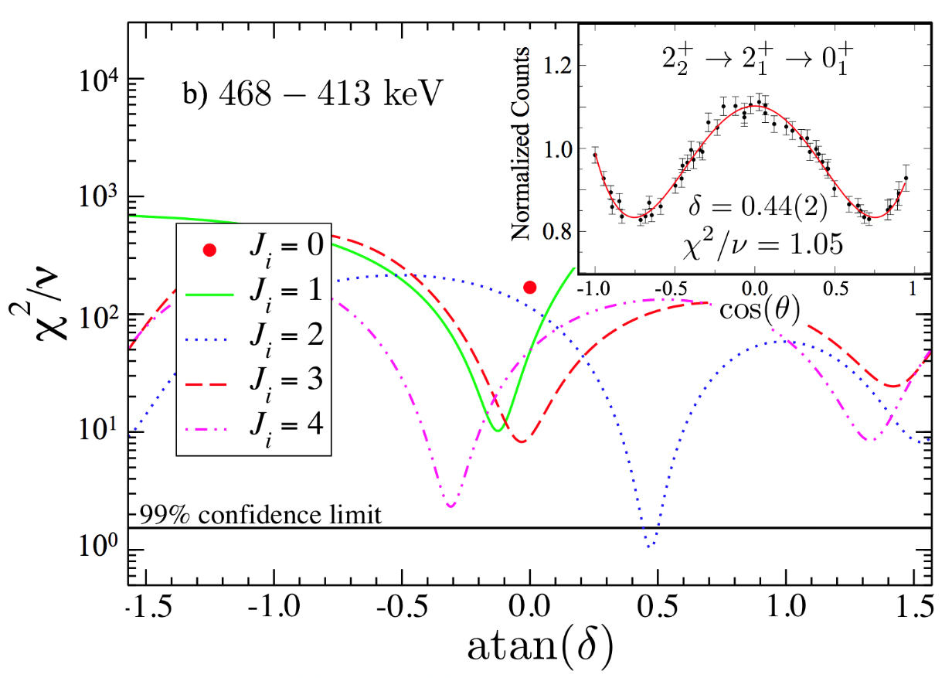
Extraction of conversion coefficients
Any α_{K} larger than the α_{K}(M1) value immediately indicates an E0 component
Consider the 468-keV transition – α_{K} would imply a pure M1 transition, but γγ angular correlation determines E2/M1 mixing ratio δ=0.44(2)
Angular correlations are vital to be able to reliably extract J → J E0 components

Slide 19
Organization of the ¹⁸⁸Hg level scheme
Using the extracted branching ratios, E2/M1 mixing ratios, absolute or relative B(E2) values determined
  Transitions labelled in absolute B(E2) in Wu (blue), or relative B(E2) (black italic), showing clear preference for in-band decays
New suggested 0₃⁺ band
New suggested “K=4” band
Known “prolate” band
Known “oblate” band
Confirmed “γ” band
>1.9
>0.7

Slide 20
Comparison to model calculations: E2 transitions
Transitions labelled in absolute B(E2) in Wu (blue), or relative B(E2) black italic),
>1.9
Experimental B(E2)
>0.7
“K=2”
“K=4”
“K=6”
Calculations by S. Peru
Mean field derived from HFB calculation using Gogny D1M interaction
GCM applied to yield 5-dimensional collective Hamiltonian – no restrictions to axial symmetry
States from calculations grouped into bands according to their spectroscopic properties
β=0.20γ=27°
Calculated B(E2)
β=0.20γ=35°
β=0.24γ=21°

Slide 21





Collaborators
¹⁸⁸Hg: A.D. MacLean (Ph.D thesis work), S. Péru, C.E. Svensson, M. Zielińska, I. Deloncle, F.A. Ali, C. Andreoiu, G.C. Ball, N. Bernier, H. Bidaman, V. Bildstein, M. Bowry, R. Caballero-Folch, A. Diaz Varela, I. Dillmann, A.B. Garnsworthy, G. Hackman, B. Jigmeddorj, A.I. Kilic, A.T. Laffoley, B. Olaizola, H.P. Patel, A.J. Radich, Y. Saito, J. Smallcombe, J. Turko, K. Whitmore, and T. Zidar
⁷⁴Zn: M. Rocchini, M. Zielińska, S.M. Lenzi, D.D. Dao, F. Nowacki, V. Bildstein, A.D. MacLean, B. Olaizola, Z. Ahmed, C. Andreoiu, A. Babu, G.C. Ball, S.S. Bhattacharjee, H. Bidaman, C. Cheng, R. Coleman, I. Dillmann, A.B. Garnsworthy, S. Gillespie, C. Griffin, G.F. Grinyer, G. Hackman, M. Hanley, A. Illana, S. Jones, A.T. Laffoley, K.G. Leach, R.S. Lubna, J. McAfee, C. Natzke, S. Pannu, C. Paxman, C. Porzio, A.J. Radich, M. Rajabali, F. Sarazin, K. Schwarz, S. Shadrick, S. Sharma, J. Suh, C.E. Svensson, D. Yates, and T. Zidar

Slide 23
Shape coexistence well established in Hg isotopes
Difference in mean-squared charge radii for Hg show odd-even staggering – large changes in ground state deformation observed
Energy systematics of deformed intruder states display “typical” parabolic dependence on valence neutron number
Information on excited 0⁺ states drops dramatically outside region that can be probed with two-nucleon-transfer reactions
  population cross section in many reactions, especially HI fusion evaporation, often extremely small
  Is there another configuration as in the Pb isotopes and triple shape coexistence?
Garrett, Zielińska, & Clement, PPNP 124, 103931 (2022)

Slide 24
Some recent results on studies of shapes of ¹⁸⁸Hg
Results of Coulomb excitation of ¹⁸⁸Hg
  Systematic studies of ¹⁸²⁻¹⁸⁸Hg at ISOLDE [Bree et al., PRL 112, 162701 (2014), Wrzosek-Lipska et al., EPJ A55, 130 (2019)]
  Results consistent with coexisting shapes – weakly deformed oblate ground state and strongly deformed prolate excited band
Lifetime measurements for states above 12₁⁺ isomer yielded small B(E2) values – first clear indication of nearly spherical states in ¹⁸⁸Hg [Siciliano et al., PRC 102, 014318 (2020)]

Slide 25
γ-ray spectroscopy – a very versatile tool
Weak interaction tests e.g. studies of Fermi superallowed β-decay
  ⁶²Ga decay – beam rate of 6 – 12k/s, placement of γ-rays to 1 ppm level permits very sensitive tests related CKM matrix unitarity
    A.D. MacLean et al., PRC 102, 054325 (2020)
Nuclear structure investigations e.g. ⁷⁴Zn and N=40 “island of inversion”
  M. Rocchini et al., PRL 130, 122502 (2023)

Slide 26
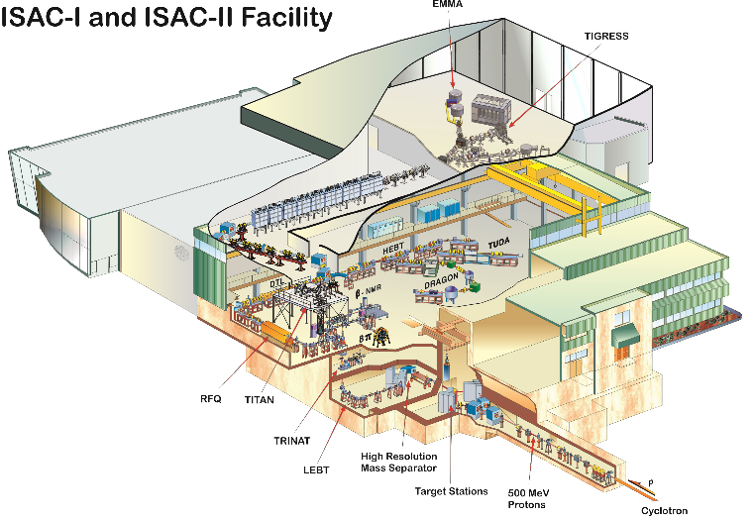
Canada’s Isotope Separator and Accelerator (ISAC)
Programs in
Nuclear Structure & Reactions
Nuclear Astrophysics
Fundamental Symmetries
Material Science
Nuclear Medicine
Select accelerated RIBs:
⁹⁵Sr¹⁵⁺ 10⁷ pps
¹¹Li⁺ 3x10³ pps
¹¹Be⁺ 10⁵ pps
ISAC II:
> 6 AMeV for A<150
~3500 RIB hours / yr
600 users, 2/3 international
Factor 2-2.5 oversubscribed
~ 2 year managed backlog
Complementary capabilities to in-flight facilities like FRIB, RIBF
ISAC I:
60 keV & 1.7 AMeV
Selected beams (measured yields):
²⁶Al > 10¹⁰ pps
^{37,38m}K > 10⁹ pps
²¹¹⁻²¹³Fr > 10⁹ pps
²¹¹Rn > 10⁸ pps
²²⁵Ra > 10⁸ pps
¹⁰³Rb ~ 3 pps
ISOL facility with highest primary beam intensity (100 μA, 480 MeV protons)

Slide 27
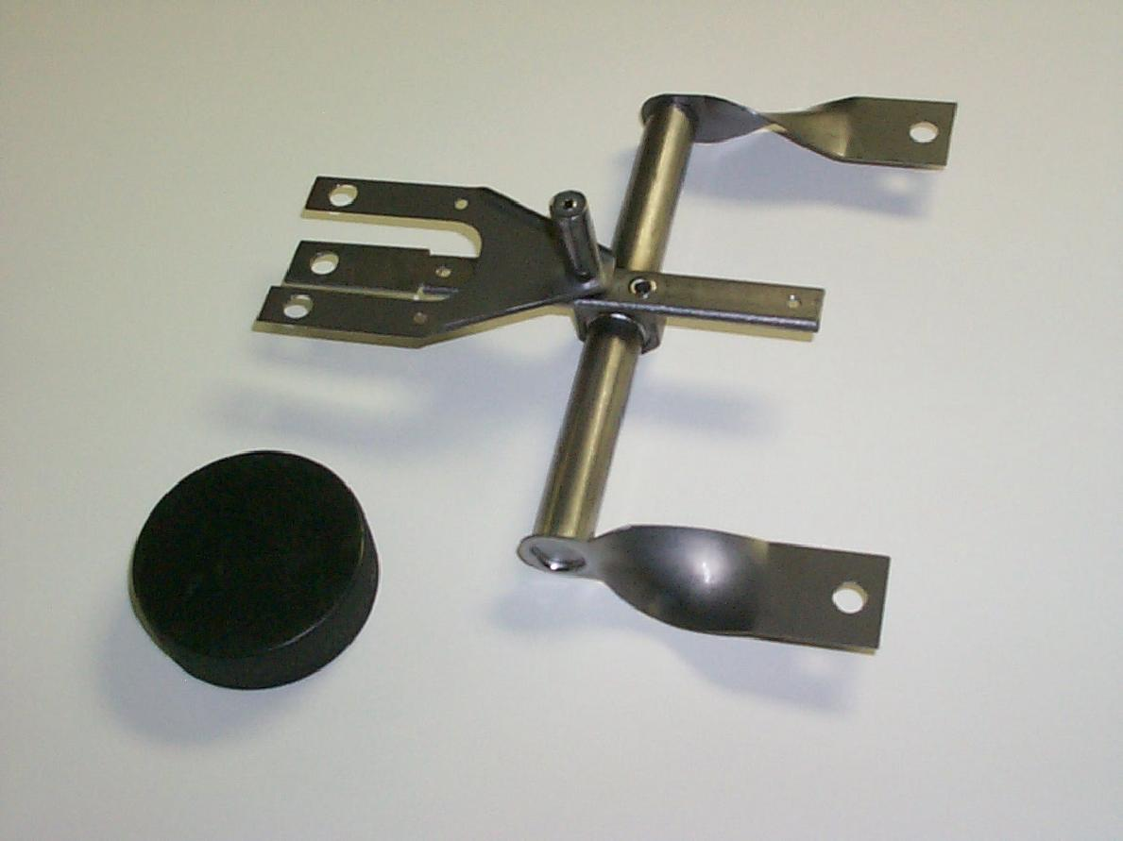
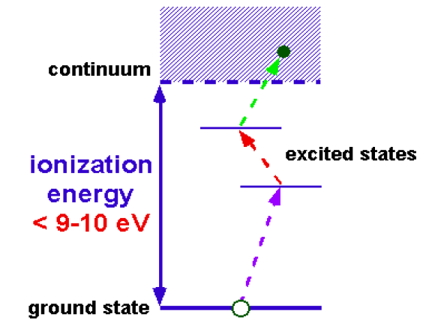

Isotope Separation Online (ISOL) at ISAC
Element selection via laser ionization
20-60 keV
ions
High Demand:
Over 2000 hours of TRILIS operation per year
Proton induced spallation and fission
480 MeV
proton beam
Experimental ion yields

Slide 28
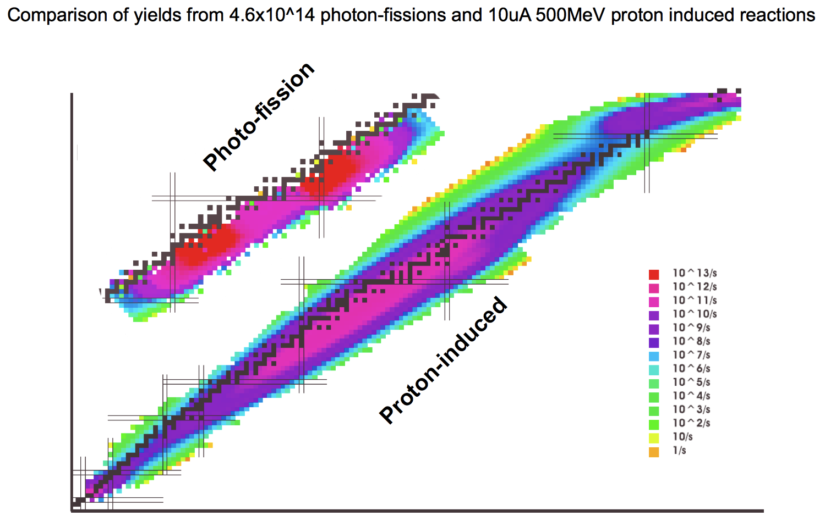
What will ARIEL do for us?
Excellent yields near the fission peaks
Multi-user capability that enables experiments of longer duration
Both points are important to our future programme
N=82
N=50
Z=50
Z=28

Slide 29
Comparison of moments of inertia
MOI of bands in ¹⁸⁸Hg similar to analogous bands in Pb isotopes
Staggering of the “γ” band displays a pattern consistent with a triaxial shape
“γ”-band staggering
“Prolate” bands
“Oblate” bands
0⁺ state appears to be highly perturbed – what is the origin of this?

Slide 30
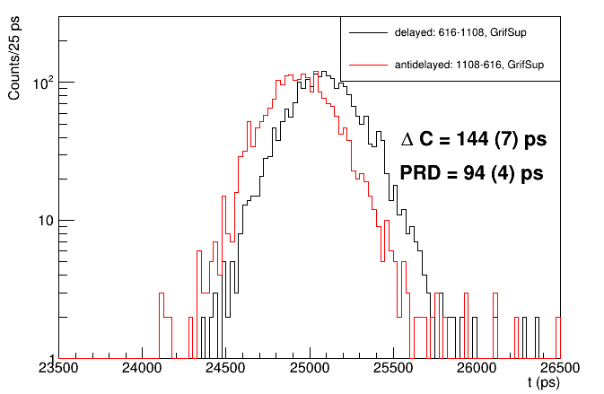
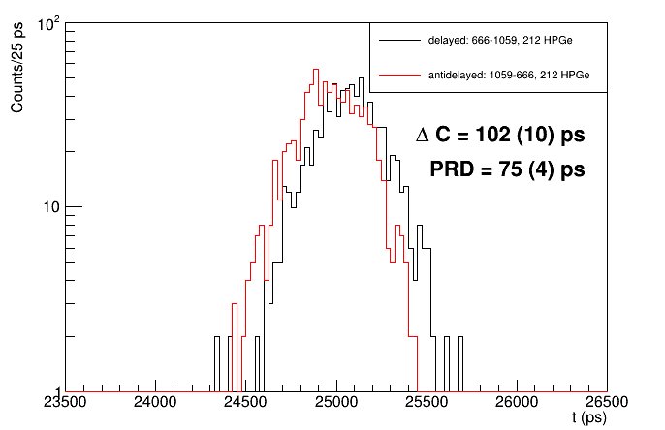
New results: lifetime of 0₃⁺ and 2₂⁺ levels
B(E2;0₂⁺ → 2₁⁺) = 70(8) W.u., B(E2;2₂⁺ → 0₂⁺) = 8(3) W.u.
  0₂⁺ band appears to be weakly collective
B(E2;0₃⁺ → 2₁⁺) = 14(4) W.u
1938
(2⁺)
1938
(2⁺)
LaBr₃ gate
1060-keV
LaBr₃ gate
1108-keV
878
2₂⁺
829
0₃⁺
LaBr₃ gate
666-keV
LaBr₃ gate
616-keV
212
2₁⁺
212
2₁⁺
HPGe gate
212-keV
τ = 23(6) ps
τ = 16(3) ps
Lifetime analysis: H. Bidaman (Guelph)

