Slide 1
NEW PHYSICS SEARCHES FROM BELOW
Cédric DELAUNAY
Laboratoire d’Annecy de Physique Théorique
CPPM Seminar | April 15, 2024

Slide 2
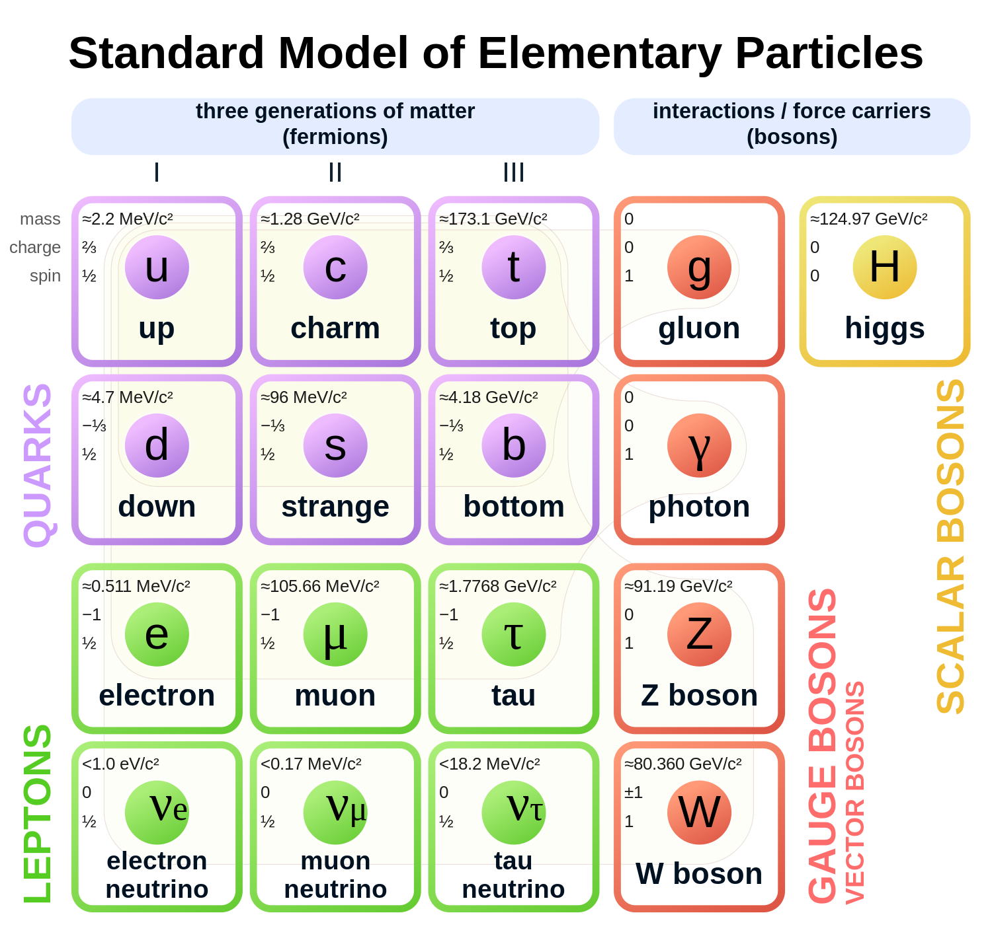
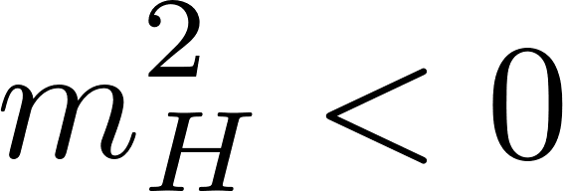
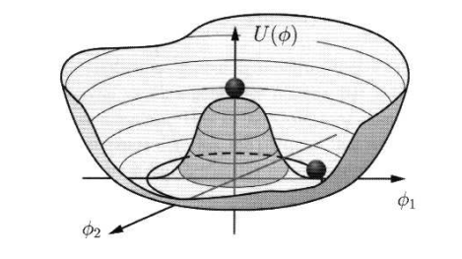
The Standard Model
QCD+EW interactions
ruled by gauge invariance
Higgs interactions
The Higgs field fills up the vacuum, making the W/Z bosons and the charged fermions massive

Slide 3
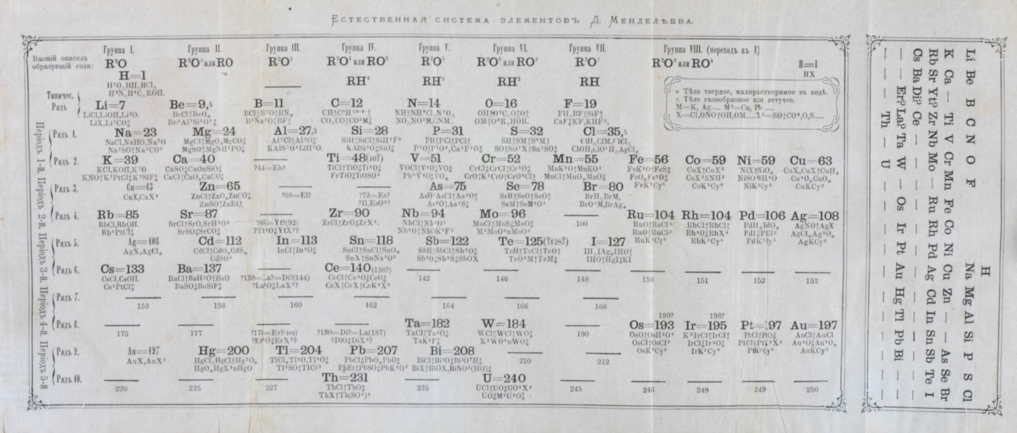
Is This the End?
History analog:
XIXth century « elementary » particles
Mendeleev’s table
ca. 1870
Only 2 fundamental forces: Gravitation (Newton’s law)
& Electromagnetism (Maxwell’s theory)

Slide 4
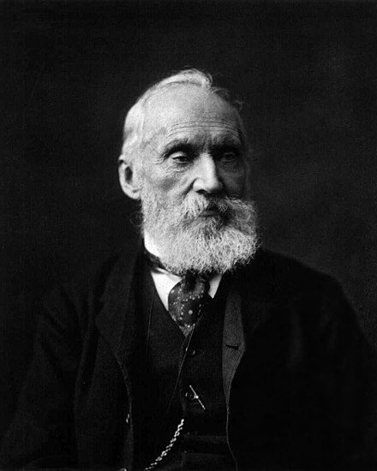
Is This the End?
History analog:
At the closing XIXth century,
William Thompson is often quoted having said that:
“There is nothing new to be discovered in physics now. All that remains is more and more precise measurements.”
Yet, universality of the speed of light → relativity,
stability of atoms (+UV catastrophe) → quantum mechanics
William Thompson
aka. Lord Kelvin
More than 100 years later (at smaller distances)
we are facing a similar situation

Slide 5
An Incomplete Masterpiece
A Standard Model
Neutrino oscillations
→ Lepton number-violating interactions needed
Matter/antimatter asymmetry
→ new CP-violating interactions needed
Dark matter
→ new type of matter needed

Slide 6
An Incomplete Masterpiece
A Standard Model
New Physics, i.e. physics that is not described by
the Standard Model, has already been (indirectly) discovered
The SM is an approximation of a more fundamental theory
However, the NP energy scale is unknown. Nevertheless, the SM provides some guidance

Slide 7
The hierarchy problem
Quantum fluctuations bury away the weak force down to much shorter distances
from new particle of mass
beyond the SM,
fluctuating in the vacuum
If
we have a (naturalness) problem,
unless there is mechanism that protects the Higgs mass

Slide 8
The strong CP problem
In principle, QCD violate CP symmetry through
This term is topological and predicts an electric dipole moment for the neutron that is not observed experimentally
In practice, QCD is found to respect
CP to a very-high degree, why?

Slide 9
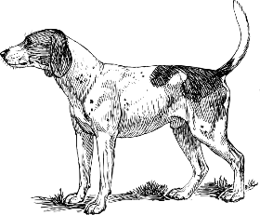
The flavor puzzle
Charged fermion masses arise from a single source (the Higgs field)
Yet, they differ by many orders of magnitude, why?

Slide 10
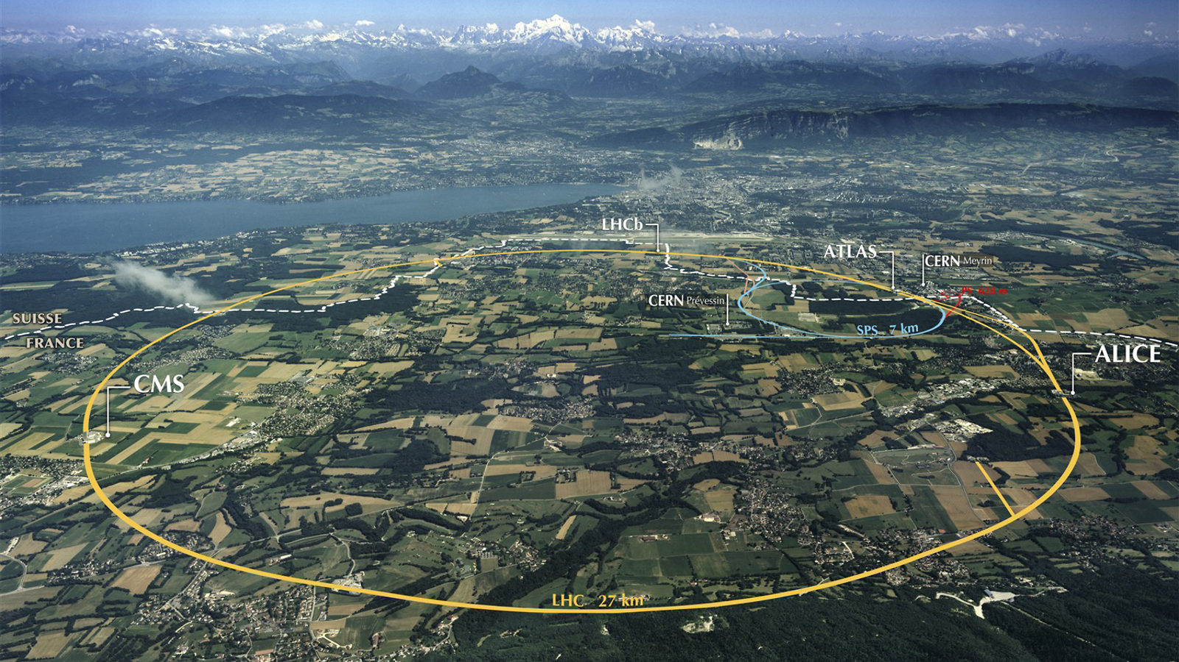
Challenging the Standard Model
The Standard Model was tested experimentally
up to TeV energies ∼
at the Large Hadron Collider
(and indirectly at LEP and flavor factories)
∼TeV
Standard
Model

Slide 11
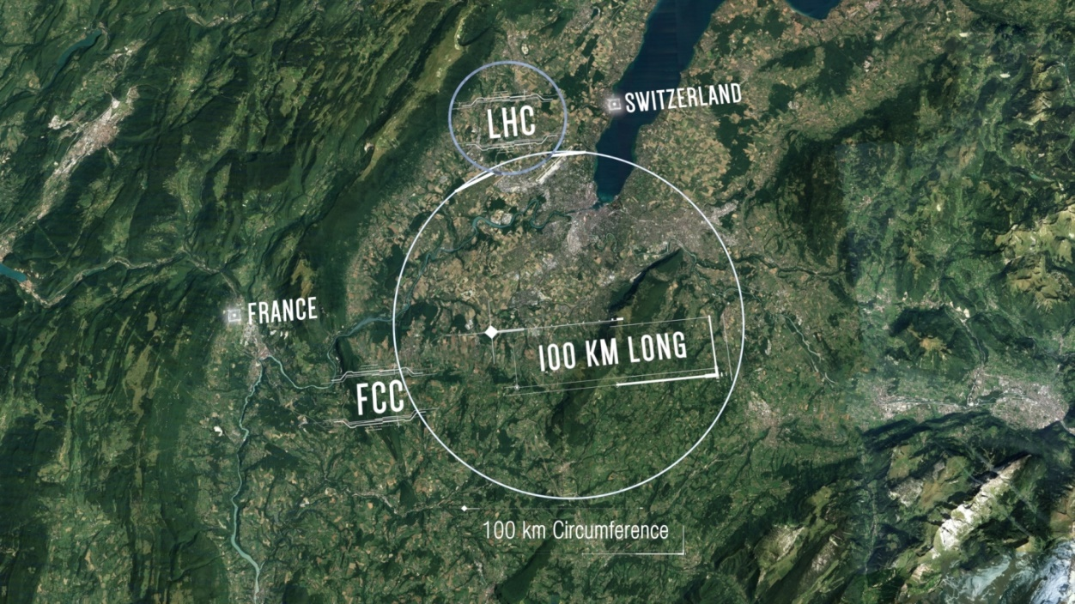
Challenging the Standard Model
Next generation of high-energy colliders plan to extend the reach by a factor ∼10
10TeV
∼TeV
Standard
Model

Slide 12
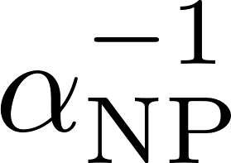
Challenging the Standard Model
Colliders probe heavy BSM particles
with large coupling to known particles
Much lighter BSM particles could have escaped
detection if very weakly coupled
∼TeV
Exploring this region requires
precision measurements
at low energies
Standard
Model
∼1/(0.1-0.01)

Slide 13
Light New Physics
Sub-GeV physics beyond the SM is well-motivated theoretically :
moduli fields in String theory compactifications
approximate new global symmetries, e.g. QCD axion, ALPs, dilaton
light (mediators for) non-thermal DM, e.g. DM produced by freeze-in
cosmological solutions to the Higgs hierarchy problem, e.g. relaxion

Slide 14
The Precision Frontier

Slide 15
Atomic Spectrometry
Accuracy of spectroscopic measurements is very (very!) high:
18 digits in optical clock frequency comparison, e.g. ytterbium vs. strontium
BACON coll. (Nature 591, 2021)
Can it be used to probe BSM physics?

Slide 16
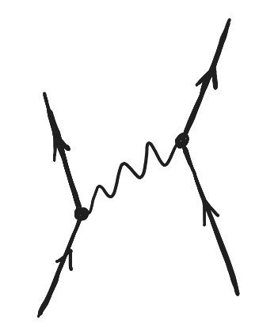
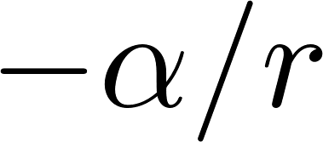
Atomic Spectrometry
Accuracy of spectroscopic measurements is very (very!) high:
18 digits in optical clock frequency comparison, e.g. ytterbium vs. strontium
BACON coll. (Nature 591, 2021)
New bosons coupled to electrons and/or nuclei in a parity-preserving way will induce an exotic atomic force

Slide 17
Extracting New Physics
Nuclear finite size is a major obstacle for
MBPT theory
uncertainty
finite nuclear size
The range of the NP interaction must extend beyond the nucleus.
(NP interactions that breaks P or CP are well-known exceptions. Those are better probed in APV and EDM experiments)
Many-body effects need to be controlled for multi-electron atoms.

Slide 18
One Possible Strategy
Focus on few-body systems where precision QED calculation is possible, e.g. Hydrogen, μH, Helium or positronium (e⁺e⁻), muonium (μ⁺e⁻)
Hydrogen and muonic hydrogen spectral lines are the best measured and so they have a higher sensitivity to NP.
However, these lines are used by the CODATA collaboration to determine the values of fundamental constants (= parameters not predicted by the SM), assuming the SM (mostly QED) theory holds!

Slide 19
Another Possible Strategy
Construct observables less sensitive to theory uncertainties. e.g. Isotope shifts
Frenquencies are governed by EM interactions, which are universal for all nuclei of same Z
Thus EM contributions largely cancel out in isotope shifts:
NP (conserving P&CP) couples to the entire nucleus A and is only mildy suppressed in the frequency difference:
→ No need to calculate the first 6 digits!

Slide 20
Phys.Rev.Lett. 130 (2023) 25, 121801
CD (LAPTh),
J.-P. Karr (LKB),
T. Kitahara (Nagoya),
J. C. J. Koelemeij (V.U. Amsterdam),
Y. Soreq (Technion),
and J. Zupan (U. Cincinnati)
The BSM CODATA

Slide 21
The Hydrogen Frontier
Measurements of atomic lines in hydrogen are very precise:
Parthey et al. (2011)

Slide 22
The Hydrogen Frontier
Measurements of atomic lines in hydrogen are very precise:
Parthey et al. (2011)
QED prediction is even better:
TH uncertainty

Slide 23
The Hydrogen Frontier
Measurements of atomic lines in hydrogen are very precise:
Parthey et al. (2011)
QED prediction is even better:
TH uncertainty
limited by proton radius
Direct comparison fixes the Rydberg constant:
Tiesinga et al.
[CODATA 2018]
most precisely known
fundamental constant
in physics!

Slide 24
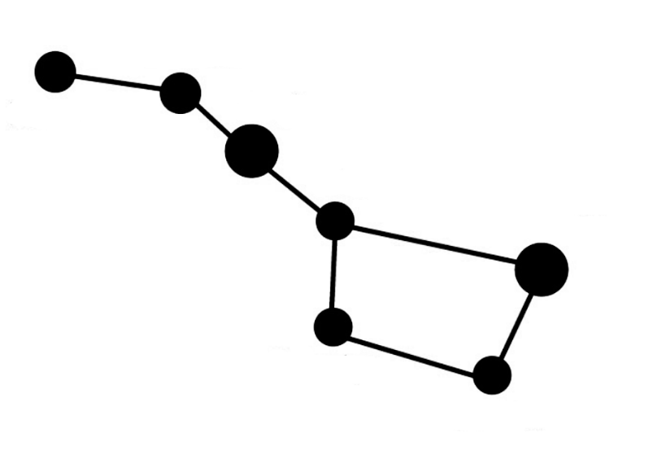
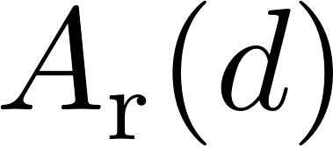
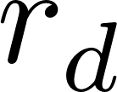
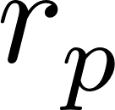
A Constellation of Constants
Rydberg constant
hydrogen (+22 other lines)

Slide 25
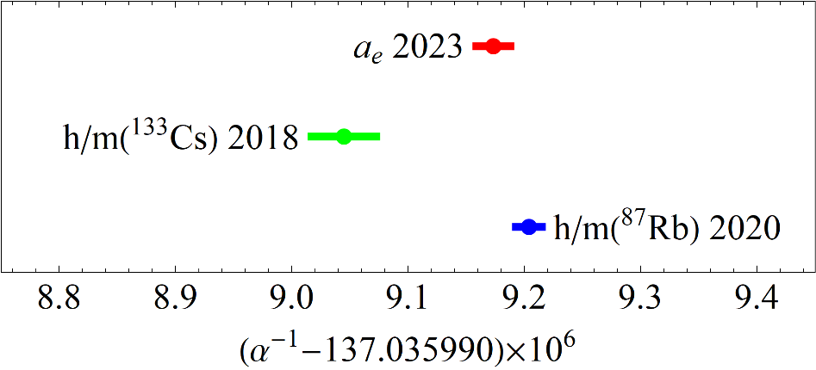
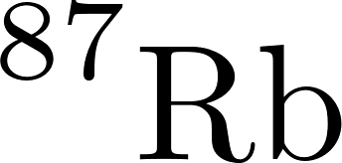
A Constellation of Constants
Rydberg constant
hydrogen (+22 other lines)
fine structure constant
electron
or atomic recoil
Fan et al. [2023]
There are tensions there…
Morel et al. [2020]
Parker et al. [2018]

Slide 26
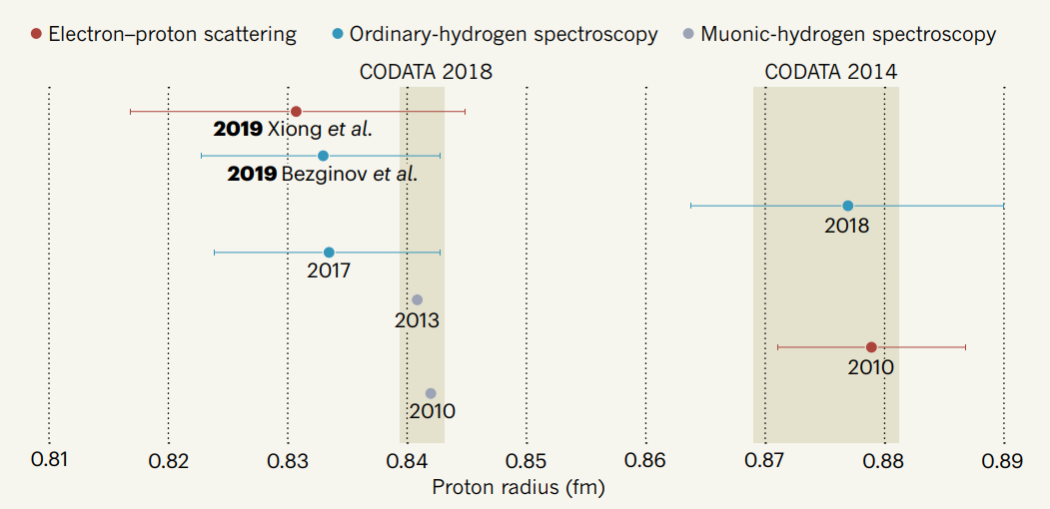
A Constellation of Constants
still a proton size puzzle…
Rydberg constant
H:LS
hydrogen (+22 other lines)
H:1S-3S@LKB
H:2S-4P
fine structure constant
electron
or atomic recoil
Fan et al. [2023]
proton|deuteron (charge) radius
Morel et al. [2020]
Parker et al. [2018]
muonic hydrogen|deuterium Lamb shifts
or ordinary hydrogen|deuterium lines
or e-proton|e-deuteron scattering data

Slide 27
A Constellation of Constants
Rydberg constant
hydrogen (+22 other lines)
atomic mass
constants
fine structure constant
cyclotron motion
or HD+ molecular lines
Patra et al. [2020]
electron
or atomic recoil
Fan et al. [2023]
proton|deuteron (charge) radius
Morel et al. [2020]
Parker et al. [2018]
muonic hydrogen|deuterium Lamb shifts
or ordinary hydrogen|deuterium lines
or e-proton|e-deuteron scattering data

Slide 28
A Constellation of Constants
Rydberg constant
hydrogen (+22 other lines)
atomic mass
constants
fine structure constant
cyclotron motion
or HD+ molecular lines
Patra et al. [2020]
electron
or atomic recoil
Fan et al. [2023]
proton|deuteron (charge) radius
Morel et al. [2020]
Parker et al. [2018]
muonic hydrogen|deuterium Lamb shifts
or ordinary hydrogen|deuterium lines
or e-proton|e-deuteron scattering data
to be determined together in a global fit
→ CODATA recommended values
https://pml.nist.gov/cuu/Constants/

Slide 29
CODATA 2018 values
This accuracy relies on assuming the SM. Is this robust to BSM?

Slide 30
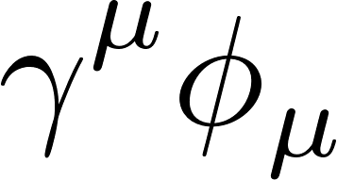
BSM CODATA
New particles below will affect the observables used to determine the fundamental constants:
scalar
vector

Slide 31
BSM CODATA
New particles below will affect the observables used to determine the fundamental constants:
spin
scalar
vector
Yukawa potentials
contributing to spectral lines
hydrogen
deuterium
μH/μD
HD⁺

Slide 32
BSM CODATA
New particles below will affect the observables used to determine the fundamental constants:
spin
scalar
vector
Yukawa potentials
contributing to spectral lines
One-loop correction to
hydrogen
deuterium
μH/μD
HD⁺

Slide 33
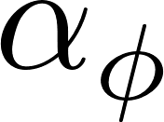
BSM CODATA
New particles below will affect the observables used to determine the fundamental constants:
spin
scalar
vector
Yukawa potentials
contributing to spectral lines
One-loop correction to
Theoretical prediction for an observable :
evaluated @LO in
TH uncert.

Slide 34
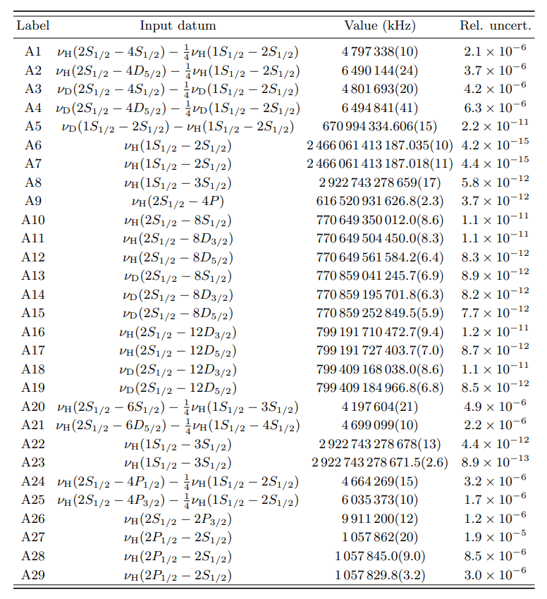
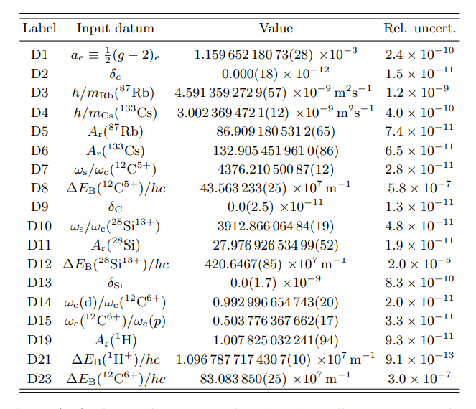
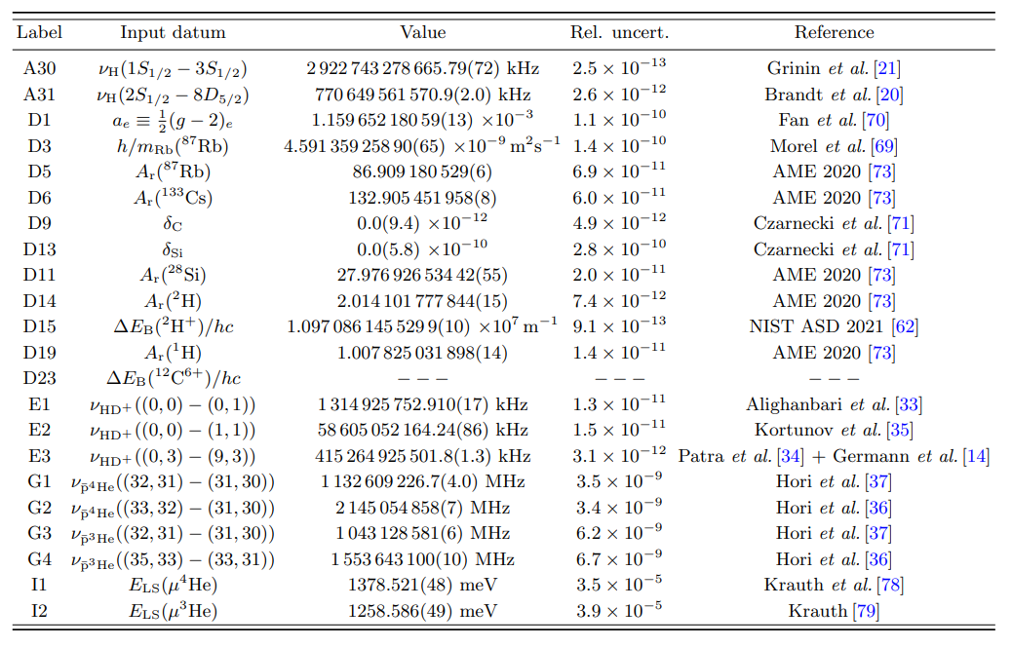
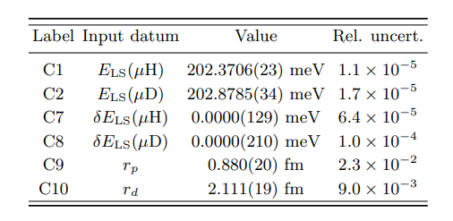
Datasets
CODATA18
← used for validation
DATA22
including post-CODATA18 improvements from
Hydrogen/Deuterium
g_{e}-2,masses…
Hydrogen, HD+, pbar-He
μHe lines, g_{e}-2 and atomic masses
μH/μD

Slide 35
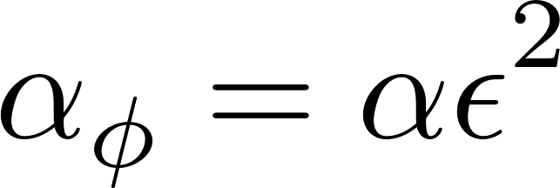
New Physics Models
U(1)_{B-L}
Dark photon
← highlights deuterium
Higgs portal
← from nucleon form-factors
← larger effects in muonic atoms and molecules
Up-Lepto-Darko-philic
(ULD) scalar
Hadrophilic scalar
← highlights molecules
← couples only to up-quark
+ dominant decay to invisible states (see later)

Slide 36
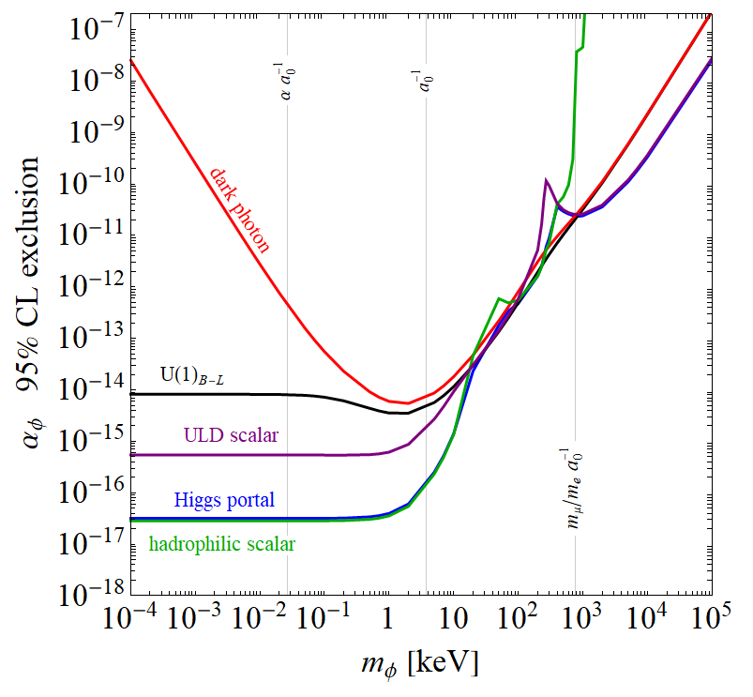
New Physics Bounds

Slide 37
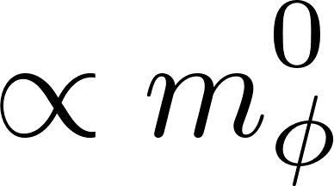
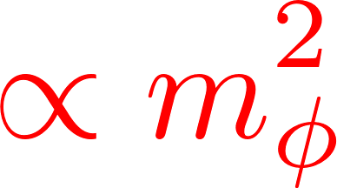
New Physics Bounds
thanks to
Deuterium data
stronger sensitivity
from muonic atoms
in models where
stronger sensitivity
from internuclear forces
in molecules in models
where

Slide 38
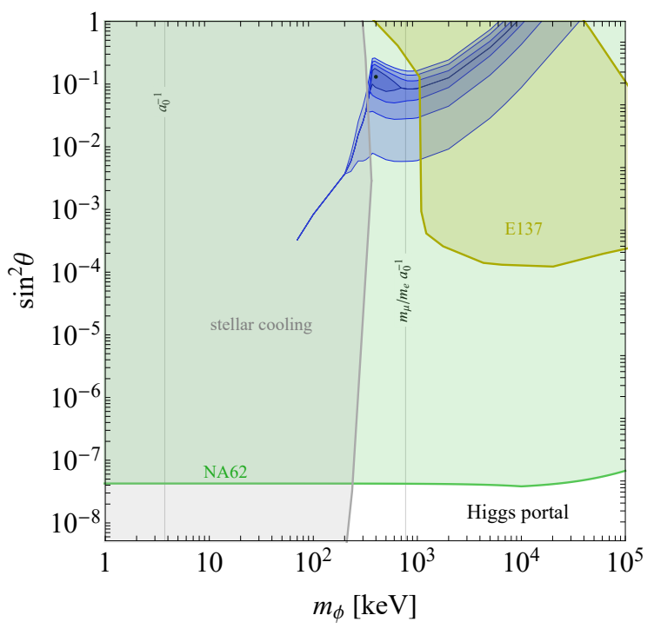
Non-zero Higgs Portal?
Best-fit point
is largely excluded by searches

Slide 39
Non-zero Higgs Portal?
Best-fit point
is largely excluded by searches
The NA62 bound is driven by
coupling to heavy quarks
through one-loop penguins
The E137 beam-dump bound relies on scalars dominantly decaying to

Slide 40
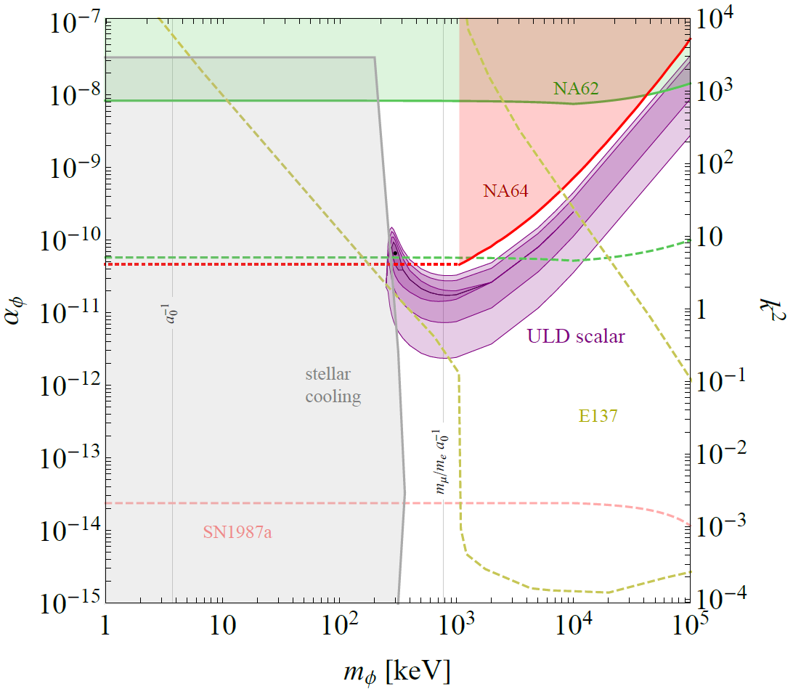
Evidence for ULD scalar
Best-fit point
evades the NA62 bound by coupling only to up quarks
The E137 bound does not apply assuming invisible decay dominantes ( ?)
In that case NA64 is relevant
yielding a weaker bound but
NP sensitivity not clear below MeV
Andreev et al. [2021]

Slide 41
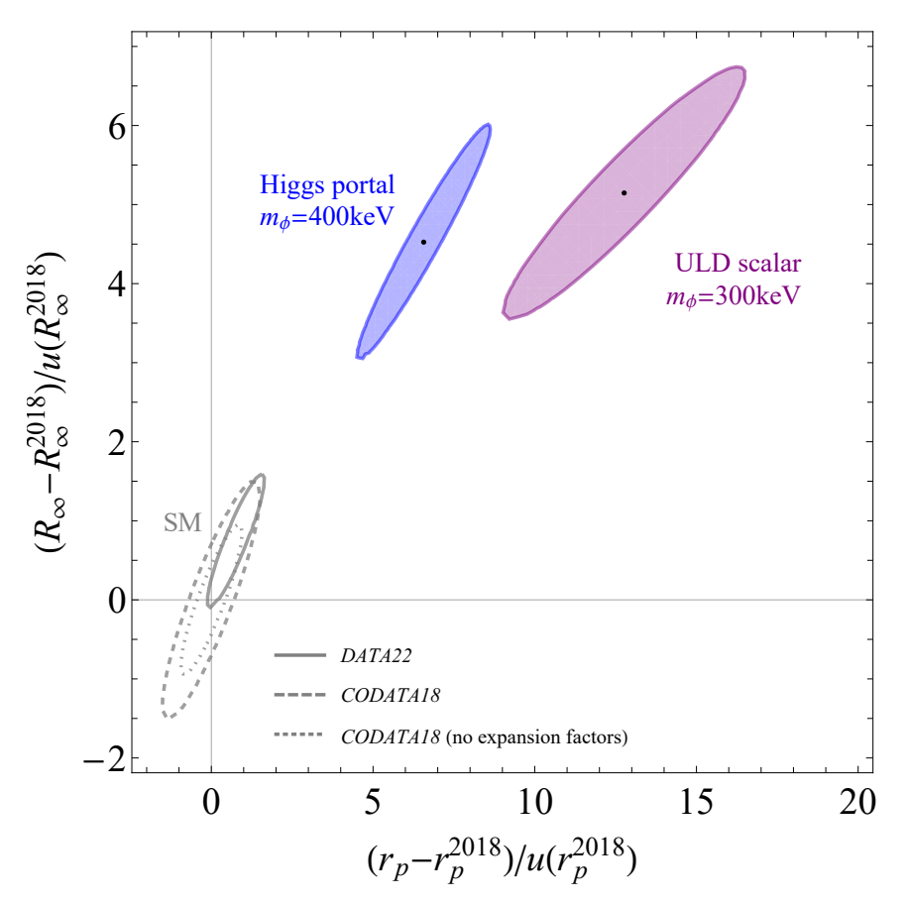
Impact on fundamental constants
Fondamental Contants undergo huge shifts
in the presence of NP

Slide 42
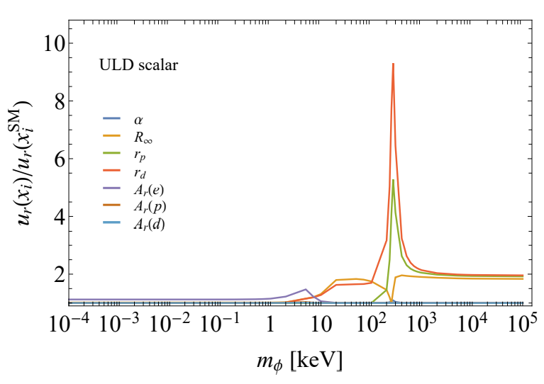
Impact on fundamental constants
Fondamental Contants undergo huge shifts
in the presence of NP
and their uncertainty significantly inflates
relative to the SM-only hypothesis

Slide 43
Phys. Rev. D 96, 093001 (2017) CD, Ozeri, Perez and Soreq
Phys. Rev. Lett. 120, 091801 (2018) Berengut, Budker, CD, et al
Phys.Rev.Res. 2, 043444 (2020) Berengut, CD, Geddes and Soreq
Isotope shifts

Slide 44
Isotope Shift Theory
IS involve nuclear physics and are challenging to calculate.
However so one can do perturbation theory
There are two nuclear effects at leading order:
constants depending on
the electronic configuration
transition index
field shift
mass shift
adding/removing neutrons affects
the nuclear charge distribution,
represented @LO by the charge radius
changing the nuclear mass modifies:
the center-of-mass (normal MS)
and electron-electron repulsion terms (specific MS)

Slide 45
IS Theory (continued)
Nuclear masses are measured at accuracy (from spin precession in Penning traps).
However, charge radii are poorly known and electronic constants can be obtained within ∼1% from atomic structure calculations.
→ are we stuck again?
Not quite, since the nuclear parameters are common to all electronic states and the electronic states are the same for all isotopes (at least at first order in these perturbations).
This simple observation grants us with a trick, noticed by King in the 60’s

Slide 46
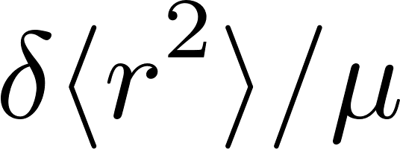
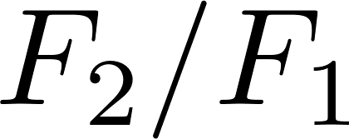
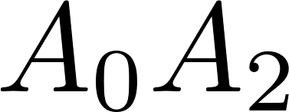
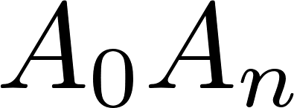
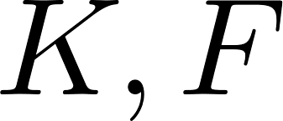
King plot linearity
The trick is to use two distinct transitions, one being used to fix the unknown nuclear parameter
This yields a linear relation among the IS of the two transitions.
Testing King’s linearity does not require calculation of

Slide 47
Nonlinearities beyond the SM
NP brings about another nuclear parameters:
breaking King’s linearity :
The nonlinearity is conveniently quantified by
e.g.

Slide 48
Extracting the NP coupling
Directly solving King’s equation gives:
NL in data
NL predicted
by IS theory
Electronic alignment
→ strong suppression
for
Nuclear alignment
→ suppression of

Slide 49
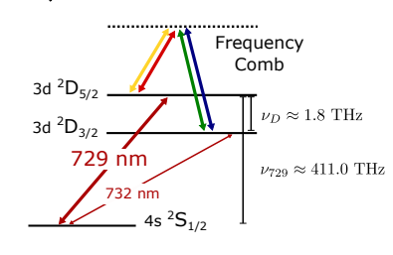
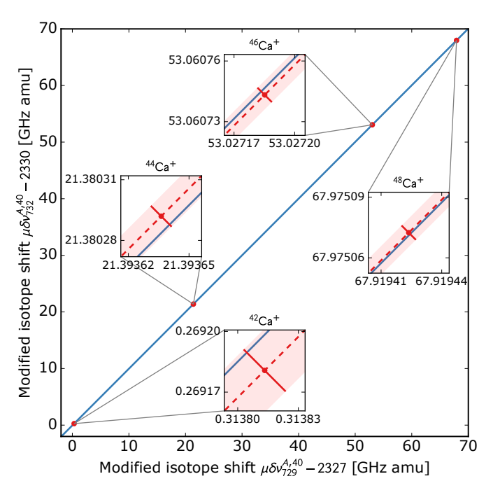
IS linearity in Ca+
Solaro et al. | Phys. Rev. Lett. 115, 123003 (2020)
Using optical clock (S→D) transitions
with ∼20Hz accuracy
Measurements are consistent
with linearity within uncertainties

Slide 50
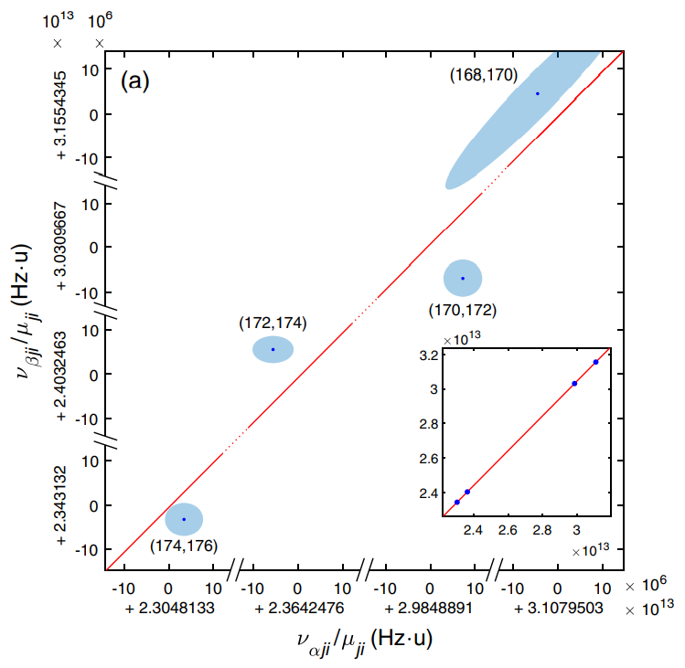
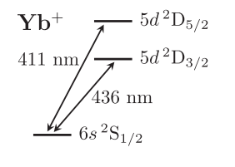
Nonlinearities in Yb+
Counts et al. | Phys. Rev. Lett. 125, 123002 (2020)
Using optical clock (S→D) transitions
with ∼300Hz accuracy
Nonlinearities at 3σ → NP evidence?

Slide 51
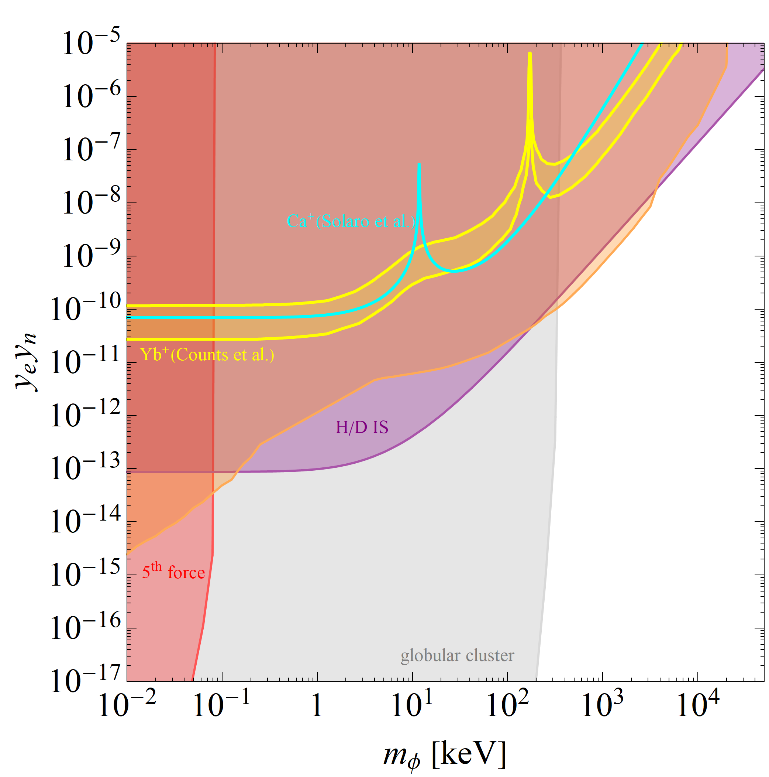
NP nonlinearities are correlated
Ca+ bound excludes NP as the origin of the Yb+ nonlinearities
in most of the mass range
Moreover, the NP coupling needed is excluded by other observables
electron g-2 and nuclear scattering
combined bound
Hydrogen/Deuterium
IS consistent with QED
Subleading nuclear effects are the dominant cause of what is observed in Yb+
CD et al. (2017)
Flambaum et al. (2017)
first-time calculation of NLs

Slide 52
Nonlinearities from nuclear physics
Beyond LO, electrons adapt to the change of nucleus
Only a finite # of terms are relevant for a fixed accuracy.
How many? What A dependence?
There are candidates e.g. higher-moments of the nuclear charge distribution. Unfortunately, no EFT-like expansion is known…

Slide 53
Overcoming nuclear nonlinearities
Nonetheless, NP can still be probed without theory calculation of NLs
Using more transitions (and isotopes) to fix the nuclear parameters sourcing the nonlinearities.
For instance, assuming only one term dominates (like FS²):
Then the mIS of 3 transitions are linearly related
(generalization to any number of independent nuclear parameters is straightforward)

Slide 54
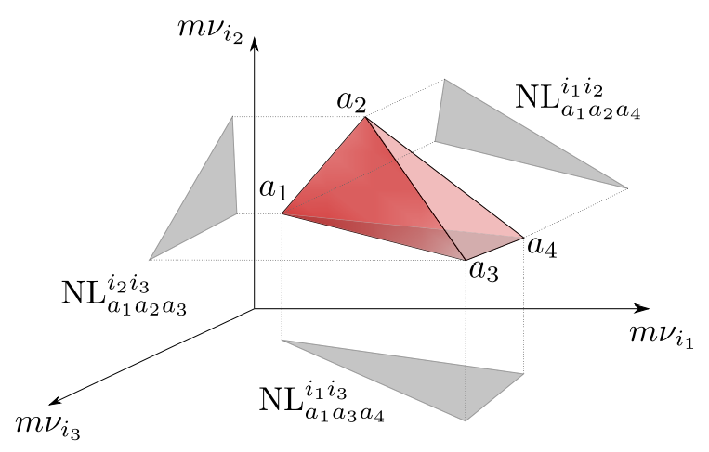
Generalized King Plots
IS data for 4 isotope pairs are predicted to lie in a plane in 3D → generalized King’s linearity
Again NP breaks this prediction
NL measured by the volume

Slide 55
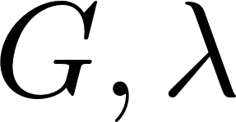
Extracting NP coupling
The NP coupling can be extracted using only spectroscopy, without knowledge of or :
volume in data
volume predicted
by IS theory with one
nuclear source of NL

Slide 56
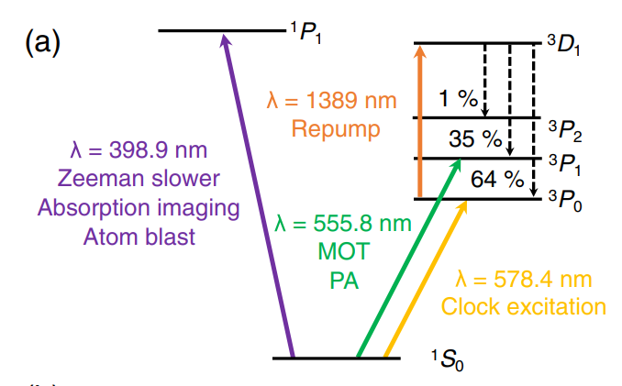
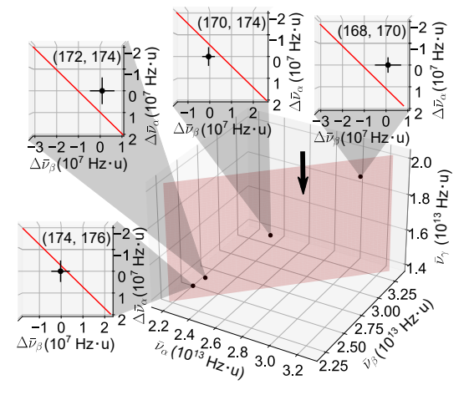
Generalized King plot in Yb/Yb+
Ono et al. | Phys. Rev. X 12, 021033 (2022)
Experimental 3D King plot
using different transitions in Yb/Yb+
shows ∼3σ evidence for a
second source of NL!
This calls for a 4D King plot…

Slide 57
Conclusions

Slide 58
Conclusions
The Standard Model is incomplete.
Until recently, physicists focused on searching for BSM at the highest energies (TeV and above), thinking physics at lower energies is very well understood.
Yet,
Light & weakly-coupled New Physics is still possible and well motivated theoretically. Atomic spectroscopy can be repurposed to search for it.
These searches, by probing very different types of BSM physics, complement the efforts (to be) invested at colliders
→ « multi-messenger » search program

Slide 59
In the XXth century, understanding atomic spectra led to amazing conceptual revolutions in physics.
Wouldn’t it be a cute thing that yet a deeper knowledge of Nature came from atoms, once again?

Slide 60
backups

Slide 61
The Light Vector Case
inverse Bohr radius
Vectors with induce a long-range force
Then, effects are suppressed for couplings aligned with QED ( ) because:
massless dark photon is unobservable!
This behavior is only manifest for and calculated at the same order in couplings. Otherwise:
would fictitiously distinguish
photon from darkphoton

Slide 62
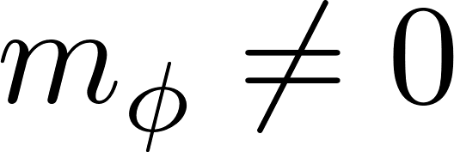
The Light Vector Case
inverse Bohr radius
Vectors with induce a long-range force
Then, effects are suppressed for couplings aligned with QED ( )
Instead, we use a simple prescription:
with
included to all orders
by shifting
in
deviations from either or
can be treated as perturbations at LO

Slide 63
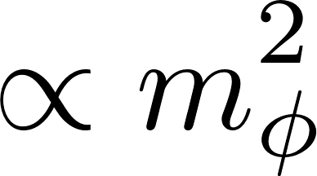
The Light Vector Case
inverse Bohr radius
Vectors with induce a long-range force
Then, effects are suppressed for couplings aligned with QED ( )
Instead, we use a simple prescription:
with
included to all orders
by shifting
in
deviations from either or
can be treated as perturbations at LO
Hence:
or

