Slide 1
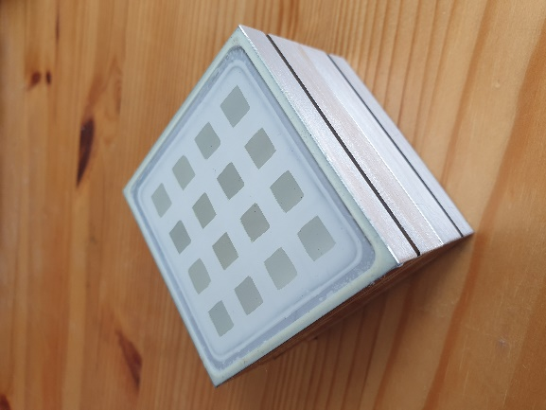
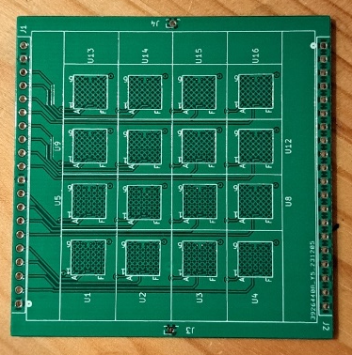
DM LAB activities GSI/IPHC
Development and characterization of position-sensitive scintillators for WIMP detection
Status
Modelling and simulation of 1000 element array reveals outstanding detection qualities
R&D on additive manufacturing of inorganic scintillator crystalites (beads) in optically matching substrates and ceramics employing sintering processes have started
Expectations
Background dicrimination improvement 2-3 orders of magnitude!
gamma and particle origin determination
Plans for 2024
development of a prototype segmented scintillator with 32 channels
characterization of the prototype
2x4x4 CeBr₃ crystals, close-packed array
40x34 mm² active volume
readout by an array of single SiPM (MICROFJ−60035−TSV)

