Slide 1
Grainita Friday meeting
16/05/2024
magali.magne@clermont.in2p3.fr

Slide 2
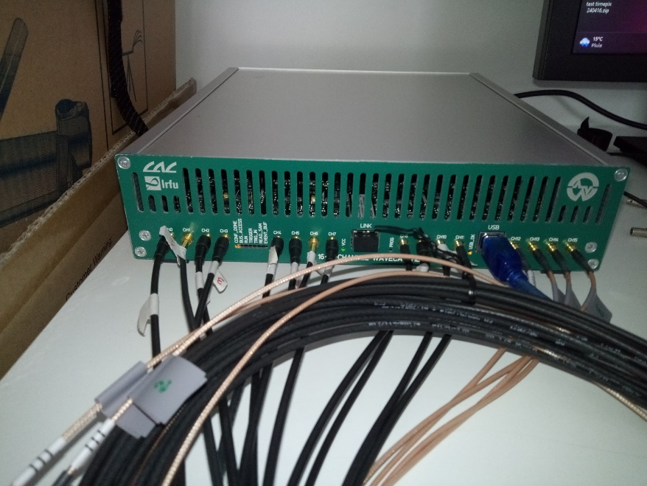
Thanks for wavecatcher 16 channels
The wavecatcher 16 channels is well arrivied at Clermont ➔ thanks to Jacques
Thanks to Ianina for the tutorial
FYI :
  on the box is wrote 11 cables MCX MCx , but in the box it’s 12 cables MCX MCx
We easly make some test to have a best understanding of the new parameters of this version.
We also play whith the busy signal

Slide 3
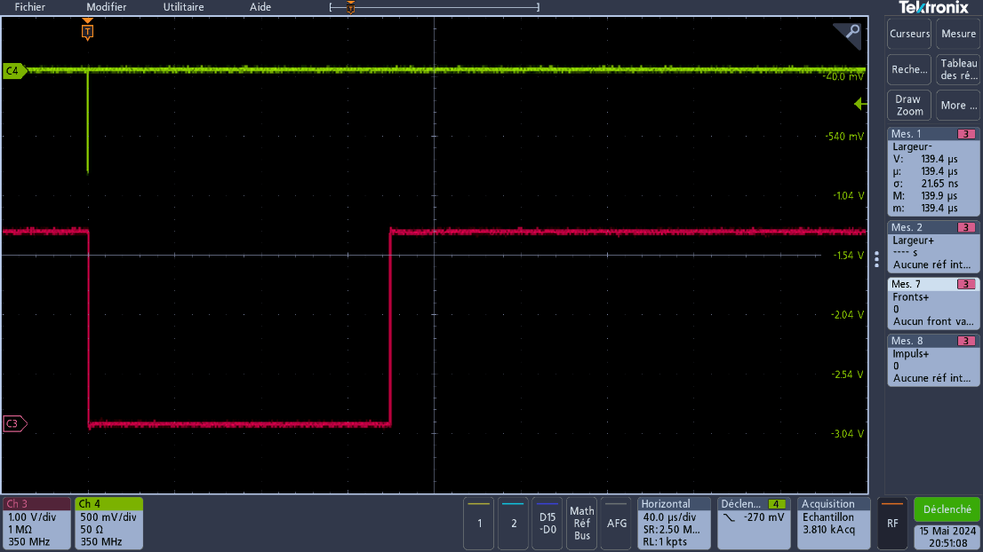
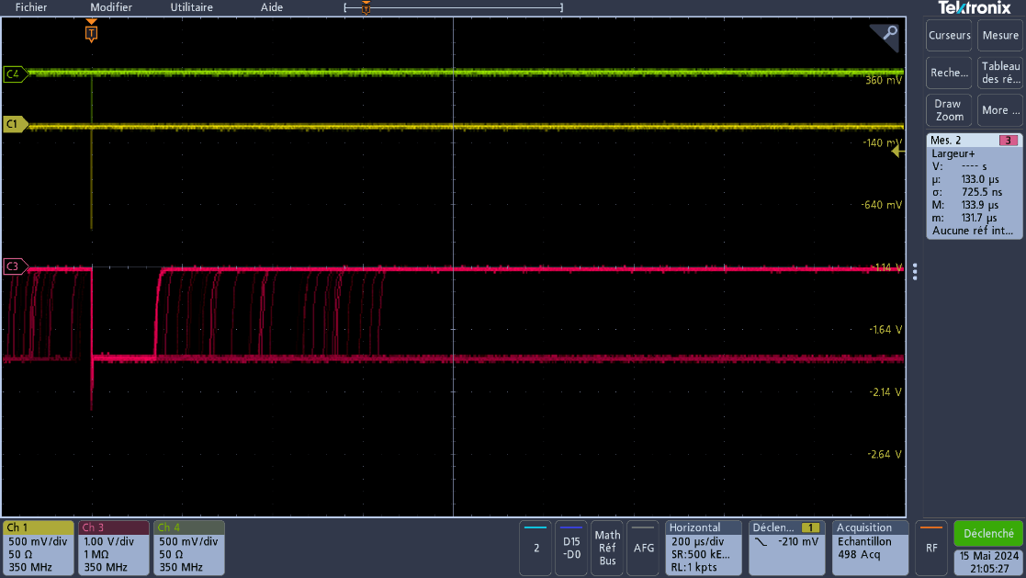
Wavecatcher test
We evaluate the lost trigger fonction of the beam frequency in burst mode
5 s
25 s
freq(hz) | % of lost trigger
100,00 | 0,00
150,00 | 0,00
200,00 | 4,51
300,00 | 35,46
400,00 | 51,65
500,00 | 61,48
600,00 | 67,28
Trigger Signal shape
Good test with frequency under 150Hz
Test with frequency upper 200Hz

Slide 4
Question about wavecatcher
What is the minimum width detect by the Trigger input?
  We see : if the signal is under 50 ns we loose some triggers
  Now we put 100ns width , we have now all trigger

Slide 5
Mechanical
Questions :
  We need to have picture and final dimension of the drift chamber
    ➔ to evaluate where I put it and what is the dimmnsion between detector and drift chamber

Slide 6
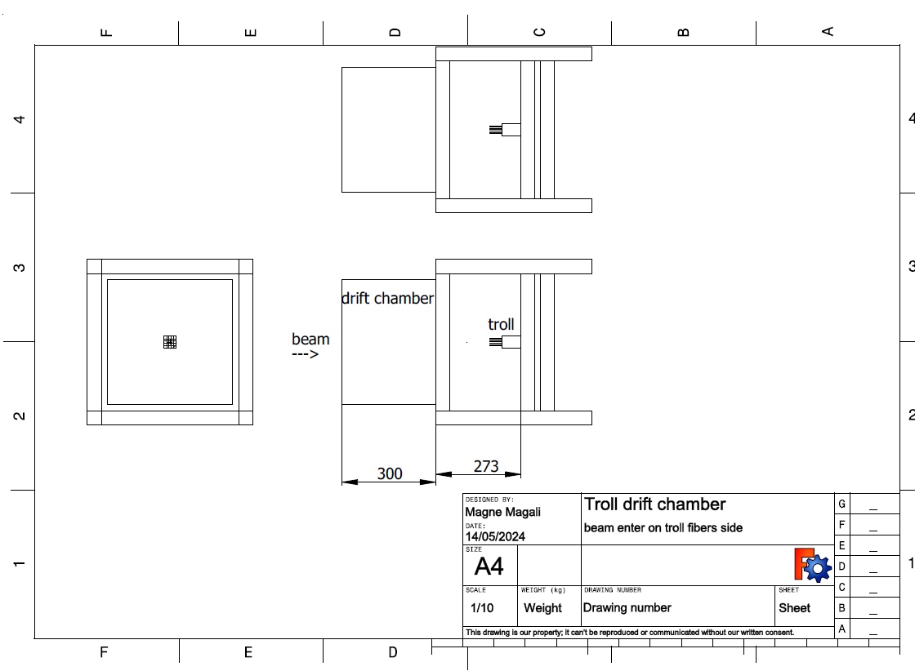
Installation – version 1 beam enter in fiber side of the troll
fibers
Timepix & pmts coincidence 2*2 cm

Slide 7
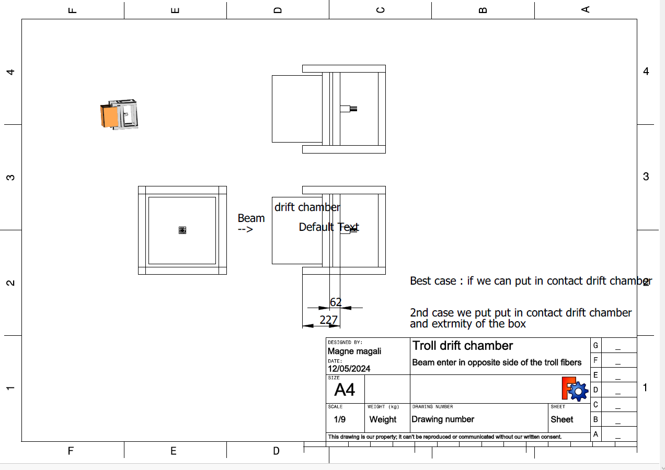
Installation – version 2 beam enter in opposite fiber side of the troll
Timepix & pmts coincidence 2*2 cm
troll

Slide 8
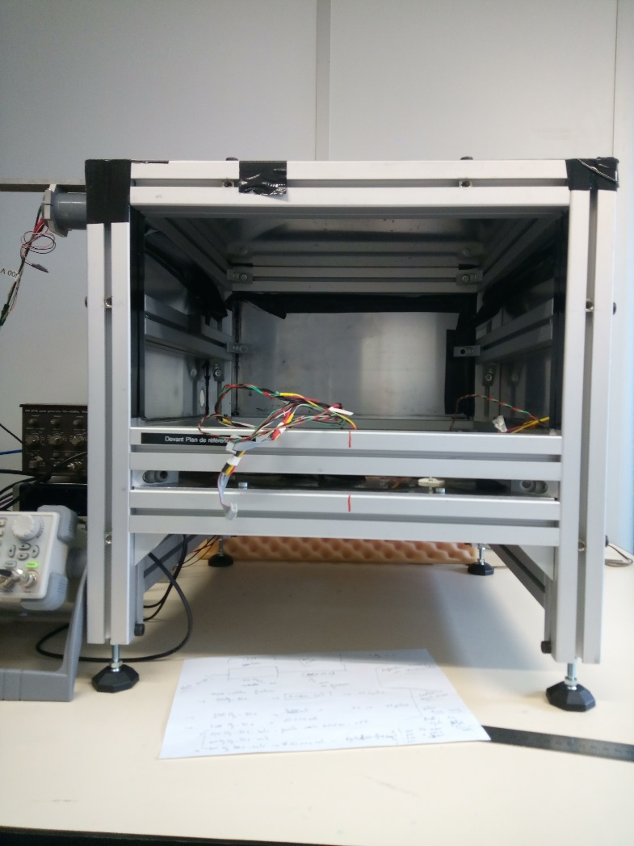
Test bench in pictures
Muon setup - LPC
Beam configuration
beam
Drift chamber
table

Slide 9
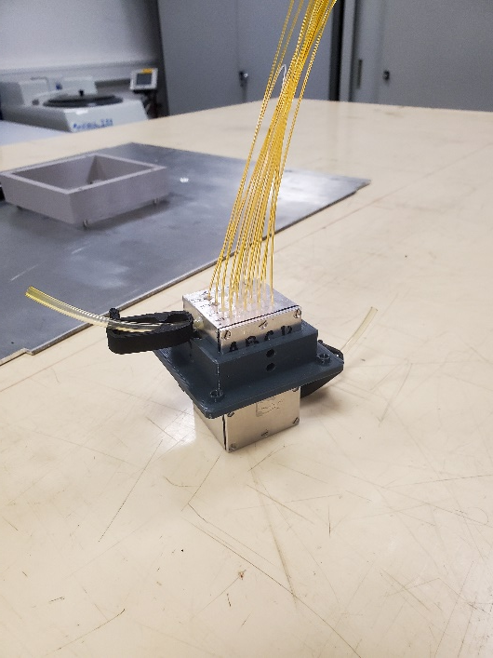
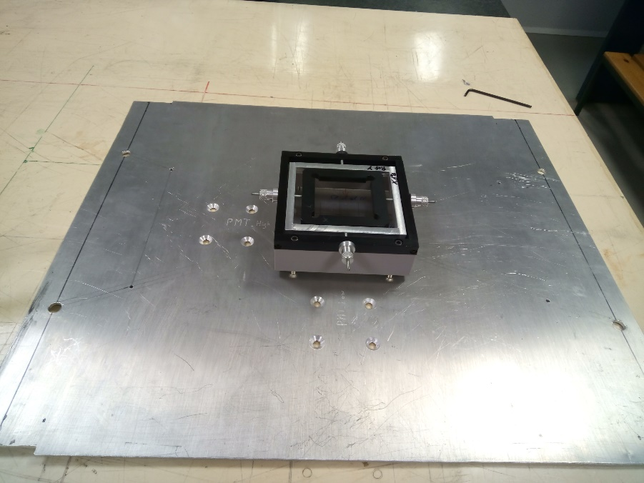
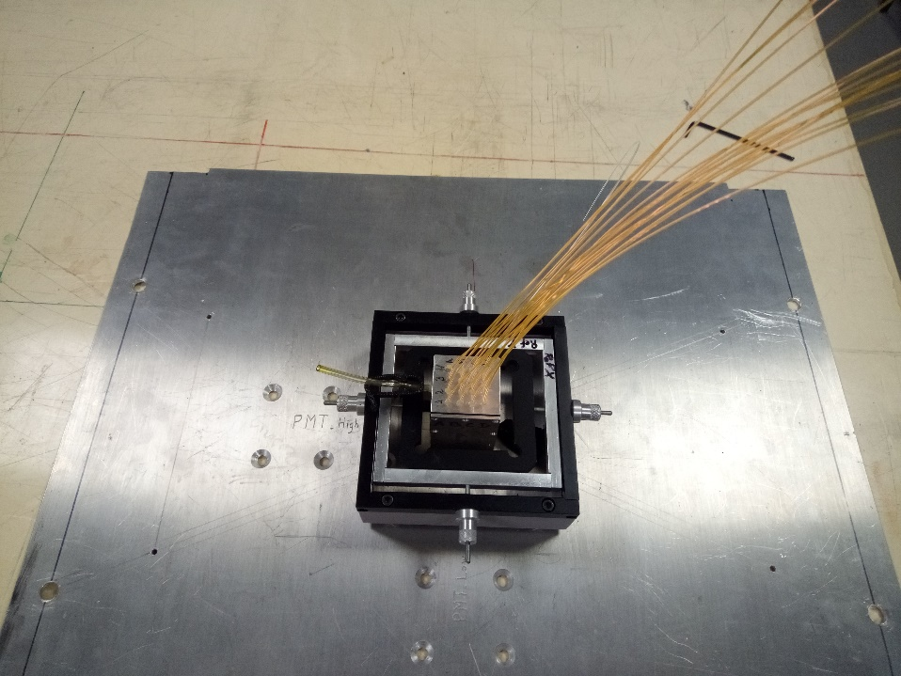
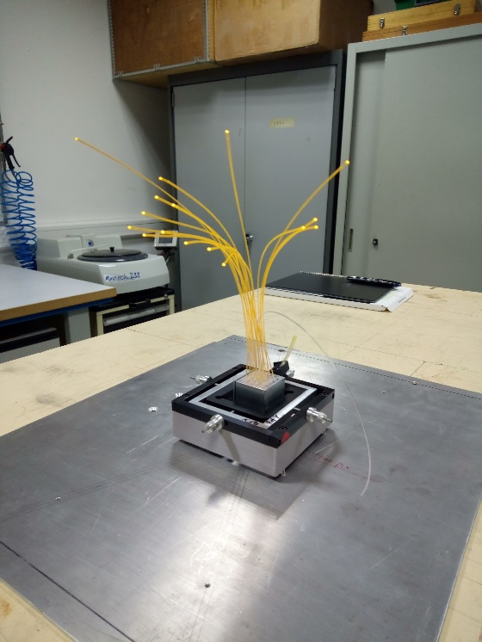
Troll fixation :in Progress
Xy table – fixe in middle position to be well align with the middle troll/ structure
We exept a valid structure end of next week

Slide 10
Test beam schedule : June 10th to 19th ???
Monday June 10th
Afternoon:
Tuesday 11th
Test in Lab
Wednesday 12th
LPC ?
Thursday 13th
Friday 14th
LPC ?
Saturday 15th
Sunday 16th
Monday 17th
Morning
travel
Begin installation in Lab
Study drift chamber signal
Alignement of several detector
Morning & Afternoon
Travel
Morning or Afternoon
Come back to CERN
Installation in test beam Area ?
Begin of beam
Beam
Beam
Tuesday 18th
Beam ?
Travel to LPC ?
Wednesday 19th
Cern or LPC?

