Slide 1
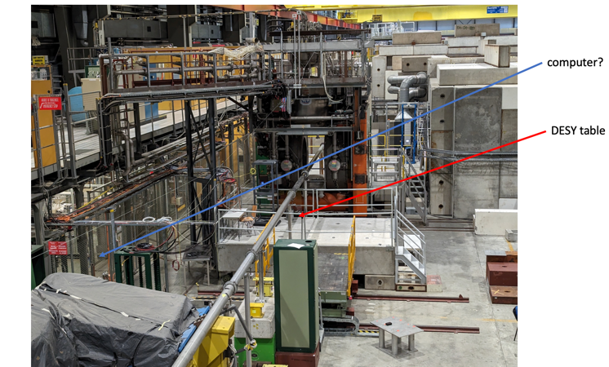
Test beam zone (Thank you Yuri Guz for info)
Yuri has taken a photo of the H2 test zone showing were we could put the “adjustable table” (DESY) with our apparatus. Of course the section of the beam pipe is removed Typically users put electronics and DAQ computer in rack behind and communicate thru network a connected computer would be about 10m cable
bla

Slide 2
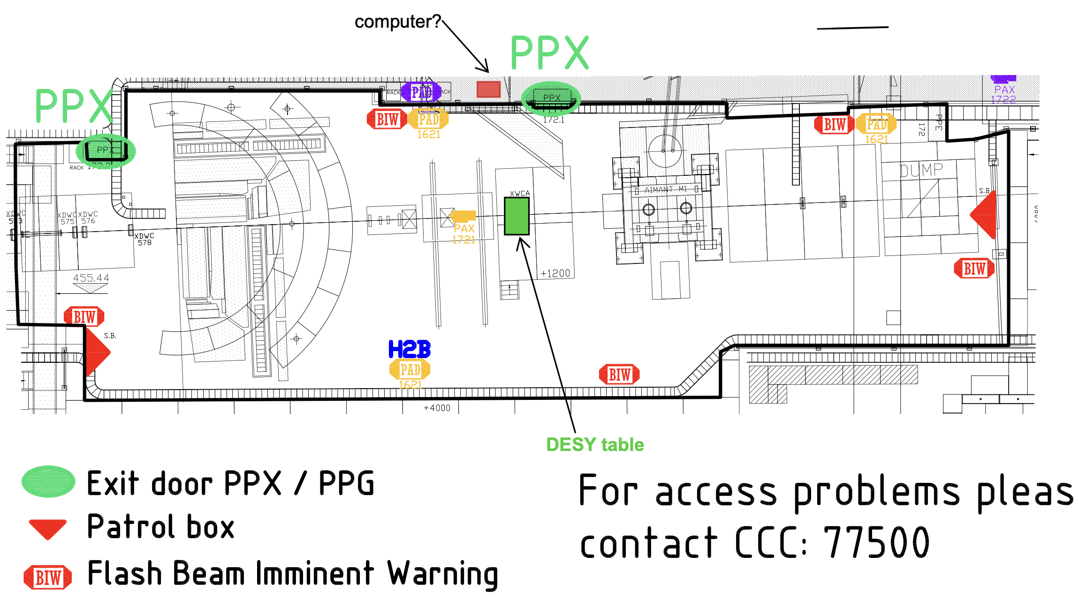
Test beam map (sent by Yuri)
New version of the map
It is not written but on the photo one sees an electronic rack downstream with respect to the DESY table: probably used for electronics of drift chamber

Slide 3
Test platform installation and positioning
Yuri proposes to find an adjustable platform: on average" they are ~ 120cm x 80 cm.
The drift chambers (they offer to lend us) needs 30 cm along the beam and ~40 cm across the beam. The system gives 250 micron position accuracy in X Y (+ angle?) the DAQ of the system works with a trigger and inscribe in the output event the “clock time” so it is easy to associate position info and wavecatcher info (test?)
How do we install our proto (Troll + amplifiers + wavecatcher + Timepix +PMT) + “light tight cover”
The muon beam is large > 4cm about 400 muons in 4x4 cm^2 So our trigger scintillators do not need to be “accurately positioned” with the beam (if we are wrong by 1cm no big problem)
But my estimate is that the muon angle distribution is small (beam pipe +-5cm over >10m long beam pipe? 5mrad) How do we control that the troll angle is with fibers // to the beam to better than 0.3 fibersize/ 6cm =5mrad) The drift chamber accuracy is 3mrad. Can we intall the Troll with a long ruler to check the Fiber angle to <3 mrad vs beam average? How?
In my opinion (to be discussed!): with the great muon flux we can measure the trigger scintillators position with respect to the measuring position devices since the events will stop abruptly at the edge of the scintillators. The exact position of the fibers is more delicate but since we will have > 12000 muons per hour (with the wavecatcher taking 40 evts/s) we will have about 30 muons/hour/mm^2 and we can locate fibers vs measuring device since there should be no scintillation light at the fiber positions. (recent news 80 evts/s)

Slide 4
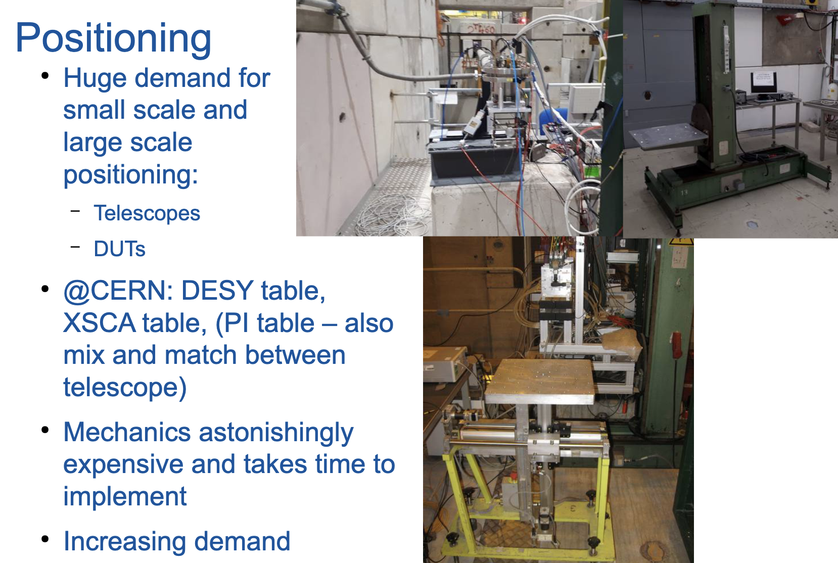
Examples of test platform
Bexamples of DESY table can be found on the web: https://indico.cern.ch/event/731649/contributions/3237174/attachments/1779463/2894298/andre_rummler_infrastructure_bttb_16_01_2019.pdf
Which one will we have? Ask Yuri Guz? Ask to have it “on site” before Friday June 14?

Slide 5
Computer position problem
A delicate problem is the computers positions:
We are used to connect the DAQ PC’s to the wavecatcher with a USB cable.
The standard procedure for CERN test beam users is to install the DAQ computers with the electronics in the zone and to “talk” with these computers with the CERN network there are access to the CERN network in the zone and in the control barrack. This is what is done for the drift chamber device.
If we wish to connect “directly” but outside the zone a 10 m optical cable could probably be enough according to Yuri but the position rather awkward. (It is shown on the photo and “plan”)
The control room barrack is quite a bit further away (20m 30 m? said Yuri)
What do we do? We buy the optical cable anyhow?
Perhaps we can verify “at home in coming weeks” that we can do this talk to computer through network with our system. But this means we login to the CERN network! How many of us have access to CERN Login with “Two factor Identification” !
Will we have to share a password?

Slide 6
Hardware to bring (I)
The main hardware is of course the Troll1 (at Clermont) and which seems to have better “uniformity among fibers than some others” A LED test should be done to verify its present uniformity.
The main aim is to test this troll with water (?) and eventually heavy liquid (as Marie Hélène has suggested) if we succeed in controlling the heavy liquid attack on aluminium with H2O2 . (Bring Heavy liquid syringe demineralized water etc…
Since there can be no second thought in a Cern beam test, probably we should foresee to bring more spares (usually present in our labs) … this will be shown in the list below

Slide 7
Hardware to bring (II)
Troll1 + PMT + scintillator trigger + 16 Mcx cables + SiPM card +… + “house”
Spares MCx surely
Spare PMT + scintillators? (the Orsay ones?)
HV PMT units and HV and signal cables + spares
NIM crate with: >2 discriminator unit
A NIM coincidence unit with VETO entry for veto wavecatcher busy or drift chamber busy
Logical Fan IN Fan out for choosing between muons events or LED events
TTL to NIM unit converter to transform the wavecatcher TTL veto to NIM and LED pulser trigger to NIM
16 channel wavecatcher (bring 8 channels as spare hum!)
Its 4.5 volts power supply for the SiPM card
DAQ PC’s + cables and USB keys
The green LED (with a spare!) + A pulser allowing to have an output with a permanent DC level 1.9 volts just below the conducting voltage and 2.3 volts pulses 25 𝜇s long (this is important for pulse shape I propose to bring the Orsay LED pulser)

Slide 8
Hardware to bring (III)
Probably other general use devices
A Tektronix scope
A soldering gun
Lemmo signal coax (+BNC lon cables?) + connectors + 50 ohms termination… + BNC lemmo transition+…?

Slide 9
Trigger implementation
As explained above we plan to use the drift chamber: according to Yuri Guz the dead time is about 100 mks and and a busy pulse is used in their system to veto trigger
Our wave catcher has a more subtle busy pulse : the dead time is 140 mks for each trigger but there are also long dead time which starts after buffers are full
Testing with LED pulse we see that at 30 Hz we never have full buffer but when we try to send triggers at 40 HZ long deadtime arrives and the system is blocked and the max rate is 30Hz . However if we send 40Hz (50?) pulse for 5 seconds only, the buffers are not full (during the spill) and are emptied between spills. Recently Jihane and Dominique have shown that abandoning some event display etc…) we could increase to about 150Hz during the spill
Clearly it is essential that the trigger is the same for the 2 devices and we have to combine the VETO. Most probably it is critical to not delay trigger for the drift chamber measuring position with time delay!
In my opinion (to be discussed) we could in our NIM crate do our PMT coincidence + wavecatcher veto and send the result to the drift chamber coincidence+ veto and trigger unit We then bring back the resulting pulse for triggering the wave catcher (delay not important << 25 mks counting of photoelectrons)
We could also do all trigger electronics in their coincidence crate… more rational! But we will be less “at ease” Decision? Could we “see” their crate and electronics weeks before???

Slide 10
Data rate
The muon rate in our 2x2 cm counters according to last meeting Stephane slides could be
75-125 Hz . Using the last improvement of Wave catcher we could acquire all muons in our 2X2 trigger counter in a spill at 75-125 ? The max is 150 . I use 80 below
=> 400 in 5 s spill
If at 1 spill / 50 s => 28800 events per hour Could be 48000 if 1 spill/30s
The files size on a recent test were 500 Kbytes 1000 evts with the same for LED and cosmic.
=> After 1 hour data taking could be up to 48000 events => 24 Mbytes => not a huge problem to transfer data from the wavecatcher PC to analysis PC

Slide 11
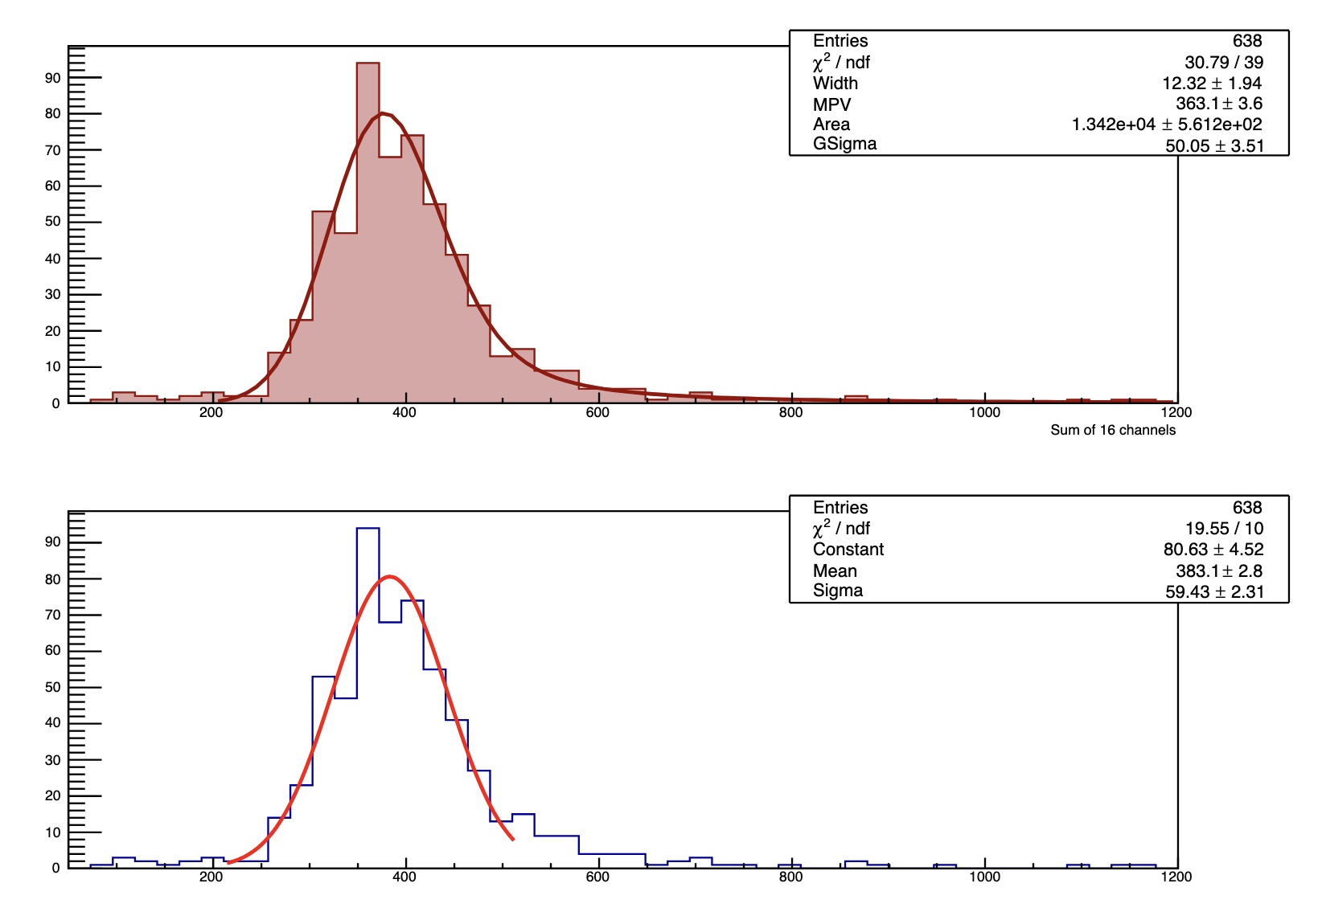
Nphe histograms
Below are 2 fits of Nphe done by Marie Hélène for ZnWO4 +water . One of the fit is done with a Landau curve. The other by a gaussian. The Gaussian fits less well but has a smaller relative error .
The cosmic are almost never perfectly aligned with a fiber. However in our case we can have some muons being along the fibers and other not. Should we not give also not a “fitted mean” but simply the average and the rms of all events less accurate statistically but more true when 2 populations.

Slide 12
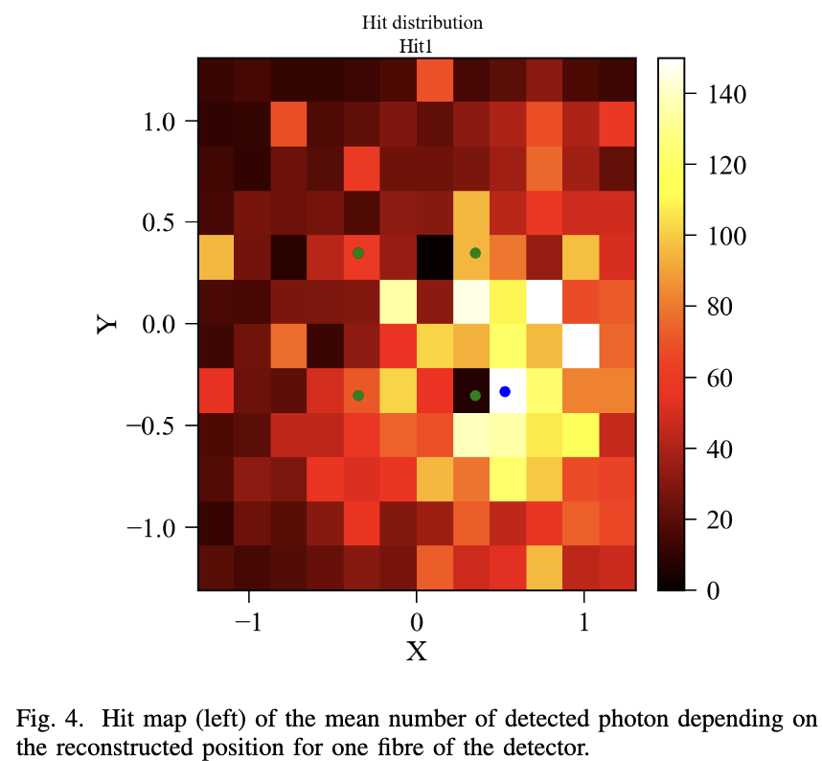
On line analysis (or briefly after?) I
We should obtain 100000 – 200000 events so a detailed on line analysis is almost surely unrealistic… but we should evaluate that the data is enough and of sufficient quality… Clearly the LED tests play an important role because we can check all SiPM are “reasonable” . Probably we should divide the DAQ in successive period 1 hour? And take short (1000 evts LED runs + dark current) every hour?
After the first hour the most important thing is to check the position of fibers and verify the angle is OK
Is a plot like the one of Hervé, the good solution ?
In one hour we should get about 28000 evts (with 80Hz) 70 evts/mm^2 With a plot 20x20 mm^2 400 bins, one should see the fibers in black : Allows to center the plot (the stat error on average Nphe in each bin about 3% (?)) The fibers should be black and in one bin only (after a deltax deltay shift of bin center) if the angle is OK
Well not perfectly black since fiber area is 0.78 mm^2 not 1mm^2

Slide 13
On line analysis (or briefly after?) II
The preceeding page was looking at results with total number of Phe (summed over 16 fibers)
We should prepare “maps” Nphe for each fiber for the 16 fibers (a bit like centrality?) Online we cannot do it for 400 1mm^2 positions ;-)
Do 9 maps for 9 entry regions???? (Or 4 entry regions only ?) like
X = from-10mm , to -3.33 and -3.33 + 3.33 and 3.33,10 mm
And Y = -10mm to -3.33 and -3.33 +3.33 and 3.33, 10 mm Or other values???

Slide 14
Urgent things !
The beam is in 6 weeks!
Mechanics => find the installation solution for horizontal troll + PMT +amplifiers give drawing (+photo?) in <1 week (2?) Obtain photo of Drift chamber?
Electronics => Obtain a drawing (?) a photo (?) of the drift chamber electronics . Define how to merge trigger of drift chamber and our PMT coincidence + Wavecatcher VETO. Keep possibility of LED test without entering in beam zone <1 week (2?)
Electronics_ software: decide how to read the wavecatcher : “PC inside the zone+ PC PC connection thru internet “ or “long cable PC outside” 2weeks (3?)
Analysis software : prepare LED tests soft plots prepare mu beam soft plots etc… <3 weeks (4?)

