Slide 1
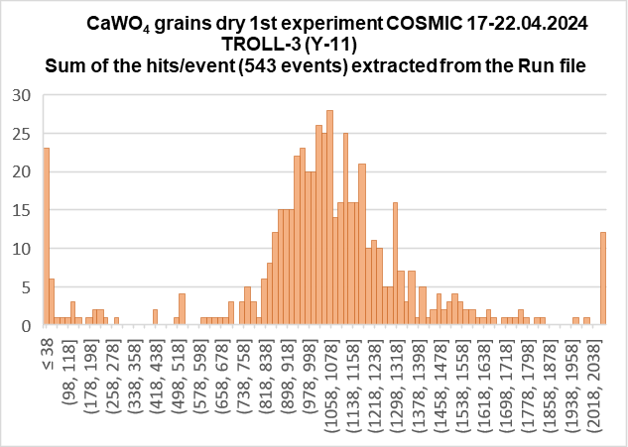
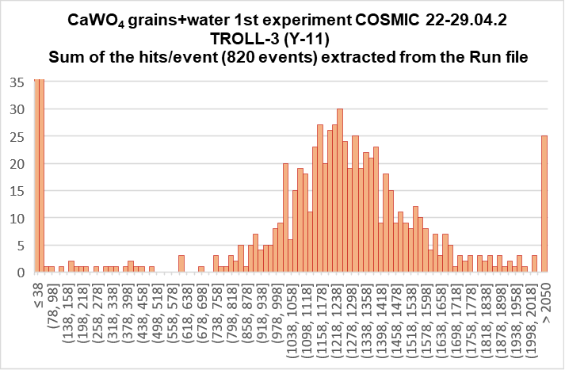
GRAiNITA test bench updates: 3 May 2024
The preliminary results for CaWO₄ grains (dry and with water) in TROLL-3 under
excitation with the cosmic muons:
Mean ~1060
Mean ~1240

Slide 2

GRAiNITA test bench updates: 3 May 2024
Condition | Estimated number of phe
 | ZnWO₄ grains (TROLL-2, O-2(300) WLS fibers) | CaWO₄ grains (TROLL-3, Y-11 WLS fibers)
Dry | 660-650 | 1060
With water | 780-800 | 1240
! No dark current correction
The “yield” for CaWO₄ grains is about 1.6 times higher in comparison with ZnWO₄ grains
With adding of water we gain about 17-20% of light (both for CaWO₄ and ZnWO₄)
Condition | Counting gate, mks | Dark current, N_{phe}
ZnWO₄ grains (TROLL-2, O-2(300) WLS fibers) | 25 | 46
CaWO₄ grains (TROLL-3, Y-11 WLS fibers) | 12.5 | 35

Slide 3
Brief summary
Using of CaWO₄ grains for GRAiNITA
Advantages ☺
More light in comparison with ZnWO₄
Two times shorter counting time (and lower dark current level)
Custom Y-11 WLS fibers (less self-absorption compare to O-2 WLS fibers)
Disadvantages ☹
Lower density (77.5% of ZnWO₄) -> increase of the detector size…
Possible solution: partial substitution of Ca²⁺ ions to Pb²⁺ ions, i.e. scintillation grains
of Ca_{1-x}Pb_{x}WO₄ (“cook and look” approach)

