Slide 1
Test beam installation
Questions and what I understand
Installation of several detector ?
Positions and measures
Mecanics
Trigger logic
Data …
Meeting Friday May 3th
Magali Magne

Slide 2
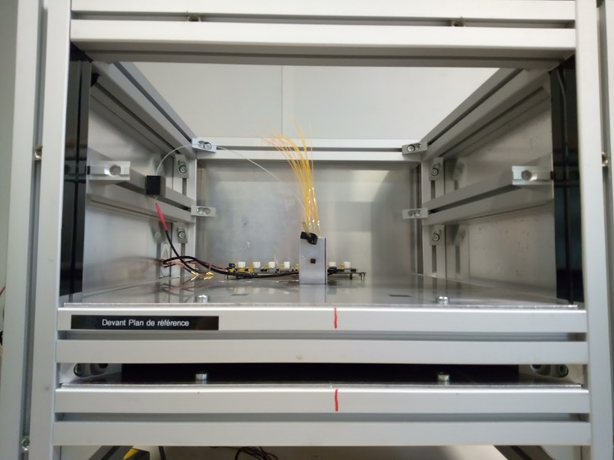
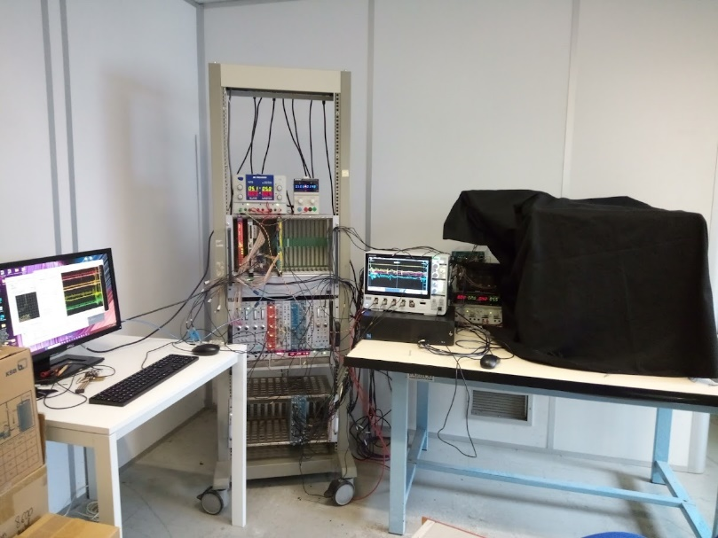
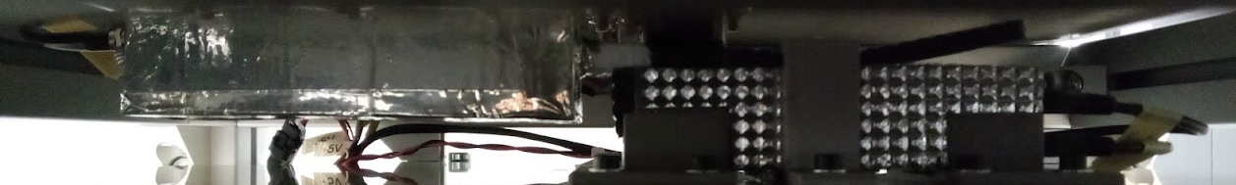
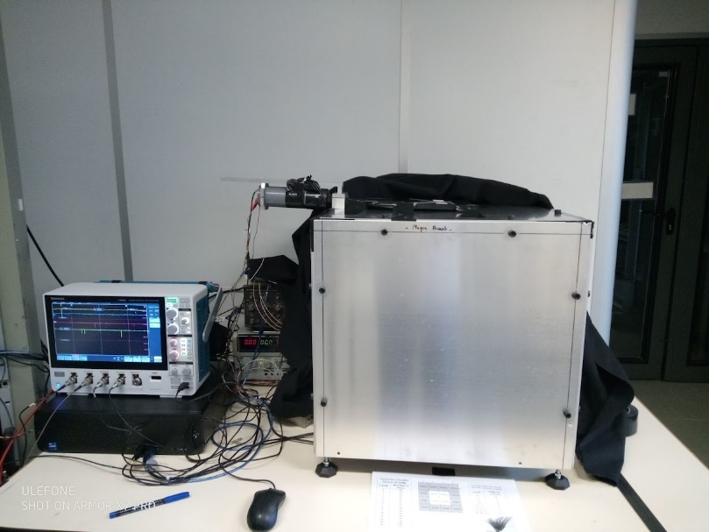
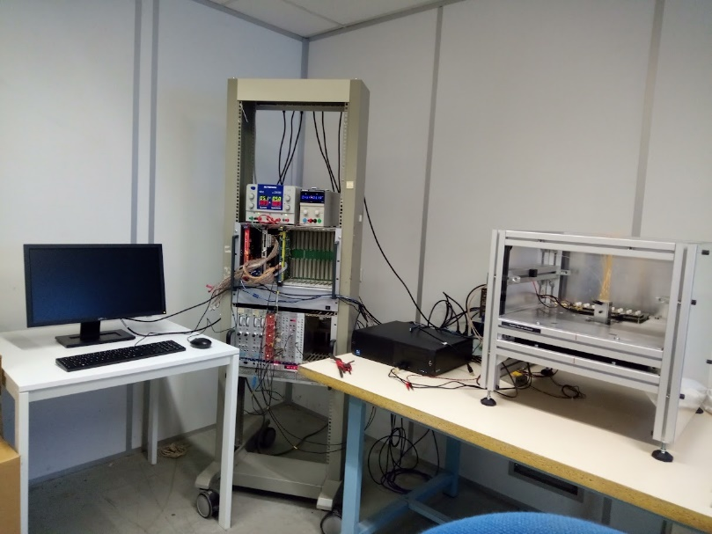
LPC Cosmic test bench in pictures ☺
2 Scintillators + 2 pmts
Active zone 1,9*1,9 cm
Timepix
Active zone 1,4*1,4cm
Between the both planes
Old pictures
New ones for next meeting ☺
Outside the box
Inside the box :

Slide 3
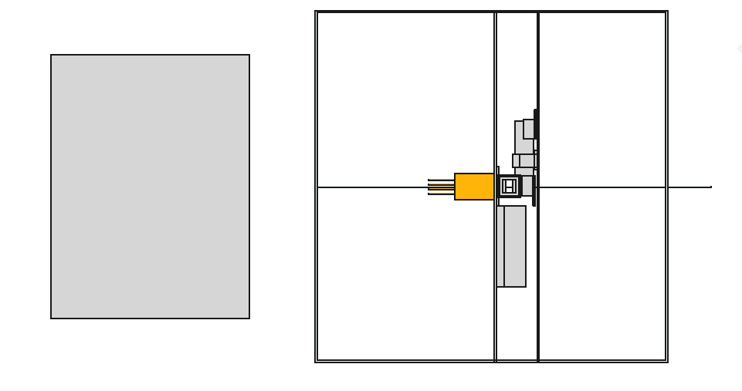
Instalation : missing measures
Axial beam View
Pmt +scintillator 15*15cm
troll
33,9 cm
2 scintillators planes 1,9*1,9cm
+ associate pmts
27,4 cm
Drift chamber
4 cm
Timepix
40 cm
beam
53,4 cm
?
Height ?
?
30 cm
Table ?
platform

Slide 4
Instalation : missing measures
Axial beam View
Pmt +scintillator 15*15cm
troll
33,9 cm
27,4 cm
Drift chamber
Timepix
Beam ➔ 4cm diameter
40 cm
?
53,4 cm
Height ?
30 cm
Table ?
?
platform

Slide 5
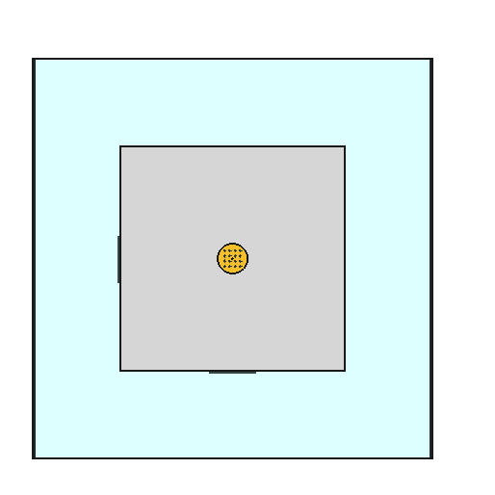
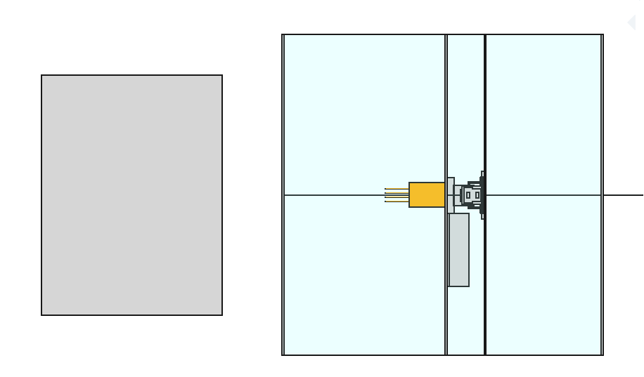
Instalation : missing measures with beam
platform
computer
BT power supplies
Nim crate
Front beam view
VME crate
ASM board
Wavecatcher
box
troll
Top view
?
2/3 m
?
33,9 cm
27,4 cm
Drift chamber
?
Drift chamber
Beam ➔ 4cm diameter
40 cm
53,4 cm
30 cm

Slide 6
Sipm Signal : cabling versus acquisition
If we want to test the both acquisition during the test beam .
The easy way to exchange it quikly
The more complex way is to have mcx to mcx cable for wave catcher and to open the box .
  Disconnect MCX lemo and putMcx /mcx
We need to be caution to do that in test beam configuration.
For MCx – mcx cables we only have 6 at LPC whith a short lengt of 80 cm
Grainita box
Ampli
Lemo /lemo
Nim crate
ASM
16 MCX- Lemo cables
Sipm board
we need
16 MCX- Lemo cables
I
Lemo /lemo
We have
2 m / 10ns
Wave catcher
16 channels
Mcx inputs
In red is what IJCLab team need to provide

Slide 7
Cabling
Ethernet link external
computer
Cables lenght : to be definied
BT power supplies
Grainita test bench
3 USB cables (2 foor timepix / 1 for cooling )
Timepix :
Wavecatcher
Cooling Copper pair cable : BT voltage
1 usb cable drive Sipm HV
Troll
Copper pair cable : BT voltage (5 V)
16 copper cables MCx => Lemo or MCx to MCx
VME crate
ASM board
3 HV cables
3 PMT + scintillateur
Copper pair cable : BT voltage (5 V)
3 copper cables Lemo
Nim crate
CERN : prévoir des prises courant suisse ou /et adaptateur

Slide 8
Table of several cables
 | depart | arrivé | fonctions | type de cable | nombres | longeur
Timepix | detecteur 1 | pc | transfer data | usb | 1
 | detecteur 2 | pc | transfer data | usb | 1
 | cooling | pc | pilotage cooling | usb | 1
 |  | alim bt 1 | alim bt parametrique | cuivre | 1 paire
Troll | carte Preamp | pc | slow control Preamp | usb
 |  | alim bt 1 | power preamp board
 |  | Nim crate | trannsfer data | MCx - Lemo | 16
 |  | or wavecatcher | transfer data | MCx -MCx | 16
PMt + scintillator | detector1 | Nim crate | HV voltage | HV cable | 1
 | detector2 |  |  | HV cable | 1
 | detector3 |  |  | HV cable | 1
 | detector1 | alim bt | LV voltage | cuivre | 1 paire
 | detector2 |  |  | cuivre | 1 paire
 | detector3 |  |  | cuivre | 1 paire
 | detector1 | Nim crate | signal for coincidence system | Lemo -Lemo | 1
 | detector2 |  |  | Lemo -Lemo | 1
 | detector3 |  |  | Lemo -Lemo | 1

Slide 9
Where to put what ?
- Beam area → Point zéro
- near the beam → 2 à 3m
- outside the beam area ➔ 10m ??
- control room → 20m /30m barrack
Optical link ?
Ethernet cable
Daq computer
Telenet to test computer
Test computer
BT 1 : fixe preamp
BT power supplies
BT 2 : fixe PMTs
BT 3 : variable - cooling
Troll
Wavecatcher
VME crate
ASM board
Nim crate

Slide 10
Daly drift chamber:
Where to put it exactly : in the space area near the beam
  Geometry / distance
Signal give :
  Trigger / veto / busy
  format / delay …
Data format : timestamps ….

Slide 11
Computer and usb inputs
Our acquisition pc have : 5 USB ?
Timepix detector : 2 usb
Timepix cooling : 1 for µprocessor +1 for power supply
Vme caen for ASM board : 1 usb
Wave catcher : 1 USB ? Or 1 ethernet ??
Pulse generator : 1 USB to drive it by pc , we have 1 pulse generator , which are able to drive by usb ( ON/ off for led run )

Slide 12
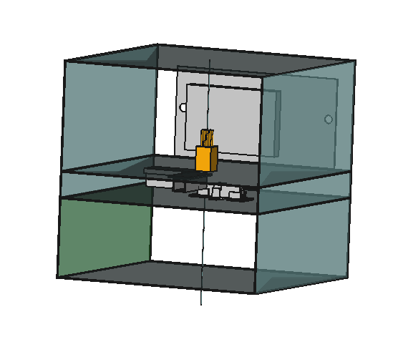
To do list :
Timing : measure on clermont test bench ➔ Next week
Mecanics :
  Fixation of the SiPm board in the box ➔ in progress
  Finish and test the troll fixation ➔ in progress
Test the pulse génération interface to drive it by computer for led run
Make test with wave catcher 16 channels ➔ mid of the month of May
Redo test to validate the system before test bench ( nned 10 days before beam )

