Slide 1


Ununiformality study
Denys Klekots
(Taras Shevchenko National University of Kyiv)
denys.klekots@cern.ch
denys.klekots@gmail.com

Slide 2
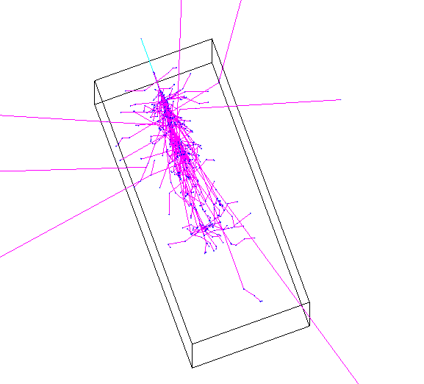
Quick recap
The simulation gives the energy deposited in a strip for each simulated event.
Each strip has the dimensions of 1x1x400 mm. There are 168 by 168 such strips in the detector.
WLS fibres are located each 7 mm and the energy deposited in the strip that contains fibre is not recorded in the simulation output.

Slide 3
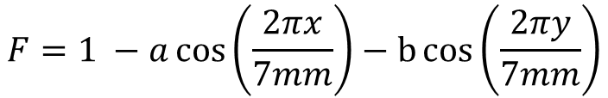
Simulation setup
The position of the primary hit was quasi-uniformly distributed in the square between fibers.
The energy deposited in each strip was multiplied by the following weight
7 mm
y
x
$$F=1 −a\cos\left(\frac{2πx}{7mm}\right)−b\cos\left(\frac{2πy}{7mm}\right)$$
Fibers
7 mm

Slide 4
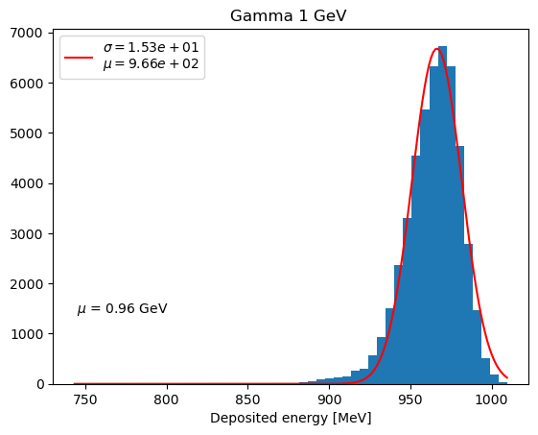
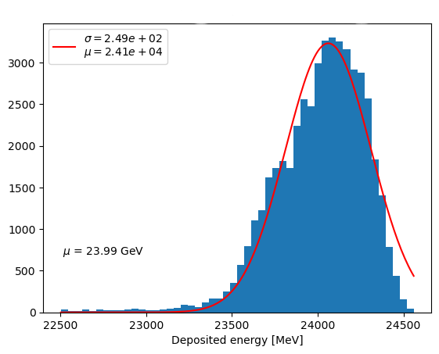


Measured energy
a = b = 7%
Histograms of event by event measured energy
Gamma 25 GeV
$$\frac{σ}{E}=1,53\%$$
$$\frac{σ}{E}=1\%$$

Slide 5
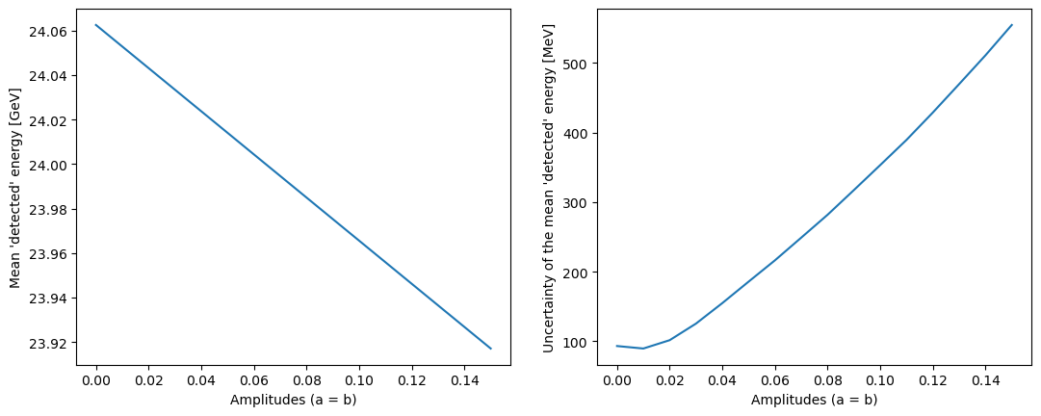
Dependence of the efficiency on the amplitudes 25 GeV

Slide 6
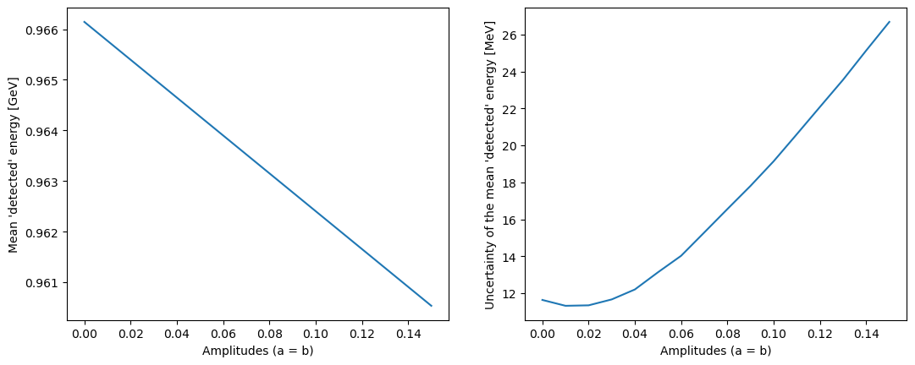
Dependence of the efficiency on the amplitudes 1 GeV

Slide 7
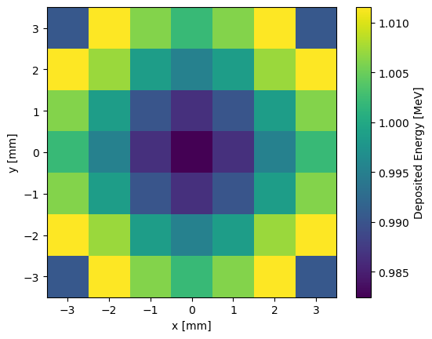
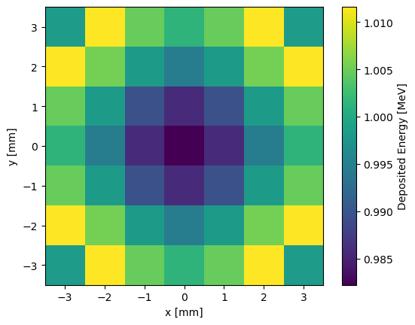
Efficiency maps
25 GeV
1 GeV

Slide 8
Conclusions
The constant term error on energy measurement grows about linearly with the “non-uniformity”
The efficiency maps are very similar
σ/E is worse for 1 GeV gammas compared to 25 GeV

Slide 9
Thank you for your attention

Slide 10
Backup slides

Slide 11
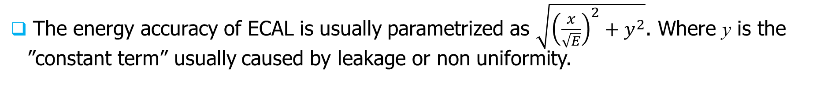
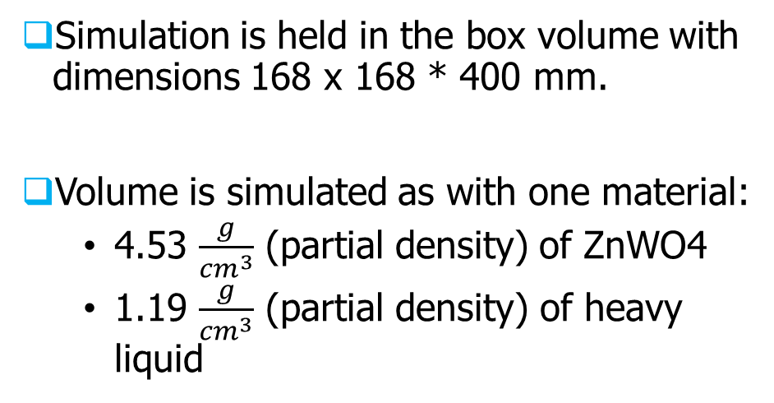
Resolution: constant term simulation. Quick recap
The energy accuracy of ECAL is usually parametrized as $\sqrt{{\left(\frac{x}{\sqrt{E}}\right)}^{2}+y^{2}}$. Where y is the ”constant term” usually caused by leakage or non uniformity.
Simulation is held in the box volume with dimensions 168 x 168 * 400 mm.
Volume is simulated as with one material:
  4.53 $\frac{g}{{cm}^{3}}$ (partial density) of ZnWO4
  1.19 $\frac{g}{{cm}^{3}}$ (partial density) of heavy liquid

Slide 12
Simulated detector
Geant4 simulation was made to calculate the energy detection ununiformality.
The simulated primary gamma (25 GeV in this presentation) hit the top face of the detector.
The fibers were simulated inside the detector. The distance between fibers is 7 mm. Fibers are cylinders of diameter equal to 1.
The detector was virtually split into strips with dimensions of 1 mm by 1 mm by 400 mm.

Slide 13
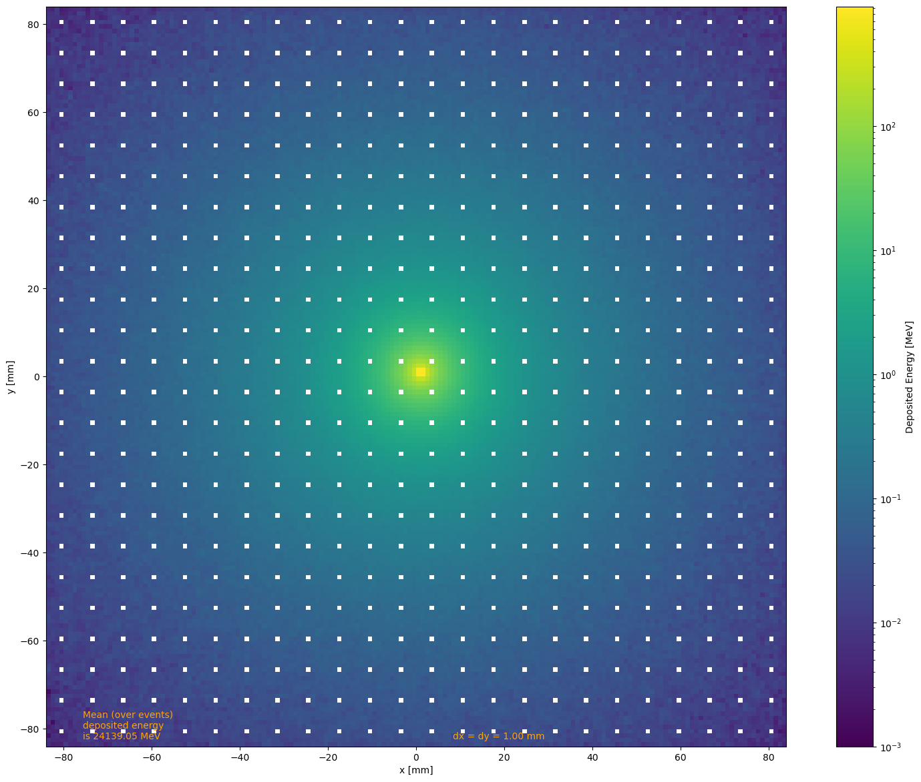
Energy deposition in strips
The plot shows energy mean deposition in strips over 1000 events. The energy deposition of strips containing fibers was omitted (as there is no scintillation in fibers).

Slide 14

Weights of the strips
The energy deposited in each strip was multiplied by the weight.
The weight was estimated from others studied.
This approach takes into account that light collection efficiency is different for different strips.
a = b = 7%

Slide 15
Energy deposition histogram.
The histogram shows the energy deposited in the calorimeter, after encountering strip weights and excluding energy deposited in fiber strips.
The particles were shot nearly randomly in the cube with dimensions 7 by 7 mm.

Slide 16
Efficiency map
Each bin of the histogram represents the mean (over 1000 events) energy that was deposited if the primary hit was in this specific bin.
The histogram is rescaled in such a way that its mean value is equal to 1.

Slide 17
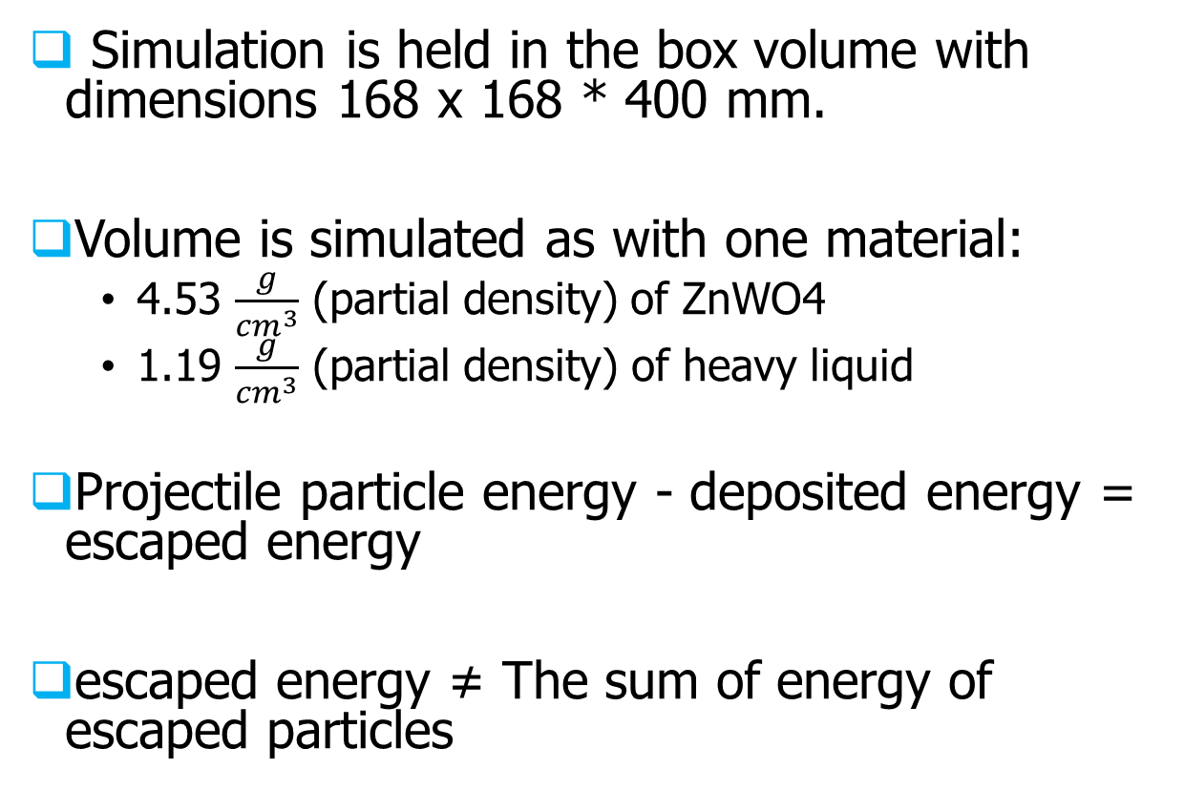
Geant4 simulation setup
Simulation is held in the box volume with dimensions 168 x 168 * 400 mm.
Volume is simulated as with one material:
  4.53 $\frac{g}{{cm}^{3}}$ (partial density) of ZnWO4
  1.19 $\frac{g}{{cm}^{3}}$ (partial density) of heavy liquid
Projectile particle energy - deposited energy = escaped energy
escaped energy ≠ The sum of energy of escaped particles

