Slide 1
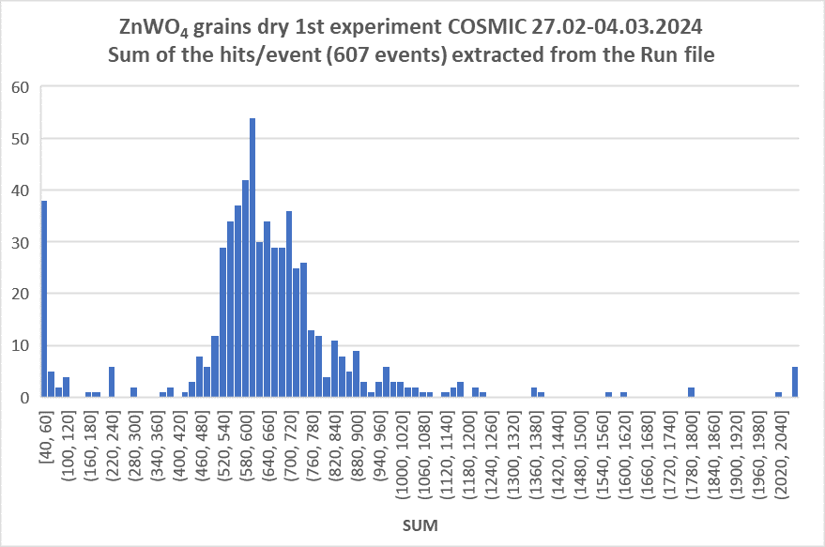
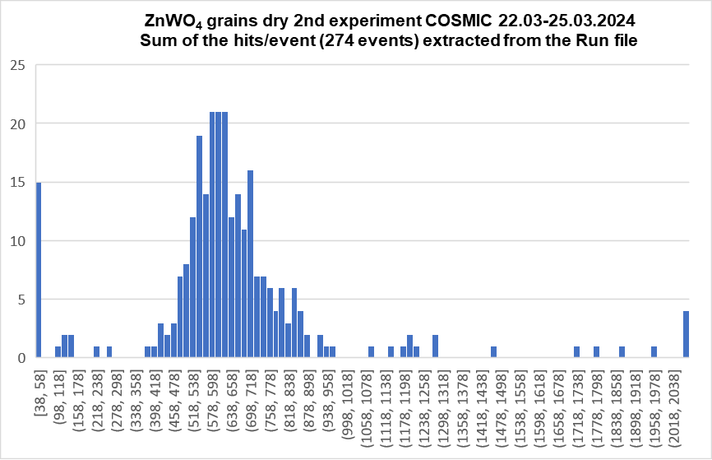
GRAiNITA test bench updates: April 2024
We are continuing our tests with TROLL-2 and 16-channel WaveC:
1. At the moment we have the results for the two independent experiments
with dry ZnWO₄ grains under excitation with the cosmic muons:
Mean ~660
Mean ~650
The results for the 1st and the 2nd experiment are quite similar – we have the reproducibility ☺

Slide 2
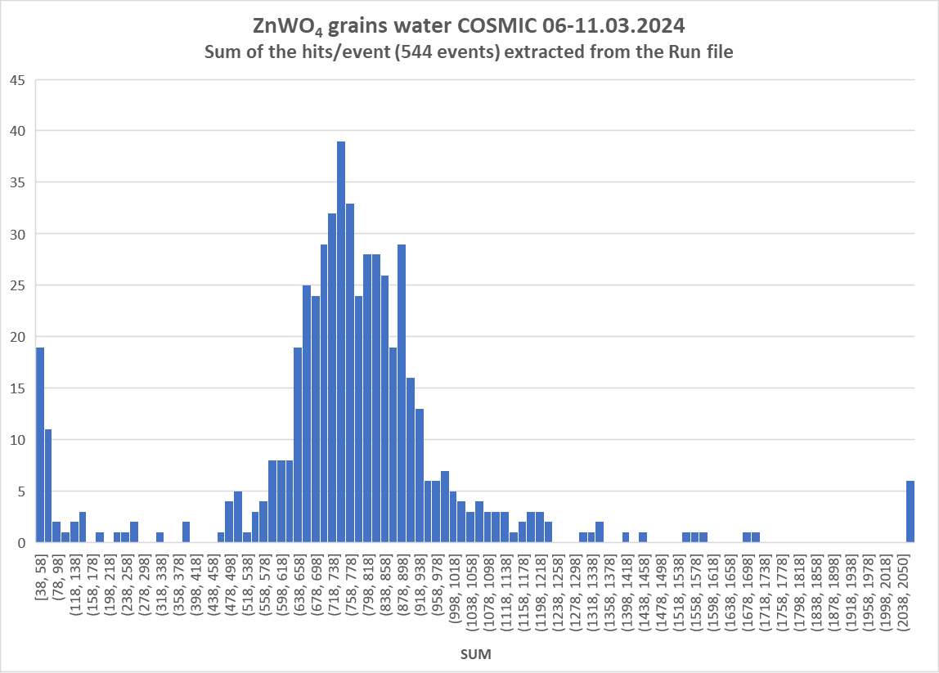
GRAiNITA test bench updates: April 2024
2. We have the results for ZnWO₄ grains+water
Mean ~780
About 18% increase from “dry” to “water” -> 21% for results obtained using TROLL-1
We have the reproducibility ☺

Slide 3
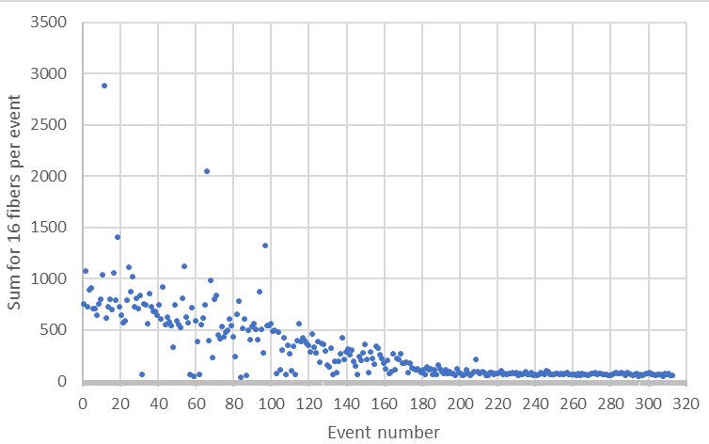

GRAiNITA test bench updates: April 2024
3. We have tried to do the measurements for ZnWO₄ grains+heavy liquid (3Na₂WO₄·9WO₃)
After about 3 days from the start of the acquisition we totally lost the response ☹
12
24
36
48
60
Time after the start of the acquisition, hours

Slide 4
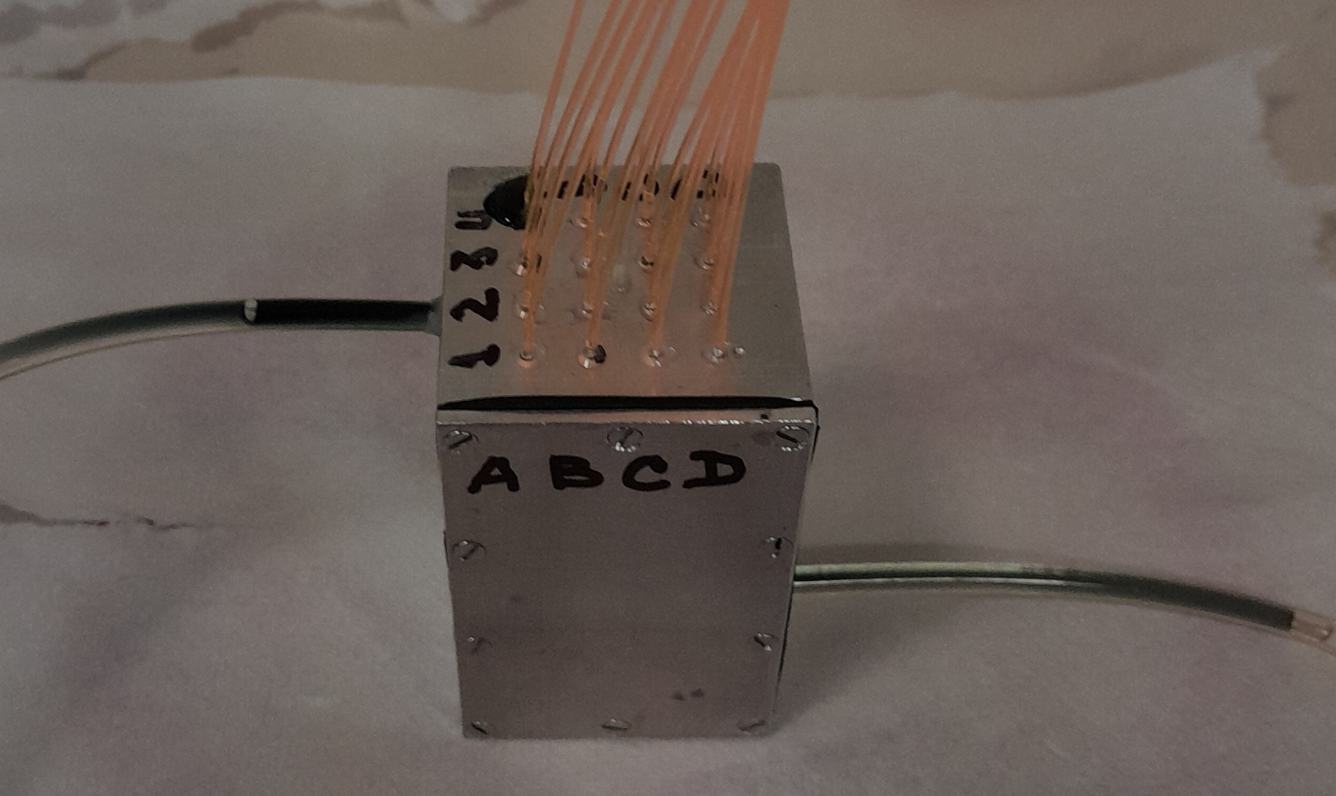
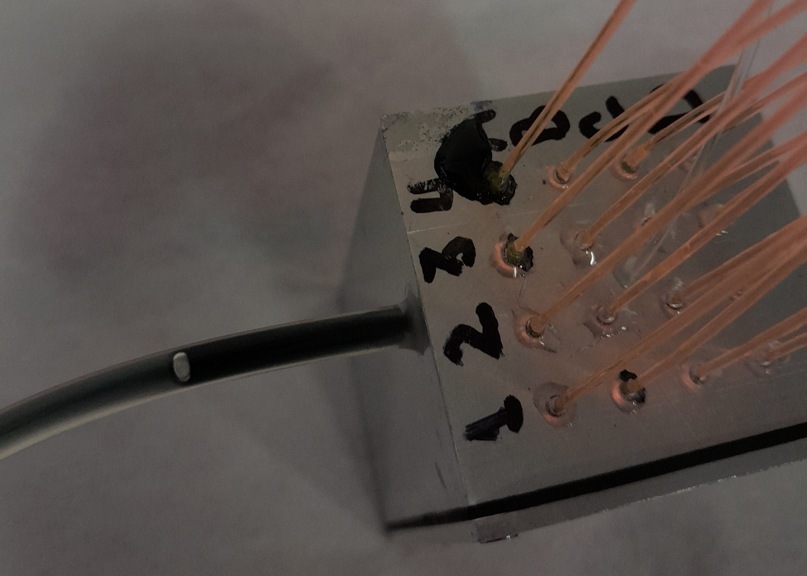
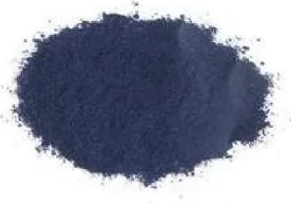
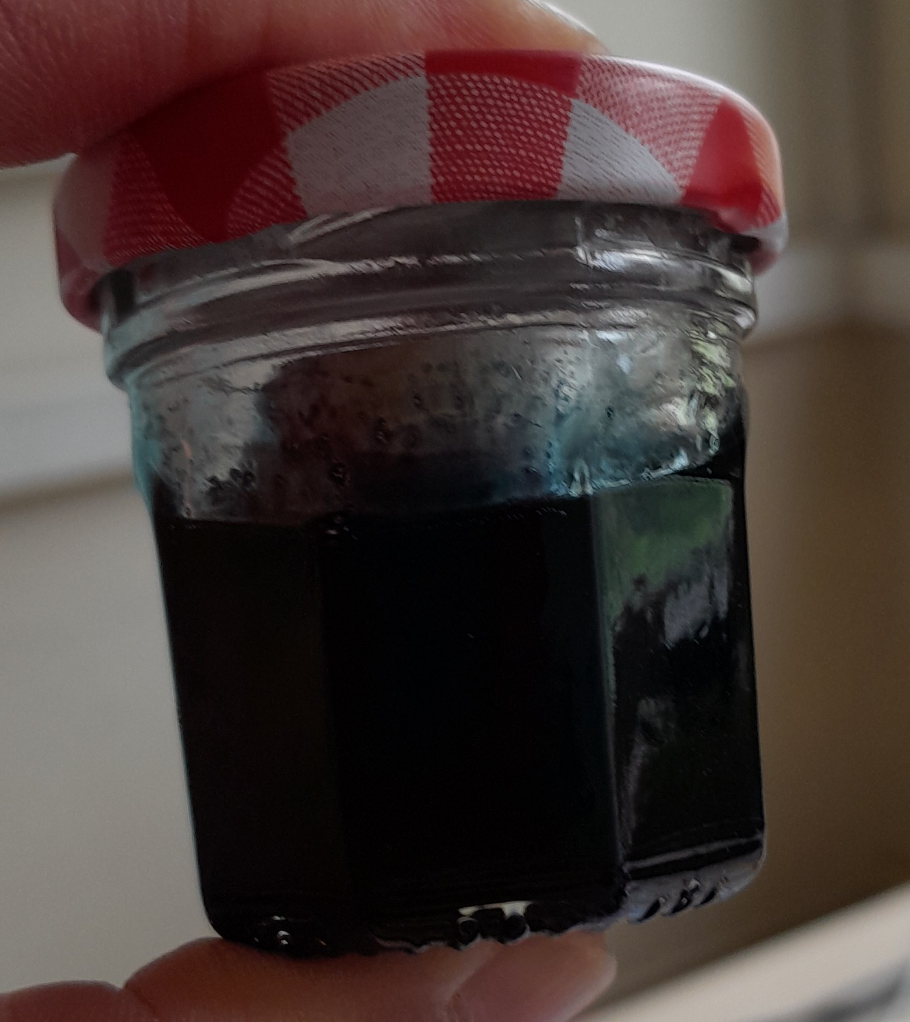
GRAiNITA test bench updates: April 2024
The heavy liquid inside the TROLL-2 became totally non-transparent (dark blue color)!!!!
Red-Ox rection between W⁺⁶ (heavy liquid)
and Al(TROLL’s body)
precipitation of blue
tungsten oxide WO_{2.72-2.9}
Experimental proof
piece of Al immersed into heavy liquid after ~20 hours

Slide 5

GRAiNITA test bench updates: April 2024
The Troll-2 and grains were successfully washed with water. No damage was found “by eye” ☺
To check if the TROLL-2 is still functioning well after ”heavy liquid disaster” we have started the cosmic run for ZnWO₄+water (ongoing)

Slide 6
Possible scenarios
Making of the TROLL-3 from another materials:
stainless steel – possible but very problematic
since it is very difficult to machine the stainless steel…
PMMA – possible but maybe it is not “strong” enough
2. Using of H₂O₂ (hydrogen peroxide or “l’eau oxygénée”) to avoid the Red-OX reaction - possible but
additional experiments are needed to find the proper concentration of H₂O₂
the effect of H₂O₂ can be non-permanent

Slide 7
Steps in the nearest future
Producing of the TROLL-3 with Y-11 WLS fibers to perform the tests with CaWO₄ grains (dry and with water, no heavy liquid).
Doing the tests for CaWO₄ grains using TROLL-2. Of course, O-2(300) WLS fibers are far from perfect for detection of the CaWO₄ luminescence, but at least we can estimate the yield from CaWO₄ (with O-2(300) the yield should be 2 times lower than with Y-11)

