Slide 1
Study of the energy escaping from the GRAiNITA electromagnetic calorimeter.
Denys Klekots
(Taras Shevchenko National University of Kyiv)
denys.klekots@cern.ch denys.klekots@gmail.com

Slide 2
Outline
Introduction.
Considered ways of energy escaping.
Event-wise distribution of energy escaping.
Energy escaping vs position of the hit.
Prediction of the escaped energy.
High exit-escape energy events.
1 GeV gamma results.

Slide 3
Resolution: constant term simulation. Quick recap
The energy accuracy of ECAL is usually parametrized as $\sqrt{{\left(\frac{x}{\sqrt{E}}\right)}^{2}+y^{2}}$. Where y is the ”constant term” usually caused by leakage or non uniformity.
Next step if the scan of the small prototype with testbeam muons gives nonuniformity as in LHCb (plot => +-6% Grainita ?)
Simulation is held in the box volume with dimensions 168 x 168 * 400 mm.
Volume is simulated as with one material:
4.53 $\frac{g}{{cm}^{3}}$ (partial density) of ZnWO4
1.19 $\frac{g}{{cm}^{3}}$ (partial density) of heavy liquid

Slide 4
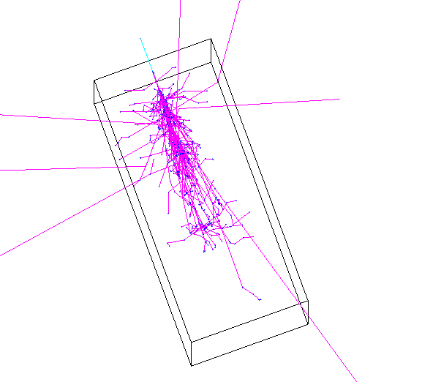
Energy escaping notation
Primary gamma 25 GeV
Geant4 simulation was made to calculate the effects of the energy escaping.
The simulated primary gamma (25 GeV in this presentation) hit the top face of the detector.
The following ways of energy escape were counted:
Escape from the entry facet
Escape from the exit facet
Escape from the side facets
Escape into nuclear reactions (about 100 MeV ± 40 MeV)
Entry facet
Side facet
Exit facet

Slide 5
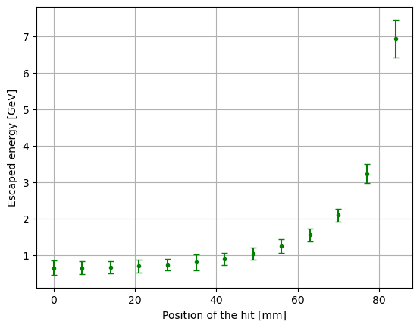
Escaped energy vs gamma energy point. Quick recap
The figure describes the dependence of the escaped energy on the position of the gamma quanta entry point. The step size is 7 mm.
Top view
gamma entry
position
y
x

Slide 6
Distributions of the escaped energy
The 1000 events were generated

Slide 7
E escaping vs hit position
Dots give a mean value.
Error bars give the Gaussian sigma.
Top view
gamma entry
position
168 mm
168 mm

Slide 8
Escaped energy prediction
If a hit is far from the detector edge, the uncertainty of the escaped energy is under 1%.
The light collection in the prototype is in the bands of the light fibers.
What if one could find the correlation between how much energy escaped through the side facet and how much was deposited near that facet?

Slide 9
Centre-close hit Edep vs Eesc calibration
If the primary gamma hits near the center of the detector there is no correlation between energy escaping through the cell edge and the energy deposited in this cell.
The energy that escaped through this edge is shown in the plot

Slide 10
Edge-close hit Edep vs Eesc calibration
Good correlation for close to the edge hits
Escaped energy can be predicted based on deposited energy in such cases.
The energy that escaped through this edge is shown in the plot

Slide 11
High exit-escape energy events
Preshower ⇒ more than 20 MeV in first 64 mm (4X0) of volume.
1000 events were simulated.
65 events were without preshower.
111 events had exit-escape energy of more than 250 MeV:
66 with preshower
45 without preshower

Slide 12
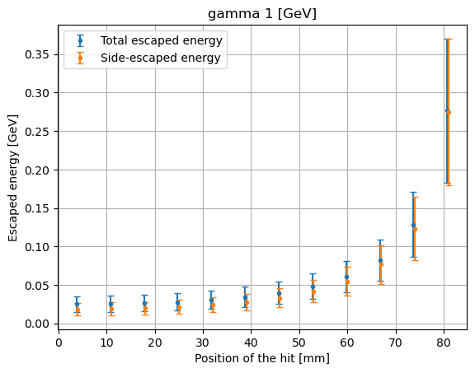
Results for 1 GeV gammas
Side-escape [MeV] | 1 GeV |  |  | 25 GeV
Hit position | Mean [MeV] | RMS [MeV] | Sigma [MeV] | Mean [MeV] | RMS [MeV] | Sigma [MeV]
3,5 [mm] | 18,38 (1,83%) | 9,21 (0,9%) | 7,88 (0,78%) | 447,92 (1,79%) | 43,98 (0,18%) | 44,7 (0,18%)
59,5 [mm] | 54,58 (5,45%) | 22,26 (2,2%) | 18,7 (1,87%) | 1343,47 (5,37%) | 110,08 (0,44%) | 109 (0,44%)
The escape energy (relative to primary gamma energy) is similar to 25 GeV, but the fluctuations are much larger.
Larger fluctuations are due to fewer particles in the shower.

Slide 13
Conclusions
The result of the simulation shows that most of the energy is escaping from the side facets.
The escaping energy can be predicted with deflection from a mean value under 1% for most of the detector region (except close to the detector edge).
In case the hit is close to the detector edge, the escaped energy is calibrated with deposited energy in the last cell, which gives the possibility to predict escaped energy with a deflection from a real value under 1%.
Relative energy escape is similar for 1 GeV gamma and 25 GeV, but fluctuations are lower for larger gamma energies.

Slide 14
Thank you for your attention

Slide 15
Backup slides

Slide 16
Geant4 simulation setup
Simulation is held in the box volume with dimensions 168 x 168 * 400 mm.
Volume is simulated as with one material:
4.53 $\frac{g}{{cm}^{3}}$ (partial density) of ZnWO4
1.19 $\frac{g}{{cm}^{3}}$ (partial density) of heavy liquid
Projectile particle energy - deposited energy = escaped energy
escaped energy ≠ The sum of energy of escaped particles

Slide 17
Escaped energy fluctuations
The 1000 events were simulated for the gamma quanta of the 25 GeV with an entry point in the axis of the simulated box.
The histogram shows the distribution of the escaped energy on event event-wise basis.
$$RMS= \sqrt{\frac{1}{N}\sum_{i=1}^{N}{{\left(E_{i}−μ\right)}^{2}}}$$
$$N=1000$$

