Slide 1


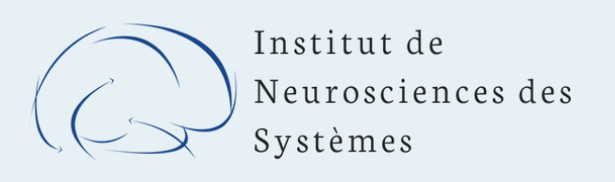



Optically Pumped Magnetometers for recording brain activity
CG Bénar & JM Badier
Institut de Neurosciences des Systèmes, Marseille
Séminaire CPPM 27 may 2024

Slide 2
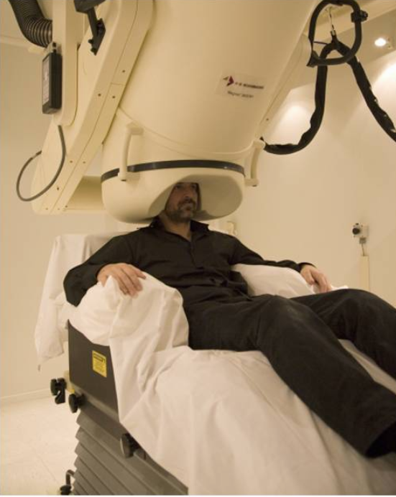
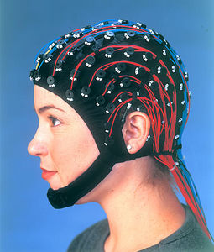
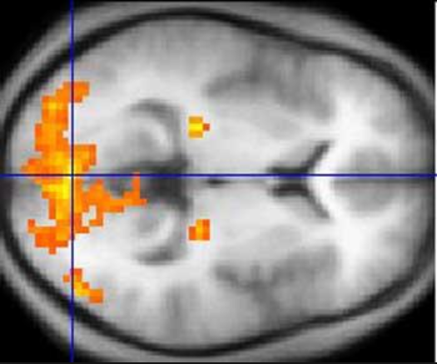
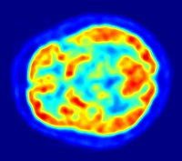
Non-invasive brain mapping
Functional MRI (fMRI)
Positron Emission Tomography (PET)
Electroencephalography
(EEG)
Magnetoencephalography
(MEG)
Imaging
High spatial resolution (mm)
Low temporal resolution
Electrophysiology
High temporal resolution (ms)
Requires solving an inverse problem

Slide 3


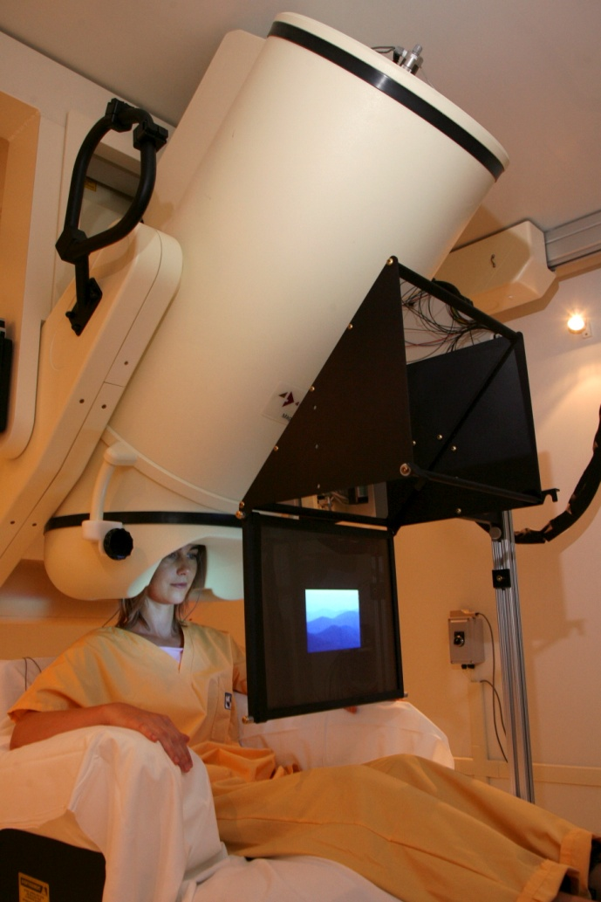




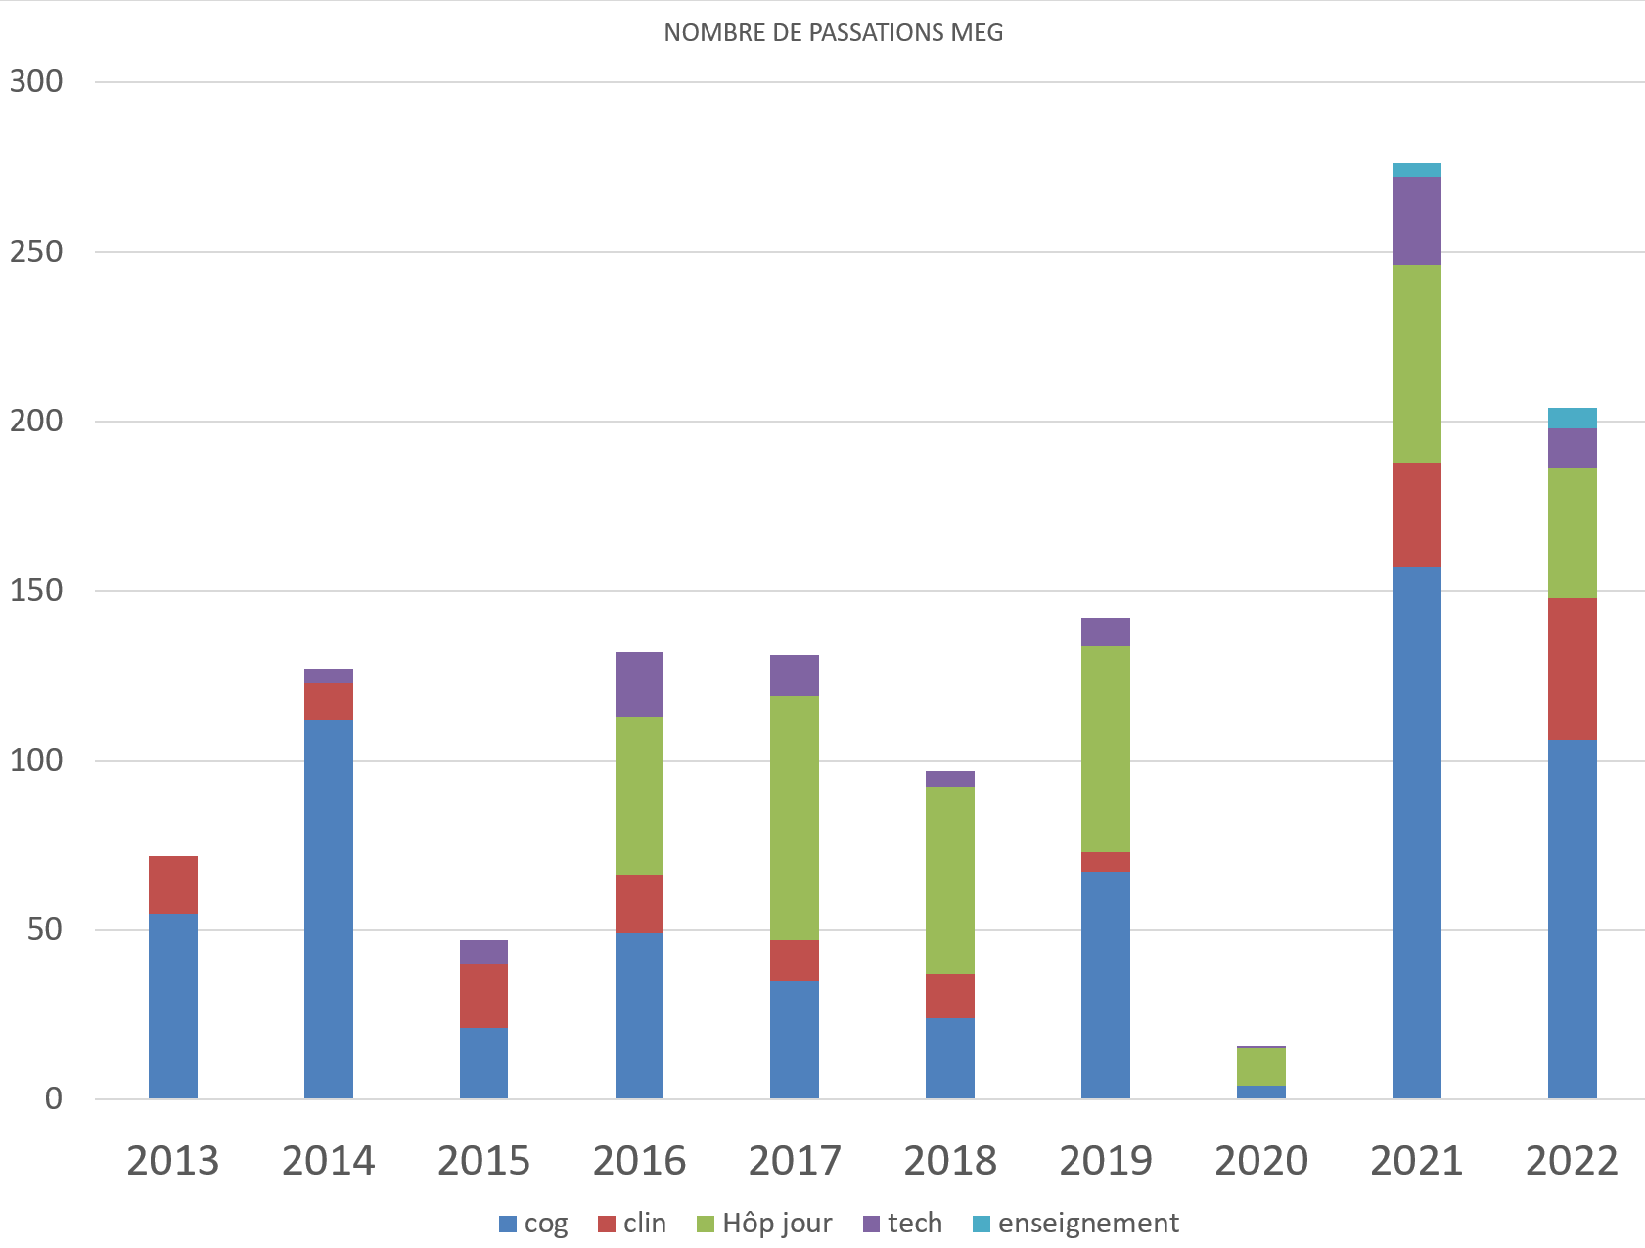

The MEG Platform
Open to the community (fundamental and clinical research)
  large scale projects (RHU, ERC, AMU institutes)
  strong link between AMU and APHM
Agreement with APHM and ARS for a day hospital (only one in France)
http://meg.univ-amu.fr
Operational manager: JM Badier
Scientific manager: CG Bénar

Slide 4
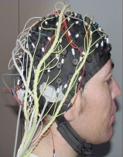
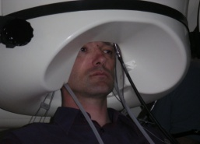
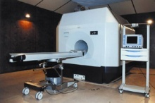
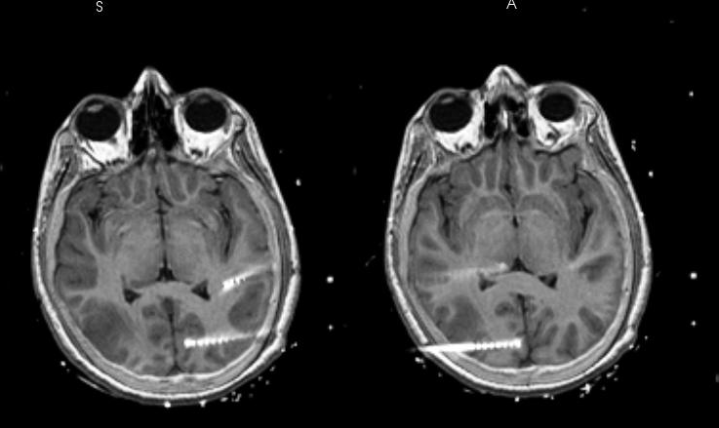
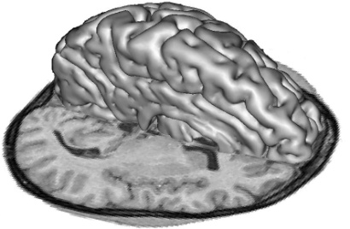
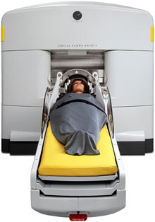
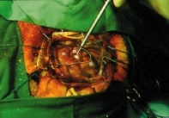
Presurgical evaluation of epilepsy
Phase 1
Phase 2
Semiology (video)
Imaging
(MRI, PET)
EEG
MEG
Intracerebral EEG
Cognition
Epilepsy
?
Surgery

Slide 5
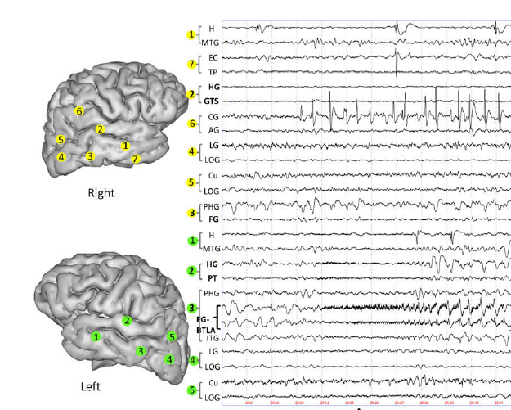
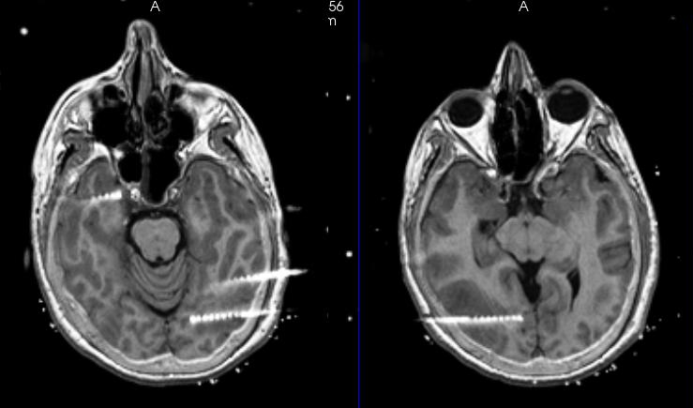
Intracerebral EEG
Trebuchon da Fonseca et al 2009
See Bancaud and Talairach 1962

Slide 6
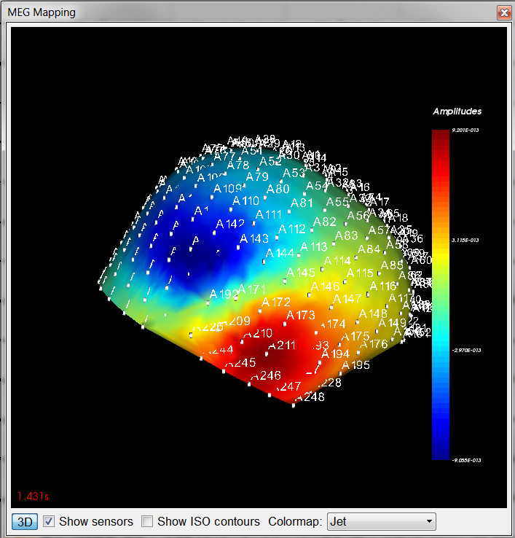
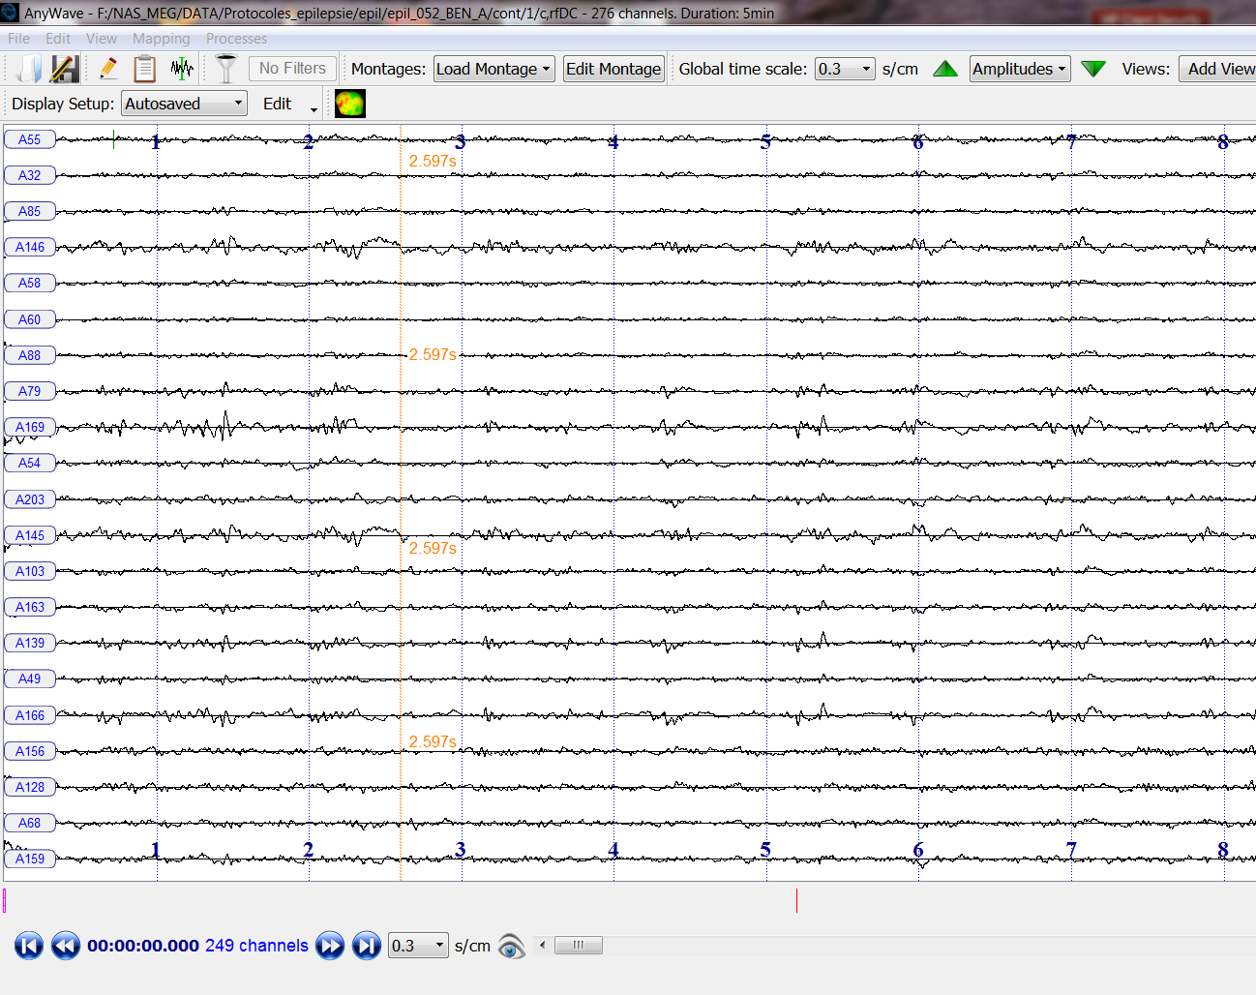
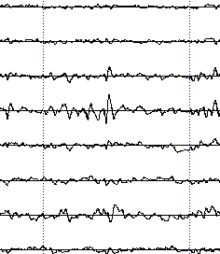
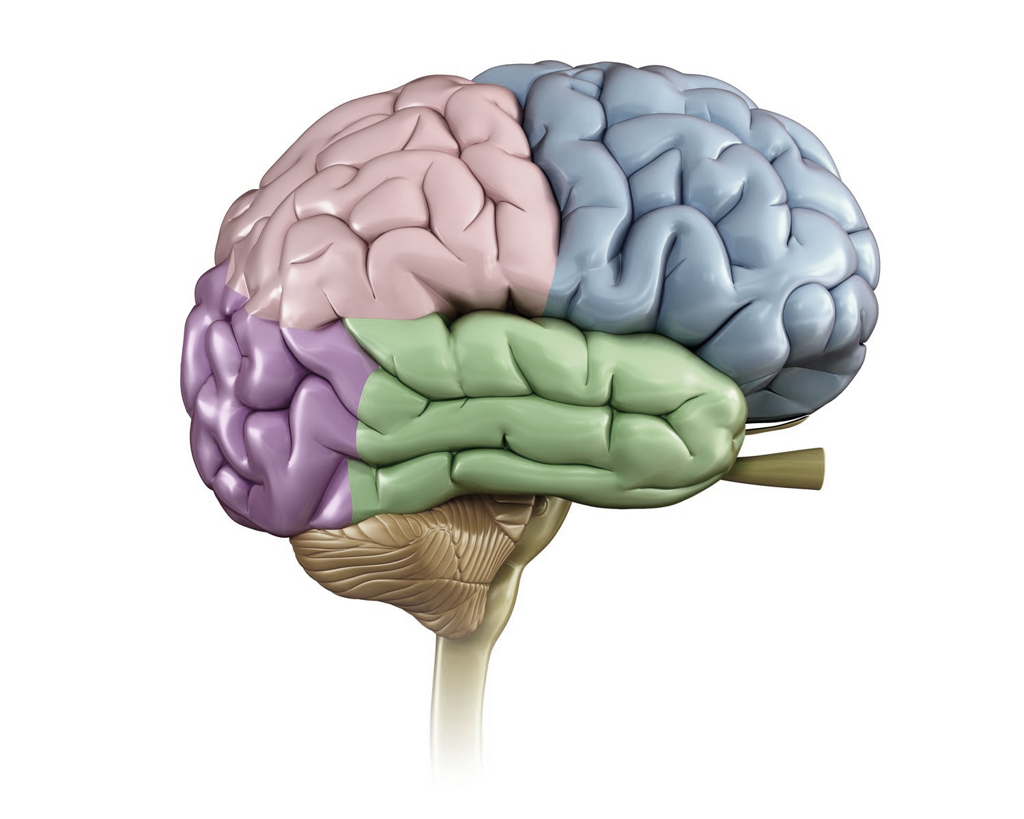
Epileptic discharge in MEG
?
Where does it come from in the brain?
Il –posed inverse problem: we need models and constraints
Anywave software meg.univ-amu.fr

Slide 7
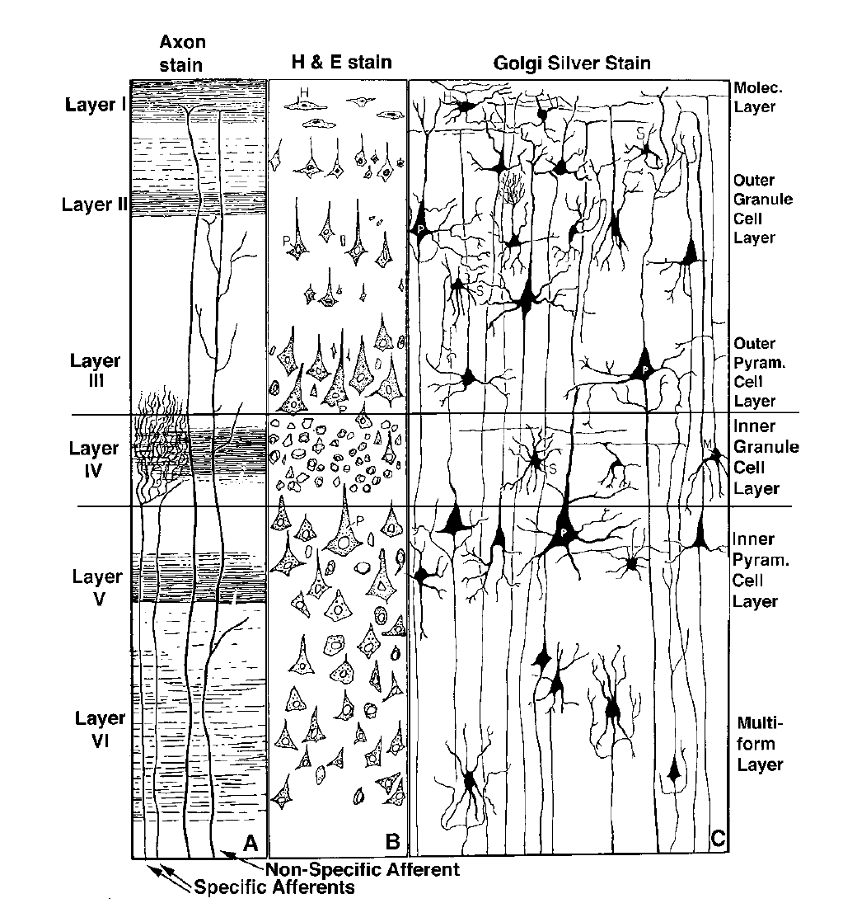
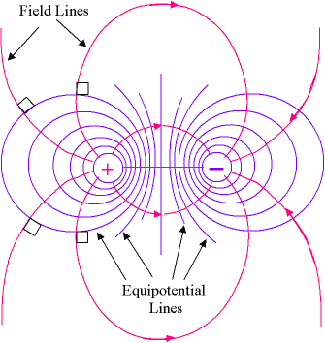
A model of brain sources: the current dipole
puits
source
Seen from far enough, a small patch of cortex is equivalent to a current dipole

Slide 8
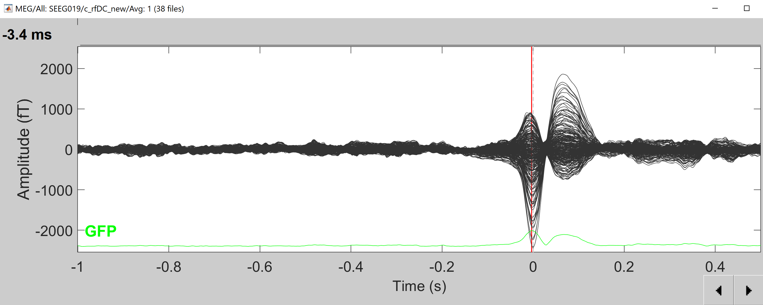
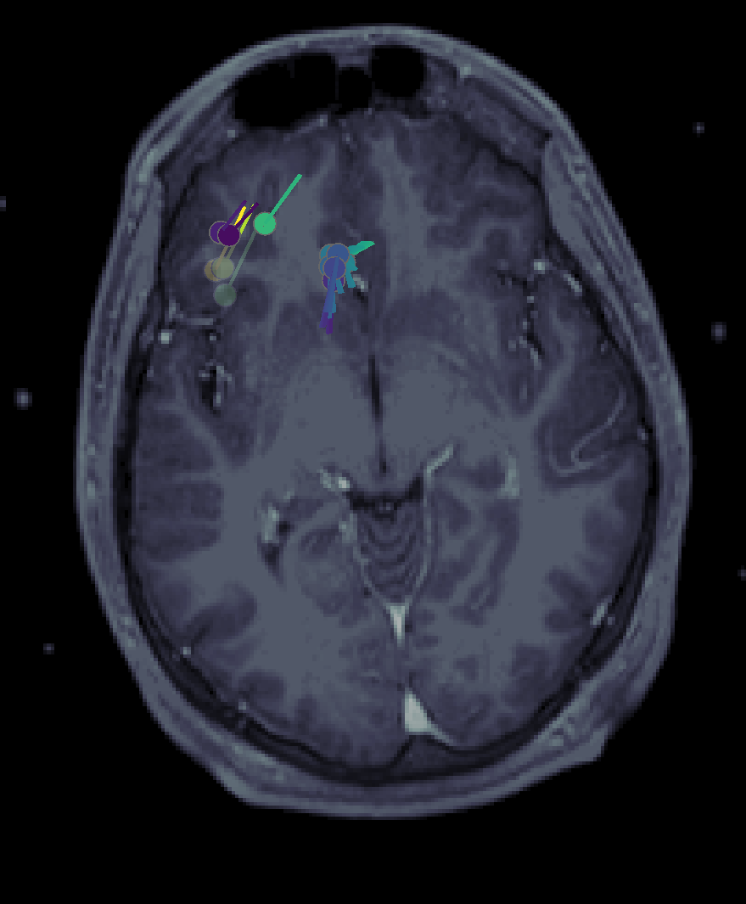
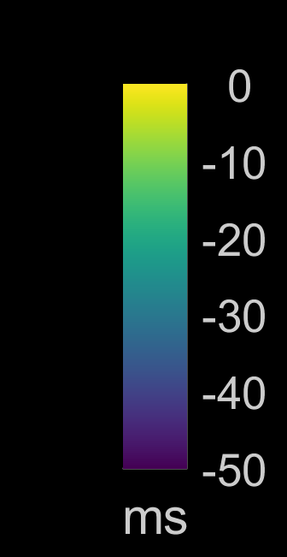
Dipole source localization
Average of 38 spikes
Moving dipole
MEG- Brainstorm

Slide 9
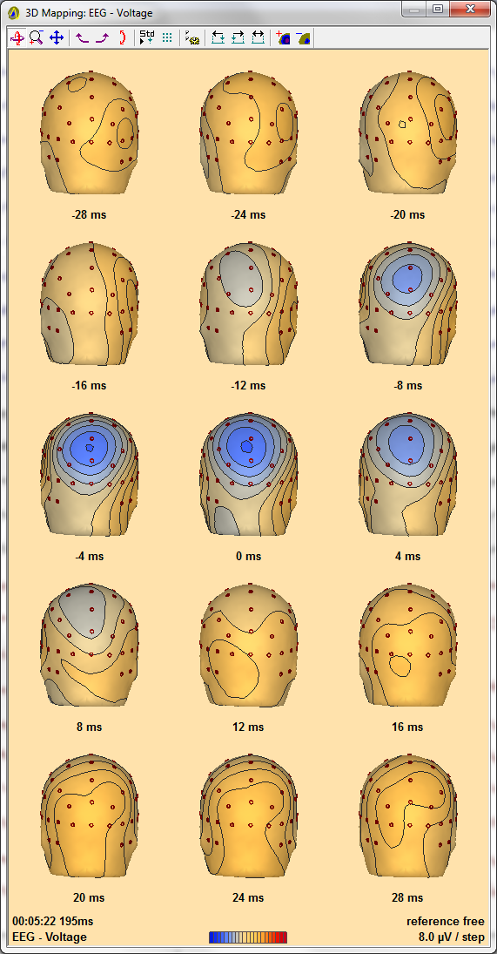
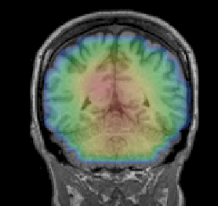
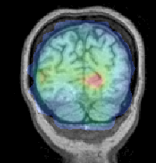
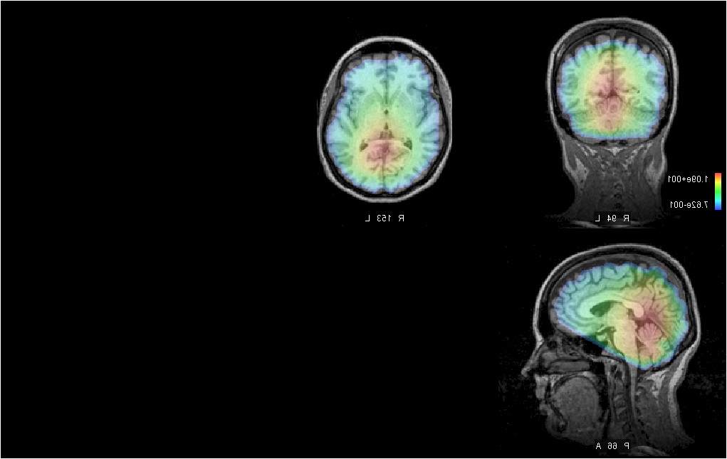
EEG versus MEG (1)
EEG
MEG
1
2
3
1
2
3
L
R
L
R
L
R
4
5
6
4
5
6
Gavaret et al Brain Topogr 2016
MEG fields are orthogonal to EEG fields
MEG fields are not smeared by the skull low conductivity unlike EEG

Slide 10
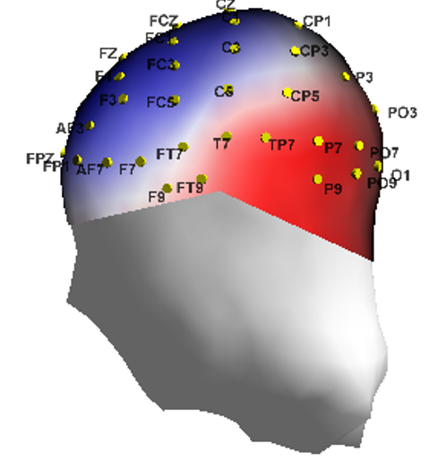
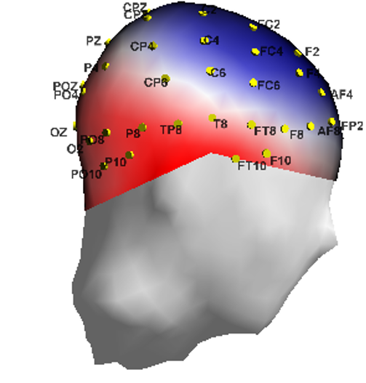
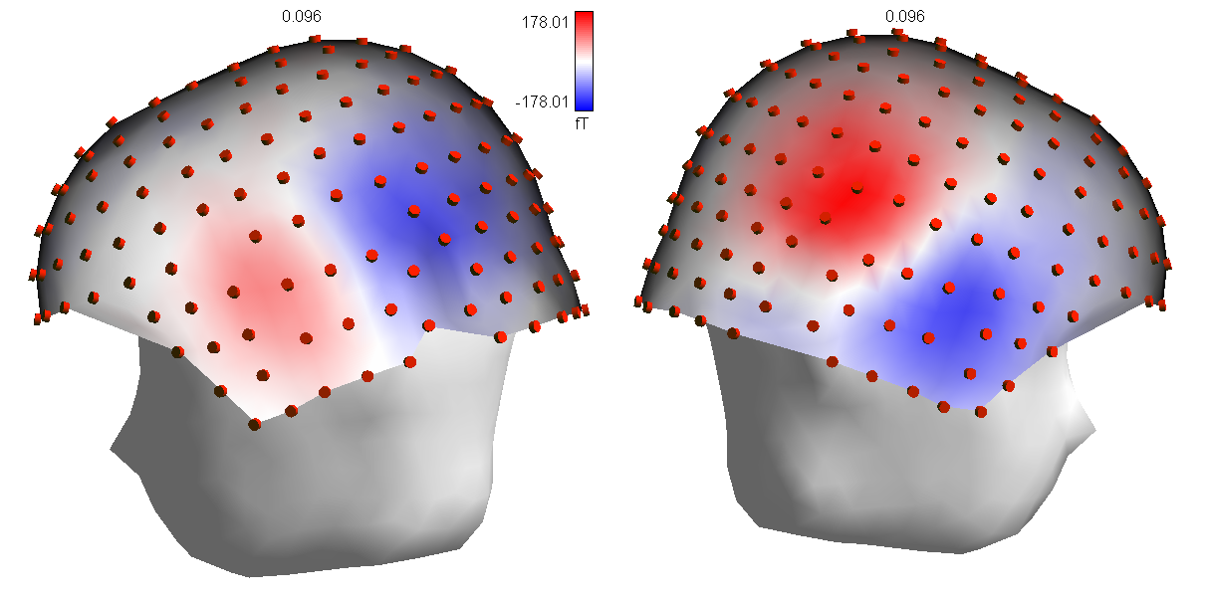
EEG versus MEG (2)
EEG
MEG
auditoryN/M100

Slide 11
Important methodological questions
There are many (many!) different solutions to the inverse problem (from surface measures to the brain).
  How do they compare ?
  How to tune their parameters?
Can one see deep sources from the surface (mesial temporal regions)
  Important in epilpsy and cognition
  Can we avoid implanting depth electrodes?

Slide 12
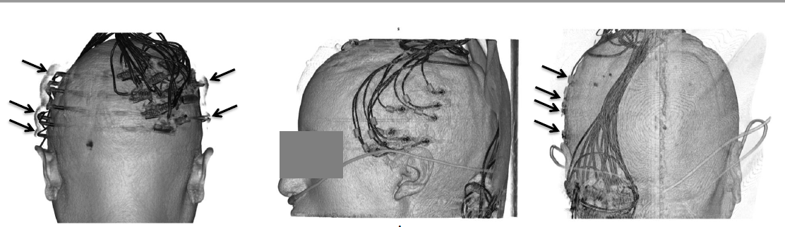
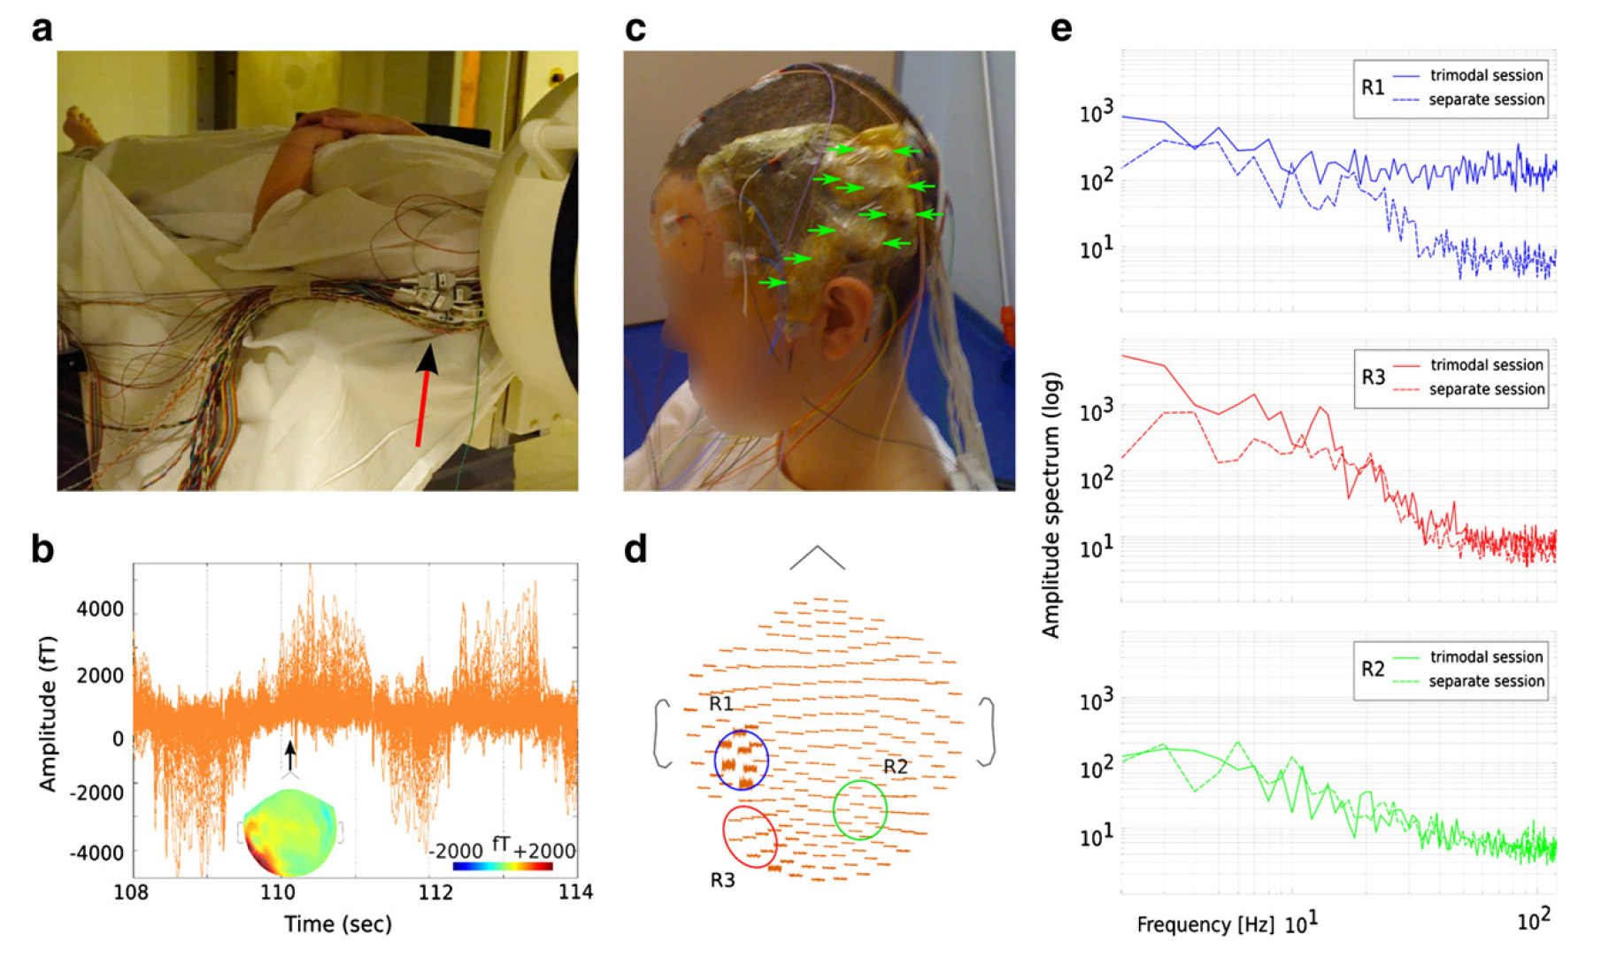
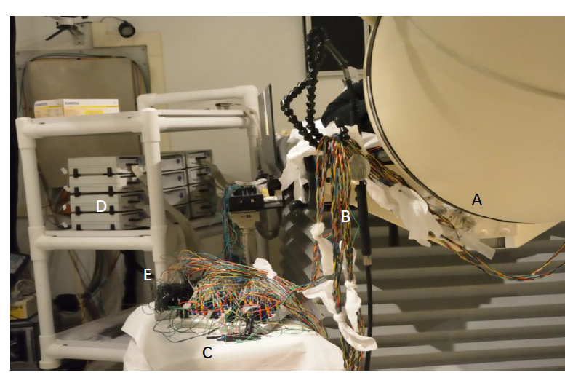
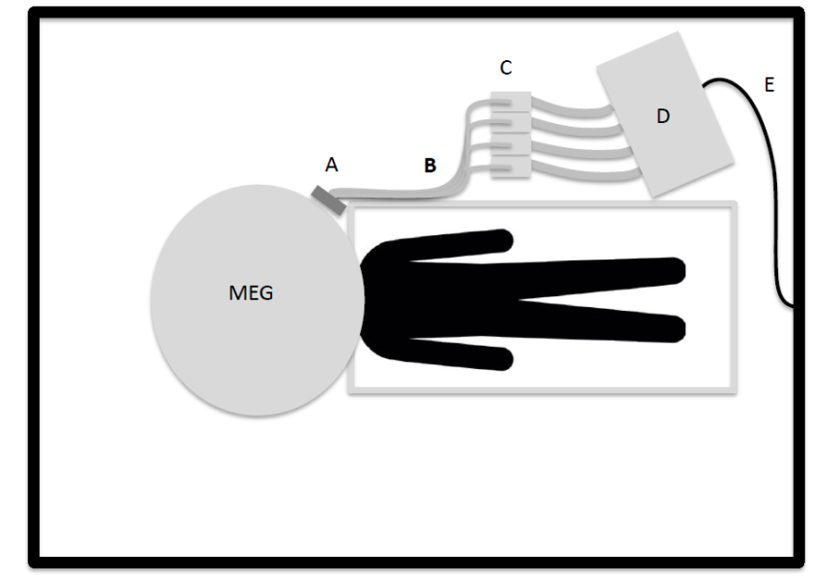
Simultaneous MEG/SEEG recordings
Dubarry et al Neuroimage 2014
Badier et al J Physiol Meas 2016

Slide 13
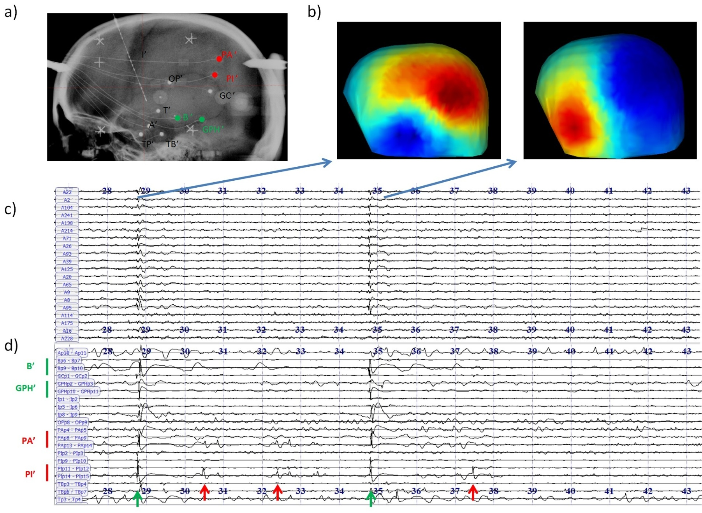
Example of Simultaneous MEG-SEEG recordings
Bénar Gretsi 2016, Badier et al J Physiol Meas 2017

Slide 14
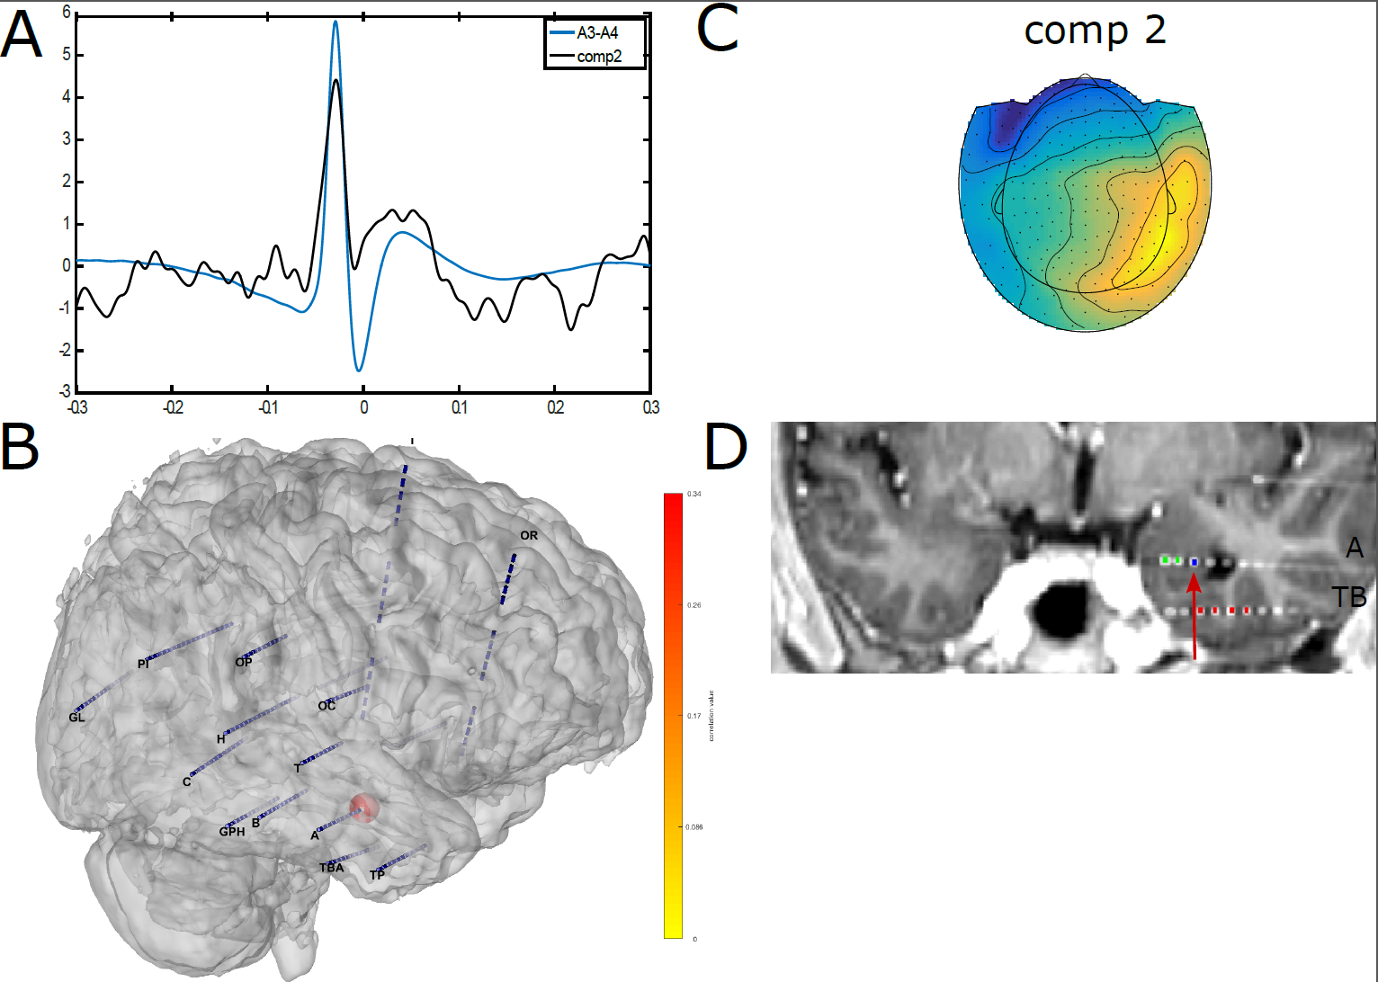
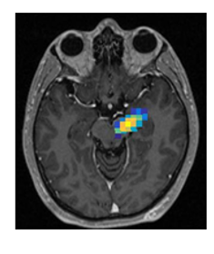

Extraction of deep sources from MEG
Pizzo et al Nat Comm 2019

Slide 15
Limitations of current MEG sensors
Require supra conductivity:
  cumbersome and expensive
  Fixed helmet (problematic in children, no control of spatial sampling)
a new generation of sensors has arrived, the OPMs, that have the potential to replace the classique SQUIDs

Slide 16
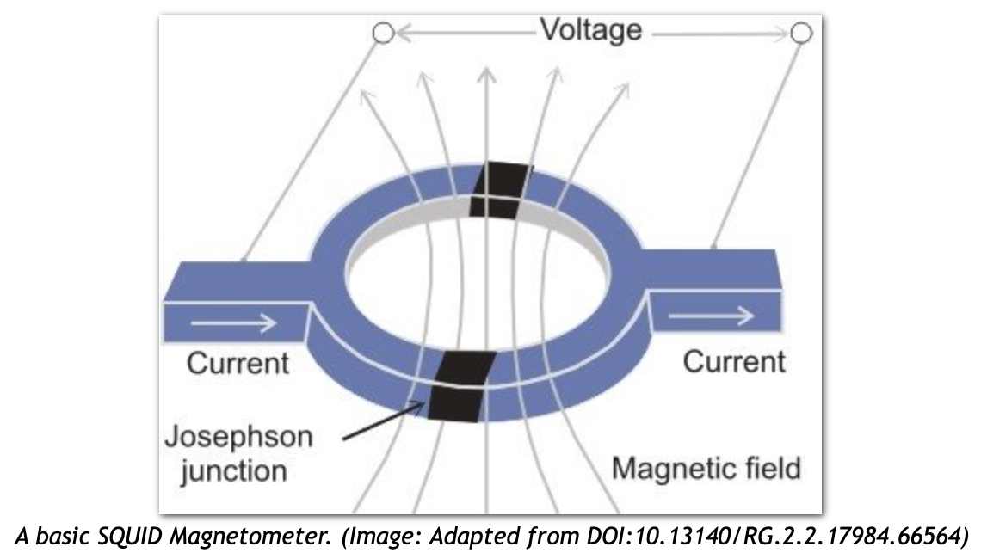
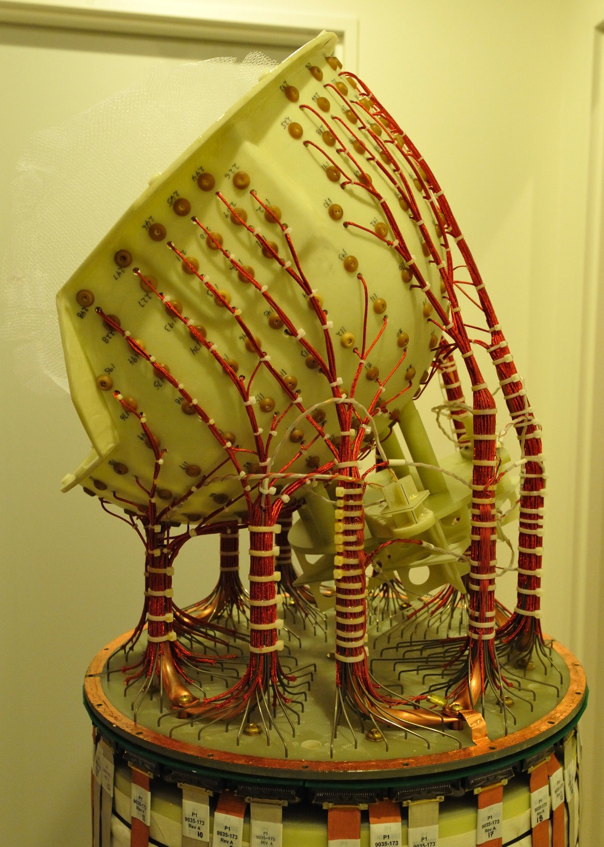
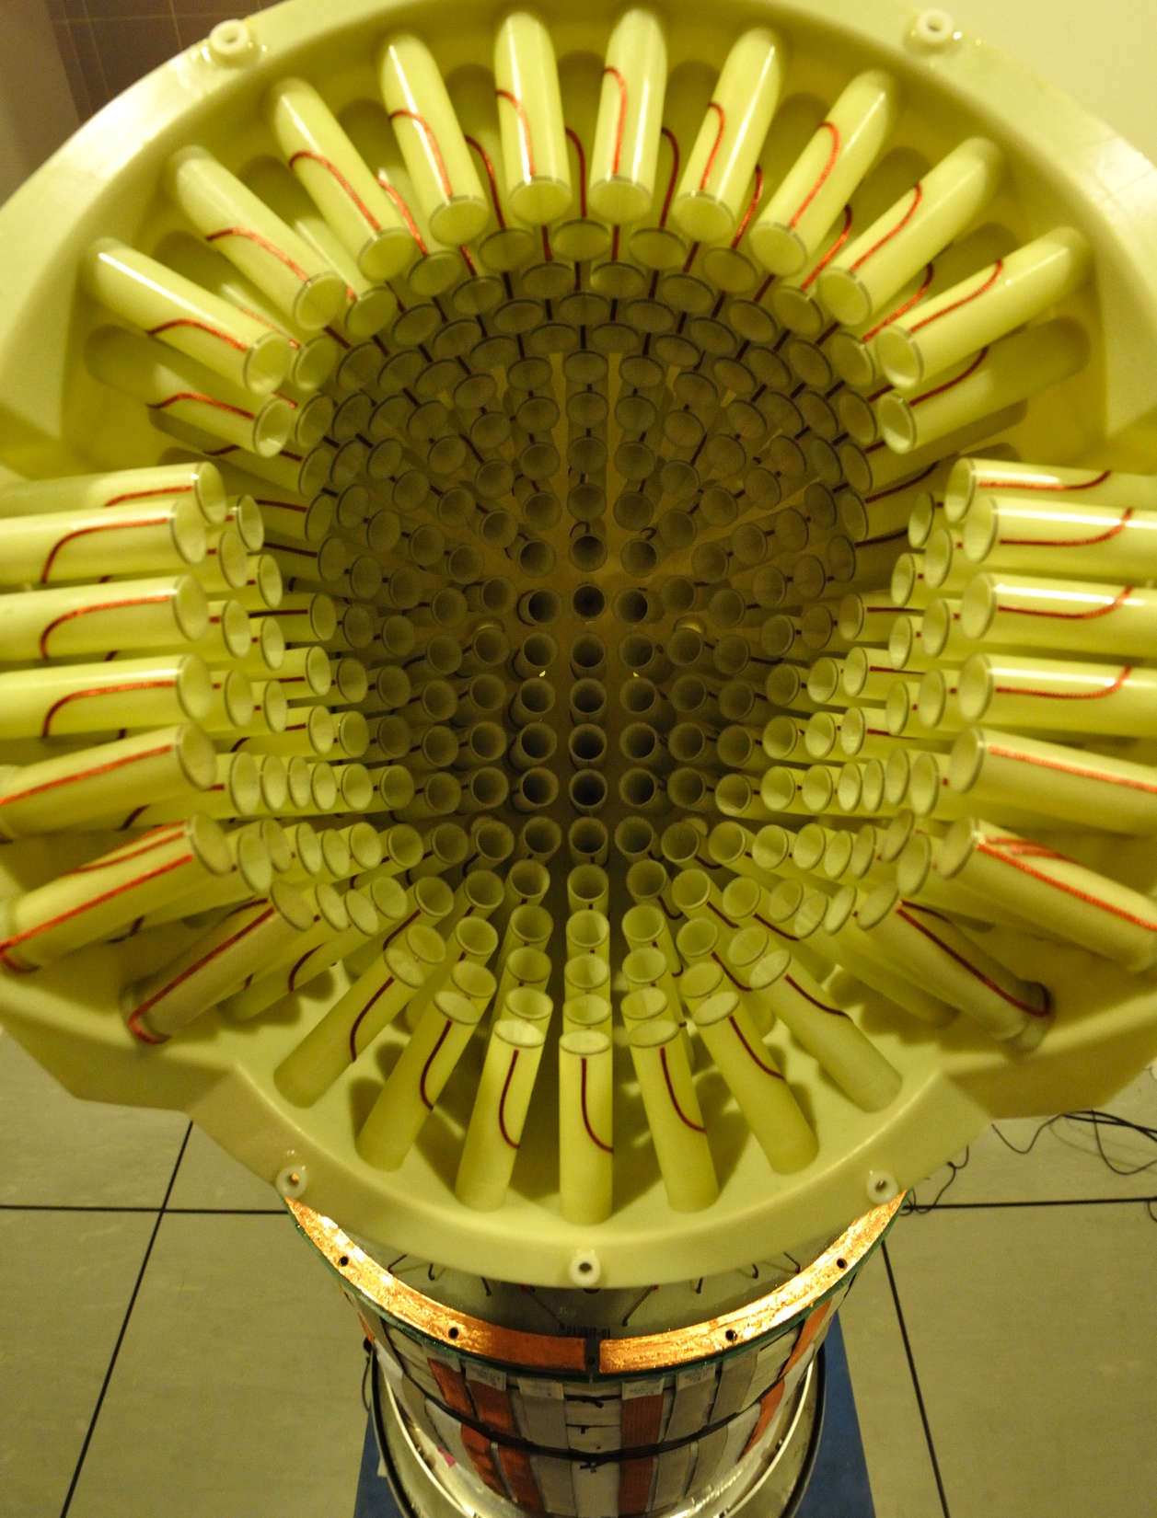
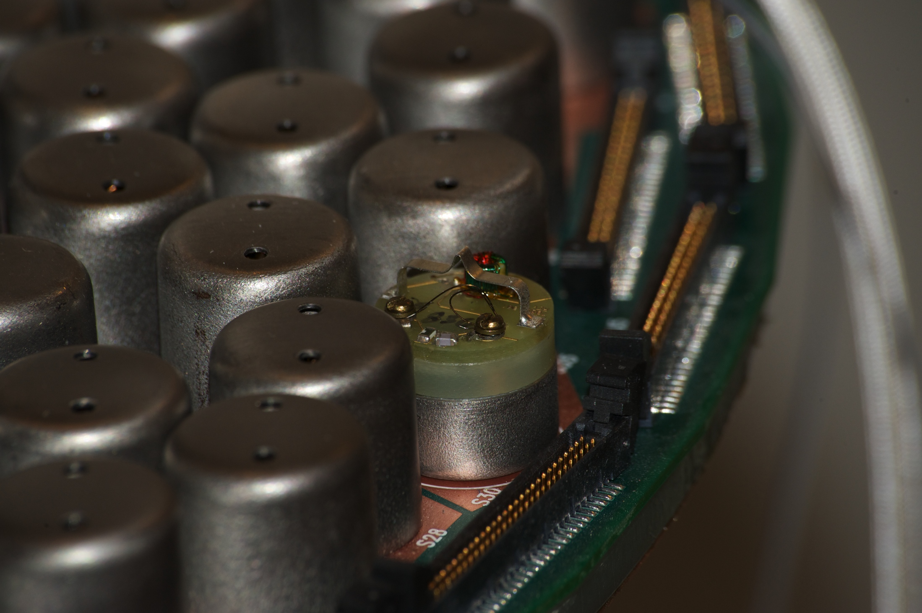
Current sensor: Superconducting QUantum Interference Device (SQUID)

Slide 17
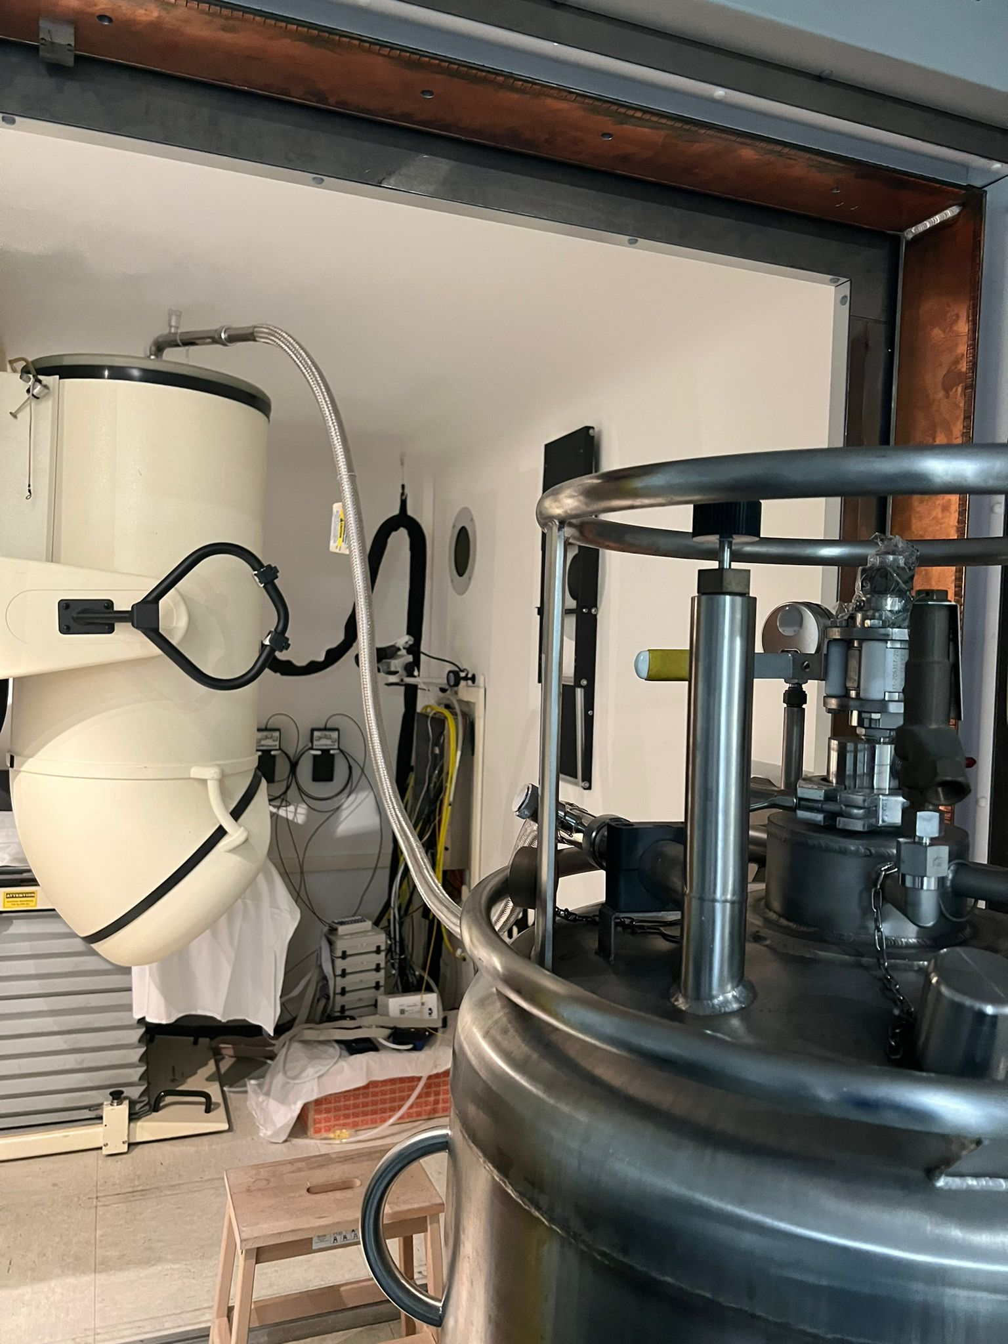
Why so few MEG labs?
Using cryogenic technology:
  Complex maintenance
  Use of liquid helium: Economic and ecological problems
Fix size of the sensor
No movement during recording
-> High cost

Slide 18
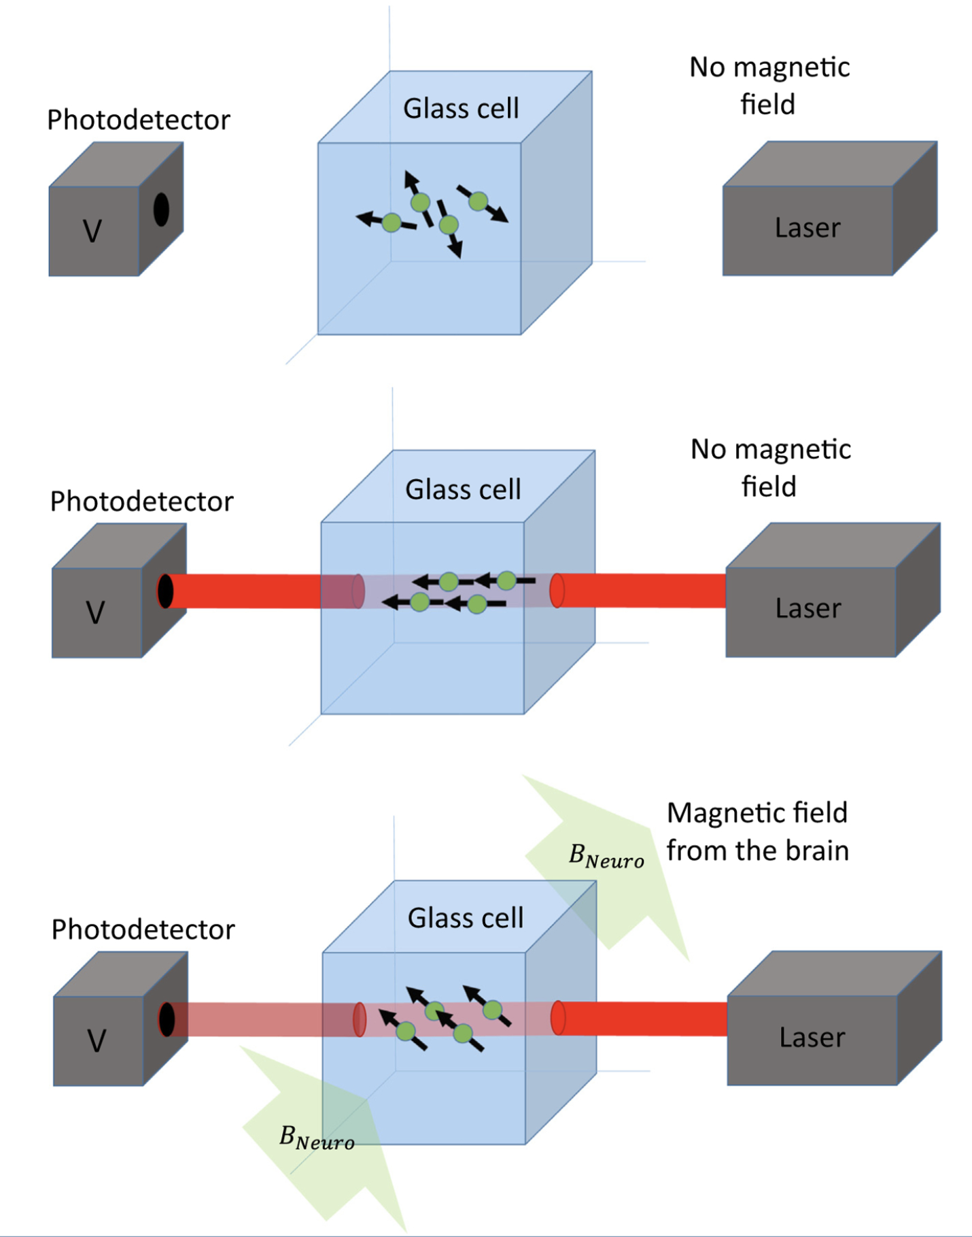
Opticaly Pump Magnetometer
Simple description for non-physicists (us)
Alkali OPMs (rubidium)
Brookes et al. 2022

Slide 19
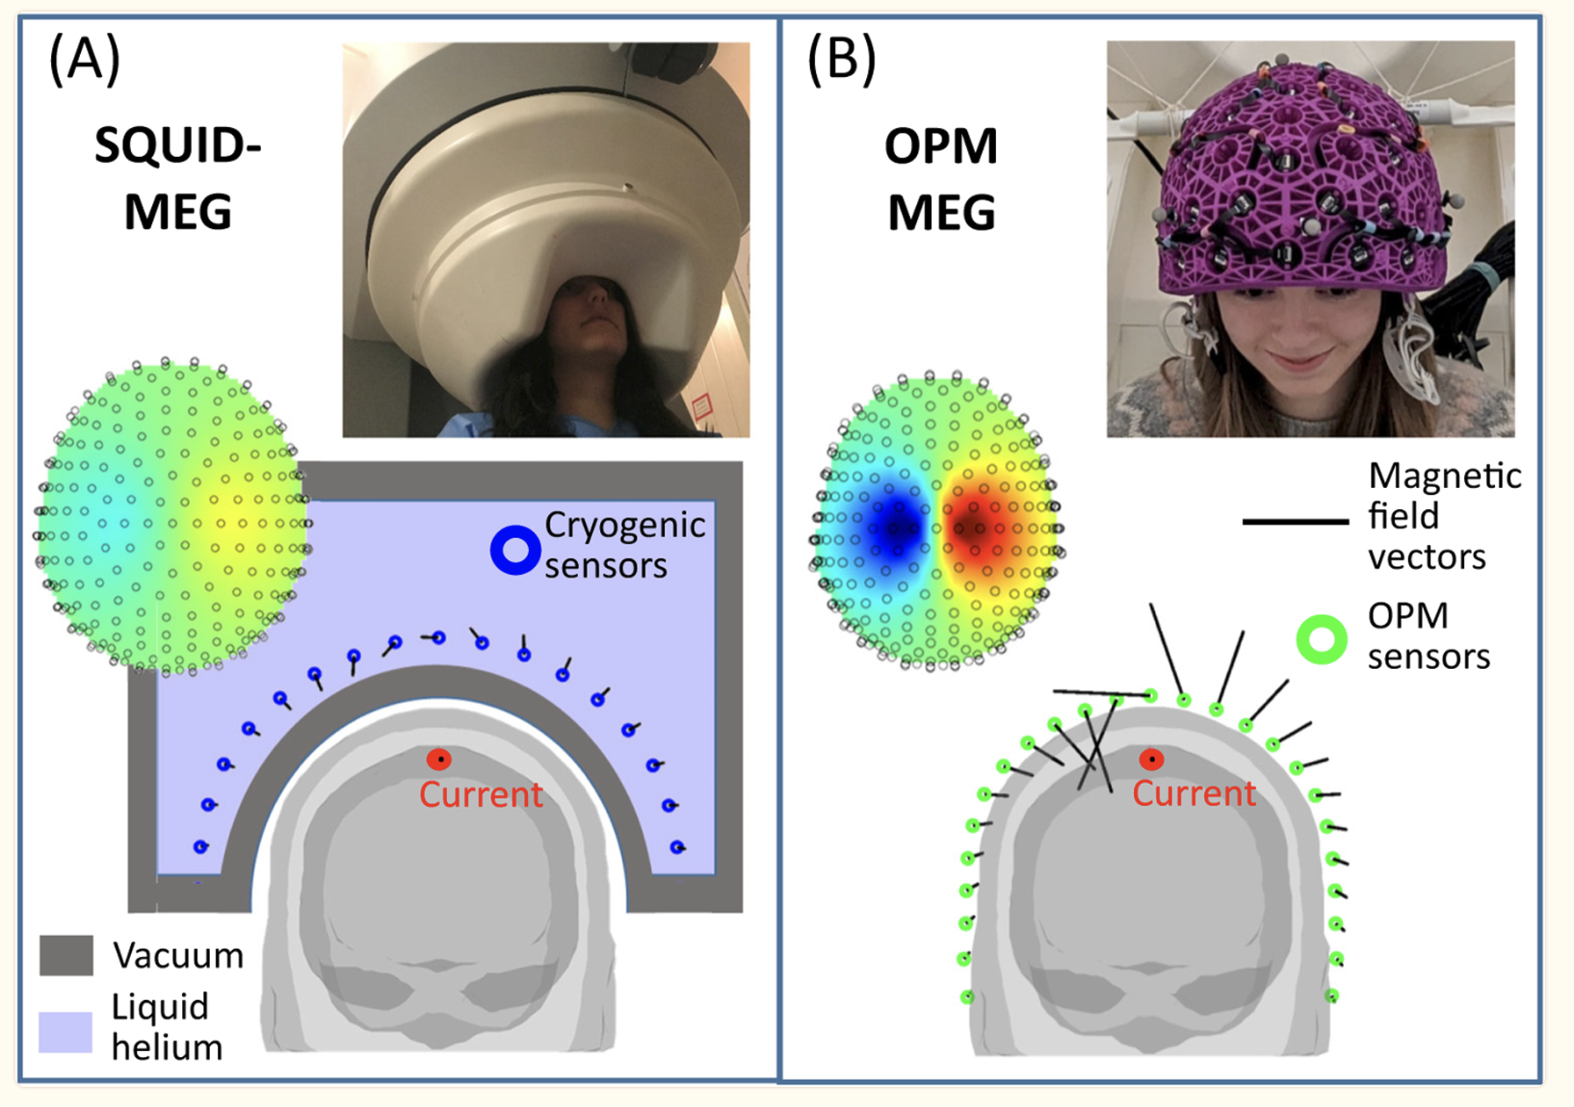
OPM v. SQUID. Amplitude of the fields
Brookes et al. 2022

Slide 20
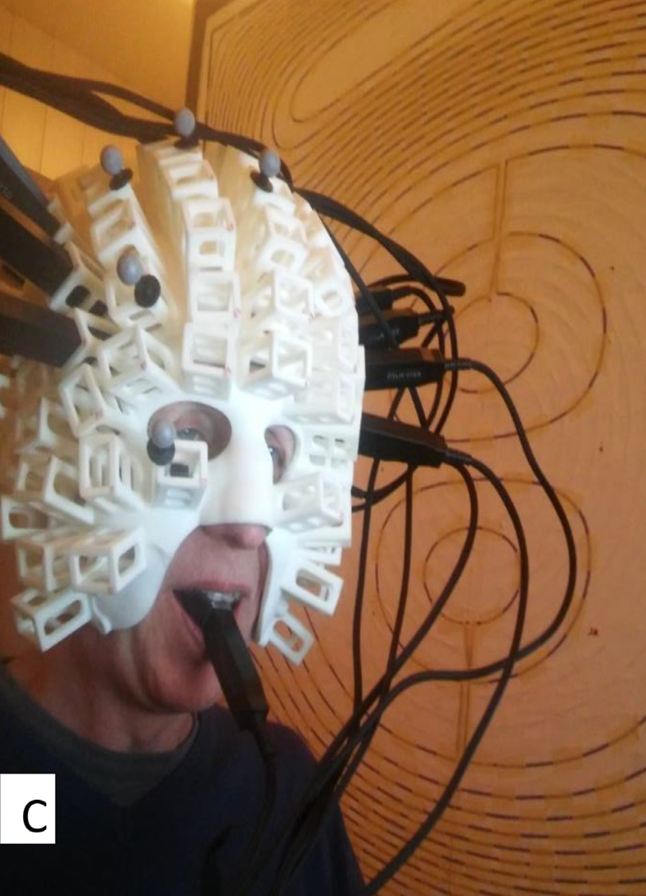
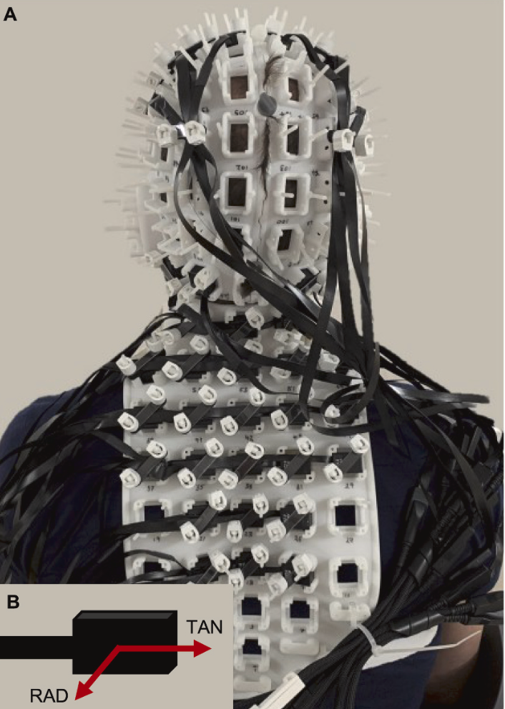
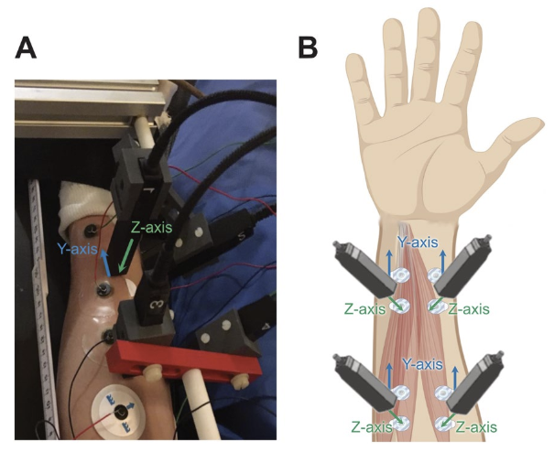
New advances:
Epilepsie. Vivekananda et al. 2020. Mellor et al. 2021. Feys et al. 2022. Badier et al. 2023.
Pédiatric applications. Feys et a. 2021. Boto et al. 2022.
Portable systems. Boto et al. 2018. Pedersen et al. 2022. Seymour et al. 2022. Rhodes et al. 2023.
Peripheral nerves. Bu et al. 2022, Greco et al. 2023, Mardel et al. 2024.
Neuromuscular pathologies. Sometti et al. 2021. Semeia et al. 2022.
…
Tierney et al. 2021
Mardell et al. 2024
Greco et al. 2023

Slide 21
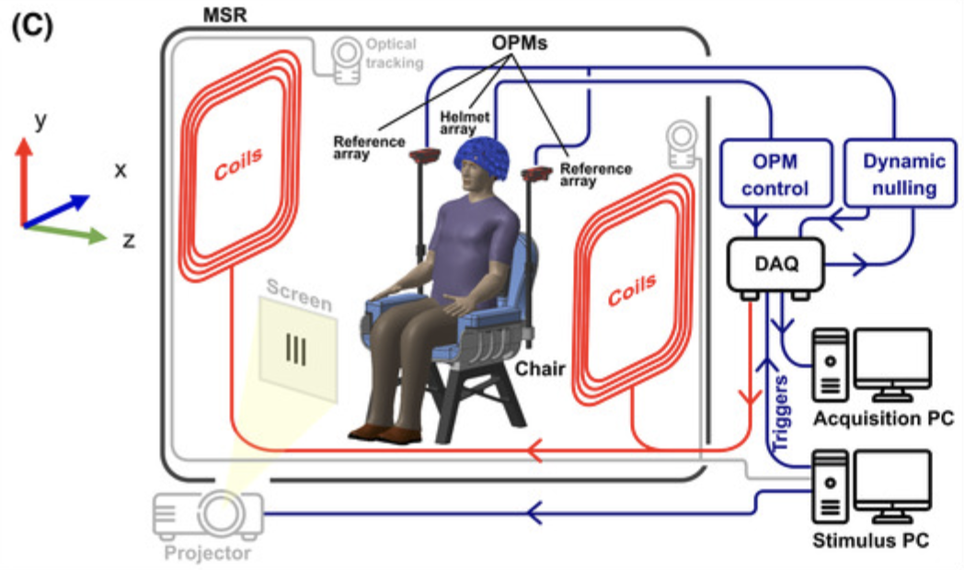
Zero-field-> compensation coils
Rea et al. 2022

Slide 22


OPMs and OPMs !
Alkali
⁴He
Limited dynamic ± 1.5 nT
Requires compensation to obtain a field close to zero
Sensitivity < 15-23 fT/√Hz
Limited bandwidth: < 100 Hz
Vectorial measurement possible
Heat dissipation (150°c) !
Higher dynamic ±125 nT
No need for compensation coils.
Sensitivity <30 fT/√Hz
High bandwidth: DC-2 kHz
Current sensor size
Vectorial measurement by construction
Operation at room temperature
Squid:
- Dynamic: 16 nT
- Sensitivity: 5 fT/√Hz
https://quspin.com/products-qzfm/
Mag4Health

Slide 23


OPM et épilepsie (⁴He)
Nb : Vectorial measurment
D. Schwartz et al. Cermep. CRNL
E Labyt et al. Mag4Health

Slide 24


OPM versus SQUIDs ?
-> Enregistrements simultanés
SQUIDs
OPMs

Slide 25



Badier et al. 2023

Slide 26

OPM what we get:
Stronger signal amplitude
Higher spatial frequency (source distinction)
Tangential measurements for better magnetic field sampling
Miniaturization
Movement possible -> seizure recording
Schofield et al. 2024

Slide 27








NewMEG project
OBJECTIVES
1) validate a magnetoencephalography system using OPM sensors in a clinical context (testing and certification of a 48-sensor system)
2) develop a high-resolution system for clinical and fundamental research (prototype of an optimized 96-sensor system).
2 CIFRE PhDs
2 clinical protocols: epilepsy and head injury (AP-HM); collab F Bonini, O Félician, M Didic
Acquisition of a 96-channel system

