Slide 1
Algebraic description of the hydrogen atom hidden symmetry
Keti Sikharulidze
Summer School on Particle and Astroparticle Physics
Annecy, 2024

Slide 2
Introduction
To derive energy spectrum formula of hydrogen atom one has to go through solving the famous Schrödinger’s differential equation. Although Pauli was the first to realize that the accidental degeneracy was connected to some hidden symmetry, that later proved to be true.

Slide 3
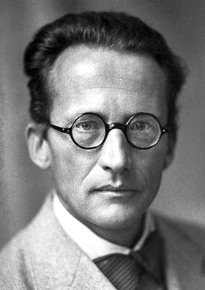

Slide 4
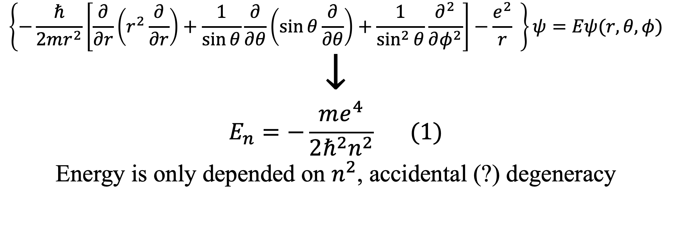
Schrödinger’s equation for hydrogen atom and energy spectrum
$$\left\{−\frac{ℏ}{2mr^{2}}\left[\frac{∂}{∂r}\left(r^{2}\frac{∂}{∂r}\right)+\frac{1}{\sin{θ}}\frac{∂}{∂θ}\left(\sin{θ\frac{∂}{∂θ}}\right)+\frac{1}{\sin^{2}{θ}}\frac{∂^{2}}{∂φ^{2}}\right]−\frac{e^{2}}{r} \right\}ψ=Eψ(r,θ,φ)$$
$$↓$$
$$E_{n}=−\frac{me^{4}}{2ℏ^{2}n^{2}} (1)$$
Energy is only depended on $n^{2}$, accidental (?) degeneracy

Slide 5
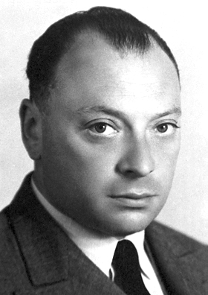

Slide 6

Laplace-Runge-Lenz vector
Classical: $Λ=\frac{1}{m}\left\{p×L\right\}−α\frac{r}{r}$
Quantum: $Λ=\frac{1}{2m}\left(\left\{p×L\right\}−\left\{L×p\right\}\right)−α\frac{r}{r}$
Hamiltonian: $H=\frac{1}{2m}p^{2}−\frac{α}{r}$

Slide 7
This is what Mr. Zee had to say about some calculations

Slide 8
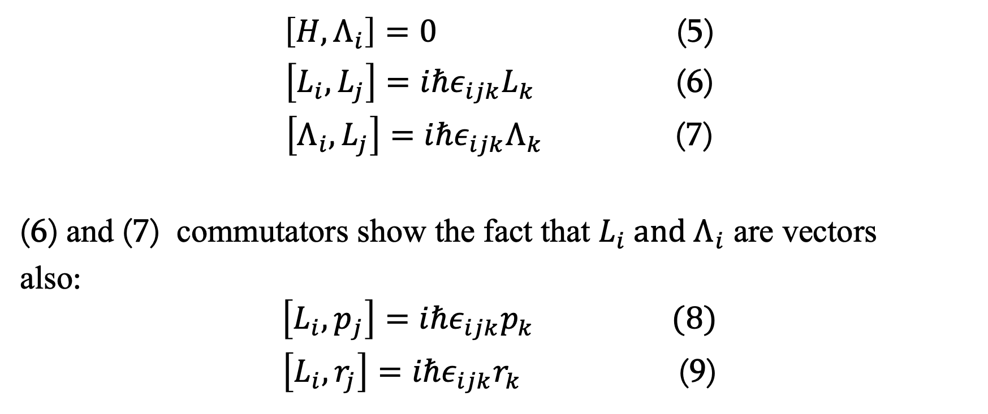
Following commutation relations hold:
$\left[H,Λ_{i}\right]=0$ (5)
$\left[L_{i},L_{j}\right]=iℏε_{ijk}L_{k}$ (6)
$\left[Λ_{i},L_{j}\right]=iℏε_{ijk}Λ_{k}$ (7)
(6) and (7) commutators show the fact that $L_{i}{ and Λ}_{i}$ are vectors
also:
$$\left[L_{i},p_{j}\right]=iℏε_{ijk}p_{k} (8)$$
$\left[L_{i},r_{j}\right]=iℏε_{ijk}r_{k}$ (9)

Slide 9
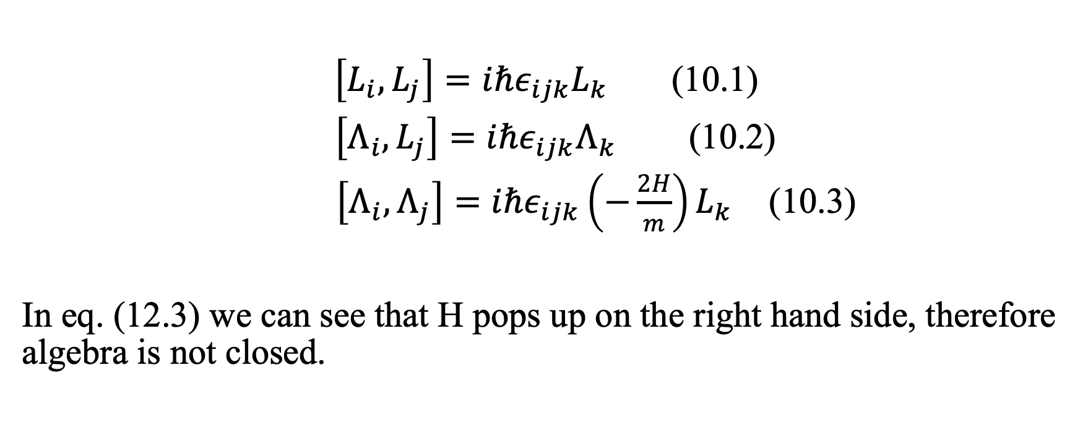
SO(4) algebra
$\left[L_{i},L_{j}\right]=iℏε_{ijk}L_{k}$ (10.1)
$\left[Λ_{i},L_{j}\right]=iℏε_{ijk}Λ_{k}$ (10.2)
$\left[Λ_{i},Λ_{j}\right]=iℏε_{ijk}{\left(−\frac{2H}{m}\right)L}_{k}$ (10.3)
In eq. (12.3) we can see that H pops up on the right hand side, therefore algebra is not closed.

Slide 10
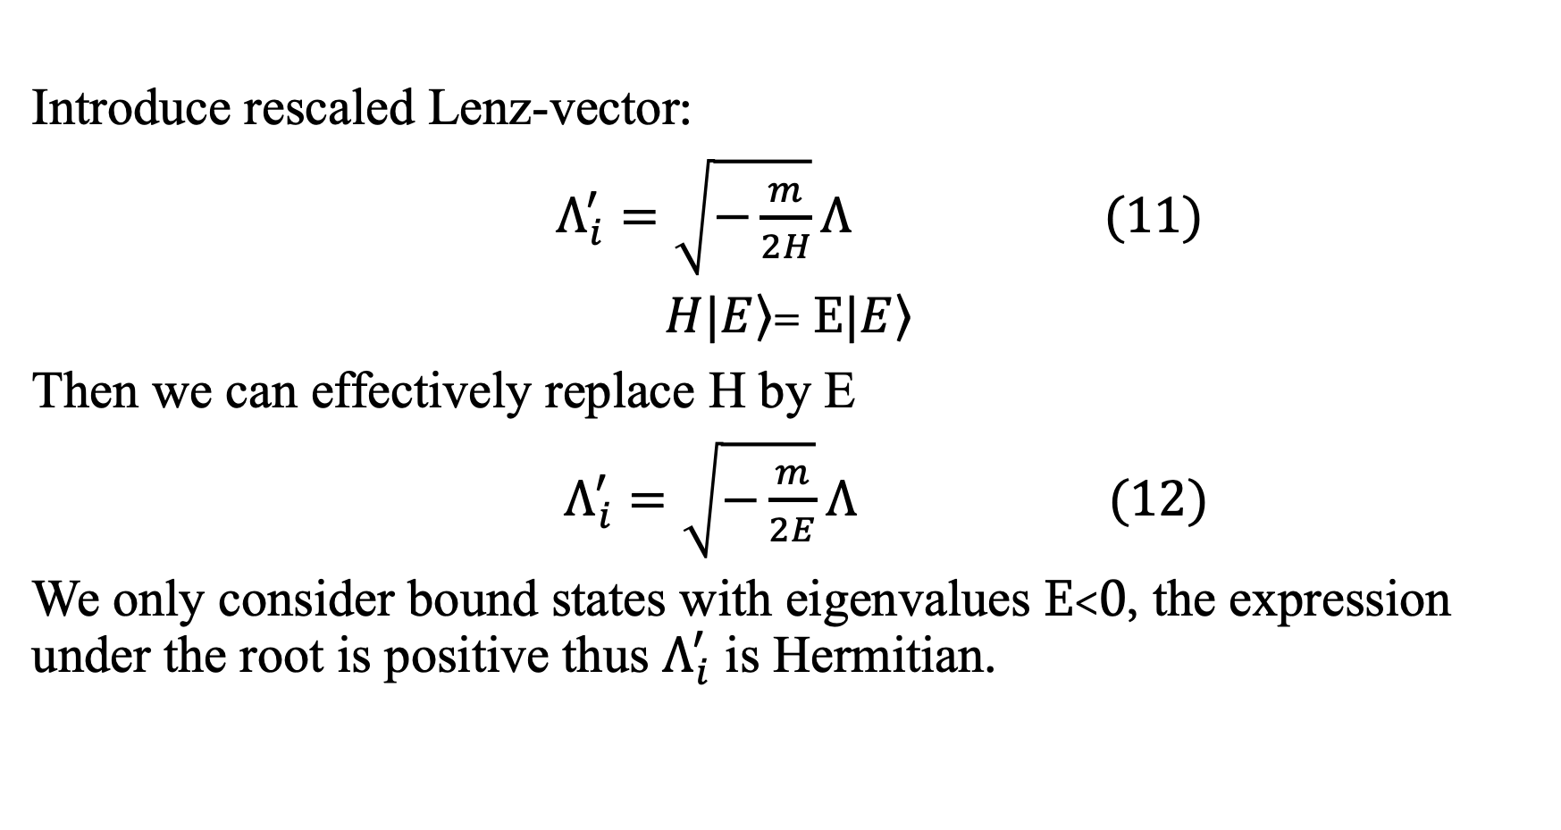
Introduce rescaled Lenz-vector:
$Λ_{i}^{′}=\sqrt{−\frac{m}{2H}}Λ (11)$
$H|\left.E\right\rangle$= E$|\left.E\right\rangle$
Then we can effectively replace H by E
$Λ_{i}^{′}=\sqrt{−\frac{m}{2E}}Λ (12)$
We only consider bound states with eigenvalues E<0, the expression under the root is positive thus $Λ_{i}^{′}$ is Hermitian.

Slide 11

New commutation relations will look like:
$\left[L_{i},L_{j}\right]=iℏε_{ijk}L_{k}$ (13.1)
$\left[{Λ′}_{i},L_{j}\right]=iℏε_{ijk}{Λ′}_{k}$ (13.2)
$\left[{Λ′}_{i},{Λ′}_{j}\right]=iℏε_{ijk}L_{k}$ (13.3)

Slide 12
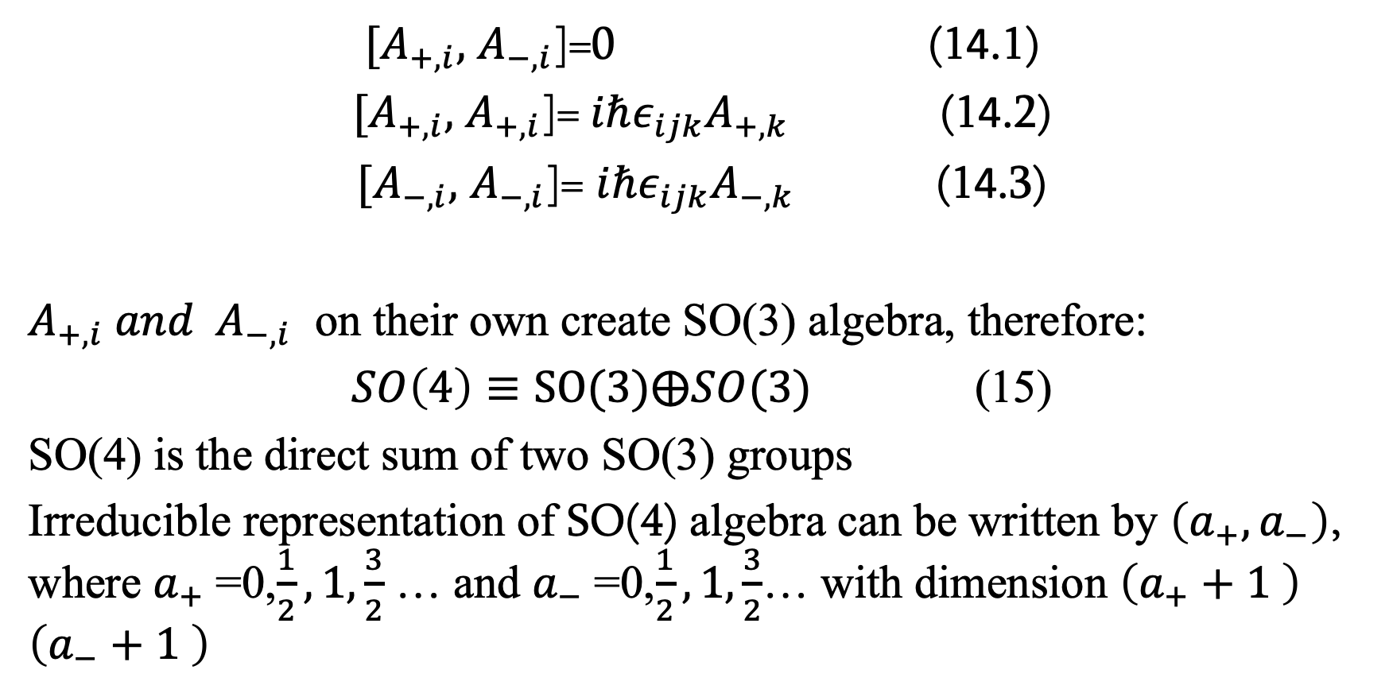

Introduce new operators $A_{±}= \frac{L_{i}±Λ_{i}^{′}}{2}$
$[A_{+,i},$ $A_{−,i}$]=0 (14.1)
$[A_{+,i},$ $A_{+,i}$]=$iℏε_{ijk}A_{+,k}$ (14.2)
$[A_{−,i},$ $A_{−,i}$]= $iℏε_{ijk}A_{−,k}$ (14.3)
$A_{+,i} {and A}_{−,i}$ on their own create SO(3) algebra, therefore:
$SO\left(4\right)≡SO(3)⨁SO(3)$ (15)
SO(4) is the direct sum of two SO(3) groups
Irreducible representation of SO(4) algebra can be written by $\left(a_{+},a_{−}\right)$, where $a_{+}$=0,$\frac{1}{2},1,\frac{3}{2}$ … and $a_{−}$=0,$\frac{1}{2},1,\frac{3}{2}$… with dimension $\left(a_{+}+1 \right)$ $\left(a_{−}+1 \right)$

Slide 13
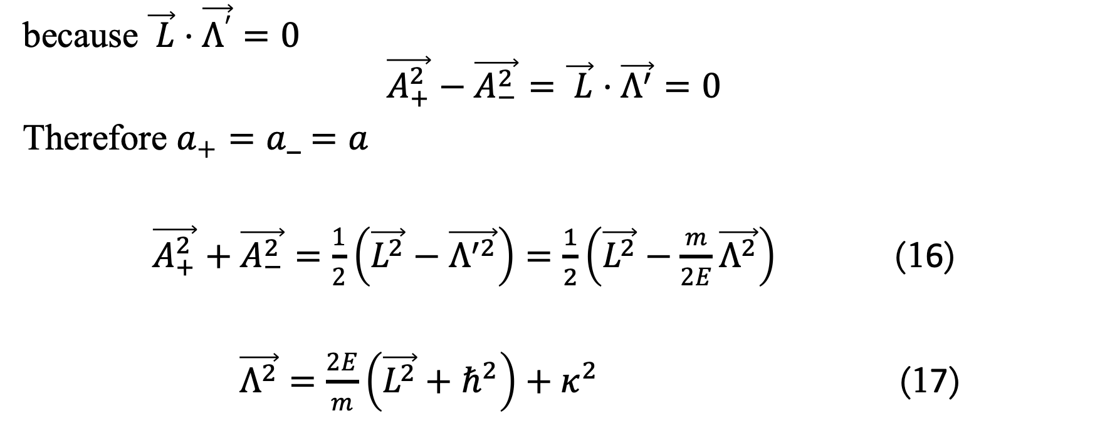
Kazimir operators
because $\vec{ L}⋅\vec{Λ^{′}}=0$
$$\vec{A_{+}^{2}}−\vec{A_{−}^{2}}=\vec{ L}⋅\vec{Λ^{′}}=0$$
Therefore $a_{+}=a_=a$
$\vec{A_{+}^{2}}+\vec{A_{−}^{2}}=\frac{1}{2}\left(\vec{L^{2}}−\vec{Λ^{′2}}\right)=\frac{1}{2}\left(\vec{L^{2}}−\frac{m}{2E}\vec{Λ^{2}}\right)$ (16)
$\vec{Λ^{2}}=\frac{2E}{m}\left(\vec{L^{2}}+ℏ^{2}\right)+κ^{2}$ (17)

Slide 14
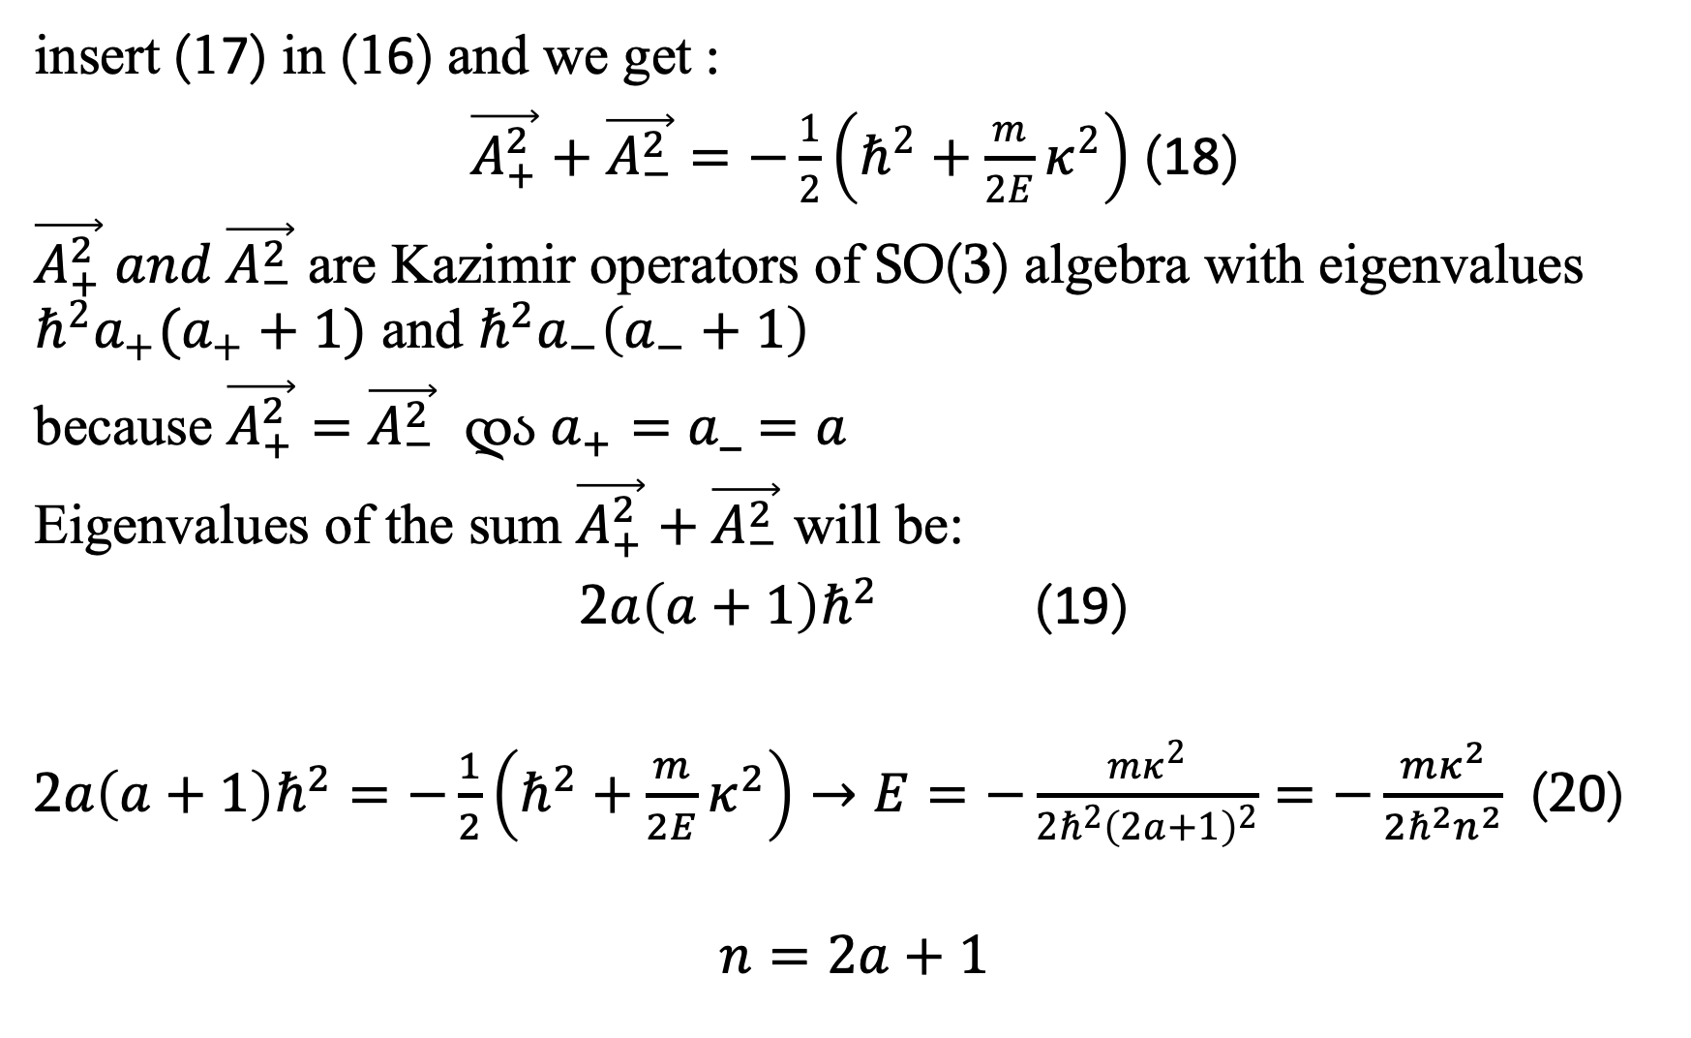
insert (17) in (16) and we get :
$\vec{A_{+}^{2}}+\vec{A_{−}^{2}}=−\frac{1}{2}\left(ℏ^{2}+\frac{m}{2E}κ^{2}\right)$ (18)
$\vec{A_{+}^{2}} and \vec{A_{−}^{2}}$ are Kazimir operators of SO(3) algebra with eigenvalues $ℏ^{2}a_{+}(a_{+}+1)$ and $ℏ^{2}a_{−}\left(a_{−}+1\right)$
because $\vec{A_{+}^{2}}=\vec{A_{−}^{2}}$ და $a_{+}=a_=a$
Eigenvalues of the sum $\vec{A_{+}^{2}}+\vec{A_{−}^{2}}$ will be:
2$a\left(a+1\right)ℏ^{2}$ (19)
2$a\left(a+1\right)ℏ^{2}=−\frac{1}{2}\left(ℏ^{2}+\frac{m}{2E}κ^{2}\right)→E=−\frac{mκ^{2}}{2ℏ^{2}{\left(2a+1\right)}^{2}}=−\frac{mκ^{2}}{2ℏ^{2}n^{2}}$ (20)
$$n=2a+1$$

Slide 15
Conclusion
With the help of SO(4) algebra and many tedious calculations, we derived hydrogen atom energy spectrum formula without ever mentioning any differential equation. Also we explained why the “accidental” degeneracy was not accidental at all.

Slide 16
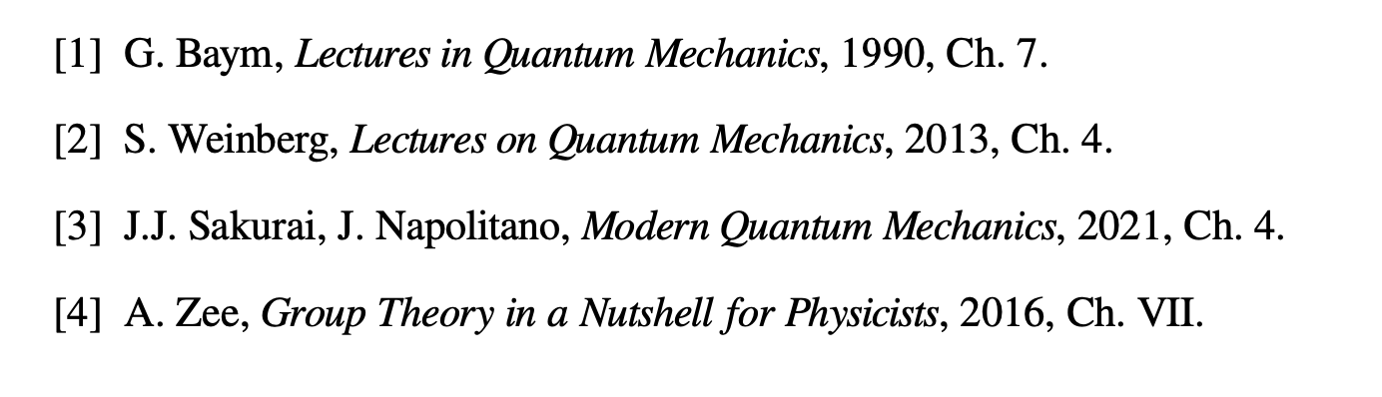
Bibliography

Slide 17
Thank you for your attention

