Slide 1
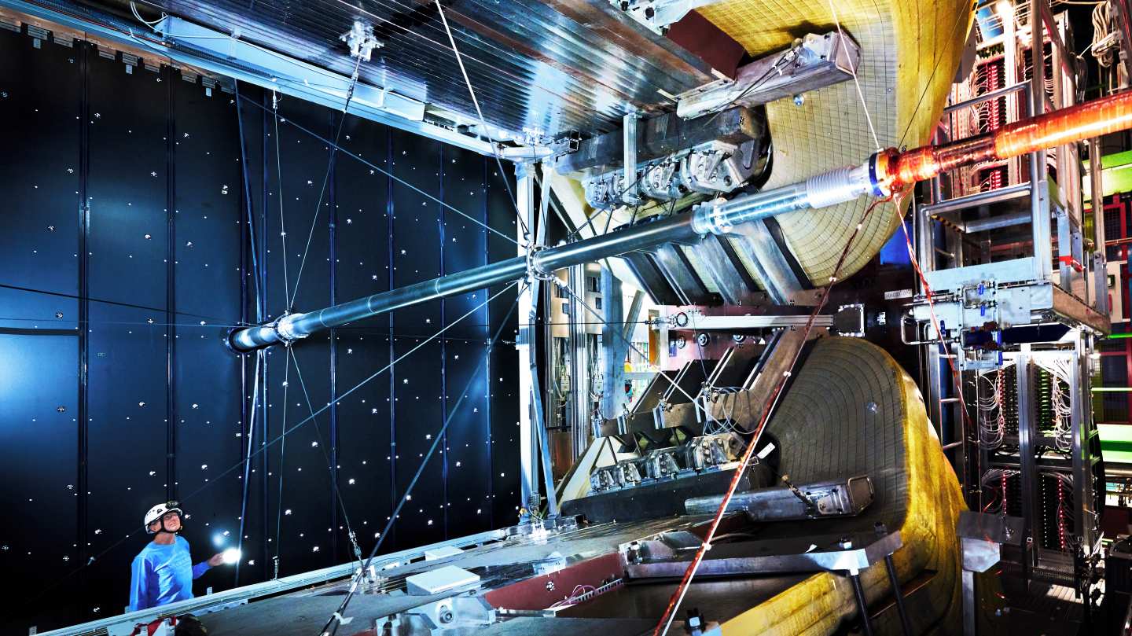
Search for an excited state of $Ξ_{c}^{+}$
.

Slide 2
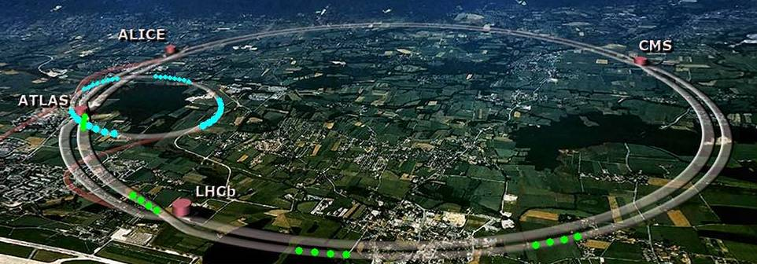
´Lhcb is a forward spectrometer optimized for doing b-physics.`
The majority of bb pairs is produced in the forward direction.

Slide 3
´Lhcb ADVANTAGES

Slide 4
Decay
G. Robertson – EPS 2023

Slide 5
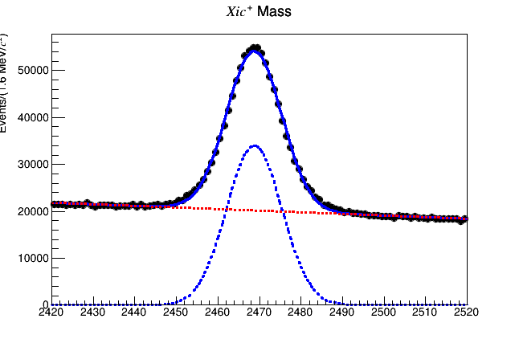
Invariant mass reconstruction

Slide 6
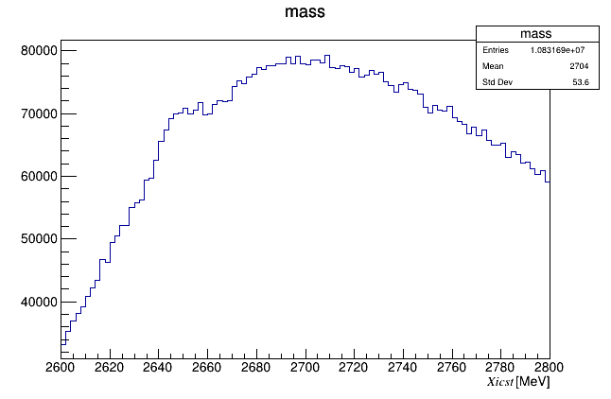
Challenges

Slide 7
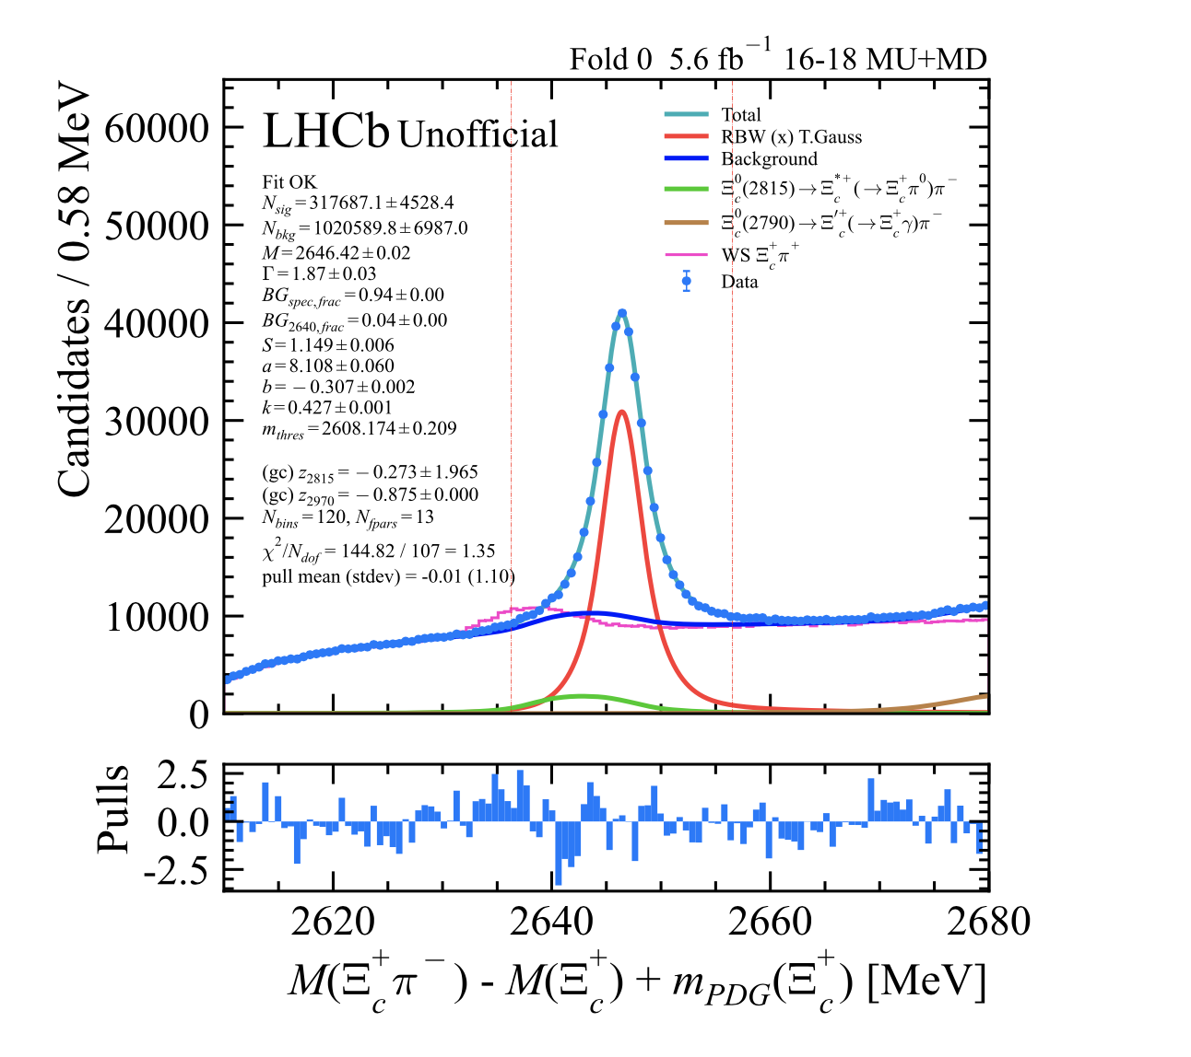
Next steps
Mass range (MeV)
First attempt to the fit.
Fit obtained in the analysis note.
Ryunosuke H. O’Neil1, Marco Pappagallo, Mark Williams, Observation of a new excited Ξc+ baryon in the Ξc+π+π− mass spectrum, LHCb-ANA-2023-039 February 7, 2024, v0.5.0

Slide 8
Thank you

