Slide 1
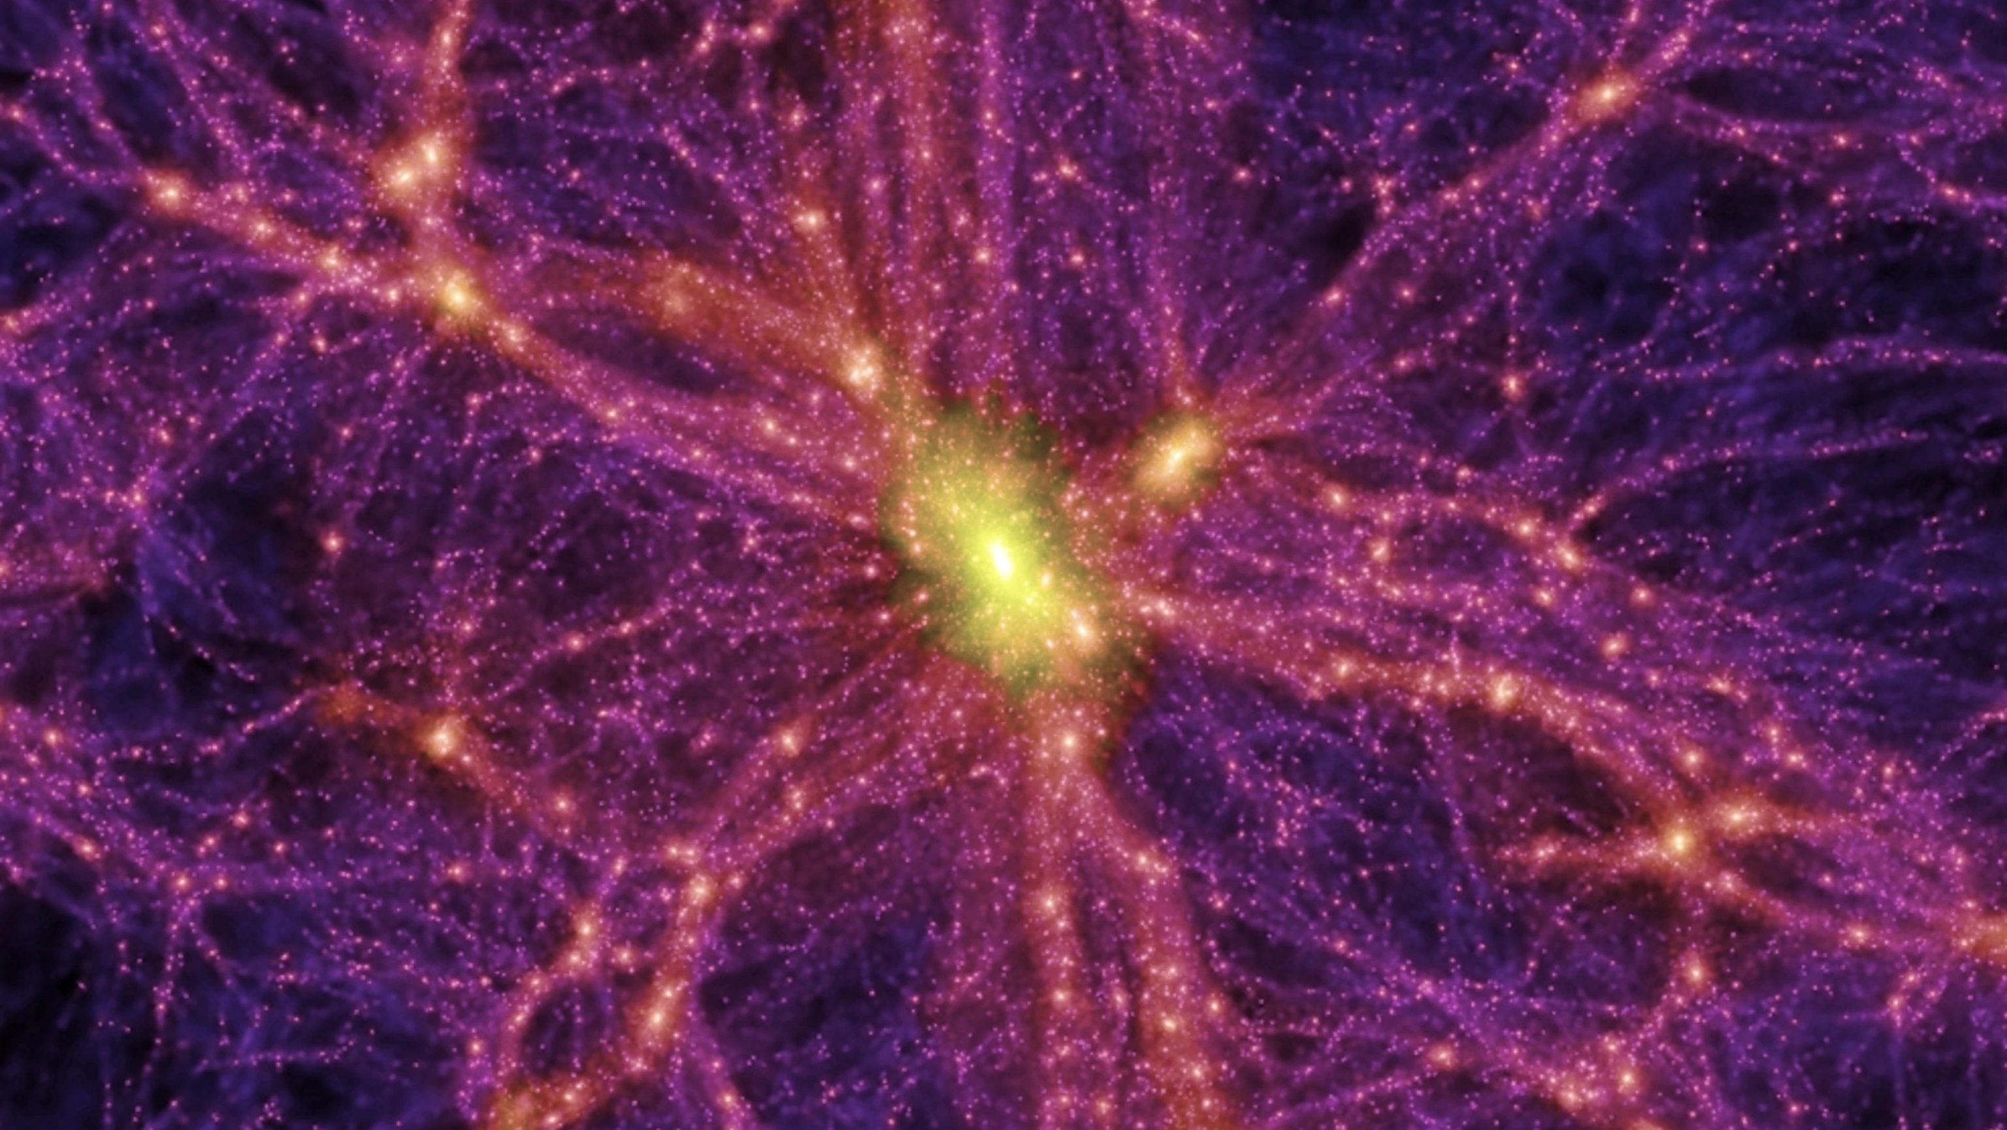
Quaerere Axions (QUAX)
Detection of Axions as Dark Matter
Gaia Musaio Somma
University of Bari
22, July
GraSPA2024

Slide 2
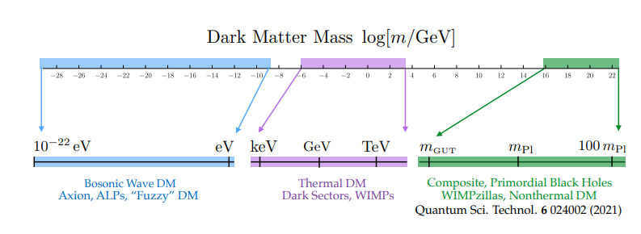
Dark Matter as a cosmic wave
We are searching for light and massless particles…
$$m≤10 eV$$
Particle
Wave
$$λ=\frac{h}{mv}$$
$$ρ_{DM}=0.3−0.4 GeV/{cm}^{3}$$
$$n_{a}\sim 3×{10}^{12} axions/{cm}^{3}$$
Macroscopic wavelike behaviour
…classic field oscillating at a frequency related to the particle mass

Slide 3
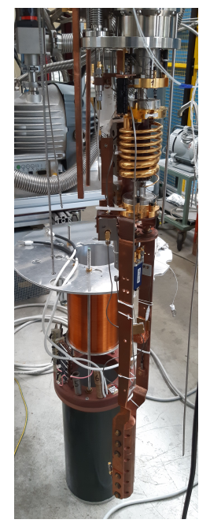
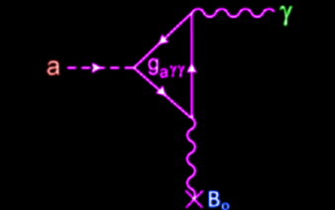
QUAX is designed to detect axions
It uses resonance techniques to convert axions into detectable photons
Axions are predicted to interact with photons through a coupling mechanism described by the parameter $g_{aγγ}.$This interaction can be represented by the Langrangian
$$L_{aγγ}=g_{aγγ}a E∙B$$
where $a$ is the axion scalar field, $E$ and $B$ are the electric and magnetic field respectively.
Haloscope: a cosmic rardio receiver
A 3D microwave cavity is placed inside a strong magnetic field (8 T). Axions should interact with this field
to produce microwave photons at a frequency corresponding to $m_{a}$(resonant frequency).

Slide 4
Detecting Axion-Photon Conversion with Transmon Qubit
Resonant Frequency Shift
Transmon Qubit: a two-level system created in a supercunducting circuit.
It is coupled to the cavity, but it operates in the dispersive regime: the qubit does not absorb or emit photons directly. In the limit of a few photons in the resonator:
where $g$ is the qubit-resonator coupling rate, $ω_{r}$ and $ω_{q}$ are the resonator and qubit frequency respectively and
$∆=\left|ω_{q}−ω_{r}\right|.$ In this limit: $∆≫g.$
The amount of shift depends on the presence and number of photons produced by axions conversions
$$H_{int}=ω_{r}\left(a^{†}a+\frac{1}{2}\right)+\frac{1}{2}\left(ω_{q}+\frac{g^{2}}{∆}+\frac{2g^{2}}{∆}a^{†}a\right)$$
Frequency shift of the cavity
Variation of the qubit’s energy state

Slide 5
Transmon Qubit
Toolkit: capacitor, inductor, wire (all SC)
$$H=4E_{c}n^{2}+\frac{1}{2}E_{L}φ^{2}$$
$$H=4E_{c}n^{2}−E_{J}\cos{φ}$$
$$H=\frac{h}{2π}ω_{r}\left(a^{†}a+\frac{1}{2}\right)$$
$H=ω_{q}$ $a^{†}a+\frac{α}{2}a^{†}a^{†}aa$
AHO
QHO
$$H=ω_{q}\frac{σ_{z}}{2}$$
$$ω_{r}=1/\sqrt{LC}$$
Josephson relations:
Simple LC ciruit is not a good two level atom approximation
$$V=\frac{h}{4πe}\frac{dΦ}{dt}$$
$$I=I_{c}\sin{Φ}$$

Slide 6
How do we detect the frequency shift?
Dipspersive readout technique
The transmon qubit is initialised in a known quantum state.
A microwave signal is sent to the cavity at its original resonant frequency.
The signal exiting the cavity is measured.
Due to the interaction between the qubit and the cavity, the output signal will exhibit a phase shift depending on the qubit state.
The state of the qubit then can be inferred without directly measuring the qubit (non-distructive measurement).
The Josephson Parametric Amplifier (JPA) amplifies the weak signals from the microwave cavity with minimal added noise.
The entire setup is mainteined at cryogenic temperatures to minimise thermal noise.

Slide 7
Thank you for your attention!

