Slide 1
Brownian motion and integration of stochastic differential equations

Slide 2
Einstein derivation of diffusion equation
two hypothesis:
The motion of the suspended pollen particles is caused by the frequent impact with water molecules
This motion can be described in terms of probabilities of imbalances of statistically independent impacts
Two important results derived:
→

Slide 3
Langevin derivation
Langevin assumes that the particle only acts two forces:
viscous drag: assuming the particle is a sphere of radius a immersed in a liquid with viscosity, and assuming the formula for the drag is the same as for a macroscopic object
fluctuating force X: it represents the impact of molecules of the liquid on the particle; it must therefore be negative or positive with equal probability. We say that X is a Gaussian white noise with null average (this translates the affirmation that it can be, with equal probability, negative or positive), and delta correlated in time:
We get:
which can be solved to:

Slide 4
Numerical integration of stochastic differential equations
It can be shown that, given a generic stochastic differential equation of the form:
where is a Gaussian white noise of mean zero and delta correlated in time as before, once we discretize time, can be given by:
For the specific case of a free Brownian particle, q(x)=0 and
Using the general formula above, we get:

Slide 5
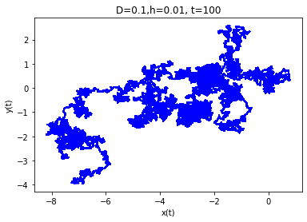
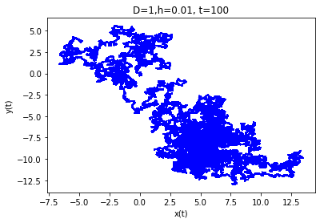
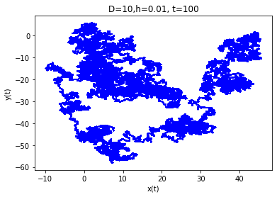
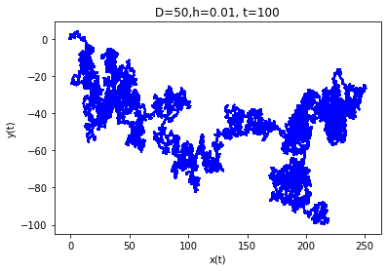

Slide 6
