Slide 1
Characterization of
semiconductor
photoconductivity
Sara Atlante
GraSPA2024 summer school
Annecy, 16 July

Slide 2
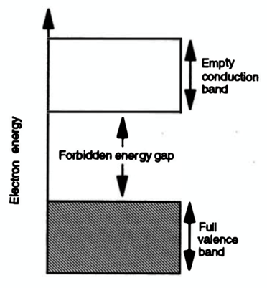
A brief theory introduction
Band Structure : valence band, forbidden band, conduction band.
Photons radiation energy:
E_{g} > hν → no photon absorbed, opaque material
E_{g} = hν → photon absorbed
E_{g} < hν → photon absorbed, transparent material,
excited electron

Slide 3
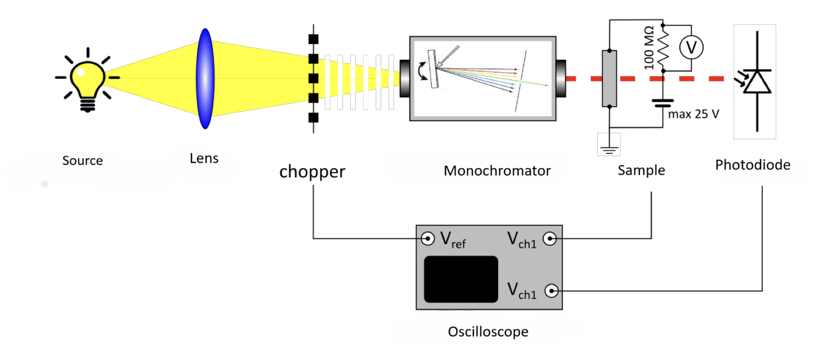
How we characterized the semiconductor?
We calculate the energy gap from the parameters of Transmittance and Photocurrent.

Slide 4
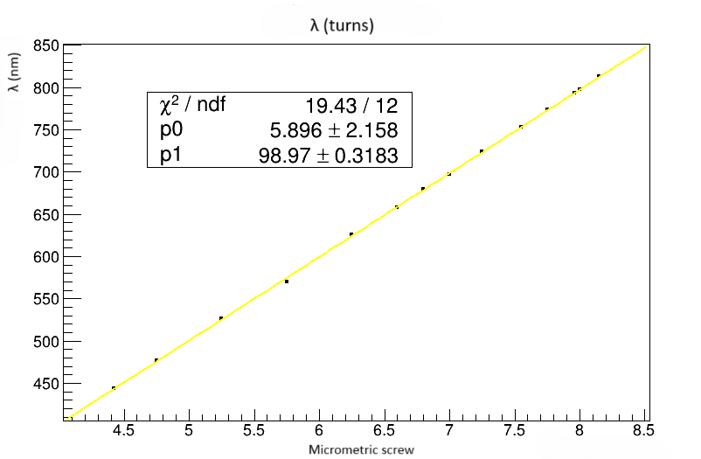
Monochromator calibration
We found a correspondence between the turns of the micrometric screw and the wavelength

Slide 5
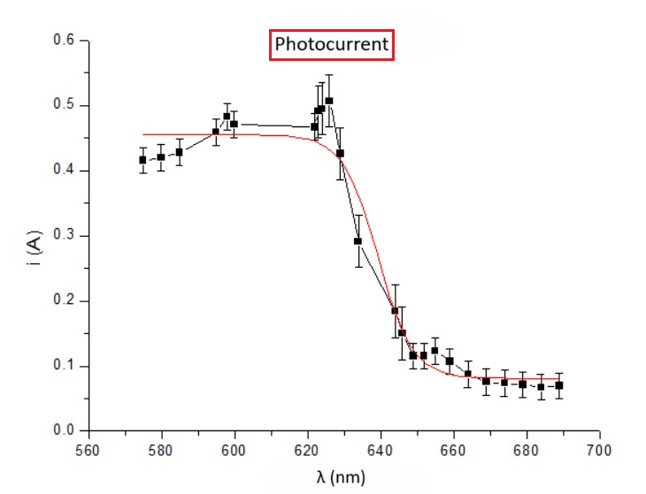
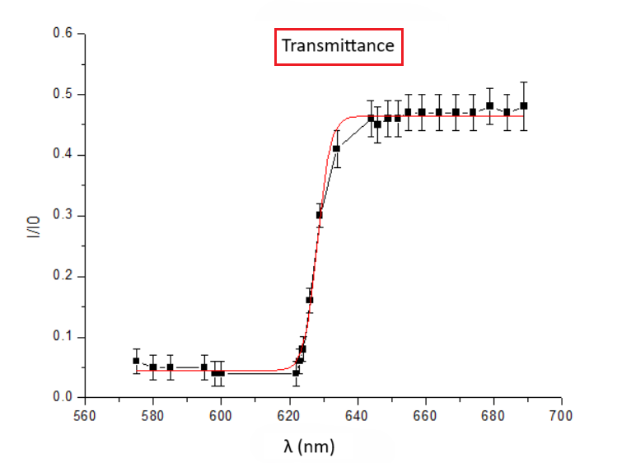
Photocurrent and transmittance fits
*By the Ohm’s law, the photocurrent was the ratio between V absorbed (∀ λ) and R of the circuit ( R = 1.01 ± 0.02 MΩ )
I0 incident intensity (without sample)
I transmitted intensity (with sample)

Slide 6
Results
We derived the Transmittance and Photocurrent, we calculate and compare the inflection and maximum points
 | λ₀ inflection (nm) | λ₀ maximum (nm)
Transmittance | 628 ± 2 | 627 ± 4
Photocurrent | 639 ± 5 | 630 ± 7
λ _{t} = ( 632 ± 5 ) nm →
The sample was a GaSe semiconductor.

Slide 7
Thank you for the attention!

Slide 8
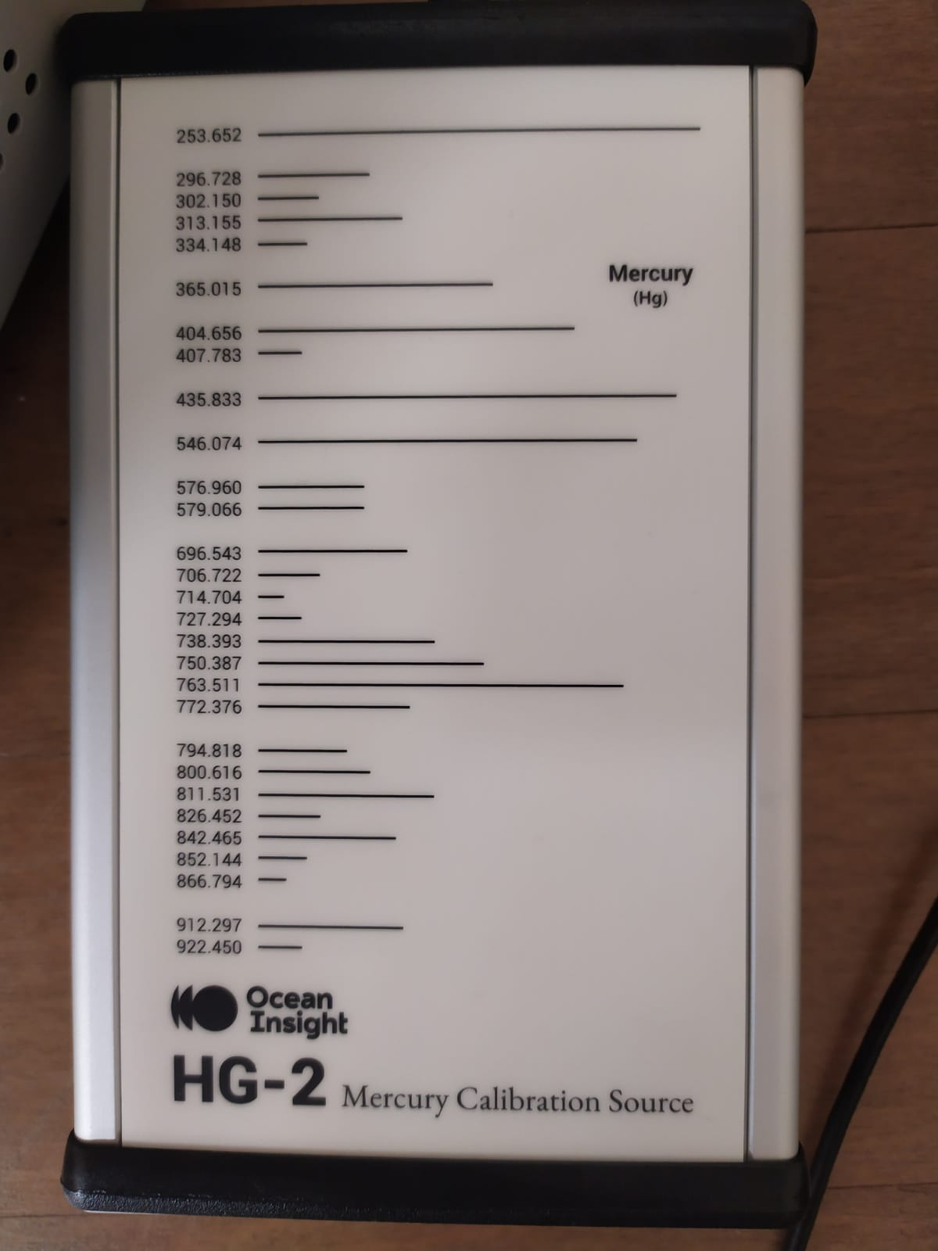
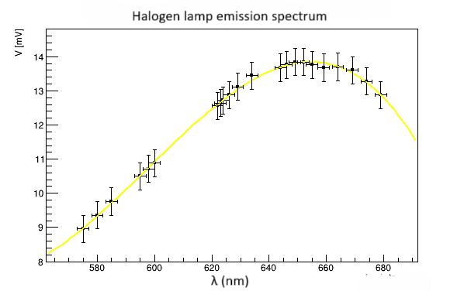
Backup
Spectrum Emission

