Slide 1
STUDY OF THE ANOMALOUS KINEMATIC EFFECTS ON WWγ PRODUCTION PROCESSES IN THE CONTEXT OF AN EFFECTIVE THEORY
LUCA ATTINÀ
GraSPA 2024 Summer School
16th July 2024

Slide 2
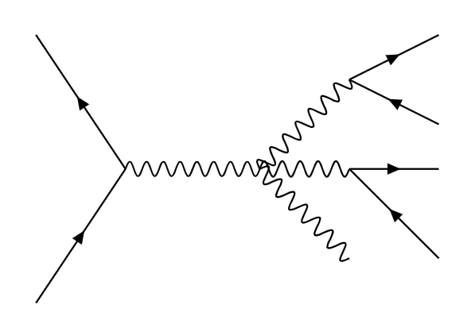
Tribosonic production processes
Products: Electroweak Bosons.
Predicted by the Standard Model, but extremely rare^{[1]}.
σ [fb]
$$e^{−}ν_{e}μ^{+}ν_{μ}γ$$
$$e^{−}$$
Examined process:
$$pp→W^{+}W^{−}γ$$
$$→$$
$$q′$$
$$→$$
$$e^{+}ν_{e}μ^{−}ν_{μ}γ$$
$$W^{+}$$
$$ν_{e}$$
$$Z/γ$$
$$W^{−}$$
$$ν_{μ}$$
Triple Gauge Couplings (TGC) and Quadruple Gauge Couplings (QGC) are foreseen.
Anomalies may be signs of a new physics Beyond Standard Model.
$$μ^{+}$$
$$γ$$
$$q$$
QGC
2
[1] https://twiki.cern.ch/twiki/pub/CMSPublic/PhysicsResultsCombined/CMSCrossSectionSMPSummaryBarChart.pdf

Slide 3
Standard Model Effective Field Theories
Effective Field Theories are useful to study phenomena up to energy scales bigger than the ones reached by experiments.
They are low energy limits of new Physics theories (BSM).
?
E
SM Lagrangian is extended through 6-Dim Operators. These are weighted with Wilson Coefficients.
$$ℒ_{SMEFT}=ℒ_{SM}^{(4)}+\sum_{n,i}{\frac{1}{Λ^{n−4}}}c_{i}^{(n)}Q_{i}^{(n)}$$
Scattering amplitude:
n-Dim Operators
$$𝒜=𝒜_{SM}+{\frac{c_{W}}{Λ^{2}}𝒜}_{Q_{W}}$$
SM Lagrangian
Scale of New Physics (1 TeV)
Wilson Coefficients
$${\left|𝒜\right|}^{2}={\left|𝒜_{SM}\right|}^{2}+2\frac{c_{W}}{Λ^{2}}Re\left(𝒜_{Q_{W}}^{∗}𝒜_{SM}\right)+\frac{c_{W}^{2}}{Λ^{4}}{\left|𝒜_{Q_{W}}\right|}^{2}$$
Therefore we study:
SM
Linear
(Interference)
Quadratic
3

Slide 4
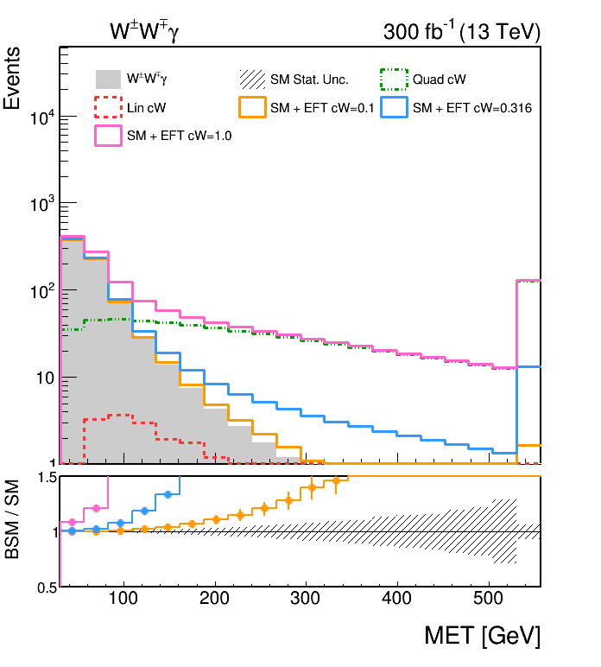
Events generation, kinematic cuts and analysis
The generator used is MadGraph5_aMC@NLO (v2.6.5) together with the SMEFTsim^{[2]} package.
Events have been generated trough Monte Carlo simulations by defining the initial and final states.
Kinematic cuts have to be introduced to select experimental boundaries:
Transverse Momentum:
$p_{T}^{l}>5 GeV$
$p_{T}^{γ}>20 GeV$
Pseudorapidity ($η=−ln⁡\left[\tan\left(\frac{θ}{2}\right)\right]$):
$\left|η_{l}\right|<2.5$
$\left|η_{γ}\right|<2.5$
Missing Transverse Energy:
$MET>30 GeV$
W bosons masses:
$50 GeV<m_{W}<110 GeV$
QU
SM
LI
Being ${\left|𝒜\right|}^{2}∝σ$, the total cross section will be:
$$σ_{TOT}=σ_{SM}+\frac{c_{W}}{Λ^{2}}σ_{LI}+\frac{c_{W}^{2}}{Λ^{4}}σ_{QU}$$
Ratio Plot
4
[2] Brivio I., “SMEFTsim 3.0 -- a practical guide”, J. High Energ. Phys. 2021, 73 (2021).

Slide 5
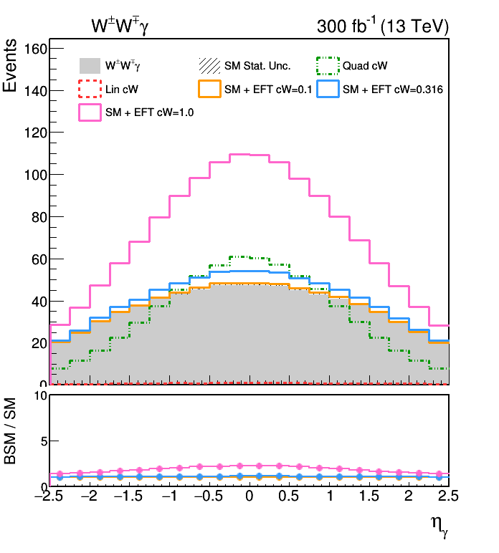
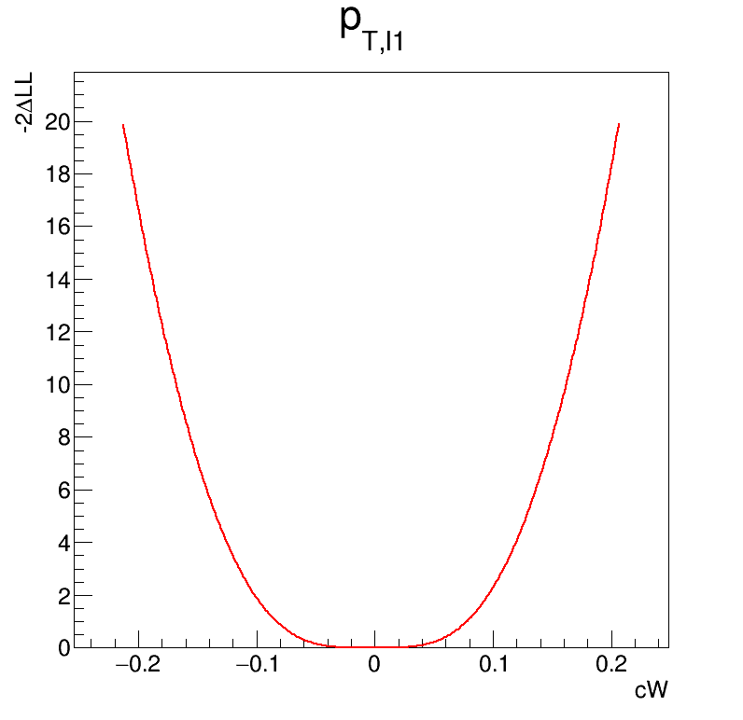
Some quantities result more sensitive to the introduction of the Q_{W} operator, causing a substantial shift from the SM component (e.g. MET).
Others are less sensitive to it (e.g. η_{γ}).
Likelihood Scan
$$ℒ\left(c_{W}\right)=\prod_{k}{\frac{{(N_{k}\left(c_{W}\right))}^{n_{k}^{}}}{n_{k}!}}e^{−N_{k}(c_{W})}$$
H₀: c_{W} = 0 (pure SM).
$$−2Δlogℒ=−2[logℒ\left(c_{W}\right)−logℒ\left(0\right)]$$
QU
SM
LI
95% C.L.
68% C.L.
Likelihood Scan for P_{T,l1.}
5

Slide 6
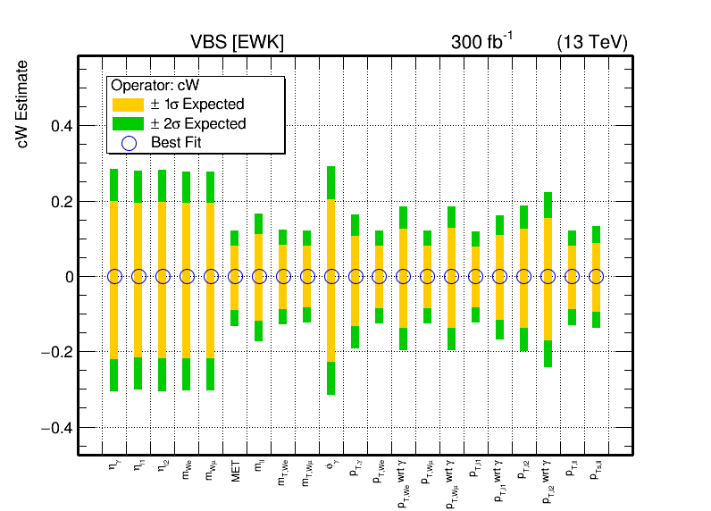
Conclusions
( )
( )
Sensitivity of channel ${pp→W}^{+}W^{−}γ →e^{±}ν_{e}μ^{∓}ν_{μ}γ$
(300 fb⁻¹ – 13 TeV)
The estimated confidence intervals for c_{W} are:
[-0.083 , 0.078] (68% C.L.)
[-0.123 , 0.118] (95% C.L.)
Channel | WZγ (best var. p_{T,l1}) | VZγ (best var. p_{T,l1}) | VZZ (best var. p_{T,l1})
68% C.L. | [-0.20 , 0.21] | [-0.26 , 0.26] | [-0.63 , 0.63]
95% C.L. | [-0.31 , 0.32] | [-0.37 , 0.37] | [-0.97 , 0.97]
6

Slide 7
Bibliography and webliography
Grzadkowski B. et al., “Dimension-six terms in the Standard Model Lagrangian”, J. High Energ. Phys. 2010, 85 (2010). doi: https://doi.org/10.1007/JHEP10(2010)085
Brivio I., “SMEFTsim 3.0 -- a practical guide”, J. High Energ. Phys. 2021, 73 (2021). doi: https://doi.org/10.1007/JHEP04(2021)073
Brivio I., Trott M., “The standard model as an effective field theory”, Phys. Rept. 793 (2019), 1-98, doi: https://doi.org/10.1016/j.physrep.2018.11.002.
Bellan R. et al., “A sensitivity study of VBS and diboson WW to dimension-6 EFT operators at the LHC”, J. High Energ. Phys. 05 (2022) 039, doi: https://doi.org/10.1007/JHEP05(2022)039.
Bellan R. et al., “A sensitivity study of triboson production processes to dimension-6 EFT operators at the LHC”, J. High Energ. Phys. 2023, (2023) 158, doi: https://doi.org/10.1007/JHEP08(2023)158.
CMS Collaboration, “Observation of the production of three massive gauge bosons at √s= 13 TeV”, Phys. Rev. Lett. 125, (2020) 151802, doi: https://doi.org/10.1103/PhysRevLett.125.151802.
CMS Collaboration, “Observation of WWγ production and search for Hγ production in proton-proton collisions at √s = 13 TeV”, (2023), doi: 10.48550/arXiv.2310.05164.
ROOT Reference Documentation: https://root.cern/doc/v628/.
7

Slide 8
THANK YOU FOR YOUR TIME!

Slide 9
BACKUP

Slide 10
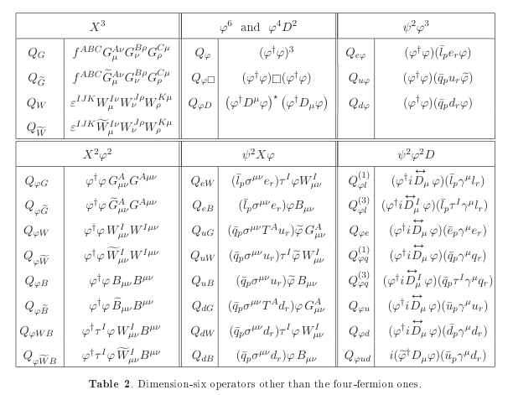
Analysis has been carried on working with the operator^{[3]}:
$$Q_{W}=ε_{ijk}W_{μ}^{iν}W_{ν}^{jρ}W_{ρ}^{kμ}$$
where:
$$W_{μν}^{i}{=∂_{μ}W}_{ν}^{i}−{ ∂_{ν}W}_{μ}^{i}{ − gε^{ijk}W}_{μ}^{j}W_{ν}^{k}$$
Warsaw Basis:
59 indipendent operators.
[3] Grzadkowski B. et al., “Dimension-six terms in the Standard Model Lagrangian”, J. High Energ. Phys. 2010, 85 (2010).

Slide 11
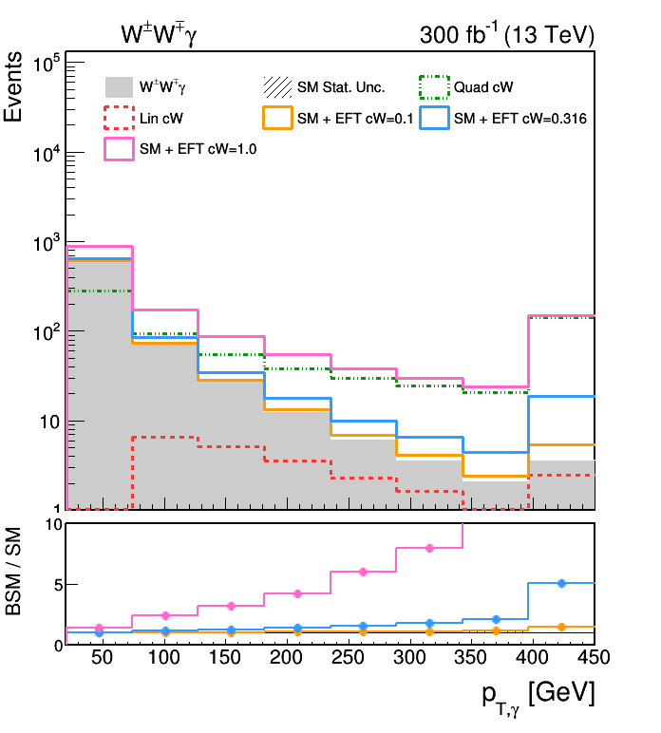
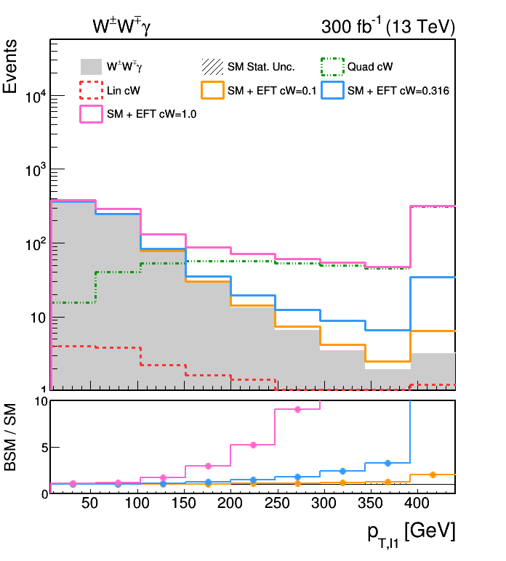
The analysis can also be carried on applying more than one operator at the same time.
$${\left|𝒜\right|}^{2}={\left|𝒜_{SM}\right|}^{2}+2\sum_{i}{\frac{c_{i}}{Λ^{2}}Re\left(𝒜_{Q_{i}}^{∗}𝒜_{SM}\right)}+\sum_{i}{\frac{c_{i}^{2}}{Λ^{4}}{\left|𝒜_{Q_{i}}\right|}^{2}}+\sum_{i,j}{\frac{c_{i}c_{j}}{Λ^{4}}Re\left(𝒜_{Q_{i}}^{∗}𝒜_{Q_{j}}\right)}$$

