Slide 1
New insight into the structure of ⁴He nuclei
A. Chbihi
GANIL

Slide 2
outline
Motivation to study α particle.
NC-GSM predictions, open quantum system.
Correlation functions limits
Alternative solution : experiment to constrain theory.
Conclusion

Slide 3
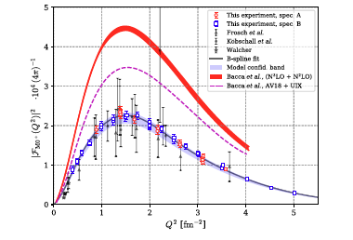
Why study the α particle?
inelastic e- scattering 4He(e-,e-’)
4He nucleus is one of the most extensively studied atomic nuclei, given the small number of constituents (4 nucleons), it can be accurately described by state-of-the-art theoretical calculations, based on χEFT.
Still disagreement to reproduce the proton-decaying from the GS to the first excited state
Recent experiment was performed at Mainz Microtron (MAMI) to investigate this resonance via inelastic e- scattering ( 4He(e-,e-’) 4He*).
The new experiment improves significantly the precision (the red boxes).
Surprisingly, the measured value for this transition is only half of what χEFT had predicted, raising doubts about previous models that treat 4He as a closed quantum system.
credit : A. Stonebraker
S. Kegel et al., Measurement of the α-particle monopole
transition form factor challenges theory: A low-energy
puzzle for nuclear forces?, Phys. Rev. Lett. 130, 152502
(2023).

Slide 4
Why study the α particle?
inelastic e- scattering 4He(e-,e-’)
Is it a vibrational monopole transition “breathing” mode of the 4 nucleons ?
or
molecular like state [p+3H] or mixture with other states ?
credit : A. Stonebraker
S. Kegel et al., Measurement of the α-particle monopole
transition form factor challenges theory: A low-energy
puzzle for nuclear forces?, Phys. Rev. Lett. 130, 152502
(2023).

Slide 5
Open quantum system
Recent calculation using coupled channel representation of the No Core Gamow Shell Model (NCGSM) which treats 4He nucleus as an open quantum system.
This approach took into account 3 reaction channels : [p+t], [3He+n] and [d+d], in order to solve the N-body problem more accurately.
In short this study treats the 4He nucleus as a system where two particle interact, providing a more accurate explanation of its behavior.
N. Michel, W Nazarewicz and M. Ploszajczak .
PRL 131, 242502 (2023)).

Slide 6
Results
The occupation of real part of the probability of the 3 channels, p, n and d as function of ΔΕ_{th} ,
the channels are correlated: an increase in the occupancy probability of one channel typically results in a decrease in the other.
At ΔΕ_{th} <150 keV the [3H+p] channel is dominant (95%)whereas the weights of closed channels n and d are small.
At ΔΕ_{th} ≈ 400 keV, the [3H+p] occupation drops to 32% and the [2H+2H] channel becomes dominant.
At ΔΕ_{th} ≈ 780 keV the neutron channel opens up, while the proton channel amplitude is very small and the wave function is dominated by the the deuteron component.
The statistical uncertainty is on Re (a_{c}² ) increases (Im (a_{c}² )) because of the different life times that the resonance state can have.
Top: Occupation Re(a_{c}² ) of orthogonalized p, n and d channels vs ΔΕ_{th} (shifted with p-t channel’s threshold)
Bottom: Corresponding imaginary channel occupation Im (a_{c}² ).

Slide 7
Result on the monopole transition form factor
accepted as erratum of PRL
(private communication N. Michel)
Im (a_{c}² ) amplitudes are of the same order of magnitude as Re(a_{c}² )
Thus there is a large statistical uncertainty on channel occupations around ΔΕ_{th} ≈120 keV.
NCGSM-CC predicts a large decay width, Γ ≈ 260 keV at ≈ 120 keV.
Consequently the monopole form factor is not ideal observable to constrain nuclear interaction.

Slide 8
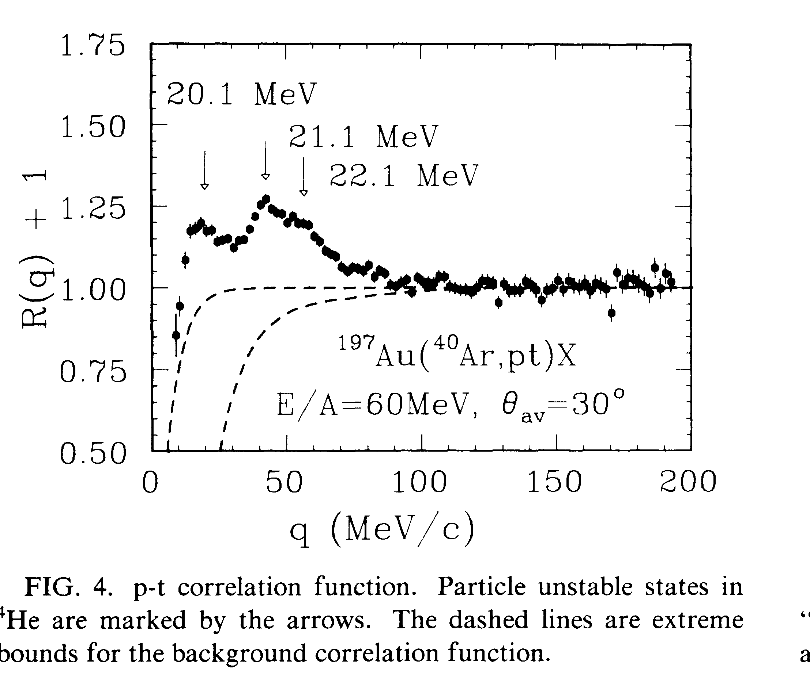
Other information on the 3-channels ?
correlation functions of d-d and p-t
PochodzallaPRC35p1695_1987

Slide 9
Correlation functions from FAZIA for ⁶⁴Ni+⁶⁴Ni @ E/A = 32MeV
Invariant mass
Huge background due to enormous reaction channels which can produce p, d and t

Slide 10
proposed experiment
To validate the NCGSM-CC predictions, an experimental study of the branching ratio of different alpha particle decay channel as function of E* is required.
We propose the experiment 4He(n,n’)4He*
The neutron beam is provided by the LINAC-NFS facility using the converter 7Li for monoenergetic neutron of E_{inc} = 31 MeV.
Cross section measurement and invariant/missing mass of channels : [3H+p] and [3He,n].
We will obtain the [d+t] or 4He + n channel provided by the reaction n+4He->5He*
For the [d+d] the neutron incident energy threshold is at 30 MeV therefore, we will use the Be converter which provides a continuous neutron beam up to 40 MeV.

Slide 11
Target and detection
ACTAR TPC demonstrator filled with pure 4He gas will be used at the same time as target and detector. It will permit to identify the charged particles in the exit channel.
Three auxiliary Si-walls, positioned at the front and on the 2-sides surrounding the active volume. Particle identification with ΔE-E technique.
The signal left in ACTAR TPC will be correlated to the energy deposit in the Si-detectors. For the particles with lower energies (<1. MeV), the identification will rely on the correlation between the total energy loss in the active volume with the range of the particle in the gas.
As a consequence, it will be possible to identify the decay channels, and hence measure their branching ratio that have not been previously measured.

Slide 12
simulation with Hipse; Denis Lacroix
n + 4He @ 30 MeV
Invariant mass for the channel [p +t]
Kinematics of proton in [p+t]
triton
Kinematics of deuteron in [d+t]
triton

Slide 13
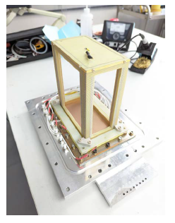
Test beam request
This LoI will allow to test the ACTAR-TPC Demonstrator apparatus in the following conditions:
First use of ACTAR TPC with pure 4He gas: we test the thick-GEM amplification system in beam conditions;
Measurement of the auxiliary Si detectors time resolution with the 4He(n,n’) reaction;
Validation of absolute cross section measurement with ACTAR TPC and a neutron beam;
Optimization of the 4He gas pressure and the placement of Si auxiliary detector for measuring various reaction channels.

Slide 14
Conclusion
It is necessary to measure the branching ratio of the channels : [p+ 3H], [n+3He] and [d+d] simultaneously as function of E*.
The reaction 4He(n,n’)4He* with NFS neutron beam and ACTAR-TPC is ideal.
It will allow to deduce the weight of the [p+t], [n+3He] and [d+d].
Constraints on NCGSM-CC calculations and other theories.

