Slide 1
Transport theory and deblurring to Analyze Secondary Decay Emissions in Correlations measurements
Pierre Nzabahimana
17th Workshop on Particle Correlations and Femtoscopy, WPCF 2024, Toulouse (France) on November 4-8, 2024.
LA-UR 24-31506

Slide 2
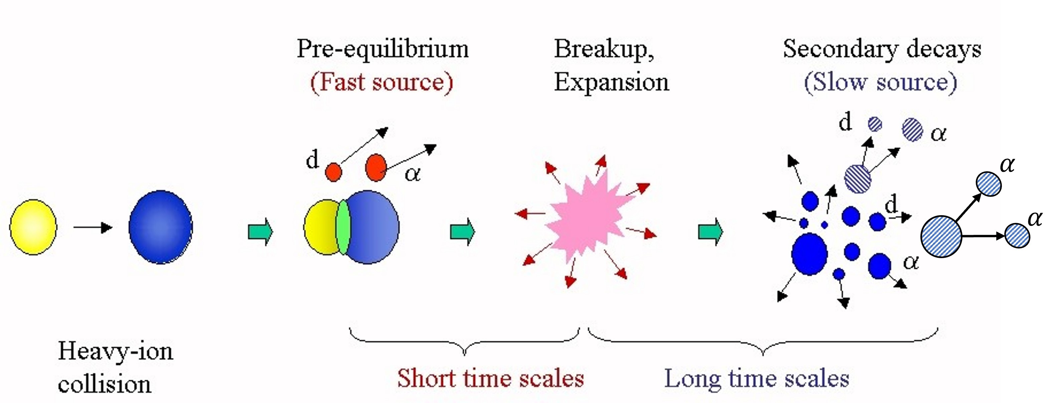
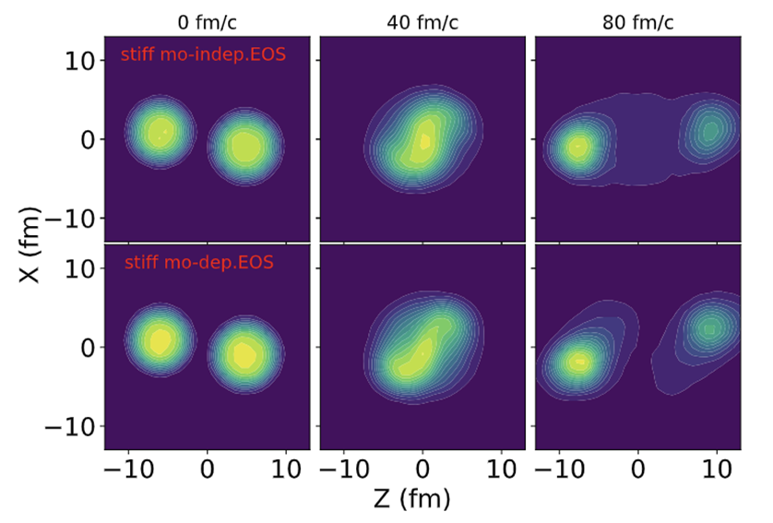
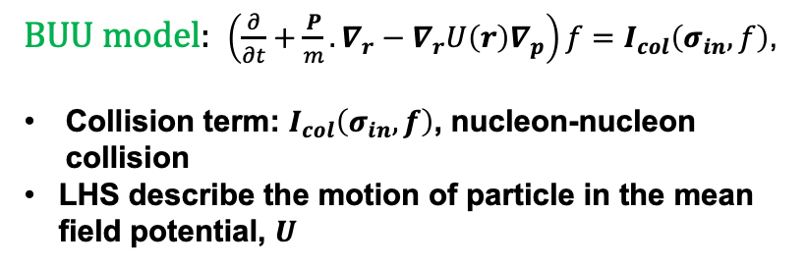
Heavy-Ion Collision Model
Particles emission during Heavy-Ion collision: Heavy nucleus, $A>$ 4
Density contour plots for the reaction
Ar+Sc at 80 MeVA
Transport Model: Boltzmann-Uehling-Uhlenbeck (BUU)
BUU model: $\left(\frac{∂}{∂t}+\frac{P}{m}.∇_{r}−∇_{r}U\left(r\right)∇_{p}\right)f=I_{col}\left(σ_{in}, f\right)$,
Collision term: $I_{col}\left(σ_{in},f\right)$, nucleon-nucleon collision
LHS describe the motion of particle in the mean field potential, $U$
Mo-indep: momentum independent,
mo-dep: momentum dependent
P. Danielewicz Nucl. Phys. A, 673 (2000)

Slide 3

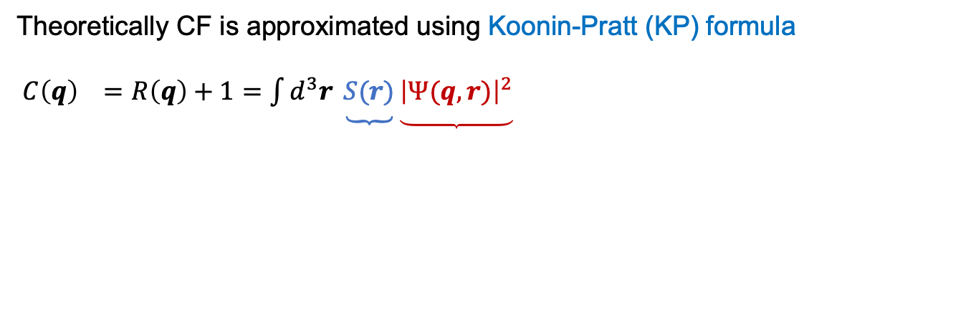

Particle Correlation Functions (CF)
Theoretically CF is approximated using Koonin-Pratt (KP) formula
$C\left(q\right) =R\left(q\right)+1=\int{d^{3}r \underbrace{S(r)}\underbrace{{\left|Ψ(q,r)\right|}^{2}}}$
-Squared relative wave function
-Obtained– solving Schrodinger equation for two-particle scattering problem
Known:
From experiment measurements:
$$R\left(q\right)+1=\frac{P_{12}(p_{1},p_{2})}{P_{1}\left(p_{1}\right)P_{2}(p_{2})}$$
Numerator- probability of coincident particle emission
Denominator- product of the probability of single emission
$q= 0.5(p_{1}−p_{2})$ or $q=0.5μ(v_{1}−v_{2})$
Source Function
Unknown- need to be Estimated using BUU
$S^{BUU}\left(r\right)=\frac{\int{d^{3}R f(\frac{P}{2}, R+\frac{r}{2}, t_{>})f(\frac{P}{2}, R−\frac{r}{2}, t_{>})}}{{\left|\int{d^{3}r f}\right|}^{2}}$
where $R=0.5\left(r_{1}+r_{2}\right)$, $r=r_{2}−r_{1}$,
-$f$ particle phase-space distribution, $t_{>}$ time between emissions
Steven E. Koonin. Phys. Let. B, 70(1):43–47, 1977.
Scott Pratt and M. B. Tsang. Phys. Rev. C, 36:2390–2395, Dec 1987.
David H. Boal and Julian C. Shillcock. Phys. Rev. C, 33:549–556, Feb 1986.

Slide 4
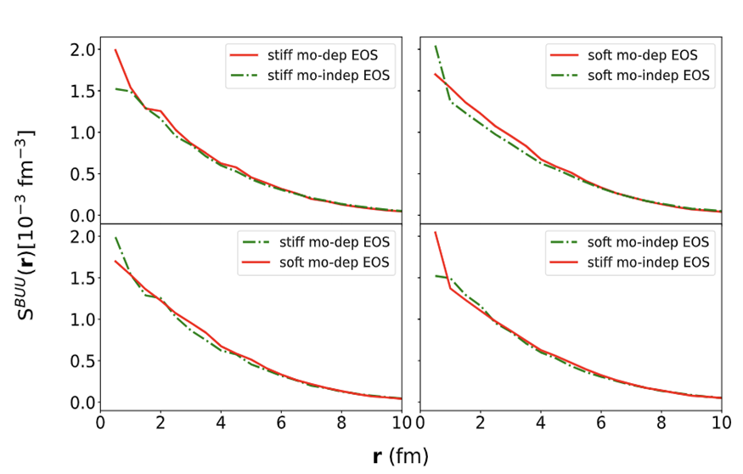
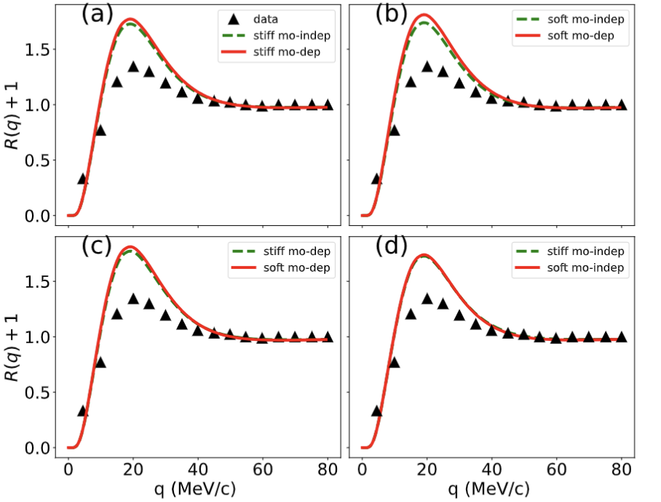
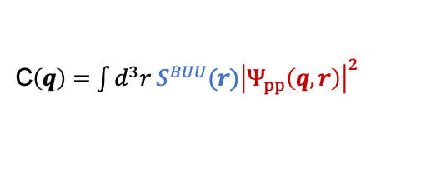
P-P correlation from BUU
Ar +Sc, at E/A=80 MeV, 200-400 MeV/c, Tot. momentum
C$\left(q\right)=\int{d^{3}r{ S^{BUU}(r)\left|Ψ_{pp}\left(q,r\right)\right|}^{2}}$
Ar +Sc, at E/A=80 MeV, 200-400 MeV/c, Tot. momentum, peaks result from p-p s-wave interactions
Various line styles –various EOSs- No significant difference observed between source (correlation) functions for different EOSs
Triangles represent p-p correlation from
Verde et al., 2003 (PhysRevC.67.034606)
Nzabahimana, Pierre, Thesis (2023)

Slide 5
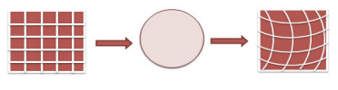

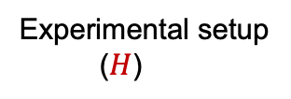
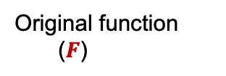
Deblurring and RL algorithm
Blurred/Measured function
$g\left(E_{d}\right)=∫dE_{d}^{’}H\left(E_{d} | E_{d}^{’}\right)F\left(E_{d}^{’}\right)$ Or
In histogram form
$g_{i}=\sum_{j}{H_{ij}F_{j} }$
with $H(E_{d}|E_{d}^{’})$– probability to measure particle characteristic to be $E_{d}$ when it is actually $E_{d}^{’}$
Optical terminology: H - blurring or transfer matrix/ Response Matrix.
Original function
($F$)
Experimental setup
($H$)
Measured/blurred
(g)
DOI: 10.1109/ELINFOCOM.2016.7562935
Nzabahimana, P., et al. (2023), W. H. Richardson(1972), L. B. Lucy, (1974)
P. Danielewicz and M. Kurata-Nishimura (2022)

Slide 6
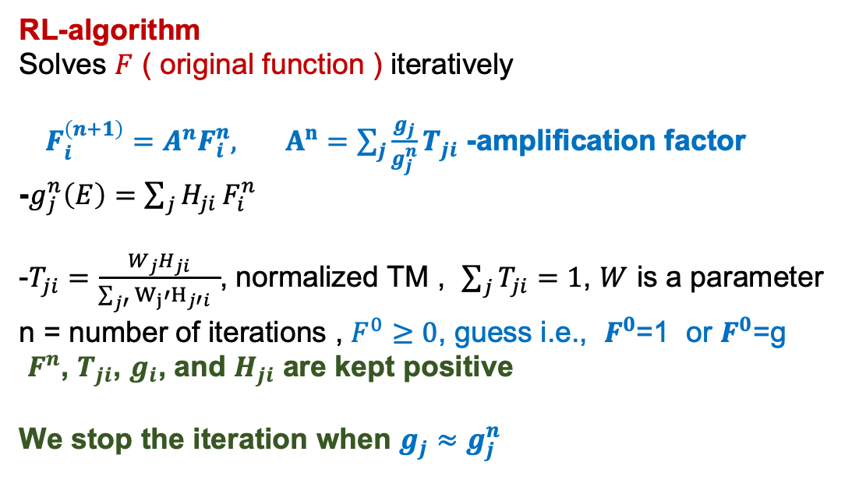
Deblurring and RL algorithm
RL-algorithm
Solves $F$ ( original function ) iteratively
$F_{i}^{\left(n+1\right)}=A^{n}F_{i}^{n},$ $A^{n}=\sum_{j}{\frac{g_{j}}{g_{j}^{n}}}T_{ji}$ -amplification factor
-$g_{j}^{n}\left(E\right)=$ ${\sum_{j}{H_{ji}}F}_{i}^{n}$
-$T_{ji}=\frac{W_{j}H_{ji}}{\sum_{j′}{W_{j}′H_{j′i}} }$, normalized TM , $\sum_{j}{T_{ji}=1}$, $W$ is a parameter
n = number of iterations , $F^{0}≥0$, guess i.e., $F^{0}$=1 or $F^{0}$=g
$F^{n}$, $T_{ji}$, $g_{i}$, and $H_{ji}$ are kept positive
We stop the iteration when $g_{j}≈g_{j}^{n}$
Nzabahimana, P., et al. (2023), W. H. Richardson(1972), L. B. Lucy, (1974)
P. Danielewicz and M. Kurata-Nishimura (2022)

Slide 7
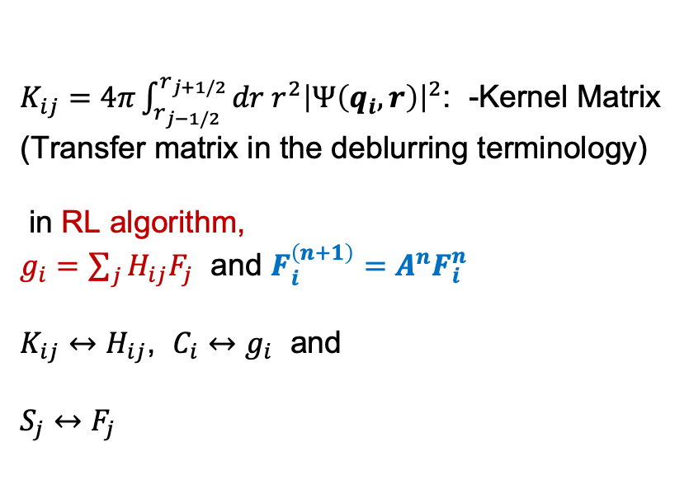

RL algorithm for source function
Recall
C$\left(q\right)=\int{d^{3}r{S(r)\left|Ψ\left(q,r\right)\right|}^{2}}$ and
Write CF in discretized form
$C_{i}=\sum_{j=1}^{N}{K_{ij}S_{j}}$
Source function:
$S≅\sum_{j=1}^{N}{S_{j}(r)g_{j}(r)}$
$g_{j}\left(r\right)=\left\{\begin{aligned}1 r_{j−1/2}<r<r_{j+1/2} \\ 0 otherwise\end{aligned}\right.$
$K_{ij}=4π\int_{r_{j−1/2}}^{r_{j+1/2}}{dr r^{2}{\left|Ψ\left(q_{i},r\right)\right|}^{2}}$: -Kernel Matrix (Transfer matrix in the deblurring terminology)
in RL algorithm,
$g_{i}=\sum_{j}{H_{ij}F_{j} }$ and $F_{i}^{\left(n+1\right)}=A^{n}F_{i}^{n}$
$K_{ij}↔H_{ij}$, $C_{i}↔g_{i}$ and
$S_{j}↔F_{j}$
D.A. Brown and P. Danielewicz (1997)
D.A. Brown and P. Danielewicz (2001)
Nzabahimana, P., & Danielewicz, P. (2023)

Slide 8
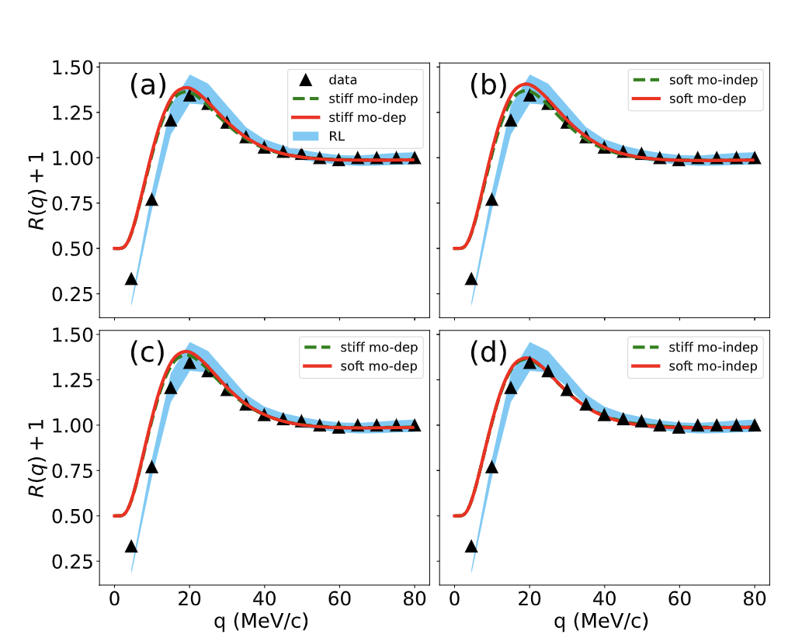
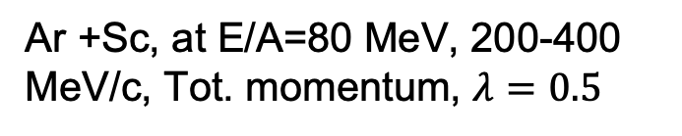
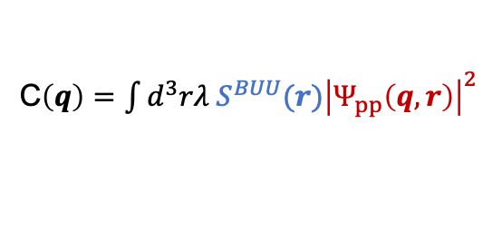
P-P correlation from BUU and deblurring (RL algorithm)
C$\left(q\right)=\int{d^{3}rλ{ S^{BUU}(r)\left|Ψ_{pp}\left(q,r\right)\right|}^{2}}$
Ar +Sc, at E/A=80 MeV, 200-400 MeV/c, Tot. momentum, $λ=0.5$
Various line styles –various EOSs
No significant difference observed between source (correlation) functions for different EOSs
Calculation for RL algorithm reproduces experimental data
Calculation from BUU do not reproduce experimental data in low q region- effect of slow emission
Triangles represent p-p correlation from
Verde et al., 2003 (PhysRevC.67.034606)
Nzabahimana, Pierre, Thesis (2023)

Slide 9
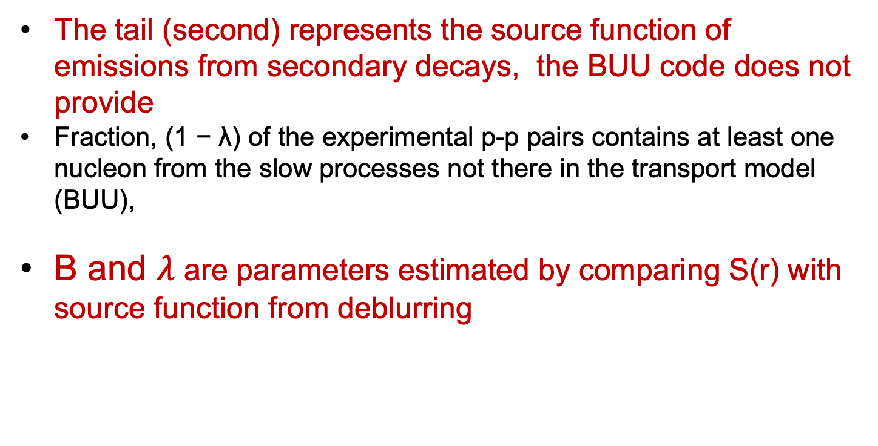
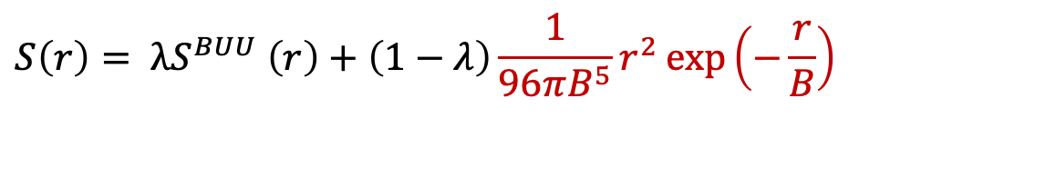
Addition of a tail (correction ) to BUU source
$$S\left(r\right)= λS^{BUU} \left(r\right)+\left(1−λ\right)\frac{1}{96πB^{5}}r^{2}\exp\left(−\frac{r}{B}\right)$$
The tail (second) represents the source function of emissions from secondary decays, the BUU code does not provide
Fraction, (1 − λ) of the experimental p-p pairs contains at least one
nucleon from the slow processes not there in the transport model (BUU),
B and $λ$ are parameters estimated by comparing S(r) with source function from deblurring

Slide 10
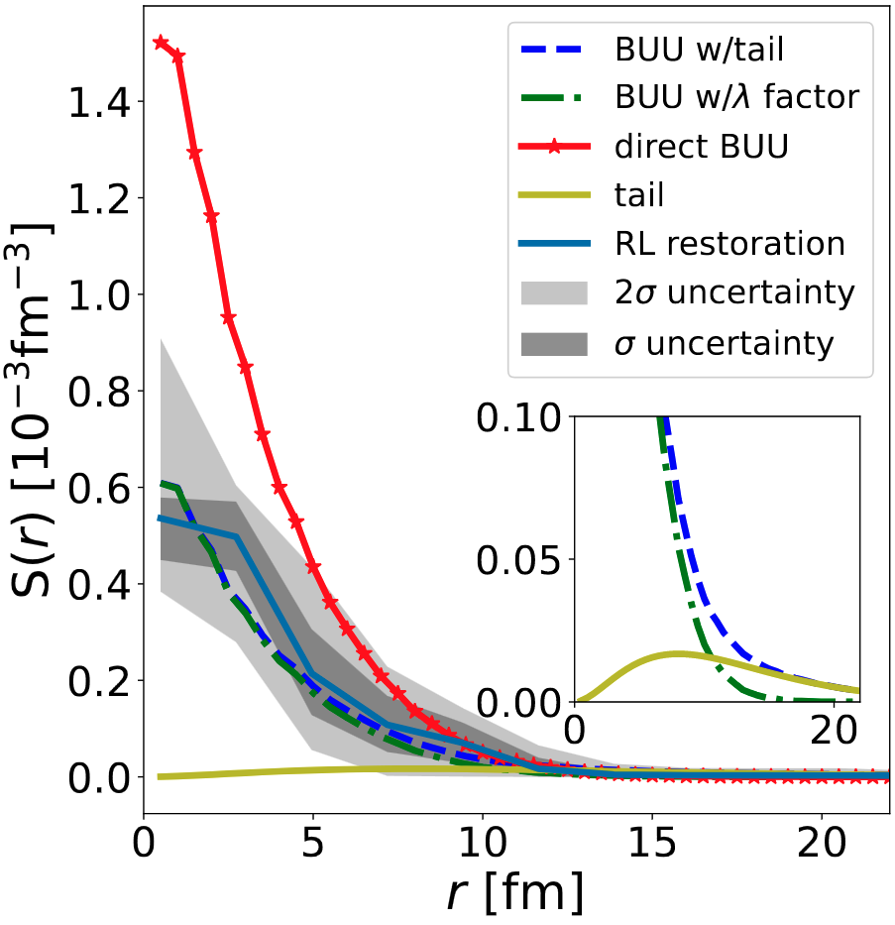
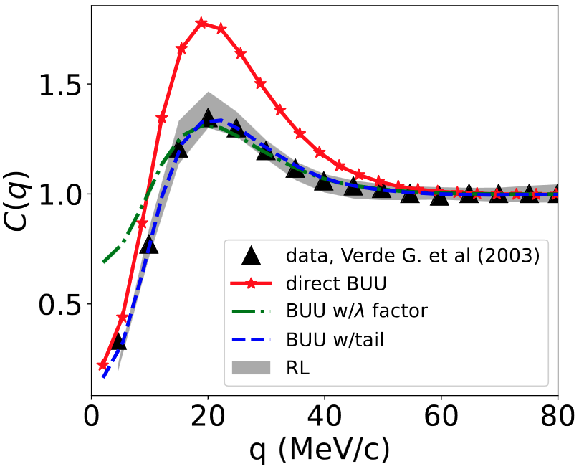
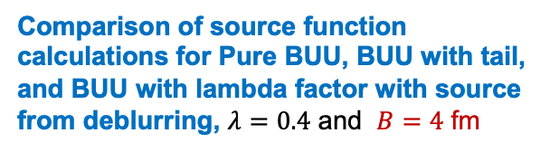
P-P correlations function: BUU with tail correction and RL
Peak at q=20 MeV/c- correspond to p-p s-wave interaction
Correlation functions calculations for BUU with tail and deblurring agree with measured correlations
Comparison of source function calculations for Pure BUU, BUU with tail, and BUU with lambda factor with source from deblurring, $λ=0.4$ and $B=4$ fm

Slide 11
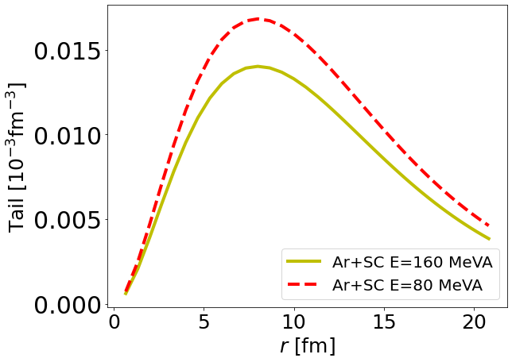
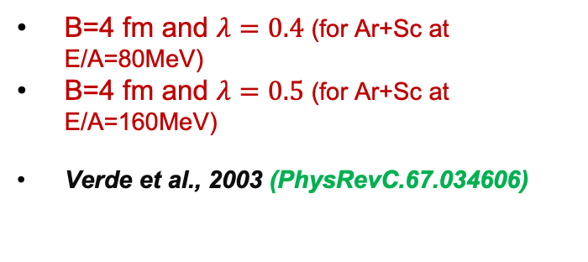
Slow emission contribution to the source function
Secondary decay distribution estimation for:
Ar+Sc at E/A=160 MeV ( preliminary results)
Ar+Sc at E/A=80 MeV
B=4 fm and $λ=0.4$ (for Ar+Sc at E/A=80MeV)
B=4 fm and $λ=0.5$ (for Ar+Sc at E/A=160MeV)
Verde et al., 2003 (PhysRevC.67.034606)
We observe the decreasing in slow emissions as function of energy

Slide 12
Summary
We discuss BUU for PP correlation
  Adding a tail to BUU p-p source reproduces measured correlations
  Contribution from slow emissions reduces as function of energy
Use this approach to estimate other Heavy-ions reaction parameters (needed data)
Planning to develop deblurring backage for the community use

Slide 13
Thank you for your ATTENTION
Co-authors: Pawel Danielewicz, Giuseppe Verde

Slide 14
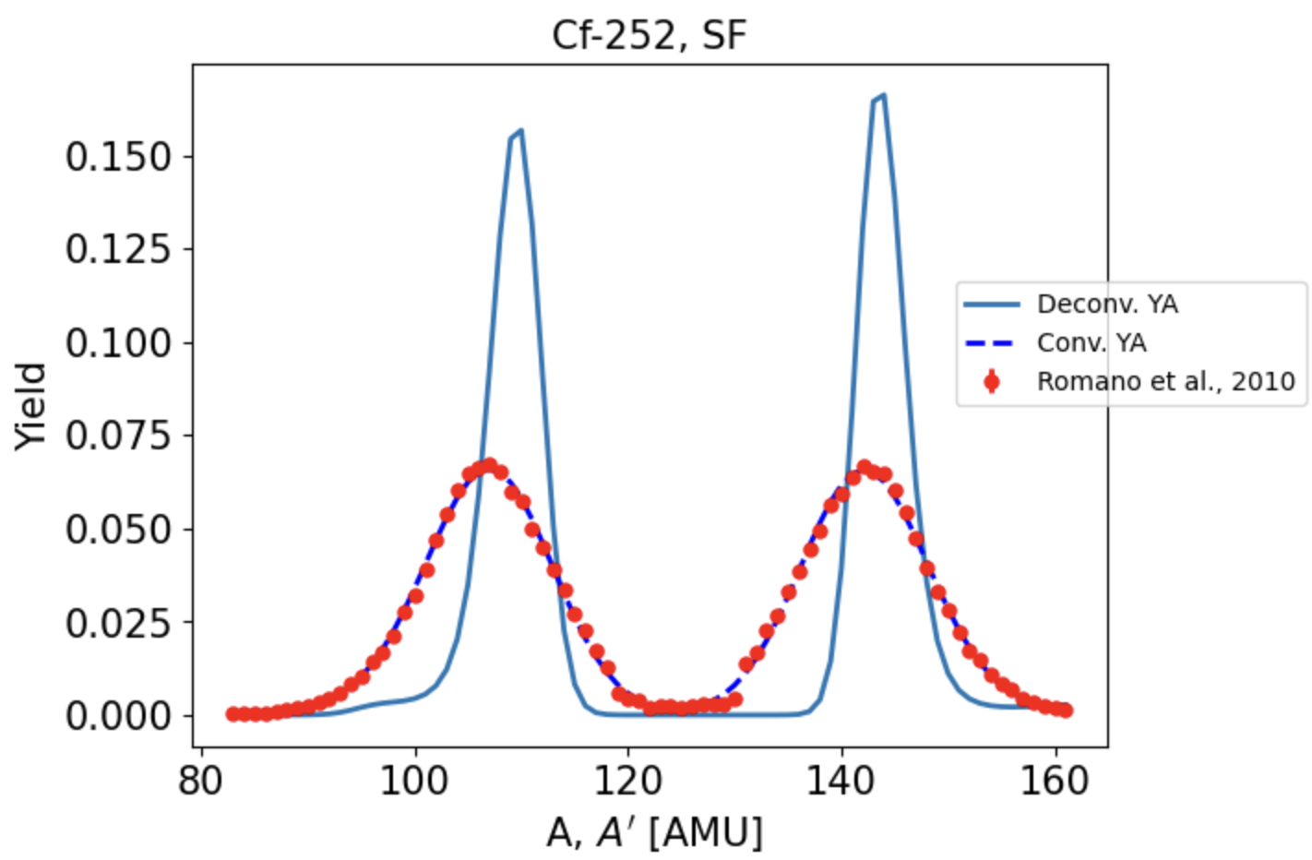
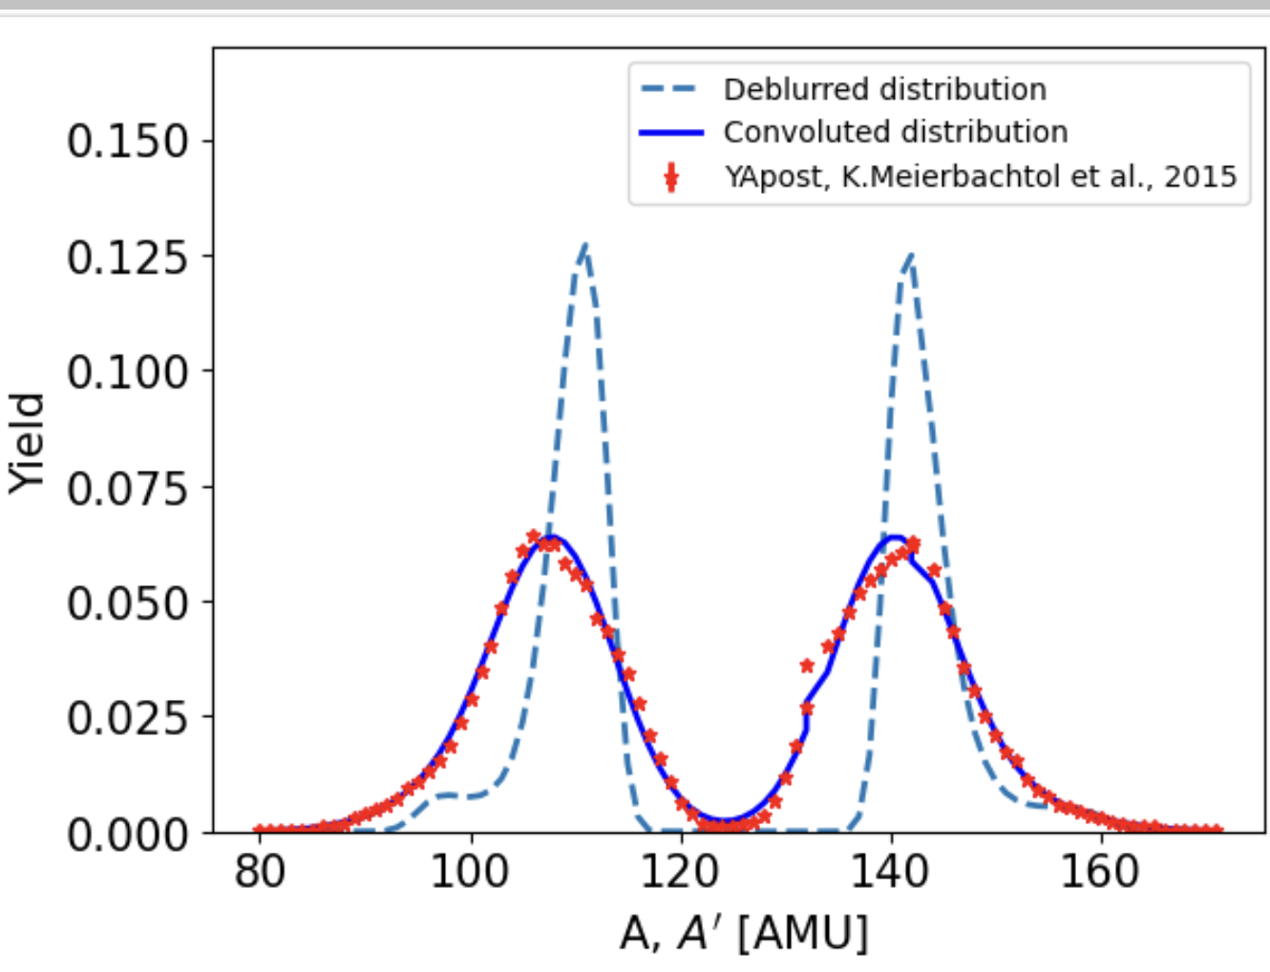
Deblurring fission fragment mass distribution from measured distribution
Dots – experimental fission fragment mass distribution (YA), Solid lines – deblurred (deconvoluted ) YA
Dashed line – results from convoluting the deblurred YA with TM- this should reproduce the experimental YA- TM need to be correct
Shift in the peak position data and deblurred YA is equivalent to mean of average number of emitted neutrons

Slide 15
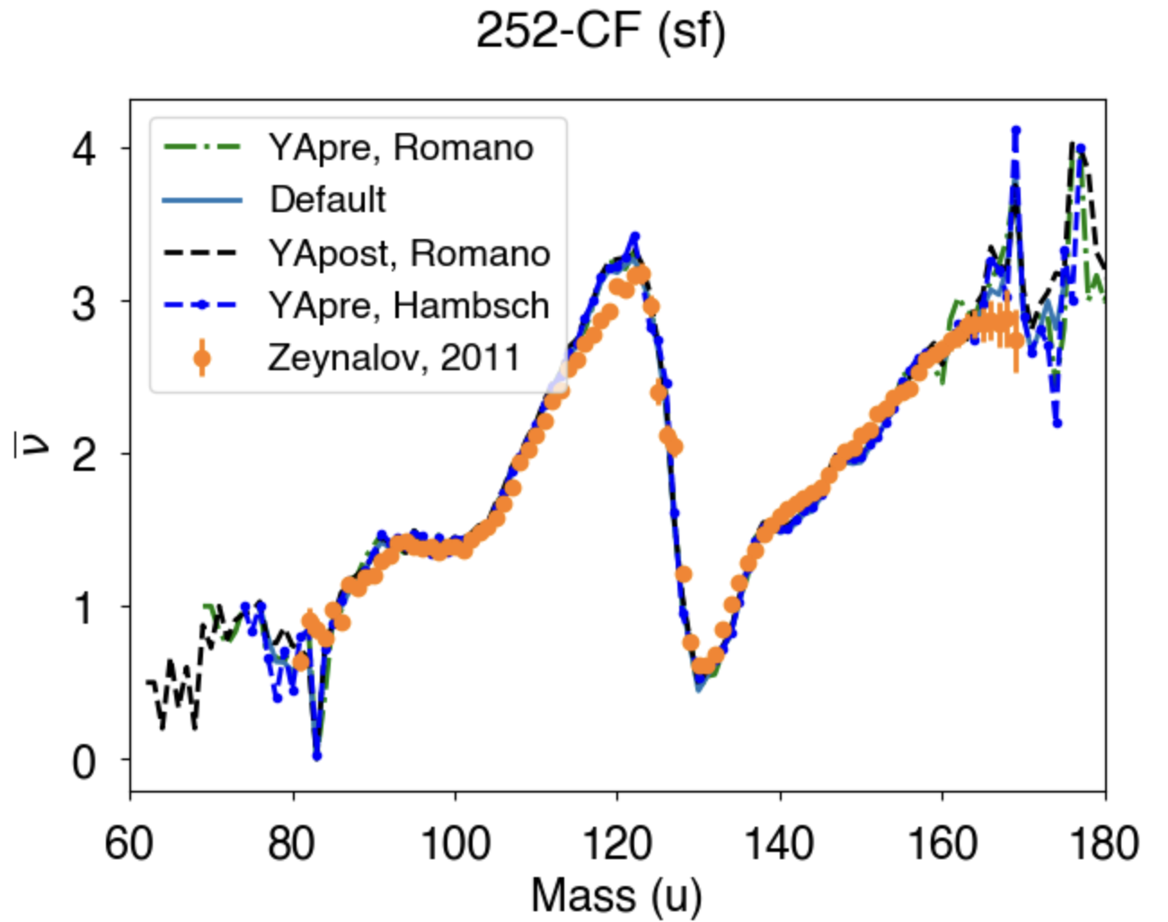
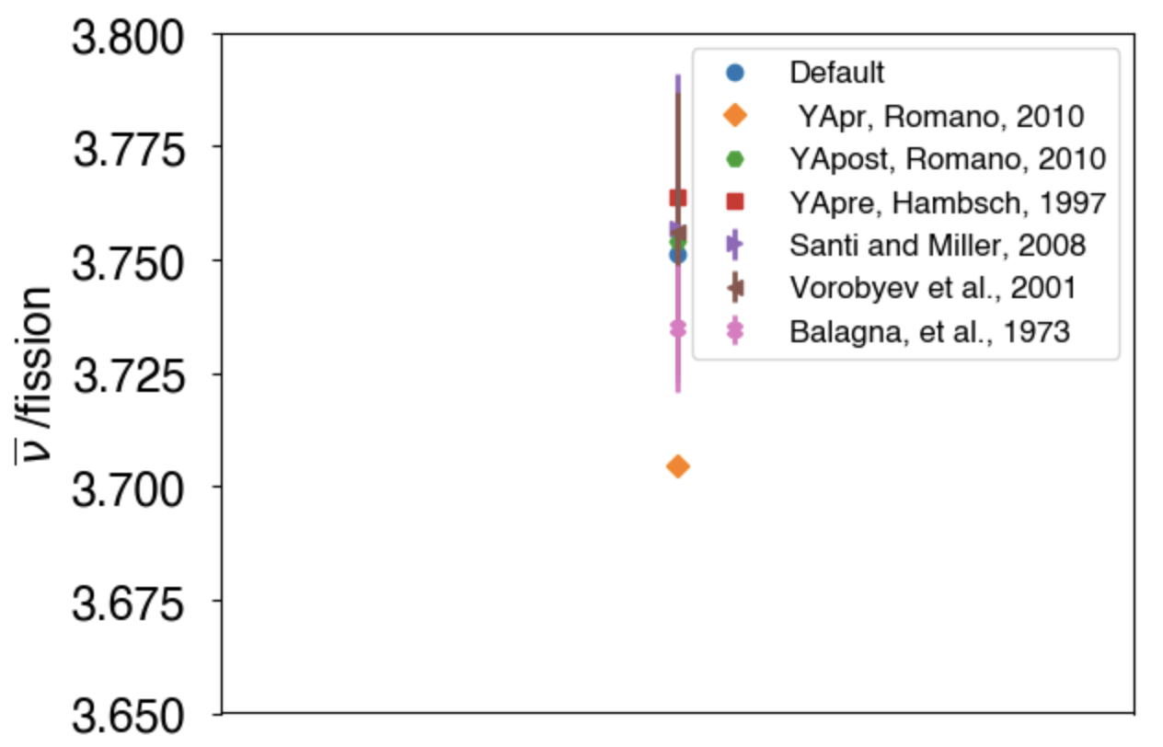
Average neutron multiplicity from CGMF for Spontaneous CF-252 (SF)
Average number of neutron emitted per fission
Average prompt neutron multiplicity per fragments
Comparison of average neutron multiplicities for Deblurred YA input and Default CGMF YA input
Results from deblurring Inputs agree with Default CGMF and both agree with experimental data ( see left and right figures)

Slide 16
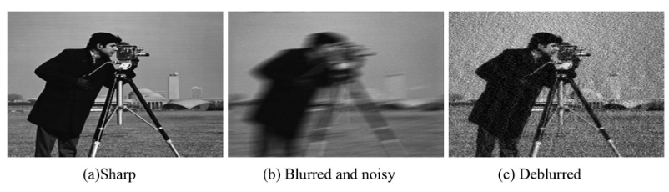
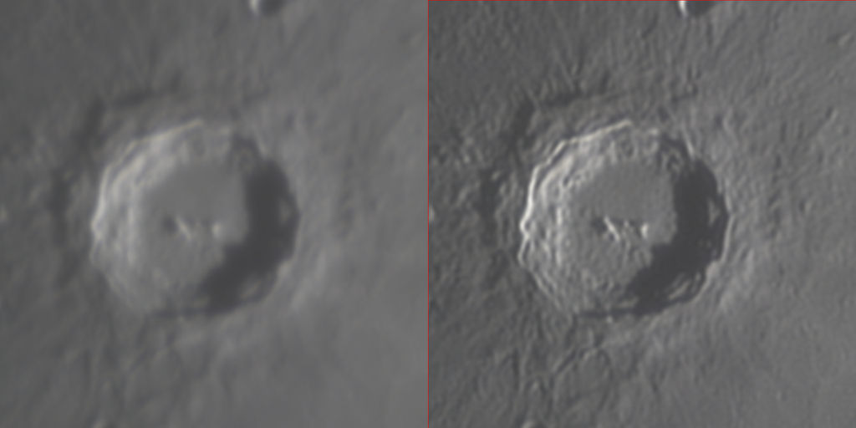
Deblurring Technique: overview
1. Deblurring in optical image processing
Original image
Optical System
Blurred image
DOI: 10.1109/ELINFOCOM.2016.7562935
Source: https://doi.org/10.1016/j.matpr.2020.11.076
Deblurring:
- Technique to restore the original image from blurred image
- Originally developed in Optics
- Use Richardson-Lucy (RL) Algorithm,
derived from Bayesian Theory
Before and after deblurring of image of lunar crater Copernicus
https://en.wikipedia.org/ wiki/Deconvolution
Nzabahimana, P. (2023). PhD thesis

Slide 17
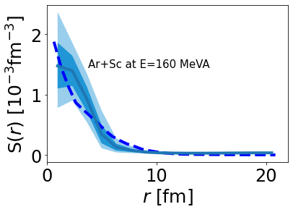
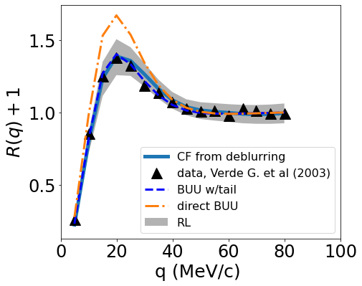
P-P correlation/source function for Ar+Sc at E/A=160 MeV

Slide 18
Extension of deblurring method to other problem ( current work)

Slide 19
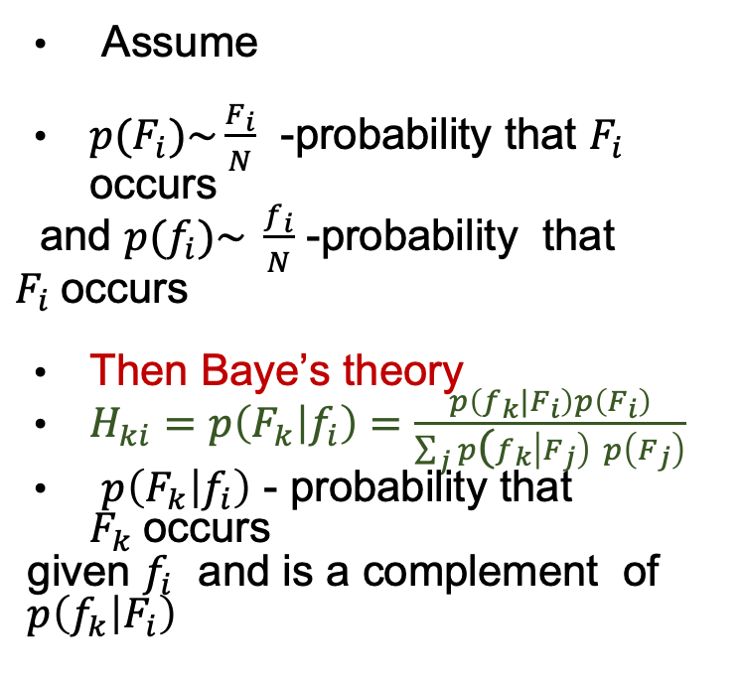
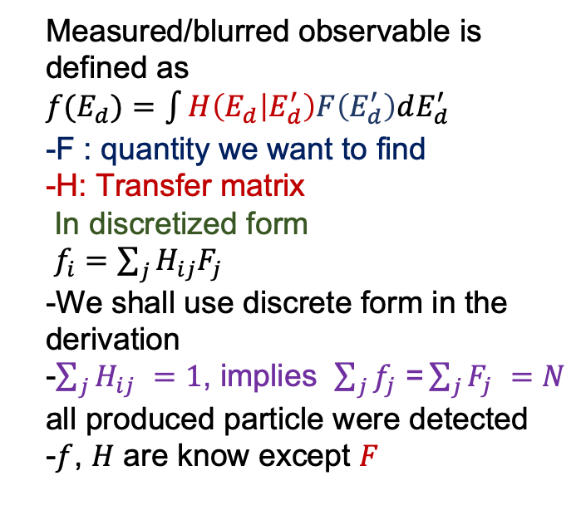
Baye’s theory for deblurring
Measured/blurred observable is defined as
$f(E_{d})=$ $\int{H\left(E_{d} | E_{d}^{′}\right)F\left(E_{d}^{′}\right)dE_{d}^{′}}$
-F : quantity we want to find
-H: Transfer matrix
In discretized form
$f_{i}=\sum_{j}{H_{ij}F_{j} }$
-We shall use discrete form in the derivation
-$\sum_{j}{H_{ij} }=1$, implies $\sum_{j}{f_{j}\text{ =}\sum_{j}{F_{j} }}=N$ all produced particle were detected
-$f$, $H$ are know except $F$
Assume
$p(F_{i})\sim \frac{F_{i}}{N}$ -probability that $F_{i}$ occurs
and $p(f_{i})\sim \frac{f_{i}}{N}$ -probability that $F_{i}$occurs
Then Baye’s theory
$H_{ki}=p\left(F_{k} | f_{i}\right)=\frac{p\left(f_{k}|F_{i}\right)p\left(F_{i}\right)}{\sum_{j}{p\text{(}f_{k}\left|F_{j}\right) }p\left(F_{j}\right)}$
$p\left(F_{k} | f_{i}\right)$ - probability that $F_{k}$occurs
given $f_{i}$ and is a complement of
$p\left(f_{k} | F_{i}\right)$
Pawel Danielewicz and Mizuki Kurata-Nishimura
Phys. Rev. C 105, 034608 (2022)
G. D’Agostini, Nucl. Instrum. Methods. Phys. Res. A 362, 487 (1995).
Res. A 362, 487 (1995)

