Slide 1
Proton Femtoscopy with 3D Source in Au+Au Collisions at $\sqrt{s_{NN}}=2.4$ GeV
Jędrzej Kołaś
for the HADES Collaboration
(jedrzej.kolas.dokt@pw.edu.pl)

Slide 2
The Plan
Motivation & goals
CF construction
Results on 1D CFs
Digression about fitting
Results on 3D CFs
Future prospects

Slide 3
High Net-Baryon Density Region
Dynamics of heavy-ion collisions (HIC) at high net-baryon are unknown
Protons $→$ present throughout the whole duration
Study of proton dynamics $→$ a true study of HIC at high $μ_{B}$
https://cloud.itp.uni-frankfurt.de/s/YJb9zEfzwqXmwgp

Slide 4
Which Part of The Koonin-Pratt Equation I Like the Most?
The Koonin-Pratt equation:
$$C\left(\vec{q}\right)=\int{d^{3}r}S\left(\vec{r}\right){\left|ψ\left(\vec{q},\vec{r}\right)\right|}^{2}$$
Not much data on one-dimensional p-p source dynamics for baryon-rich region
The three-dimensional p-p source dynamics have not been studied
We know more about $S\left(\vec{r}\right)→$ we know more about our collisions
In this work:
Longitudinal Co-Moving System (LCMS)
Pair Rest Frame (PRF) - occasionally
1D – q_{inv}
3D – Bertsch-Pratt Parametrisation (out-side-long)
long
$$\vec{q}$$
Beam
$$\vec{k}$$
$$θ$$
out
$$φ$$
side

Slide 5
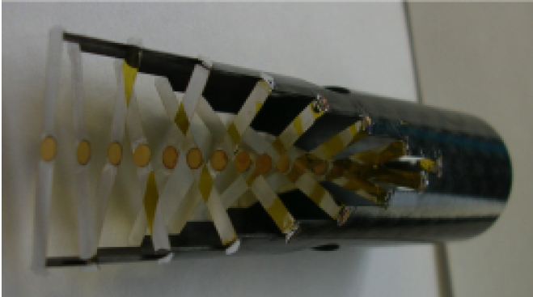
The HADES Detector
Fixed target experiment at FAIR/GSI
Large angular coverage:
$θ∈\left({18}^{°},{85}^{°}\right)$
$φ∈\left(0^{°},{360}^{°}\right)$
Tracking detector with good momentum resolution
Target – composition of multiple target plates:
R. Greifenhagen „Two pion intensity-interferometry in collisions of Au+Au at $\sqrt{s_{NN}}=2.4$ GeV measured with HADES”, PhD Thesis
https://www.gsi.de/en/about_us/50_years_gsi/urban_sketchers_at_gsi_and_fair

Slide 6
Scientific Goal
Multi-differential and multi-dimensional p-p analysis:
Precise determination of p-p source
Dynamics of the p-p source
Comparison with models (which implement different EoS)
Dataset:
Au+Au (big system)
$\sqrt{s_{NN}}=2.4$ GeV (low energy)
HADES detector
1D
Strong interaction parameters
k_{T} dependence
y dependence
Centrality dependence
asHBT
3D

Slide 7
Mixing
Event Level
Pair Level
Dimensions:
Centrality | - | 10%
Target | - | 1 Au plate
y | - | 0.23 a.u.
k_{T} | - | 200 MeV/c
$φ−Ψ_{E.P.}$ | - | ${45}^{°}$
…
…
y
Centrality
…
k_{T}
…
$$φ−Ψ_{E.P.}$$
Target Plate
…

Slide 8
1D Correlation Functions

Slide 9
One-Dimensional Correlation Functions
Raw results on 1D p-p correlation functions (most central)
Other centralities are in the backup
Visible k_{T} dependence
Many points $→$ great for fitting
Not corrected for momentum resolution (yet)
WORK IN PROGRESS

Slide 10
One-Dimensional Correlation Functions
Raw results on 1D p-p correlation functions (most central)
Other centralities are in the backup
Visible difference in radii $→$ breaking boost-invariance
Many points $→$ great for fitting (again)
Not corrected for momentum resolution (soonTM)
WORK IN PROGRESS

Slide 11
Fitting – 1D
C++ code implementing the Koonin-Pratt equation [2]
Currently implements:
Schrodinger solution for p-p interaction with Reid soft-core potential (CorAL)
Phase-shift solution for p-p interaction data from Reid (CorAL)
Lednicky-Lyuboshitz formalism for p-p interaction (TPI)
Code is in the early development stage
[2] https://github.com/JohnTheBlindMilkman/JJCorrFitter

Slide 12
Fitting – Wavefunction Comparison
R_{inv} = 2 fm
R_{inv} = 5 fm
Bigger differences for smaller radii are observable

Slide 13
Fitting – 3D
R_{out} = 2 fm
R_{side} = 2 fm
R_{long} = 2 fm
Very early results for the future 3D fits

Slide 14
3D Correlation Functions

Slide 15
Three-Dimensional Correlation Functions
WORK IN PROGRESS

Slide 16
Three-Dimensional Correlation Functions
WORK IN PROGRESS

Slide 17
Three-Dimensional Correlation Functions
WORK IN PROGRESS

Slide 18
Summary & Outlook
We intend to learn about the dynamics of high net-baryon density HIC
Raw results on 1D and 3D p-p CFs are shown
The results look promising w.r.t. the amount of observables which will be studied and their expected uncertainty
We develop a fitter for 1D and 3D p-p CFs in cartesian coordinates
With the momentum resolution correction in place, we will be able to learn about the p-p femtoscopic radii
First time in 3D?
In the future, we plan to compare the results with model predictions
We also intend to measure the strong interaction (cross-check)

Slide 19
Thank you for your attention

Slide 20
Backup

Slide 21
Cuts & Corrections
Dataset:
Au + Au $\sqrt{s_{NN}}=2.4$ GeV
Event:
Target plate selection, X and Y vertex cut ($μ±nσ$)
Must have EP reconstructed
Centrality 0-10%, 10-20%,… etc.
Track:
Not at MDC edge
Bannana cut
Bad layers < 2
Pair:
Not the same ToF cell
Fraction of Close Hits = 70% (OneUnder)
Corrections:
Energy-loss
Purity
Momentum resolution

Slide 22
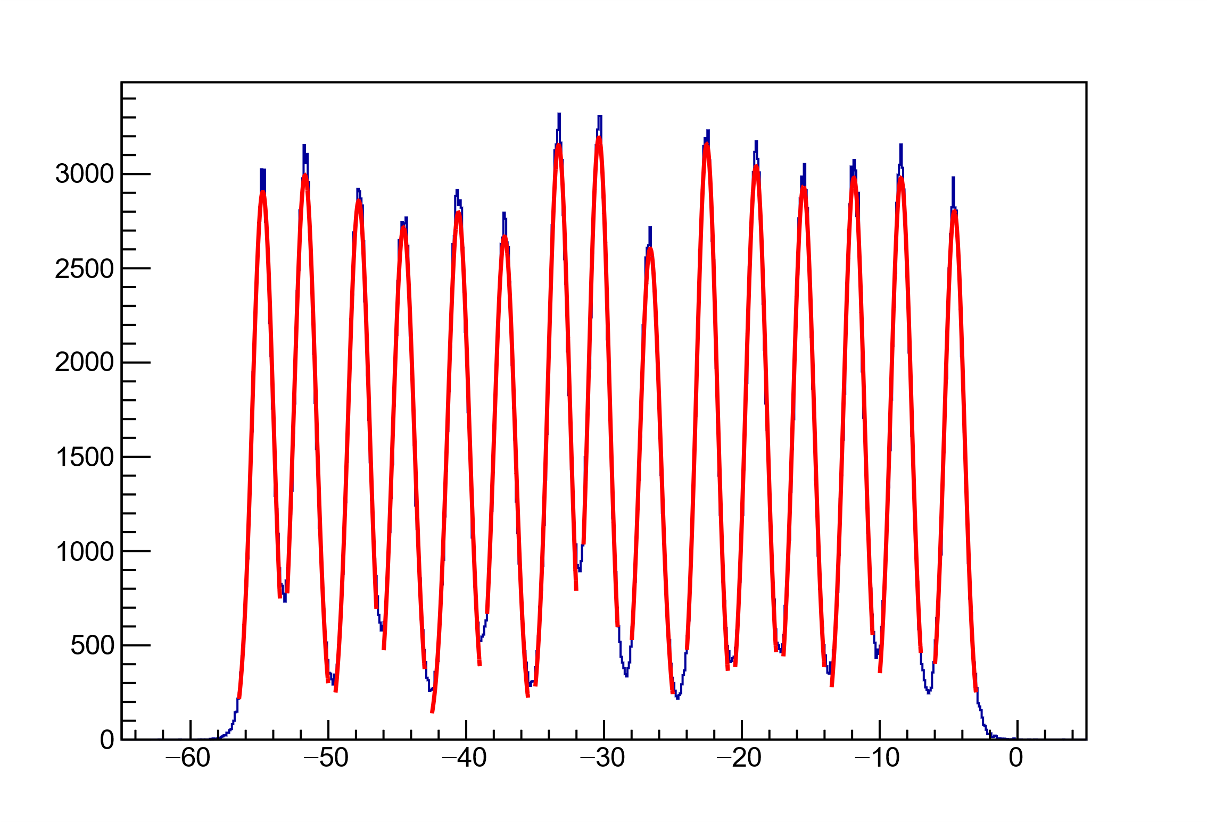
Target Vertex
z Vertex

Slide 23
One-Dimensional Correlation Functions

Slide 24
One-Dimensional Correlation Functions

Slide 25
One-Dimensional Correlation Functions

Slide 26
One-Dimensional Correlation Functions

