Slide 1
Club Data
Conditioned Batch Normalizations
Antoine BRALET (antoine.bralet@univ-smb.fr)
20/02/2024
1

Slide 2
Context | CBN
Overall Context

Slide 3
Context
Context | CBN
INPUTS
METHODS
OUTPUTS
Input 2
Value
Deep Network
Classification
Input 1
Map

Slide 4
Context
Context | CBN
INPUTS
METHODS
OUTPUTS
Additional Input
Value
Deep Network
Classification
Major Input
Map

Slide 5
Context
Context | CBN
INPUTS
METHODS
OUTPUTS
Additional Input
Value
Deep Network
Classification
Major Input
Map

Slide 6
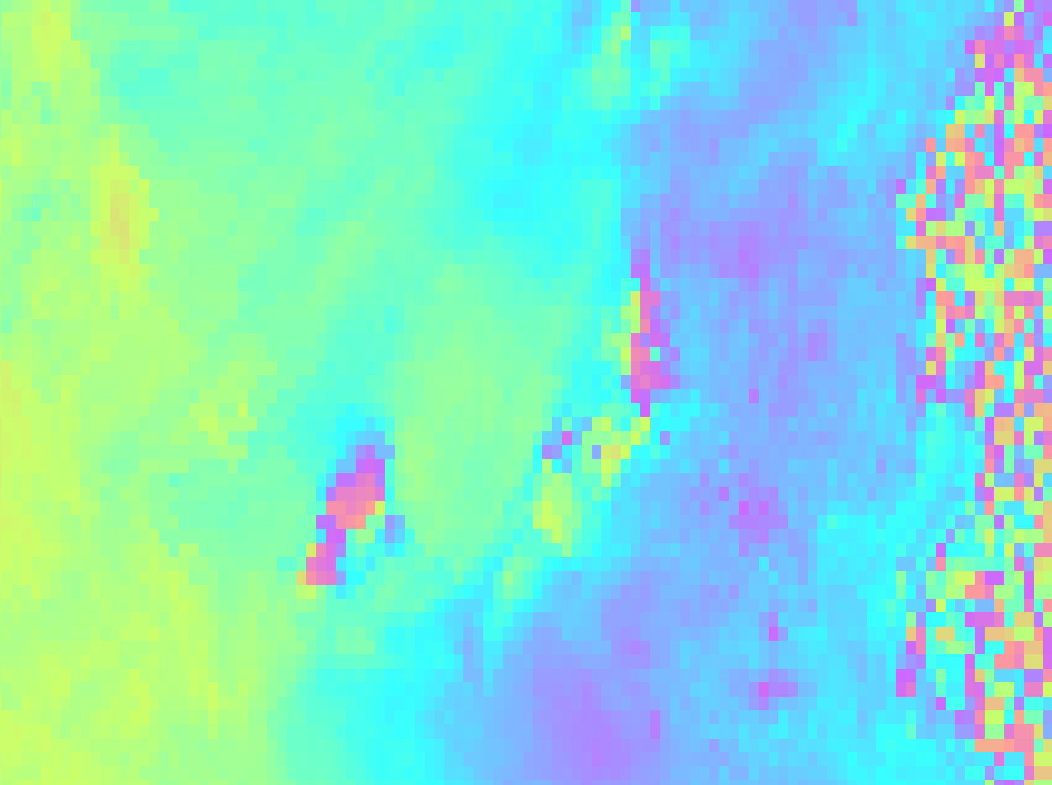
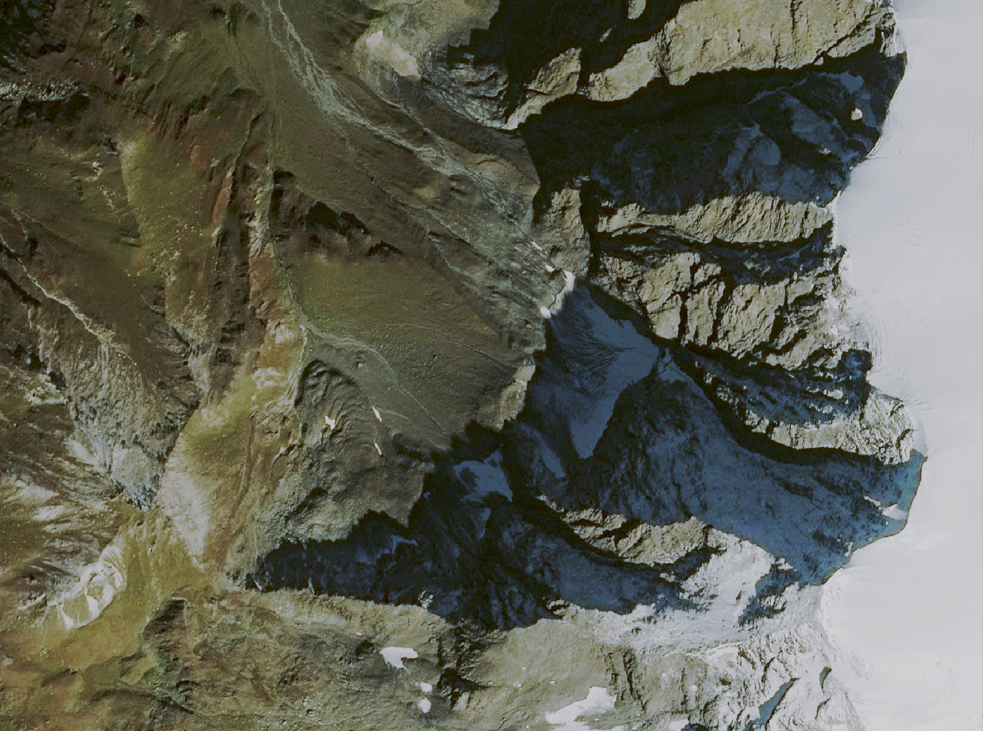
Example(s?)
Context | CBN

Slide 7
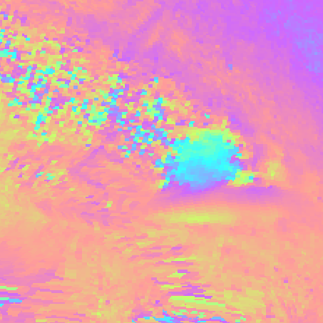
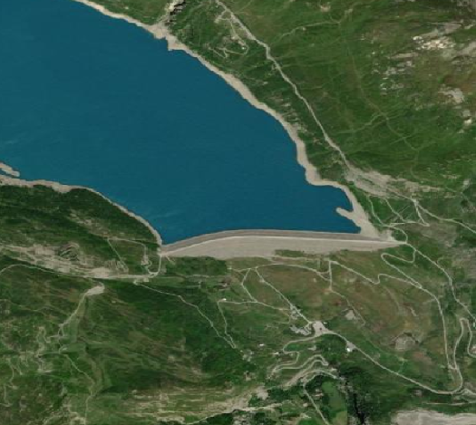
Example(s?)
Context | CBN

Slide 8
Example(s?)
Context | CBN

Slide 9
Example(s?)
Context | CBN
What about you ?

Slide 10
Context | CBN
Conditioned Batch Normalization

Slide 11
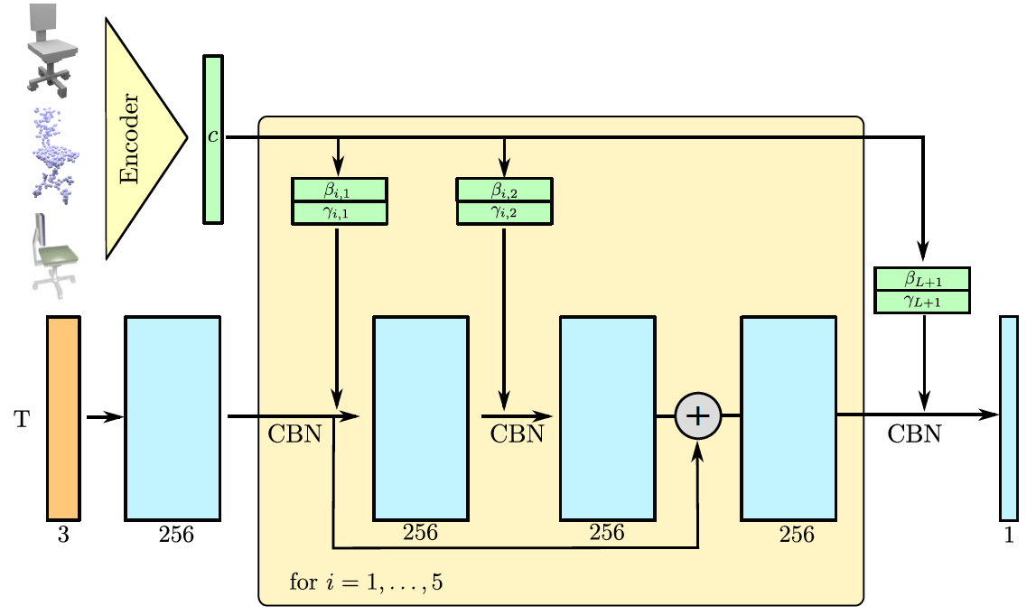
Occupancy Network [Mescheder et al., 2019]
Context | CBN
Knowledge
(3D image, point cloud, 2D image)
Question
(3D coordinates)
Answer
(Inside/Outside the object)
[Mescheder et al., 2019] Mescheder, L., Oechsle, M., Niemeyer, M., Nowozin, S., & Geiger, A. (2019). Occupancy networks: Learning 3d reconstruction in function space. In Proceedings of the IEEE/CVF conference on computer vision and pattern recognition (pp. 4460-4470).

Slide 12
Batch Normalization
Context | CBN
$f_{out}= γ . \frac{f_{in} − μ}{σ+ε}+ β$

Slide 13
Conditioned Batch Normalization
Context | CBN
$f_{out}= γ(c). \frac{f_{in} − μ}{σ+ε}+ β(c)$

Slide 14
Conditioned Batch Normalization
Context | CBN
[Vries et al, 2017]
H. de Vries, F. Strub, J. Mary, H. Larochelle, O. Pietquin, and A. C. Courville. Modulating early visual processing by language. In Advances in Neural Information Processing Systems (NIPS), 2017.
[Dumoulin et al, 2017]
V. Dumoulin, J. Shlens, and M. Kudlur. A learned representation for artistic style. In Proc. of the International Conf. on Learning Representations (ICLR), 2017

Slide 15
Thank you
for your attention
Antoine BRALET (antoine.bralet@univ-smb.fr),
20/02/2024
15

