Slide 1
Foundational Principle : Single Photoelectron Response
Modeling & Feasibility studies
Journées 2024 de l'atelier détecteurs gazeux
Thursday, 21st March 2024
GANIL
Alexandra Kallitsopoulou, Thomas Papaevangelou PhD Candidate CEA/IRFU/Université Paris – Saclay
On behalf of PICOSEC Micromegas Collaboration

Slide 2
Outline
Introduction to the PICOSEC Micromegas technology
Modeling the Timing characteristics
Feasibility studies using alternative digitizers
Conclusions

Slide 3
The PICOSEC Micromegas Technology

Slide 4
What is our motivation?
Timing with a few 10’s of Picosecond
Tracking challenges for HL-LHC:
LHC will go to higher energy & luminosity
5x nominal instaneous luminosity → Increased particle densities
20x current integrated luminosity → Increased radiation damage
What are the needs:
Reduction of mixing different events due to pile-up
Track to vertex association → 3D tracking with timing information
Extra detector requirements:
Large area coverage
Resistance to aging effects
Multi-pad readout tracking
Giant improvement ~ 3 orders of magnitude compared to standard MPGDs
Detector Technologies
Gaseous detectors
Resistive Plate Chambers (RPCs) (σ_{t} ~ 30 ps)
Micro-Pattern Gaseous Detectors (σ_{t} ~ 1 ns)
Notes:
The motivation is to achieve timing with a few 10s of a picosecond. The idea is rising from the need of high-rate experiments to deal with pile-up phenomena.
For example, HL LHC estimates per average of 140 pp interaction per bunch crossing, which means that event reconstruction is not straightforward. The new 4D tracking era can include timing as an extra parameter for triggering or event selection.
On average 140 p-p interactions per bunch crossing
Necessary timing resolution ~20ps
But this push to the limits of existing detector designs. We have to be able to scale up the modules, be resistant to aging, and read out multi-channels.
For this, some technologies already have reached a fraction of 20 ps.
For example, Avalanche PD has a big gap and high resistivity they cannot survive at such a high rate.

Slide 5
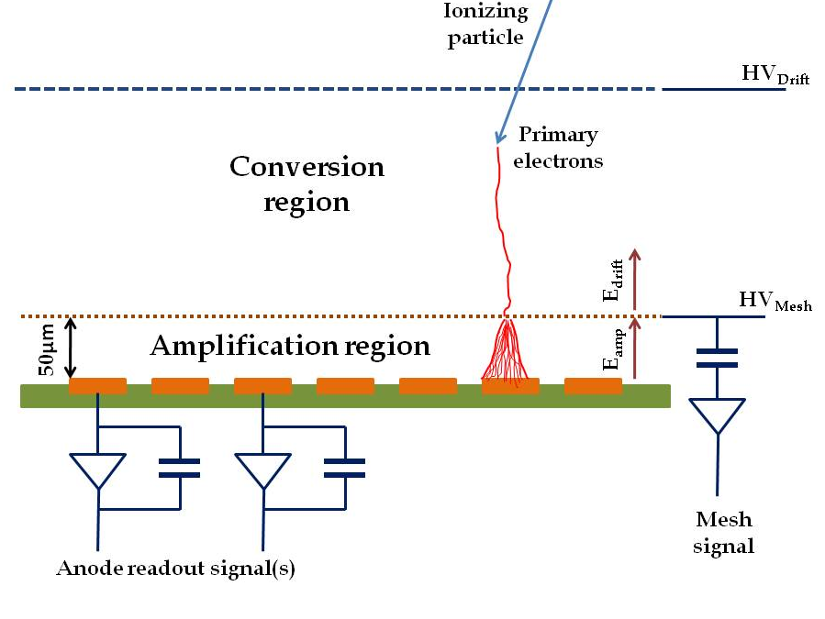
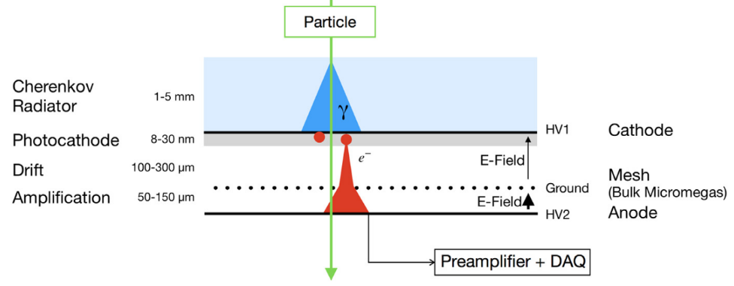
The PICOSEC Micromegas Technology
Limitations of the Micromegas Timing Potential
Stochastic nature of ionization
Randomness of last ionization
Time jitter of a few ns
Modifications in MM Geometry
Smaller Drift Gap
Elimination of the stochastic nature of ionization
Higher applied Drift Voltage→Pre-avalanche
Y. Giomataris, P. Rebourgeard, J.P. Robert and G. Charpak, “Micromegas: A high-granularity position sensitive gaseous detector for high particle-flux environments”, Nuc. Instrum. Meth. A 376 (1996) 29
Additional Components
Cherenkov radiator +
Solid converter→Photocathode Prompt photoelectrons
J.Bortfeldt, et al., “PICOSEC: Charged particle timing at sub-25 picosecond precision with a Micromegas based detector”, https://doi.org/10.1016/j.nima.2018.04.033
Notes:
So the idea of the stochastic nature of ionization means that the incident particle can cause ionizations randomly in the gas.
In the picosec in order to minimize this probability of direct ionization we use smaller drift gap. But we still have somehow to create our signals. For this we have a radiator, as for the relativistic particle that crosses this will create Cherenkov photons and those will then be converted by the photocathode material to photoelectrons.
This very small drift gap offers a great advantage to apply even higher electric field in creasing the probability of creating an avalanche even from the 1st stage, i.e preamplification

Slide 6
Modeling the Timing

Slide 7
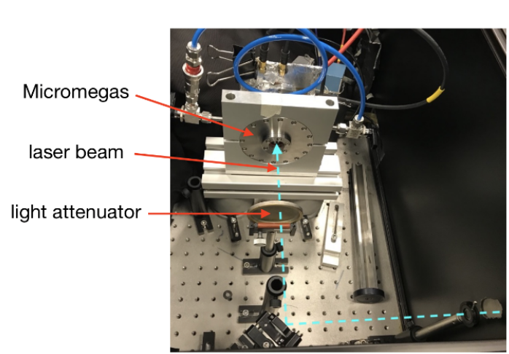
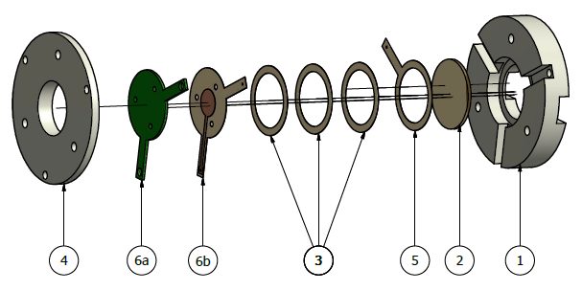
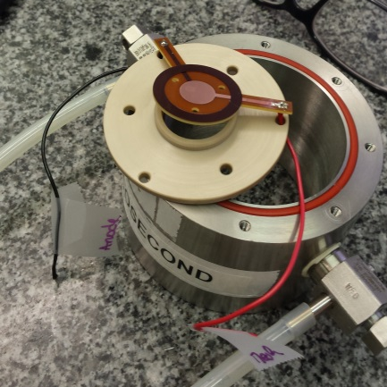
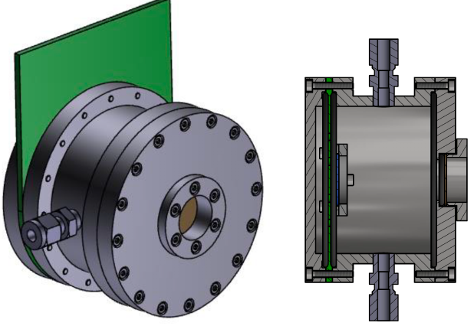
Single Photoelectron Measurements
The Sensor:
Laser Beam (IRAMIS/CEA)
Fast Photodiode → Reference
UV Ultra short laser pulses
Controlled number of photoelectrons
Perform measurements independently of the photocathode material
Laser repetition rate up to 10kHz - 5MHz spot ∅ = 2mm
Different Detector technologies
Bulk Micromegas ∅ 1cm
MicroBulk Micromegas ∅ 1cm
Single Channel Prototypes
Bulk Micromegas ∅ 1cm
119μm drift gap,
CsI photocathode deposited on Al layer (275/525V – High Gain)
COMPASS Gas :
80% Ne – 10% CF₄-10%C₂H₆
Notes:
Since the very first tests, single prototypes are always the basis of the prof of principle of the detector technology.
Through the years there has been different designs, not only on the readout layer but also on the vessel containing it, in order to optimize the detector response.
In the R&D phase we have to quantify the effect of every single component of the detector that might affect its timing resolution. This stage comprises of testing different photocathode materials as well as the gas composition.

Slide 8
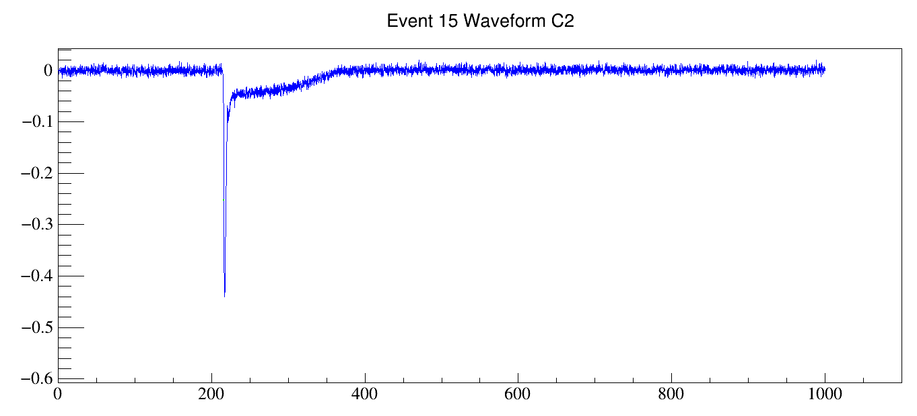
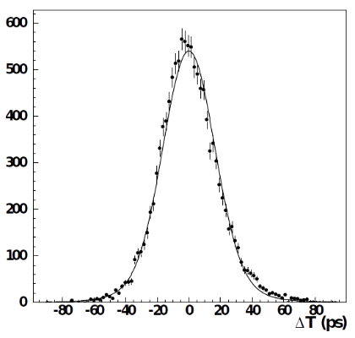
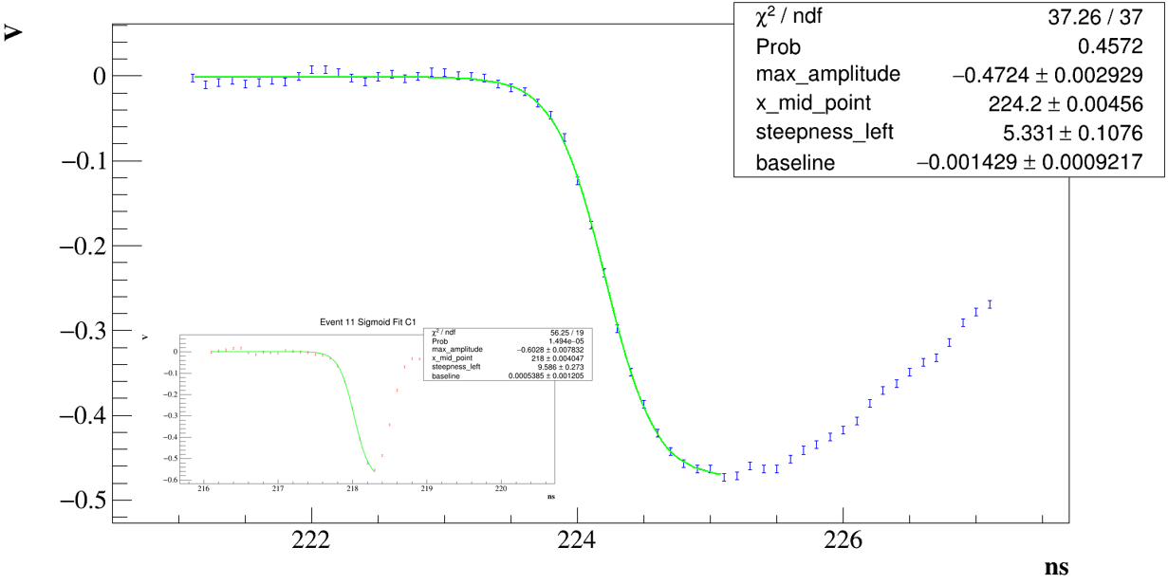
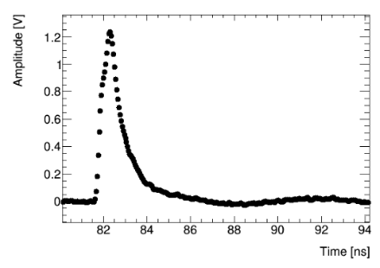
Standard Waveform Analysis
Experimental Data used in this work
2 Data-Set collected
Spe-Set ( single photoelectrons)
Exp-Set (multi-photoelectrons ~7.8 p.e.)
Amplitude[V]
Ion tail
Electron peak
Timing Resolution: 18.3 ± 0.2 ps
The Standard CFD Technique
Adjust a curve to the experimental data
Fitting the leading edge of the waveform with logistic function
$f\left(x;p_{0}, p_{1},p_{2},p_{3}\right)=V\left(t\right)=p_{3}+\frac{p_{0}}{1+e^{−\left(x−p_{1}\right)p_{2}}}$
Timing at 20% of peak amplitude for all signals
(SAT – Signal Arrival Time)
Subtract the PICOSEC signal from the PD0 signal
Distribution of SAT ➔ RMS = Timing resolution
Time[ns]
Photodiode
Notes:
To demonstrate the timing algorithms we are going to use data coming from the Laser Test taken with a single pad prototype, with 119μm drift gap, CsI photocathode and operating in
High field of 525 drift and 275 anode voltage.
The signals of both the picosec and the photodiode can be seen in the upper right. PICOSEC Signal is a two component signal, comprising of the fast drifting electron peak and the slow ion tail.
On the other hand, the Photodiode’s signal is more sharp with clear electron peak.
The standard timing algorithm procedure starts by adjusting a curve to both the signals of the photodiode and the PICOSEC, which is the logistic function.
The Signal Arrival Time is extracted by this fit at 20% of peak maximum, and then we subtract PICOSEC Value from the respective photocathode value.
After correcting for dynamical errors we can came up with a SAT distribution, which is fitted with a double Gaussian and its RMS defined the timing resolution, which for this data set is set to 18.3 ps
This procedure and the results we achieved will be our reference analysis, and with this we will compare our new algorithms for their validity and consistency.

Slide 9
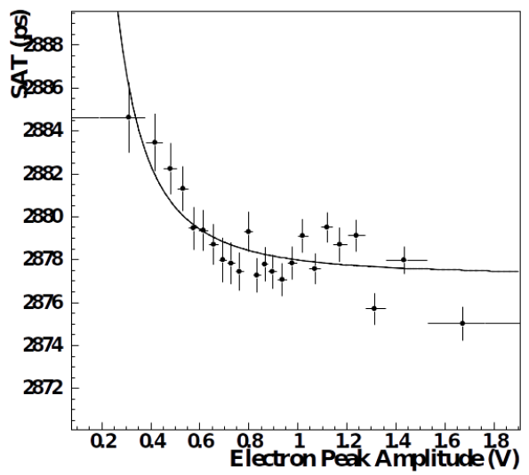
Correcting for Dynamical Errors
In principle, CFD method DOES NOT suffer from time walk effects
However we observe dependence on signal amplitude
Its origin has nothing to do with offline analysis procedure BUT
Results from the microscopic behavior of the avalanche
Photoelectrons drift with different velocities than the total avalanche
g$\left(x;a,b,w \right)=a+\frac{b}{x^{w}}$
Calibration curve
$$Corrected SAT=SAT−\frac{a}{{Pulse Amplitude}^{b}}+c$$
Notes:
Talking about dynamical errors we mean that the dependence of SAT on the signal amplitude. But in principle the CFD technique does not suffer from time walk effects.
This dependence can be seen by splitting the data into bins of peak size(amplitude or charge), fitting each data set with Gaussian and then by shorting SAT values in rising values of the size.
On the left you can see the results for the data set we used, this small dependence has nothing to do with the offline analysis procedure, but instead it reveals the pulse formation dynamics, and the microscopic behavior of the avalanche, and the fact that the avalanche drifts with different velocity than its electrons individually. Even though we have reduced more the drift gap to create avalanches as early as possile, this is still a remaining effect. For this reason, we parametrize this dependence with a power law and correct for this. While on the other hand the constant thr thechnique truly suffers from time walk effects
And the effect is corrected on the offline analysis.

Slide 10
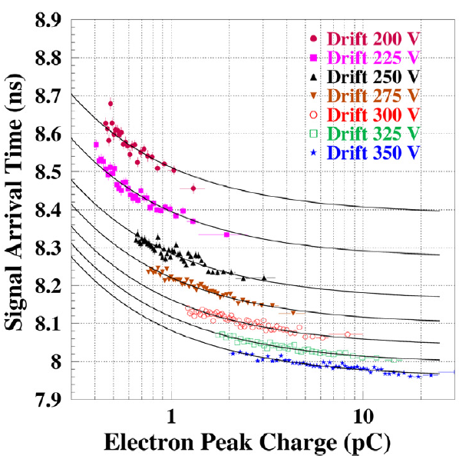
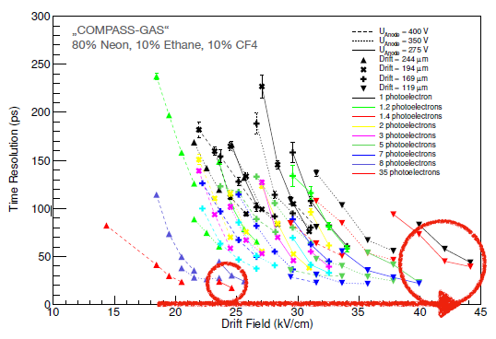
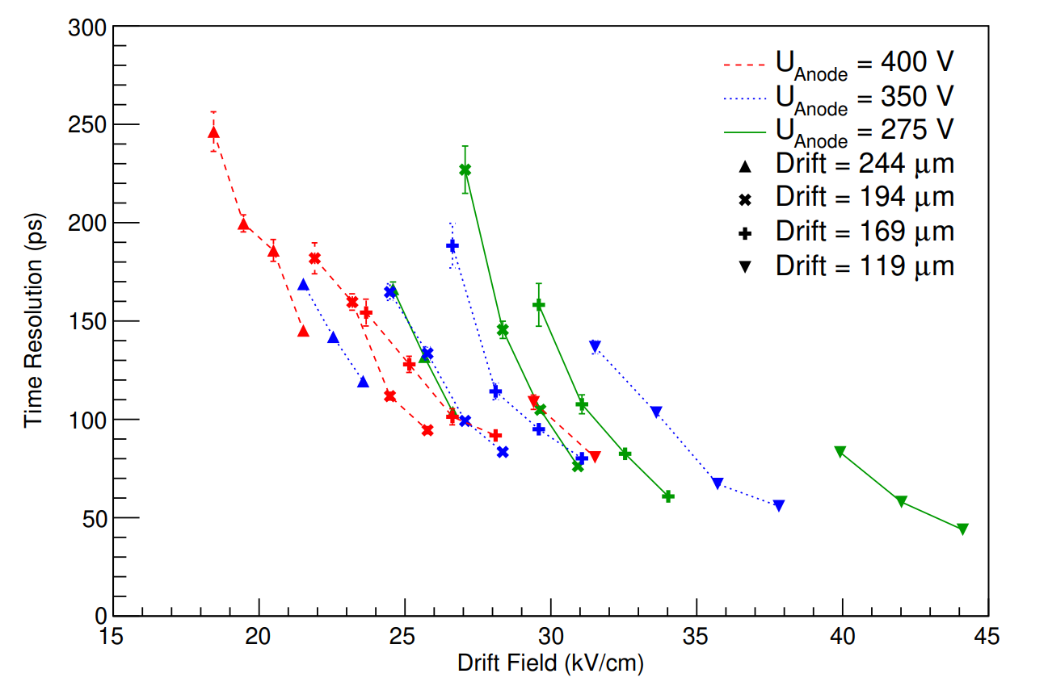
Important Observables
Data taking & Output
Signal Arrival Time has a dependence on Electron peak charge
Timing resolution improves with
Higher drift field &
Smaller gap(<50ps for 120μm for single pe)
L.Sohl-PhD Thesis “Development of a PICOSEC Micromegas for fast timing in high rate (archives-ouvertes.fr)
L.Sohl-PhD Thesis “Development of a PICOSEC Micromegas for fast timing in high rate (archives-ouvertes.fr)
J.Borteldt, et al. “PICOSEC: Charged particle timing at sub-25 picosecond precision with a Micromegas based detector”, Nuc. Instrum. Meth. A (2021)https://doi.org/10.1016/j.nima.2018.04.033
Notes:
Continuing the collaboration with IRAMIS laser Facility, the way of better understanding of the detector was open. Some detailed studies having the control of number of photoelectrons, resulted to very important statements of detector response.
And say which one are those…
Great achievement of those measurements was that we observed some important statements of the detector response.
The dependence of SAT with electron peak charge in different operation Voltages, The grater the drift voltage the smaller the SAT
In parallel it is evident that timing resolution improves with higher field and smaller gap reaching even a resolution of 50 ps for 120μm gap and

Slide 11
Understanding the Timing
The purpose of the simulation was to simulate the observed effects
and investigate the mechanisms producing them
Simulation Studies Summary
SAT vs charge shape
Independent of Drift Voltage/Field!
Large signals arrive earlier than smaller ones!
Resolution vs charge
Independent of Drift Voltage/Field!
Modeling the behavior:
Phenomenological model describing the dynamical and statistical properties of the detector signal
Notes:
Physics
Synchronous Cherenkov photons
Synchronous Photoelectrons from the photocathode
Photoelectron conversion(Townset Coeff)
Preamplification Avalanche
Transport through the mesh
Amplification Avalanches

Slide 12
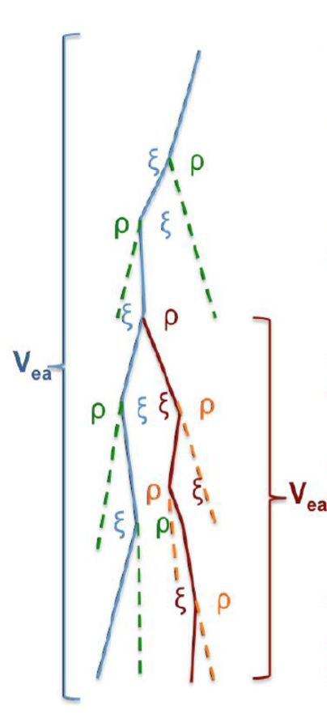
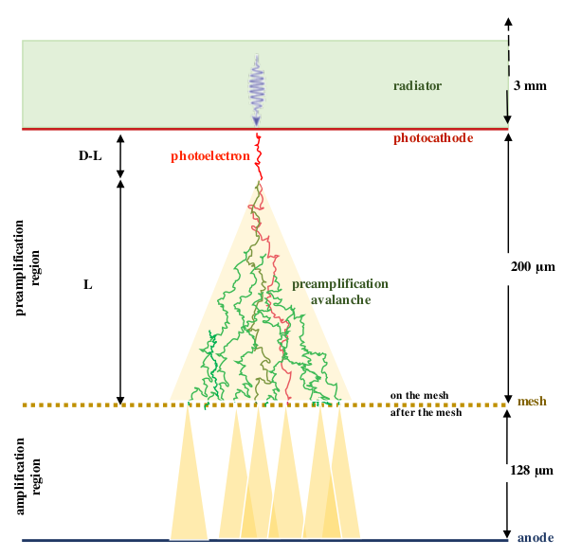
Understanding the Timing
The purpose of the simulation was to simulate the observed effects
and investigate the mechanisms producing them
Simulation Studies using GARFIELD++
Modeling Aspects:
SAT time walk seen in single pe data is explained:
SAT reduces with avalanche length
Long avalanches → big e-peak charge
SAT reduces with e-peak charge
SAT & Timing resolution are determined by:
The drift path of the primary photoelectron
→ number of photoelectrons in avalanche & its length
J.Borteldt, et al. “Modeling the timing characteristics of the PICOSEC Micromegas Detector”, Nuc. Instrum. Meth. A (2021) https://doi.org/10.1016/j.nima.2021.165049
Notes:
Physics
Synchronous Cherenkov photons
Synchronous Photoelectrons from the photocathode
Photoelectron conversion(Townset Coeff)
Preamplification Avalanche
Transport through the mesh
Amplification Avalanches

Slide 13
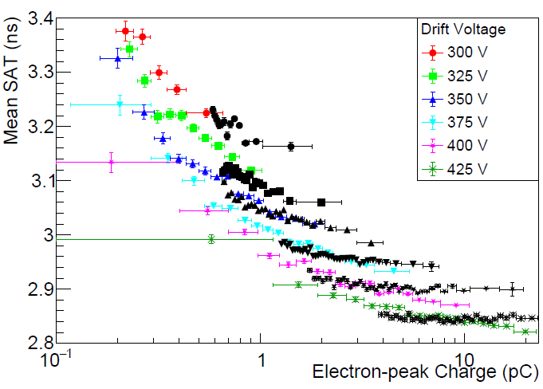
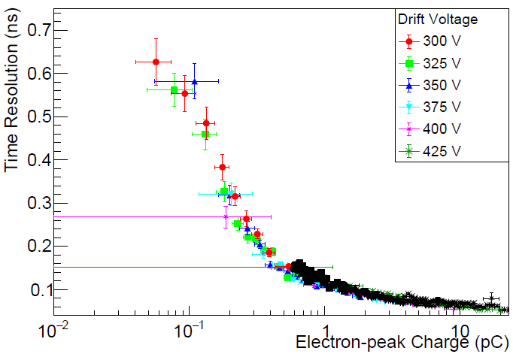
Understanding the Timing
The purpose of the simulation was to simulate the observed effects
and investigate the mechanisms producing them
Simulation Studies using GARFIELD++
Modeling Aspects:
SAT time walk seen in single pe data is explained:
SAT reduces with avalanche length
Long avalanches → big e-peak charge
SAT reduces with e-peak charge
SAT & Timing resolution are determined by:
The drift path of the primary photoelectron
→ number of photoelectrons in avalanche & its length
Agreement between simulation & experimental data
Notes:
Physics
Synchronous Cherenkov photons
Synchronous Photoelectrons from the photocathode
Photoelectron conversion(Townset Coeff)
Preamplification Avalanche
Transport through the mesh
Amplification Avalanches

Slide 14
Feasibility Study for Online Timing

Slide 15
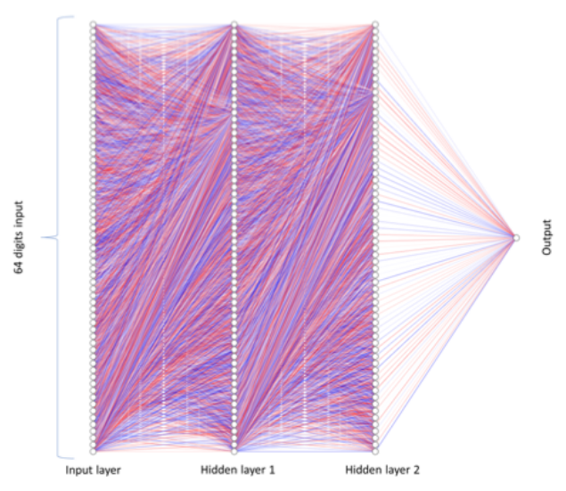
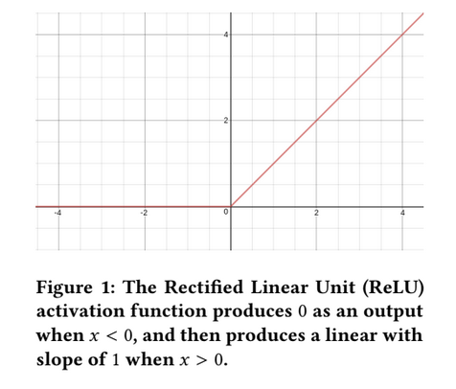
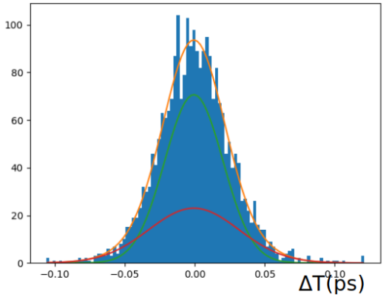
Timing with Artificial Neural Networks
Architecture:
Feed Forward Neural Network
One input layer
Two hidden layers with 64 neurons each
Output layer
ReLU activation Function for all nodes
Cost Function → Mean squared error
First Indication:
Using particle beam data
Check if we reproduce the same results as the offline analysis
K-fold validation technique to Train and Test the ANN
Timing resolution :
24.2$±$0.6 ps

Slide 16
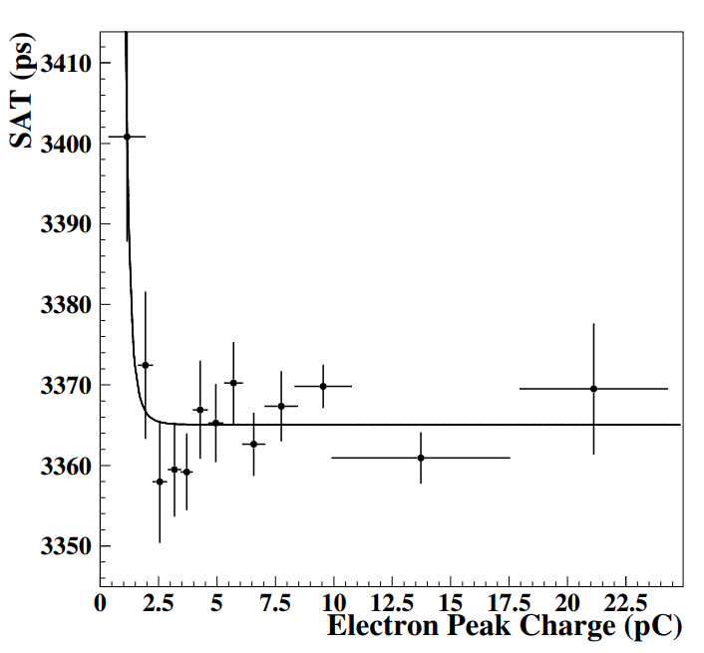
Timing with Artificial Neural Networks
Architecture:
Feed Forward Neural Network
One input layer
Two hidden layers with 64 neurons each
Output layer
ReLU activation Function for all nodes
Cost Function → Mean squared error
Take advantage of the Single Photoelectron data
that indicate small time walk dependence
Use of the same Laser Beam Data:
Need of a wide sample of data for the Training process
Starting from the single photoelectron data set
Train with emulated multi photoelectron pulses
Test with the real multi photoelectron pulses

Slide 17
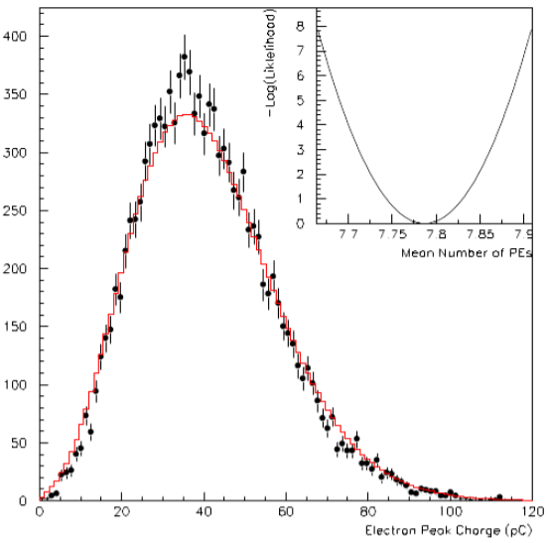
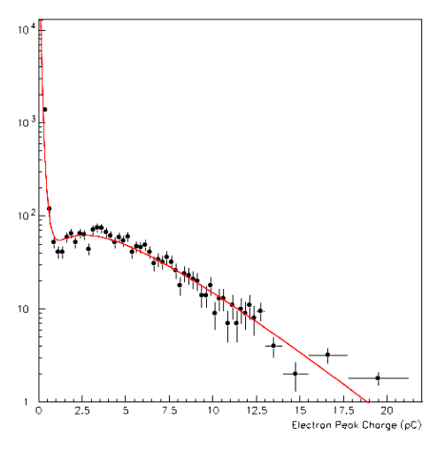
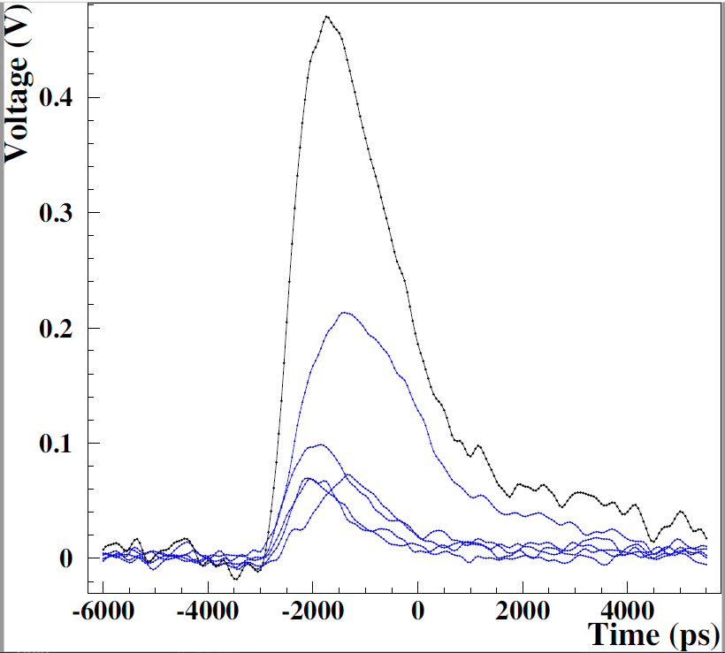
The Simulation Model
EXP-Set contains ~7.8 photoelectrons
Log-likelihood estimation method
Convolution fit of
Poissonian x Polya distribution using $\hat{ μ_{pe}}$
$\hat{μ_{pe}}$ = 7.8 pes
EXP-set data points
Convolution fit
Creating Multi-photoelectron pulses:
Multiplicity N of single p.e.
According to a Poissonian with mean of 7.8
N waveforms selected randomly among the SPE-set
Each shifted in time to t-reference being zero
Same clock for triggering and digitization
3rd degree polynomial interpolation between digitization to estimate relative position
Ν = 5
Sum of N single pulses
Single pes waveforms

Slide 18
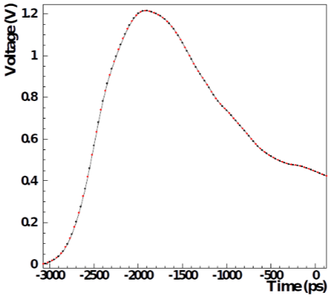
The Simulation Model
Creating Multi-photoelectron pulses:
Multiplicity N of single p.e.
According to a Poissonian with mean of 7.8
N waveforms selected randomly among the SPE-set
Each shifted in time to t-reference being zero
3rd degree polynomial interpolation between digitization to estimate relative position
Ν = 5
Sum of N single pulses
Single pes waveforms
Negative Effect
Having the same digitization
This process eliminates any time jitter that would occur naturally.
Additional random digit shift ± 50ps (25 ps)
Notes:
Supposing that PICOSEC-MM (including the front-end electronics) is a
linear device, the detector response to N-photoelectrons should be emulated
by the sum of N single-pe waveforms. Then, for the simulation of waveforms
as those comprising the EXP-set, we implement the following algorithm:
A multipicity, N, of single-pe is chosen according to a Poissonian dis-
tribution with mean value equal to 7.8.
. N waveforms are selected randomly among the ones of the SPE-set.
. Each of the selected single-pe waveforms is shifted in time, in order the
respective reference time (dened by the reference photodiode) to be
at zero.
. A common set of time coordinates have been used for all single-pe
waveforms, where zero corresponds to the reference time.
. A local 3rd degree polynomial interpolation between digitization points
is used, on each single-pe signal, to estimate the relative position

Slide 19
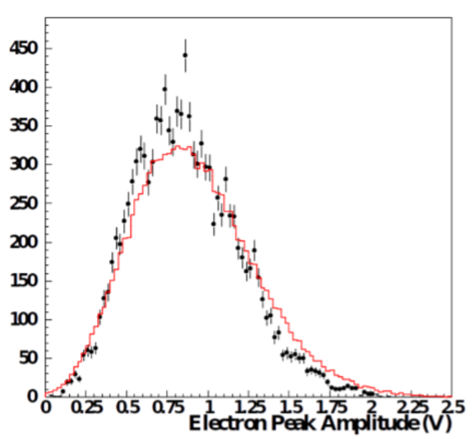
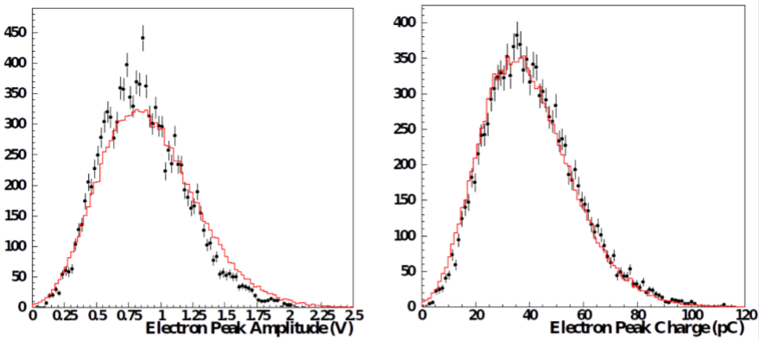
The Simulation Model II - Evaluation
Simulated pulses
EXP-set pulses
Challenges
Limited number of SPE pulses
Emulated pulses will share the same SPE waveforms
Should share similar properties with the EXP-set
Electron peak size
Timing Resolution
Noise contribution
Cumulative property
Due to interpolation between digitization points
Electron peak charge is more reliable parameter

Slide 20
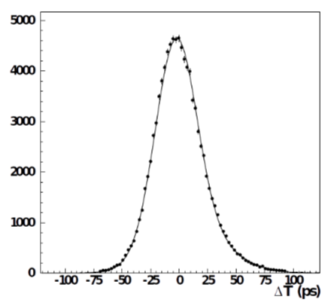
The Simulation Model II - Evaluation
Timing resolution :
21.3$±$0.6 ps
Timing Properties
Offline Analysis
Timing with CFD @ 20% of Peak Maximum
Data with noise correspond to RMS of random noise
Photodiode noise data correspond to the resolution of the device → due to synchronization
Worse than the EXP-set resolution by 3ps
Noise affects the resolution
Simulated pulses
EXP-set pulses
EXP with noise
EXP with diode noise
$$V\left[ExpData\right]=V\left[ExpData_{noise}\right]+V\left[photodiode\right]$$
$$=N_{pe}^{2}∙σ_{1pe}^{2}+N_{pe}^{2}∙σ_{photodiode}^{2}$$

Slide 21
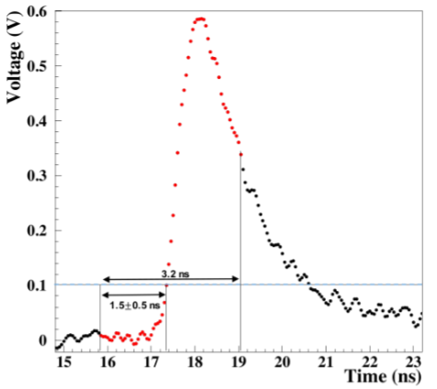
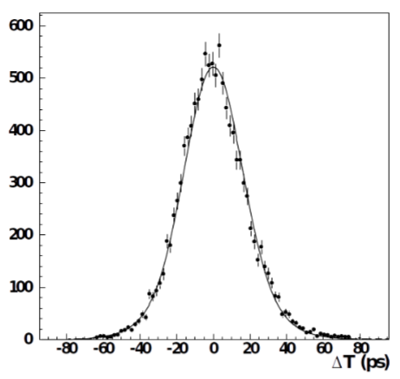
Feed the ANN
Alternative Digitizers
Red points represent the input layer (3.2 ns)
Threshold trigger at 100mV
Provide the timestamp
The starting point simulates the behavior of the SAMPIC starting digitization ( 64ch/sample)
Timing resolution :
18.5$±$0.6 ps
Validation of ANN – Challenges
Use only the EXP-set
K-fold cross validation
Increase the danger of bias
Good first indication

Slide 22
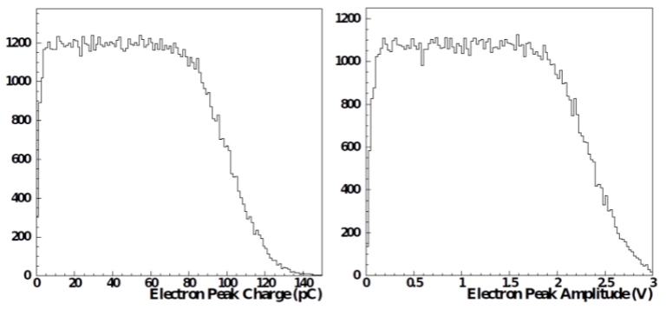
Feed the ANN
Validation of ANN – Solution
Use Unknown events
The Simulation Model Pulses
Reduce further the probability of bias
Generate the Simulation Model Pulses with a uniform distribution of Npes

Slide 23
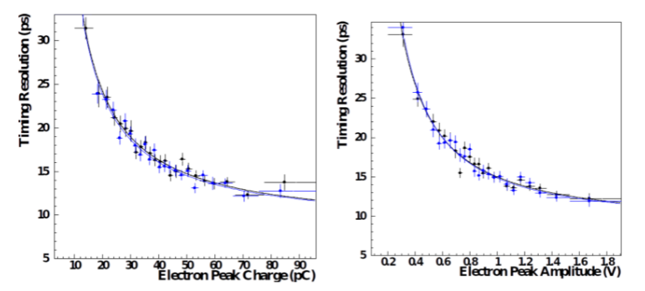
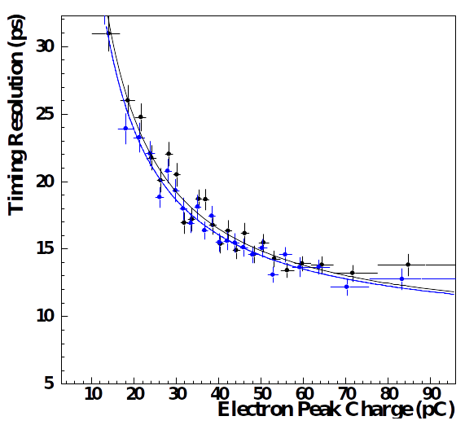
Results and Tests
Prove that ANN is not a black box
Timing resolution :
21.3$±$0.5 ps
Train the ANN with uniform number of photoelectrons
Test with real experimental data – aka. Exp-Set
Timing resolution:
23.6 $±$ 0.5 ps (offline)
24.7 $±$ 0.6 ps (ANN)
Simulated data EXP-Set data
Timing resolution :
18.5$±$0.6 ps
Test with “Noisy” Data
Test with Simulated Data
50ps SP(20GS/s)
200ps SP(5GS/s)
Timing resolution:
19.1 $±$ 0.5 ps
Strong evidence that ANN works properly
Test with less digitization points

Slide 24
Conclusions
PICOSEC detection concept overcomes timing limitations of gaseous detectors
We demonstrated the physical processes adapting on its operation
The development of signal processing algorithms explore the properties of the detector and offer the ability for online precise timing
An ANN for real timing signal processing, is able to provide precise timing and can be used for fast event selection
Main demand of adequate training samples → Simulation model
It was proven that the ANN learns a signal analysis procedure and it is consistent and unbiased
Notes:
EvetyNo Robusteness
Gain can affect robustness and timing
Adjusted according to application demands

Slide 25
The PICOSEC Micromegas Collaboration
AUTH (Greece) I. Angelis, K. Kordas, C. Lampoudis, I. Maniatis, I. Manthos, K. Paraschou, D. Sampsonidis, A. Tsiamis, S. E. Tzamarias
CEA-IRFU, LIST, LIDYL(France) S. Aune, D. Desforge, I. Giomataris, T. Gustavsson, A. Kallitsopoulou, M. Kebbiri, P. Legou, T. Papaevangelou, M. Pomorski, E. Scorsonne
CERN (Switzerland) J. Bortfeldt, F. Brunbauer, C. David, K.J. Floethner, M. Lupberger, M. Lisowska, H. Müller, E. Oliveri, G. Orlandini, F. Resnati, L. Ropelewski, L. Scharenberg, T. Schneider, M. van Stenis, R. Veenhof
HIP (Finland) F. Garcı́a
LIP (Portugal) M. Gallinaro
NCSR Demokritos, (Greece) G. Fanourakis
NTUA (Greece) Y. Tsipolitis
Stony Brook University (USA) P. Garg
Jefferson Lab (USA) K. Gnanvo
USTC (Hefei, China) J. Liu, B. Qi, X. Wang, Z. Zhang, Y. Zhou
University of Zagreb(Croatia) M. Kovacic, A. Utrobicic
University of Pavia (Italy) D. Fiorina
Univeristy of Virginia (USA) S. White
12 institutes from 9 countries
46 collaborators

Slide 26
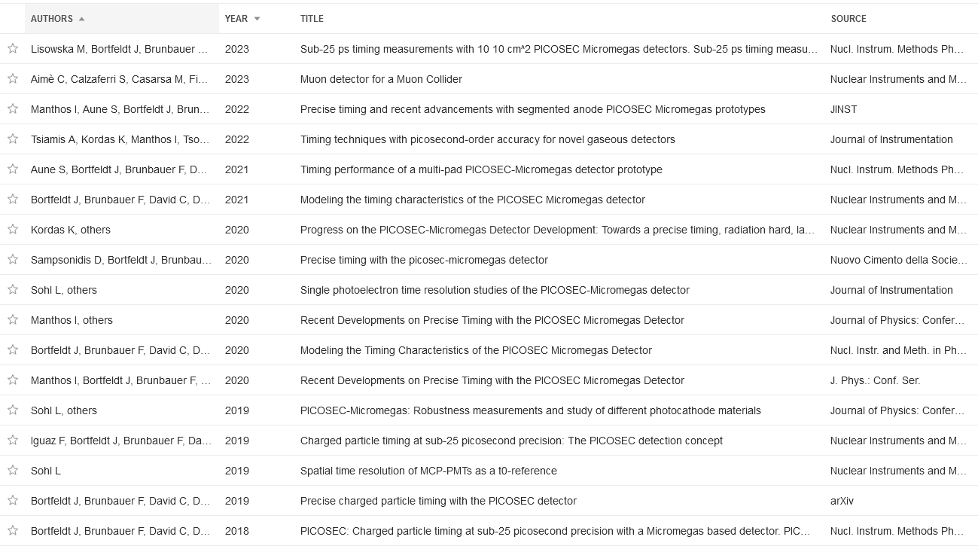
A relevant series of publication (and contribution to conferences)
Notes:
Giving a relevant series of publications and contribution to conferences…

Slide 27
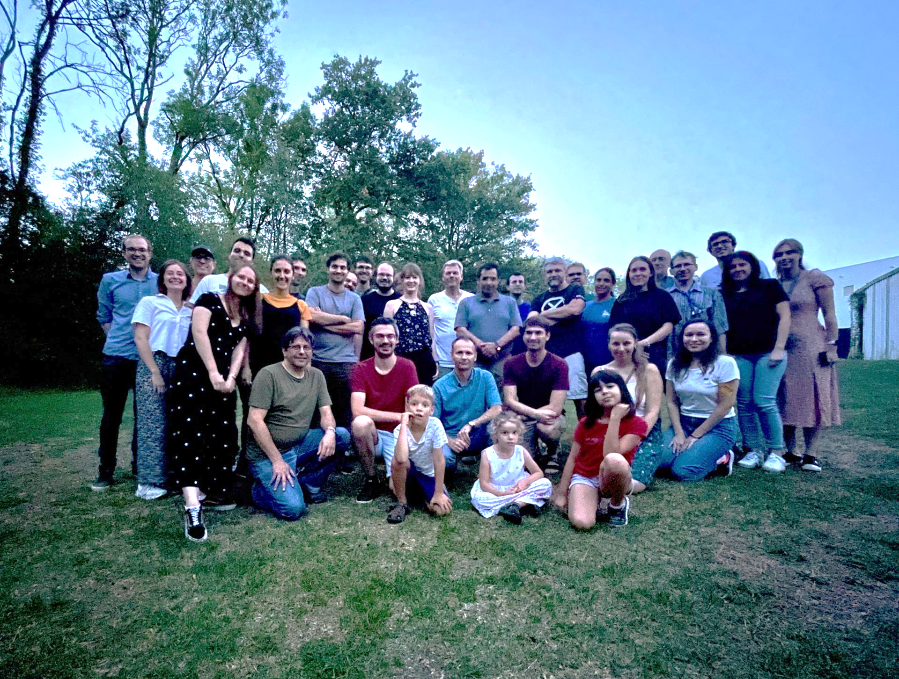
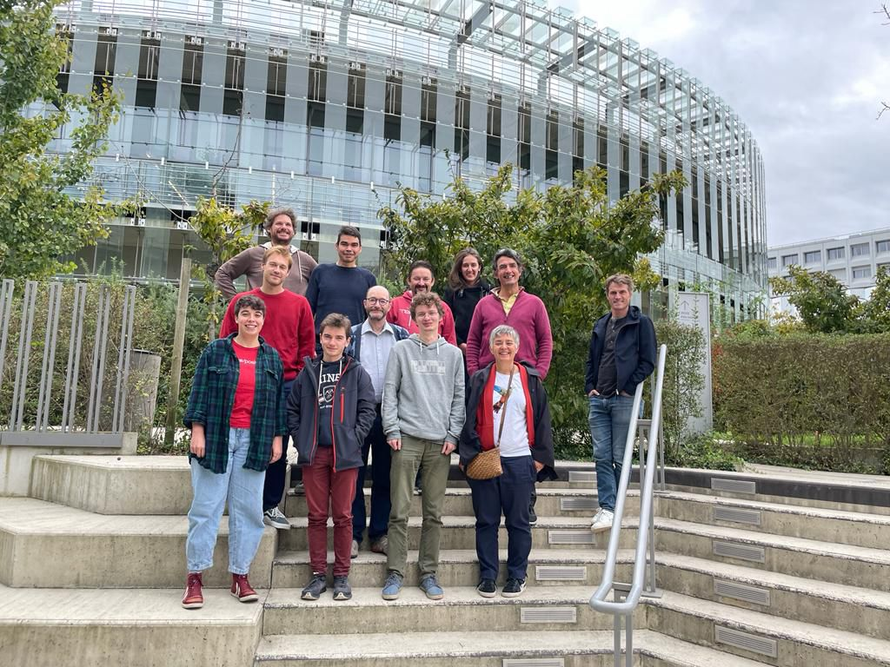
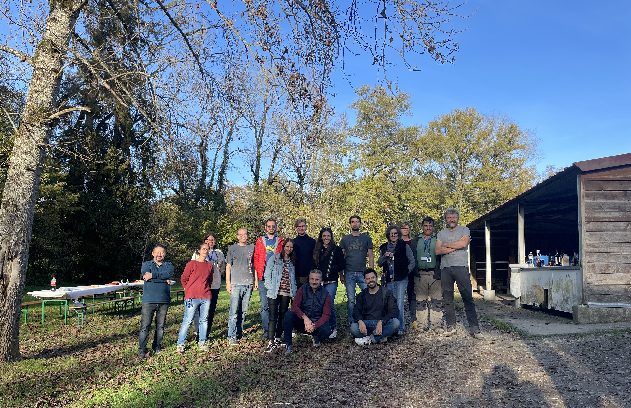
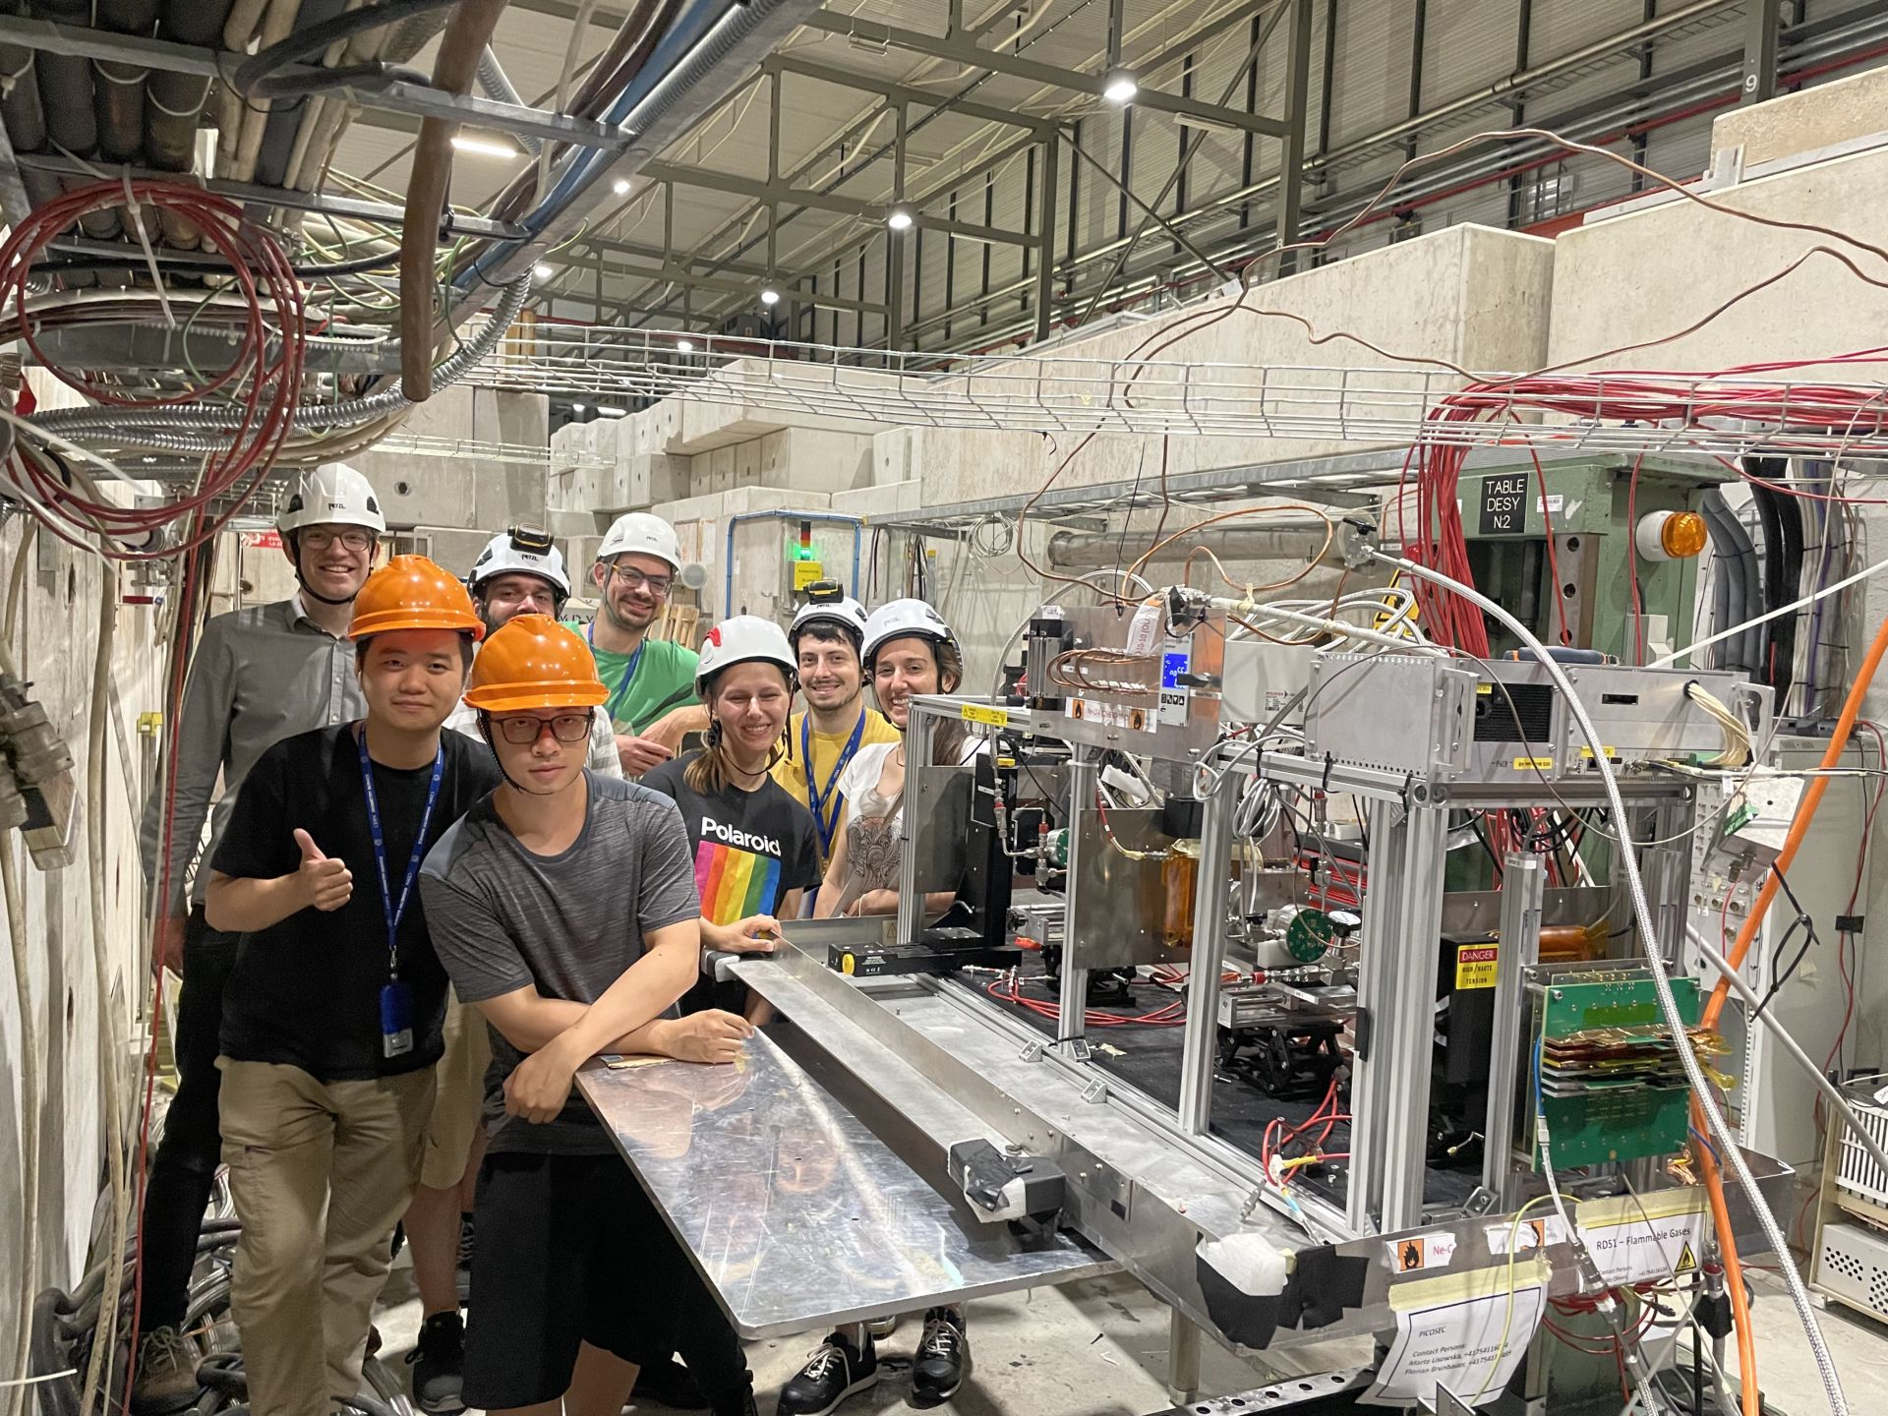
In the end, it’s all a matter of timing…

Slide 28
Thank you for your attention
CEA SACLAY
91191 Gif-sur-Yvette Cedex
France
alexandra.kallitsopoulou@cea.fr
thomas.papaevangelou@cea.fr

Slide 29
BackUp Slides

Slide 30
Detailed simulation
https://indico.ph.liv.ac.uk/event/266/attachments/799/1097/Liverpool_picosec_seminar.pdf
http://ikee.lib.auth.gr/record/297707

Slide 31
Detailed simulation
https://indico.ph.liv.ac.uk/event/266/attachments/799/1097/Liverpool_picosec_seminar.pdf

Slide 32
Detailed simulation
https://indico.ph.liv.ac.uk/event/266/attachments/799/1097/Liverpool_picosec_seminar.pdf

Slide 33
Detailed simulation
https://indico.ph.liv.ac.uk/event/266/attachments/799/1097/Liverpool_picosec_seminar.pdf

Slide 34
Phenomenological model: A deeper looking under the hood
https://indico.ph.liv.ac.uk/event/266/attachments/799/1097/Liverpool_picosec_seminar.pdf

Slide 35
https://indico.ph.liv.ac.uk/event/266/attachments/799/1097/Liverpool_picosec_seminar.pdf

Slide 36
Finding the Number of Photoelectrons – Deconvolution Algorithm
Assuming that the number of photons (n) in the Cherenkov radiator follows a Poisson Distribution : $Poisson\left(n;μ\right)=\frac{μ^{n}e^{−μ}}{n!}$
Each of these photons has either the probability to interact in the photocathode or to escape : $Binomial\left(k;n,ε\right)=\frac{n!}{k!\left(n−k\right)!}ε^{k}{\left(1−ε\right)}^{k}$
The probability to observe k photoelectrons is the convolution of the Poisson and Binomial resulting to a new Poissonian $f\left(k;μ,ε\right)=Poisson\left(k;μ∙ε\right)$
Every single photoelectron is distributed via Polya distribution, thus the multi-photoelectron charge distribution should be fitted with the convolution of Poissonian and N-Polya $P_{N}\left(n;\overline{n}, θ, Ν\right)=\frac{{\left(θ+1\right)}^{Ν\left(θ+1\right)}}{\overline{n}Γ\left(Ν\left(θ+1\right)\right)}$
Using Log-Likelihood estimation for the number of photoelectrons we conclude to the desired value of 7.8 p.e.
https://iopscience.iop.org/article/10.1088/1742-6596/1498/1/012014/meta

Slide 37
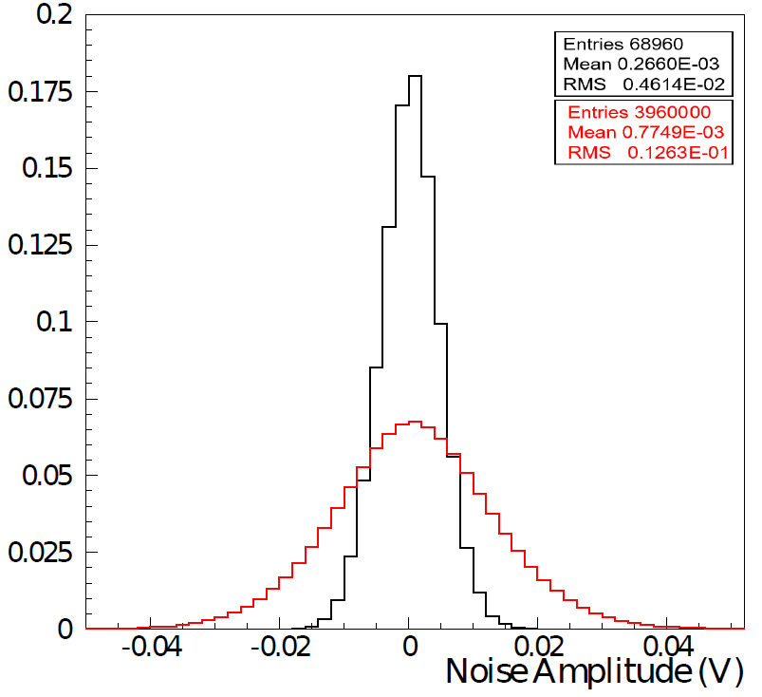
The Simulation Model II
Limited number of single pulses
The Simulated pulses share the same Spe waveforms
Should follow the same behavior as the Exp-set
Reproduce and compare the distributions of electron peak size
Noise Contribution
Noise has the cumulative property
Affect the determination of Epeak max
Add a limitation to our model
RMS single pes = 0.0046
RMS SM pulses = 0.013
Simulated pulses
EXP-set pulses
Notes:
Having the model developed we have now to test if it carries the same properties as the EXP-set.
First we compare the e peak charge and amplitude distributions, and we see that the peak charge in h better agreement between the two sets, so we will use this parameter for our parametrizations.

Slide 38
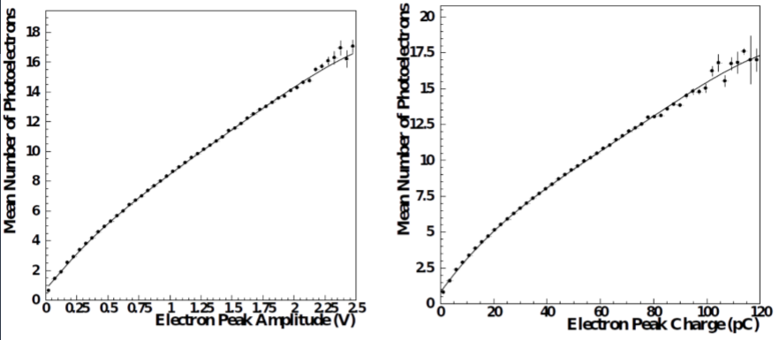
Investigating the Extra timing Error
Noise is added as a function of the number of photoelectrons
Which defines the SIZE of the waveform
Number of photoelectrons as a function of electron peak SIZE
Fit with a 4th degree polynomial
On an event-by-event basis
Corresponding noise is: $σ_{}= \sqrt{N_{pe}} ∙σ_{1pe}$
Data with noise corresponds to RMS of random noise
Data with random noise and error of reference device resolution
We are sensitive due to synchronization process
Simulated pulses
EXP-set pulses
EXP with noise
EXP with phd noise
$$V\left[ExpData\right]=V\left[ExpData_{noise}\right]+V\left[photodiode\right]=$$ $N_{pe}^{2}∙σ_{1pe}^{2}+N_{pe}^{2}∙σ_{photodiode}^{2}$

Slide 39
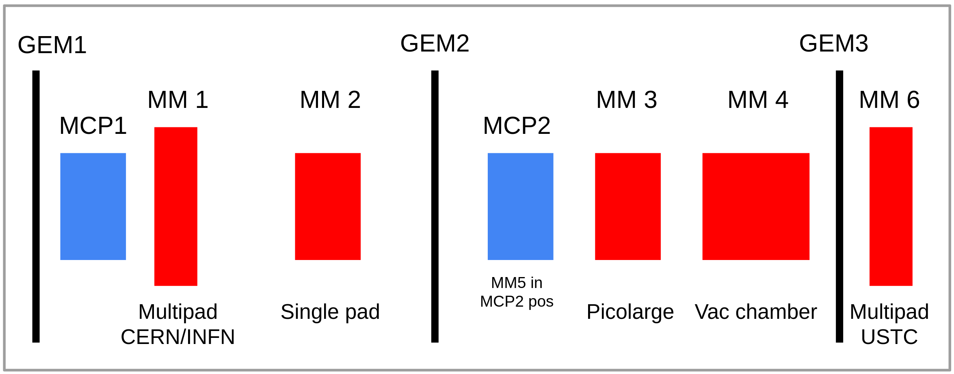
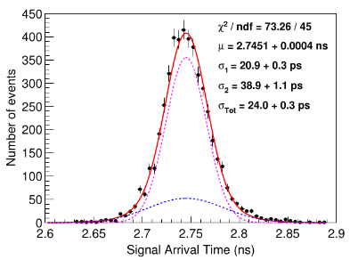
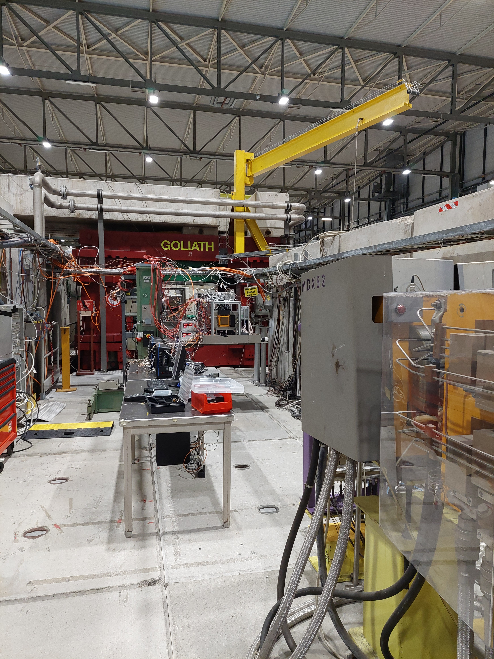
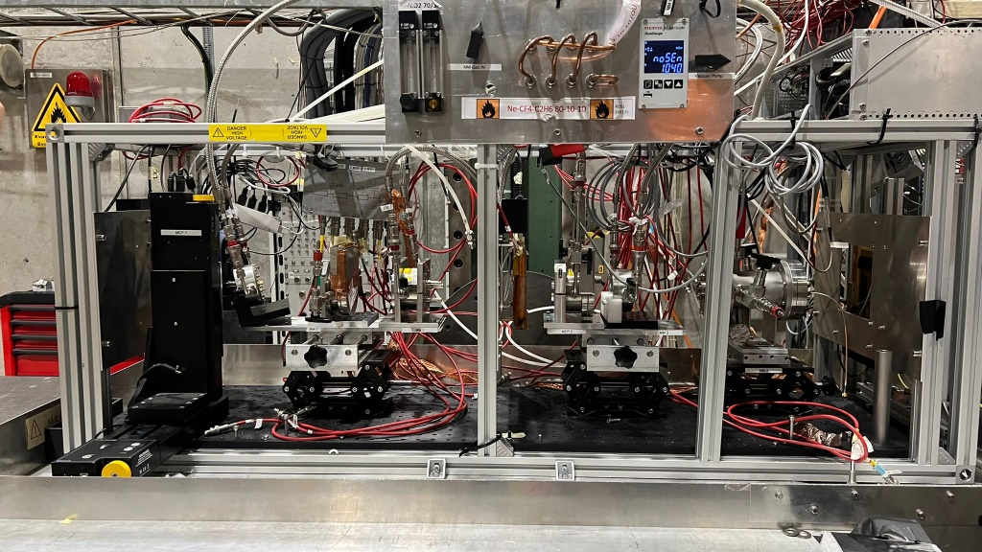
Detector Testing - Particle beams
Particle Beams @ CERN SPS H4 Beamline
Muons (80-150GeV)
8cm diameter of beam
${10}^{5}$muons/spill (measured rate ~kHz/${cm}^{2}$)
The Setup
Use GEMs for tracking
Use MCP PMTs as timing reference devices and for triggering
Detectors Under Test
Electronics: Commercial/Custom-made preamplifiers
Digitizers – Lecroy scopes
First timing measurement @ Particle Beam ( 2017 )
Single Prototype : Thin Gap (200μm) with MgF2 & CsI photocathode
11 p.e.
J.Borteldt, et al. “PICOSEC: Charged particle timing at sub-25 picosecond precision with a Micromegas based detector”, Nuc. Instrum. Meth. A (2021)https://doi.org/10.1016/j.nima.2018.04.033
Timing Resolution → RMS of Signal Arrival Time Distribution
Notes:
Although all the important information about the optimization of the detector can be very well understood from a laser test, through the years the better understanding was coming by also supplementary measurements in particle beams, which is a more realistic case for the detector operation

