Slide 1
CAT’S UP
GANIL/CENBG
TRACKER FOR GANIL EXPERIMENT
GANIL/PHY/DELPH/Sebastien Herlant
19/03/2024

Slide 2
Summary
What is CATS and why an upgrade?
Detector
Electronic and DAQ system
Current use and result
Detector Upgrade
Electronics Upgrade (Renocats)
History
New Front-end
SAM backend
Status and raodmap
GANIL/PHY/DELTA/Sebastien Herlant
07/10/2019

Slide 3
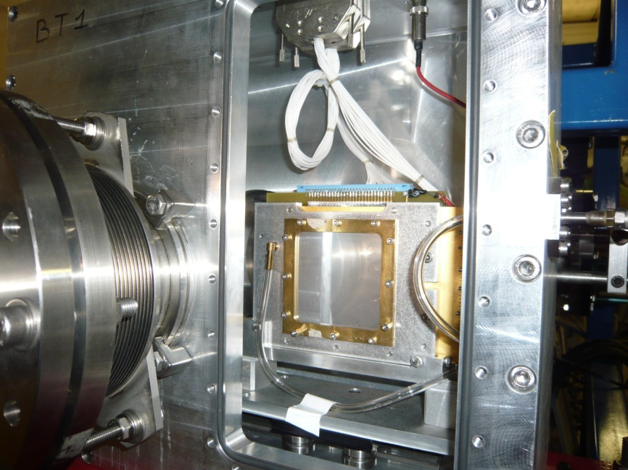
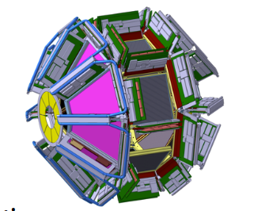
What is CATS
CATS is a Low presure multiwire proportionnal chamber for secondary beam tracking
Goal:
Providing event by event particle tracking until 5.10^5 pps
Time of flight measurement (accuracy between 440ps to 1,2ns)
Position of ion (spatial resolution 400-700µm)
Efficiency close to 100% with ion from He up to Ni at 40-50 MeV/u
Particularity:
Very transparent detector (4,4µm of Mylar foil)
Fast response to accept high flux
Aluminium strips for low budget material
Low pressure gas (6-8 mbar)
Typical use:
S.Ottini-Hustache et al, CATS…,NIMA431(1999).
Two detectors CATS
Separated by around 50cm
Silicon detectors
And/or Gamma detector around the target
beam
GANIL/PHY/DELPH/Sebastien Herlant
19/03/2024

Slide 4
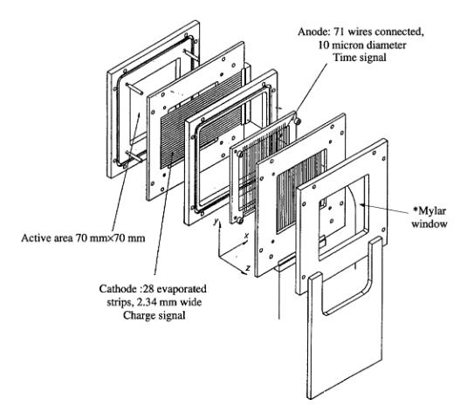
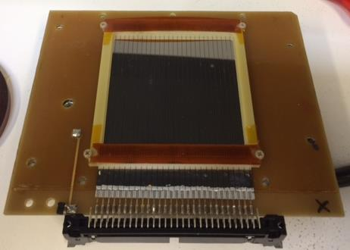
The detector
Design
One wire anode (70 wires of 20µm every 1mm)
Two cathodes aluminium strip X and Y (28 strips/pitch 2,54mm, 0,9µm thick Mylar foil with 200nm Aluminium strips evaporated on Mylar)
Area of 70*70mm^2 and 6,4mm gap
Difficulties:
Very transparent and fragile detector (4,4µm of Mylar foil)
Fast response to accept high flux
Aluminium strips for low budget material
Low pressure gas: 6/8 mbar
Cathode fragile
need regular, difficult maintenance
GANIL/PHY/DELPH/Sebastien Herlant
19/03/2024

Slide 5
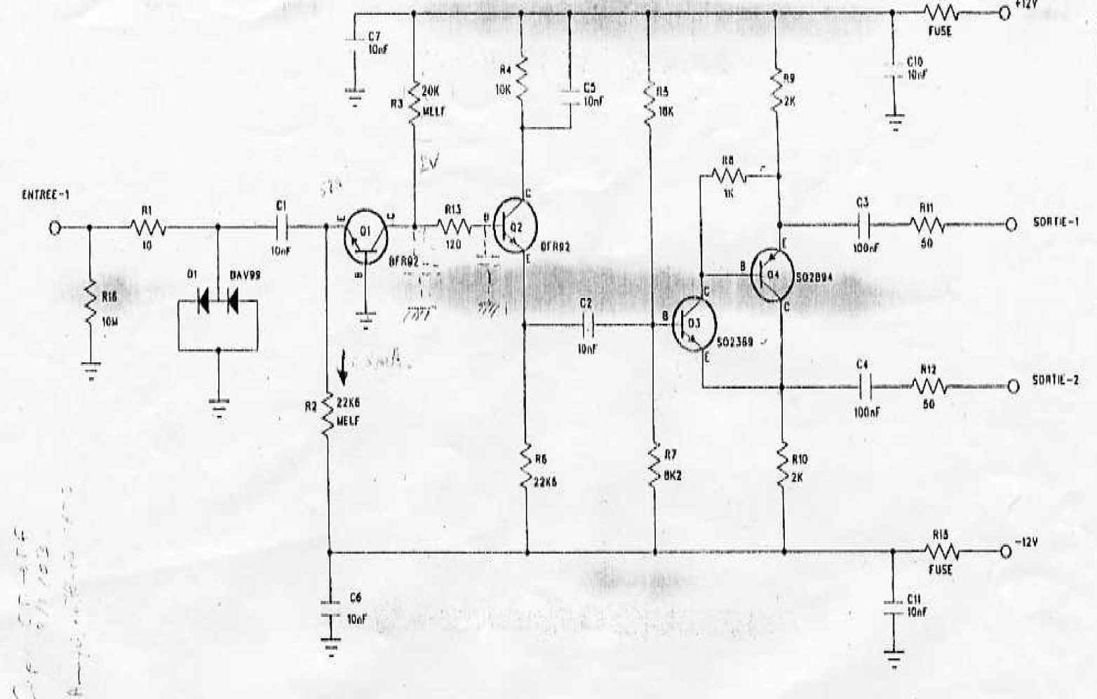
The electronic
Front-end
CPLear: Differential integrator with very low capacitance
Mainly electron signal over 40ns (ion currents last about 1.5 μs)
Very low dead time
Very hard to manage
precision on low capacitance
Back end
Delay line 500ns (500m cables) by channel for coupling with master detector
Digitization by QDC on VXI system
Acquisition coupling with new system (VME//Numexo/µTca) by centrum module
Cplear design
Obsolete system / No more production and difficulties to couple DAQ with the others system
GANIL/PHY/DELPH/Sebastien Herlant
19/03/2024

Slide 6
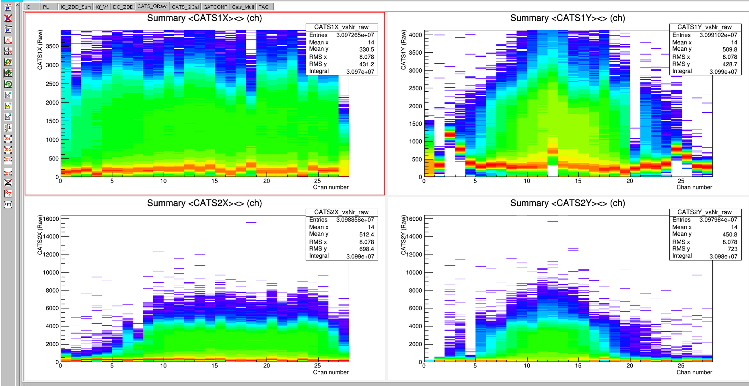
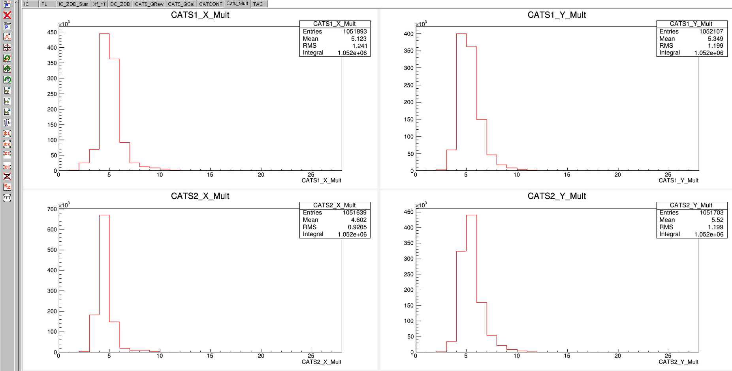
Actual result
Used currently on Mugast Campaign at Lise
3.10^5pps during 300 hours with no or one detectors changing
Normalization on beam intensity, checking beam purity
Incidence ion on target for reconstruction
Multiplicity around 5 channel
Picture from Lise Mugast campaign 2023
GANIL/PHY/DELPH/Sebastien Herlant
19/03/2024

Slide 7
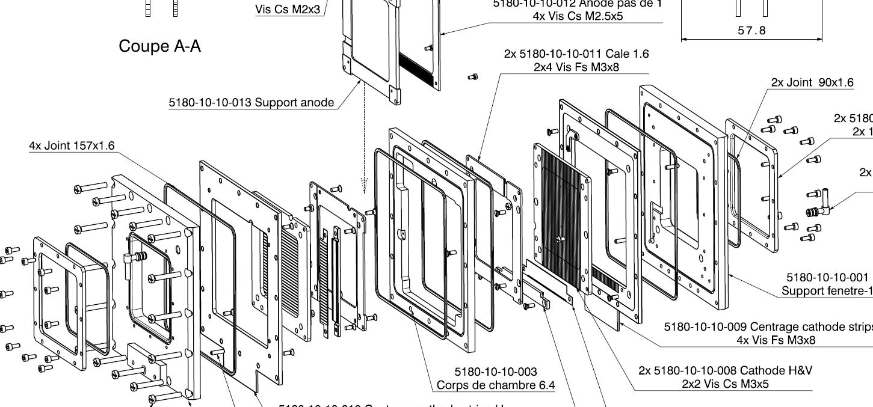
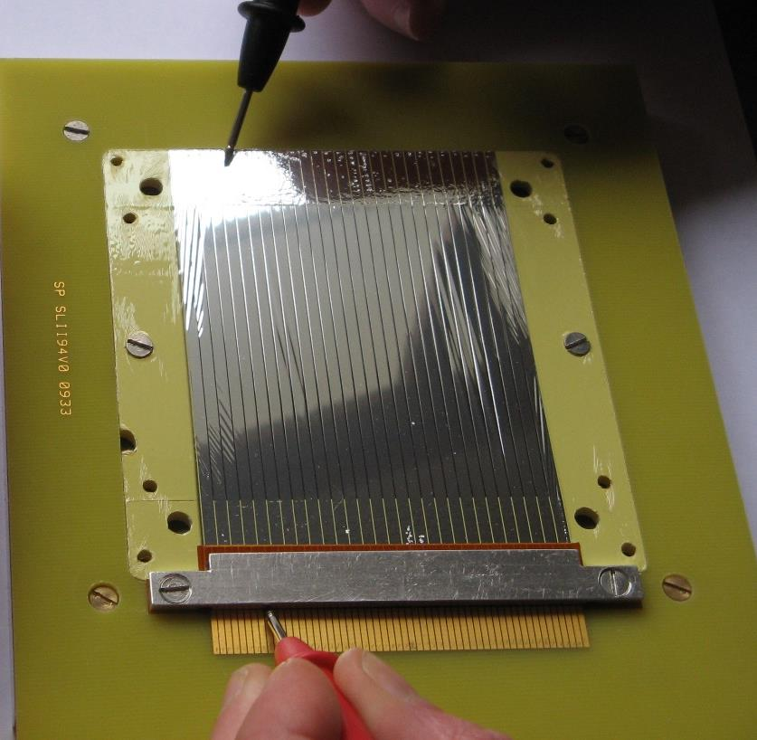
Detector Upgrade
Easier maintenance detector
Independence of striped mylar cathode from PCB signal reading
Same pieces for X and Y plane and possibility to put wires plan in X or Y position.
Mechanical Connection stripped without silver paste
Mechanical connection for High tension on the anode (no soldering wire)
Modification of wire plan for capacitance isolation of strips planes from HT line in calibration mode
New design: M.Riallot (IRFU) followed by P.Gangant (Ganil)
GANIL/PHY/DELPH/Sebastien Herlant
19/03/2024

Slide 8
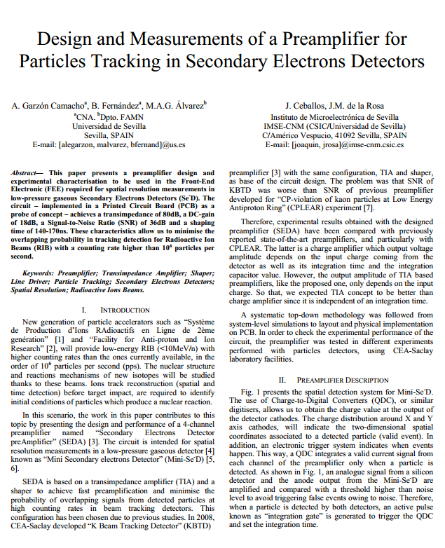
Electronic Upgrade
History
Upgrade idea: Use current preamplifier for fast response signal
KBTD: first design at IRFU on 2008: Pb of noise, project stopped
Review on 2013 by University of Sevilla KBTD for SED tracker without changing DAQ system
Prototype and publication made but no finalization of the project and loss of the details studies and simulation.
Opening Cat’s up project on 2018 at Ganil with CENBG collaboration to review the SEDA design and coupled it with SAM acquisition system (Get system like)
A.Garzon Camacho et al, SEDA electronics (2012).
GANIL/PHY/DELPH/Sebastien Herlant
19/03/2024

Slide 9
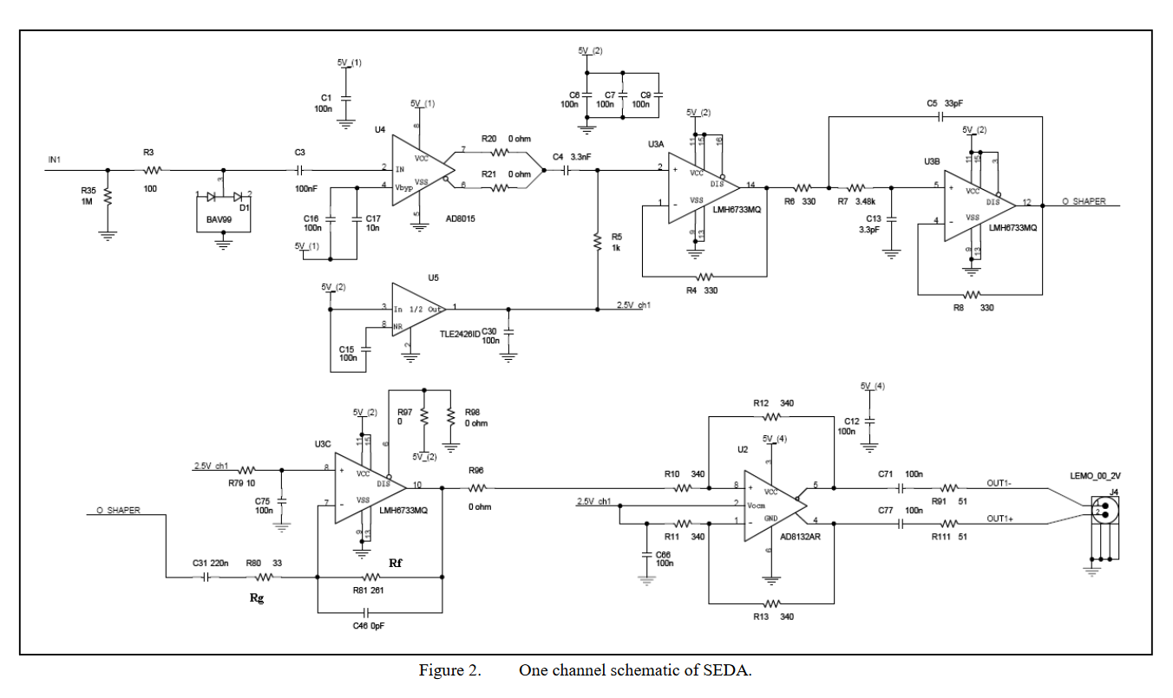
Electronic Upgrade
Front end design by current preamplifier
Response signal is independent of integration time and just proportional to the charge.
Wide bandwith : so very high sensibility to noise and impedance variation
Characteristic
Spark protection
TIA: AD8015 IC
80dB/10KΩ
240MHz BW
3pA/√Hz noise
Shaper block :LMH 6733
Rise and fall time adjustment
HPF and LPF cut-off biquad
40dB/decade reduction noise
SEDA design:
Transimpedance wideband amplifier and
triple amplifier/shaper
Goal:
dynamic: 20fC to 400fC
Note: BW and noise decrease with input capacitance
GANIL/PHY/DELPH/Sebastien Herlant
19/03/2024

Slide 10
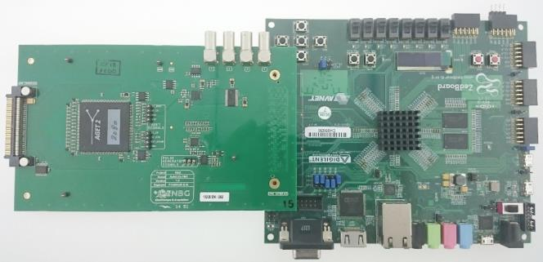
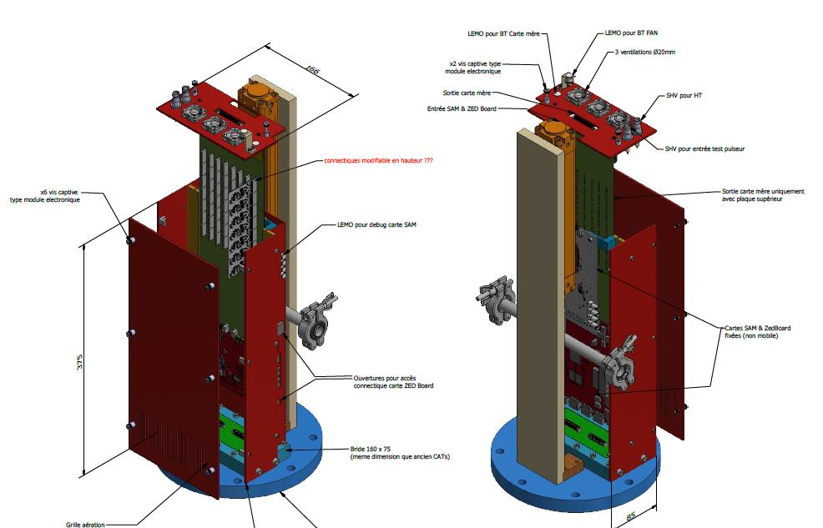
Electronic Upgrade
Back end system
SAM design from CENBG (Get light system)
Squeeze Get premaplifier.
Use shapping Get (Sallen-Key Filter)
Digitization with one GET chip (64-channels)
Acquisition by Zedboard (Commercial card): No CoBo Card
Coupling with dedicated card (collaboration with GTA Ganil)
Very Compact design
Delay adjustable to 5 µs
Old system
New system
SAM+Zedboard
Electronic integration
GANIL/PHY/DELPH/Sebastien Herlant
19/03/2024

Slide 11
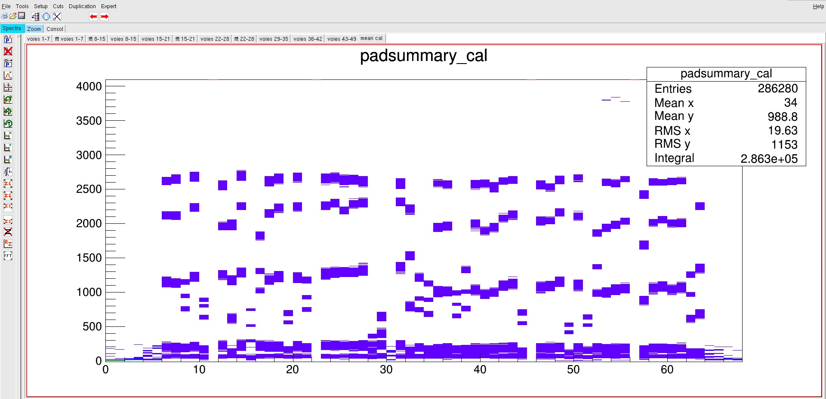
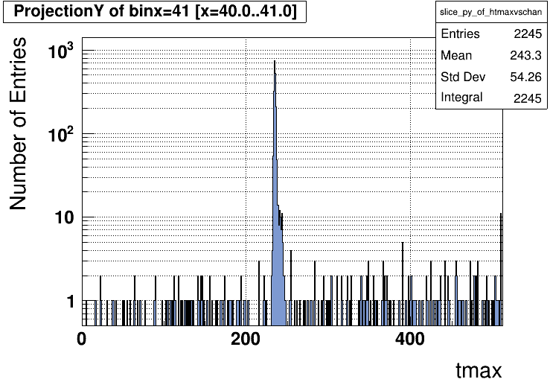
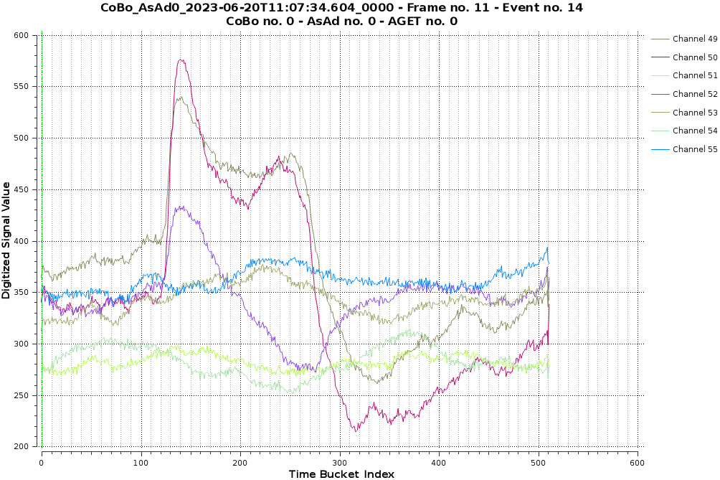
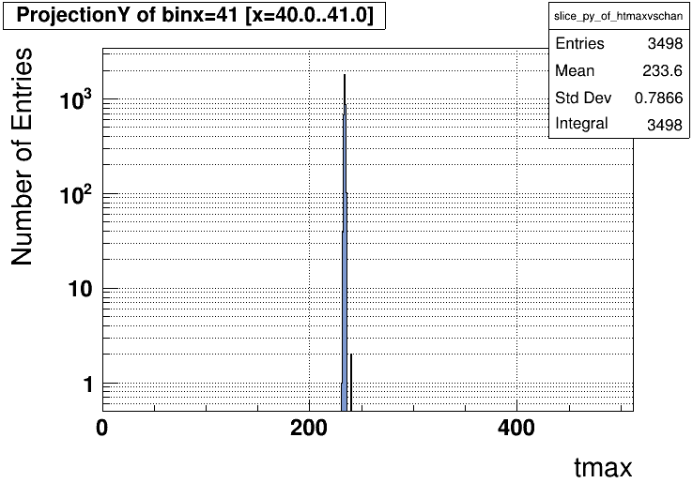
Results
pulse 25mV
Global response to 3 différents signal input
Detector response alpha source
Pulse 50mV
GANIL/PHY/DELPH/Sebastien Herlant
19/03/2024

Slide 12
Status and roadmap
Detector Upgrade
Prototype validated
Production made (4 detectors)
Need final tests with definitive electronic and beam commissioning expected in 2025
Electronics Upgrade
Prototype characterized and lot of behaviours understood
New design and production of mother front end board to be tested for S/N improvement by :
Reduction of strips length before preamplifier
Stripped embedeed into PCB (more parasitic capacitance but less CEM sensibility)
Actual test and optimization of centrum card adaptation for zedboard
Mechanical electronics integration design to be adjusted
GANIL/PHY/DELPH/Sebastien Herlant
19/03/2024

Slide 13
Thanks for your attention
GANIL team
Sebastien Herlant
Julien Pancin
Charly Nicolle
Thomas Roger
Johan Goupil
Frédéric Saillant
Gilles Wittwer
Sebastien Coudert
CENBG Team
Patrick Hellmuth
Abdel Rebii
Fréderic Druillole
GANIL/PHY/DELPH/Sebastien Herlant
19/03/2024

