Slide 1

Sfp connectivity and Microtca for Advanced RemoteTrigger
Project Status
Phase 1: SMART AMC
Phase 2: SMART MCH

Slide 2
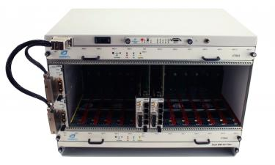

SMART_AMC Architecture (Phase 1)
µTCA.0
Numexo2
END POINT
ROUTER
(SOM)
7Z045
15 ports
Numexo2
END POINT
BEAST
END POINT
ROUTER
(SOM)
7Z045
16 ports
RFSoC Digitizer
HUB
(SOM)
7Z100
END POINT
AGATA Digitizer
Only one AMC carrier board ➔ but 2 functions:
HUB
ROUTER
END POINT
AGATA Digitizer
ROUTER
(SOM)
7Z045
END POINT
Up to 240 digitizers or boards synchronized by 17 AMC’s (1 HUB & 16 ROUTERS)
housed in 2 µTCA shelves
On the shelf board
END POINT
ROUTER
(SOM)
7Z045
15 ports
A new Timestamping and Trigger System for GANIL, AGATA, GRIT, …
and available for any Lab
ASIC based
front end board
END POINT

Slide 3
A - Main characteristics (Phase 1)
COMMUNICATION RATES
- HUB ↔ ROUTER: Line Rate = 4 Gb/s; Payload Data Rate = 400 MB/s; Reference Clock = 100 MHz
- ROUTER ↔ EP’s: Line Rate = 2 Gb/s; Payload Data Rate = 200 MB/s; Reference Clock = 100 MHz
CLOCK & TIMESTAMPING
HUB to ROUTER (to EP’s) : 8B/10B encoding/decoding with Recovered Clock = 100 MHz;
TS on 48 bits/10ns (more than 1 month of experiment)
AUTOMATIC ALIGNMENT
HUB to EP’s : with external TDC chip
TRIGGER @ HUB LEVEL
Trigger req./val. : based on uplink and downlink frames (build with EP ID recognition/digitizer type)
Multi-partitions : 240, 480, up to 720 digitizer channels (typically 45x16ch-NUMEXO2 boards)
Multiplicity : threshold by partition
Acceptance window: for late channels arriving during a trigger cycle
Logic Equation : (OR/AND/NOT) between partitions for the final decision (ACCEPT/REJECT)
32 bit Event Number : for accepted returned frames
Max 208 KHz/channel – Total trigger rate @HUB level: 800 Mtrig_req/s

Slide 4
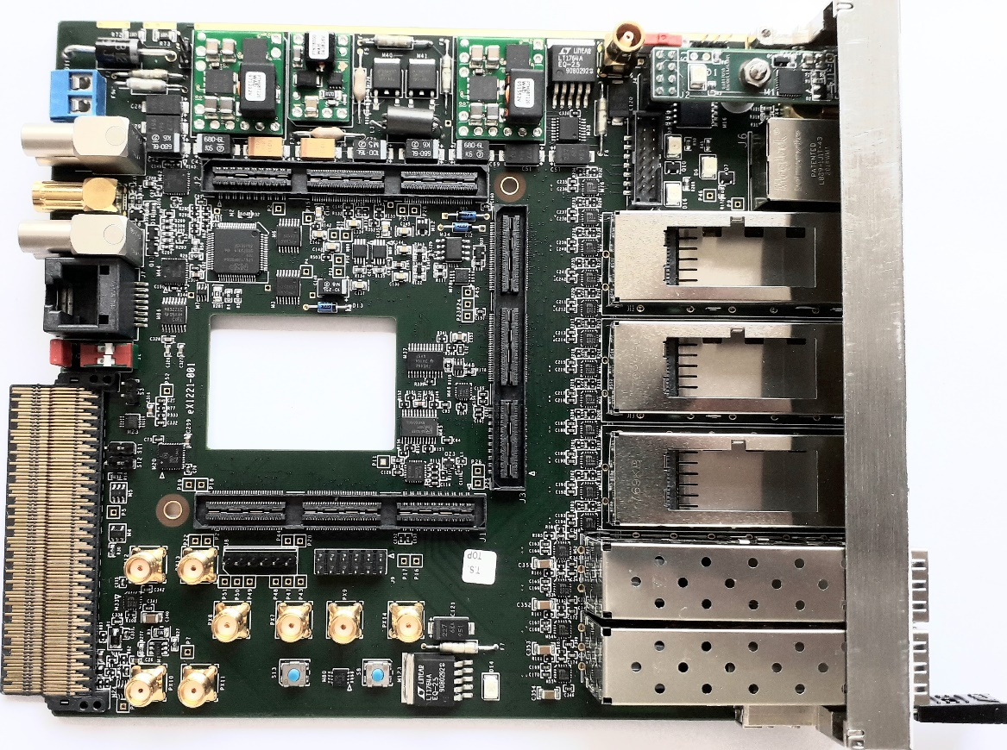
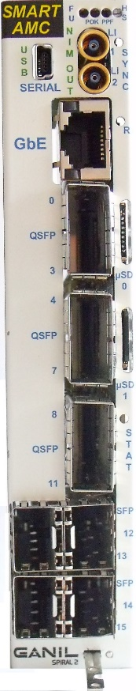
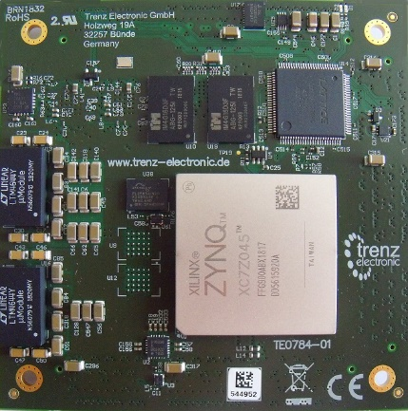
SMART AMC status in terms of
Hardware and Production
SOM and SOC USED on SMART AMC BOARD (Phase 1)
- HUB: TE0784-01 from TRENZ Company with Xilinx XC7Z100-2FFG900I
- ROUTER : TE0784-01 from TRENZ Company with Xilinx XC7Z045-2FFG900I
Production: 26 SOM ordered in 2023 for GANIL (2H/10R) and AGATA (14R)
26 SMART_AMC boards will be assembled in 2024

Slide 5
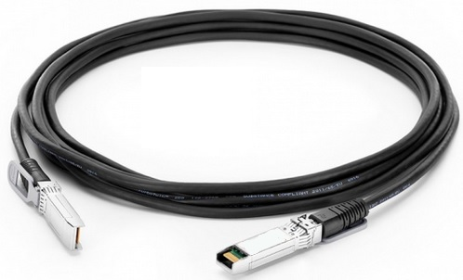
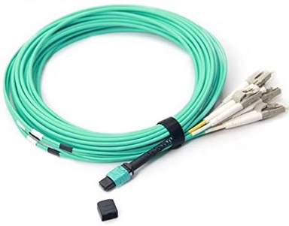
New communication media qualified for SMART
(all them remotely identified by “SFP_QSFP_device_checker”
SFP+ to SFP+
(10Gb/s passive cables)
2 Finisar SFP transceivers
0ne 6.1 Gb/s and one 8.5 Gb/s
(more than 150 m with OM3 fiber)
QSFP to MPO
(Finisar FTL410 series)
QSFP to 4xSFP+
(40G breakout passive cables)
QSFP(ch.1) to SFP adapter
(Useful with passive cables
or transceivers)

Slide 6
SMART - Phase 1 Documentation
written
written
written
written
to be written
writing in progress

Slide 7
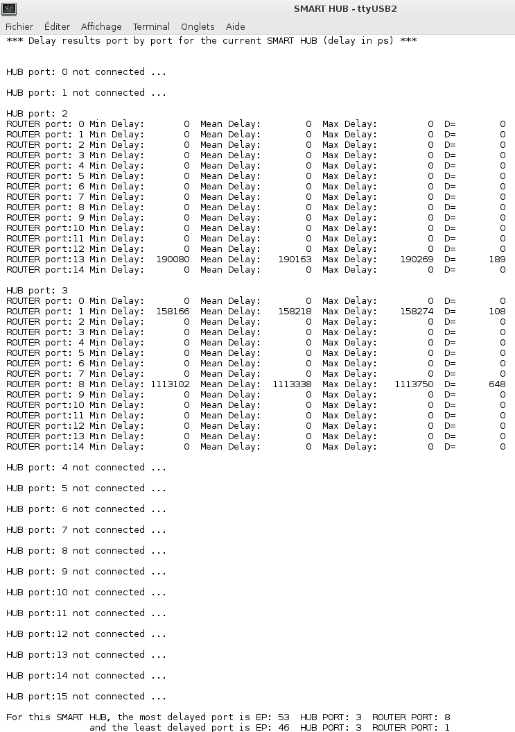
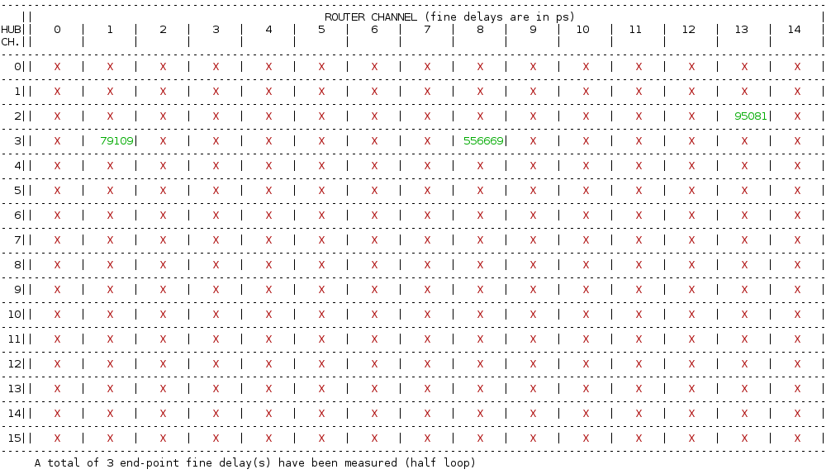
SMART AMC delay measurement results 1/2
OM3 fiber – 5 m
10Gb Copper cord – 2 m
OM3 fiber – 100 m

Slide 8
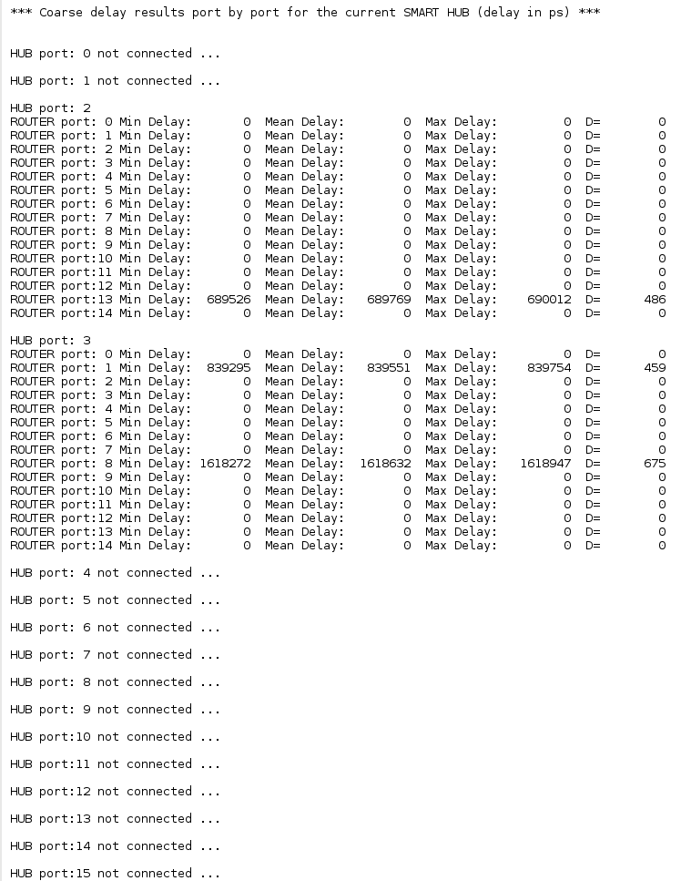
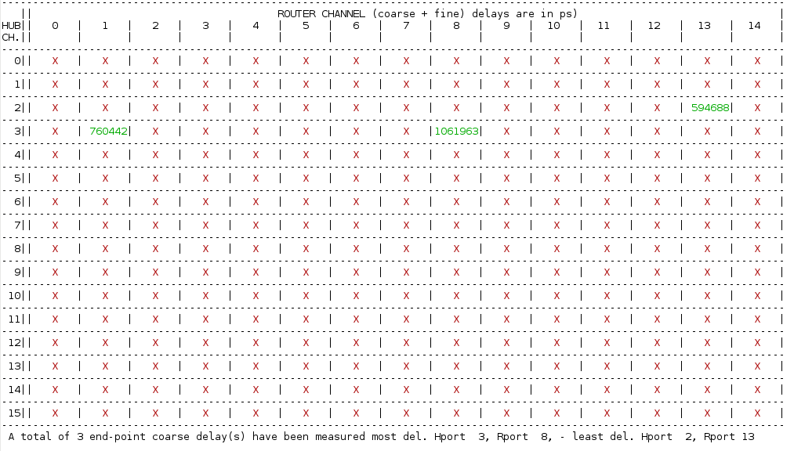
SMART AMC delay measurement results 2/2
OM3 fiber – 5 m
10Gb Copper cord – 2 m
OM3 fiber – 100 m

Slide 9
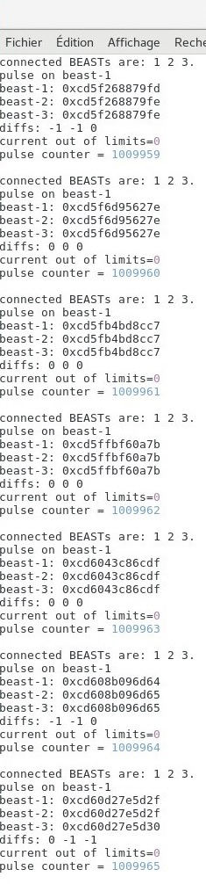
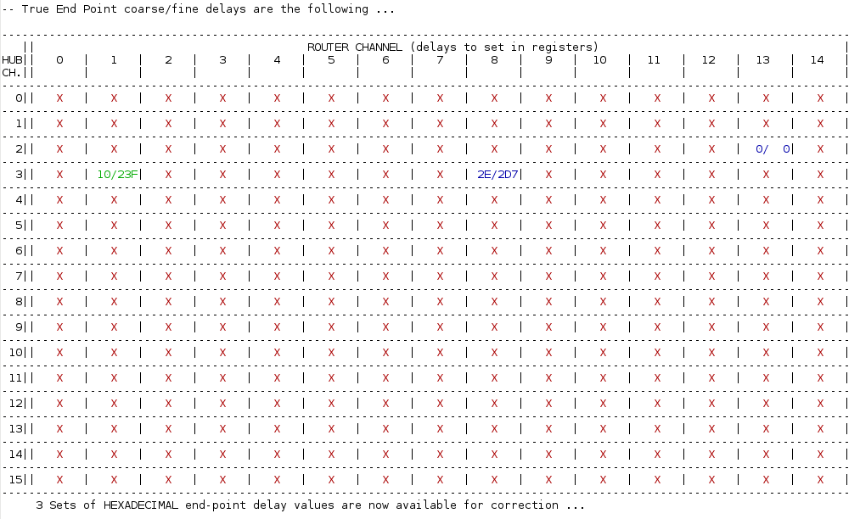
SMART AMC – End Point delay setup
June 2023 – One month of test

Slide 10
Involved manpower in SMART project and
Updated schedule for SMART AMC (Phase 1)
A minimum of 7 people involved in the project:
  Project leader, global architecture, firmware, software, CAD:……….….Gilles Wittwer
  PCB Routing, component ordering, manufacturing follow-up: ...........Maria Blaizot
  Embedded software (Linux OS, slow control): ……………………………….…Sébastien Coudert/Frédéric Saillant
  CPLD firmware: ………….………………………………………..……………………….….Patrice Bourgault
  SMART IP in NUMEXO2, Production Tests and Trigger features…........Matthieu Bezard
  SMART GUI: ………………………………………………….……………..…...…..…..…...Blandine Duclos
Main tasks 6 SMART AMC prototypes tested and SMART concept validated Annual GANIL project review Final firmware versions ready for HUB and ROUTER (CLK & TS) Green light for SMART AMC production over 2 years (SOM, active components and µTCA FP mechanics purchase) Embedded Linux with automatic alignment included Specifications ready for “French public market” production Subcontractor selected for assembly of 26 SMART AMC boards Delivery of SMART AMC production | Main key dates June 2022 July 2022 July 2023 April -> October 2023 June 2024 April 2024 May 2024 Summer 2024

Slide 11
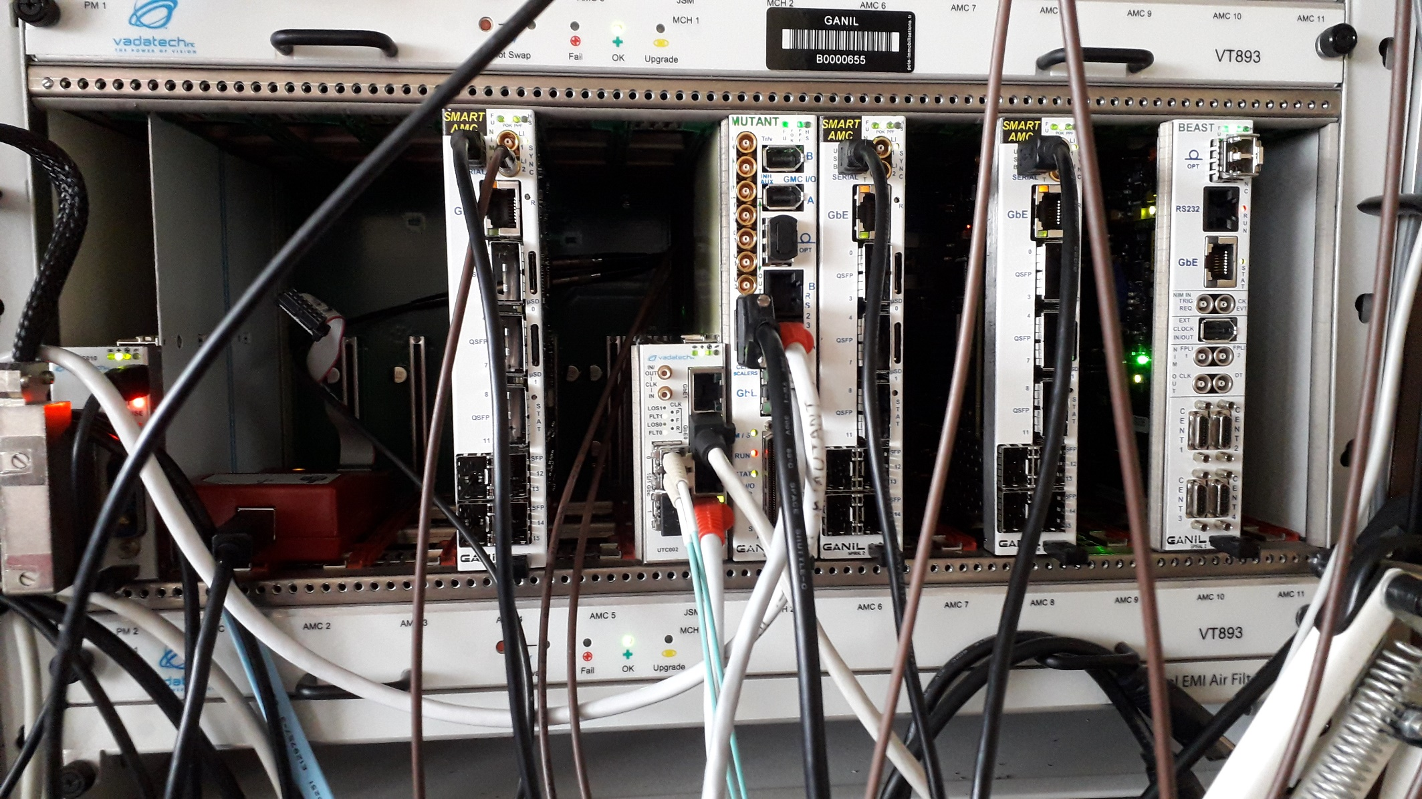
Tests of SMART AMC in one µTCA

Slide 12
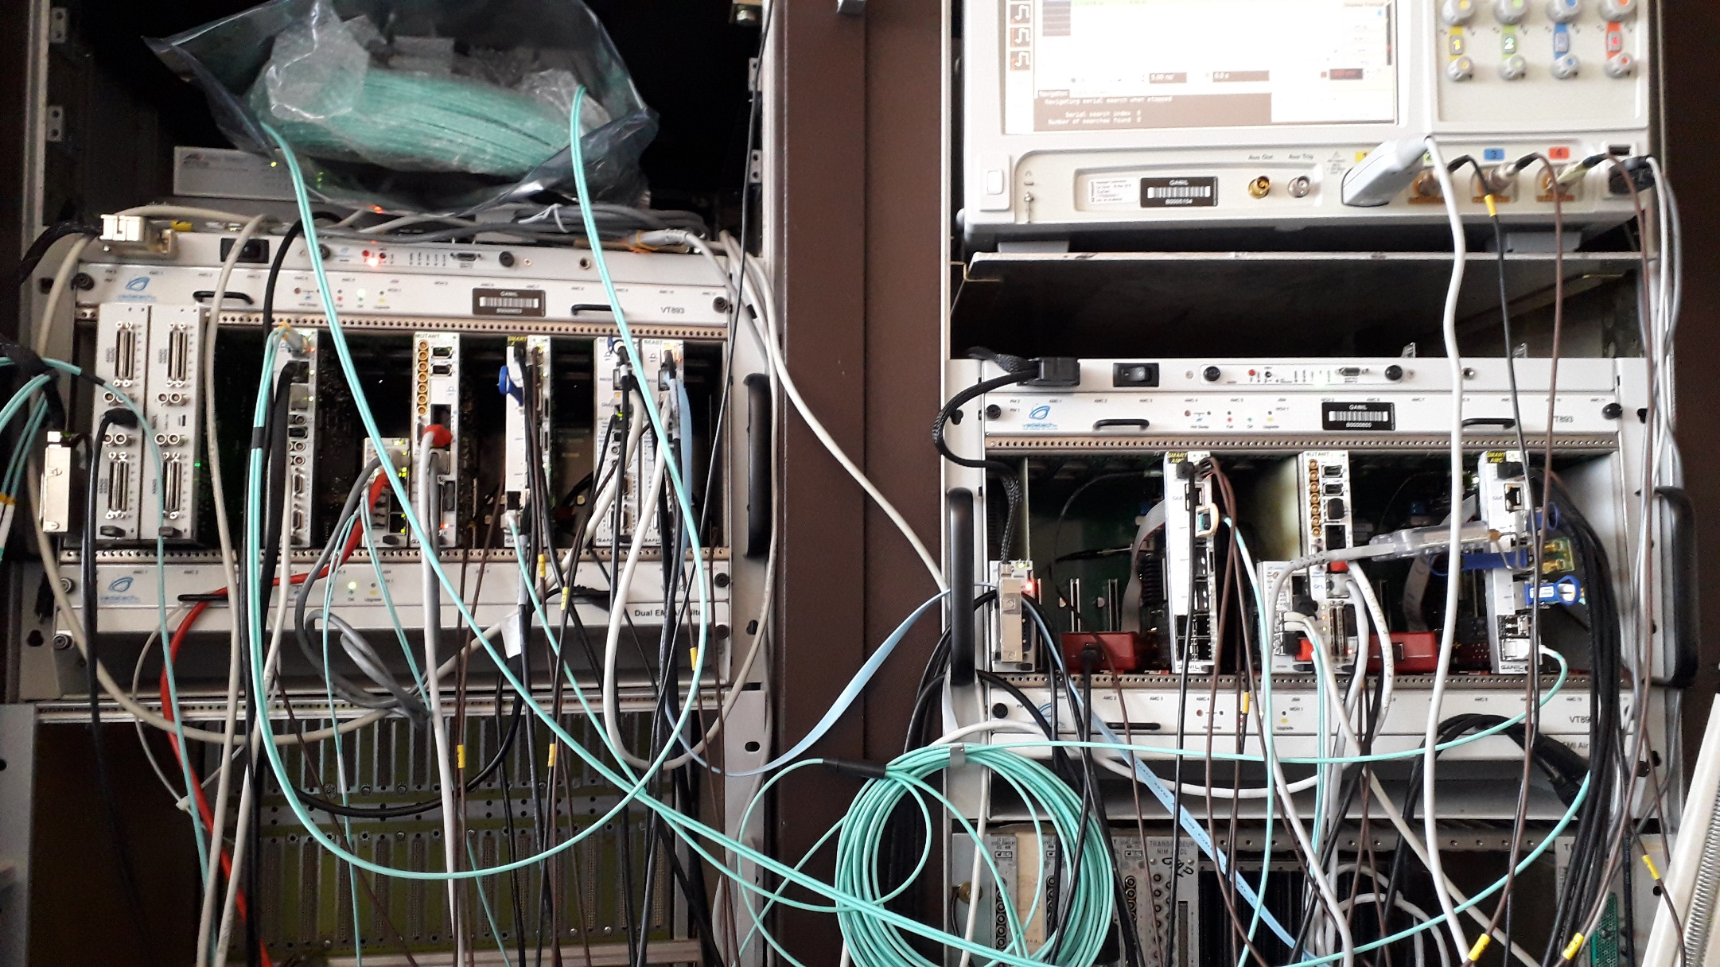
Few pictures of SMART AMC test bench
100m OM3 fiber
between one ROUTER and one BEAST
2 m DAC (SFP<->SFP)
between one ROUTER and one BEAST
2 m DAC (QSFP<->4SFP)
between one ROUTER and one BEAST
10 m MPO breakout cable (OM3 MMF) from HUB to 2 ROUTERS

Slide 13
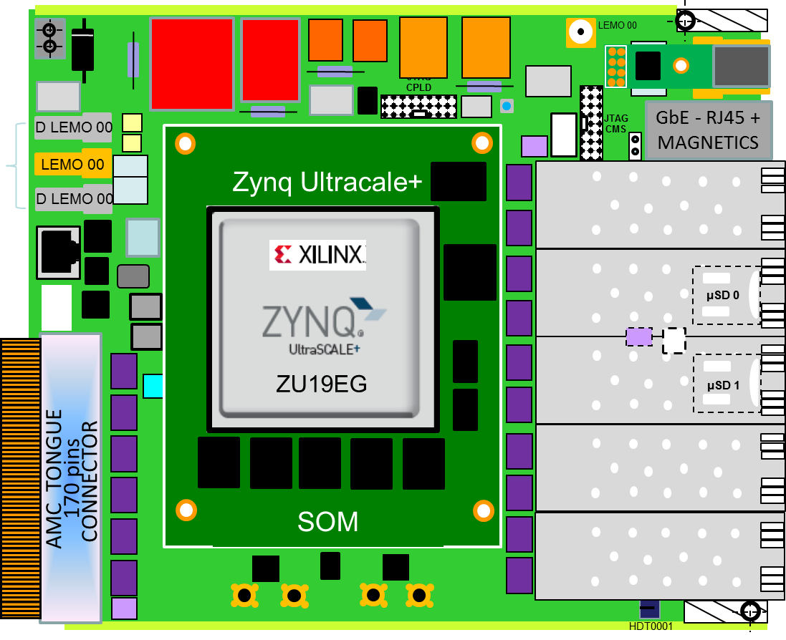
AGATA week 2022, my last slide was:
Main requirement: Increasing the number of EP’s (digitizers) from 240 to 480 !
Preliminary
5
QSFP
-
To 20
Routers
To 12
Routers
A total of 32 transceivers is required
Conclusion, strong demand for SMART MCH construction  Phase 2

Slide 14

SMART (Phase 2) Full Architecture
Numexo2
12
SMART
END POINT
Up to15 ports
backplane
10111100
ROUTER
Numexo2
END POINT
7
Up to
12
ports
SMART
On the shelf board
SMART
MicroTCA
Carrier
Hub
Up to20
ports
END POINT
dual star
12
12x4Gb/s
backplane
ROUTER
On the shelf board
6
END POINT
COMMERCIAL MCH
(SLOW CONTROL
& IPMI )
COMMERCIAL MCH
(SLOW CONTROL
& IPMI )
10111100
1
AGATA digitizer
1
SMART
END POINT
SMART
AGATA digitizer
ROUTER
END POINT
ROUTER
RFSoC Digitizer
SMART
END POINT
Numexo2
8
RFSoC Digitizer
backplane
END POINT
ROUTER
END POINT
Numexo2
COMMERCIAL MCH
(SLOW CONTROL
& IPMI )
ASIC based
front end board
END POINT
Up to 480 End Points synchronized
by 32 SMART AMC routers
and 1 SMART MCH
housed in 3 µTCA shelves
1
END POINT
SMART
ASIC based
front end board
ROUTER
END POINT

Slide 15
Zynq-7000 vs Zynq UltraSCALE+ ZU19
vs latest Kintex UltraSCALE+ KU19P
SMART
MCH
2nd candidate
1728
288
SMART
MCH
1st candidate
Device Name
ZU19EG
Zynq-7000 SoCs
SMART AMC
ROUTER | HUB
(984)
128
Up to 2016 FIFO’s
ready to use
16 x GTX |
16 x GTX

Slide 16

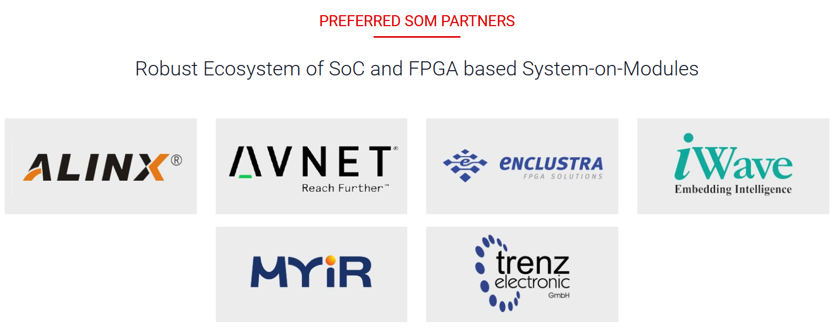




SOM provider for SMART MCH

Slide 17
SMART MCH - SOM block diagram
QUAD BYTE TRANSFER

Slide 18

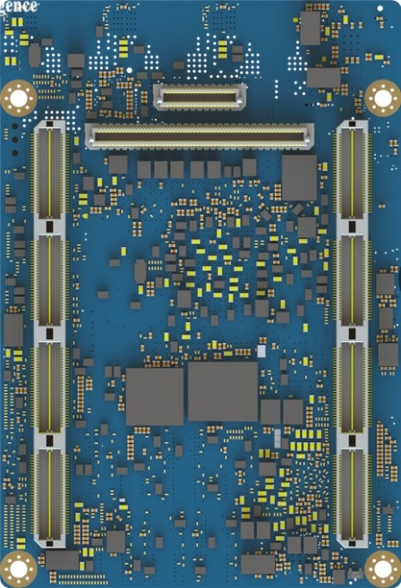
SMART MCH - SOM top & bottom
2 connectors
2 x 240 pin SAMTEC
QTH/QSH connectors
(4 rows x 60 balls &
4 rows x 20 balls)
(4 banks x 2 rows of 30 pins)

Slide 19
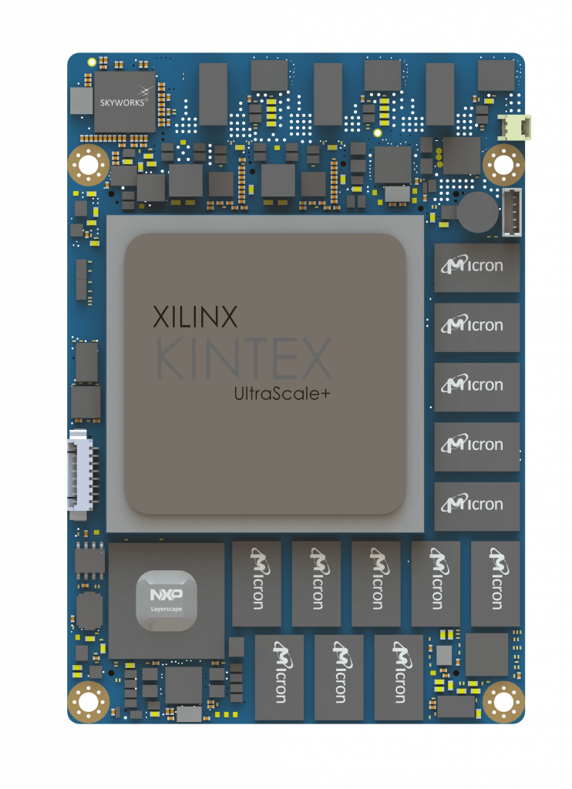

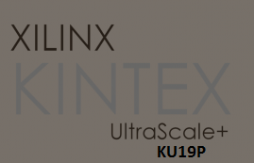



SMART MCH implantation
LM
1117
LM
1117
LM75
M5V0
LEMO 00
SMART
MCH
P
O
K
P
P
F
P1V8
P2V5A
100
EP
91
F
U
H
S
D LEMO 00
FPLI
1
FPLI
2
GANMAX3221
74AVCH
8T245
74AVCH
8T245
NIM OUT
2 x
J
T
A
G
CMS
GbE - RJ45 +
MAGNETICS
P5V0
XO
74LCX
257
Mini USB
Type B
(RS232)
U
S
B
LPC
2138
TDC
Gb
E
74LC
125
100
LVEP
11
SERIAL
D LEMO 00
NC7
WV07
LMV
981
100
LVEP
11
74AVCH
8T245
quad
mux/
demux
eq/pe
0
QSFP
3
LEMO 00
100
EP
91
NB7L
572
1:8
clk buf
D LEMO 00
NB7L
572
74AVCH
8T245
NIM
I/O1
S
Y
N
C
U
S
B
O
T
G
SI
5338
ICS854
S058I
quad
mux/
demux
eq/pe
4
QSFP
7
P2V5D
SI
5338
5
QSFP
-
20
HUB
ports
R
TCA
9548A
TCA
9548A
74AVCH
8T245
NIM
I/O2
74AVCH
8T245
Memory and Bandwidth
Enhanced FPGA
quad
mux/
demux
eq/pe
quad
mux/
demux
eq/pe
8
QSFP
11
S
quad
mux/
demux
eq/pe
1:8
clk buf
ICS854
S058I
12
HUB
ports
(via backplane)
ICS854
S058I
1:8
clk buf
quad
mux/
demux
eq/pe
12
QSFP
15
MCH TONGUE 1 CONNECTOR
170 pins
1:8
clk buf
ICS854
S058I
P
quad
mux/
demux
eq/pe
CLK
IN/OUT
LM75
74AVCH
8T245
quad
mux/
demux
eq/pe
16
QSFP
19
DS90
LV001
P2V5C
P3V3
N
DS90
LV001
P2V5B
SMA - CLK_IN/OUT
HDT0001

Slide 20
SMART MCH project schedule
Main tasks Global architecture defined SOM Iwave iW-Rainbow-G47M chosen and ordered 1st SOM + Development platform delivered Embedded bare metal C code developed and tested on kit for required peripherals (LS1021A processor – Code Warrior suite) 19 new symbols developed for CAD tools (Cadence-Concept) 2 Iwave SOM ordered for AGATA 1st firmware developed for KU19P FPGA (Xilinx-Vivado 2022.1) 19 new footprints prepared for CAD tools (Cadence-Allegro) SMART MCH schematics SMART MCH board routing SMART MCH prototype assembly SMART MCH prototype tests (hardware, firmware, software) SMART MCH Production (4 units –> 2 for AGATA & 2 for GANIL) | Main key dates September 2022 October 2022 January 2023 Mai 2023 July 2023 August 2023 September 2023 January 2024 January 2024 April 2024 June 2024 September 2024 March 2025


Slide 21
SMART
Production costs summary
(last update: August 2023)
 | SMART AMC ROUTER | SMART AMC HUB | SMART MCH
PCB (14 layers) | 640+150(VAT) | 640+150(VAT) | ~1000(estimation)
Front panel kit + Drilling + Silkscreen | 20 50 70 | 20 50 70 | 20 50 70
Assembly + Passive components | 850 | 850 | 900
Active components (provided) | 600 | 600 | 700
SOM | 2300 | 2600 | 9000
UART2USB board | 120 | 120 | 120
Price/Unit (€) | 4800 | 5100 | 11860

Slide 22

SMART tomorrow …
A unique synchronization and trigger platform for several trigger types from GANIL to SPIRAL2
SMART
MCH
Master Trigger
SMART
AMC/MCH
CDT TPC trigger
example
SMART
AMC HUB
CDT trigger
SMART
ROUTER
SMART
ROUTER
EP1
EP
15
EP1
EP1
EP
15
EP
31
SMART
ROUTER
EP
16
EP
17
SMART
ROUTER
SMART
ROUTER
SMART
ROUTER
EP1
EP
15
EP1
EP
15
EP1
EP
15
EP1
EP
15
SMART
ROUTER
SMART
ROUTER
SMART
ROUTER
EP1
EP
15
EP1
EP
15
EP1
EP
15
SMART
also weaves its web !

Slide 23
Merci de votre attention
?
questions

