Slide 1
Study of the energy escaping from the GRAiNITA electromagnetic calorimeter.
Denys Klekots
(Taras Shevchenko National University of Kyiv)
denys.klekots@cern.ch denys.klekots@gmail.com

Slide 2
Outline
Resolution: constant term simulation
Geant4 simulation setup
Shower development. Deposited energy
Radial analysis of energy deposition
Energy of escaped particles
Escaped energy fluctuations
Escaped energy vs gamma energy point

Slide 3
Resolution: constant term simulation
The energy accuracy of ECAL is usually parametrized as $\sqrt{{\left(\frac{x}{\sqrt{E}}\right)}^{2}+y^{2}}$. Where y is the ”constant term” usually caused by leakage or non uniformity.
We have made a ANR for an ECAL 18cmx18cmx40 cm.
: Is it big enough or will there be a y term from leakage $→$ Geant4 simulation $→$ presentation (material mixture 4.53 ZnWO4 +1.19 heavyliquid (25%water 75% hexasodium tungstate )).
Next step if the scan of the small prototype with testbeam muons gives nonuniformity as in LHCb (plot => +-6% Grainita ?)
1) Estimate by simulation our ECAL constant term for this type of nonuniformity.
2) Estimate constant term from light yield vs depth due to WLS absorption
3) Try simulation with fibers in crystal+ liquid mixture
Other simulation ideas? Suggestions?
Credit to Jacques Lefrancois for this slide

Slide 4
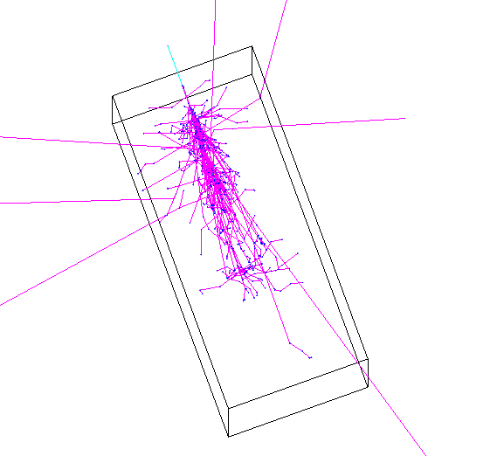
Geant4 simulation setup
Simulation is held in the box volume with dimensions 175 x 175 * 400 mm.
Volume is simulated as with one material:
4.53 $\frac{g}{{cm}^{3}}$ (partial density) of ZnWO4
1.19 $\frac{g}{{cm}^{3}}$ (partial density) of heavy liquid
Projectile particle energy - deposited energy = escaped energy
escaped energy ≠ The sum of energy of escaped particles

Slide 5
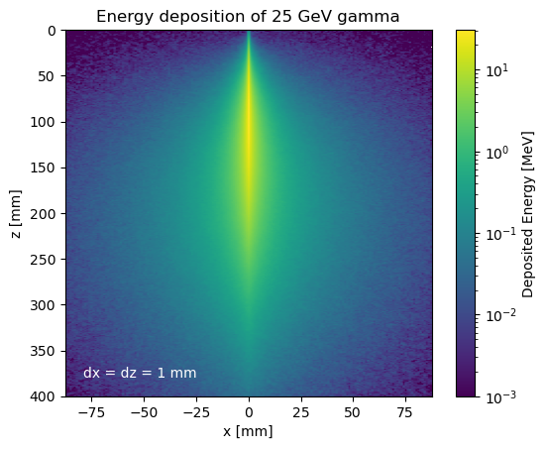
Shower development. Deposited energy
Incoming gamma

Slide 6
Radial analysis of energy deposition
d$r$ = 1 mm
Incoming
gamma
25 GeV
$$r$$
400 mm
Most of the energy is deposited near the axis of incoming gamma

Slide 7
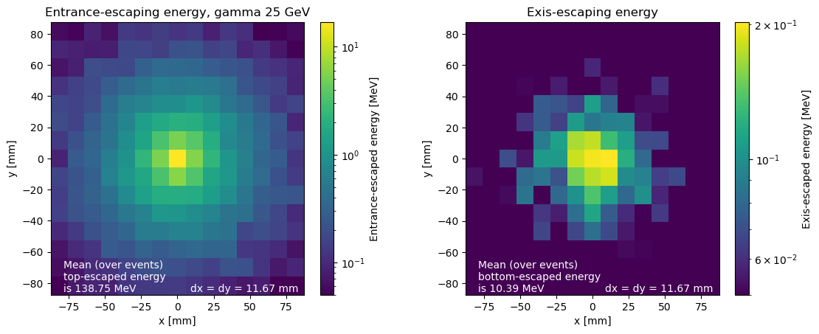
Energy of escaped particles
The energy of an escaped particle is:
Its mass + kinetic energy if particle was created in pair production.
It's kinetic energy otherwise.

Slide 8
Escaped energy fluctuations
The 1000 events were simulated for the gamma quanta of the 25 GeV with an entry point in the axis of the simulated box.
The histogram shows the distribution of the escaped energy on event event-wise basis.
$$RMS= \sqrt{\frac{1}{N}\sum_{i=1}^{N}{{\left(E_{i}−μ\right)}^{2}}}$$
$$N=1000$$

Slide 9
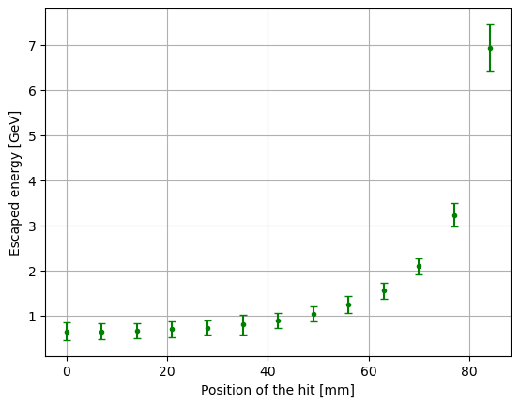
Escaped energy vs gamma energy point
The figure describes the dependence of the escaped energy on the position of the gamma quanta entry point. The step size is 7 mm.
gamma entry
position
y
x

Slide 10
Thank you for your attention

