Slide 1
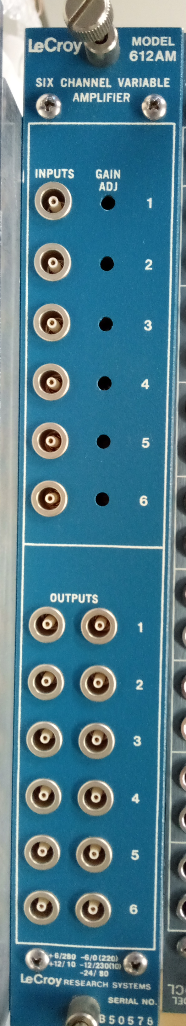
LPC Grainita test bench status
➔ End of January 2024
→ January 9th : visit at IJClab to keep a troll with his acquisition system
The troll well arrived at Clermont
What has happened to the LPC since then?
  I was hill during a full week ➔ delay
  We protect the structure of the light ➔ we wait some material to improve the dark in the box
  We bought 20 MCx – LEMO cables ( expect begin of February)
  For amplifier of external Channels, I found a NIM module (Lecroy 612AM 6 channel variable amplifier) ➔ not tested now

Slide 2
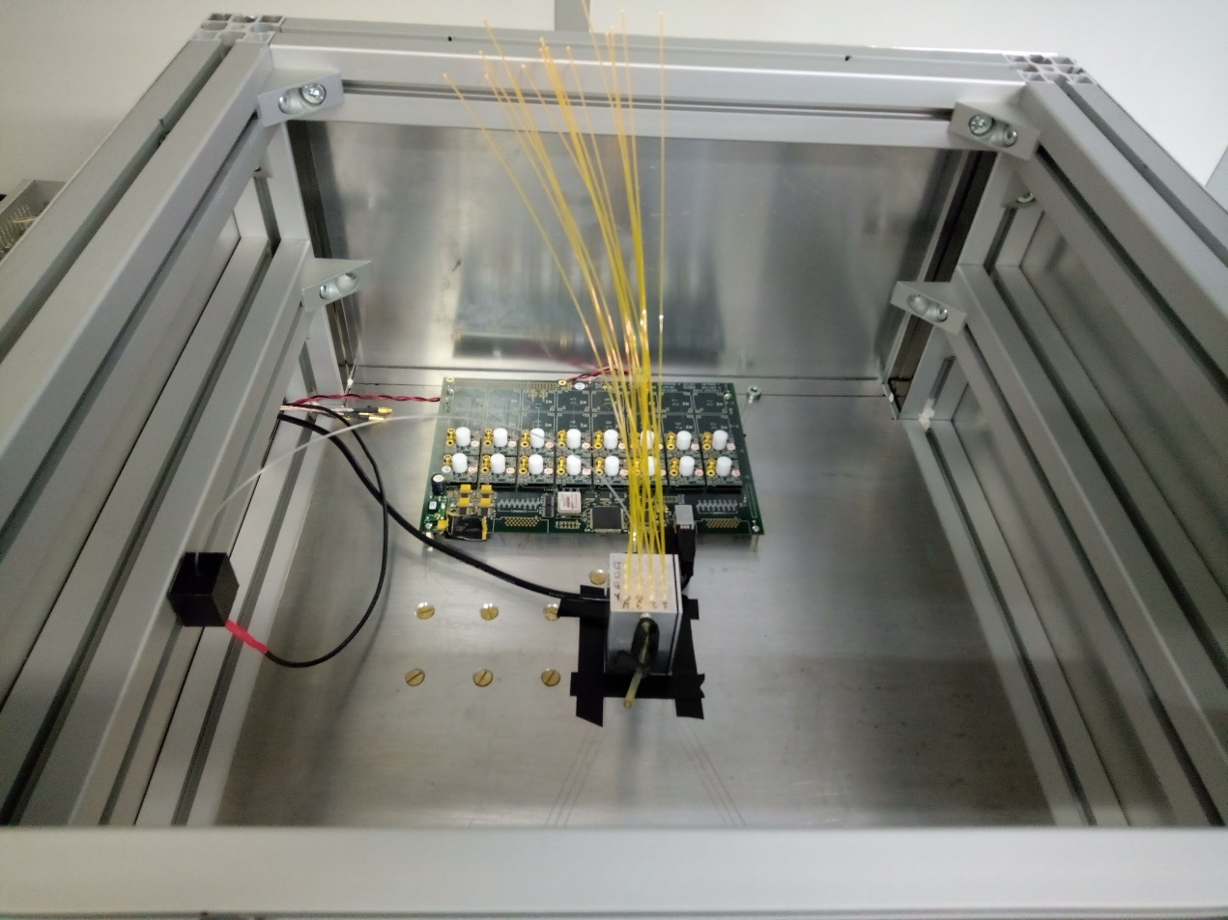
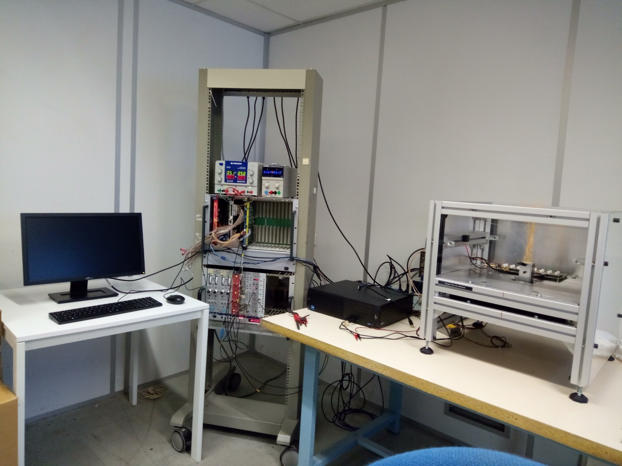
Few pictures of the test bench
Green led
Area for the troll.
A a mechanical part is being designed to fix the correct alignement between the 3 detectors
Troll + preamp
2 Pmts & timepix

