Slide 1
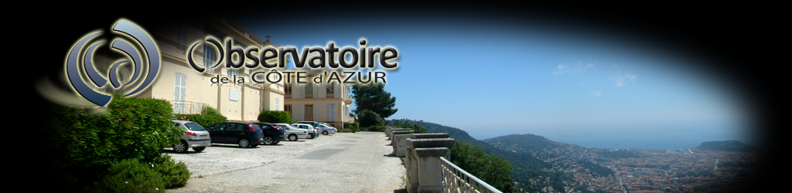




Parametric Instability Mitigation in GW detectors
ARTEMIS, Observatoire de Nice
Stéphanie Grabielle
Thomas Harder (former PhD), Remi Soulard, Jean-Pierre Coulon, Margherita Turconi, Walid Chaibi
Workshop R&D Virgo-ET (4-6th March 2024)

Slide 2
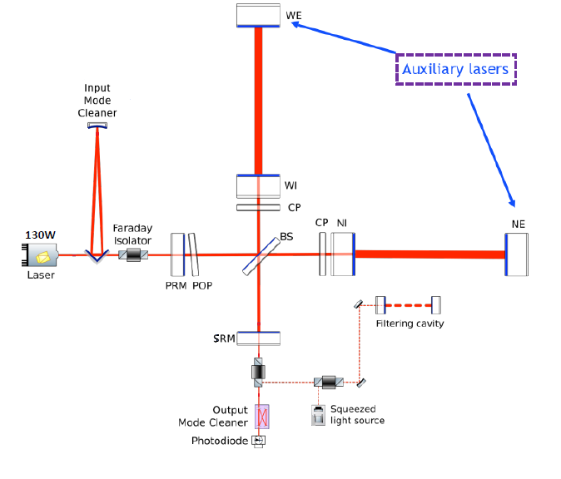
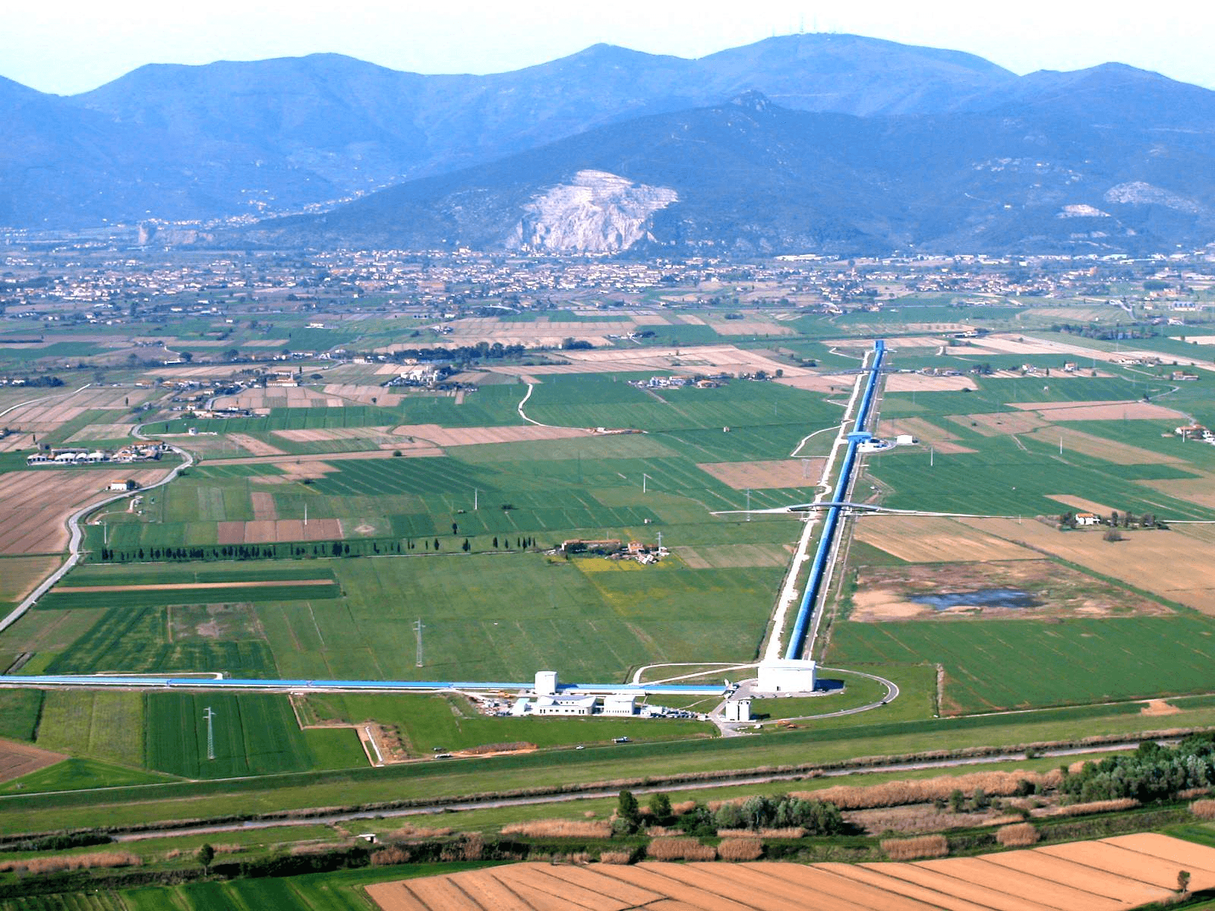
GW Detectors
300kW
300kW
40W
80W
High laser power
Post-O5 : 250W→ 1.5 MW
ET : 500W→ 3 MW
One limitation to the power increase : Parametric instabilities

Slide 3
Outline
Parametric instabilities (PIs) are a real limitation to power increase
What are PIs?
Mitigation strategy
Results

Slide 4
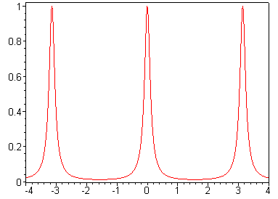
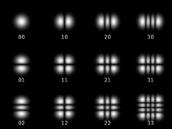



Linear optical cavity
q-1
q
q+1
2π
$$E_{in}$$
$$E_{t}$$
Normalized Transmittance
$$E_{r}$$
-2π
0
2π
Round-Trip phase
n
n+m
m
HG modes
Stable cavity : non degeneracy of HG modes’ resonance frequencies

Slide 5








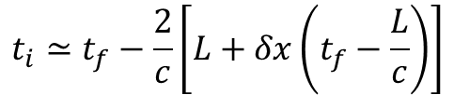





Light scattering
$δx\left(t\right)=$ $δx_{0}\cos\left(Ωt\right)$
$$ℰ_{+}$$
Stokes process
$$Ω$$
$$ω$$
$$ℰ_{−}$$
$$t_{i}≃t_{f}−\frac{2}{c}\left[L+δx\left(t_{f}−\frac{L}{c}\right)\right]$$
$$ω−Ω$$
$ℰ_{−}\left(t_{f}\right)=ℰ_{+}\left(t_{i}\right)$= $ℰ_{0}e^{iωt_{i}}$= $ℰ_{0}e^{iω\left(t_{f}− \frac{2}{c}\left[L+δx\left(t_{f}− \frac{L}{c}\right)\right]\right)}$
Jacobi-Anger expansion (order 1)
Anti-stokes process
$$Ω$$
Signal
$$ω$$
$$ω$$
$$ω−Ω$$
$$ω+Ω$$
Stokes
Anti-stokes
$$ω+Ω$$

Slide 6
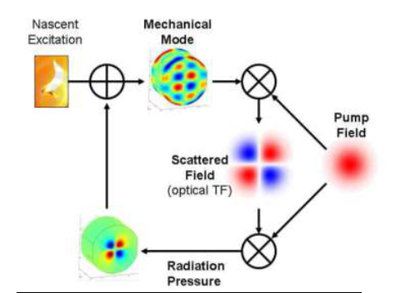
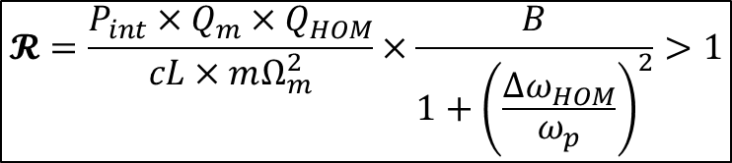
PI due to mirrors internal modes
Instability condition
Intracavity power
Mechanical quality factor
HOM optical quality factor
Parametric gain
Overlap
$$𝓡=\frac{P_{int}×Q_{m}×Q_{HOM}}{cL×mΩ_{m}^{2}}×\frac{B}{1+{\left(\frac{Δω_{HOM}}{ω_{p}}\right)}^{2}}>1$$
α mechanical mode energy
Cavity pole
HOM detuning
cavity
Evans et al, Phys. Lett. A, 374(4), 665-671 (2010)
[Braginsky et al, PLA 287 (2001)]

Slide 7
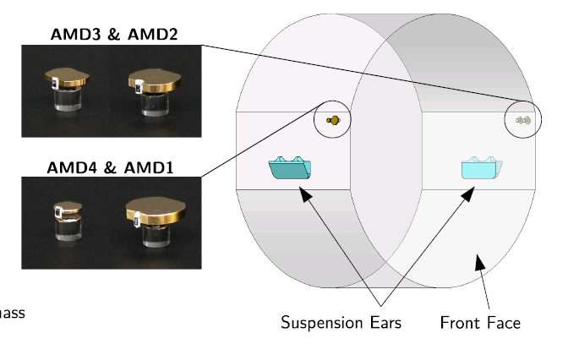
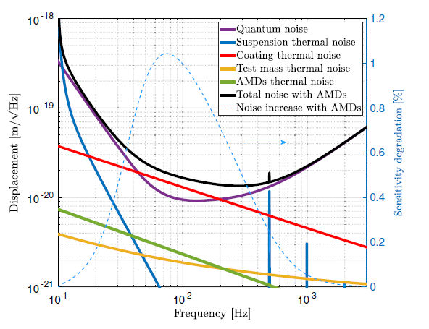
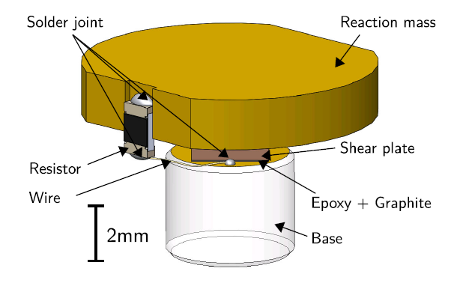
LIGO solution since O3
Passive dampers to lower the Qm factor→ decrease of the parametric gain
Mitigation strategies: Acoustic Mode Dampers
Impact: increase of thermal noise in detection BW
[S. Biscans PHYS. REV. D 100, 122003 (2019)]

Slide 8
Mitigation strategies: Active damping by Electrostatic driver
Electrostatic driver (ESD): control of the mirror position
Ω_{m} = 2π ∙15 kHz
ESD damping
Parametric ring UP
Applied force
Thermal tuning with the RH changes the Mirror radius of curvature and
shifts the beating note far from the most critical mode (E)
[PRL 118, 151102 (2017)]

Slide 9
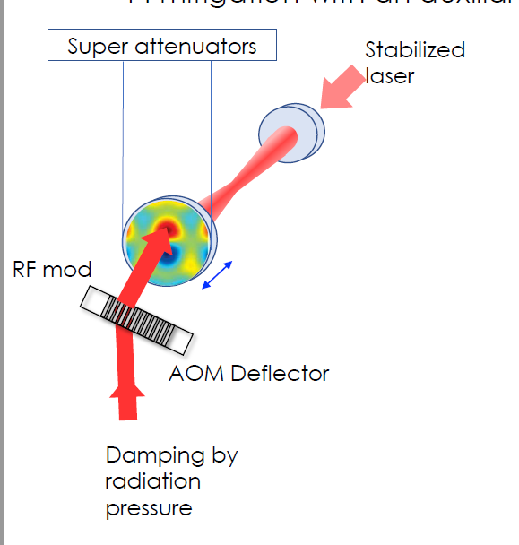
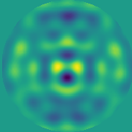
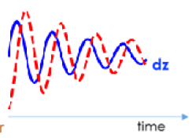

Mitigation based on Radiation Pressure
35cm
$$π/2$$
Laser
AOM
AOM
Horizontal deflection
Vertical deflection
Damping by radiation pressure
Random access
Fast deflection
Mechanical damping
Light scattering → Optical damping
T. Harder et al. Optics Express Vol. 31, Issue 2, pp. 1486-1500 (2023)

Slide 10
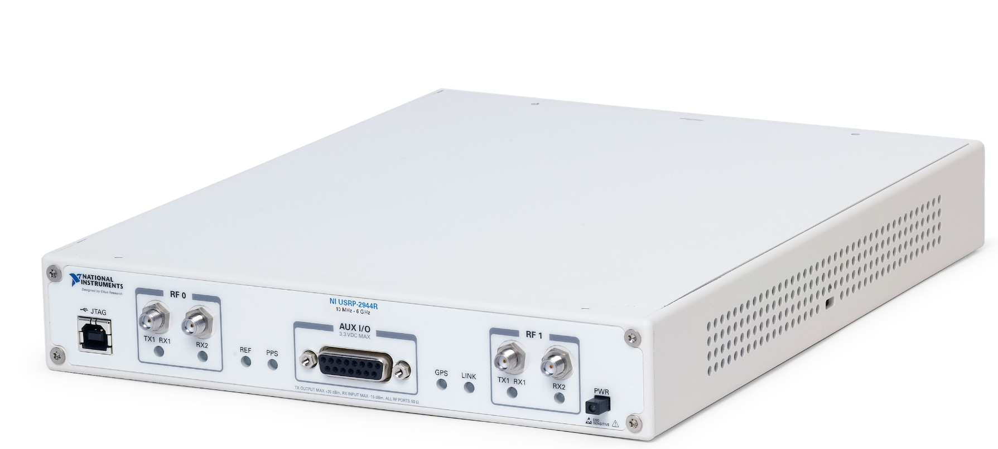
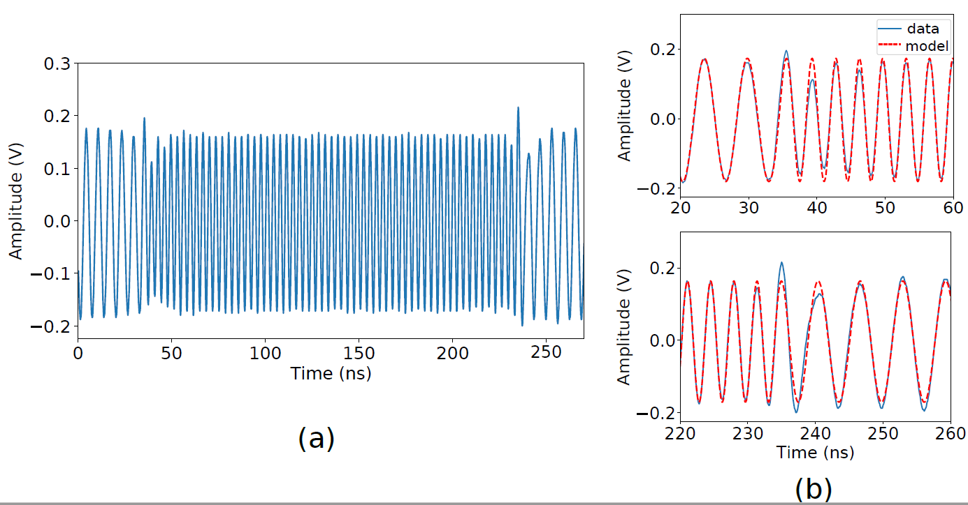
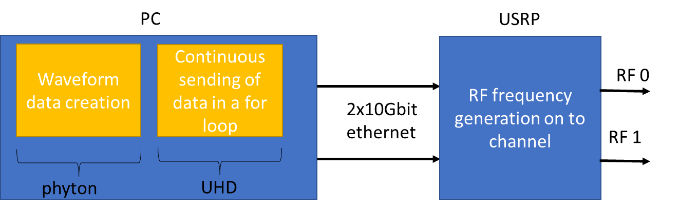
Fast and Random access : USRP
  Control via UHD software on linux machine
  IQ composition with carrier frequency up to 6GHz
  Change of frequencies within ~2-7ns

Slide 11
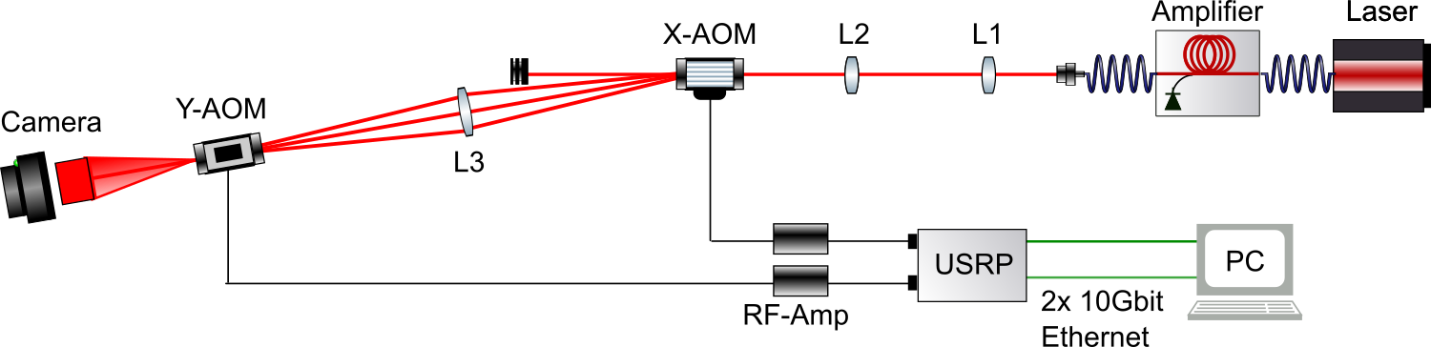
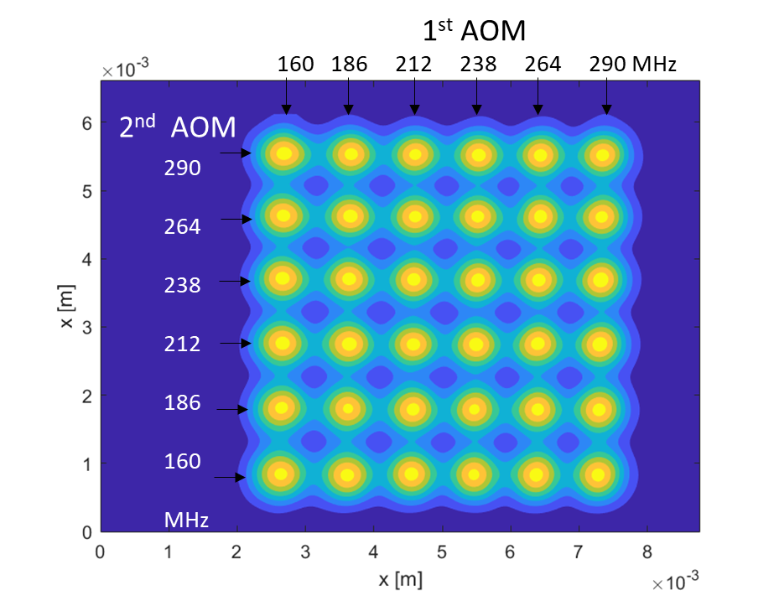
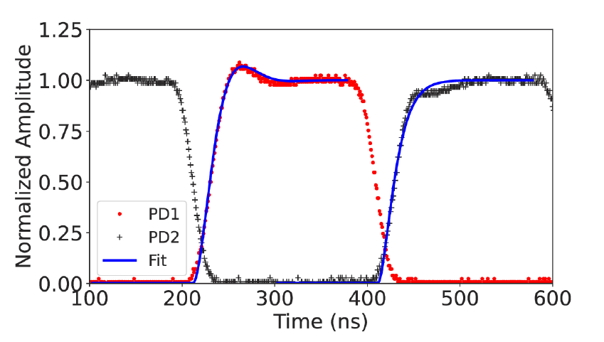

Fast Deflectors
17W
3,6W
Collimator
Laser
$$\frac{Δθ_{div}}{Δθ_{def}}≃\frac{1}{6}$$
~50ns
T. Harder et al. Optics Express Vol. 31, Issue 2, pp. 1486-1500 (2023)

Slide 12
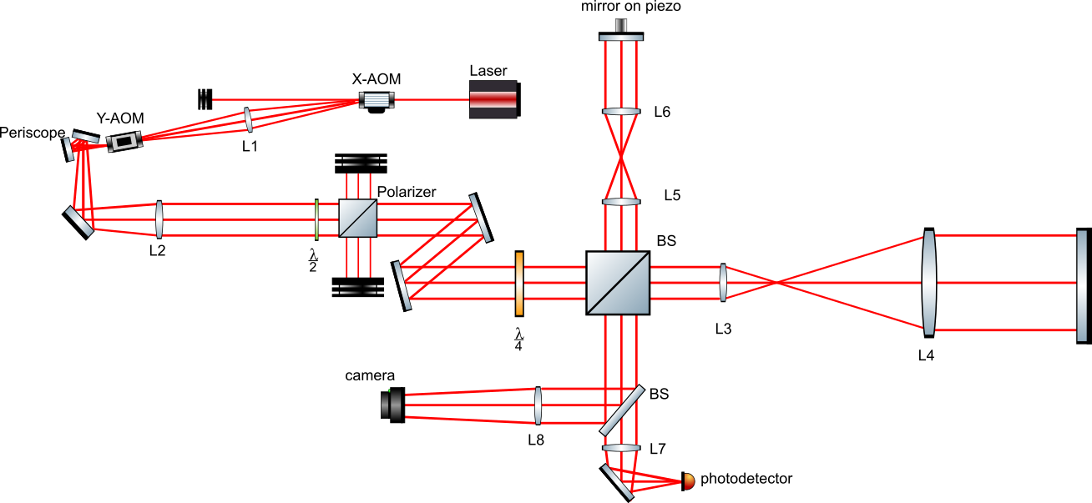
First results – Sensitivity and limitations
Goal: Measuring a mirror mode
Experimental setup
USRP
RF-AMP
RF-AMP
L
L
vacuum

Slide 13
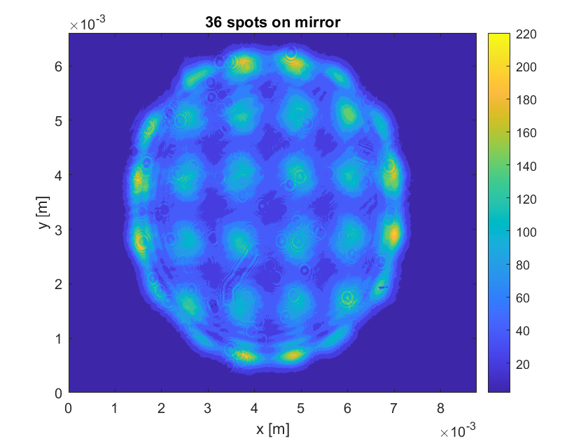
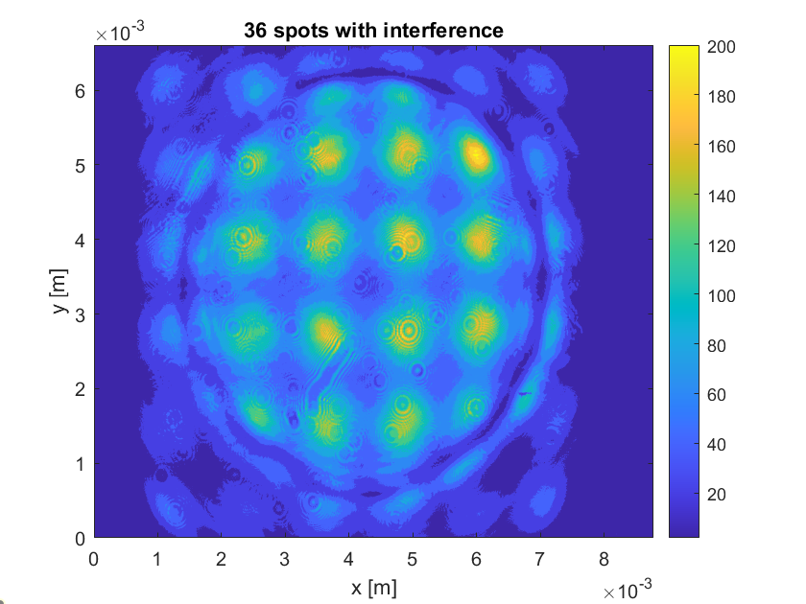
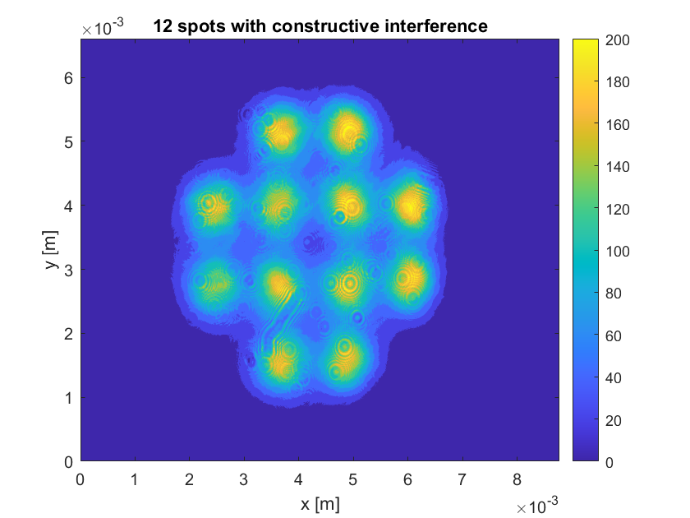
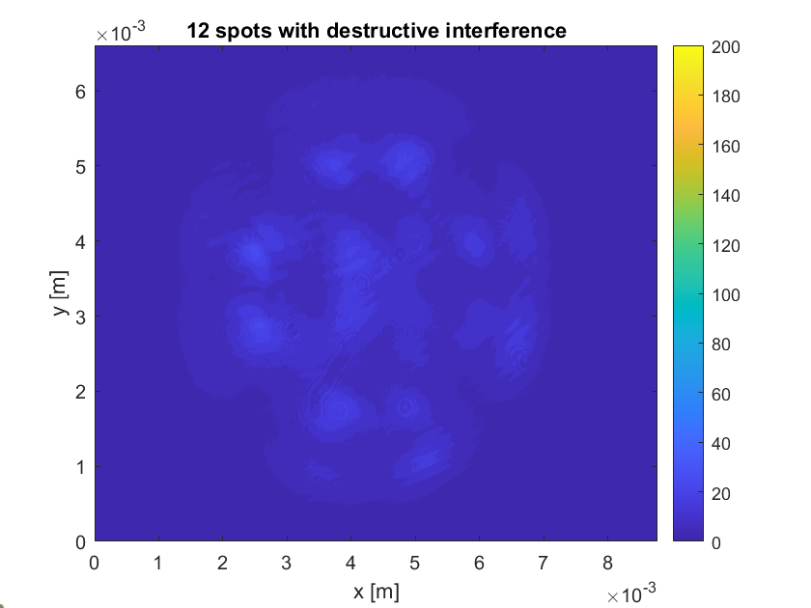
First results – Sensitivity and limitations
Experimental setup
clipping
Spherical aberration
USRP
RF-AMP
RF-AMP
L
12 spots in phase
vacuum
L

Slide 14
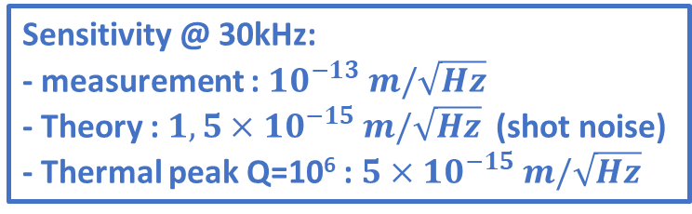
First results – Sensitivity and limitations
Experimental setup
Sensitivity @ 30kHz:
- measurement : ${10}^{−13} m/\sqrt{Hz}$
- Theory : ${1,5×10}^{−15} m/\sqrt{Hz}$ (shot noise)
- Thermal peak Q=10⁶ : ${5×10}^{−15} m/\sqrt{Hz}$
USRP
RF-AMP
RF-AMP
L
L
vacuum

Slide 15
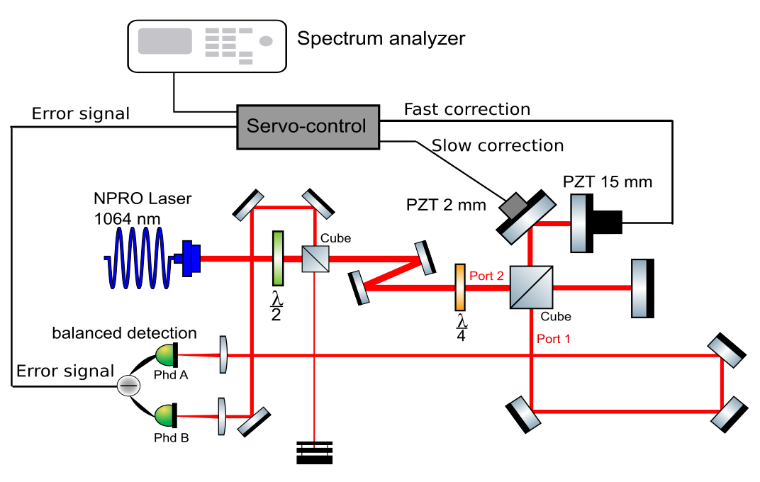
Current experiment: measurement sensitivity improvement

Slide 16
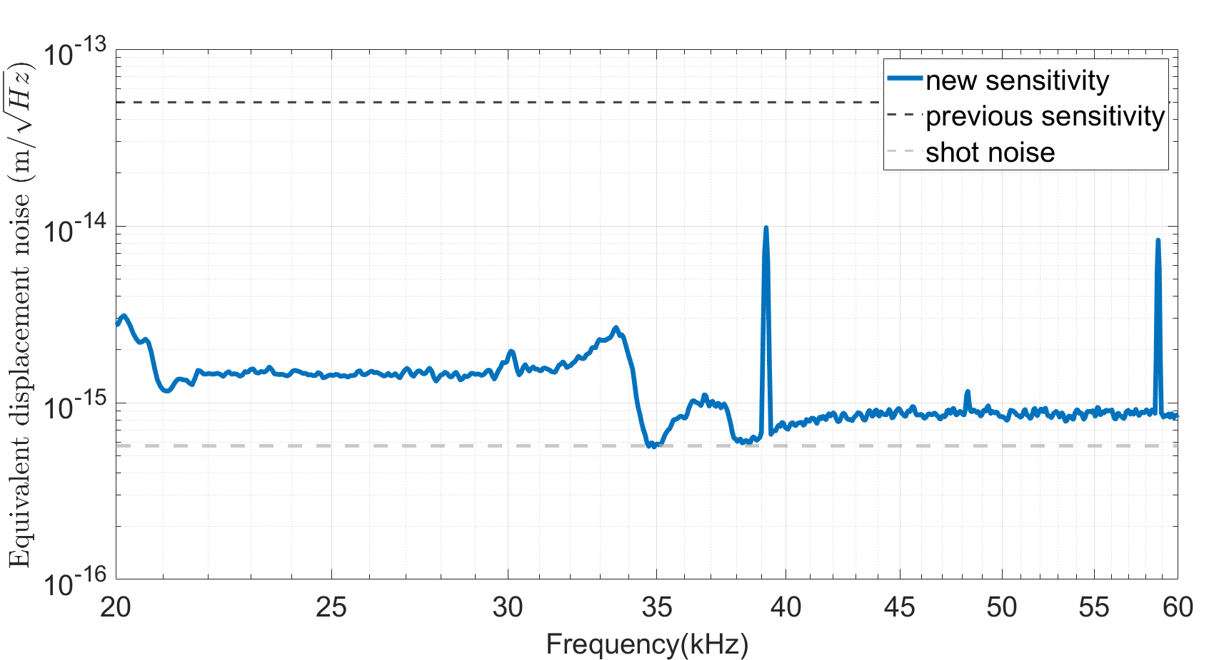
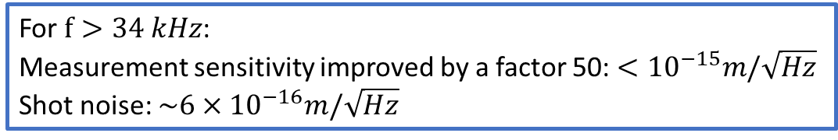
Current experiment: measurement sensitivity improvement
For $f>34 kHz$:
Measurement sensitivity improved by a factor 50: $<{10}^{−15}m/\sqrt{Hz}$
Shot noise: $\sim {6×10}^{−16}m/\sqrt{Hz}$

Slide 17

PIs observation and mitigation
Servo-control
USRP
RF-AMP
RF-AMP
L
L
vacuum
Electrostatic actuator
cavity

Slide 18
Conclusion and perspectives
To conclude
Parametric Instability Mitigation via radiation pressure
Random access and fast deflection capacities demonstrated
Measurement sensitivity improvement by a factor 50
What’s next
Implementation in presence of PI
Simulations on the mitigation efficiency

Slide 19
Thank you for your attention

Slide 20
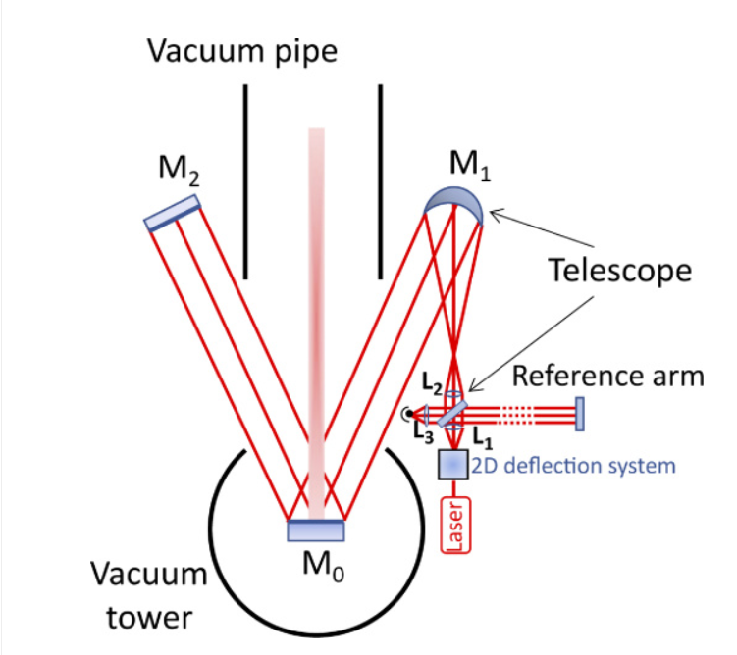
Perspectives towards implementation on a GW detector
T. Harder et al. Optics Express Vol. 31, Issue 2, pp. 1486-1500 (2023)

Slide 21

Example: Brillouin scattering in fibers
Spontaneous Brillouin scattering
Stimulated Brillouin scattering
Optical fiber
Signal
$$ω$$
Anti - stokes
$$ω+Ω$$
Beat note
Stokes
$$ω−Ω$$
Acoustic wave, $Ω$
Parametric Amplification

Slide 22
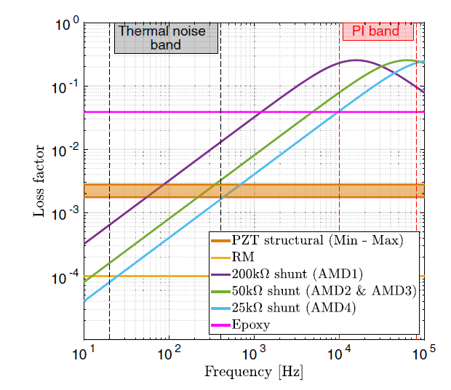
AMD: thermal noise

