Slide 1



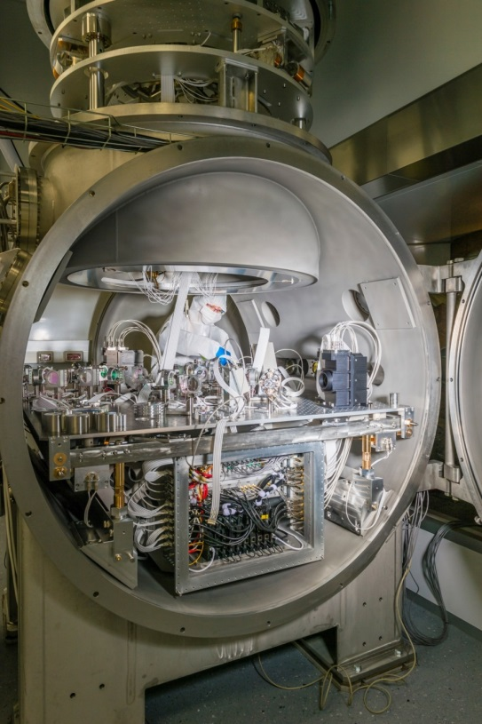
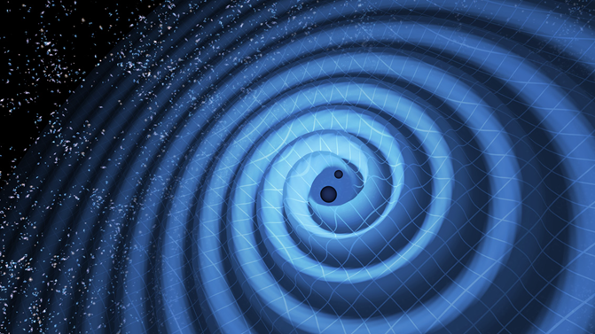
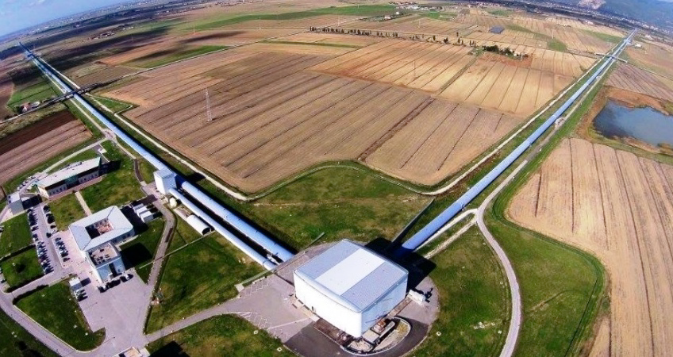
Banc suspendu sous vide et développements associés
R. Gouaty, on behalf of the LAPP gravitational waves group

Slide 2
LAPP instrumental activities in Virgo and towards ET
LAPP involved in design, construction, installation and commissioning of Virgo detector
Some areas of technical expertise:
  Optical benches and sensors
  Output Mode Cleaner cavities
  Photon calibrators
  Digital electronic and software for real time controls
  Data Acquisition

Slide 3
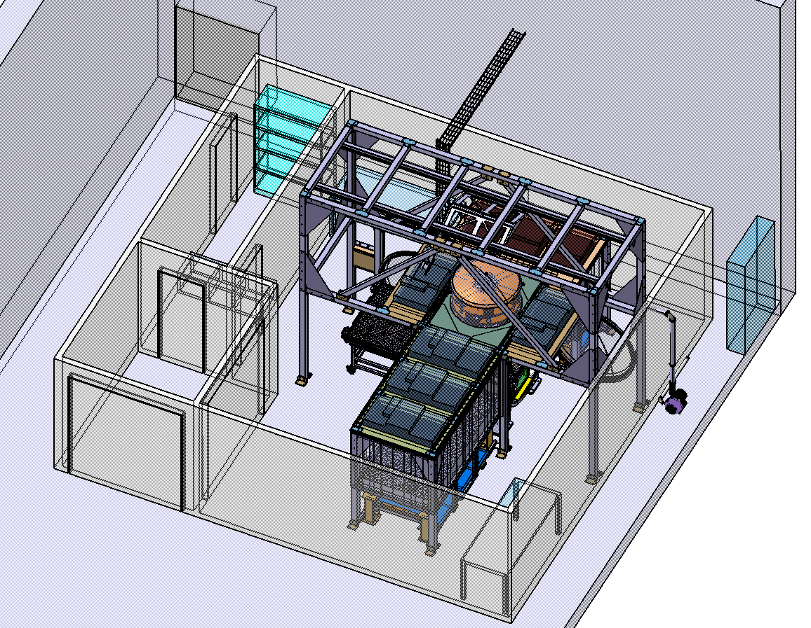
R&D platform: an optical bench suspended under vacuum
Install at LAPP an optical bench suspended under vacuum
for developments and tests in optics, mechanics and electronics of the next decade
Need a new clean room at
LAPP/Université Savoie Mont-Blanc
to host the new system.
7 benches installed at Virgo between 2015 and 2021, in operation.
Optical bench including on-board electronics inside a air-tight container.

Slide 4
R&D platform: main objectives
Precise measurements of back-scattered light (budget from ANR, March 2023→ March 2026)
Development and tests of new optical cavities for “Output Mode Cleaner”
Design and test a Sagnac interferometer as a bench tilt sensing
→ to improve suspension controls: reduction of tilt-translation couplings
Measurements of thermal noise from coatings of interferometer mirrors
Tests and integration of new electronics
  move the digital processing out of the vacuum tank → less thermal dissipation
  distribution of electrical power without contact → better seismic isolation
  characterization of low noise photodiode preamplifiers in quiet environment
Tests and integration of new mechanical designs
  improve bench local controls in position
  improve thermal dissipation from the bench to outside
  improve the cleanliness
R&D in optics:
the focus of this talk
See talk from F. Frappez, N. Letendre given in session 5 « électronique et computing »

Slide 5
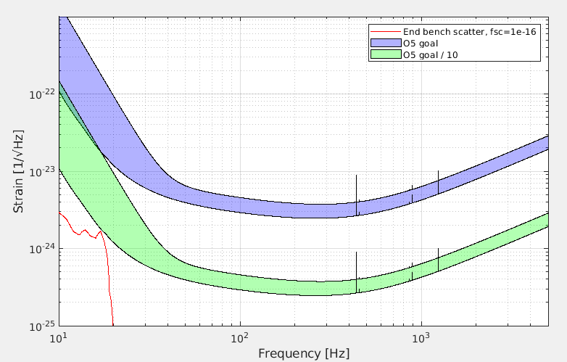
Precise measurements of back scattered light: main motivations
  Sensitivity of gravitational wave detectors limited by scattered light noise (despite lots of efforts already made to mitigate it)
    Biggest impact at low frequency (few Hertz – few tens of Hertz) → will be come even more critical for ET
    At higher frequencies, around mechanical resonances of bench parts
    → Need precise measurements of scattered light to characterize components installed on the GW detectors
  Light scattered at small angles is the dominant contribution in kilometer long optical cavities, but it is hard to measure
  Evidences for light undergoing multiple scattering:
  → ultimately the most challenging, as it can bypass the seismic isolation
  → coupling mechanism needs to be better studied
Excitation applied to the bench
Projected scattered light noise from Virgo end bench compared to O5 sensitivity
Scattered light that sees the bench motion twice

Slide 6
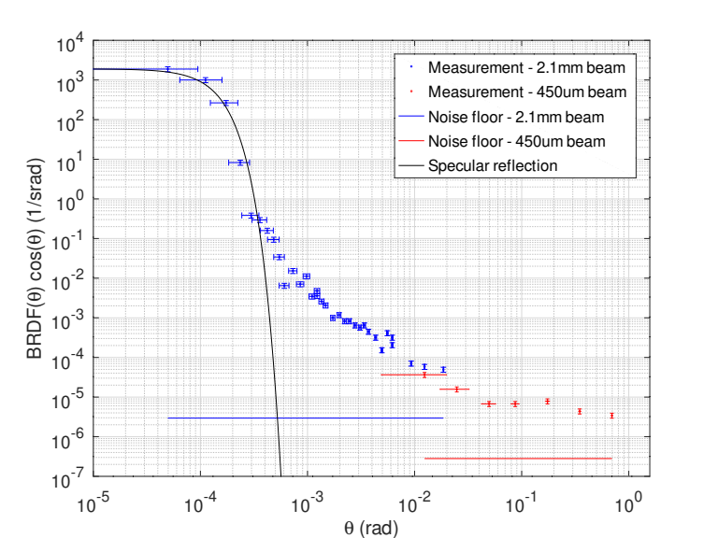
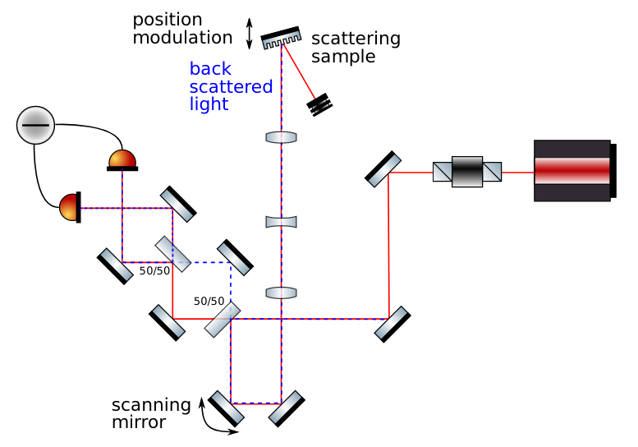
Precise measurements of back scattered light with back scatter meter
  Back scatter meter prototype already developed and tested on a non-isolated bench
    → achieved a sensitivity to recoupled back scattered light fsc~10⁻¹⁴
M. Was, E. Polini, Opt. Lett. 47(9), 2334-2337 (2022)

Slide 7
Precise measurements of back scattered light: next steps and perspectives
  Perform a systematic characterization of the components installed on the GW detector benches
  Improve back-scatter meter sensitivity, by placing the setup on an in-vacuum suspended bench:
    More accurate control of the position modulation
    Reduce beam jitter due to uncontrolled angular motions
    Suppress pertubation due to air turbulences
    → Aims at a factor ~100 of improvement in sensitivity: 10⁻¹⁶ in fraction of scattered light
    → Measure of scattering at small angle (with large beams), with angular resolution of ~15 μrad, for Virgo like mirrors
    → Study of multiple scattering (simulations + measurements)
  Postdoc (ANR budget) to be hired for 2 years from fall 2024-fall 2025

Slide 8
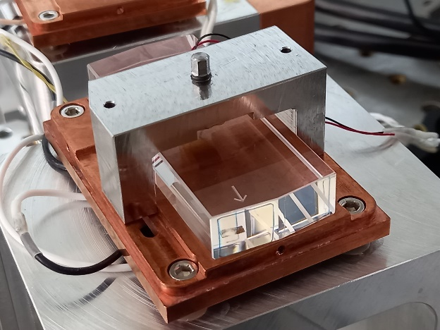
Development of new Output Mode Cleaner cavities: motivations
Output Mode Cleaner cavity: filtering out high order modes and side bands at the interferometer output port
→ key component to reduce the contrast defect and reach targetted sensitivity
Virgo Output Mode Cleaner is a bow-tie cavity made of a monolithic substrate of fused silica:
Cavity optical length controlled with Peltier
cells and small PZT actuator
This type of cavity has been operated
successfully in Virgo for more than 20 years
Now reaching limits of this technology:
  2% of internal optical losses > about half of the losses are due to Rayleigh scattering inside the substrate.
  → optical losses must be reduced for future detector upgrades (squeezing efficiency)
  OMC length noise limited by thermo refractive noise:
    about a factor 100 below O4 sensitivity with OMC lock precision of 10⁻¹³ m.
    Noise coupling proportional to F², and √(dark fringe power) → may become critical for future sensitvity upgrades

Slide 9
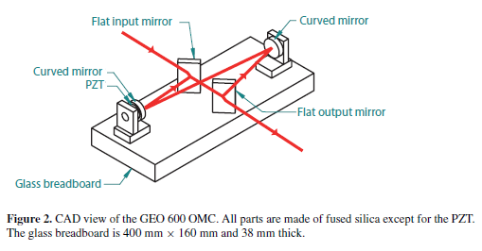
Development of new Output Mode Cleaner cavities: proposed R&D
Develop and test an open OMC cavity: beam propagating in vacuum inside the cavity
Main requirements:
  Bring the cavity optical losses below 1%
  Ensure low cavity length noise: ≤ 10⁻¹⁶ m/√Hz
  Preserve ability to adjust the cavity length (using piezoelectric ceramics bonded to the fused silica mirrors)
Two mechanical construction schemes to be explored:
  « tombstone » design: rectangular pieces of glass bonded to a glass breadboard, similar to LIGO/GEO design
  drilled through glass spacer, with circular optics bonded to it, as is commonly used for optical reference cavities
Open cavity will need to be tested on suspended bench in vacuum:
  Avoid air turbulences for the beam resonating inside the cavity
  Good seismic isolation required to qualify the mechanical design:
    Measure mechanical resonances associated to the bonding
    Measure length noise of the PZT actuator (larger bandwidth than current one)
M. Prijatelj et al., 2012 Class. Quantum Grav. 29 055009

Slide 10
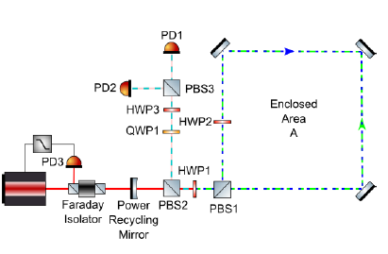
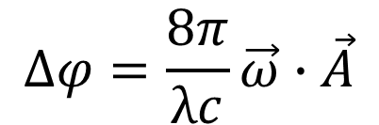
Sagnac interferometer as an angular sensor: principle and motivations
Principle of the experiment: measure the relative phase shift between the two counter-propagating beams
Angular velocity of the bench
$$∆φ=\frac{8π}{λc}\vec{ω}∙\vec{A}$$
Proposal : explore the use of a Sagnac interferometer as a sensor of the angular motion of the in-vacuum suspended bench
Main motivations:
  Use it either as a sensor fully installed on the bench or as a reference to characterize other sensors
  Improve angular control of the bench / reduce cross coupling between angular and translation motions
  → reduce the coupling of scattered light with GW detectors, in particular at low frequencies (few Hertz) where it is challenging

Slide 11
Sagnac interferometer as an angular sensor: proposed R&D
Build a first prototype (with homodyne detection) to achieve a shot noise limited optical phase sensitivity of 5x10⁻¹⁰ rad/√Hz with 100 mW of input laser power, 1m² of enclosed area
Then improve further the sensitivity at 1.5x10⁻¹¹ rad/√Hz with:
  Power recycling cavity of finesse ~300
  1 W of input power
Suspended bench in vacuum is necessary:
  To remove acoustic motion of the optics and air turbulence
  To validate and calibrate the setup
  To test the setup with the proposed use case in GW
Korth, W. Z. et al, Passive, free-space heterodyne laser gyroscope, 2016 Class. Quantum Grav. 33035004

Slide 12
Measurements of thermal noise from coatings of interferometer mirrors
See R. Flaminio’s talk given in session 1 « miroirs et coatings »
LAPP participating to ANR project « MICRONG» (Collaboration LAPP, LMA, CEA-LETI, III-V Lab, RIBER)
Main Goal: develop AlGaAs coatings of very high optical quality on 200 mm diameter mirrors
Use in-vacuum suspended bench to measure new mirror coating thermal noise in the future

Slide 13
Some information on budget
Estimation of costs
clean room 195-265 k€
on-going preparation of hiring a company for project management, to better define the clean room design and estimate more precisely the budget
scientific equipment: 570-620 k€ - recently re-evaluated by +50 k€ due to vacuum chamber cost update after market consultation (PUMA)
including optomechanics for scattered light measurement, as 1st experiment
Current resources: 425 k€ (mainly for equipment)
140 k€ (Labex Enigmass: vacuum tank and bench mechanics)
225 k€ (ANR: suspension and optomechanics)
60 k€ (LAPP: bench mechanics, 1st step of clean room project management)
Missing budget : 340 to 460 k€
180-250 kEuros for infrastructure (clean room) > asking to IN2P3
160-210 kEuros for scientific equipment > plan to ask to EGO

