Slide 1


16/4/2024 IRN Terascale, Frascati
Recent results and future perspective in the search for Axion dark matter at LNF
Alessandro D’Elia, Laboratori Nazionali di Frascati: alessandro.delia@lnf.infn.it

Slide 2
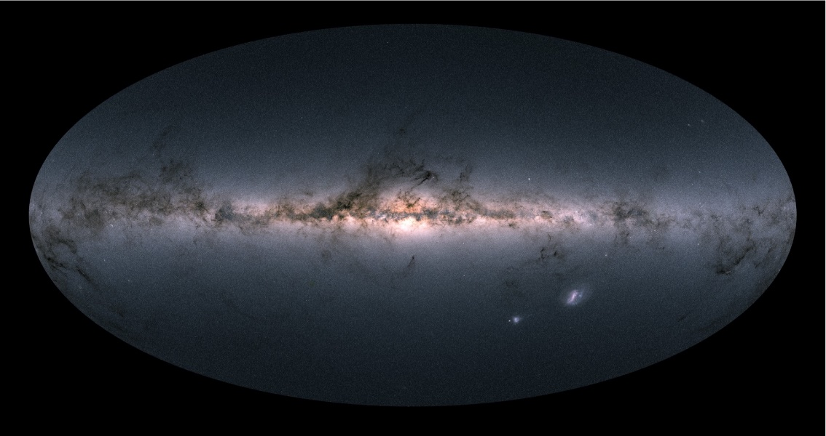


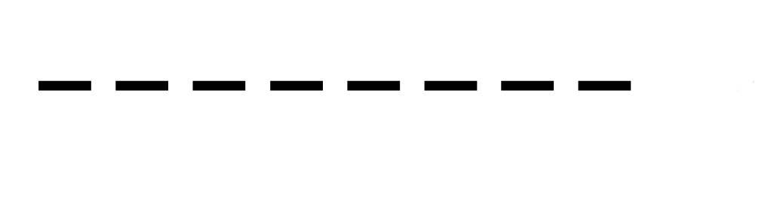


Axions as dark matter
Hypotetical particles introduced to overcome the strong CP problem
Axions properties such as charge neutrality, spin 0, small mass and negligible interaction with the ordinary matter make them an ideal candidate for dark matter
a
γ
Galactic axions
Photons detector
$$\vec{B}$$
~10 T
Notes:
Axions are hypothetical particle postulated to solve the strong CP problem. They are aslo excellent candidate for dark matter. What is important to know here, is that axions in presence of strong magnetic field will convert into photons. To search for axions signal we use an haloscope that is basically an axions antenna. It is made of a resonant cavity immersed in magnetic field. An axion conversion effect will result in a localized power excess in the resonant cavity spectrum. This power excess is extrtemely small, thus the photon detector with the highest sensitivity is required.

Slide 3
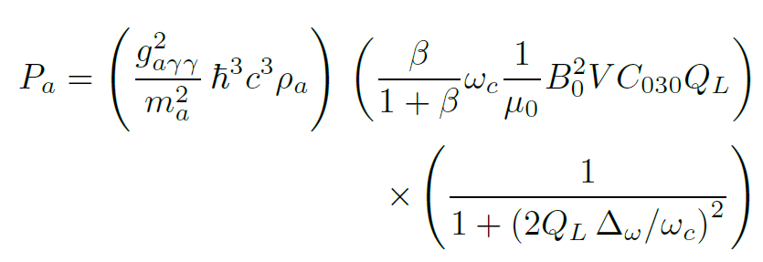
Axions as dark matter
Haloscope
cryostat
Localized power excess ~10⁻²³ W @ 10 GHz
Notes:
Axions are hypothetical particle postulated to solve the strong CP problem. They are aslo excellent candidate for dark matter. What is important to know here, is that axions in presence of strong magnetic field will convert into photons. To search for axions signal we use an haloscope that is basically an axions antenna. It is made of a resonant cavity immersed in magnetic field. An axion conversion effect will result in a localized power excess in the resonant cavity spectrum. This power excess is extrtemely small, thus the photon detector with the highest sensitivity is required.

Slide 4




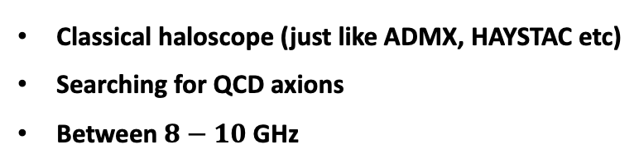
The QUAX experiment is a light DM hunt experiment
Classical haloscope (just like ADMX, HAYSTAC etc)
Searching for QCD axions
Between $8−10$ GHz
LNL (Legnaro)
a
γ
LNF (Frascati)
Galactic axions
Photons detector
$$\vec{B}$$
~10 T
Courtesy of A. Rettaroli

Slide 5
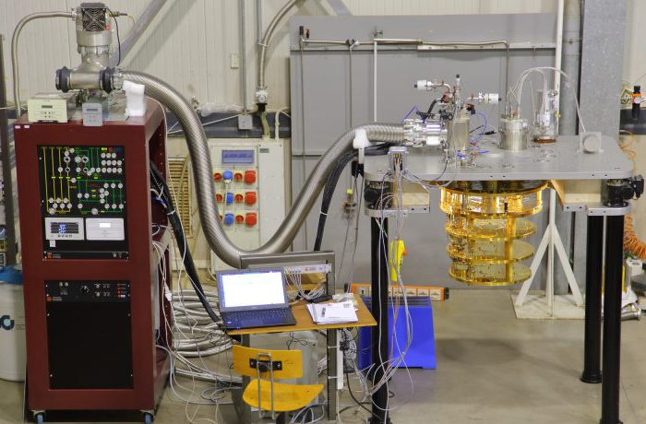
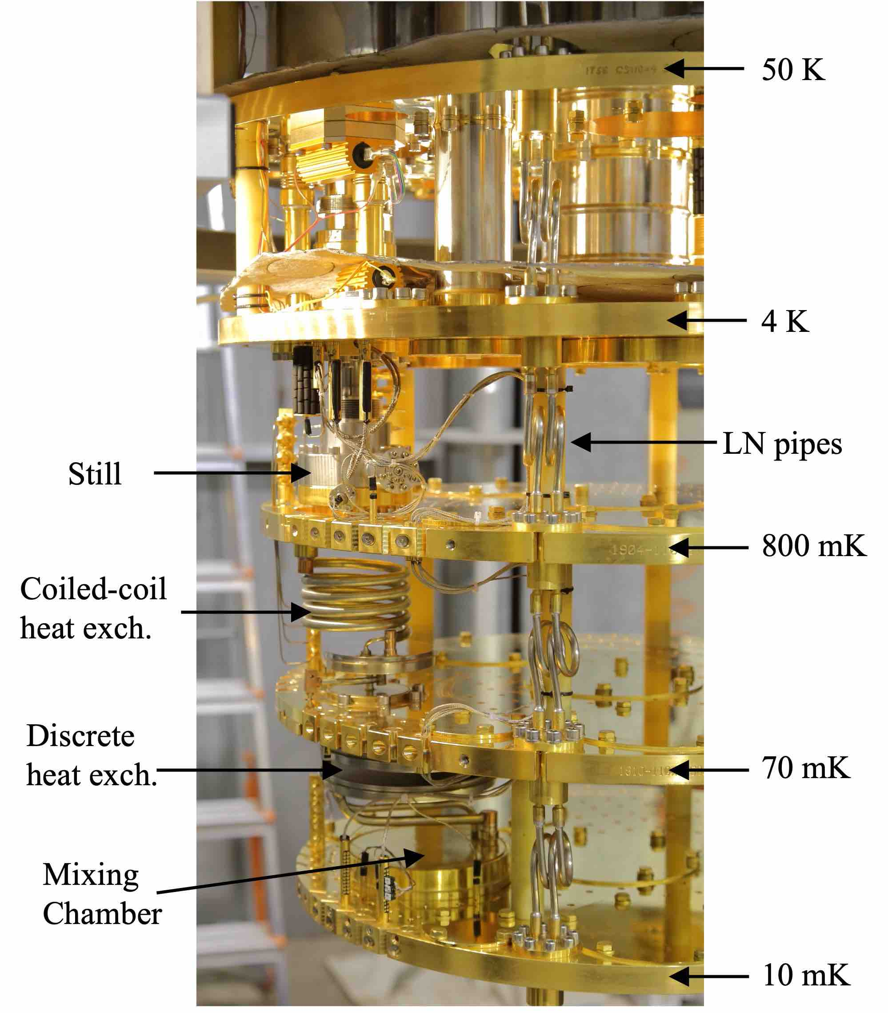
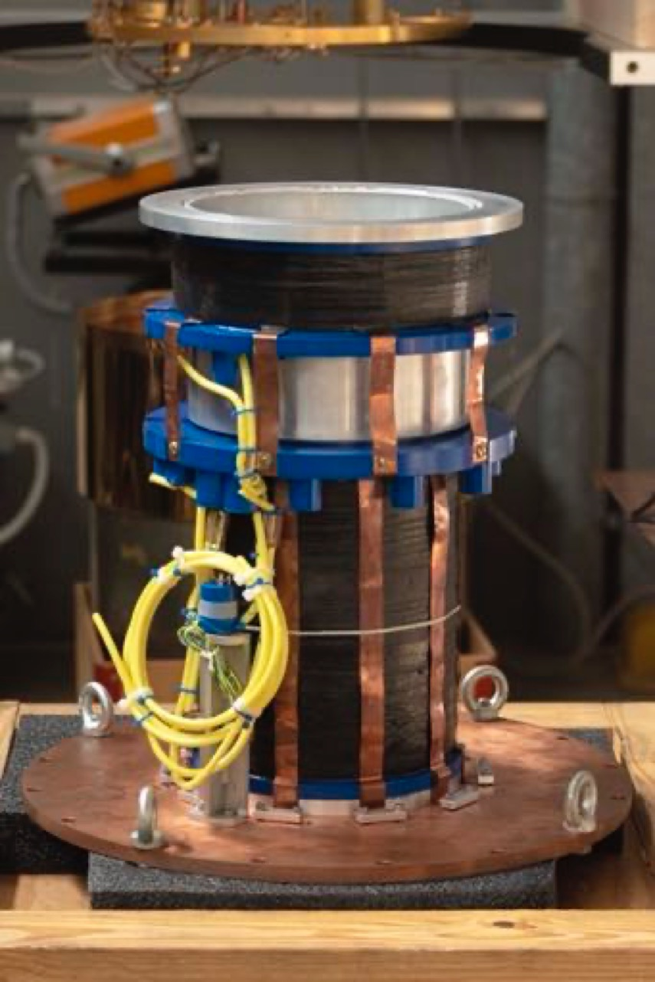
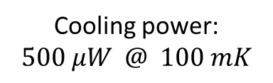

COLD Laboratory
$$T_{base}=8 mK$$
Cooling power:
$$500 μW @ 100 mK$$
9 T magnet
Notes:
Finally we will test the performances as a single microwave photon detector of our best 8 in terms of MF resiliency) device. We will do this in Frascati @ coldlab where we have a dilution He refrigerator that can go down 8 mK equipped with a 9 T magnet. in our group We have a vast experience in the characterization of Josephson effect based devices.

Slide 6
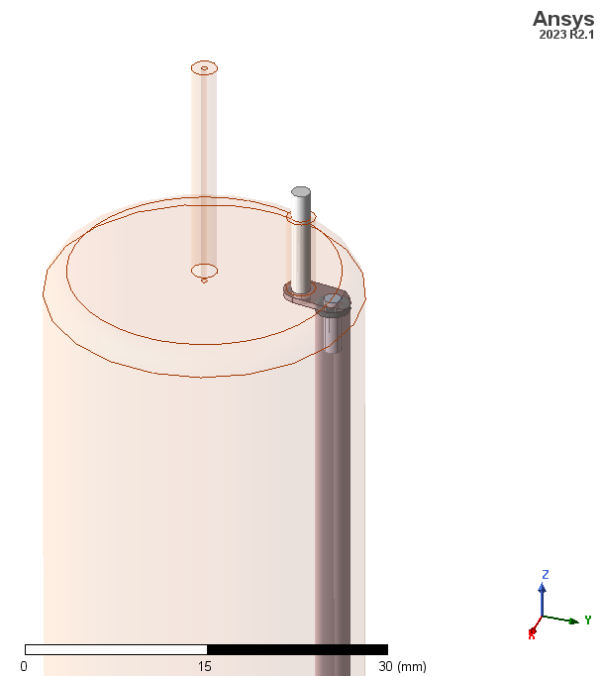
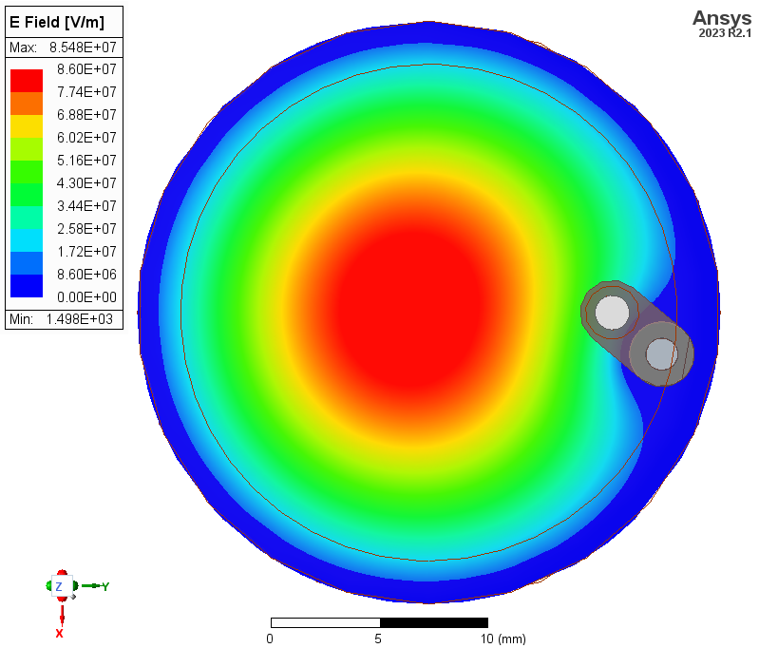
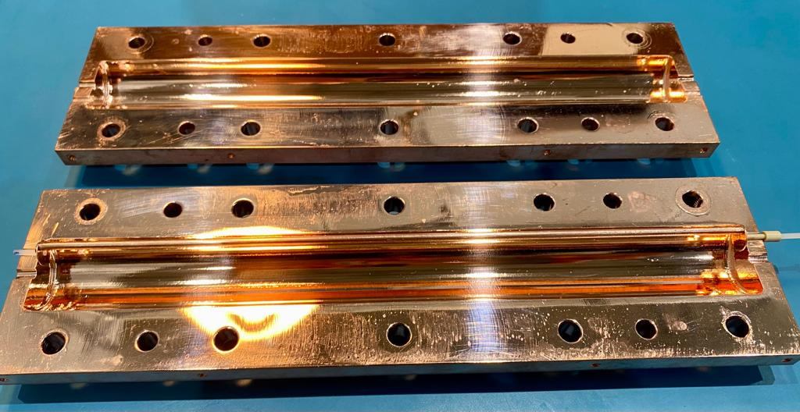
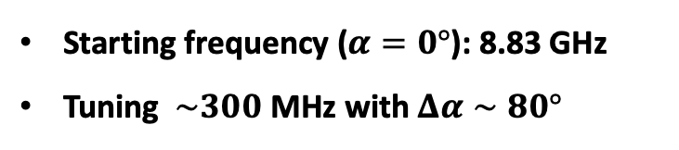
Microwave cavity + tuning
HFSS simulations by Simone Tocci
OFHC Copper
Radius = 13.5 mm, height = 246 mm
TM₀₁₀ mode
Starting frequency ($α=0°$): 8.83 GHz
Tuning $\sim 300$ MHz with $Δα∼80°$
Courtesy of A. Rettaroli

Slide 7
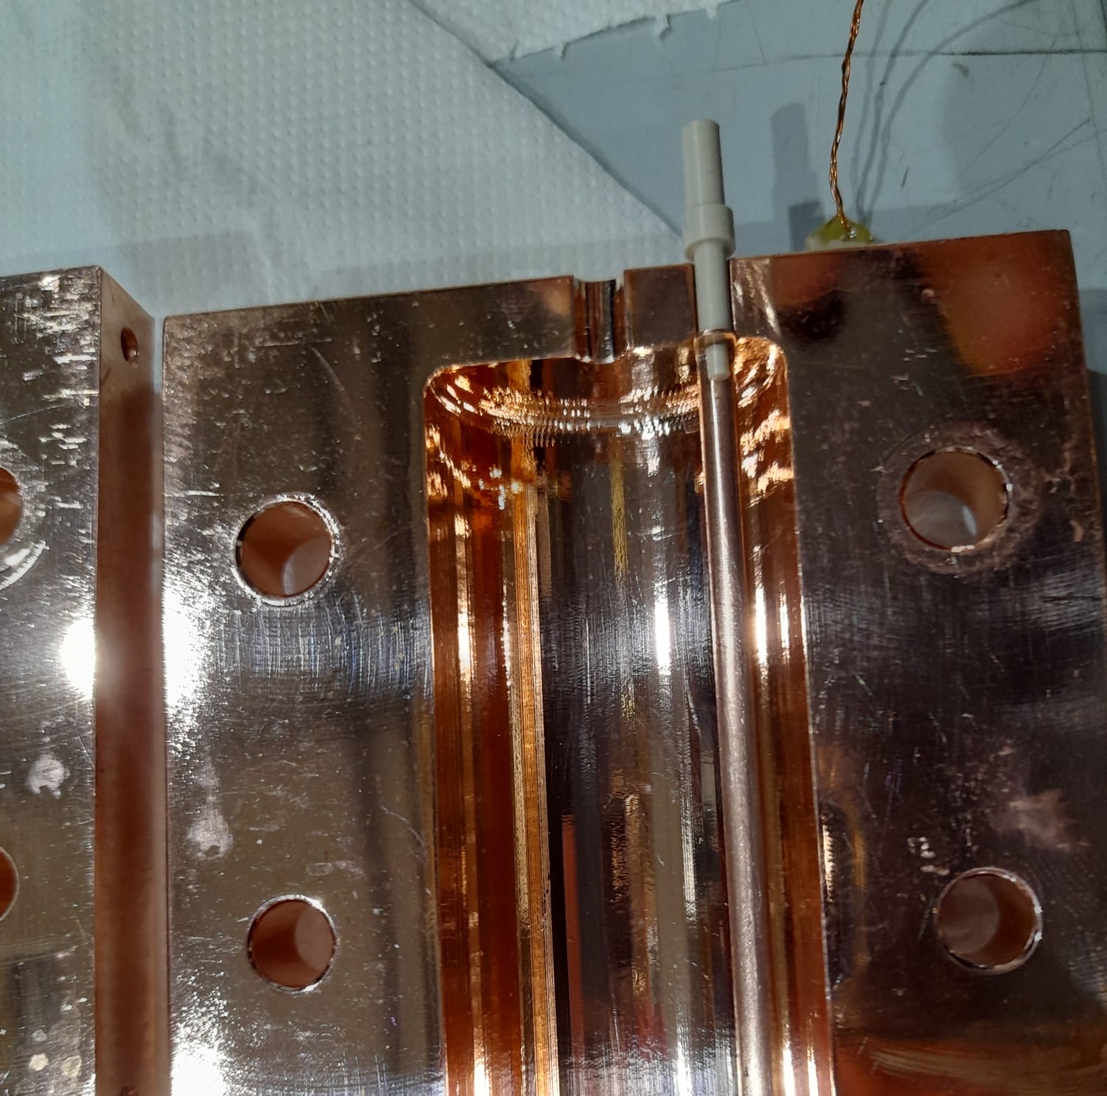
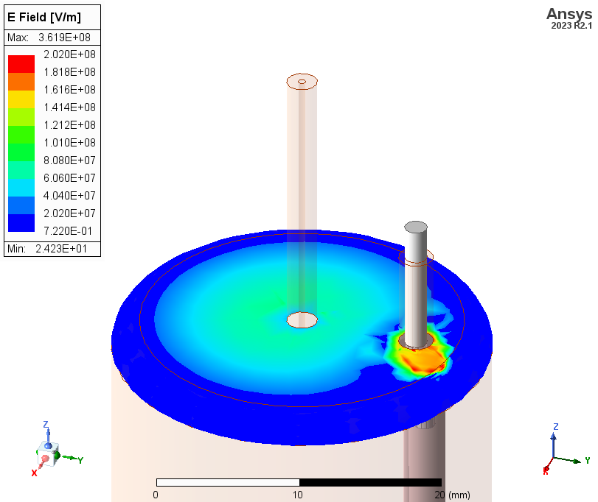
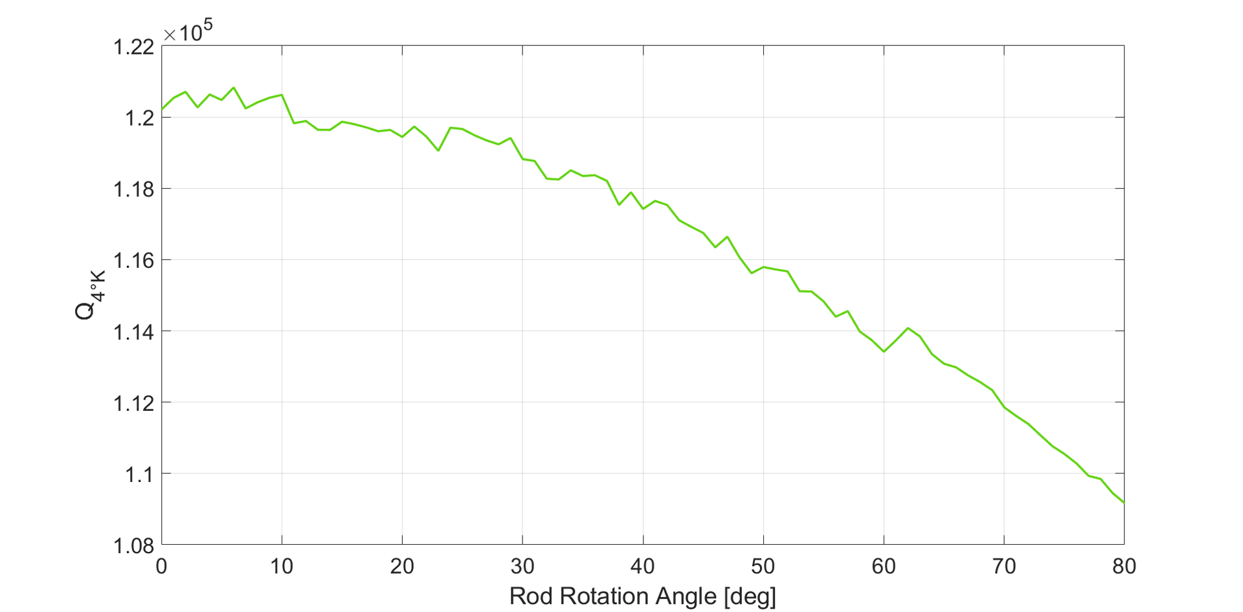

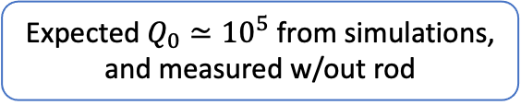
Microwave cavity + tuning
Trapped field between metallic disk and cavity endcap
Expected $Q_{0}≃{10}^{5}$ from simulations, and measured w/out rod
Measured $Q_{0}≃{5×10}^{4}$ w/ rod
This is likely due to losses caused by the rod configuration and PEEK
Courtesy of A. Rettaroli

Slide 8
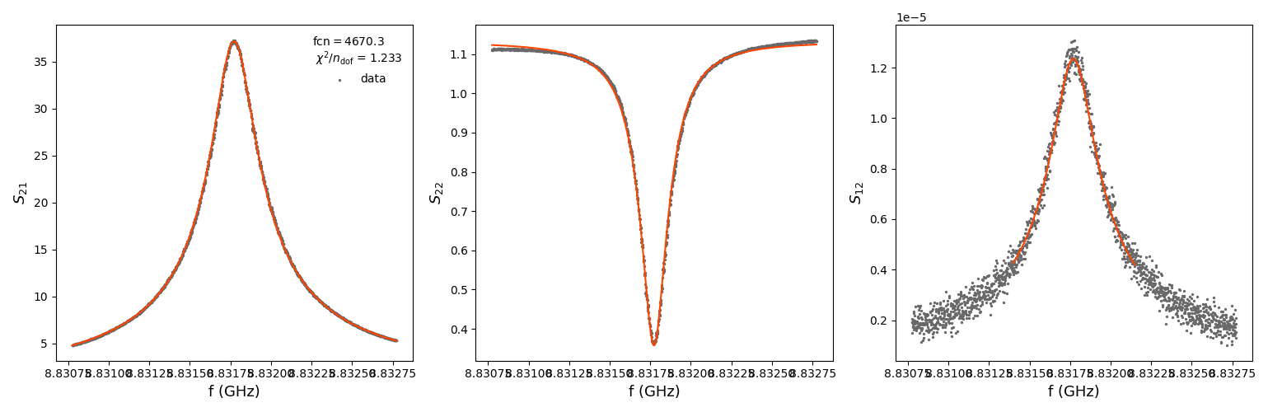
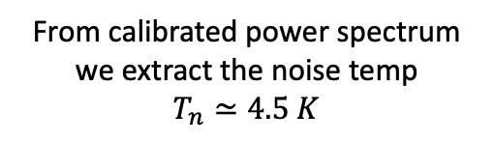
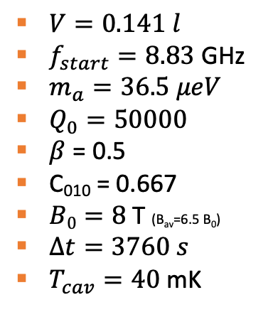
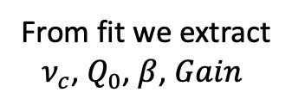
Calibration+ power spectrum
Fit procedure
Raw power spectrum
LO
cavity
Fits by Gianluca Vidali ( Master student)
$V=0.141 l$
$f_{start}=8.83$ GHz
$m_{a}=36.5 μeV$
$Q_{0}=50000$
$β$ = 0.5
C₀₁₀ = 0.667
$B0=8$ T (B_{av}=6.5 B₀)
$Δt=3760 s$
$T_{cav}=40$ mK
From fit we extract
$ν_{c}$, $Q_{0}$, $β$, $Gain$
From calibrated power spectrum we extract the noise temp
$$T_{n}≃4.5 K$$
Courtesy of A. Rettaroli

Slide 9
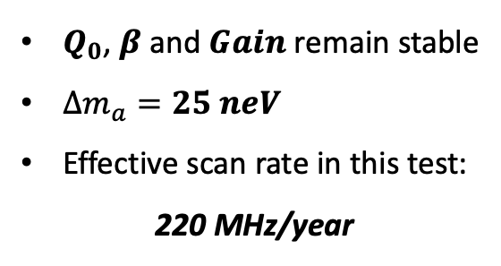
6 MHz tuning
6 MHz scan
Performed the same procedure on each run
$Q_{0}$, $β$ and $Gain$ remain stable
$Δm_{a}=25 neV$
Effective scan rate in this test:
220 MHz/year
Courtesy of A. Rettaroli

Slide 10
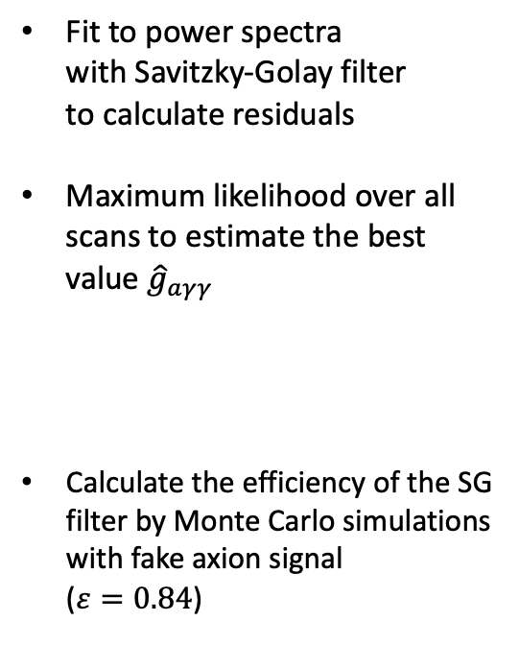
Analysis
Fit to power spectra
with Savitzky-Golay filter
to calculate residuals
Maximum likelihood over all scans to estimate the best value ${\hat{g}}_{aγγ}$
Calculate the efficiency of the SG filter by Monte Carlo simulations with fake axion signal
($ε=0.84$)
Example of power spectrum with SG fit
Cumulative normalized residuals over all scans
Courtesy of A. Rettaroli

Slide 11
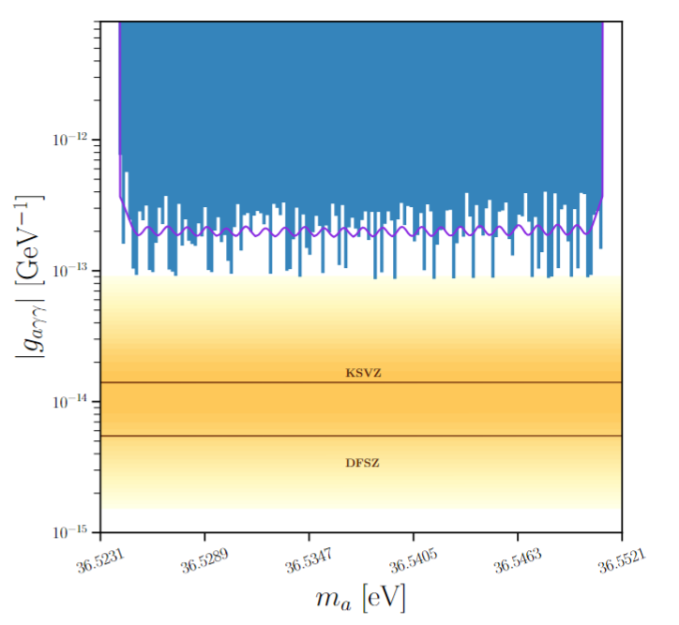

Final plot g_{aγγ}
Touched the QCD line
Avg value $g_{aγγ}=2×{10}^{−13} GeV^{−1}$
QUAX@LNF this run
A. Rettaroli et al PRD 2024 (submitted)
Courtesy of A. Rettaroli

Slide 12
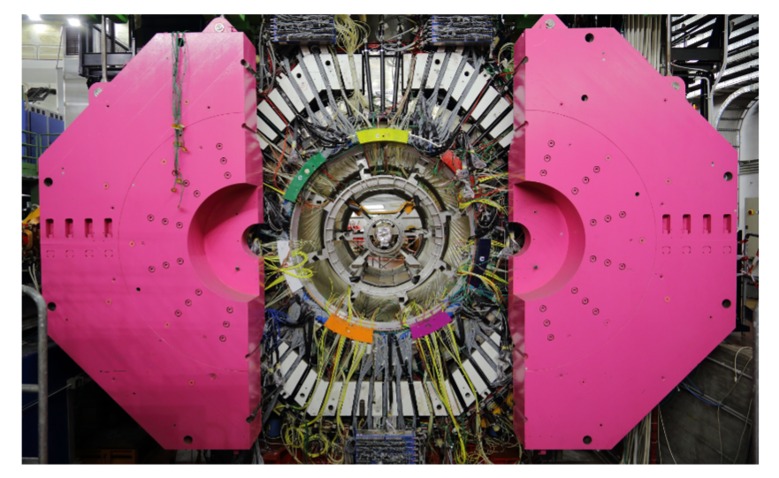
FLASH
the FINUDA magnet for Light Axion SearcH
  1.1 T superconducting magnet. Succsessfully operated again after xxx years
  240 MHz tuning (~ 1μeV of axion mass range)
  Low frequency region that is still unexplored (resonant cavity up to 2.5 m³⁾

Slide 13
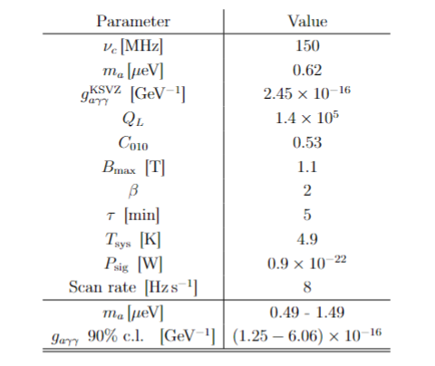
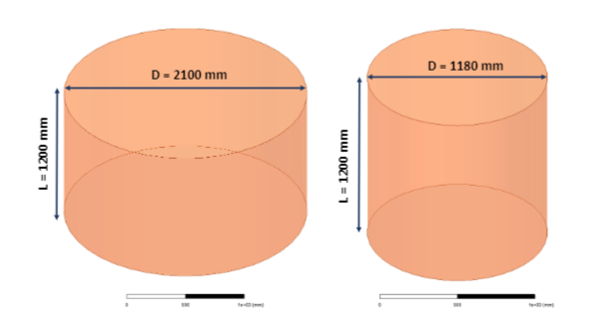
FLASH
D. Alesini et al, Physics of the Dark Universe,2023

Slide 14
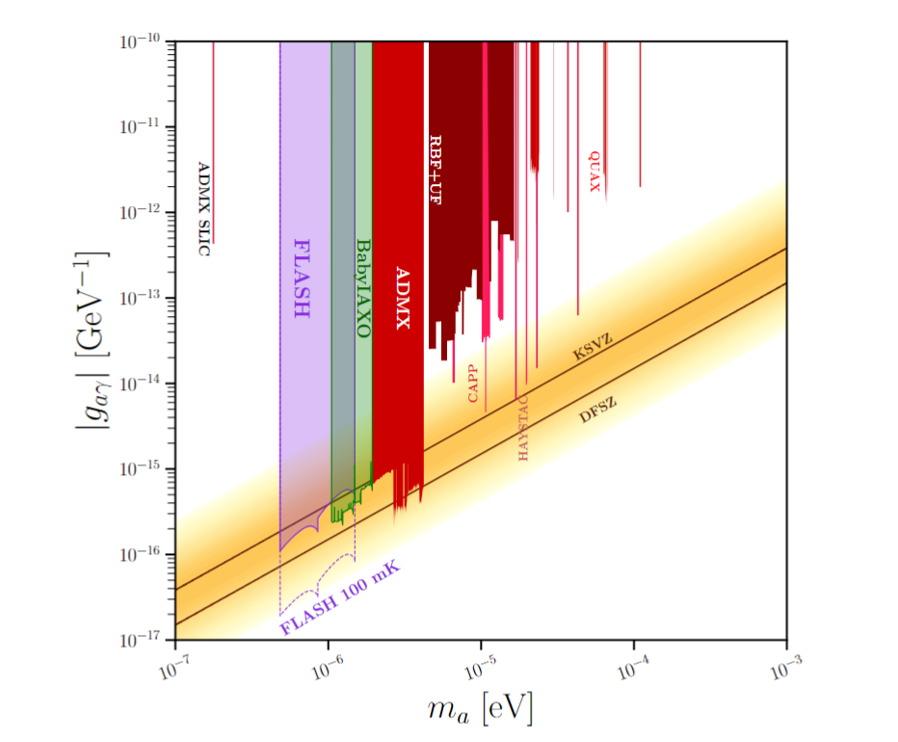
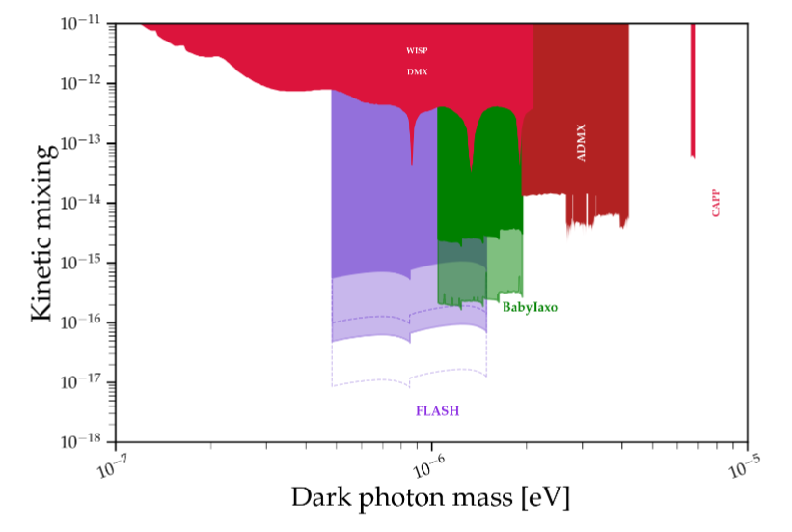
FLASH
And much more like:
Chamaleons
High frequency gravitational waves
D. Alesini et al, Physics of the Dark Universe,2023

Slide 15
Conclusions
Flash aims to use FINUDA magnets to operate a large haloscope
  ~ 1μeV of axion mass range
  1.1 T magnet. Cavity (diameter 2.1 m and 1.18 m, height 1.2 m)
Hunt for axion dark matter into an hardly accesible mass region
Potential for discovery of new physics (chamaleons, high frequency gravitational waves)
First QUAX@LNF run with complete haloscope
  2 weeks of data taking.
  9 T magnet. Operated at 8 T.
  Tuning rod to scan frequencies.
  ~ 25 neV of axion mass scan
Still much room for improvements.
QUAX competitive in the panorama.

Slide 16
Thank you for your attention!

Slide 17
backup

Slide 18
Figures of merit in a haloscope
The signal power is very faint
The scan rate depends critically on noise temperature

Slide 19
L1
L2
L3
L5

Slide 20
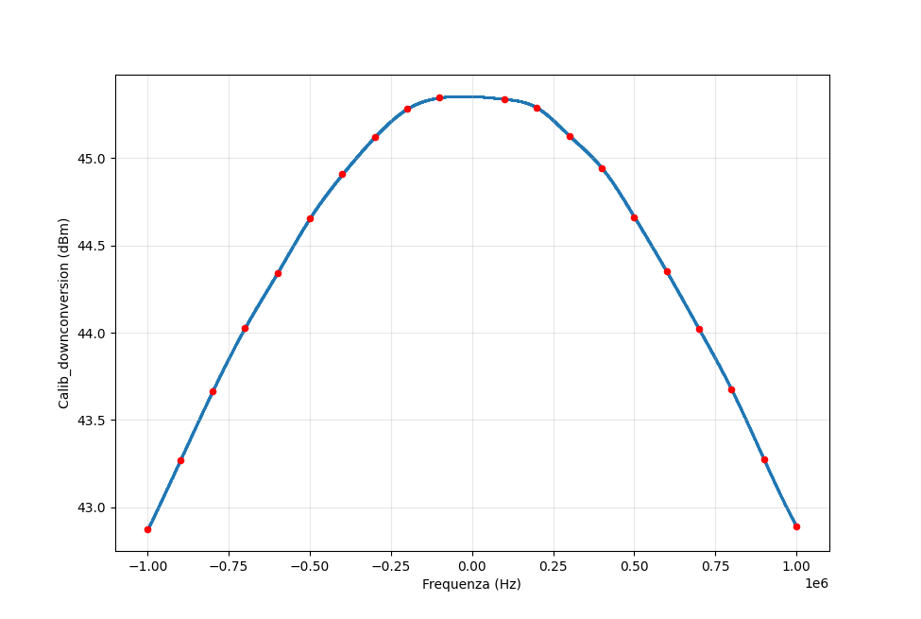
All calibrated scans
Calibration of downconversion hardware

