Slide 1

Search for Light-Feebly Interacting Particles with the PADME experiment
Paola Gianotti

Slide 2
Dark Matter hypotheses
Theorized WIMPs haven’t yet shown up.
Physicists are looking for signals in region previously unexplored.
The “new” approach rather than relying on a single experiment is trying to form a net of dedicated experiments.
arXiv:1707.04591v1 [hep-ph] 14 Jul 2017
Theories postulate DM could be lighter than previously thought. It could be made of other not yet discovered particles: Axions, ALPs, Dark Higgs, X17.

Slide 3
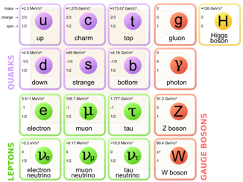
New Forces
Dark Sector
There are many attempts to look for new physics phenomena to explain Universe dark matter and dark energy.
One class of simple models just adds an additional U_{D}(1) symmetry to SM, with its corresponding vector boson (A’)
U(1)_{Y}+SU(2)_{Weak}+SU(3)_{Strong}[+U_{D}(1)]
The A’ could itself be the mediator between the visible and the dark sector mixing with the ordinary photon. The effective interaction between the fermions and the dark photon is parametrized in term of a factor ε representing the mixing strength.
Z’?
Dark fermions
χ
?
ψ
?
A’
?
h’?
Standard Model
The search for this new mediator A’ is the main goal of the PADME experiment at LNF.
Holstom, PLB 166 (1986) 196

Slide 4
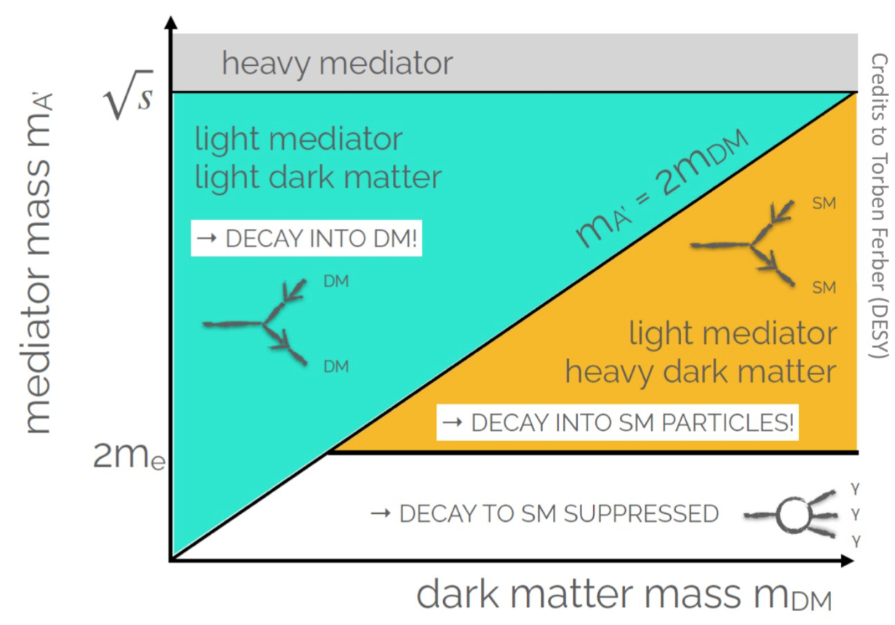
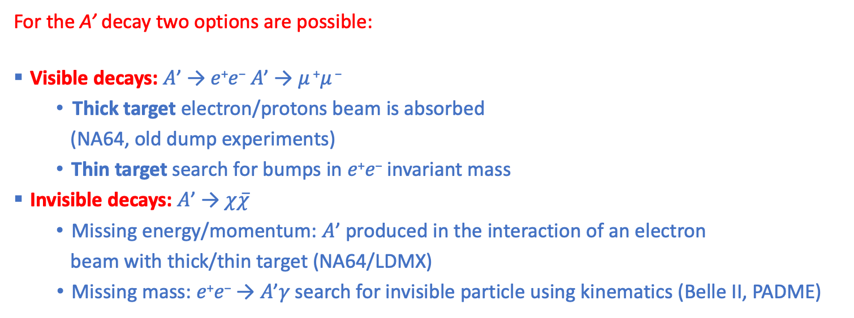
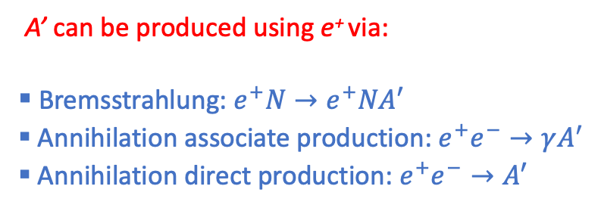
Experimental approaches
A’ can be produced using e⁺ via:
Bremsstrahlung:${ e}^{+}N→e^{+}NA′$
Annihilation associate production: $e^{+}e^{−}→γA^{′}$
Annihilation direct production: $e^{+}e^{−}→A′$
  For the A’ decay two options are possible:
Visible decays: 𝐴’ → 𝑒⁺𝑒⁻ 𝐴’ → 𝜇 ⁺𝜇 ⁻
    Thick target electron/protons beam is absorbed
      (NA64, old dump experiments)
    Thin target search for bumps in 𝑒⁺𝑒⁻ invariant mass
Invisible decays: 𝐴’ → $χ\overline{χ}$
  Missing energy/momentum: 𝐴’ produced in the interaction of an electron
    beam with thick/thin target (NA64/LDMX)
Missing mass: 𝑒⁺𝑒⁻ → 𝐴’𝛾 search for invisible particle using kinematics (Belle II, PADME)
Bremsstrahlung
Annihilation
Production

Slide 5
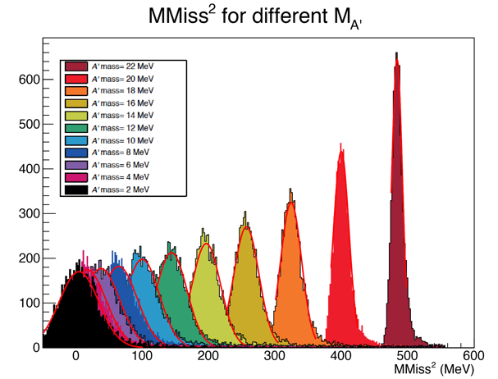
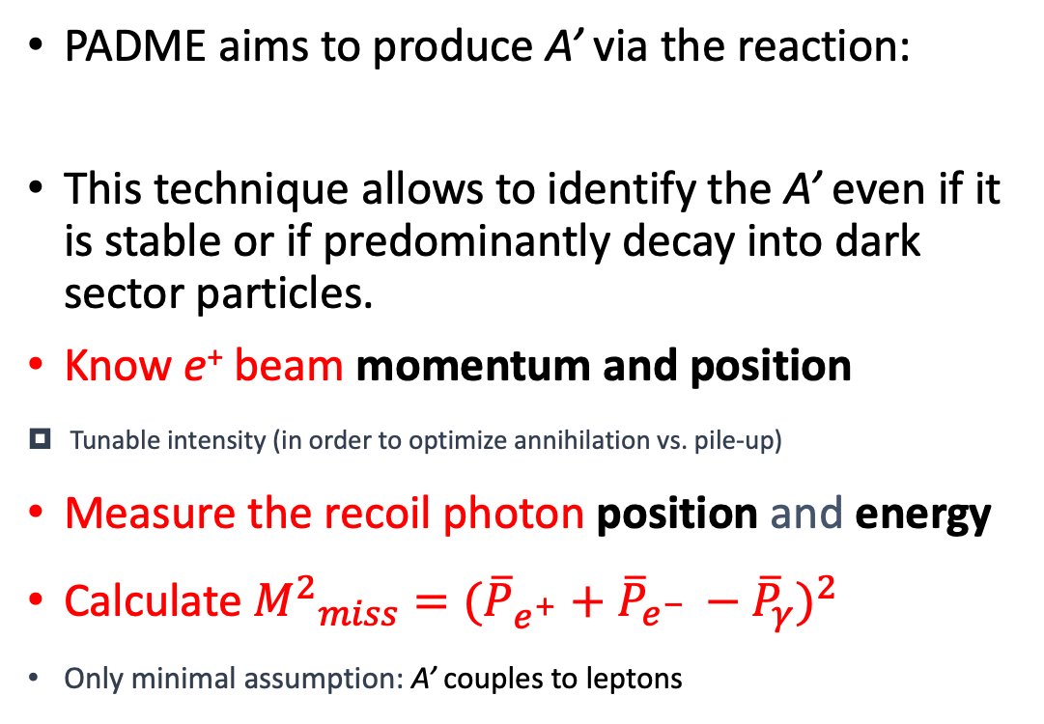

A’ production at PADME
γ
PADME aims to produce A’ via the reaction:
This technique allows to identify the A’ even if it is stable or if predominantly decay into dark sector particles.
Know e⁺ beam momentum and position
Tunable intensity (in order to optimize annihilation vs. pile-up)
Measure the recoil photon position and energy
Calculate ${M^{2}}_{miss}=({\overline{P}}_{e^{+}}+$ ${\overline{P}}_{e^{− }}−{\overline{P}}_{γ})^{2}$
Only minimal assumption: A’ couples to leptons
one photon + nothing
$$e^{+}e^{−}→A^{′}γ$$
e⁺e⁻ → γ (E_{miss})

Slide 6
Expected results
The possibilities of the PADME experiment are tightly linked with the characteristics of the positron beam.
The picture is showing the PADME expected sensitivity as a function of the beam characteristics. PADME started taking data in Oct. 2018 with a bunch length of ~ 250 ns.
2.5x10¹⁰ fully GEANT4 simulated 550 MeV e⁺ on target events.
Number of BG events is extrapolated to 1x10¹³ positrons on target.
2 years of data taking at 60% efficiency with bunch length of 200 ns
4x10¹³ POT = 20000 e⁺/bunch x2 x3.1x10⁷s x 0.6x49 Hz

Slide 7
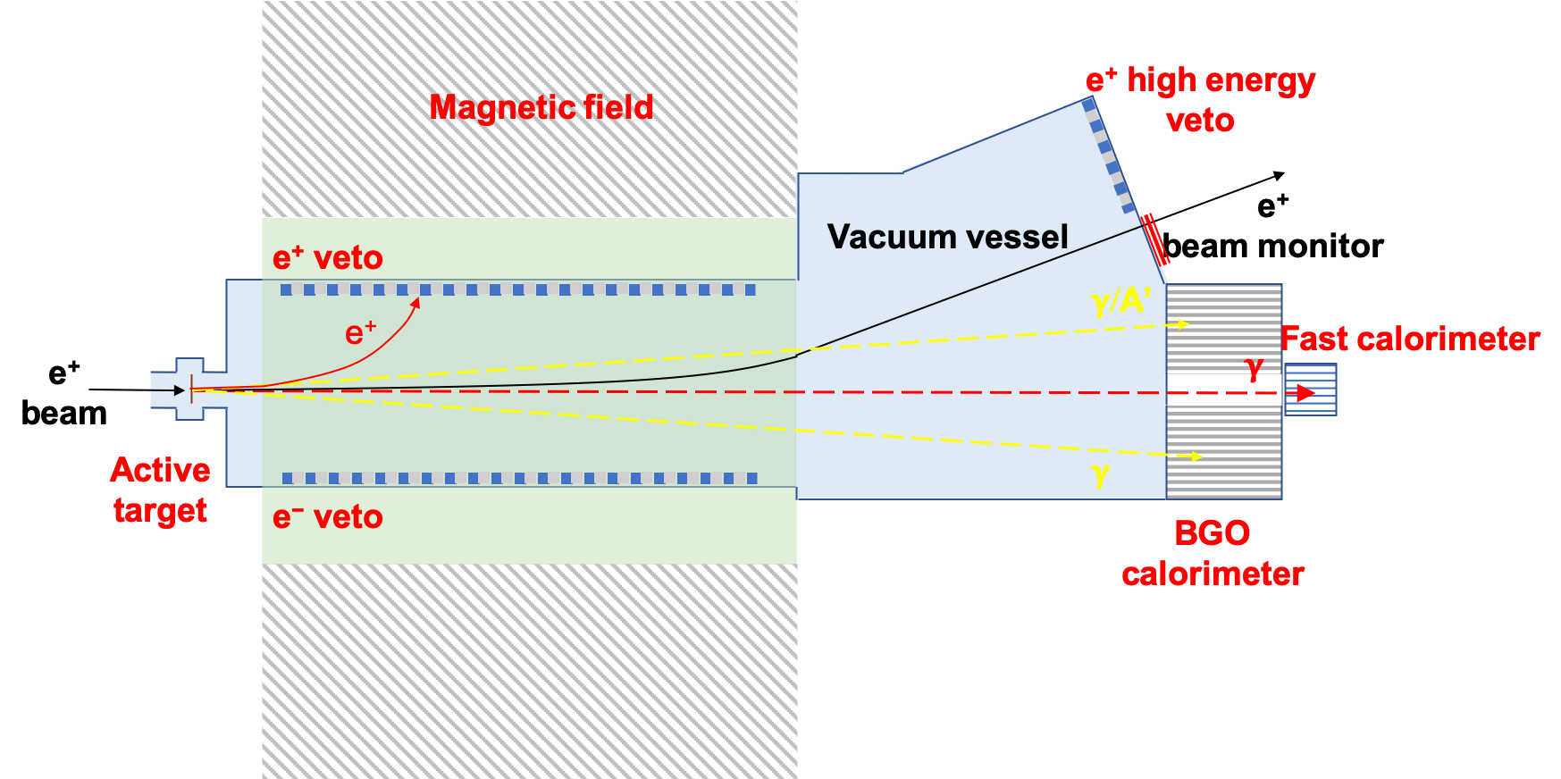
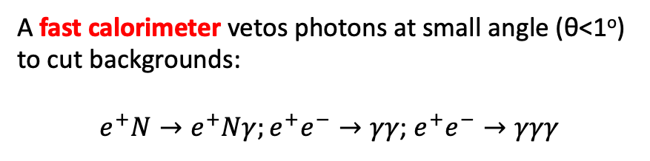
Signal and Background
PADME signal events consist of single photons measured with high precision and efficiency by a forward BGO calorimeter.
Since the active target is extremely thin (~100 μm), the majority of the positrons do not interact.
A magnetic field is mandatory to precisely measure their momentum before deflecting them on a beam dump.
The main source of background for the A’ search is Bremsstrahlung events. This is why the BGO calorimeter has been designed with a central hole.
A fast calorimeter vetos photons at small angle (θ<1º) to cut backgrounds:
$e^{+}N→e^{+}Nγ;e^{+}e^{−}→γγ$; $e^{+}e^{−}→γγγ$
In order to furtherly reduce background, the inner sides of the magnetic field are instrumented with veto detectors for positrons/electrons.
For higher energy positron another veto is placed at the end of the vacuum chamber.

Slide 8
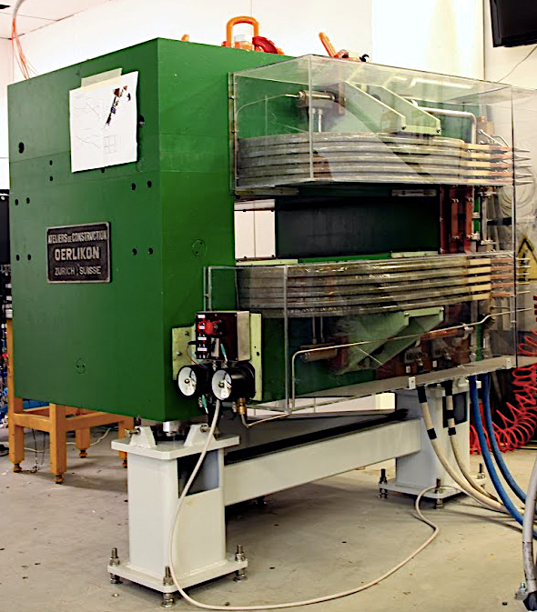
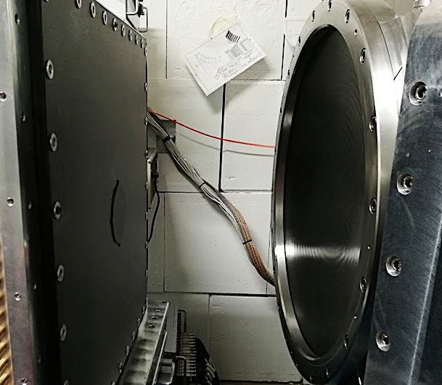
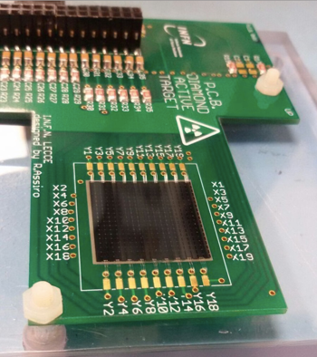
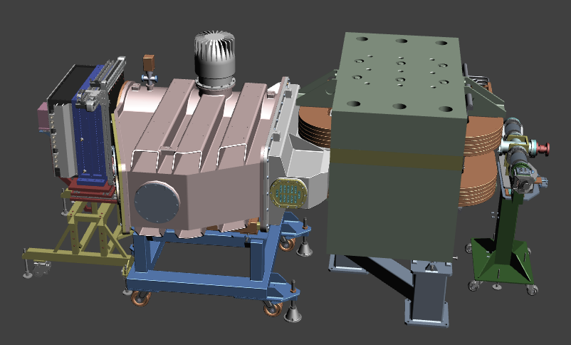
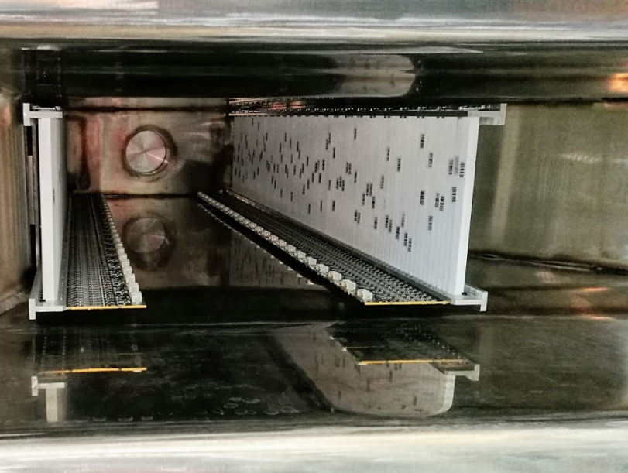
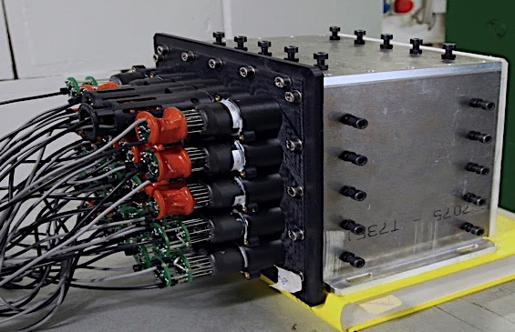
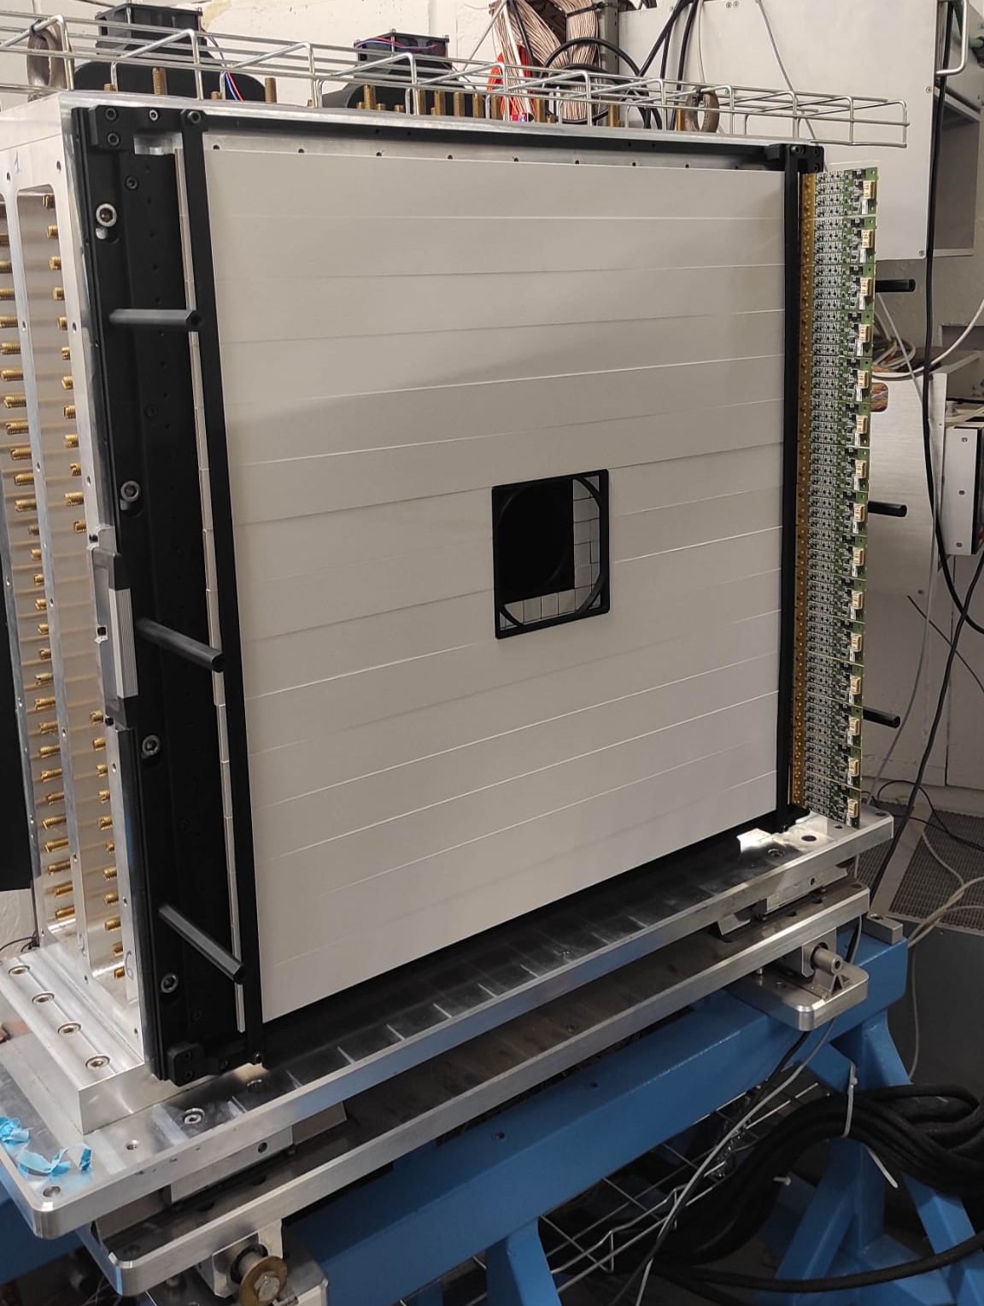
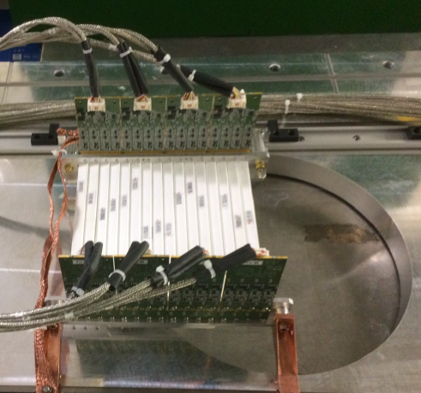
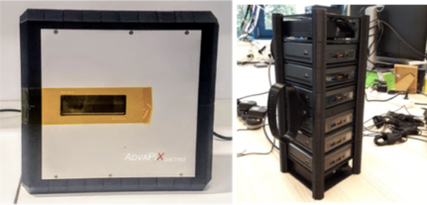
The PADME detector
C-fiber window
Active target
(Lecce & University Salento)
BGO calorimeter
(Roma, Cornell U., LNF, LE)
Dipole magnet
(CERN TE/NSC-MNC)
Veto scintillators
(University of Sofia, Roma)
PbF₂ calorimeter
(MTA Atomki, Cornell U., LNF)
Plastic scintillator eTagger
(Roma, LNF)
1m
TimePIX3 array
(ADVACAM, LNF)

Slide 9
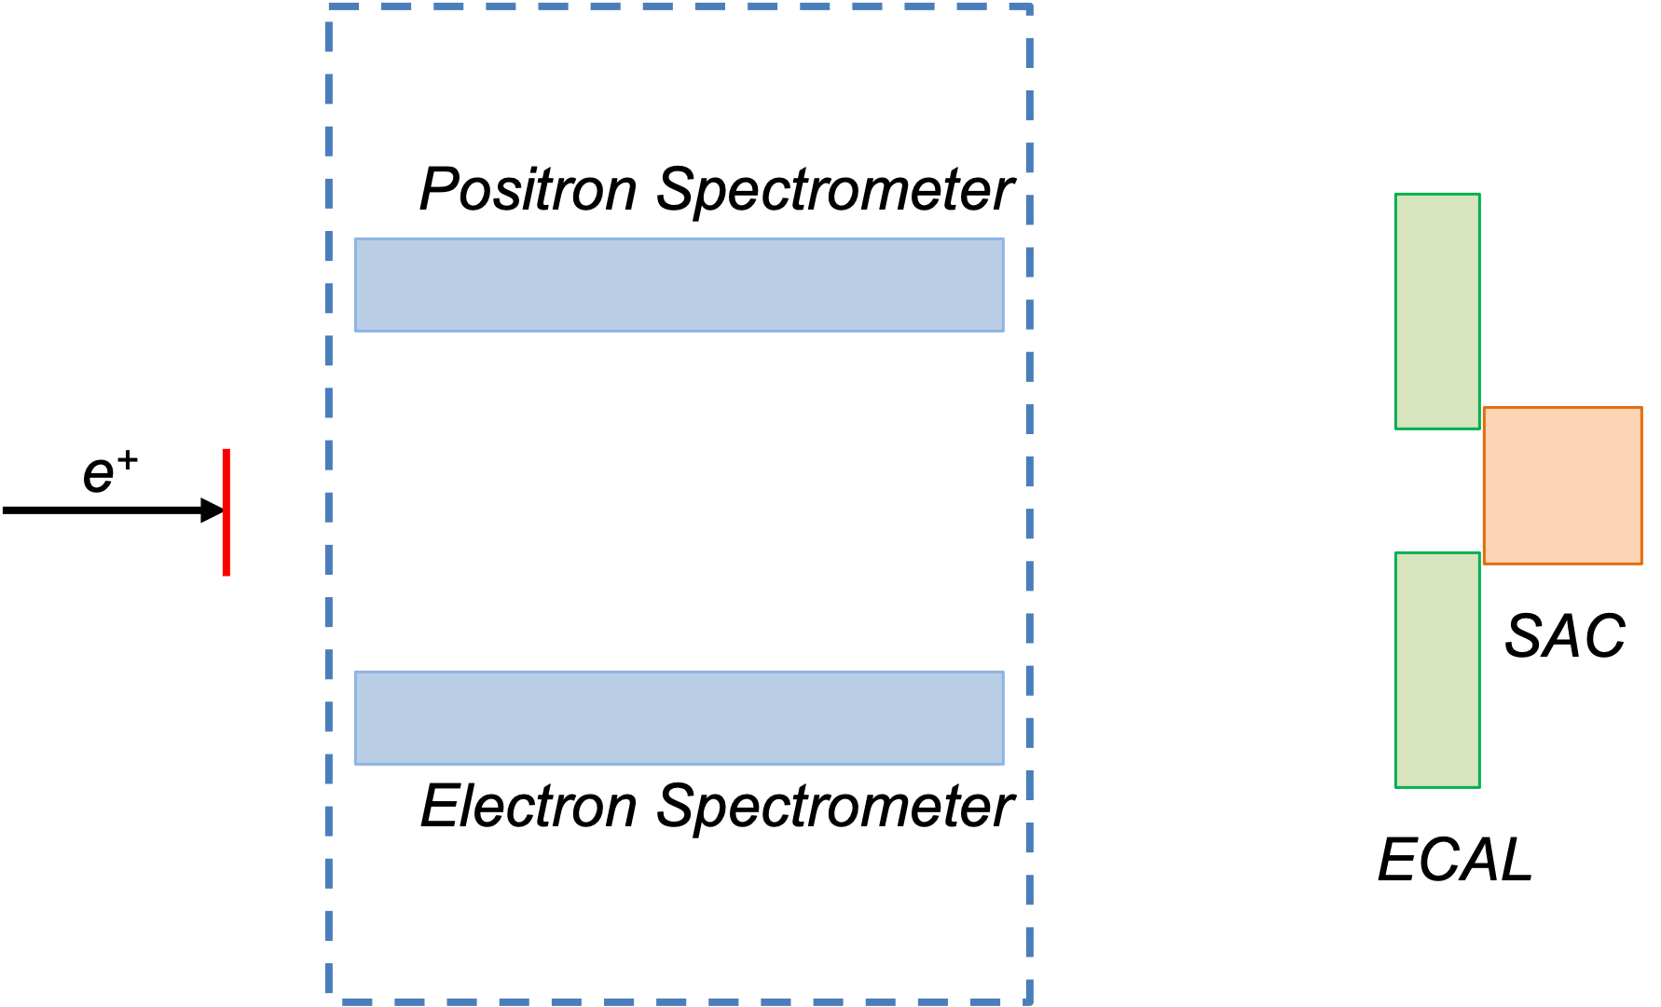
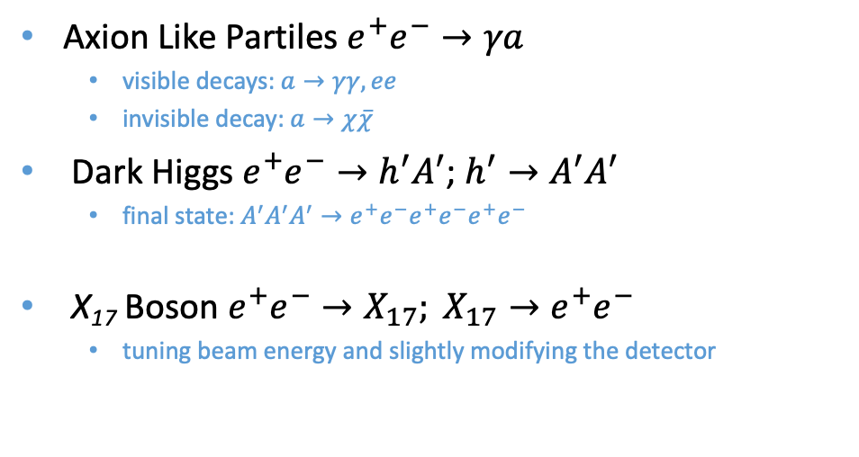
Dark Sector Studies at PADME
The PADME approach can explore the existence of any new particle produced in e⁺e⁻ annihilations:
γ
Axion Like Partiles $e^{+}e^{−}→γa$
  visible decays: $a→γγ,ee$
  invisible decay: $a→χ\overline{χ}$
Dark Higgs $e^{+}e^{−}→h^{′}A^{′}$; $h^{′}→A^{′}A^{′}$
  final state: $A^{′}A^{′}A^{′}→e^{+}e^{−}e^{+}e^{−}e^{+}e^{−}$
X₁₇ Boson $e^{+}e^{−}→X_{17}; X_{17}→e^{+}e^{−}$
  tuning beam energy and slightly modifying the detector
a
3e⁺
3e⁻
eTAG
e⁺
e⁻

Slide 10
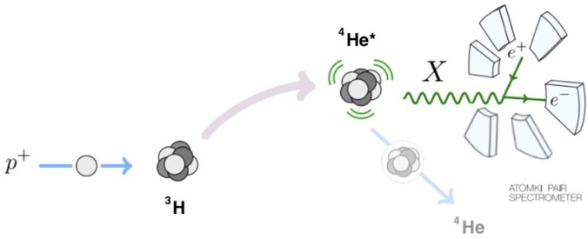
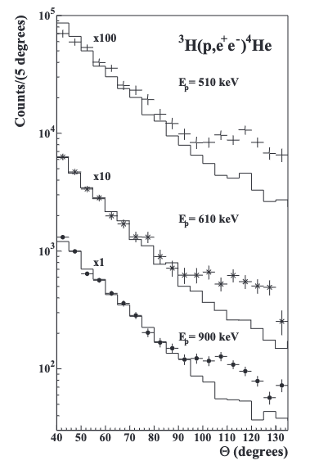
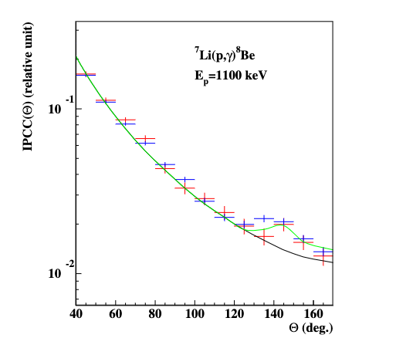

The ⁸Be anomaly
Studying de-excitation of light nuclei via IPC, an anomaly appeared in the decay of ⁸Be, ⁴He and ¹²C.
¹²C*
¹¹B
¹²C
Is this a signal of a FIP?
$$m_{X}=17.01±0.16(stat)±0.21\left(sys\right)MeV$$
$$m_{X}=16.94±0.12(stat)±0.21\left(sys\right)MeV$$
$$m_{X}=17.3±0.11(stat)±0.20\left(sys\right)MeV$$
Phys. Rev. Lett. 116, 042501 (2016) JPC 1056 no. 1, 012028 (2018)
Phys. Rev. C 104, 044003 (2021)
Phys. Rev. C 106, L061601 (2022)

Slide 11
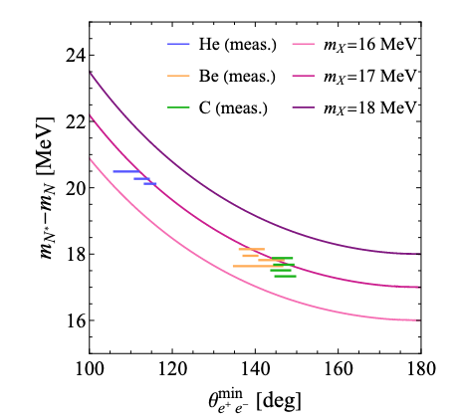
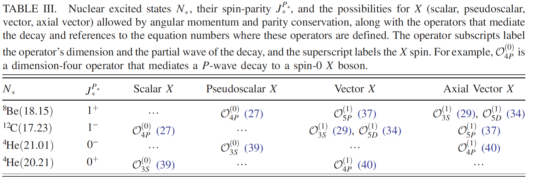
Theoretical interpretation
All the three anomalies ≳ 7σ, hard to claim statistical fluctuations
The introduction of a new particle improves the fits to the data
SM explanations strongly disfavoured ⁸Be [PLB 773 (2017) 159-175] ⁴He [PRD (2021) 2104.04808]
⁸Be - ⁴He - ¹²C anomalies are kinematically & dynamically consistent for V (and AV) [PRD 102 (2020) 036016]
For ¹²C the effect was predicted, and then confirmed by experimental data [PRD 2006.01151 [hep-ph]]
X17 couples differently to up and down quarks. Coupling to electron neutrino is also allowed in the framework of NSI
Phys.Rev.D 102 (2020) 036016
Phys. Rev. D 108, 015009 (2023)
Notes:
NSI Non-Standard neutrino Interactions

Slide 12
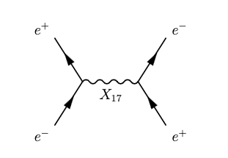
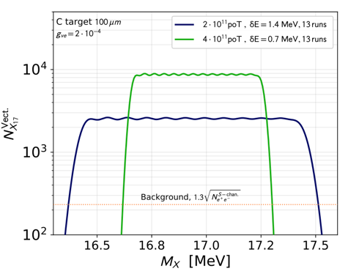

X17 study @ PADME
X17 can be resonantly produced with positron beams [Phys.Rev. D97 (2018) no.9, 095004]
Using constraints from Atomki measurements two spin-parity assumptions have been considered: vector and axial-vector
𝐵𝑟 (𝑒⁺𝑒⁻ → X₁₇) ≃ 5 × 10⁻⁶ ;
Γ_{V} ≃ 0.5 (g_{ve}/0.001)² eV < 10⁻² eV for the vector case
[Darmé et al. Phys. Rev. D 106 (2022) 115036]
The data taking strategy consists in counting 𝑒⁺ 𝑒⁻ events varying beam energy in small steps in the range E ∈ [265; 297] MeV.
The sensitivity of the scan depends on the energy step ΔE used in the scan.
Darmé et al. Phys. Rev. D 106 (2022) 115036
Notes:
E ∈ [265; 297] MeV, corresponds to a scan in the c.m. energy range sqrt(s) ∈[16.46; 17.42] MeV, 2σ around the X17 mass hint as measured in 4He (blue line)
(green line) scan in the interval E ∈ [273; 291] MeV, corresponding to sqrt(s)∈ [16.72; 17.25] MeV, 2σ around the X17 mass hint obtained using a combination of the 4He and 8Be
ΔE =0.7 MeV

Slide 13
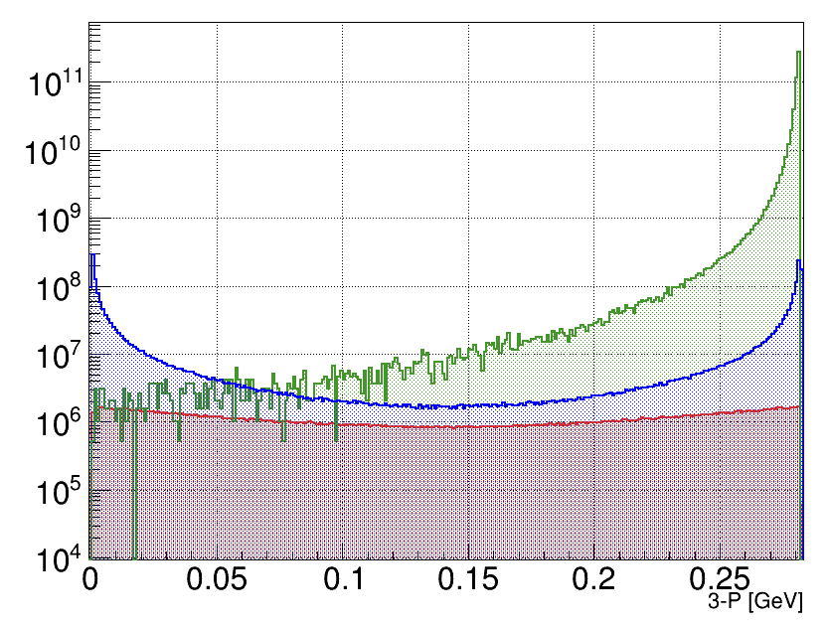
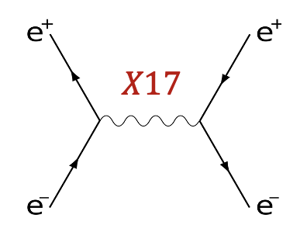
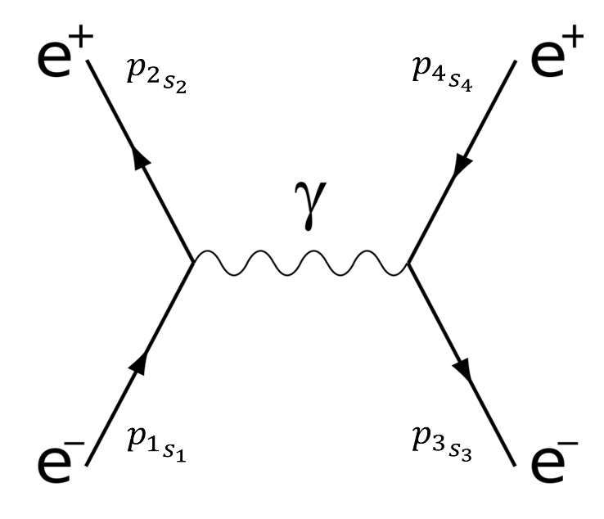
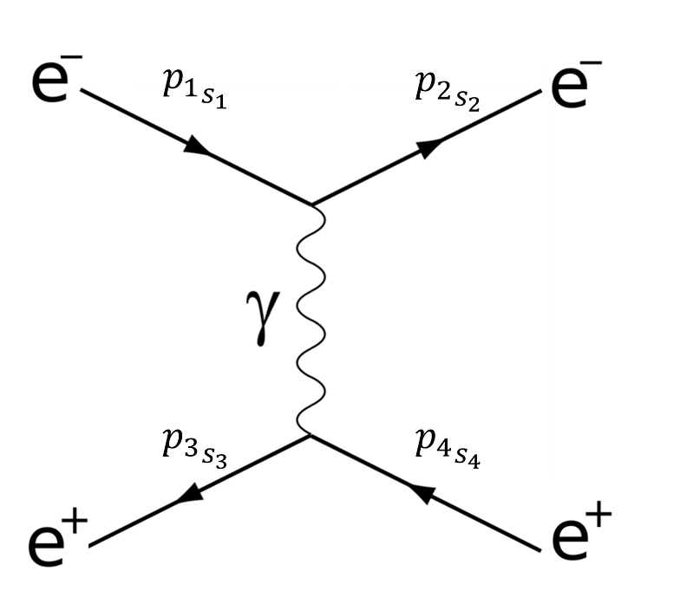
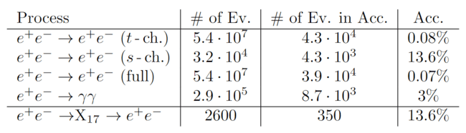
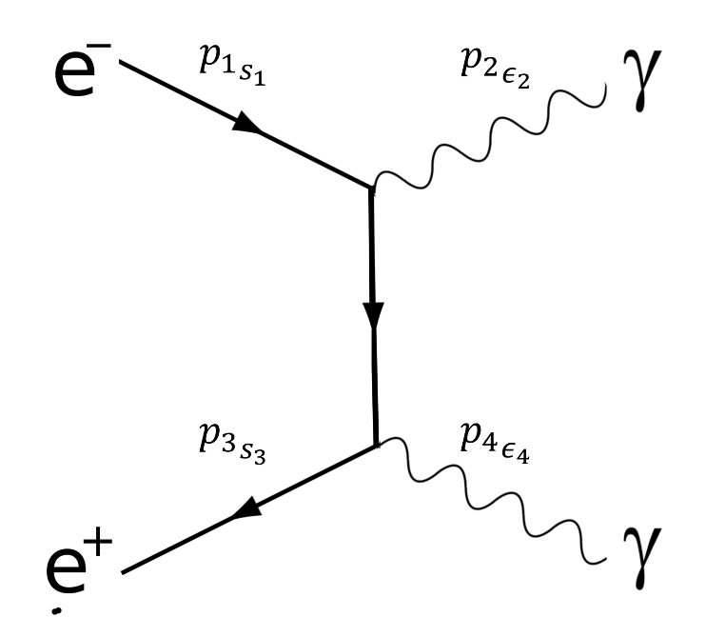

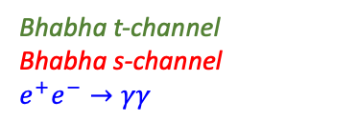
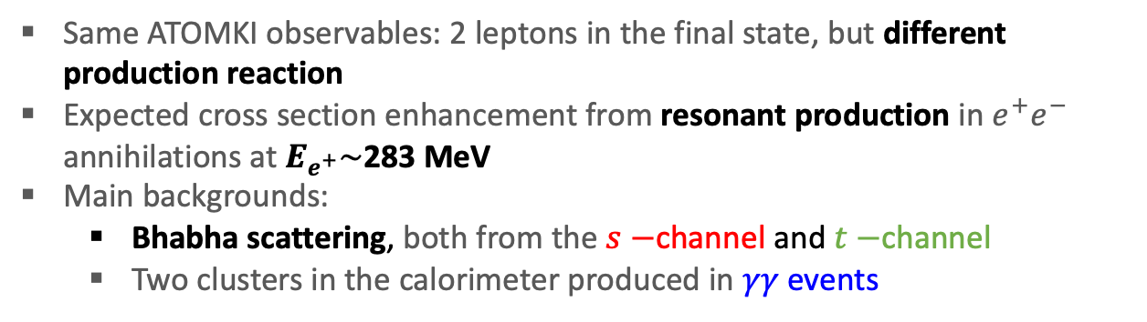
X17 Background
Same ATOMKI observables: 2 leptons in the final state, but different production reaction
Expected cross section enhancement from resonant production in $e^{+}e^{−}$ annihilations at $E_{e^{+}}\sim$283 MeV
Main backgrounds:
  Bhabha scattering, both from the$s−$channel and$t−$channel
  Two clusters in the calorimeter produced in $γγ$ events
Bhabha t-channel
Bhabha s-channel
$$e^{+}e^{−}→γγ$$
Signal
$$g_{ve}={2×10}^{−4} and δE=1.4 MeV$$
Background
Notes:
t channel scattering; s channel annihilation

Slide 14
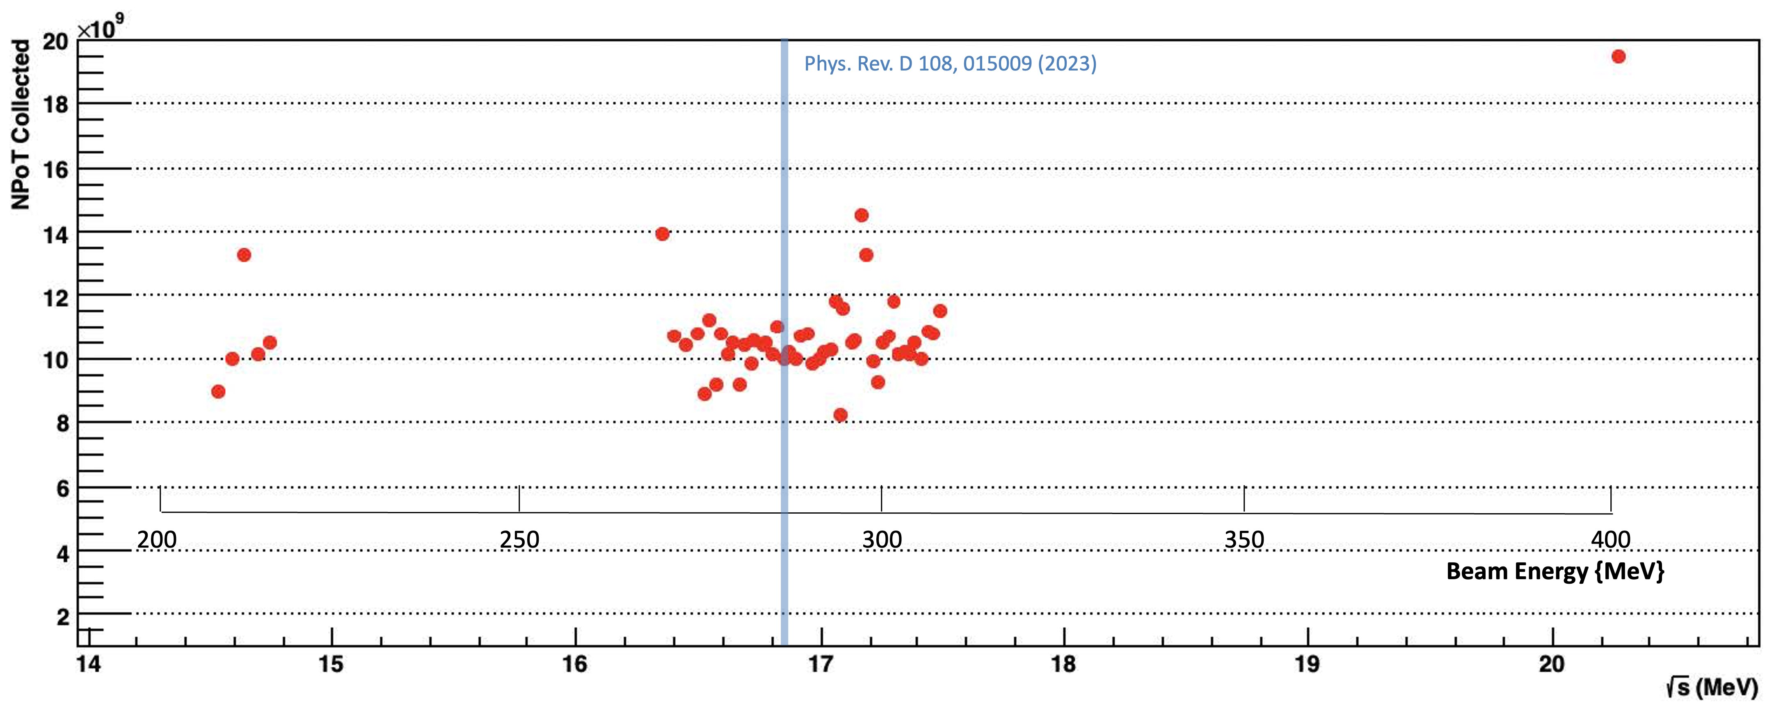
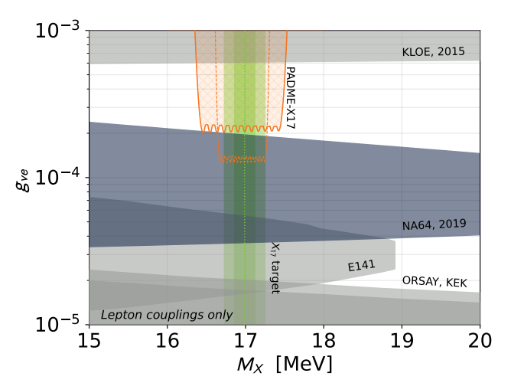
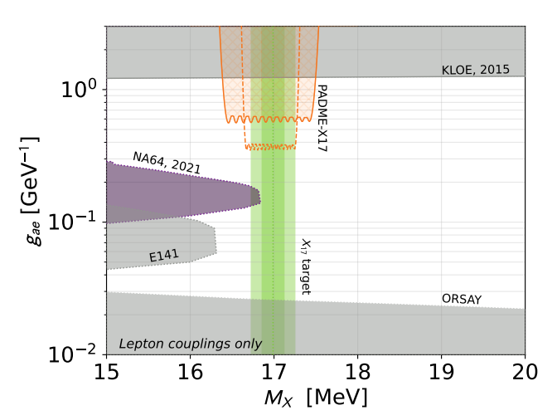


RUN III Expected results
NPOT vs Beam Energy and $\sqrt{s}$
Background from Bhabha scattering under control down to ε = few 10⁻⁴
Challenge: achieve a precise luminosity and systematic errors control (<1%)
Collected 10¹⁰ POT per each point of the scan
PADME maximum sensitivity in the vector case
The PADME precision on M_{X17} measurement:
ΔM_{X17} =(17.47-16.36)/47 ~ 20 KeV
M_{X}$±2σ$
Dots energy values explored by PADME
Blue Combined Be, He, C Atomki mass ranges
Cyan mass range fit results in PRD 108, 015009 (2023)
vector
psedoscalar
Signal
should emerge on top of
Bhabha BG in one or
more points of the scan.

Slide 15
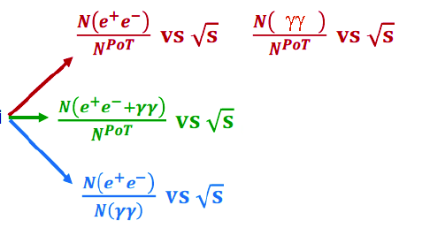
Analysis Strategy
Several observables can be used for the analysis:
N(2cl)/N_{PoT} = existence of X₁₇
  High statistical significance
  No eTag systematic errors
N(2e)/N(2γ) = existence of X₁₇
  eTag efficiency and systematics
  lower statistical significance due to 2γ cross section
  Independ from N_{PoT} , error dominated by tagging efficiency
N_{e+e-}/N_{PoT} = vector nature of X₁₇
  Systematic errors due to eTag, tagging efficiency stability
N_{γγ}/N_{PoT} = pseudo-scalar nature of X₁₇
  Systematic errors due to ETag tagging efficiency stability
Observables :

Slide 16
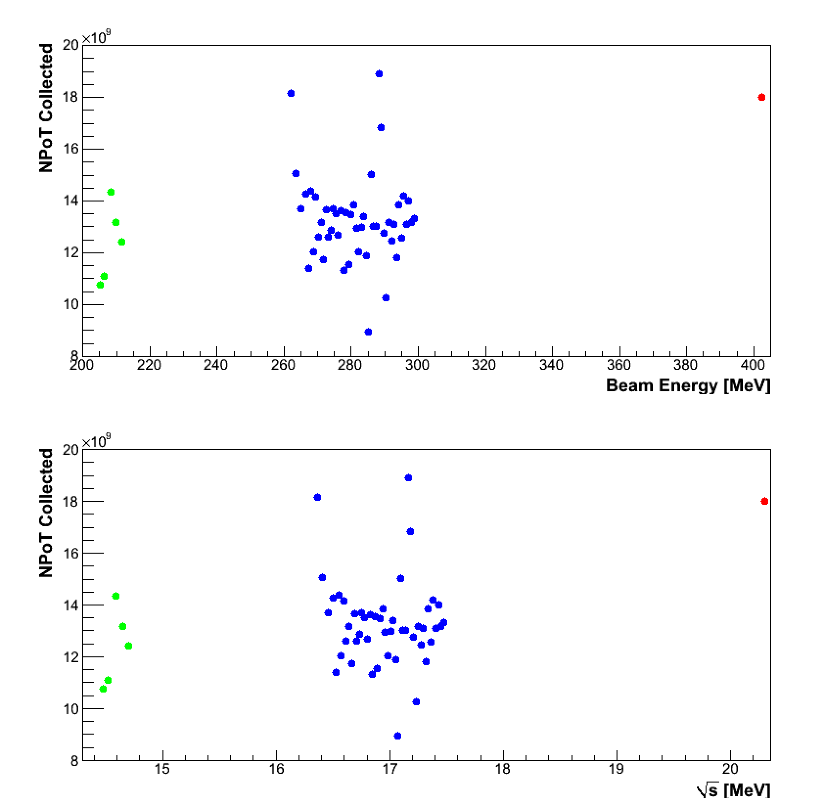
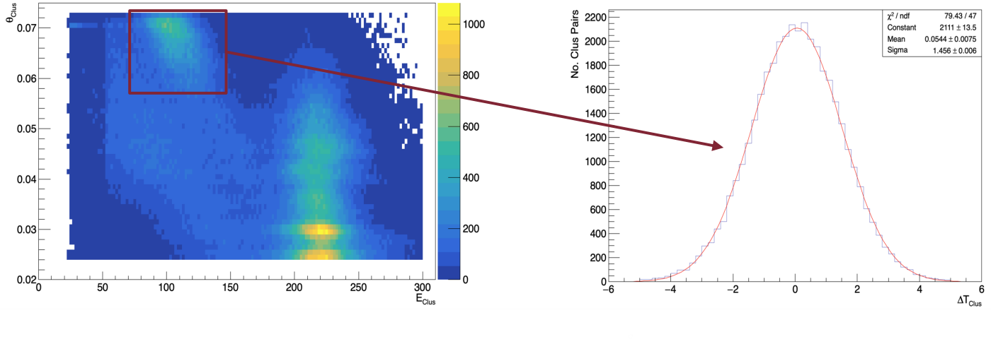
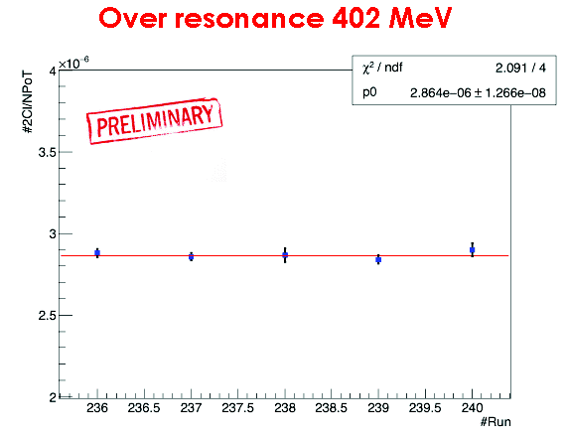
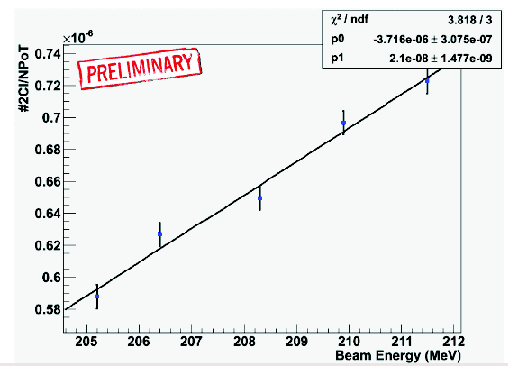

Blind Analysis Strategy
Using far side-bands we define calibrations and selection criteria
205-212MeV and 402 MeV
Using near side-bands we perform fine tuning on 2Cl evts.
Over resonance 402 MeV Below resonance 205 – 212 MeV
Θ_{clus} [mrad]
$$σ_{t}=1.4 ns$$
E_{clus} [MeV]
Δt_{clus} [ns]

Slide 17
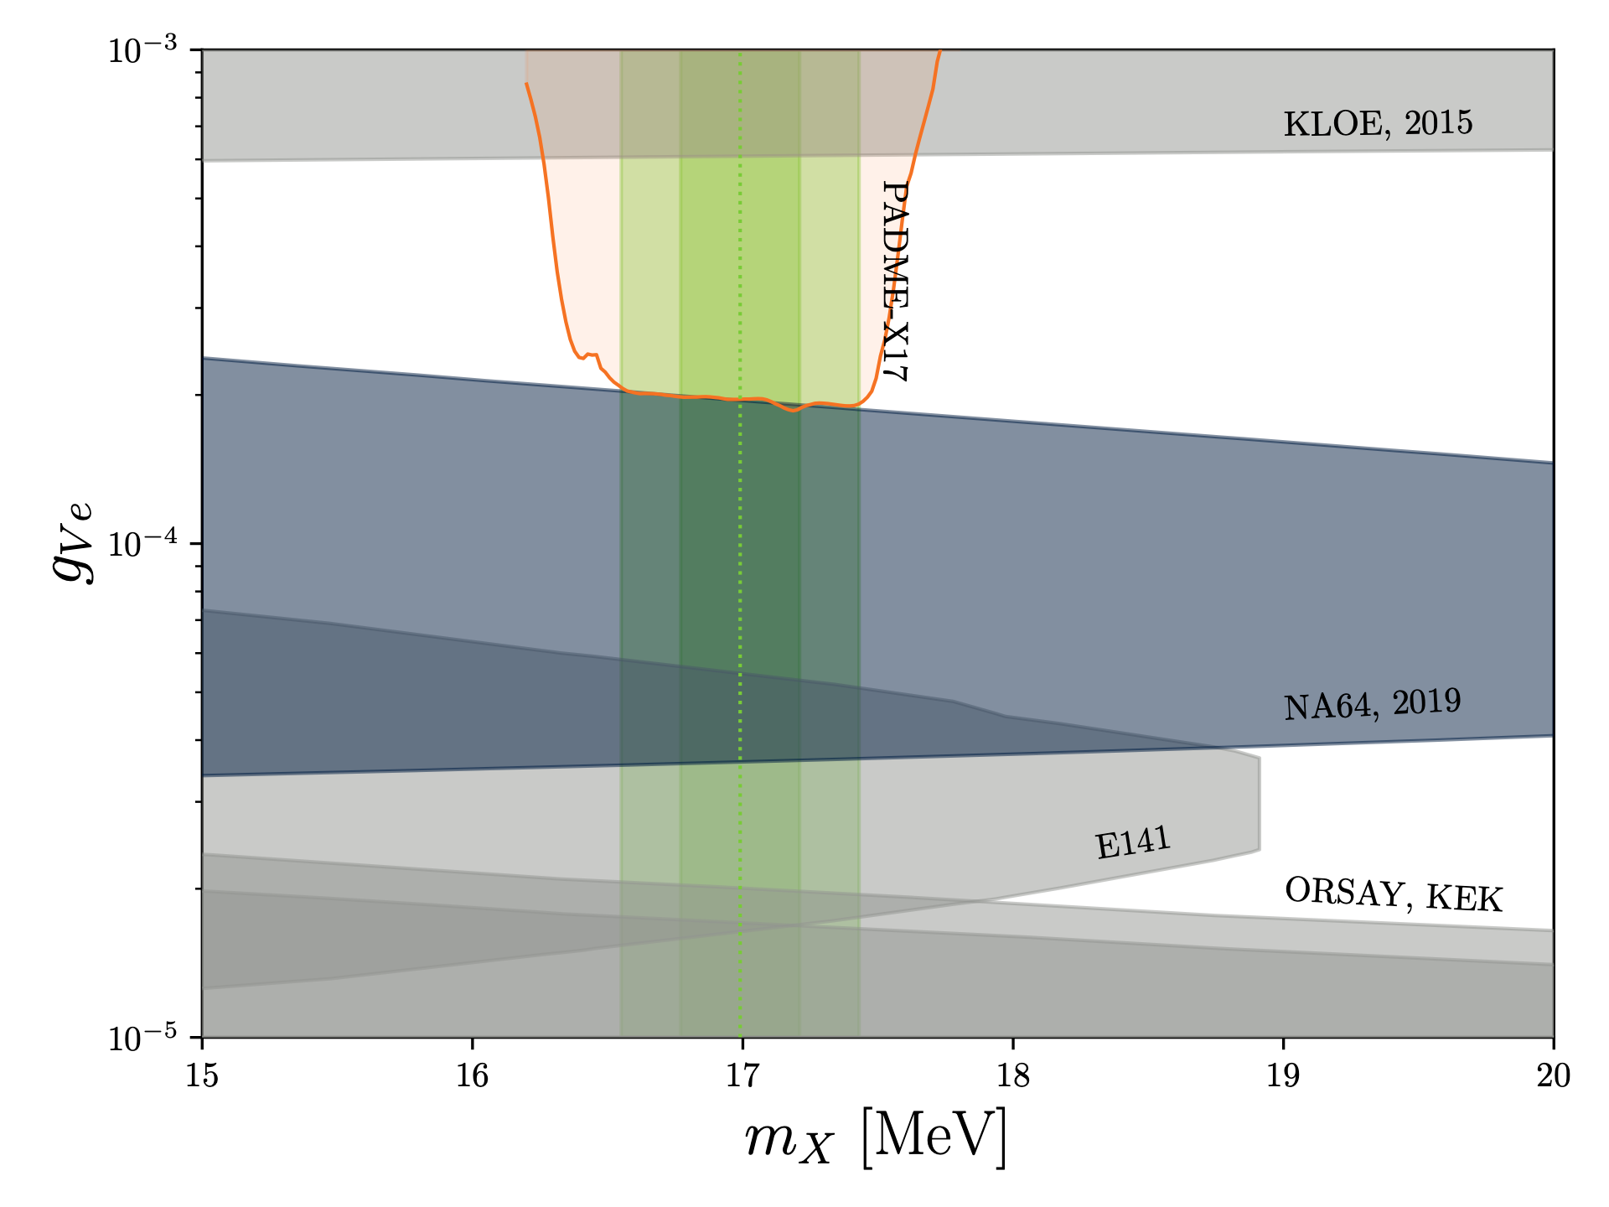
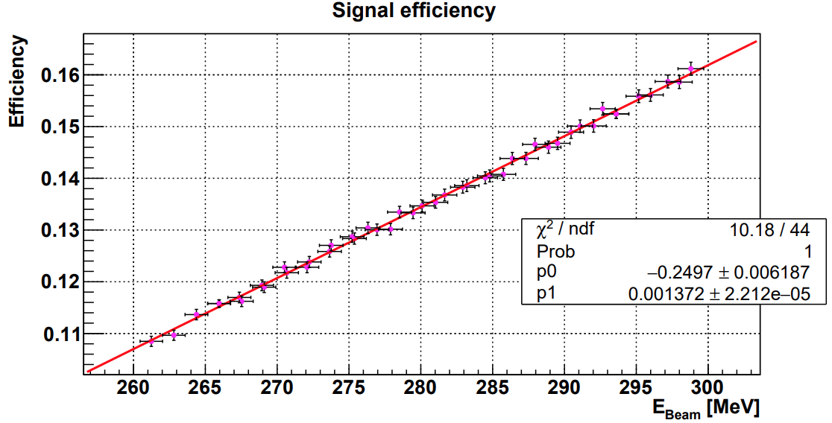
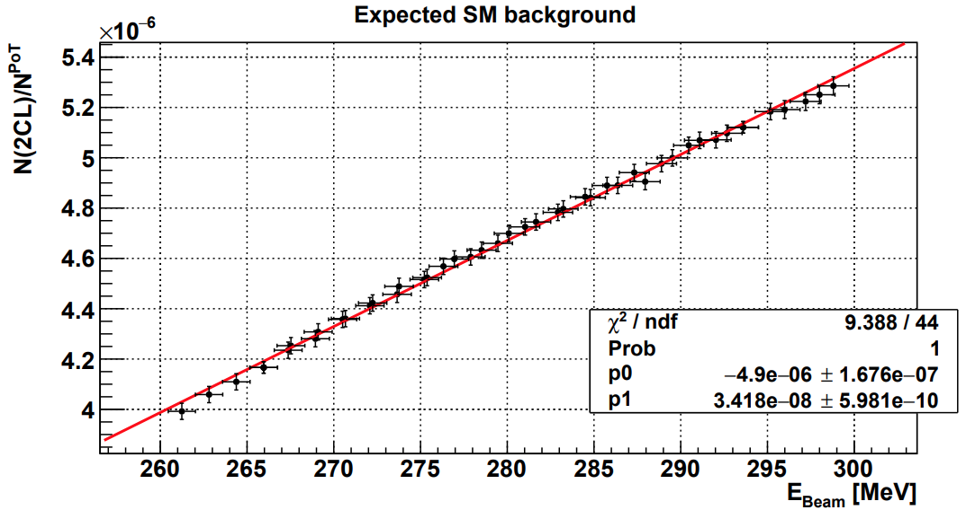
Updated sensitivity estimates
Considering the actual number of POT/energy point from Run III (real data)
Using measured beam energy spread σ_{E}/E=0.3% (real data)
Estimating of the total background and acceptance (MC)
Considering the electron motion in the diamond target (theory work)
σ_{E}/E = 0.3%
Courtesy G. Grilli da Cortona
The plot shows a certain loss in sensitivity due to the effect of electron motion in the target. This occurs because the signal is distributed over a broader number of energy bins.
Notes:
Actual σ_{E}/E=0.25% is influent since the dominant effect is that of electron energy spread

Slide 18
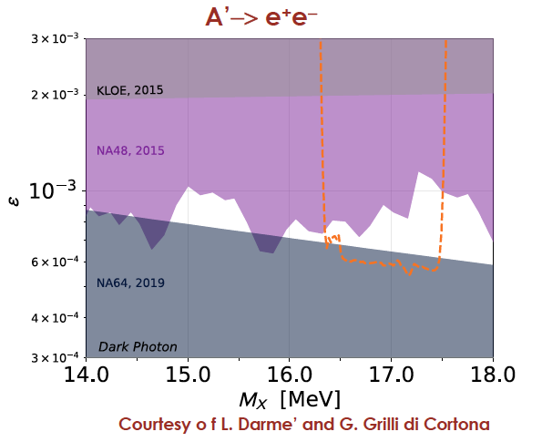
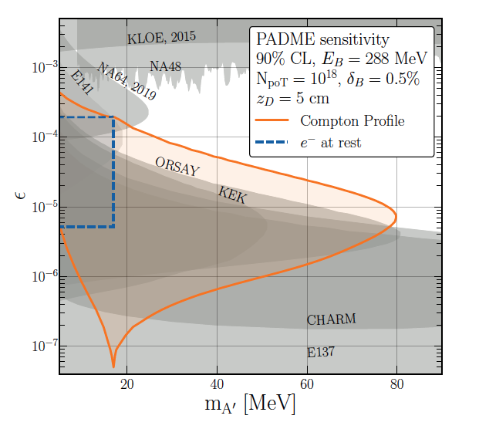
Dark photon prospects
The PADME exclusion limit will provide also the best constraint on general Dark Photon visible decays scenario in the 17 MeV region.
There are also prospects achievable with a positron beam with E = 288 MeV
impinging on a 5 cm-thick tungsten target, assuming a total of 10¹⁸ PoT, in the background-free limit.
Arias-Aragon et al. arXiv:2403.15387v1
Notes:
NA48/2 limit using π0->γe+e- points extracted from HEPData: https://www.hepdata.net/record/ins1357601
The orange region depicts the forecasted 90% C.L. sensitivity (corresponding to ∼ 2.7 signal events)

Slide 19


Conclusions
The PADME experiment searches for signals of dark matter in positron annihilations:
  PADME is the first experiment to study the reaction e⁺e⁻ → γ A’ with a model independent approach;
  Three data takings: analysis is ongoing;
  Many physics items can be explored:
    visible/invisible dark photons, ALPs search, Fifth force, dark Higgs, X17 boson
  Data taking will continue next year 2024.
is exploring the DARK SECTOR…

Slide 20
BACKUPS

Slide 21
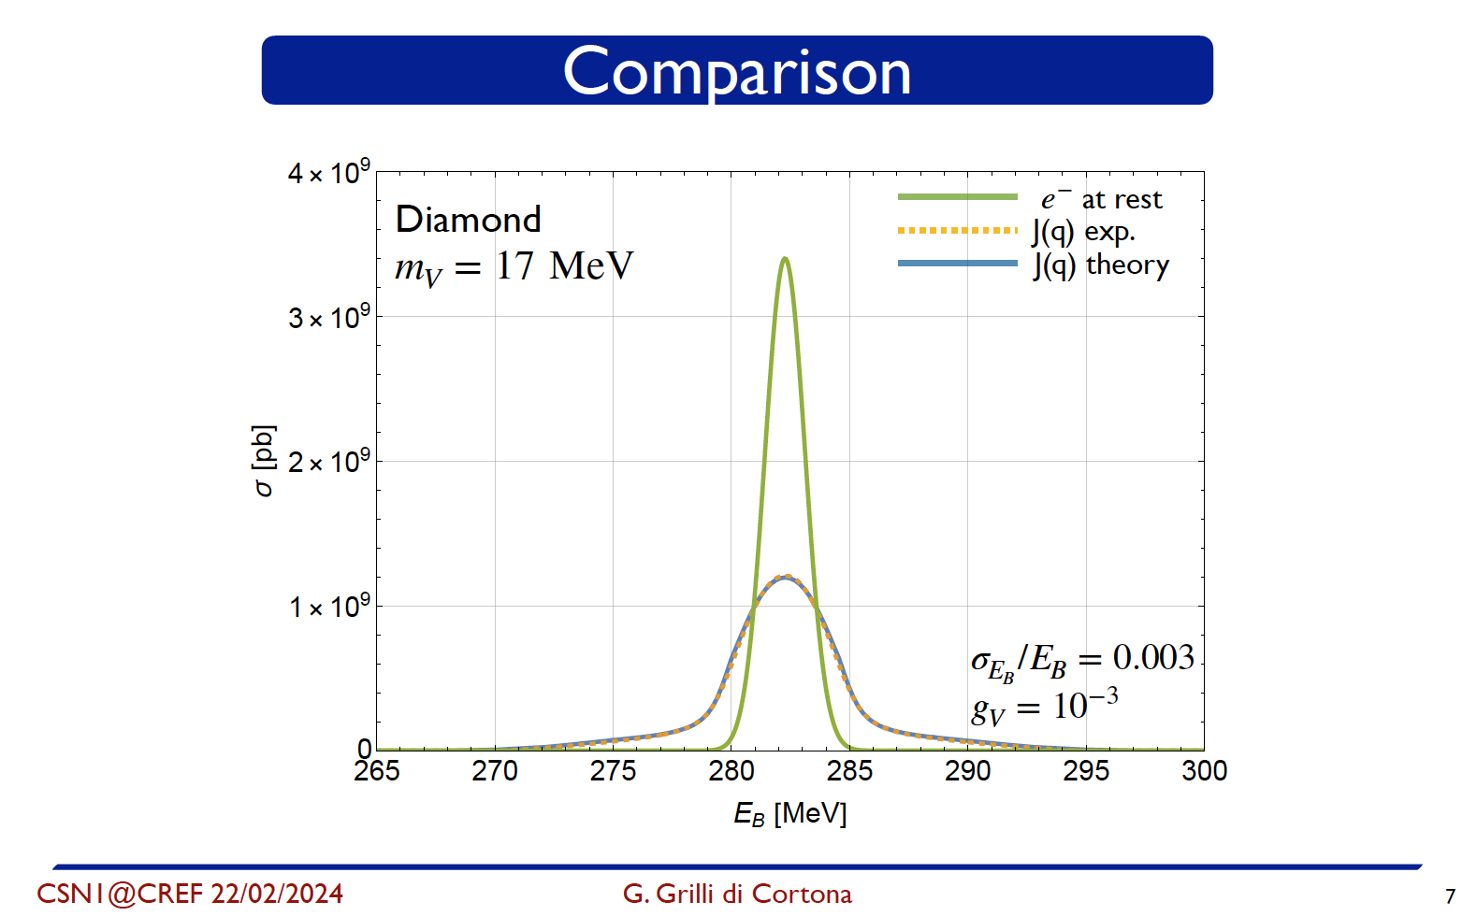
Notes:
Compton scattering data (dashed line)
Hartree-Fock analytical treatment (solid line)

Slide 22
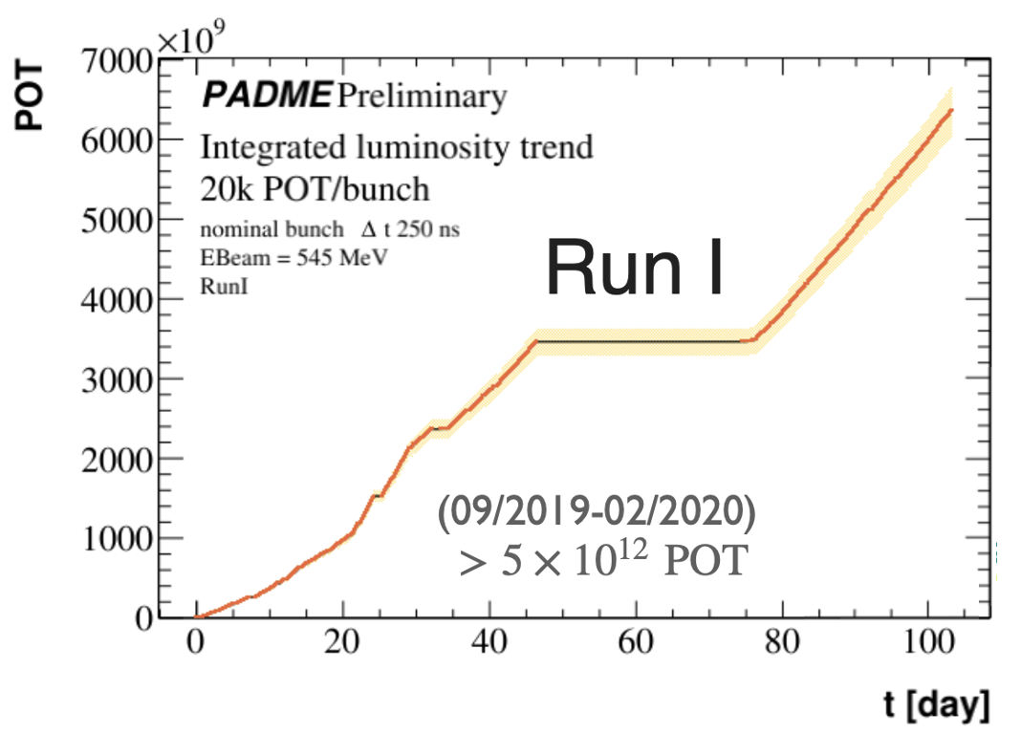
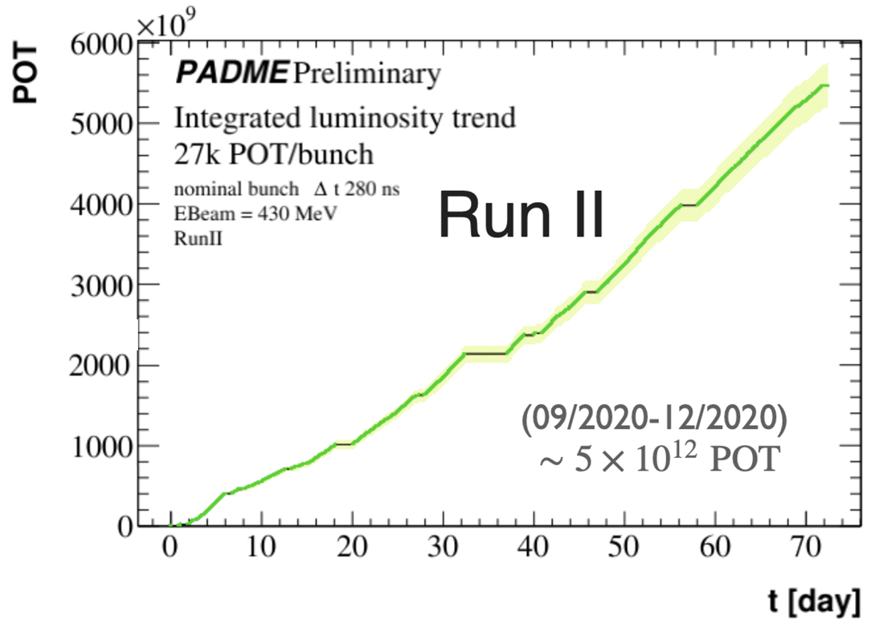



PADME Data Taking
RUN I 1.6×10⁷ PoT
RUN I 1.6×10¹⁰ PoT
RUN II 1.6×10¹⁰ PoT
$$e^{+}e^{−}→γγ$$
E [MeV]
Two physics runs in winter 2019 and winter 2020. Similar statistics, approximately 1/2 of minimal goal (10¹³ particles-on-target). Slightly lower beam momentum in Run II, 430 MeV/$c$, wrt to Run I, 490 MeV/$c$
Run Ia secondary beam; Run 1b primary beam->Reduced beam-induced background
Run II wrt Run I:
  Detailed MC simulation of beamline JHEP 09 (2022), 233
  Improved vacuum separation between experiment and beamline
  Less beam-induced background with primary wrt secondary beam
  Longer beam bunch to reduce pile-up
Bunch Length and Structure

Slide 23





e⁺e– → γγ cross section
Below 0.6 GeV known only with 20% accuracy.
Can be sensitive to sub-GeV new physics since available measurement $e^{+}e^{−}→non−charged particles$.
Used 10% of Run II sample.
Tag-and-probe method on two back-to- back clusters exploiting energy-angle correlation.
$$σ\left(e^{+}e^{−}→γγ\left(γ\right)\right)=1.977±0.018\left(stat\right)±0.119 mb$$
QED@NLO $σ\left(e^{+}e^{−}→γγ\left(γ\right)\right)=1.9478±0.0005\left(stat\right)±0.0020\left(syst\right) mb$
Phys.Lett.B 663 (2008) 209-213

Slide 24

LNF LINAC and beam-lines
 | electrons | positrons
Maximum beam energy (E_{beam})[MeV] | 800 MeV | 550 MeV
Linac energy spread [Dp/p] | 0.5% | 1%
Typical Charge [nC] | 2 nC | 0.85 nC
Bunch length [ns] | 1.5 - 40
Linac Repetition rate | 1-50 Hz | 1-50 Hz
Typical emittance [mm mrad] | 1 | ~1.5
Beam spot s [mm] | <1 mm
Beam divergence | 1-1.5 mrad
Accumulator
IP1
DAΦNE
IP2
BTF
LINAC
Able to provide electrons and positrons
  PADME Duty cycle approx 50*200 ns= 10⁻⁶ s
  The accessible M_{A’} region is limited by E_{beam}
    0-23.7 MeV can be explored with 550 MeV $e^{+}$ beam

Slide 25



X17 Measurement Strategy
PADME veto spectrometers cannot be used to constrain $e^{+}e^{−}$ vertices not coming from the production target.
Idea: identify $e^{+}e^{−}→e^{+}e^{−}$ using
  the BGO calorimeter, as for γγ events.
eTAG
e⁺
Timepix
e⁻
Lead
Glasss
With magnet off the $e^{+}e^{−}$ will reach ECal
    Precise measurement (3%) of electron-positron pair momentum and angles;
    Reconstruction of invariant mass of the pairs (small pile-up).
To identify clusters of photons or electrons in ECal
    New detector: Electron tagger (eTAG) plastic scintillator slabs with same ECal vertical size.

