Slide 1
Fifo 128w 24b
Christophe Flouzat
CEA Saclay - Irfu
Notes:
1

Slide 2
updated parameters
nb bits of words shall be 24 bits
depth = maximum fiting in a 160x750 box
clock push 500 MHz with 60% up, 40 % down
clock pop 200MHz (read every 8 cycles)
8x 3bit serialization : not included yet
2
Notes:
2

Slide 3
routing
note: rotated view for slideware
+--------------------+---------+---------+---------+
| Setup mode | all | reg2reg | default |
+--------------------+---------+---------+---------+
| WNS (ns):| 0.236 | 0.236 | 0.470 |
| TNS (ns):| 0.000 | 0.000 | 0.000 |
| Violating Paths:| 0 | 0 | 0 |
| All Paths:| 6216 | 3132 | 6200 |
+--------------------+---------+---------+---------+
# HOLD WNS TNS FEP
#----------------------------------------
View : ALL 0.107 0.000 0
Group : in2out N/A N/A 0
Group : reg2out N/A N/A 0
Group : in2reg 0.107 0.0 0
Group : reg2reg 0.108 0.0 0
3
Notes:
3

Slide 4
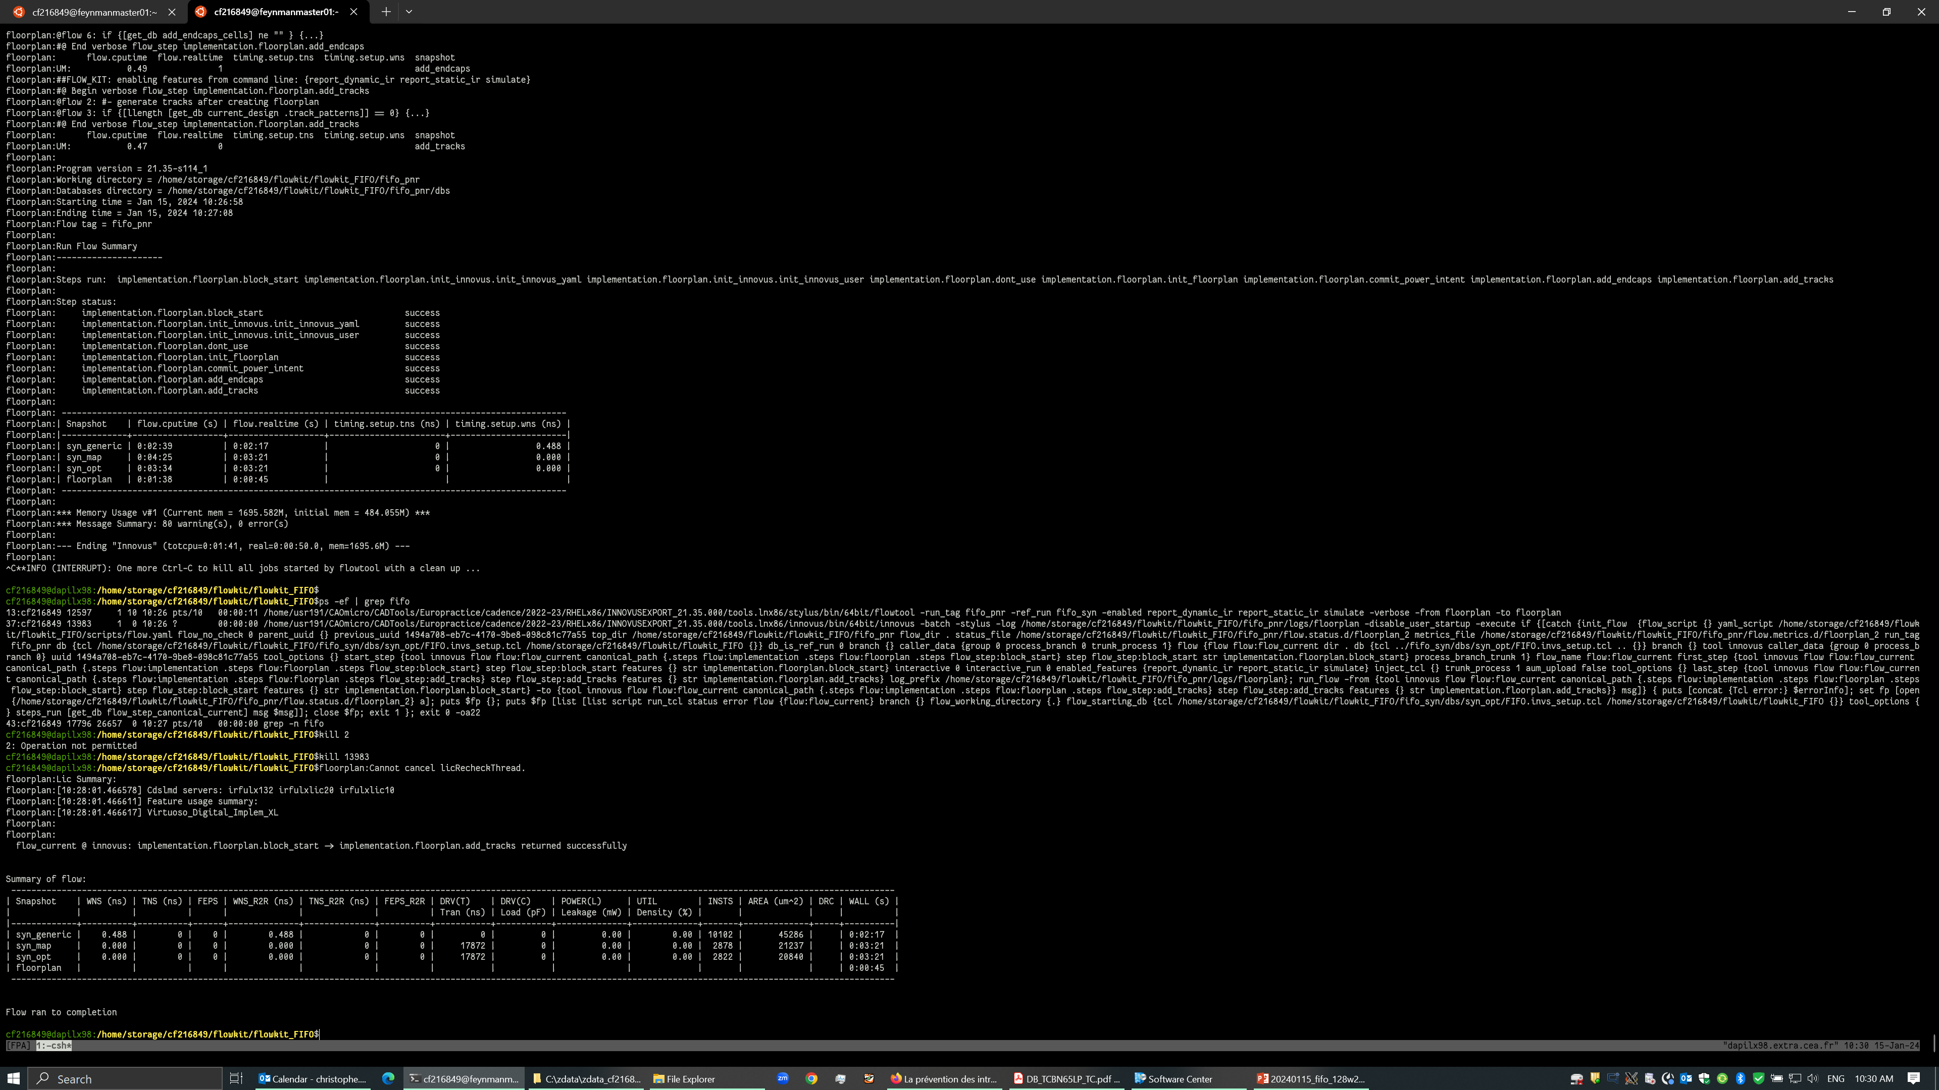
flowkit

