Slide 1
Calibration with AuxTel: measure atmospheric transmission
- Status of the extraction of atmospheric transmission with CALSPEC spectrophotometric standards (Jérémy)
Continuous function -> Effective passbands
Atmospheric parameters: grey absorption, aerosols, ozone, PWV
Atmosphere monitoring for 2 years: water seasonal effects
- Perspectives
- using other spectra than CALSPEC standards (Corentin)
- AuxTel photometry (Sylvie)
- Best precision on the brightest stars: actual limitations
- Can we use this photometry to test atmospheric color-corrections?
- AuxTel, ComCam and after (Discussion: all)
note: ComCam will have only 3 filters in place, but ugriZy are all available
- AuxTel follow-up strategy with ComCam & LSST
- Atmospheric corrections (color / flux): ComCam & LSST

Slide 2
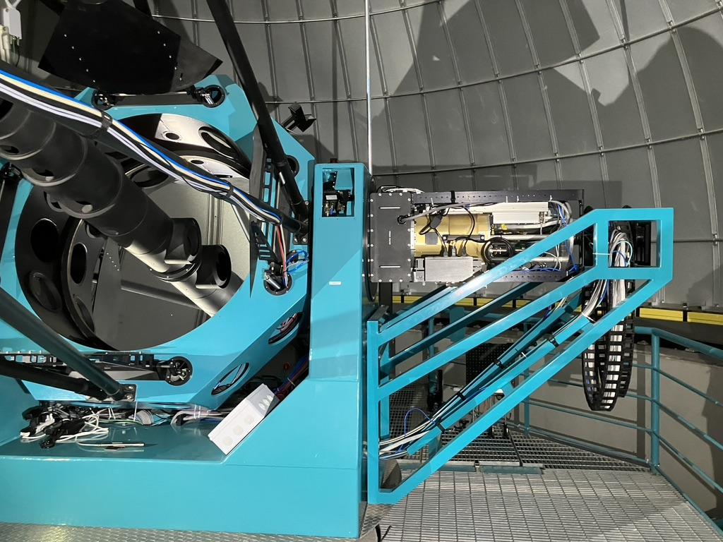
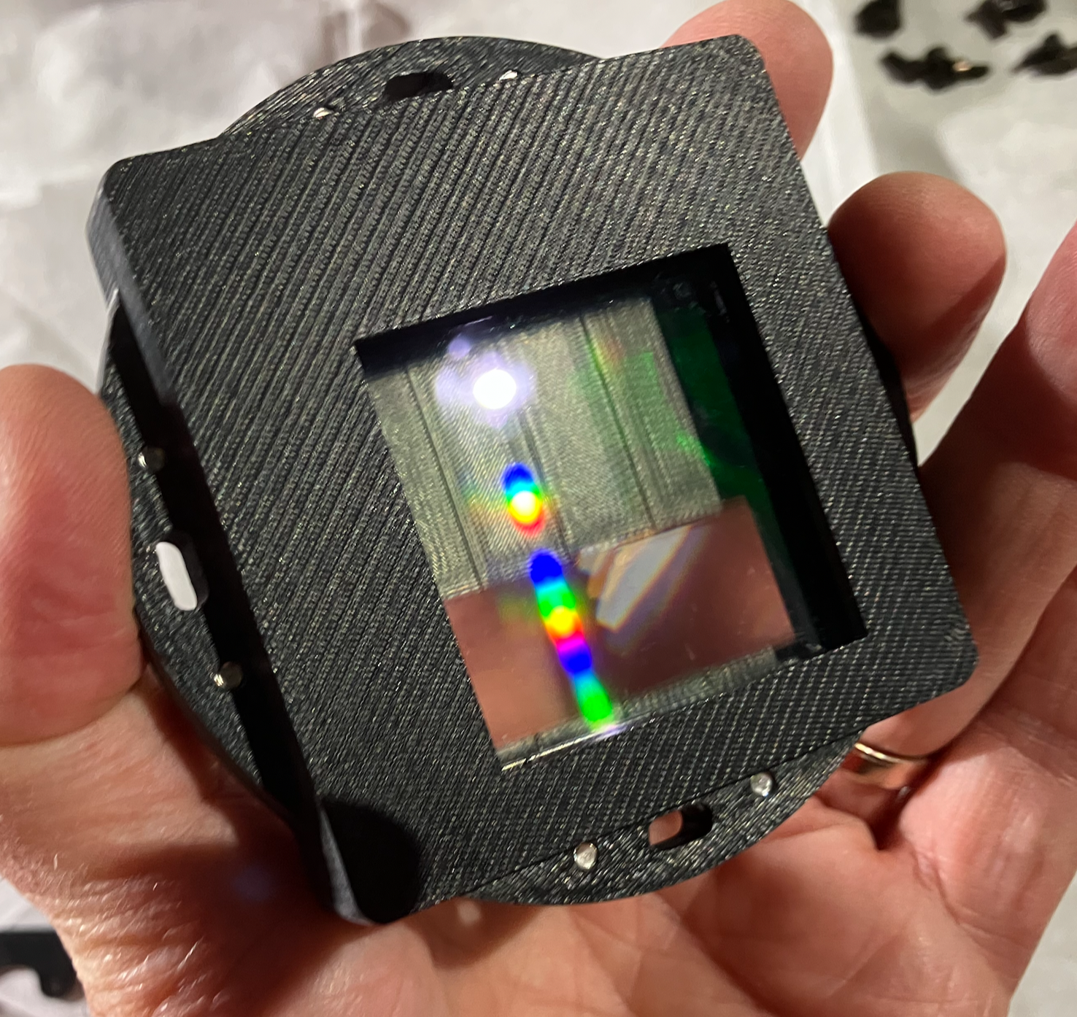
Context: the AuxTel spectrograph mission measure the atmospheric transmission as a function of λ to derive the expected fluxes for each object under standard atmospheric conditions
Holographic disperser, a french proposal that was not in the initial project

Slide 3
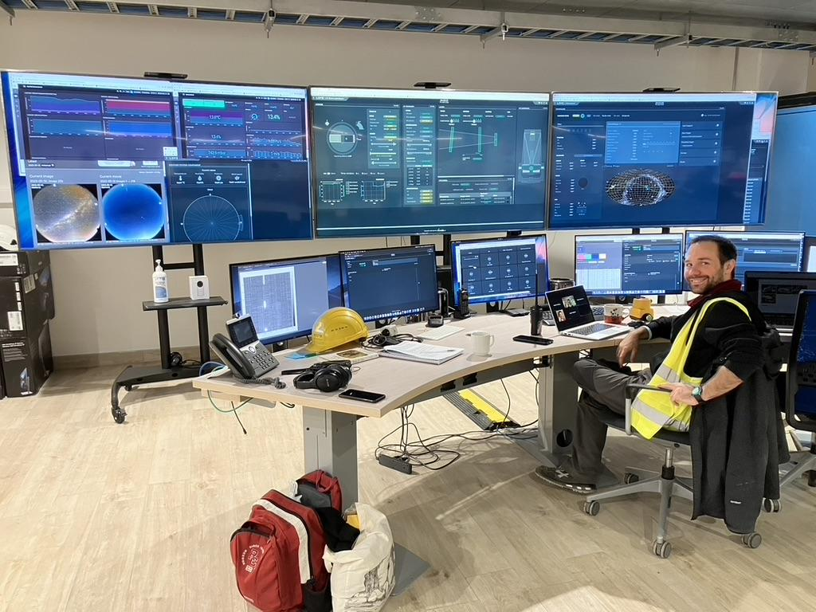

Slide 5
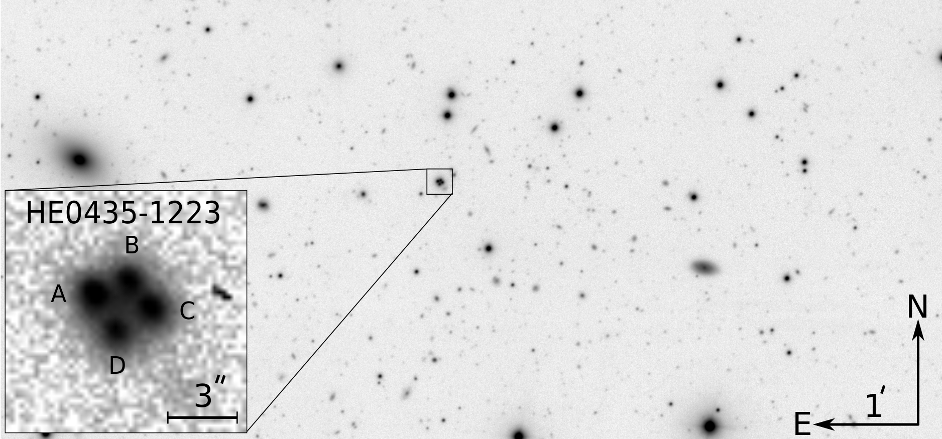
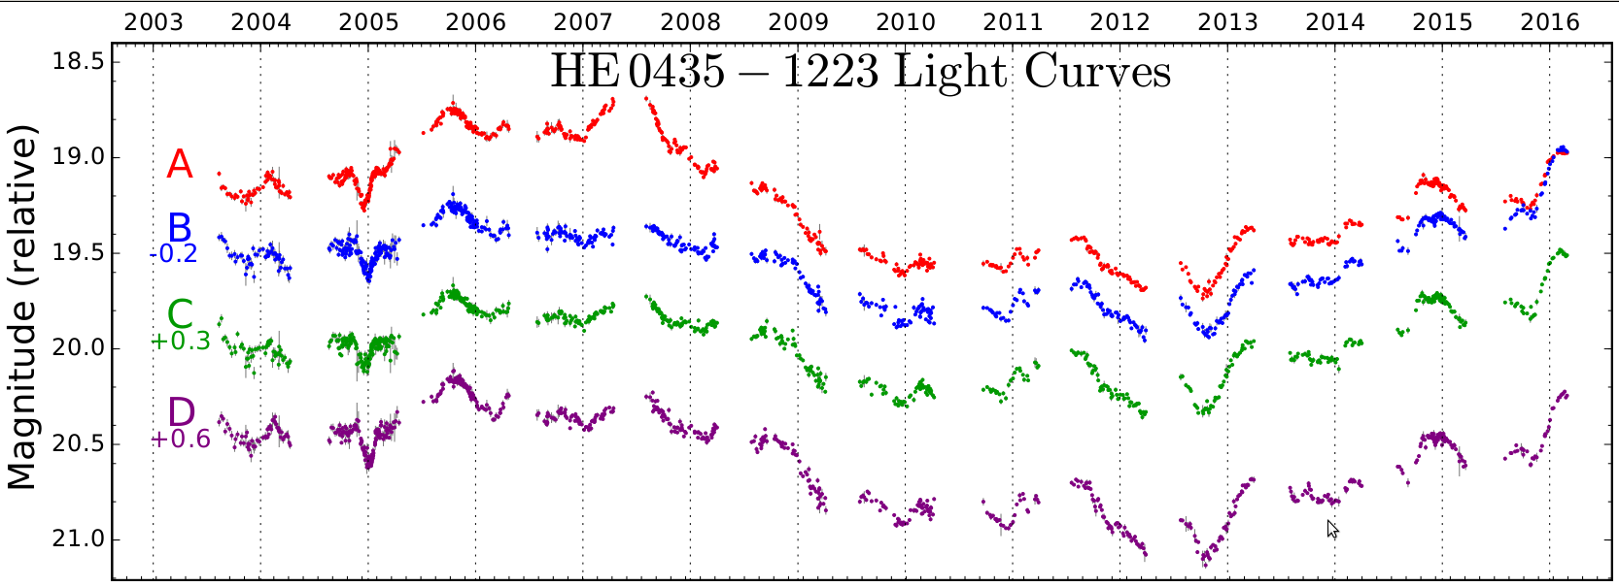
Science case for the best photometry:
strong lensing time-delay
time delays of HE0435−1223: H₀ to 3.8% precision from strong lensing
Estimate H₀ from the measured delays and lens model

Slide 6
AuxTel, the LSST hygrometer

Slide 7
AuxTel
Rubin Auxiliary Telescope (AuxTel) primary objective is to characterize and monitor the local atmospheric transmission in parallel with the main Simonyi telescope:
1.2 m telescope on the next hill, equipped with a slitless spectrograph (LATISS)
In operation since 01/2020 as a pathfinder to test LSST systems and start characterising the atmosphere.

Slide 8
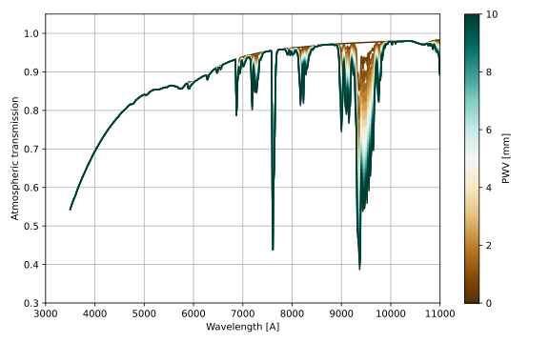
Atmospheric transmission description
Atmospheric transmission can be decomposed in four components:
Rayleigh scattering in λ⁻⁴ proportional to on-site pressure
Ozone absorption band at ~600nm is quite stable (satellite observation)
Aerosols (<450nm) vary with human and natural activities
Water (non-linear absorption bands) varies daily and seasonally
H₂O
H₂O
H₂O
O₂
Precipitable Water Vapor (PWV) [mm]
aerosols
ozone
O₂

Slide 9
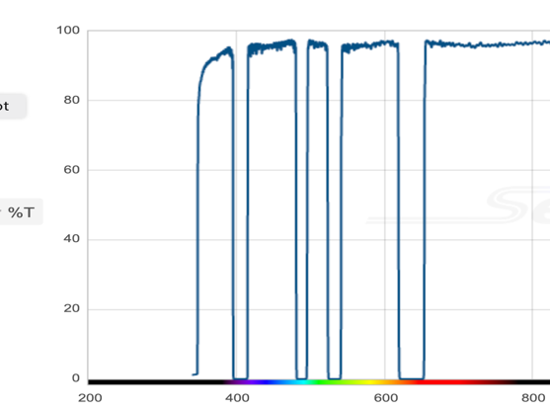
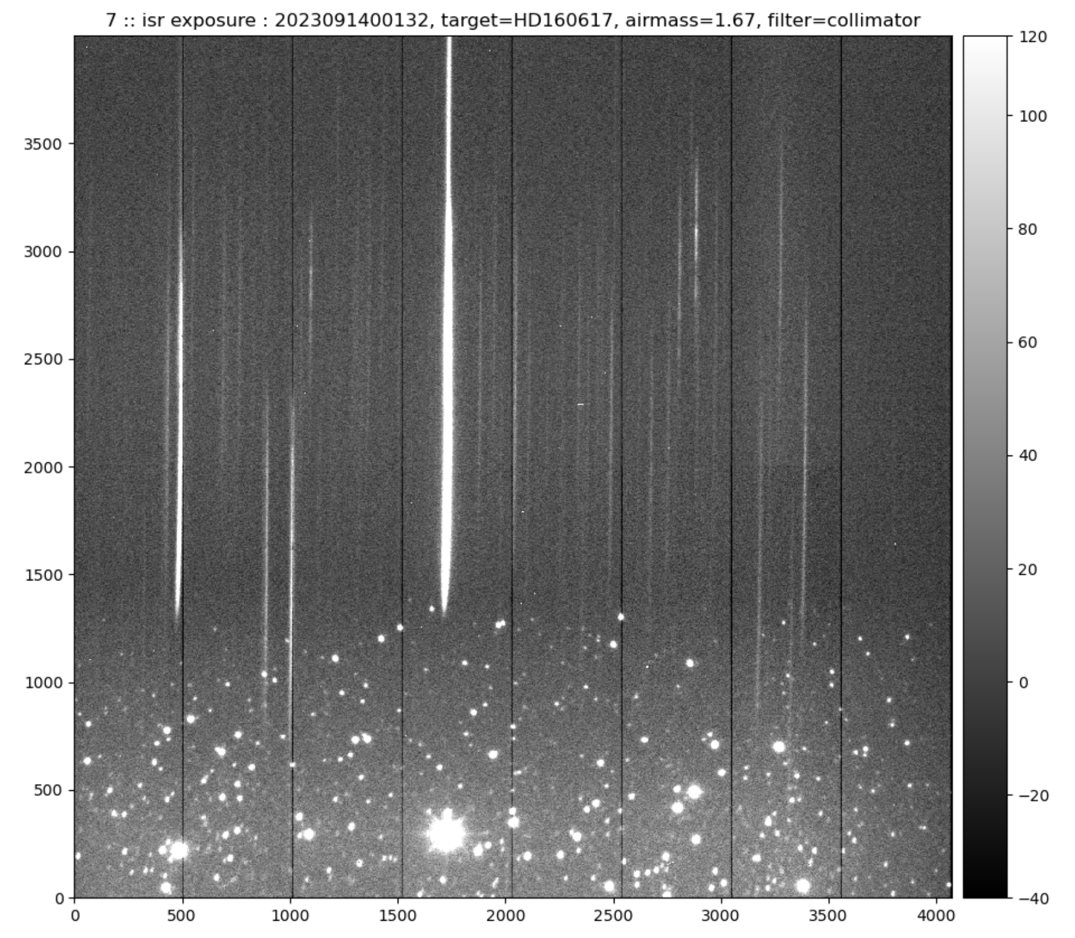
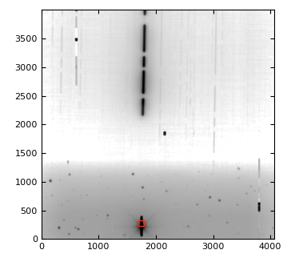
AuxTel spectrographs
Holographic disperser and mask
Blazed grating + quad-notch filter
Aperture photometry in 4 “blue” rectangles
Spectrum extraction by forward modelling

Slide 10
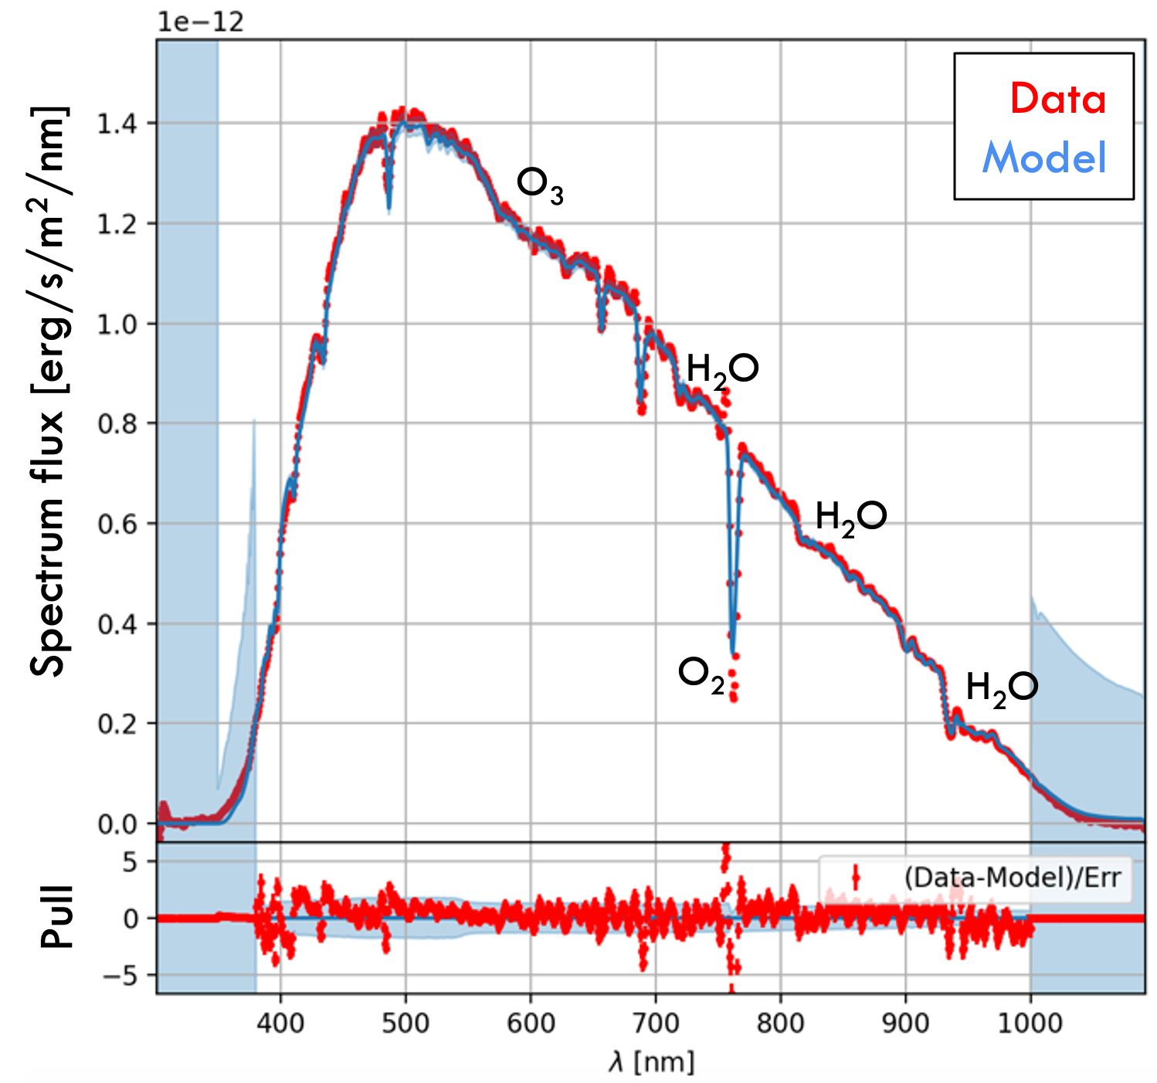
AuxTel spectra
Spectrum extraction pipeline based on forward modelling (Spectractor)

Slide 11
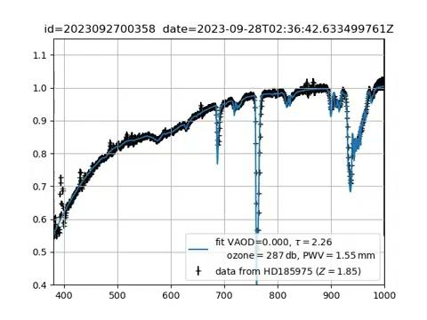
Seven months of South polar star observation
black: AuxTel spectrum divided by AuxTel throughput and CALSPEC spectrum
blue: Libradtran atmospheric model

Slide 12
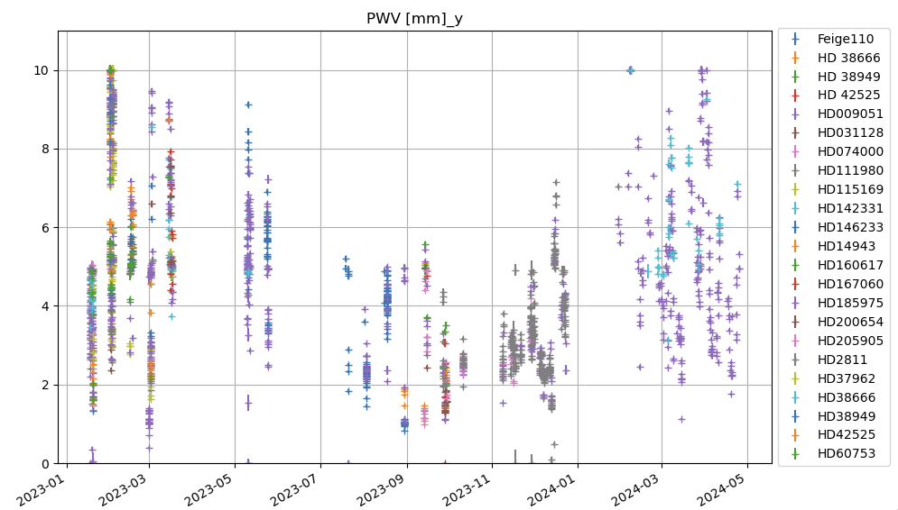
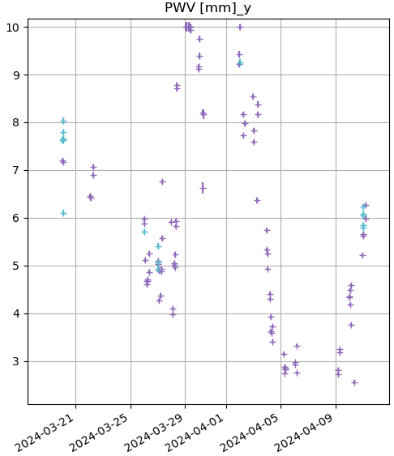
Hygrometry
PWV=Precipitable Water Vapor
18 months of AuxTel PWV
Zoom on 3 weeks

Slide 13
Photometric repeatability on differential color measurements in Auxtel
Sensibility of photometry to atmospheric parameters
Sylvie Dagoret-Campagne, Marc Moniez
2024-06-12

Slide 14
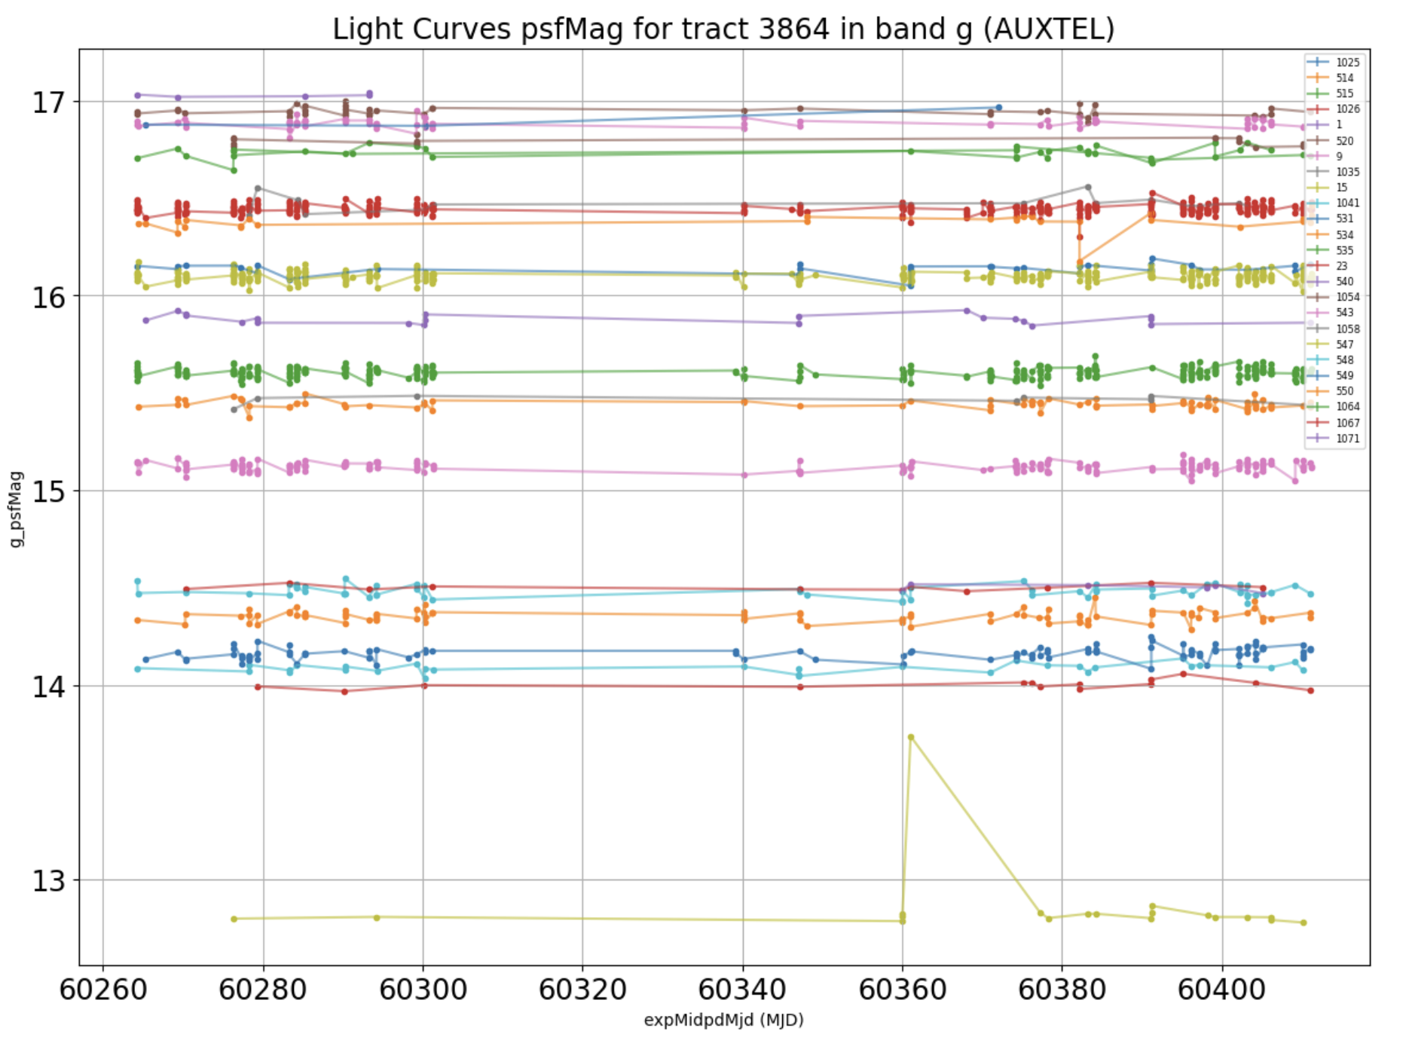
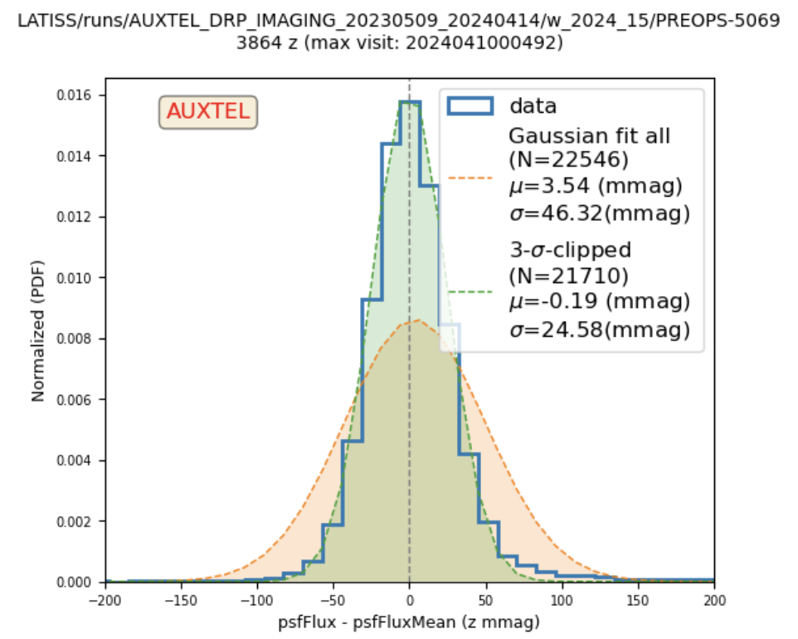
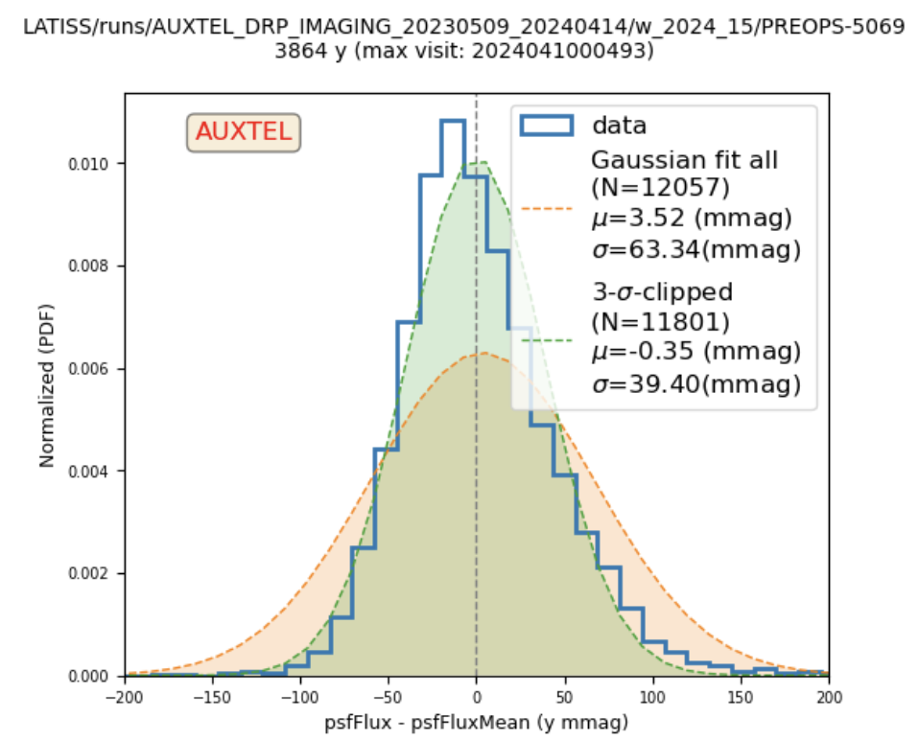
Photometric repeatability on Light curves context
> 20 mmag in G
Similar resolution
In R
requirements
5 mmag or less
Official Photometric calibration not working well in Auxtel by now.
But how to show evidence for atmospheric parameter variations in Photometry ?
> 25 mmag in Z
> 40 mmag in Y

Slide 15
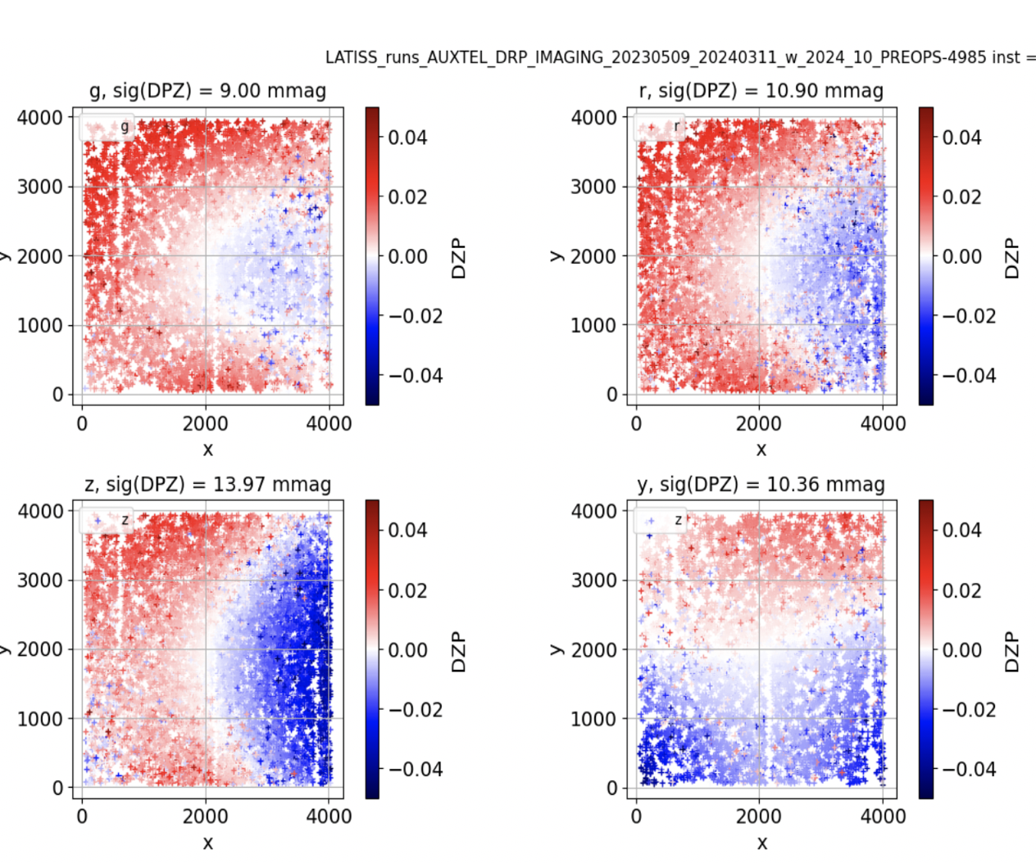
The zero-Point calibration problem
Different stages of calibration not easy to setup
Catalog matching photometry
FGCM
Ex : ZP Non-uniformity corrections
Per CCD zero-point
Try to extract photometry independently of complicated DM-pipeline calibration

Slide 16
Focus on One Light Curve at a time
Calibration relies after the selection of isolated bright stars
Instrumental aperture flux
Calibrated psf Magnitude

Slide 17
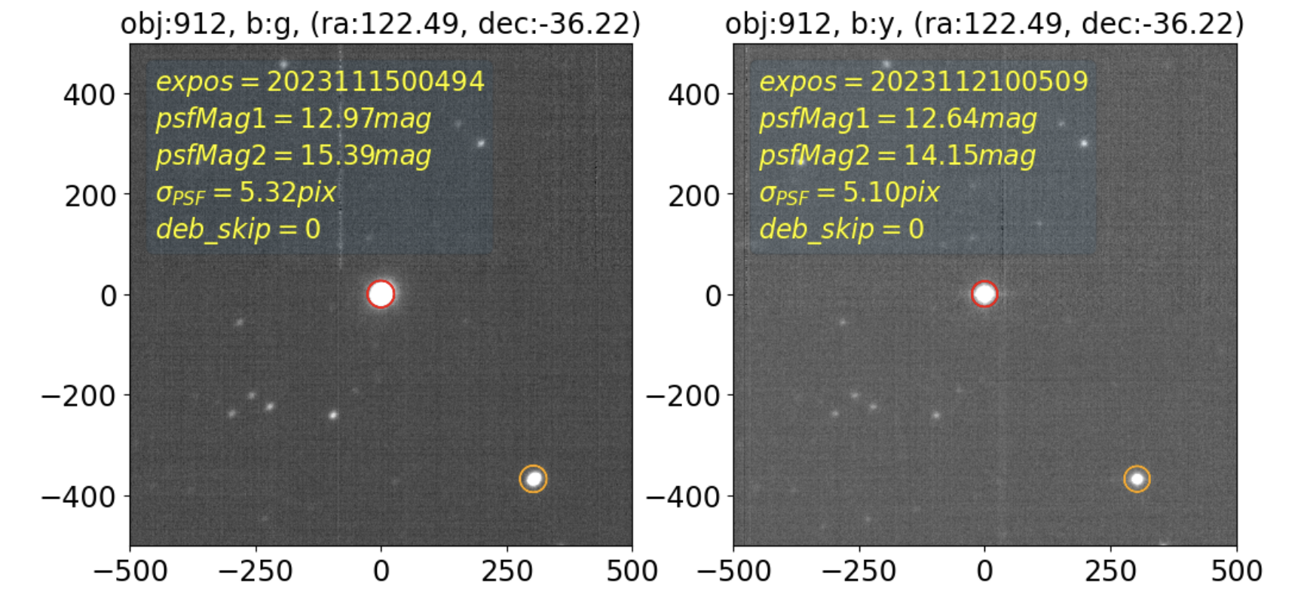
Example of selected one isolated bright star with DM object with a light-curve
Compare two close stars ( here distance : 45 arcsec)
And compare differential fluxes/colors
Star 1 – Star 2 on same exposure (get rid off Zero-point calibration)
Selection of exposures in different bands within less than 1 minute
Band g
Band r

Slide 18
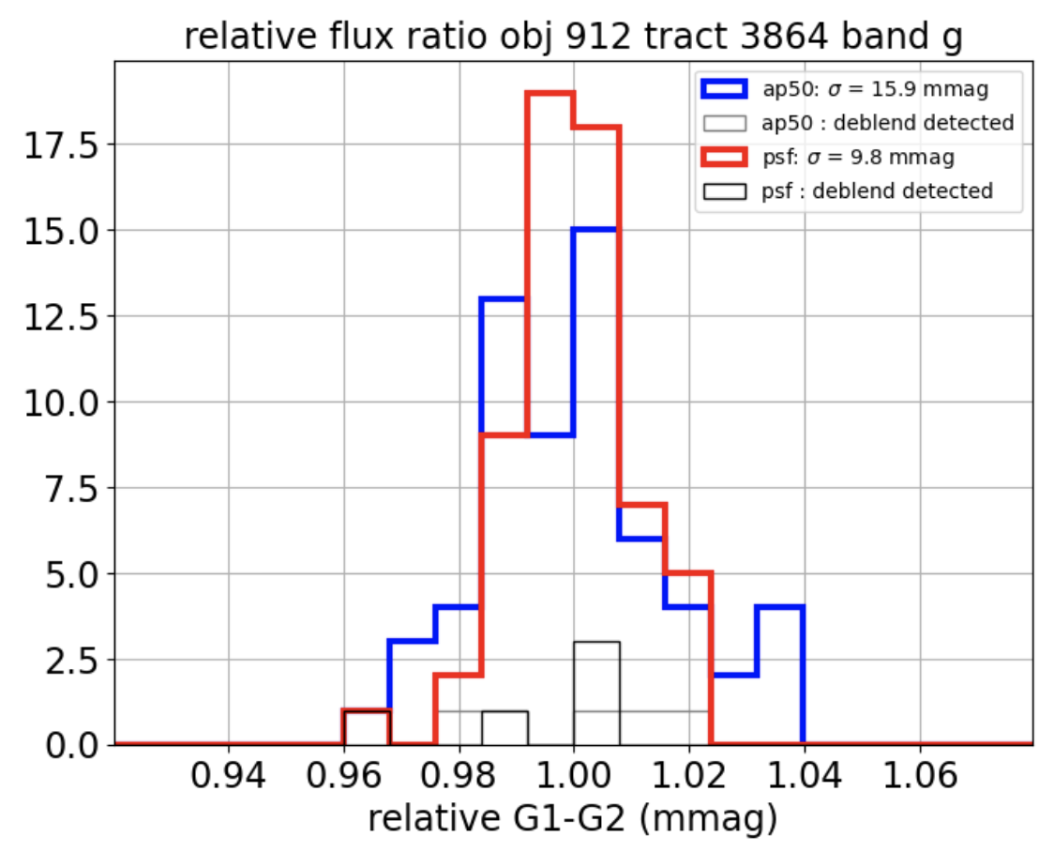
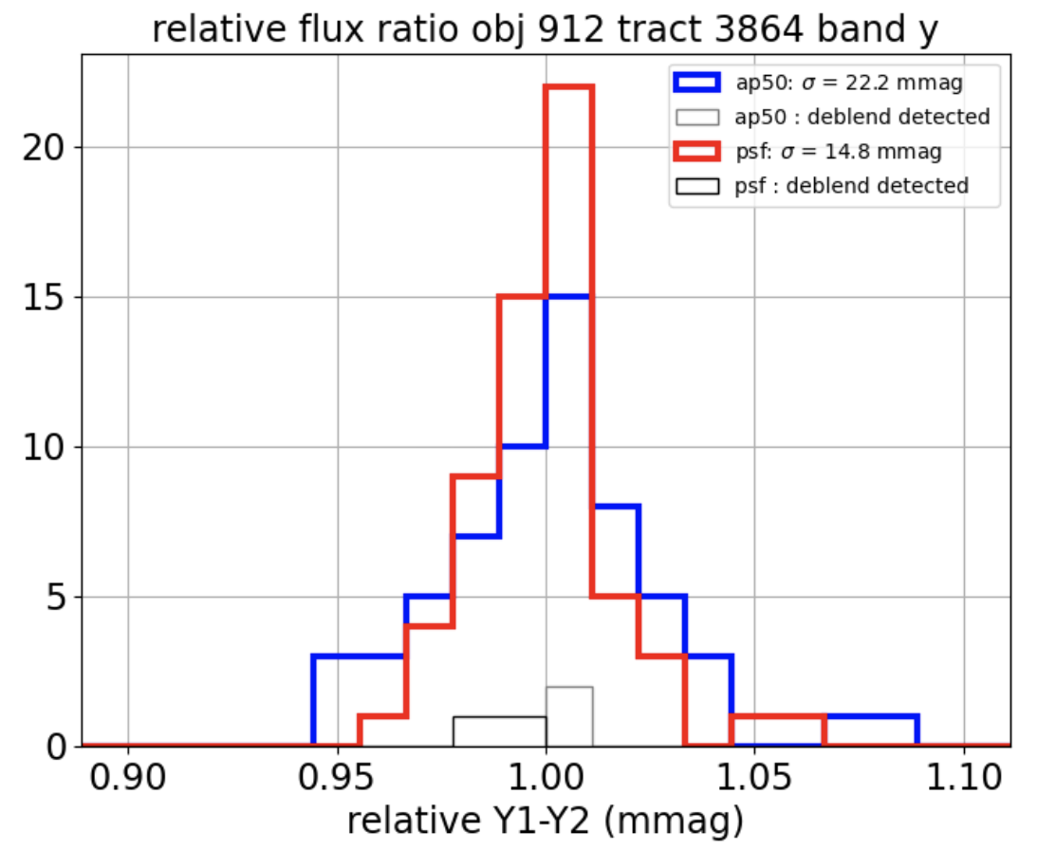
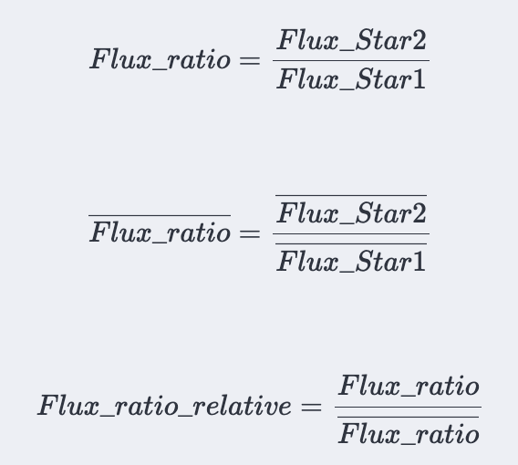
Relative flux ratio in the same band
relative flux ratio
relative flux ratio
Take away
1) psfMag better than aperture flux Mag
2) Instrinsic photometry measurement accuracy ~ 10 mmag (above req) in G,R when cancelling Zero Point
3) Atmospheric effect noticeable in band Y with 15 mmag ?

Slide 19
Differential light curves in G,R with PSF Magnitude
Shown:
Three «flux ratios» or magnitude differences
1) G(star 1)-G(star 2) : expect intrinsic photometric performances without atm effect and SED color effect
2) Color G-R on star 1 only from less 1min exposure
3) G-R color difference between the 2 stars
Take away
40 mmag resolution on G-R is due to bad ZP calibration
12 mmag in band or relative color difference is the photometric accuracy excluding ZP effects

Slide 20
Differential light curves in G,Y with PSF Magnitude
Shown:
Three «flux ratios» or magnitude differences
1) G(star 1)-G(star 2) : expect intrinsic photometric performances without atm effext and SED color effect
2) Color G-Y on star 1 only from less 1min exposure
3) G-Y color difference between the 2 stars
Take away
40 mmag resolution on G-Y is due to bad ZP calibration
Not sensitive to PWV variations
10 mmag in band or relative color difference is the photometric accuracy excluding ZP effects
Could try to detect PWV variations

Slide 21
Differential light curves in R,Y with PSF Magnitude
Shown:
Three «flux ratios» or magnitude differences
1) R(star 1)-R(star 2) : expect intrinsic photometric performances without atm effect and SED color effect
2) Color R-Y on star 1 only from less 1min exposure
3) R-Y color difference between the 2 stars
Take away
40 mmag resolution on G-Y is due to bad ZP calibration
Not sensitive to PWV variations
10 mmag in band or relative color difference is the photometric accuracy excluding ZP effects
Could try to detect PWV variations

Slide 22
Differential light curves in Z,Y with PSF Magnitude
Shown:
Three «flux ratios» or magnitude differences
1) Z(star 1)-Z(star 2) : expect slight atmospheric effect if SED slope is different for Star1 and Star 2
2) Color Z-Y on star 1 only from less 1min exposure
3) G-Y color difference between the 2 stars
Take away
40 mmag resolution on Z-Y is due to bad ZP calibration
Not sensitive to PWV variations
15 mmag in band or relative color difference is the photometric accuracy excluding ZP effects
Could try to detect PWV variations

Slide 23
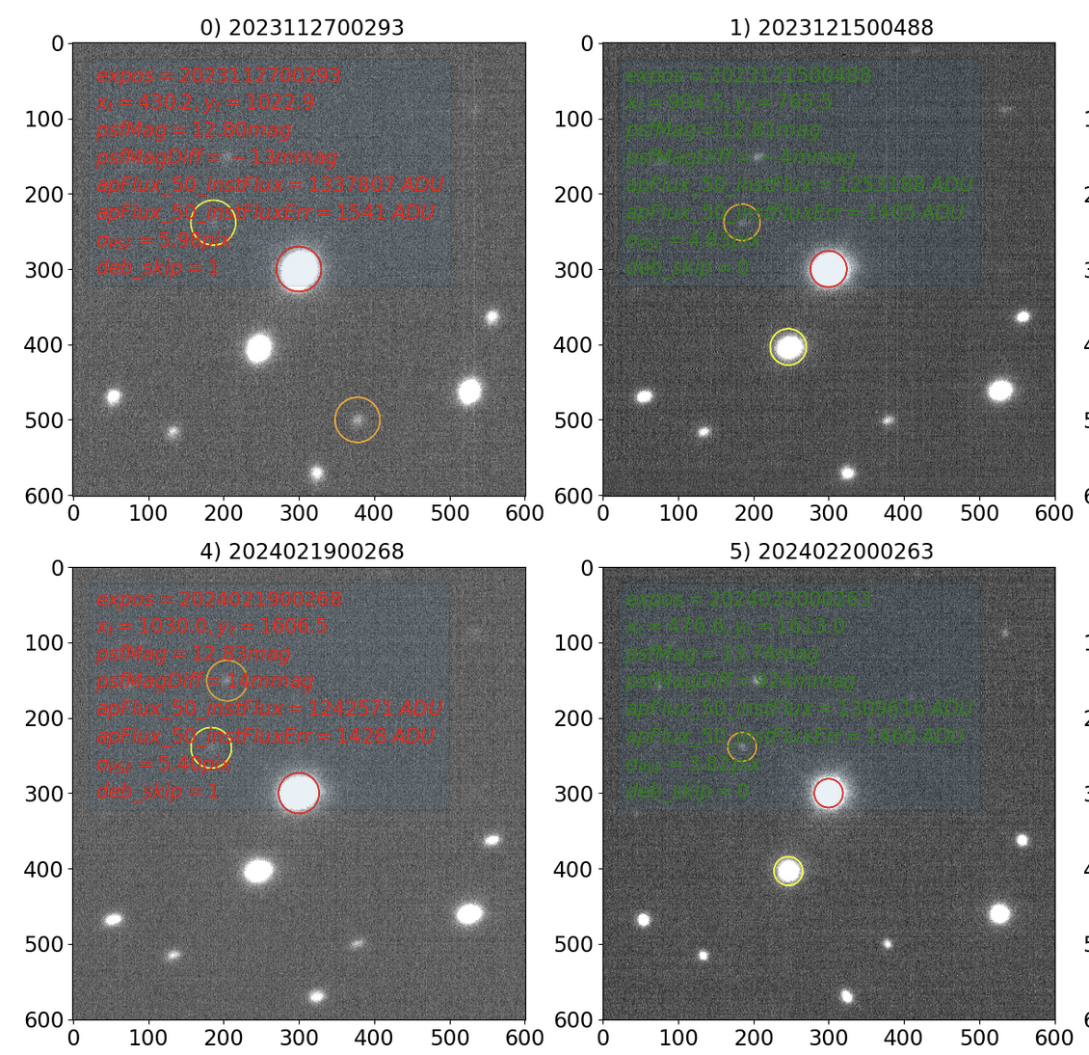
Problems encountered in photometry of isolated stars: Blending
Isolated star 1
Distance star1-star2 = 11 arcsec
Show a random flag deblend_skipped true or false depending on exposure

Slide 24
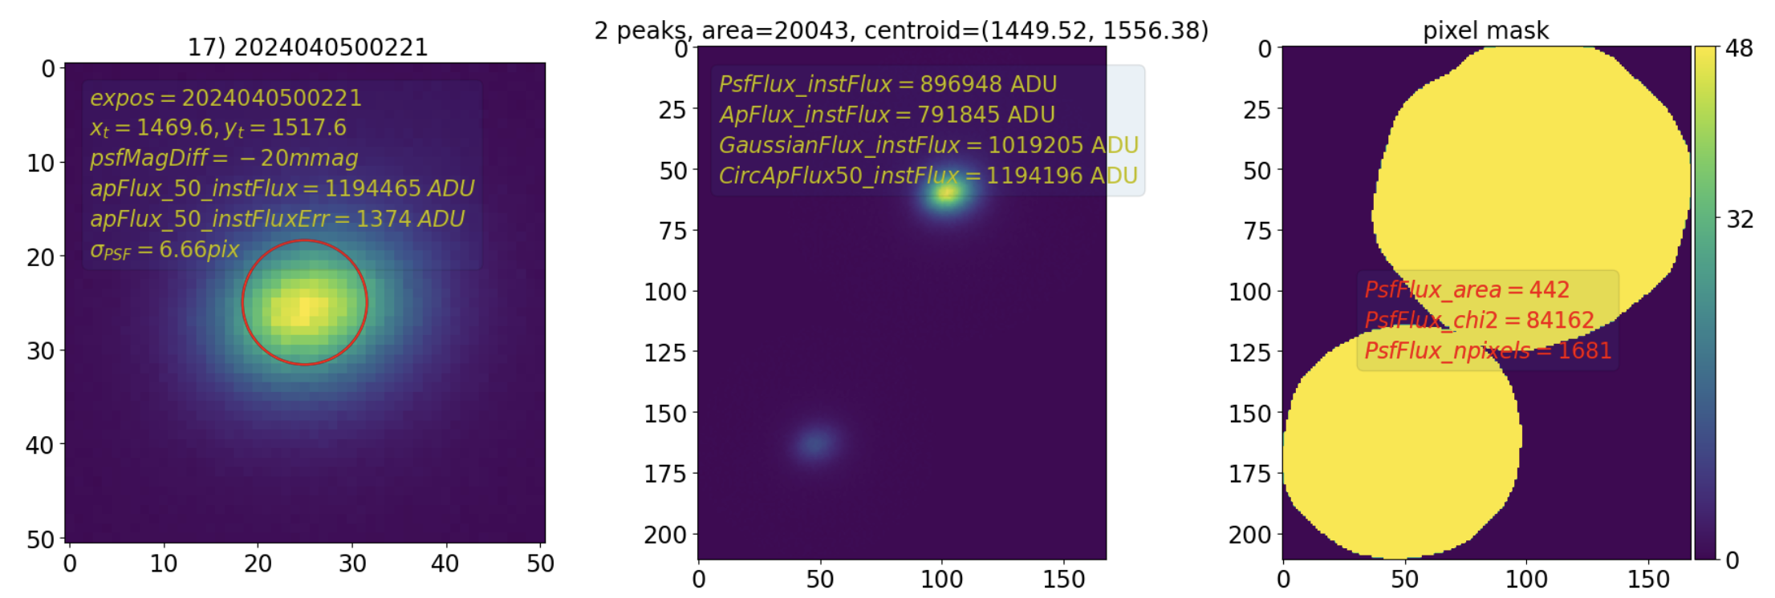
Problems encountered in photometry of isolated stars: Big star footprint
Left : my cutout
Middle heavy footprint
Right : pixel mask

Slide 25
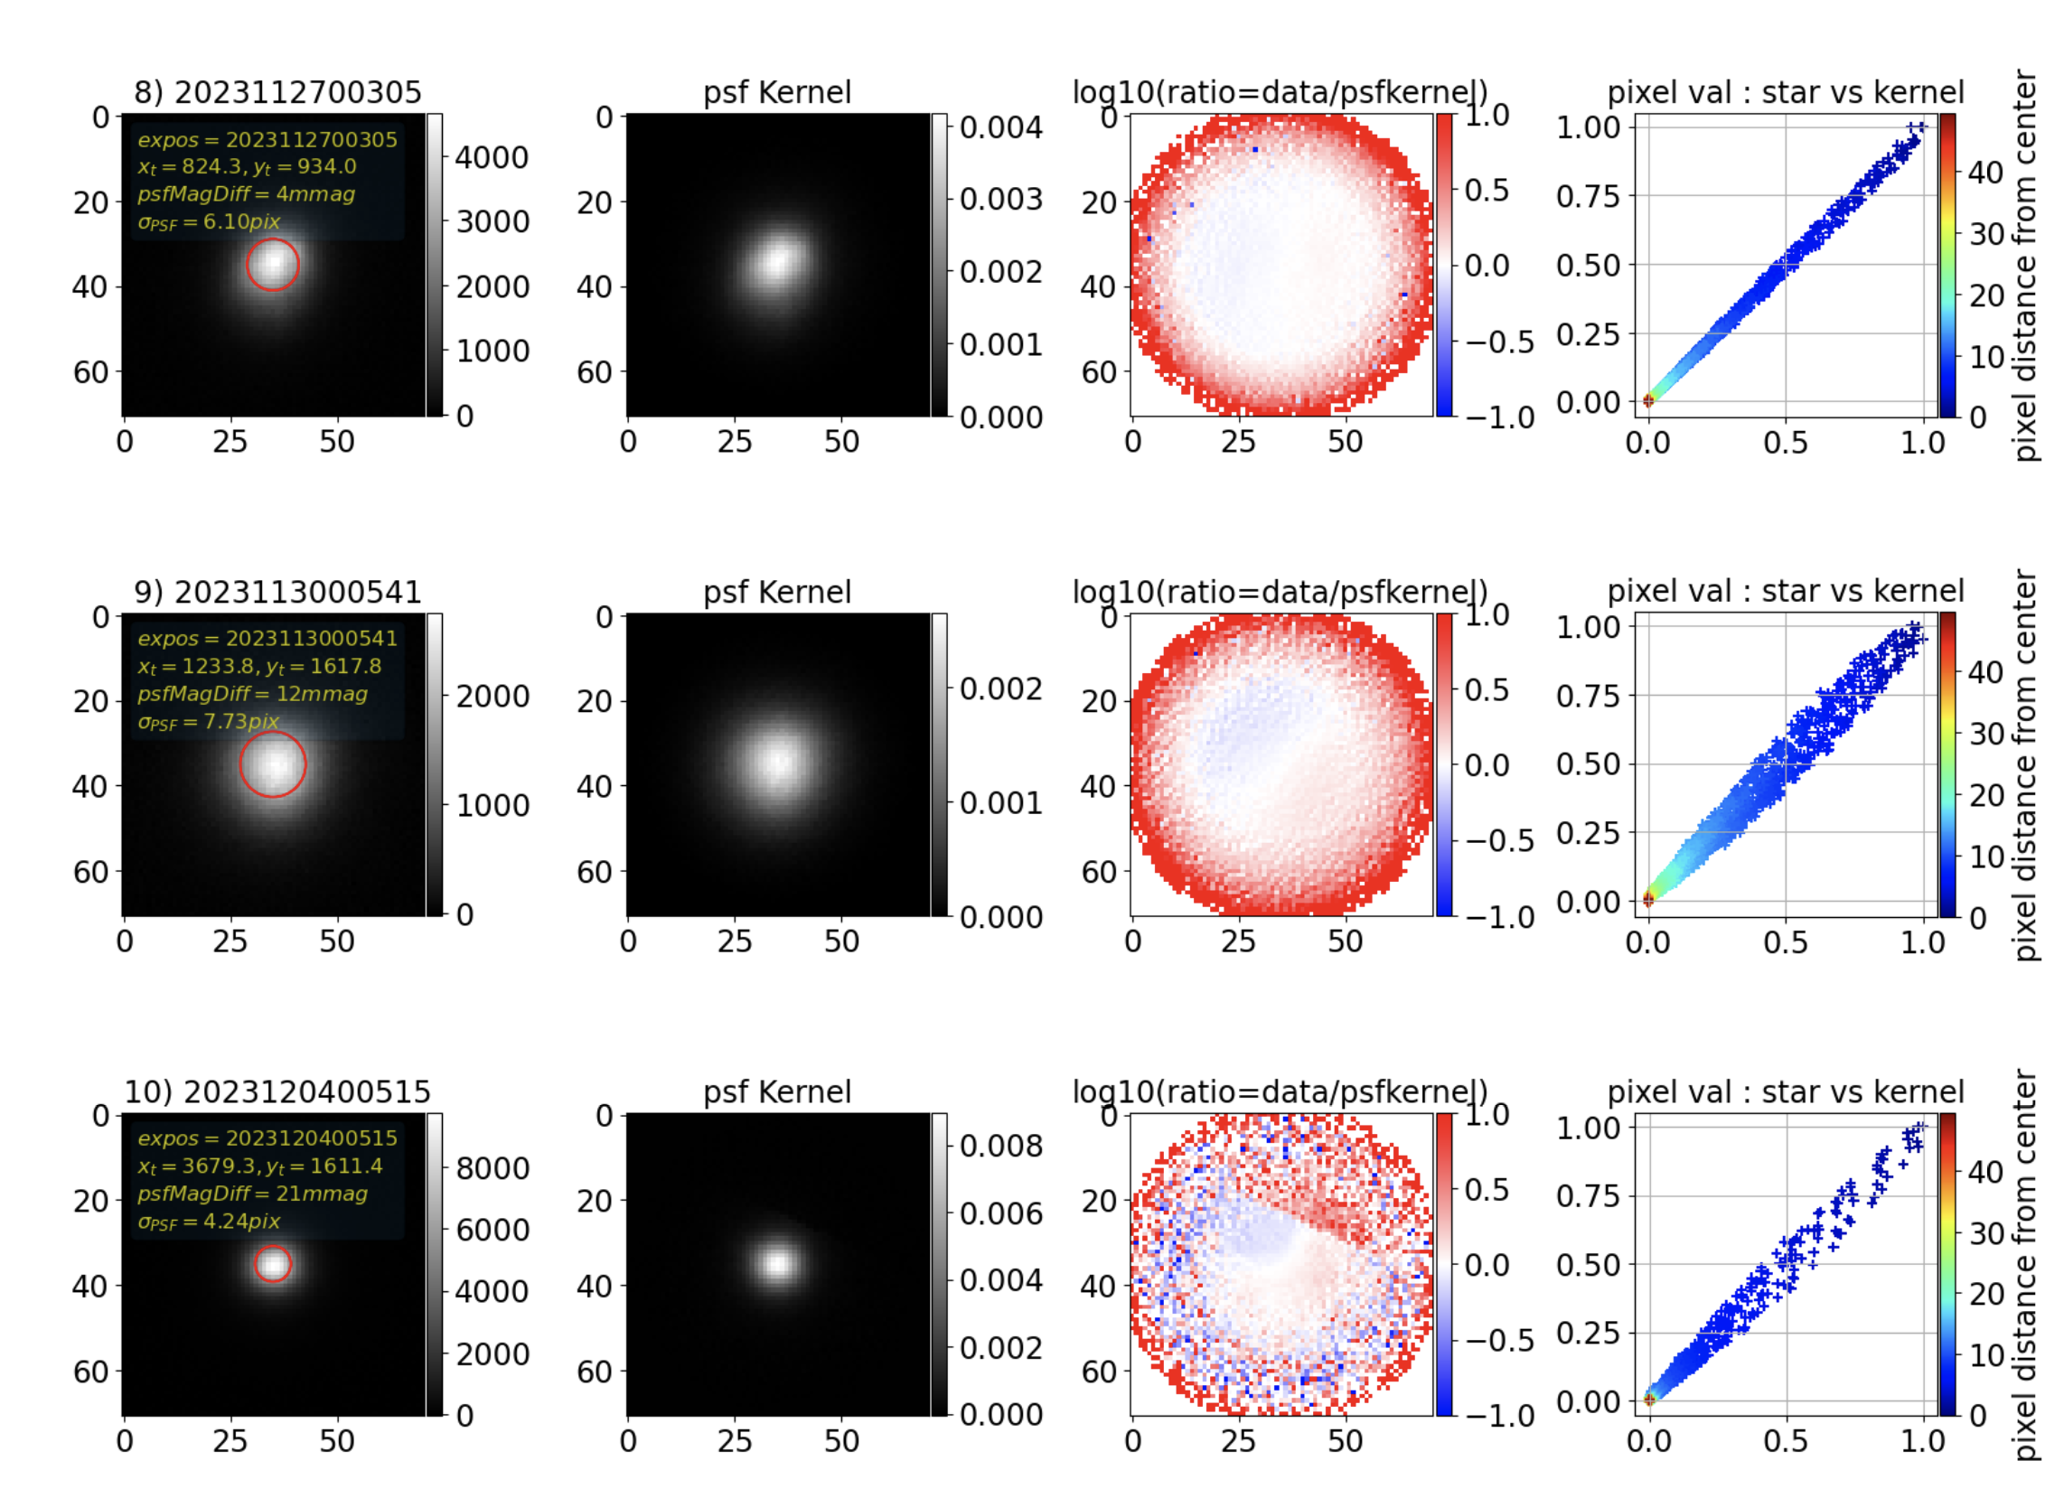
Problems encountered in photometry of isolated stars: Bad PSF
Top : good uniform psf
Middle : non-uniform psf
Bottom : strange data/psf ratio

Slide 26
Problems encountered in photometry of isolated stars: Bad PSF

Slide 27
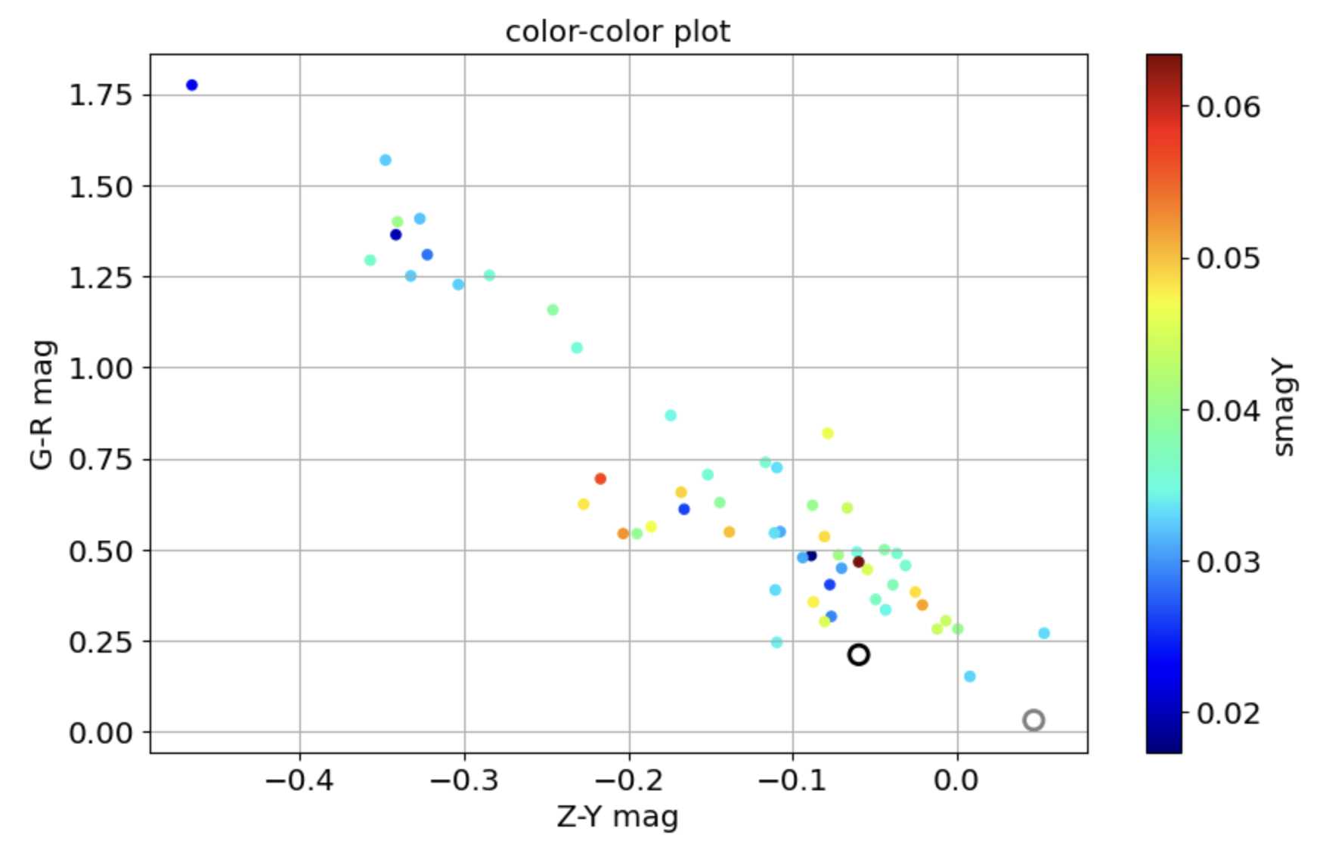
Isolated Bright stars for calibration : Star1-Star2 colors
color | g1-r1 | g2-r2 | g1-y1 | g2-y2 | r1-y1 | r2-y2 | z1-y1 | z2-y2
mean | 0.210940 | 0.70546 | 0.308111 | 1.216009 | 0.098398 | 0.512060 | -0.059711 | 0.016295
std | 0.032865 | 0.03095 | 0.043392 | 0.041790 | 0.057754 | 0.061969 | 0.051999 | 0.046869
Need to find two close stars
with much more difference in Z-Y to be sensitive to atmospheric variation impact due to SED color difference
Star 2
Star 1

Slide 28
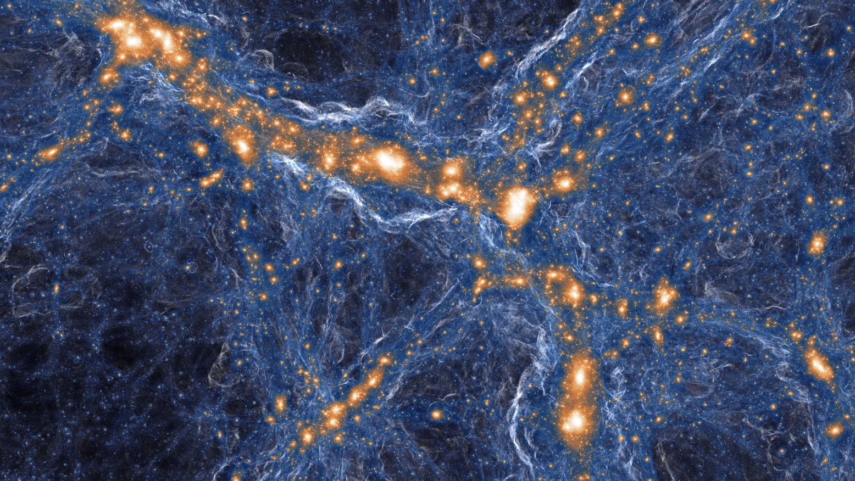
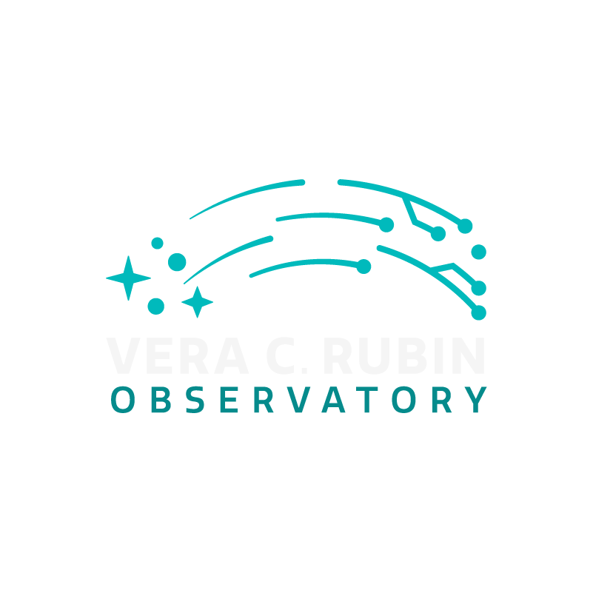
New AuxTel standards with Gaia
Illustris TNG simulation
LSST LPCA group:
Philippe Gris, Nicoleta Pauna, Julie Leproux, Corentin Ravoux
With a lot of help from IJCLab team
LSST France meeting - 12 june 2024

Slide 29
Scientific goals (SNe Ia)
Impact of PWV (Precipitable water vapor) on SNe Ia bands
i,z,y bands interesting for high-redshift SNe Ia
Proposed DDF scenario has a lot of y-band visit: impact or correction of atmosphere variability
FGCM cross-verification/external data input
Standard atmosphere
Figure from Martin

Slide 30
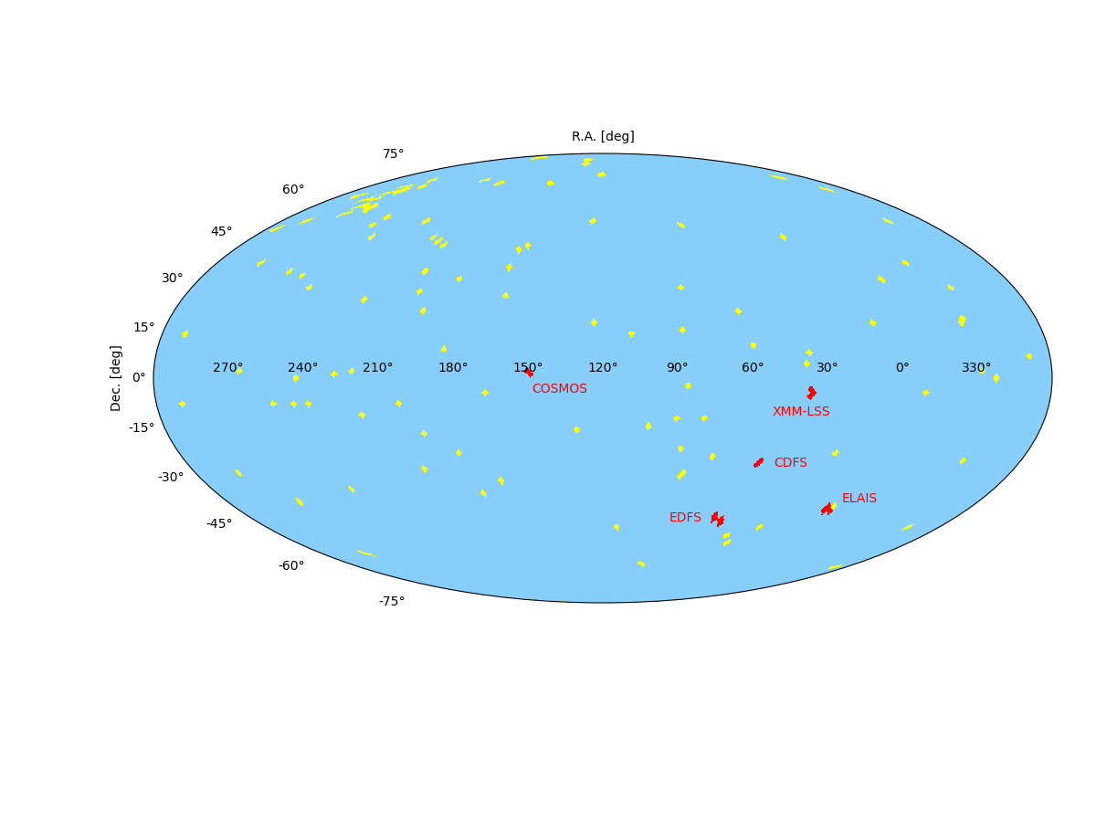
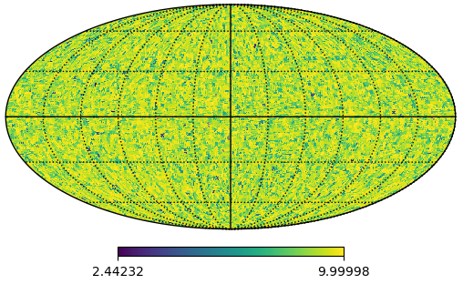
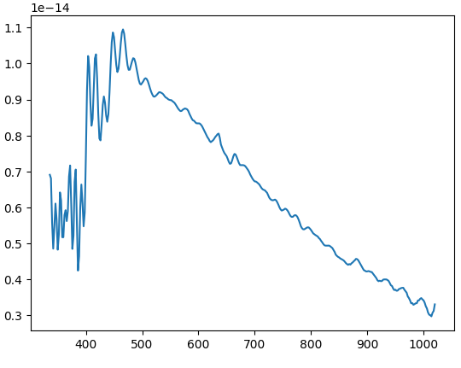
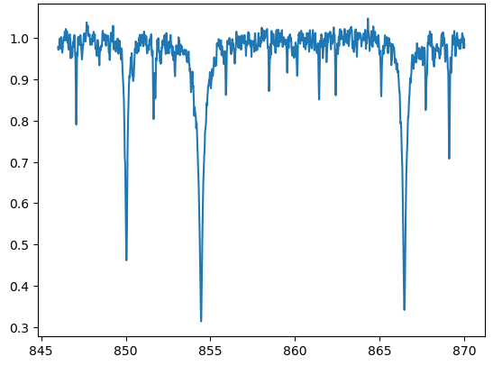
Gaia DR3 catalog
CALSPEC stars and DDF
GAIA stars for PWV (g < 10)
CALSPEC spectra does not cover DDF
Gaia = largest catalog of star spectra out of atmosphere
BP/RP spectrograph: low resolution at [330-1050]nm
RVS spectrograph: high resolution at [846-870]nm
Optimal coverage of the full LSST sky (including DDF)
g mag
BP/RP spectrum
RVS normalized spectrum
Wavelength [nm]
Wavelength [nm]

Slide 31
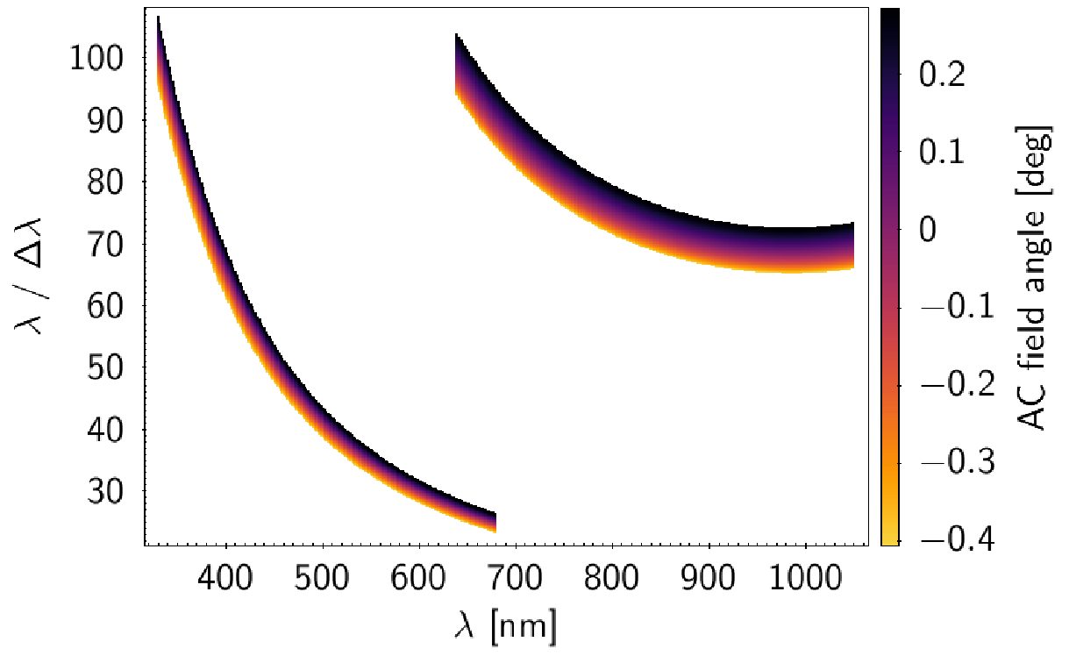
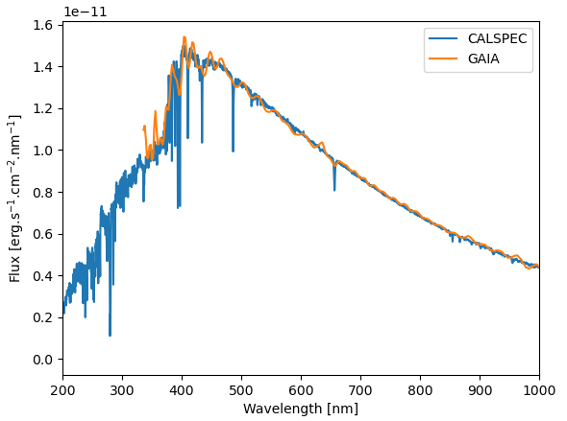
Gaia DR3 spectrum
BP/RP spectrum of poorer resolution compared to CALSPEC but in the interest region of AuxTel
First test:
Matching of spectra between CALSPEC and GAIA
Quick modification of Spectractor with GAIA spectrum
Carrasco et al. 2021
HD160617 spectrum

Slide 32
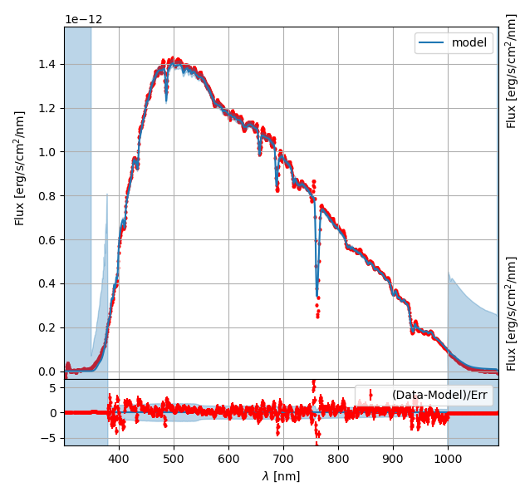
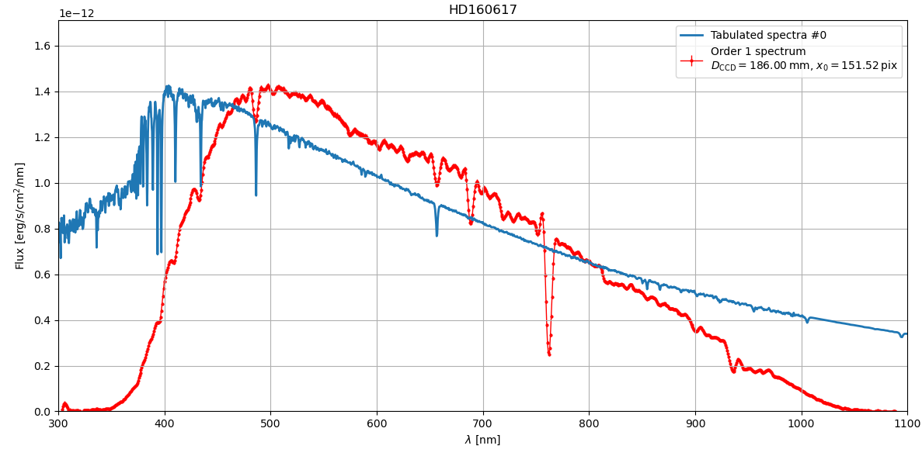
Spectractor with Gaia spectrum
Spectractor =
Standard spectrum ∗ Gaussian smoothing ∗
Atmosphere model ∗ Auxtel transmission
AuxTel
CALSPEC

Slide 33
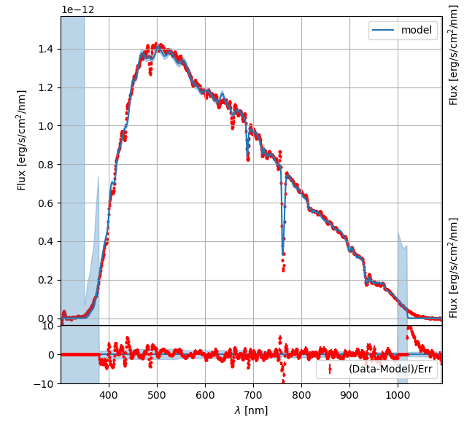
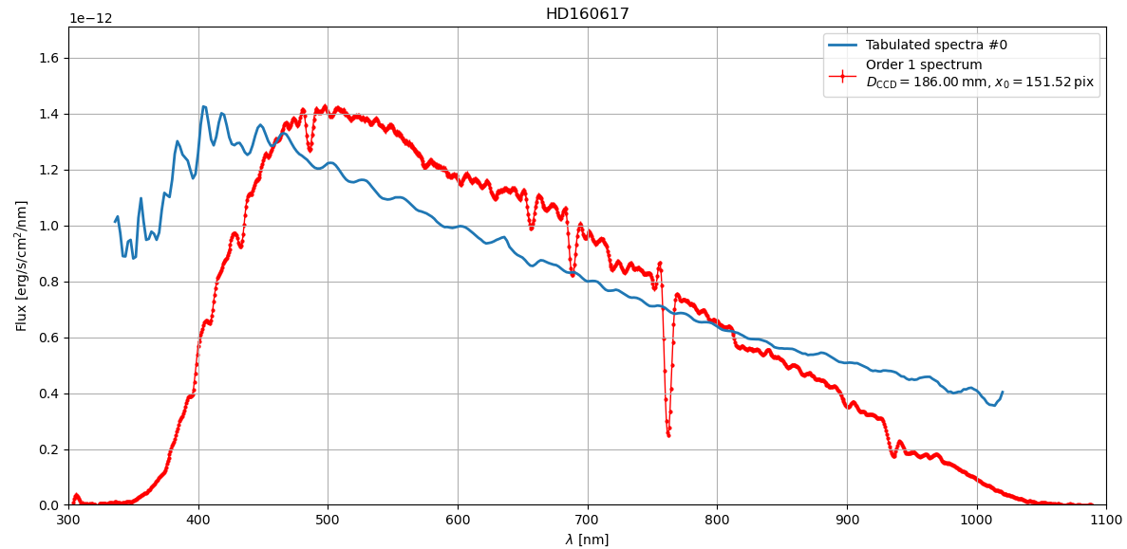
Spectractor with Gaia spectrum
Spectractor =
Standard spectrum ∗ Gaussian smoothing ∗
Atmosphere model ∗ Auxtel transmission
AuxTel
GAIA

Slide 34
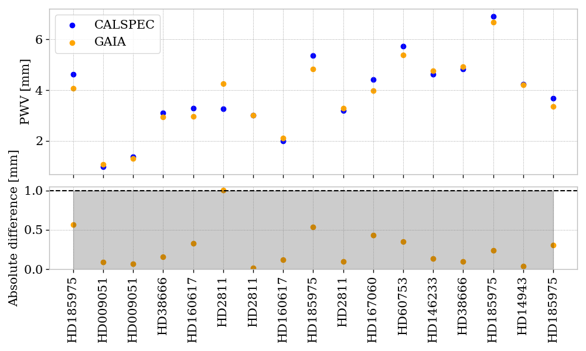
PWV measurement results
Comparison of Spectractor measurement between CALSPEC and GAIA
Agreement for most stars (PWV difference below 1 mm)
Can be improved with improved treatment of Gaia spectra

Slide 35
What’s next ?
At the catalog stage:
Improve cross-matching between GAIA and CALSPEC
Remove the variables objects from the Gaia catalog (cross-matching, main sequence selection)
Uniform coverage of sources for all LSST sky
Focus on DDF
Catalog with different star types
At the spectrum stage:
Smoothing of the GAIA spectra to remove fluctuations (gaussian, or remove high order in the spectra decomposition)
Addition of spectrum error inside the Spectractor forward modeling
Proper GAIA implementation inside Spectractor (Astroquery, storing the selected source catalog)

Slide 36
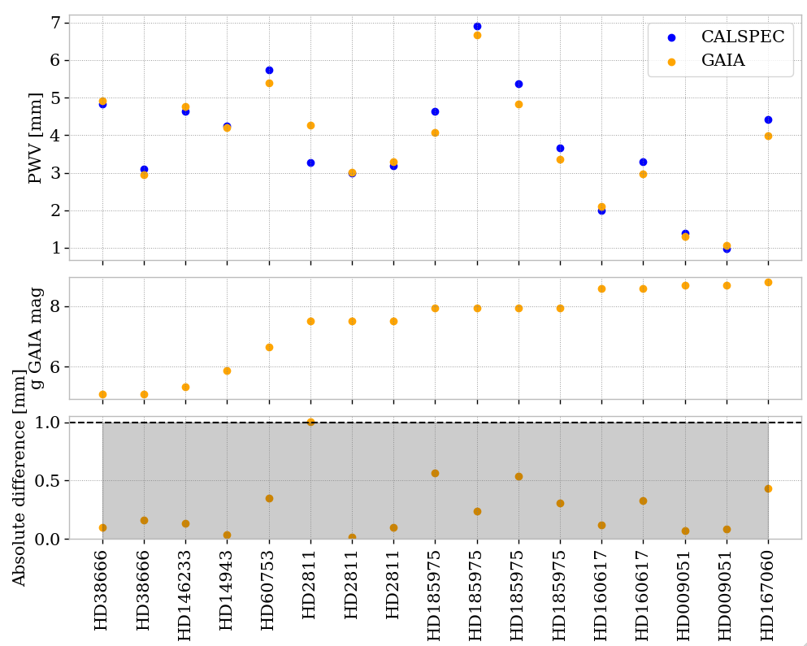
Annexe: with magnitudes

Slide 37
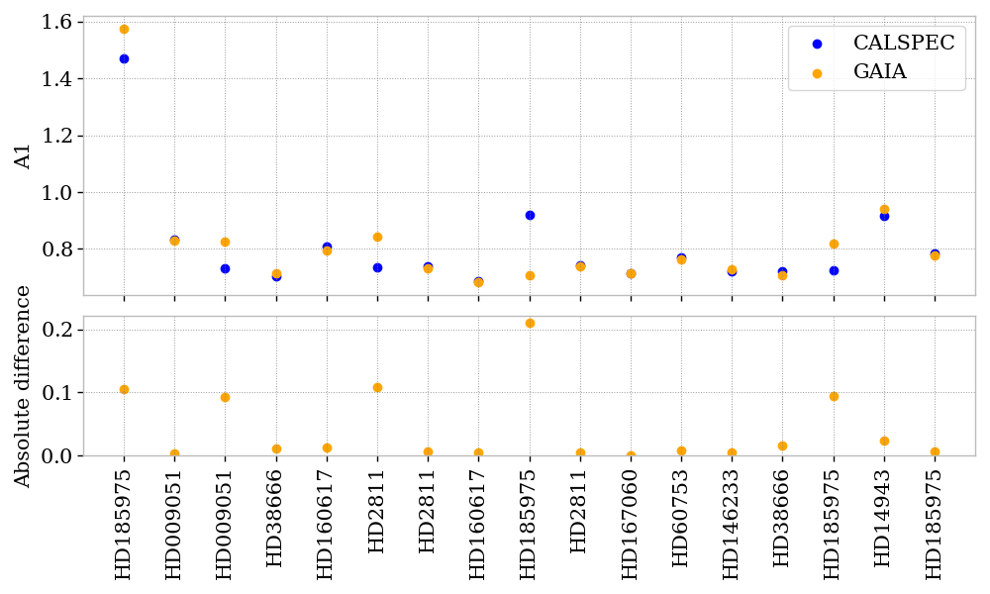
Annexe: other fitted parameters

Slide 38
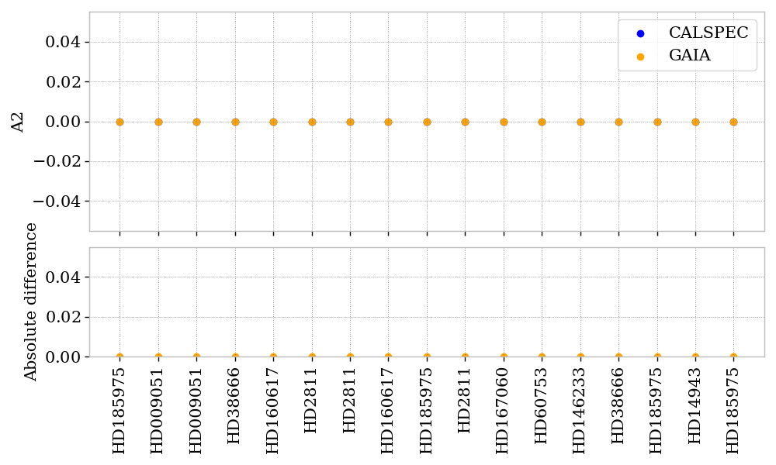
Annexe: other fitted parameters

Slide 39
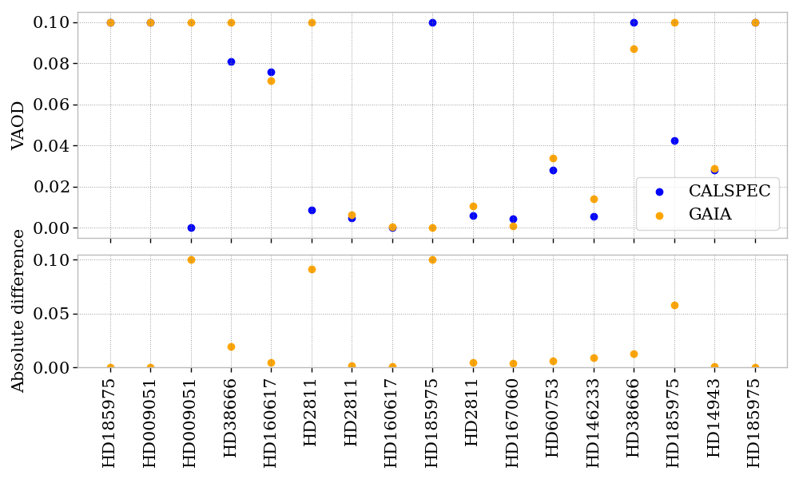
Annexe: other fitted parameters

Slide 40
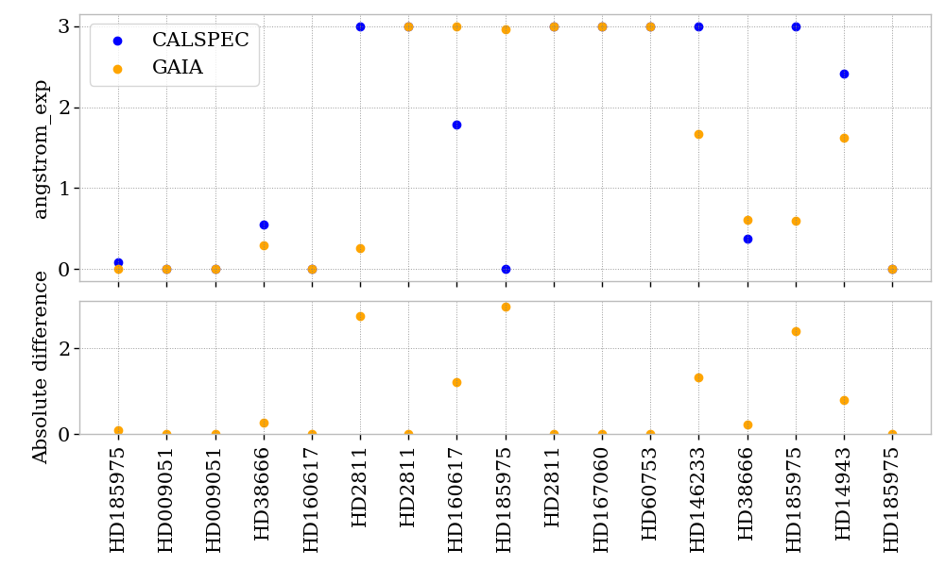
Annexe: other fitted parameters

Slide 41
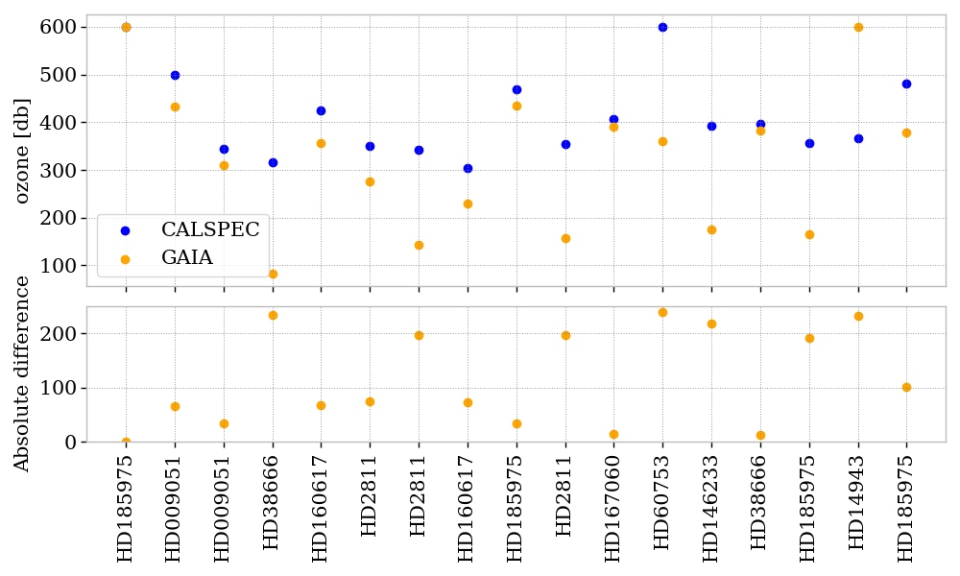
Annexe: other fitted parameters

Slide 42
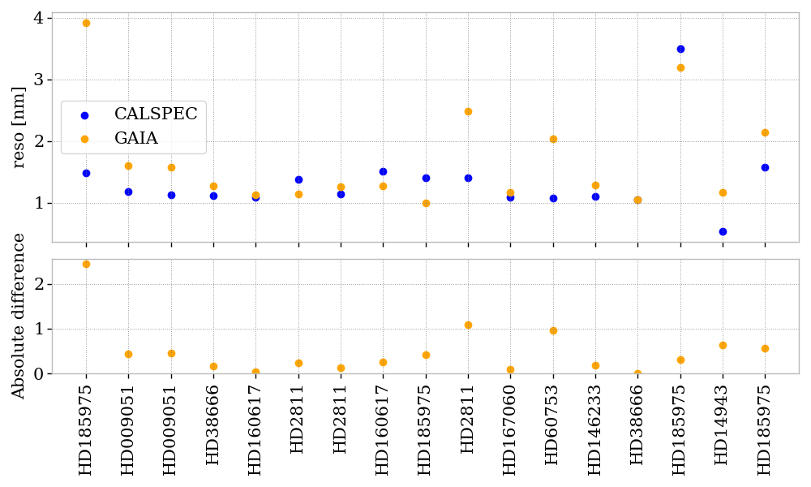
Annexe: other fitted parameters

Slide 43
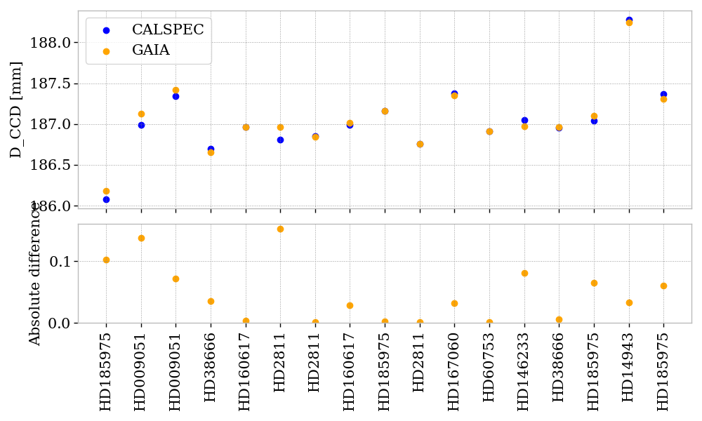
Annexe: other fitted parameters

Slide 44
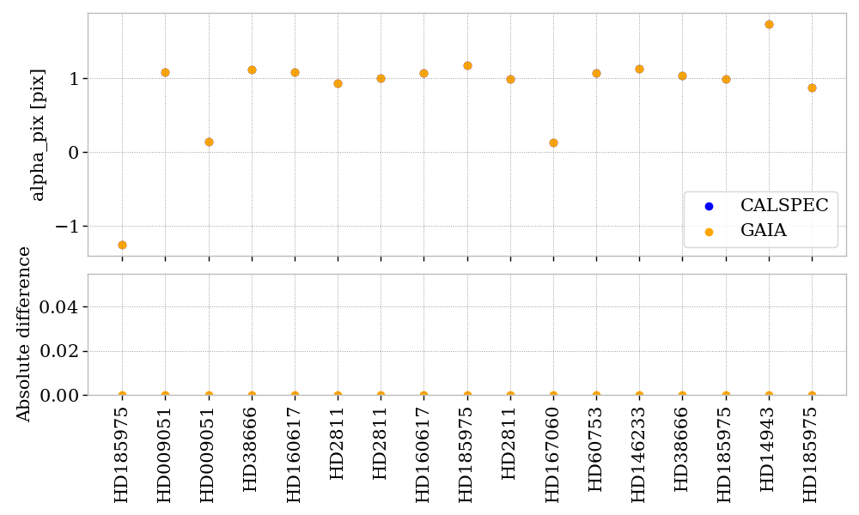
Annexe: other fitted parameters

Slide 45
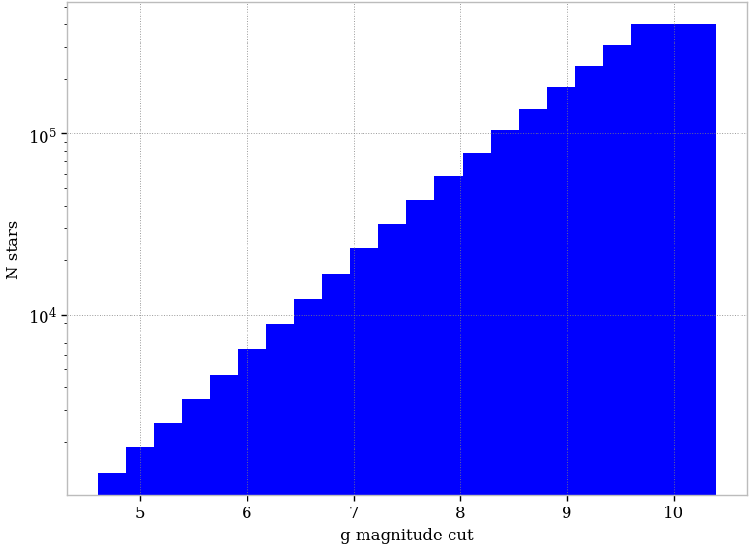
Annexe: Gaia number of stars

Slide 47
Calibration with AuxTel: Discussion / tentative planning

