Slide 1
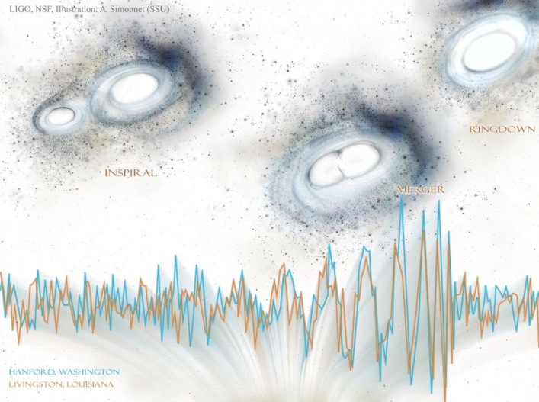
Gravitational Waves and Cosmology
3rd Manitou School
Dr. S. Mastrogiovanni
(mastrosi@roma1.infn.it)
S. Mastrogiovanni 3nd Manitou School Toulouse 1-6 July 2024

Slide 2
Material for cosmology with GWs
S. Vitale, “Inferring the Properties of a Population of Compact Binaries in Presence of Selection Effects”, Handbook of GW astronomy (2021).
S. Mastrogiovanni, “Cosmology with Gravitational Waves: A review”, Annalen der Physik (2022)
J. Gair, “The Hitchhiker's guide to the galaxy catalog approach for gravitational wave cosmology”, arXiv:2212.08694 (Accepted AJ)
S. Mastrogiovanni, “ICAROGW: A python package for inference of astrophysical population properties of noisy, heterogeneous and incomplete observations”, arXiv:2305.17973, zenodo tutorials.
S. Mastrogiovanni, “A novel approach to infer population and cosmological properties with gravitational waves standard sirens and galaxy surveys”, arXiv:2305.10488
S. Mastrogiovanni 3nd Manitou School Toulouse 1-6 July 2024

Slide 3
Introduction to data analysis
To blackboard (See notes on DA)
S. Mastrogiovanni 3nd Manitou School Toulouse 1-6 July 2024

Slide 4
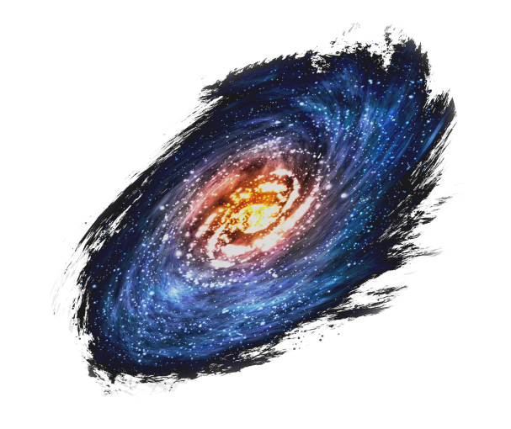
Introduction to cosmology
The universe expansion can be using a scale factor. Galaxies are placed on an expanding carpet. If we measure the distance between galaxies as a function of time, we find that it increases
Expansion
S. Mastrogiovanni 3nd Manitou School Toulouse 1-6 July 2024

Slide 5
Introduction to cosmology
For an expanding universe, we need to define a physical distance and and comoving distance.
Physical distance
Scale factor
Comoving distance
Hubble’s parameter
Expansion
Hubble’s Law
In an expanding Universe, objects naturally run-away from each other with a velocity proportional to their distance.
S. Mastrogiovanni 3nd Manitou School Toulouse 1-6 July 2024

Slide 6
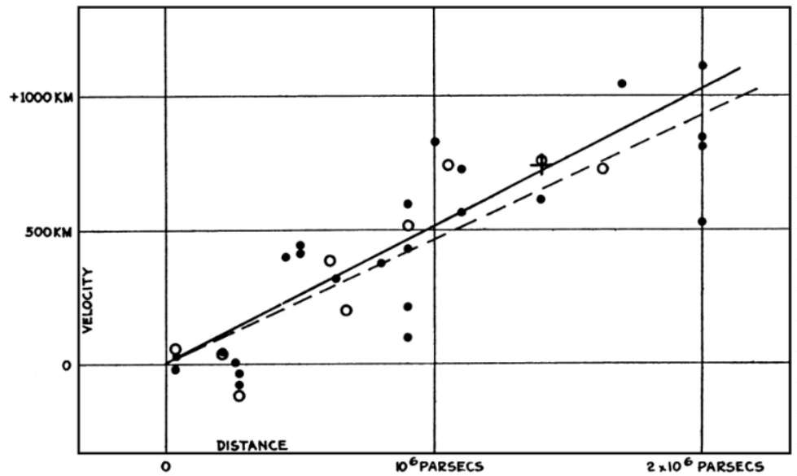
Introduction to cosmology
First observations by Hubble have shown that further galaxies display an higher recessional velocity.
Velocity [km/s]
At low distances, the Hubble parameter is constant = > Hubble constant
At high distances, the Hubble parameter is not constant anymore (depends on other cosmological parameters)
Distance [Mpc]
From Friedman’s Equations
S. Mastrogiovanni 3nd Manitou School Toulouse 1-6 July 2024

Slide 7
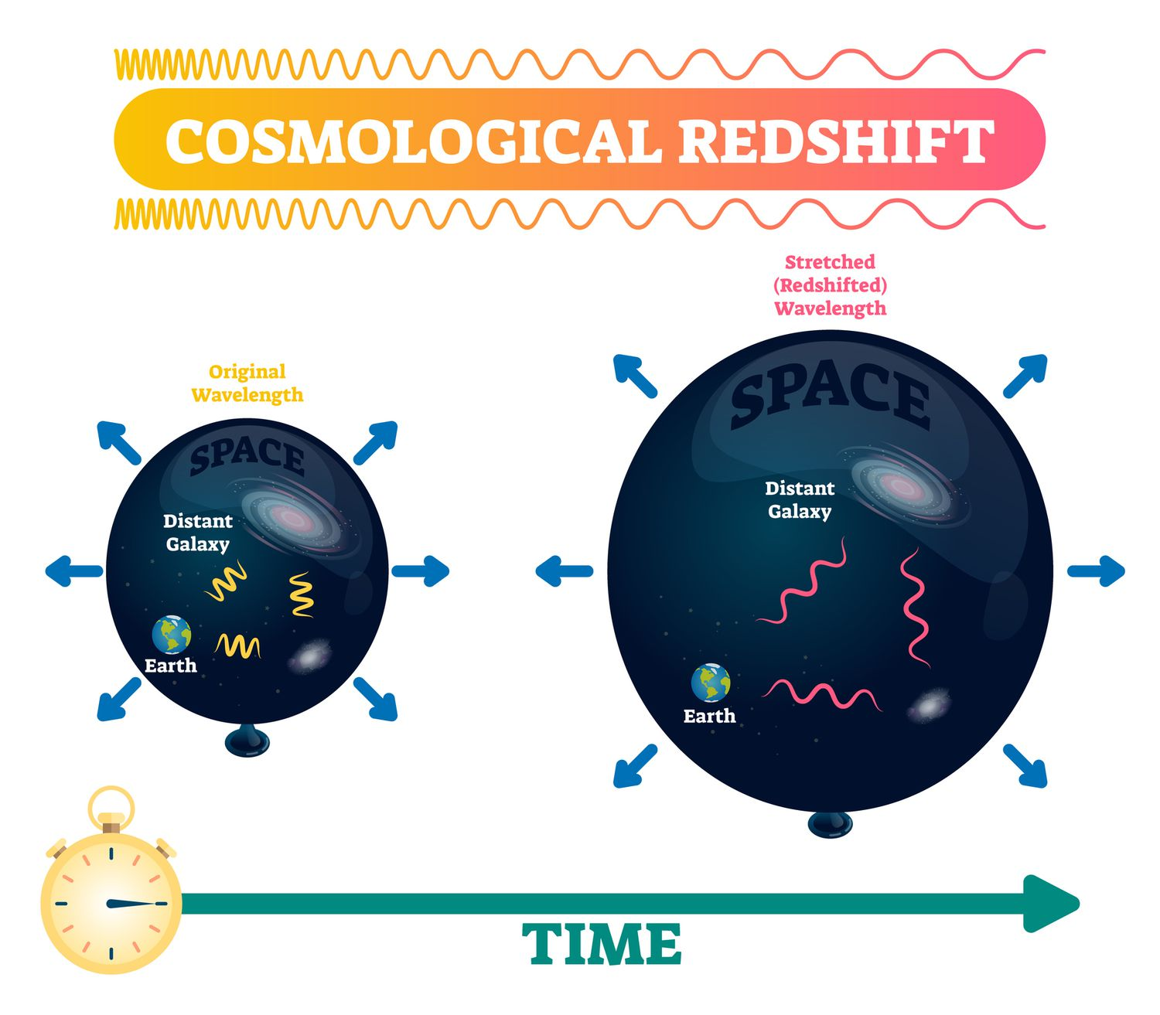
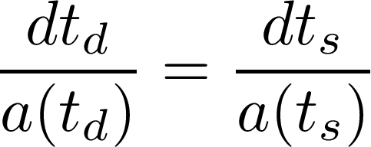
Introduction to cosmology
Waves travelling in an expanding universe are redshifted. This can be demonstrated from the definition of comoving distance.
Comoving distance pulse 1
Comoving distance pulse 2
S. Mastrogiovanni 3nd Manitou School Toulouse 1-6 July 2024

Slide 8
Introduction to cosmology
In cosmology exists several definitions of distances. The last definition we will see in the luminosity distance.
Luminosity at observer
Luminosity at source
Flux
If we know the intrinsic luminosity of a source we can measure its luminosity distance
S. Mastrogiovanni 3nd Manitou School Toulouse 1-6 July 2024

Slide 9
Introduction to gravitational waves cosmology
Gravitational Waves at cosmological distances have special properties
GW frequency evolution at source
GW frequency evolution at source
Cosmological redshift
Detector’s chirp mass
The frequency evolution of a GW is the same at the source anad at the detector, we just need to define a detector frame mass.
S. Mastrogiovanni 3nd Manitou School Toulouse 1-6 July 2024

Slide 10
Introduction to gravitational waves cosmology
What about the amplitude of a GW?
Amplitude at the source
We need to replace all the source quantities with detector quantities and we will note that
From the GW it is possible to directly measure the luminosity distance of the source
S. Mastrogiovanni 3nd Manitou School Toulouse 1-6 July 2024

Slide 11
Introduction to gravitational waves cosmology
Let’s and summarize what we have learnt
From the GW sourced by a CBC at cosmological distance, we can measure the detector masses and the luminosity distance.
GWs are the only source for which we can measure directly a distance.
If provided with a redshift (recessional velocity), GWs can be used to probe cosmology.
How do we get a redshift?
Let’s take a step back for a second
S. Mastrogiovanni 3nd Manitou School Toulouse 1-6 July 2024

Slide 12
Introduction to gravitational waves cosmology
In recent years, we used several methods to assign a redshift to GW sources
Bright sirens: An associated Electromagnetic (EM) counterpart (GRB, Kilonova etc…) can provide the identification of the host galaxy.
Dark sirens: Galaxy surveys can be used to identify possible hosts in the GW localization volume.
Spectral sirens: Knowledge of the source-frame mass distribution can be used to assign a redshift to GW sources.
S. Mastrogiovanni 3nd Manitou School Toulouse 1-6 July 2024

Slide 13
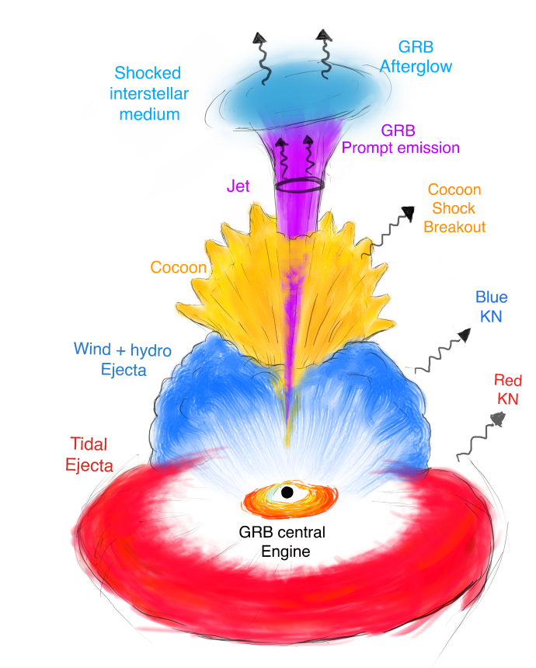
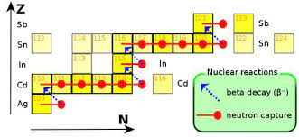
Introduction to bright sirens
Ascenzi+, Journal of Plasma Physics, 87, 1 2021
S. Mastrogiovanni 3nd Manitou School Toulouse 1-6 July 2024

Slide 14
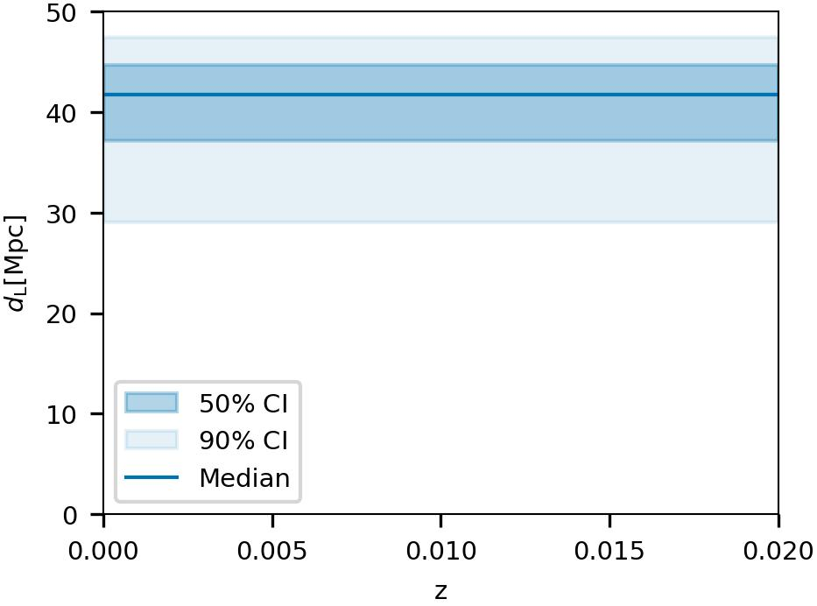
Introduction to bright sirens
GW170817: A binary neutron star merger detected by LIGO and Virgo. From the GW, source distance ~ 40 Mpc [LVK+, ApJL, 848 (2017)].
S. Mastrogiovanni 3nd Manitou School Toulouse 1-6 July 2024

Slide 15
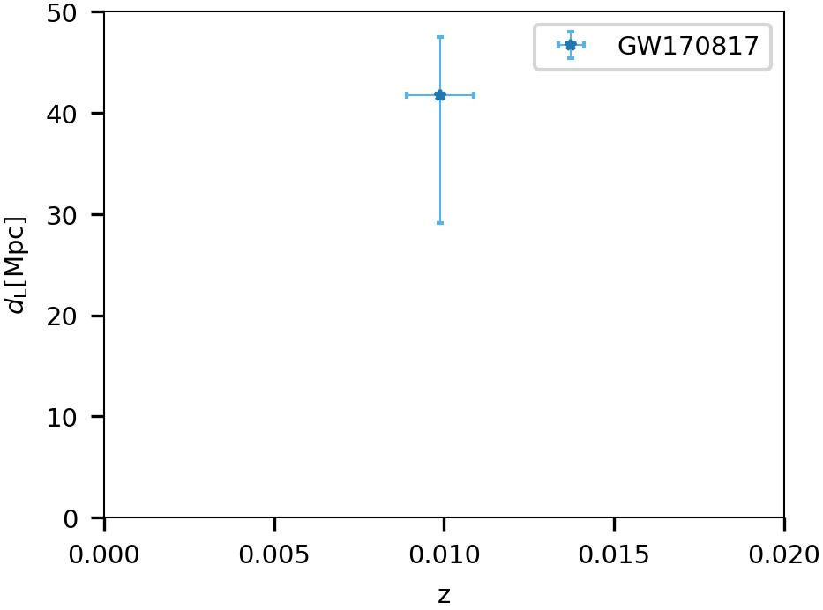
Introduction to bright sirens
GW170817: A binary neutron star merger detected by LIGO and Virgo. From the GW, source distance ~ 40 Mpc [LVK+, ApJL, 848 (2017)].
Short Gamma-ray burst and Kilonova: Two associated EM counterparts allowed the identification of the source host galaxy NGC4993.
S. Mastrogiovanni 3nd Manitou School Toulouse 1-6 July 2024

Slide 16
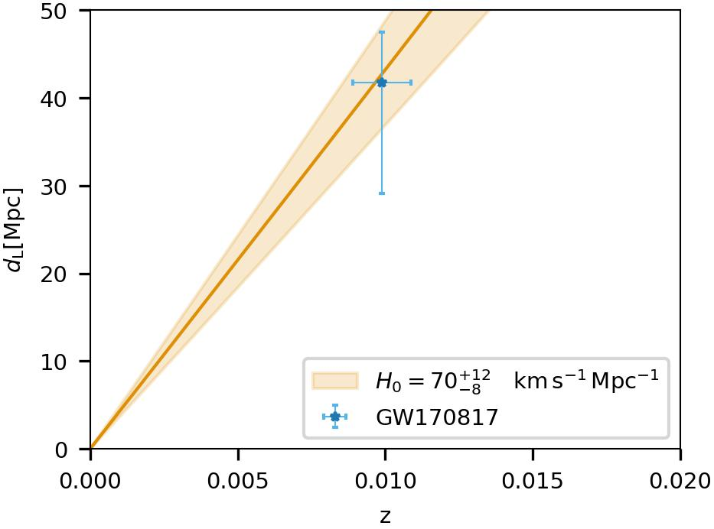
Introduction to bright sirens
GW170817: A binary neutron star merger detected by LIGO and Virgo. From the GW, source distance ~ 40 Mpc [LVK+, ApJL, 848 (2017)].
Short Gamma-ray burst and Kilonova: Two associated EM counterparts allowed the identification of the source host galaxy NGC4993.
This type of events will difficult to detect, we might expect to have 0-10 others in the next two observing runs [SM+ A&A (2017), Patricelli+, MNRAS (2022)]
[LVC+, Nature (2017)]
S. Mastrogiovanni 3nd Manitou School Toulouse 1-6 July 2024

Slide 17
Introduction to bright sirens
In the case of an EM counterpart, we need to modify the hierarchical likelihood to take into account the fact that we also measure redshift and sky position from the EM counterpart
Overall likelihood
Rate of CBC with EM counterparts
Detection probability
We make two assumptions:
The detection probability is dominated by the GW.
The EM and GW likelihoods can be separated in two independent terms.
S. Mastrogiovanni 3nd Manitou School Toulouse 1-6 July 2024

Slide 18
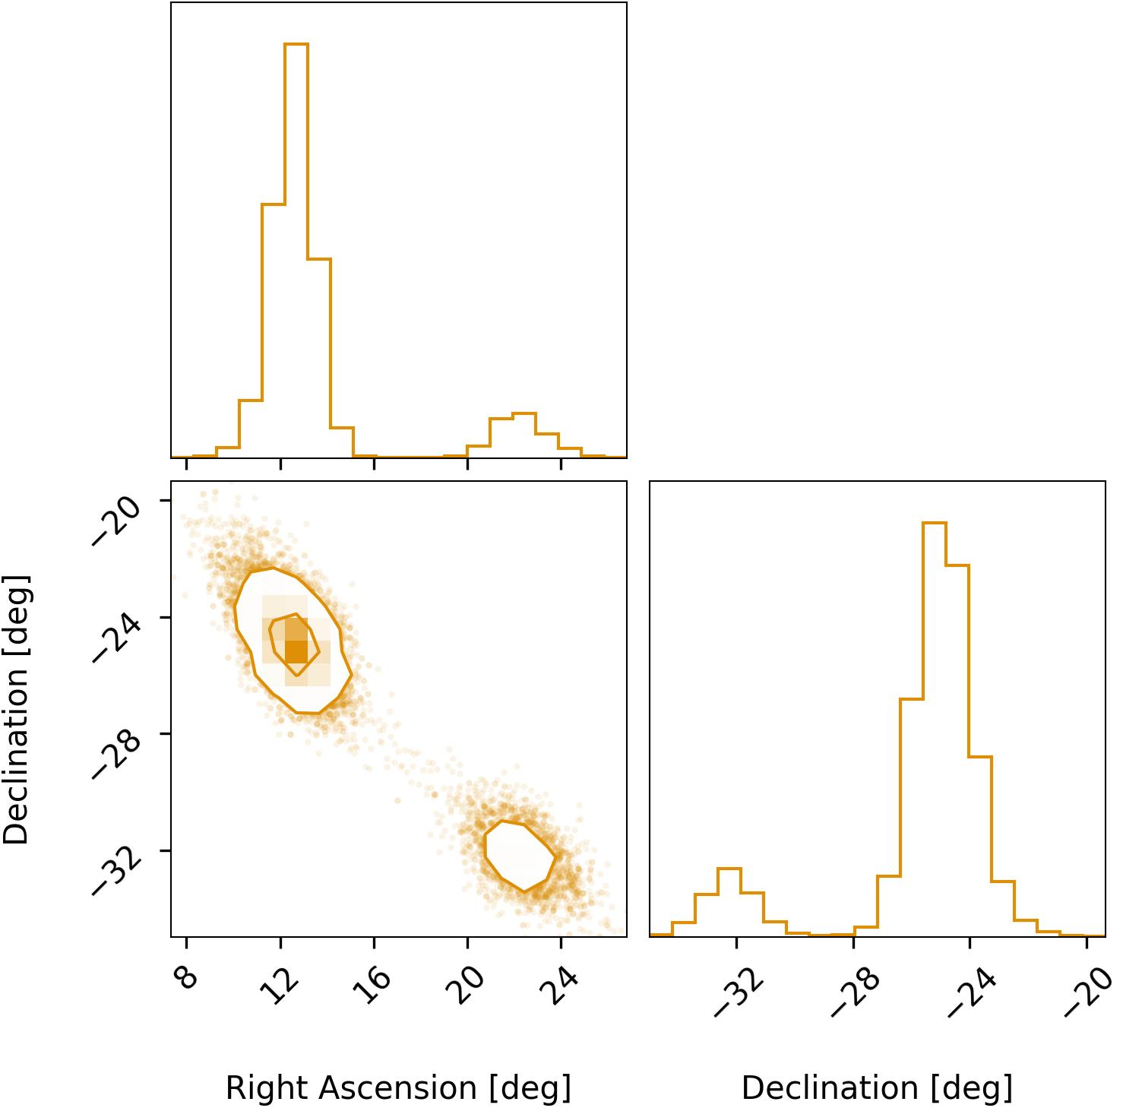
Introduction to dark sirens
GW190814
Localization volume 88,000 Mpc³
In the case that the GW is not observed with EM counterpart, we can use galaxy catalogs to identify possible galaxy hosts [Schutz, Nature 1986].
Galaxy surveys will provide possible redshifts.
GW will provide luminosity distance.
Best localized events provide better constraints for cosmology.
[LVK, ApJL 896 (2020)]
S. Mastrogiovanni 3nd Manitou School Toulouse 1-6 July 2024

Slide 19
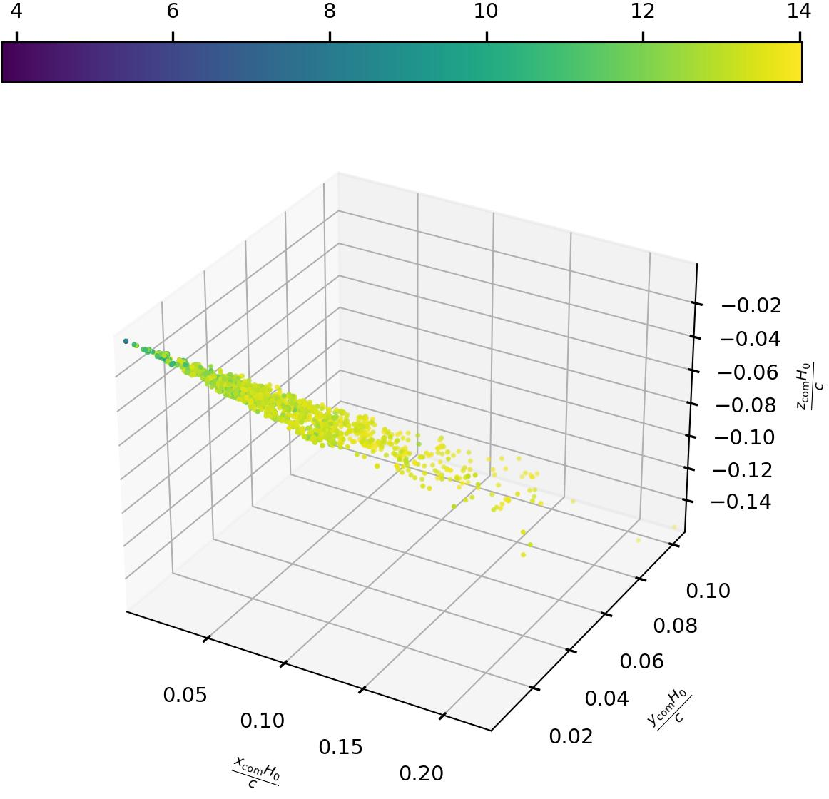
Introduction to dark sirens
Apparent magnitude
A cosmological model has statistical support when the GW localization matched an overdensity of galaxies.
Galaxy catalogs are not complete at higher redshifts, we need to apply corrections in order to now bias our analyses [R. Gray+, PRD (2019)]
GW190814 H₀=67.7 km/s/Mpc
GW190814 H₀=120 km/s/Mpc
Fainter galaxies
S. Mastrogiovanni 3nd Manitou School Toulouse 1-6 July 2024

Slide 20
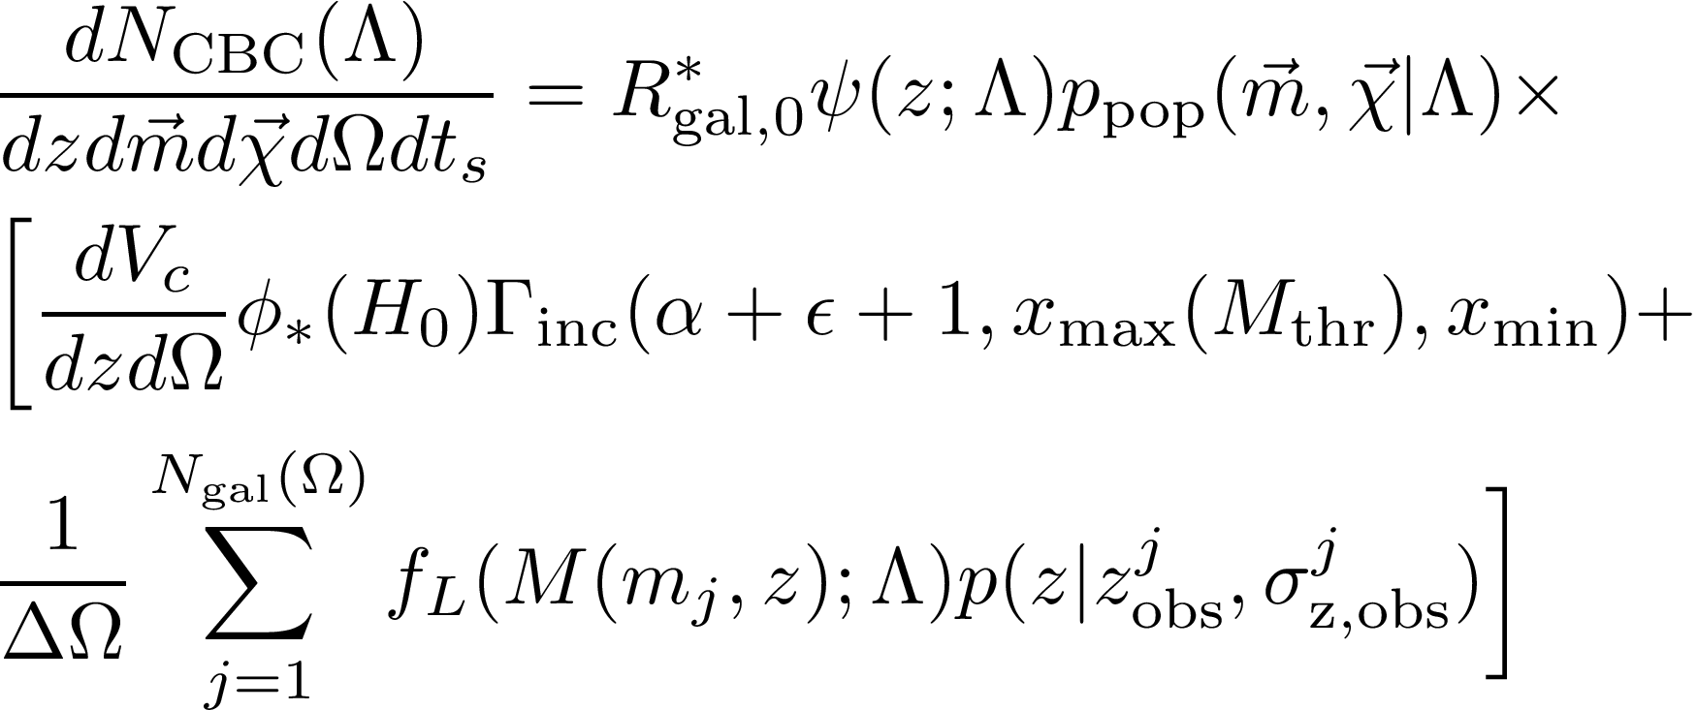
Introduction to dark sirens
The CBC likelihood is often parametrized in terms of redshift and source-frame time
CBC per galaxy per year
Term similar to the vanilla rate
Number density of galaxies per steradian (completeness correction)
Integral of Schecter function
Number density of galaxies per steradian (catalog)
Luminosity weight
Galaxy localization in redshift
Sky pixel area
S. Mastrogiovanni 3nd Manitou School Toulouse 1-6 July 2024

Slide 21
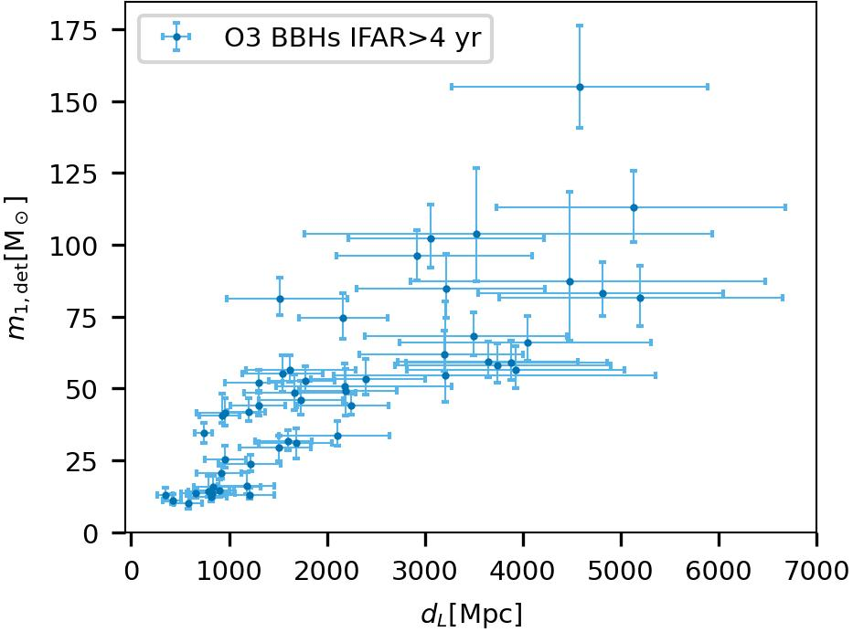
Introduction to spectral sirens
Many GW are detected with large sky localizations and are very far (galaxy catalogs highly incomplete).
If BBHs are preferentially produced at a given mass, we can exploit the mass-redshift relation to assign a redshift to the GW source [SM+, PRD 104 (2021)].
Excess of BBHs
S. Mastrogiovanni 3nd Manitou School Toulouse 1-6 July 2024

Slide 22
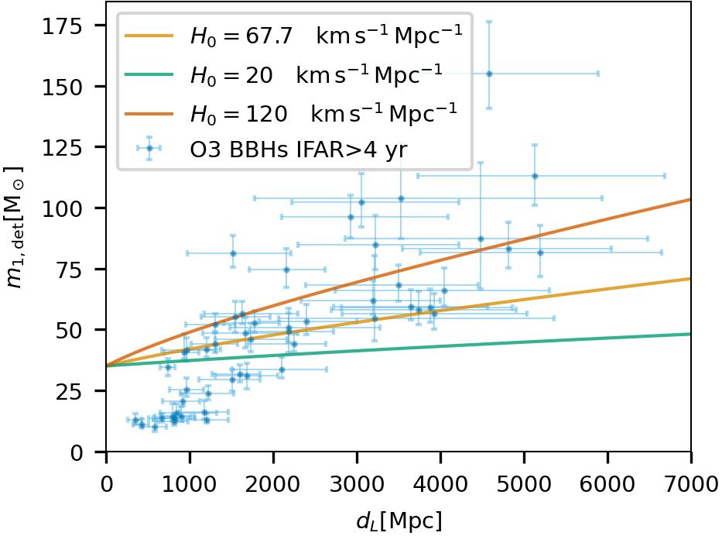
Introduction to spectral sirens
If we assume an overdensity of BBHs produced at 35 solar masses, some “extreme” cosmologies can not fit the overdensity of BBHs.
35 solar mass feature
S. Mastrogiovanni 3nd Manitou School Toulouse 1-6 July 2024

Slide 23
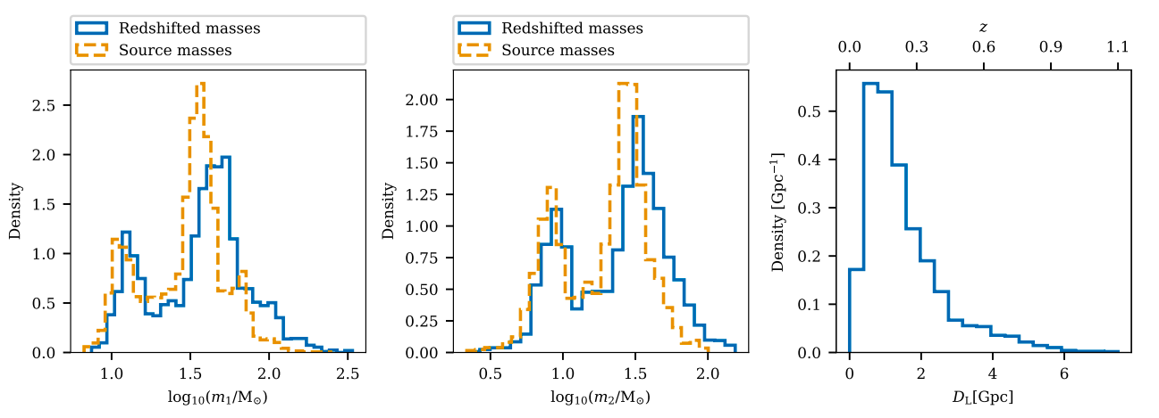
Latest LIGO, Virgo KAGRA GW results
During O1 (~4 months):
3 confident BBHs
During O3 (~12 months):
1 consistent with BNS masses (GW190425)
4 events compatible with NSBH masses
2 events compatible with BNS masses
~80 confident BBHs.
Tentative EM counterpart from GW190521
During O2 (~8 months):
7 confident BBHs
1 confident BNS+EM counterpart
See also Tab 1 from 2111.03604
Simone Mastrogiovanni - Vulcano Workshop 2022 - Sept 26th Elba Island
S. Mastrogiovanni 3nd Manitou School Toulouse 1-6 July 2024
Notes:
Messages: * Results, we constrained the NS Eos and my codes have contributed to many scientific results and are employed in many works.
* The common thread here is DA.

Slide 24
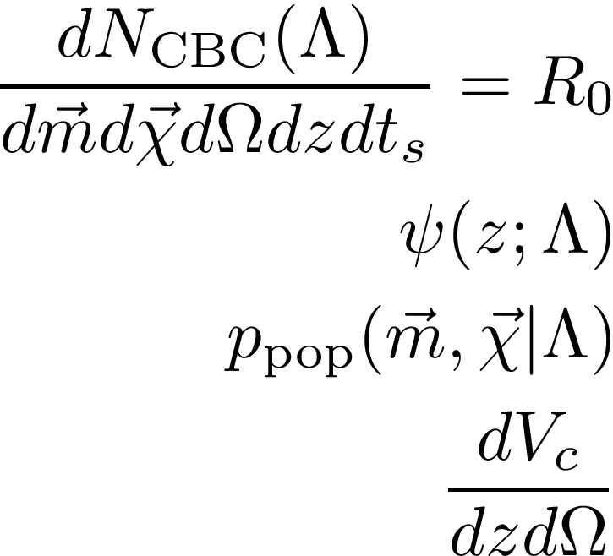
Introduction to spectral sirens
The CBC likelihood is often parametrized in terms of redshift and source-frame time
Rate of CBC [#mergers Gpc^-3 yr^-1]
Rate evolution function, e.g. (1+z)^gamma. Two models available
Probabilities for source-frame masses and spins, 8 models for masses, 2 for spins
Comoving volume (depends on cosmology)
S. Mastrogiovanni 3nd Manitou School Toulouse 1-6 July 2024

Slide 25
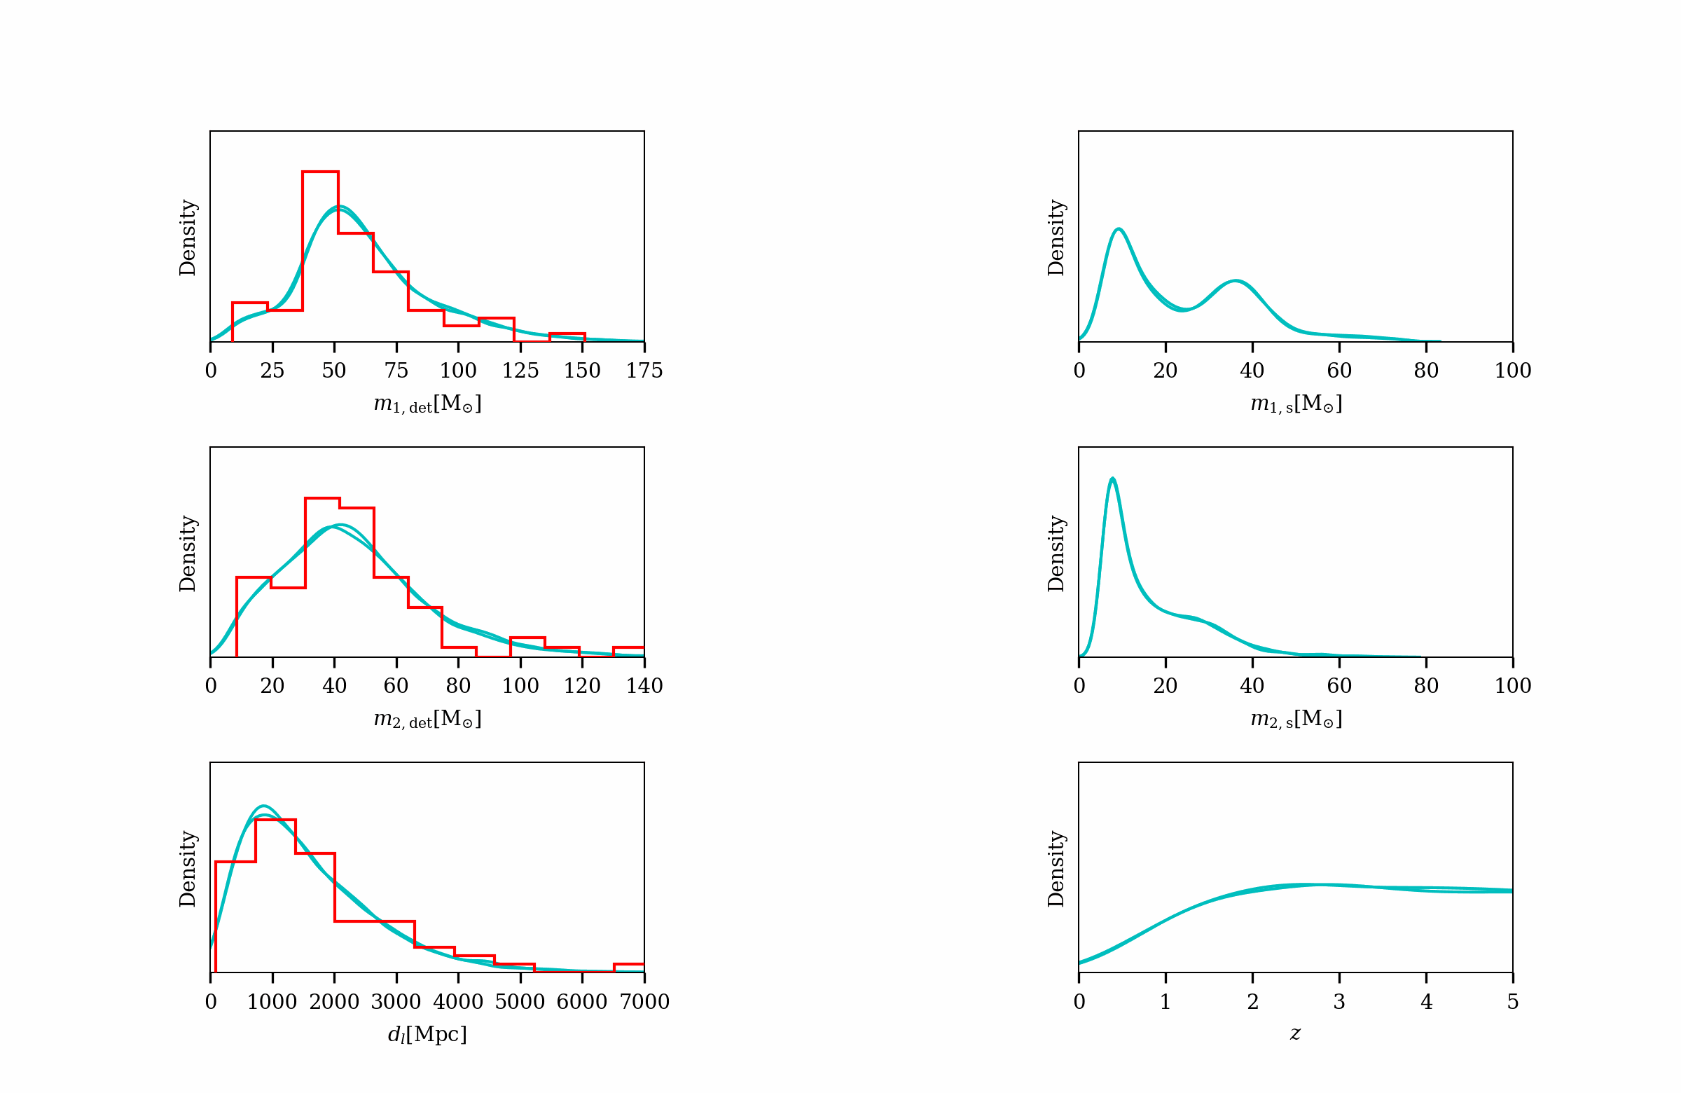
Introduction to spectral sirens
Detector frame
Source frame
Detector Frame
Source Frame
Population:
64 events.
PISN.
Planck cosmology
Cosmology
Selection biases
Cosmology +
Selection bias
+
Astrophysics
Simulation
Simone Mastrogiovanni - Vulcano Workshop 2022 - Sept 26th Elba Island
S. Mastrogiovanni 3nd Manitou School Toulouse 1-6 July 2024
Notes:
Messages: * Results, we constrained the NS Eos and my codes have contributed to many scientific results and are employed in many works.
* The common thread here is DA.

Slide 26
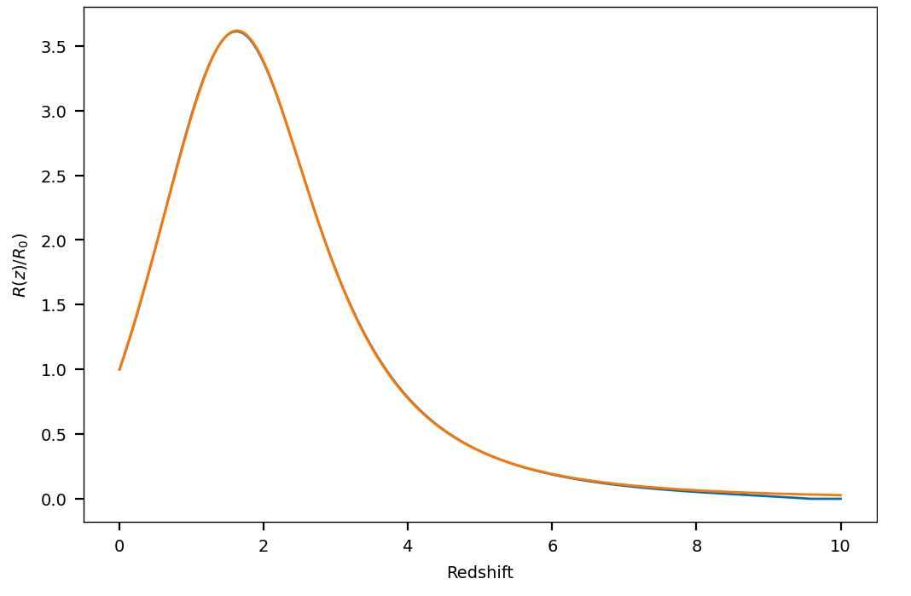
Latest LIGO, Virgo KAGRA GW results
Several mass models include various scales to describe stellar processes [LVK+ 2021 ApJL 913 L7].
As a consequence, the masses of GW observations are redshifted by the expansion of the Universe [Ye+ PRD 104 2021].
Peak of SFR?
S. Mastrogiovanni 3nd Manitou School Toulouse 1-6 July 2024
Notes:
Messages: * Results, we constrained the NS Eos and my codes have contributed to many scientific results and are employed in many works.
* The common thread here is DA.

Slide 27
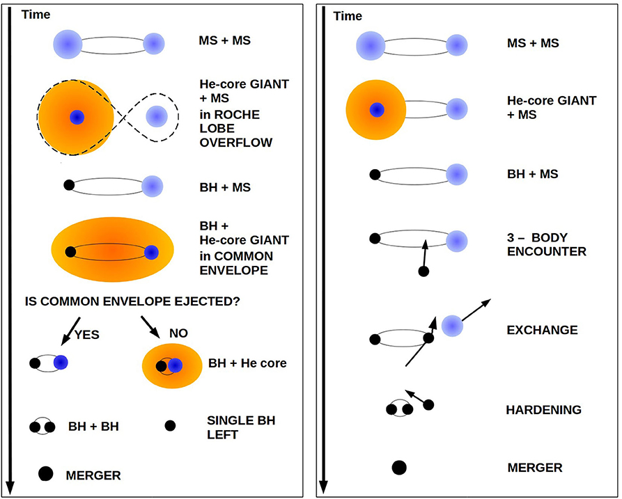
Latest LIGO, Virgo KAGRA GW results
Two main formation channels:
Isolated stellar binary evolution: First generation black holes with spins aligned with the orbital angular momentum.
Hierarchical mergers: Possibly n-th generation black holes (spin~0.7) with isotropic spins.
Peak of SFR?
[Mapelli M. Handbook of Gravitational Wave Astronomy]
S. Mastrogiovanni 3nd Manitou School Toulouse 1-6 July 2024
Notes:
Messages: * Results, we constrained the NS Eos and my codes have contributed to many scientific results and are employed in many works.
* The common thread here is DA.

Slide 28
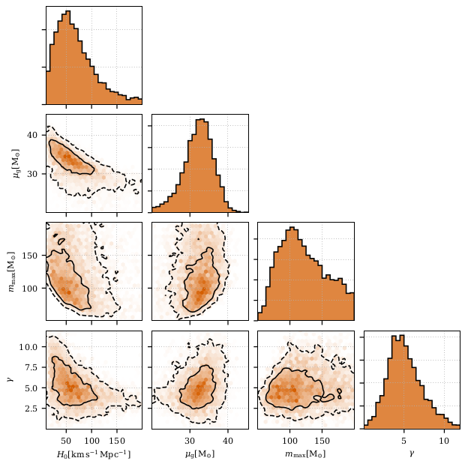
Latest LIGO, Virgo KAGRA GW results
Statistical result with GW data only,
no galaxy catalog information has been used
The excess of BBHs around 35 solar
masses sets a scale for the redshift
and provides constraints on H0.
[LVK+, arXiv 2111.03604 (Accepted ApJ)]
Population parameters that correlate with H0
Posteriors of H₀, mu of the Gaussian peak, maximum mass of the BH and the merger rate evolution.
S. Mastrogiovanni 3nd Manitou School Toulouse 1-6 July 2024

Slide 29
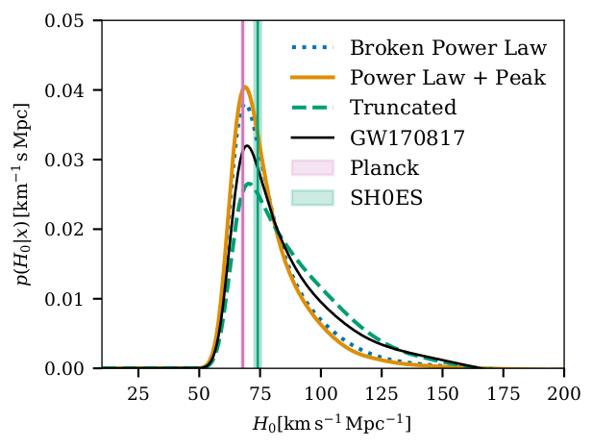
Latest LIGO, Virgo KAGRA GW results
[LVK+, arXiv 2111.03604 (Accepted ApJ)]
H₀ = 68 +12 -8 km/s/Mpc
The only EM information is the counterpart of GW170817
H₀ posterior of the 3 mass models combined with GW170817 posterior
H₀ = 69 +21 -8 km/s/Mpc
H₀ = 68 +13 -8 km/s/Mpc
H₀ = 70 +12 -8 km/s/Mpc
S. Mastrogiovanni 3nd Manitou School Toulouse 1-6 July 2024

Slide 30
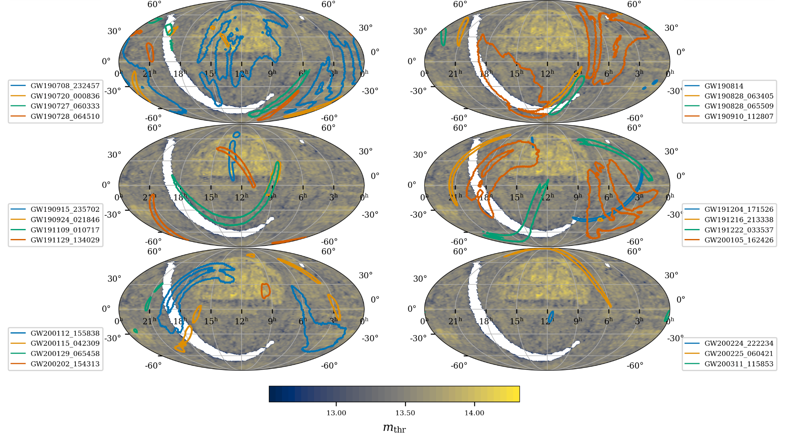
Latest LIGO, Virgo KAGRA GW results
GW190814
Sky area ~ 20 sq. deg.
Localisation volume
= 8.8 x 10⁻⁷ Gpc³
[Dalya+, MNRAS 479 (2018)]
One of the highly localised GW events
[LVK+, arXiv 2111.03604 (Accepted ApJ)]
S. Mastrogiovanni 3nd Manitou School Toulouse 1-6 July 2024

Slide 31
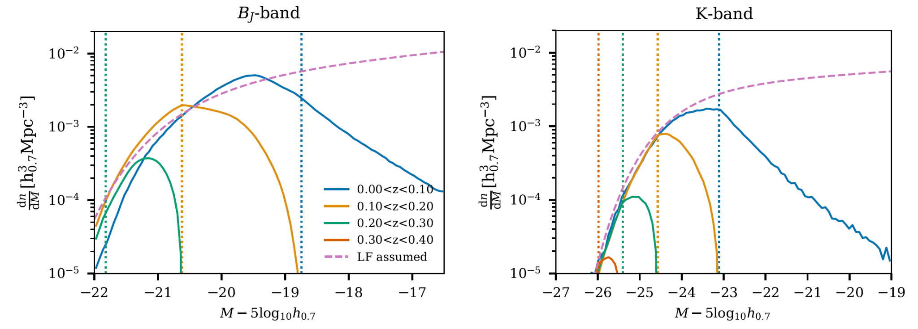
Latest LIGO, Virgo KAGRA GW results
The galaxy catalog is incomplete, namely it does not contain all the galaxies
Schechter luminosity function
Schechter luminosity function
S. Mastrogiovanni 3nd Manitou School Toulouse 1-6 July 2024

Slide 32
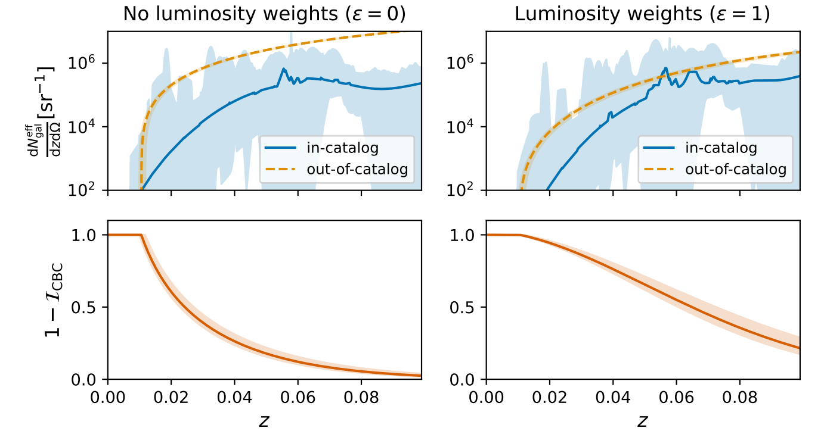
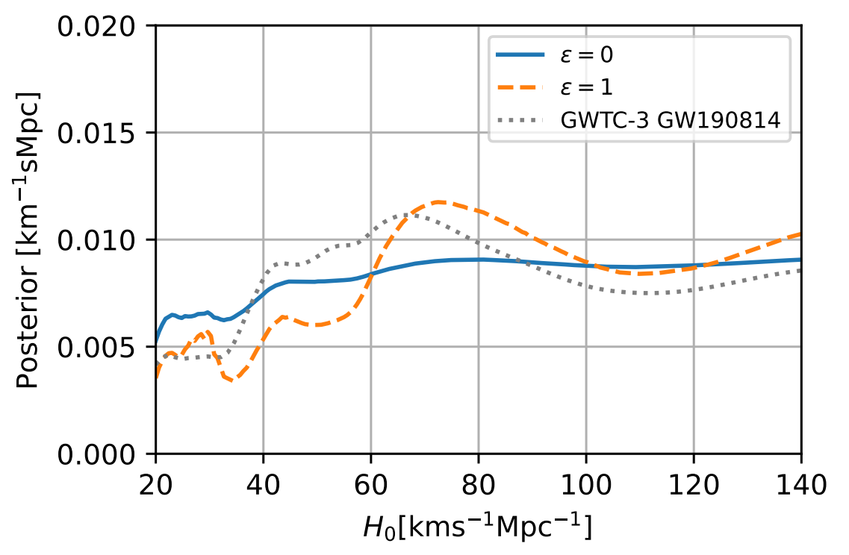
Latest LIGO, Virgo KAGRA GW results
Red-luminous galaxies preferred hosts
Equal host probability
[Mastrogiovanni+, PRD 108 (2023)]
S. Mastrogiovanni 3nd Manitou School Toulouse 1-6 July 2024

Slide 33
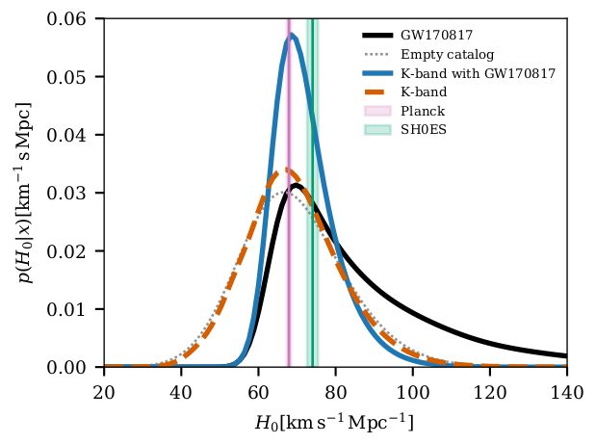
Latest LIGO, Virgo KAGRA GW results
[LVK+, arXiv 2111.03604 (Accepted ApJ)]
H₀ = 68 +8 -6 km/s/Mpc
Main result of the paper showing various H0 posteriors.
We select the K-band for the luminosities of galaxies and the preferred mass model (powerlaw+Gaussian peak)
H₀ = 67 +13 -12 km/s/Mpc
H₀ = 67 +14 -13 km/s/Mpc
H₀ = 70 +12 -8 km/s/Mpc
S. Mastrogiovanni 3nd Manitou School Toulouse 1-6 July 2024

Slide 34
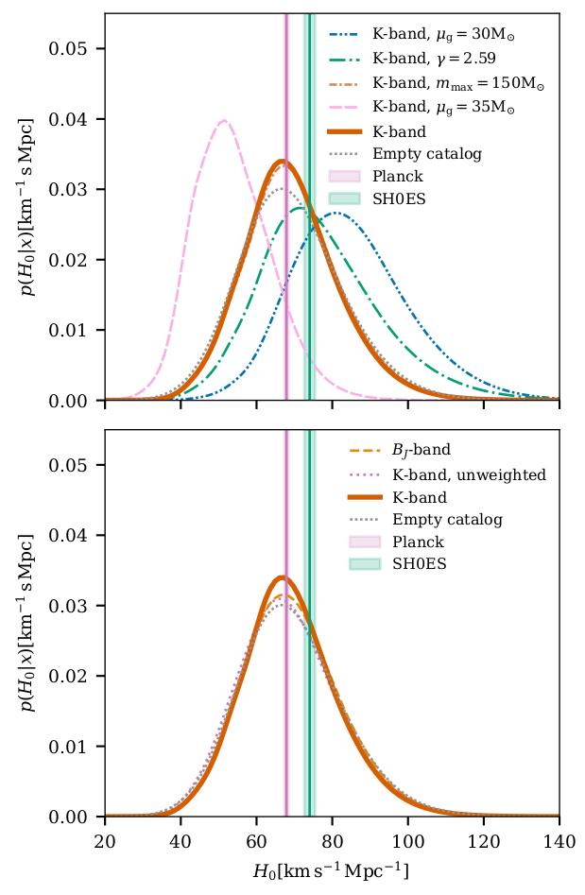
Latest LIGO, Virgo KAGRA GW results
Varying certain population parameters affects the H0 posterior significantly
Systematic plot showing the H0 different posteriors when varying:
population parameters (top plot)
galaxy catalog parameters (bottom plot)
Varying galaxy catalog parameters affects the H0 posterior only marginally
S. Mastrogiovanni 3nd Manitou School Toulouse 1-6 July 2024

Slide 35
Learn how to estimate H0 with EM counterparts and galaxy catalogs
Link
S. Mastrogiovanni 3nd Manitou School Toulouse 1-6 July 2024

